Slide 1
2108.04249
Dian-Wei Wang
2024.09.14

Slide 2
Reference(s)
2108.08336

Slide 3
VEV Insertion Approximation (VIA)
Kadanoff-Baym equation for fermions

Slide 4
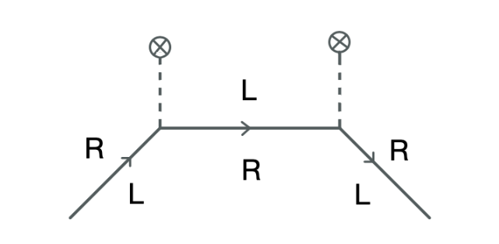
VEV Insertion Approximation (VIA)
VEV insertion

Slide 5
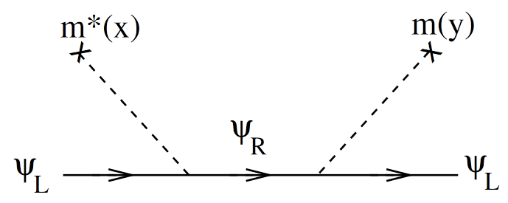
VEV Insertion Approximation (VIA)
Boltzmann equation

Slide 6
Semiclassical (WKB)
Boltzmann equation
$δf$: asymmetry in distribution
${\vec{F}}_{0}$: CP conserved force
$δ\vec{F}$: CP violated force

Slide 7
Example: $τ$ lepton source
Adding dimension 5 operator

Slide 8
Result: $τ$ lepton source
VIA
WKB
$γ$: collision rate

Slide 9
Example: t-c mixing source
maximal CP violation

Slide 10
Result: t-c mixing source
sign flip
sign flip

Slide 11
Thanks for your listening!
Dian-Wei Wang
2024.09.14

