Slide 1
Holographic spin alignment for vector mesons
arXiv:2403.07522v1 [hep-ph]
Hiwa A. Ahmed (何瓦)
School of Nuclear Science And Technology, UCAS
Weekly Group Meeting
Sep. 21st, 2024

Slide 2
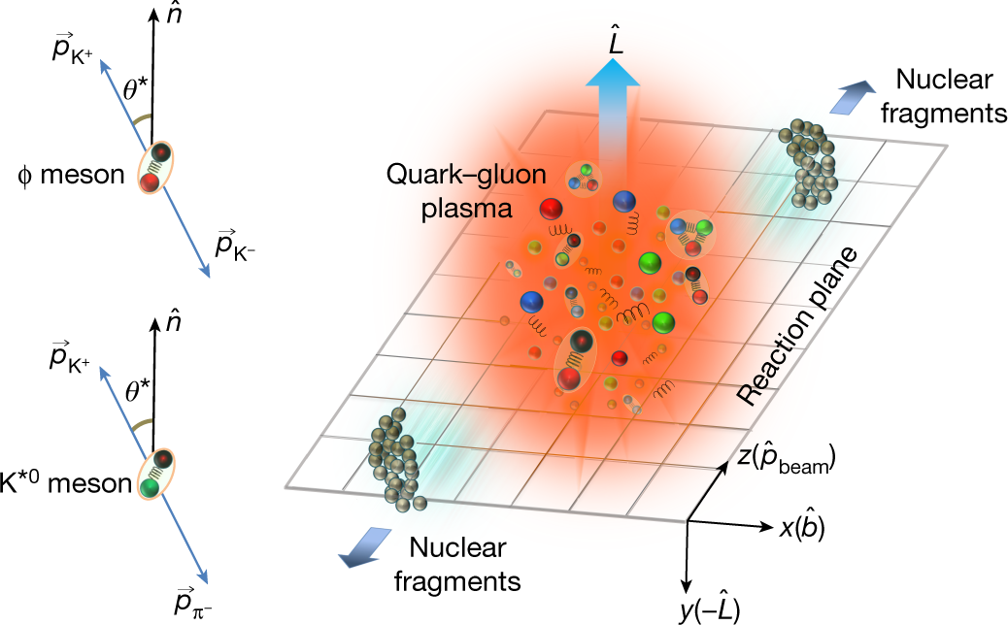
Introduction
Spin alignment in heavy ion collisions refers to the phenomenon where the spins of particles, typically vector mesons produced in these collisions show a preferred alignment along a particular direction.
In a non-central heavy-ion collision, where the nuclei collide with a certain impact parameter (i.e., not head-on), a large amount of angular momentum is imparted to the system.

Slide 3
Introduction

Slide 4
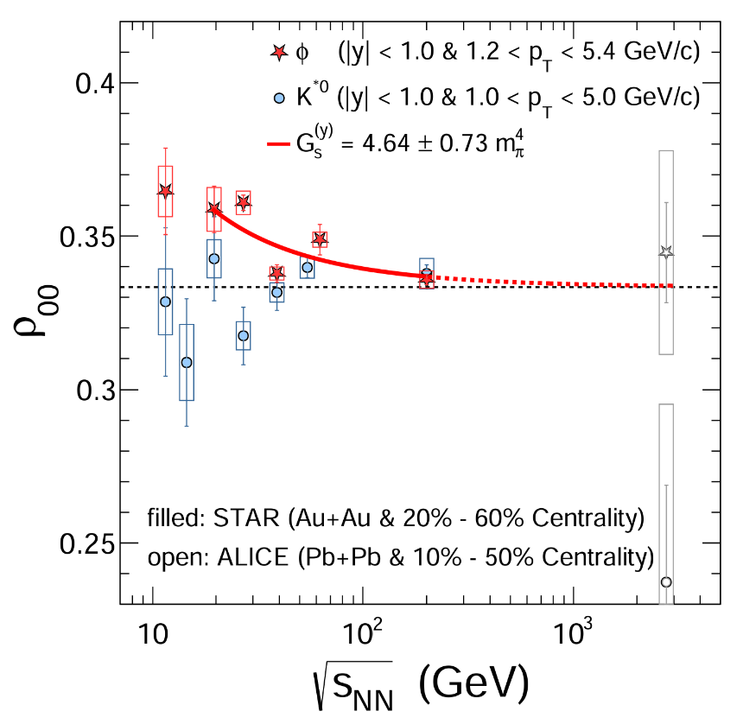
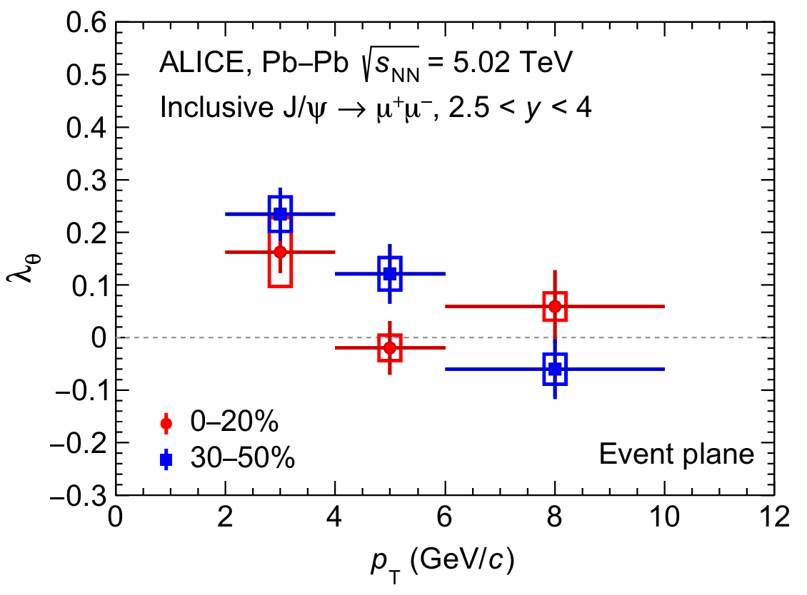
Motivation
Recent measurements by the STAR collaboration at RHIC and by the ALICE collaboration at the LHC, show that the $φ$ and $J/ψ$ mesons are preferably to be longitudinally and transversely polarized respectively.
However, there are no currently theoretical works to understand the difference between $ρ_{00}$ for $φ$ and $J/ψ$ systematically and consistently.

Slide 5
Dilepton production rate
The S-matrix element for the process of an initial state $i$ to a final state $f$ plus a lepton pair $l\overline{l}$ is
The transition probability for the process:
The differential production rate for dileptons as a function of total momentum

Slide 6
Dilepton production rate
$ρ_{αβ}$ is interpreted as the meson’s spectral function in the thermal medium
The spectral function can be decomposed using a complete basis of polarization vectors
The dilepton production rate reduces to

Slide 7
AdS/CFT Correspondence
Keeping this in hand, it is possible to evaluate the two-point correlators by using the partition function of the bulk gravity due to

Slide 8
Formalism
The quadratic action for vector meson as a generic Maxwell form
8

Slide 9
Formalism

Slide 10
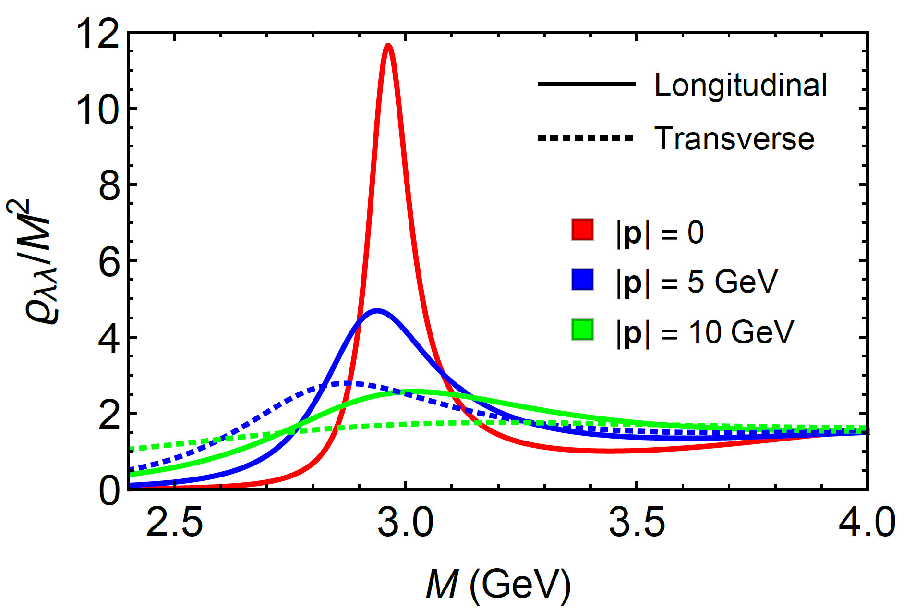
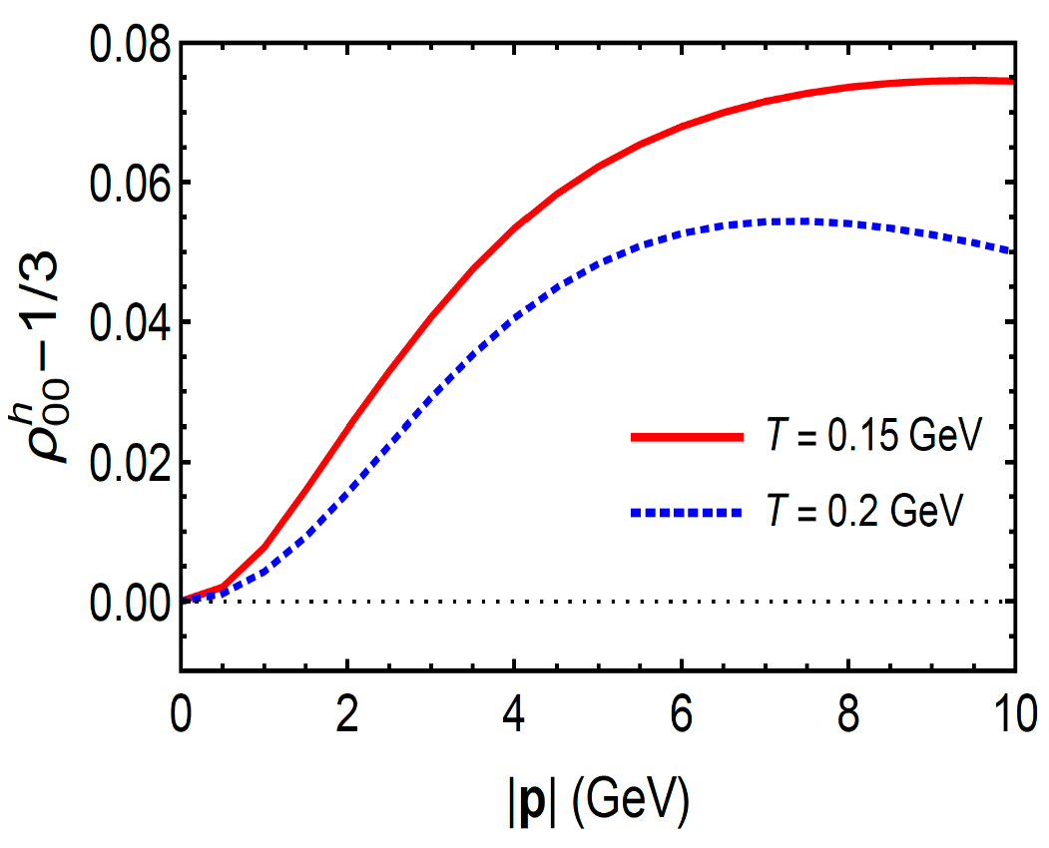
$J/ψ$ meson spin alignment
Helicity frame: spin quantization direction is

Slide 11
$J/ψ$ meson spin alignment
The spin quantization direction as $y−$direction:

Slide 12
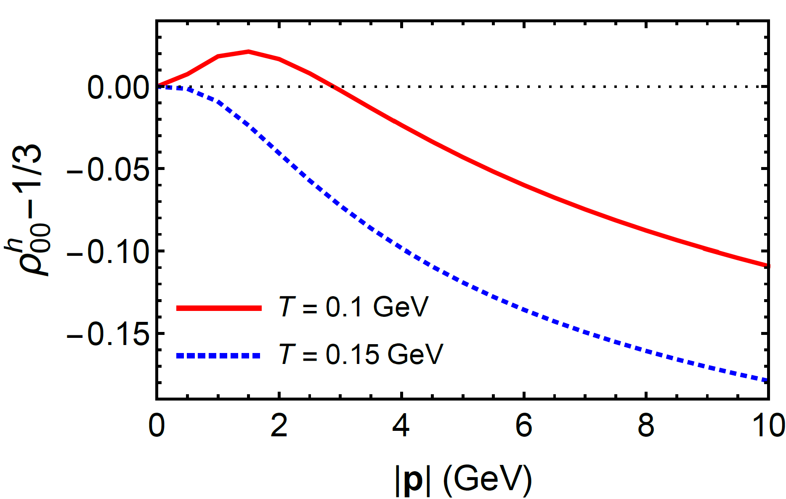
$φ$ meson spin alignment
Helicity frame: spin quantization direction is

Slide 13
$φ$ meson spin alignment
The spin quantization direction as $y−$direction:

Slide 14
$$Summary$$
The spin alignment of flavorless vector mesons with a holographic description have studied through the dilepton decays of vector mesons.
The spin alignment in the helicity frame $ρ_{00}^{h}$ deviates from 1/3 when the meson has a non-vanishing momentum which shows opposite behaviors for $J/ψ$ and $φ$.
The global spin alignment for $φ$mesons given by the soft-wall model quantitatively agrees with a previous prediction obtained within the quark coalescence model.
The consistency between two models may imply that the meson’s spin alignment is a non-perturbative property in the strongly interacting matter.

