Slide 1
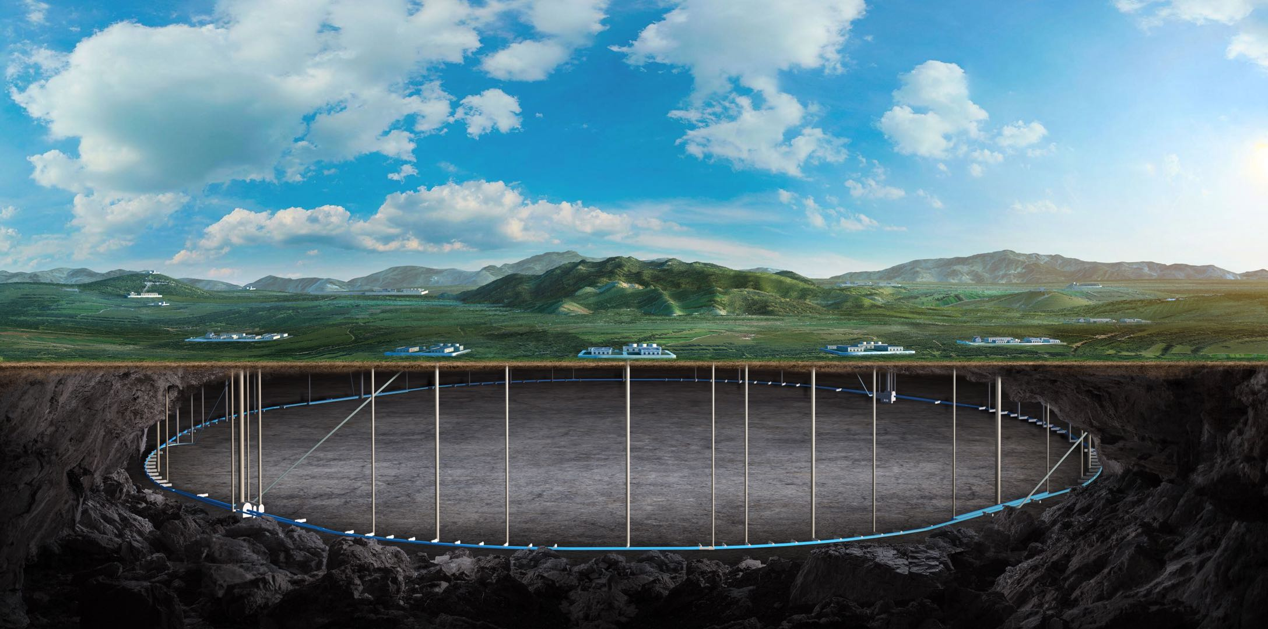
CEPC Detector Magnet
Feipeng Ning
On behalf of SC magnet Team

Slide 2
Outline
Physical design of the magnet
工作联系单
Superconducting cable LTS and HTS, summary of the latest work and the next work arrangement

Slide 3
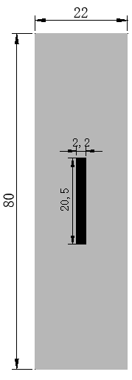
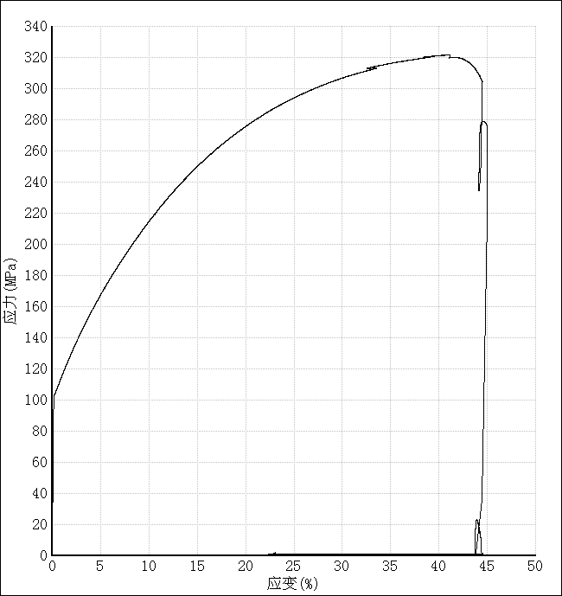
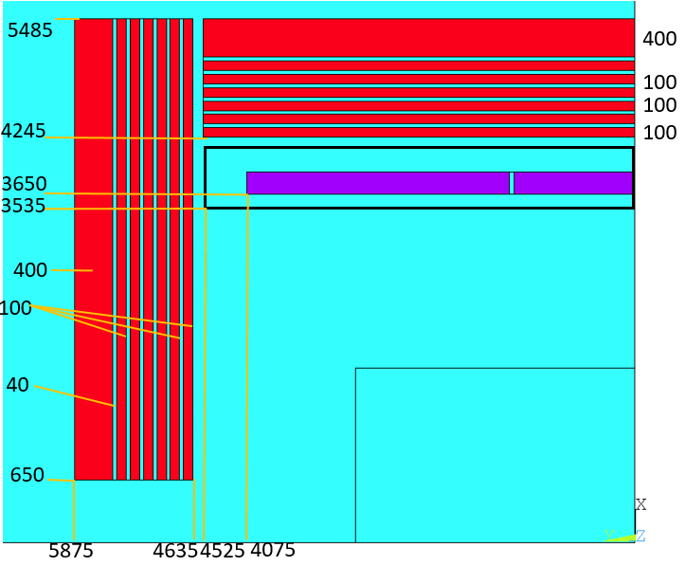
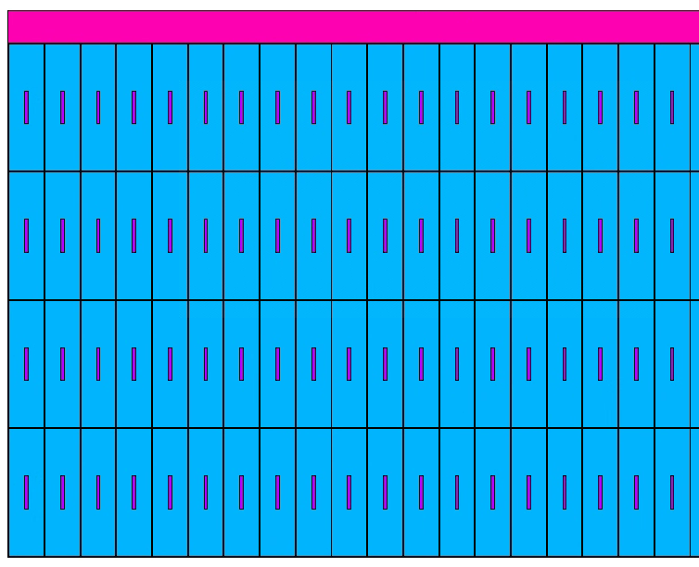
Physical design of the magnet
physical design of the magnet
Cable structure:
NbTi Rutherford cable
Doped Pure Al
泊松比 | 0.33/0.34
杨氏模量 | 如曲线
热膨胀系数 | 14.23×10⁻⁶ K⁻¹
4.2KRp_{0.25} | 105MPa
电缆结构
芯线：铌钛/铜卢瑟福电缆，2.2mm*20.5mm
铝稳定体：高强度高纯铝，22mm*80mm
稳定体材料
基于4N8铝的掺杂高强度高纯铝，实测材料参数：4.2K屈服强度105MPa

Slide 4
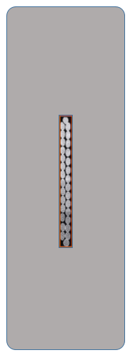
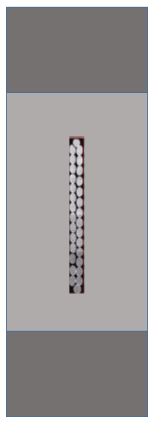
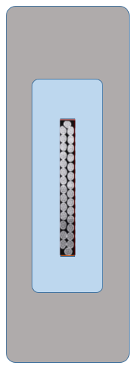
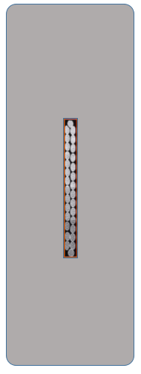
Physical design of the magnet
优化的目标：
 | 高强度纯铝 | 铌钛超导复合线 | 5系铝合金
屈服强度@4.2K | ~105 MPa | 800 MPa | 500 MPa
Cable structure | 电缆截面56*22 | 电缆截面56*22 CMS型 | 电缆截面56*22 BOX型 | 电缆截面56*28 | 电缆截面70*22 | 电缆截面80*22
Coil at 4.2 K
Aluminum stabilizer | - | 4.7-79.2 | 12.8-96.5 | 54.3-95.6 | 4.7-76.9 | 2.6-71.7
SC cable | - | 205-307 | 188-246 | 190-248 | 200-355 | 217-253
Al alloy | - | 2.5-20.8 | 30.2-57.1 | - | - | -
Support | - | - | - | 3.27-24.7 | 2.6-21.7 | 3-21.3
Coil at 4.2 K, energized
Aluminum stabilizer | 103 | 46.7-94.2 | 52.5-102 | 58.3-103 | 46.8-96.3 | 42.4-89.1
SC cable | 288 | 111-283 | 80-223 | 88.9-243 | 101-354 | 134-216
Al alloy | - | 46-98 | 46.7-125 | - | - | -
Support | 126 | - | - | 58.9-152 | 46.2-98.1 | 34.4-80.4

Slide 5
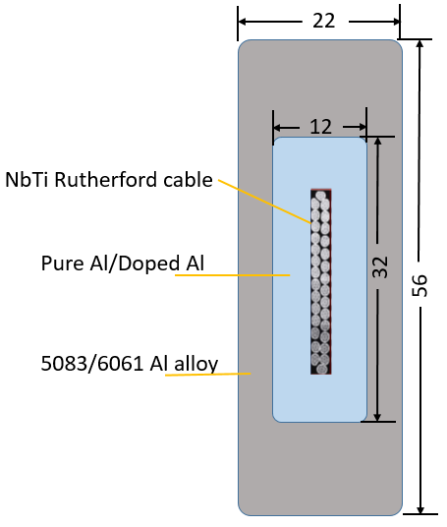
Physical design of the magnet
Cable structure:
Summary of the Superconducting Detector Magnet Workshop, 23/09/2023
Present
CEPC LTS cable

Slide 6
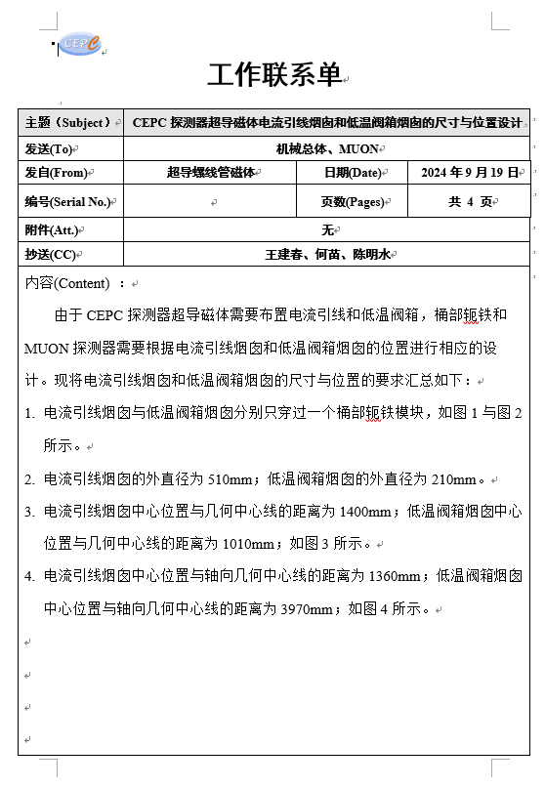
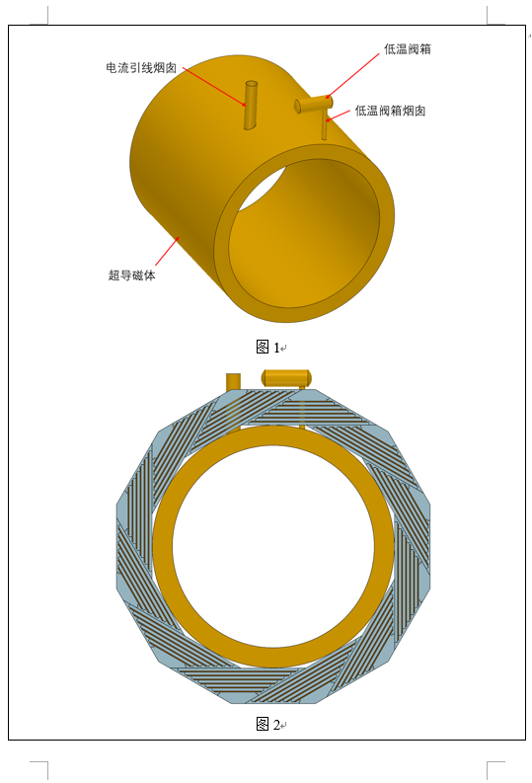
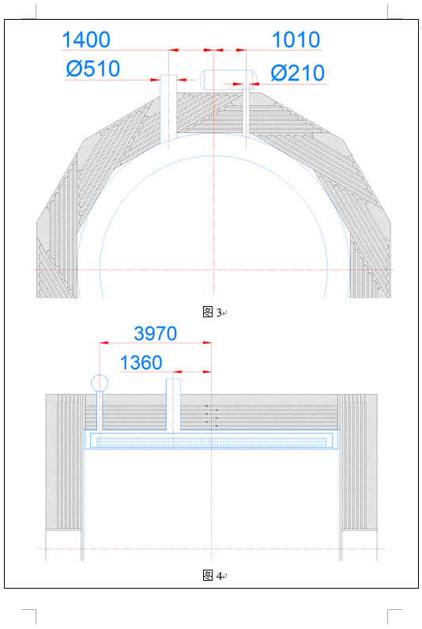
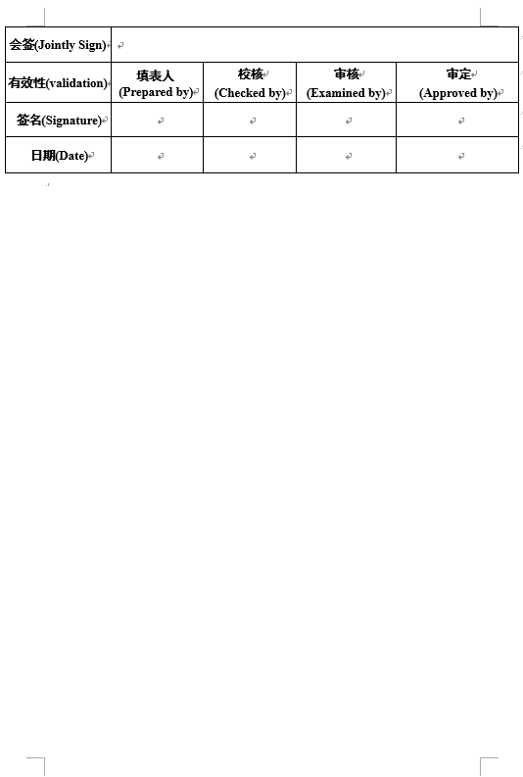
The chimneys of the magnet
Location and size of the chimneys.
工作联系单

Slide 7
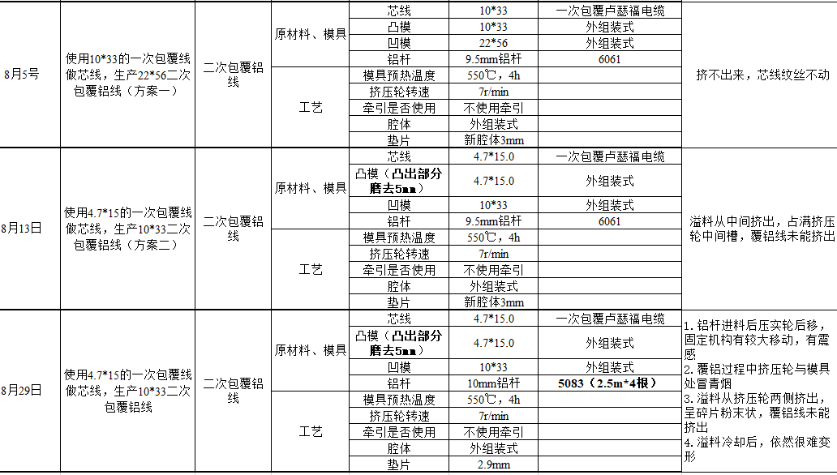
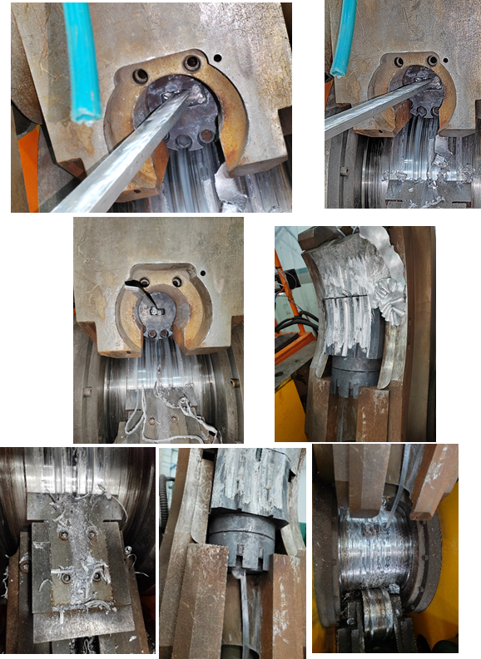
Superconducting cables: LTS and HTS
Aluminum stabilized LTS cable:

Slide 8
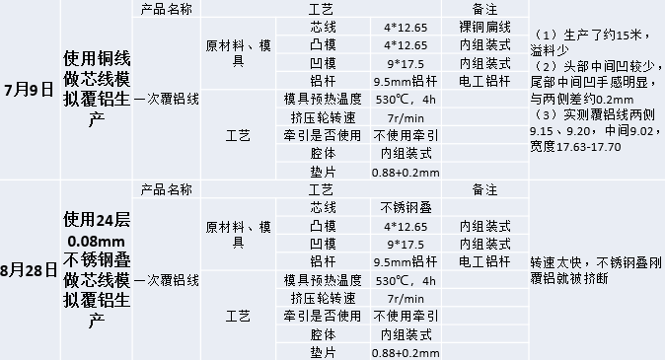
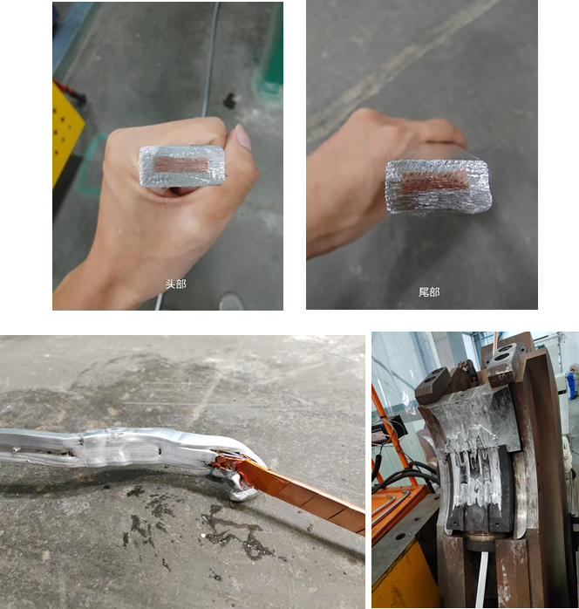
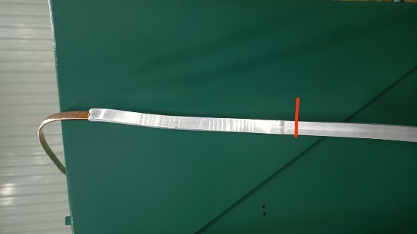
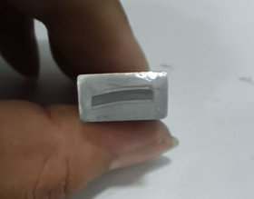
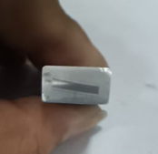
Superconducting cables: LTS and HTS
Aluminum stabilized HTS cable:
超导叠的尺寸控制；
厚铝带倒角；
厚绕包铜带；
扩大凸模尺寸
9月19日，不锈钢叠覆铝实验：
旧的不锈钢叠
转速降到5转，
温度530，
凸模尺寸：13.2*4.8 mm²
出来约30cm不锈钢叠卡断
绕包带段爹导致堵塞模具口

Slide 9
Thank you for your attention!

