Slide 1
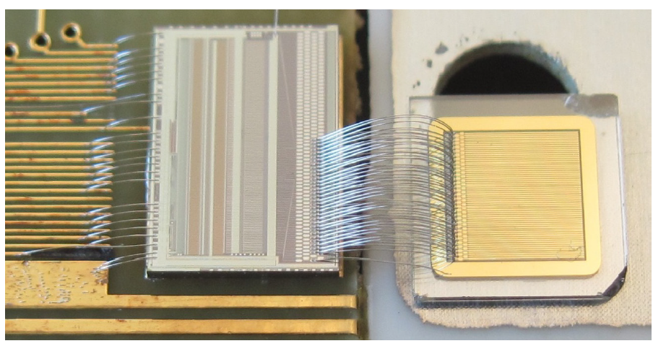
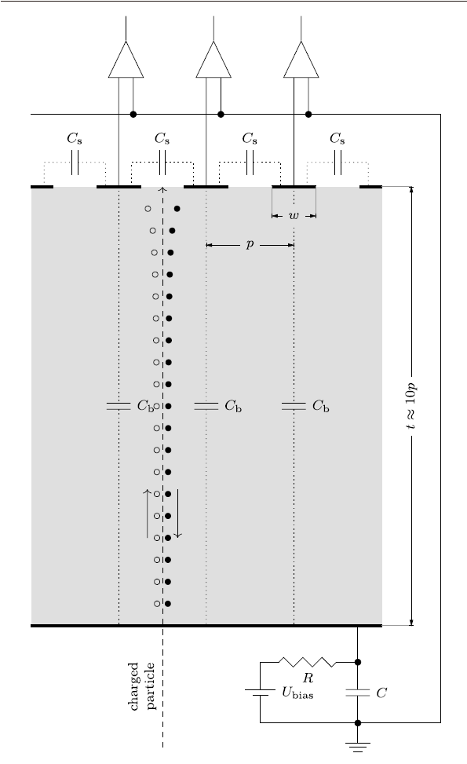
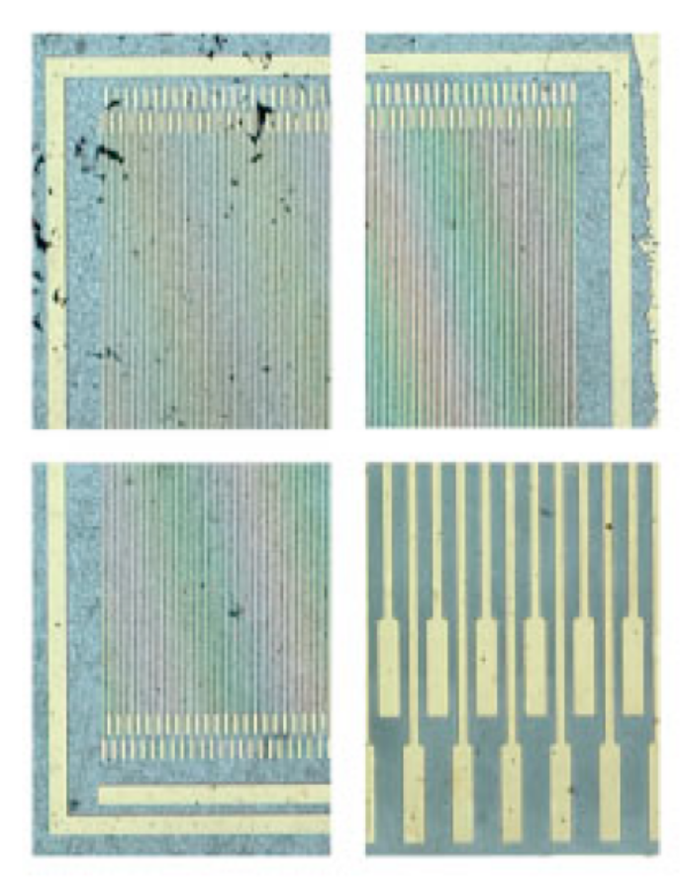
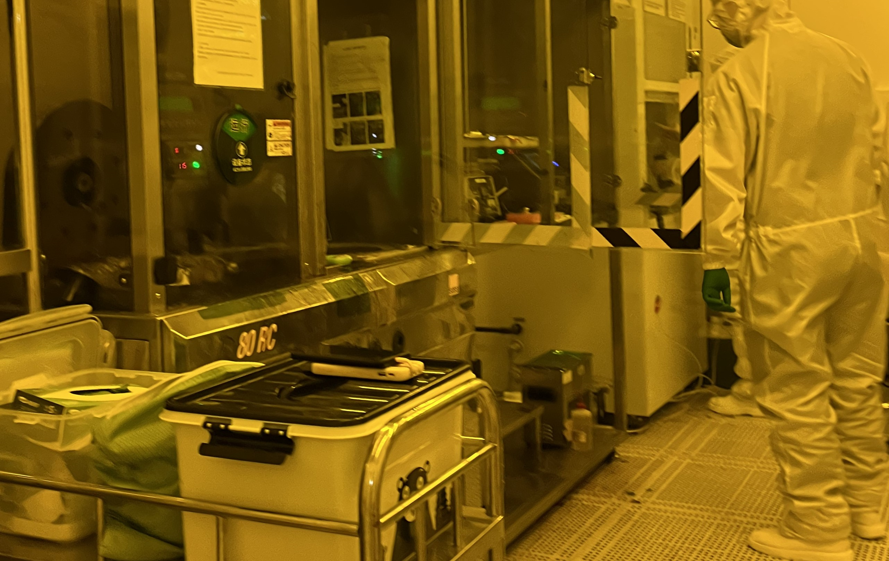
Strip electrodes on Diamond
NJU 微加工中心制作电极
绘制电极图案 (dwg, dxf, gds文件)
制作光掩膜板（SF100无掩模光刻机）
金刚石衬底湿法，干法清洗
涂光刻胶，匀胶
有掩膜紫外光刻(MJB4光刻机)
显影
磁控溅射/电子束蒸发镀膜（KJL/PVD75 Cr/Au）
去光刻胶
Wire bonding
形成电极，测试I-V
50 μm pitch：25 μm wide strips with a 25 μm gap between strips
both sides with 500 °A Cr and 2000 °A Au
metalization is performed by sputtering
annealed at 400 °C for 4 min in an N2 atmosphere.
bias electrode side of the device was attached with silver paint to a ceramic hybrid containing a bias pad and RC bias filter circuit to power the device
each readout strip could be directly wire bonded from the diamond strip detector to a VA2.2 readout channel
微结构中心老师：
陈莉
王洁
李婷婷
光刻间

Slide 2
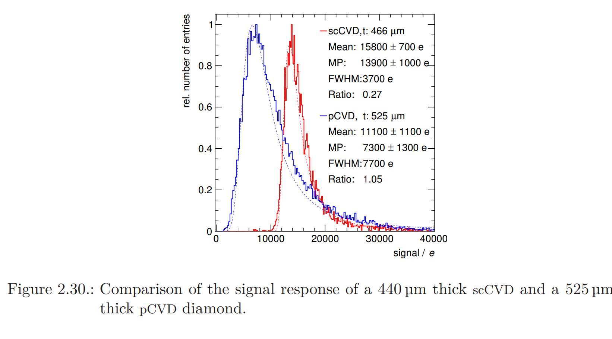
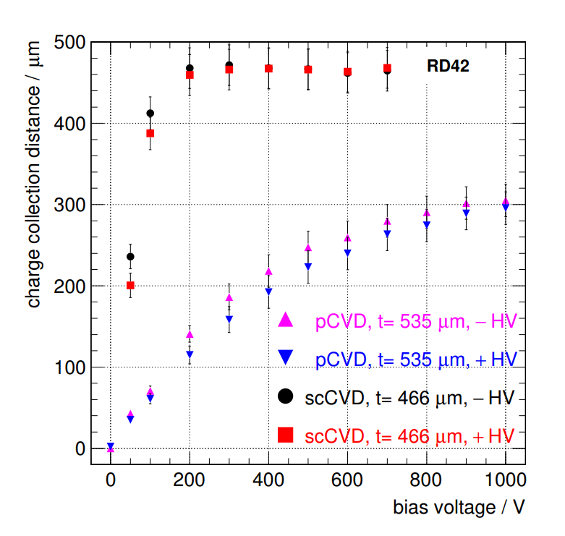
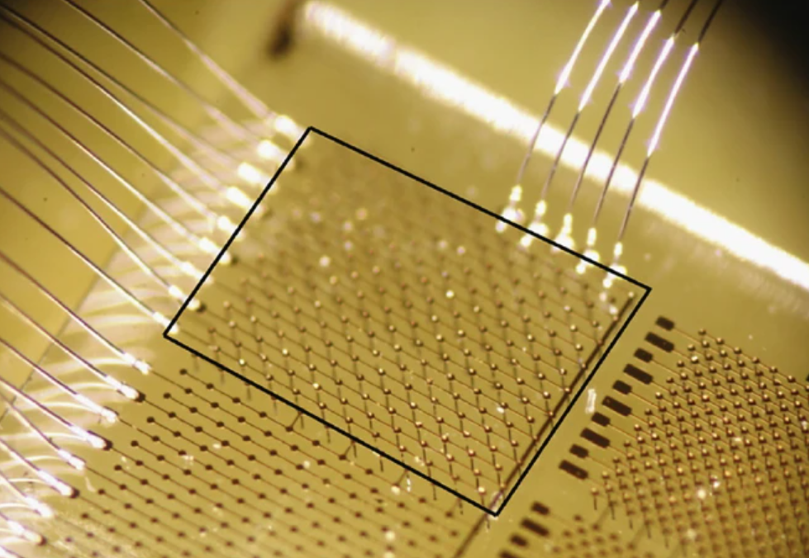
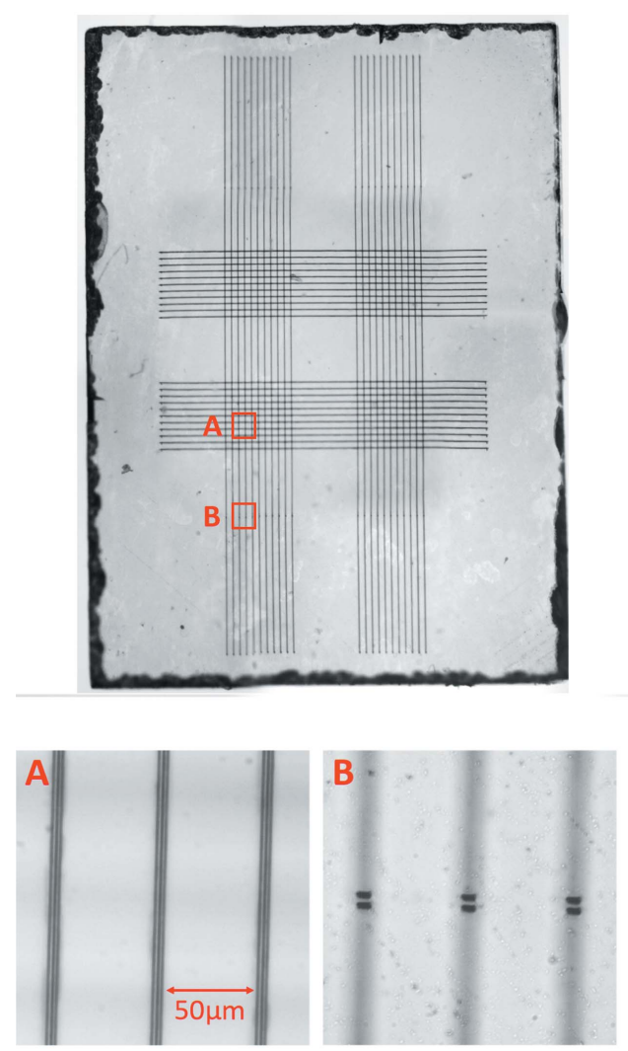
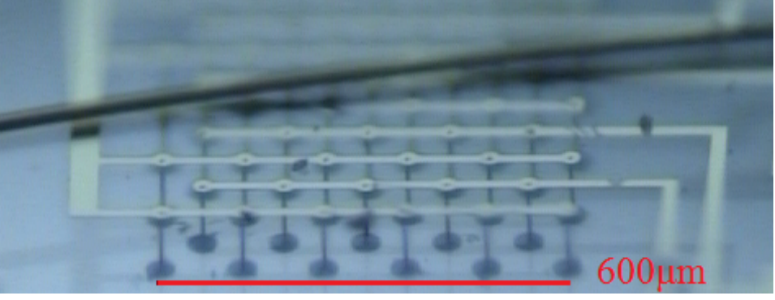
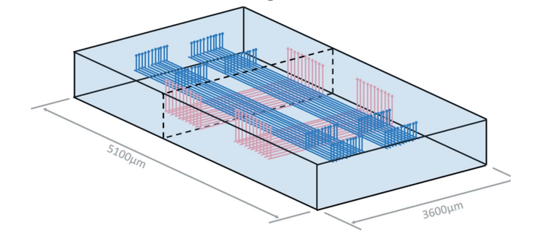
3D electrodes on Diamond
3D electrodes：
利用飞秒脉冲激光，引发金刚石体内sp3相至导电的sp2相的转变，sp2导电条为电极
相比于微条电极，时间和空间分辨率提升30%，同时提升抗辐照性能
Coherent Libra钛蓝宝石飞秒激光器，激光波长800nm，脉冲宽度50 fs，频率1 kHz,脉冲能量700nJ
飞秒脉冲激光👉唐楼L119

