Slide 1
Examination of T/CP Invariance in the $e^{+}e^{−}→^{+}^{−}$Reaction at BESIII
Yunhe Yang¹, Ziyu Zhang¹, Aiqiang Guo², Chunxu Yu¹
¹NanKai University
²Institute of Modern Physics, Chinese Academy of Sciences

Slide 2
Signal MC
MC sample | Number 2021 (M) | Generated Model
$$τ^{+}→e^{+}ν_{e}{\overline{ν}}_{τ}$$ $τ^{−}→μ^{−}{\overline{ν}}_{μ}ν_{τ}$ | 0.5 | PHOTOS TAULNUNU
$$τ^{+}→e^{+}ν_{e}{\overline{ν}}_{τ}$$ $τ^{−}→μ^{−}{\overline{ν}}_{μ}ν_{τ}$ | 0.5 | PHOTOS TAULNUNU

Slide 3
Exclusive MC
We generated several kinds exclusive MC, which are used to distinguish electron, muon, pion and kaon.
MC sample | Number(M) | Generated Model
$$ψ\left(2S\right)→τ^{+}τ^{−}→e^{±}e^{∓}4ν$$ | 0.5 | PHOTOS TAULNUNU
$$ψ\left(2S\right)→τ^{+}τ^{−}→μ^{±}μ^{∓}4ν$$ | 0.5 | PHOTOS TAULNUNU
$$ψ\left(2S\right)→τ^{+}τ^{−}→π^{±}π^{∓}2ν$$ | 0.5 | TAUSCALARNU
$$ψ\left(2S\right)→τ^{+}τ^{−}→K^{±}K^{∓}2ν$$ | 0.5 | TAUSCALARNU

Slide 4
Inclusive MC
MC sample | Number 2021 (M)
Inclusive MC | 2300

Slide 5
Event selection
Good Charged Choose
$\left|V_{r}\right|<1.0cm, \left|V_{Z}\right|<10cm, \left|cosθ\right|<0.93$
$N_{total}=2$
Good Photon Choose
$dang≥{10}^{◦}, 0≤TDC≤700ns$
$Barrel EMC: \left|cosθ\right|≤0.8, E_{γ}≥25MeV$
$Endcap EMC: 0.86≤\left|cosθ\right|≤0.92, E_{γ}≥50MeV$
$N_{γ}=0$

Slide 6
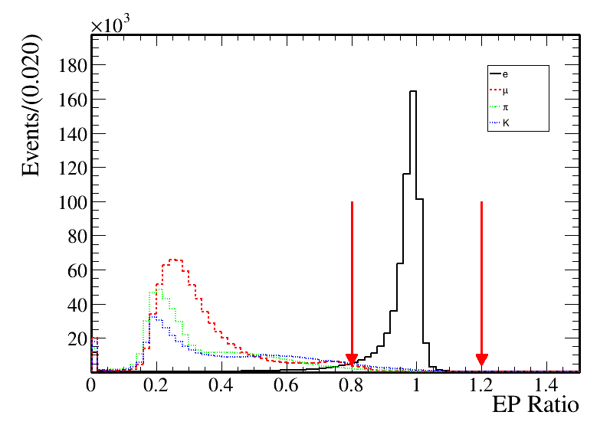
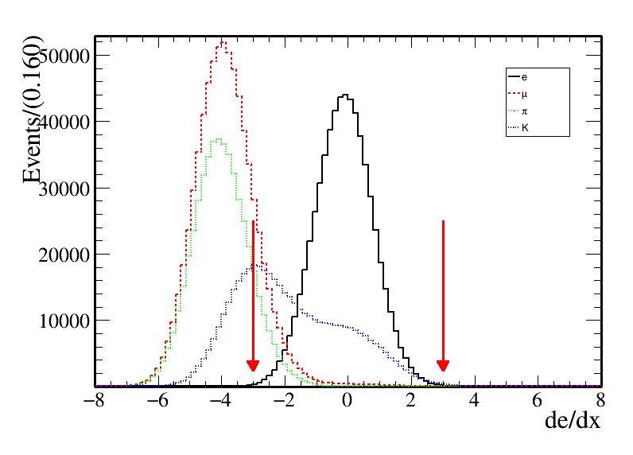
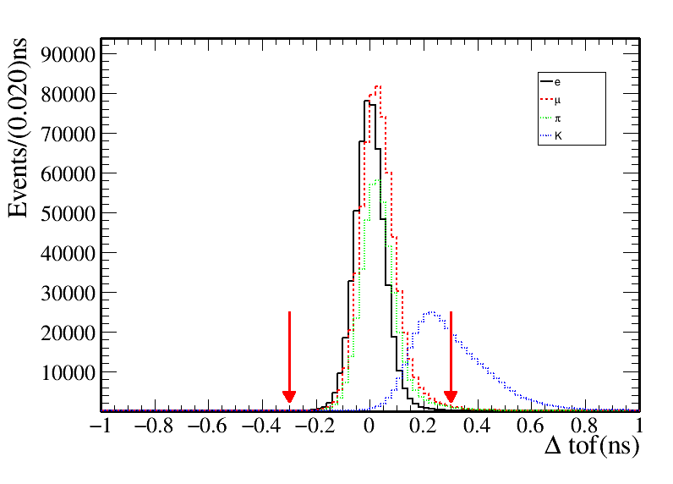
Electron identification
$E/P>0.8,$ E is the energy in EMC, P is momentum in MDC
Number of electron: $N_{e}=1$
Difference between the expected flight time and the measured time in TOF under e hypothesis : $\left|Δtof\right|<0.3$
dE/dx of MDC under e hypothesis: $−3{<χ}_{dE/dx}^{e}<3$

Slide 7
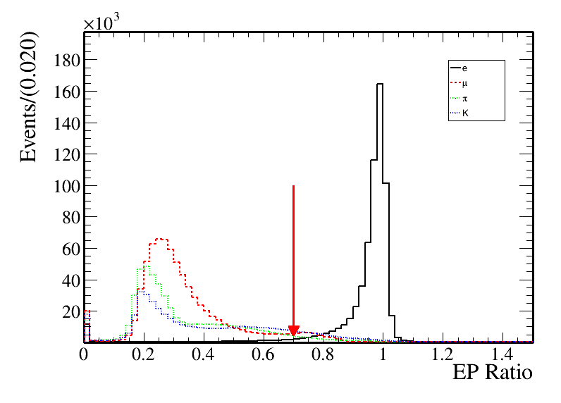
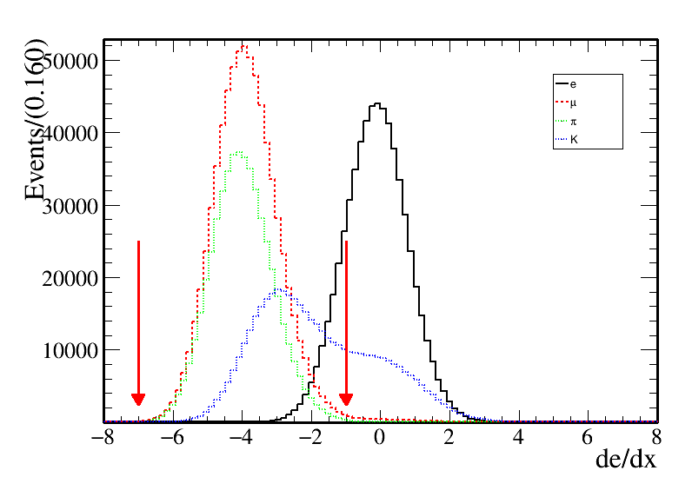
Muon identification
$E/P<0.7,$E is the energy in EMC, P is momentum in MDC
Number of muon: $Nμ=1$
Difference between the expected flight time and the measured time in TOF under e hypothesis : $\left|Δtof\right|<0.3$
dE/dx of MDC under e hypothesis: $−7<χ_{dE/dx}^{e}<−1$

Slide 8
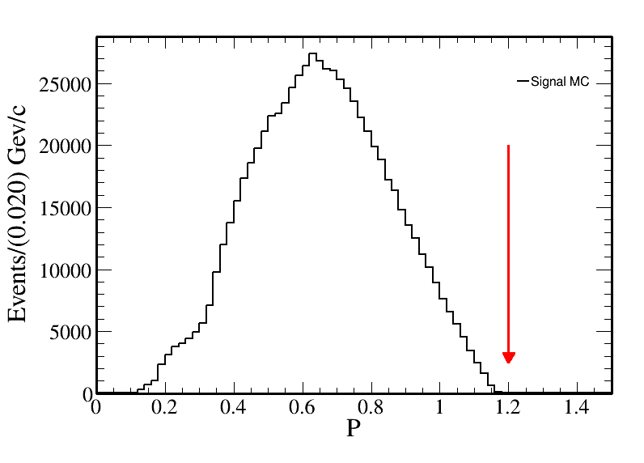
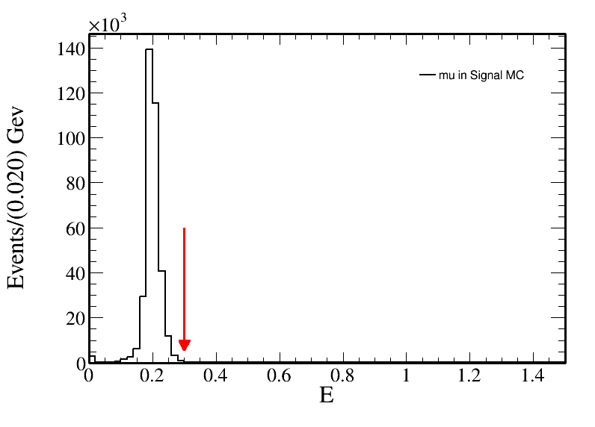
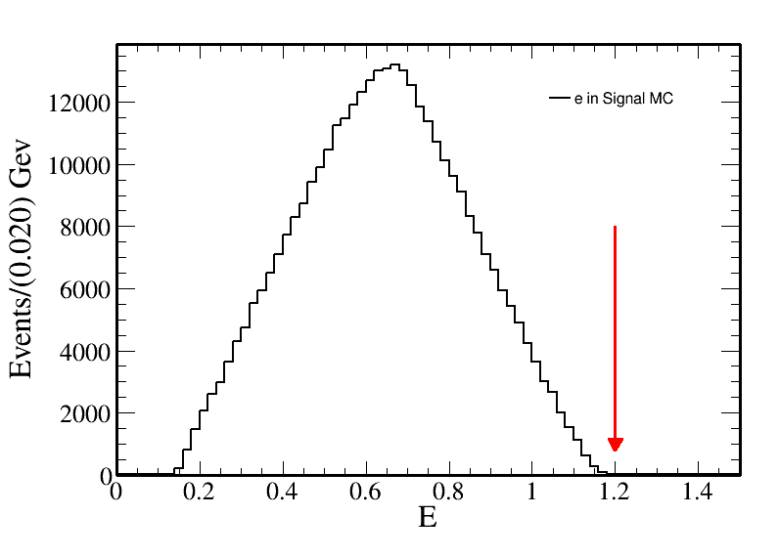
Further selection
Momentum in MDC: $P<1.2$
The energy in EMC: $E_{e}<1.2$
The energy in EMC: $E_{μ}<0.3$

Slide 9
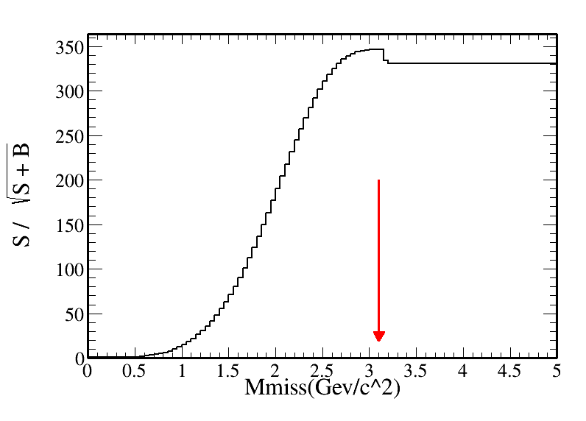
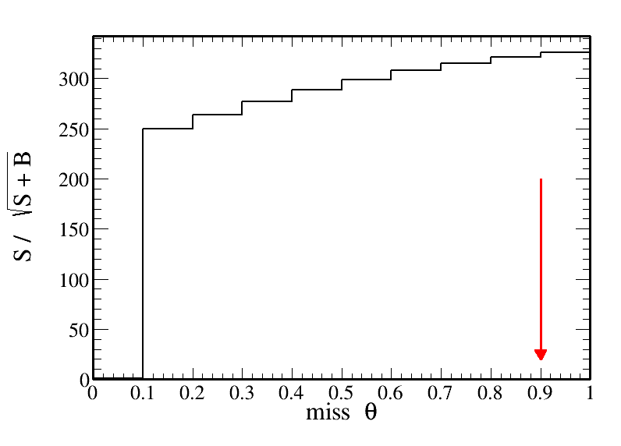
Further selection
$M_{miss}=\left(P4_{ψ\left(2S\right)}−P4_{ll}\right)∙m()$
$cosθ_{miss}=\frac{−{\left(p_{1}+p_{2}\right)}_{z}}{|p_{1}+p_{2}|}$
The missing mass: $M_{miss}<3.10$
The missing cos theta: $|cosθ|<0.9$

Slide 10
Background
Total | Signal | Background
256330 | 170381 | 85949

Slide 11
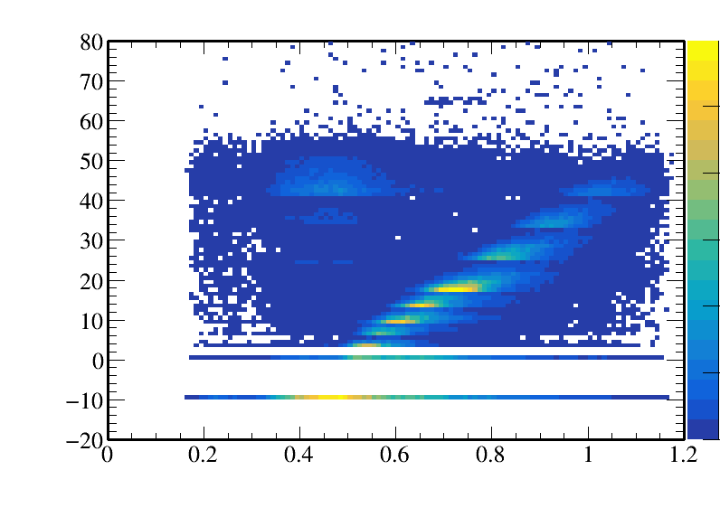
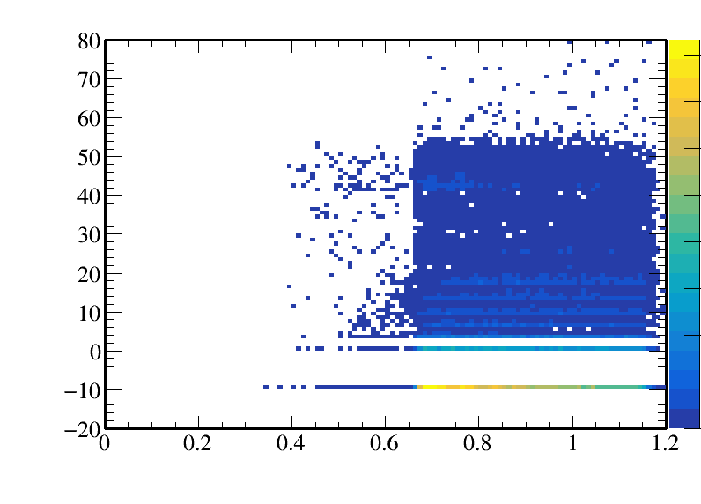
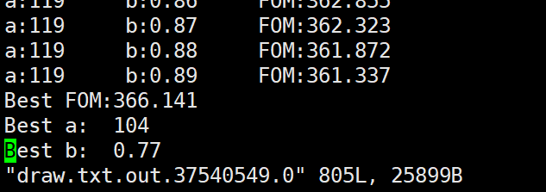
Background Analyse
Use the relationship between P and depth in the MUC
$ψ\left(2S\right)→τ^{−}τ^{+}→eπ3ν:muc_{depth}>104×(P−0.77)$

Slide 12
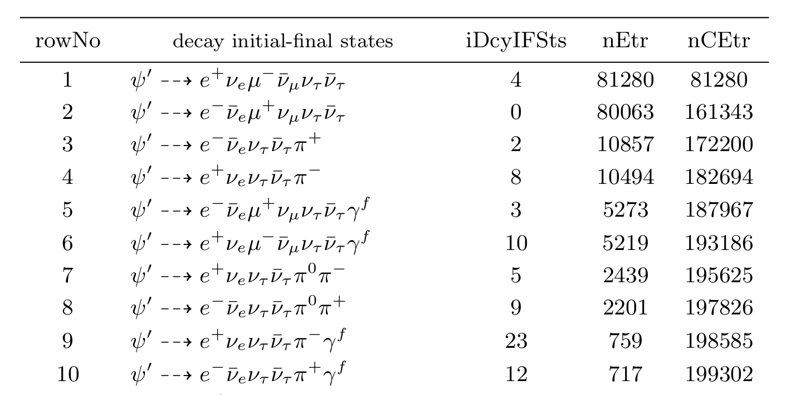
Background
Total | Signal | Background
207734 | 161343 | 46391

Slide 13
接下来的工作
本底还是很多，需要继续优化。
研究如何计算<A>

