Slide 1
SRF system and beam operation of RAON in IBS
ASSCA 2025
2025. 03. 24
Office of High Energy Linac Development
Institute for Rare Isotope Science, IBS
Youngkwon Kim

Slide 2
OUTLINE
01
Introduction
02
Mass production of SCL3 cryomdoule
03
Installation and commissioning

Slide 3
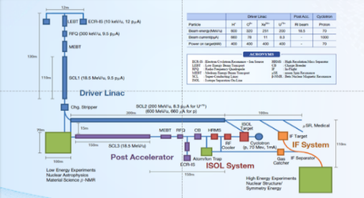
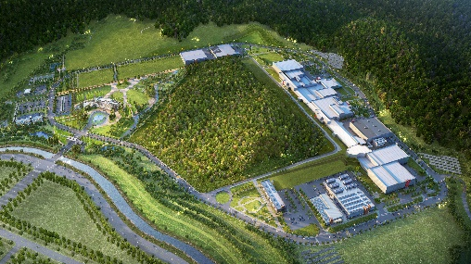
Overview
Goal: To build a heavy ion accelerator complex RAON,
for rare isotope science research in Korea.
* RAON - Rare isotope Accelerator complex for ON-line experiments
Budget: KRW 1,432 billion (US$ 1.26 billion, 1$=1,135krw)
- accelerators and experimental apparatus : 460.2 billion won
- civil engineering & conventional facilities : 972 billion won (incl. site 357 billion won)
Period: 2011.12 ~ 2021.12 (1st phase, SCL3 + experimental system)
System Installation Project
Development, installation, and commissioning of the accelerator systems that provides high-energy (200MeV/u) and high-power (400kW) heavy-ion beam
Providing high intensity RI beams by ISOL and IF
ISOL: direct fission of ²³⁸U by 70 MeV proton
IF: 200 MeV/u ²³⁸U (intensity: 8.3 pμA)
Providing high quality neutron-rich beams
e.g., ¹³²Sn with up to 250 MeV/u,
up to 10⁹ particles per second
Providing More exotic RI beam
production by combination of ISOL and IF
Facility Construction Project
Construction of research and support facility to ensure the stable operation of the heavy-ion accelerator, experiment systems, and to establish a comfortable research environment
※ Accelerator and experiment buildings, support facility, administrative buildings, and guest house, etc.

Slide 4
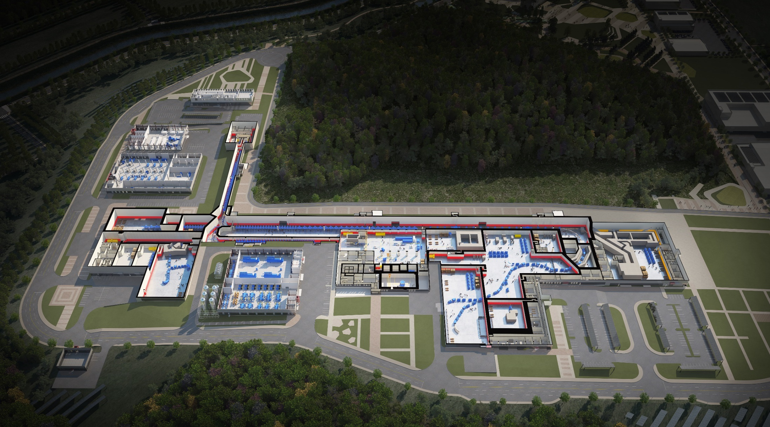
RAON layout
Control
Center
Utility
ECR IS
SCL1
ISOL System
HPMMS/
CLS
IF System
SCL3
SCL2
BIS
μSR
NDPS
KOBRA
Cyclotron
HRS
LAMPS
SCL1 is postponed. (cancelled?)
SCL3 was installed and is under operation.
SCL2 is in prototyping. (2nd phase)

Slide 5
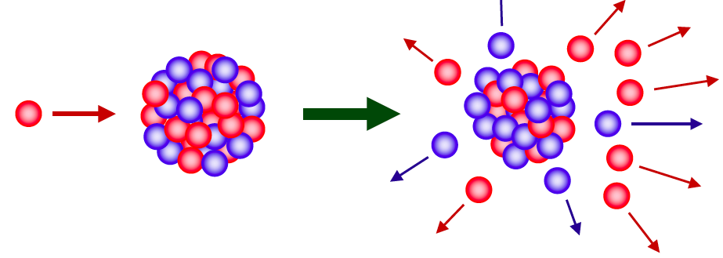
ISOL and IF
ISOL (Isotope Separator On-Line)
proton → thick target (ex. Uranium ) → target spallation or fission (low energy)
RI Ions
Reacceleration
RI Beam
Cyclotron
Proton 70 MeV, 70 kW
Driver LINAC
Heavy ion
e.g. U : 200MeV/u, 400 kW
RI ion beam
Fast Beam
Experiment
IF (In-flight Fragmentation)
Heavy ion beam → thin target (ex. Carbon) → projectile fragmentation (high energy)
Ref.: D. Jeon, Initial Commissioning of the RAON Superconducting Linac and its Future Perspective, IFPC2023

Slide 6
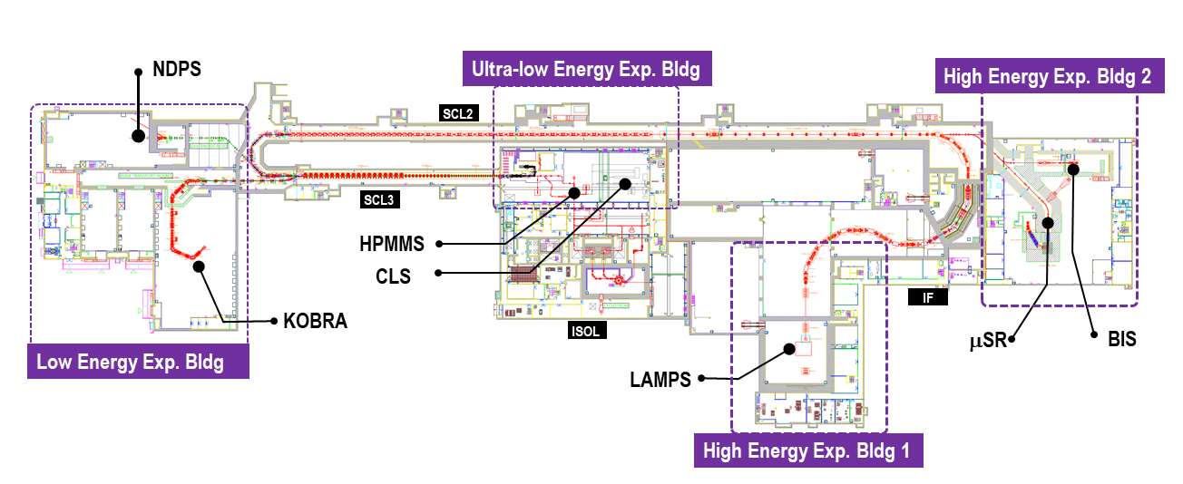
RIBs at RAON
ISOL → IF
ISOL → SCL3 → SCL2 → IF
ISOL → SCL3 → KOBRA
Broad energy range, Variety, High intensity of RIBs will be available at RAON
 | KOBRA (low-E IF) | ISOL | IF (high E)
Driver | SCL3 | Cyclotron | SCL3 → SCL2
Post accelerator | SCL3 or SCL3 → SCL2
Production mechanism | Direct reactions Multi Nucleon Transfer | p induced U fission | PF, U fission
Available RIB energy | < a tens of MeV/u | > A few of keV/u | < a hundreds of MeV/u

Slide 7
Expected rare isotope from RAON
IF
ISOL
KoBRA
ISOL+IF
RAON will provide access to unexplored regions of nuclear chart

Slide 8
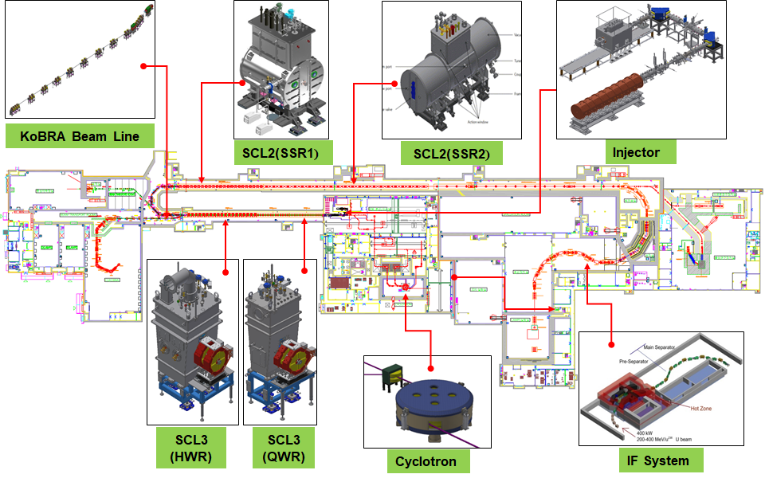
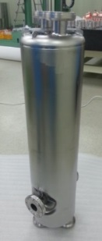
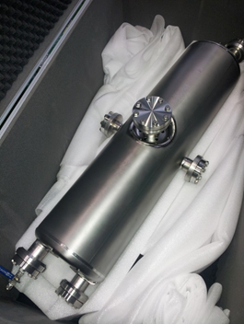
Introduction on SCL
RF Parameters
 | QWR | HWR | SSR1 | SSR2
Optimum $β$ | 0.047 | 0.12 | 0.32 | 0.51
$$f [MHz]$$ | 81.25 | 162.5 | 325 | 325
$$L_{eff}\left(=β_{o}λ\right)[mm]$$ | 173.5 | 221.5 | 276.9 | 470.8
$$R/Q[Ω]$$ | 469 | 295 | 233 | 290
$${E_{peak}}/{E_{acc}}$$ | 5.7 | 5.2 | 4.1 | 3.7
$${B_{peak}}/{E_{acc}} [{mT}/{({MV}/m)]}$$ | 10.4 | 9.0 | 6.9 | 7.7
$$E_{acc} [{MV}/m]$$ | 6.1 | 6.6 | 8.5 | 8.7
$$V_{acc} [MV]$$ | 1.06 | 1.46 | 2.35 | 4.1
 | Cavity | # of cav. per CM | # of CM | Cav. Op. T (K)
SCL3 | QWR | 1 | 22 | 4.5
 | HWR | 2 | 13+2 | 2.05
 |  | 4 | 19 | 2.05
SCL2 | SSR1 | 3 | 23 | 2.05
 | SSR2 | 6 | 23+2 | 2.05

Slide 9
Mass production of SCL3 cryomdoule
Contracts
 | SCL31 |  | SCL32
 | Products | Quantity | Products | Quantity
Final deliverables | QWR cryomodule | 22 | HWR cryomodule A | 15
 |  |  | HWR cryomodule B | 19
Subcomponents to be fabricated | Superconducting cavities | 18 | Superconducting cavities | 104
 | Power couplers | 20 | Power couplers | 104
 | Tuners | 22 | Tuners | 104
 | Cryostat | 21 | Cryostat A | 14
 |  |  | Cryostat B | 18
Contract amount | $ 9,065,128 |  | $ 25,457,148
Period | 2017. 12 ~ 2020. 07 |  | 2018. 05 ~ 2022. 01
Domestic vendor: VitzroTech (cavity: RI as subcontractor)

Slide 10
Schedule for mass production
 | 2017 | 2018 |  |  |  | 2019 |  |  |  | 2020 |  |  |  | 2021
QWR
HWR
Contract(‘17.12)
cavity fabrication (’18.03 ~ ‘20.06)
module & tuner fabrication (‘18.03~’19.03)
coupler fabrication (‘18.03 ~ ‘20.01)
vertical test (‘18.08 ~ ‘20.07)
module assembly (‘19.07 ~ ‘20. 08)
Helium jacket issue based on the KGS (Korea Gas Safety)
horizontal test (‘19.08 ~ ‘20. 09)
Contract(‘18.05)
cavity fabrication (‘18.09~’21.06)
module fabrication (‘18.12 ~ ‘20. 06)
tuner fabrication (‘19.01 ~ ‘20. 04)
coupler fabrication (‘19.03 ~ 21.04)
vertical test (‘20.02 ~ ‘21. 07)
module assembly (‘20.09 ~ ‘21.10)
Fabrication delay due to COVID-19 in subcontractor (RI, Germany)
Design change of beam sphere and beam port
horizontal test (‘20.10 ~ ‘21. 11)

Slide 11
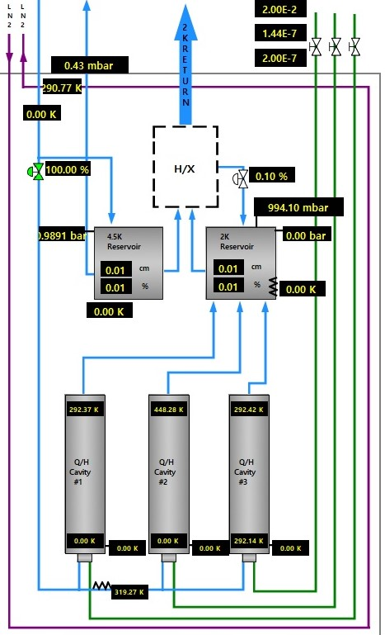
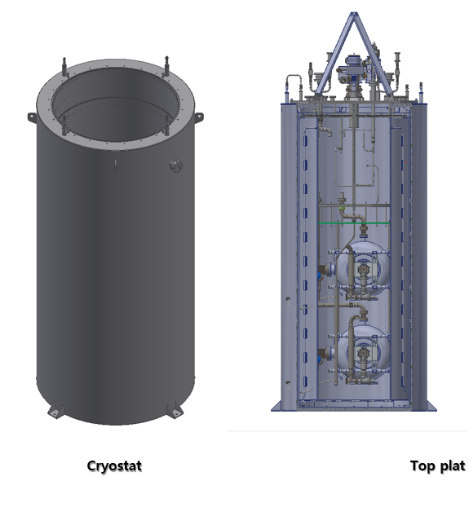
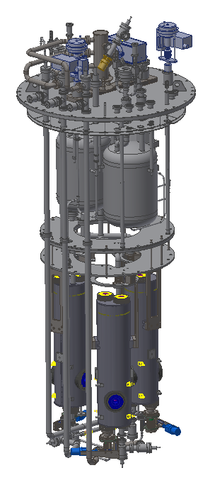
Vertical Test
Vertical test
Vacuum Chamber
Ion Pump
2K Reservoir
4K Reservoir
ID=1,200 mm
Height=3,000 mm
Vacuum Line
Cryostat
Top flange
2 stats for dressed cavity and 1 stat for bare & dressed cavity

Slide 12
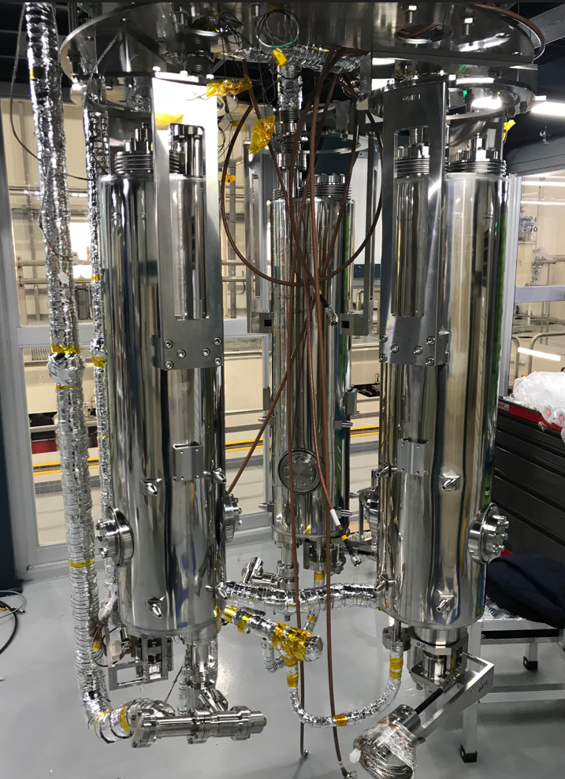
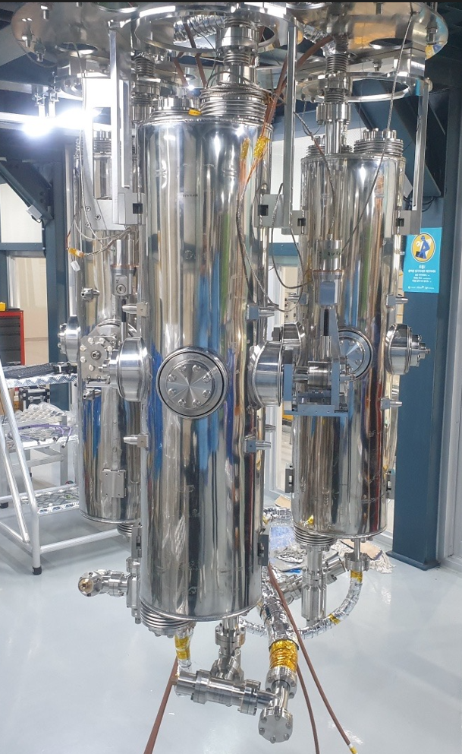
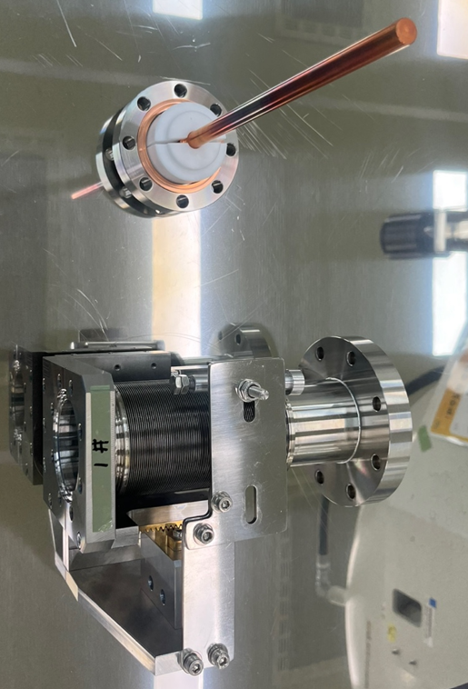
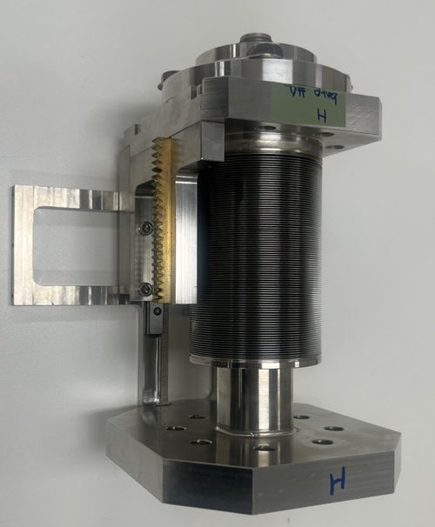
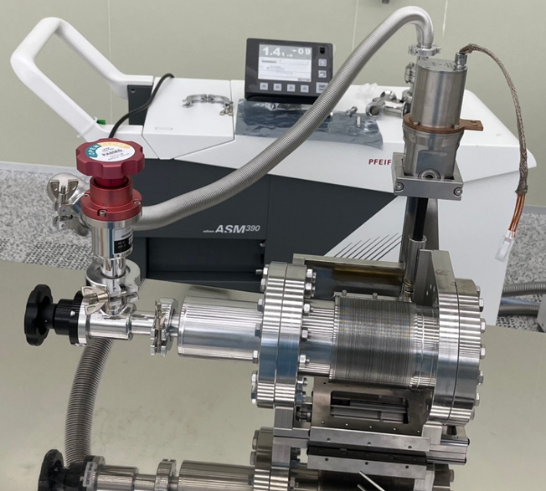
Top flange assembly
Inner conductor
Outer conductor and bellows
Motor
Variable coupler

Slide 13
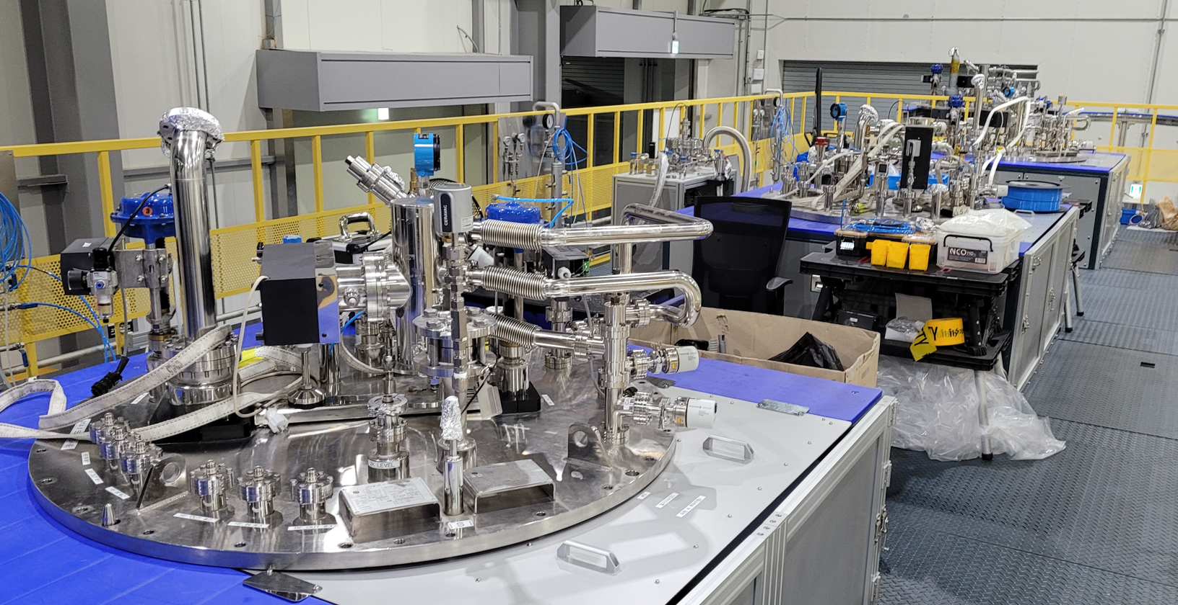
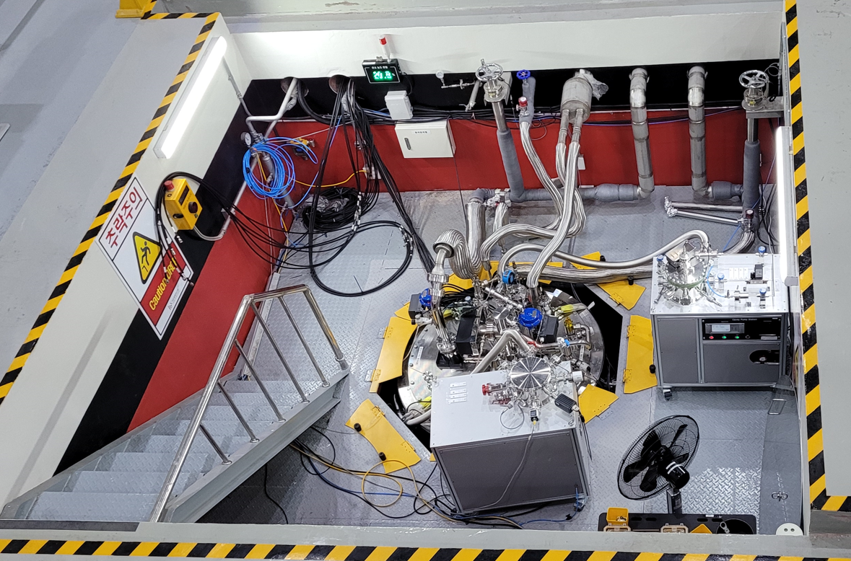
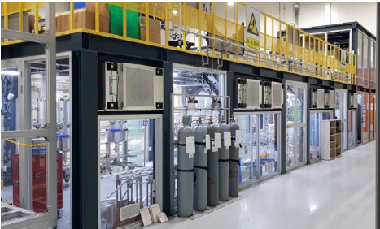
Performance Test
Cryogenic valve
Ion pump
Vacuum pumping lines
& vacuum gauges
GHe supply & return
VLP return
Feedthroughs
LN2 supply & return
Vacuum pump
for cavity
Assembly area(clean room) for vertical test
Top flange in the vertical test pit

Slide 14
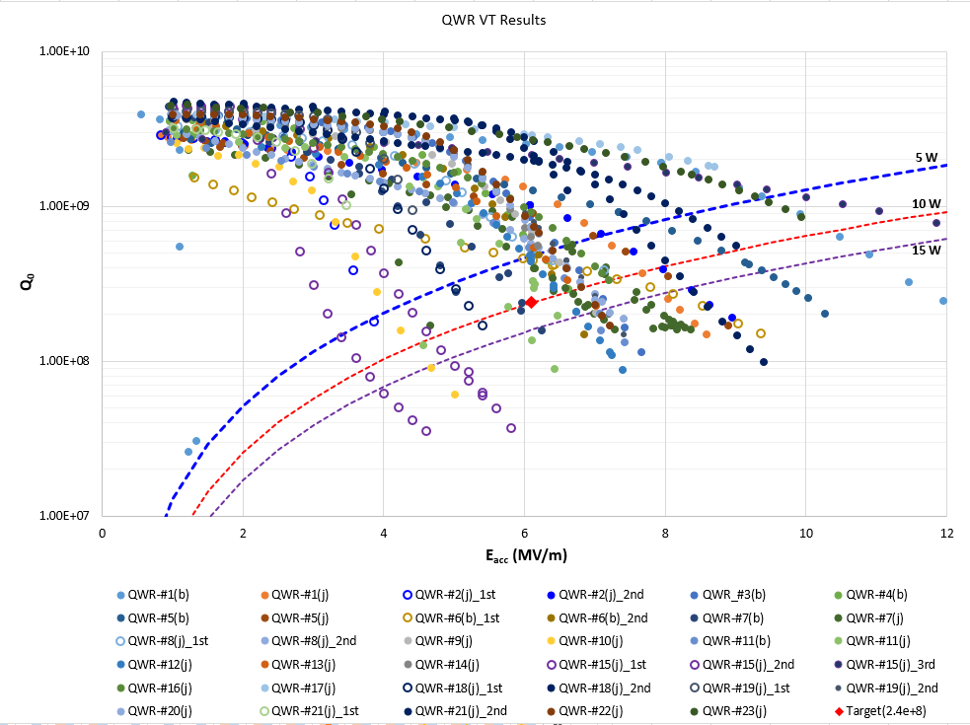
QWR VT results
E_{acc}: 6.1 MV/m, Q₀=2.4e+8@4.2K, Number of cavity: 22 ea

Slide 15
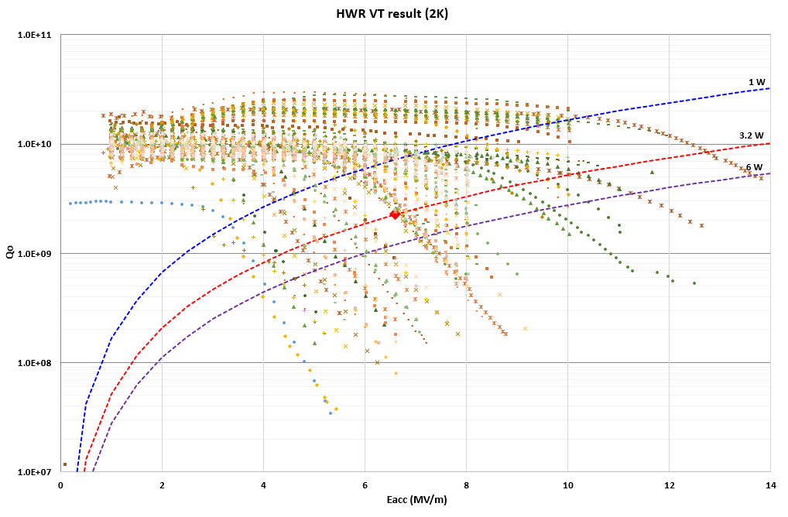
HWR VT results
E_{acc}: 6.6 MV/m, Q₀=2.3e+9@2.05K, Number of cavity: 106 ea
VT yield ~75 %
Main cause of failure: field emission

Slide 16
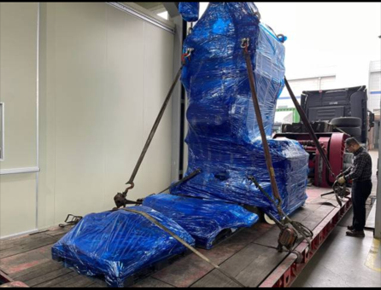
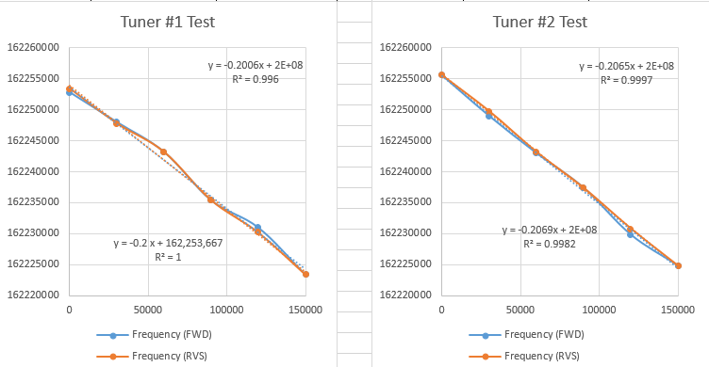
Horizontal Test
Installation in the bunker
Cavity frequency check & tuner operation test
Leak test and vacuum pumping for cavity
Leak test and Purging cryogenic pipes
Connecting cryogenic lines, signal cables, DC bias, RF transmission lines, etc
Test procedure
Cool-down
Thermal shield cool-down by LN2
Cavity cool-down through cool-down line
4K Test
Cable calibration
MP conditioning
Static and total thermal load measurement
Field emission conditioning with pulsed RF power, if necessary
2K Test
2 K pump-down: df/dp measurement (~3MV/m)
Q_{ext} measurement with VNA
Static and total thermal load measurement
LFD & tuner operation test
Alignment measurement
Tuner test at room temp.
(~0.2 Hz/pulse, ~30 kHz span)

Slide 17
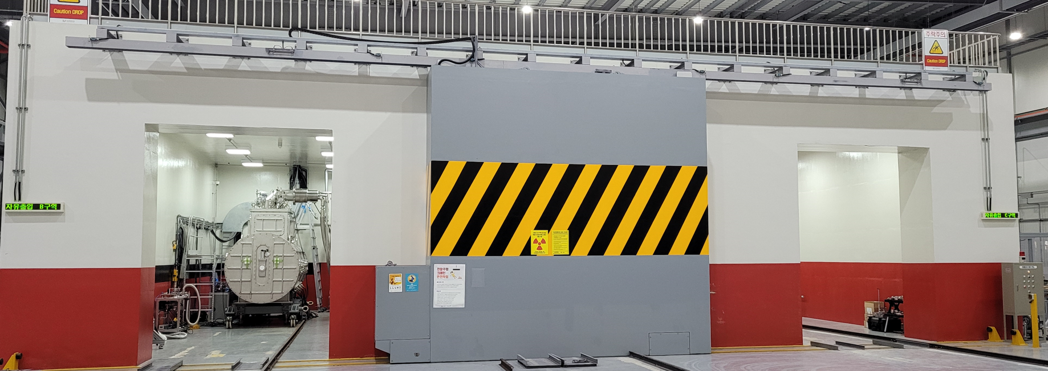
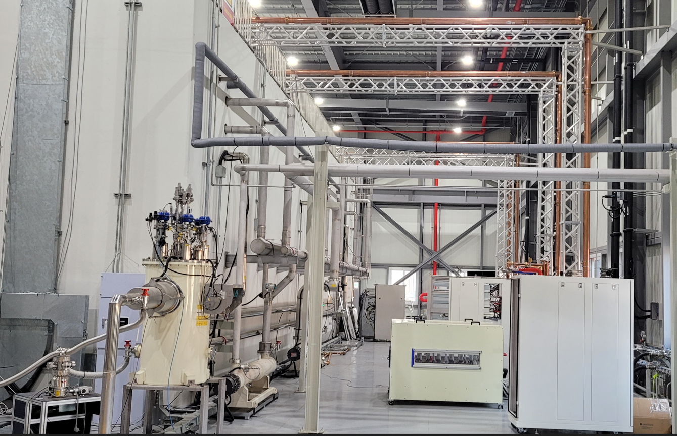
Horizontal Test
Horizontal test facility
Horizontal test bunkers
RF transmission line
Helium distribution lines
SSPA
Valve box for HT

Slide 18
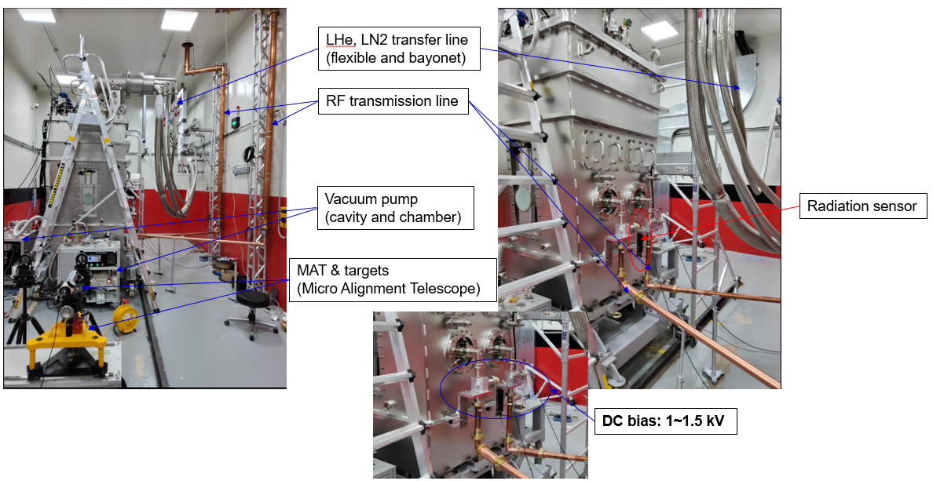
Horizontal Test
Horizontal Test
Test setup

Slide 19
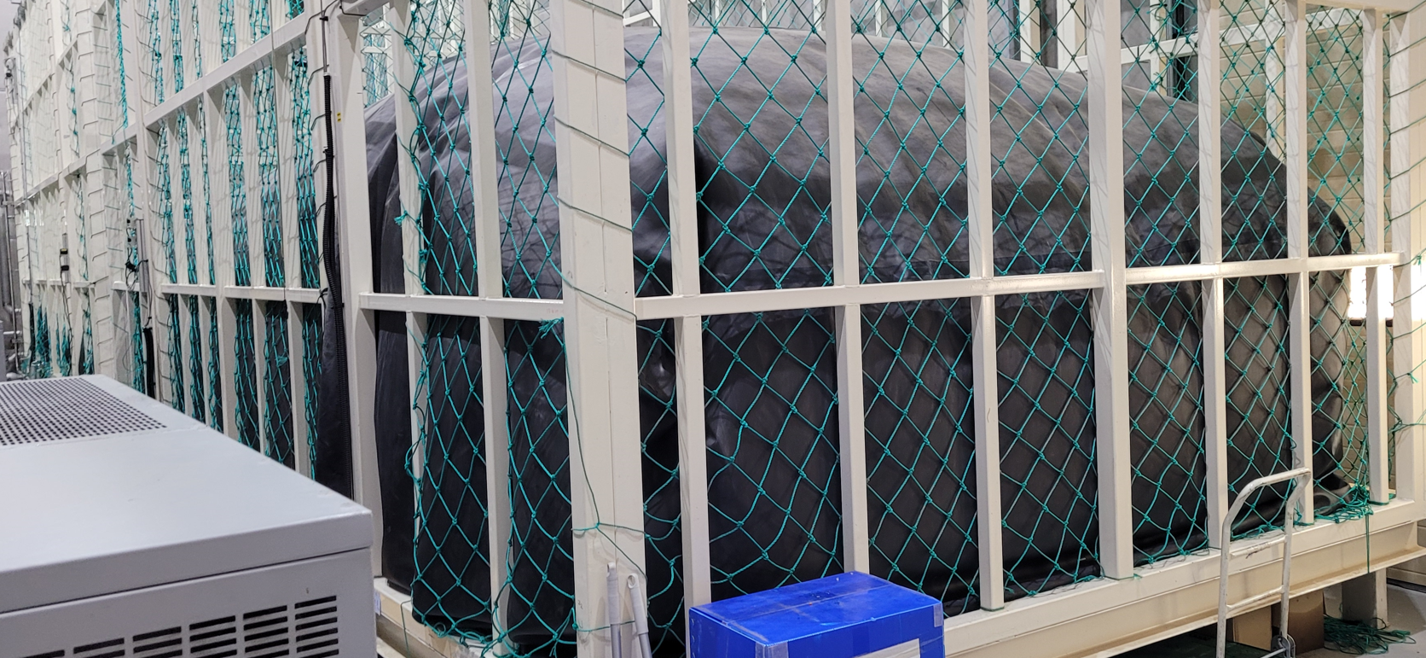
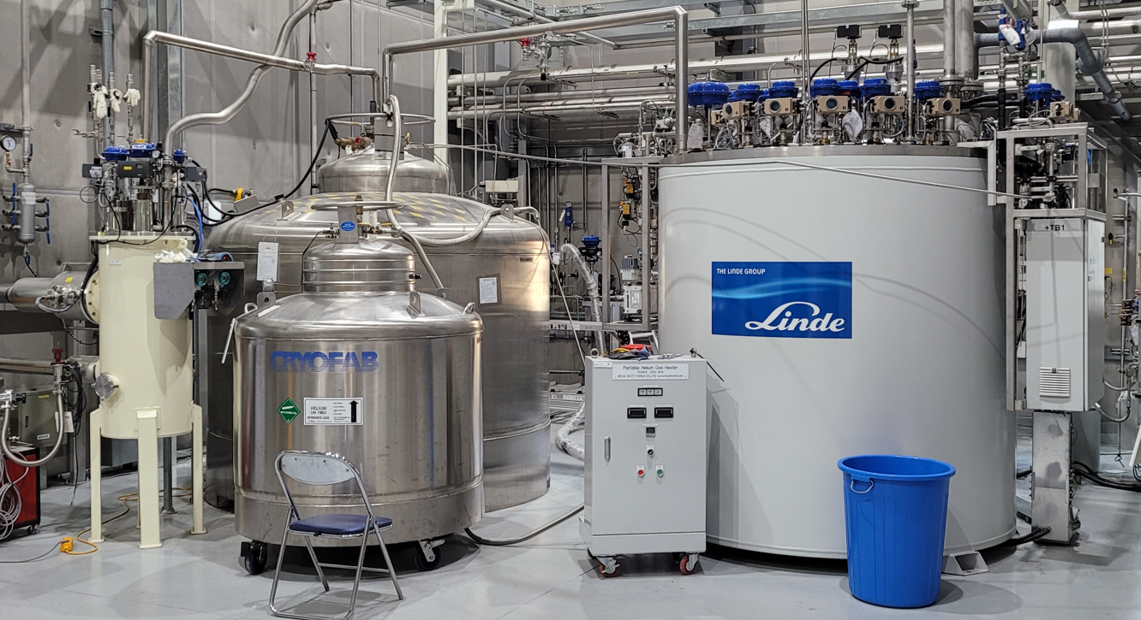
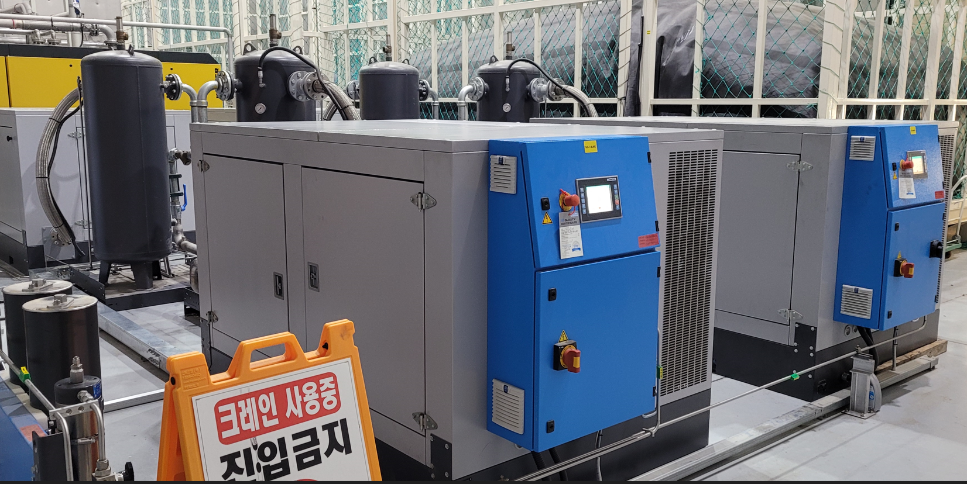
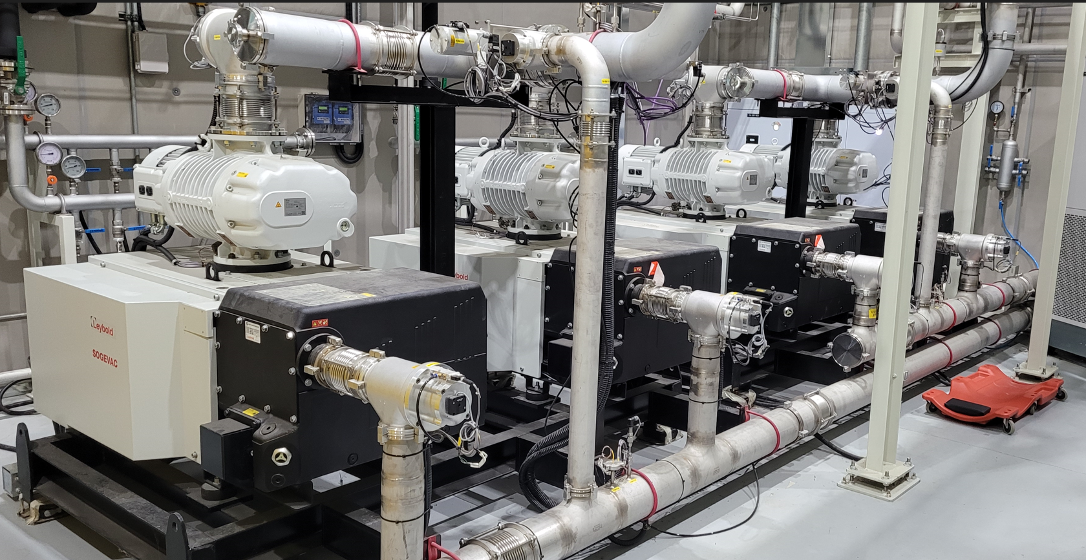
Horizontal Test
Horizontal Test
P&ID for cryomdules and cryogenics system in SRF TF
Liquefier (280 L/h) and dewar (3,000 L)
Recovery compressor and gas bag
Thermal shield cooled by LN2
Thermal intercepts
- 4 K intercepts: loop thermosiphon connected with 4 K reservoir
- 40 K intercepts: copper braid wire connected with thermal shield
3 cryogenic valves: 1 for cool-down and 2 for JT expansion
Heat exchanger to precool the LHe before 2 K expansion
Vacuum pumping system to maintain 35 mbar
Pump-down system(vacuum pumps): 1.5g/s each

Slide 20
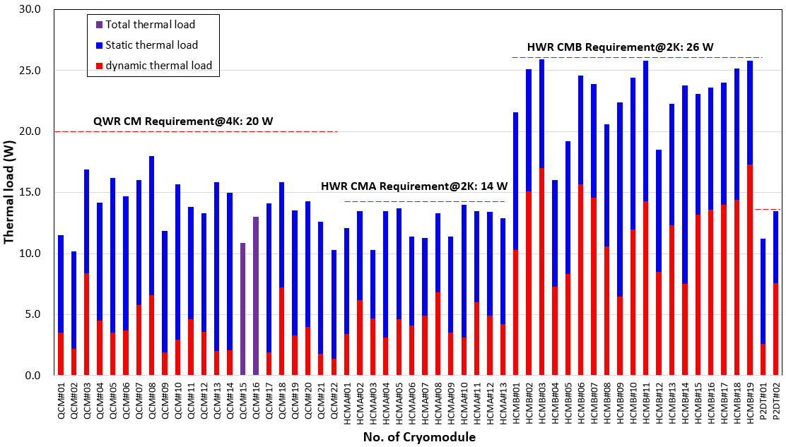
Horizontal Test
Thermal load measurement results
Dynamic thermal load of each cryomodule is the sum of the dynamic thermal load of cavities in the cryomdoules

Slide 21
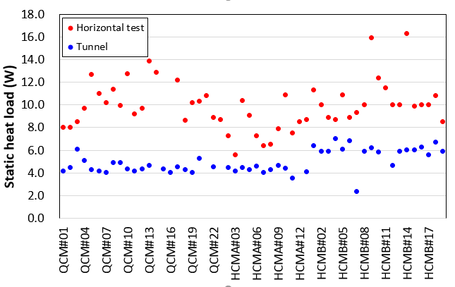
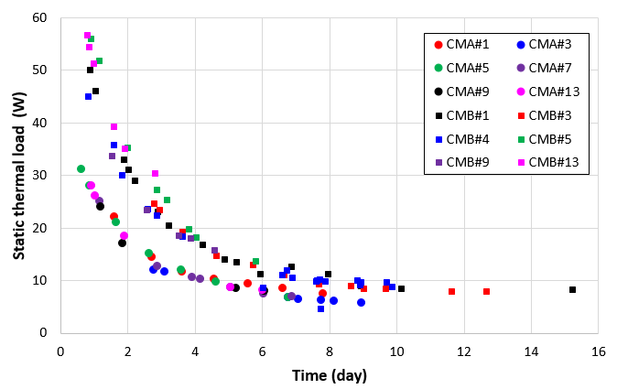
Horizontal Test
Static thermal load of HT vs. tunnel
Static thermal load
Static thermal load change w.r.t. time during HT
Wrong measurement
Heat load | QWR |  | HWR CMA |  |  | HWR CMB
 | 4.5 K | 40 K | 2.05 K | 4.5 K | 40 K | 2.05 K | 4.5 K | 40 K
Estimated (50% margin) | 7.5 | 83.3 | 4.5 | 4.5 | 117.9 | 6.8 | 7.5 | 181.5
Measured in tunnel (avg.) | 4.5 | - | 4.3 | 5.1 | - | 6.1 | 6.8 | -
Main reason: Large mass (~40 Kg) of tuner
Static thermal load that we had measured were 5.6 W and 8.3 W for HWR CMA and HWR CMB, respectively while the average static thermal load measured during the experiments were 8.0 W and 10.7 W, respectively.

Slide 22
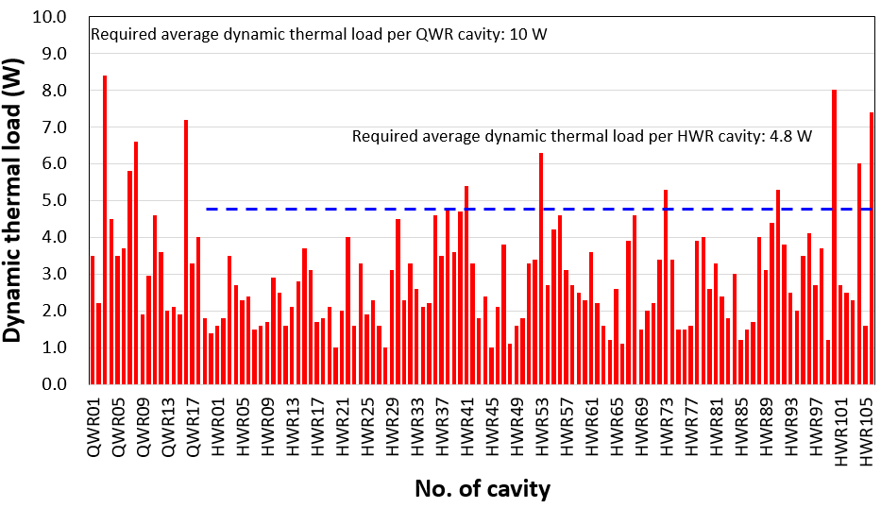
Horizontal Test
Dynamic thermal load of each cavity

Slide 23
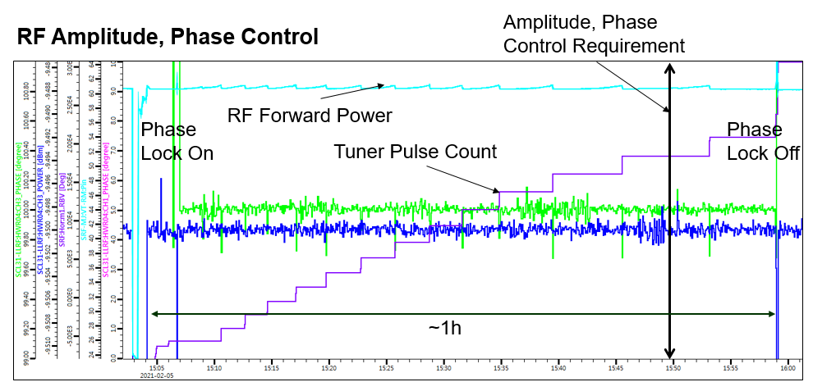
Phase and amplitude locking test of cryomdoule
Amplitude and phase lock worked find @ operating Eacc (6.6 MV/m)
Stability: amplitude = ±0.13%, phase=±0.63°
Phase was well controlled by the integration of LLRF-tuner control system

Slide 24
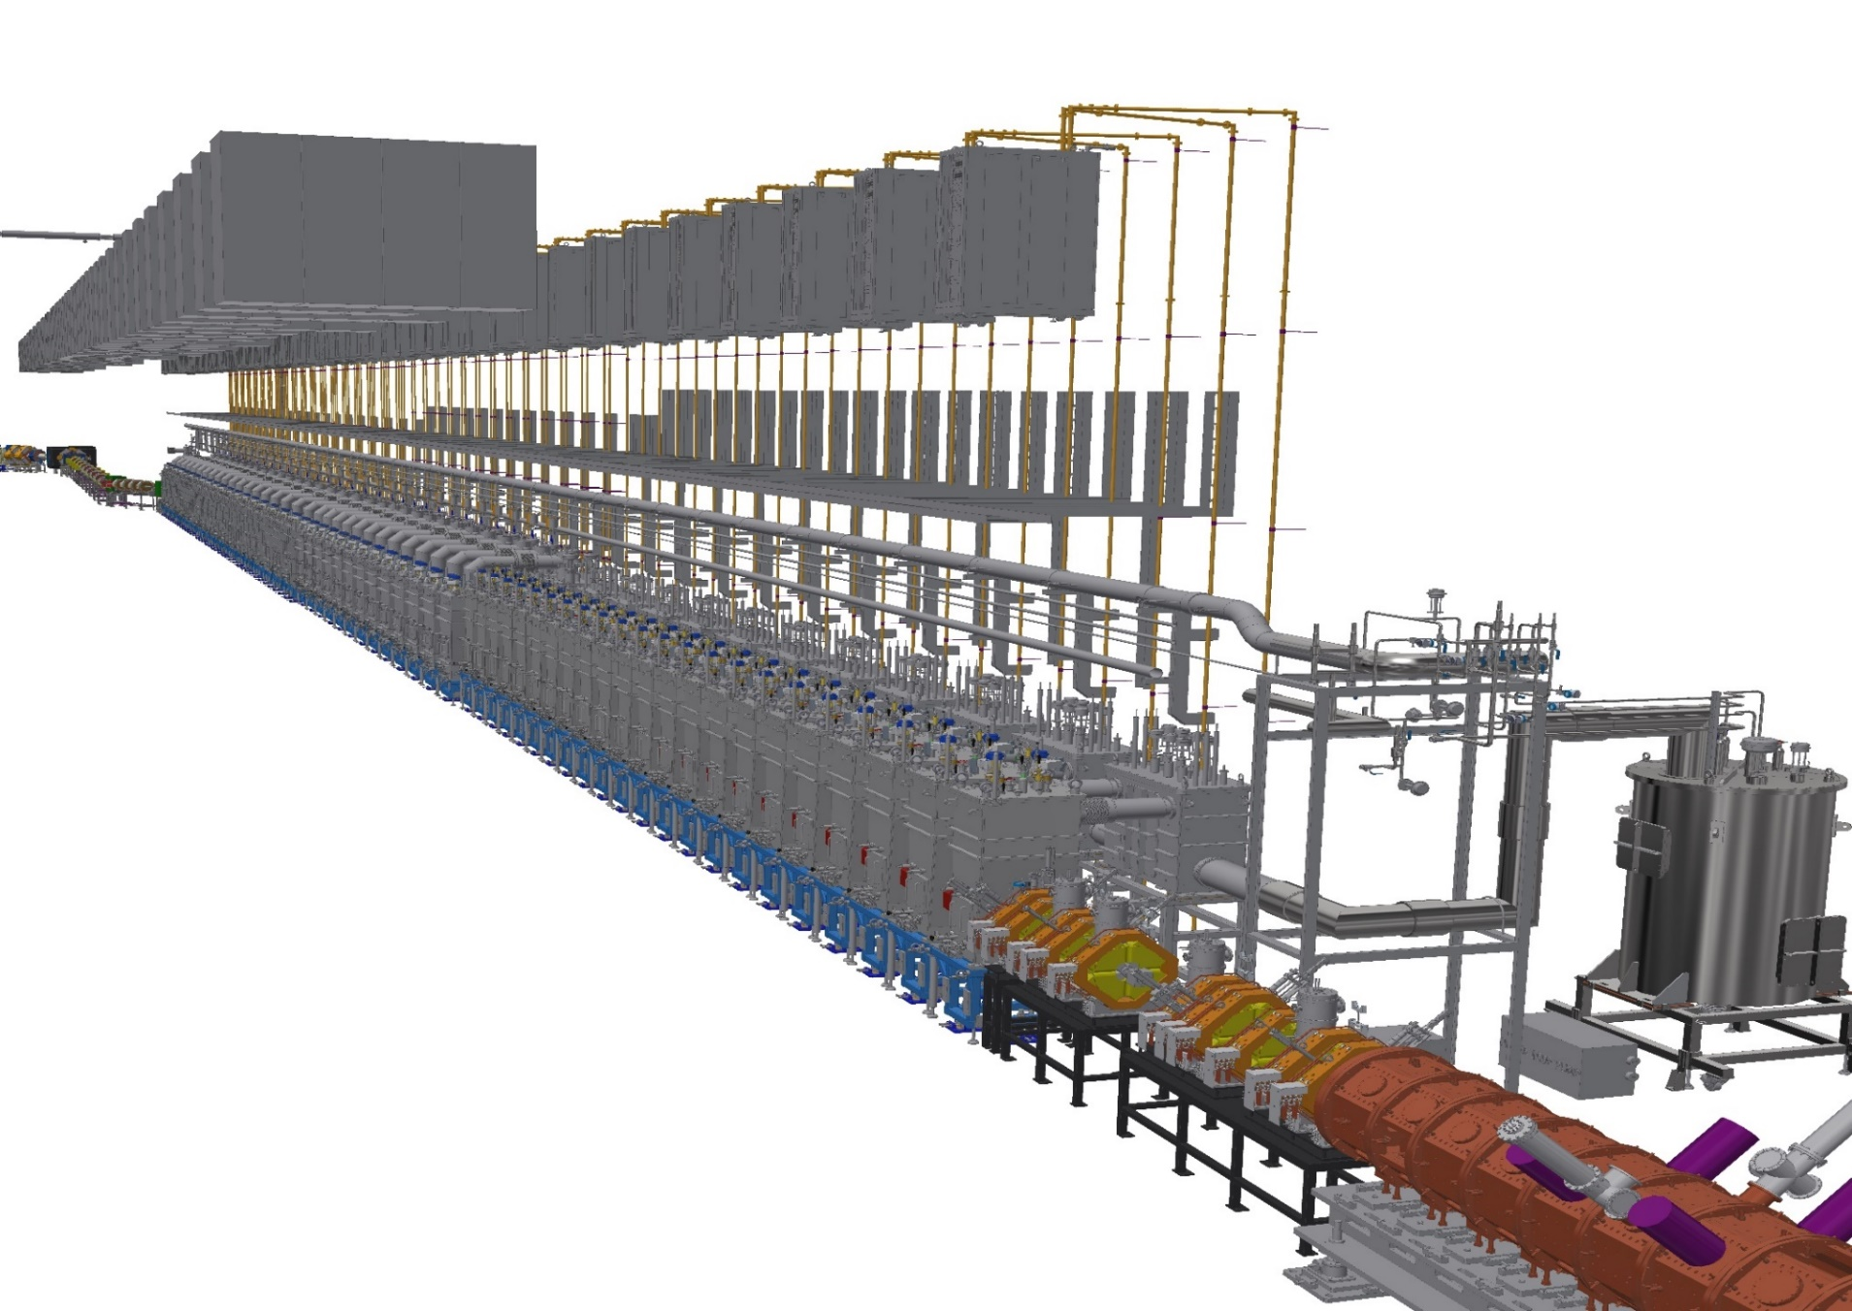
Installation

Slide 25
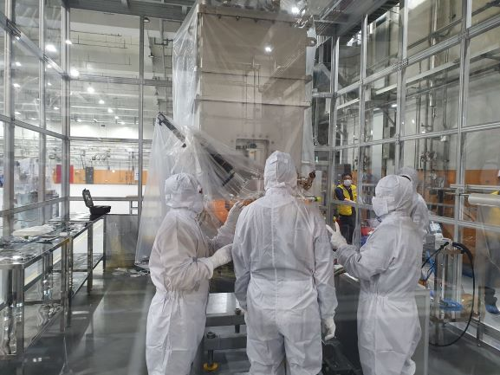
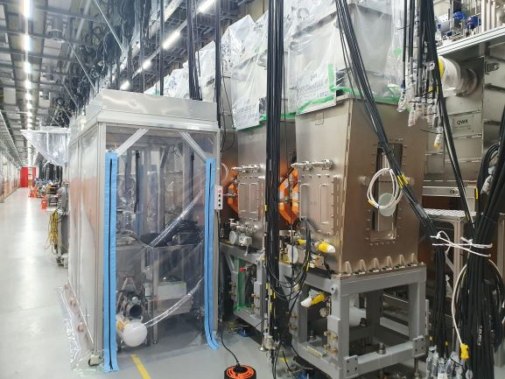
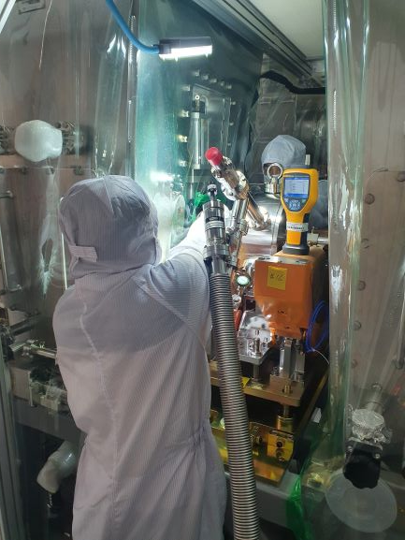
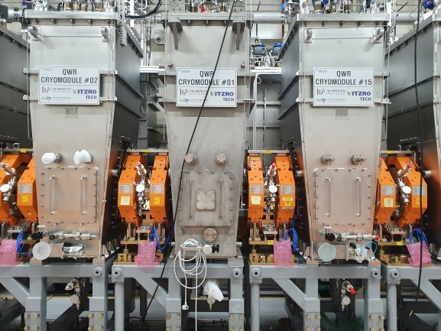
Cryomodule and warm section is clean assembled in the portable clean booth in tunnel

Slide 26
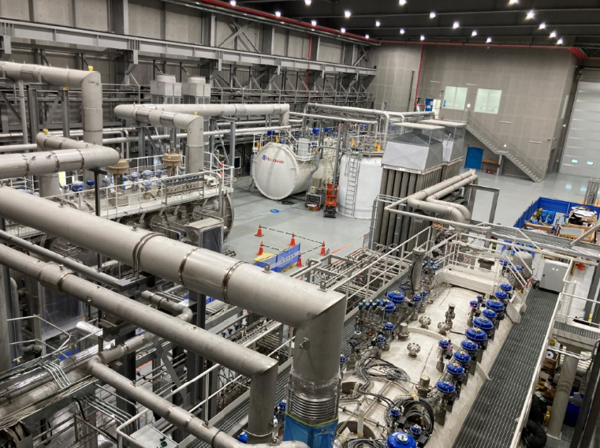
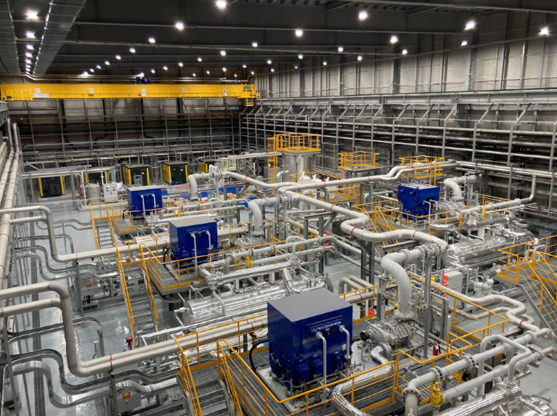
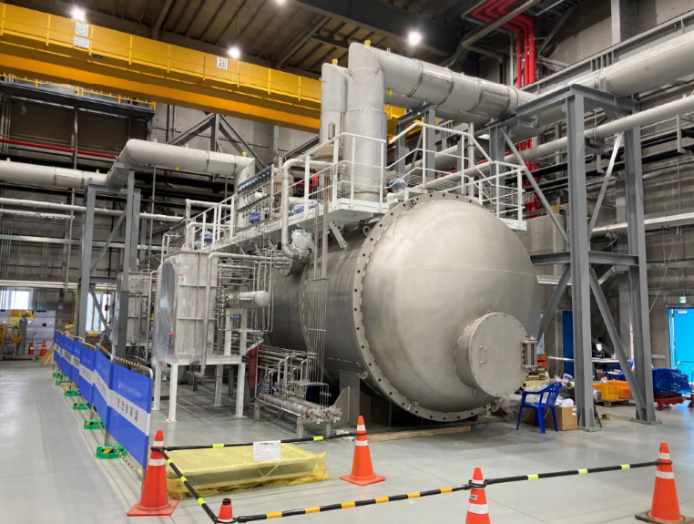
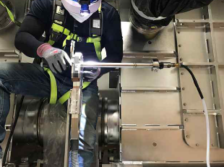
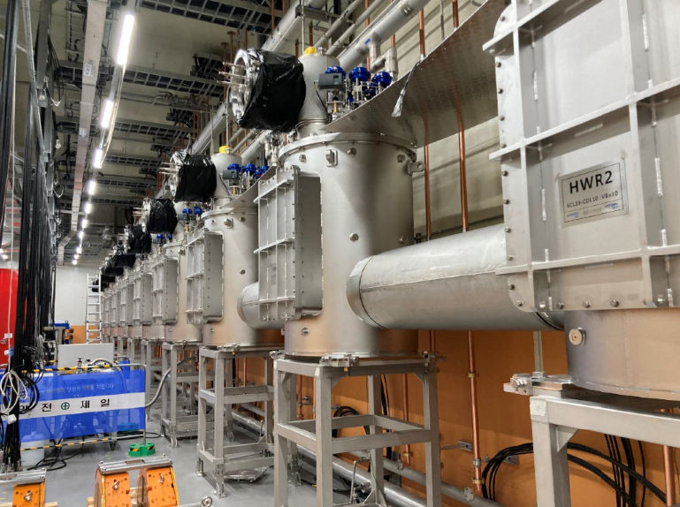
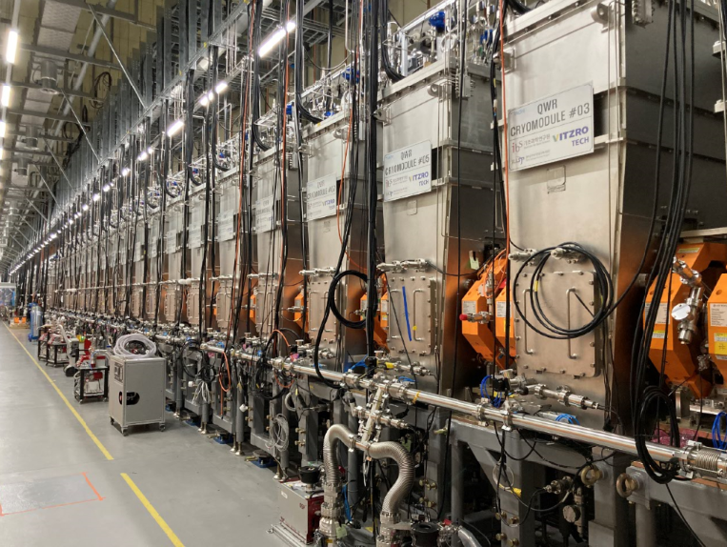
Cryogenic plant
SCL3 plant: 4.2 KW at 4.5 K, SCL2 plant: 13.5 kW at 4.5 K
Cold box
Warm compressors
LHe distribution box
Welding VBx to CM
VBx connection
QWR CMs, VBx in rear side

Slide 27
Cool down of SCL3
4 K cool-down of cryogenic system, CDS(cryogenic distribution system) and thermal shield in CM
10 days
Temperature (K)
Time (month-date)

Slide 28
Cool down of SCL3
4 K cool-down of cavities (fast cool-down for QWR)
10 days
Temperature (K)
Time (month-date)

Slide 29
Cool down of SCL3
2 K cool-down of HWRs
1 days
Temperature (K)
Pressure (mbara)
Time (hh:mm)
Time (hh:mm)

Slide 30
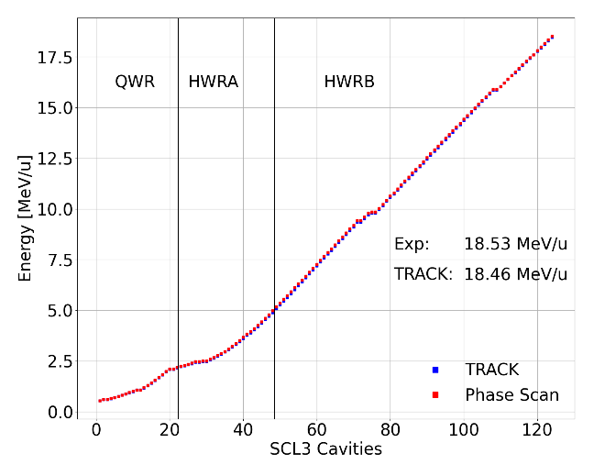
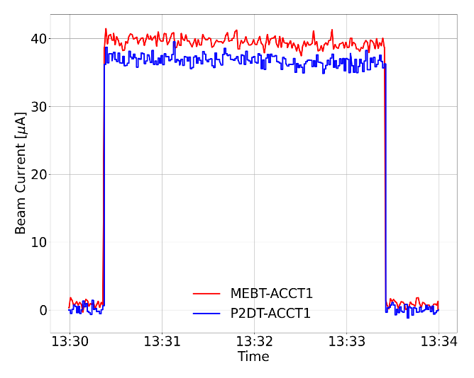
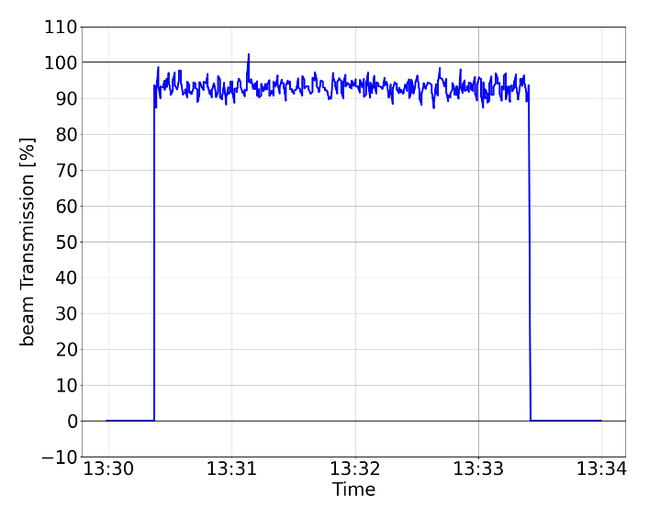
SCL3 Beam commissioning (April ~ Sep., 2024)
Beam Energy 18.5 MeV/u
⁴⁰Ar⁸⁺ beam accelerated by the entire SCL3(QWR/HWR) on May 17, 2024
[ Energy in SCL cavities ]
[ Beam current measured by ACCT in MEBT and P2DT ]
[ Beam transmission through SCL3 ]

Slide 31
SCL3 Beam commissioning (April ~ Sep., 2024)
8 cavities (out of 124) were not used due to lack of spare SSPA (Q3, Q12, Q21), control issue(HA6, HA8, HB24, HB28, HB61).
Accelerating fields: QWR < 5 MV/m, HWR < 5 MV/m
Beam commissioning with ⁴⁰Ar⁸⁺ and experiment with KoBRA and NDPS for external users (3 teams).
RI beam (²⁵Na⁵⁺) from ISOL was successfully accelerated by SCL3 and measured in KoBRA.
Beam time was limited upto 40 minutes due to malfunction of FPC and tuner.
Improvement of FPC and tuner is in progress.
3rd cool-down and beam operation in 2025 is in preparation.
Cool-down will be started in April 2025.

Slide 32
대전광역시 유성구 국제과학로 1
1, Gukjegwahak-ro, Yuseong-gu, Daejeon, Korea
T 042 878 8842
F 042 878 8866
THANK YOU

