Slide 1
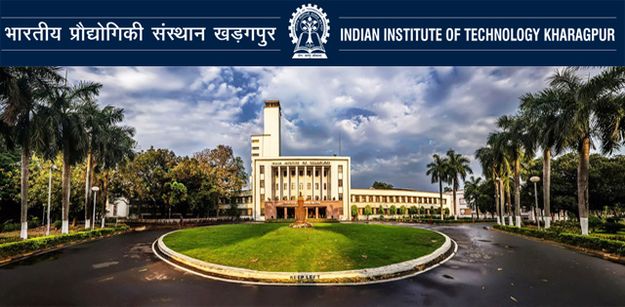
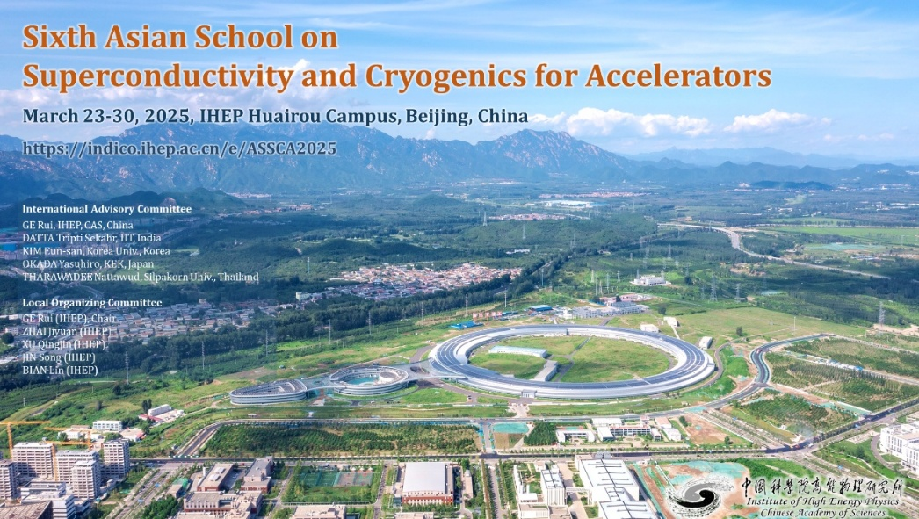
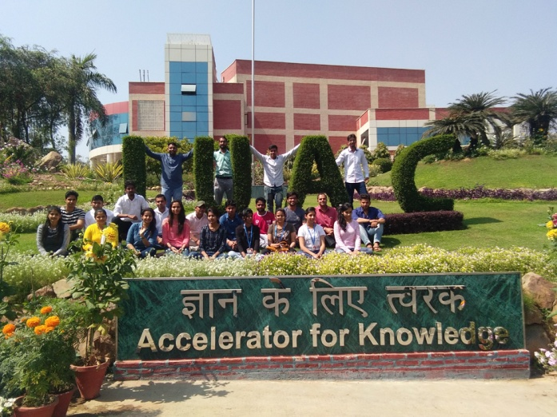

Role of Cryogenics & Superconductivity for Particle Accelerator : Overview
T S Datta (Retired From )
Indian Institute of Technology. Kharagpur. India
&
Inter University Accelerator Centre. Delhi

Slide 2
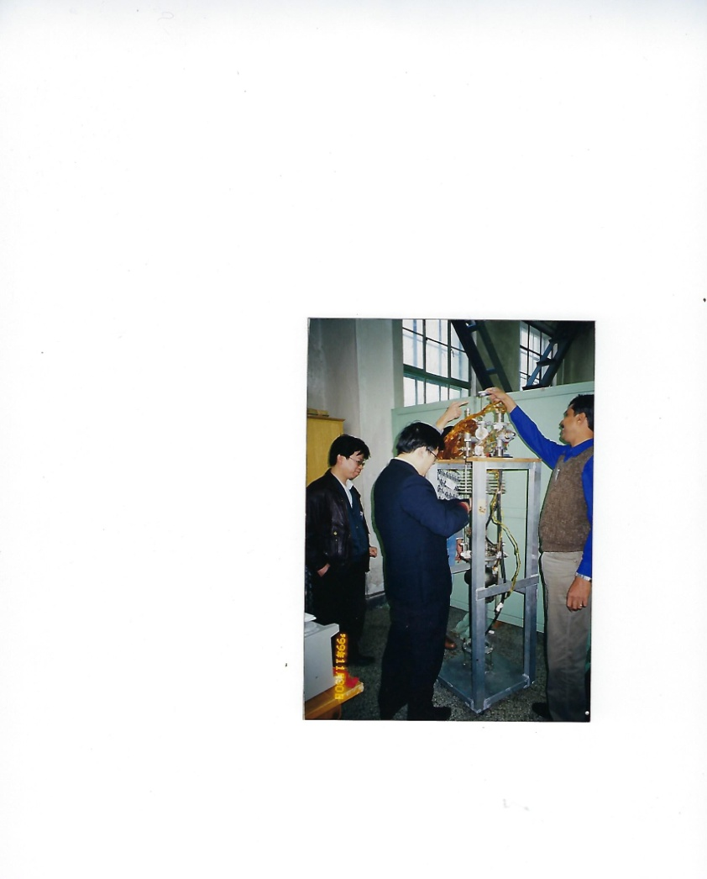
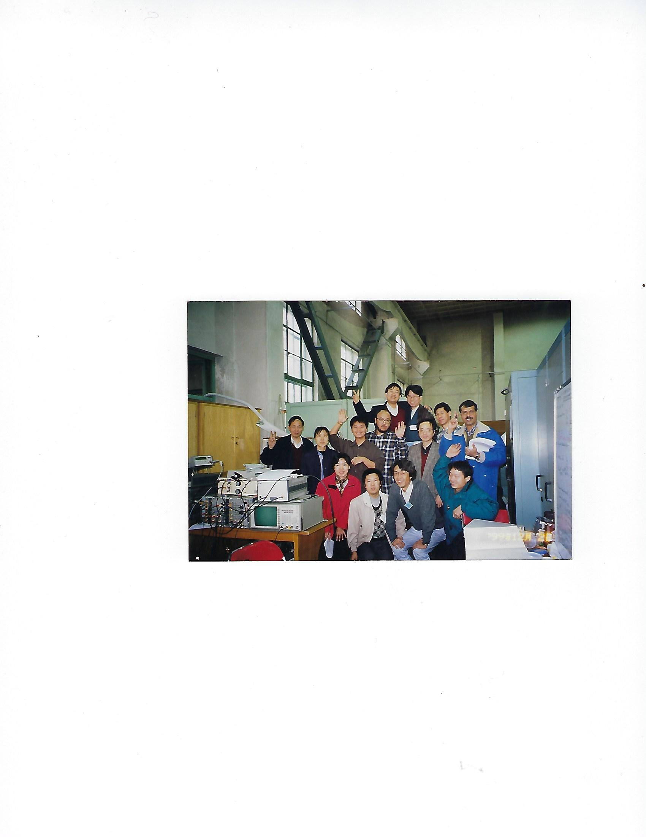
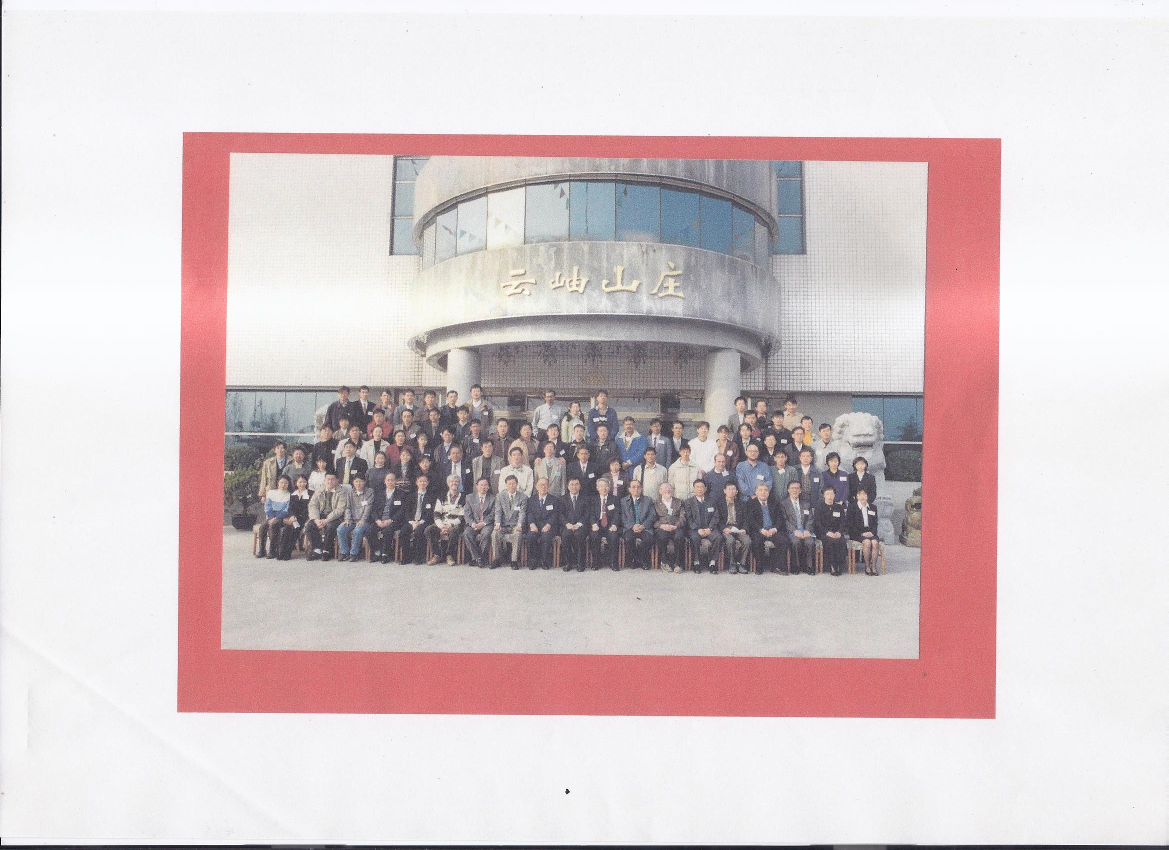
ASIAN ACCELERATOR SCHOOL (AAS) at Huairou BEIJING in Dec. 1999
( Special Thrust on Cryogenics & Superconductivity )
First School ( 15 days): I was a Student
We are back to Huairou, China after 25 years
Jubilant Cavity Team after
Successful Test
Looking for the Hotel . Any Idea??
Organised by KEK, JSPS , IHEP & CAS
Many Students ( 12 countries) from that School are contributing today on
Accelerator Development programme in Asia

Slide 3
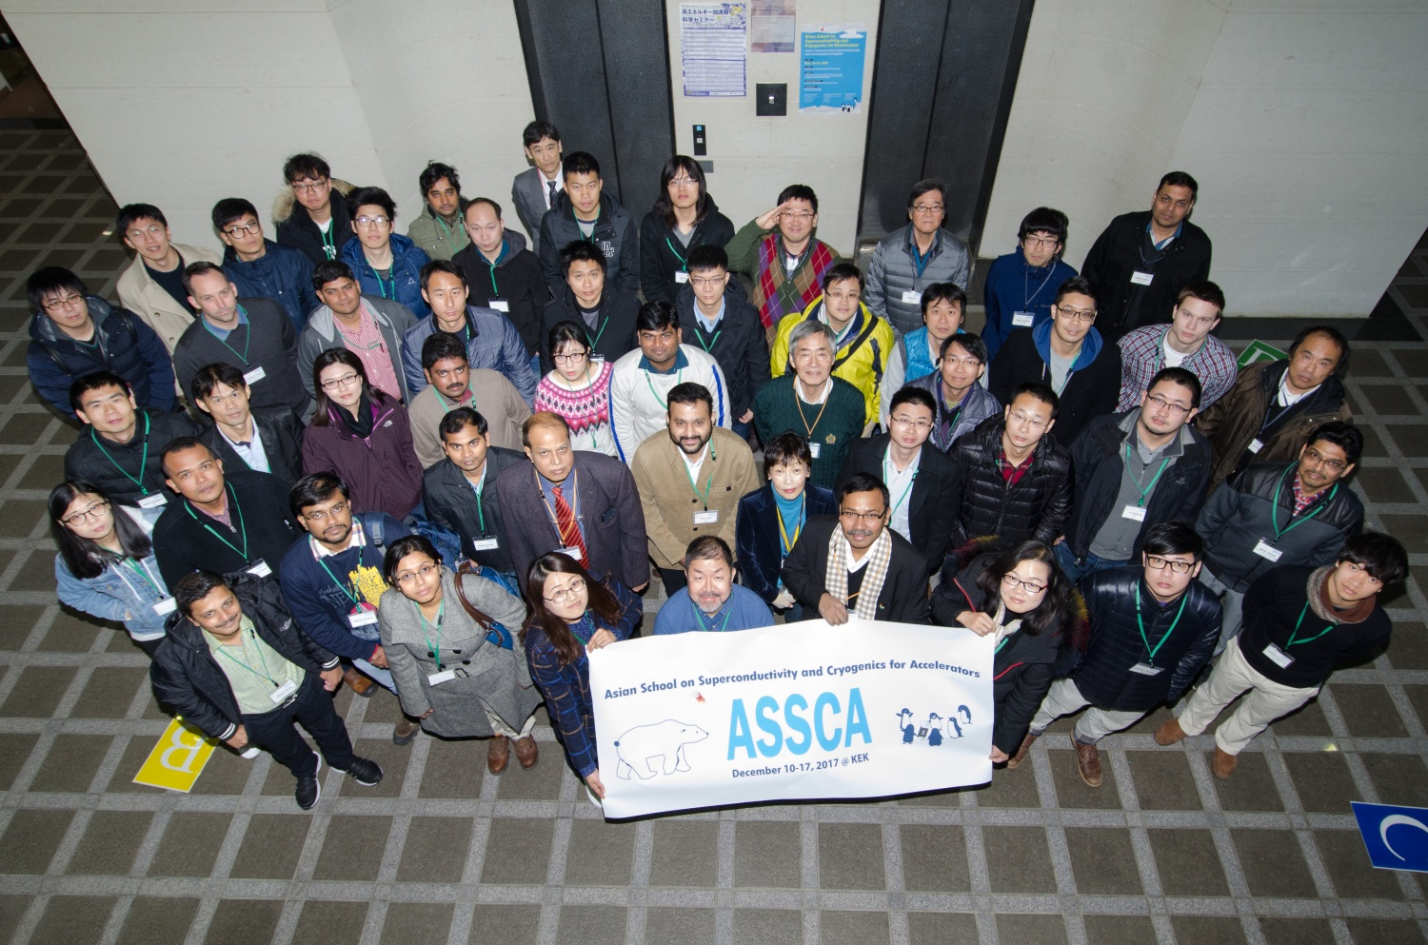
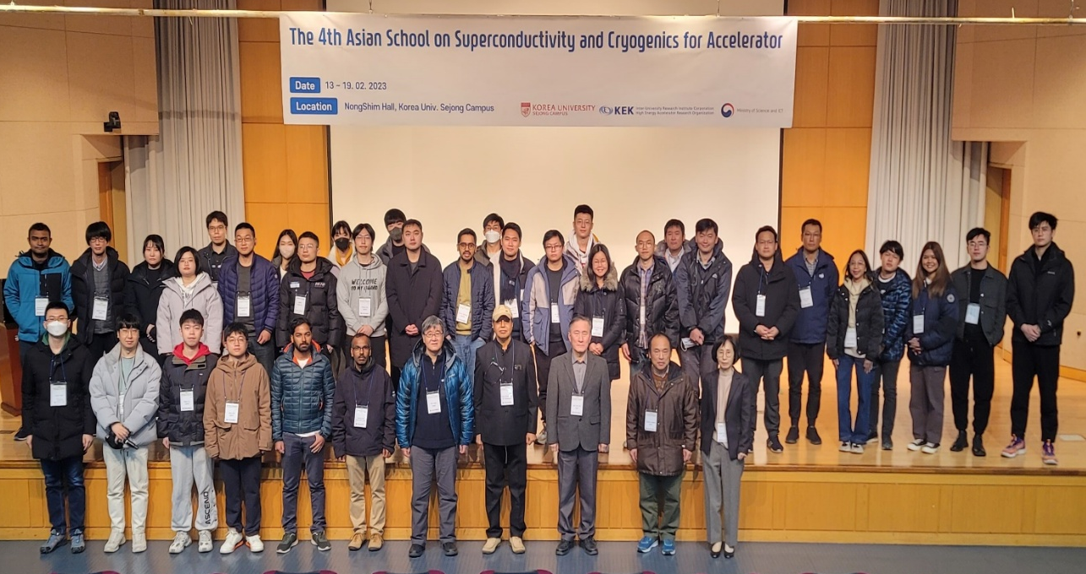
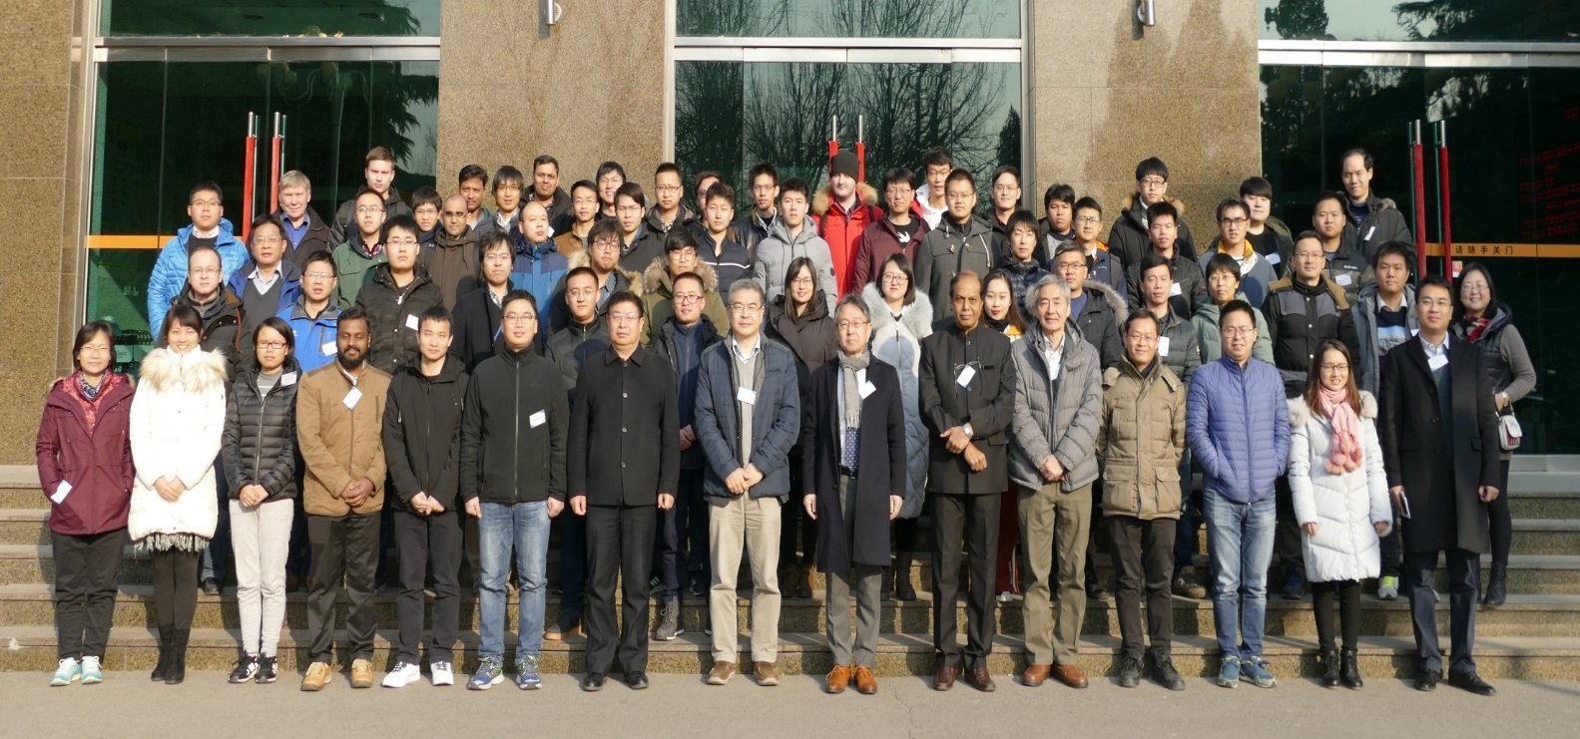
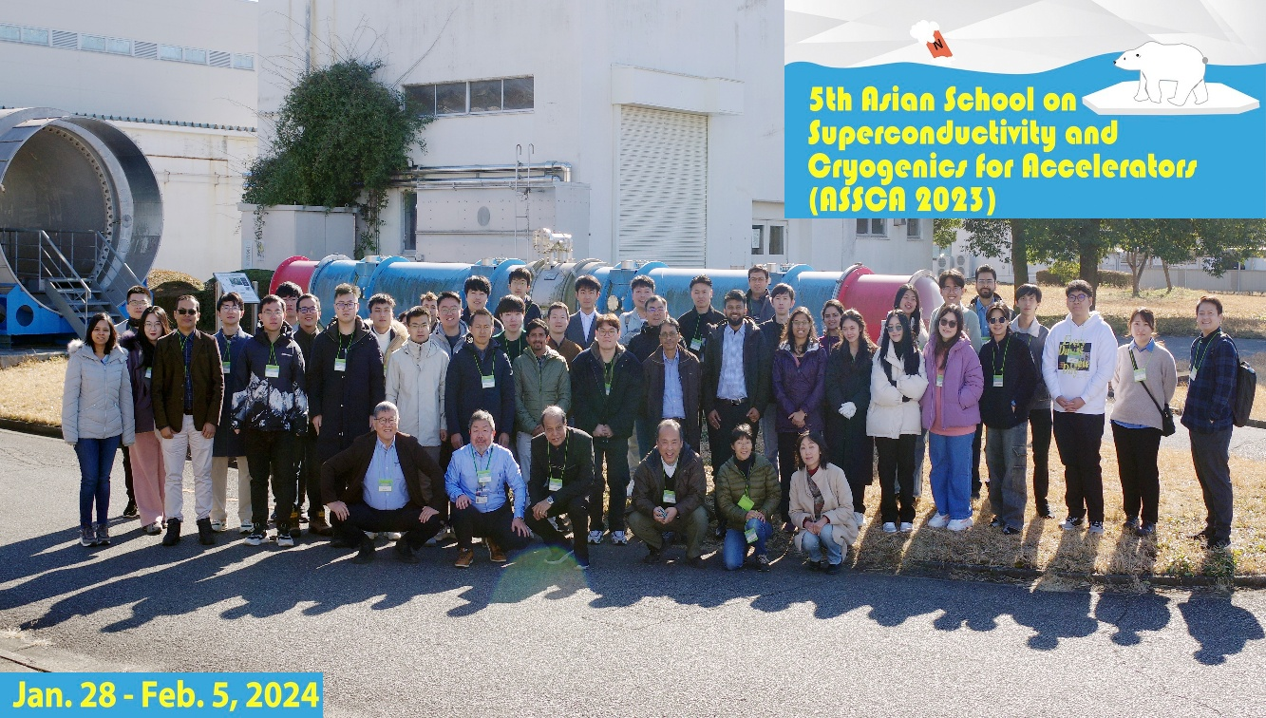
2nd ASSCA KEK, Japan in 2017
4 ^{th} ASSCA at Korea in 2023
3rdASSCA at IHEP, Beijing in 2018
5 ^{th} ASSCA at KEK. Japan in 2024

Slide 4
Realization of High Power Accelerator ( LHC. ILC/CEPC) is possible because of Superconductivity
BENEFITS
Outline of my Talk
Compact Size
Low Power Consumption
Basics on Cryogenics & Superconductivity
History on Accelerator with Cryogenics
Role of Superconductivity ( SC) for Accelerator
Major programme Present & Future
Conclusion
Cryogenics Superconductivity Particle Accelerator

Slide 5
BY THIS TIME, YOU ARE FAMILIER ON CHINA, JAPAN, KOREA MAJOR PARTICLE ACCELERAOR ACTIVITY WITH SUPERCONDUCTIVITY & CRYOGENICS
We had a nice Summary Talk on major Asian Programs : Yesterday Morning
CHINA :
1. SHINE : Prof Zhentang Zhao
2. CEPC : Prof Gao Jie
3. CiADS/ HIAF : Prof. Juan He
4. BEPC/ ADS/ HIAM : Prof. Ge Rui
JAPAN & KOREA & India
1. Super KEK- B : Prof Michiru Nishiwaki
2. RAON : Prof Youngkwon Kim
3. ILC ( Japan)
4. JPARC (Japan )
5. SNS & Cyclotron ( India )

Slide 6
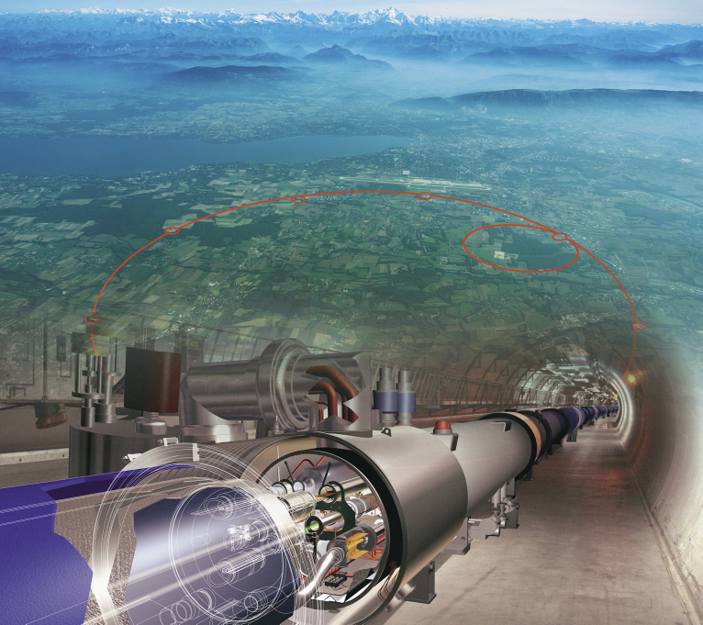
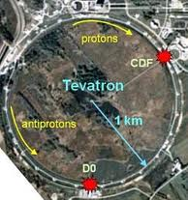
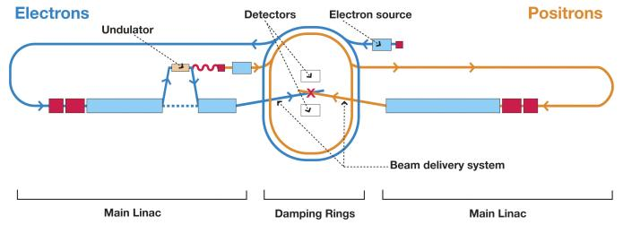
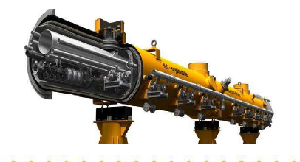
SUPERCONDUCTIVITY FOR ACCELERATOR
PRESENT : LHC @ Switzerland
PAST : AT FERMI LAB
EUROPE
USA
1 TeV
7 TeV
4.25 km
Superconducting Magnet
1.0 km
Future: ILC/ CEPC
( Asia) or VLHC @CERN
Superconducting Cavity
250 GeV
Total Length : 31 km.

Slide 7
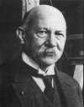
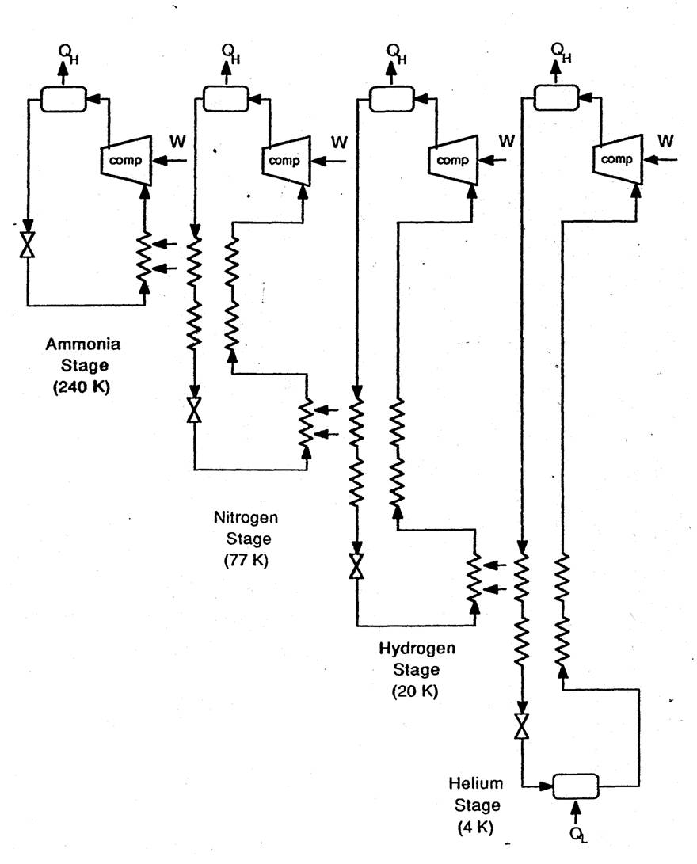
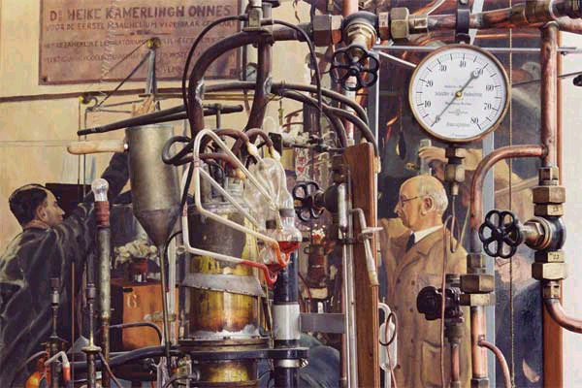
1908 : Heike Kamerlingh Onnes Succeeded in Liquefying Helium
1911 : Discovery of Superconductivity
Cascade Helium
Liquefier
(1853-1926)
Prof. discovered Superconductivity with his own Liquid Helium 100 years back
LN2
LH2
LHe
FAMOUS R-T PLOT
The physics laboratory in Leiden became the "coldest place on earth” in 1908

Slide 8
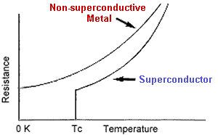
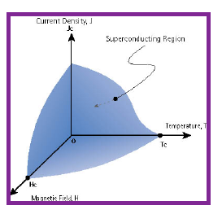
Cryogenics
Greek Word ( 12 th Century)
Icy Cold
Production
Where is the Boundary for Cryogenic Range : 120 K ( - 153 C) ??? ( I will discuss on Friday)
SUPERCONDUCTIVITY
Superconductivity Destroyed If any Parameter Exceeds its critical value: And they are Interlinked
T> T_{c}, I >I_{C}, H>H_{c}
Superconductivity - The phenomenon of losing resistivity R=0 when sufficiently cooled to a very low temperature (below a certain critical temperature).
Chilled water is not enough to Cool Superconductor below Tc .
Hence Cryogen

Slide 9
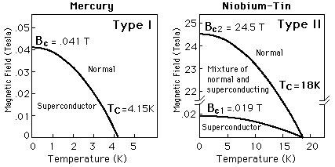
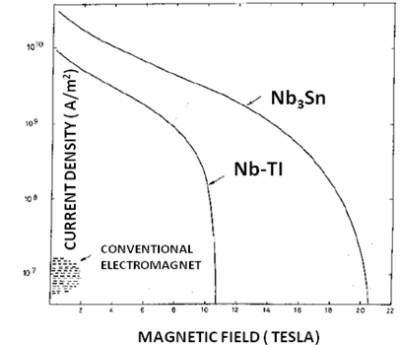
Superconductivity is Destroyed If any Parameter Exceeds its critical value: And they are Interlinked : T> T_{c}, I >I_{C}, H>H_{c}
SC Zone

Slide 10
A. Common Cryogen
B. Practical Superconductor
Liquid | Boiling Point
LNG | 111K
Liquid Oxygen | 90 K
Liquid Argon | 83 K
Liquid Nitrogen | 77.4 K
Liquid Hydrogen | 20 K
Liquid Helium | 4.2 K
Super fluid Helium | 2.1 K
Material | T_{c} ( K)
Hg | 4.2
Pb | 7.2
Nb | 9.2
NbTi | 10 K
Nb₃Sn | 18K
High Temp Superconductor
MgB₂ | 39K
YBCO | 90
BSSCO | 110 K
Blue Colour Applicable for Accelerator

Slide 11
Cryogenics + Superconductivity + Nuclear Science
Breakthroughs.
1. ULT through nuclear adiabatic demagnetisation.
2. Polarised targets for nuclear experiments. ( Bubble Chamber)
3. High field magnets for Particle Accelerators.
  4. Cryogenic detectors for high precision spectroscopy.
  5. Superconducting Cavities for Particle Accelerators.
  6. Cryopumping for better vacuum in Beam line pipe
  7. Neutrino Detector with Liquid Argon Target

Slide 12
Cryogenics - Superconductivity - Accelerator
( Brief History)
1908 - Kamerlingh Onnes Liquefied Helium (4.2 K)
1911 - Superconductivity is Born !!
1960 - Bubble Chamber with Liquid hydrogen
1980 - Tevatron , First Accelerator Using SC Magnet ( 70 Yrs) !!!!
1986 - High Temp Superconductors ( > 77 K )
1988 - Tristan, Japan Accelerator with SC Cavity
2005- 2017 : ECR and Spectrometer HTS Magnet with Cryocooler
2011 - Commissioning of LHC ( Largest Cryogenics)
2010- 2020 : Tesla collaboration on Cavity. Achieved 35 MV/m
2015-2025 : Many Accelerator Program with Superconductivity Initiated
2025 – 30 - International Linear Collider (ILC)/ CEPC/Free Electron Laser / Spallation Neutron Source/ UL- LHC and many more

Slide 13
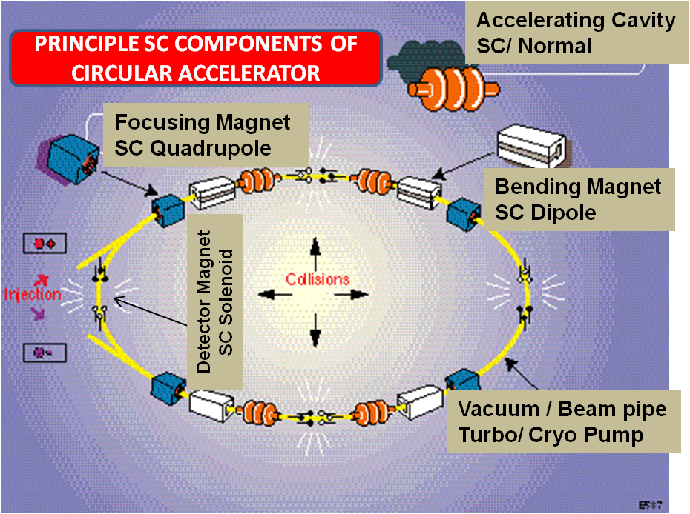
MAIN COMPONENTS OF A CIRCULAR ACCELERATOR/ COLLIDER
1. CAVITIES : ENERGY
2. MAGNETS : GUIDES & FOCUSS THE BEAM
3. DETECTOR : DETECTS NEW PARTICLE
All these main components of Accelerator either can be made by normal Copper Conductor or by Superconductor
Cavities are the Engine and Magnets are the Steering

Slide 14
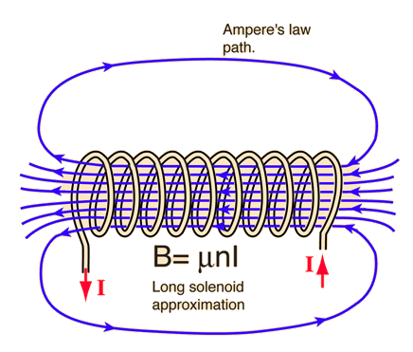
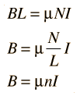
High Energy Physics are the biggest promoter of Superconducting Magnet
through Powerful Accelerator ( Next to MRI)
High Energy ( E) means (High Velocity (v) )
Needs high Magnetic Field (B) to bend the ion beam
Magnetic Field by Magnet
Electric Field by Cavity
B is proportional to Ampere Turns ( nI)
I ( Current) is limited in normal Conductor ( Cu, Al) because of Joule Heating ( I²R) Power Loss. To compensate we can Increase no of layers ( Size !! )
Or, we can have efficient cooling system/ very high heat Transfer coefficient and surface Area ( LN2 Cooling ???? : Good question by Students!! )
( Possible for High Field Pulsed Magnet)
Superconductor (R=0) : No Joule Heating ( Except at Joint and Current lead)

Slide 15
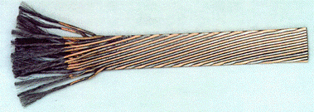
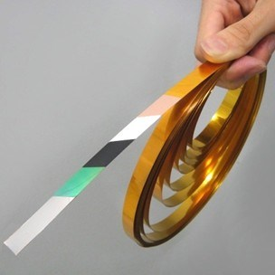
Practical Superconductor Today
VERY GOOD ELECTRICAL
CONDUCTORS ARE NOT
SUPERCONDUCTOR
(Cu, Ag, Au)
Material | Tc ( K) | Hc ( T | Application
Pb | 7.2 | .08T | Cavity
Nb | 9.2 | 0.2 | Cavity
Nb-Ti | 10 | 15(T) | Magnet
Nb₃Sn | 18 | 24.3 | Magnet
Nb₃Ge | 23 | 38 | Magnet
YBCO | 93 | >100 | Magnet & power application
BSSCO | 110 | >100 | Magnet & power application
MgB₂ | 39 |  | Promising for MRI
Pure Metal, Clean Surface, Not High Hc, Easy fabrication
Type 1
Most Popular for Present day Accelerator
High Hc, Tc
Ductile
Type 2
High Tc, Jc,
High Cost,Brittle
Now based on T_{c}, we need different cooling medium that is the criteria
To distinguish LTS and HTS

Slide 16
Main Components for Superconducting Accelerator
RF Generator/ High Current Power Supply
Will be covered in this School
Drive Coupler / Current Lead
Superconducting Elements
(RF Cavity & Magnet)
Cryomodule
CRYO LINE
4.2/ 2 K
Helium Refrigerator
2K System

Slide 17
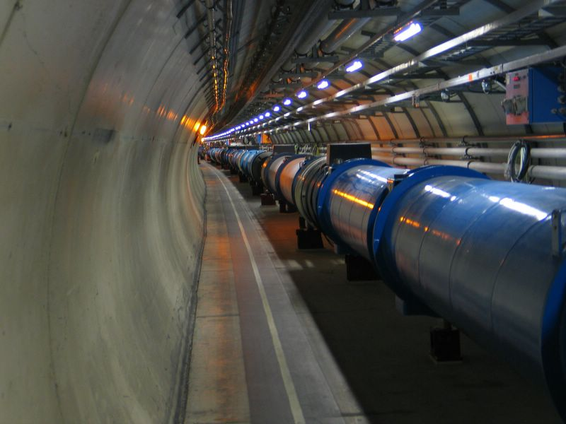
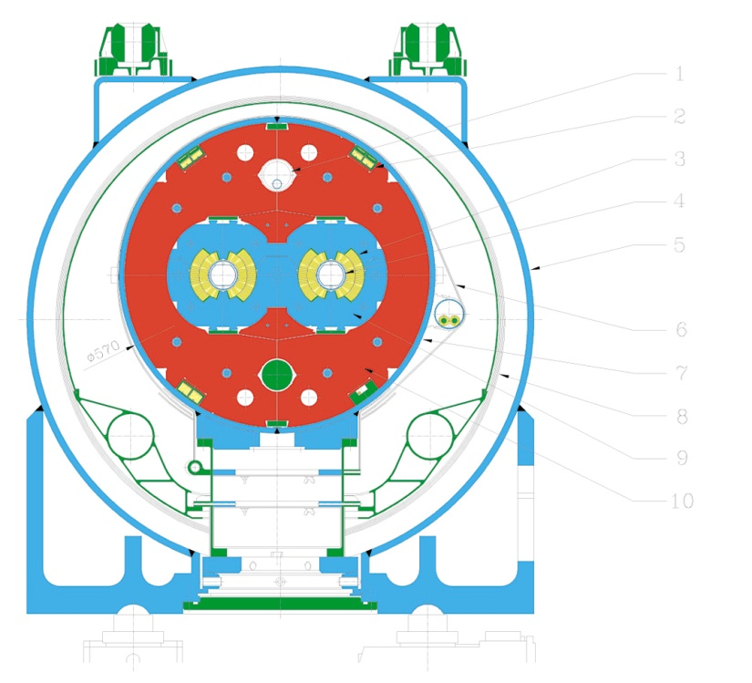
Present
LARGE HADRON COLLIDER ( LHC) AT CERN
Worlds Largest Particle Accelerator
27 km Circumference at Swiss- France Border.
Proton - Proton Collider with collision energy 14 TeV
Largest Cryogenics and SC network as on Today
Total 6000 Superconducting Nb-Ti Magnets
Total Refrigeration Capacity 144 ( 18x8) kW at 4.2 K
Higgs Boson ( God Particle ) in 2012
First Collision at 3.5 TeV Beam Energy in 2010
Collision at Design Beam Energy (7 TeV) in 2015
LHC
HL-LHC
VLHC
Nb- Ti SC magnet generates a field 8.3 Tesla and operates at 1.9 K

Slide 18
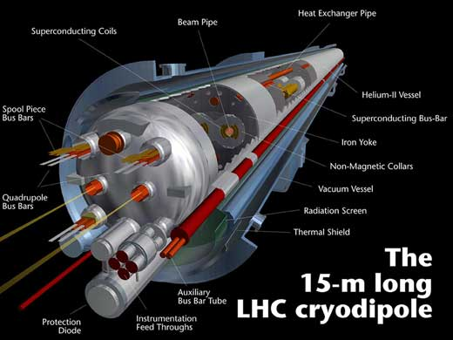
Power and Size Comparison for CERN LHC
IF NO SUPERCONDUCTOR
ENERGY : 7 TeV
E in GeV, B in Tesla, R ( radius) in meter
DESCRIPTION | SUPERCONDUCTING MAGNET | NORMAL MAGNET
Field | 8.3 Tesla | 2.1 Tesla
Total Length | 27 km | 108 km
No of Magnets | 1500 | 6000
Ref. Power | 144 kW @ 4.2 K
Power at Room Temperature | 144 x 225 33MW | 3300 MW
Power reduction from 3300 MW to 33 MW
Size reduction from 108 km to 27 km

Slide 19
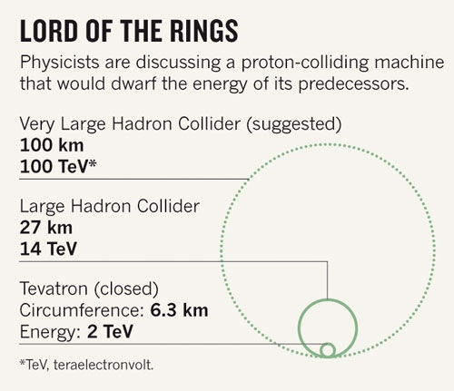
Future
LHC
HL-LHC
VLHC
High luminosity | 5 x 10³⁴ cm⁻²s⁻¹
24 High Field Nb₃ Sn Quadrupole Magnet (11- 12 T ) before and after ATLAS/ CMS Detector
Using of Superconducting Crab Cavity : 16 for shaping the bunch beam
MgB2 Current lead to have higher Jc at 50 K
Total length Replacement ~ 1 km
Expected to operate in 2030
16 Tesla magnets for 100 TeV pp in 100 km
When ????????

Slide 20
Few Accelerators with SC Magnet
Accelerator Energy Field Length Year
(TeV) ( Tesla) (Km.)
Tevatron 0.9 4 6.3 1984
( USA. P P-)
HERA 0.92 5.3 6.3 1989
( Germany, P e)
SSC 20 6.8 87 cancel
(USA P P)
LHC 7 8.3 27 2011
( Switzerland) P P
Now Many are in Asian Countries
To be updated soon : Sorry
Practical Power Comparison
SPS( CERN) : 352 MW 315 GeV : Normal
HERA( DESY) : 6MW 920 Gev : SC

Slide 21
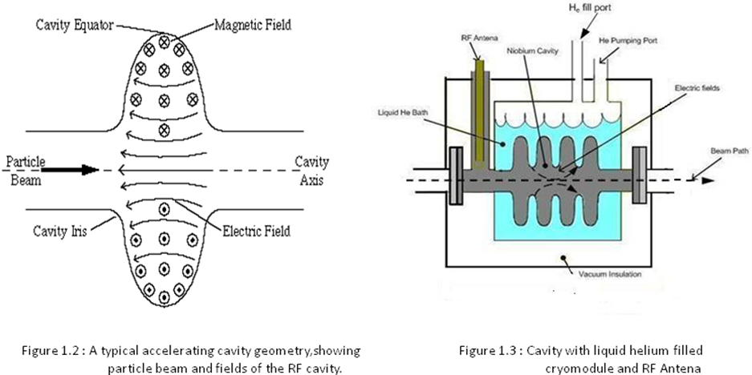
SUPERCONDUCTING RF CAVITY
RF POWER FEED TO THE CAVITY ( LC CIRCUIT), ELECTRIC FIELD (E= MV/m) GENERATES ( Max at IRIS where Beam Passes)
SURFACE CURRENT ON CONDUCTOR,
HEAT ( Loss) ON WALL BECAUSE OF SURFACE RESISTANCE : COOLING BY WATER / LIQUID HELIUM
HIGHER SURFACE RESISTANCE
MORE HEAT : MORE LOSS

Slide 22
Why Superconducting Cavity?
Unlike DC superconductor ( Magnet), there are finite resistive power loss in RF Superconductor because of Surface Resistance
Resonant cavities have Quality factors, Q, whose value depend on resistive losses (P_{d}) .
High Q , Low Loss
Q is inversely Proportional to Surface Resistance.
(R_{s}) Copper/ R_{s} (Niobium) = 10⁵
Surface Resistance
Note : These are the very basics and you will be learning a lot from the lecture of Prof Kako-san on Wednesday

Slide 23
Power Comparison in Cavity ( Normal vs Superconductor
Example
Description | Normal ( Cu) QWR Cavity | Superconducting ( Niobium)
E_{acc} ( MV/m) | 1 | 1
G, f | 17, 97 MHz | 17, 97 MHz
Rs | 3 milli-ohm | 10 nano- ohm
Q₀= G/Rs | 6.5 x 10³ | 2.1 x 10 ⁹
Power Loss | 9000 W @ 300K | 0.5 W at 4.2 K
Plug Power | 9000 W | 150-200 W
Estimated Refrigeration Load for ILC: 210 KW
Total AC Power Consumption : 50MW : Cu Cavity : 500- 1000 MW
Saving
2 Standard Nuclear Power Plant : 235 MW

Slide 24
Accelerators with SC cavity
Lab year f Active Gradient
(MHz) Length
KEK 1988 508 48m 4.5 MV/m
DESY 1991 500 20 2
CEBAF 1996 1497 169 5
CERN 1997 352 462m 6
ILC Future 1300 22 km 31.5
TESLA COLLABORATION : Field Improved to 20 MV/m ( 2000 – 2008)
AND NOW : 30 – 40 MV/m

Slide 25

Remember : Normal Copper Cavity, We can Have, E_{acc}= 100 MV/m
( Bunch beam rather than Continuous)
But Superconducting Cavity, Field is limited based on H_{c} value and It can not be more than 50 MeV/m for Niobium
Very High Frequency ( 5 GHz) RF cavity :
Normal Copper Cavity may be better
Even at 2 K with High frequency, R_{s} will be high and hence higher dynamic Load at 2 K
Remember (R_{s}) _{sup} is Proportional to ( Frequency ) ²

Slide 26
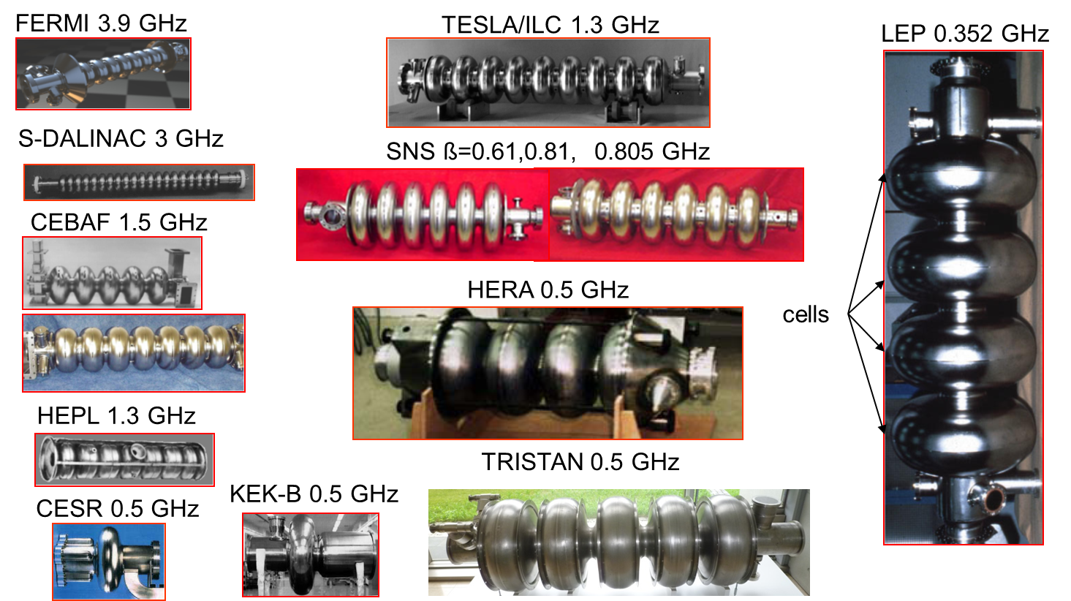
SRF Cavity Production in Worldwide Projects
Half
Wave
Resonators
(HWR)
Elliptical
multi-cell
cavities
Spoke
cavities
Quarter
Wave
Resonators
(QWR)

Slide 27
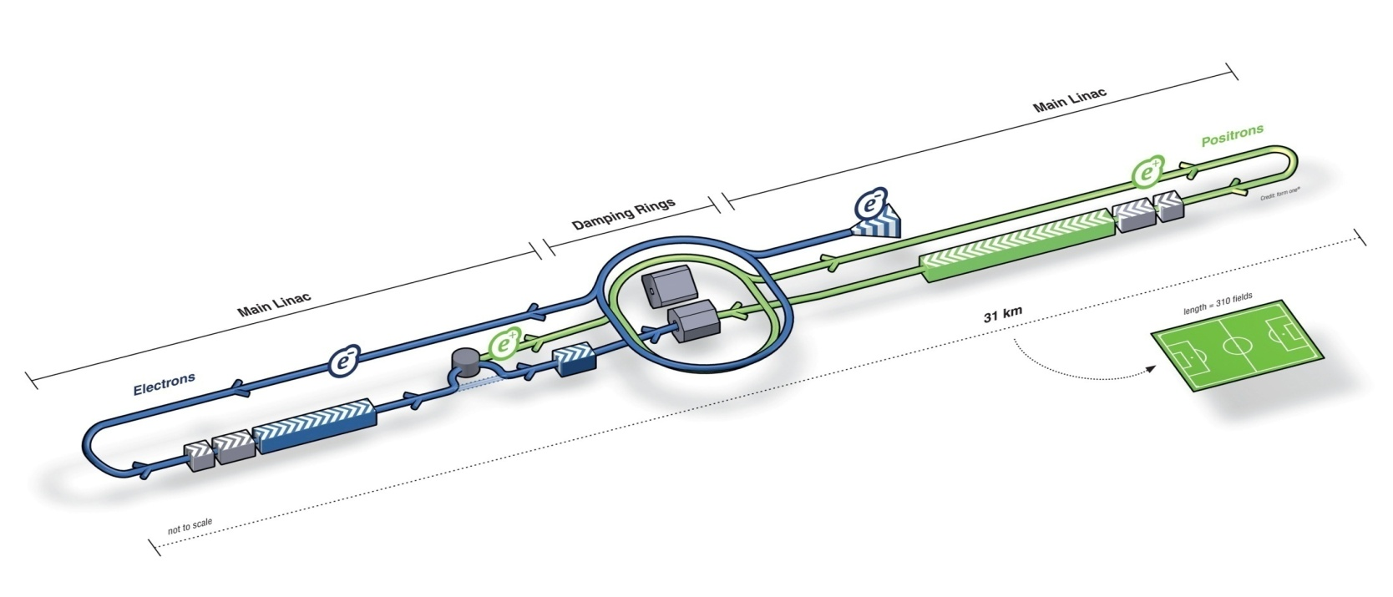
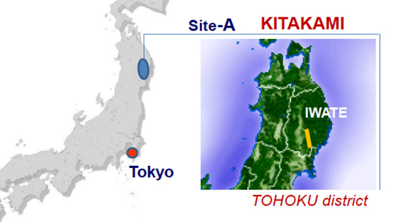
INTERNATIONAL LINEAR COLLIDER ( ILC)
R& D Program are on
Yet to Get Final Approval
From Japan Govt
Electron – Positron Collider : Proposed Site at KITAKAMI, Japan
Max. Center-of-mass energy | 500 | GeV
Peak Luminosity | ~2x10³⁴ | 1/cm²s
Beam Current | 9.0 | mA
Average accelerating gradient | 31.5 | MV/m
Beam pulse length | 0.95 | ms
Total Site Length | 31 | km
Total AC Power Consumption | ~230 | MW

Slide 28
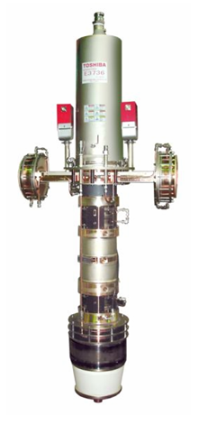
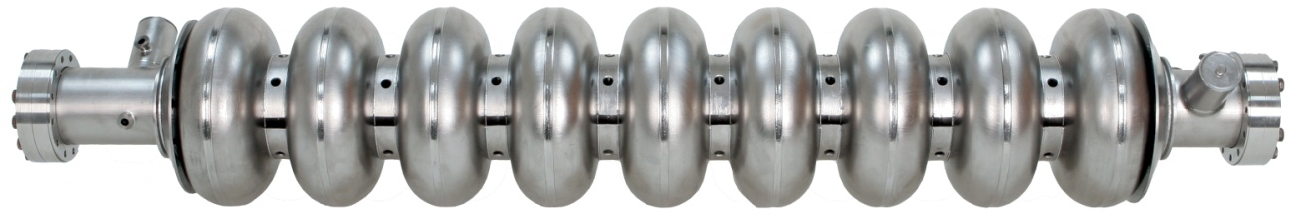
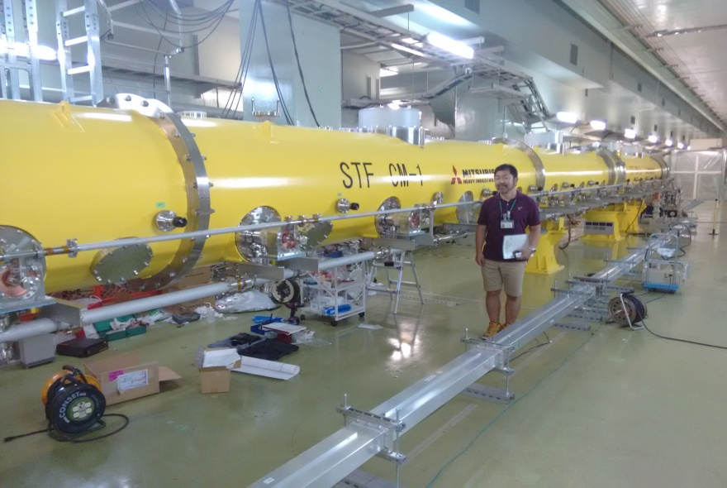
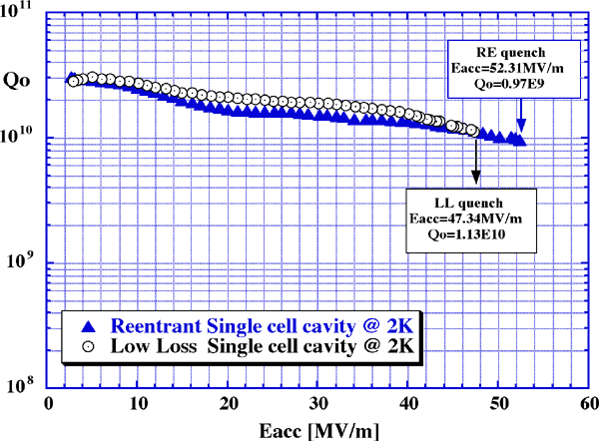
ILC Superconducting Cavity/ Cryomodule
9 cell cavity,~ 1m long
10MW
L band
klystron
Test : > 35 MV/m, Q = 0.8 x 10 ^{10,} With Beam > 31.5 MV/m
ILC needs : 16000 9- cell cavities and more than 1000 Cryomodules with each length of approx 12 m)
Total Estimated Refrigeration Capacity at 4.2 K ~ 210 kW ( Remember CERN 144 kW)

Slide 29
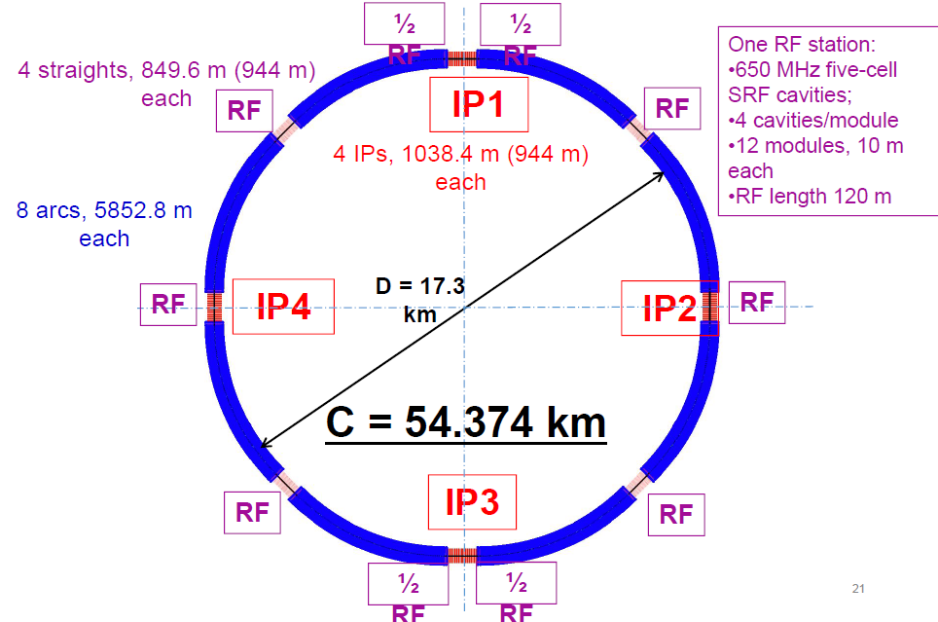
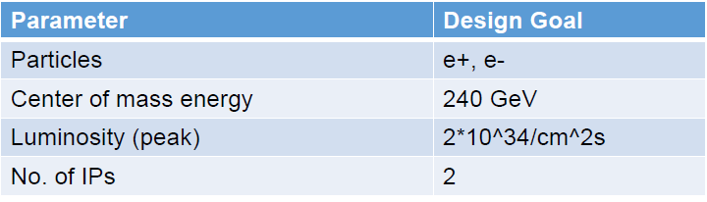
The Circular Electron Positron Collider (CEPC) circumference of ~ 100 km at Quinghuada, China ( 2022-30)
C= 100km
Booster ring: 256, 1.3 GHz 9-cell SC cavities
Collider ring: 480, 650 MHz 2-cell SC cavities
Note : Design under Revision
Refrigeration Capacity `96kW at 4.2 K
Estimated Project Cost ~ $6 billion

Slide 30
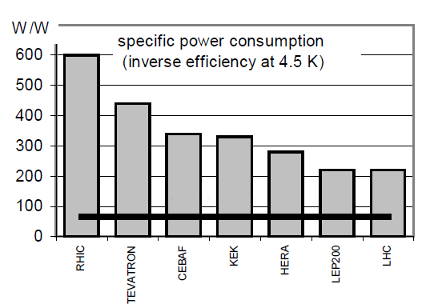
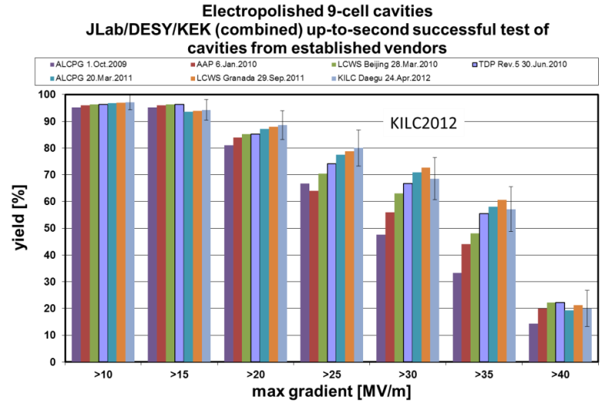
Parallel there is also improvement on efficiency of the Helium Refrigerator
TARGET FOR ILC
ACHIEVED
Power consumption reduced from 600 W to 225 W to take care of 1 W loss at 4.2 K ( Higher Refrigeration Capacity : Higher Carnot efficiency % )
Not updated : % has improved for the last 5 years
Realization of ILC/CEPC : Less Power Consumption by Refrigerator and Improvement of field gradient ( > 30 MV/m) : Power and Size

Slide 31
Cryogenics & Superconductivity for Particle Detector and other Application
Bubble Chamber : Liquid Hydrogen & SC Magnet ( Earliest and now Obsolete )
Particle Detector like ATLAS/ CMS : Giant Superconducting Magnet (present ): Liquid Helium
Neutrino Detector : Liquid Argon ( DUNE)
Spallation Neutron Source : Supercritical Subcooled Liquid Hydrogen ( ESS )

Slide 32
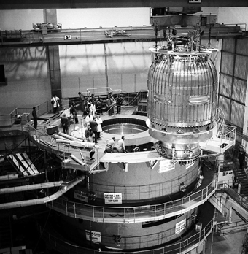
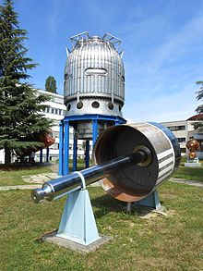
Bubble Chamber Filled with Liquid Hydrogen ( 1956- 1985)
( First Application of Cryogenics in Major Accelerator programmer)
Bubble chamber : Tracks of charged particles by means of a visible string of bubbles that are left by the particles as they fly through a Liquid Hydrogen ( Purest Target) at a temperature 24 to 29 K with pressure from 40 Psig to 70 Psig)
BEBC project ( 1966) giant cryogenic bubble chamber surrounded by a 3.5 T superconducting solenoid magnet that operated at CERN Super Proton Synchrotron (SPS) until 1984
developments in electronics and new wire chamber detectors, brought an end to the bubble-chamber
Remains of the BEBC at CERN Science Museum

Slide 33
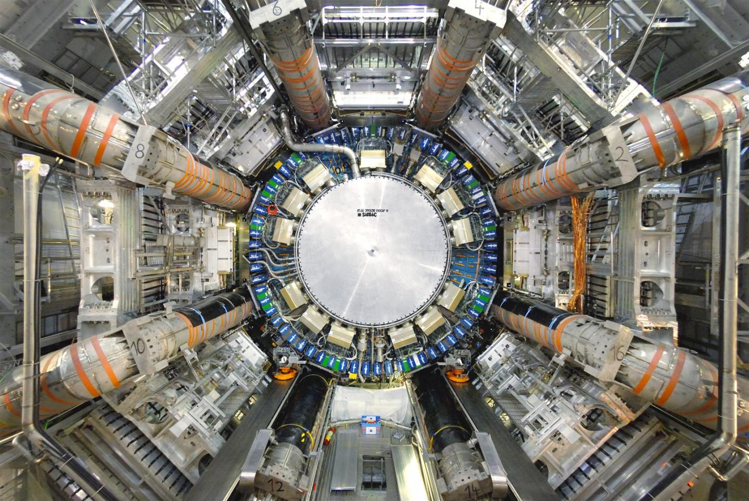
Detector with Superconducting magnet
Momentum Resolution ( Sagitta) ~
Resolution better with high field ( B) and longer length (L)
Before Collision, we need strong focusing ( Achieved by Quadrupole magnet High Field gradient ( T/ M) h to have higher Luminosity
ATLAS (A Toroidal LHC Apparatus) is Particle Detector at LHC, CERN
46 m long, 25 m high and 25 m wide, the 7000-tonne detector is the largest volume particle detector ever constructed.
The magnet system on the ATLAS detector includes eight huge SC magnets arranged in a torus and a central SC Solenoid around the LHC beam pipe

Slide 34
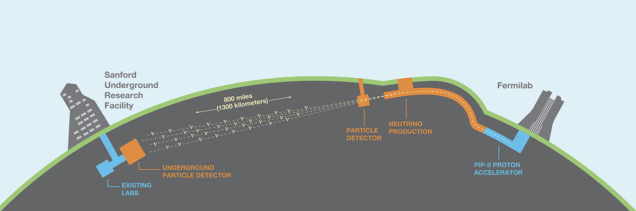
The Deep Underground Neutrino Experiment (DUNE): Neutrino Detector
PIP-II’s new linear accelerator for 100 GeV Proton will be built with the latest superconducting radio-frequency technology at Fermi lab, USA .
protons will slam into the graphite target of the Long-Baseline Neutrino Facility to produce neutrinos
The South Dakota Neutrino detector at Sanford will be the largest of its type ever built and will use 70,000 tons of liquid argon

Slide 35
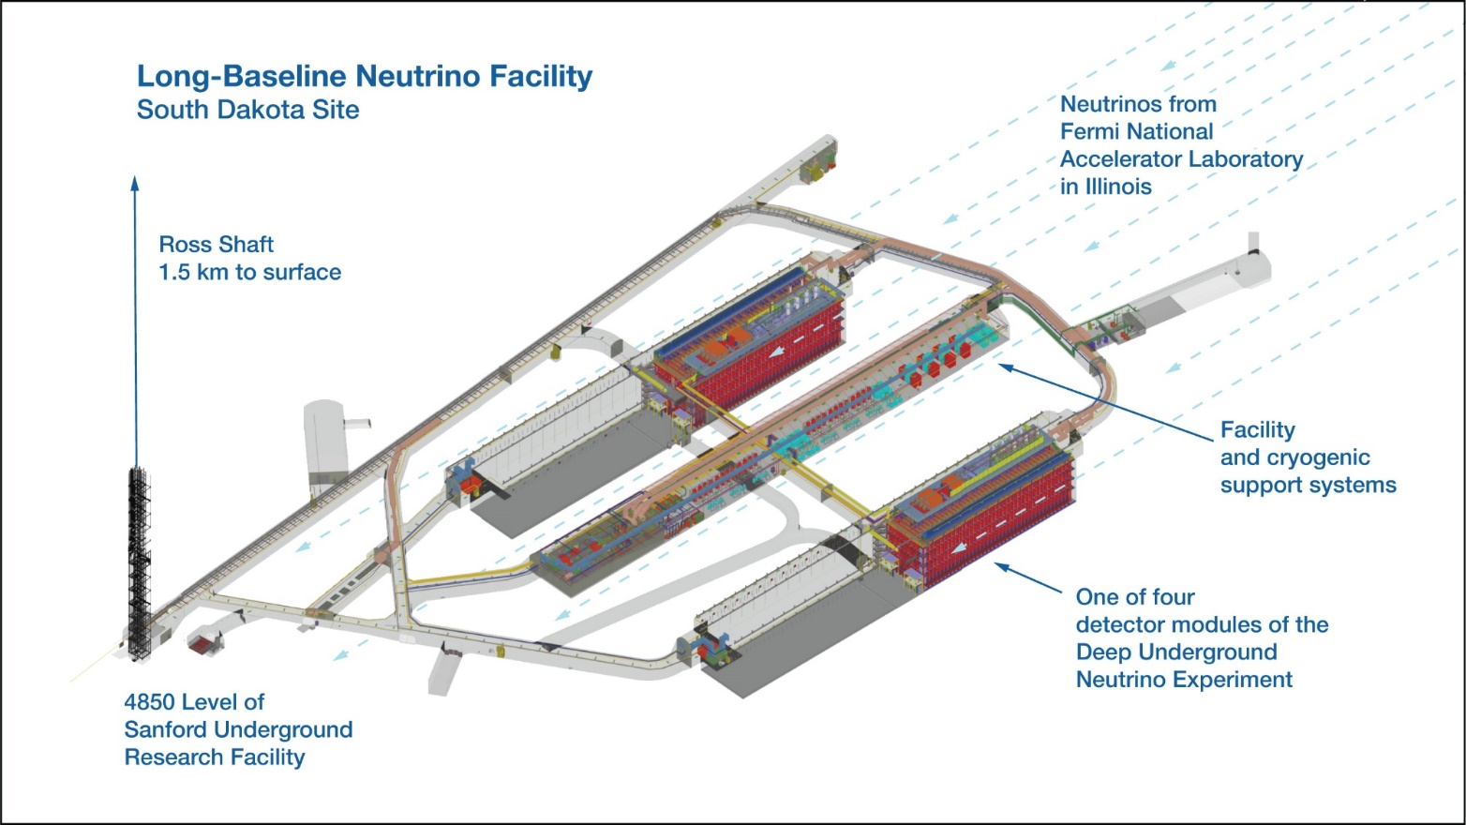
The Deep Underground Neutrino Experiment (DUNE)
Each Cryostat : 18 m height , 19 m wide and 66 m long : Total four Cryostats

Slide 36
Why Liquid Argon ?
Argon as a noble gas, it does not react chemically.
It is its third most common component, surpassed only by nitrogen and oxygen. ( Cheap )
Density is higher at Liquid Phase
Liquid argon’s most important feature is that it acts as both a target and detector for neutrinos,
With 40 protons and neutrons, liquid argon is denser than water or oil, so liquid-argon detectors see more neutrino collisions per unit volume than their oil- or water-based predecessors.

Slide 37
All These Superconducting Magnet and Cavity works if it is cooled below its Critical Temperature
We need Cooling Medium & Hence Cryogenics
As on Today, No Superconductor with Tc at room Temperature is discovered
Thank God
We did not loose our Job

Slide 38
Now I will be skipping the Cryogenics ( Introduction) in this lecture.
I will be talking on Cryogenics on Friday ( March 29, 2025) Morning
Except the advantage of 2K over 4.2 K for Accelerator

Slide 39
Transition from He I to He II ( Super fluid)
78 K
Detailed will be discussed by Prof Nakai- san on Saturday
4.2 K
Must for Present & Future High Power Accelerator ( important
2 K
Super-fluidity is the characteristic property of a fluid with zero viscosity which therefore flows without loss of kinetic energy ( no Pressure drop)

Slide 40
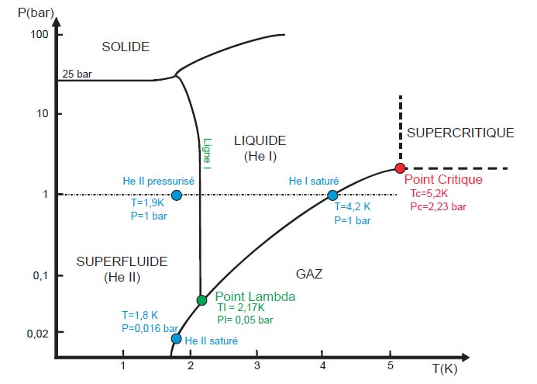
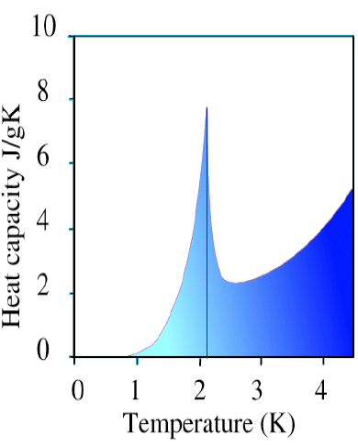
transition to a super-fluid phase below the λ-point (2.17K)
Low Viscosity
High Conductivity
High Specific Heat
SOLID
Liquid He I
Superfluid
He II
GAS
Advantages
Super-fluid Helium can easily flow through SC strand /Cable
2. Small temperature rise with a heat input ( specific heat )
3. Large Conductivity maintain equal temperature. SC Magnet is stable

Slide 41
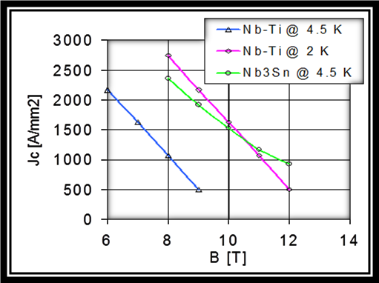
FOR HIGH FIELD MAGNETS LIKE LHC AT CERN
Example :
For gh Field Magnet :
NbTi at 2 K or Nb₃Sn at 4.2 K ?
It was important decision for CERN to have Magnetic field of 8.3 Tesla

Slide 42
SURFACE RESISTANCE WITH TEMPERATURE (T) & RF FREQUENCY ( f)
Niobium
For High Frequency Cavity: 2 K is Choice
WHY 2K?
R_{BCS}= 400
Nb : Tc= 9.2 K
R_{BCS}= 4
Note : These are the very basics and you will be learning a lot from the lecture of Prof Kako-san on Wednesday

Slide 43
MAJOR ACCELERATOR PROGRAMME ( Present & Future)
with cryogenics and superconductivity)
China
    ADS / CSNS : Cavity ii. SHINE ( Cavity) iii CEPC ( Cavity & Magnet) iv. HEPS
Japan
    Super KeK- B : Magnet & Cavity, ii )Proton Accelerator at JPARC ( Magnet) iii) ILC ( Cavity)
Korea
    RAON : Cavity and Magnet, KOMAC : Cavity, PLS
INDIA
    ADS/ SNS ; Cavity ( RRCAT, BARC, VECC)
    Superconducting Linac at IUAC & TIFR iii) Superconducting Cyclotron : VECC. Kolkata
ASIA
Other Major Accelerator Projects
LHC ( Switzerland). ESS ( Sweden), European X FEL ( Germany)
FermiLab ( PIP), USA, CEBAF ( USA), FAIR ( Germany)

Slide 44


Superconducting LINAC at IUAC, Delhi
Where I worked more than 20 years
CRYOGENIC SYSTEM
Nb Cavity
SC LINAC
Total 27 cavities are housed in 5 Indigenously Developed Cryomodules
Energy ~ E
1st Phase
Energy ~ 2E
2nd Phase

Slide 45





IUAC SUPERCONDUCTING CAVITY
First lot of QWR developed at USA in Collaboration with ANL. Remaining 20 cavities developed at IUAC
Two Spoke Cavities developed at IUAC for PIP project ,
Performance Curve of a Cavity
(Annotated Slide)

Slide 46





Except the Helium refrigerator, all the Components ( Cavities, Cryomodule, LHe Transfer line) were developed at IUAC, Delhi
IUAC SC LINAC ( Delhi, India)
LOW ENERGY
SC CAVITY
CRYO MODULES
BEAM LINE
LN2 LINE
Running for Last 20 years
OLD CCI HE REF
CRYO LINE
HIGH ENERGY
300 L/hr
NEW LINDE HE REFIGERAOR
CRYOGENIC CONTROL ROOM

Slide 47
Conclusion & Challenges
Superconductivity and Cryogenics are essential for High Power Accelerator
Challenges : Superconducting Magnet : High Field (15 – 20 Tesla) & Superconducting Cavity : Gradient 30 MV/m :
2 K/4 K Cryomodule with low heat leak
Cryogenic System : Improvement of COP ( Plug power vs. Refrigeration Load)
Feasibility of Beam line HTS Magnet ( LN2 Cooled/ CryoCooler)
Cost and Restricted Supply of Helium Gas
Limited Man Power with this specialized field ( Important )
Are you ready to Lead ?

Slide 48

Will Superconductivity & Cryogenics Control High Energy Physics, Transport, Power and Medical in Near Future ?????
My Intention was only to transfer 20 % (Carnot efficiency) of my lecture to you
Superconductor
Thanks for your Kind Patience
See you on Friday Morning
Who win ? The little boy or Sumo Wrestler ?
Your Answer ?
Any doubt : Please Contact me : tsdatta59@gmail.com

Slide 49


Neutrino from Nuclear Reactor and Particle Detector
Placing the detectors far underground shields them from cosmic rays and other interference at Earth’s surface.

Slide 50

PIP-II
Neutrino From Particle Accelerator
High-energy ( 100 GeV) proton beam exits the final accelerator of Circumference 3.3 km, more than 1 megawatt of protons will slam into the graphite target of the Long-Baseline Neutrino Facility to produce neutrinos
The protons' interactions with the protons and neutrons in the target material produce new, short-lived particles such as pions and kaons. These particles travel a short distance (about 200 m) through a "decay pipe,“ decays into neutrinos that continue on in the same direction, forming a neutrino beam. Of the three known neutrino types, a beam produced in this manner contains mostly muon neutrinos.
PIP-II’s new linear accelerator will be built with the latest superconducting radio-frequency technology developed at Fermilab,

Slide 51

Superconducting Cyclotron
The K value of Cyclotron indirectly tells about the energy of the proton beam. Higher K value means higher Energy and that can be achieved either by increasing field ( B) or by increasing diameter (2r)
World First Superconducting Cyclotron ( K -500 ) at NSCL, MSU. USA in 1981
WORLD’S LARGEST SC CYCLOTRON IN RIKEN. JAPAN ( 2006- 2007)
Beam energy : 440 MeV/ nucleon for Carbon
SC magnet : Main Coil : 6 Nos
SC Material : Nb- Ti
Type : Ratherford
Max Sector Field : 3.8 T at 5 kA
Operating Temperature : 4.5 K
Jacket Material : Aluminum alloy
Stored Energy : 235 MJ
18 m Dia, 9 m Height, K= 2500, Weight ; 8000Tons

