Slide 1
High field magnets for particle accelerators part I
E. Todesco, CERN
Sixth Asian School for Superconductivity and Cryogenics, March 25th 2025

Slide 2
Acknowledgments
I wish to acknowledge the contribution of numerous teams working in different labs (from West to East)
  LBNL, FNAL, NHFML, BNL in the US
  CIEMAT, CEA, PSI, CERN, INFN, UTwente in EU
  IHEP, IMP in China
  KEK in Japan
Special thanks in the preparation of this talk to (from East to West): A. Yamamoto, Q. Xu, T. Salmi, L. Rossi, B. Auchmann, A. Milanese, S. Izquierdo Bermudez, A. Ballarino, L. Bottura, H. Felice, H. ten Kate, L. Chiesa, B. Strauss, S. Prestemon, P. Ferracin

Slide 3
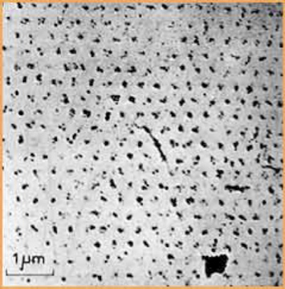
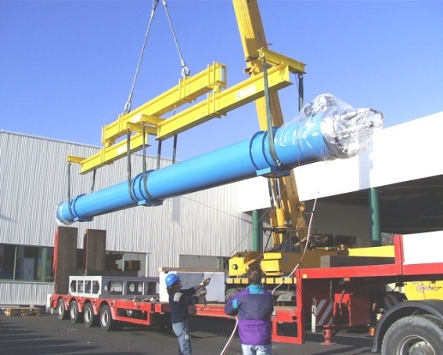
Foreword: from quantum physics to real world
Superconducting magnets are an exciting, fancy and dirty mixture of physics, engineering, and chemistry
An example of the variety of the issues to be taken into account
  The field of the LHC dipoles (8.3 T) is related to the critical field of Niobium-Titanium (Nb-Ti), which is determined by the microscopic quantum properties of the material, plus aspects related to superconducting magnet design (margins, instabilities, …)
  The length of the LHC dipoles (15 m) has been determined by the maximal dimensions of (regular) trucks allowed on European roads
Quantized fluxoids penetrating a superconductor used in accelerator magnets
A 15 m truck unloading a 27 tons LHC dipole

Slide 4
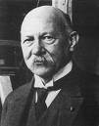
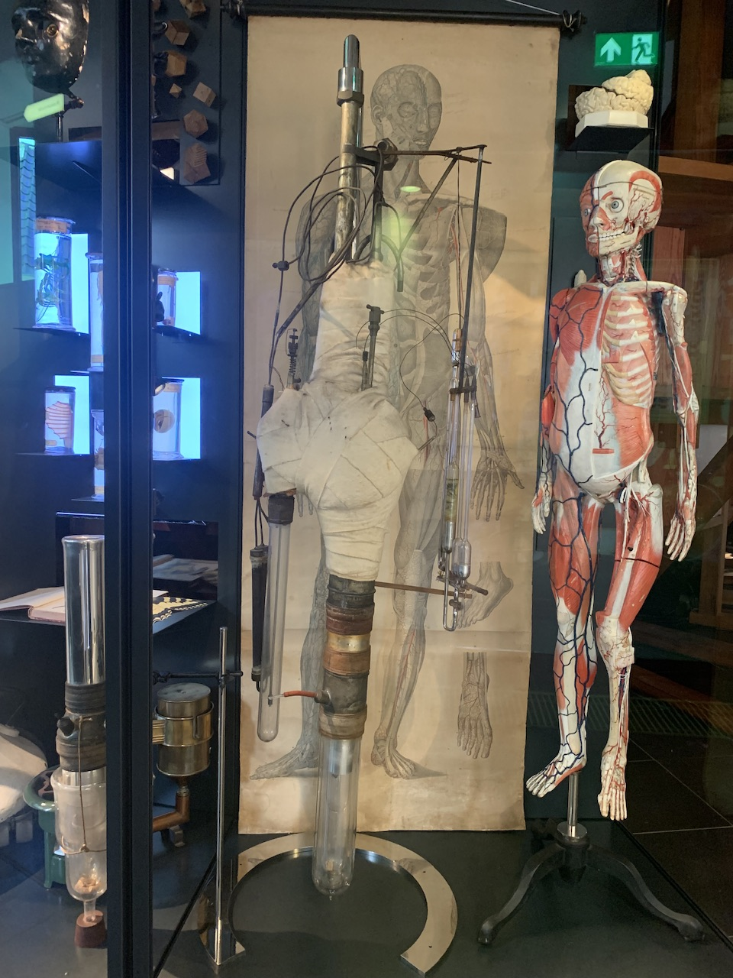
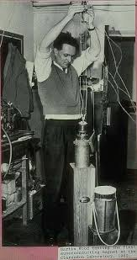
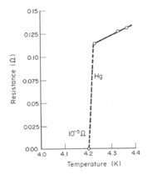
Foreword: why superconductivity is so special
The history of superconductivity applied to magnets is a very interesting paradigm
  Theory lags behind experimental results, arriving several decades later
  Applications of superconductivity to build magnets above 1 T arrive 50 years after the Onnes discovery
  The discovery is made possible by a technological achievement (making liquid He), explicitly mentioned in the attribution of the Nobel prize (whereas superconductivity itself is not mentioned)
  ”For his investigations on the properties of matter at low temperatures which led, inter alia, to the production of liquid helium”
Heinke Kamerlingh Onnes
(18 July 1853 – 4 February 1928)
Nobel prize 1913
Onnes He liquefactor,
Boerhaave museum, Leiden
First superconducting magnets, 60’s

Slide 5
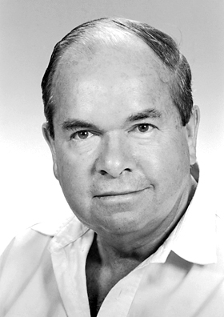
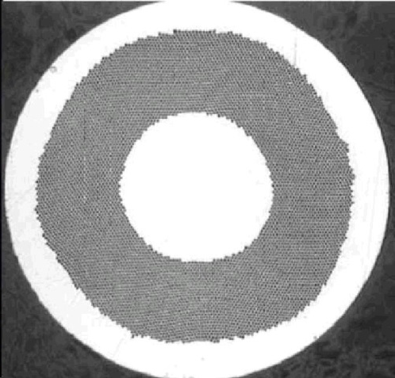
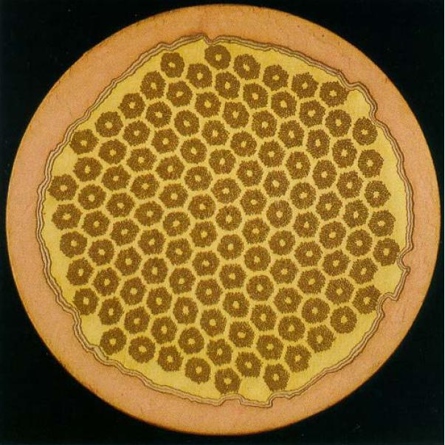
Foreword: why so long ?
First magnets done with superconductors were limited to very small fields
  To have magnets reaching order of teslas, one requires type II superconductors
Moreover, a bulk superconductor cannot be used in superconducting magnets
  About half of the strand must be composed of Cu
  The superconductor magnetization creates instabilities (heat dissipation followed by thermal runaway) – superconductor must be arranged in filaments of 0.01 to 0.1 mm transverse size
About 1 mm
Alexei Abrikosov, Russian
(1928-2017) Nobel prize 2003
Nb-Ti strand used for the LHC dipole
filament size 6-7 mm
Nb₃Sn strand used in LARP
filament size ≈50 mm

Slide 6
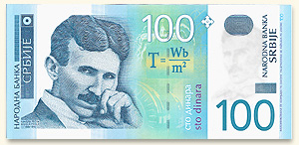
Foreword: cost
The cost optimization is a key element of the design
  The magnet system is a major part of the high energy collider cost
  In the LHC budget (accelerator only, not experiments, and having the LEP tunnel), 50% for the magnets, and 15% for the cryogenics to keep them at 1.9 K
Affordable magnets → compact devices → ecologic and sustainable
  This is another intrinsic feature of superconducting magnets for the collider main arcs

Slide 7
Contents – day I
Features of superconducting magnets for accelerators
Scaling laws for mechanics and protection, and operational margins
35 years of Nb-Ti in accelerators: from the the ISR (1975) to the LHC (2009)
35 years of Nb₃Sn short models: from the 80s to 2015

Slide 8
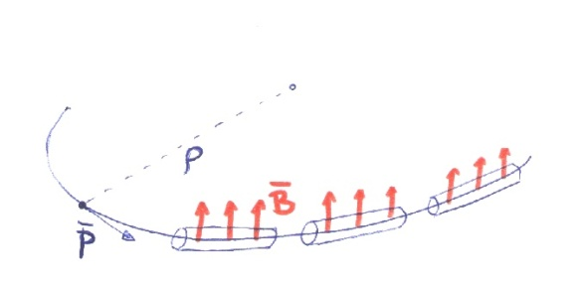
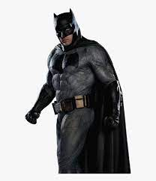

Field, collider size, and energy
Energy of a particle accelerator is given by magnetic field and accelerator size
    Ex. LHC: B: 8.3 T
    ρ: 2800 m
    E. 7000 GeV
Long accelerators ?
High fields ?
Speed of light

Slide 9
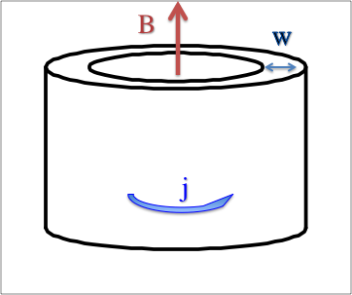
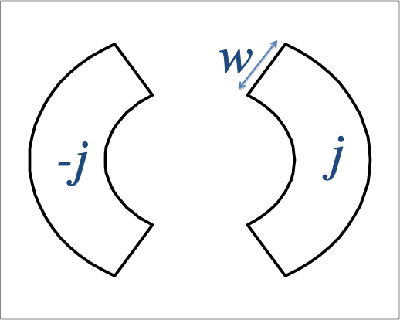
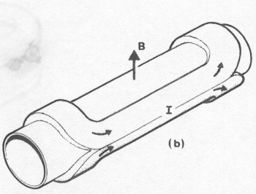
Magnet, coil and current density
In a solenoid the field is given by the current density times the coil width
In a dipole it is half of it The constant μ is terribly small (≈10⁻⁶ T m/A)
              Magnetic field is an effect of special relativity
Field in a dipole
Field in a solenoid

Slide 10
The leap of superconductivity
Copper or aluminium conductors can operate at 1 A/mm² – with active cooling, up to 5 A/mm²
  How to make 8 T ? With 3000 mm of winding thickness (3 m!)
Superconducting technology allows about 500 A/mm² : a reduction of a factor 100 in the active part of the magnet
  This means that each cm of coil width can make 3 T
  Zero resistance as an ecologic device (no consumption, but cryogenics), but compactness as well means sustainability
  Small is beautiful … especially when you have to make thousands of them

Slide 11
Features of superconducting magnets for accelerators
Overall current densities of ∼500 A/mm² are a peculiar feature/challenge for accelerator magnets (overall current density = current density over insulated coil)
  One order of magnitude above applications as HEP detector magnets or fusion magnets
This large current density is needed for compactness required in the transverse size:
  ∼10 cm for the active part (coil around the bore), ∼1 m for the total size of the cryostat
Other applications have other types of challenges as
  Total size for HEP detector magnets, total size and pulsed field for ITER magnets
  Coupling between circuits and different temperatures in the SC link
 | Overall current density (A/mm²) | Superconductor current density (A/mm²) | Ramp | Field in conductor (T)
Tevatron dipole | 360 | 1550 | slow | 4.7
LHC dipole | 360/440 | 1260/1820 | slow | 8.6
ATLAS BCT | 30 | 950 | very slow | 3.9
ITER (TF & CS) | 20 to 40 | 150 | very fast | 5 to 13
HL-LHC SC link | 17 | 1450 | slow | Self field (<1 T)

Slide 12
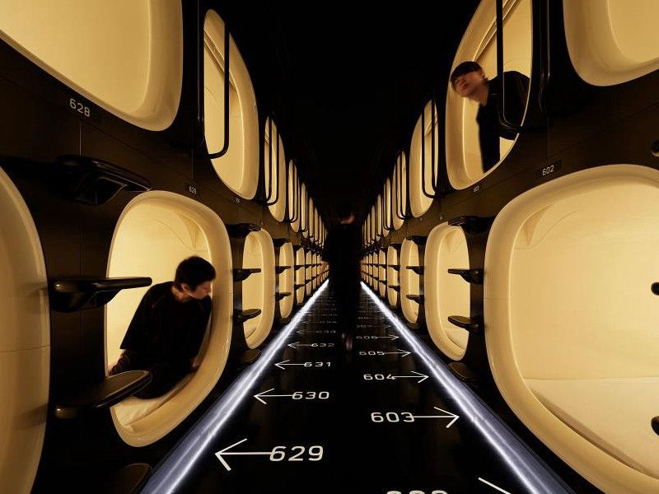
Features of superconducting magnets for accelerators
Compact, highly optimizied, and cost-effective: the capsule hotels of applications of superconductivity ?
Nine Hours Narita Airport capsule hotel

Slide 13
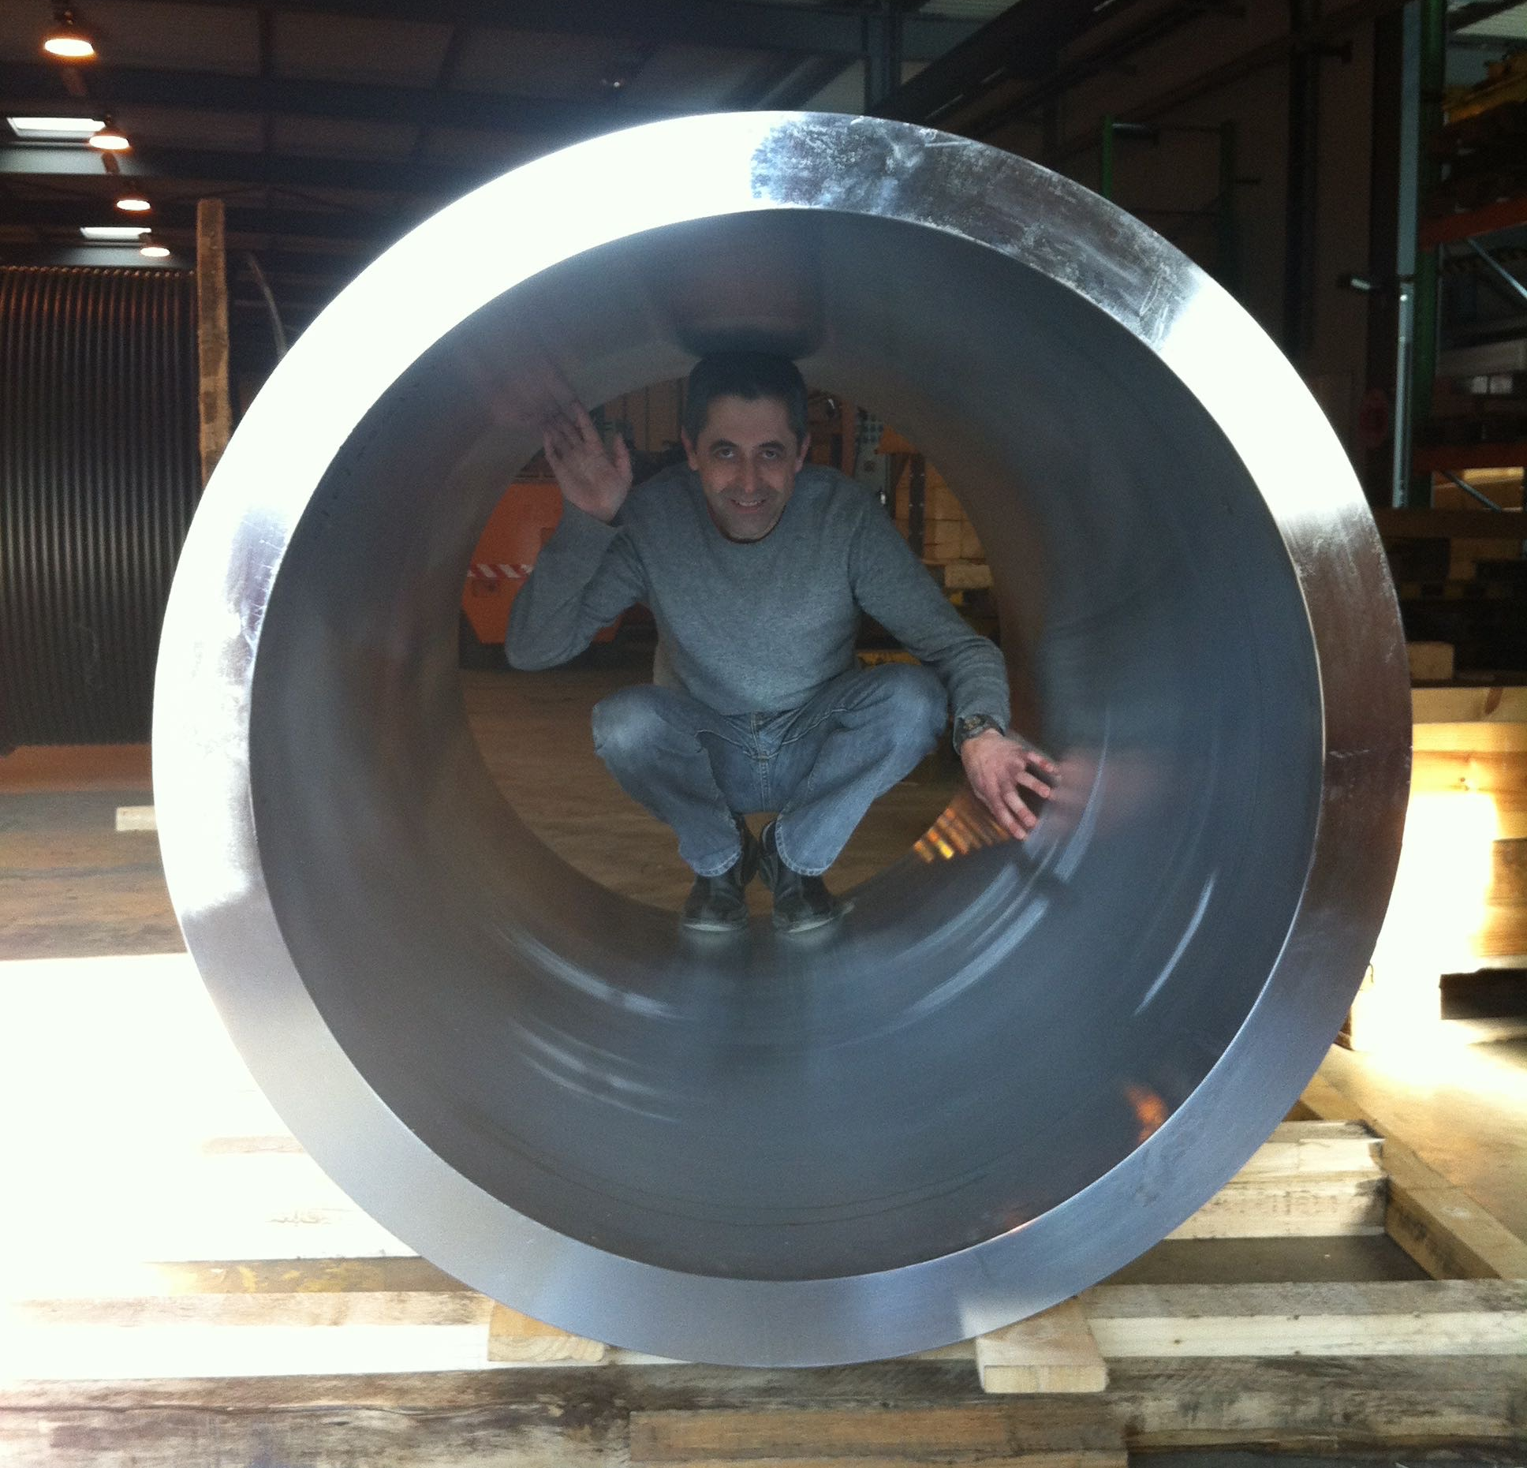
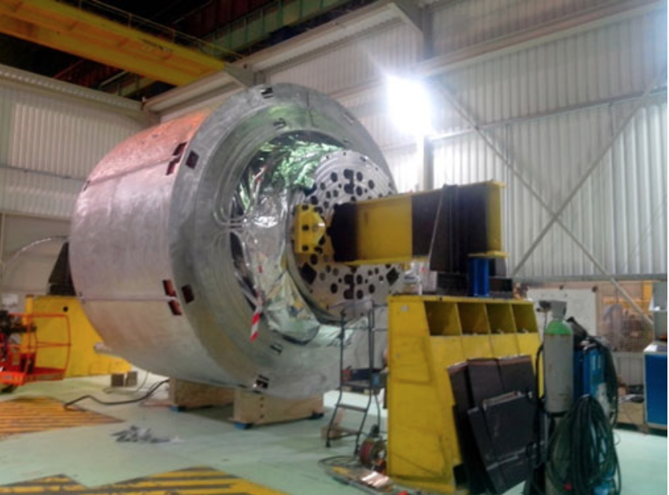
Features of superconducting magnets for accelerators
Compact, highly optimized, and cost-effective: the capsule hotels of applications of superconductivity ?
Iseult 11.7 T MRI solenoid in Nb-Ti
P. Vedrine, et al. IEEE TAS 18 (2008) 868
L. Quettier, et al. IEEE TAS 30 (2020) 4400604
A colleague in the structure
of FrescaII, a 14.5 T Nb₃Sn magnet
demostrator for accelerators

Slide 14
Requirements of superconducting magnets for accelerators
Stress: locally, it is j×B
  The accumulation of high current density and high field induces a stress in the conductor of order of 100 MPa (unless it is intercepted)
  200 MPa is considered a limit that is better not to approach for a Nb₃Sn magnet to be produced in thousands units [F. Mangiarotti, 2LOr2E-02, experience on MQXF]
Protection:
  Energy extraction is not viable → energy has to be dumped in the coil
  How? Once a quench is detected, rapidly (order of 10-100 ms) induce a global resistive transition
Field quality:
  <1 per mil relative error over two third of the aperture and over the operational range
  Accelerators increase the energy of a factor 5 to 20, and even at “low field” and during the energy ramp the relative error has to be < 1 per mil
  This needs fine filaments, twisting of filaments and twisting of strands in Rutherford cable

Slide 15
Contents – day I
Features of superconducting magnets for accelerators
Scaling laws for mechanics and protection, and operational margins
35 years of Nb-Ti in accelerators: from the the ISR (1975) to the LHC (2009)
35 years of Nb₃Sn short models: from the 80s to 2015

Slide 16
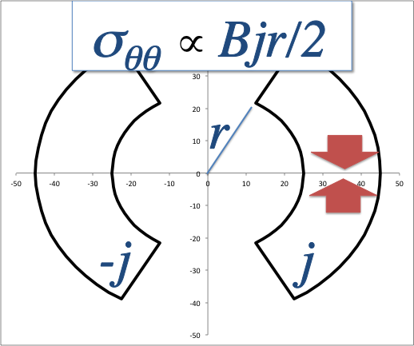
Electromagnetic forces
There are two different types of stress in a sector coil
  That have a totally different scaling on magnet parameters
Accumulation of azimuthal stress in the midplane
  Scales with r (aperture radius), B and j, times a shape factor
  This is the dominant part for all accelerator magnets below 15 T
  Higher fields B can be compensated by lower j (less effective magnets)
  Scale factor is 1.1 to 1.5
Some cases | Tevatron | LHC | 14 T for FCC-hh | 20 T for FCC-hh
Field (T) | 4.4 | 8.3 | 14 | 20
Aperture radius (mm) | 38.05 | 28 | 25 | 25
Overall j (A/mm²) | 360 | 400 | 400 | 400
rBj/2 (MPa) | 31 | 46 | 70 | 100

Slide 17
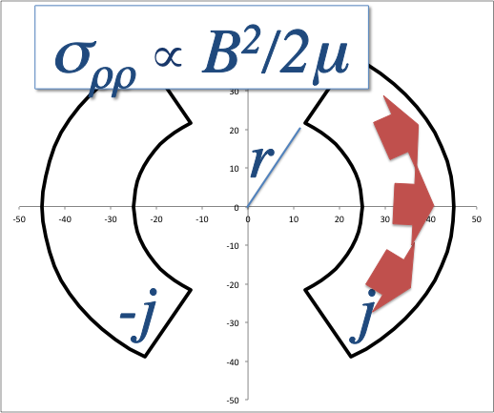
Electromagnetic forces
There are two different types of stress in a sector coil
  That have a totally different scaling on magnet parameters
Accumulation of radial stress
  Scales with magnetic pressure B²/2μ , factor in front is 1 - 1.5
  At 14 T you get towards 150 MPa
  High or low current densities do not make difference
Some cases | Tevatron | LHC | 14 T for FCC-hh | 20 T for FCC-hh
Field (T) | 4.4 | 8.3 | 14 | 20
Aperture radius (mm) | 38.05 | 28 | 25 | 25
Overall j (A/mm²) | 360 | 400 | 400 | 400
rBj/2 (MPa) | 31 | 46 | 70 | 100
B²/2μ (MPa) | 7 | 27 | 78 | 159

Slide 18
Field is pressure
The limits in the materials are order of 150 – 200 MPa
  For Nb-Ti, insulation should not go above these levels to avoid breaking
  For Nb₃Sn, the conductor degrades with strain, at levels corresponding
  to 150-200 MPa
Note that in a dipole with thin coil, the radial pressure can be about 50% than magnetic pressue
  Therefore, at 15 T we start approaching the limits …
We will see in the lecture of day 2 how to go above 15 T (stress managed structures) for mechanics
Field (T) | 4 | 8 | 12 | 16 | 20
B²/2μ (MPa) | 6 | 25 | 57 | 100 | 160

Slide 19
Field is energy density
Since the energy has to be dumped in the coil, the energy density in the coil must be lower than the coil enthalpy from cryogenic temperatures to 300 K
  Energy density in the coil: stored energy in the magnet / volume of the coil
Integral of coil enthalpy from 0 to 300 K is typically 0.5 J/mm³
Magnetic field is pressure, but pressure is energy density
  1 MPa = 1 MN / m² = 1 MJ / m³ = 0.001 J / mm³
Obviously, the energy density in the coil is larger than the magnetic field energy density …
Field (T) | 4 | 8 | 12 | 16 | 20
B²/2μ (MPa) | 6 | 25 | 57 | 100 | 160
B²/2μ (J/mm³) | 0.006 | 0.025 | 0.057 | 0.100 | 0.160

Slide 20
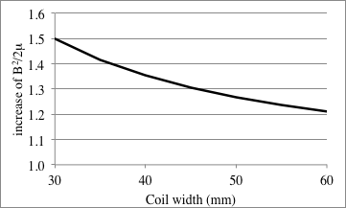
Field is energy density
Note that in a dipole, the energy density on the coil is typically 20%-50% more than the energy density of the magnetic field (see previous formula)
So the integral of the coil enthalpy sets a limit on the magnet protection – also in this case at 15 T we reach values where the paradigm of design used until today do not wark any more
We will see in the lecture of the next day how to go above 15 T (stress managed structures) both for mechanics and protection
Field (T) | LHC | HL-LHC quads
B (T) | 8.3 | 11.3
Coil width (mm) | 30 | 36
B²/2μ (J/mm³) | 0.025 | 0.057
Energy density on the coil | 0.050 | 0.100

Slide 21
Loadline
Loadline is the (quasi)linear relation between current density and field
  When the combination of current density and field in the coil meets the critical surface at the operational temperature, this is the maximum theoretical field (called short sample field)
j
Critical surface at operational temperature
Loadline for superconducting magnets
B

Slide 22
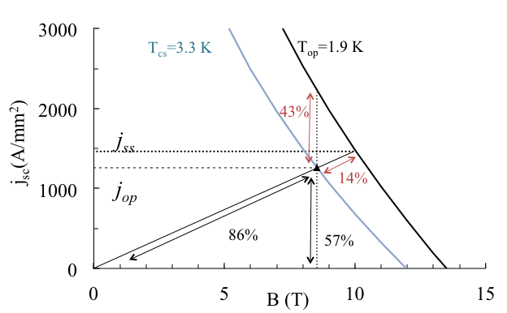
Margins
One has to step back from the critical surface to have an operational margin
  Loadline margin: (1 - fraction of the maximum performance) 14% in the figure
Operational margins for LHC magnets

Slide 23
Margins
One has to step back from the critical surface to have an operational margin
  Loadline margin: (1 - fraction of the maximum performance) 14% in the figure
  Current margin: (1 – fraction of the maximum current at that field) 43% in the figure
Operational margins for LHC magnets

Slide 24
Margins
One has to step back from the critical surface to have an operational margin
  Loadline margin: (1 - fraction of the maximum performance) 14% in the figure
  Current margin: (1 – fraction of the maximum current at that field) 43% in the figure
  Temperature margin: how much we can heat to reach the cricital surface:3.3 K–1.9 K =1.4 K
Typical values for Nb-Ti
at 20% loadline margin:
50% current margin
2 K temperature margin
Operational margins for LHC magnets

Slide 25
Lessons to be taken
Dipoles give half of a field compared to a solenoid, with the same coil width and coil thickness
Superconductivity allows a jump in current density from the 1-5 A/mm² that can be obtained in Cu to 500 A/mm²
  Every cm of coil gives about 3 T ! 100 more compact devices mean more ecological devices
Limits due to mechanics: field is magnetic pressure, and 150 -200 MPa are reached around 15 T for radial pressure
  There is also the azimuthal pressure, that has a different scaling
Limits due to protection: field is energy density, and values aobut 0.1 J/mm³ are reached around 15 T
  So one cannot dump the energy in the coil
In the next two sections we show the path of Nb-Ti and Nb₃Sn up to 15 T

Slide 26


Contents
1975 to 2008: Nb-Ti technology in accelerators
1960
1970
1980
1990
2000
2010
2020
2030
2040
2050

Slide 27
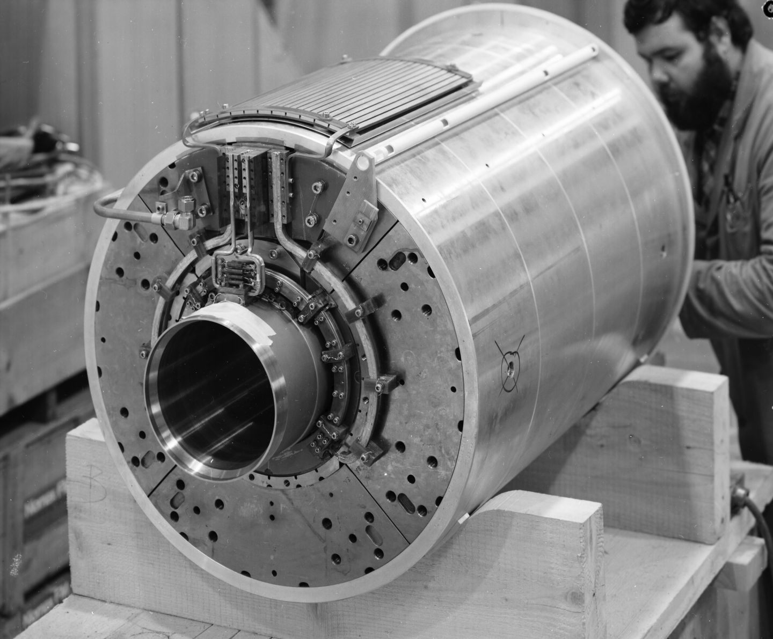
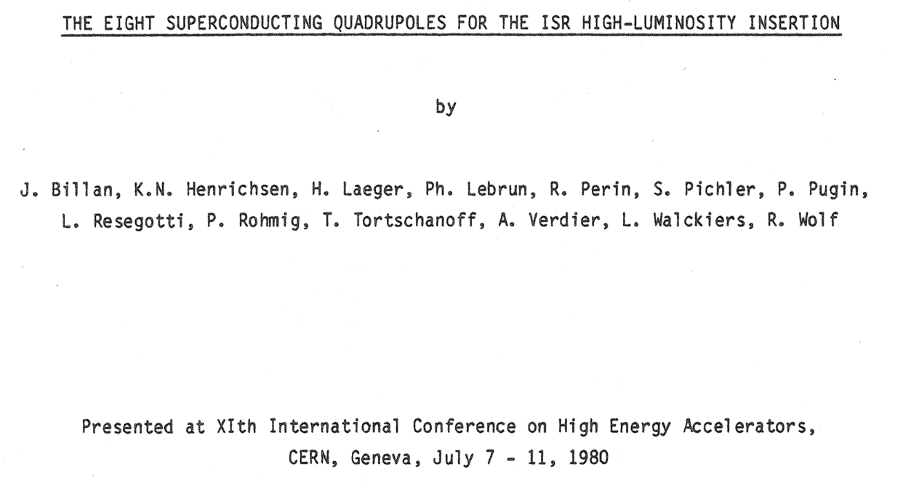
ISR quadrupoles
First superconducting quadrupole magnets installed in a collider based on Nb-Ti
  Eight quadrupoles for the ISR insertion region, 43 T/m in 173 mm bore –
  Pole field 3.8 T, but peak field in the superconductor 5.8 T
  Rectangular Nb-Ti wire with twisted filaments (no need of field quality along the ramp)
This design did not further evolve: no transposed cable

Slide 28
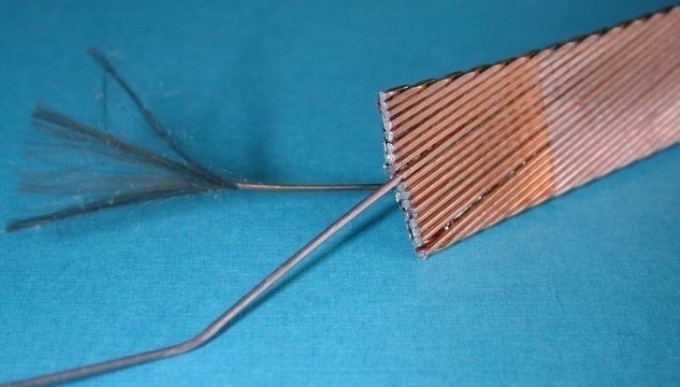
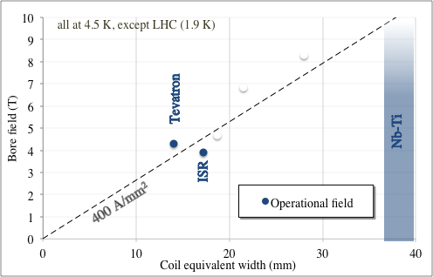
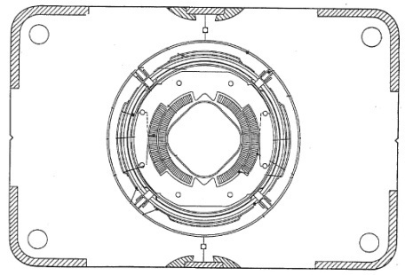
From ISR to LHC
1980-1986: Tevatron is the first collider using 4.3 T superconducting dipole magnets
  First use of Rutherford cable, first use of collars
  774 dipoles, 6-m-long magnets, in house production in FNAL
  [R. Hanft et al., TM-1182, 1630, 03/1983]
Tevatron dipole cross-section
Note: for ISR quad, G r=3.8 T is used as bore field, but coil peak field is 5.8 T - for the coil width see appendix

Slide 29
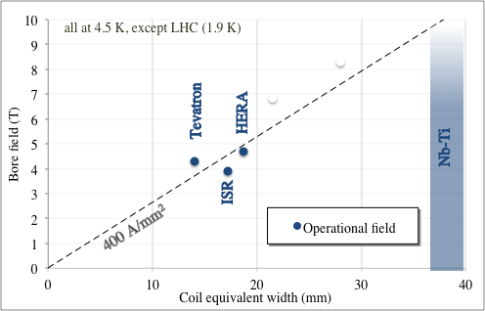
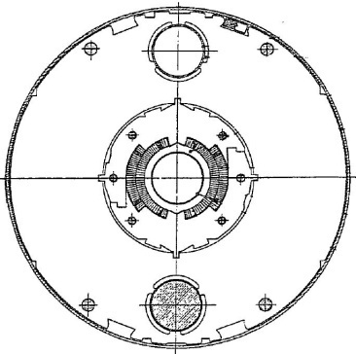
From ISR to LHC
1985-1990: HERA dipoles break the 4.5 T operational field barrier
  454 dipoles, 9-m-long magnets, industrial production, Al collars
  [R. Meinke, IEEE TAS 27, 1728 (1991)]
HERA dipole cross-section

Slide 30
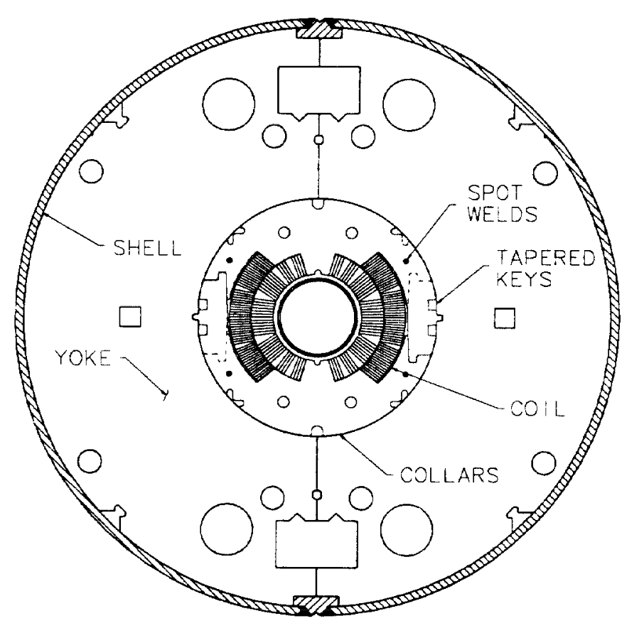
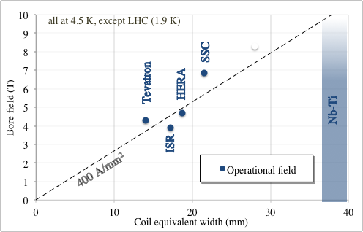
From ISR to LHC
1984-1995: SSC protoypes break the 6.5 T barrier and double the length, above 15 m
  19 dipole prototypes, 17-m-long magnets with 50 mm aperture
  15 dipole prototypes, 15-m-long magnets with 40 mm aperture
  [J. Strait, et al., IEEE Trans. Magn. 25 (1989)] Project canceled in 1993
SSC dipole cross-section

Slide 31
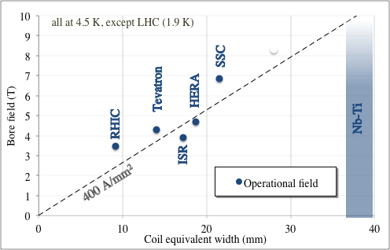
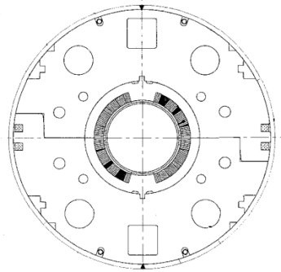
From ISR to LHC
1994-1996: RHIC dipoles (3.5 T) explore the option of a low-cost magnet, with large margin, not requiring test before installation
  300 units, 9.45 m long [M. Anerella, et al., NIM 499 (2003) 280-315]
RHIC dipole cross-section

Slide 32
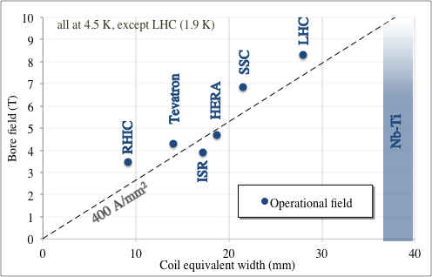
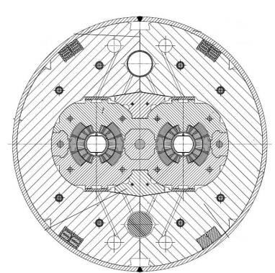
From ISR to LHC
2000-2005: LHC dipoles break the 8 T operational field barrier
  1278 dipoles, 14.3-m-long magnets, industrial production – towards the limit of Nb-Ti for main dipoles
  First operation at 1.9 K following Tore Supra experience
  [R. Perin, in Encyclopedia of Applied Superconductivity (IOP, London, 1998) 919–950 and L. Rossi, IEEE TAS 13, 1221 (2003) ]
LHC dipole cross-section

Slide 33
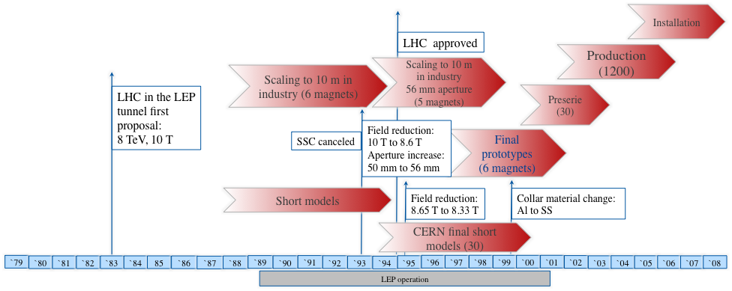
LHC timeline
Initial development in industry and institutes (mature technology) - approval based on a 10 m long magnet
Reduction of field from initial 10 T to 8.3 T
Short model at CERN from 1995 - Design changes up to the very end of prototypes

Slide 34
Lessons to be taken
The history of Nb-Ti dipole magnets is a walk along the ~400 A/mm² line, increasing the coil width from ~15 mm (Tevatron) to ~30 mm (LHC dipoles) and the field from 4.3 T to 8.3 T

Slide 35
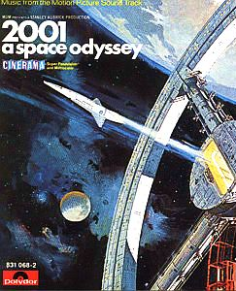

Contents
Nb₃Sn short model dipoles from 1987 to 2015
First solenoids
ISR
Tevatron
1960
1970
1980
1990
2000
2010
2020
2030
2040
2050

Slide 36
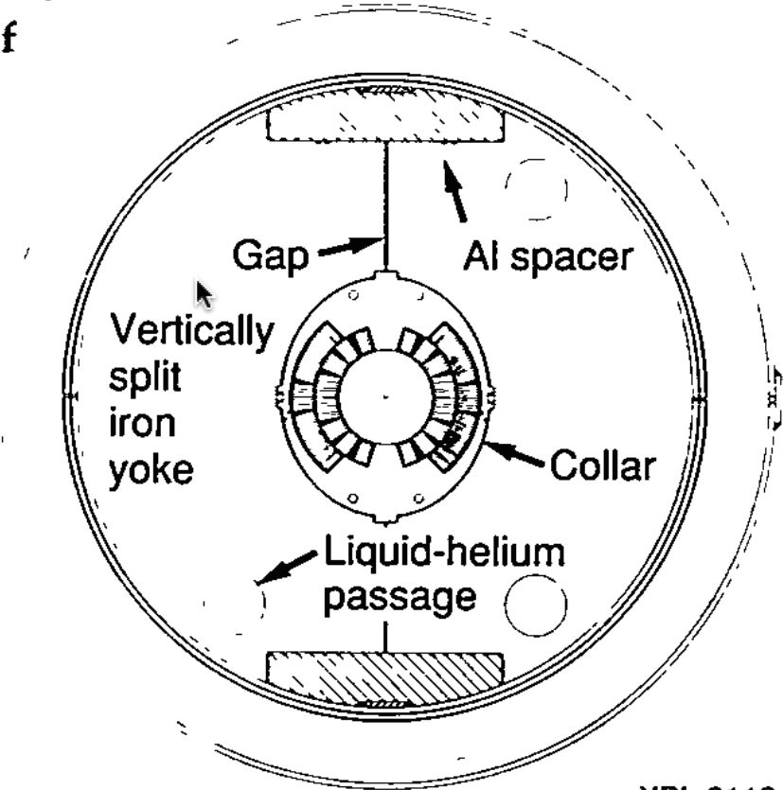
Above 10 T
10 T is the limit for Nb-Ti field in accelerator magnets (LBNL D19 went just above 10 T)
  However operational field must be much lower
Nb₃Sn, discovered before Nb-Ti, can tolerate higher field, at the price of a more complex process of coil manufacturing (reaction at 650 C, impregnation)
In the next slides we will show that the paradigm of «More field ? More coil !» that we have seen for the Nb-Ti magnets is kept
LBNL D19 cross-section
[S. Caspi, et al,] mid 90’s
Iseult 11.7 T solenoid
P. Vedrine, et al. IEEE TAS 18 (2008) 868
L. Quettier, et al. IEEE TAS 30 (2020) 4400604
Nb-Ti and Nb₃Sn critical surfaces

Slide 37
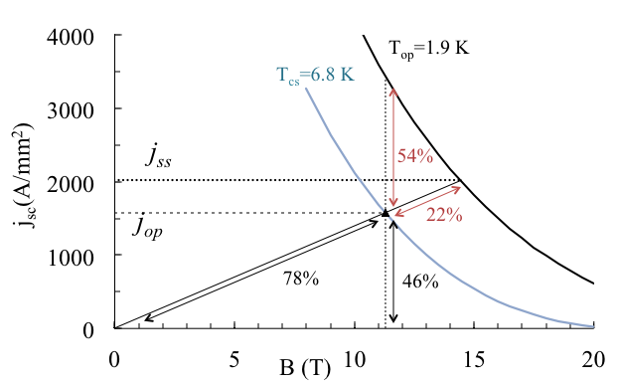
Nb₃Sn margins
Nb₃Sn has similar current margin as Nb-Ti at 20% loadline margin, but much higher temperature margin (4.5 K instead of 2 K)
Typical values for Nb₃Sn
at 20% loadline margin:
50% current margin
4.5 K temperature margin
Operational margins for HL-LHC magnets

Slide 38
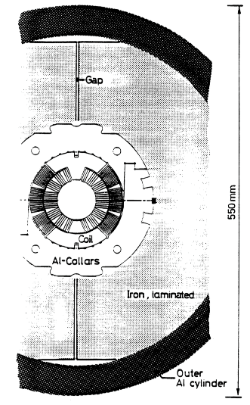
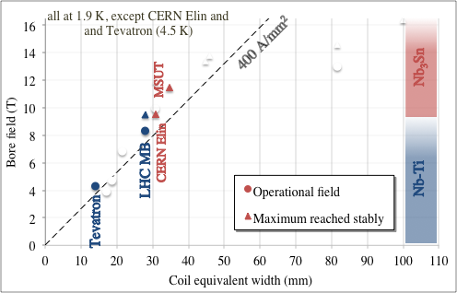
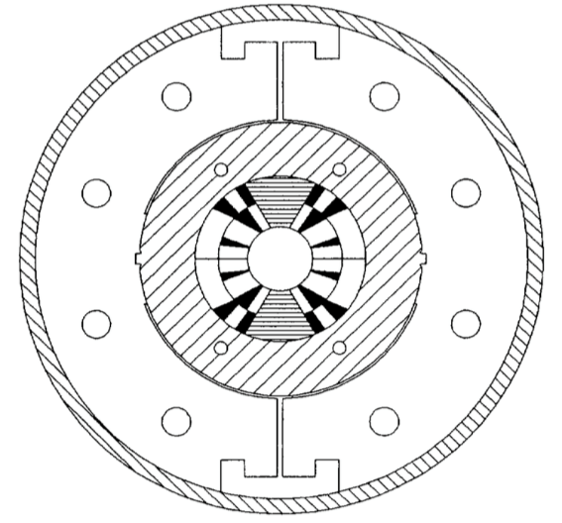
History of records in dipole field for Nb₃Sn
1989: CERN Elin reaches 9.5 T at 4.3 K (Nb₃Sn option for LHC)
1992-1997: MSUT reaches 11.3 T a 4.5 K, and >11.8 T a 1.9 K 25 years later
Note the difference: now we talk about achieved field
  The LHC has 8.3 T operational field but models, proto and series magnets >9.0, 9.5 T
CERN-Elin dipole cross-section
  [S. Wenger, et al., IEEE TAS 25 (1989)]
MSUT dipole cross-section
  [A. Den Ouden, et al. IEEE TAS 7 (1997)]

Slide 39
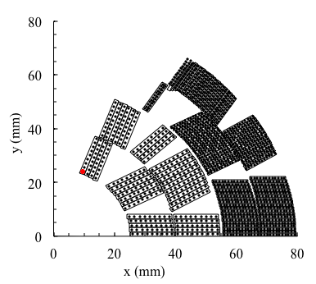
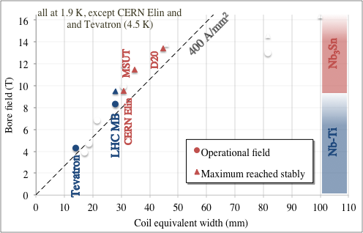
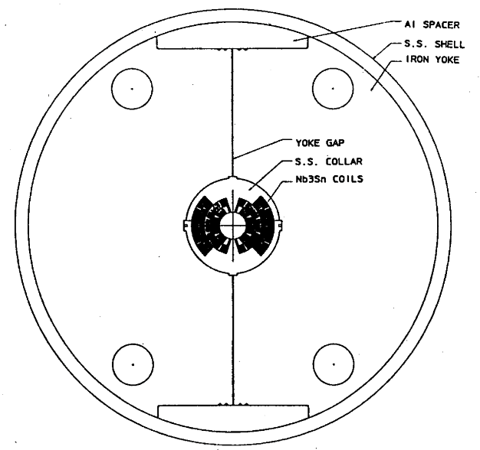
History of records in dipole field for Nb₃Sn
1993-1997: LBNL D20 reaches 13.4 T at 1.8 K
  Complex coil, four layers [D. dall’Orco, et al. IEEE TAS 3 (1993)]
  [A. McInturff, et al, Particle Acc. Conf. (1997)]
D20 dipole coil cross-section
D20 dipole cross-section

Slide 40
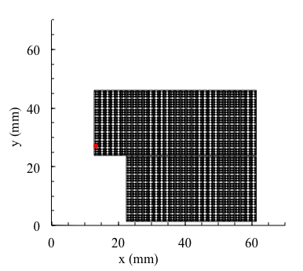
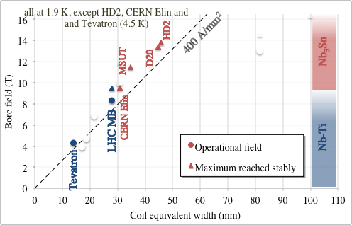
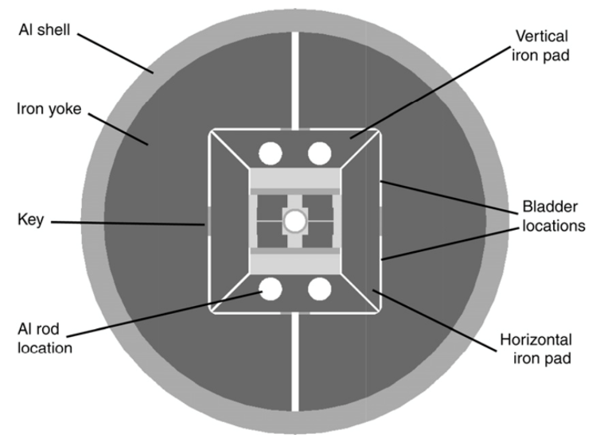
History of records in dipole field for Nb₃Sn
2005-2010: LBNL HD2 reaches 13.8 T at 4.5 K (never tested at 1.9 K)
  Block coil, flared ends [G. L. Sabbi, et al. IEEE TAS 15 (2005) 1128]
HD2 dipole coil cross-section
HD2 dipole cross-section

Slide 41
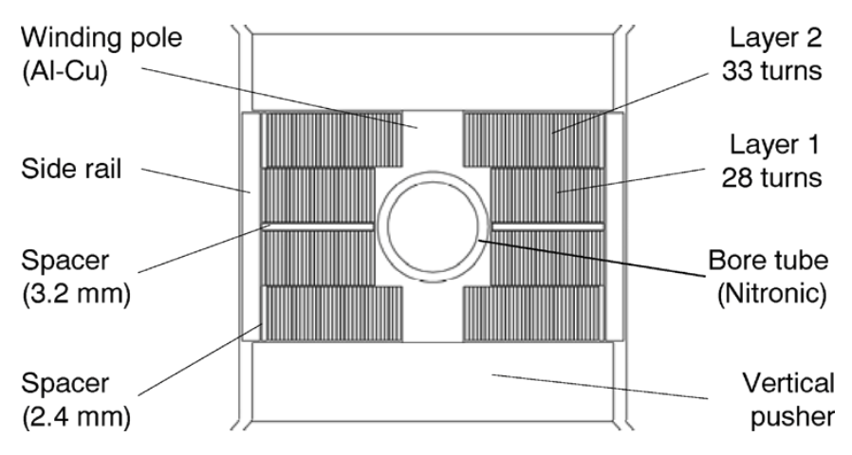
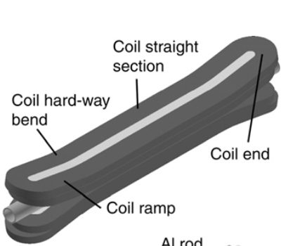
Block coils
HD2 sets a new paradigm in magnet design
  Block coils remove the issue of azimuthal stress since there is an inner structure
  The only left is radial stress
  The price is a discontinuity between upper and lower deck
This is why they are used in large aperture magnets (see next)
  The 3D is also non trivial: flared ends

Slide 42



History of records in dipole field for Nb₃Sn
2012-2019: CERN-CEA Fresca2 reaches 14.5 T at 1.9 K
  Block coil with 4 layers – Very large aperture (80 mm)
  Large coil width, low current density
  This is not a magnet for accelerator, but proves the technology
  [A. Milanese, et al, IEEE TAS 22 (2012)] [G. Willering, et al, IEEE TAS 29 (2019)]
Fresca2 dipole coil cross-section
Fresca2 dipole cross-section

Slide 43
Lessons to be taken
Nb-Ti solenoids up to 12 T have been built: nevertheless, 8-9 T is the limit for applications to main dipole accelerators
Above 8-9 T operational field, one has to use Nb₃Sn, featuring a more complex manufacturing procedure
There is a 1-2 T difference between operational field in several hundreds (thousands) magnets and maximum achievable field in one magnet or in a short model: our community should be more clear on this distinction
As for Nb-Ti, for Nb₃Sn, the history of the short model dipoles walks around the 400 A/mm² line, exploring the 10 – 14 T range and coil widths from 30 to 50 mm, with the exception of Fresca2
  Note that MDPCT1 reached more than 14 T, with a 50 mm coil width (see next sections)

