Slide 1
High field magnets for particle accelerators part II
E. Todesco, CERN
Sixth Asian School for Superconductivity and Cryogenics, March 26th 2025

Slide 2
Acknowledgments
These slides are an extended version of the plenary talk given at ASC conference in Salt Lake City, September 2024
I wish to acknowledge numerous teams working in different labs (from West to East)
  LBNL, FNAL, NHFML, BNL in the US
  CIEMAT, CEA, PSI, CERN, INFN, UTwente in EU
  IHEP, IMP in China
  KEK in Japan
Special thanks in the preparation of this talk to (from East to West): A. Yamamoto, Q. Xu, T. Salmi, L. Rossi, B. Auchmann, A. Milanese, S. Izquierdo Bermudez, A. Ballarino, L. Bottura, H. Felice, H. ten Kate, L. Chiesa, B. Strauss, S. Prestemon, P. Ferracin

Slide 3
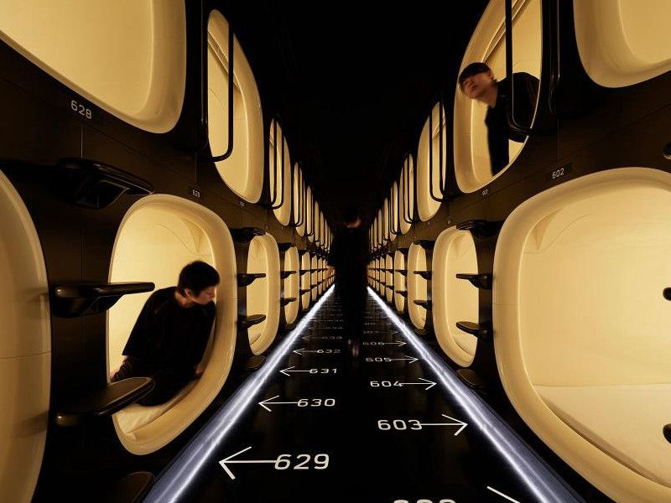
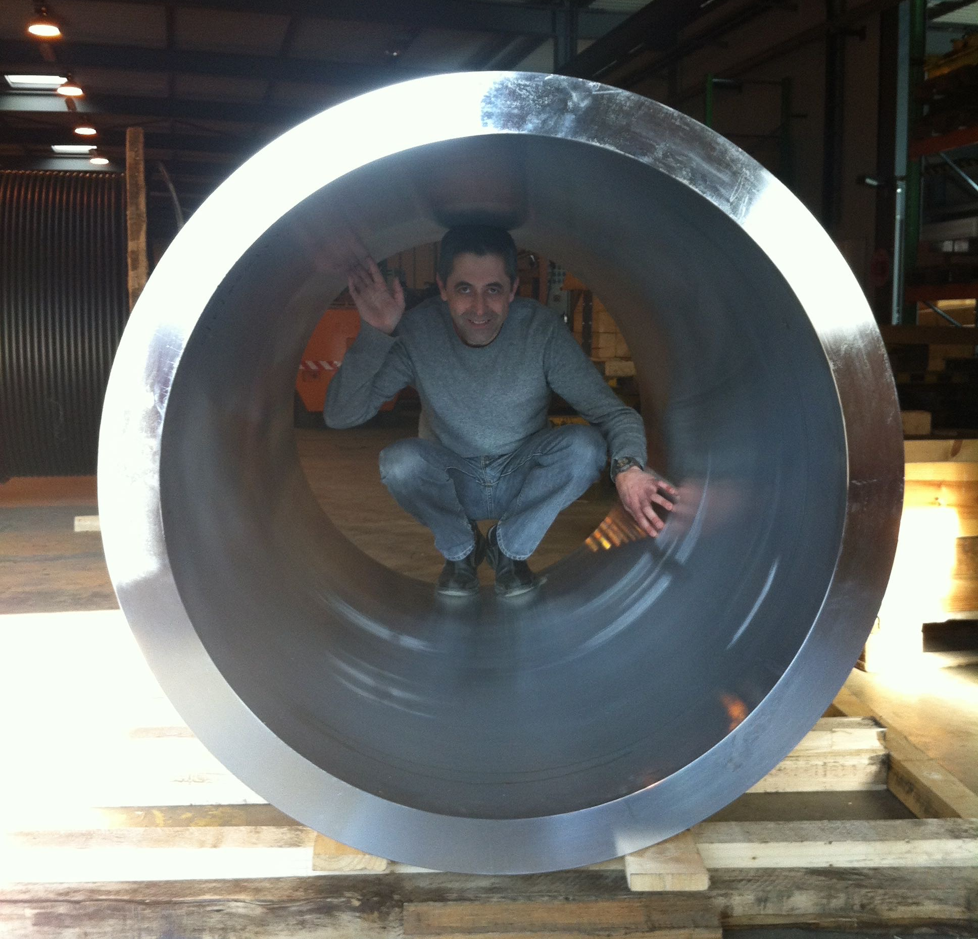
Features of superconducting magnets for accelerators
Compact, highly optimizied, and cost-effective: the capsule hotels of applications of superconductivity ?
A colleague in the structure
of FrescaII, a 14.5 T Nb₃Sn magnet
demostrator for accelerators
Nine Hours Narita Airport capsule hotel

Slide 4
Features of superconducting magnets for accelerators
Overall current densities of ∼500 A/mm² are a peculiar feature/challenge for accelerator magnets (overall current density = current density over insulated coil)
  One order of magnitude above applications as HEP detector magnets or fusion magnets
This large current density is needed for compactness required in the transverse size:
  ∼10 cm for the active part (coil around the bore), ∼1 m for the total size of the cryostat
 | Overall current density (A/mm²) | Superconductor current density (A/mm²) | Ramp rate (mT/s) | Field in conductor (T)
Tevatron dipole | 360 | 1550 | ∼ 4 | 4.7
LHC dipole | 360/440 | 1260/1820 | ∼ 8 | 8.6
ATLAS BCT | 30 | 950 | ∼ 0.8 | 3.9
ITER (TF & CS) | 20 to 40 | 150 | ∼ 400 | 5 to 13
HL-LHC SC link | 17 | 1450 | ∼ 8 | Self field (<1 T)

Slide 5
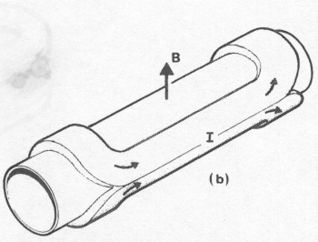
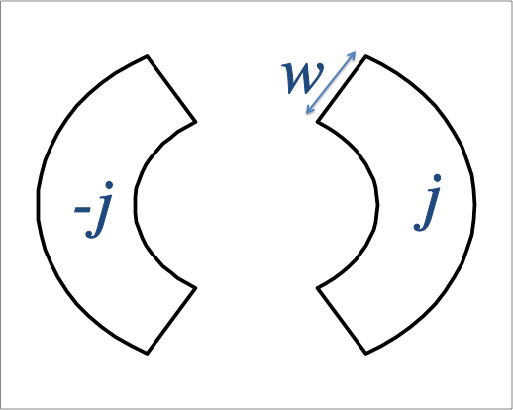
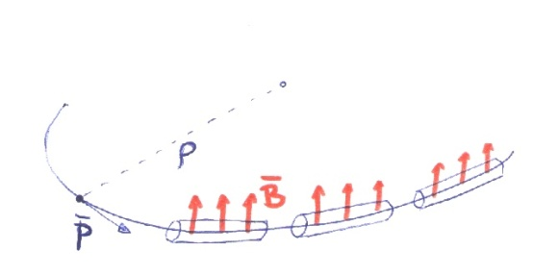


Field, collider size, and energy
Energy of a particle accelerator is given by magnetic field and accelerator size
Long accelerators ?
High fields ?
Field of a magnet is given by current density and coil width
Superconductivity allows not only zero consumption (except cryogenics), but for accelerator magnets gives a leap in the overall current density of two orders of magnitudes from ~5 to ~500 A/mm²: enabling technology
μ₀/2
Speed of light

Slide 6
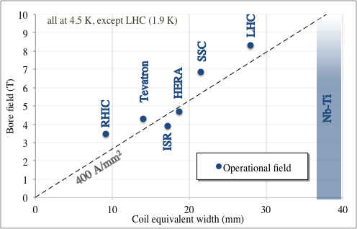
From ISR to LHC
The history of Nb-Ti dipole magnets is a walk along the ~400 A/mm² line, increasing the coil width from ~15 mm (Tevatron) to ~30 mm (LHC dipoles) and the field from 4.3 T to 8.3 T

Slide 7
Above 10 T
10 T is the limit for Nb-Ti field in accelerator magnets (LBNL D19 went just above 10 T)
  However operational field must be much lower
Nb₃Sn, discovered before Nb-Ti, can tolerate higher field, at the price of a more complex process of coil manufacturing (reaction at 650 C, impregnation)
Nb-Ti and Nb₃Sn critical surfaces

Slide 8
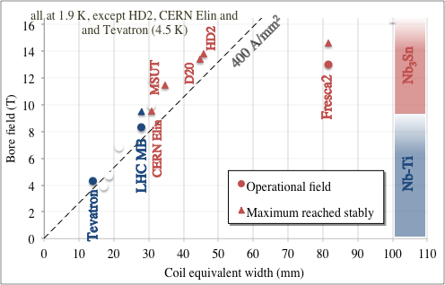
From 10 T to more than 14 T
There is a 1-2 T difference between operational field in several hundreds (thousands) magnets and maximum achievable field in one magnet or in a short model
As for Nb-Ti, for Nb₃Sn, the history of the short model dipoles walks around the 400 A/mm² line, exploring the 10 – 14 T range and coil widths from 30 to 50 mm, with the exception of Fresca2
  Note that MDPCT1 reached more than 14 T, with a 50 mm coil width (see next sections)

Slide 9
Contents
The LARP / HL-LHC MQXF Nb₃Sn age: towards mini series and long lenghts (2004-2030)
100 TeV colliders: parameters and challenges
Towards Nb₃Sn dipoles for 100 TeV colliders (2015-2050)
HTS: opportunities and challenges

Slide 10


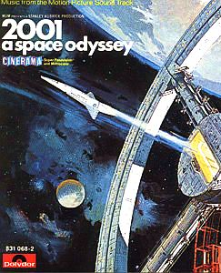

Contents
2004 to 2028: LARP and HL-LHC towards long lengths and mini-series
8 T LHC Nb-Ti dipoles
First solenoids
ISR
Tevatron 4.3 T Nb-Ti dipoles
1960
1970
1980
1990
2000
2010
2020
2030
2040
2050

Slide 11
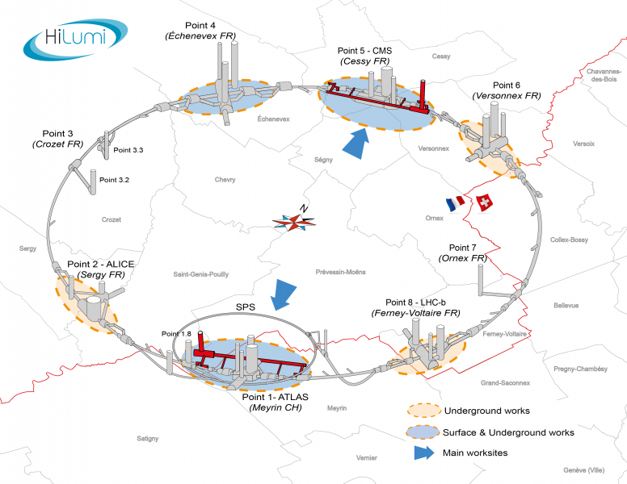
The high luminosity LHC (HL-LHC)
Scope: LHC upgrade to reach 10 times more collisions data in the period 2030-2045
  Same collision energy of 13.6 TeV center of mass
  HL-LHC will accumulate 10 times more data (3-4000 fb⁻¹) than the LHC (3-400 fb⁻¹)
  How ? [O. Bruning, L. Rossi, “The HL LHC” (2015) World Scientific]
  More protons in the beam
  Larger aperture magnets → More focussed beam
  Better geometry of the collisions (crab cavities)
Nb₃Sn technology will be used for the first time
in the interaction region of a collider
  [E. Todesco, et al., SUST 34 (2021) 053001]
  As it was done 45 years ago in ISR with Nb-Ti
China provides correctors as in kind contribution
A superconducting link in MgB₂ will be used
  This will be another prima in applications of SC to HEP
  [A. Ballarino, J. P. Burnet, “The HL LHC” (2015) World Scientific Chapter 8]
HL-LHC project [L.Rossi, O. Brüning et al]

Slide 12
The high luminosity LHC (HL-LHC)
China contributes with 12 superconducting magnets in Nb-Ti, double aperture, to HL-LHC
HL-LHC project [L.Rossi, O. Brüning et al]

Slide 13


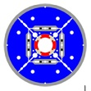
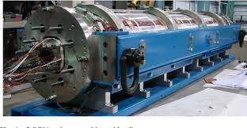
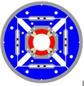
The US LHC accelerator R&D program
In 2004, US-DOE launched the LARP to support the LHC luminosity upgrade – direct R&D program
This program (2004-2015) paved the way to HL-LHC approval
  Proof of performance achivement, peak fields of 10-11 T
  Selection of the structure based on Al shell (so-called bladder and keys)
  [S. Caspi, et al. IEEE TAS 11 (2001) 2272]
  LARP proved the first scaling in length for Nb₃Sn to 3.4 m on TQ
[S. Gourlay, et al. IEEE TAS 16 (2006) 324]
TQS
HQ
3.4 m long Nb₃Sn magnet [G. Ambrosio, et al. IEEE TAS 17 (2007) 1035]

Slide 14
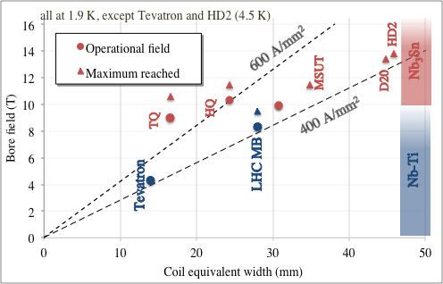
The US LHC accelerator R&D program
LARP TQ and HQ magnets proved that Nb₃Sn conductor can work at very large current densities (600-700 A/mm²)
  Here stress is not an issue (small aperture, and quadrupole)
  Protection is an issue, but these were short models – not protectable with QH only
[S. Gourlay, et al. IEEE TAS 16 (2006) 324]
TQS
HQ

Slide 15
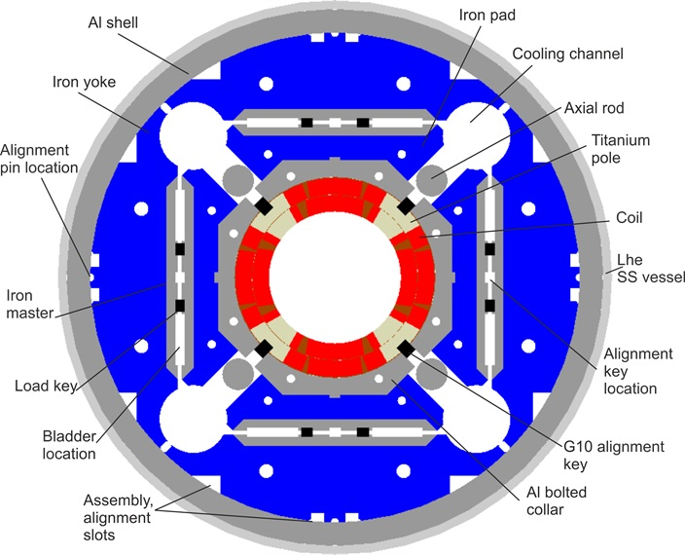
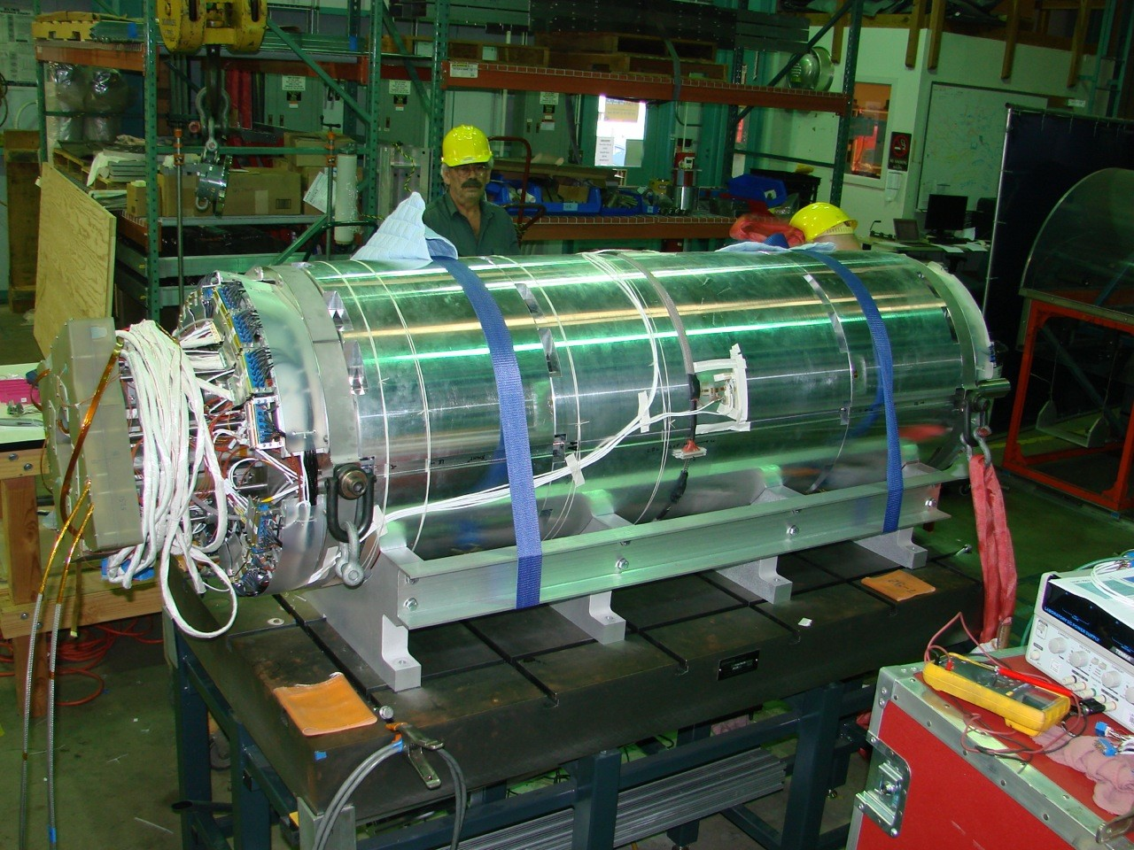

The Nb₃Sn triplet magnets MQXF
Large aperture: 150 mm diameter
    110 MPa of accumulation of stress in the midplane due to e.m. forces
US: 20 units of 4.2 m long quadrupoles
CERN: 10 units of 7.15 m long quadrupoles
Operational parameters (at 7 TeV)
  11.3 T peak field in the coil
  462 A/mm² overall j
  Operates at 77% on the loadline
Conductor: 40 strand cable, 0.85 mm strand
  High j_{c} Nb₃Sn strand RRP B-OST, 1280 A/mm² at 15 T, 4.22 K
  Production of more than 3000 km of 0.85 mm diameter strand, with cable unit lenghts of 500 m and 800 m
  [J. Fleiter, et al. 2LOr2E-03 ]
  [L. Cooley, et al. FCC week (2024) https://indico.cern.ch/event/1298458 ]
MQXF cross-section
(P. Ferracin, G. Ambrosio, et al. IEEE TAS 26 (2016))

Slide 16
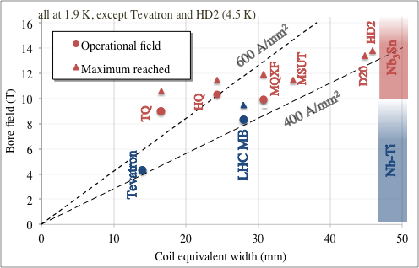
The Nb₃Sn triplet magnets MQXF
Rather large current density (460 A/mm² operational, and up to 550 A/mm2 reached), but not so large as in HQ and TQ
MQXF cross-section
(P. Ferracin, G. Ambrosio, et al. IEEE TAS 26 (2016))

Slide 17

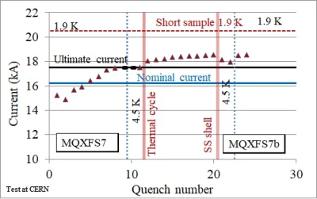
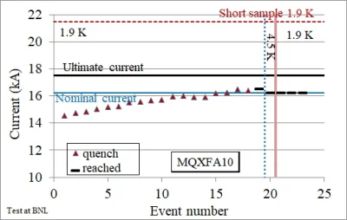
Results: reproducibility
1-m-long models: 6 reaching performance out of 7
4.2-m-long magnets:
  Two prototypes not reaching performance
  11 out of 12 series magnets reaching requirements
  (3 magnets required a coil replacement, one to be done)
  7.15-m-long magnets: [S. Izquierdo Bermudez et al. 2LOr2E-01]
  Two prototypes not reaching performance,
  4 out of 4 series magnets reaching requirements
  (issue with performance limitations has been solved)
Full statistics and timeline in the appendix

Slide 18
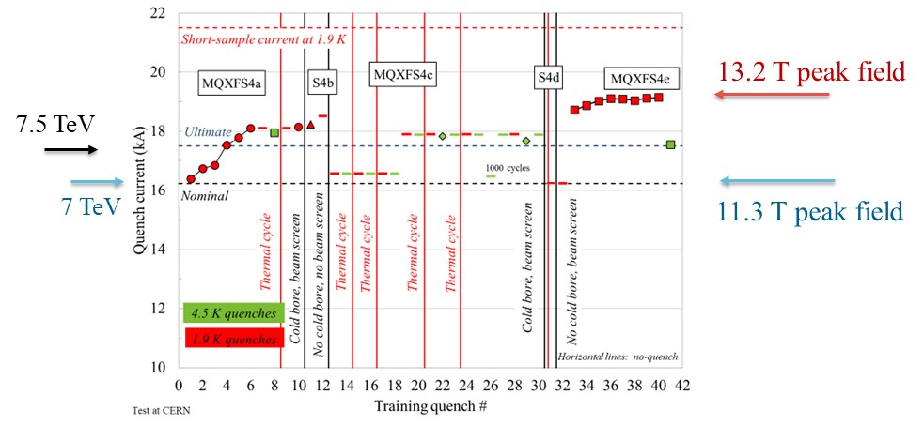
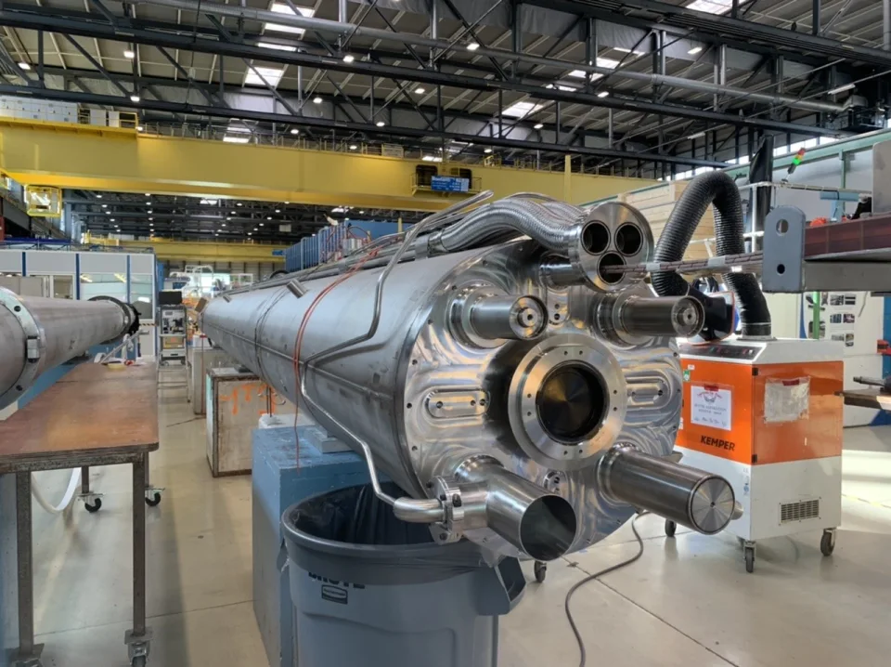
Results: operational margins
Short models
  Reached 1.5 – 2 T more than requirements (above 13 T) [F. Mangiarotti, et al. 2LOr2E-02]
  Reached systematically operational field also at 4.5 K
Long magnets are not powered above nominal
  Reached systematically operational field also at 4.5 K (>2.5 K temperature margin)
MQXFS4 test results [S. Izquierdo Bermudez, J. C. Perez, P. Ferracin, F. Mangiarotti, et al.]
One of the first 7-m.long Nb₃Sn magnets

Slide 19
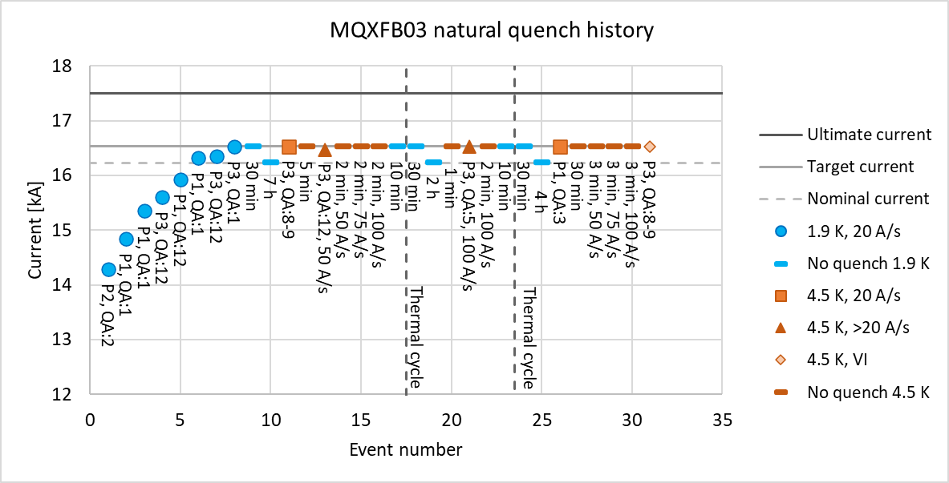
Results: training
Virgin training (1st powering after assembly)
  To reach nominal current (11.3 T peak field, 78% of loadline) usually needs 2-5 quenches in short model, 5-20 quenches in long magnets
  CERN magnets have so far a faster training
Training after thermal cycle: absent

Slide 20
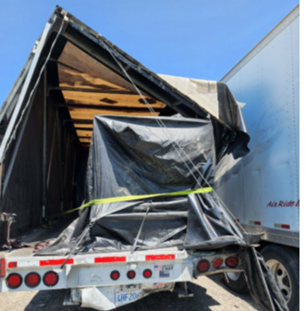

Results: endurance and resiliance
Endurance:
  Several thermal cycles both on short and on long magnets, showing no degradation
Nb₃Sn is brittle, but after impregnation and correct loading can resist well
  Accident during transport for MQXFA11, 10 g experienced, magnet reached performance
Powering test of first six conform MQXFA magnets
[J. Muratore, B. Ahia, S. Feher, G. Ambrosio et al. ]
Non conform MQXFA11 transport

Slide 21
Results: overcoming limitations
The first two 7-m-long prototypes did not reach requirements
  The following two reached requirement, but still show performance limitations at 4.5 K
  MQXFBP1 was disassembled, and longitudinally broken filaments were found in the limiting coil
  The issue was removed by not having the binder in the outer layer of the coil (note that the US collaboration kept the original baseline, not seeing this issue)
Broken filaments in coil 108, limiting MQXFBP1
[A. Moros, S. Sgobba, et al. IEEE TAS 33 (2023) 4000208]
[I. Santillana, et al. SUST 37 (2024) 085007]
MQXFB prototypes performance
[S. Izquierdo Bermudez, F. Mangiarotti, et al. IEEE TAS 33 (2023) 4001209]

Slide 22
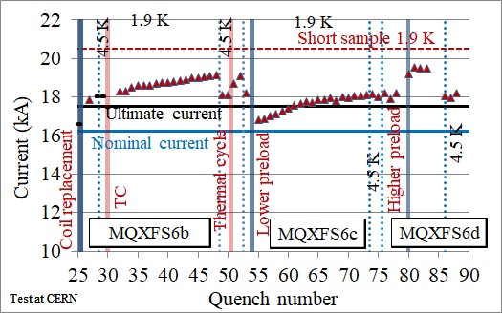
Preload matters (for cosθ)
The structure based on Al shells aims at full preload just below nominal current
  Very low preload has also been tested, corresponding to preload at 70% of nominal current: magnet was tsill able to operate at nominal current, but nearly 2 kA of maximum reachable current were lost
  (S. I. Bermudez, et al., IEEE TAS 32 (2022) 4007106)
Preload experiment on MQXFS6 (S. Izquierdo Bermudez, F. Mangiarotti, et al.)

Slide 23
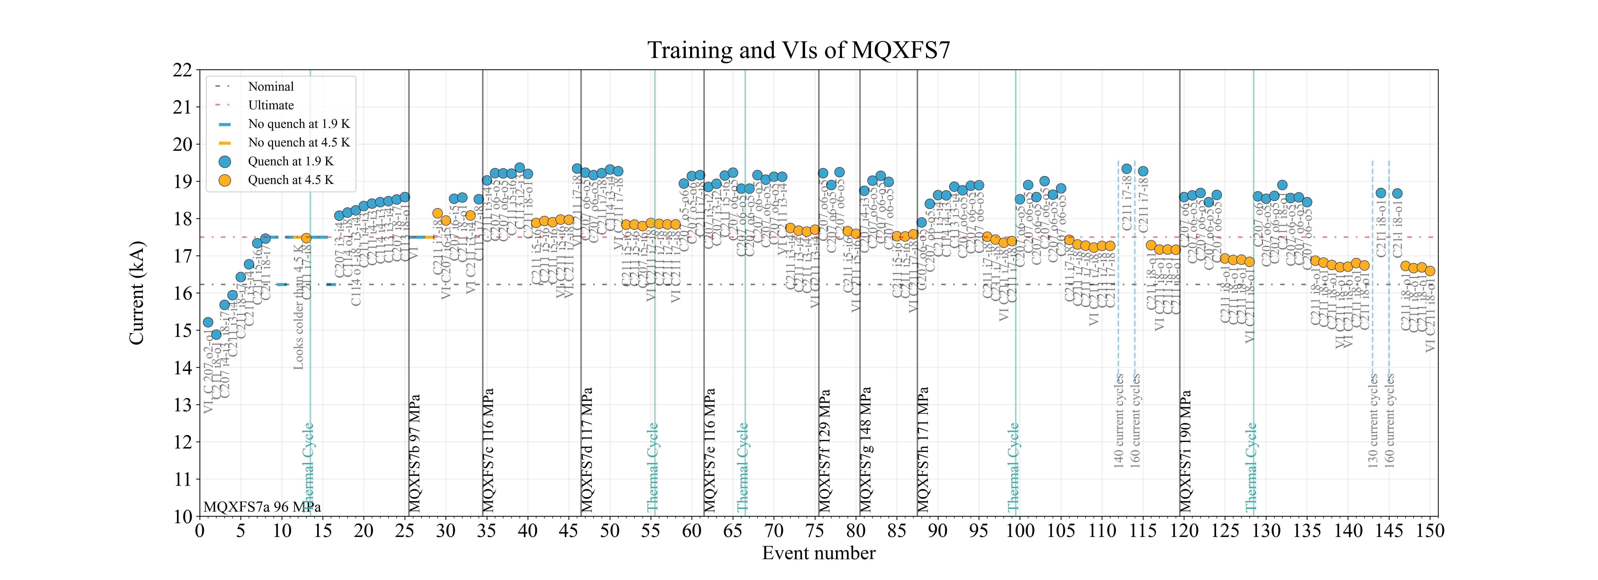
Stress limits (for cosθ)
Similar to what done in TQ magnet, higher preload were explored (up to 200 MPa)
  At 200 MPa nominal performance is still reachable, but signs of degradation in PIT coils
  Test with RRP will be done this year
90% s.s.
at 1.9 K
171 MPa
190 MPa
7 TeV
80% s.s.
at 1.9 K
96 MPa
117 MPa
148 MPa
129 MPa
E. Todesco on behalf of WP3

Slide 24
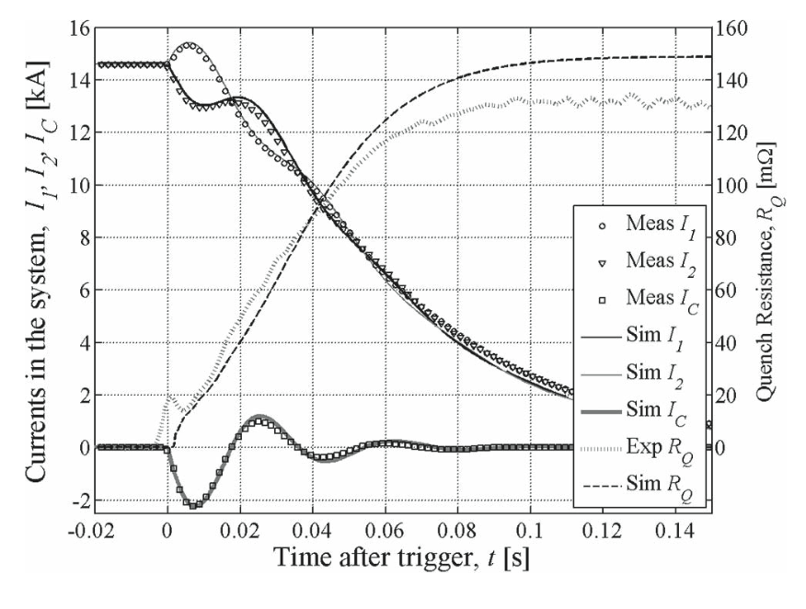
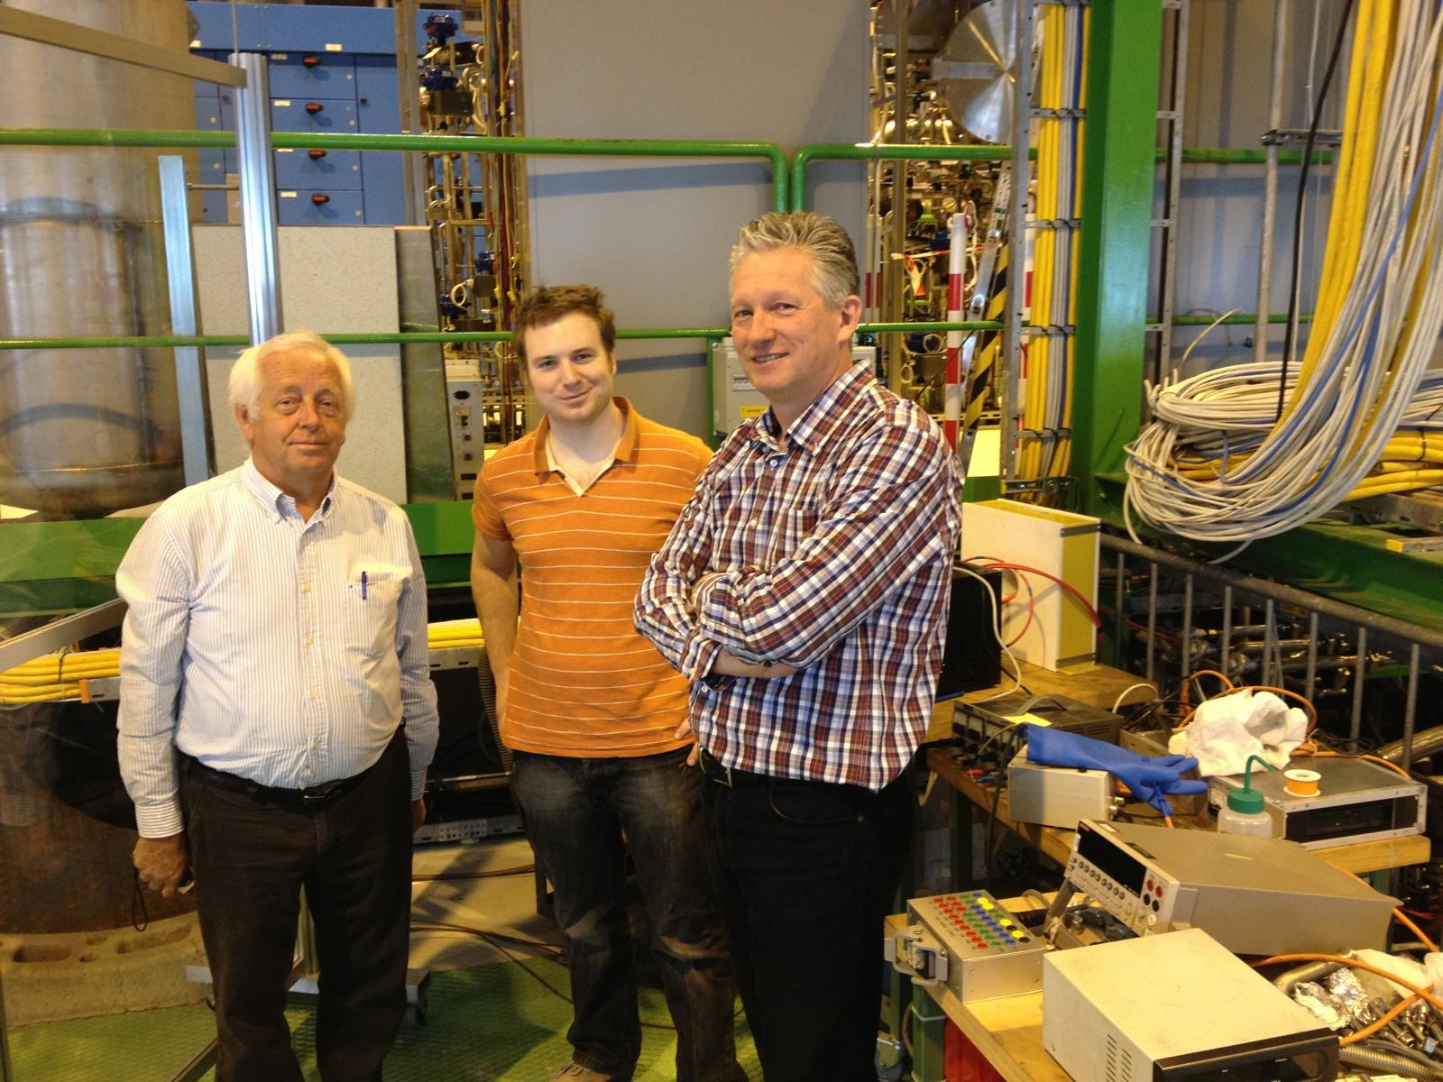
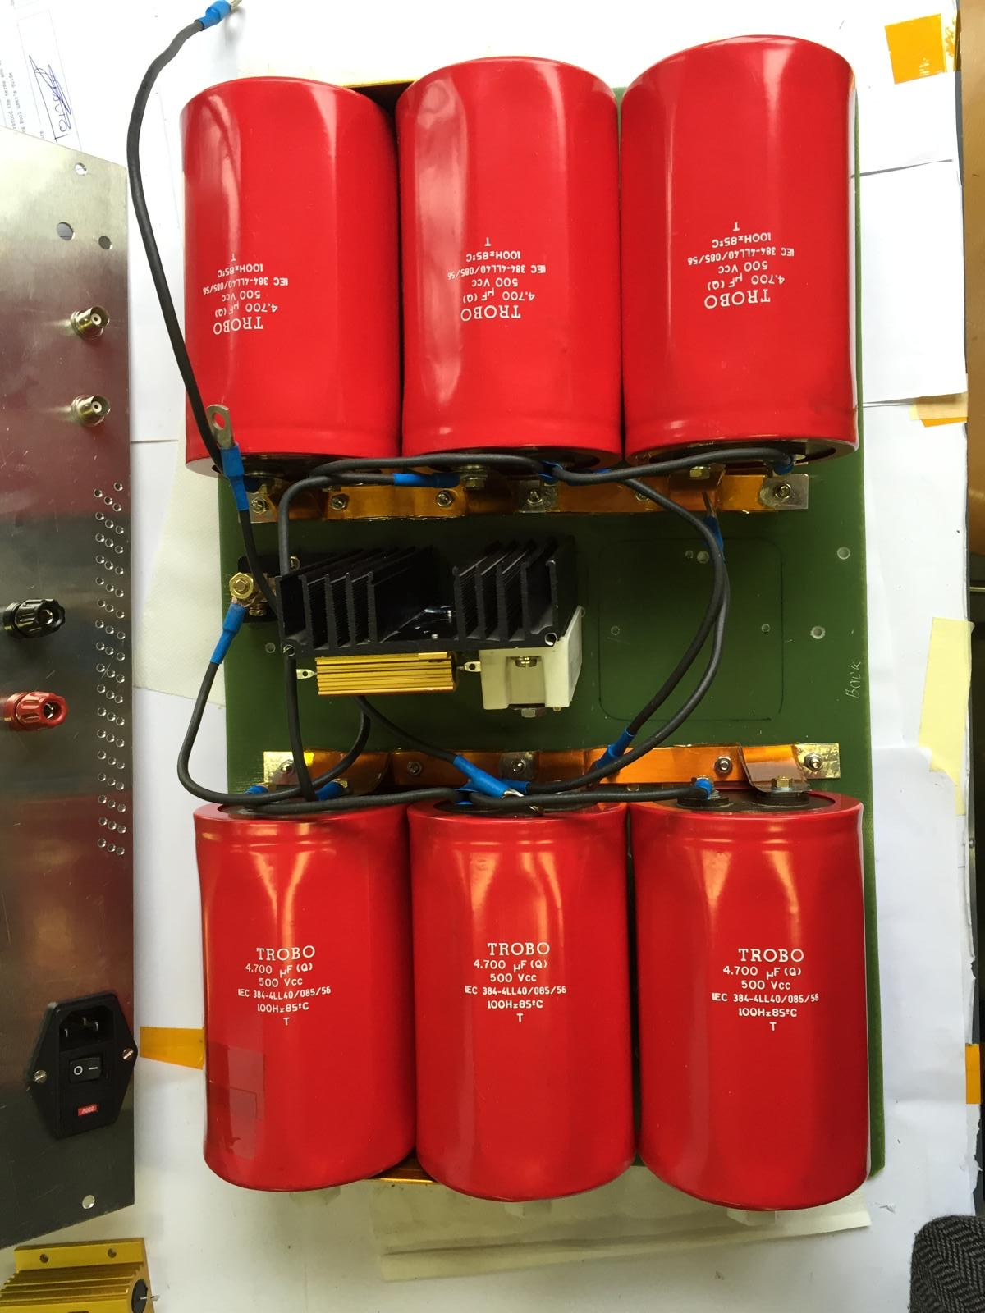
Results: new paradigm for protection
HL-LHC uses CLIQ as a protection system, together with the standard technique of outer layer quench heaters
  CLIQ units provoke a quench in the coils via the discharge of a capacitor and the ensuing current pulse
  Developed at CERN by G. Kirby, V. Datskov, and E. Ravaioli in 2013-2018
This technique also used in China to protect short models magnets for SPPC
  CLIQ discharge in MQXF magnets [E. Ravaioli, et al, IEEE TAS 25 (2015) 4001305]

Slide 25
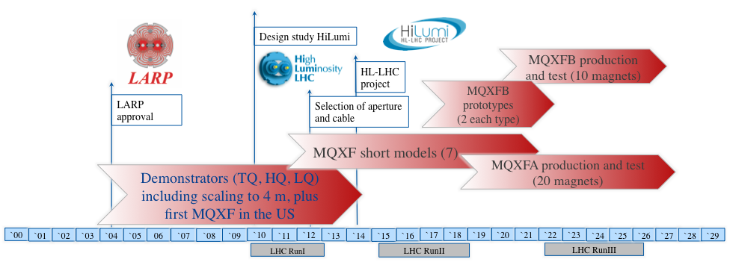
Timeline for HL-LHC
25 years from initial studies to installation - All development and production in laboratories (4 different ones: BNL, FNAL, LBNL, CERN)

Slide 26
Lessons to be taken
HL-LHC project is proving the viability of Nb₃Sn magnets with 11.5 T peak field and up to 7 m long
  30 full size magnets are being produced, with the same design, in US and at CERN: we are halfway
  Magnets are compatible for operation in the HL-LHC in terms of performance, endurance, field quality, protection, etc ..
Short models reached systematically >13 T peak field, i.e. 1.5 T more
  For preload and limits in stress, see [F. Mangiarotti, et al., 2LOr2E-02 and G. Vallone, et al. 2LOr2E-05]
Magnets built in three production lines (two in the US and one at CERN): this is the first requirement for industrialization
Synergy betweeen US and CERN has been instrumental in the project success

Slide 27
Contents
The LARP / HL-LHC MQXF Nb₃Sn age: towards mini series and long lenghts (2004-2030)
100 TeV colliders: parameters and challenges
Towards Nb₃Sn dipoles for 100 TeV colliders (2015-2050)
HTS: opportunities and challenges

Slide 28
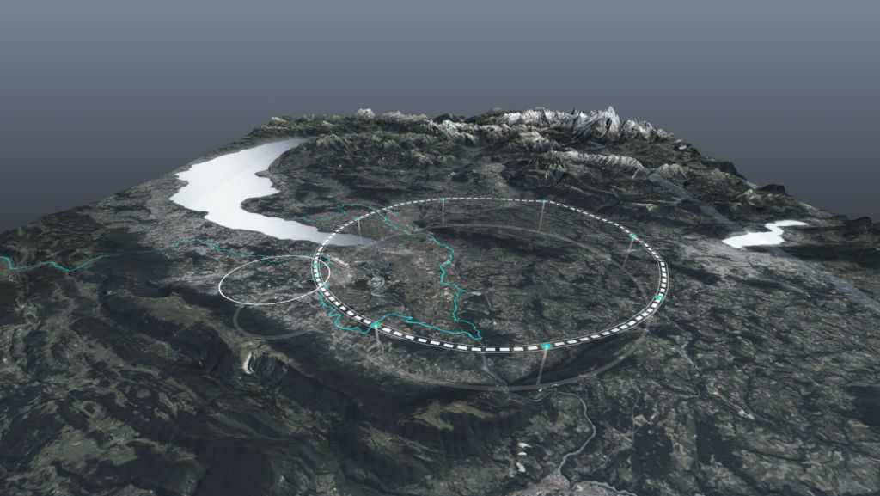
FCC-hh requirements: a 100 TeV collider at CERN
    First baseline: 16 T magnets, 100 km tunnel, 100 TeV [M. Benedikt, et al., FCC-hh CDR, EPJST 228 (2019)]
Nb₃Sn option for FCC-hh: a proton-proton collider for 90 TeV c.o.m energy in a 91 km tunnel, based on 14 T operational field magnets
  Magnets should prove to be able to reach 15-15.5 T in standalone tests
  Similar as in the LHC, started with 8 TeV and 10 T, ended in 7 TeV and 8.3 T
An 100-120 TeV option based on HTS is also proposed (see last part), with 16-20 T field
FCC-hh parameters | CDR 2019 | 2024-Nb₃Sn | 2024-HTS
Dipole field (T) | 16.0 | 14.0 | 16-20
Tunnel length (km) | 100 | 90.7 | 90.7
Arc length (km) | 82.0 | 76.9 | 76.9
Arc filling factor (adim) | 0.80 | 0.87 | 0.85
Energy c.o.m (TeV) | 100 | 90 | 100-125
Loadline margin | 86% | 80% | TBD

Slide 29
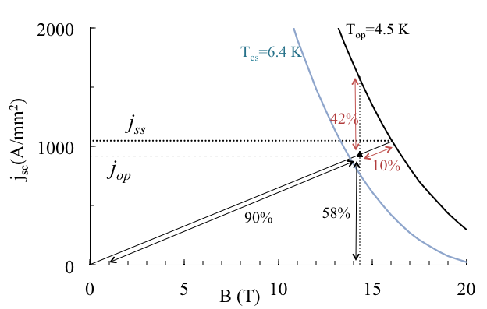
Options for FCC-hh
  First option: 4.5 K operation
  HL LHC quadrupoles show that, being designed at 78% of loadline fraction at 1.9 K, they can also operate at 4.5 K (at 90% of loadline)
  Is it possible to imagine the whole machine at 4.5 K, and 90% of loadline at 4.5 K ? (looks very challenging !)
Advantages
  30% reduction of power consumption
  One could think about dry magnets
  (not complelety filled with LHe)
  to reduce He inventory: looks very
  challenging for protection, as LHe
  is good insulator !)

Slide 30
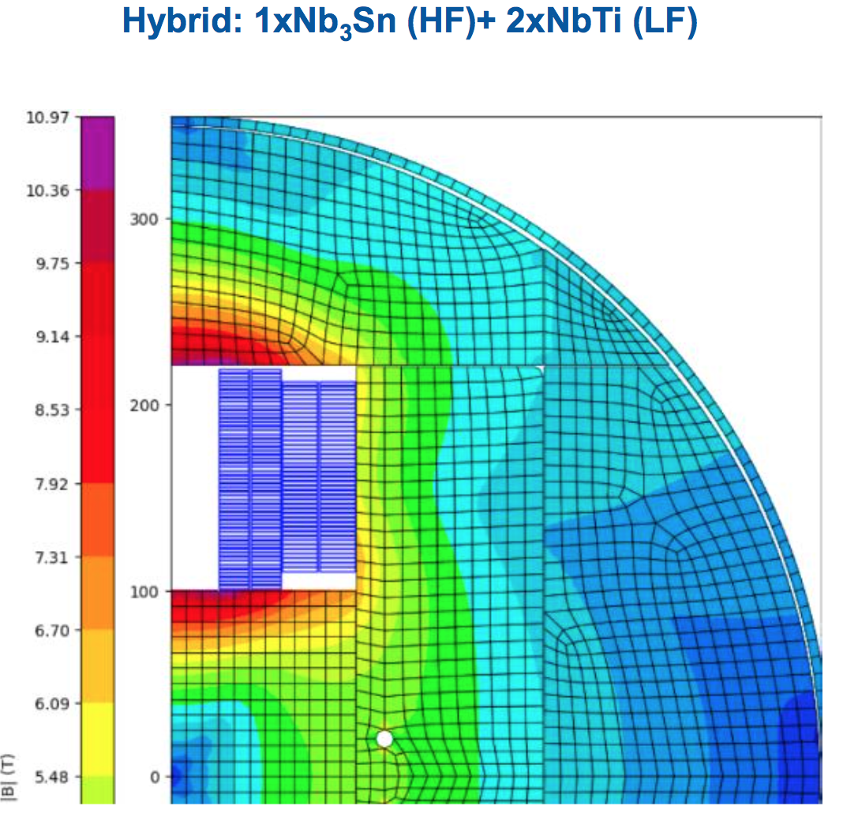
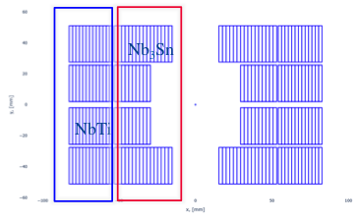
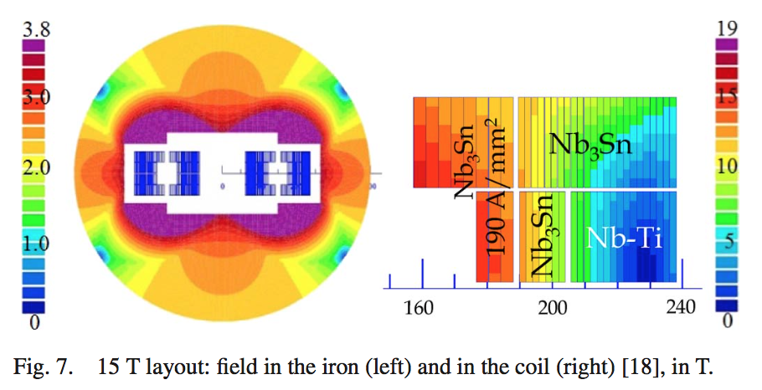
Options for FCC-hh
  Second option: hybrid magnets
  At 14 T, a large part of the coil is below 8.5 T: it can be replaced by Nb-Ti (much cheaper)
Advantages
  30-50% reduction of cost of conductor
Hybrid option succesfully used in common coil magnet LPF1 from IHEP
  Easy in a common coil, more complex in block coil and cosθ
15 T dipole for HE-LHC
[E. Todesco, et al., IEEE 24 (2014)]
Hybrid Nb₃Sn / Nb-Ti BONDh 14 T dipole
[A. Haziot, et al.]
Hybrid Nb₃Sn / Nb-Ti DAISY 12 T dipole
[F. Toral, et al., IEEE 2025]

Slide 31
Options for FCC-hh
  Third option: 12 T magnets
  This would give 73 TeV c.o.m – 14% reduction of energy, but 20-25% less expensive magnet
  Advantages
    30% reduction of conductor mass and cost
    Very close to the level achieved for the 11 T
Fourth option: 20 m long magnets
  Appears challenging, but LHC started with 9 m long magnets and 10 T, and ended with 8.3 T and 15 m long magnets
  Advantages:
    30% less magnets (1200 less magnets !) – shorter production time, less tests …
    Increase in filling factor → 3.5% more energy or 3.5% less field

Slide 32
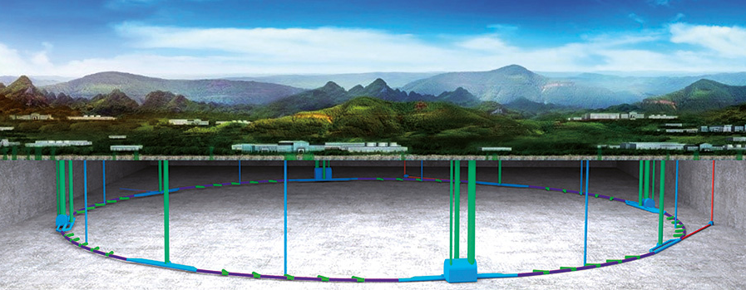
SPPC requirements: a 100 TeV collider in China
A 100 km tunnel, initially with two options for the main dipoles [CDR of 2019]
  A 12 T magnet based on Nb₃Sn (and common coil design)
  A 20-24 T magnet based on HTS (IBS or REBCO conductor)
Updated version of CDR: 100 TeV with a 20 T magnet based on Nb₃Sn and HTS, with a common coil geometry http://cepc.ihep.ac.cn/CEPC_tdr.pdf
  13 T given by Nb₃Sn
  7 T by HTS insert (REBCO or IBS)
SPPC parameters | Nb₃Sn (2019) | HTS (2019) | Nb₃Sn/HTS (2023)
Dipole field (T) | 12.0 | 20-24 | 20 (13+7)
Tunnel length (km) | 100 | 100 | 100
Arc length (km) | 81.8 | 81.8 | 81.8
Arc filling factor (adim) | 0.79 | 0.79 | 0.79
Energy c.o.m (TeV) | 75 | 125-150 | 125

Slide 33
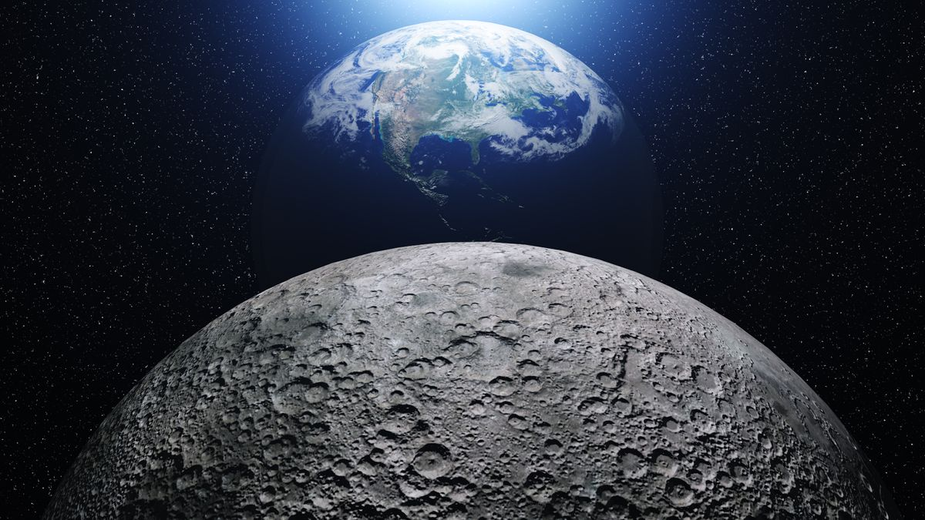
Superconductor needs
Order of 0.5 to 1 TA m: half to one million of km of cable carrying 1 kA
  Equivalent to 1 kA superconducting cable/wire connecting 1.5 to 3 times the distance of the Earth to the Moon
 |  | Energy c.o.m. | Field | Current density | Ampere turns per meter of magnet | Magnet lenght | Number of magnets | Total
 |  | (TeV) | (T) |  | (A) | (m) | (adim) | (TA m)
LHC | Nb-Ti | 7.0 | 8.3 | 380/480 | 3800 | 14.3 | 1232 | 0.067
FCC-hh | Nb₃Sn | 90 | 14 | 360 | ~8000 | 14.3 | ~4500 | ~0.5
FCC-hh | HTS | 125 | 20 | 400 | ~14000 | 14.3 | ~4500 | ~0.9
SPPC | HTS | 125 | 20 | ~400 | ~14000 | 14.3 | ~4500 | ~0.9

Slide 34
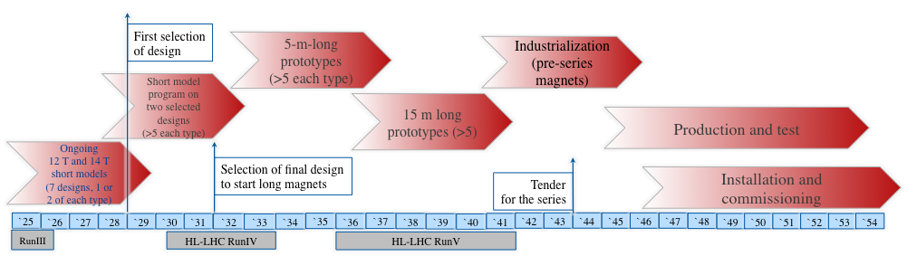
Timeline for FCC-hh
Select the design by the end of LS3 (we should start having some indications from tests in 2026-2027)
Have a full short model program to verify reproducibility and margins in 2029-2031
Scaling in length in two steps
Industrialization for final magnets, with preseries
9 years of production, installation and commissioning in parallel

Slide 35
Contents
The LARP / HL-LHC MQXF Nb₃Sn age: towards mini series and long lenghts (2004-2030)
100 TeV colliders: parameters and challenges
Towards Nb₃Sn dipoles for 100 TeV colliders (2015-2050)
HTS: opportunities and challenges

Slide 36

Contents
2015 to 2050:
magnets for colliders towards 100 TeV
8 T LHC Nb-Ti dipoles
First solenoids
ISR
Tevatron 4.3 T Nb-Ti dipoles
CERN Elin Nb₃Sn 9.5 T
1960
1970
1980
1990
2000
2010
2020
2030
2040
2050

Slide 37


Three programs
MDP - US
  Generic R&D for high field dipoles for HEP
  20 T target, stress management design, reduction of training, operating towards ss
  Hybrid magnets HTS/Nb₃Sn
  >14 T proved with Nb₃Sn, but followed by degradation
EuroCirCol, followed by HFM programme - CERN
  Direct R&D for 14 T Nb₃Sn dipoles for FCC-hh
  Direct R&D for 16-20 T dipoles with HTS (hybrid or not)
  Focus on sustainability, and cost
  >16 T field proved in a magnet with 50 mm aperture but without flared ends
IHEP programme - China
  Direct R&D for 20 T dipoles for SPPC
  4.5 K operational temperature, hybrid Nb₃Sn/HTS, common coil
  12.5 T reached with 14 mm aperture diameter, common coil, racetracks
Programme
Programme

Slide 38
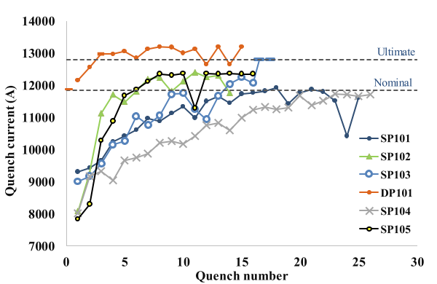
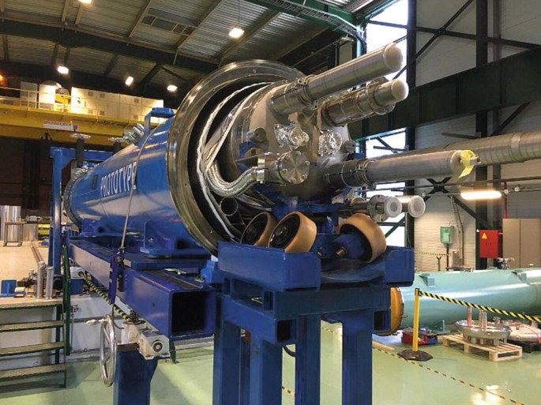
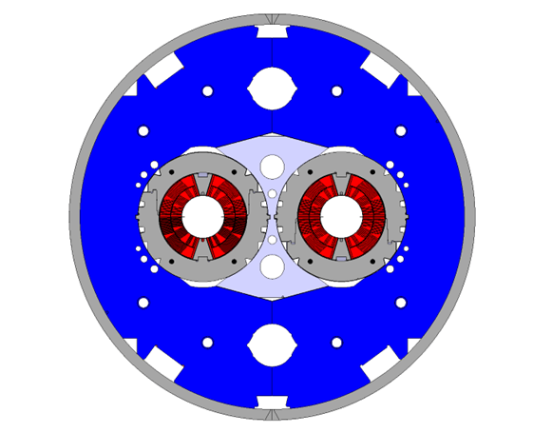
Cosθ designs
2011-2021: 11 T (CERN and FNAL)
  Efficient magnet with 490 A/mm² overall current density
  Some short models reached 12 T bore field, but with lack of reproducibility [see C. Abad Cabrera et al., 4LOr2E-06]
  First two-in-one Nb₃Sn dipole
  First Nb₃Sn dipole with all features for integration in an accelerator
  CERN made first scaling to 5.5 m, reaching >11 T, but many magnets showed performance degradation
12.0 T
11.3 T
[G. Willering, et al. IEEE TAS 28 (2018) 4007205]
[M. Karppinen, et al. IEEE TAS 22 (2012) 4901504]
[S. Zolbin, et al. IEEE TAS 25 (2015) 4002209]

Slide 39
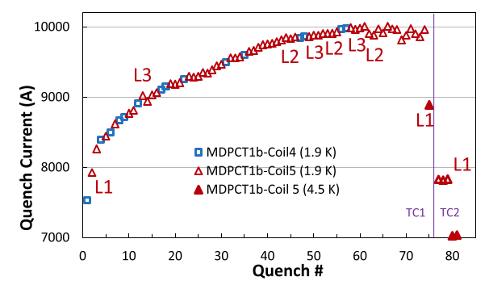
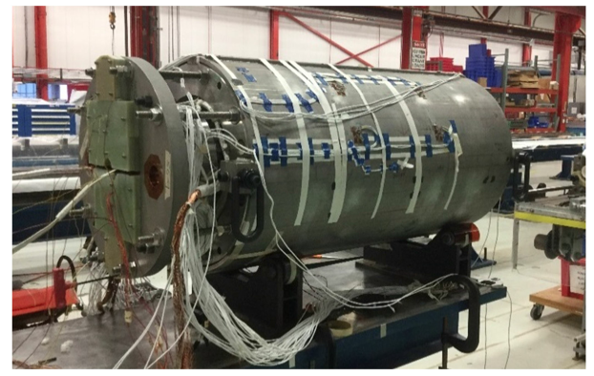
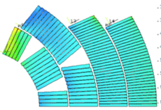
Cosθ designs
2015-2020: MDPCT1 (FNAL) a four layer cosθ magnet
  World record of 14.0 T at 4.5 K, level also reached at 1.9 K – first magnet above 14 T with « reasonable » coil width (50 mm) – long training
  But: severe degradation after thermal cycle
FNAL abandoned this path, in EU this line is continued
  A two layer cosθ magnet aiming at 12 T at INFN and CERN, test foreseen in 2026
  A four layer cosθ magnet aiming at 14 T at INFN, test in 2029
14 T
Power tests of MDPCT1 [S. Stoynev, et al. IEEE TAS 32 (2022) 4000705]

Slide 40
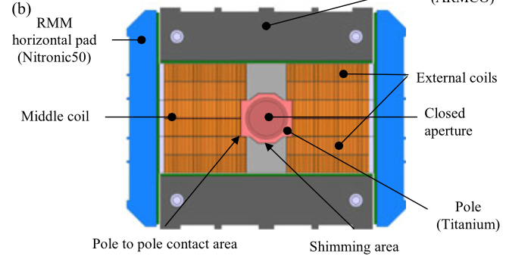
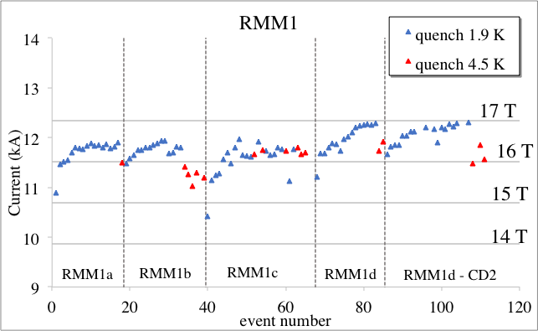
Block design
2015-2023: RMM is a block magnet, without flared ends, that reached 16.9 T bore field in 50 mm aperture (but the coil is huge, not afforable for accelerator, as in FRESCA2)
  No training to 15 T !
Planned magnets (test in >2025)
  A double layer 14 T dipole «a la HD2» developed at CERN
  A four layer 14 T dipole «a la Fresca2» developed at CEA, but with grading
    RMM cross-section [S. Izquierdo Bermudez, et al. IEEE TAS 27 (2017) 4002004]
    RMM powering J. C. Perez, G. Willering, et al.

Slide 41
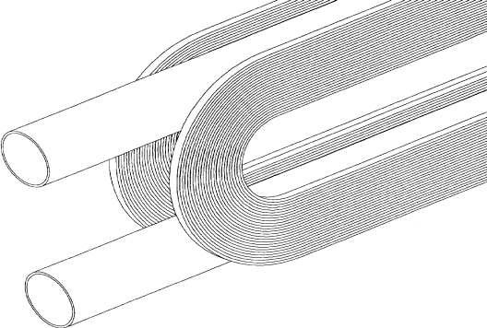
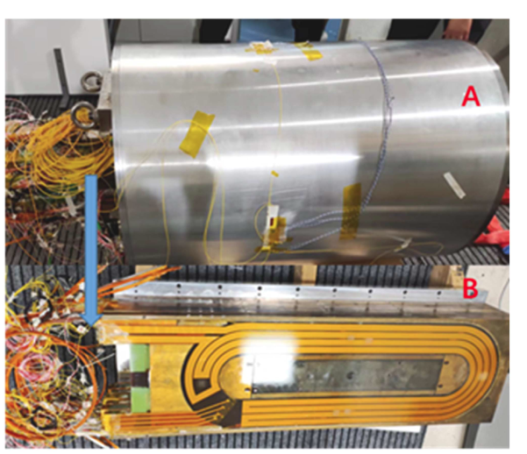
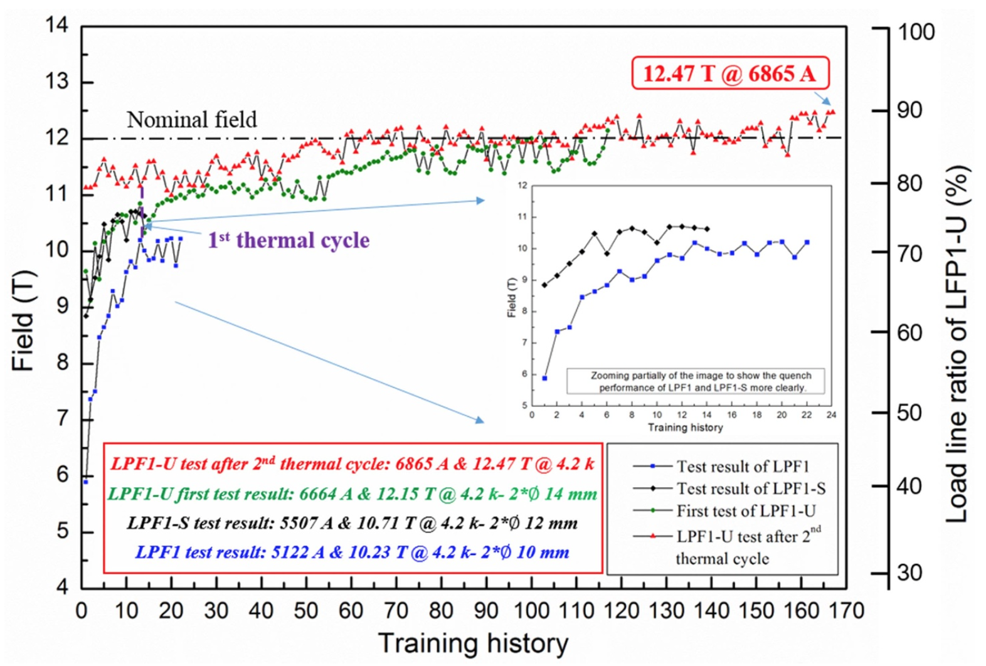
Common coil
IHEP has chosen the common coil design
  Steps aiming at final 20 T increasing field and aperture
  2018-2023 LFP1: 12.5 T reached within 14 mm aperture
    ]
Ongoing or planned
  IHEP is building LFP3
  CIEMAT plans a 14 T common coil with Nb₃Sn only (see also C. Martins, 1LPO1G-08)
Common coil design [R. Gupta, IPAC 1997 3344]
LFP3 magnet [J. Shi, Q. Xu, et al., IEEE TAS 34 (2024) 4701405]
    LPF1 training [C. Wang, et al., SUST 36 (2023) 065006]

Slide 42
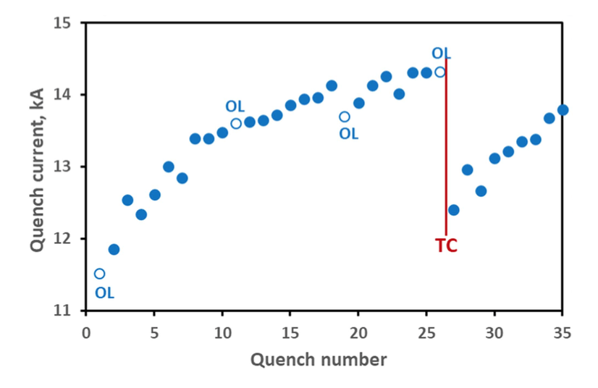
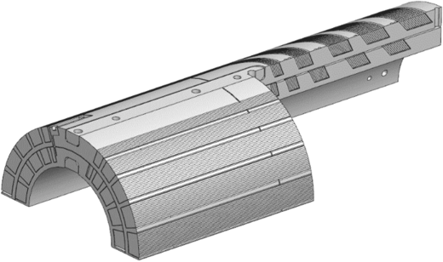
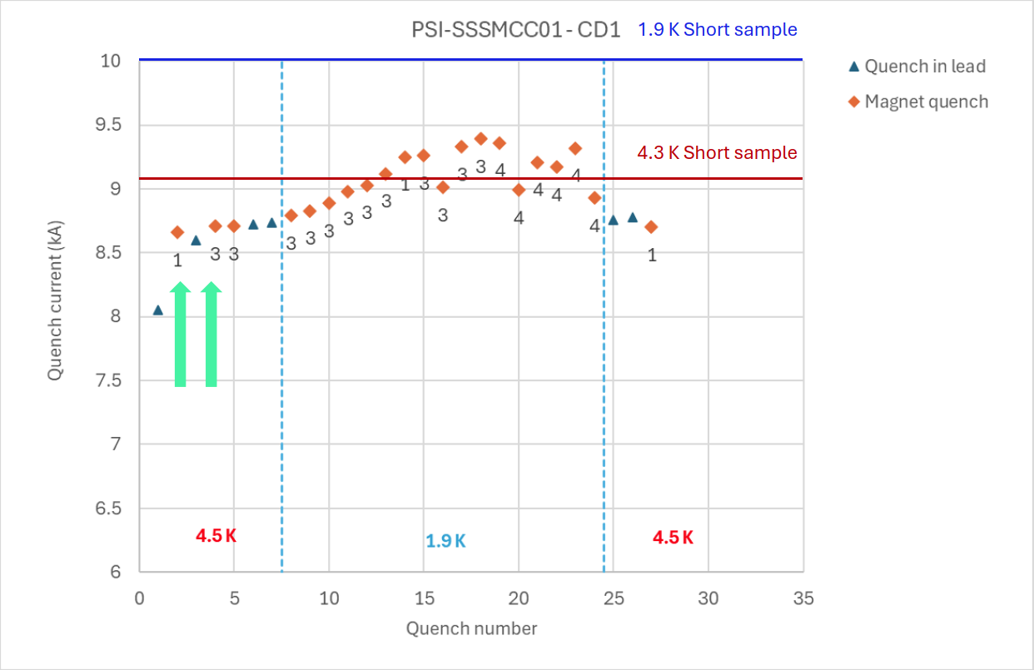

Stress management: cosθ and common coil
12.7 T peak field
Stress management consists in mixing the coil and the structure
  Advantage: (i) Stress is intercepted at each block of conductors and (ii) the structure enthalpy can contribute to protection
  Possible disadvantage: preload is not (or only partially)
FNAL: SMCT (stress managed cos theta)
  Cables blocks are wound in a former
  Cos theta configuration with radial and
  azimuthal stress interception
  Mirror reached 12.7 T peak field (87% ss))
PSI: SMCC (stress managed common coil)
  Racetracks wound in a former
  Subscale reached 7 T peak field
  Full scale magnet in 2025-2026
10.0 T peak field
[A. Zlobin, 4LOr2E-01] I. Novitski, et al. IEEE TAS 34 (2024) 4001305]
[D. Araujo, et al. ASC 2024]

Slide 43





Full stress management: CCT
Canted cos theta is the extreme case of stress management
  Winding on a former following the shape of a tilted solenoid: each cable turn is supportetd by the structure [D. Meyer, R. Flask, NIM (1970)] : less efficient use of conductor, but a modular design, allowing adding layers
LBNL worked on this design since 2010
  CCT5 in Nb₃Sn: 8.5 T in 90 mm aperture
  [D. Arbealez, et al. IEEE TAS 32 (2022) 4003207]
PSI reached 10.1 T in a 66 mm aperture
  Using Nb₃Sn, design based on CCT5
  [B. Auchmann, et al. IEEE TAS 34 (2024) 4000906]
MDP is also building HTS magnets
  1.5 T reached with Bi2212 CCT in 31 mm ap.
  2.9 T with REBCO CCT in 65 mm ap. (LBNL)
  1.5 T with REBCO COMB (FNAL)
  [P. Ferracin, et al. 4LOr1B-01]

Slide 44

Summarizing
Demonstrators
Stress managed

Slide 45
Lessons to be taken
Stress managed structures are a new paradigm, mixing structure and coil : this allows avoiding stress accumulation and could ease protection since the structure could take part of the energy and increase the current density
  However, you lose the possibility of preloading the coil → training can become an issue
  Stress management can allow to use higher current densities, i.e go to more efficient magnets
  At 20 T stress managed magnets are mandatory: US-MDP and PSI are investing on this option
Up to 14 T operational field stress interception (management) is not mandatory, but can provide precious additional margin for a long production as for SPPC or FCC-hh
The worldwide efforts are focussed on different designs
Continuous (order of >10 years) and coherent efforts are the key to success

Slide 46
Contents
Features of superconducting magnets for accelerators
35 years of Nb₃Sn dipole magnets for accelerators: from 10 to 14 T
The HL-LHC achievements
Nb₃Sn dipoles for 100 TeV colliders
HTS: opportunities and challenges

Slide 47

The ideal superconductor would have …
… a critical current that does not decrease with field
… a critical current that does not increase at lower fields (to reduce hysteresis, persistent currents)
… 1500 A/mm² (just what is needed, nothing more) at high temperatures
Ideal superconductor,
at temperatures >> 70 K
[Raffaello et al., The School of Athens,
detail, Musei Vaticani (1510)]
… and
Cheap: 5 $/(kA m)
Stress resistent at least up to 200 MPa
Available in long (km) lengths

Slide 48

The ideal superconductor for accelerator magnets
… a critical current that does not decrease with field
… a critical current that does not increase at lower fields (to reduce hysteresis, persistent currents)
… 1500 A/mm² (just what is needed, nothing more) at high temperatures
HTS are the ideal superconductor ?
[Raffaello et al., The School of Athens,
detail, Musei Vaticani (1510)]
… and
Cheap: 5 $/(kA m)
Stress resistent at least up to 200 MPa
Available in long (km) lenghts
[courtesy of P. Lee]

Slide 49
Three conductors for HTS
BSSCO 2212 (mainly developed in the USA [T. Shen, 3MOr1A-01] )
  Available in round strand, dipole magnets reaching 1.5 T have been done in LBNL (1.5 T)
  Expensive, complicated manufacturing process (more than Nb₃Sn): reaction at 800 C (in 100 bar of O₂ ?)
  REBCO (a hope for a very fast track to fusion, [see plenary talk at ASC of D. Dunn])
  Recently, large reduction of cost, but still one order of magnitude above what neeed in the unfavorable direction, and with limited lengths
  Available in tape, cable geometries are being considered (Roebel, Corc®, Star ®)
  Hysteresis losses can be a showstopper: the filament is the tape width
  IBS (strong impulse from China) [see plenary talk at ASC of K. Iida]
  Critical current is improving
  Potentially cheaper than REBCO

Slide 50


Two options: hybrid or full HTS ?
All-HTS coil open the possibility of 20 K operation, which could consume less energy
  Beware of drawing conclusions on sustainability … it is a very complex computation that is notalways not totally intuitive – cost of HTS at 20 K is 2-3 times the cost at 4.5 K
«Hybrid» makes use of HTS in higher field regions, and of cheaper Nb₃Sn up to 15 T
  This option is being developed in the US by MDP, and in China by IHEP
Hybrid design for 20 T magnet
[P. Ferracin, et al, IEEE TAS 33 (2023) 4002007
and 4LOr1B-01]
Hybrid design for 20 T magnet
[Q. Xu, et al, CEPC design report, pg 749]

Slide 51



The challenge of hysteresis for tapes
The larger temperature margin and lower j at low field, allows stability with very large filaments in one direction (up to 12 mm)
Hysteretic losses, that are today critical for the FCC-hh (target of 5 kJ/m is given), can be a showstopper in this case
In case of HTS insert, both common coil and cosθ have the cables perpendicular to the field: the ideal is the block, where they are parallel
Feather magnet tested in 2017
had block aligned: it reached 4.5 T
[L. Rossi, et al, Instruments 5 (2021) ]
Is REBCO tape a viable conductor for
HEP main dipole magnets ?
[see talk of R. Kang]
Aligned block design in Feather
[J. van Nugteren, G. Kirby, et al,
IEEE TAS 25 (2015) 4000705]
First powering of Feather
[L. Rossi, et al, IEEE TAS 28 (2018) 4001810]

Slide 52

The challenge of protection and detection
Thanks to the larger temperature margin the quench velocity in HTS is very small – detecting the quench is troublesome and takes much more time than in LTS
Moreover: magnetic pressure energy density enthalpy
Three strategies
  Have the structure participating to the removal of the heat (as in stress managed magnets?)
  Invent a cheap extraction system for long magnets that can be applied to every magnet
  [see ESC system, E. Raxaioli, et al, 1LPo1G-01]
  Avoid quench
Field | Pressure | Energy density
B (T) | B²/2μ (MPa) | B²/2μ (J/mm³)
5 | 10 | 0.010
10 | 40 | 0.040
15 | 90 | 0.090
20 | 160 | 0.160
  [see T. Salmi, et al, 1LPo1I-04]

Slide 53
Lessons to be taken
HTS opens a path towards operational fields higher than 15 T and higher operational temperatures
  This could also open the possibility of simpler cryogenic systems, and be more economical – however the global optimization of the systen is not trivial
Today the adaptability of present state of the art of HTS tapes to main magnets for HEP accelerators is not proven
  A large current cable, windable, is needed – many efforts in the past years but a clear solution is not yet available
  We are not sure that the conductor itself is viable for very special requirements needed by HEP applications – is the hysteresis due to large filaments a showstopper ?
  Field quality still very far from requirements
  Protection at 20 T requires new paradigms
The 20 T target makes us enter in «new physics», requiring a well defined strategy to prove within 5-10 years if HTS is a viable technology for HEP

Slide 54
Some personal final remarks
There is no free lunch: every tesla is gained with lot of effort, time, and technical advancements
Since our research timelines are very long, collaboration in space and in time between different teams is needed – competition does not work, joining the efforts is much more effective
To handle information between generations and between labs, journals (and conferences) are fundamental: (i) write, even about setbacks (ii) travel (iii) read, read, read … and forget, and then read again
Long time ago, colleagues were building magnets without computer codes: analytical methods are an essential tool that can give a lot of insight

Slide 55

Thanks !
First Nb₃Sn quadrupole made in the US after reception at CERN, December 2023

