Slide 1
SRF technology: LLRF and RF operation
Feng Qiu, on behalf of LLRF grp of IMP & KEK
Institute of Modern Physics (IMP), Chinese Academy of Science

Slide 2
01
Introduction
02
LLRF Basics
CONTENTS
03
Operation Activities

Slide 3

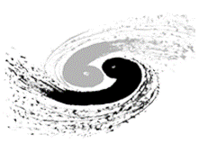



Self Introduction
F. Qiu, Senior Staff Scientist, Affiliation: Institute of Modern Physics (IMP), China
  PhD degree @ IHEP (Beijing), Assistant Prof. @ KEK (previous affiliation)
Research Direction
LLRF Control Algorithm
Application of AI-technique in ACCLs
2007-2012，IHEP, PhD
2020/12 @ IMP, Staff Scientist
2020/11, from KEK to IMP
From 2025
2012-2020，KEK, RF grp.， Assistant Prof.（Permanent）
2025, China initiative ADS （CiADS）
2
Notes:
I obtained my PhD degree from the IHEP in 2012. Afterward, I came to Japan and worked as a postdoctoral researcher at KEK. In 2014, I was promoted to the position of Assistant Professor. In 2020, I transitioned from KEK to work at the IMP. Currently, I hold the position of staff at IMP. In the next year, we will move to the southern China to attend the China initiative ADS project.

Slide 4
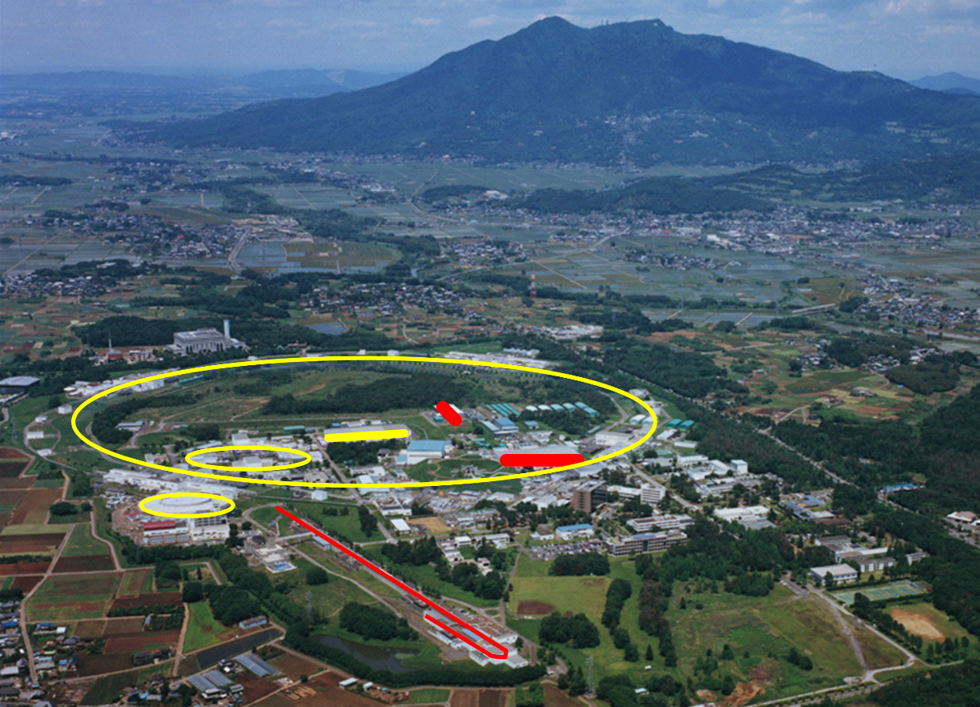
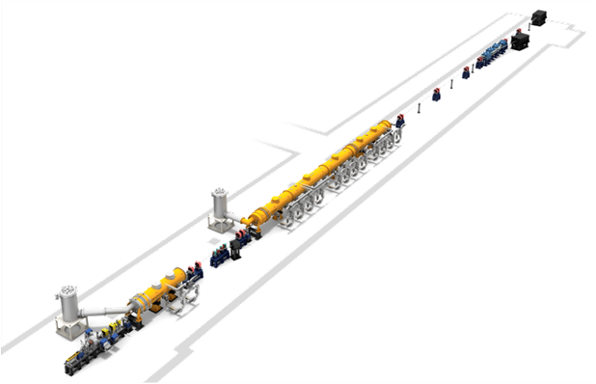

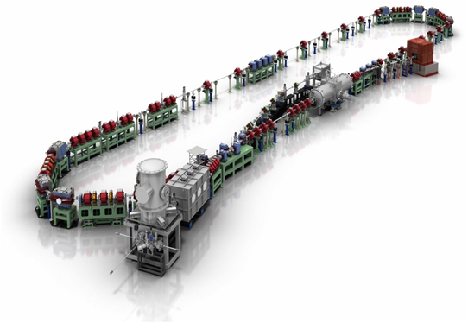
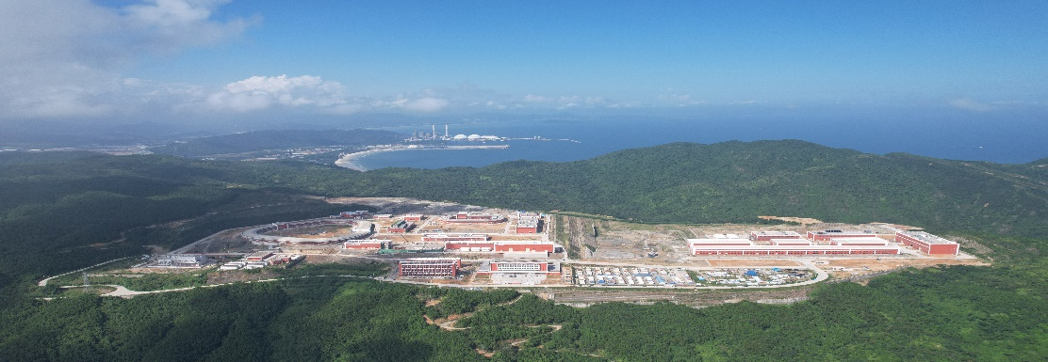
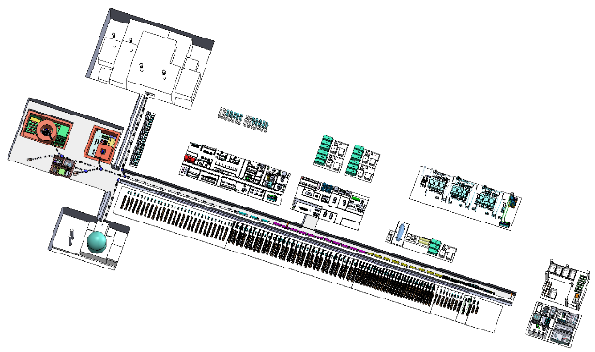
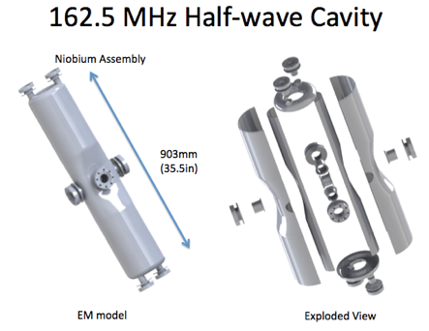
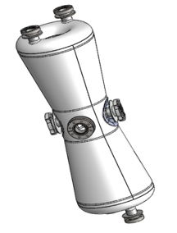
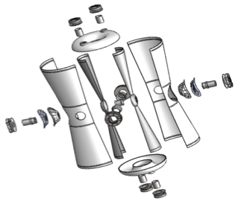
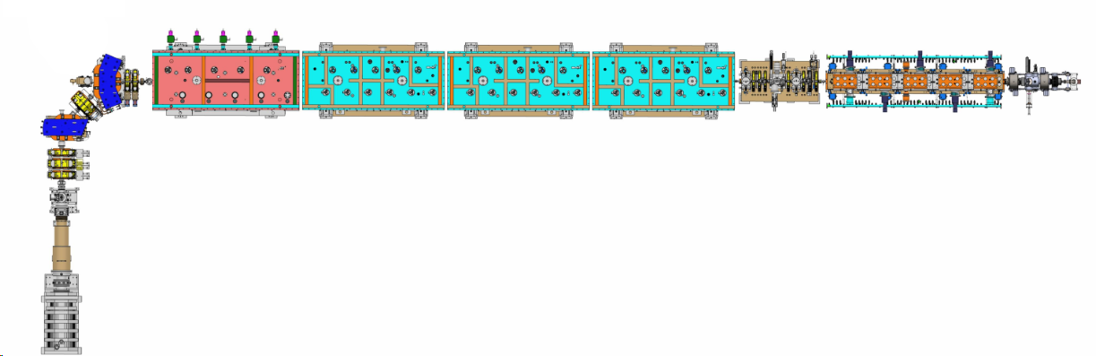
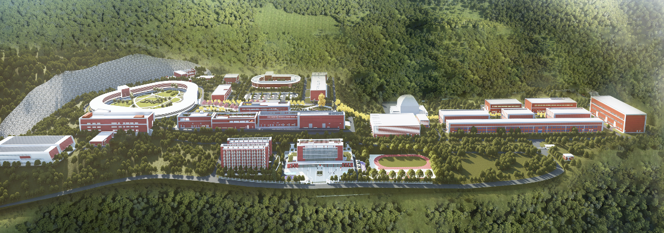
Self Introduction (cont’d)
Main project involved: cERL and STF @ KEK; CiADS (& its prototype facility: CAFe) @ IMP
KEK
STF（Superconducting test-facility）
Cav | Q_{L} | RF Source
Bun | 1.1e5 | 8 kW SSA
Inj₁ | 1.2e6 | 25 kW Kly.
Inj₂ | 5.8e5 | 300 kW Kly.
Inj₃ | 4.8e5
ML₁ | 1.3e7 | 8 kW SSA
ML₂ | 1.0e7 | 16 kW SSA
@Tsukuba
Mont. Tsukuba
SRF
cERL (compact ERL)
~20 MeV
KEKB-LINAC
SRF
cERL 1.3 GHz, CW
CiADS
@Huizhou
Sep. 2023
CiADS
~20 MeV, 10 mA
1 RFQ+ 23 SC
Q_{L}: 5e5~1e6
10 kW SSA
Aerial View
SRF
Architectural Rendering
RFQ
HWR₀₁₀ (β=0.1)
HWR₀₁₅ (β=0.1)
Linac Prototype
HIAF (High Intensity heavy-ion Accl. Facility)
CAFe (Chinese ADS Front-end), 162.5 MHz, CW
3
Notes:
In KEK, I was

Slide 5
What is RF system?
  The Radio Frequency (RF) systems in particle accelerators are responsible for generating and controlling the electromagnetic fields that accelerate charged particles
  These systems are broadly categorized into high-power RF system—such as RF power sources and high-power couplers—and Low-Level RF (LLRF) systems
RF
Target
Low-energy beam
RF source
High-energy beam
Coupler
GUN
RF cavity
Beam Acceleration
4
Notes:
The primary function of the Low-Level RF (LLRF) system is to stabilize the accelerating field using feedback control within a specified tolerance. Meanwhile, the main role of the high-power RF system is to efficiently deliver RF power from the RF source to the RF cavity with minimal reflection.

Slide 6

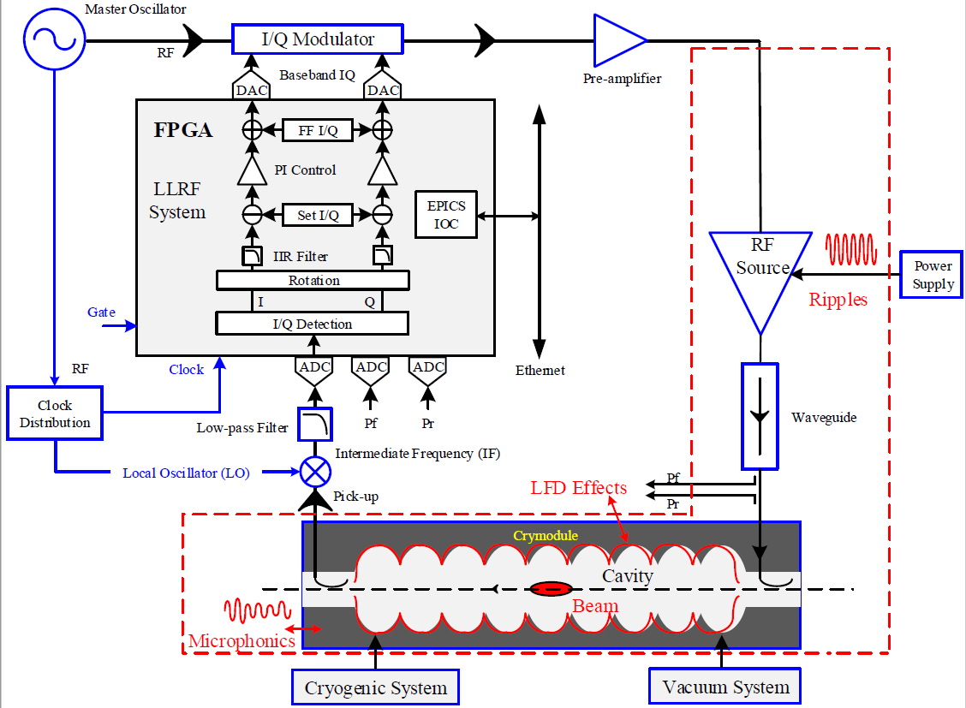
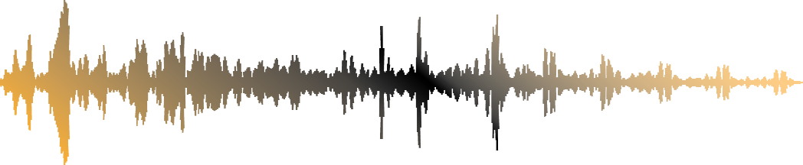
What is LLRF?
  LLRF systems precisely regulate the amplitude and phase of these fields with feedback (FB) to ensure stable and efficient accelerator operation.
Stabilize the acc. field with feedback with specified tolerance
LLRF
Kly.
RF signals (cavity pick-up）
Deliver power from RF source to RF cavity with mini. reflection
Power distribution sys.
FB Loop
Cryomodule
Coupler
Cavity pick-up
…
…
Cavity
beam
Disturbance
5
Notes:
The primary function of the Low-Level RF (LLRF) system is to stabilize the accelerating field using feedback control within a specified tolerance. Meanwhile, the main role of the high-power RF system is to efficiently deliver RF power from the RF source to the RF cavity with minimal reflection.

Slide 7
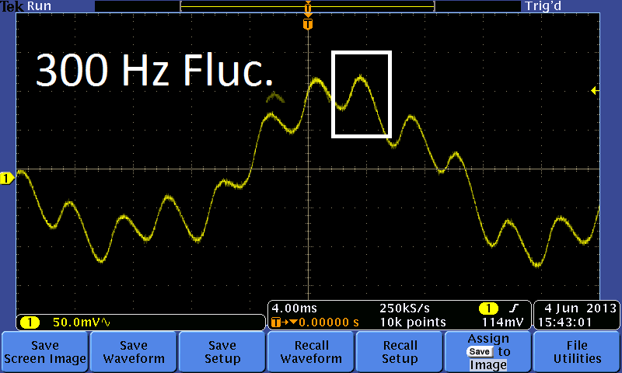
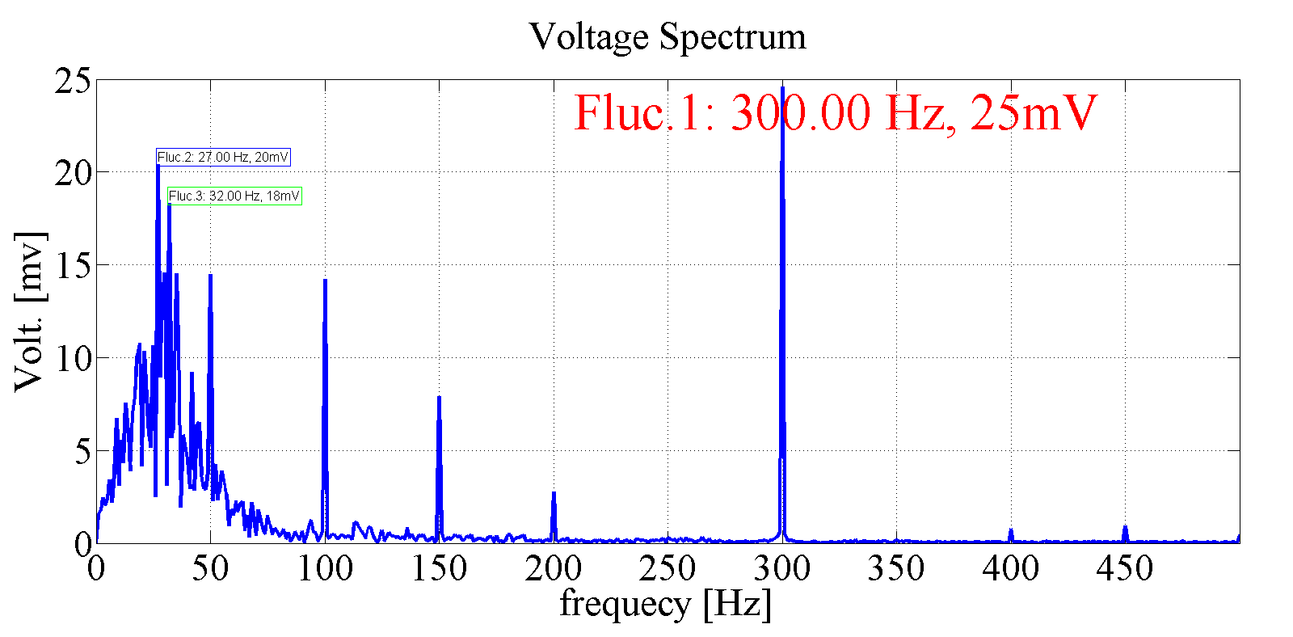
Why need FB?
  Many disturbances exists in the RF control loop.
FB is required to stabilized the beam’s accelerating field
Power supply ripples
Lorentz detuning
Beam-loading
Microphonics
Phase noise of MO
Temperature drift
…
What would happen if the loop is open
cavity phase
6
Notes:
The primary function of the Low-Level RF (LLRF) system is to stabilize the accelerating field using feedback control within a specified tolerance. Meanwhile, the main role of the high-power RF system is to efficiently deliver RF power from the RF source to the RF cavity with minimal reflection.

Slide 8
Why LLRF important？
  What is the benefits of the LLRF system
Beam
Energy Spread(ΔE/E):
0.25%→0.006%
Beam Quality
ACCL Reliability
Beam Availability
Automation
Beam Stability
& Availability
LLRF
RF Stability
& Reliability
SRF-LINAC
7

Slide 9
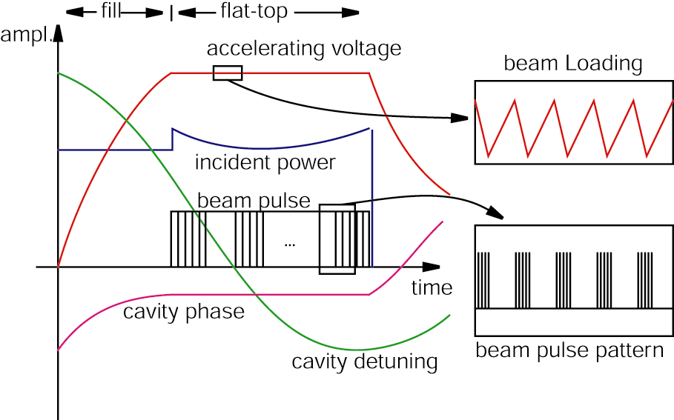
Operation Mode: CW v.s. Pulse
  CW (Continuous Wave) Mode
    RF field is always on
    Duty Factor: 100%
    Used in high-average-power systems
Pulsed Mode
  RF field is on only for limited time windows
  Allows reduced average power and thermal load
Amp
RF always ON
Amp
RF Pulse Width
Rep. Period
8

Slide 10
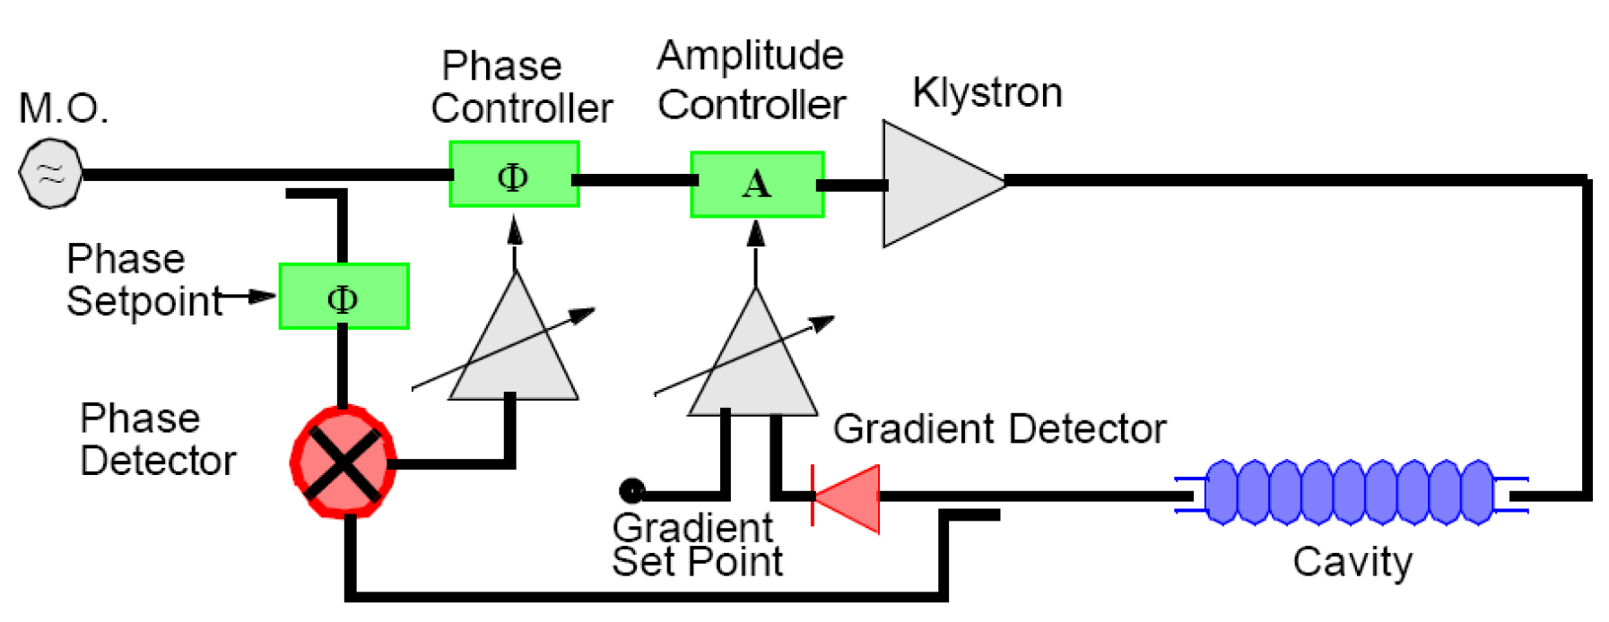
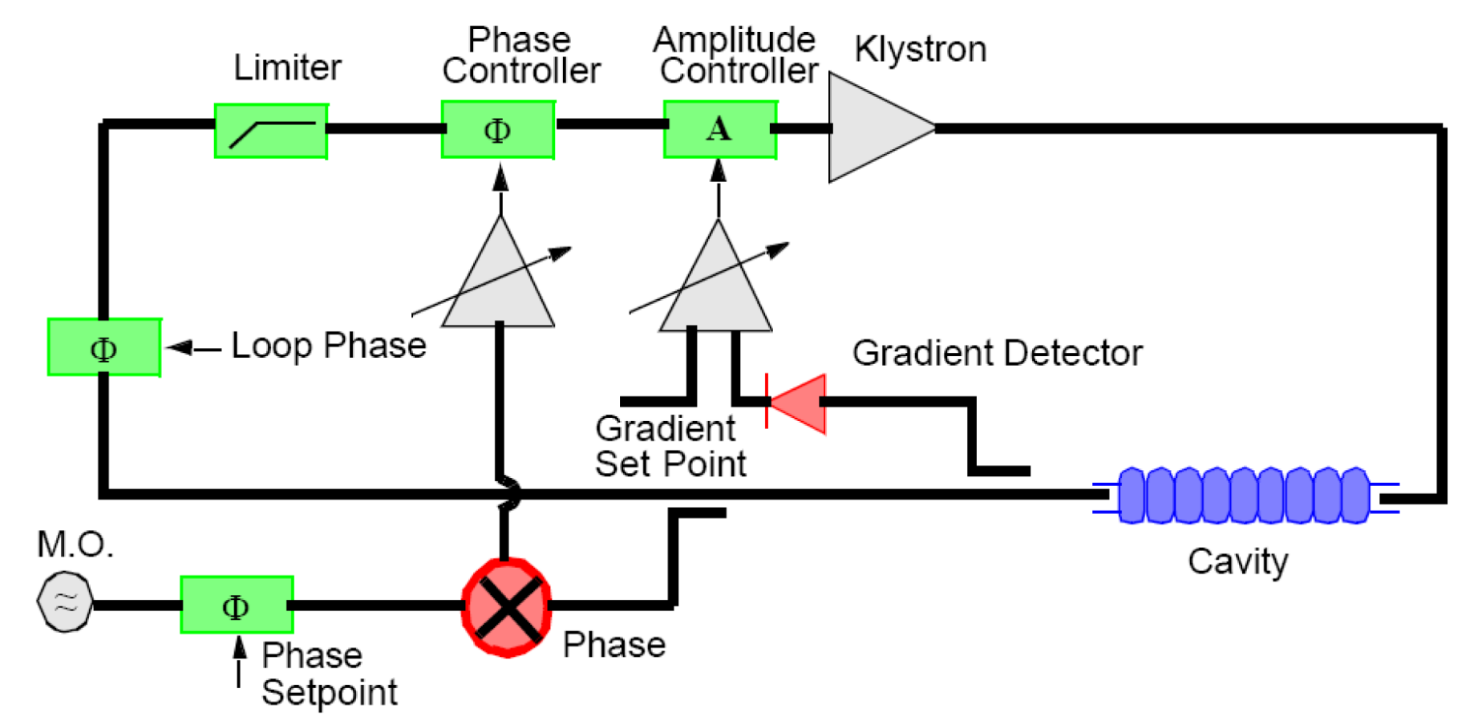
Control Mode: GDR v.s. SEL
  🔹GDR Mode (Generator-Driven Resonator)
    Driven by fixed external reference.
    Assumes cavity stays tuned.
    Sensitive to detuning and vibrations.
    Enables accurate phase/amplitude control.
    Used in beam operation and runtime.
    Syncs with timing and beamline systems.
🔹 SEL Mode (Self-Excited Loop)
  Uses cavity’s natural resonant frequency.
  Automatically adapts to detuning.
  Immune to frequency drift.
  No external reference needed.
  Ideal for tuning, RF commissioning, and tests.
  Robust under dynamic conditions.
f = f_{ex}
f = f_{cav}
9

Slide 11
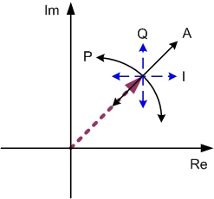
Control Strategy: A/P Control v.s. I/Q Control
🟩 A&P Control
✓ Advantages:
  Intuitive physical interpretation
  Not sensitive to loop phase
✗ Limitations:
  Requires nonlinear transformations
  Sensitive to phase wrap-around
🟥I/Q Control
✓ Advantages:
  Setpoint can cover zero
  Linear and efficient for signal processing
✗ Limitations:
  Less intuitive than A&P ctrl.
  Sensitive to the loop phase
Polar
Cartesian
10

Slide 12

LLRF Learning Resources
Books
Stefan SIMROCK and Zheqiao GENG, Low-Level Radio Frequency Systems, Springer, 2022
Accelerator School
Stefan SIMROCK and Zheqiao GENG. LLRF lecture, The 8th International Linear Accelerator school, Dec. 4 - 15, 2013，Ankara University, Turkey
Sven PFEIFFER, LLRF Controls and Feedback: Free-Electron Lasers and Energy Recovery Linacs, CAS-CERN Accelerator School on Free Electron Lasers and Energy Recovery Linacs, 2016, Hamburg, Germany
11

Slide 13
01
Self-Introduction
02
LLRF Basics
CONTENTS
Control System Basics
LLRF Control Loop Modeling
LLRF Feedback Optimization

Slide 14
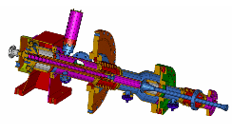
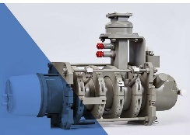
Components of a typical control system
  A control system is a device, or set of devices, that manages, commands, directs or regulates
  the behavior of other devices or systems
    Plant：The physical system or process to be controlled, such as the SRF system
    Controller：The unit that computes control signals based on the reference input and feedback to influence the plant’s behavior. Common types include PID and fuzzy controllers.
    Sensor：A Device that measures the output or state of the plant and provides feedback to the controller
    Actuator：A device that converts the controller’s output signal into physical action to drive the plant. It serves as the interface between the control signal and the physical system (e.g. piezo tuner in resonant frequency control loop )
Waveguide
13

Slide 15
Open loop v.s. Closed loop
  A control system is a device, or set of devices, that manages, commands, directs or regulates
  the behavior of other devices or systems
Open-Loop Control
  No feedback used
  Control action is fixed
  Cannot correct errors
  Simple but less accurate
Closed-Loop Control
  Uses feedback signal
  Continuously adjusts control
  Can correct disturbances
  More accurate and stable
14

Slide 16
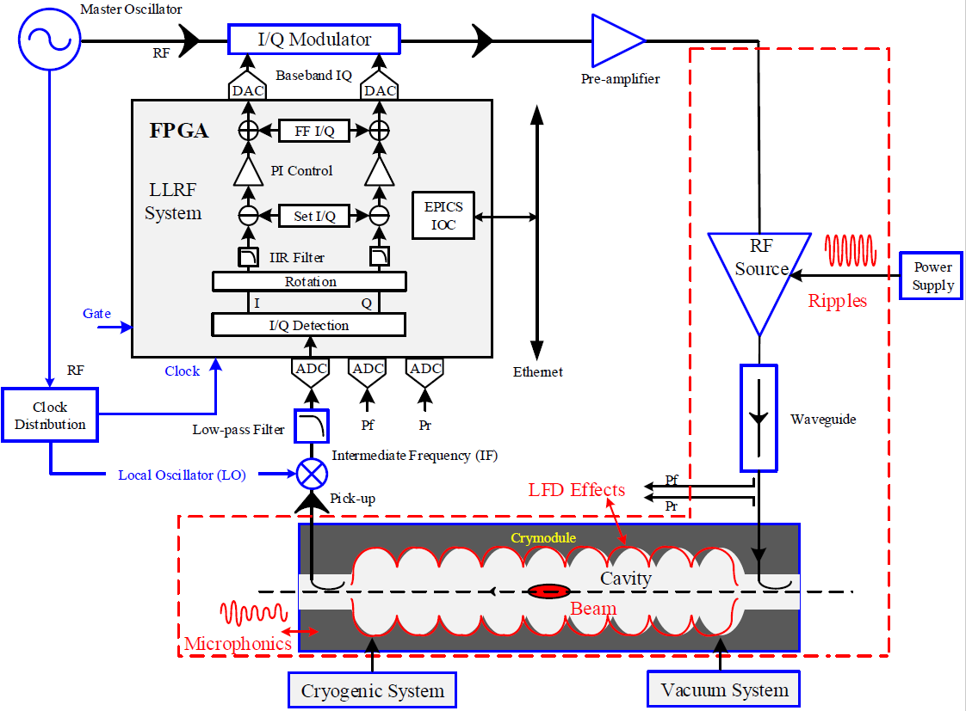
Example: LLRF Control System
  Example for LLRF FB control system
Plant
Sensor
Controller

Slide 17
Transfer Function
  A Transfer Function (TF) is the ratio of the output to the input of a system in Laplace domain.
  The X(s) and Y(s) are the Laplace-transform of the input/output signal, respectively.
  H(s) represents the system’s response characteristics.
    Captures all dynamic behavior of the system.
    Enables analysis and design in the frequency domain.
Transfer function
Complex freq. domain
Laplace-transform
Time domain
Fourier-transform
Freq. domain
16

Slide 18
Frequency Response
  Frequency response measures how the magnitude and phase of a system's output change as a function of input frequency.
  To analyze frequency response, we evaluate the transfer function along the imaginary axis, by substituting s=jω
20 ms
20 ms
E.g. a 50 Hz sinewave
17

Slide 19
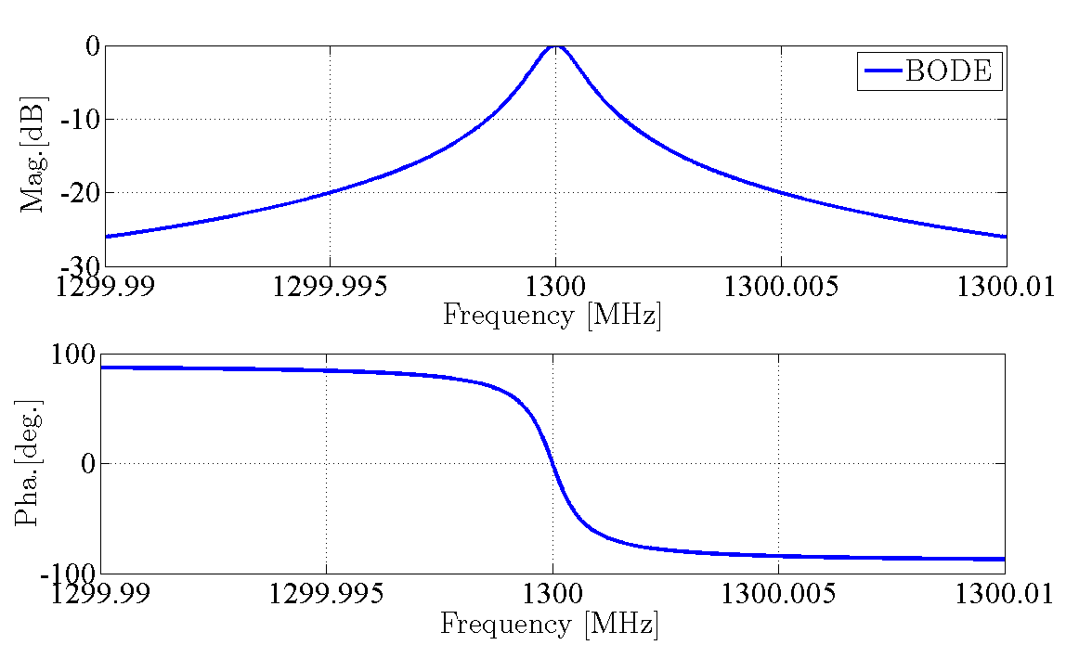
Example: RLC circuit
  RLC parallel circuit (RF Cavity)
18

Slide 20
Stability Criteria (Bode Diagram)
  Stability is one of the most fundamental properties in a feedback system. Without stability, any further analysis or control effort becomes meaningless
  A system is stable if the gain margin is positive and the phase margin is greater than zero in the Bode plot
Bode Plot (open-loop)
Stability criteria
[dB]
Open-loop-based
Closed-loop-based
0 dB
Root Locus
Bode Plot
Characteristic eq.
Routh-Hurwitz
Gain Margin
[deg]
Frequency
Gain Margin:
Phase Margin
-180 deg
Phase Margin
19

Slide 21
01
Self-Introduction
02
LLRF Basics
CONTENTS
Control System Basics
LLRF Control Loop Modeling
LLRF Feedback Optimization

Slide 22
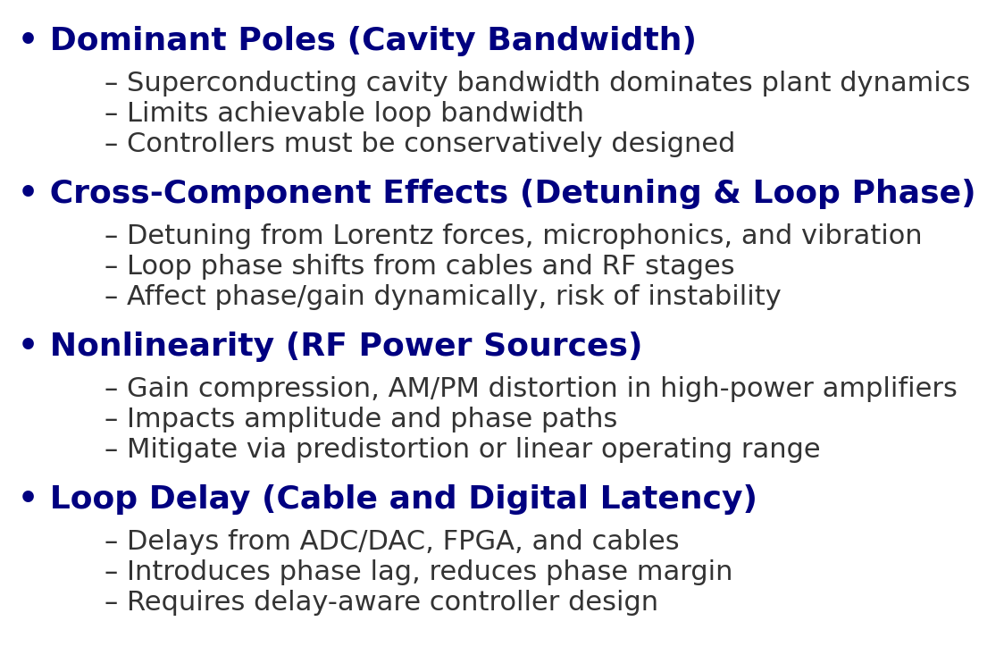
Modeling (base-band)
  The cavity bandwidth of SRF cavity is significantly narrower than that of other high-power RF components, such as power amplifiers, couplers, or waveguides.
  In real RF control systems, nonlinear effects and loop delay cannot be ignored.
Dominant Poles
nonlinearity
Loop delay
& Loop phase
21

Slide 23
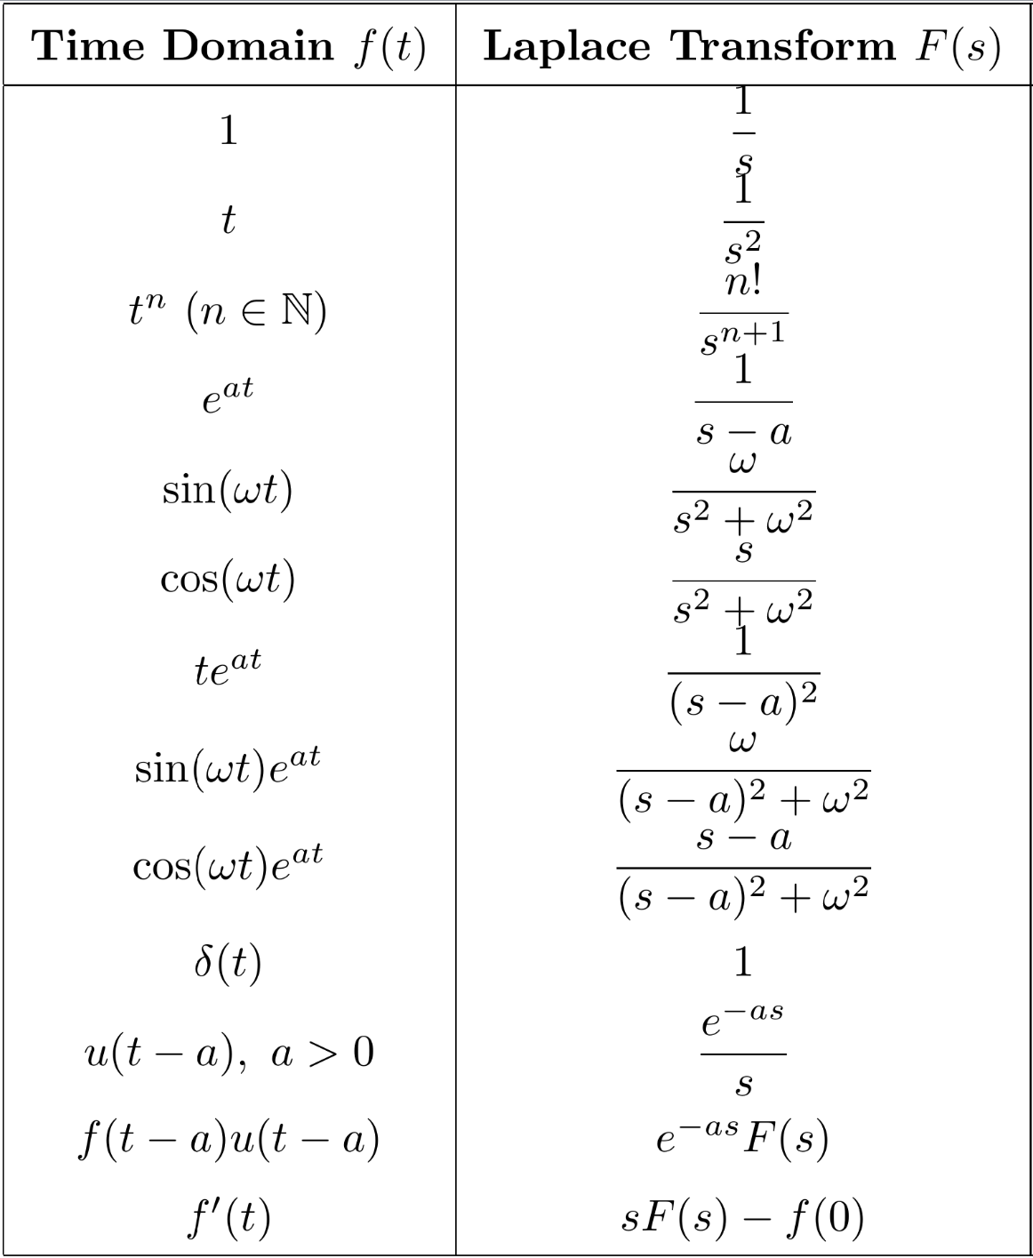
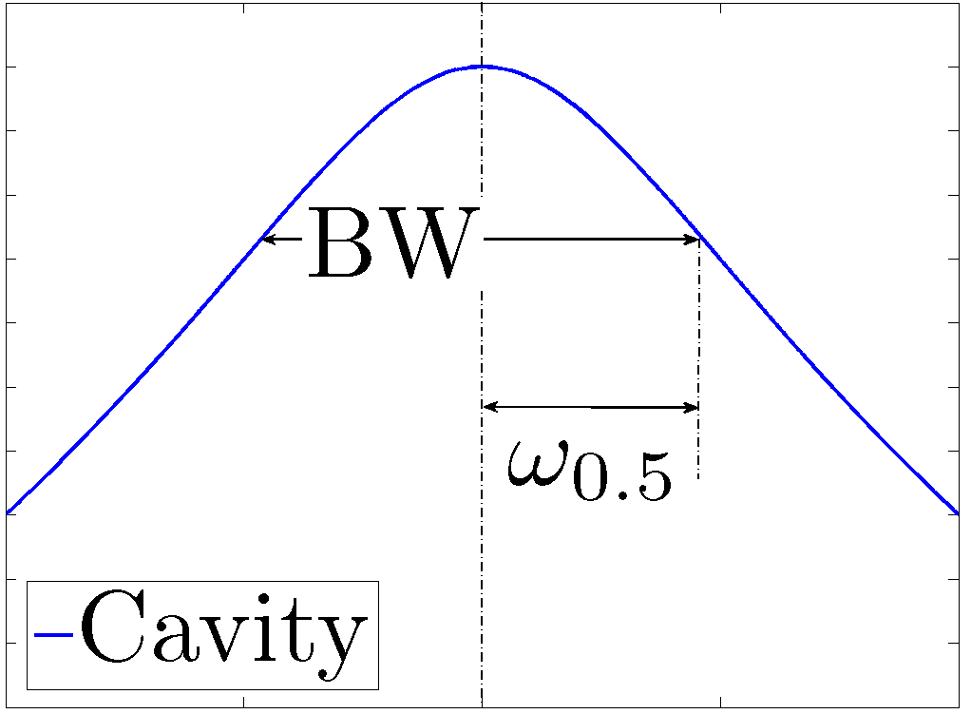
Base-band Cavity Model (TF)
  Base-band cavity differential equation → Cavity TF Model
Cavity BW ~ 100 Hz
RF components BW ~ MHz
0
frequency
22

Slide 24


Base-band Cavity Model (State-space Model)
  The state-space cavity model
Cross Component
Single Input Single Output (SISO)
Cross
Multi-Input Multi-Output (MIMO)
23

Slide 25
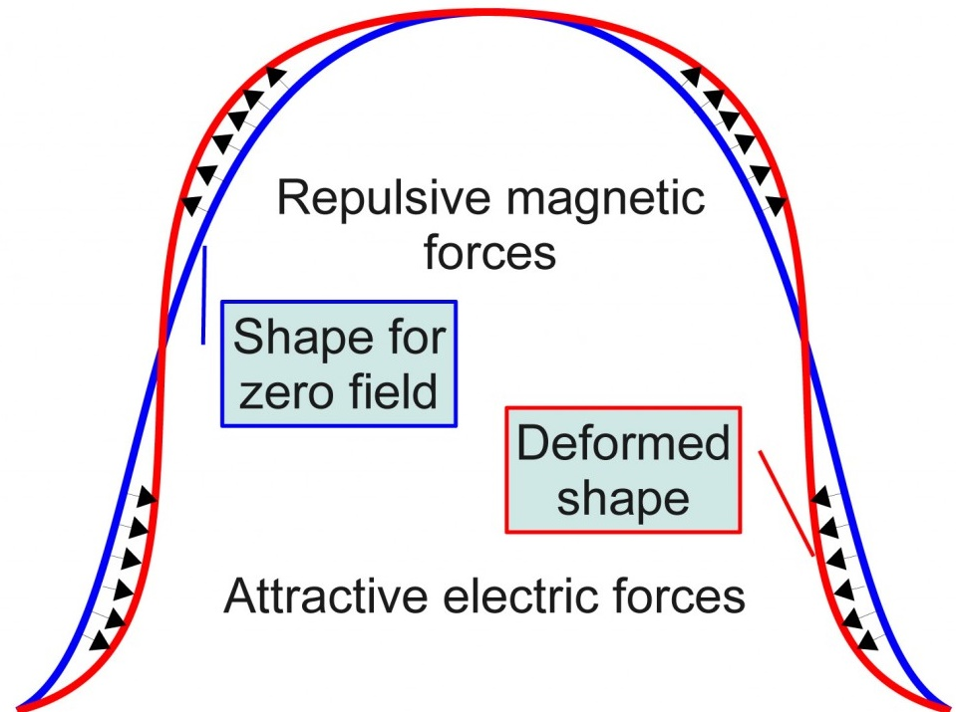
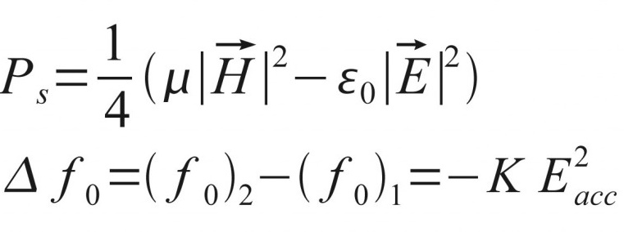
Cavity Mechanical Model
  Non-linear coupling between the electrical and mechanical models
Lorentz pressure
Lorentz force detuning
If r = const, then dynamic LFD is zero
24

Slide 26
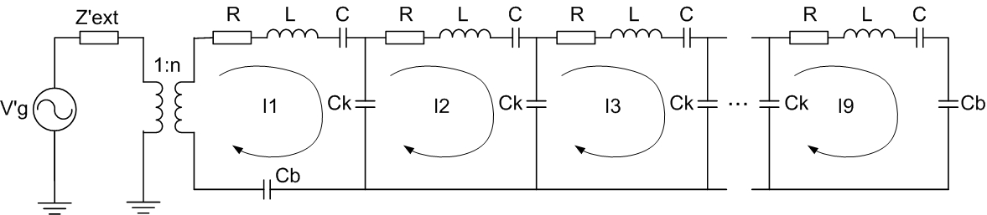
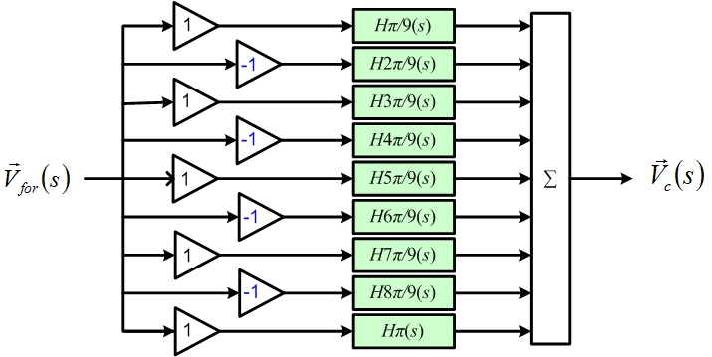
Parasitic Mode Model
  In multi-cell cavities, the electromagnetic field is distributed across multiple resonant cells, each of which can support not only the fundamental accelerating mode but also higher-order or parasitic modes
25

Slide 27
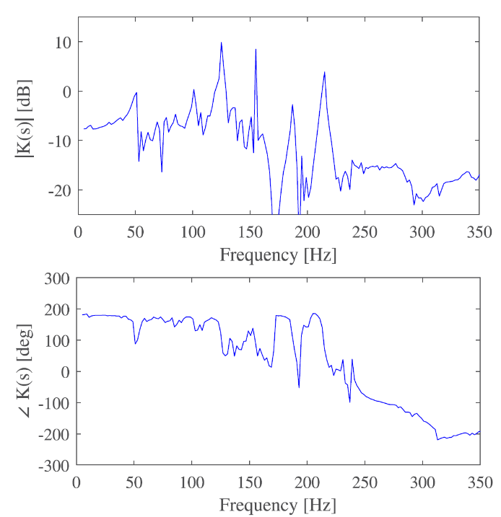
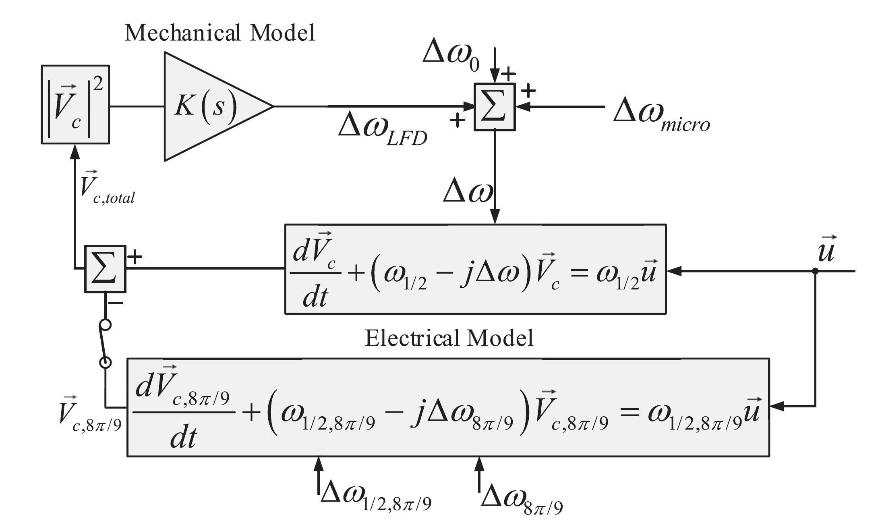
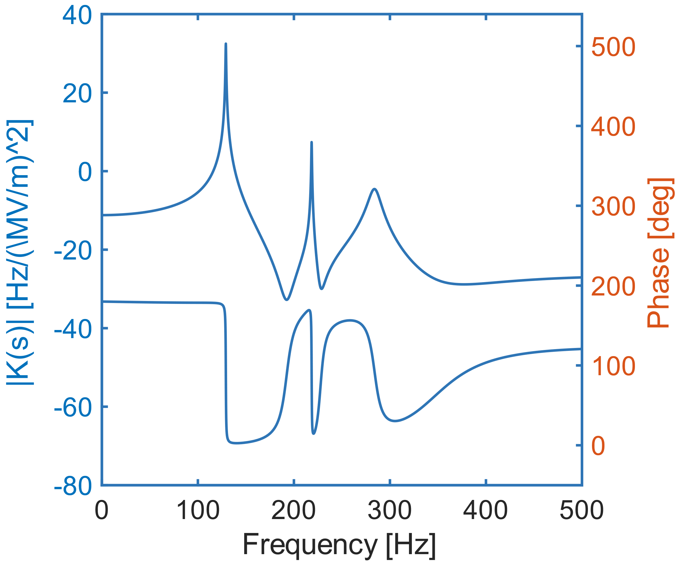
Cavity Model (overall)
  Only the dominant mechanical mode and the dominant parasitic mode is considered
26

Slide 28
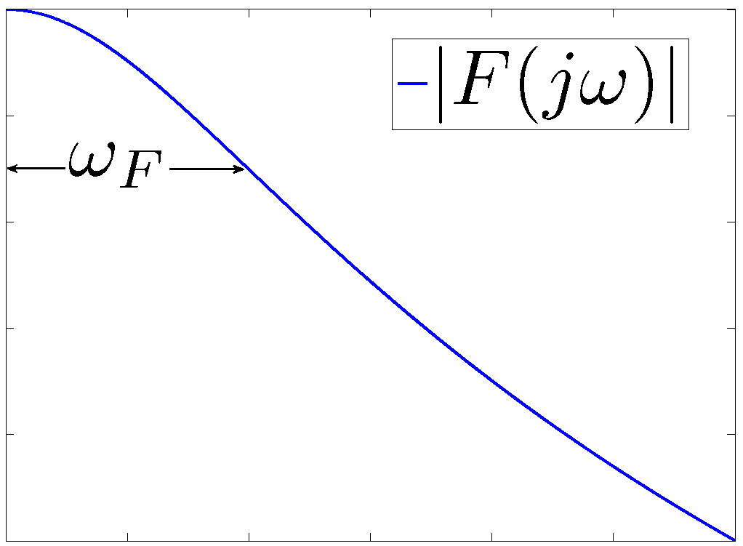
Controller and Sensor
  PI controller is the most popular FB controller in the LLRF community
  Sensor can be modeled as a low-pass filter with higher BW（>100 kHz） than the SRF cavity
low pass filter
27

Slide 29
Down-conversion
  Step1: Down-conversion from the RF signal to IF signal
  Step2: Base-band (BB) demodulation (from IF to I/Q)
Filtered by LPF
BB
IF
ADC
Sensor
Controller
DAC
Set
I/Q detection
LO
RF
BB
IF
RF
28

Slide 30
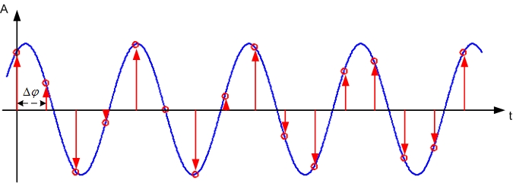
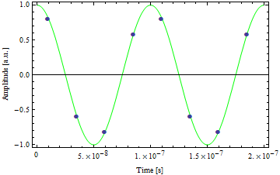
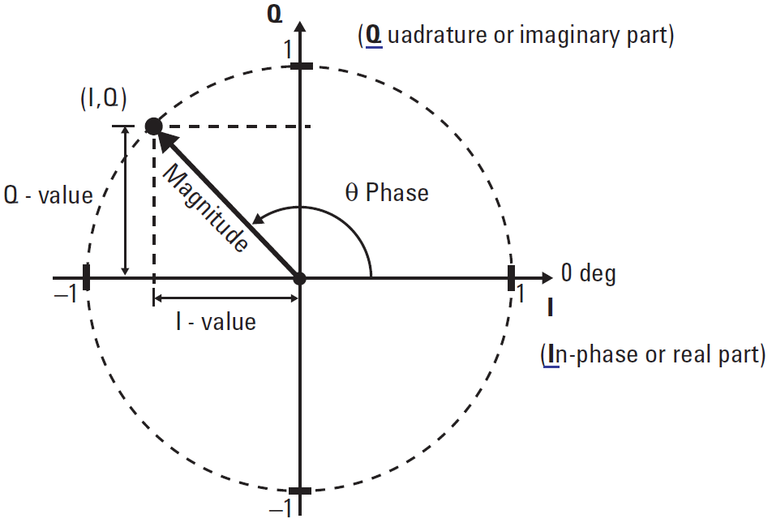
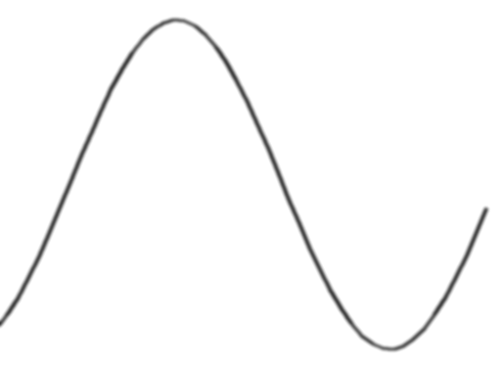
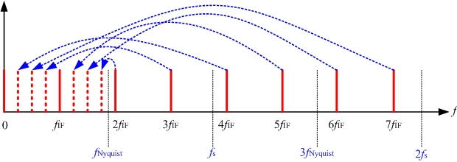
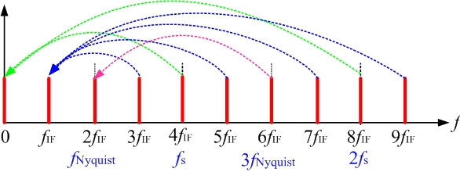
I/Q Sampling v.s. Non-I/Q Sampling
  I/Q sampling: Nonlinearities in the analog front-end or the ADC generate harmonics, which will be aliased to the IF frequency → Non-I/Q Sampling
I
Q
I
IF
IQ Det.
IQ Sampling:
ADC
-I
-Q
Fs
Q
Time [s]
29

Slide 31
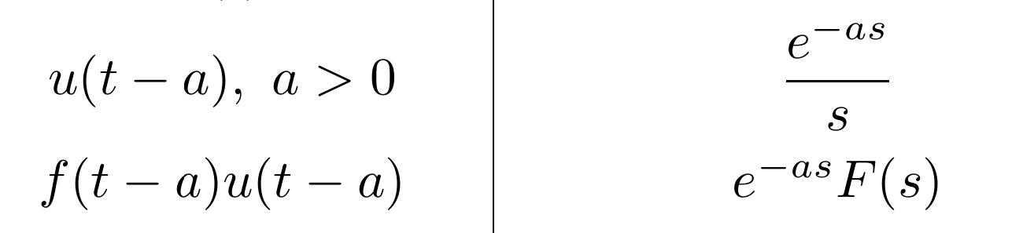
Loop Phase & Loop Delay Model
  Loop phase refers to the total phase shift introduced in the FB loop by components such as cables, mixers, …
  Loop delay is the total time latency between signal measurement and corrective action in the FB loop
30

Slide 32
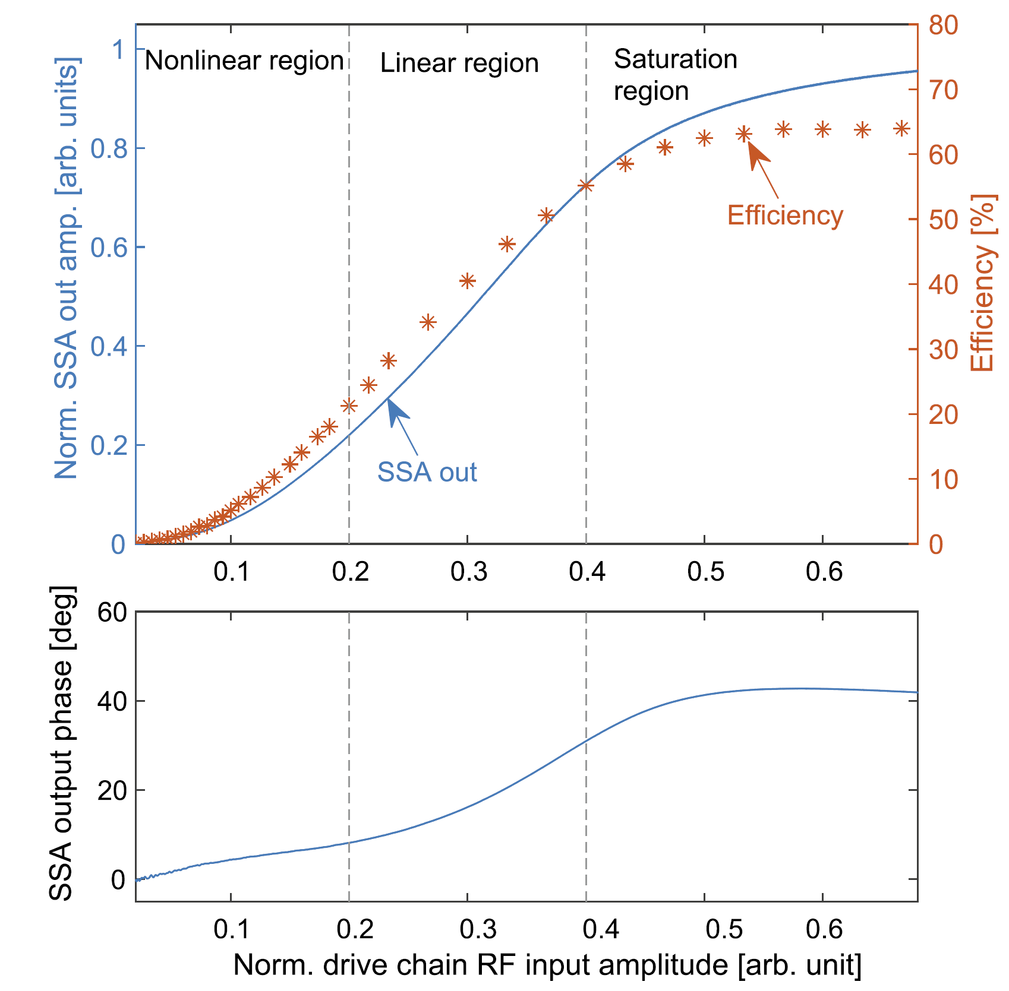
Non-linearity (cont’d)
  Non-linearity in RF power sources refers to the distortion of output amplitude and phase
Polynomial Model
Rapp’s Model
Can be approximated as linear near its operating point
31

Slide 33
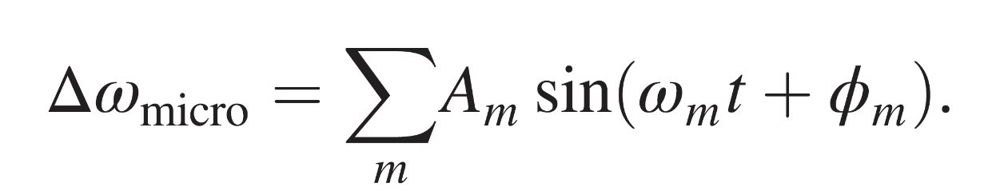
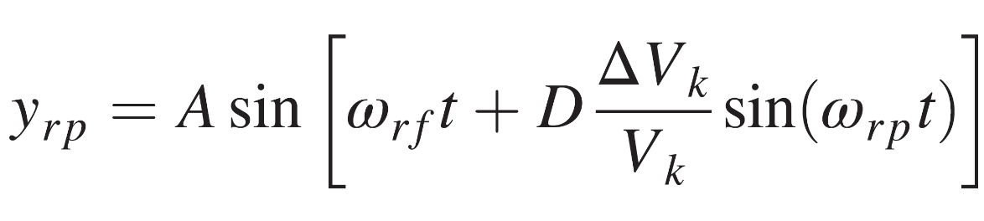
Disturbance Model
  Disturbance and noise should be also carefully considered in the LLRF FB loop
Ripple
Beam
Microphonics, LFD
High Frequency Noise
32

Slide 34
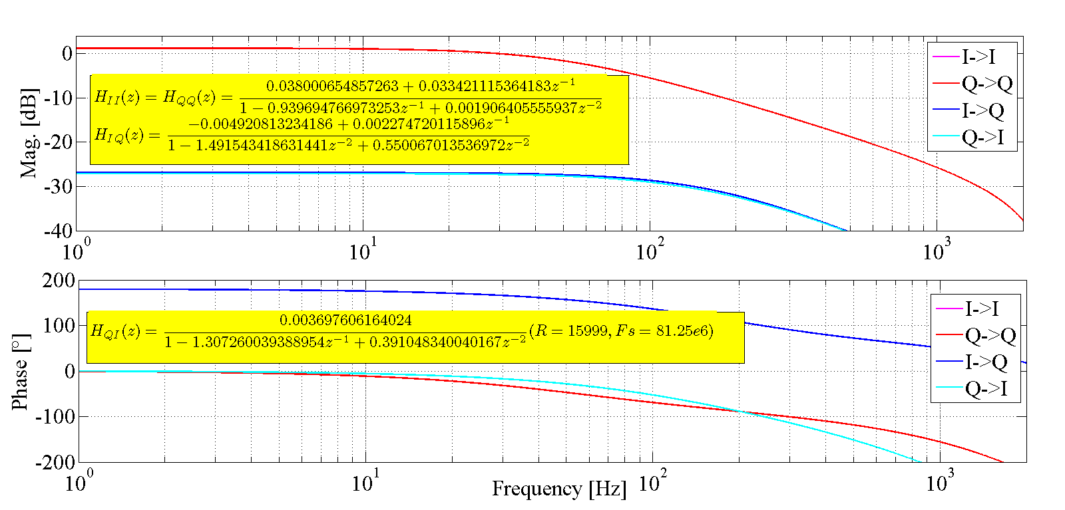
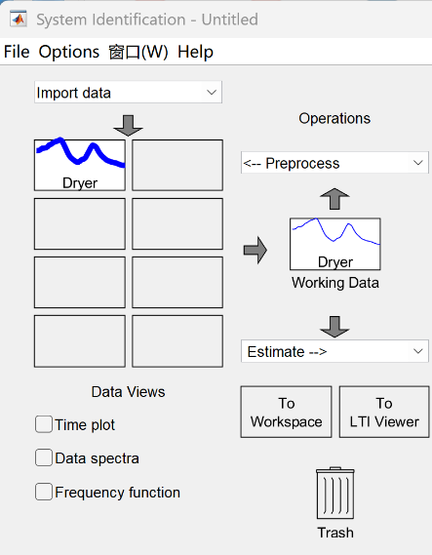
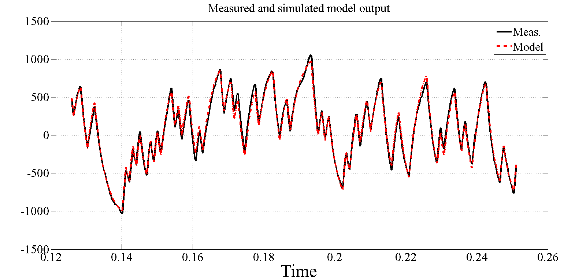
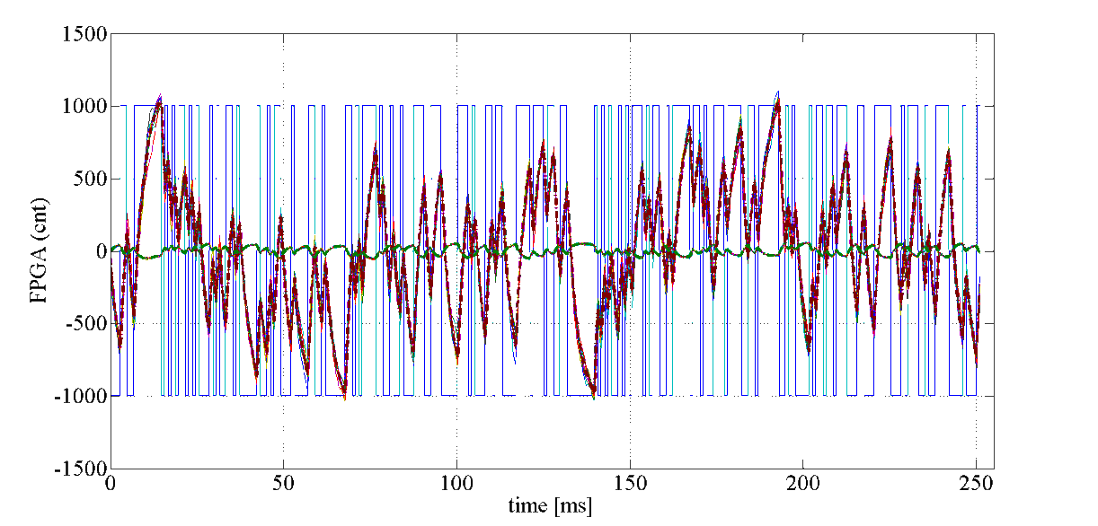
System Identification (Black-box)
  Black-box identification is a system modeling approach where the internal structure is unknown, and the model is derived solely from input–output data using statistical or data-driven techniques.
DAC
Unknown Sys.
FPGA
TF Models
Pseudorandom Sequence
A
ADC
-A
Matlab System Identification Toolbox
Meas. v.s. Model
Actual Case
33

Slide 35
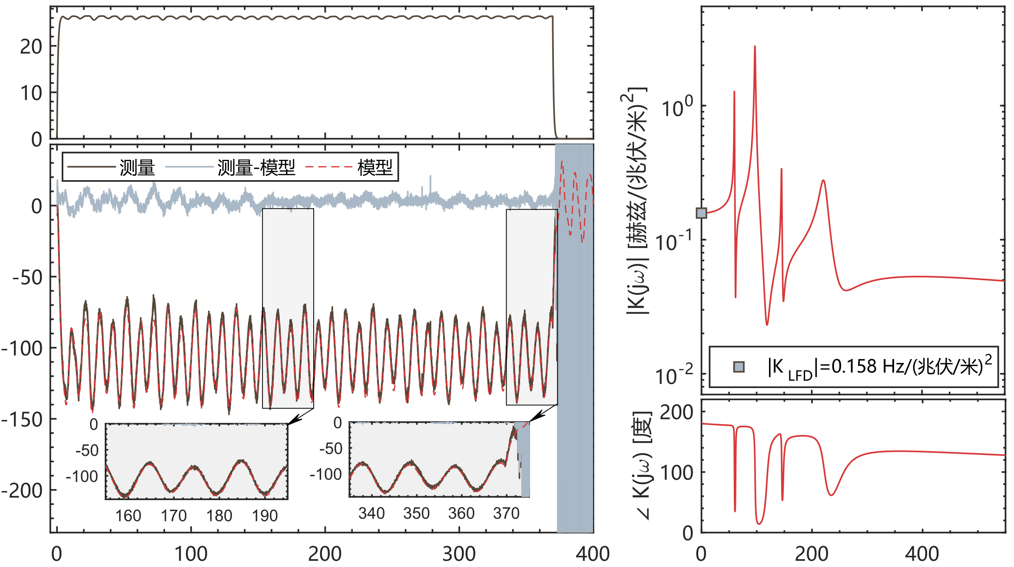
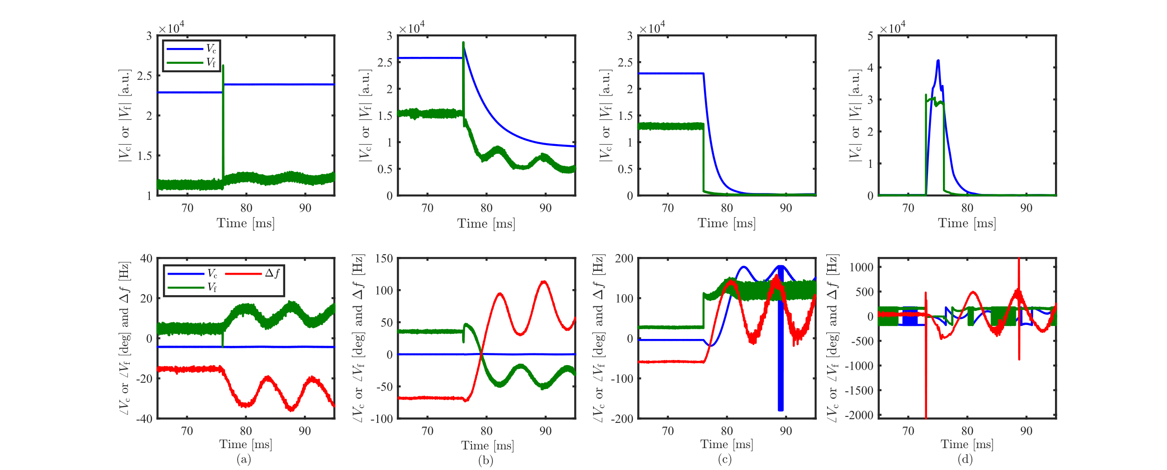
System Identification (Grey-box)
  Grey-box identification combines measured input–output data with partial knowledge of the system’s physical structure.
  Black-box identification relies purely on data without using any physical insight.
Epeak [MV/m]
Mechanical
Model
Fault Data
|K( jω)| [Hz/(MV/m)²]
测量过程中发生机电耦合，导致测量无法进行
Sim.
Meas.
Detuning [Hz]
CM3-5
∠K( jω) [deg]
State-space Model (Physical Structure)
CM2-5
Freq. [Hz]
Time [ms]
34

Slide 36
Real-time RF Simulator
  Real-Time Cavity Simulator
35

Slide 37

Real-time RF Simulator
  Support real-time simulation of complex dynamic behaviors in high-frequency FB loop
General
LFD(Pulse)
LFD(CW)
Parasitic Mode
Piezo
Beam-loading
Power Supply Ripple
Microphonics
36

Slide 38
Simplified Model
  The simplified model assumes linear behavior, excludes mechanical dynamics and cross-component coupling (such as loop phase and detuning), and considers only the fundamental π-mode for multi-cell cavities.
Disturbances
Disturbances（d）
Controller
Cavity
Output(y)
Σ
Σ
MIMO
SISO
Σ
Loop delay
Σ
Noise
Sensor
Noise（n）
W/o non-linearity
W/o mechanical model
Only π mode (for multi-cell cav.)
W/o cross components
  Loop phase = 0
  Detuning = 0
37

Slide 39
Disturbance and Noise Propagation
  We want to suppress disturbances while not amplifying sensor noise, which creates a fundamental trade-off in controller design (e.g. FB gains)
Disturbances（d）
Controller
Cavity
Output(y)
Σ
Loop delay
Σ
Sensor
Noise（n）
Feedback
Minus
38

Slide 40




Loop Gain v.s. Stability
  In general, a larger FB gains leads to higher loop bandwidth and improved disturbance rejection, but it can also introduce high-frequency oscillations due to reduced phase margin.
Measurement result @ CAFe
Field oscillates @ ~ 1 kHz
May oscillation at high frequency domain
2005 - "Respect the Unstable," IEEE Control Systems
Magazine, Vol. 23, No. 4, pp. 12-25, August 2003
39

Slide 41


Loop Gain v.s. Stability (cont’d)
  A system is stable if the gain margin is positive and the phase margin is greater than zero in the Bode plot
Loop Gain
Loop Delay
40

Slide 42
01
Self-Introduction
02
LLRF Basics
CONTENTS
Control System Basics
LLRF Control Loop Modeling
LLRF Feedback Optimization

Slide 43




Suppression of Parasitic Mode
  Parasitic modes can be excited unintentionally during closed-loop operation.
  Extra attention is required for modes closest to the fundamental mode.
42

Slide 44


Suppression of Parasitic Mode (cont’d)
  Using a high-order low-pass filter is an alternative approach
  However, it can introduce significant phase delay, which may reduce the system’s phase margin.
  Careful design is needed to balance attenuation and stability.
Higher order Low-pass was inserted
43

Slide 45

Non-linearity Compensation
  Key issues introduced by nonlinearity:
    Reduced effective gain in saturation region: Limits controllability and stability of the closed-loop system
    Significant loop-phase variation in LLRF systems between beam-on and beam-off states, reducing phase margin and system reliability.
    Complex parameter tuning
  Digital Predistortion Technique (DPD)
Lower Gain
Larger Gain
Following compensation, the combined plant comprising the power source and cavity can be approximated as a linear system
loop-phase variation
44

Slide 46



Non-linearity Compensation (cont’d)
  Typically, DPD model is deployed within the FPGA using a lookup table (LUT)-based architecture
40 deg → ±2 deg
45

Slide 47
01
Self-Introduction
02
CONTENTS
LLRF Basics
03
Operation Activities

Slide 48
03
Operation Activities
CONTENTS
Instabilities during RF Operation
Disturbance Rejection
In-situ mitigation of SRF faults
ML-based Pattern Recognition for SRF faults
Notes:
Next, let move to the activities in café facility

Slide 49

SRF Instabilities
SRF faults account for most beam trips (Eu-XFEL/CEBAF/ELBE/CAFe)
Problem: Minimize cavity faults to enhance beam availability, reliability, and stability
Solution: Gain a deep understanding of the unstable mechanisms behind cavity faults
CAFe @ 2.5 mA, 45 kW
CAFe @ 10 mA, 200 kW
Cry: 2% PS: 2%
Vac: 2% PS: 1%
Requirements
Rad: 3%
Diag: 7%
Human: 5%
Ctrl: 8%
Ctrl: 6%
Stability
He Fluc.
IS: 9%
Quench
IS: 21%
Cav. FE
Availability
Reliability
SRF: 64%
SRF: 73%
…
RF Trips
SRF faults contribute to the dominant beam trips
Notes:
During the long-term operation of accelerators, various types of faults can occur. Based on the experience of major international laboratories, superconducting cavity malfunctions constitute a significant portion of the total faults. Common issues include the complexity and diversity of superconducting cavity faults. Addressing the challenge of reducing superconducting cavity faults to enhance beam reliability is an international issue. Resolving this problem requires an in-depth study of the unstable physical mechanisms and fault patterns of superconducting cavities.

Slide 50


Quench v.s. Helium Pressure Fluc.
  Quench: Localized overheating of the cavity wall → Breakdown of superconductivity
  Helium pressure fluc.: Sudden changes in helium pressure (caused by cryogenic system faults or SC magnet quenching etc.)
Quench
Helium Pre. Fluc.
Helium pressure fluctuates simultaneously in all of the cryomodules
Algorithm to calculate loaded Q
Rapid dec. of cavity loaded Q
Unchanged loaded Q
A. Bellandi et al., IEEE Transactions on Nuclear Science, vol. 68, no. 4, pp. 385-393
Notes:
A quench is caused by localized overheating of the cavity wall, while helium pressure fluctuations are indicated by a sudden change in helium pressure. Although the two patterns exhibit similar RF waveforms, they differ mainly in that a quench usually leads to a rapid drop in the cavity's loaded Q, while helium pressure fluctuations typically do not. The dynamic loaded Q can be calibrated by solving the cavity equation.

Slide 51




Flashover v.s. Electronic Quench
  Field emission (FE) induced fault patterns: Flashover and E-quench
E_{acc} loss
None
1% ~ 30%
100%
FE
Flashover
E-quench
Item
Flashover
Partial E-quench
E-quench
Range
>15 MV/m
>25 MV/m
>35 MV/m
Duration
5 ~ 10 μs
~ 5 μs
~ 1 μs
6 μs
2 μs
Pick-up
Pick-up
burst noise
burst noise
Flashover
Amp [norm. units]
Amp [norm. units]
Vc
Pick-up
V_{c} Amp [norm. units]
burst noise
Partial E-quench
Total E-quench
Flashover: Discharge at pick-up antenna, the actual field remains unchanged
(Partial) E-quench: Discharge at cavity inner conductor, the actual field rapidly decreases
Time [ms]
Notes:
We have observed two field emission-induced cavity fault patterns in CAFÉ2, known as flashover and E-quench. Since a burst noise signal appears in both patterns, the two can easily be confused. The main difference between the two patterns is the location of the discharge. The discharge in an E-quench occurs in the inner conductor of the cavity, while flashover typically occurs in the pick-up coupler. Flashover usually does not affect the actual cavity voltage, whereas E-quench results in energy loss

Slide 52




Ponderomotive Instability v.s. Microphonics
  Ponderomotive Instability: Non-linear coupling between the electrical and mechanical modes of the cavity, which accompanied by the accelerating gradient and detuning beginning to oscillate with increasing amplitude
  Microphonics: Cavity frequency changes caused by connections to the external world (e.g., vacuum pump vibration)
Simplified LFD transfer function
Ponderomotive Effects
Microphonics
~120 Hz
~120 Hz
0~50 Hz
Micro.
Ponder.
Cavity & Mech. Model
Divergent Oscillation
Vibration (w/o divergency)
Notes:
Both ponderomotive and microphonics effects are indicated by an oscillation of the cavity detuning. The main different is that the ponderomotive effects are caused by the non-linear coupling btw xx and xx, mode of a cavity. On the other hand, the microphonics are derived from the external vibration source. In the RF signals, the ponderomotive effects is usually characterized by an divergent oscillation on certain mechanical modes, while the microphonics are typically without divergence. In addition, the frequency range of these two patterns shows also difference.

Slide 53
Ponderomotive Instabilities
  Two types of ponderomotive instabilities are present in superconducting cavities: monotonic and oscillatory instabilities
Δf < 0
Δf > 0
V_{c}
A_{cav}
Oscillatory Instability
Monotonic
Instability
A₁
A₂
|A-λE|=0
Detuning
Characteristic Matrix A
D. Schulze, Ponderomotive stability of R. F. resonators and resonator control systems. ANL-TRANS-944, 1972
A. Bellandi, PhD thesis, Hamburg. 2021
Notes:
We can analyze the stability of the coupled system using the Characteristic Matrix. Here, we have the transfer function and characteristic matrix for each mechanical mode, as well as the characteristic matrix for the cavity model. By combining these two models, the overall matrix is determined. Solving for the eigenvalues using the determinant allows us to identify two separate unstable regions. In the negative detuning direction, we observe oscillatory instability, while in the positive detuning case, monotonic instability occurs. These concepts will be introduced in the following slides.

Slide 54


Ponderomotive Instabilities (cont’d)
  Monotonic Instability may cause V_{c} statically to drop or jump under certain conditions
V_{c}
Conditions for Monotonic instability
k_{LFD}
Static Drop
Static Jump
Static Drop
Detuning
V_{c}
Unstable
region
Detuning
D. Schulze, Ponderomotive stability of R. F. resonators and resonator control systems. ANL-TRANS-944, 1972
A. Bellandi, PhD thesis, Hamburg. 2021
Notes:
If we keep increasing the cavity gradient, the cavity resonant curves will be distorted by LFD. A static drop and static jump will be appeared under certain condition. In CAFE2, we observed that Monotonic Instabilites phenomenon

Slide 55


Beam-loading
  Transient beam-loading
  Beam-induced virtual detuning angle
Generator
Cav.
Beam
Virtual detuning angle
→Tuner false response
10 mA → transient RF fluctuation
10 mA Beam induced virtual detuning angle @ CAFe
4 deg
Notes:
We have encountered two types of faults caused by transient beam effects. One is the transient RF fluctuation caused by the beam loading effect. The other is the virtual detuning angle caused by the beam. It should be noted that the cavity may not actually be detuned. However, since the angle between the forward voltage and cavity voltage changes due to the beam, which can lead to a false response of the frequency tuner.

Slide 56



LLRF Trips & Cavity OFF
  LLRF trip: Trips caused by LLRF system
    Loop Fault: FB loop oscillation caused by inappropriate control parameters (e.g. loop phase, FB gains)
    Clock Glitch: electronics being affected by the radiation showers in the tunnel, leading to a bit-flip of the digital data
  Cavity OFF: External machine interlock caused trip (e.g., RF source interlock)
Loop Fault
Clock Glitch
Cav. OFF
Field oscillates @ ~ 1 kHz
DAC output suddenly drop
Vc
Pha. [deg]
Amp [norm. units]
Amp [norm. units]
Time [ms]
About 2000 fault events were labeled
(by subject matter experts)
Mag. [dB]
Frequency [Hz]
Notes:
Various factors can cause the LLRF control loop to trip. For example, inappropriate control parameters may result in loop oscillation. Here, we show the measured loop oscillation caused by incorrect PI parameters, which is consistent with the Bode diagram. Another LLRF trip may be caused by a bit-flip in the digital data, known as a clock glitch. Here, we show the measured DAC output during one of these events, where the DAC output suddenly drops during closed-loop operation. The final type of trip refers to an external interlock-induced cavity shutdown. Our subject matter experts have identified the above 8 patterns and labeled approximately 2,000 fault events, which form the basic dataset for training the machine learning models

Slide 57
03
Operation Activities
CONTENTS
Instabilities during RF Operation
Disturbance Rejection
In-situ mitigation of SRF faults
ML-based Pattern Recognition for SRF faults
Notes:
Next, let move to the activities in café facility

Slide 58



Pulse Mode Operation @ cERL
The cERL was once operated in pulse mode to increase beam energy for isotope production
We observed poor pulse-to-pulse stability under PI control, although intra-pulse stability was satisfactory. Fluctuations in the measured beam energy were noted
Pulse shape
RF Stability (Pulse-to-pulse)
Amp
Detuning
Phase
Beam Energy Fluctuation
Pulse-to-pulse
57
Notes:
During pulsed-mode beam operation at cERL, we observed poor pulse-to-pulse stability when using the traditional PI controller, although the intra-pulse stability appeared relatively good. Analyzing one hour of beam energy data revealed significant fluctuations in beam energy, which were closely correlated with variations in pulse-to-pulse RF stability

Slide 59





Disturbance Observer-based (DOB) Control
Disturbance Observer (DOB) ctrl.: Reconstruct disturbance estimation ( ), then cancel d with from the LLRF control loop
$$\hat{d}$$
$$\hat{d}$$
Cav
PI
y
d
Remove the high-frequency components
y
$$H_{PI,d→y}(s)=\frac{G_{p}\left(s\right)}{1+PI\left(s\right)G_{p}\left(s\right)}$$
$$\hat{d}$$
$$H_{PI+DOB,d→y}(s)≈[1−Q\left(s\right)]∙\frac{G_{p}\left(s\right)}{1+PI\left(s\right)G_{p}\left(s\right)}$$
Re-construction
$$s=jω→0, Q\left(s\right)≈1,→ 1−Q(s)≈0$$
58
Notes:
Assuming that external disturbances, such as the beam, is 'd,' and the cavity's output is 'y,' we can then reconstruct the disturbance signal 'dhat’ from y using the inverse cavity model. Subsequently, we can eliminate 'dhat' from the control loop. Please note that a low-pass 'Q' filter is required to remove high-frequency components

Slide 60





DOB Control (cont’d)
  This control method has been shown to significantly enhance both pulse-to-pulse RF stability and beam energy stability
RF stabilities (intra-pulse)
RF stabilities (Pulse-to-pulse)
Beam
PI+DOB
PI
PI
PI+DOB
PI
PI+DOB
Beam Energy
(NO fluc.)
F. Qiu*, et al., Application of disturbance observer-based control on pulsed superconducting radio frequency cavities Phy. Rev. Accel Beam 21, 032003 (2021)
59
Notes:
We implemented the PI+DOB control in the cERL LLRF system. Here are the results for intra-pulse stability in the presence of an approximately 1 mA beam. As you can see, the beam-induced RF transient is effectively compensated by the proposed DOB control.
Additionally, here are the results for pulse-to-pulse RF stability. As shown, the DOB control significantly improves pulse-to-pulse stability, and at the same time, the fluctuations in beam energy are effectively eliminated.

Slide 61



Power Supply Ripples
  Significant 300 Hz and 20 kHz high-voltage power supply ripples have been observed in the cERL SRF cavity.
  The traditional PI controller is not sufficiently effective in suppressing these ripples, particularly the 20 kHz component.
60

Slide 62





Active Noise Control
  Active Noise Control behaves as an adaptive notch filter, which is particularly effective for attenuating sinusoidal interference.
The adaptive weights 𝑤1[𝑘] and 𝑤2[𝑘] are updated by the least mean
square (LMS) algorithm
61

Slide 63
03
Operation Activities
CONTENTS
Instabilities during RF Operation
Disturbance Rejection
In-situ mitigation of SRF faults
ML-based Pattern Recognition for SRF faults
Notes:
Next, let move to the activities in café facility

Slide 64


SRF faults (transient beam-loading)
CAFe → Stable operation of 10 mA proton beam
  In March 2021，CAFe achieved stable operation at hundreds of kW for 100 hours, confirming the feasibility 10 mA beam operation.
Fault
SRF cavities
Operation
Self-recovery
Pulse
CW Operation
10 mA
Recovery within second-level
10 mA
CAFe
0 mA
CERN-COURIER evaluates this achievement as an outstanding accomplishment and a milestone breakthrough in the field of ADS
Transient beam-loading @10 mA
Amp. [a. u.]
ΔA/A ~ 3%
The transient loading of a 10 mA beam is the critical challenge!!
Δθ ~ 3 deg
Pha. [deg]
Time [μs]
63
Notes:
One challenge in this work is the transient loading of a 10 mA beam. In a complex system like CAFe, faults cannot be completely avoided. When a fault occurs, we have to stop the beam, wait for the fault to be recovered, and then reload the pulsed beam. The transient load of the 10mA beam may cause transient RF instabilities

Slide 65



Iterative Learning Control（ILC）
Iterative Learning Control (ILC) →widely used for beam-loading compensation
Step1： Calibrate the error between the reference signal (r) and cavity pick-up signal (y)
e_{j} (k)=r_{j} (k)-y_{j} (k)
Step2： Update the current feedforward (FF) output (u_{j+1}) using the previous FF (u_{j}) and error (e_{j})
A matrix or a zero-phase filter
u_{j+1} (k)=Q_{ILC} [u_{j} + L(e_{j} )]
A matrix or a plant-inversion-model or PID
E.g. Norm Optimal ILC
Complicated
The main ILC algorithm is usually implemented outside FPGA
—— D. H. Owens, Springer, 2015
64
Notes:
Iterative Learning Control (ILC) is widely used in control systems to compensate for repetitive disturbances, such as beam loading in accelerators. However, due to its complex structure such as matrix calculation, most current ILC algorithms are implemented outside the FPGA, which partially reduces their real-time capability.

Slide 66




FPGA-based ILC (Basic Idea)
In most cases, a beam pulse can be considered quasi-rectangular, which means the FF could also be rectangular pulse. This assumption may significantly simplify the algorithm design
Beam profile @ CAFe
FF
“quasi-rectangular”
u_{j+1} (k) = Q_{ILC} [u_{j} + L(e_{j} )]
u_{j+1} (k) = ε_{j} + F_{j} , ε_{j} = L(e_{j})
F_{j+1} = F_{j} + E_{j}
Constant Value (only a register inside FPGA)
65
Notes:
In most cases, a beam pulse can be considered quasi-rectangular, meaning the feedforward (FF) signal can also take a rectangular pulse shape. This assumption significantly simplifies the algorithm design. By replacing the matrix with a register, we can directly implement the algorithm inside the FPGA.

Slide 67





FPGA-based ILC (Confirmation)
The new ILC algorithm was demonstrated during the CAFe beam-commissioning
  High band-width: works in 1 MHz repetitive rate;
RF waveforms during iter. proc.
Convergence curve
Cav. Field
FF
Cav. Field
FF
Implementation
Field Amp.
Field Pha.
20 μs beam
C. Y. Xu，et al., Application of a modified iterative learning control algorithm for superconducting radio-frequency cavities, Nucl. Instrum. Methods. A . 955,166237 (2022)
66
Notes:
We have successfully demonstrated the new design during the CAFe beam commissioning. The entire design was successfully integrated into the FPGA. As we can see, transient beam loading is well compensated after several iterations. The FPGA-based structure ensures that the algorithm operates at a very high repetition rate, even exceeding 1 MHz. This significantly reduces fault recovery time

Slide 68


Burst-noise and RF Oscillatory
  Another Two typical SRF faults that were confused CAFe for a long time
    Field emission (FE)-induced burst-noise appears in the cavity pick-up signal
    Pondermotive instabilities typically causes RF field oscillation
Flashover
FE
6 μs
burst noise
Amp [norm. units]
Vc
Pick-up
Pick-up
Gradient
burst noise
Transfer function of Mech. mode
LLRF out
LLRF response
Time
The burst noise can lead to an unexpected LLRF response, resulting in a cavity fault
  The accelerating gradient and detuning beginning to oscillate with increasing amplitude
67
Notes:
During CAFe commissioning, we struggled with two types of SRF faults for a long time. The first issue was FE-induced burst noise appearing in the cavity pick-up signal. Depending on the intensity of the FE current, the cavity voltage could be affected or remain stable. This burst noise triggered unexpected LLRF responses, leading to cavity faults. The second issue was RF oscillations caused by ponderomotive instabilities, which typically indicate nonlinear coupling between electrical and mechanical modes

Slide 69

Mitigation of Burst-noise-induced SRF Faults
  The low-pass filter can’t completely remove the burst-noise, furthermore, the phase margin will be impacted

Slide 70



Mitigation of Burst-noise-induced SRF Faults (cont’d)
  When the LLRF system detects a burst-noise event, it immediately generates a burst-noise trigger, which remains active for a time interval of ΔT (>15 μs, longer than the burst noise period)
  During the burst-noise period, PI output (u_{PI} ) is overwritten by u_{delay} which holds the data from u_{PI} 0.8 μs prior to burst-noise trigger; then the u_{PI} is maintained until the trigger is over
0.8 μs
PI output
u_{delay}
u_{PI}
reset
Pick-up
Implementation
∆T(~15 μs)
Burst-noise Trigger
u_{delay} is the PI output during the normal state operation
69
Notes:
When the LLRF system detects a burst-noise event, it immediately generates a burst-noise trigger, which remains active for a time interval of ΔT (>15 μs, longer than the burst noise period)
During the burst-noise period, PI output (u_{PI} ) is overwritten by u_{delay} which holds the data from u_{PI} 0.8 μs prior to burst-noise trigger; then the u_{PI} is maintained until the trigger is over

Slide 71


Mitigation of Burst-noise-induced SRF Faults (con’d)
  The unexpected LLRF response can be eliminated
  The effectiveness of the proposed algorithm was confirmed during the long-term operation
Cavity pick-up
Cavity forward
Beam
W/o proposed algorithm
With proposed algorithm
Beam
Burst-noise trigger
Field amp.
Field pha.
24 hours
70
Notes:
We can see that without the proposed algorithm, burst noise may cause unexpected feedback responses, which can eventually lead to SRF faults. However, with the proposed algorithm, these unexpected responses are not observed, and SRF faults can be eliminated. We have confirmed the proposed algorithm in the beam commissioning.

Slide 72



Mitigation of Ponderomotive Instabilities
  Proper feedback control may shrink the unstable region
Unstable boundary
System Matrix (Open loop)
W/O LLRF FB
Cav
Unstable Region
A_{OL} =
λ> 0
λ= 0
Mech.
|I-λA_{OL}|<=0
λ< 0
λ: eigenvalue
System Matrix (Closed loop)
With LLRF FB
λ> 0
A_{FB}=
FB
λ< 0
LLRF FB
|I-λ A_{FB} |=0
K_{a}=K_{p}=Gain
S. K. Koscielniak, Ponderomotive Instability of Generator-Driven Cavity, in Proc. of IPAC 2019, Melbourne, Australia, 2019
Notes:
Here is the system matrix of the cavity model coupled with the mechanical model. By calculating its determinant, we can determine the unstable boundary of the oscillatory instability. If we implement the LLRF feedback with both the previous model, we obtain a combined system matrix. As you see that, the instability boundary strongly depends on the feedback parameters, meaning we can potentially reduce the unstable region by optimizing the LLRF feedback.

Slide 73





Mitigation of Ponderomotive Instabilities (cont’d)
  Ponderomotive instabilities was mitigated by optimizing the LLRF FB parameters
CM₄₋₁
Gain opt.
~ 30 MV/m
-36 Hz, 30 MV/m
Before Gain Opt
After Gain Opt
CM₄₋₁
Frequent Instability
Tuner Scan
-36 Hz
CM₄₋₂
Before Gain Opt
After Gain Opt
CM₄₋₂
Frequent Instability
120 Hz Mode
Notes:
We measured the unstable boundary by scanning the cavity detuning using the frequency tuner. For instance, this black point corresponds to a detuning of -36 Hz and a gradient of 30 MV/m. By scanning the gradient and detuning point by point, we determined the measured boundary, as indicated by this red point, which agrees with the simulation results. During the CAFe operation, we observed that two of the cavities frequently experienced oscillatory instabilities. With the help of these analytical boundary maps, we optimized the feedback parameters again, and successfully mitigated the oscillatory instabilities.

Slide 74
03
Operation Activities
CONTENTS
Operation Difficulties
Disturbance Rejection
In-situ mitigation of SRF faults
ML-based Pattern Recognition for SRF faults
Notes:
Next, let move to the activities in café facility

Slide 75


Collect the critical-waveform data (cavity voltage, forward/reflected…) by digital low-level radio-frequency (LLRF) DAQ systems
Data-analysis were performed by subject matter experts
Classification of SRF Faults
  Collect the critical-waveform data (cavity voltage, forward/reflected…) by digital low-level radio-frequency (LLRF) DAQ systems
  Data-analysis were performed by subject matter experts
Cavity voltage (V_{c}), forward (V_{f}*)/reflected (V_{r}*) and DAC output (V_{LLRF}) signals are recorded (10 kHz ~ 100 kHz, 50000 samples for each signal)
Complicated & Time-consuming
Features of the DAQ：
  10 kHz ~ 100 kHz rates
  0.5 s ~ 5 s waveforms
  8 ADC channels
Expert-based fault analysis requires expertise and intuition (which makes it difficult to provide real-time fault feedback to operators)
→ Automatically Fault Classification (using machine learning tech.)
C. Tennant et al., Phys. Rev. Accel. Beams, 11 871 (2020) 114601
Notes:
Before and after each fault, the digital LLRF system records a large amount of fault data. By analyzing this data, we can identify fault patterns and understand the physical mechanisms behind them.
However, expert-based fault analysis relies on experience and intuition, making real-time fault feedback challenging. The JLAB RF team has successfully implemented automatic fault classification using machine learning. Inspired by their work, we have developed our own ML-based fault classification models.

Slide 76




ML-based SRF Faults Classification
  Eight patterns were recognized and labeled by subject matter experts
  Expert-based feature engineering method were applied
Obtaining high-quality, well-labeled event data is the essential first step
Data Pre-processing
Feature Engineering
Supervised ML-based SRF faults classification
Autoregression (AR)-based Feature-Extraction
JLAB
Weights of AR Model
Require the signal to be autocorrelated, resulting in difficulty in capturing the abrupt fault patterns in CAFe (e.g. , E-quench & flashover)
Machine
Learning
Expert experience-based Feature-Extraction
Eight expert-defined features
What we have applied in this presentation
Notes:
Fault classification in machine learning can be divided into three main steps: data preprocessing, feature engineering, and supervised classification. During feature engineering, we can use automated methods like Autoregression (AR) to extract features from time-series signals. However, AR relies on signal autocorrelation and may not work well for abrupt faults. In this presentation, we will demonstrate a feature extraction method based on expert knowledge. Since we use a supervised learning algorithm, it is also crucial that the data is pre-labeled by subject matter experts

Slide 77



Feature Engineering
  Distribution of expert-defined features
Eight features for each fault events
Features | Q_{id} | F_{max} | F_{ratio} | ΔΘ | E_{id} | Δρ_{max} | r_{rms1} | r_{rms2}
Method | Modeling | Freq. Domain Analysis |  | Signal Characteristic |  |  | Statistical Feature
Q_{id}
ΔΘ
Merits
Limited numbers of features
Features are physically meaningful
Features are not affected by the DAQ sampling rate
F_{max}
F_{ratio}
Drawbacks
Specific algorithms are required
Generalizability & Scalability need further validation
E_{id}
Δρ_{max}
Notes:
We have extract eight expert defined features using different methods. We compare the distribution of some of these features, and as you can see, This expert feature Qid is a strong indicator for distinguishing between quench and non-quench events. Finally, we summarize the advantages and disadvantages of our method

Slide 78





Result of the ML Model
  Prediction Accuracy: ~94% (Expert) v.s. ~89% (AR)
  XGB (eXtreme Gradient Boosting) model wins by a small margin
abrupt signals (e.g., burst-noise)
AR Features
Expert Features
True Label
True Label
E-quench
E-quench
73%
95%
Predicted Label
Predicted Label
Notes:
After feature engineering, we carried out the machine learning process. Here, we compare the confusion matrix between the AR method and our method. As you can see, the AR method has relatively low accuracy when dealing with fault patterns that include abrupt signals, whereas the Expert Feature method generally does not have this issue. The possible reason is that the AR model assumes signal correlation, making it difficult to handle abrupt changes. Additionally, we compared three different ML models, with the XGB model coming out on top by a slight margin

Slide 79



Collect the critical-waveform data (cavity voltage, forward/reflected…) by digital low-level radio-frequency (LLRF) DAQ systems
Data-analysis were performed by subject matter experts
Big Data Analysis
  ML models can automatically classify SRF faults
  Big data analysis helps confirm which cavity suffers from specific fault patterns.
ML model
Notes:
We have observed various patterns of RF faults in the beam operation and commissioning. Before and after each fault, the digital LLRF system records an amount of fault data. Through data analysis, we can further identify fault patterns and study the physical mechanisms behind these faults

Slide 80



Automations
Fault can’t be completely prevented → Reducing cavity recovery time is critical
Building upon the ability to accurately classify RF faults, we have further developed the cavity autoloading program
Interlock Sources
Loading | Manual | Auto
Single Cav. | 2～5min | 1～3min
Order | Serial | Parallel
Condition check | Experience | Program
Auto Recovery | No | Yes
Total finished | 1~2 hrs | 1～3min
Autoloading all cavities
Recovery after single cavity interlock
20+
Main Flowchart
Courtesy: Q. Chen @ IMP
Notes:
CiADS, consisting of 155 cavities and a large number of RF components, manual loading is impractical.

Slide 81
Thanks for your attention

