Slide 1

Cryomodules for SC accelerator
Rui Ge (IHEP)
The Sixth Asian School on Superconductivity & Cryogenics for Accelerators (ASSCA 2025)
HEPS Campus, Huairou, Beijing, March 29th, 2025

Slide 2
Content
Large scale SC accelerator and related cryomodules
Cryostats and cryomodules
Basic knowledge for the cryomodule
Typical cases
Summary

Slide 3
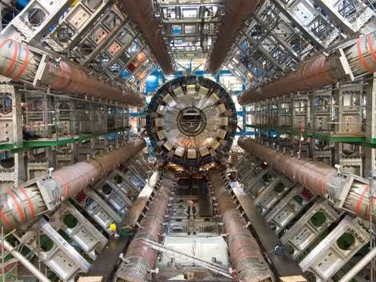
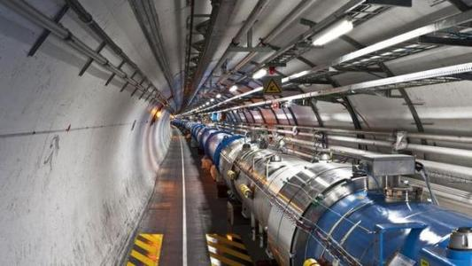
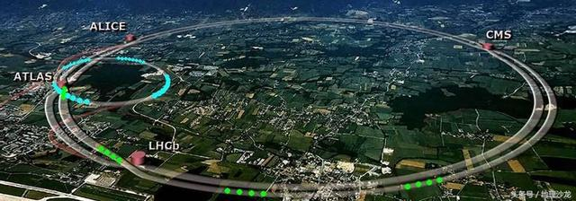
Large scale SC accelerator and cryomodules
CERN-Large Hadron Collider(LHC)

Slide 4
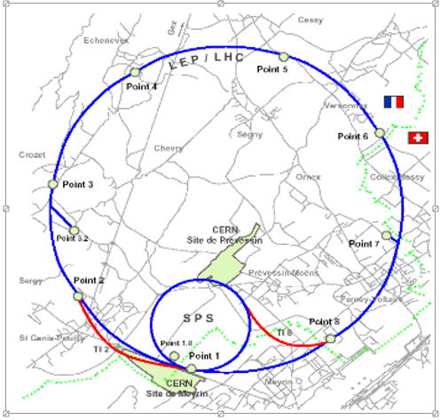
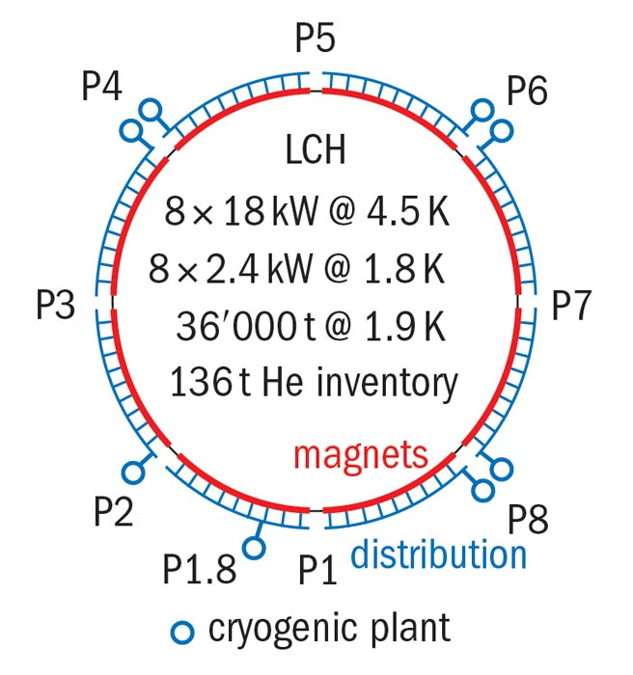
LHC Cryogenics is constituted with:
24Km of high-field superconducting magnets operating in superfluid helium at 1.9K or 4.5K
SRF cavities operating in helium at 4.5K
LHC experiments ATLAS &CMS with magnets operating at 4.5K

Slide 5
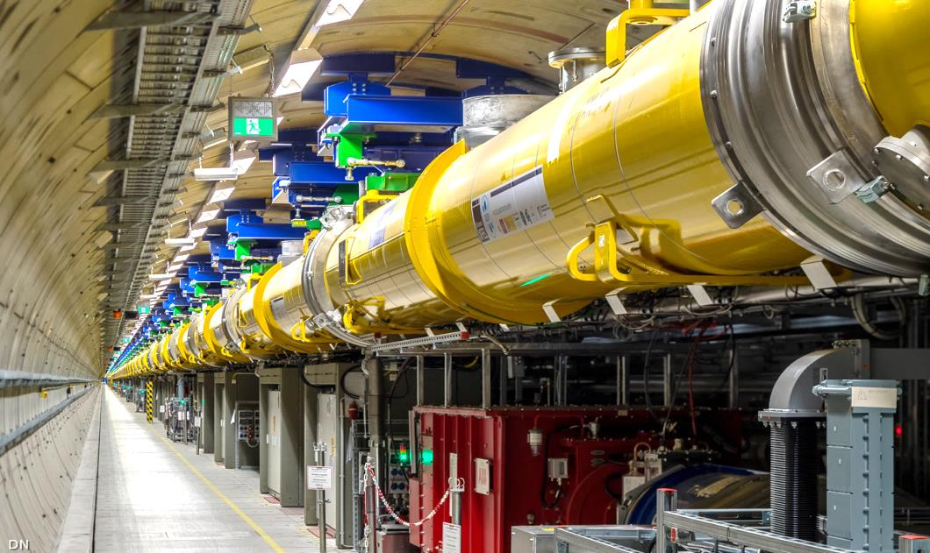
Large scale SC accelerator and cryomodules
  European XFEL:
T. Schnautz
  Length of accelerator: 1500m
  Length of facility: 3400m
  Accelerator modules : 96
  Design electron energy: 17.5 GeV
  Start of beam operation: January, 2017
  Start of user runs: September, 2017
  Electron energy in October, 2017: 14.9 GeV
  SASE-Operation of all three undulators with variable bunch pattern
  XFEL cryogenic system:
  Beam operation with 5000 bunches / sec with high intensity of X-ray laser
671 control valves
2647 temperature sensors
  XFEL enables simultaneous provision of different experiments with various and high puls-rates
800 pressure sensors
212 flow sensors
>100 level sensors
433 regulation loops
> 22000 records
> 220000 properties

Slide 6
International large SC accelerators based on SRF
Name | Accelerator Type | Lab | T (K) | Refrigeration Capacity | Status
CEBAF | Electron Linac | JLab | 2.1 | 4.2 kW @ 2.1 K | Operating
12 GeV Upgrade | Electron Linac | Jlab | 2.1 | 4.2 kW @ 2.1 K | Operating
ESS | Proton Linac | ESS | 2.0 | 3 kW @ 2 K | Under Construction
SNS | H⁻ Linac | ORNL | 2.1 | 2.4 kW @ 2.1 K | Operating
E Linac | Electron Linac | TRIUMF | 2.0 | 288 L/Hr | Operating
S-DALINAC | Electron Linac | TU Darmstadt | 2.0 | 120 W @ 2.0 K | Operating
ERL | Electron Linac | Cornell | 1.8 | 7.5 kW @ 1.8 K | Proposed
XFEL | Electron Linac | DESY | 2.0 5 -8 40-80 | 2.5 kW @ 2 K 4 kW@ 5 -8 K 26 kW @ 40-80 K | Operating
ATLAS | Heavy Ion Linac | ANL | 4.7 | 1.2 kW @4.7 | Operating
LCLS II | Accelerator | SLAC | 2.1 K | 4 kW @ 2 K 14 kW @ 35 -55 K 1.2 kW @ 5 – 8 K | Design (2019) TESLA Tech
ISAC - II | Heavy Ion Linac | TRIUMF | 4 |  | Operating
FRIB | Heavy Ion Linac | MSU | 2.1 4.5 33/55 | 3.6 k W @ 2.1 K 4.5 kW @ 4.5 K 20 kW @ 35/55 K | Operating

Slide 7
Typical superconducting and cryogenics facilities in China
Name | Lab | T (K) | Capacity | Status
BEPC-II | IHEP | 4.5 | 1kW @ 4.5. K | Operating
ADS Injector I | IHEP | 2 | 100W@2K | Operating
PAPS | IHEP | 4.5/2 | 300W@2K | Operating
HEPS | IHEP | 4.5 | 2kW @ 4.5. K | under construction
CEPC | IHEP | 2/4.5 | 4*18KW@4.5K | planning
CSNS II | IHEP | 2 | 1KW@2K | Under construction
ADS Injector II | IMP | 4.5 | 1000W@4.5K | Operating
HIAF | IMP | 2 | 2KW@2K 10KW@4.5K | under construction
CIADS | IMP | 2 | 4.8KW@2K 18KW@4.5K | under construction
SSRF | SARI | 4.5 | 600W@4.5K | Operating
SSRF II | SARI | 4.5/2 | 60W@2K | Operating
SHINE | SARI | 2 | 13KW@2K | under construction
DALS | DICP | 2 | 370W@2K | under construction
S³FEL | IASF | 2 | 10KW@2K | under construction
HALF | USTC | 4.5 | 500W@4.5K | under construction

Slide 8
Large scale SC accelerator and cryomodules
The superconducting and cryogenics are linked together through the cryomodules
The performance of the cryomodules have directly effects on the large SC accelerators
SC cryomodule and its components, such as cavity, coupler, tuner and cryostats have always been the research object of major laboratories and have continuously achieved breakthrough results.
This lecture mainly from the cryogenic perspective to introduce the cryomodule.

Slide 9
Content
Large scale SC accelerator and related cryomodules
Cryostats and cryomodules
Basic knowledge for the cryomodule
Typical cases
Summary

Slide 10
Cryostats and cryomodules
Cryostats that contain superconducting radio frequency cavities are frequently referred to as cryomodules.
The function of the cryomodules are to maintain the cavities and cold mass at the required temperatures.
Cryomodules are one of the branches or parts of the cryogenics.
Research of cryomodules require many disciplines’ knowledge, such as cryogenics, vacuum, mechanic, materials, heat transfer and even hydrodynamics etc.

Slide 11
Design principles
In addition to the common requirements with other types of cryostats, superconducting accelerator cryostats also have their own unique requirements, the design goal as follows:
Design temperature, Complex combination of multiple temperature zones
Comprehensive utilization of cryogenic engineering materials. Usually, dozens of materials are used simultaneously in a cryostat
The optimized structural design and its maintainability are related to the performance, construction, and operating costs of large superconducting accelerators
Low heat leakage is a common requirement for all cryostats
Low temperature sealing is a global challenge, Sometimes even a small leak can have extremely negative effects
Precision alignment and measurement may be unique to SC accelerator cryostats
Vacuum and leak detection techniques are also crucial
Cryostats usually need to comply with the regulations and requirements for pressure vessels in the country where they are located
……

Slide 12
Content
Large scale SC accelerator and related cryomodules
Cryostats and cryomodules
Basic knowledge for the cryomodule
Typical cases
Summary

Slide 13
cryogenic engineering materials and its main characteristics
Types of materials
Thermal expansion and contraction characteristics of materials
Specific heat of materials
Thermal conductivity of materials

Slide 14
Materials suitable for use at cryogenic temperatures
Austenitic stainless steels e.g. 304, 304L, 316, 321
Aluminum alloys e.g. 6061, 6063, 1100
Copper e.g. OFHC, ETP and phosphorous deoxidized
Brass
Fiber reinforced plastics such as G-10 and G-11
carbon fiber
Teflon (depending on the application)
Niobium and Titanium (frequently used in superconducting RF systems)
Invar (Ni/Fe alloy) useful in making washers due to its lower coefficient of expansion
Indium (used as an O ring material)
Kapton and Mylar (used in Multilayer Insulation and as electrical insulation)
Quartz (used in windows)

Slide 15
Materials unsuitable for use at cryogenic temperatures
Martensitic stainless steels—undergoes ductile to brittle transition when cooled down.
Cast Iron—also becomes brittle
Carbon steels—also becomes brittle. Sometimes used in 300 K vacuum vessels but care must be taken that breaks in cryogenic lines do not cause the vacuum vessels to cool down and fail.
Rubber and most plastics.

Slide 16
Materials’ thermal expansion and contraction characteristics
Material | ΔL/L (300–100 K) | ΔL/L (100–4 K)
Stainless steel | 296 × 10⁻⁵ | 35 × 10⁻⁵
Copper | 326 × 10⁻⁵ | 44 × 10⁻⁵
Aluminum | 415 × 10⁻⁵ | 47 × 10⁻⁵
Iron | 198 × 10⁻⁵ | 18 × 10⁻⁵
Invar | 40 × 10⁻⁵ | /
Brass | 340 × 10⁻⁵ | 57 × 10⁻⁵
Epoxy/fiberglass | 279 × 10⁻⁵ | 47 × 10⁻⁵
Titanium | 134 × 10⁻⁵ | 17 × 10⁻⁵
Thermal contraction for practical engineering materials
between 300 and 100 K
between 100 and 4 K
Most of the cold shrinkage occurs in the liquid nitrogen temperature range

Slide 17
Materials’ thermal contraction to the design of the cryostats
Allow components room to contract through the use of sliding joints, bellows or only fixing at a single point
Install sufficient slack into wire and cable assemblies to allow for contraction
Overlap thermal shields and multilayer insulation to avoid gaps upon cool down and contraction
Analyze the effect of thermal contraction on system alignment and on the possibility of interferences between adjacent components
Play particular attention to the impact of thermal contraction on different materials connected to or adjacent to each other

Slide 18
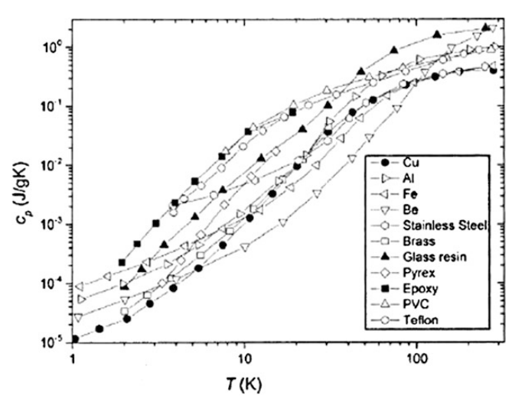
Specific heat of materials
The lower temperature the lower specific
Materials’ specific heat characteristics usually caused the long cool down time especially for the large scale cryogenic system.
Low specific heat at low temperature means small heat leakage caused big temperature increase

Slide 19
Heat conductivity of materials
Low conductivity and thermal interception are effect ways to reduce the heat conduction
Enhanced heat transfer by use high heat conductivity materials

Slide 20
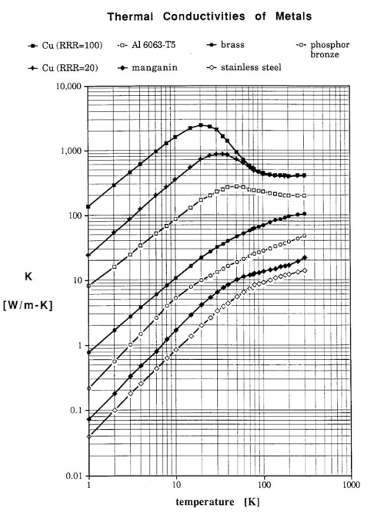
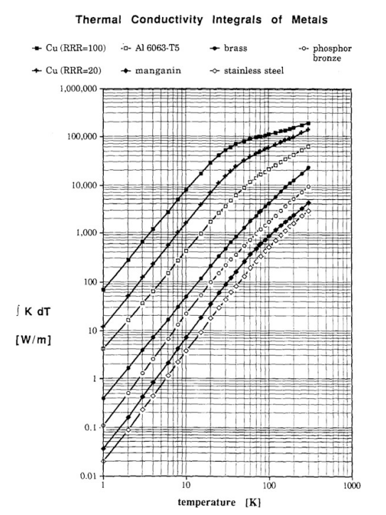
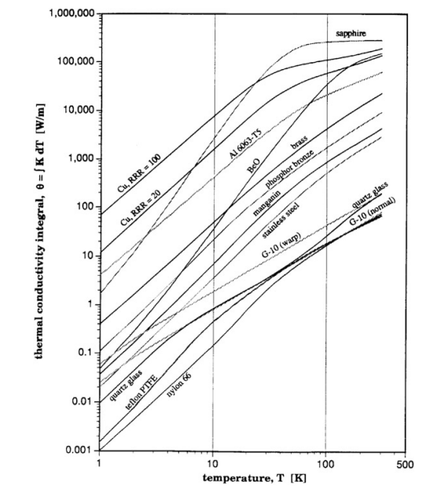
Heat conductivity of materials

Slide 21
Cryogenic heat transfer technology
Conduction, heat transport in the solid
Q=-K(T) A gradT Fourier’s law of heat conduction
Convection, heat caused by moving fluid
Q=hA(Tw-Tf) Newton’s law of cooling
Radiation, heat caused by electromagnetic
Q=σεA(Th⁴-Tc⁴) Stefan-Boltzmann’s law
Fully utilize the basic principles of heat transfer to carry out thermodynamic design of the cryomodules

Slide 22
How to reduce the conduction heat transfer
Application of materials with low conductivity
Most of the support of the crymoduels use the materials such as fiber-glass G10, G11, carbon fiber, Teflon etc., with lower conductivity but higher mechanic performance to realize the transition between the cold mass and the vacuum vessel
Intermediate heat interception also an effect way to reduce the heat conduction
This method often used for the high power coupler, conduction cold current-leads and cold beam pipes to the warm end flanges

Slide 23
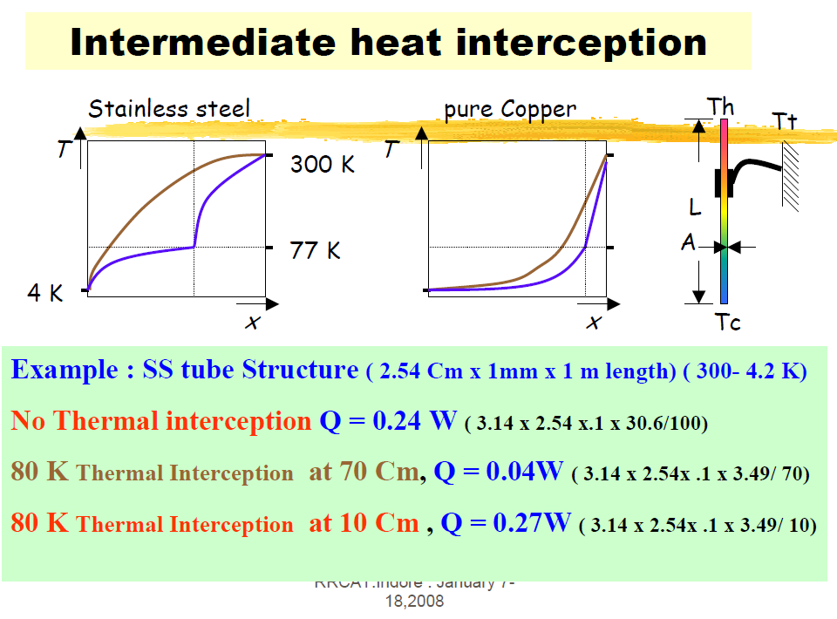

Slide 24
How to reduce the radiation heat transfer
1. Intermediate thermal shield
For 4.5K cryomodules, normally one LN2 cooled thermal shield
For 2K cryomodules, normally one layer lN2 or GHe(40K -70K) cooled shield and one Ghe (5K-8K)
Some new projects only use one Ghe (40K-70K) cooled shield, which depend on the cost performance
2. Material of low emissivity
Metal materials can get low emissivity by mechanic and electronic polishing
3. MLI-the most popular way to reduce the radiation in Cryomodules and other cryogenic equipments

Slide 25
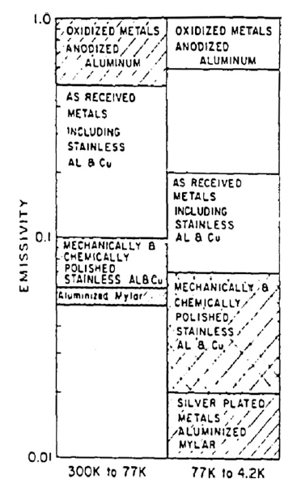
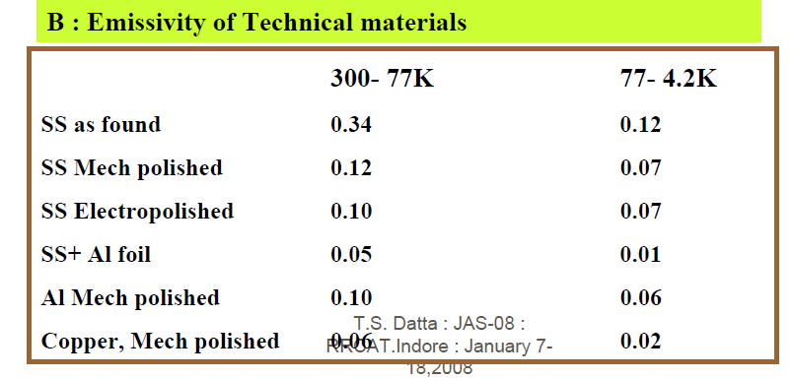
Emissivity of technical materials
Multi Layer Insulation(MLI)

Slide 26

Multi Layer Insulation(MLI)
Superinsulation
Materials: thin aluminized Mylar or aluminized kapton+nonconductive mesh or paper
Feature: reduce or eliminate the thermal conduction between the successive layers

Slide 27
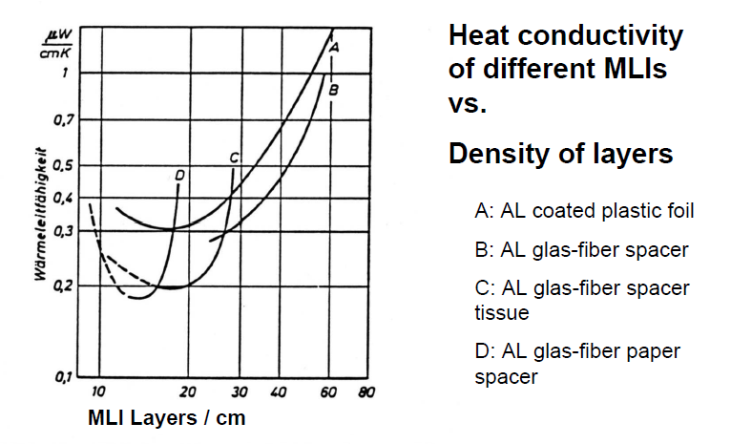
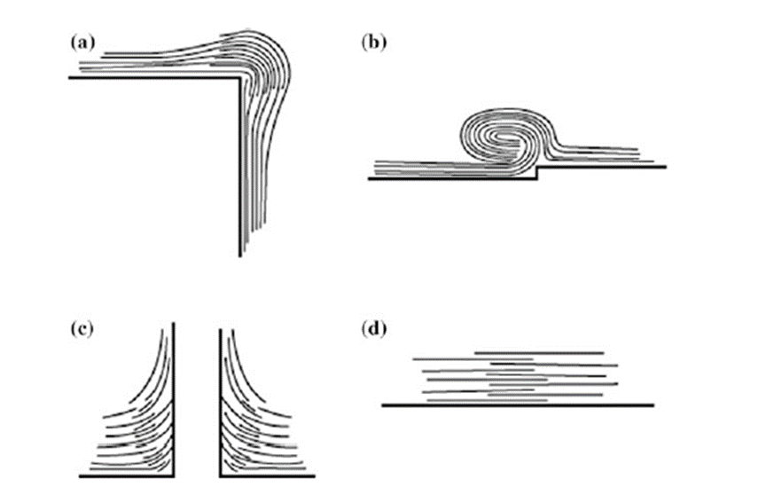
Multi Layer Insulation(MLI)
Proper installation of MLI

Slide 28
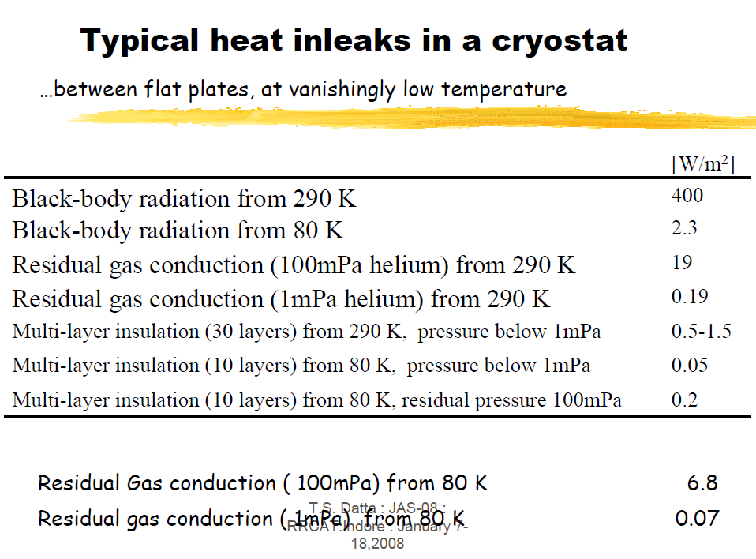

Slide 29
Content
Large scale SC accelerator and related cryomodules
Cryostats and cryomodules
Basic knowledge for the cryomodule
Typical cases
Summary

Slide 30
Typical cryomodules
TESLA type Cryomodules, already or currently being applied in Euro-XFEL,LCLS-II, SHINE, S3FEL, the total amount is close to 300. If consider future ILC and CEPC, the total amount would be more than 1000. The most widely used cryomodule
Spoke type cryomodules applied in ADS, CSNS-Ⅱ, which characteristic is bottom support of the cavities or magnets
Superconducting wiggler and undulator with carbon fiber support the cold mass.

Slide 31
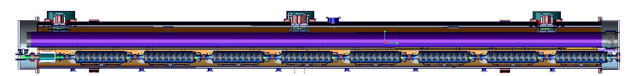
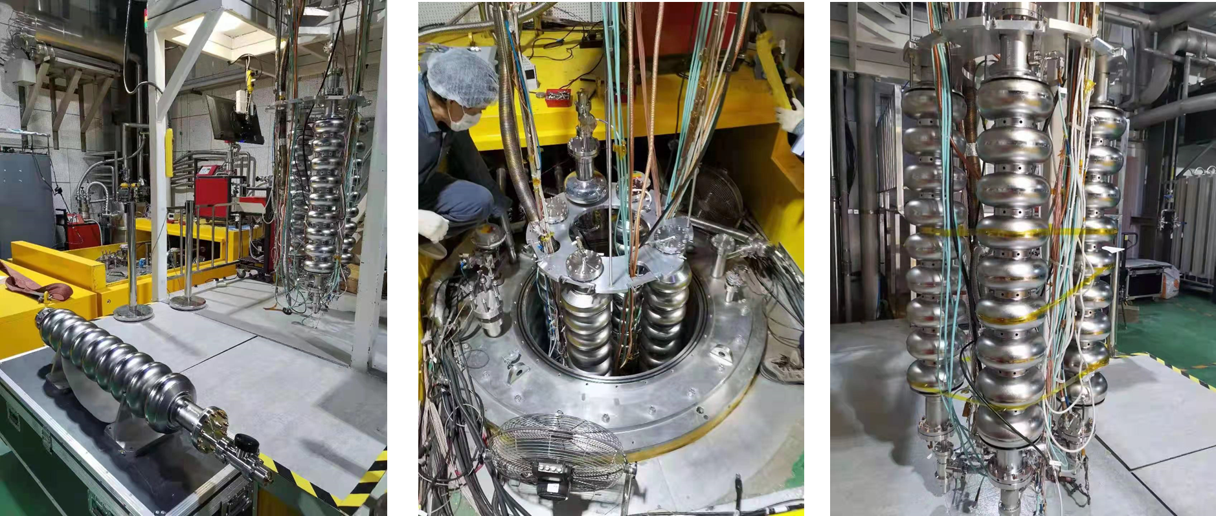
TESLA type cryomodule

Slide 32
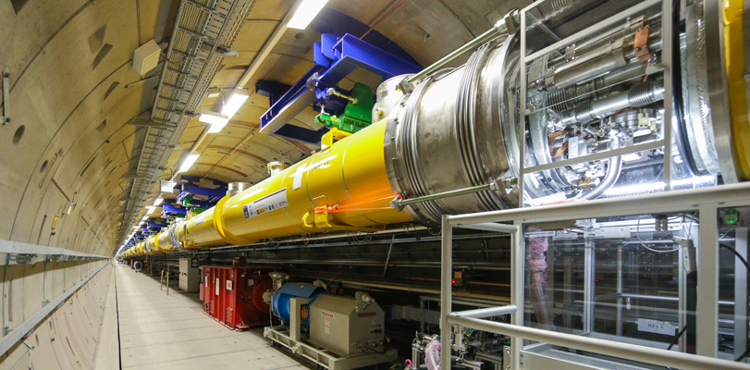
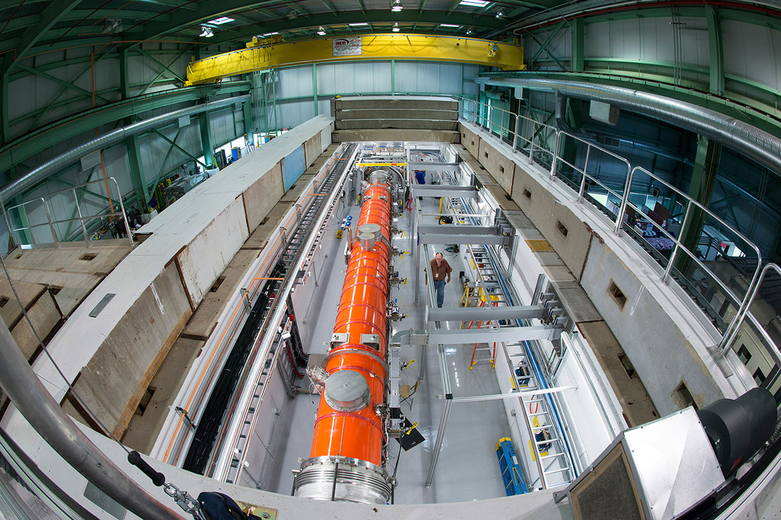
TESLA type cryomodule
TESLA type cryomodules have been applied in Euro-XFEL and LCLS –II, which have been operating stably and produces scientific achievements.
IHEP deeply involved in the cryomodules prototype and mass production.

Slide 33
TESLA type Cryomodules
Taylor-Hobson holder
Suspension Bracket
Support post
Vacuum Vessel
Pressurized 2 K helium feeding
Helium Gas Return Pipe
Wire Position Monitors
Shield gas return
Shield He cooling
Invar Rod
Thermal shields
Two phase flow
Coupler port
Sliding supports
Cavity helium tank

Slide 34
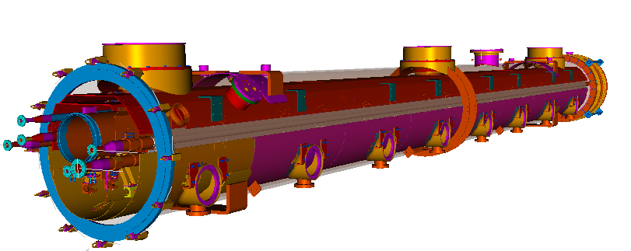
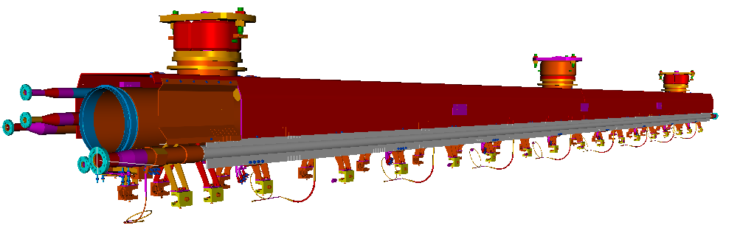
EXFEL Cryomodule
CRYOSTAT
COLD MASS
General
Overall length(flange to flange, m) | 11.177
Diameter of Vacuum vessel ,m | 0.965
Overall weight, t | 7.8
Cryo-system working temperature, K | 2
Number of cavities (Eight 9-cell cavities ) | 8
Number of solenoids | 1

Slide 35
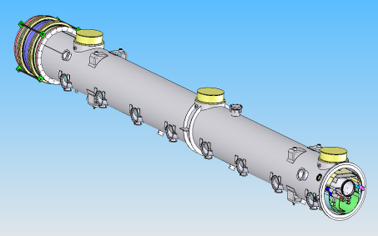
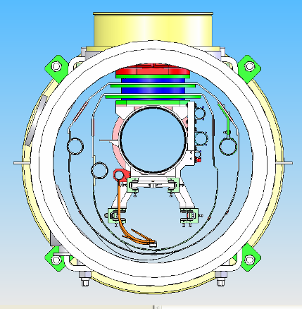
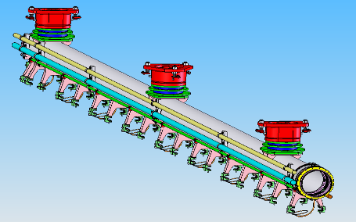
The middle post is fixed

Slide 36
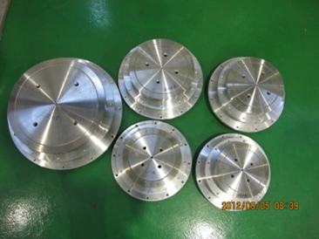
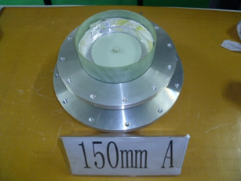
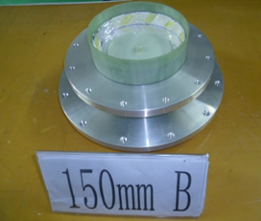
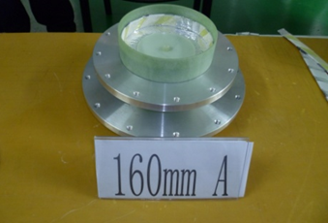
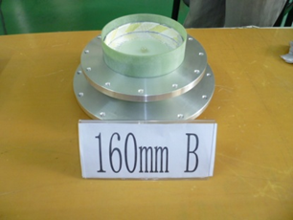
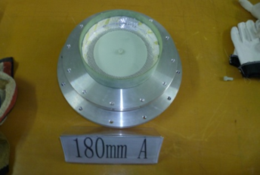
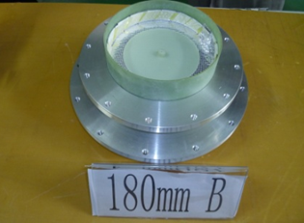
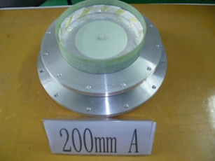
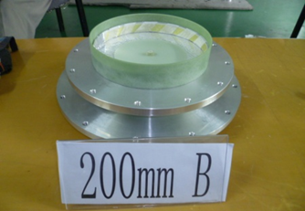
POST support with G10 tube
Different size G10 POST have been developed, one type of which applied in the Euro-XFEL cryomodule, the traction test is 5 tons, the broken traction test by DESY is more than 10 tons
One type of the post have been applied in ADS cryomodule to support the cavity and magnets from the bottom, the pressure broken test is more than 18 tons

Slide 37
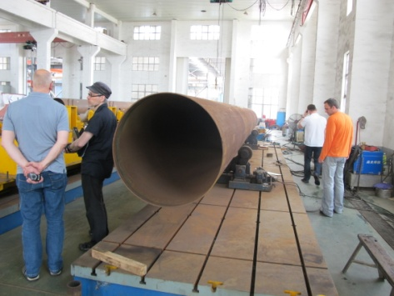
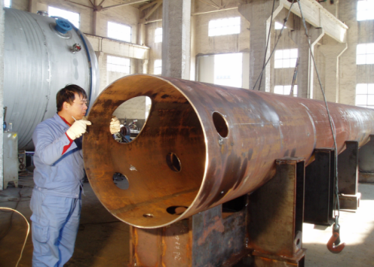
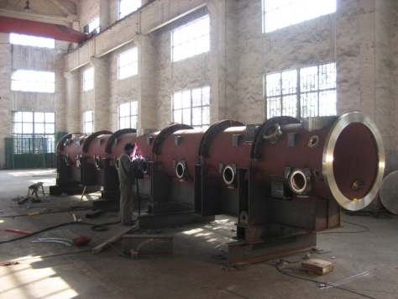
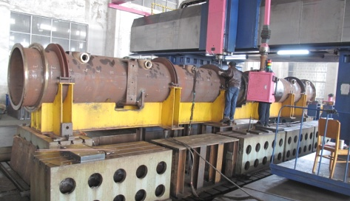
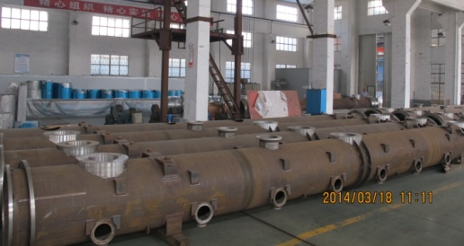
Machining
Machining accuracy control
Welding stress and deformation control
The two major technical difficulties at that time

Slide 38
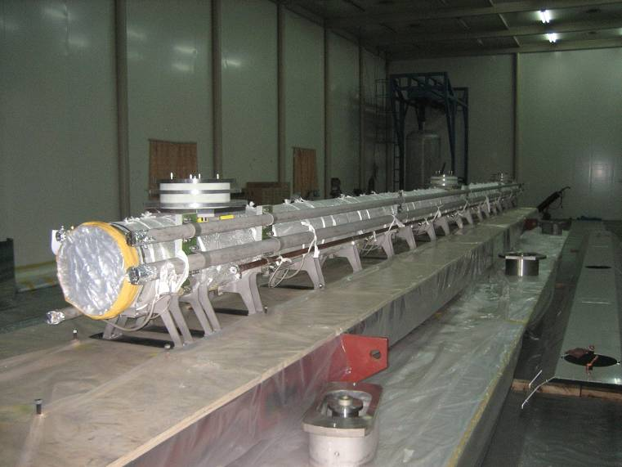
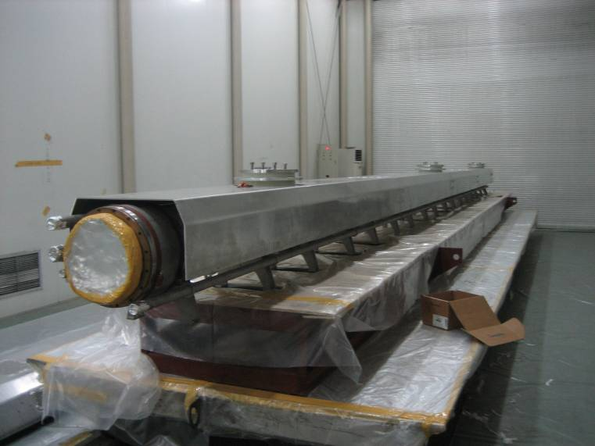
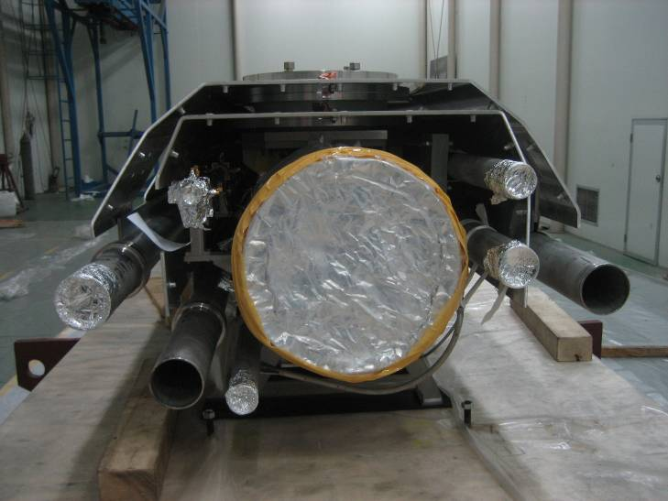
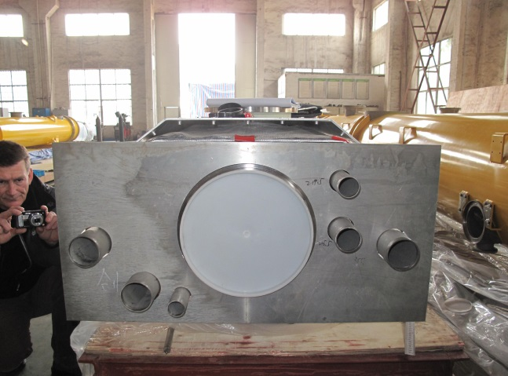
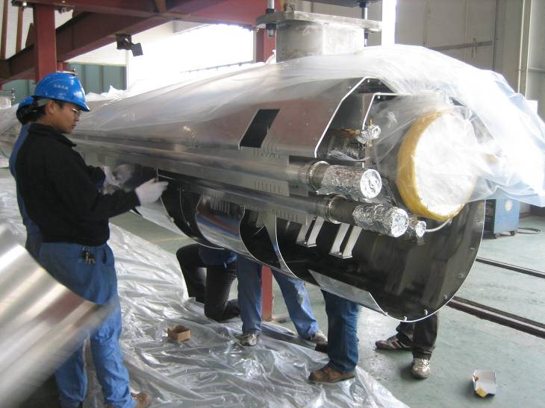
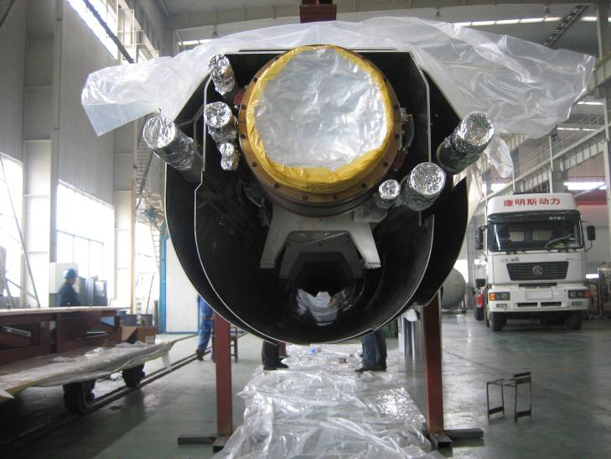
Pre-assembly of the cold mass

Slide 39
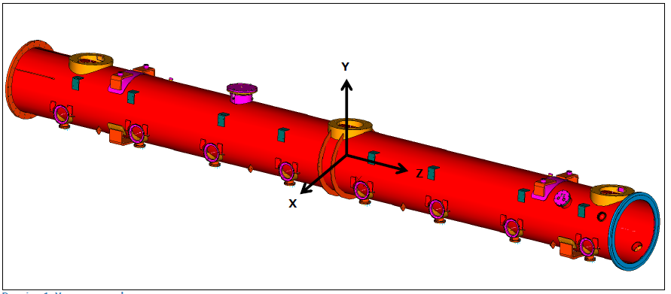
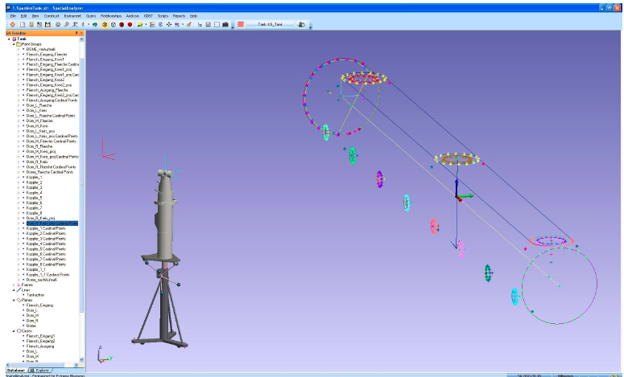
Alignment and measurement
Alignment of the vacuum vessel
Δx=±0.5
Δy=±0.5
Δz =±0.5

Slide 40
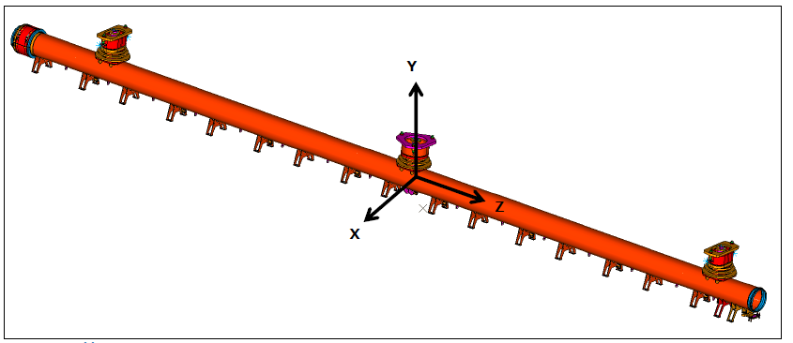
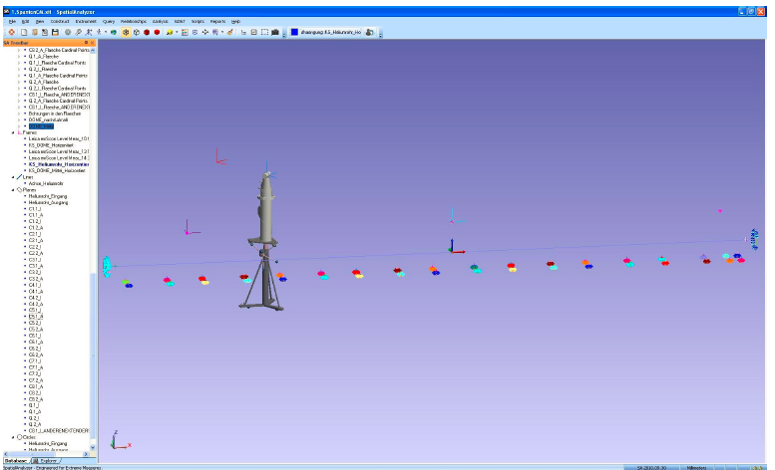
Alignment and measurement
Alignment of the cold mass
Δx=±0.3
Δy=±0.5
Δz=±1

Slide 41
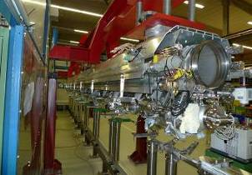





Assembly

Slide 42


Horizontal test

Slide 43

Mass production of EXFEL cryostat

Slide 44


Slide 45


IHEP high Q cryomodule

Slide 46

IHEP high Q cryomodule

Slide 47

IHEP high Q cryomodule
低温控制界面

Slide 48

IHEP high Q cryomodule
Cryomodule cool down test

Slide 49



ADS Spoke cavity cryomodule
TCM
CM1
CM1
CM2

Slide 50

ADS Spoke cavity cryomodule
The first time to use post bottom support of the cavity and magnet string, each position of which can be precisely adjusted

Slide 51

ADS Spoke cavity cryomodule

Slide 52

ADS Spoke cavity cryomodule cacuum vessel
Power coupler
Current leads
Signal cable
Tuner maintenance
A little difference with TCM, add tuner maintenance ports

Slide 53




ADS Spoke cavity cryomodule integration

Slide 54





ADS Spoke cavity cryomodule integration

Slide 55

Cavity and magnet alignment and adjustment

Slide 56



ADS Spoke cavity cryomodule integration
Cold shrink compensation
The structure of 5K and 80K shields are similar

Slide 57

ADS Spoke cavity cryomodule integration

Slide 58








ADS Spoke cavity cryomodule integration

Slide 59


Application of bottom support technology
CSNS-II 648MHz elliptical cavity cryomodule

Slide 60



Application of bottom support technology
CSNS II 648MHz elliptical cavity cryomodule

Slide 61

Superconducting wiggler

Slide 62


Superconducting wiggler

Slide 63

Superconducting wiggler

Slide 64




Superconducting wiggler carbon fiber rod
The room temperature side of support components include three sealing o-rings and one coil spring, which can be used for precise alignment of magnet position
Upside support components are mainly used to support liquid helium tank
Downside support components are mainly used to transport and self-centered design
Heat partition can reduce the heat load, the theoretical calculating value of heat load of every support components is 0.0025W@4.5K
300K
60K
4.5K

Slide 65


Carbon fiber rod traction test at LN2
Number | Test date | Stating tensile force | Finish time | Hold time | Finally tensile force
01 | 5月16日15:00 | 1350kg | 19:00 | 4h | 1348kg
02 | 5月17日9:44 | 1344kg | 13:41 | 4h | 1350.6kg
03 | 5月17日15:09 | 1348kg | 19:12 | 4h | 1375kg
04 | 5月18日9:14 | 1348kg | 13:20 | 4h | 1356kg
05 | 5月18日14:27 | 1356kg | 18:30 | 4h | 1401kg
06 | 5月19日09:17 | 1352kg | 13:20 | 4h | 1353kg
07 | 5月21日08:57 | 1353kg | 12:11 | 3h | 1401kg
08 | 5月21日13:43 | 1352kg | 17:53 | 4h | 1313kg
Test the tensile strength of the tension rod, test the displacement and deformation of the tension rod after being subjected to tension. The hand-on training course of this school.

Slide 66

Superconducting wiggler

Slide 67


Application of carbon fiber rod support technology
CSNS-II 324MHz double spoke cavity cryomodule
The carbon fiber rod support technology also has been applied in CSNS-II double spoke cavity cryomodule, the prototype have past test and the mass production undergoing .

Slide 68
Summary
Cryostat or cryomodule is a technology closely related to superconducting technology.
Many types of the cryomodules have been successfully developed, but the design principles and the technologies are very similar.
looking forward to the emergence of new superconducting and cryogenic technologies

Slide 69
Thank you for your attention!

