Slide 1
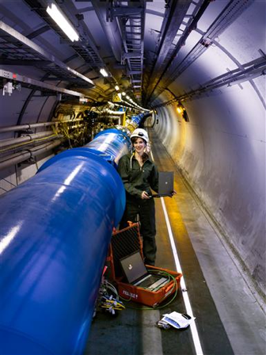

Superconducting Magnets for Accelerator
Science
CERN LHC

Slide 2
Item
Accelerator & Magnet
Superconducting Accelerator Magnet
Superconductivity
Superconducting Magnets for Hadron Colliders
Superconducting magnet applications in various accelerators
Summary

Slide 3
Item
Accelerator & Magnet
Superconducting Accelerator Magnet
Superconductivity
Superconducting Magnets for Hadron Colliders
Superconducting magnet applications in various accelerators
Summary

Slide 4
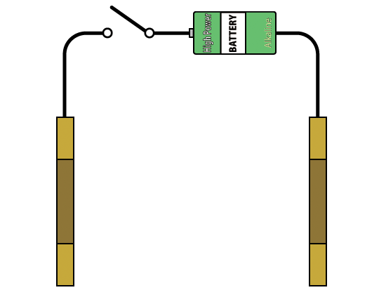
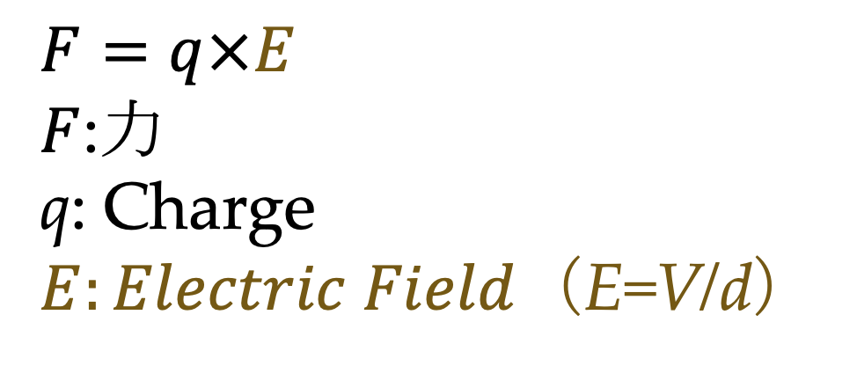
Accelerator？
V
d
Accelerate Charged Particle
$$F=q×E$$
$F$:力
q: Charge
$E:Electric Field$（E=V/d）

Slide 5
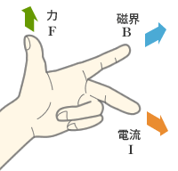
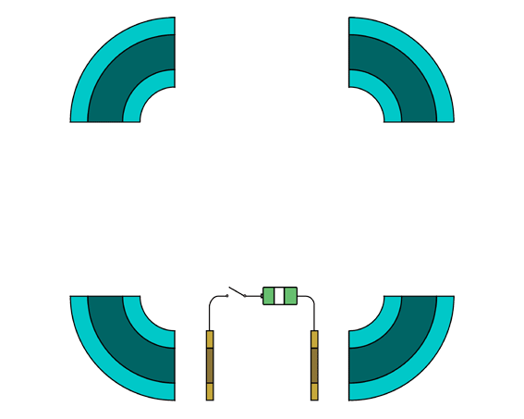
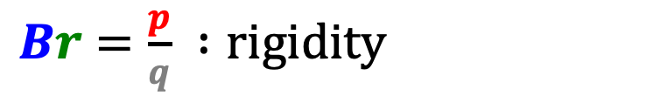


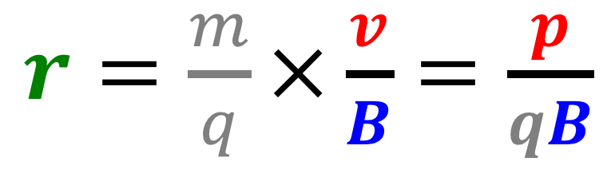
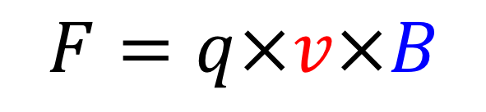
Ring Accelerator
Synchrotron
$$F=q×v×B$$
$$=\frac{m×v×v}{r}$$
EM Force
遠心力
$$=q×v$$
Bent Beam by Magnetic Field
Ring Orbit by Magnetic Field
Reuse Accelerator Cavity
Stronger B Field for Higher Energy
Bending
Magnet
Focusing
Magnet
Accelerating Cavity
$r=\frac{m}{q}×\frac{v}{B}$ $=\frac{p}{qB}$
$Br$ $=\frac{p}{q} :rigidity$

Slide 6
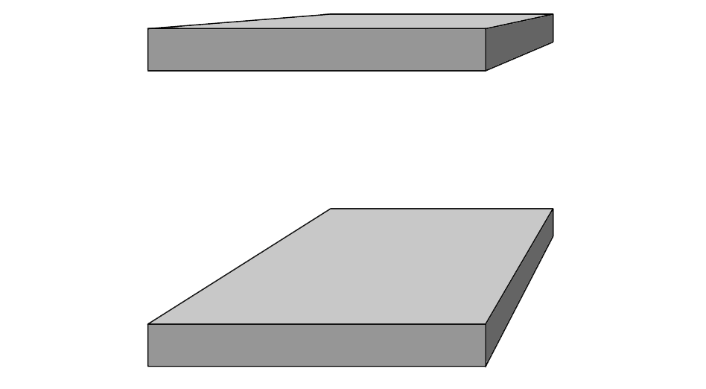


Magnets for Synchrotron
Bending
Magnet
Bending Magnet
  Normal Dipole
  Bend Beam
  Uniform Field
Accelerating Cavity
Focusing
Magnet
N
S
Focusing Magnet
  Normal Quadrupole
  Focus Beam
  Gradient Field
S
N

Slide 7

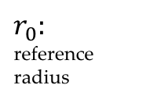
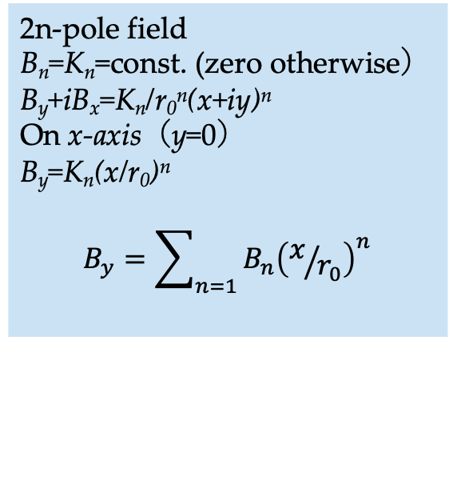
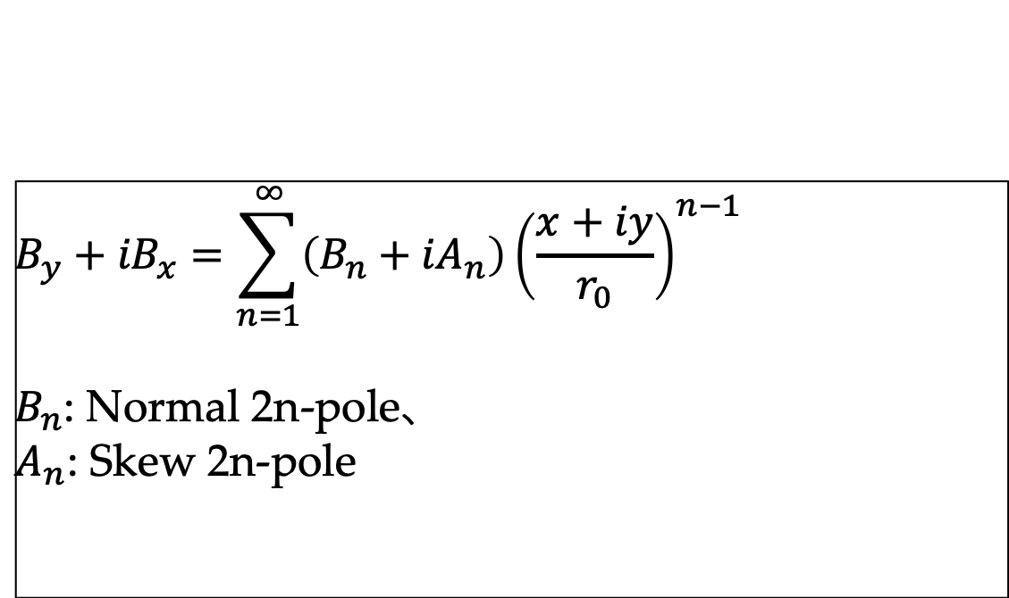



Multipole Field
$$B_{y}+{iB}_{x}=\sum_{n=1}^{∞}{\left(B_{n}+{iA}_{n}\right){\left(\frac{x+iy}{r_{0}}\right)}^{n−1}}$$
$B_{n}$: Normal 2n-pole、
$A_{n}$: Skew 2n-pole
$$y$$
N
$$B_{y}$$
$$B_{x}$$
$$x$$
$$r_{0}:$$
reference
radius
S
Normal Dipole
B₁=const. (zero otherwise）
B_{y}=B₁
B_{x}=0
Uniform Field
2n-pole field
B_{n}=K_{n}=const. (zero otherwise）
B_{y}+iB_{x}=K_{n}/r₀^{n}(x+iy)^{n}
On x-axis（y=0）
B_{y}=K_{n}(x/r₀)^{n}
$$B_{y}=\sum_{n=1}{B_{n}{\left(x/{r_{0}}\right)}^{n}}$$
S
Normal Quadrupole
B₂=G₀=const. (zero otherwise）
B_{y}+iB_{x}=G₀/r₀(x+iy), G₀/r₀=g₀
B_{y}=g₀x
B_{x}=g₀y
Uniform Gradient Field
N
S
N

Slide 8
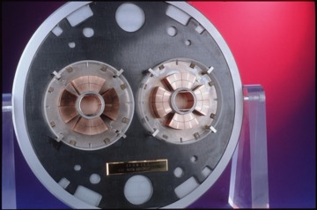
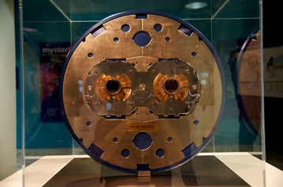
LHC: Large Hadron Collider
１cell：BM６＋FM１＋DFM１
1 arc = 23 cell
F or DF Magnet
B Magnet
8 x 2.45 km arc, 8 x 545 m straight section

Slide 9
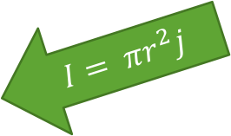

Create Uniform Field
y
$I=$ $πr^{2}j$
$B_{θ}\left(r\right)$ $=$ $\frac{μ_{0}πr^{2}j}{2πr}=\frac{μ_{0}rj}{2}$
$B_{x}\left(x,y\right)=−\frac{μ_{0}rj}{2}$ $\sin{θ}=−\frac{μ_{0}yj}{2}$
$B_{y}\left(x,y\right)=\frac{μ_{0}rj}{2}\cos{θ}$ $=−\frac{μ_{0}xj}{2}$
x

Slide 10
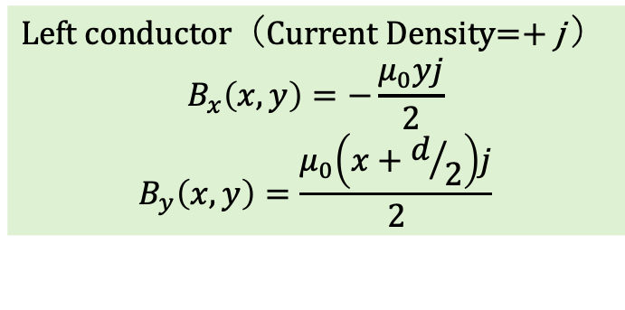

Create Uniform Field
Left conductor（Current Density=$+$j ）
$$B_{x}\left(x,y\right)=−\frac{μ_{0}yj}{2}$$
$$B_{y}\left(x,y\right)=\frac{μ_{0}\left(x+d/2\right)j}{2}$$
$$\frac{d}{2}$$

Slide 11
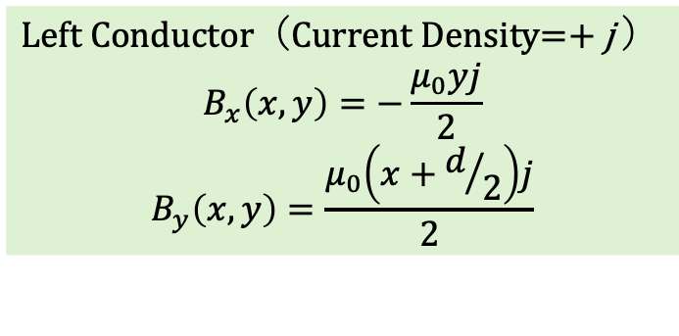
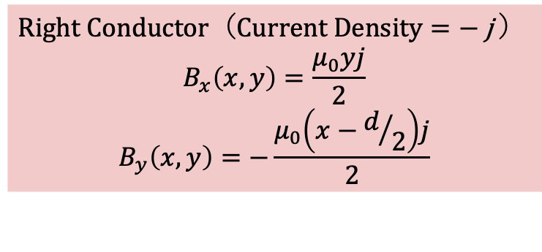

Create Uniform Field
Left Conductor（Current Density=$+$j ）
$$B_{x}\left(x,y\right)=−\frac{μ_{0}yj}{2}$$
$$B_{y}\left(x,y\right)=\frac{μ_{0}\left(x+d/2\right)j}{2}$$
Right Conductor（C$urrent Density=−$j ）
$$B_{x}\left(x,y\right)=\frac{μ_{0}yj}{2}$$
$$B_{y}\left(x,y\right)=−\frac{μ_{0}\left(x−d/2\right)j}{2}$$
$$\frac{d}{2}$$
$$\frac{d}{2}$$

Slide 12

Create Uniform Field
Center（Current Density=0）
$$B_{x}\left(x,y\right)=0$$
$$B_{y}\left(x,y\right)=\frac{μ_{0}jd}{2}$$
Left Conductor（Current Density=$+$j ）
$$B_{x}\left(x,y\right)=−\frac{μ_{0}yj}{2}$$
$$B_{y}\left(x,y\right)=\frac{μ_{0}\left(x+d/2\right)j}{2}$$
Right Conductor（C$urrent Density=−$j ）
$$B_{x}\left(x,y\right)=\frac{μ_{0}yj}{2}$$
$$B_{y}\left(x,y\right)=−\frac{μ_{0}\left(x−d/2\right)j}{2}$$
$$\frac{d}{2}$$
$$\frac{d}{2}$$

Slide 13
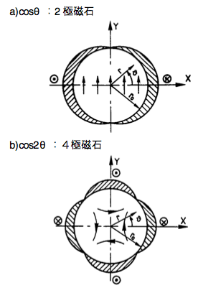

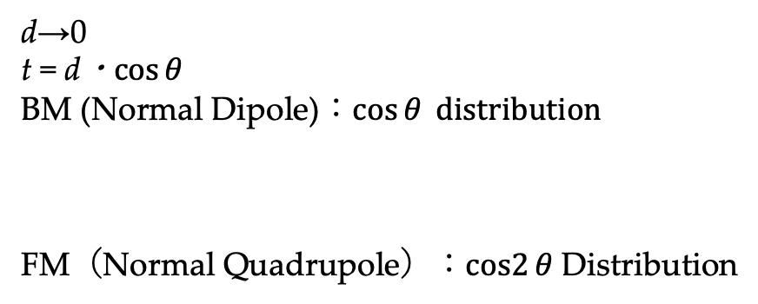

Cosθ coil
$$B_{x}\left(x,y\right)=0$$
$$B_{y}\left(x,y\right)=\frac{μ_{0}jd}{2}$$
$$t≈d×\cos{θ}$$
d→0
t = d・$\cos{θ}$
BM (Normal Dipole)：$\cos{θ} distribution$
FM（Normal Quadrupole）：$cos2{θ}$ Distribution
θ

Slide 14
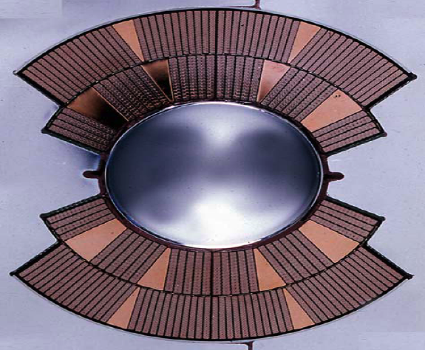
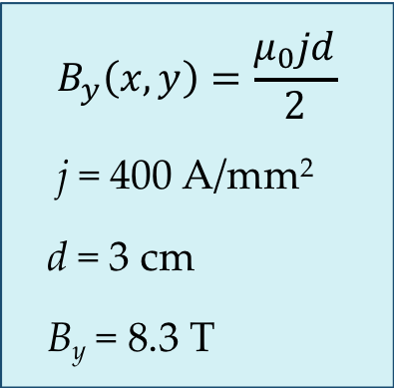
Create Uniform Field：LHC Dipole
$$B_{y}\left(x,y\right)=\frac{μ_{0}jd}{2}$$
j = 400 A/mm²
d = 3 cm
B_{y} = 8.3 T
Actual Coil
Inner Cable
Width：15.1 mm
Thickness：1.9 mm
Turn Number：15*2
Current Density：400 A/mm²
Outer Cable
Width：15.1 mm
Thickness：1.48 mm
Turn Number：26*2
Current Density：520 A/mm²
Power consumption：total LHC: 120MW 〜 600W/Tm

Slide 15
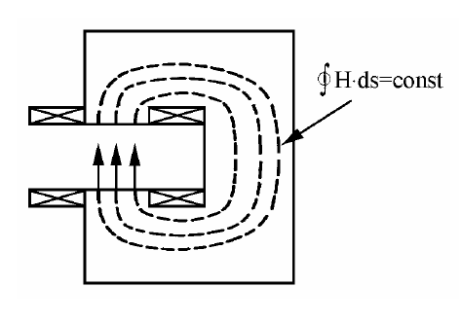
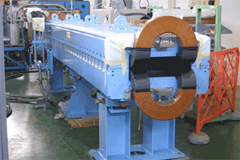
Normal Conducting Magnet
Ohmic Heating：W = VI = RI² → Cooling limitation：10 A/mm²
1/40 of Superconductor：40 times large coil?：Not real
Real normal magnet：Magnetic circuit with Iron Yoke
Iron Saturation：2 T limit
g
H=NI
B~μ₀NI/g
P = ρi(NI)L
~ ρjBLg/μ₀
(P: Power consumption、
ρ: Resistivity
j: Current Density,
L: Conductor length / turn）
LHC with Normal Magnet
4 times large accelerator
10 times large Power Cons.
0.05(gap)*0.1(width)*1(length)m & 2T ~ 15kW (@ 10A/mm²) 〜 7kW/Tm

Slide 16
Item
Accelerator & Magnet
Superconducting Accelerator Magnet
Superconductivity
Superconducting Magnets for Hadron Colliders
Superconducting magnet applications in various accelerators
Summary

Slide 17
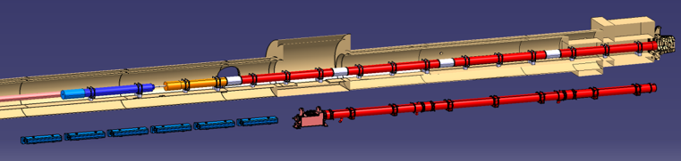





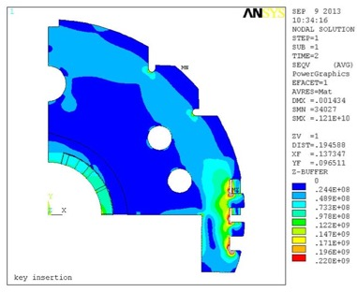
Superconducting Accelerator Magnet
IT Quads.& D1
HL-LHC
IT Quads. w/ Nb₃Sn
Q1
Corrector
Package
Q2b
Q2a
Q3
SC D1
IP
NC D1
Nominal LHC

Slide 18
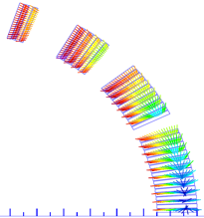

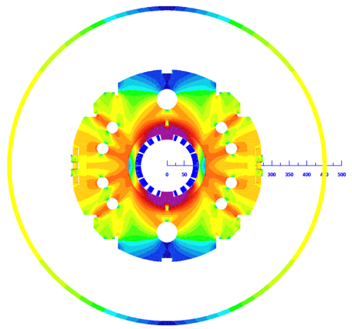
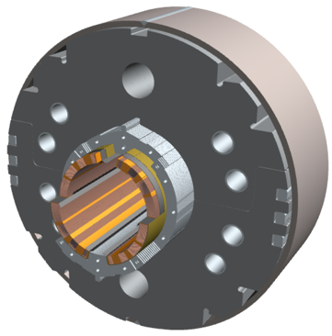
HL-LHC D1 magnet
Lorentz force
High Current in High Field
=Strong Lorentz force
=Strong Structure
φ60 mm HX hole
Field tuning hole
Shell (SUS304L)
4-way split stainless steel collars
(NSSC130S)
Stack tube (S45C)
Brass shoe
QPH + Insulations
key (S45C)
Cu/NbTi cable
(LHC MB outer) +
Apical insulation
Iron yoke
(EFE by JFE steel )
Radiation resistant
GFRP wedge
(S2 glass + BT resin)
Mid-plane

Slide 19
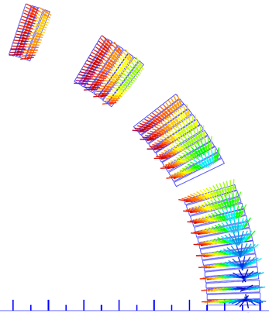

Prestress to support coil
X=X₀+ΔX
f₁
f_{n-1}
….
….
k₁
k_{n}
~const.
f_{i-1}
f_{i}
f_{i+1}
….
δx_{i}
k_{i}
δx_{i+1}
k_{i+1}
….
Prestress $∝r, B, J$

Slide 20
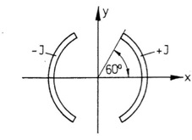
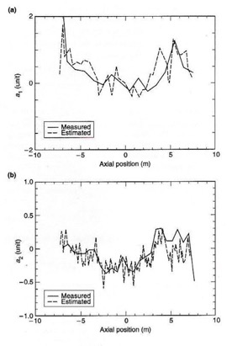
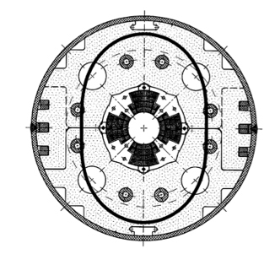
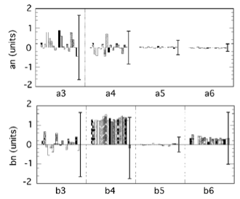
Error Field
Error Field＝Orbit distortion: small as possible 〜10⁻⁴
Error due to coil size error
Error due to magnet deformation
+
–
–
A2, A6, A10, …
+
–
–
+
+
High Precision Structure技術
A1, A3, A5, …

Slide 21
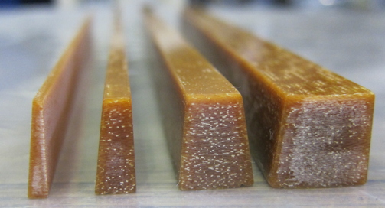
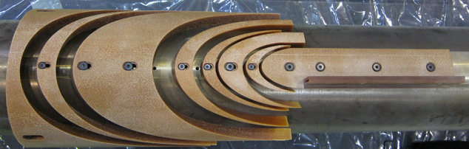
Magnet Assembly
Size Control of Coil Parts
Pole shim and wedges tolerance: ±20 μm
Pole shim and wedges
End spacers

Slide 22
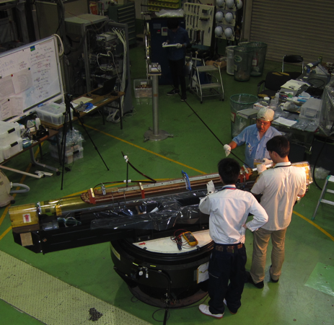
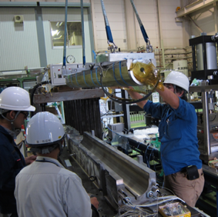
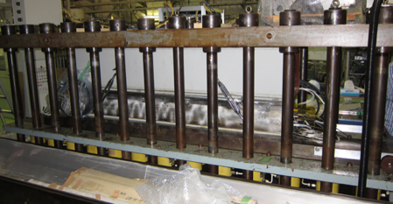
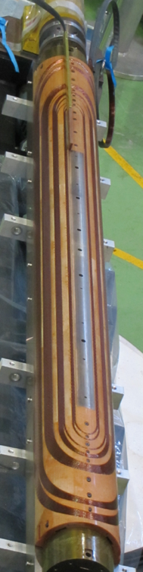
Magnet Assembly
Coil winding and Curing
Tensioner
Feeder
Winding mandrel
Hydraulic rams
Turn table

Slide 23
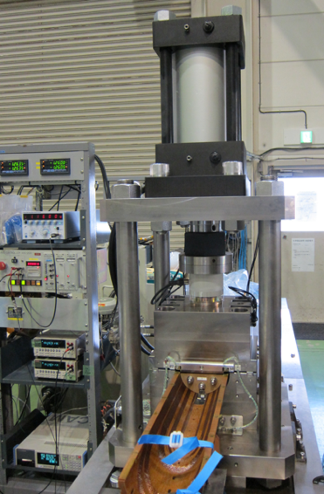
Magnet Assebly
Coil size measurement
コイルサイズを確認して予備応力を制御する

Slide 24
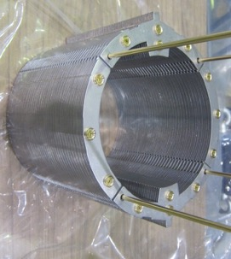
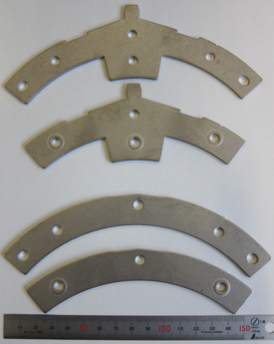
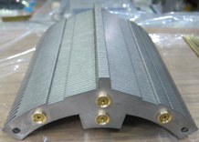
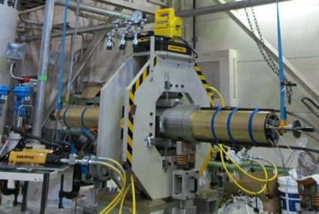
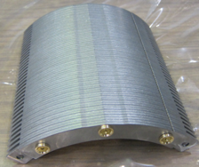
Magnet Assebly
Collaring
Collar plates were fabricated by fine-blanking.
Good size accuracy in the critical parts:±10 μm
Four-way split collar even for a dipole
Alternate lamination of Fixing- and Spacer-collar
(t2.3 mm, t2.6 mm)
Embossing to control PF to be 96%
Vertical
collar
Fixing-collar
Sub-stack
Four-way split collar
Spacer-collar
Horizontal
collar
Fixing-collar
Spacer-collar
Collar plates fabricated by
fine-blanking
Collaring press

Slide 25
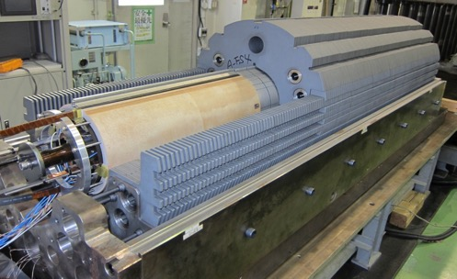



Yoke plates were fabricated by fine-blanking.
Alternate lamination of Fixing- and Spacer-yoke (t5.6 mm, t6 mm)
Spacer sheets were periodically inserted to control PF to be 98%
Magnet Assebly
Yoking
Ramp box
Upper yoke
Fixing-yoke
Yoke assembly
Key slots
GFRP collar
SS collar
Spacer-yoke
Lower yoke
Yoke sub-stack
Keys
Loading

Slide 26




Magnet Assebly
Final Assembly
2 m long half shells were longitudinally welded.
Magnet assembly was completed after end ring welding and splice work.
Shell welding
Completion of fabrication
End ring welding
Splice work

Slide 27
Item
Accelerator & Magnet
Superconducting Accelerator Magnet
Superconductivity
Superconducting Magnets for Hadron Colliders
Superconducting magnet applications in various accelerators
Summary

Slide 28





Discovery of Superconductivity and
Meissner Effect
Heike Kamerlingh Onnes
  1908 Helium liquified
  1911 April 8th Discovery of Hg Supercon.
1933 Meissner Effect

Slide 29

BCS Theory
Bardeen, Cooper, Schrieffer
BCS Theory（１９５７）
  Cooper Pair

Slide 30





Normal Conductor
W = VI = RI²
V = RI

Slide 31





Superconductor
Pair interchange kinetic momentum: no loss

Slide 32
BCS Theory
Bardeen, Cooper, Schrieffer
Based on Cooper pair
Bose–Einstein condensation
  All Cooper pairs have the same momentum
  Energy Gap
Fermi
Surface

Slide 33
Superconuductors
Type II Superconductor
  Mixed State (1957 Abrikosov)
    Penetration Depth λ＞ξ Coherent Length
    Alloy, Compound
  Flux penetration in Superconductor
  Current Flow inside Superconductor
Type I Superconductor
  Meissner Effect
    Penetration Depth λ＜ξ Coherent Length
    l: Electron Mean Free Path Pure Metal
  Current Flow only on Thin Surface

Slide 34
Critical Current and Pinning
Pinning potential
Flux Flow
  Flux Move
  Induced Voltage
  Need to stop Flux
Pinning Force
  Week superconducting state
    Easier to turn to normal
  Normal Site = Flux Pinned
  Pinning Force = Critical Current

Slide 35

Meissner Effect and Pinning Effect
Stick by Pinning Effect
Enforce flux pinning by pushing
superconductor to magnet rail
Superconductor
Superconductor
Float by
Meissner Effect
Ｎ
Ｓ
Ｓ
Ｎ
Ｎ
Ｓ
Ｓ
Ｎ
Ｎ
Ｓ
Ｓ
Ｎ
Ｎ
Ｓ
Ｓ
Ｎ
Ｓ
Ｎ
Ｓ
Ｎ
Ｓ
Ｓ
Ｎ
Ｓ
Ｎ
Ｓ
Cross Section

Slide 36

Critical Surface
Critical Current Density is function of
  Temperature
  Magnetic Field
NbTi: 3000A/mm² @ 4.2K, 5 T

Slide 37








Real Superconductor：
Multi-filament superconductor
dice
NbTi/Cu
Multi Billet
Hydrostatic Extrusion
Drawing
Hydrostatic Extrusion
Nb/Bronds
Nb/Al/Cu
Billet
Heat Treatment
Twist
Drawing
Wire
Insulation
Rutherford Cable
NbTi
Al stabilized Cable
Cabling
CICC
Cable
Nb₃Sn
Soldered Cable

Slide 38


Multi-filament Superconductor
Magnetization
Coupling between Filaments
Shielding Current with Jc
–M
Type-I
Type-II (without Pinning)
Type-II (with Pinning)
+J_{c}
+J_{c}
Twist to de-couple
H
Magnetization
＝ Proportional to
Filament Size

Slide 39





Quench and Protection
〜10⁻¹⁰ Ωm
Current
Copper
NbTi
〜10⁻⁷ Ωm
Quench = Abrupt phase transition to normal
Current flow in Copper → Still fast temperature rise
Temperature rise depends: MIITs
MIITs/I²: time to reach a temperature
  Cu/NbTi=1, 400 A/mm² →
Rapid detection of quench and shutting down current is needed

Slide 40
Quench Protection
Magnet
PS
Extraction R
Fast Shutting Down of Current
  External Dump Resistor
    Extract energy to outside
    High terminal voltage
  Quench Protection Heater
    Voltage is distributed in the magnet
    The energy is dumped into the magnet
  In principle combination of these two methods is used
PS
Magnet
Heater

Slide 41





Quench Protection of Large Accelerator
Magnet System:
Neutrino Beam Line
Quench Protection Heater
  Powered by Capacitor Bank
  Magnet Current τ≈1 sec
Cold Diode
  Turn On Voltage: 6V
  Forward Voltage: 1V
trigger
trigger
Quench Detector
Dump Circuit
  Protect Cold Diodes and SC Bus Bars
  Time Constant: 20 sec
Protection Circuit for Accelerator String

Slide 42




LHC Incident in 2008
Cause
  Bad solder joints
  Insufficient quench detection
  Huge stored energy
Damage: 300MJ dissipated: ~15 magnet damaged
Recovery: 2 years: several thousand solder joints repaired

Slide 43
Item
Accelerator & Magnet
Superconducting Accelerator Magnet
Superconductivity
Superconducting Magnets for Hadron Colliders
  History
  On going
  Future
Superconducting magnet applications in various accelerators
Summary

Slide 44

History of Accelerator and Superconductivity
1908 Liquid Helium (K. Onnes)
1911 Superconductivity (Hg：K. Onnes)
1933 Meissner Effect (W.Meissner)
1957 BCS Theory (J.Bardeen L.Cooper J.Schrieffer)
1965 First International Symposium of Magnet Technology (SLAC)
1970 Industrialization of NbTi Composite Conductor
1977 FNAL/Tevatron prototype magnet
1979 Industrialization of MRI Magnet
1983 FNAL/Tevatron: 6.3km (4.4T, 6.1m, 774)
1986 High Tc Superconductor (K.Muller, J. Bednorz)
1988 SC Tokamak （TORE SUPRA）
1989 SC Cavity (KEK/TRISTAN)
1990~ Industrialization of MCZ Magnet
1992 DESY/HERA: 6.3km (4.7T, 8.8m, 416)
1993 SSC Cancel: 87.1km (6.6T, 15.8/13.3m, 7956/504)
1998 BNL/RHIC: 3.8km (3.5T, 9.7m, 288)
2001 MgB₂ (J. Akimitsu)
2008 CERN/LHC: 26.7km (8.3T, 14.2m, 1232)
PARTICLE ACCELERATORS by M. Stanley Livingston and John P. Blewett, 1962, p. 6.

Slide 45

History of Superconducting Magnet
Early Days（1960s）
1961 MIT Conference
  J.E.Kunzler (Bell Lab.): Nb₃Sn 6.8T Win!
  J.Hulm (Westinghouse): NbZr 6T ！
初めての磁石
  1954 G. Yntema 0.71 T
Kunzler:10T Nb₃Sn Magnet
Win 2 case of scotti！
But Bell lab. stop SCM R&D
J. Hulm: NbTi !
Kunzlerによる最初の特許

Slide 46

NbTi (Alloy) vs Nb₃Sn (Compound)
Jc：Nb₃Sn is better
Mechanical Property
  NbTi: Alloy → Ductile → Easier to wind coil
  Nb₃Sn: Brittle → Difficult to wind coil
Below 8T
  NbTi

Slide 47







TEVATRON
Energy Doubler (1TeV)
  Higher Field Magnet 4.3 T
Energy Saver
  ~1/2 Overall Power Saving
Tunnel is given (main ring)
SCMs are installed in the same tunnel
main ring (normal conducting) is
used as injector, but reduce energy from 400 GeV to 150 GeV
Overall energy saving ~ ½

Slide 48

Iron geometric error
FNAL dipole magnet
  Coil support creep → Coil move by -d_{y}
Iron location error：+dy
  Error in image current: (R²/r)
    Radial：-d_{y}/r•sinθ
    Azimuthal：d_{y}/r•cosθ
  Skew quadrupole
  Beam X-Y coupling
  Emittance growth at injection

Slide 49




Accelerator Superconducting Magnet:
HERA & RHIC
1998：BNL/RHIC: 3.8km (3.5T, 9.7m, 288 Magnets)
1992：DESY/HERA: 6.3km (4.7T, 8.8m, 416 Magnets)

Slide 50

Accelerator Superconducting Magnet:
Superconducting Super Collider
Start in 1988 > Terminated in 1993
Fail to control budget 4.4B$→12B$
2B$ already used

Slide 51

Synchrotron Operation
Imag
Storage (flat top)
Storage Ring
  Collider, Photon Factory
  Slow Operation Cycle
Extraction Machine
  Injector, Fixed Target
  Fast Operation Cycle
Accelration
Injection
Time
Extraction
(flat top)
Imag
Acceleration
Injection
HEB magnets: 15 times faster ramp rate to that of collider
Time

Slide 52






SSC: Influence of inter-strand coupling current on field quality
Inter-strand coupling current dominated by cross over resistances that are extremely non-uniform across the magnet cross section = non-uniform coupling current = strange field behavior

Slide 53



Accelerator Superconducting Magnet:
LHC
2008：CERN/LHC: 26.7km (8.3T, 14.2m, 1232 Magnets)

Slide 54





Magnetization decay
Measured as
  Sextupole field decay and snap back at TEVATRON
  Imbalance current observed as periodic pattern at HERA
  Model to simulate effect established by CERN (LHC)
Injection
Acceleration
Flat
top

Slide 55



Japanese Contribution to LHC
MQXA: Interaction Quadrupole
Focus Beam at Interaction Region (Increase Luminosity)
  Field Gradient 280T/m, Maximum Field 8.7 T

Slide 56
Item
Accelerator & Magnet
Superconducting Accelerator Magnet
Superconductivity
Superconducting Magnets for Hadron Colliders
  History
  On going
  Future
Superconducting magnet applications in various accelerators
Summary

Slide 57
On going
HL-LHC
High Luminosity LHC
Increase Collision Statistics
More detailed physics

Slide 58



On going
HL-LHC
Interaction Region Upgrade
  Smaller beam size at IR
    Quadrupole upgrade by Nb₃Sn
  Crab cavity
  Beam separation magnet upgrade
    NbTi superconducting magnet
  Luminosity Upgrade

Slide 59




IR Quadrupole Upgrade
Higher Field by Nb₃Sn
OST RRP strand, 132/169
Nb₃Sn: maximum field 11.4T
Wind and React to handle brittle superconductor

Slide 60



Superconducting
Transmission Line
Transmission line system for HL-LHC.
Default MgB2
Option HTS
“Development of superconducting links for the Large Hadron Collider machine,” A. Ballarino, Supercond. Sci. Technol. 27, 2014, 044024.

Slide 61


Beam Separation Dipole Upgrade
KEK Contribution
Large Aperture 150mm, 6T Dipole
Sigh of MOU between CERN and KEK
HL-LHC D1 Magnet

Slide 62
Item
Accelerator & Magnet
Superconducting Accelerator Magnet
Superconductivity
Superconducting Magnets for Hadron Colliders
  History
  On going
  Future
Superconducting magnet applications in various accelerators
Summary

Slide 63

The FCC-hh: a next energy frontier.
Future
Prospects
FCC
Geneva
Future Circular Collider (FCC)
Future 100 TeV Collider
100 km circumference
Or
HE-LHC
(High Energy LHC)
Both needs
20T HTS magnets or
16T Nb₃Sn magnets
PS
SPS
LHC
L. Bottura at WAMHTS-1
LHC
27 km, 8.33 T
14 TeV (c.o.m.)
HE-LHC
27 km, 20 T
33 TeV (c.o.m.)
FCC-hh
80 km, 20 T
100 TeV (c.o.m.)
FCC-hh
100 km, 16 T
100 TeV (c.o.m.)
L Rossi @ WAMHTS-2 Kyoto

Slide 64


FCC
Magnet Designs
L. Bottura at WAMHTS-1
16T version
4300 tons of Nb₃Sn + 10200 tons of Nb-Ti
20T version
1400 tons of HTS + 6600 tons of Nb₃Sn + 11300 tons of Nb-Ti

Slide 65
Item
Accelerator & Magnet
Superconducting Accelerator Magnet
Superconductivity
Superconducting Magnets for Hadron Colliders
Superconducting magnet applications in various accelerators
Summary

Slide 66
Superconducting magnet applications in various accelerators
Lepton colliders
Synchrotron radiation facilities
Proton extraction synchrotron
Medical synchrotron
Cyclotron
Ion source, klystron
Detector magnets

Slide 67
Superconducting magnet applications in various accelerators
Lepton colliders
Synchrotron radiation facilities
Proton extraction synchrotron
Medical synchrotron
Cyclotron
Ion source, klystron
Detector magnets

Slide 68
LEP and LEP2
LEP: electron positron collider at CERN
27 km circumference
Superconducting magnets for interaction region: focusing quadrupole magnets

Slide 69

KEK Lepton colliders and SC Magnets
TRISTAN, KEKB, S-KEKB
SuperKEKB Quadrupole magnet at Collision point

Slide 70



ILC
Magnets
Interaction Region Quadrupoles
Undulator
ILC magnets
Low field
Acceleration Region Quadrupoles

Slide 71
Superconducting magnet applications in various accelerators
Lepton colliders
Synchrotron radiation facilities
Proton extraction synchrotron
Medical synchrotron
Cyclotron
Ion source, klystron
Detector magnets

Slide 72
Synchrotron radiation facilities
Various SR facilities

Slide 73

SR facilities
Super-Bend
Traditional usage

Slide 74

SR facilities
Wiggler

Slide 75

SR facilities
HTS tape conductor coil
Superconducting undulator
Short period undulator.
Nb₃Sn high current density coil
Shorter period
Higher brightness
Higher energy
Large fixed aperture

Slide 76
Superconducting magnet applications in various accelerators
Lepton colliders
Synchrotron radiation facilities
Proton extraction synchrotron
Medical synchrotron
Cyclotron
Ion source, klystron
Detector magnets

Slide 77

Proton extraction accelerators
J-PARC
J-PARC: extraction machine
  Rapid cycle synchrotron
  J-PARC RCS (3GeV 1MW)：25 Hz
  J-PARC MR (30GeV 1MW): ~1 Hz
  Not suitable for superconducting magnets
After extraction: constant beam energy = constant magnetic field: good for superconducting magnet
  J-PARC neutrino beam line
J-PARC RCS Magnets
J-PARC MR Magnets

Slide 78



Japanese Accelerators and SC Magnets
J-PARC Neutrino Facility
Neutrino Facility needed SC magnets due to space limitation
But it's too expensive
We need SC Magnets
Combined Function Magnet Beam Line（2.6T+19T/m, 28 Magnets）Optimize Cost and Schedule

Slide 79
Muon Capture and Trasportation
Muon at J-PARC MLF: Low Energy (low momentum)
  Trap Muon in helical orbit (cyclotron motion)
  Use solenoid magnet
Current +I⦿
B
Current -I$⊗$

Slide 80








SC Solenoids in MLF Muon Science Facility
Decay Muon Beam Line
Ultra-Slow Muon Beam Line
Superconducting Curved Solenoid
Superconducting Focusing Solenoids
http://legacy.kek.jp/newskek/2009/julaug/CFCAF.html
Superconducting Solenoid

Slide 81




J-PARC g-2/EDM
Cold box
2900 mm
Very high precision solenoid (sub-ppm) for Muon storage: measure muon g-2 and EDM
Muon storage orbit
Dia. : 666 mm
NMR probe system R&D

Slide 82



COMET at J-PARC
Support to J-PARC Projects
COMET SC Magnet System: Helium Transfer Line to Muon Transport Solenoid is under construction.
Transfer Line
Muon production solenoid
Capture muon and pion with large solenoid
Helium Refrigerator
ColdBox
CurrentLeadBox
TransferTube
to PCS
Muon Transport Solenoid
TransferTube
to MTS
Muon
Transport
Solenoid
Pion
Capture
Solenoid
Detector
Solenoid

Slide 83
J-PARC
MLF Second Target
MLF Second Target
Utilize HTS to sustain high radiation environment
Secondary Particle Capture Solenoid

Slide 84

Other Extraction Synchrotron
TEVATRON, GSI SIS100
TEVATRON (800GeV ~70kW) Originally extraction machine
  Various AC loss reduction method such as ZEBRA cable
  Operation Cycle: ~ 1 min
GSI SIS100 (30GeV ~100kW)
  Superferic: 1.9T, 1Hz(4T/s)
GSI SIS100 Main Dipole Magnet

Slide 85
Superconducting magnet applications in various accelerators
Lepton colliders
Synchrotron radiation facilities
Proton extraction synchrotron
Medical synchrotron
Cyclotron
Ion source, klystron
Detector magnets

Slide 86
Superconducting magnet applications in various accelerators
Lepton colliders
Proton extraction synchrotron
Synchrotron radiation facilities
Medical synchrotron
Cyclotron
Ion source, klystron
Detector magnets

Slide 87


Medical Accelerator
Synchrotron for heavy ion accelerator
  Synchrotron: enables energy scan
  Need rapid cycle: difficult for superconducting magnets
LBNL Bevalac
QST HIMAC

Slide 88
Medical Accelerator
Superconducting Gantry
Compact and light weight with superconducting magnet

Slide 89


Medical synchrotron
Future prospect
Superconducting synchrotron for more compact machine
Fast ramp rate magnet R&D
High field gantry
Future medical synchrotron

Slide 90
Superconducting magnet applications in various accelerators
Lepton colliders
Synchrotron radiation facilities
Proton extraction synchrotron
Medical synchrotron
Cyclotron
Ion source, klystron
Detector magnets

Slide 91


RIKEN SRC
World largest superconducting ring cyclotron

Slide 92




Small Cyclotrons
DC operation: good for superconducting magnets
High field magnet for compact accelerator
Beta Installation at the University of Michigan
Mevion S250 Medical synchro-cycrotron
IBA synchro-cycrotron

Slide 93
Superconducting magnet applications in various accelerators
Lepton colliders
Synchrotron radiation facilities
Proton extraction synchrotron
Medical synchrotron
Cyclotron
Ion source, klystron
Detector magnets

Slide 94


Small applications
ECR Ion source 、Klystron
High intensity ion source
  Focusing superconducting magnet with solenoid and sexstupole magnets
CERN CLIC Klystron foucusing solenoid
GyroSERSE OPERA-3D model
Berkeley VENUS Ion Source

Slide 95
Superconducting magnet applications in various accelerators
Lepton colliders
Synchrotron radiation facilities
Proton extraction synchrotron
Medical synchrotron
Cyclotron
Ion source, klystron
Detector magnets

Slide 96
Detector magnets
Spectrometer, Thin solenoid, Toroid
Identify particle momentum and charge

Slide 97

Detector Magnets
Spectrometer
J-PARC SKS
RIKEN SAMURAI
KEK BENKEI

Slide 98
Detector magnet
Thin solenoid
Use aluminum stabilized conductor to realize particle transparency

Slide 99


Detector magnet
Thin solenoid
CDF solenoid:
  FNAL TEVATRON

Slide 100
Detector magnet
Thin solenoid
Japanese solenoids
TOPAZ: TRISTAN
VENUS: TRISTAN
BELLE: KEKB

Slide 101
Detector magnets
Thin solenoid
LHC
ATLAS solenoid
CMS solenoid

Slide 102
Detector magnets
Toroid
J-PARC TREC
LHC ATLAS TOROID

Slide 103
Item
Accelerator & Magnet
Superconducting Accelerator Magnet
Superconductivity
Superconducting Magnets for Hadron Colliders
Superconducting magnet applications in various accelerators
Summary

Slide 104



Summary
Who's next
YOU?
SC Magnet and Accelerator
Developed supplementary
Reached to NbTi limit
Higher Field by Nb₃Sn (or IBS?)
  FCC world wide development
HTS (High Temperature Superconductor)
  Still very expensive
  Needs special usage
    High Radiation
    High Filed above 20 T
Game Change = New Chance!
Kamerlingh Onnes
Find Superconductivity
Alvin Tollestrup
TEVATRON Magnet

