Slide 1
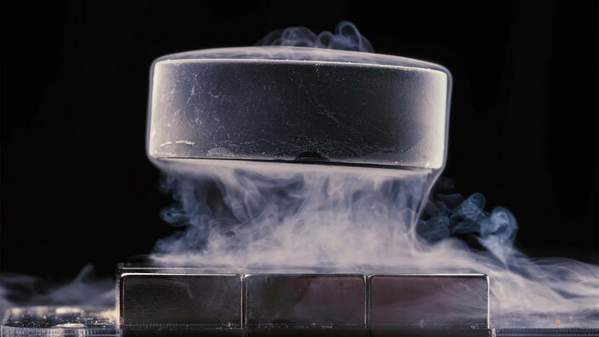


Theory of RF Superconductivity and Thin Film SRF
Teng Tan
2025.3.27
Institute of Modern Physics, CAS
Linac Center

Slide 2
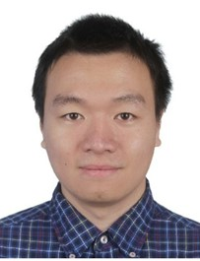
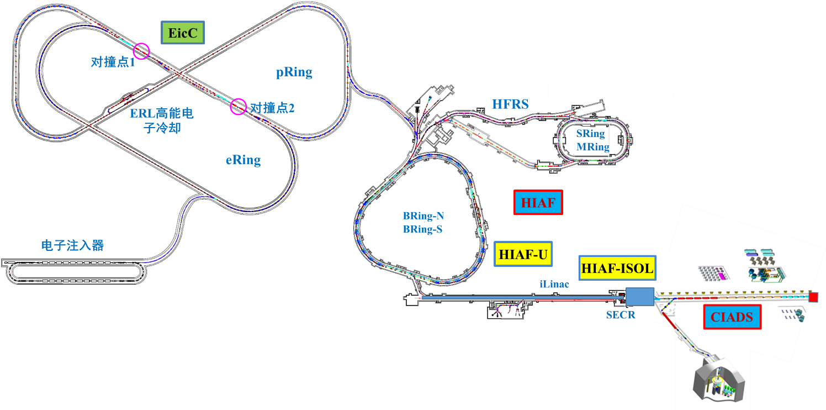
Introduction of Lecturer
Layout of IMP Huizhou Accelerator Complex
Dr. Teng Tan
Researcher, deputy director of RF surface group
Linac Center, Institute of Modern Physics, CAS
E-mail: ttan@impcas.ac.cn
Involved projects: CiADS, HIAF, IP-SAFE, (possible) EicC
Research and engineering topics: Cavity Post-processing, Thin Film SRF

Slide 3
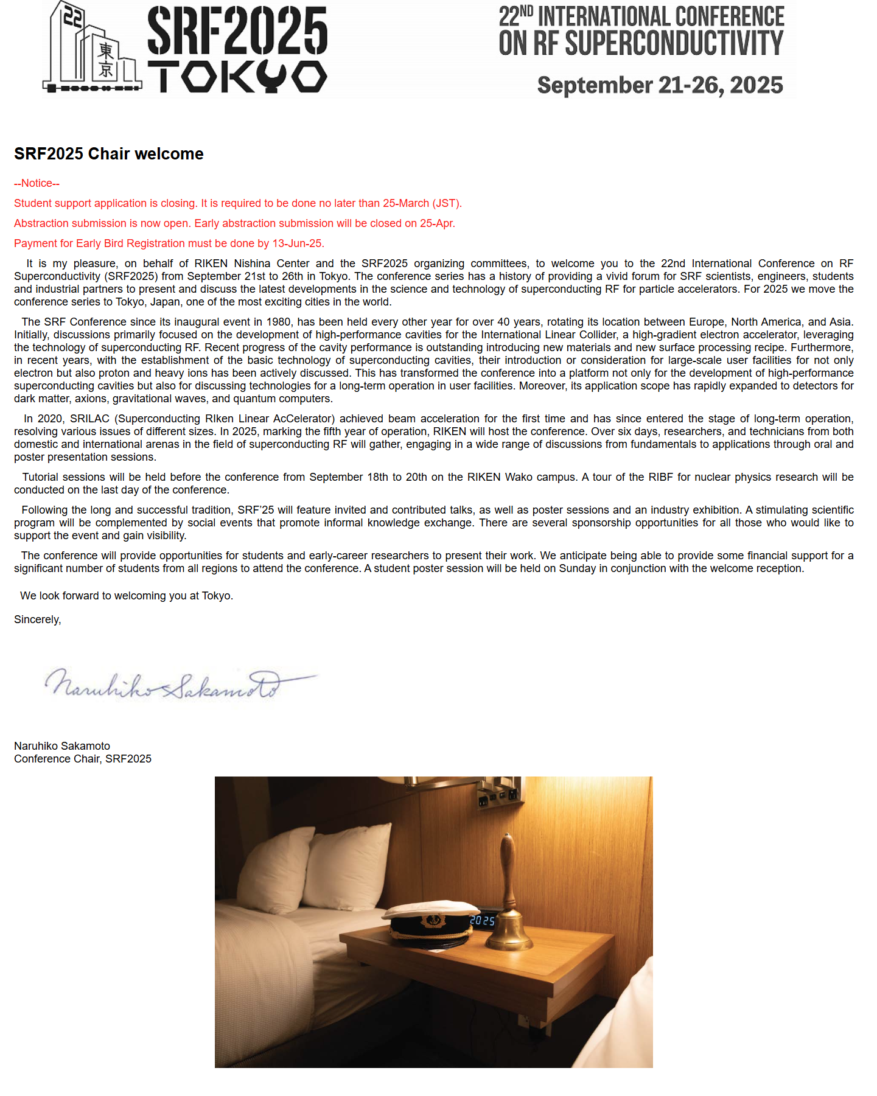

Resources of Fundamental Research Reports
《RF Superconductivity》 by Hasan Padamsee
Top meetings: SRF & TTC
Workshops: TFSRF, LCWS, etc.

Slide 4
··
01
Why SRF fundamentals
03
Some SRF Physics
Table of Contents
02
Some Physics
04
SRF Material beyond Nb

Slide 5


01
Why SRF fundamentals

Slide 6
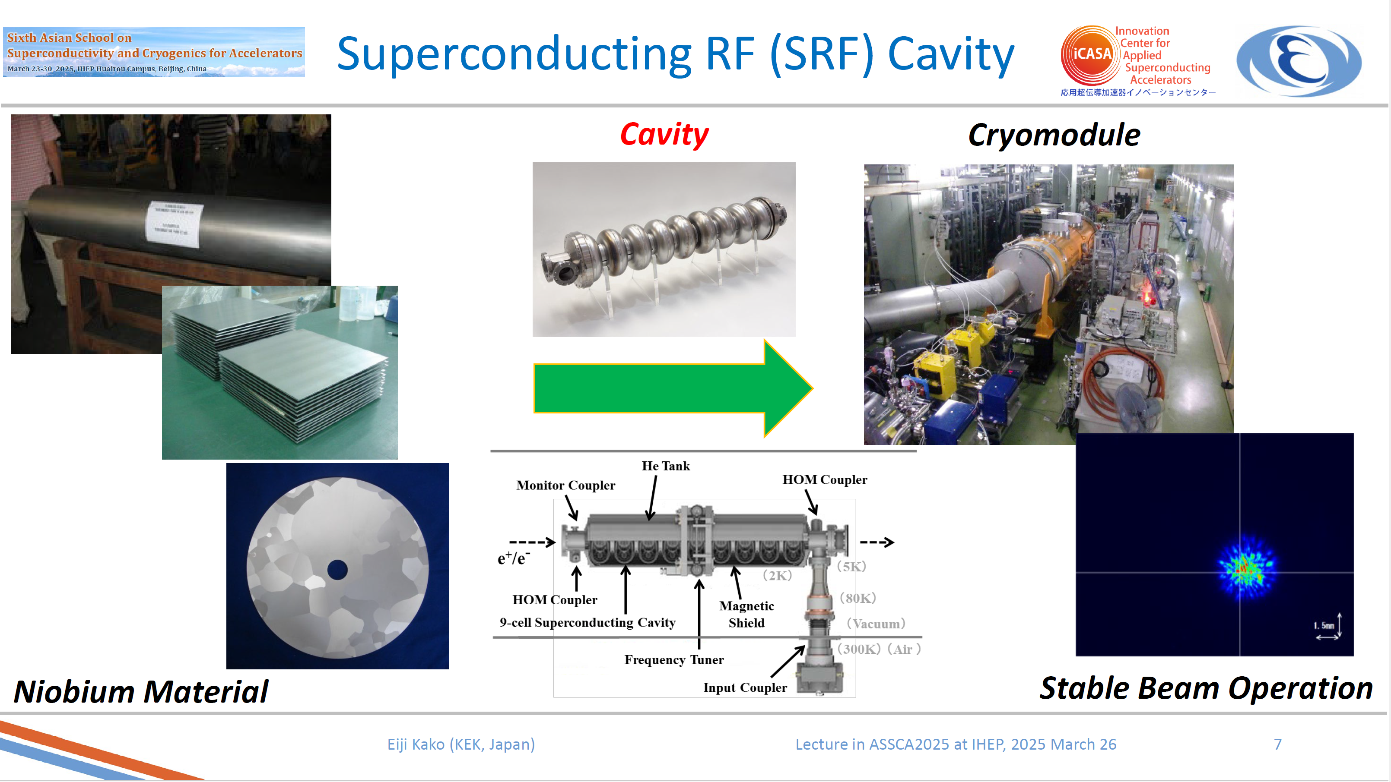
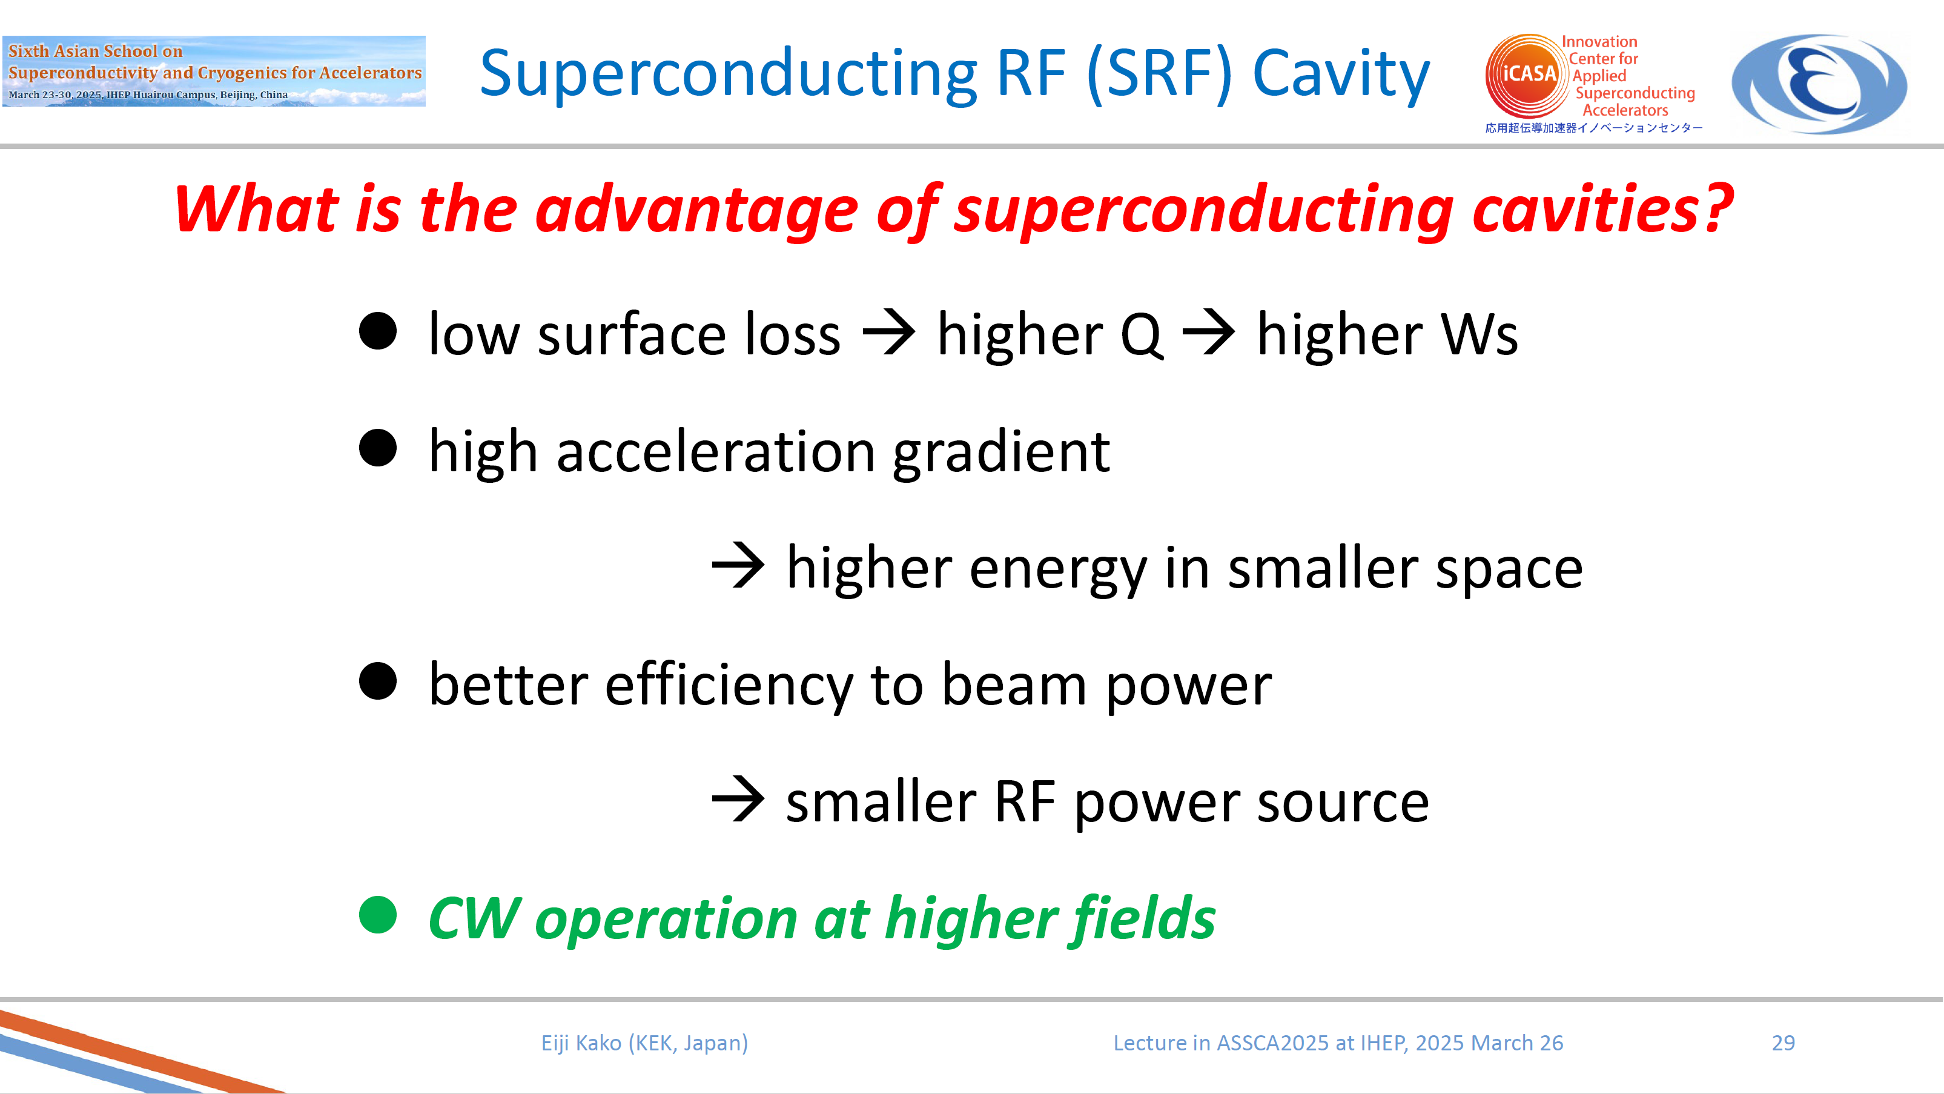
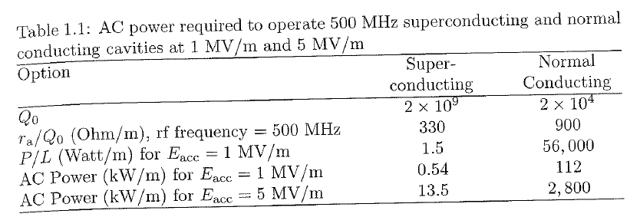
Quick review about yesterday
Material – Cavity – CM – Accelerator
Higher field, higher efficiency
How to obtain better beam output with fixed tunnel length and acceptable cryogenic cost
Hasan Pandamsee, RF Superconductivity for Accelerators

Slide 7
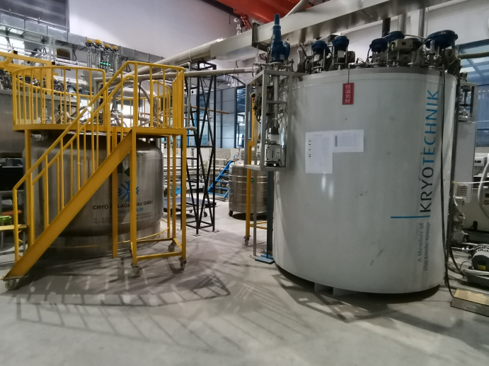
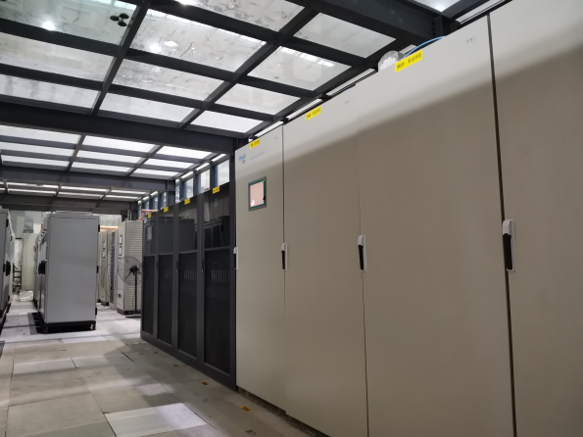
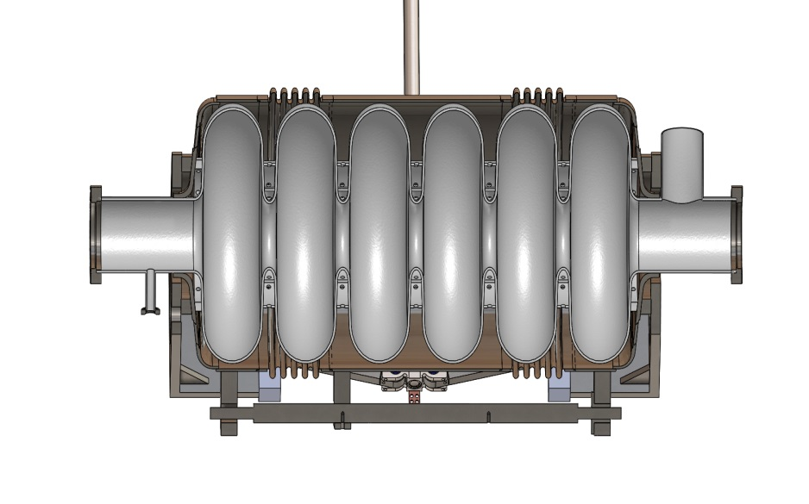
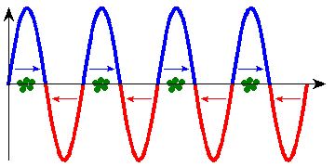
Quick review about SRF system
How to accelerate with RF power
SRF benefits:
Extremely high energy efficiency
P_{RF} ≈ P_{beam}+ P_{cavity}
P_{beam}/P_{RF} >99% for cw machine
Large aperture d
Large opening for beam halo, reduce beam loss
Low beam-cavity interaction, increase beam quality
Cryo. system
RF Amplifier
Helium jacket
Cavity
LHe
RF input
CM vacuum chamber
Vacuum
Heat
Nb
Beam
Aperture d
Helium cooling
Material: Nb
H_{c}: 240 mT
T_{c}: 9.2 K
R_{s} ~ nΩ, Q₀~1×10⁹⁻¹⁰ , P_{cavity} ~ W
10^{4~5} times better than Cu cavity
Cryomodule

Slide 8
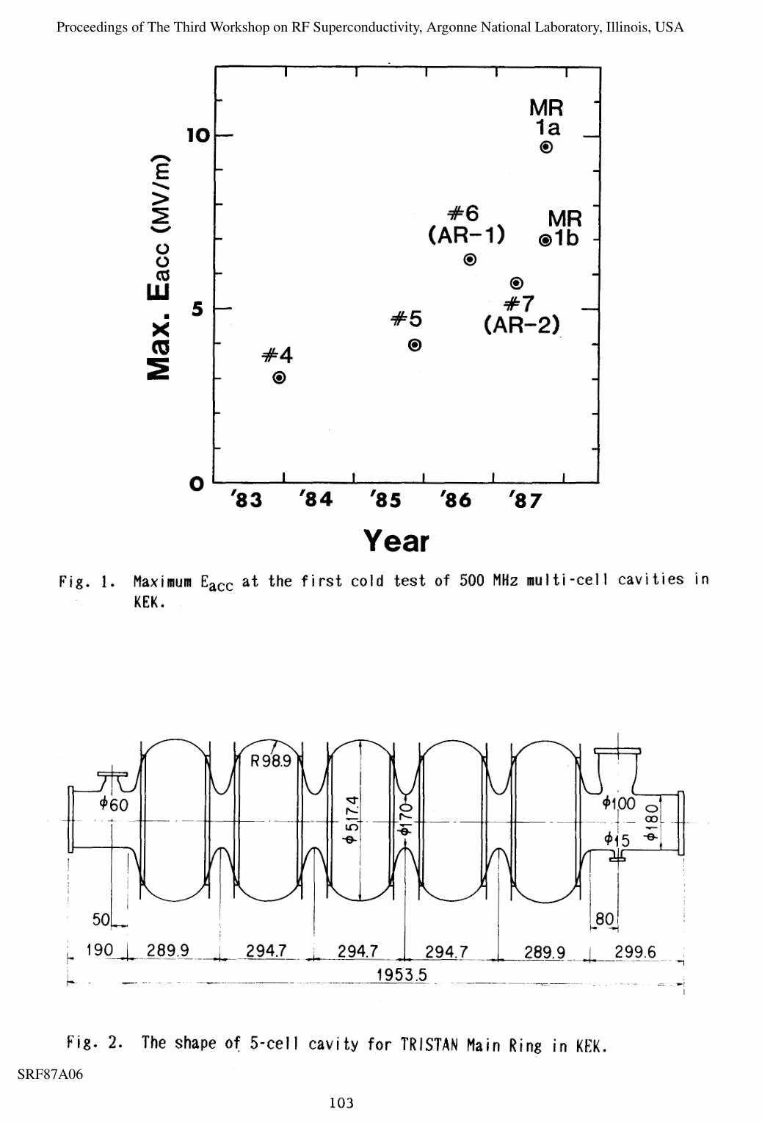
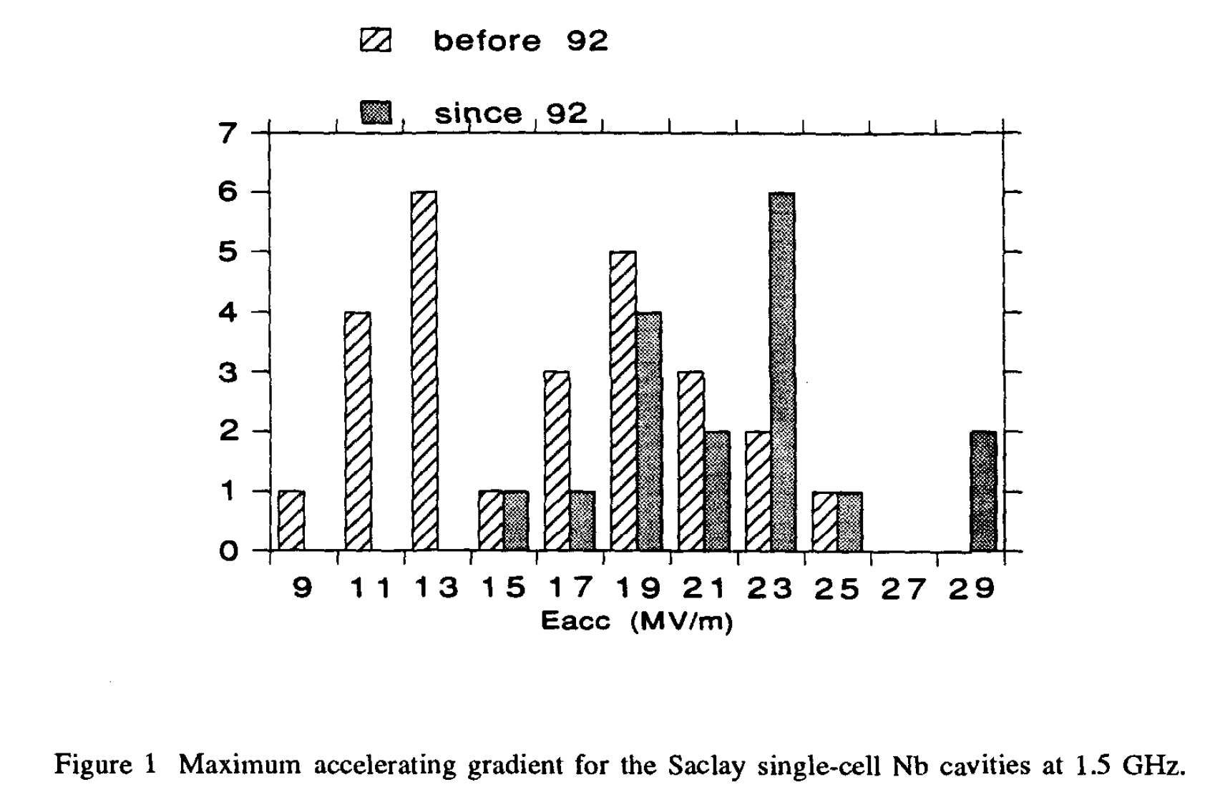
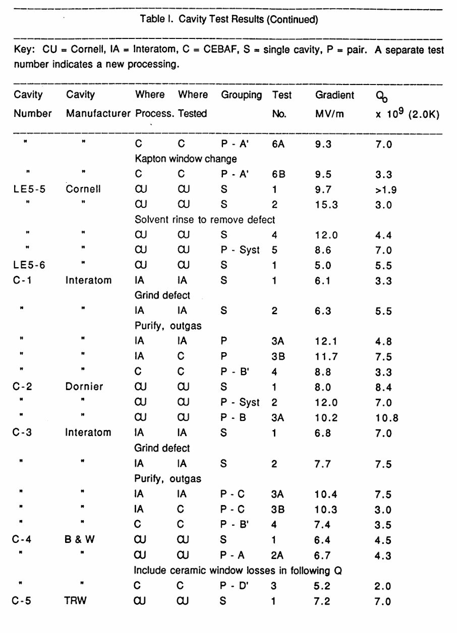
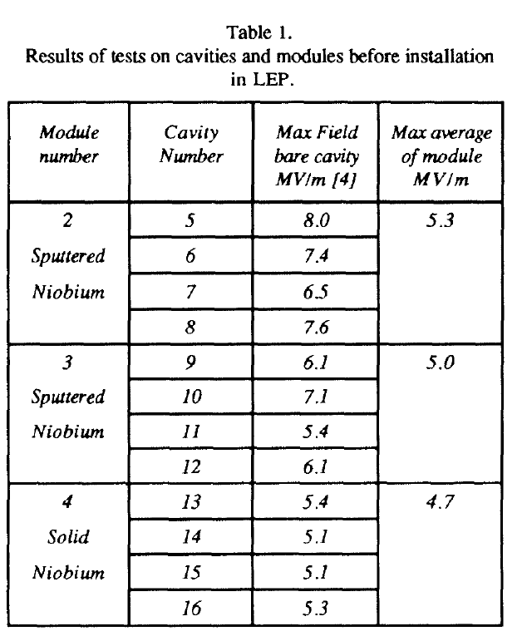
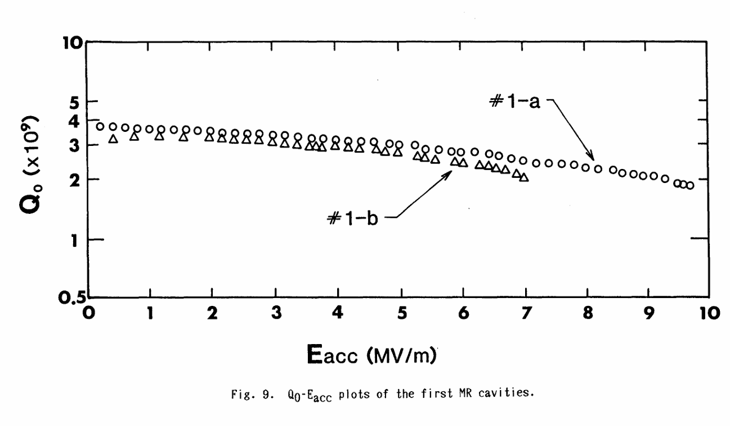
What are the cavities 40 years before
TRISTAN cavity
Saclay 1.5 GHz
Runs at 4.2 K
Typical Q₀: 1~5 × 10⁹.
Typical E_{acc}: < 10 MV/m
Simple processes
Part of JLAB SRF’89 report
LEP 352 MHz
B. Bonin, SRF’93
P. Brown, EPAC1992
Takaaki Furuya, SRF’87

Slide 9
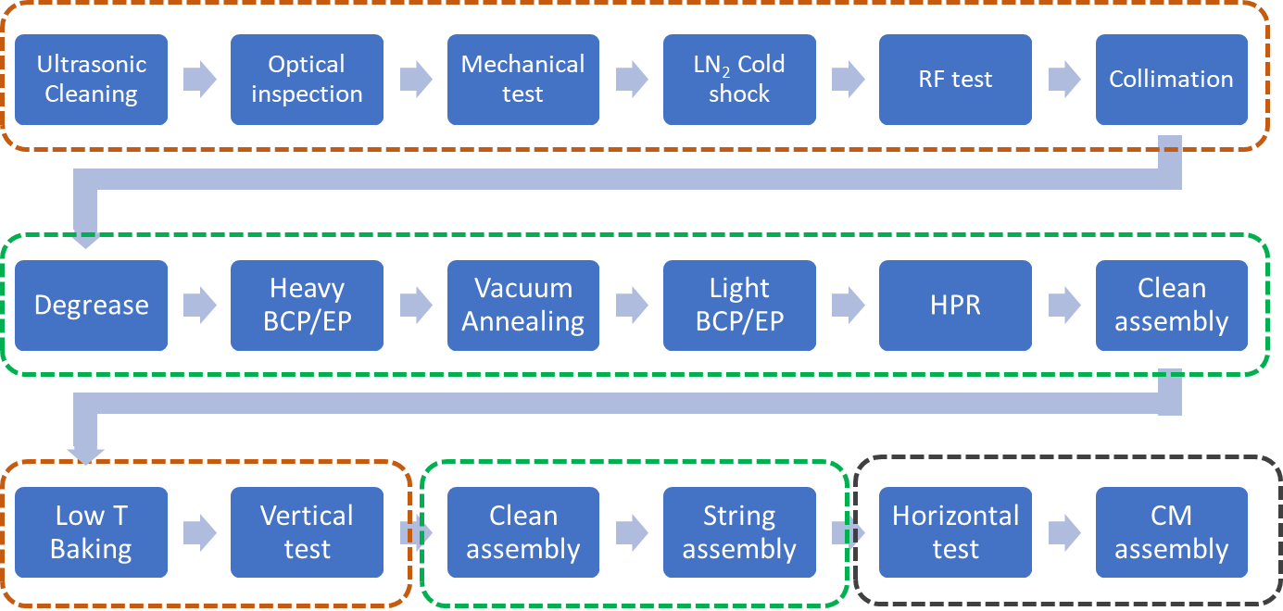
What are the cavities now
Runs at 2 K
Typical Q₀: 4 × 10¹⁰.
Typical E_{acc}: > 20 MV/m
Established processes with inspection, polishing, baking, clean assembly, etc.
IMP protocol for low beta cavities
Ultra‑high quality factor and ultra‑high accelerating gradient achievements in a 1.3 GHz continuous wave cryomodule Jin‑Fang Chen, NST, 2025

Slide 10
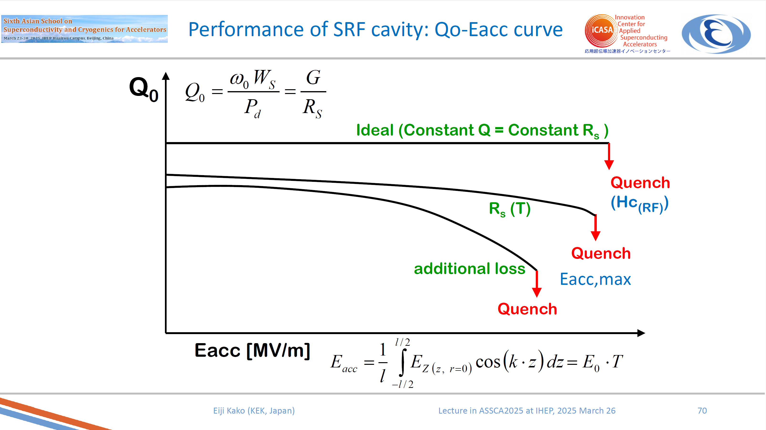
How Does SRF Cavity Behave
Many influence factors in addition to thermal feedback (details see Fesi’s talk later)
Kenji Saito, Lecture note in Tokyo University on May 2011
Limits in cavity performance Detlef Reschke DESY Tutorial, SRF 2007
https://accelconf.web.cern.ch/accelconf/srf2007/TUTORIAL/PDF/Tutorial_3c.pdf
H. Padamsee, "50 years of success for SRF accelerators — a review," Superconductor
science and technology, vol. 30, p. 05003 (23 pp), 2017.

Slide 11
What do we want from fundamental SRF research
High G: High energy with fixed tunnel length
High Q₀: High energy and low cryogenic cost.
Link processing protocols with cavities properties
Versatile application targets: Science, Medical, Industry
High Performance
High RAMI
Low cost
Impossible without breakthrough in fundamental SRF technology

Slide 12
02
Some Physics

Slide 13
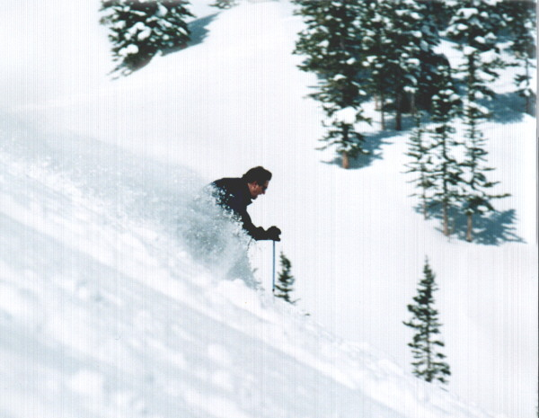
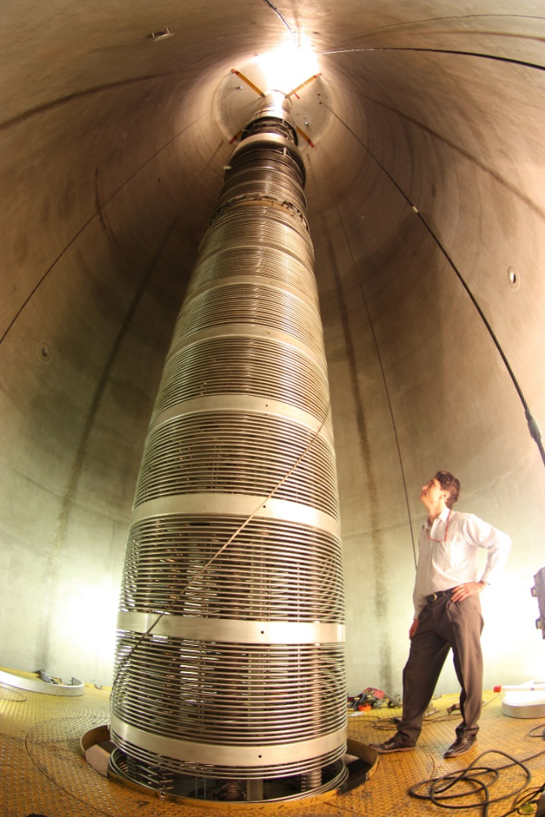
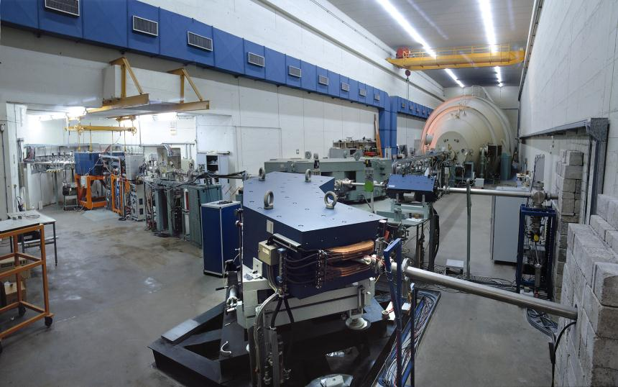
What is an RF cavity
Static/DC voltage has shortcomings

Slide 14
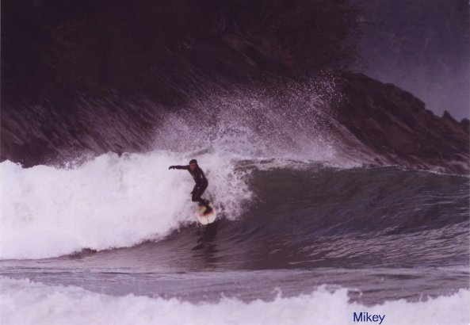
What is an RF cavity
RF field: no need for high-V protection
Major drawback: surface dissipation

Slide 15
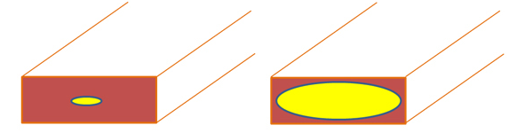
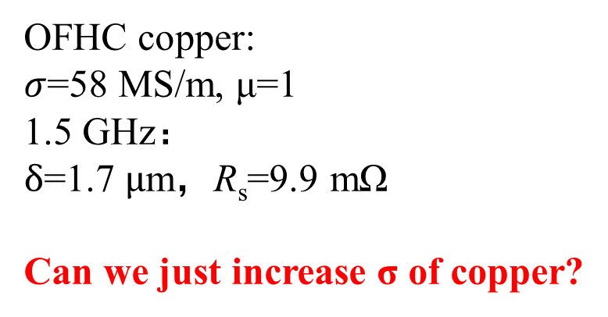

RF surface dissipation on normal metal
Skin effect:
lower ω higher ω
Surface resistance R_{s}
$$∝\sqrt{ω}$$
OFHC copper:
$σ$=58 MS/m, μ=1
1.5 GHz：
$δ$=1.7 $μ$m，R_{s}=9.9 mΩ
Can we just increase σ of copper?
j distribution depends on ω
Skin depth
Electrical Conductivity
Permeability

Slide 16
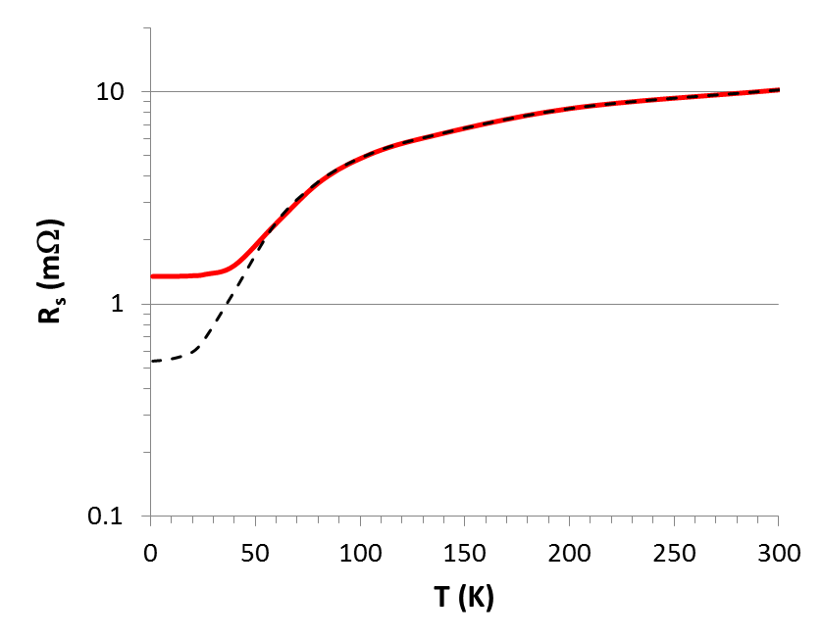
Put copper in LHe
Anomalous skin effect:
When MFP l > δ, the relationship breaks
Surface resistance of Cu at 1.5 GHz as a function of temperature
Anomalous skin effect l>δ
RRR = σ(4.2K)/σ(300K) = 300
R_{s}=1/σδ
R_{s}(4.2 K) ≅ 1.3 mΩ
Courtesy: G. Ciovati
…in spite of the resistivity decreasing by a factor 300 from 300 K to 4.2 K, R_{s} only decreases by a factor of ~8!

Slide 17
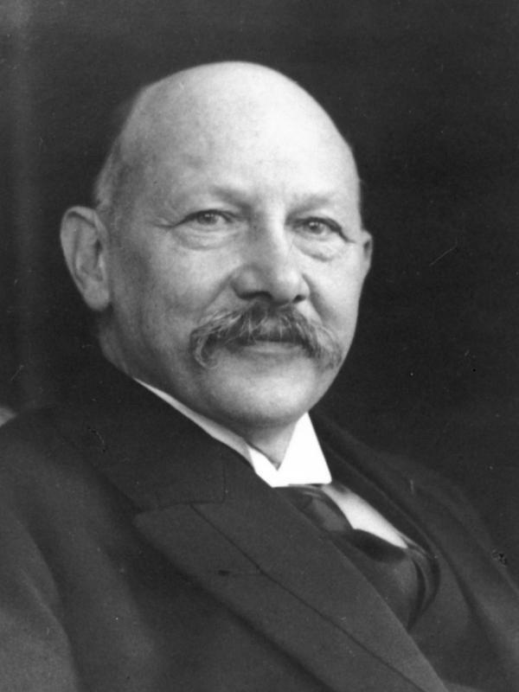
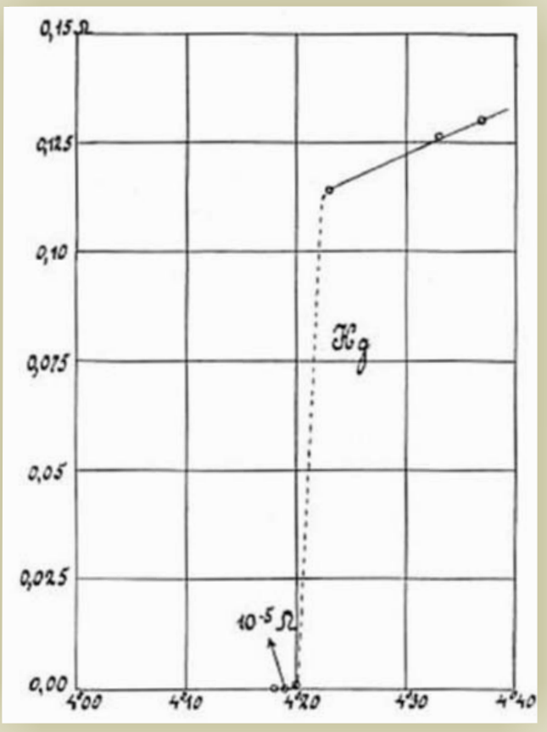
Some brief history of superconductivity
Discovery of SC:
Kamerlingh Onnes liquified He in 1908
May 1911，Hg’s R “disappeared” at 4.2K
-269℃
D. Van Delft and P. Kes, Physics Today 63, 9, 38 (2010);

Slide 18
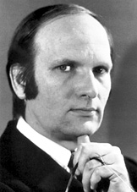
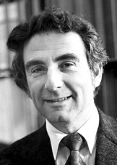
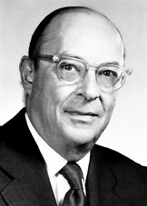
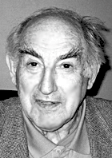
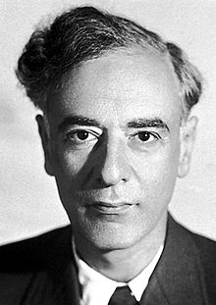
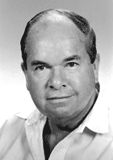
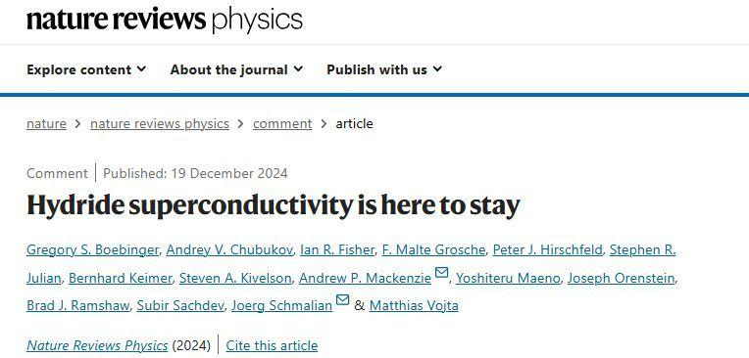
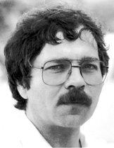
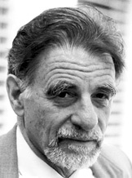
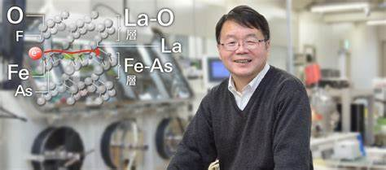
Some brief history of superconductivity
1908 Liquefaction of helium (4.2 K)
1911 Zero resistance
1933 Meissner effect
1935 Phenomenological theory of H. & F. London
1950 Ginzburg – Landau theory
1951 – 2 types of superconductors (Abrikosov)
1957 Bardeen – Cooper – Schrieffer microscopic theory
1960 Magnetic flux quantisation
1962 Josephson effect
1986 High temperature superconductors (Bednorz – Müller)
2001 MgB₂ (Nagamatsu)
2008 Iron-based SC (Hosono)
2015 H₃S at 200K
2020 C-H-S at 300K
Bardeen – Cooper – Schrieffer (BCS)
Ginzburg
Landau
Abrikosov
Bednorz
Müller

Slide 19
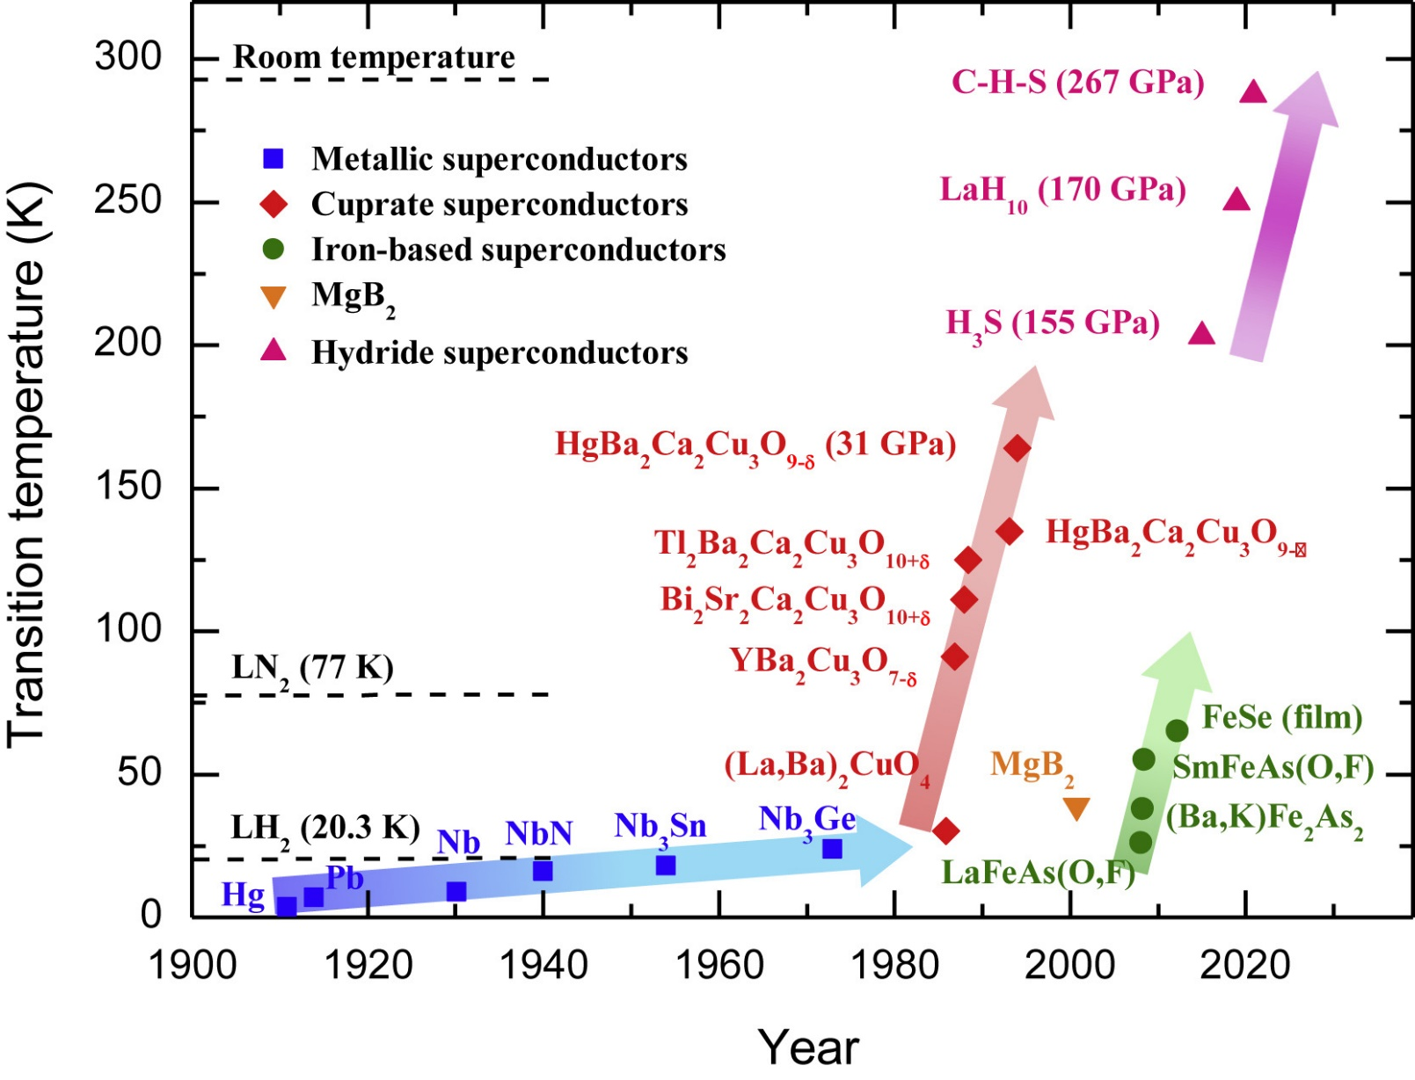
Superconducting materials
Tens of thousands of kinds
Most of them only in lab
Only LTS have applied to SRF
HTS have applied to RF electronics
Chao Yao, https://doi.org/10.1016/j.isci.2021.102541,

Slide 20
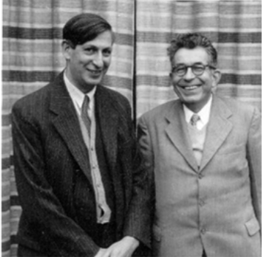
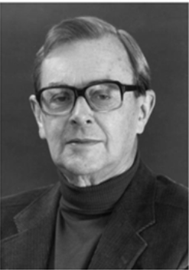
Physics (Courtesy of T. Junginger)
Overview of theories
London Theory
  Based on Maxwell´s equations. Phenomenological theory that can describe zero resistance and the Meissner effect
  Applicable to Type-II superconductors
Ginzburg Landau Theory
  Can describe non-local effects
  Applicable to Type-I and II superconductors
BCS Theory
  First microscopic theory of superconductivity
  Published 46 years after the discovery of superconductivity
H. & F. London
Pippard

Slide 21


The London Theory
The London Theory is phenomenological and does not involve the essence of superconductivity. The essence of superconductivity needs to be explained from a quantum perspective, namely the BCS theory.
First assume there are 2 kinds of electrons:
Normal electron
Superconducting electron
n_{s}(T)+n_{n}(T)=n, where n is the total electron volume density
Normal electrons: classical electrons like in other normal conductors, induce ohmic losses. Drude model for electrical resistance is still valid.
Superconducting electrons: travel and carry current without any losses. Drude model does not valid any more.
Definition of the current density:
J_{s}$=−en_{s}v$
J_{n}$=−en_{n}v$

Slide 22


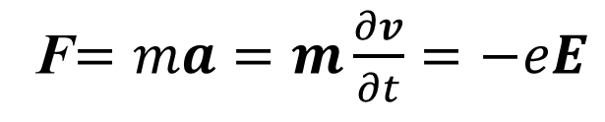
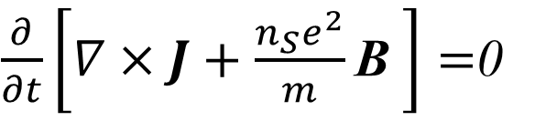
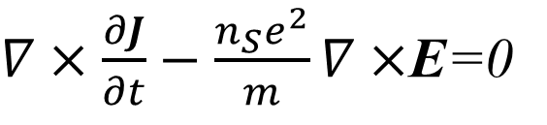
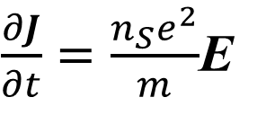
The London Theory
Assume an electron which is freely accelerated by an electric field
Lorentz force acting on the particle:
F$=ma=m\frac{∂v}{∂t}=−eE$
$\frac{∂J}{∂t}=\frac{n_{S}e^{2}}{m}$E
J$=−en_{S}v$
1st London Equation
No voltage, no J_{n}, use J for the SC current density
To explain the Meissner effect we want to derive an equation that relates J to B
Maxwell equation:
$$∇×E=−\frac{∂B}{∂t}$$
$∇×\frac{∂J}{∂t}−\frac{n_{S}e^{2}}{m}∇×$E=0
$\frac{∂}{∂t}\left[∇×J+\frac{n_{S}e^{2}}{m}\text{B} \right]=$0
The goal is to obtain a differential equation for B

Slide 23
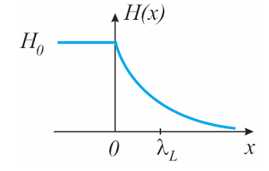


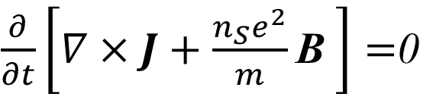
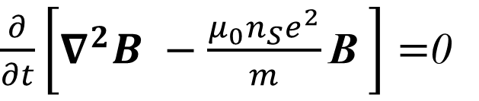


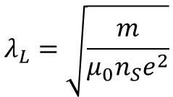




The London Theory
Ampere´s law relates the current density J and the magnetic flux density B
$$∇×B=μ_{0}J$$
$\frac{∂}{∂t}\left[∇×J+\frac{n_{S}e^{2}}{m}\text{B} \right]=$0
$$μ_{0}∇×J=−∇^{2}B$$
$\frac{∂}{∂t}\left[∇^{2}B −\frac{{μ_{0}n}_{S}e^{2}}{m}\text{B} \right]=$0
$$∇×B=μ_{0}J$$
B(x)
B₀
$$∇×∇×B=μ_{0}∇×J$$
$$∇×∇×B=∇\left(∇B\right)−∇^{2}B$$
Maxwell equation
$$∇B=0$$
2 possible solutions:
$$1. B=const$$
$$λ_{L}=\sqrt{\frac{m}{μ_{0}n_{S}e^{2}}}$$
2. B(x)$=B_{0}exp⁡(−\frac{x}{λ_{L}})$
with
London penetration depth
Either a constant B field or an exponentially decay field in SC. Can they both exist?

Slide 24
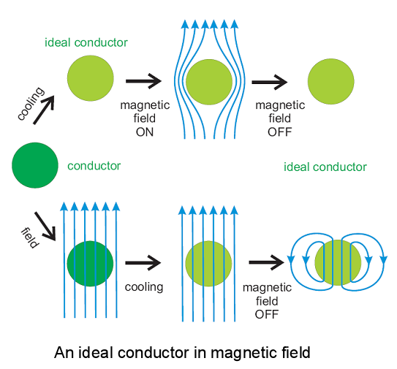


No, Meissner Effect
Consider a conductor which fulfills these solutions when cooled below its critical temperature
$$1. B=const$$
2. B(x)$=B_{0}exp⁡(−\frac{x}{λ_{L}})$
This is not what we observe in superconductors

Slide 25

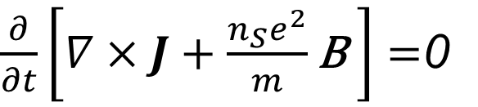



The London Theory
Only exponential decaying fields are observed
$$1. B=const$$
2. B(x)$=B_{0}exp⁡(−\frac{x}{λ_{L}})$
To explain the Meissner effect the Londons postulated:
$\frac{∂}{∂t}\left[∇×J+\frac{n_{S}e^{2}}{m}\text{B} \right]=$0
Finally, we have derived the two London equations:
$$∇×J=−\frac{n_{S}e^{2}}{m}\text{B}$$
$\frac{∂J}{∂t}=\frac{n_{S}e^{2}}{m}$E
Zero Resistance
Meissner Effect

Slide 26




The London Theory – Pippard extension
Pippard found that λ_{L} depends on the purity of the material and therefore on the electron mean free path l
He introduced of the new parameter coherence length ξ in analogy to the anomalous skin effect in normal conductors
$$λ\left(l\right)=λ_{L}\sqrt{1−{ξ0}/l}$$
Non-local relation between current density and vector potential:
$$\frac{1}{ξ}=\frac{1}{ξ_{0}}+\frac{1}{l}$$
$$\vec{R}=\vec{r}−\vec{r^{′}}$$
Pippard introduced ξ as a phenomenological parameter. Later explained by the microscopic BCS theory
A.B Pippard - Proceedings of the Royal Society of London. A Vol. 216, No. 1127 (1953)

Slide 27




The BCS Theory
What needed to be explained?
Zero Resistance and Meissner Effect
Coherence (Non-local relation between current density and E-field)
Energy Gap (exponential specific heat)
  Suggests a Bose-Einstein condensation like process
The isotope effect
  The transition temperature of mercury depends on the isotopic mass
  This suggests that the lattice is important for superconductivity
$$∝T3$$
$$∝exp⁡(−Δ/kbT)$$

Slide 28



The BCS Theory
Pairing of electrons close to the Fermi level into Cooper pairs through interaction with the crystal lattice
  Boson (no Pauli exclusion principle)
  All cooper pairs condense to the same ground state
  Coherent wave functions → no scattering → zero resistance
Size of a cooper pair is large compared to the lattice constant and is related to the coherence length ξ
Estimated size of a cooper pair:
Relaxation time of the lattice: 2π/ω_{D}≈10⁻¹³s
Electrons move with v_{F}≈10⁶m/s
Distance between electrons forming a cooper pair:
$ξ≈\text{(}\text{2}\text{π}\text{/}\text{ωD}\text{)}$ v_{F}≈10⁻⁷m

Slide 29



The BCS Theory
The superconducting state consists of electron pairs and elementary excitations, quasiparticles, behaving almost like free electrons
BCS theory
GL theory
The energy gap Δ separates the energy levels of elementary excitations from the ground state level. At 0K only the ground state is occupied
Density of elementary excitations. There are no states within the energy gap Δ
Temperature dependence of Δ:
The gap has its full value Δ₀ at 0K and vansishes at T_{C}
The BCS theory has been derived from perturbation theory – valid only close to 0 K
Close to T_{C} the Ginzburg-Landau theory is valid

Slide 30
The Ginzburg-Landau Theory
To provide a phenomenological description of superconductivity near the critical temperature T_{c}​.
Order parameters with dependance on T
4th order contribute to phase transition. Higher orders contribute very little and can be neglected.
Vitaly Ginzburg was awarded the Nobel Prize in Physics in 2003 for his work on superconductivity, including the development of the Ginzburg-Landau theory.

Slide 31








The Ginzburg-Landau Theory
$gS(B)=gN+α{\left|ψ \right|}^{2}$ $+β{\left|ψ \right|}^{4}+\frac{1}{2μ_{0}}{\left|B_{a}−B_{i}\right|}^{2}+\frac{1}{2m}{\left|\frac{ℏ}{i}(Δ−qA)ψ\right|}^{2}$
Minimizing g_{S} wrt to Δy and ΔA (variational method) yields the Ginzburg-Landau equations:
$J=\frac{qℏ}{2m}(ψ^{∗}Δψ−ψΔψ^{∗})+\frac{q^{2}}{m}{\left|ψ\right|}^{2}$ A
$$\left(ψ^{∗}Δψ−ψΔψ^{∗}\right)=0$$
London equation:
$${ns=\left|ψ\right|}^{2}$$
$$∇×J=−\frac{n_{S}e^{2}}{m}\text{B}$$
$αψ{+β\left|ψ \right|}^{2}ψ$ $+\frac{1}{2m}{\left|\frac{ℏ}{i}(Δ−qA)ψ\right|}^{2}=0$
Characteristic lengths:
Penetration depth is the length scale for the variation of the magnetic field
Coherence length is the length scale for the variation of the order parameter
Ginzburg-Landau parameter
$$λ_{L}=\sqrt{\frac{m}{μ_{0}{\left|ψ\right|}^{2}e^{2}}}$$
$$ξ_{GL}=\sqrt{\frac{{−ℏ}^{2}}{2mα}}$$
$$κ_{GL}=\frac{λ_{L}}{ξ_{GL}}$$

Slide 32







The SC-NC boundary
$ΔE$: Energy difference at a NC-SC boundary compared to the SC state
B_{c}: crtical thermodynamic field, above B_{c} the normal conducting state is energetically favorable
Vacuum/n.c
s.c
B
y
$ΔE$=0 and resolve wrt B
Energy loss:
The density of cooper pairs is suppressed over the distance $ξ$
Energy gain:
Field does not need to be expelled over the distance $λ$
$$B_{c1}= \sqrt{ξ/λ}B_{c}^{}$$
z
x
l
If $ΔE<0,$ it is energetically favourable to create normal-superconducting boundaries above the lower critical field B_{c1}
These superconductors are referred to as type-II
Exact result from GL theory
$$κ_{GL}=\frac{λ_{L}}{ξ_{GL}}>\frac{1}{\sqrt{2}}$$

Slide 33


Two types of superconductors
Type II Superconductors
  $κ>1/\sqrt{2}$
  Impure metals
  Pure niobium
  Alloys
  For $κ$>>1 local electrodynamics (London theory) applicable
Type I Superconductors
  $κ<1/\sqrt{2}$
  All elements except niobium
  Non-local electrodynamics
NC
NC
Mixed
SC
SC
Type-I
Type-II

Slide 34

Two types of superconductors
Magnets
Cavities
Under DC fields flux tubes can be pinned – no dissipation
    SC magnets are operated between H_{c1} and H_{c2}
Under RF fields flux tubes oscillate – dissipation
  RF cavities are operated in the Meissner state
Can the Meissner state persist metastable beyond H_{c1}?

Slide 35
03
Some SRF Physics

Slide 36
SRF Physics
Overview of SRF theories
Surface Resistance of Superconductors
  Two fluid model vs BCS model
  Influencing factors
  Residual surface resistance and flux
Surface Barrier and Superheating field
  Operate SRF beyond H_{c1}
  Field enhancement for thin film structure
Field emission
  Causes and F-N theory

Slide 37


Surface Resistance of Superconductors
Superconducting currents are transported by Cooper pairs formed of two electrons
  flow without friction → DC supercurrents are lossless
For temperatures above 0 K not all electrons form Cooper pairs
Cooper pairs have a finite inertia. Under RF fields a time-varying E-field is induced in the material. Normal electrons see this field, move and dissipate
$$n_{n}(T)∝e^{−∆/k_{B}T}$$
+
R_{s} > 0

Slide 38

From two fluid model
Basic ingredients for RF superconductivity
  Two fluid model (Gorter-Casimir)
  Maxwell electrodynamics
  London equations
n
electron density
n_{s}
T_{c}
temperature (K)
Basic assumptions of two fluid model
  all free electrons of the superconductor are divided into two groups:
    superconducting electrons of density n_{s}
    normal electrons of density n_{n}
  The total density of the free electrons is
  n = n_{s} + n_{n}
  As the temperature increases from 0 to T_{c}, the density n_{s} decreases from n to 0.
Close to 0 K:
$$n_{n}=exp⁡(−\frac{Δ}{k_{b}T})$$

Slide 39


From two fluid model
London equation:
Two fluid model:
= s₂
s
Electrodynamics of sc is the same as nc, only that we have to change s → s₁ – i s₂
Penetration depth:
s₁ << s₂ for sc at T<<T_{c}
Interesting to note here: -We have derived λ_{L} from DC arguments before
- Now we find λ_{L} does not depend on f for T<<T_{c}

Slide 40


From two fluid model
Electrodynamics of sc is the same as nc, only that we have to change s → s₁ – i s₂
Recall the definition of the surface impedance:
E_{z}(x,t)
H_{y}(x,t)
$σ=σ_{1}$+i$σ_{2}$
z
y
x
L_{s}: kinetic inductance

Slide 41


From BCS model
Remember: In superconductivity the relation between current and field is non-local. In 1953 Pippard introduced:
One could use this relation to develop a more complete phenomenological model, which would still be dependent on the temperature dependence of n_{s} and n_{n} from the 2-fluid model
Mattis and Bardeen (1958) used time dependent perturbation theory to derive R_{S} for weak RF fields
Within this theory no simple formula can be derived. Several approximate formula can be found in the literature for some limits. For example for the dirty limit
There are numerical codes (Halbritter (1970) to calculate R_{BCS} as a function of w, T and material parameters (x₀, l_{L}, T_{c}, D, l)
For example, http://www.lepp.cornell.edu/~liepe/webpage/researchsrimp.html
$R_{S}={\frac{1}{2}ω}^{2}λ^{3}σ_{0}μ_{0}^{2}ln\left(\frac{Δ}{ℏω}\right)exp\left(⁡−\frac{Δ}{k_{b}T}\right)$/T

Slide 42


From BCS model
Be carefureful here. The website suggests 40nm. The input required is πξ₀/2, while ξ₀≈40nm for Nb

Slide 43

BCS model vs two fluid model
The treatment within BCS theory and two-fluid model give qualitatively similar results
Quantitatively they can differ by an order of magnitude
  The BCS treatment gives qualitatively correct results for low field
To treat experimental data approximate formulae are useful, e.g.
Here A accounts for all material parameters
$$R_{S}=\frac{ω^{2}A}{T}\exp\left(−\frac{Δ}{k_{b}T}\right)$$

Slide 44


Surface Resistance of Superconductors
$$R_{BCS}=ω^{2}λ^{3}σ_{0}μ_{0}^{2}exp⁡\left(−\frac{Δ}{k_{b}T}\right)$$
This equation implies R_{S}:
Has a minimum for medium purity
Is proportional to $ω^{2 }$
Decreases exponentially with temperature
Vanishes as T→0 K
Is independent of RF field strength
In the following we will compare these assumptions to experimental data and modify the formula if necessary

Slide 45

Surface Resistance of Superconductors
The dependence of the penetration depth on l is approximated as
s₁ ∝ l
if l >> ξ₀ (“clean” limit)
if l << ξ₀ (“dirty” limit)
Nb on Cu,1.5 GHz, 4.2 K
R_{s} has a minimum for l = πξ₀/4
C. Benvenuti et al., Physica C 316 (1999) 153.
Nb films sputtered on Cu
By changing the sputtering species, the mean free path was varied.
“clean”
“dirty”

Slide 46

Surface Resistance of Superconductors
$$R_{BCS}=ω^{2}λ^{3}σ_{0}μ_{0}^{2}exp⁡\left(−\frac{Δ}{k_{b}T}\right)$$
This equation implies R_{S}:
Has a minimum for medium purity
Is proportional to $ω^{2 }$
Decreases exponentially with temperature
Vanishes as T→0 K
Is independent of RF field strength
In the following we will compare these assumptions to experimental data and modify the formula if necessary

Slide 47





Surface Resistance of Superconductors
$$R_{BCS}=ω^{2}λ^{3}σ_{0}μ_{0}^{2}exp⁡\left(−\frac{Δ}{k_{b}T}\right)$$
Normal Conducting
Superconducting
Frequency dependence for R_{BCS} and R_{res} are almost identical
Is there a common cause?
1200MHz
800MHz
$$R_{S}(0K)≠0$$
400MHz
$R_{S}=R_{BCS}$(T)+R_{res}
Measurement of the surface resistance at low field of niobium at three frequencies with the Quadrupole Resonator

Slide 48
Residual Surface Resistance
BCS DOS
Smeared DOS
Rs never goes to 0 when T goes to 0. Some constant value.
Point contact tunneling experiments on Nb and Nb₃Sn have found finite density of states (DOS) inside the energy gap
The physics remains not fully understood, however subgap states will yield a finite R_{S}(0K) irrespective of physical mechanism.
A. Gurevich Supercond. Sci. Technol. 30 (2017) 034004

Slide 49
Residual Surface Resistance
Possible contributions to R_{res}:
Trapped magnetic flux and thermal currents
Lossy oxides, metallic hydrides
Normal conducting precipitates
Grain Boundaries
Interface Losses
Magnetic Impurities

Slide 50
Trapped Magnetic Flux
Well understood contribution to R_{res}
When a cavity is cooled down in an ambient DC magnetic field not all flux is expulsed – Incomplete Meissner effect
In fact fields of a few µT (order earth magnetic field) can be completely trapped
In cryomodules thermal currents can cause additional magnetic fields which can be trapped

Slide 51


Trapped Magnetic Flux
Simple model with these assumptions:
  Fluxoids are perpendicular to the cavity surface, static and RF currents flow through them
  Flux completely trapped
  Losses are independent on RF field
Additional residual resistance=Ratio nc/sc area$×$Normal conducting surface resistance
H. Padamsee et al. RF Superconductivity for Accelerators
for RRR=300

Slide 52


Surface Resistance of Superconductors
$R_{S}=ω^{2}λ^{3}σ_{0}μ_{0}^{2}exp⁡\left(−\frac{Δ}{k_{b}T}\right)$+R_{res}
This equation implies R_{S}:
Has a minimum for medium purity
Is proportional to $ω^{2 }$
Decreases exponentially with temperature
Vanishes as T→0 K
Is independent of RF field strength
In the following we will compare these assumptions to experimental data and modify the formula if necessary

Slide 53
Surface Resistance vs Field

Slide 54
Surface Resistance of Superconductors
$R_{S}=ω^{2}λ^{3}σ_{0}μ_{0}^{2}exp⁡\left(−\frac{Δ}{k_{b}T}\right)$+R_{res}
This equation implies R_{S}:
Has a minimum for medium purity
Is proportional to $ω^{2 }$
Decreases exponentially with temperature
Vanishes as T→0 K
Is independent of RF field strength
Not only do R_{BCS} and R_{res} depend on the RF field strength there can also be additional extrinsic losses limiting the cavity performance

Slide 55
Field vs surface
A semi-infinite type-II superconductor placed in a uniform magnetic field H parallel to its surface.
The lower critical field (Hc1) is defined as the critical field under which a type-II superconductor starts to exhibit vortex penetration.

Slide 56
Field vs surface
Boundary condition of SC surface: Repulsive force for vortex near surface
Bean-Livingston barrier
C. Bean and J. Livingston, Phys. Rev. Lett. 12(1964).

Slide 57

Field vs surface
For double-side surface: thin film
H < H_{c1}, vortex is not favorable anywhere.
H_{c1} < H < H_{s}, vortex is energy-favorable inside the film, but is stopped by the surface barrier from entering the film.
H > H_{s}, surface barrier disappears, vortex enters the thin film without being hindered.
Both H_{s} and H_{c1} are larger than H_{c1} for bulk materials calculated from G-L (x<d<l)
G. Stejic, PRB, 49 1247(1994)

Slide 58
Superheating field
The superheating field H_{sh} is set by the competition between magnetic pressure (imposed by the external magnetic field), the energy cost to destroy superconductivity, and the attractive force due to the zero-current boundary condition at the interface.
H_{c1} is the field where it is energetically favourable for the flux to be in the superconductor
H_{sh} is the field where the Bean-Livingston barrier for flux entry disappears
Defects can serve as entry points for flux preventing superheating
Suggested further reading:
B. Liarte et al. - Supercond. Sci. Technol. 30 (2017) 033002

Slide 59

Field emission
Under high RF fields electrons can be released from the surface and accelerated.
Released electrons will impact on the cavity wall creating x-rays and heating → Reduced Q-value
Field emitters found on dissected cavities (size 0.5-10μm with sharp edges)

Slide 60




Field emission
Ideal RF surface
Real RF surface
Particulates
Adsorbed gas, ~monolayer
Hydrocarbon ~ 1~2nm
NbO_{x} ~10nm
NbO_{x} ~10nm
Bulk Nb ~mm
Bulk Nb ~mm
$$I(E)=\frac{A_{FN}A_{e}{\left(β_{FN}E\right)}^{2} }{φ}exp⁡(−\frac{B_{FN}φ^{3/2}}{β_{FN}E})$$
Fowler－Nordheim
$$A_{FN} =\frac{e^{2} }{8πh}=1.54×{10}^{6}⁡$$
$$B_{FN} =\frac{8π\sqrt{2m}}{3h}=6.83×{10}^{3}⁡$$

Slide 61








In-situ processing
MEBT
HEBT
CM1
CM2
CM3
CM4
Reactive plasma cleaning and helium RF power conditioning

Slide 62
04
SRF Material beyond Nb

Slide 63

SRF Material beyond Nb
Courtesy A-M VALENTE-FELICIANO, SRF 2023

Slide 64

Improve directions
Courtesy A-M VALENTE-FELICIANO, SRF 2023

Slide 65



Improve directions
  Current Nb SRF performances
    Surface impurity manipulation
    Nb thin film for special purpose
    Limit = magnetic transition of the SC material @ H_{peak}
  Superconductivity only needed inside
    Thickness ~ < 1 µm => thin films
    Q₀ (∝ 1/R_{S}) ∝ T_{C} E_{acc} ∝ H_{RF}=> Nb₃Sn, MgB₂, NbN…
    Multilayer structures
    Coated onto a thermally conductive, mechanically resistant material, e.g. Cu
  Cavity structures
    Composite materials
    Heat management of the entire cavity

Slide 66

Material Selection

Slide 67


Nb beyond Nb
Doping – infusing - baking
A. Grassellino et al, 2013 Supercond. Sci. Technol. 26 102001

Slide 68



Nb beyond Nb
SARI
Bunch of reports on TTC2024 and the next TTC

Slide 69




Nb beyond Nb – LCLS-II
D. Gonnella, TTC2024 ESS

Slide 70





Nb beyond Nb – IHEP
P. Sha, TTC2024 ESS

Slide 71




Nb beyond Nb – SARI
Y. Zong, TTC2024 ESS

Slide 72


Nb/Cu
From 1980s to now
Both composite material and thin film
JAERI
Suehiro Takeuchi, SRF’87

Slide 73





Nb/Cu
Recent composite materials
The assembled 9 HWR010 Cu/Nb cavities string
HWR Cu/Nb composite cavity
$Q_{0}$ vs. $E_{pk}$ at 4.2 K

Slide 74




Nb/Cu
LEP magnetron sputtering
Cost-saving and performance improving:

Slide 75




Nb/Cu
QWR cavities: PKU, INFN & CERN
PKU
INFN
HIE-ISOLDE

Slide 76

Nb/Cu
Energetic condensation: ECR, cathodic arc, HiPIMS
ECR
HiPIMS
AVMF, TTC2024 ESS

Slide 77



Q-slope in thin film cavities
From trapped flux to pair breaking

Slide 78



Nb₃Sn – tin vapor diffusion
Resumed in 2013 at Cornell, followed worldwide
U Wuppertal results from 1990s
WG2, TTC2024 ESS

Slide 79


Nb₃Sn – tin vapor diffusion
Single cell cavity

Slide 80





Nb₃Sn – tin vapor diffusion
IHEP progresses
Dong, TFSRF2024

Slide 81


Nb₃Sn LHe-free machine
Technique progress rapidly before 2020
Gradient reached ~20 MV/m
Good for 4K operation and conduction cooled machine
Compact machine idea at 2019

Slide 82




Nb₃Sn LHe-free machine
IHEP: Conduction cooling of 1.3 GHz 1-cell Nb cavity

Slide 83




Nb₃Sn LHe-free machine
Compact machine realized in many spots
IMP, LHe-free e-machine

Slide 84




Nb₃Sn LHe-free machine
CLASSE, single cell 1.3GHz

Slide 85




Nb₃Sn LHe-free machine
Jlab, CEBAF type 2 cavity
First demonstration of >10 MeV Nb3Sn cryomodule

Slide 86




Nb₃Sn other than tin diffusion
Bi-Polar HiPIMS
In-situ and ex-situ annealing
S. Leith, TFSRF2024

Slide 87



Nb₃Sn other than tin diffusion
Bronze route: FNAL, IMP, HZB

Slide 88





MgB₂
HPCVD
K. Chen, X. X. Xi, TFSRF2024

Slide 89



Iron based
FeSe/Nb
Potential for S/S, SIS structure
Miyazaki, TFSRF2024
Lin TFSRF2024

Slide 90


Multilayer S-I-S and SS structure
Vortices in RF field ~ oscillate ~ power dissipation
Thin SC film with d ~ λ can remain in Meissner state in a much higher B field than bulk material. Enhanced H_{c1}.
A few layers of SC thin films separated by insulating layers can shield the magnetic field step by step.
A possible way to utilize SC with low H_{c1} in SRF cavities.
A. Gurevich, APL 88, 012511 (2006)
Takayuki Kubo, SUST2016

Slide 91



Multilayer structure

Slide 92
Thank you
Questions?

Slide 93
Appendix: how to calculate R_{bcs}
Since we will deal a lot with the surface resistance R_{s} in the following, here is a simple DC model that gives a rough idea of what it means:
Consider a square sheet of metal and calculate its resistance to a transverse current flow:
In this model the surface resistance R_{s} is the resistance that a square piece of conductor opposes to the flow of the currents induced by the RF wave, within a layer δ
a
Resistance of a square metal sheet of thickness d:
a
current
δ
Surface Resistance of a square metal sheet with penetration depth δ:
d
Courtesy: S. Calatroni

Slide 94



The RF surface resistance (intuitive approach)
Consider an alternating magnetic field at the surface of a semi-infinite superconductor
Consider Faraday's law of induction
$By$(t)=B_{y}exp(i$ωt)$
Vacuum
Superconductor
$$\oint{Edl=−\frac{d}{dt}\iint{Bdxdy}}$$
B
Integration area
J,E
$$\int_{0}^{∞}{E_{z}dy}=−iω\iint_{0}^{∞}{B_{y}dxdy}$$
y
x

Slide 95





The RF surface resistance (intuitive approach)
$$\int_{0}^{∞}{E_{z}dy}=−iω\iint_{0}^{∞}{B_{y}dxdy}$$
B(x)$=B_{y}exp⁡(−\frac{x}{λ_{L}})$
Vacuum
Superconductor
$$\int_{0}^{∞}{E_{z}dy}=iωλ\int_{0}^{∞}{B_{y}dy}$$
B
J,E
E_{z} and B_{y} are both independent of y
$$E_{z}=iωλB_{y}$$
y
Ohms law:
x
$$P=σ\int{{\left|E\right|}^{2}dV}=−ω^{2}λ^{2}σ\int{{\left|B_{y}\right|}^{2}dV=}{\frac{1}{2}ω}^{2}λ^{3}σ\iint_{0}^{∞}{B_{y}^{2}dydz}$$

Slide 96





The RF surface resistance (intuitive approach)
$$P={\frac{1}{2}ω}^{2}λ^{3}σ\iint_{0}^{∞}{B_{y}^{2}dydz=}\frac{R_{S}}{μ_{0}^{2}}\iint_{0}^{∞}{B_{y}^{2}dydz}$$
n
electron density
n_{s}
$$R_{S}={\frac{1}{2}ω}^{2}λ^{3}σμ_{0}^{2}$$
Definition of the
Surface resistance
T_{c}
temperature (K)
$$σ=σ_{0}n_{n}=σ_{0}exp⁡(−\frac{Δ}{k_{b}T})$$
$$R_{S}={\frac{1}{2}ω}^{2}λ^{3}σ_{0}μ_{0}^{2}exp⁡(−\frac{Δ}{k_{b}T})$$
Close to 0 K:
$$n_{n}=exp⁡(−\frac{Δ}{k_{b}T})$$

Slide 97



