Slide 1

HOM Damper for SRF Cavities
Hongjuan Zheng (IHEP, China)
2025-03-27

Slide 2
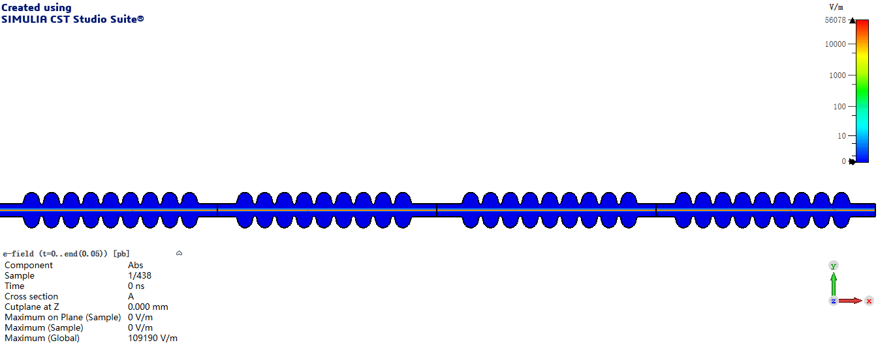
What is HOM?
HOMs (Higher Order Modes) are Eigenmodes parasitically excited in a resonant (accelerating) RF cavity
Other than and with frequency greater than the operational mode
The electromagnetic field left behind the particle beam called wakefield. Wakefields generally exist as damped, oscillatory electromagnetic disturbances, which can be described equivalently as a sum of all the resonant modes excited within the structure.
Time
TESLA 1.3GHz cavity
Wakefields include the higher order modes and the beam-excited accelerating mode, whose main effect is usually described separately as beam loading.

Slide 3
HOM Excitation by a Bunch
Bunch transverses a cavity
Deposits electromagnetic energy, which is described as wakefields (time domain) or HOMs (frequency domain)
Subsequent bunches are affected by these fields and at high beam current one must consider instabilities
When a charge passes through a cavity, it excites HOMs
If it passes exactly an axis, it will only excite monopole modes
For a point charge, the HOM excitation depends only on the bunch charge and the cavity shape

Slide 4
Why do SRF cavities need HOM dampers?
HOMs cause instabilities
Transverse modes can deflect the beam from its reference orbit, causes instable beam motion, transverse emittance growth or even beam loss
Longitudinal modes can lead to energy spread, timing/phase errors, causes longitudinal emittance growth or instability
High-current storage rings require heavy HOM damping
Quality factor (Q) of HOMs damped to the range of 10²~10⁴
HOM couplers will have to handle ~1 kW level power
For SRF cavities
HOMs cause additional cryogenic losses
Extremely low RF losses of SC cavities makes HOM damping a handicap

Slide 5
HOM damping requirements
The parasitic electromagnetic fields can be kept below the threshold by means of HOM dampers, usually attached to the beam tubes of a SC cavity
HOM damping requirements mainly from
High beam currents and beam spectrum (bunch lengths and beam structure)
High beam currents → Large HOM power
Beam spectrum → Broader frequency bandwidth with short bunch length
Beam quality and stability
Strong HOM damping (low impedance and Q_{e})

Slide 6
HOM damping challenges
Strong HOM damping while keeping the fundamental mode not compromised
Efficient damping for all harmful HOMs
Q_{e} requirements
Wide spectrum (new materials)
Engineering, fabrication, assembly and cleanliness (crucial for SC cavities)
Cost effective (large accelerators)
High average HOM power handling capabilities in vacuum (few demonstrated in operations)

Slide 7
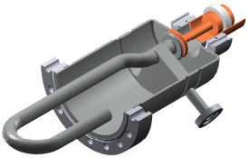
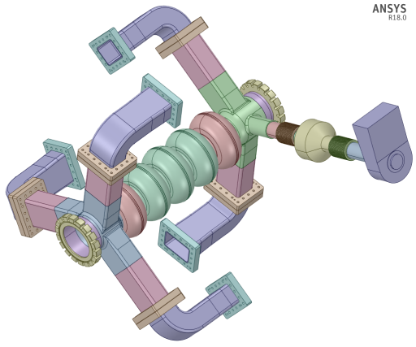
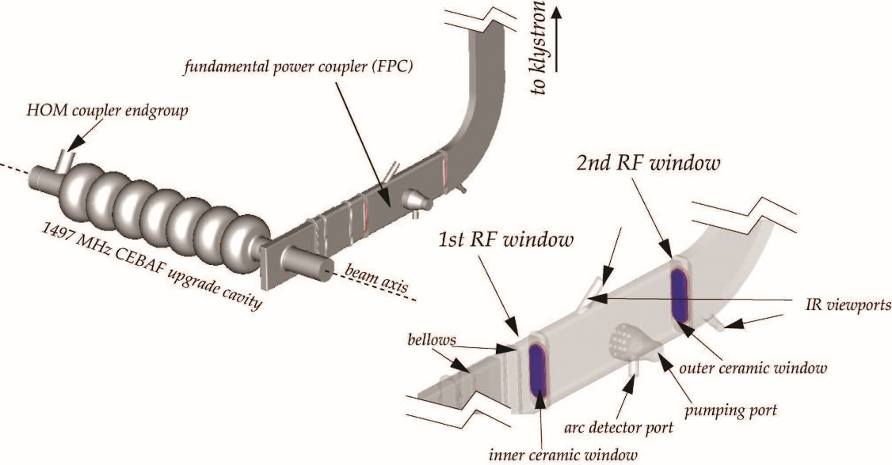
HOM damping methods
Damping methods for cavities
Coaxial HOM coupler on beam tubes
Waveguide HOM coupler on beam tubes
Beam pipe HOM absorbers
Coupling through fundamental power coupler
Coaxial
Via FPC
Waveguide
Beampipe

Slide 8
Coaxial HOM coupler
LHC

Slide 9
Coaxial HOM coupler
Extract HOM power via an antenna or a loop coupler located on beam pipe
The power is picked up by a TEM coaxial transmission line cable (no cutoff), and transmitted to a standard cable (typically 50Ω load) outside the cryomodule
Dampers of this type can provide strong damping depending on a particular RF design
Geometry is more compact than other damper types
Main disadvantage is fundamental RF rejection filters, which must be carefully tuned
Limited power handling capabilities (<1kW)

Slide 10
A bit of history
LEP-type
LEPII
LHC
HERA-type
TESLA
SNS (805 MHz)
Other-type
LHC-HL
SOLEIL
Fermilab (3.9 GHz)
CEBAF upgrade (1.5 GHz)
CEPC (650MHz)
BNL QWR (56MHz)
Proposed and developed for HERA and LEP in mid-80’s
LEP-type couplers were later adapted for SOLEIL and LHC cryomodules
TESLA HOM couplers were derived from HERA couplers with a simplified RF design due to moderate damping requirements (Q_{HOM} ~ 10⁵)
Later scaled for use at SNS (805MHz), Fermilab (3.9GHz) and 12GeV CEBAF upgrade (1.5GHz) cryomodules though there were some difficulties

Slide 11
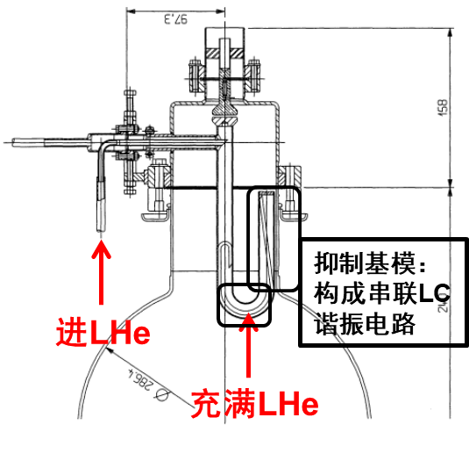
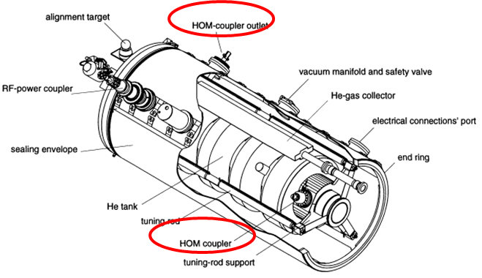
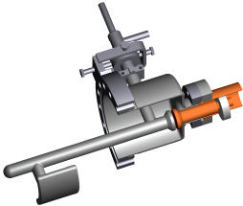
LEP/LHC HOM couplers
LEP2 (352 MHz) cavities had two “hook” type couplers, where the hook was filled with liquid helium for cooling
The notch filter can be adjusted after installation
In addition to LEP2 dipole mode couplers, LHC (400 MHz) cavities have broadband couplers
LHC had four couplers per cavity: two narrow band couplers & two broadband couplers
Max power test for LEPII coupler is 850 W, and 600 W for LHC coupler
LEPII Qe: 10³~10⁴
E. Haebel et al., SRF1997, SRF97C33.
LHC Qe: 10²~10³

Slide 12
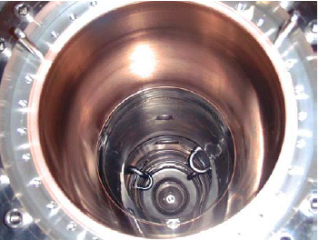
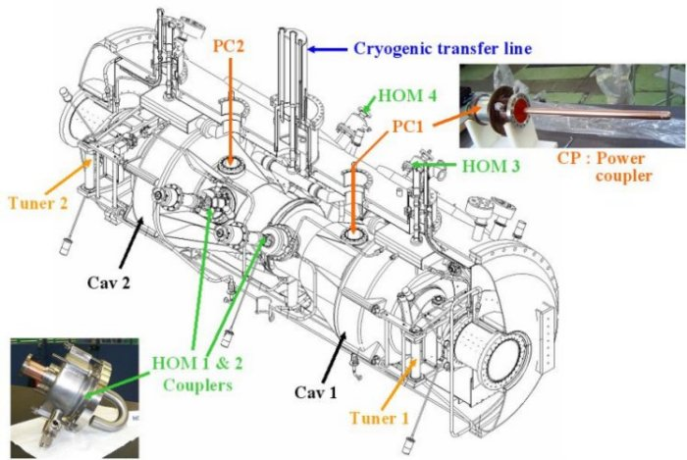
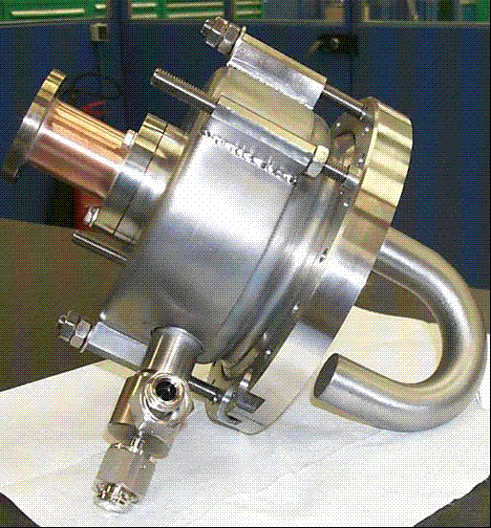
SOLEIL HOM couplers
What the beam sees passing
through the SOLEIL module
Two types of HOM couplers for dipole and monopole modes
Much higher coupling factor than in LEP or TESLA cavities
Observed in operation HOM power is just a few W
SOLEIL HOM coupler
SOLEIL cryomodule
C. Thomas-Madec et al., SRF2005, THP45.

Slide 13
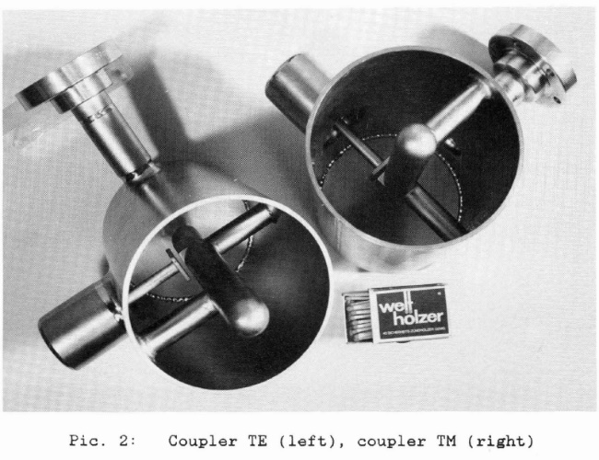
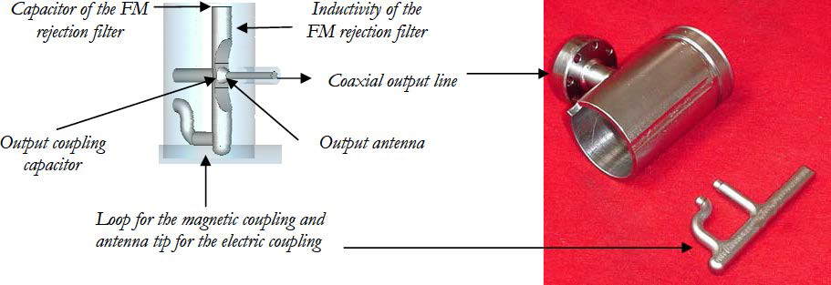
HERA/TESLA HOM couplers
HERA: 500 MHz 4-cell cavity, 1 TM coupler & 2 TE coupler for one cavity
TESLA HOM couplers were derived from HERA couplers, and widely used, such as ILC, XFEL, LCLSII (Qe~10⁵)
Scaled for SNS, JLab high gradient (HG) and low loss (LL) cavities
HOM coupler
HOM coupler
HOM coupler heating in CW operation is a key problem!!
1.3 GHz TESLA/ILC/XFEL/LCLS-II-type cavity
J. Sekutowicz, SRF93, srf93g04.

Slide 14
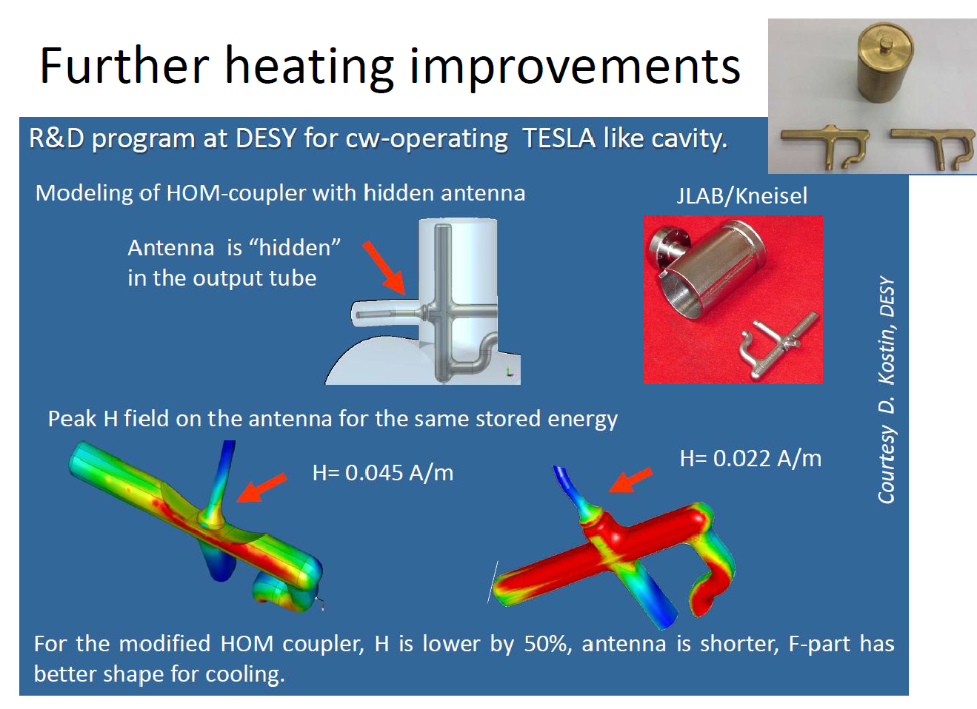
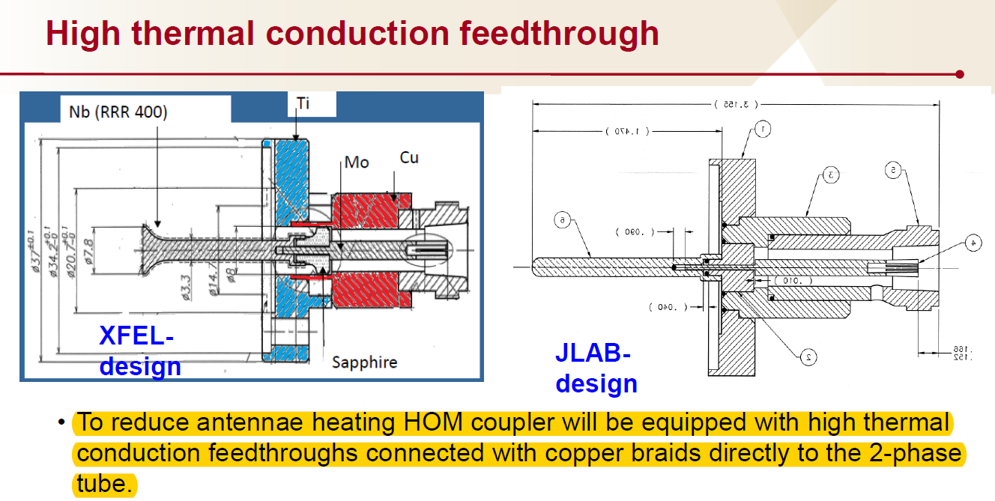
Modified TESLA HOM coupler for CW operation
Modifying antenna shape to reduce heating
Thermal straps were added between the antenna feedthrough and the 2 K supply line
Improve HOM feedthrough thermal conduction
LCLS-II Final Design Report, 2014

Slide 15
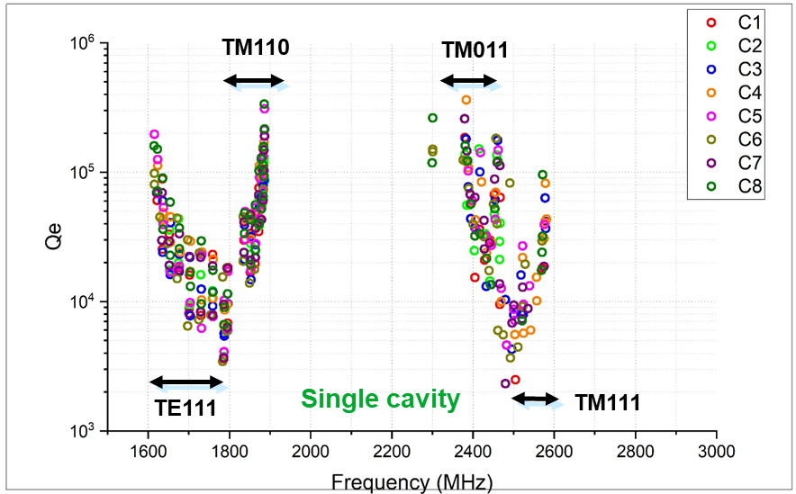
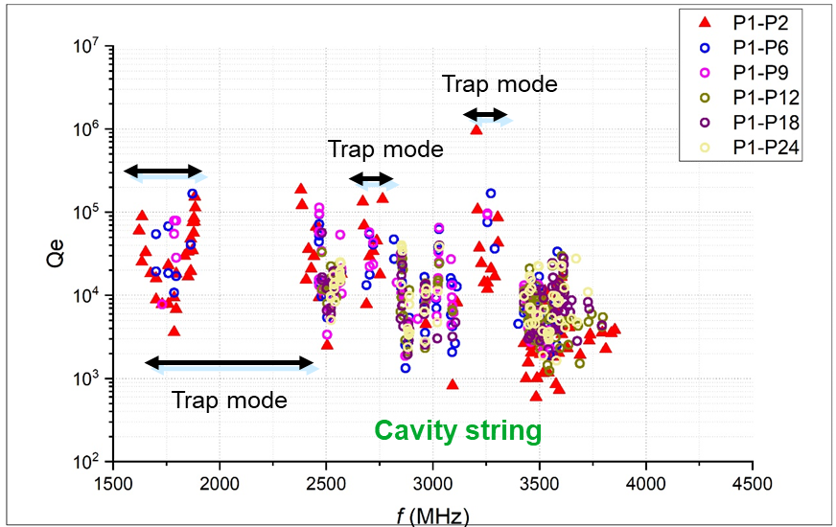
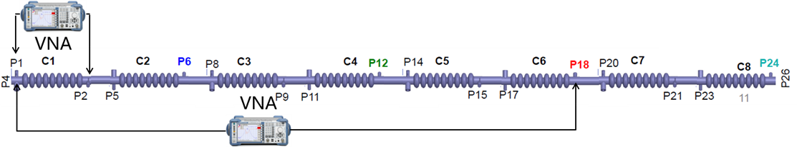
1.3 GHz TESLA HOM coupler testing in IHEP
HOM power extracting to the HOM coupler between cavities and propagating to the HOM absorber outside the cryomodule. Please pay attention to the trapped mode
HOM propagating simulation and measurement at 2 K in the 1.3 GHz cryomodule
HOM propagation in multi-cavity study is important for large accelerator

Slide 16
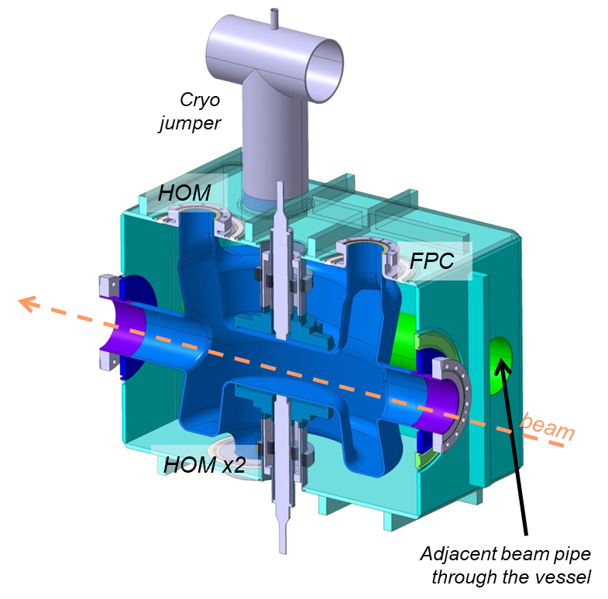
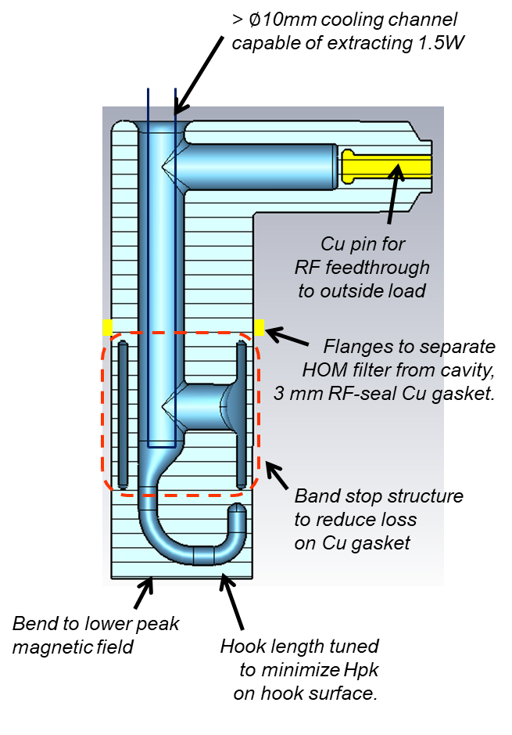
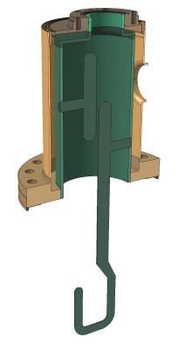
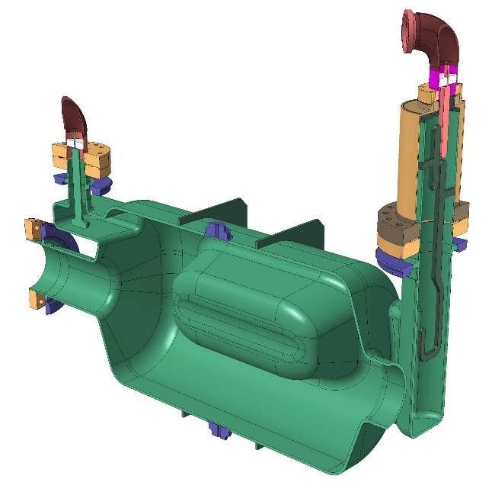
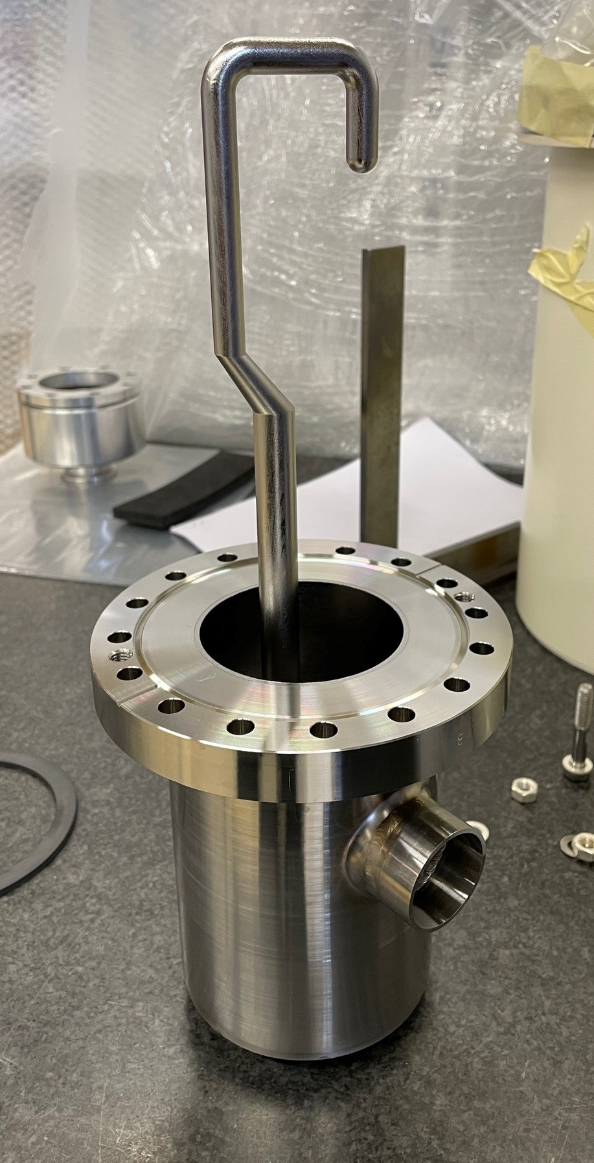
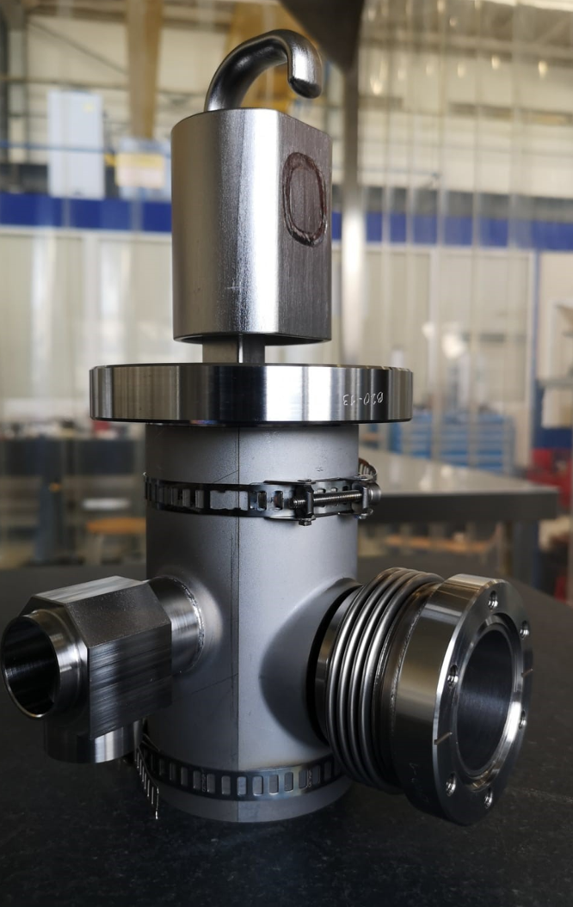
HL-LHC Crab cavity HOM coupler
HOM coupler for DQW cavity
HOM coupler for RFD cavity
RF Dipole crab cavity operating at 400 MHz
Double quarter wave crab cavity operating at 400 MHz
f_{HOMs} > 573MHz
Q_{e} > 10³
R. Calaga, eeFACT2025
S. Verdú-Andrés et al., IPAC2019, WEPRB098.
S.U. De Silva et al., LINAC2018, TUPO033.

Slide 17
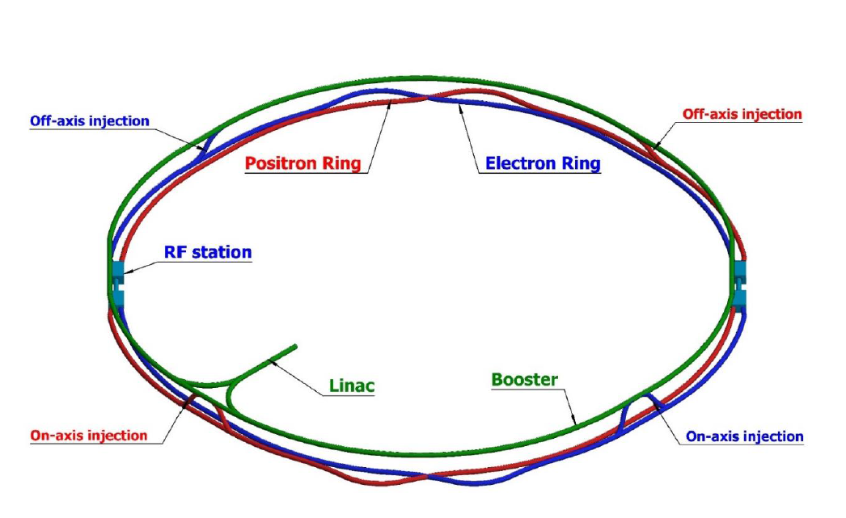
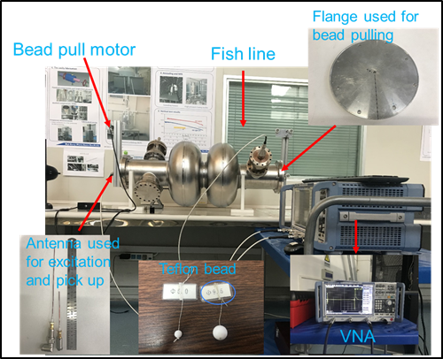
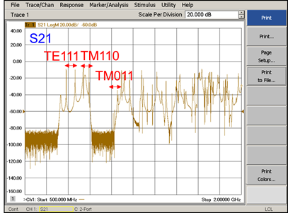
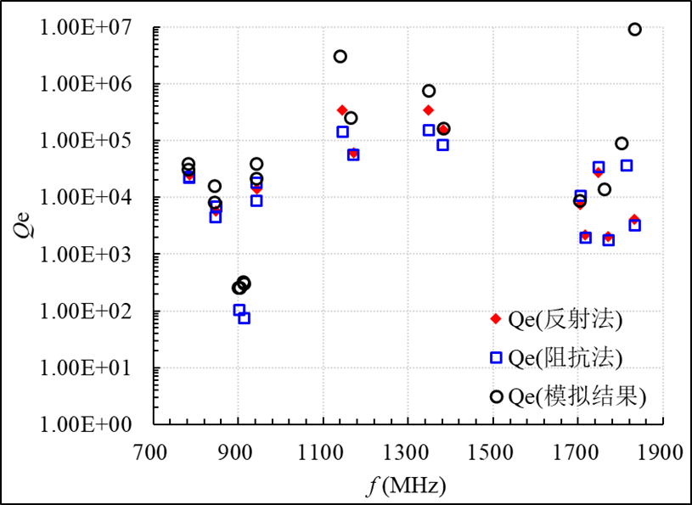
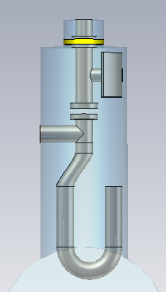
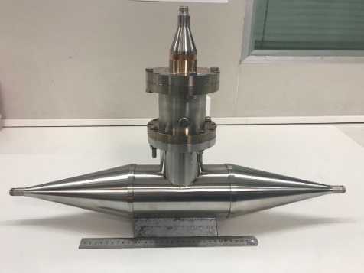
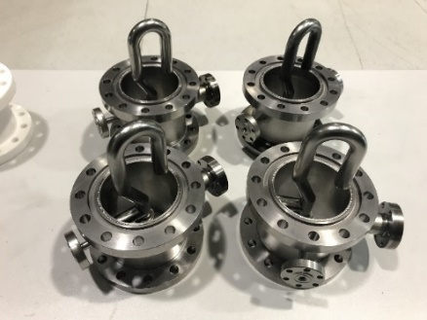
Development at IHEP
CEPC
HOM coupler developed for 650MHz 2-cell SC cavities
Damping results
Prototype
Nb part
Hongjuan Zheng et al., Nuclear Instruments and Methods in Physics Research Section A 951, 163094 (2020).

Slide 18
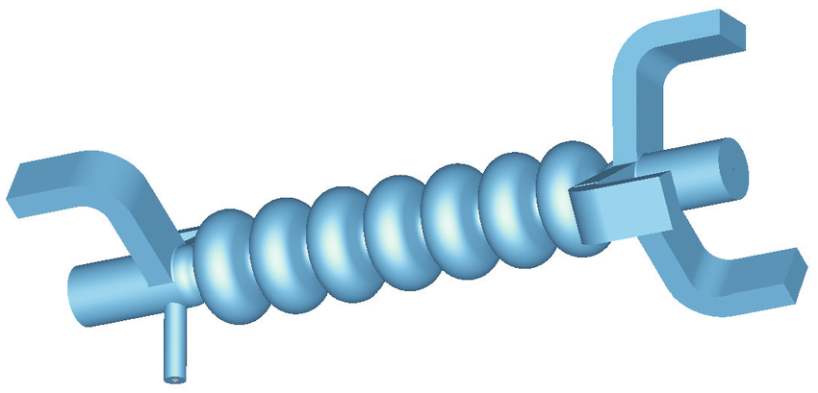
Waveguide HOM coupler
HZB.

Slide 19
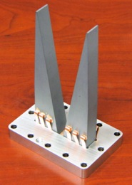
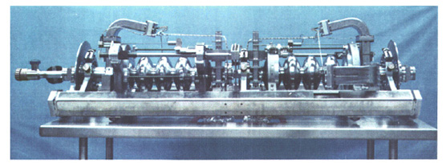
Waveguide HOM couplers
Used in CEBAF and JLab FEL SRF linacs.
New designs are being developed primarily at Jefferson Lab.
Proposed for JLab’s Ampere-class cryomodule (748.5 MHz) and “100 mA” cryomodule (1497 MHz).
While can provide very efficient damping in broad frequency range and don’t compromise the fill factor, waveguides significantly complicate the cavity and cryomodule design.
Ampere-class cryomodule: WG absorbers at RT
CEBAF: WG absorbers at 2 K
HOM load concept
R. Rimmer et al., SRF2005, THP46.
C.W. Leemann et al., Annu. Rev. Nucl. Part. Sci. 51, 413-450 (2001)

Slide 20
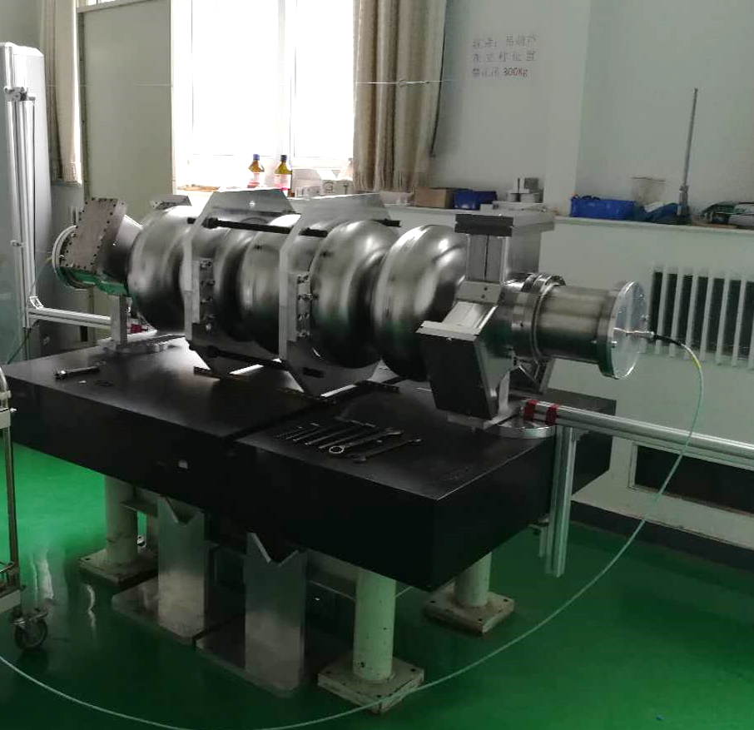
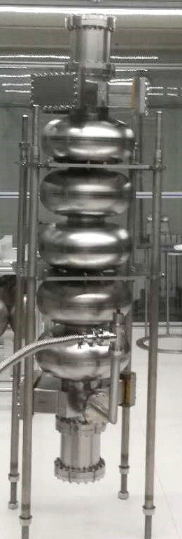
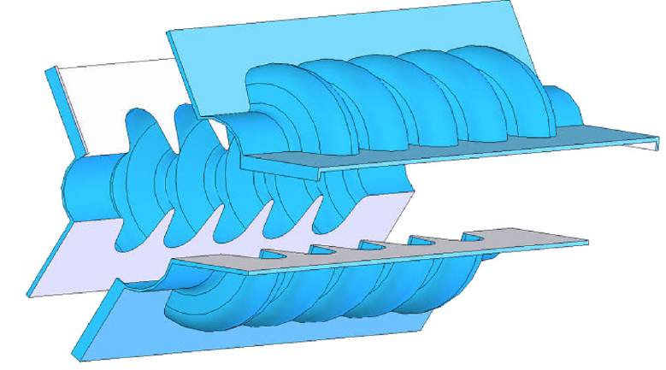
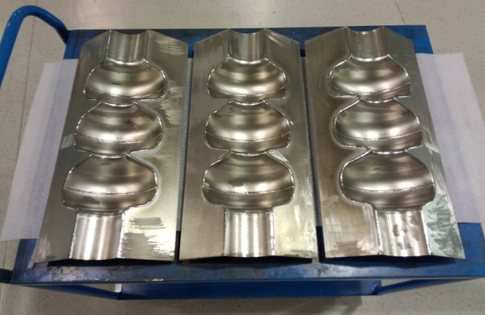
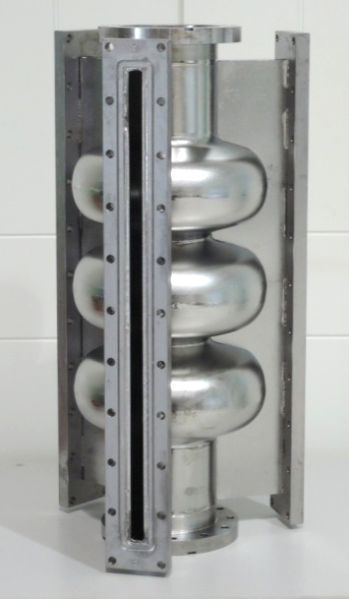
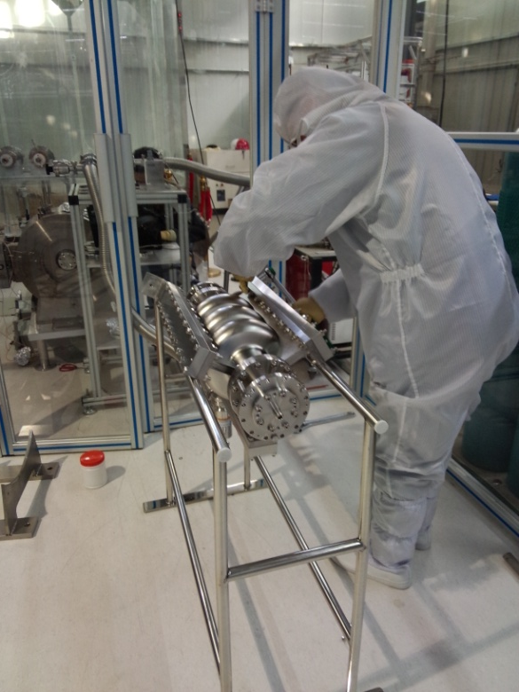
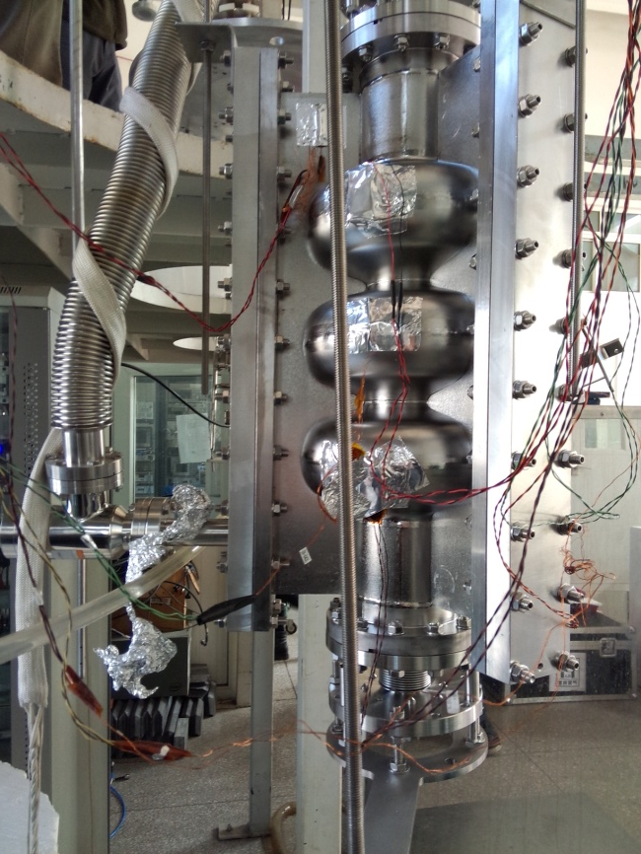
Development at IHEP
650MHz 5-cell SC cavity
1.3GHz 3-cell slotted cavity
Hong-Juan Zheng et al., Chinese Physics C 40, 057001 (2016)
Zhenchao Liu et al., SRF2017, TUPB033.

Slide 21
Beam-pipe absorber
Cornell and KEK.

Slide 22
Beam-pipe absorber
Originally developed at Cornell University and KEK for very high average power absorption
Widely used in high-current storage rings, where they operate at room temperature outside the cryomodule
Achieved QHOM ≈ 10²~10³ in single-cell storage ring cavities
Cornell developed an HOM load operating at 80 K for ERL cavities with dissipating capacity of ~200 W. KEK is also developed beam pipe HOM loads for cERL.
DESY developed a beam pipe absorber for XFEL to complement loop HOM couplers.
However, the absorbers designed to operate at cryogenic temperatures are not capable of dissipate kW level HOM power
Dampers of this type are arguably the most efficient and likely will be required to absorb very high frequency portion of HOM power, which propagates along the beam pipe
Drawbacks of beam pipe absorbers
- Absorber materials are brittle, can create particulates that contaminate SRF cavities
- Parasitic beam-absorber interaction is significant contributing to the overall HOM power
- For large SRF systems, they occupy real estate thus reduce the fill factor

Slide 23
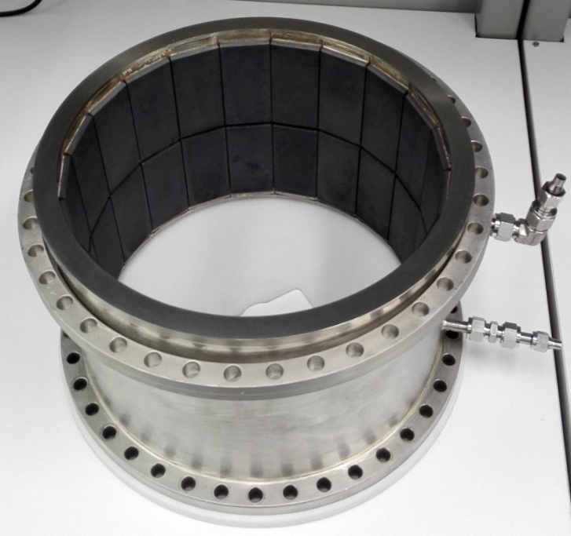
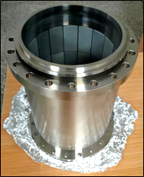
Absorbing materials
Ferrite
  Suitable for low frequency modes
  Absorb magnetic field, due to large imaginary part of μ
SiC
  Suitable for high frequency modes
  Absorb electric field, due to large imaginary part of ε
Courtesy F.B. Meng (IHEP).
Courtesy F.B. Meng (IHEP).

Slide 24
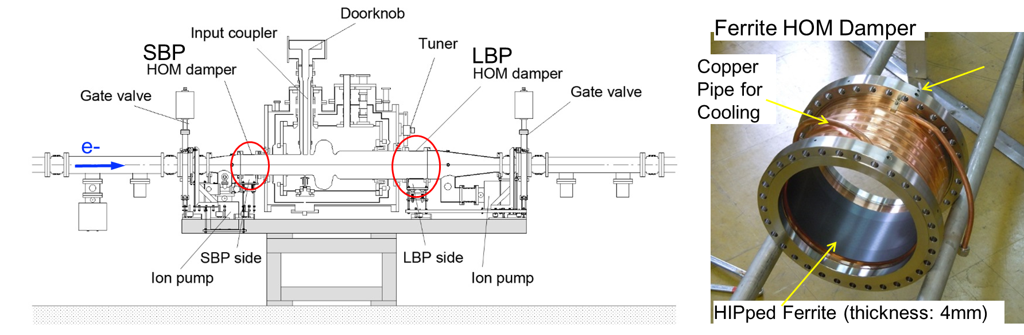
KEKB/Super-KEKB HOM beam pipe absorber
Ferrite is bonded to copper plated steel housing using HIP (Hot Isostatic Press) process
Absorbers of this design are used at KEKB and BEPC-II
A Pair of Ferrite HOM dampers for each superconducting cavity module
SBP damper : f220 x t4 x L120 ,LBP damper : f300 x t4 x L150
Max. absorbed power in KEKB : 16 kW/cavity (1.4 A, s=6 mm, 10 nC/bunch)
Expected HOM power is over 30 kW/cavity at SuperKEKB design current (2.6 A)
Takafumi OKADA, CEPC WS2024
K. Akai et al., NIM-A 499, 45-65 (2003).

Slide 25
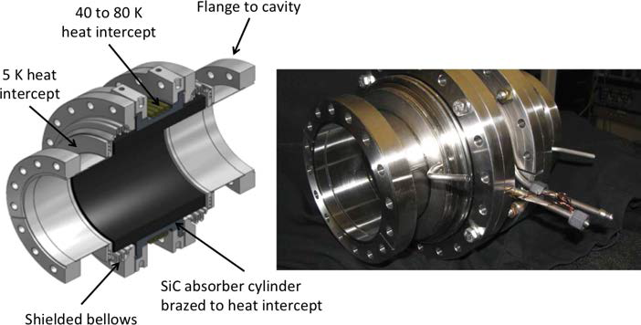
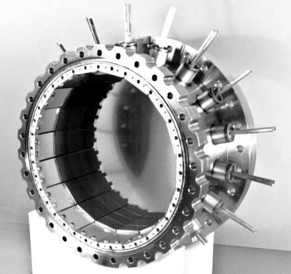
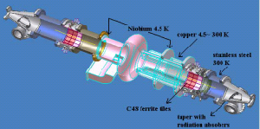
Cornell HOM absorbers
CESR HOM absorber
Ferrite tiles are soldered to water-cooled Elkonite plates, which in turn are mounted inside a stainless steel shell.
CESR-type HOM loads are used at CESR, TLS, CLS, Diamond, SSRF, and R&D ERL at BNL
Absorbed up to 2.9 kW in operation.
ERL HOM absorber
Use graphite-loaded SiC material to cover frequency range > 40 GHz
Operate at 80 K, cooled by cold He gas
Dissipating capacity of ~200 W
E. Chojnacki et al., PAC99, MOP77.
V. Shemelin et al., EPAC2006, MOPCH177.

Slide 26
EXFEL HOM beam pipe absorber
Cover the high frequency part of the HOM spectrum
Absorbers installed between 8-cavity cryomodules
5.4 W of microwave power per lossy ceramic ring during nominal operation of XFEL
Capable to dissipate up to 100 W
J. Sekutowicz et al., SRF2005, THP55.

Slide 27
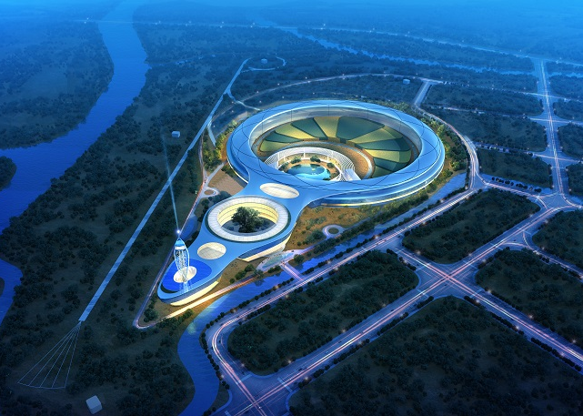
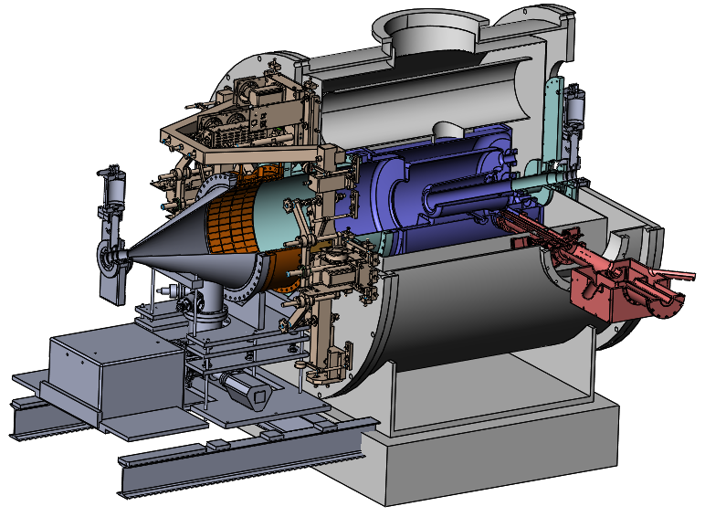
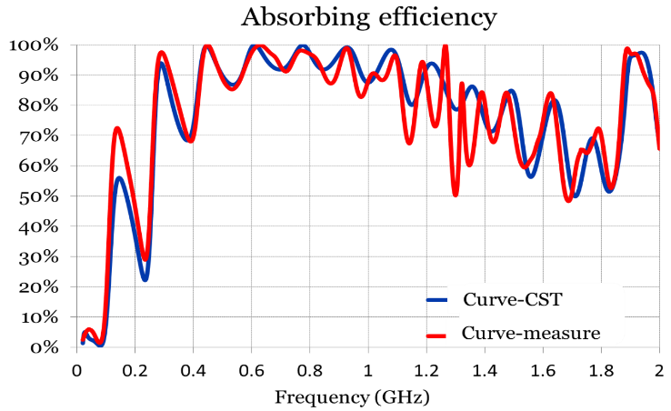
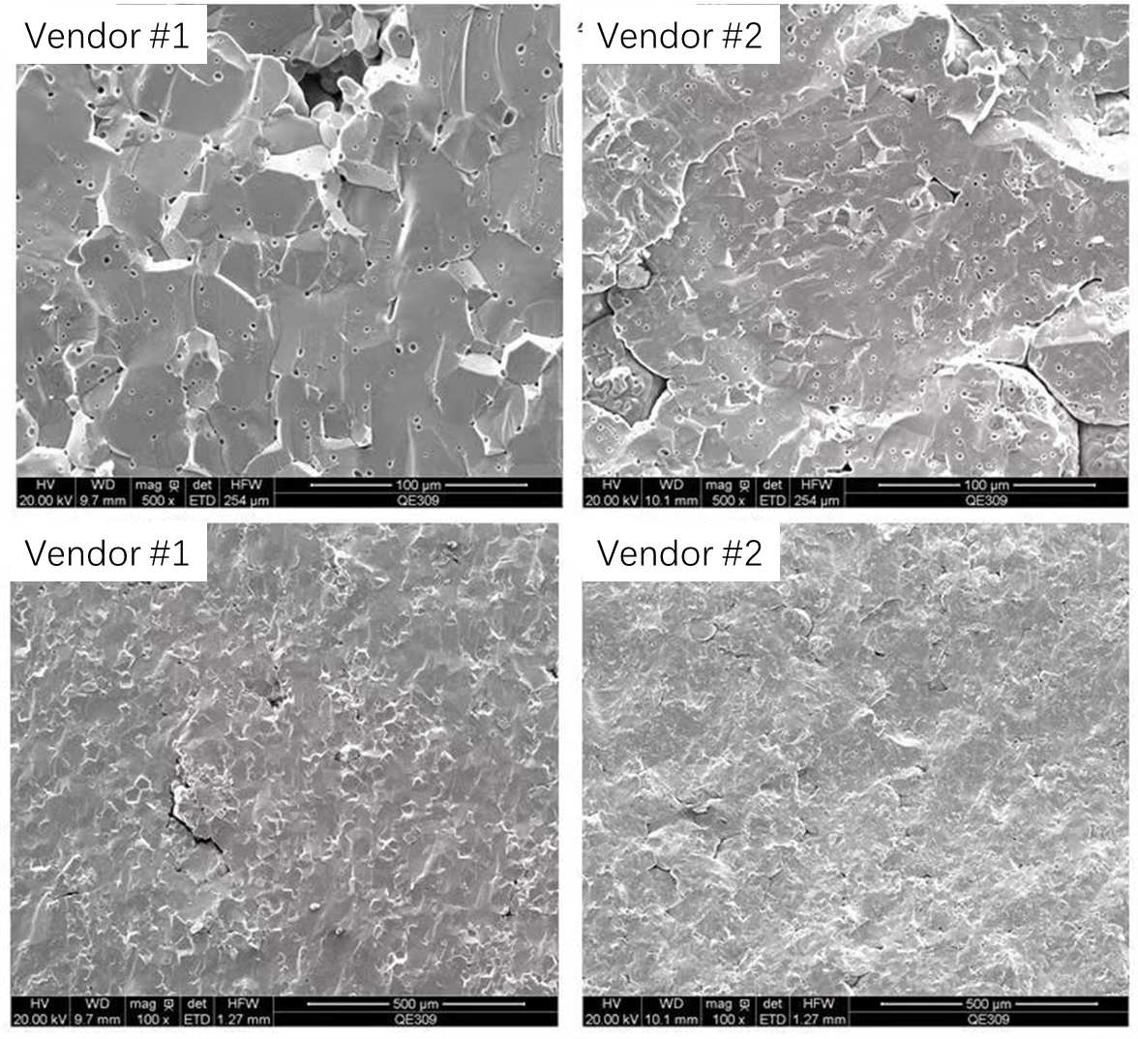


Development at IHEP: Ferrite absorber
High Energy Photon Source
166MHz module
Φ505mm for 166MHz CAV
High power test
F.B. Meng et al., SRF2017, MOPB071.
P. Zhang et al., Rev. Sci. Instrum. 90, 084705 (2019).

Slide 28






Development at IHEP: SiC absorber
Frequency range: 3.5-10GHz
Absorbing efficiency: >50%
CEPC 650MHz module
F.B. Meng et al., SRF2017, MOPB071.

Slide 29

Coupling through FPC
CEBAF.

Slide 30
Coupling through FPC
Pros:
Uses existing input fundamental coupler (no extra costs) to extract power
The power extracted will propagate to the circulator load
Neutral:
The circulator load is not a broadband device, RF power can be reflected, however a waveguide absorber can be placed outside the cryomodule (no particulate issues).
The filter however can be complex and costly since it must not damp the incoming fundamental mode.
The damping could also be waveguide mode-dependent based on design.
Cons:
Damping might prefer only one of two dipole mode polarizations and thus depends on direction of input coupler (this can be mitigated to some extent by design)
The transmission of other than the fundamental mode is limited by the RF vacuum window(s) and may require some optimization to be useful
Transmission through RF window(s) is also waveguide mode-dependent. Only problem if more than one waveguide mode is required to damp critical modes (tradeoff possible by design)
When external waveguide filter is used, it needs to be optimized to minimize insertion losses

Slide 31






Coupling through FPC
CEBAF FPC HOM waveguide Filter placed outside the cryomodule (originally conceived for intercepting klystron harmonic signals)
Frank Marhauser, SRF Hands-On Course at Jlab, 2015

Slide 32
On-cell dampers
APS.

Slide 33
On-cell dampers
Using HOM-dampers positioned on cavity dells is the most efficient way to damp HOMs directly
Pros and Cons would apply as detailed depending on the used damper technology
Works well for normal conducting (NC) cavities
This technique can only be used for cavities that do not use the TM010-mode as operating mode
The technique should not be used for SRF accelerating (TM010) cavities, when aiming for the typically high operating efficiency attractive for the usage of the cavities
For special cavities only!

Slide 34

On-cell dampers
Crab cavities are not meant for acceleration and are employed for beam manipulation (luminosity enhancement) close to interaction point of colliding beams by providing transverse deflecting fields
On-cell dampers in fact are required for trapped Lower Order Modes (LOMs), not HOMs, which exist at lower frequencies than the operating mode
The operating dipole mode used allows to place the damper on the cell
A high brightness SRF Photo injector gun cavity has been designed using a TM020-mode in the first half-cell, but typical cells in the following full cells for efficient TM010 acceleration
On-cell waveguide damper – no field enhancement
Muons, Inc. SRF photoinjector gun development
J. Mammosser et al., SRF 2013
Frank Marhauser et al., SRF 2013

Slide 35

How to determine the HOM damping scheme?
A case introduction
CEPC 650MHz cryomodule

Slide 36
HOM
Structure
Impedance
Heat
Power
Beam parameters
Beam current
Beam energy
synchrotron tune
momentum compaction factor
bunch revolution frequency
radiation damping time
β function
HOM power
Beam current
Bunch length
Bunch charge
Filling pattern
R/Q
……

Slide 37
CBI instability caused by HOM
Higher order modes excited by the intense beam bunches must be damped to avoid additional cryogenic loss and multi-bunch instabilities
Monopole HOMs can lead to energy spread, timing/phase errors, causes longitudinal emittance growth or instability
Transverse modes can deflect the beam from its reference orbit, causes instable beam motion, transverse emittance growth or even beam loss
Impedance budget
To keep the beam stable, the radiation damping time should be less than the rise time of any of the oscillation modes
If the beam spectrum coincide with the cavity impedance spectrum(~resonant case), the beam maybe unstable, and the HOM power loss will be huge (~hundred kilo watts)
In the resonant condition, the threshold shunt impedances are

Slide 38

HOM power
The average power losses can be calculated as single pass excitation by
$$P_{HOM}=k∙q∙I$$
k is the total loss factor of HOMs, which can be obtained from ABCI or CST, q is the bunch charge and I is the beam current
The average HOM power obtained by assuming that the ‘bunch spacing time (Tb)/decay constant (Td)’ of all higher order modes is the same
The resonant HOM power
The modes of the cavity are orthogonal, so the total power dissipated in HOMs is the sum of the power absorbed by each mode
In the worst case, resonant excitation occurs when the beam frequency differs from the resonance of the excitation field by an integer multiple, and the beam power loss is expressed by
$$P_{HOM}^{res}=I^{2}∙\frac{R}{Q}∙Q_{L}$$
Although, the probability of resonant buildup is small, if it does happen, the resulting mode excitation is severe. It is important that all potentially dangerous modes are carefully examined to ensure that resonant excitation is avoid

Slide 39




HOM power with filling pattern
The accurate estimations of the HOM power loss are required to determine parameters of the HOM absorbers. The power loss is depended both on the beam parameters and the geometry design of the cavities, and it can be calculated by
where J_{A} is the average beam current, Z// is the longitudinal impedance, J_{k} is the normalized Fourier harmonic of the beam current at the kth revolution harmonic, $ω_{0}=2πf_{0}$, and f₀ is the revolution frequency.
Beam spectrum and cavity impedance (CEPC:48 train)
HOM power spectrum bellow 2 GHz
Total HOM power is 1031 W after considering the real fill patterns (kqI~1.94 kW).
Dianjun Gong, Jie Gao, Hongjuan Zheng, et al., Radiation Detection Technology and Methods, 2019, 3(3): 18

Slide 40

Design considerations
Requirements / Specification
Frequency band
Impedance threshold
Maximum Power
Operation Mode
Heat Load
Choice
Type: HOM coupler, absorber or hybrid
Position: On-cell or Beam Pipe
Number of Couplers
Cooling
Position of Loads
Cavity

Slide 41


A design case: HOM damping for CEPC
Hybrid damping scheme
HOM absorber
CEPC 650MHz cavity string
HOM absorber
HOM coupler
Jiyuan Zhai, eeFACT2025

Slide 42



Cavity Spectrum and Power
Dangerous monopole: around 1200 MHz
Dangerous dipole: 800 MHz ~ 900 MHz, 1200 MHz
HOM coupler: 800~1400 MHz
HOM absorber operating frequency: 1.4 ~ 20 GHz
Hongjuan Zheng*, et al., Nuclear Inst. and Methods in Physics Research, A 951, 163094 (2020).

Slide 43

HOM coupler design
Design scheme of HOM coupler: double-notch, coaxial LC filter
Wide bandwidth for fundamental mode
No tuning needed for fundamental mode in actual
Damping requirement for fundamental mode (TM010): Qe >1×10¹¹
Collider 650 MHz Cryomodule (6x2-cell, 10 m)
HOM coupler
HOM absorber

Slide 44





HOM coupler design approach
Design Approach and Methodology
Equivalent circuit (transmission line model) → Optimize each part according to S21 curve → Change to 3D model → Electromagnetic optimization
TM010 H-field
Qe_TM010=1E12

Slide 45





Design Contents
Design contents mainly includes RF design, power dissipation, multipacting analysis, heat loss, mechanical designs
2 kW power per cavity, each direction 1 kW, assume 50 % coupled by the HOM coupler (0.5 kW). 1 kW power capacity will have enough margin.
Hongjuan Zheng*, et al., NIM-A 951, 163094 (2020).

Slide 46

CEPC 650 MHz HOM Coupler Fabrication
Four HOM couplers have been finished fabrication, post-processing, which have been assembled in the test cryomodule in the Platform of Advanced Photon Source Technology R&D (PAPS)
Compact structure design, control machining accuracy
Hongjuan Zheng*, et al., NIM-A 995, 165093 (2021).

Slide 47


RF performance for the fundamental mode
Qe for TM010:
At 2 K, Qe≥1×10¹²
The suppression of HOM couplers for TM010 at 2 K is not much different between the designed and measured values, if the installation tolerance is well controlled.
No tuning is required at 2 K.
The design can satisfy the damping requirement at cryogenic temperature.
wrong rotation angle of copper part installation
NPT: normal pressure & temperature
Spec.
1 W at
20 MV/m
Hongjuan Zheng*, et al., NIM-A 995, 165093 (2021).

Slide 48

RF performance for the HOMs
Damping for HOMs:
Measured Qe for TE111 and TM020 modes at 2 K are not much different from those of measured at room temperature.
Measured results of the other modes at 2 K are different from those at room temperature.
The damping results for HOMs becomes better under 2 K.
Satisfy the damping requirements for Higgs.
Need feedback for Z-pole.
Further optimization design is needed.
Hongjuan Zheng*, et al., NIM-A 995, 165093 (2021).

Slide 49


CEPC HOM absorber
Due to short bunch length thus wide HOM frequency range, SiC+AlN composite is chosen for cavity HOM absorbing material.
5 kW high power test show high absorbing efficiency, meets CEPC spec.

Slide 50
Summary
There are many proven designs of HOM dampers
The coaxial HOM coupler has a limited power handling capabilities, and operating within a narrow bandwidth range. In general, modules with multi-cavities often adopt this type of HOM coupler design
The waveguide HOM coupler are rarely used in currently operational accelerators, as it significantly complicate the cavity and cryomodule design
Beam pipe absorbers demonstrated power levels of several kilowatts, and operating within a wide bandwidth range
When decide the way of HOM damping, it is necessary to comprehensively consider multiple factors such as power capacity, impedance requirements, module design…….

Slide 51

Thank You for Your Attention!
Have a nice day!

