Slide 1
Fundamental Power Couplers for superconducting cavities
Tong-ming Huang
2025-3-27

Slide 2
Outline
1
Introduction
2
Get to know FPCs
3
Design issues on FPCs
4
Fabrication issues on FPCs
5
High power test issues on FPCs
6
Recent advances on FPCs
7
FPCs development at IHEP

Slide 3
Introduction

Slide 4
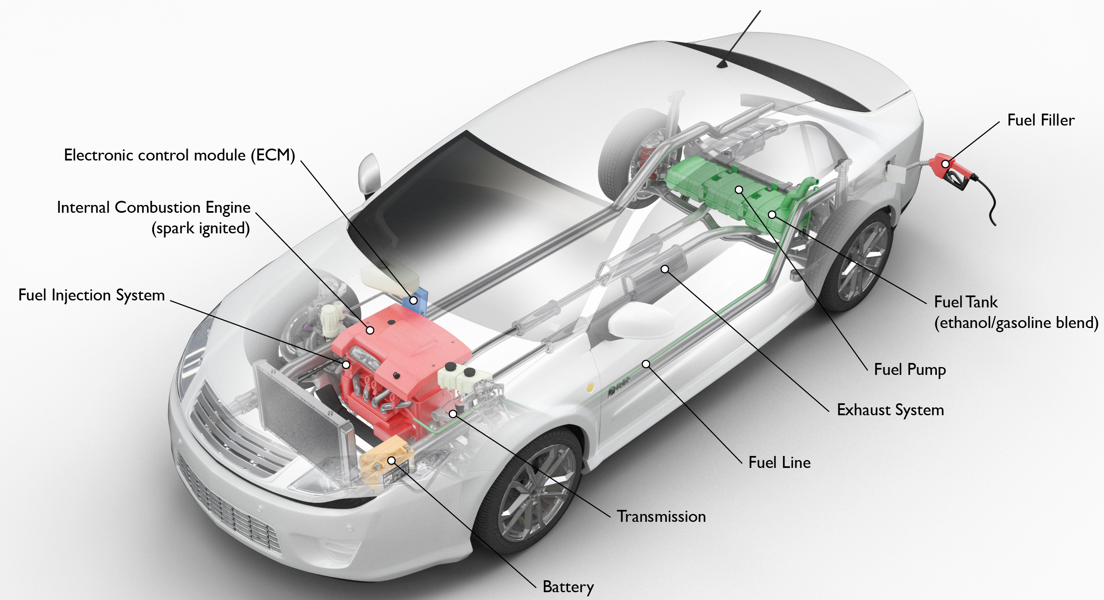
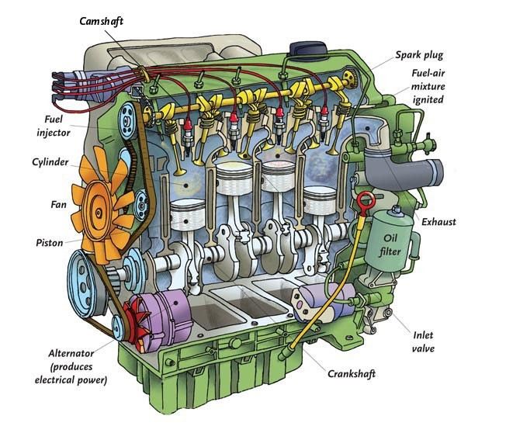
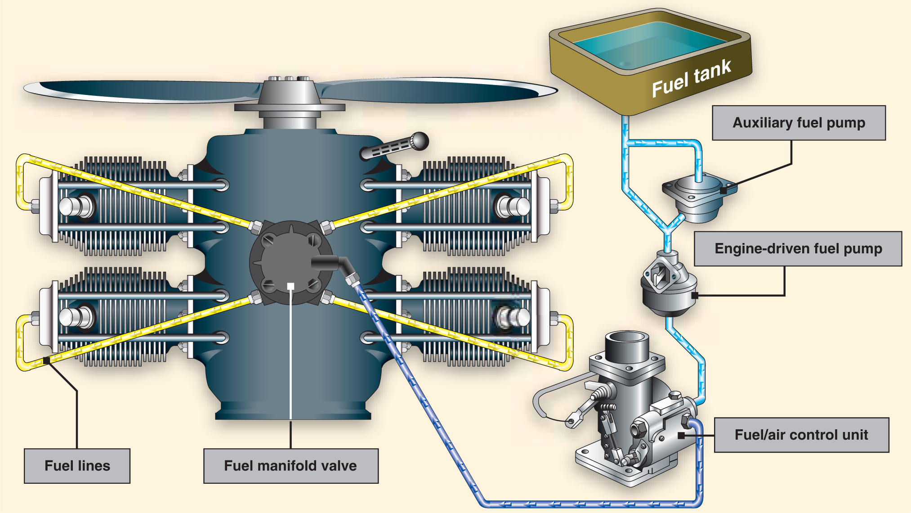
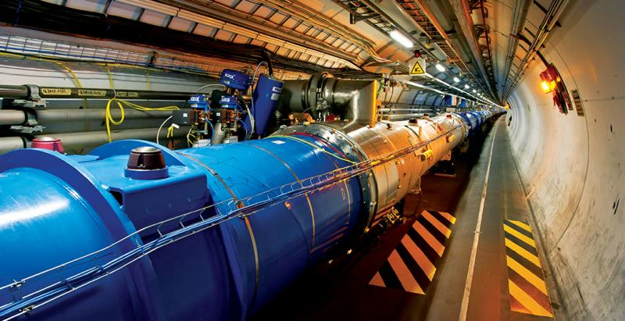
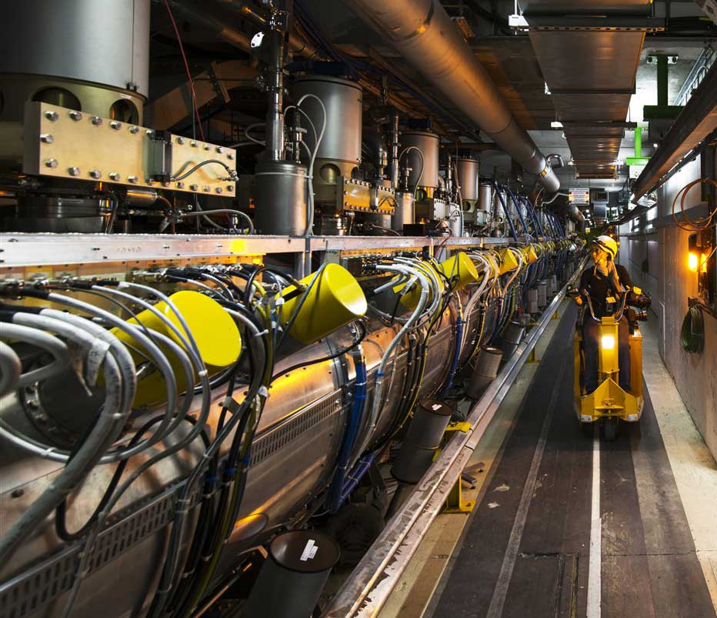
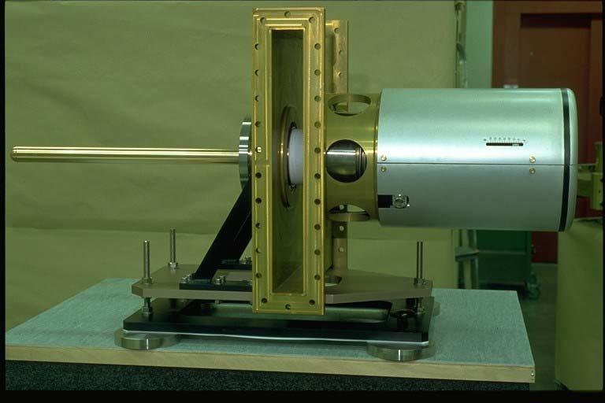
RF system in accelerator
Automobiles
Engines
Fuel injection systems
Accelerators
RF systems
Fundamental Power couplers (FPCs)

Slide 5
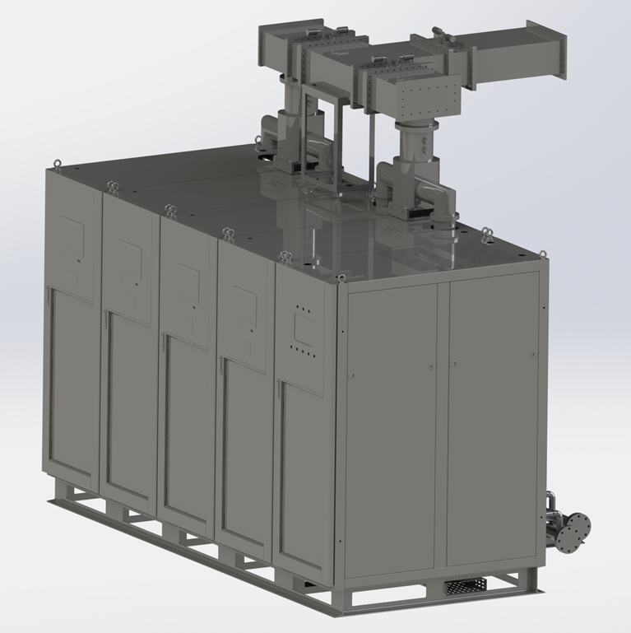
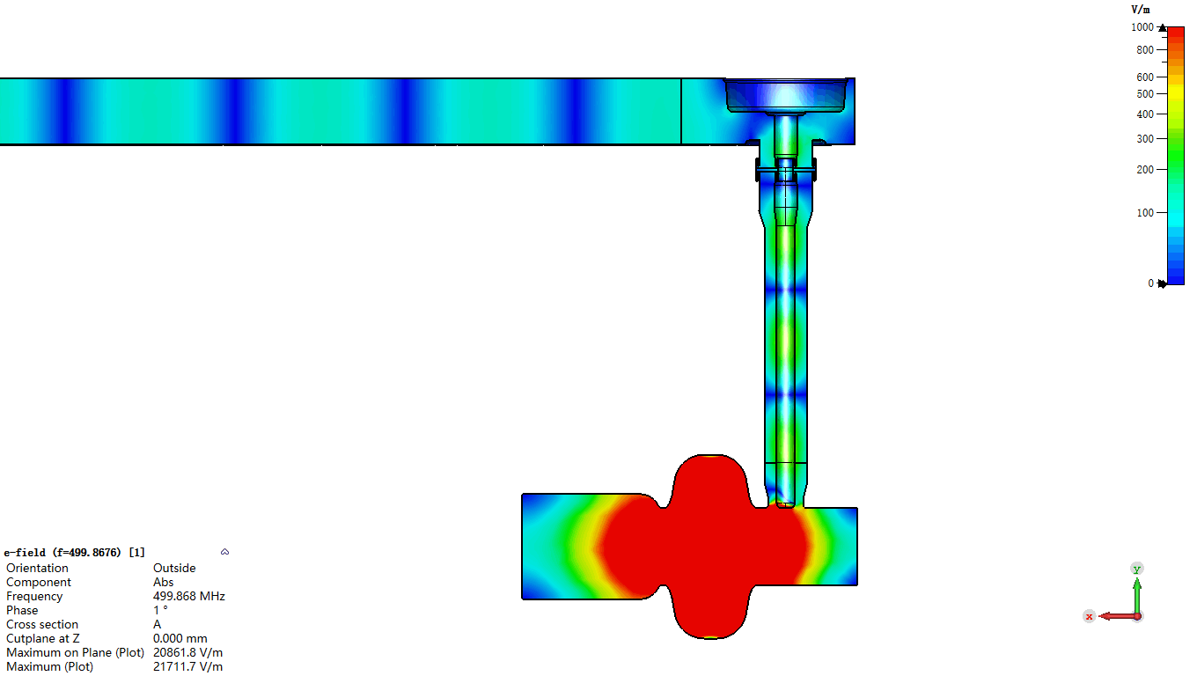

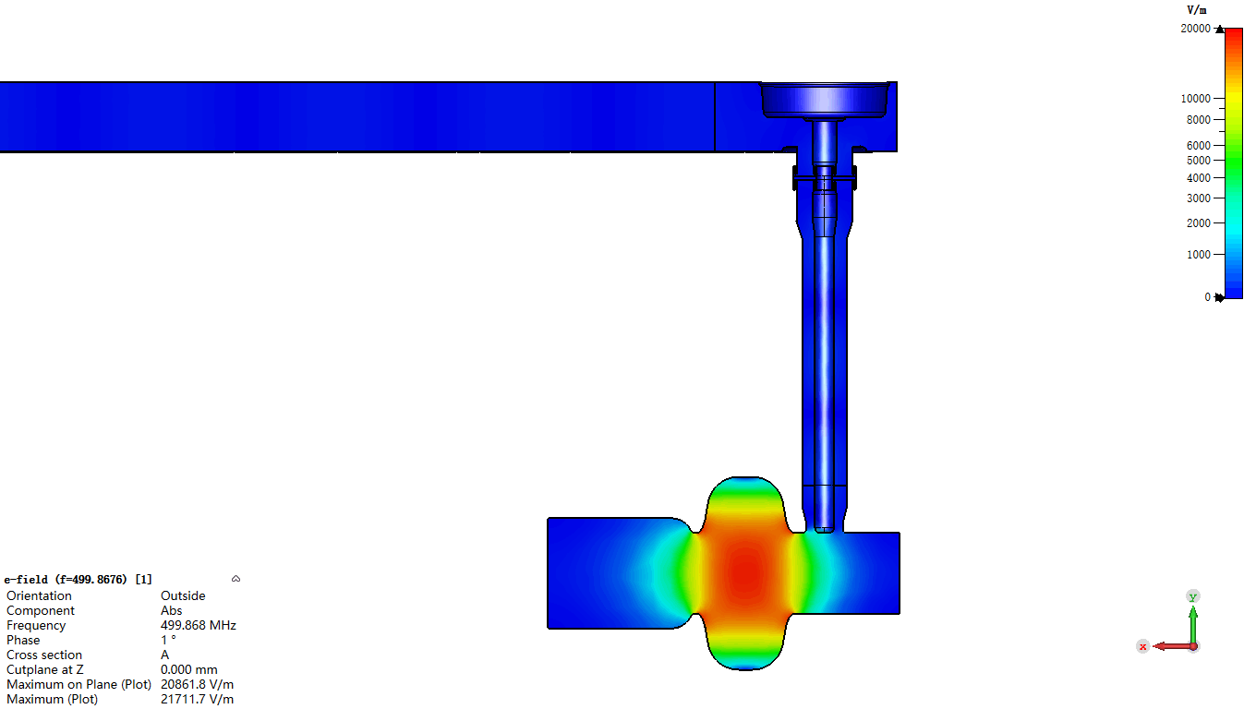
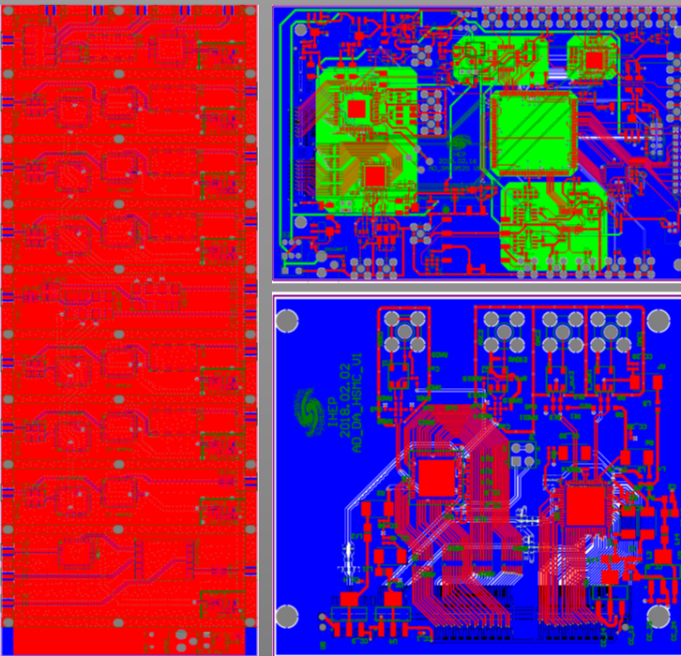
RF system cartoon
RF system cartoon
Transmission Line
Power coupler
AC Power
Transfer RF power
Coupling power
Power Source
RF system
RF Cavity
Produce RF power
Accelerate beam
Lower-level RF
Control RF system

Slide 6
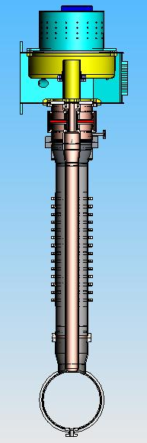
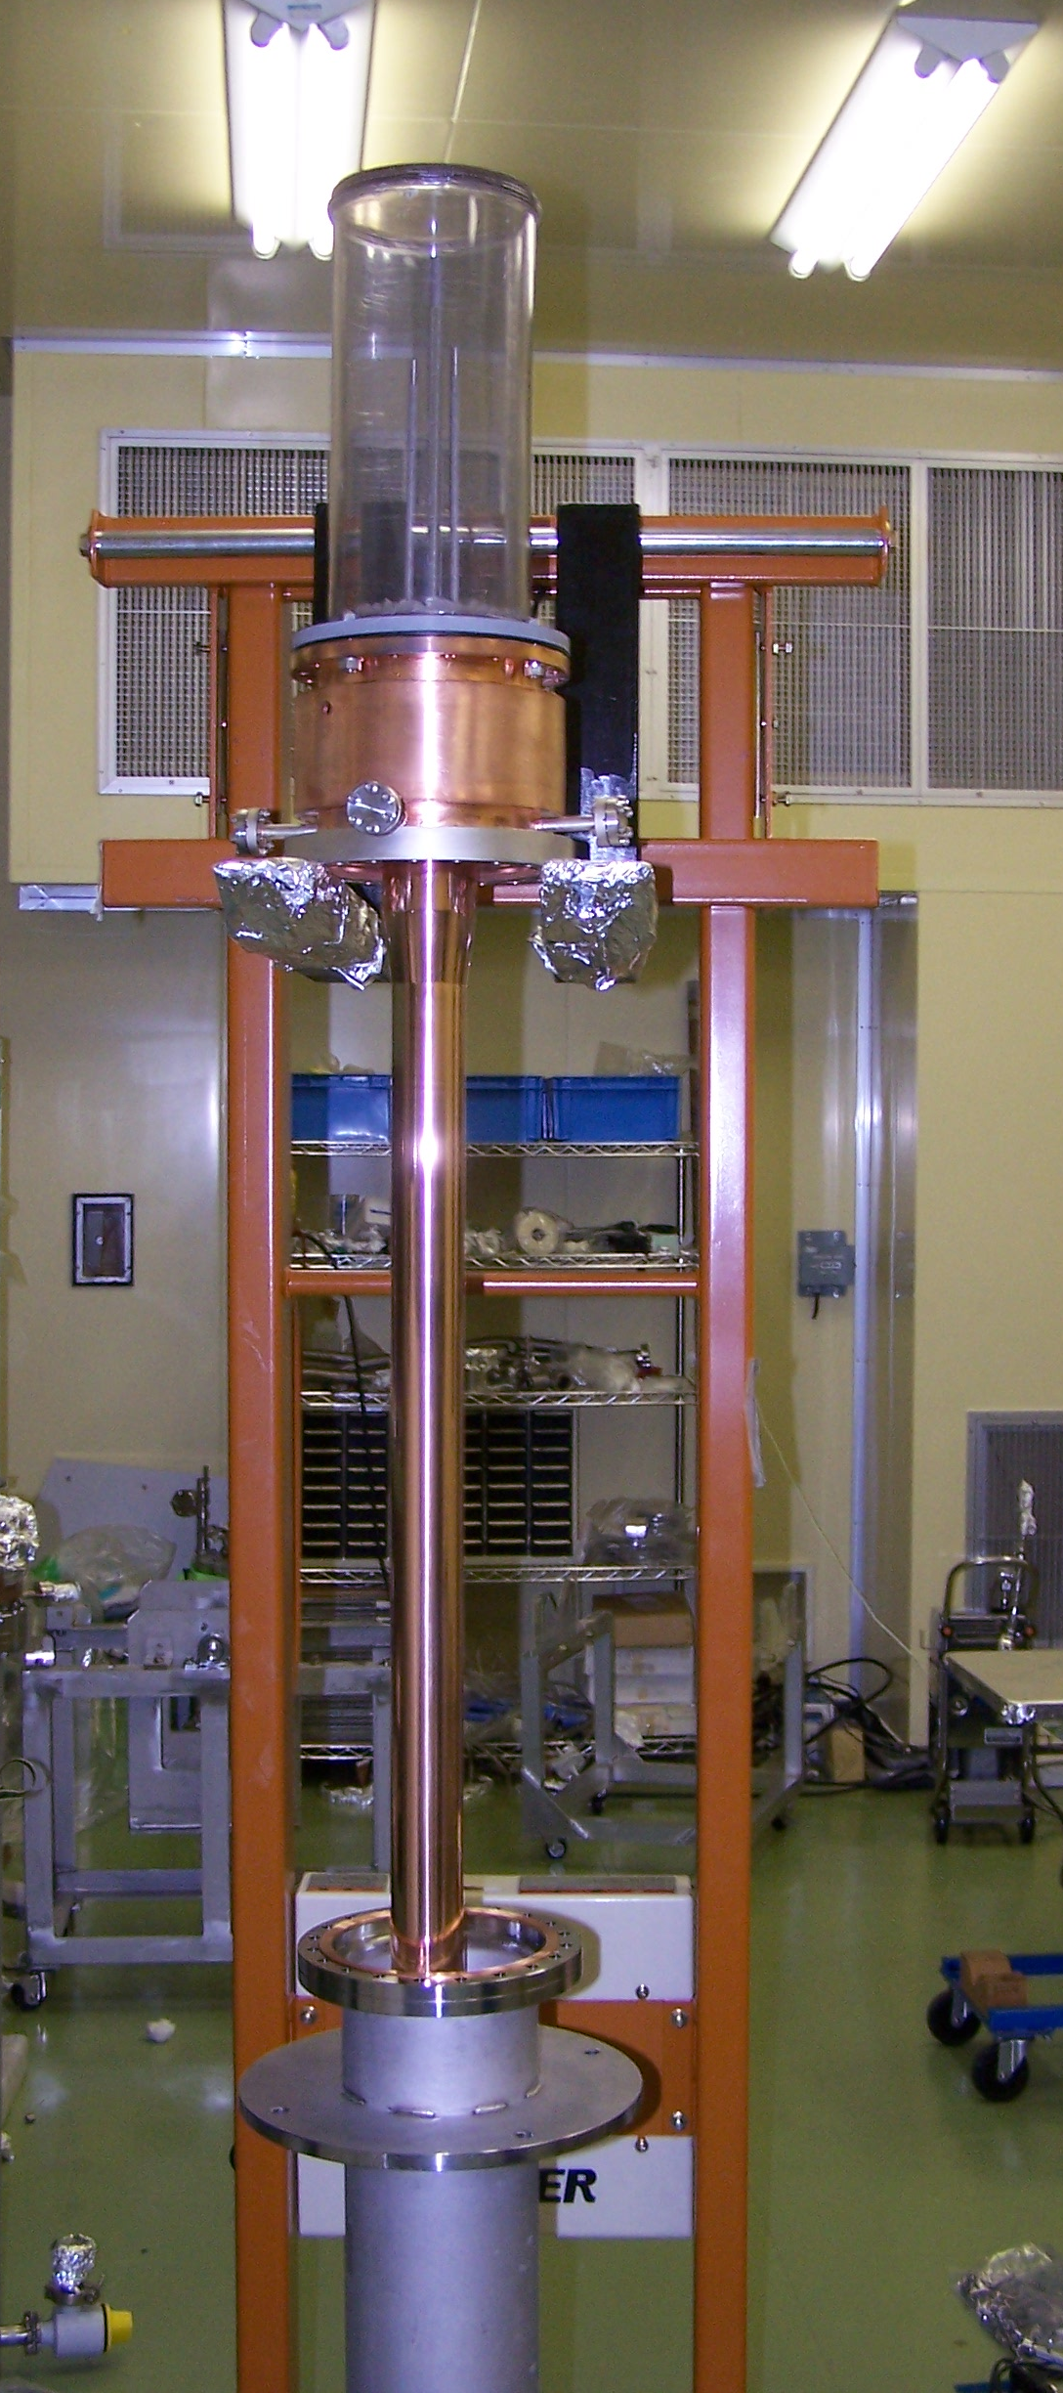
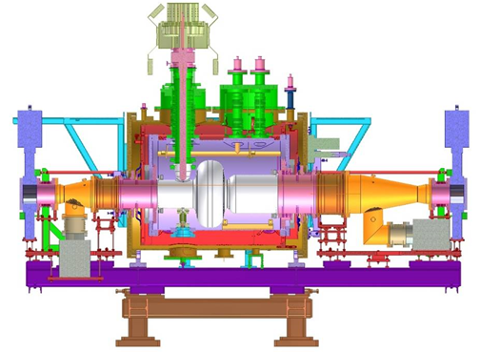
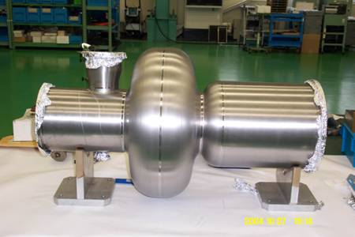
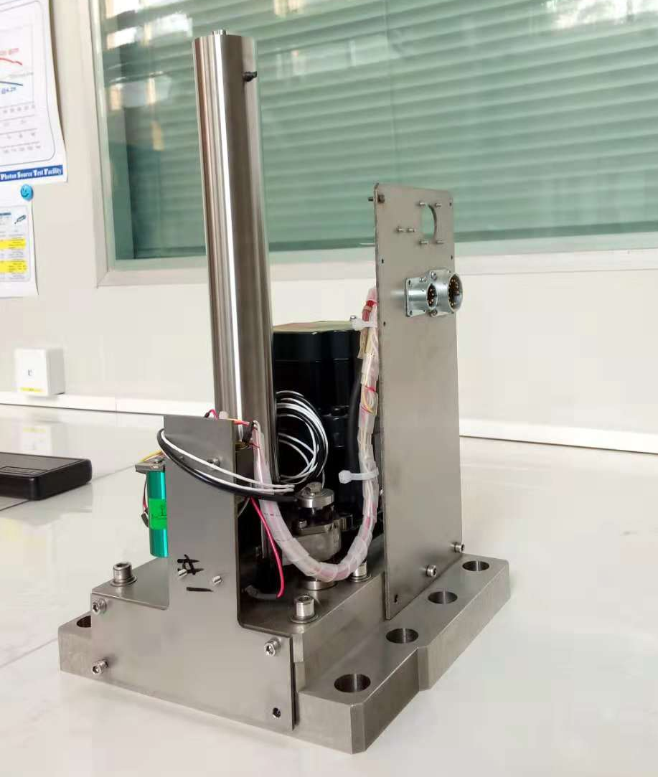
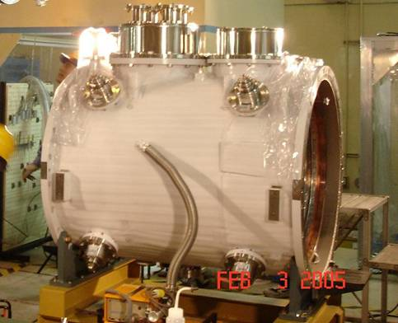
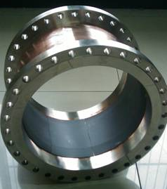
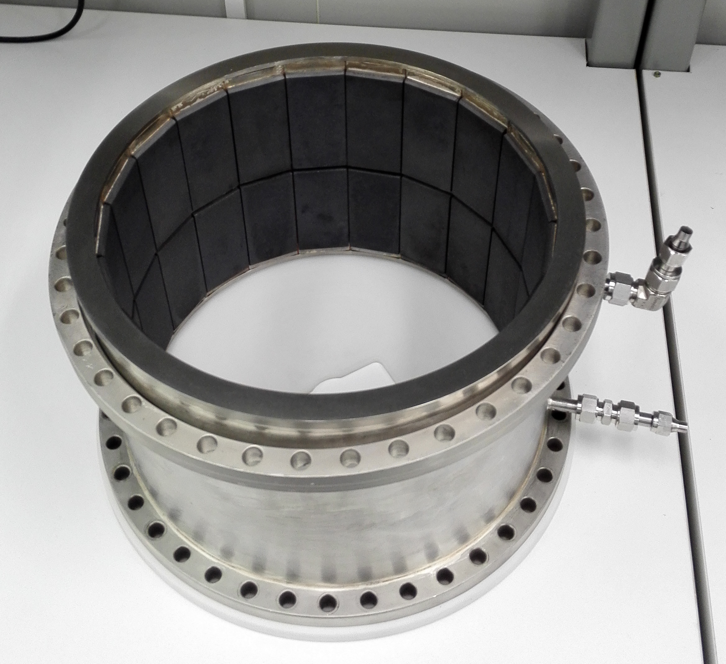
SRF Cavity package（1）
Niobium cavity
Powr coupler
Cryostat
HOM damper (Absorber)
Frequency tuner

Slide 7
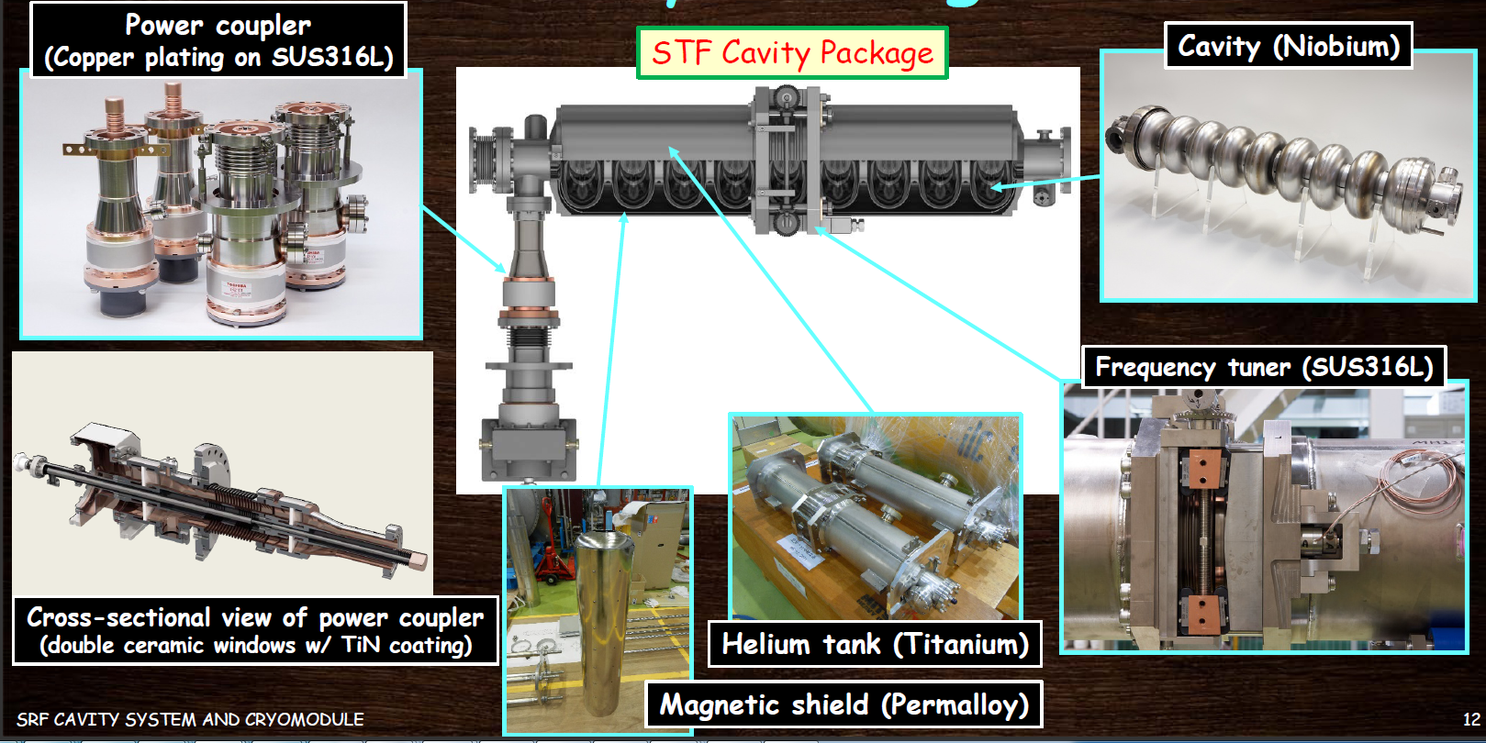
SRF Cavity package（2）
Courtesy Y.Yamamoto

Slide 8
Get to know FPCs
Several names for the same device
  HPC: High Power input Coupler
  FPC : Fundamental Power Coupler
  MPC : Main Power Coupler
  MC : Main Coupler
  PC : Power Coupler

Slide 9
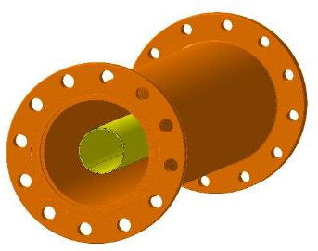
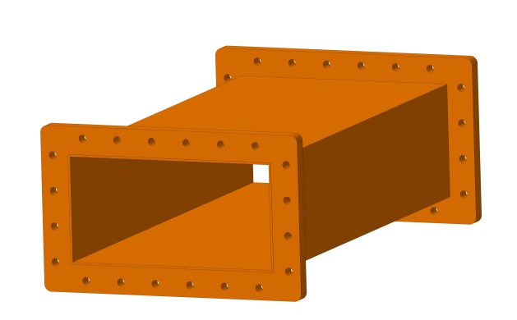
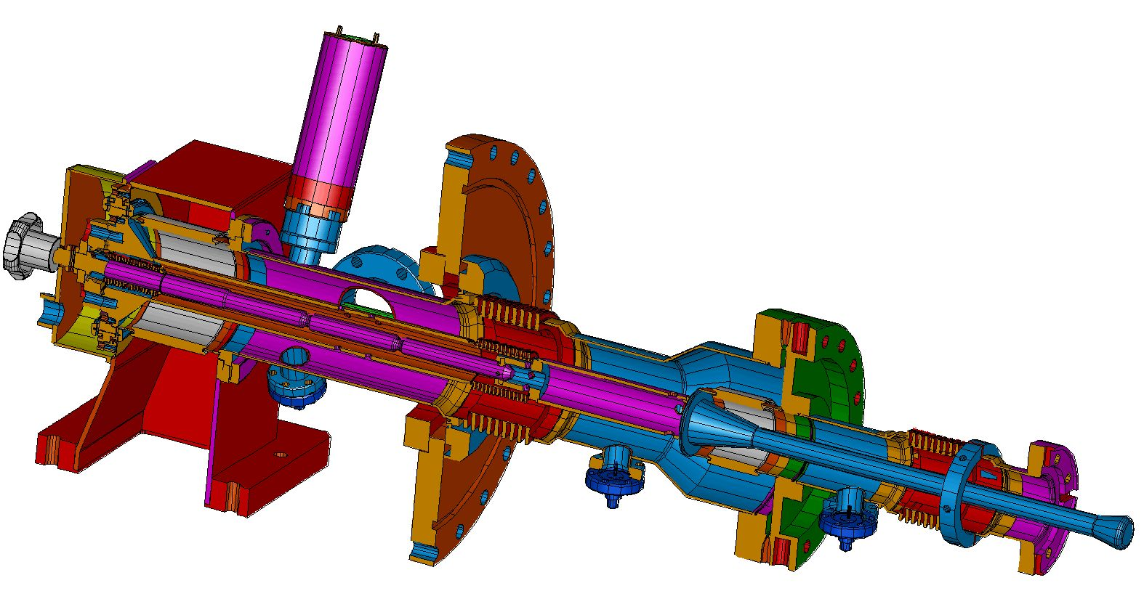
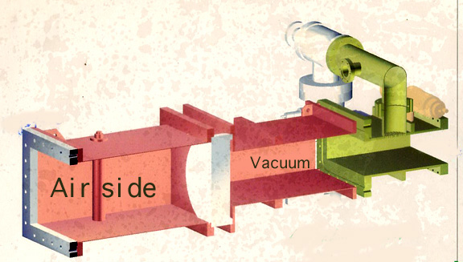
What is FPC?
Transmission component
Essence: A RF power transmission component.
FPC
Special features:
  Special location
  Multiple functions
  More complicated

Slide 10
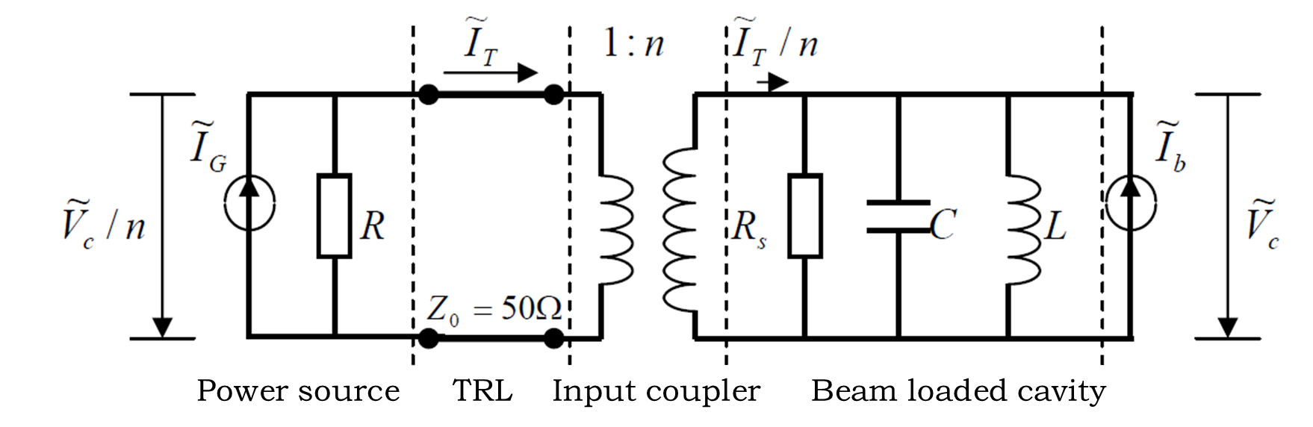
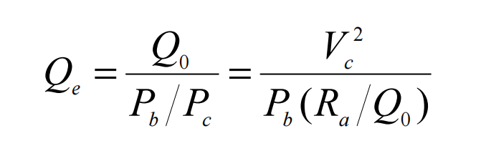
RF Functions of FPCs
Transfer RF power from the power source to the cavity and to the beam
Match the impedance of the power source to the beam loaded cavity
Variable coupling FPC: Allow to adjust the coupling to match with different beam conditions.

Slide 11
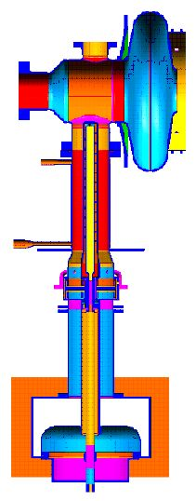
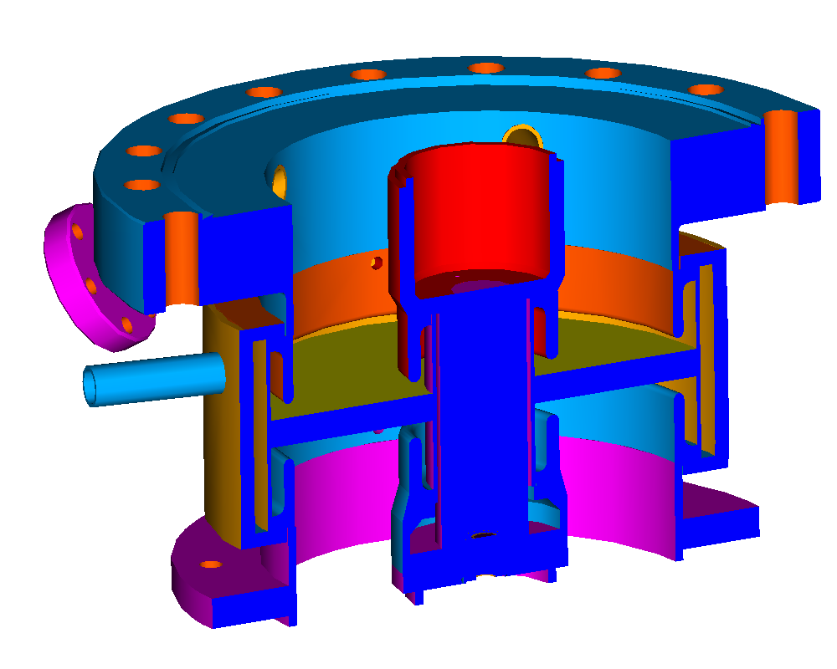
Additional Functions of FPCs
Provide a vacuum barrier for the beam vacuum
Bridge the gap between room- and cryogenic-temperature
Protect the cavity from contamination
Air
Key part: window
Vacuum
300K
Heat conduction
4K

Slide 12
Classification of FPCs
Standard of classification | Type-1 | Type-2
Structure | Coaxial | Waveguide
RF power | Continuous | Pulse
Window shape | Coaxial disk | Cylinder; Other shapes
Window number | Single window | Dual windows
Coupling adjustability | Fixed coupling | Variable coupling
Power coupling method | Electric probe coupling | Magnetic loop, slot or hole coupling

Slide 13
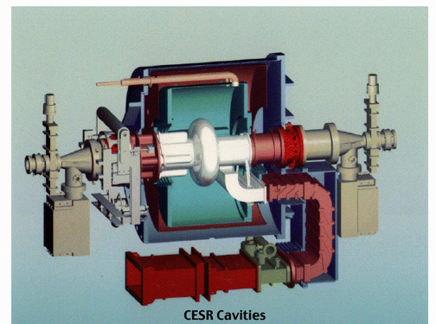
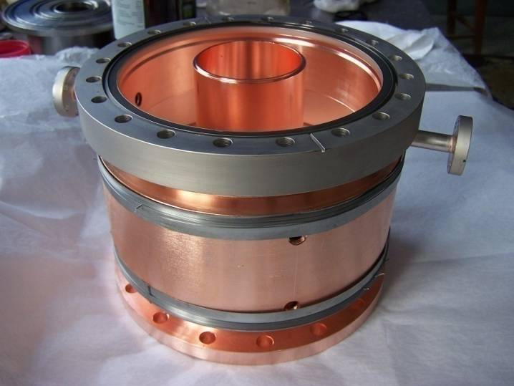
Typical FPCs ----Coax. VS WG
Pros:
  Simpler design
  Better power handling
  Easier to cool
  Higher pumping speed
Cons:
  Larger size
  Bigger heat leak
  Hard to realize coupling adjusting
Pros:
  More compact
  Smaller heat leak
  Easier to realize coupling adjusting
  Easier to control MP
Cons:
  More complicated design
  Worse power handling
  More difficult to cool
  Smaller pumping speed
Waveguide type PFC for CESR-B 500MHz SCC
Coaxial type FPC for BEPCII 500MHz SCC

Slide 14
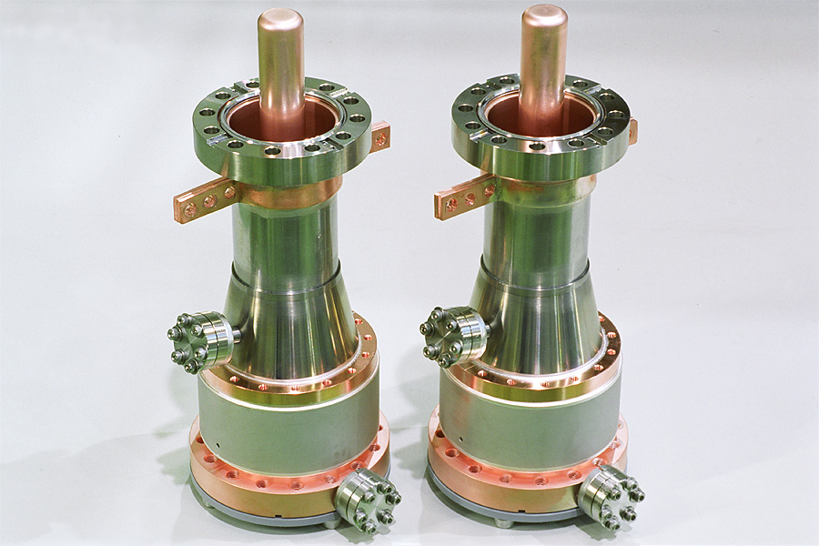
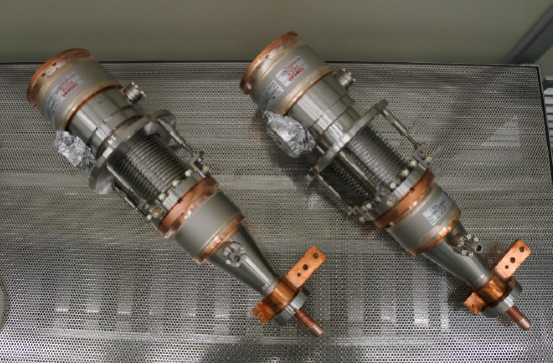
Typical FPCs ----Single VS Dual-window
KEK cERL Injector input coupler
Easy cooling →Higher average power
Simple structure → Lower cost
Assembly with cryo-module→ Potential contamination of cavity
window
KEK STF2 input coupler
Assembly with cavity in clean room → minimum pollution risk
Double vacuum safety
Hard cooling → lower average power
Complicated structure → higher cost
Warm window
Cold window

Slide 15
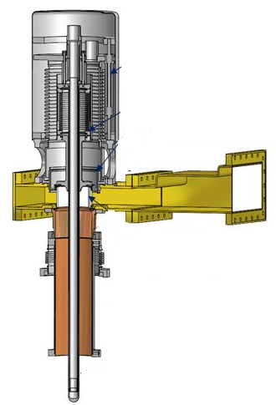
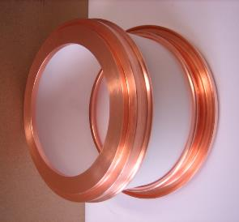
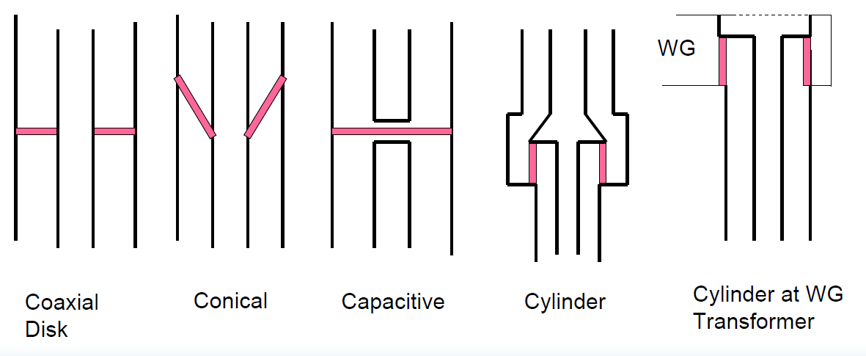
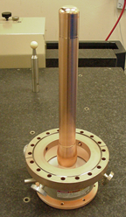
Typical FPCs ----Disk VS Cylinder window
Window shapes
FPC with disk window for SNS 805MHz SCC
FPC with cylindrical window for LHC 400MHz SCC

Slide 16
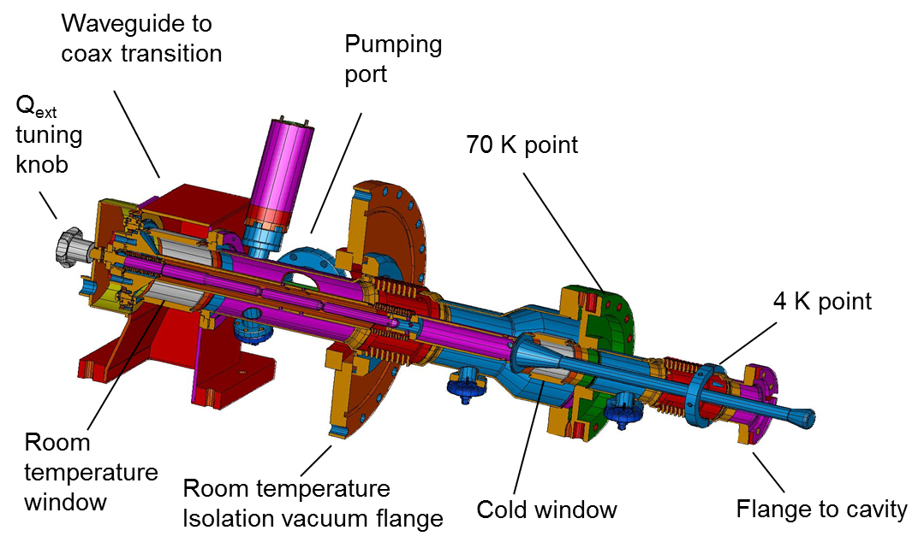
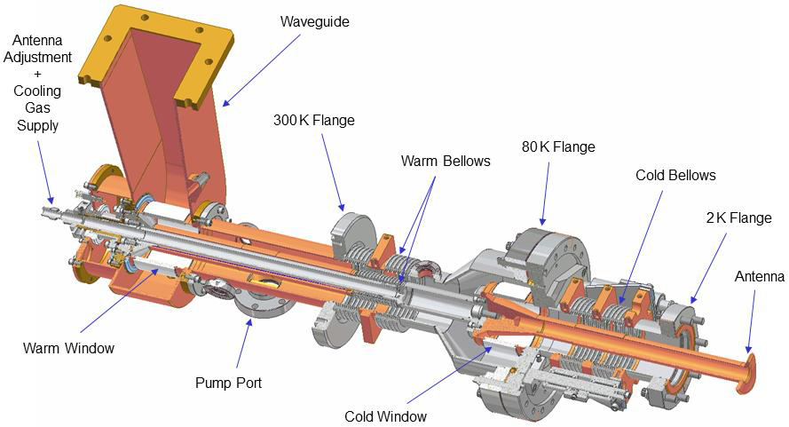
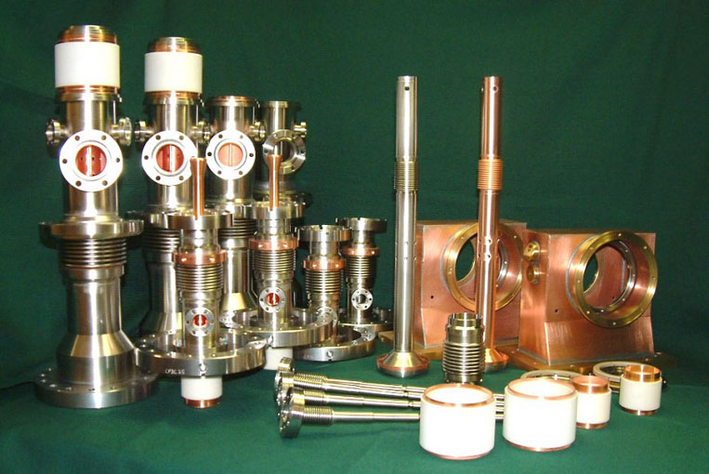
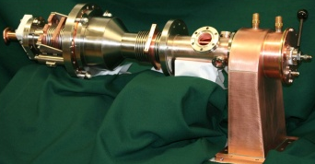
Typical FPCs ----Pulse VS CW
TTF III 1.3GHz coupler for XFEL
Cornell 1.3GHz coupler for ERL injector
1MW,1.3ms,10Hz
No cooling
Window position optimization is more meaningful.
CW,61kW
Air cooling
Larger cold window
More complicated cooling design

Slide 17
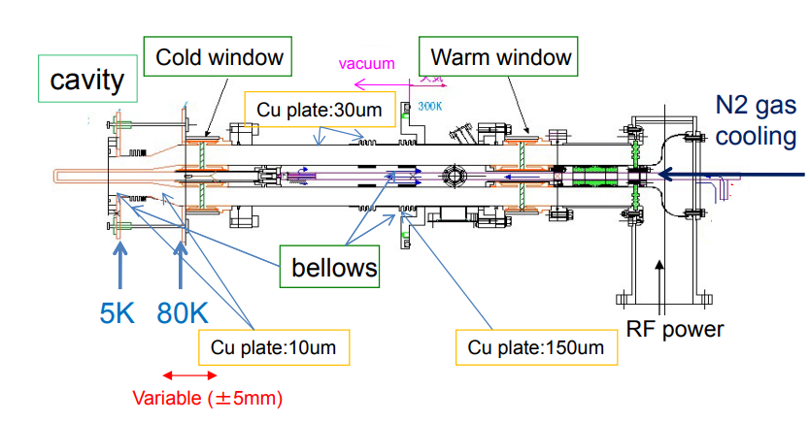
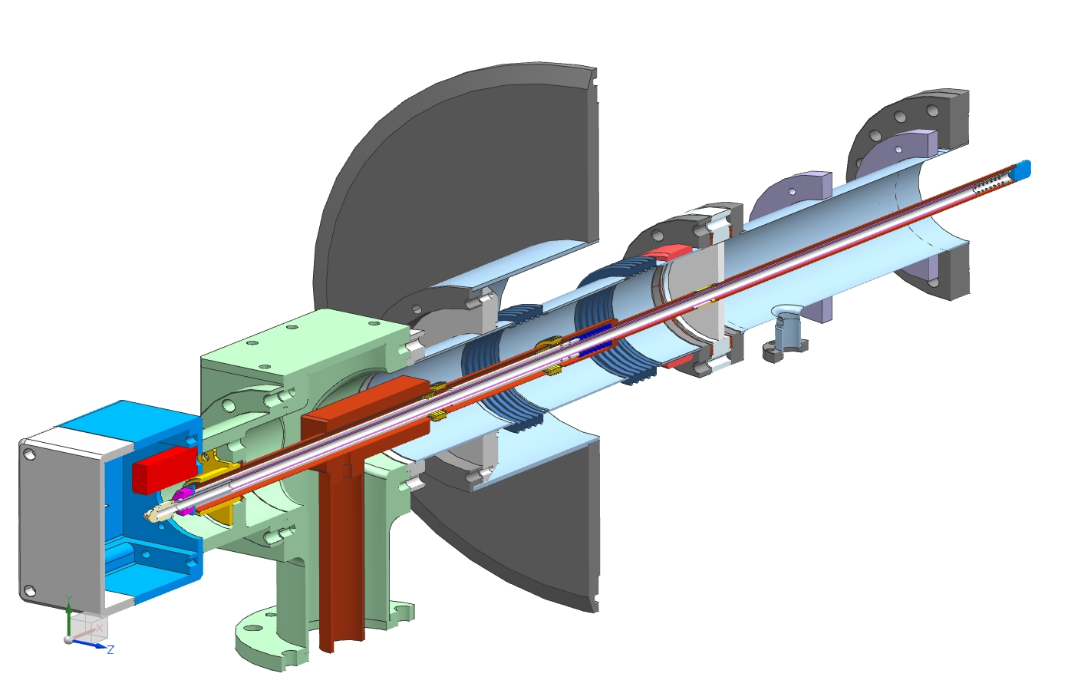
Typical FPCs ----Fixed VS Variable coupling
Fixed coupling coupler
Variable coupling coupler
Cryomodule flange
Spring to compensate
thermal expansion
“5K” intercept
“80K” intercept
Ceramic window
Antenna
Matching bump
Arc detector
Cold flange
e-pickup port
Ni-Cu bellows
3’’x 0.0158’’
stainless steel tube
Heater
1.3GHz FPC for cERL main linac
Simple design
Robust performance
Improper for multiple-mode operation
Variable Qe: 1~4*10E7
With Bellow structures in both OD and ID
Need a moving system
More challenging copper plating and cooling
Air inlet
3-1/8’’ coaxial input
325MHz FPC for Project-X Spoke cavity

Slide 18
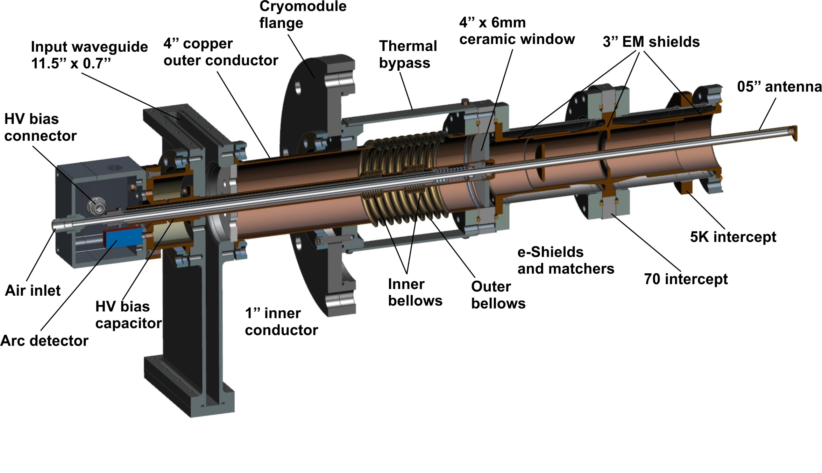
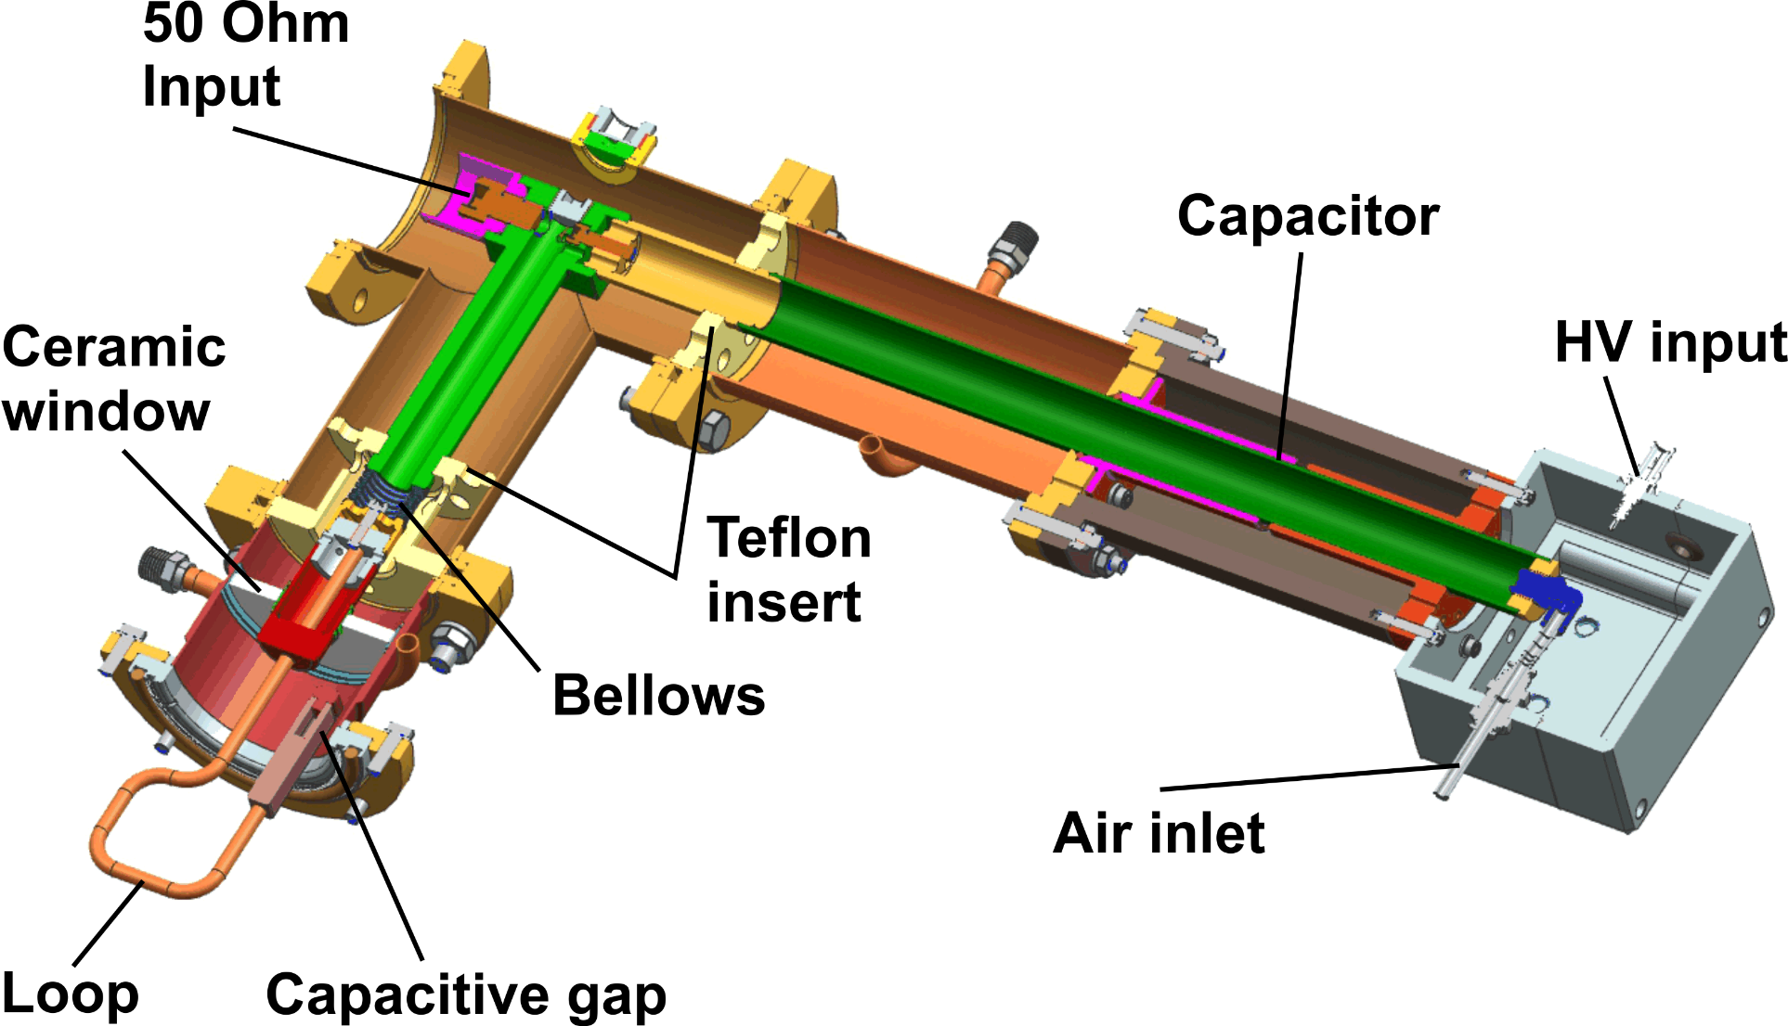
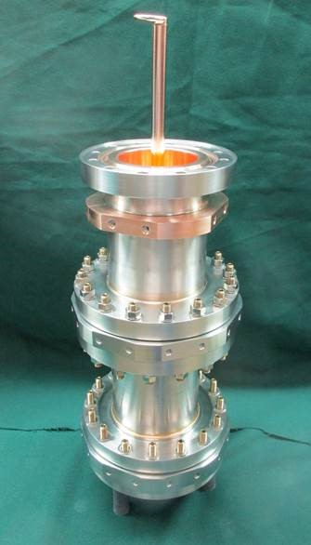
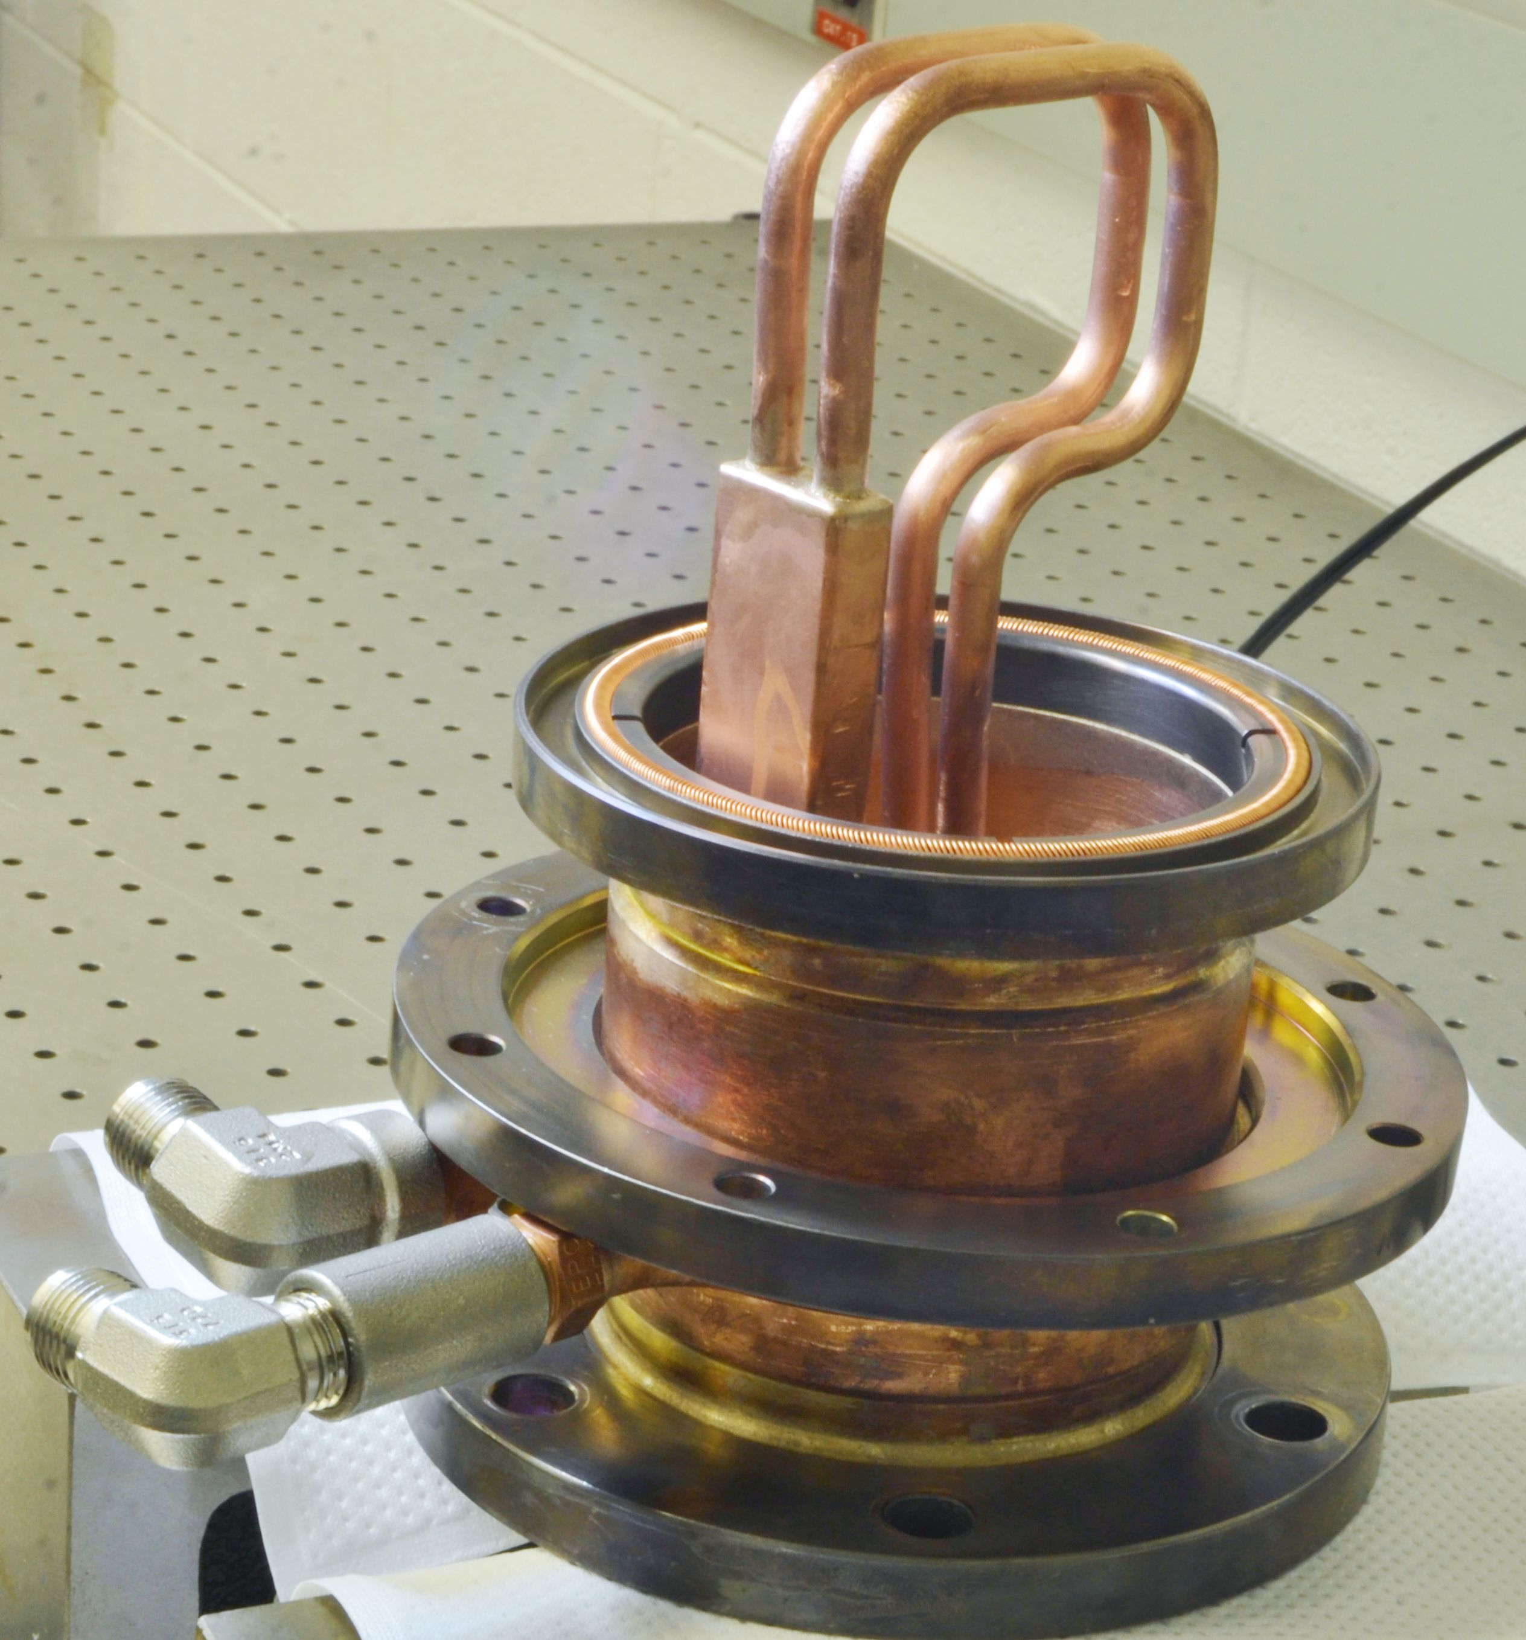
Typical FPCs ----Electric probe VS Magnetic loop
Electric coupling coupler
Magnetic coupling coupler
Easy to suppress MP by DC bias
Usually adopted by copper cavity instead of SCC
650MHz coupler for PIP-II linac LB cavity
162.5MHz coupler for PIP-II linac RFQ

Slide 19
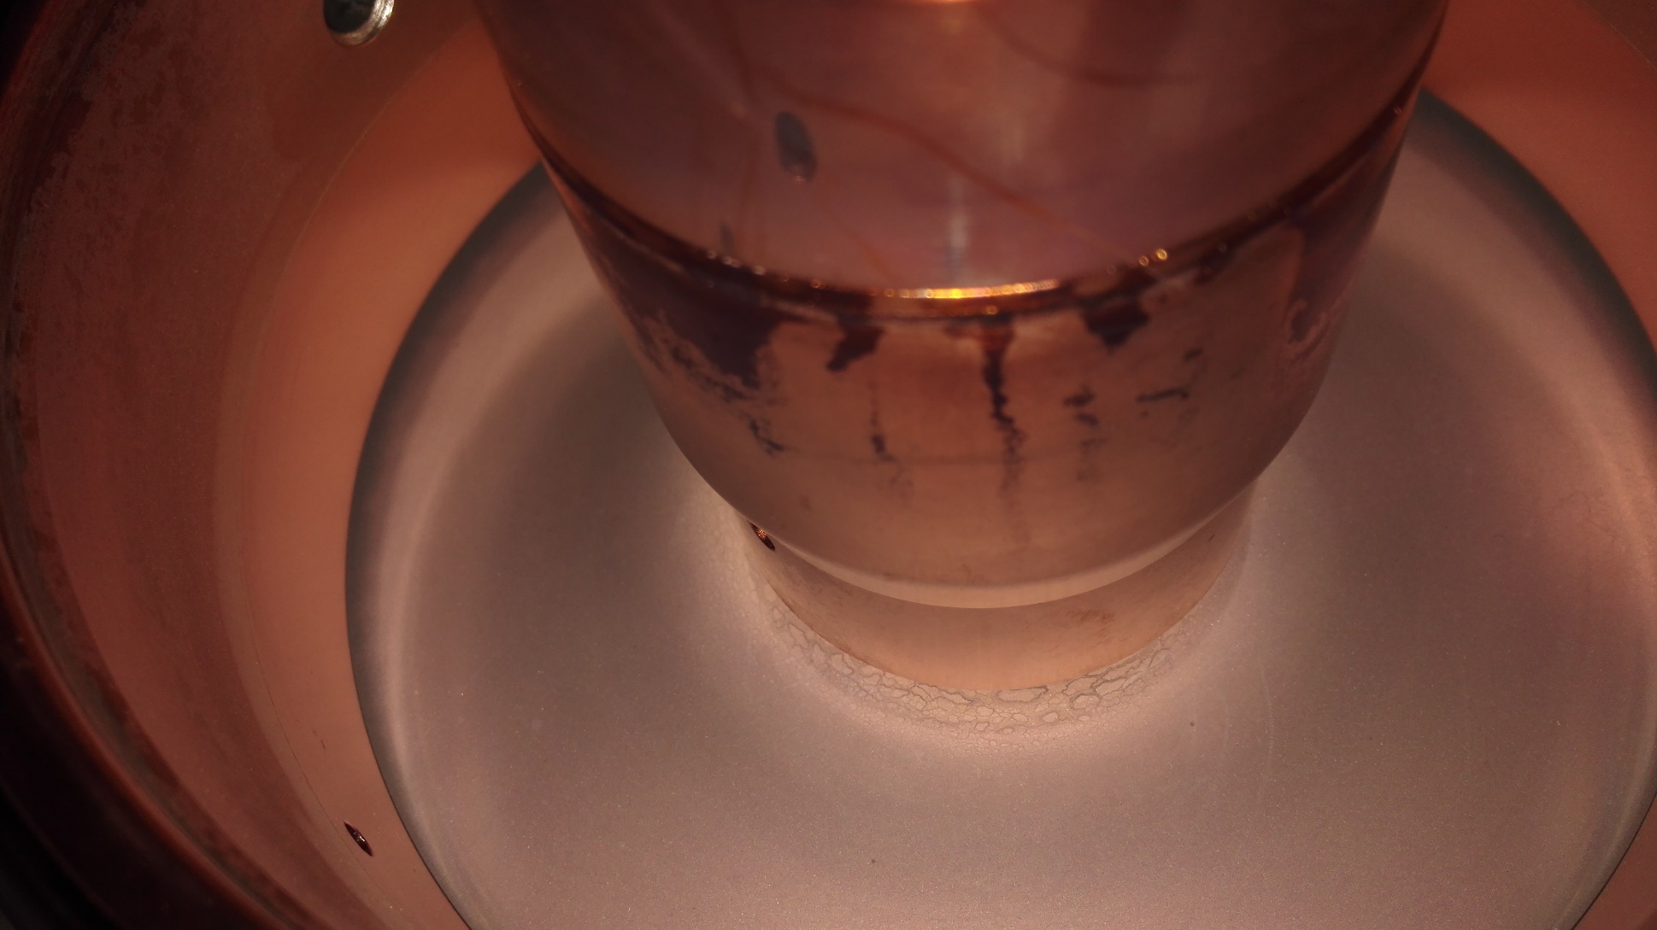
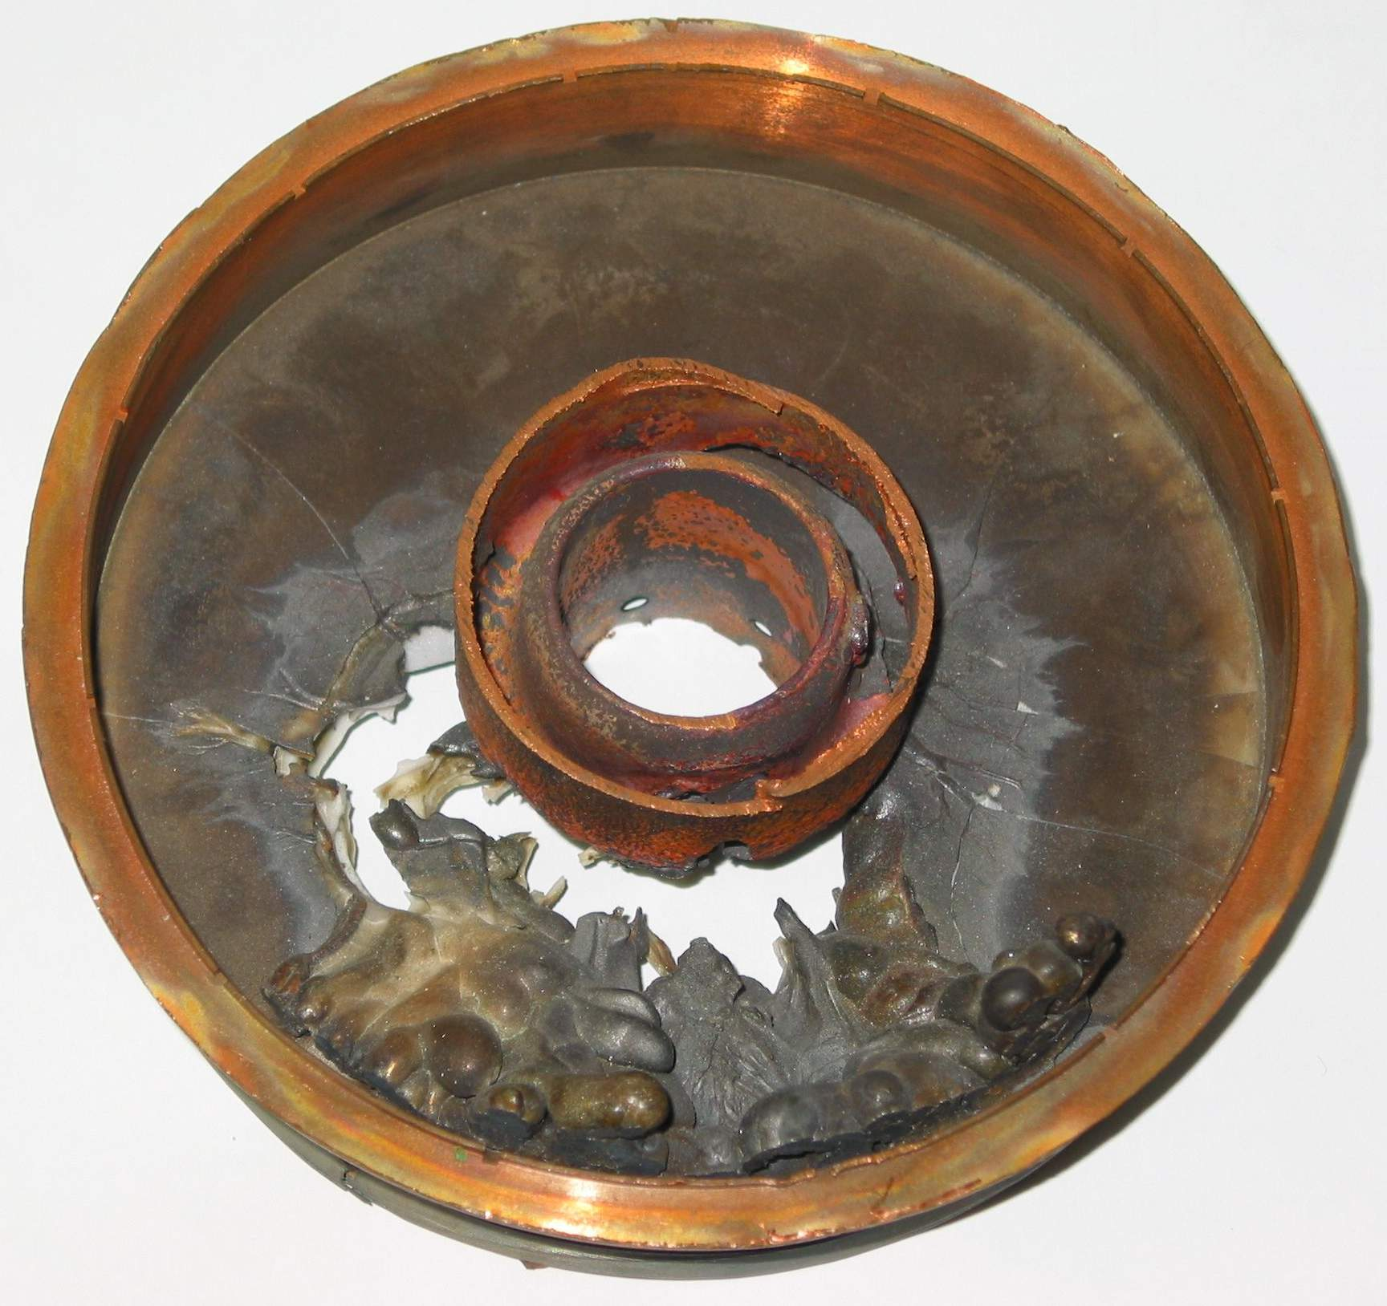
Importance and vulnerability of FPCs
Proved to be the most fragile component for SRF system.
  Ceramic window → Crack risk
  Thermal bridge → Damage risk after several thermal cycles
  High vacuum and high power → Damage risk by serious MP or ARC discharging
  Coupling adjusting → Damage due to metal (bellow) fatigue
Window crack is a big disaster:
  Vacuum failure
  Bad contamination of the SC cavity
  Long time and huge cost to recover
SCC performance may limited by FPC
  Arcing; Overheating; Multipacting
BEPCII
Courtesy W.moller
Courtesy E.Kako

Slide 20
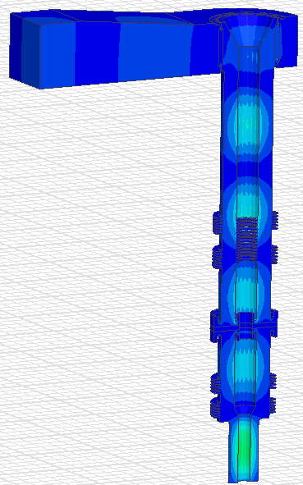
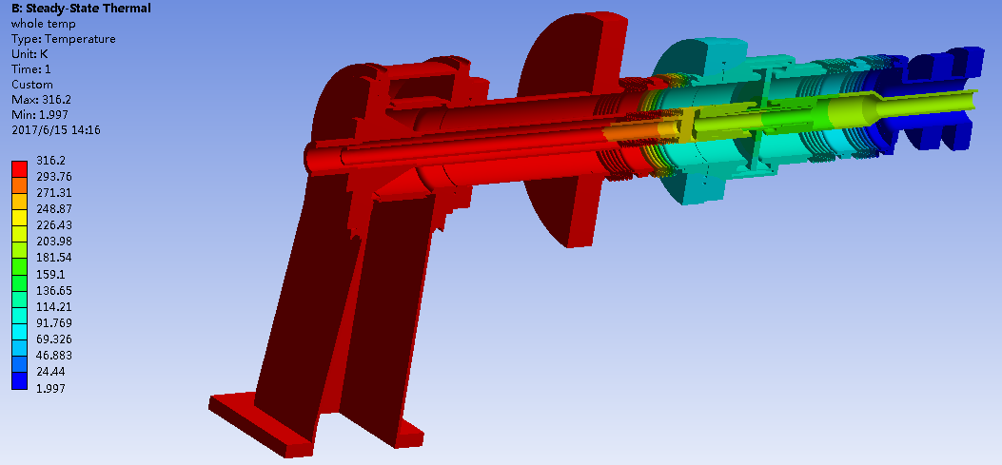
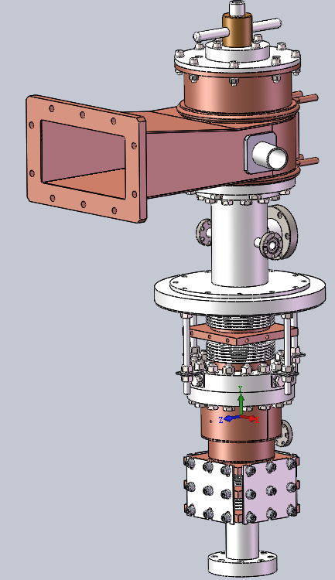














The life course of FPCs
RF and mechanical design
Fabrication
RF measurement
Cleaning and assembly
Baking
RT conditioning at test stand
Assembled with cavity
Online operation

Slide 21
Design issues on FPCs

Slide 22
How to choose the coupler type?
WG or Coax:
  Frequency : 100~300MHz→ Coax (WG too big)
  Lab’s experience
Window number
  Cavity gradient (Eacc≥20MV/m)→ clean assembly of coupler-cavity → Double window
  Vacuum safe → Double window
  High average power (CW ≥ 70 kW) → Single window (Double window hard to cool)
Window shape
  Lab’s experience: design and fabrication experiences
Coupling method
  Cavity type and design
  Coupler port location: Loop at strong magnetic field; Probe at strong electric field

Slide 23




Design flow of power coupler
  Coupler type decision
Multipacting analysis
Doorknob
Coupler port optimization
  Power dissipation analysis
Window
Vacuum section design
  Thermal analysis
Vacuum part
Window design
  Cooling design
Coupler port
Transmission optimization
  Mechanical design

Slide 24
Design criteria
Avoid excessive reflected power
Impedance matching, Qext optimization
MP free at operating power level
MP optimization
Prevent FE and breakdowns
RF field distribution optimization
Low cryogenic heat load
Meet the heat load specification
Reasonable temperature rise
Cooling optimization
Fast conditioning
Post treatment and conditioning optimization
Safe and stable operation
Interlock improving, high-power operation methods and procedure optimization

Slide 25






Optimum power coupling
Optimum coupling of FPC ($P_{ref}=0$):
$$Q_{ext}≅\frac{V_{c}}{(\frac{R}{Q})∙I_{beam}∙cosφ}$$
Required RF power when the cavity-beam system is tuned:
$$P_{g}≅\frac{{V_{c}}^{2}}{4∙\left(\frac{R}{Q}\right)∙Q_{ext}}{\left[1+\frac{I_{beam}∙(\frac{R}{Q})∙Q_{ext}∙cosφ}{V_{c}}\right]}^{2}$$
Courtesy E. Kako

Slide 26




Coupling port design- Qext optimization
Geometry parameters:
  Position of coupling port
  Antenna penetration depth /loop area /slot size
Coupling factor calculation:
  Using 3D Electromagnetic simulation software;
  Calculation tools: CST(Qext), HFSS(S11)
Courtesy E. Kako

Slide 27


Transmission matching
S11 requirements:
  S11<-30dB at the operation frequency
  BW: >5% of operation frequency
The tolerance analysis of key dimensions is necessary ;
Calculation tools:
  CST
  HFSS
  ACE3P
Sometimes S11 simulations results do not agree well with each other: Confused!

Slide 28


Multipacting
MP occurs in vacuum devices when:
  Electrons (initially emitted from the surface or residual gas) have resonant trajectories (at given power levels)
  Their impact energy on the surface is such that secondary emission occurs
  The material of the surface has a secondary emission yield (SEY) greater than 1
The harm of MP:
  Absorbing RF power
  Creating a short-circuit in the device
  Preventing normal operation
  Damage RF surface, even results window crack
  Results in abnormal T-rise: fast, outgassing-related
RT conditioning: reflection power reduced as MP occurring (B: Pf; Y: Pr; G: e-current)

Slide 29







Multipacting suppression
Methods for curing MP:
  Right geometries to avoid resonant: bigger coax diameter, higher impedance
  Reduction of SEEC:
    TiN coating of critical surfaces
    Cleaning RF surfaces before or by conditioning
  Break resonant conditions by additional fields or structures
    Coax: DC voltage bias (BEPCII)
    WG: Grooves; Magnetic bias (CESR)
Courtesy W. moller
One-side:
Two-side:
“Suppression of multipacting in rectangular coupler waveguides”
NIMA 508 (2003) 227–238

Slide 30





Multipacting simulation
Simulation tools: Multipac2.1 (2D); CST (3D); ACE3P (3D)
SEEC
Multipac2.1
ACE3P
Improper DC bias might excite MP
CST
Cal. and Meas. Comparison with DC bias

Slide 31





Multipacting simulation using CST
E-M field simulation
(CST MWS: T-solver or F-solver)
RF cal. model
E-field
MP simulation
(CST Particle Studio: Tracking)
RF
geo. opt.
MP cal. model
Particle source
Using materials with High-SEEC
(e.g. Copper-ASR)
Using materials with low-SEEC
(e.g. Copper-AGD)
SEY: the total number of secondaries produced /the total number of electron impacts.
Simulated MP band(SEY>1)

Slide 32


ARC
ARC is a severe vacuum breakdown phenomenon that can lead to window crack.
Two main causes resulted in ARC
  Electrons generated by field emission inside the cavity or multipacting on the window accumulate on the ceramic window, eventually causing ARC.
  Severe multipacting in the coupler, combined with untimely power cutoff, leads to vacuum degradation and gas ionization, ultimately resulting in ARC.
Arc is usually accompanied by outgassing, electrons and reflected power decreasing.
The harm of ARC: similar with MP, however, with higher window crack risk if ARC interlocked not timely
Signals monitored by oscilloscope as ARC happened
Purple: ARC
Red: e-current at OC;
Green: e-current at window;
Blue: Reflected rf power (decreased from 36kW to 16kW)
ARC interlock protection is the most important!
Copper sputtered on the ceramic due to ARC I/L disabled→ window cracked finally!

Slide 33



Thermal analysis--RF power dissipation
e.g. IHEP CADS 650MHz coupler, rf loss of each part can be simulated by code(CST, HFSS)
Parts | Power dissipation
ceramic | 55.3 W
Vacuum IC | 87.1 W
Vacuum OC | 13.8 W
Teflon | 37.4 W
Air IC | 42.5 W
Air OC | 19.2 W
doorknob | 20.2 W
WG | 57.2 W
Courtesy E.Kako

Slide 34



Thermal analysis--T-rise and Thermal-stress
RF-Thermal-Stress Multi-physics coupled calculation
Cooling scheme based on the thermal simulation
Calculation tools:
  ANSYS APDL
  ANSYS Workbench
  CST
  ACE3P
  COMSOL Multi-physics
Windows stress < 1/3 of Flexural strength of alumina ceramic (296 MPa)
FPC for HEPS 166MHz SCC

Slide 35

Thermal analysis--Cryogenic heat load
Since the FPC is a bridge between RT and CT, it will produce cryogenic heat load:
  Heat conduction: 300K→4K or 2K
  Heat radiation: inner antenna to cavity and outer conductor
Methods to reduce the cryogenic heat load:
  Add bellows;
  Longer OC; Thinner OC
  Thinner copper plating
  Optimum RRR of copper plating
  Higher characteristic impedance(Zc) of Coaxial section
  Introduce cooling: Add active helium gas cooling or thermal intercepts on OC
  Lower the emissivity of copper surfaces (e.g. electro-polishing of IC)
Radiation
Conduction
HEPS 166MHz SCC

Slide 36


Example： Heat load simulation
Two-way iterated rf-fluid-thermal coupled simulation
Calculation tools:
  ANSYS APDL
  ANSYS Workbench
  CST
  ACE3P
  COMSOL Multi-physics
Two-way iterated rf-fluid-thermal coupled simulation process.
“σ” stands for temperature-dependent electrical conductivity, “Prf ” stands for rf loss, T stands for temperature, and “ΔHL4.2K” stands for heat loss at 4.2 K between the last two iterations.
Thermal simulation model. “OC” stands for the outer conductor, “SS” stands for the stainless steel, “SC” stands for superconducting, and “NC” stands for normal conducting.

Slide 37
Mechanical design--Procedure
Preliminary design
Introduce dielectric materials and conductive boundaries based on the RF geometry;
Add cooling structures based on cooling design
Create vacuum interfaces to meet high vacuum
Further adjustments
Modularity
① Requirements of assembly, cryo-module
② Machining processes
Parts design
① Connecting methods: Welding, Brazing, Flanges
② Materials characteristics: SS, copper, ceramic
③ Interface specifications
④ Mechanical strength verification
Tolerances
① High power RF performance requirements
Parts are machinable
Parts and components are easy assembled
RF
Mechanical

Slide 38
Mechanical design—Special considerations
Ease of cleaning and installation
Meet the high-power RF performance
Meet the machining requirements
Add necessary flexible connections to compensate the contraction during cooling
Ensure the sealing surfaces meet the ultra-high vacuum standards
Arrange necessary structures for safe operation (Monitoring ports; bias, moving scheme)
RF, thermal design
Mechanical design
Multi-round iterative design

Slide 39
Fabrication issues on FPCs

Slide 40
Fabrication issues
Manufacturer selection
Materials
Window brazing
TiN coating
Copper plating

Slide 41
Manufacturer selection
With the knowledge of RF and ultra high vacuum
With the following fabrication technologies:
  - High precision machining
  - TIG welding and Electron Beam welding
  - Window brazing
  - Copper coating
  - TiN coating
With the following analytical facilities:
  - Materials test: RRR of copper coating , permeability of SS,
  - Vacuum leak check
  - Thickness measurement of the copper coating
  - Thickness measurement of the TiN coating
  - Others: dimensions, coaxial aliment, surface roughness

Slide 42

Materials
Materials used:
  Stainless steel: 316LN, 316L
  Copper: OFHC copper
  Aluminum:
    - For transition component
    - Low average power
  Ceramic: Al2O3, BeO
Material specifications:
  low magnetic field→ permeability of SS <1.05
  low static cryogenic losses →low thermal conductivity
  low dynamic losses → high electric conductivity
  Ultra high vacuum →
    - Low H2 content
    Hard sealing surfaces or knifes
  Bridge of RT and CT → withstand thermal cycles without changing the properties
Powerful lesson: Should pay more attention to the materials, especially assure the hardness of the vacuum sealing flanges.

Slide 43

Example: Fabrication process

Slide 44





Key technique--Window brazing
Vacuum Furnace or Hydrogen Furnace
Cu/Au(1000 ℃) or Cu/Ag (780℃)
Temperature control is critical:
  Compensate the different thermal conduction between ceramic and copper(~10 times larger)
  Avoid the ceramic crack
Fixture tooling
  Compensate the different thermal expansion between ceramic and copper(~2.5 times larger)
  Protect the ceramic from contaminated by the vapor

Slide 45




Key technique--TiN coating
The vacuum side of the ceramic needs to be TiN coated to reduce the SEEC and to avoid MP.
Requirements:
  Thickness: ~10nm
  Uniform coating
  Composition: Ti:N=0.9~1.1
  SEEC: <3
TiN coating methods:
  Evaporation
  Sputtering
    Optimize the parameters: current, voltage, time, temperature, gas inflow, workpiece placement and vacuum pressure
Magnetron sputtering(IHEP)
Evaporation (DESY)

Slide 46


Key technique—Copper plating
Usually, the rf surfaces of the vacuum parts made of SS need to be copper plated to reduce the RF dissipation;
Requirements:
  Specific thickness: >3 times of skin depth
  Optimum RRR: 30~80 (Min. cryo-genic heat load)
  Uniform coating thickness
  Free of bubbles and flaking
  High adhesiveness: Liquid Nitrogen thermal shock
  Low roughness
Copper plating methods
  Electroplating
  Sputtering

Slide 47










Copper plating: Huge challenge
Problems | Solutions
Poor uniformity (especially for Bellows) | ① Stretch the bellow ② Adopt special electrode
Bubbles or burrs exist | Introduce compressed air
Bad adhesiveness | Improve the electroplating process
Low RRR | Optimize the heat treatment process and temperature
✔
RRR measurement
Bad adhesiveness

Slide 48








Example: Fabrication of the FPC for HEPS 166MHz SCC
Window frame
Window after 1st brazing
Outer conductor
Coupler during assembly
Window
Window-IC assembly
T-box
Whole coupler

Slide 49
High power test issues on FPCs

Slide 50
Test issues
Why test?
Test flow
Preparation for test
High power test system
Diagnostics and interlocks
RF conditioning procedure

Slide 51
Why test?
Performance test:
  Visual inspection
  Dimension inspection
  RF, thermal and vacuum performance verification
Preconditioning:
  Remove the residual gases, dust and invisible particles;
  Avoid the contamination of the SRF cavity;
  Save time of online conditioning;
  Stable operation with beam.

Slide 52

Test flow
HPT: High Power Test
RT: room temperature
CT: cryogenic temperature (4.2K or 2K)
TW: traveling wave
SW: standing wave
TTF-III coupler HPT at test stand
CADS coupler online operation

Slide 53






Preparation for test
Ultrasonic clean
Pure water rinsing
Dry with ultra pure N2
Particle monitoring during assembly
Assembled in clean room
Vacuum pumping and leak check
Baking

Slide 54
High power test system

Slide 55


High power test stand of the FPC for HEPS-TF
LLRF control

Slide 56
High power test bench
Test bench: A device used for connecting two couplers under test;
Design criteria:
  - Good impedance matching
  - Easy assembly with couplers
  - Compact structure
  - For high average power test, reasonable temperature rise
    Add cooling
    Copper plating of the inner surface
Types:
  Waveguide box or elliptical cavity: frequency≥500MHz
  Low beta cavity: lower frequency

Slide 57









Typical test benches for FPC
LHC 400MHz
HL-LHC crab 400MHz
ESS 352MHz
HEPS-TF 166MHz
CADS 162.5MHz
Cornell ERL 1.3GHz
BEPCII 500MHz
KEK ERL 1.3GHz
XFEL 1.3GHz

Slide 58

RF conditioning procedure
Controlled desorption of absorbed gasses by accelerated ions and electrons
Compromise between conditioning speed and risk
Started with low DF, low power level
Test flow-1
Test flow-2

Slide 59

Diagnostics and interlocks
Vacuum pressure;
Temperatures;
Arc discharging;
Cooling water flow & pressure;
Multipacting induced electrons;
Curtesy of E.Kako

Slide 60



Conditioning results analysis

Slide 61
Recent advances on FPCs

Slide 62


Creative ceramic materials
TiN coating free ceramic: Y.Yamamoto (KEK)
  https://accelconf.web.cern.ch/srf2019/papers/mop077.pdf
  https://accelconf.web.cern.ch/ipac2018/papers/wepml053.pdf
  https://accelconf.web.cern.ch/srf2021/papers/thpfdv008.pdf
BeO ceramic: Wencan.Xu (BNL)
  https://inspirehep.net/files/e4701901036f0bc9e9b181ee03e414c2
  https://accelconf.web.cern.ch/srf2021/papers/weptev002.pdf
Saving cost
Higher average power
Summary of secondary electron emission coefficient for ceramic samples without TiN coatings.

Slide 63


Creative fabrication technologies
Coaxial Energetic Deposition (CED) from a cathodic arc plasma to grow copper films directly on stainless steel coupler parts with no Ni layer and no electrochemistry: I. Irfan(AASC)
  https://accelconf.web.cern.ch/SRF2015/papers/thpb083.pdf
3D Printing machining: Eric.Montesinos(CERN)
  https://inspirehep.net/files/e4701901036f0bc9e9b181ee03e414c2
CED copper plating

Slide 64



New coupling adjusting method
Add waveguide tuner instead of varying FPC’s position or insertion depth
  BNL: EIC 591MHz FPC
  CERN: FCC 400MHz FPC

Slide 65


State-of-the-art of the high performance
Megawatt-Level Continuous-Wave type FPC
  BNL: EIC 591MHz FPC
  CERN: FCC 400MHz FPC
Low cryogenic heat load FPC
  https://accelconf.web.cern.ch/srf2023/papers/mopmb094.pdf
High intensity, high energy
Conduction-cooled SRF cavity
Curtesy of E.Emontesinos.

Slide 66
FPCs development at IHEP

Slide 67















Development history
Tested: CW，420kW
Operate with beam stably over 8 years
Operate stably during the beam commission
Tested power: CW,100kW
Coax, fixed, capacitive, single-window
Clean assembly
Attended cavity HT
Tested power：CW,150kW
Adjustable, clean assembly
Operate stably during the beam commission
Tested power: CW,25kW
Tested at KEK：1MW,1.5ms,5Hz
Tested power：CW,150kW
Clean assembly with cavity is available
Double-window, adjustable
Tested power：CW,70kW
Test: CW, TW 250kW, SW 100kW
Op: CW TW 200kW
325MHz-Spoke
HEPS 166MHz SCC
Beta=1, QWR
500MHz-BEPCII
1300MHz-ILC
162.5/325MHz-RFQ
162.5MHz-HWR
650MHz-Elliptical
1300MHz Elliptical
650MHz Elliptical
2006
2010
2012
2014~15
2016
2017~18
2019
2020~now
Notes:
.

Slide 68
Summary sheet
Project | Cavity type | Frequency | Coupler type | Power | Status | Time
BEPCII | Single-cell elliptical (SCC) | 500 MHz | Coax, fixed, capacitive, single-window | Test: CW 420 kW (TW & SW) Op: CW 150 kW | Beam operation | 2006-2012
ILC R&D | 9-cell elliptical (SCC) | 1300 MHz | Coax, fixed, capacitive, double-window | Test: 1MW,1.5ms,5Hz(avg:7.5kW) Op: 300kW,1.5ms,5Hz(avg:2.25kW) | HPT and Cavity integration | 2010-2012
CADS | RFQ (NC) | 325 MHz | Coax, fixed, inductive, single-window | Test: CW 105 kW (TW & SW) Op: 100 kW | Beam operation | 2011-2016
 | RFQ (NC) | 162.5 MHz | Coax, fixed, inductive, single-window | Test: Not done on test bench Op: 80 kW | Beam operation
 | HWR (SCC) | 162.5 MHz | Coax, fixed, capacitive, single-window | Test: CW 20 kW (TW & SW) Op: CW 15 kW | Beam operation
 | Spoke (SCC) | 325 MHz | Coax, fixed, capacitive, single-window | Test: CW 10 kW (TW & SW) Op: CW 10 kW | Beam operation
 | 5-cell elliptical β=0.82 (SCC) | 650 MHz | Coax, fixed, capacitive, single-window | Test: CW 150 kW (TW & SW) Op: Not yet specified | HPT | 2014-2016
HEPS-TF | QWR β=1 (SCC) | 166.6 MHz | Coax, fixed, capacitive, single-window | Test: CW 50 kW (TW & SW) Op: CW 200 kW | HPT | 2016-2018
R&D | Multi-cell elliptical (SCC) | 1300 MHz | Coax, variable, capacitive, double-window | Test: CW 71 kW (TW & SW) Op: Not yet specified | HPT | 2016-2019
CEPC R&D | 2-cell elliptical (SCC) | 650 MHz | Coax, variable, capacitive, single-window | Test: CW 150 kW (TW & SW) Op: CW 300 kW | HPT and Cavity integration | 2017-2019
HEPS | QWR β=1 (SCC) | 166.6 MHz | Coax, fixed, capacitive, single-window | Test: CW, TW 250 kW, SW 100kW Op: CW TW 200 kW | HPT and Cavity integration | 2020-now

Slide 69


















IHEP FPC gallery
SCC
NC
500MHz-CW 420kW
1300MHz-Pulse 1MW,1.5ms,5Hz
162.5MHZ-CW 20kW
325MHZ-CW 25kW
650MHz-CW 150kW
166.6MHz-CW 50kW (SW)
1.3GHz-CW
70kW
650MHZ-CW 150kW
166.6MHz-CW
250kW (TW), 100kW (SW)
324MHZ-Pulse 300kW, 2.3ms, 25Hz
162.5MHZ-CW,80kW
325MHZ-CW 100kW

Slide 70
References of IHEP FPCs
http://dx.doi.org/10.1063/5.0001540
http://dx.doi.org/10.1063/5.0046377
http://dx.doi.org/10.1016/j.nima.2021.165649
http://dx.doi.org/10.1016/j.nima.2010.08.108
http://dx.doi.org/10.1088/1674-1137/32/11/017
http://dx.doi.org/10.1088/1674-1137/32/9/017
http://dx.doi.org/10.1088/1674-1137/36/4/011
http://dx.doi.org/10.1088/1674-1137/41/6/067001
http://dx.doi.org/10.1088/1674-1137/38/11/117002
http://dx.doi.org/10.1088/1674-1137/38/2/027001

Slide 71
Some useful websites for FPC R&D
https://www.jacow.org/Main/Proceedings
WWFPC（2015~2024）
  https://indico.cern.ch/event/396337/overview
  https://indico.cern.ch/event/548549/
  https://indico.cern.ch/event/642503/
  https://indico.cern.ch/event/733100/
  https://indico.cern.ch/event/827811/
  https://indico.cern.ch/event/1414187/
https://matweb.com/

Slide 72

Acknowledgement
I would like to thank all colleagues working on fundamental power couplers over the world.

