Slide 1
Superconducting undulators physics and technologies
Yuhui Li
Accelerator Division/IHEP
Aug. 26, 2025
Assca2025, Beijing

Slide 2
Outline
Superconducting undulator basics and field
  key parameters,
  Solution of the magnet field
  Electron motion in an undulator
Technology overview
  Electromagnetic undulator
  Superconducting undulator
  Permanent magnet technology & undulator design
Examples of a mechanical design
Outlook: future development

Slide 3
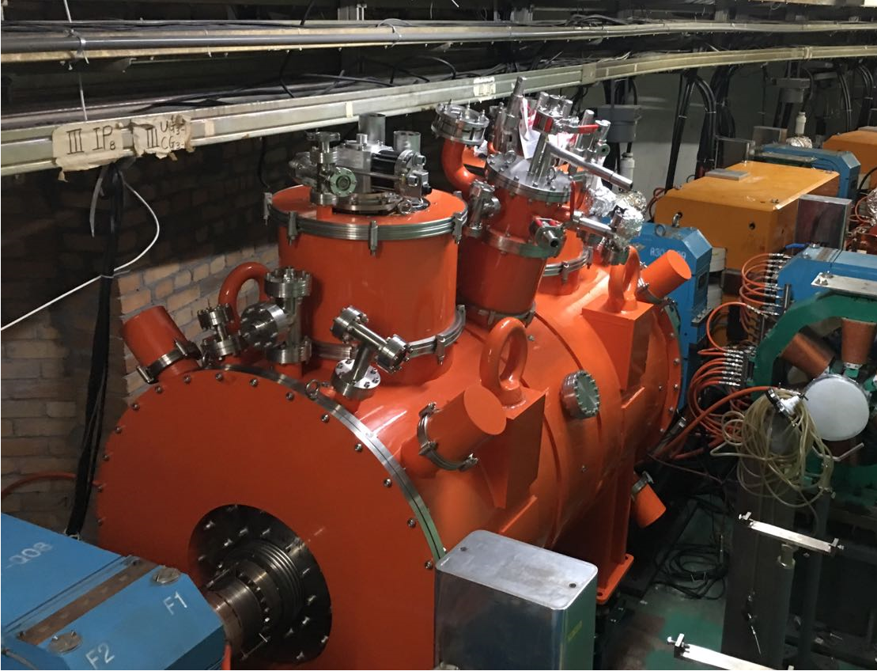
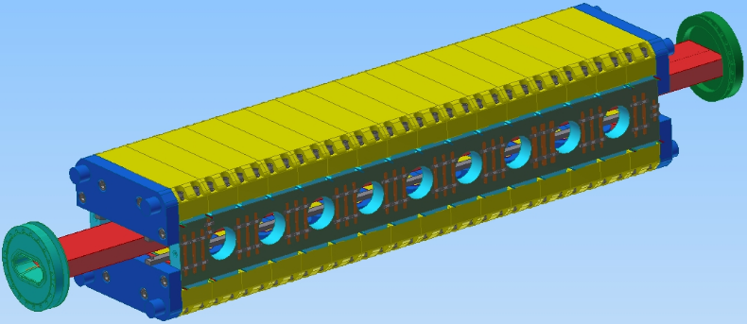
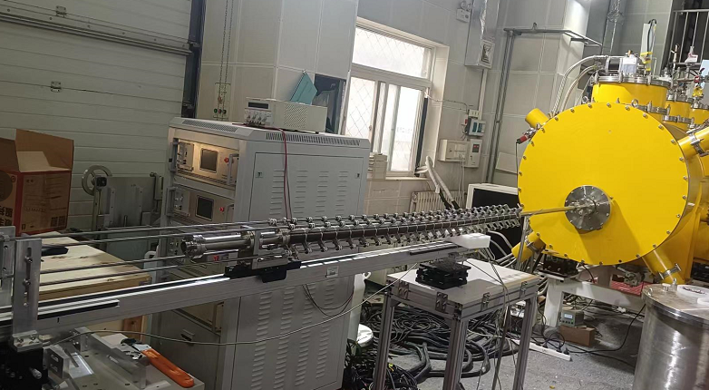
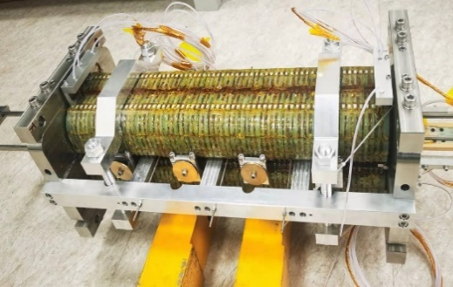
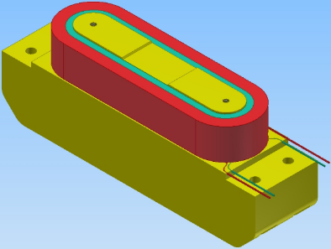
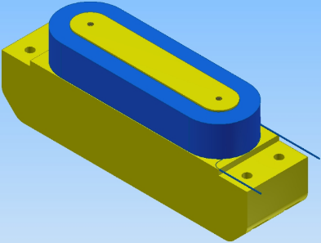
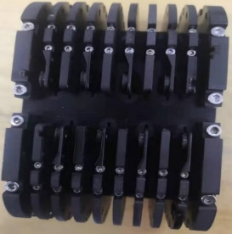
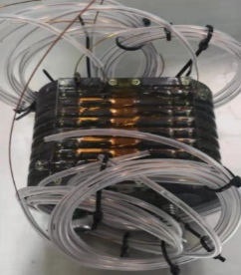
Categories of superconducting insertion devices
Superconducting insertion devices can be classified into two main categories: superconducting undulators (SCUs) and superconducting wigglers (SCWs), each with distinct characteristics and applications :
  field strength and period
  functions and utility cases
  specification and figure of merit
  coil size and winding technology

Slide 4
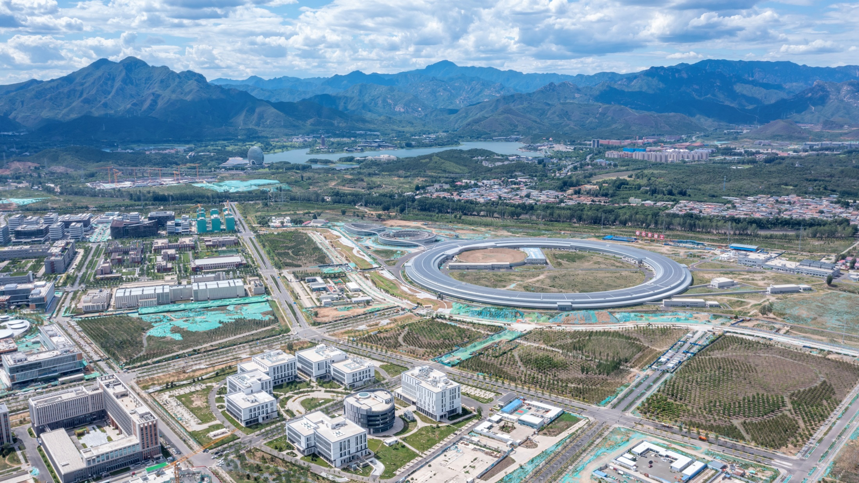
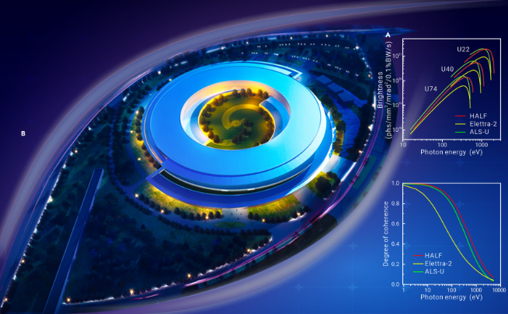

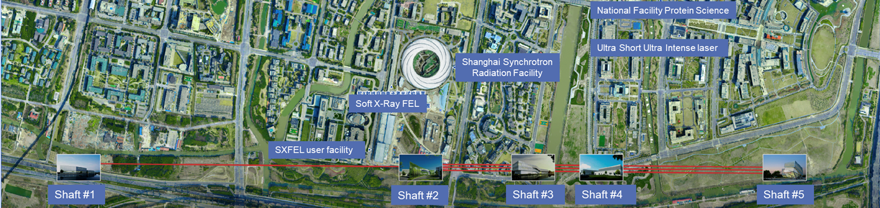

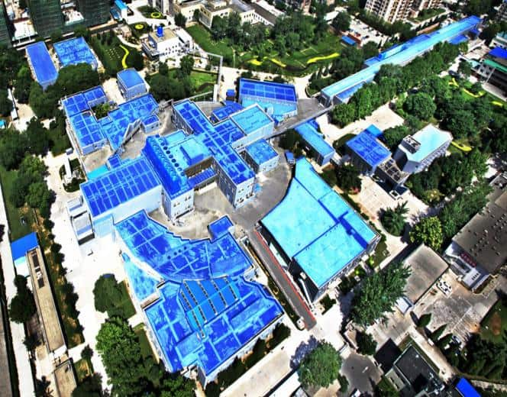
Superconducting Insertion Device applied at advanced light sources and colliders
Synchrotron radiation facilities (HEPS, HALF, …)
  SCU enhances the radiation brightness
  SCW extends the photon energy range, and it stabilizes beam energy loss due to synchrotron radiation in the multi-user mode
Free electron laser (SHINE, S3, …)
  SCU enlarge the photon energy range from a single beam line
Collider (BEPCII, CEPC …)
  SCU serves as a damping wiggler to decrease the emittance in the future

Slide 5
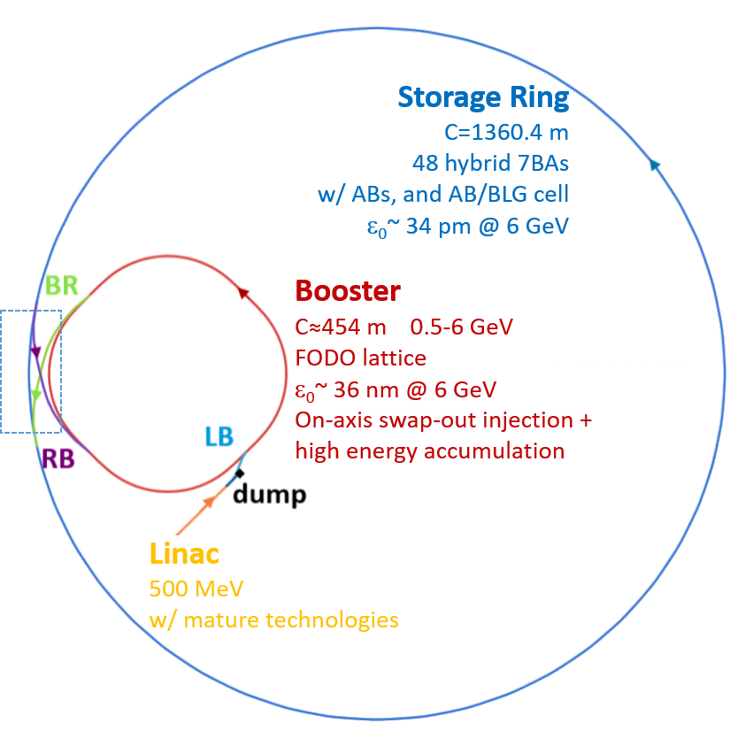
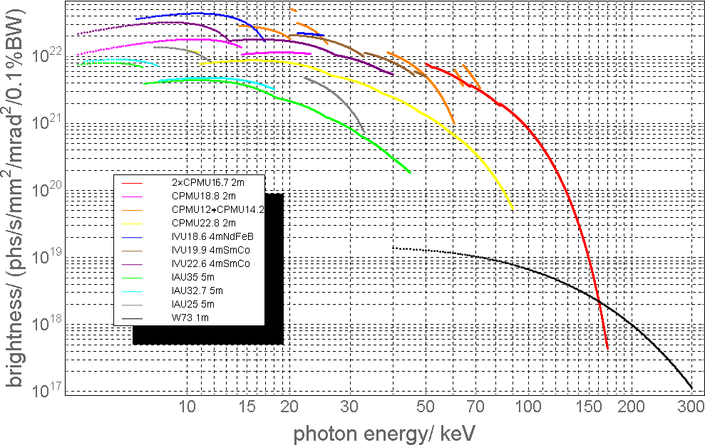
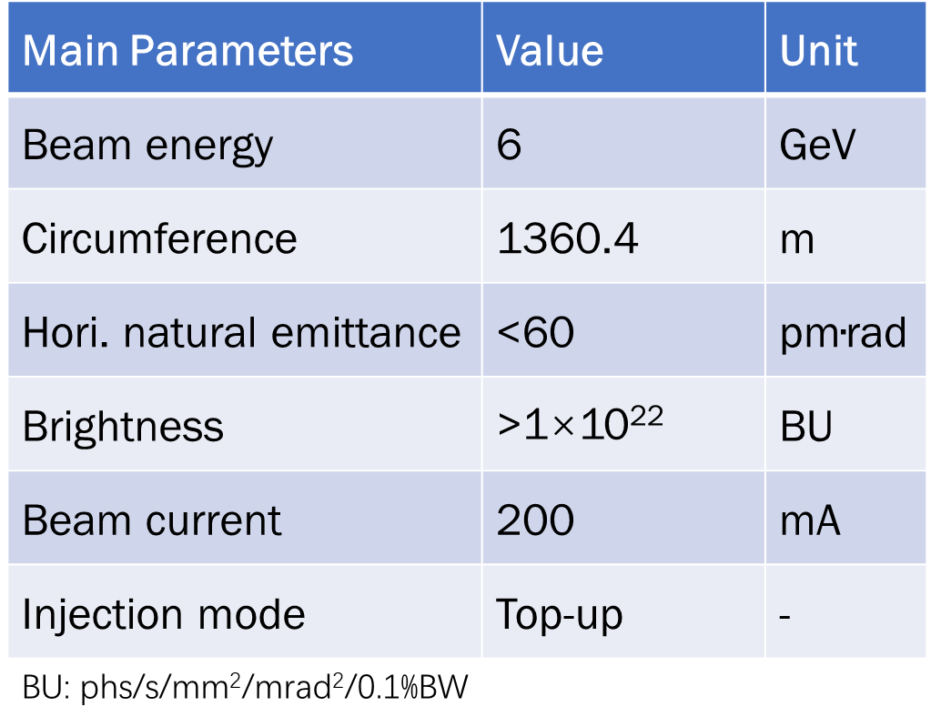
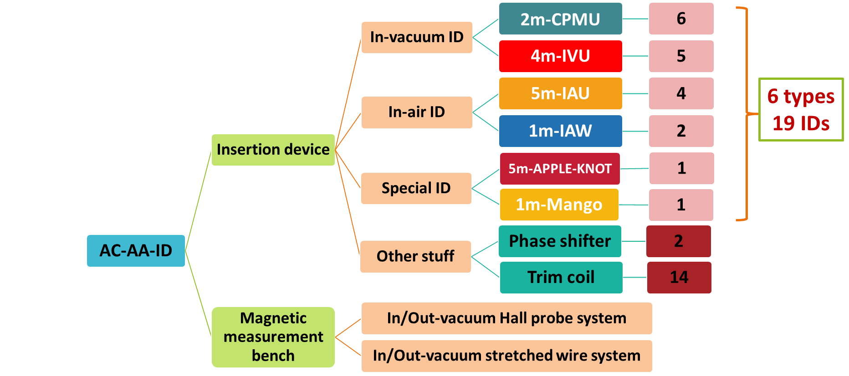
Design goals of HEPS and beamlines
HEPS is a 4th generation light source with the energy of 6 GeV and ultralow emittance of 34 pm.rad.

Slide 6
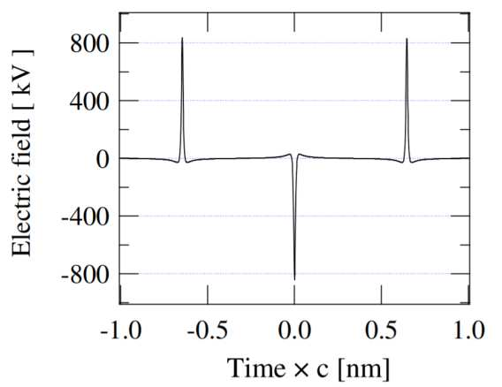
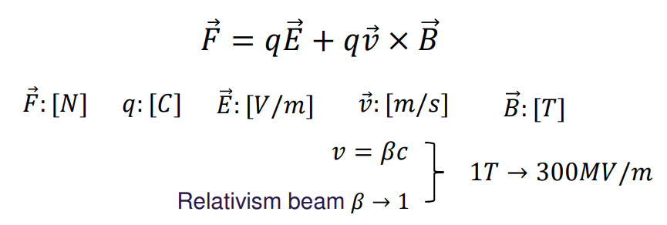
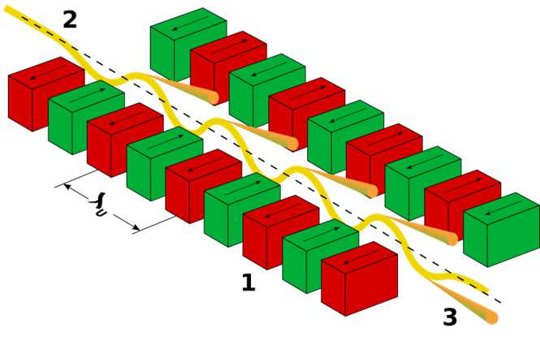
What is an undulator
Undulator: A magnet device providing periodic field to generate radiations with relativism electron beams. For example, SR in a storage ring, FEL in a linac
Deflecting charged particles for the electromagnetic radiation
Non-periodic deflection of relativism beam yields wide band radiation, and the narrow bandwidth and higher intensity are generated in a periodic field
Undulator provides a periodically alternative magnet field, forcing e-beams on an oscillating, but overall straight orbit.
Magnetic field is mostly used, because it is more efficient to deflect relativism beams than electric field:

Slide 7
Analytical solution of undulator field
Permanent magnet undulator
Electromagnet undulator
Features comparison

Slide 8
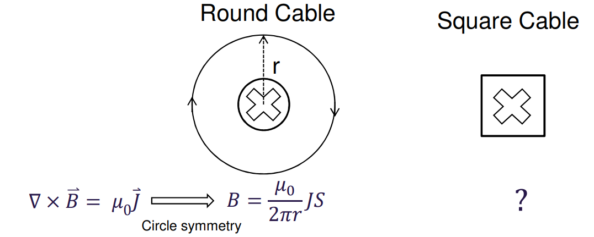
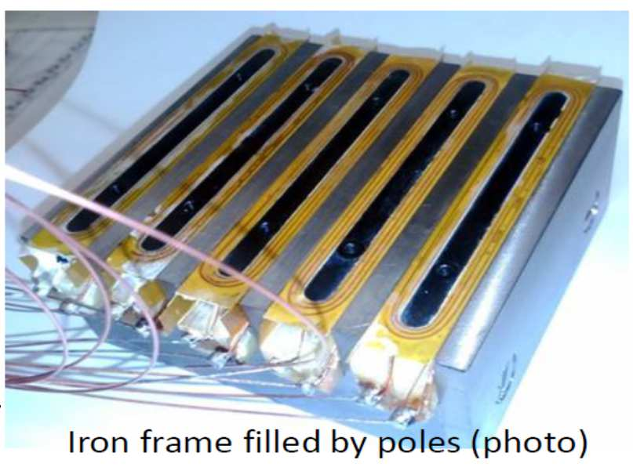

Periodic electromagnet field
Circular symmetry
Magnet field generated by periodic distributed current with square shape has analytical solution

Slide 9
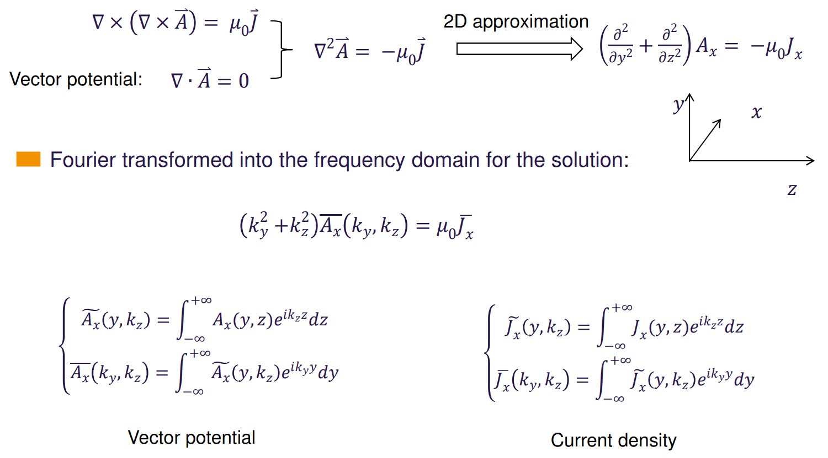
Maxwell equation of 2D UND field

Slide 10
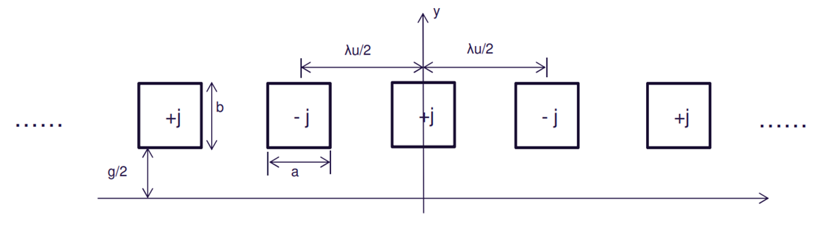
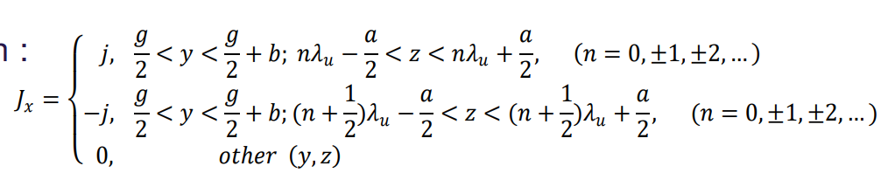
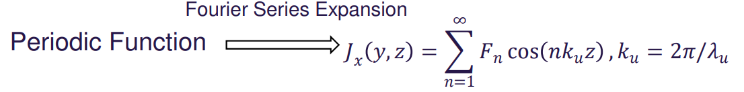
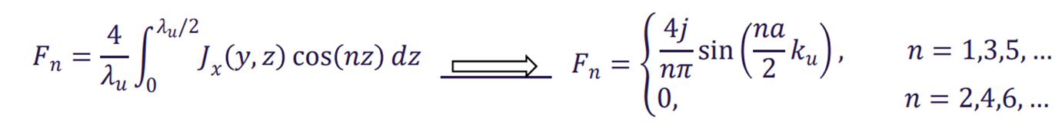
2D model of the electromagnet undulator
Planar electromagnet undulator possesses periodically alternative current distribution in 2D space
The current distribution:

Slide 11
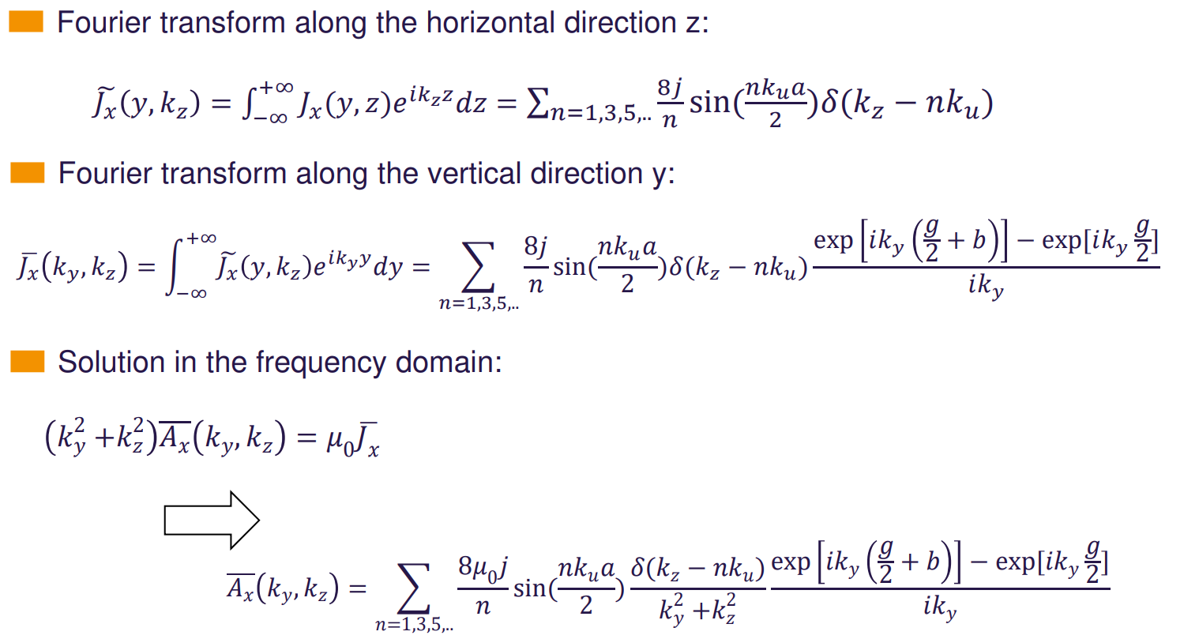
Current density in the frequency domain
Fourier transform in the horizontal direction, z:
Fourier transform in the vertical direction, y:
Vector potential in the frequency domain:

Slide 12
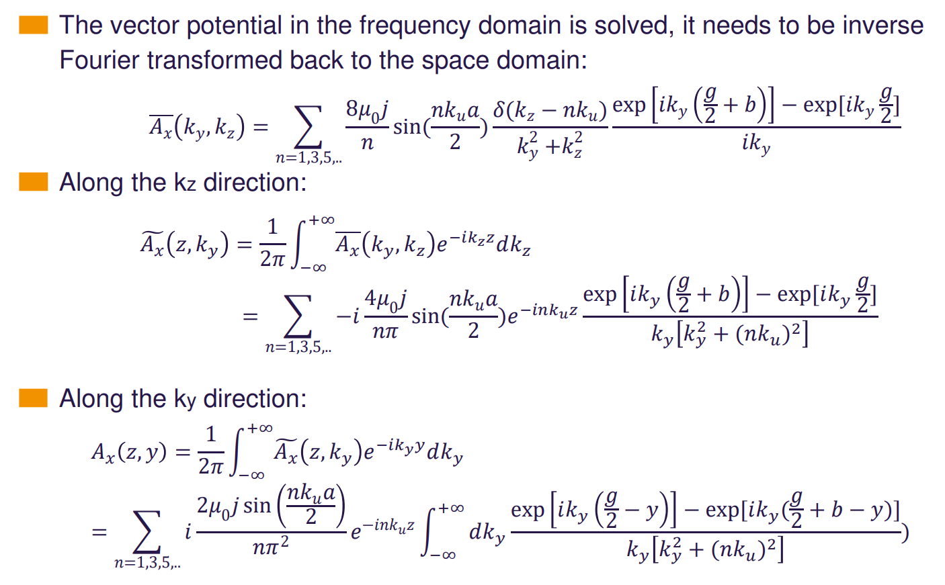
Inverse Fourier transform
The vector potential in the frequency domain is known, in the next step it is inversely transformed to the space domain
Inverse Fourier transform in the $k_{z}$ direction
Inverse Fourier transform in the $k_{y}$ direction

Slide 13
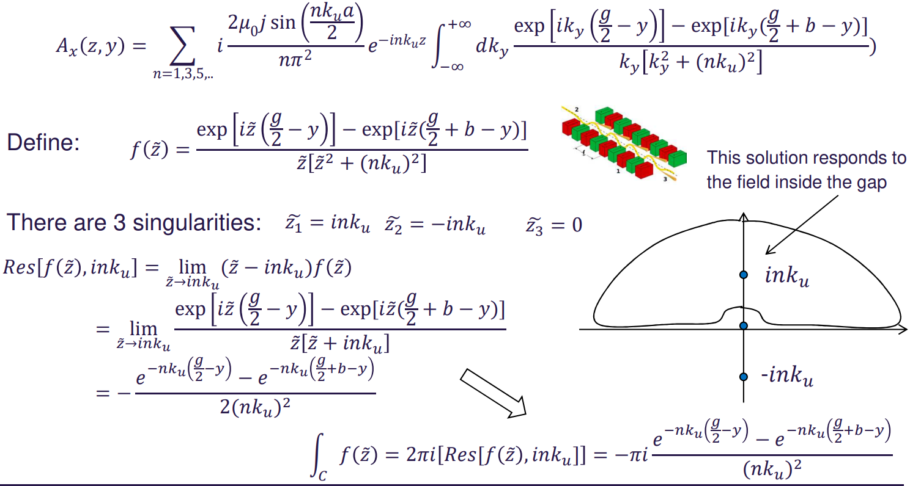
Infinity integral
Residue theorem for the integral

Slide 14
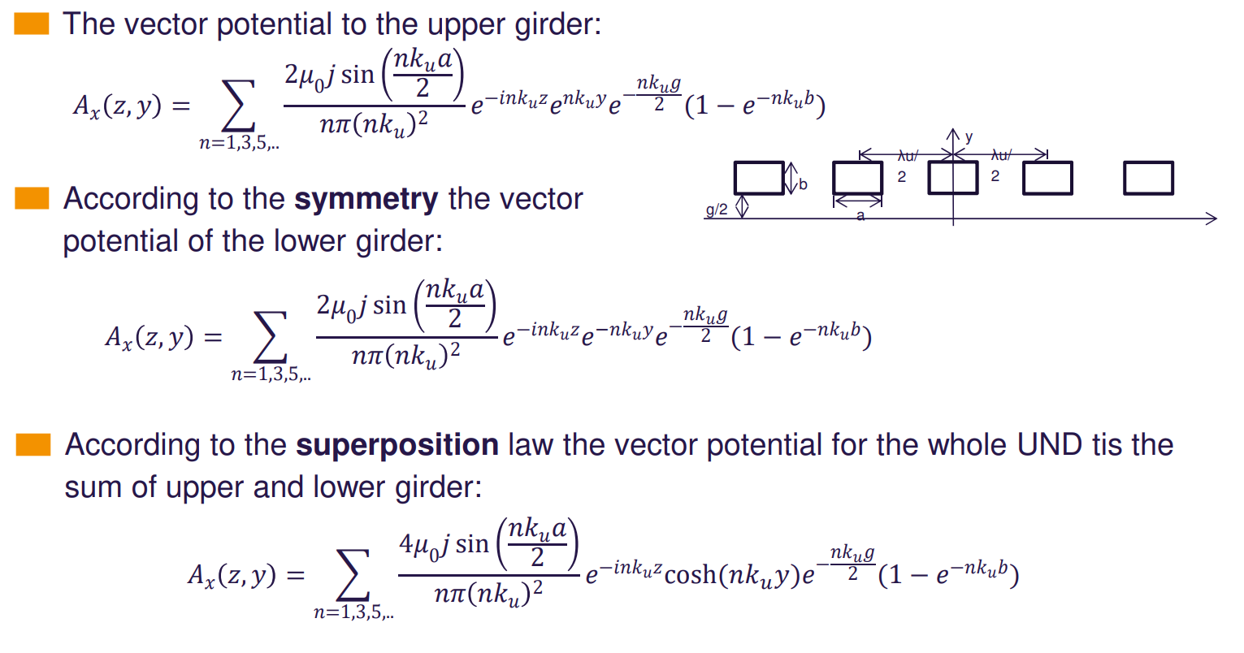
The vector potential

Slide 15
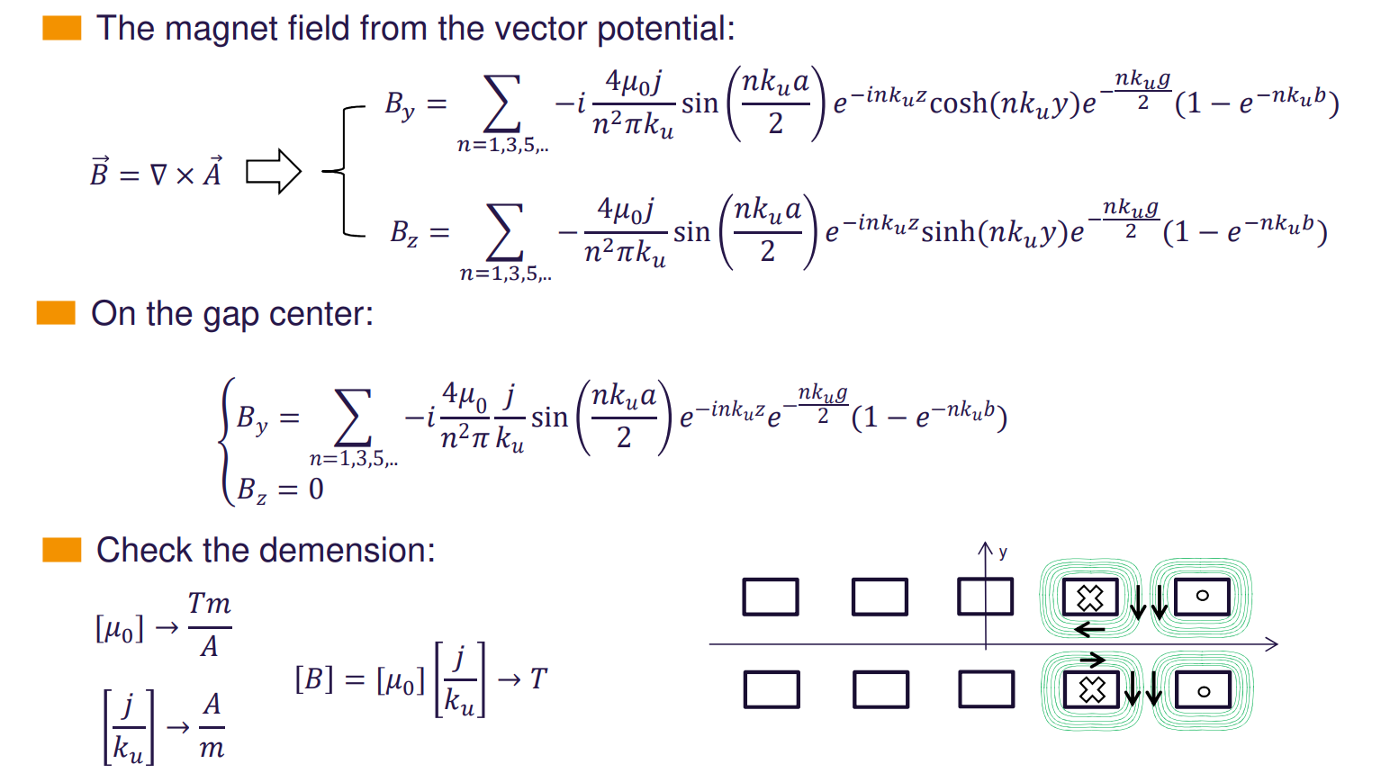
Electromagnet undulator field

Slide 16
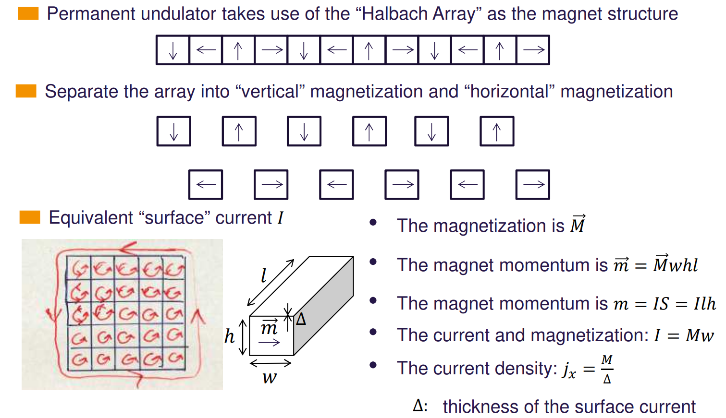
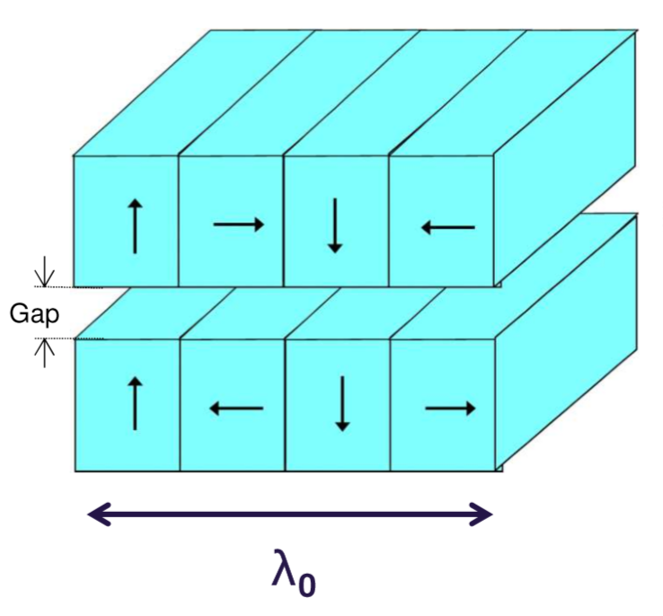
Permanent magnet undulator and Halbach Arrray

Slide 17
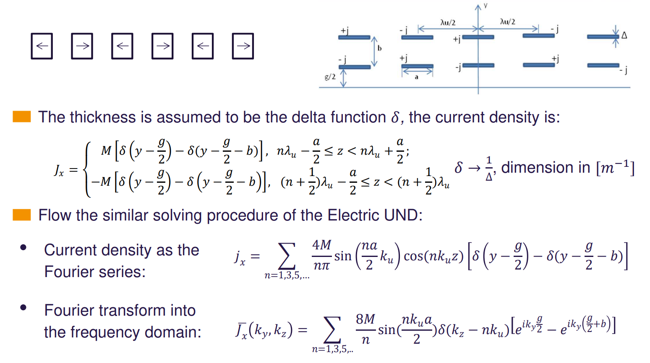
Field attribute to the horizontal magnetization

Slide 18
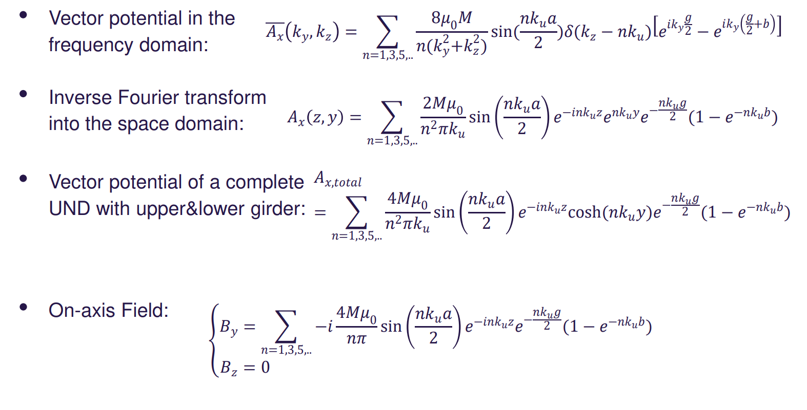
The solution to the field

Slide 19
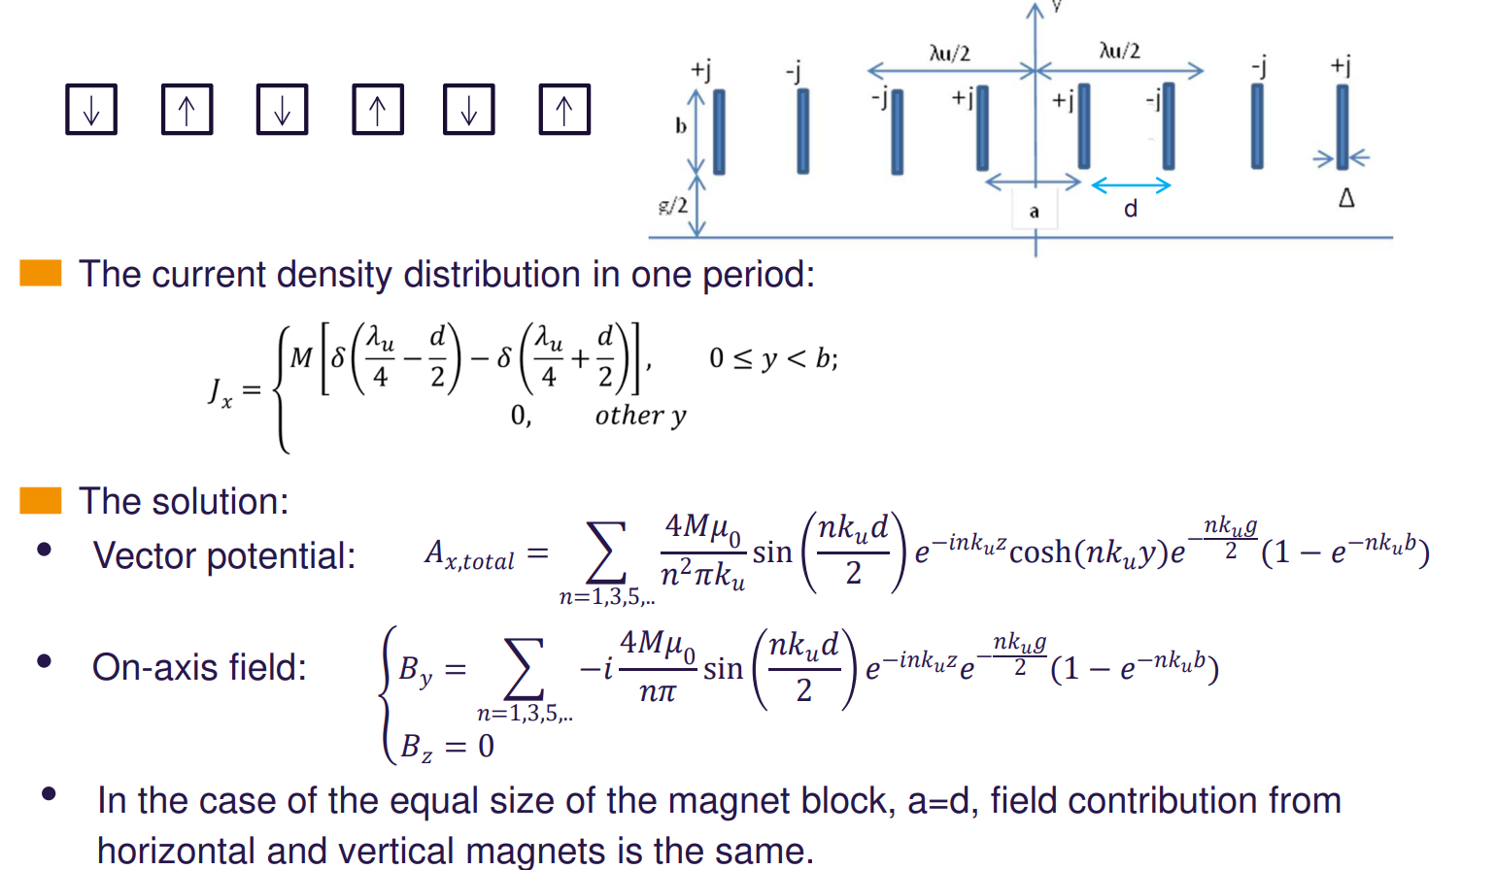
Field generated by the vertical magnetization

Slide 20
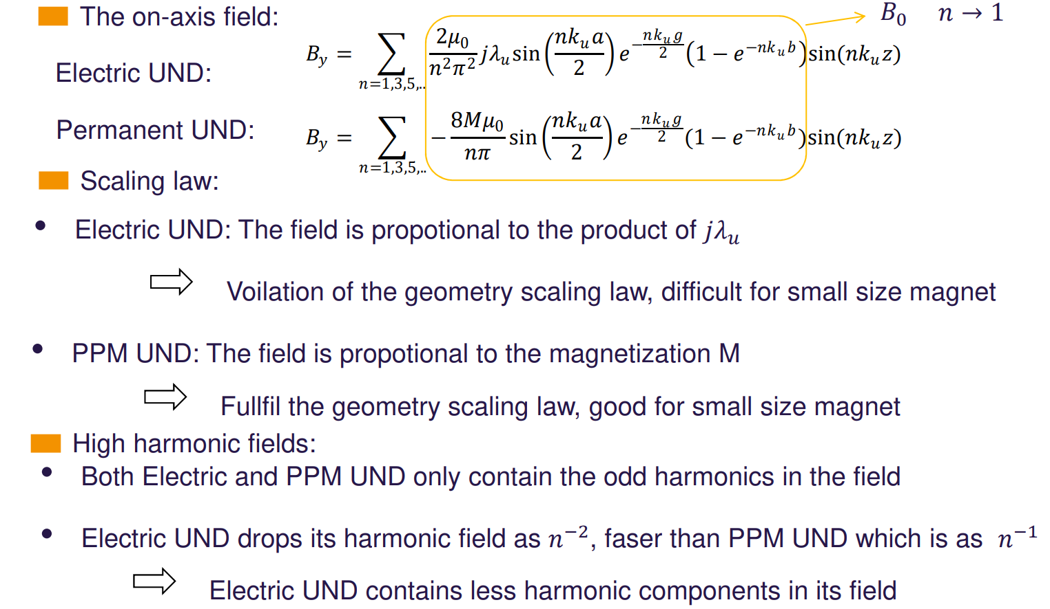
EM & PPM undulator comparison
EM Undulator:
EM UND:
Satisfy
Electro
EM undulator
EM

Slide 21
e- beam motion inside undulators
Electron momentum in an undulator
Field integral and physical meaning
Key parameters: resonance condition, K parameter, optical phase, phase error, …

Slide 22
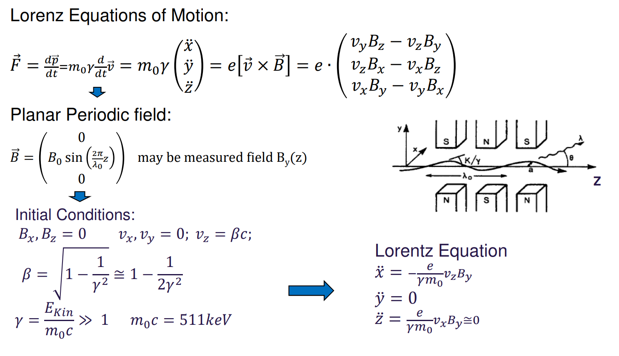
Planar undulator and acceleration

Slide 23
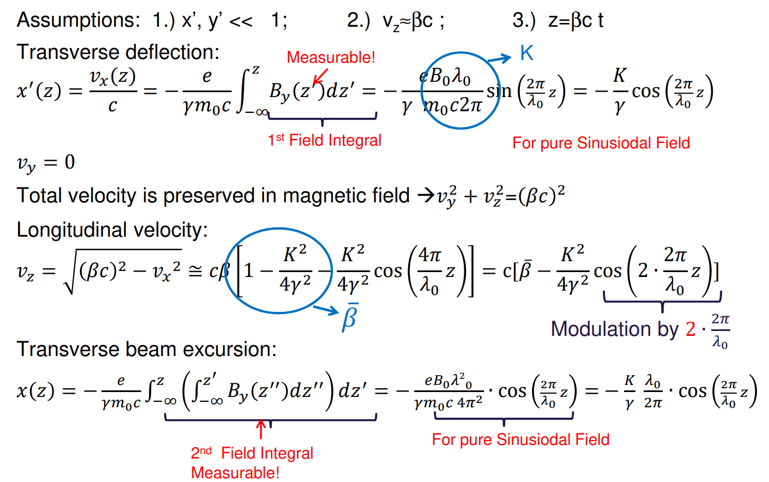
Beam deflection and excursion

Slide 24
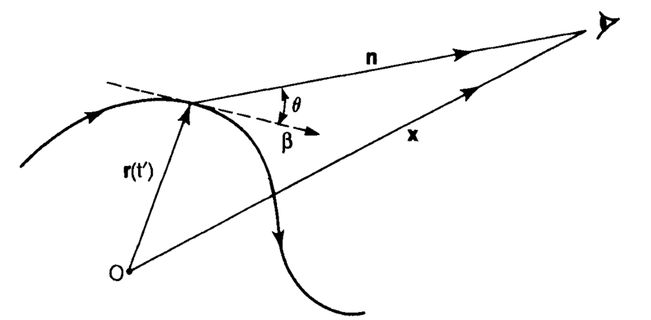
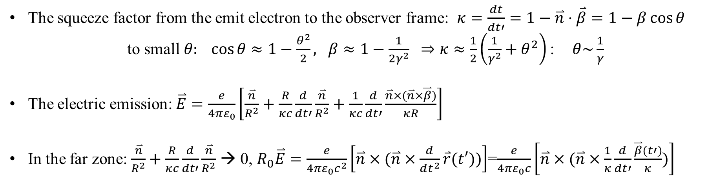
Radiation by relativistic electron
The squeeze factor from the emit electron to the observer frame: $κ=\frac{dt}{dt′}=1−\overset{⃑}{n}⋅\overset{⃑}{β}=1−β\cos{θ}$
to small$θ: \cos{θ}≈1−\frac{θ^{2}}{2}, β≈1−\frac{1}{2γ^{2}} ⇒κ≈\frac{1}{2}\left({\frac{1}{γ^{2}}+θ}^{2}\right)$ :$θ\sim \frac{1}{γ}$
The electric emission: $\overset{⃑}{E}=\frac{e}{4πε_{0}}\left[\frac{\overset{⃑}{n}}{R^{2}}+\frac{R}{κc}\frac{d}{dt′}\frac{\overset{⃑}{n}}{R^{2}}+\frac{1}{κc}\frac{d}{dt′}\frac{\overset{⃑}{n}×(\overset{⃑}{n}×\overset{⃑}{β})}{κR}\right]$
In the far zone: $\frac{\overset{⃑}{n}}{R^{2}}+\frac{R}{κc}\frac{d}{dt′}\frac{\overset{⃑}{n}}{R^{2}}$ → 0, $R_{0}\overset{⃑}{E}=\frac{e}{4πε_{0}c^{2}}\left[\overset{⃑}{n}×(\overset{⃑}{n}×\frac{d}{dt^{2}}\overset{⃑}{r}(t′))\right]$=$\frac{e}{4πε_{0}c}\left[\overset{⃑}{n}×(\overset{⃑}{n}×\frac{1}{κ}\frac{d}{dt′}\frac{\overset{⃑}{β}(t′)}{κ})\right]$

Slide 25
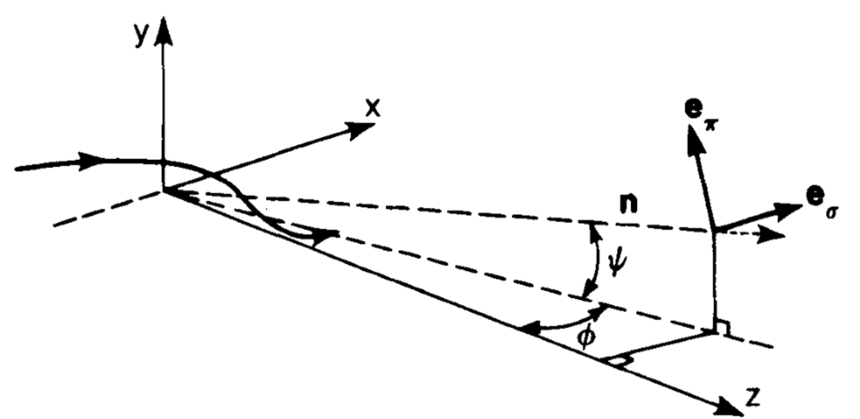
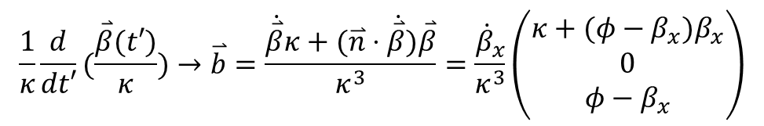

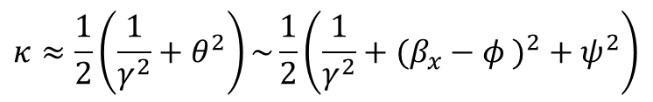
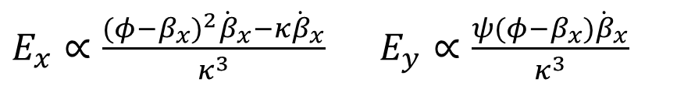
Radiation from horizontal oscillation
The squeeze factor in forms of ($φ$, $ψ$):
$$κ≈\frac{1}{2}\left({\frac{1}{γ^{2}}+θ}^{2}\right)\sim \frac{1}{2}\left({\frac{1}{γ^{2}}+(β_{x}−φ )}^{2}+ψ^{2}\right)$$
The acceleration vector:
$$\frac{1}{κ}\frac{d}{dt′}(\frac{\overset{⃑}{β}(t′)}{κ})→\overset{⃑}{b}=\frac{\dot{\overset{⃑}{β}}κ+(\overset{⃑}{n}⋅\dot{\overset{⃑}{β}})\overset{⃑}{β}}{κ^{3}}=\frac{{\dot{β}}_{x}}{κ^{3}}\left(\begin{matrix}κ+(φ−β_{x})β_{x} \\ 0 \\ φ−β_{x}\end{matrix}\right)$$
The radiation electric part in time domain:
$E_{x}∝\frac{{(φ−β_{x})}^{2}{\dot{β}}_{x}−κ{\dot{β}}_{x}}{κ^{3}}$ $E_{y}∝\frac{ψ(φ−β_{x}){\dot{β}}_{x}}{κ^{3}}$

Slide 26
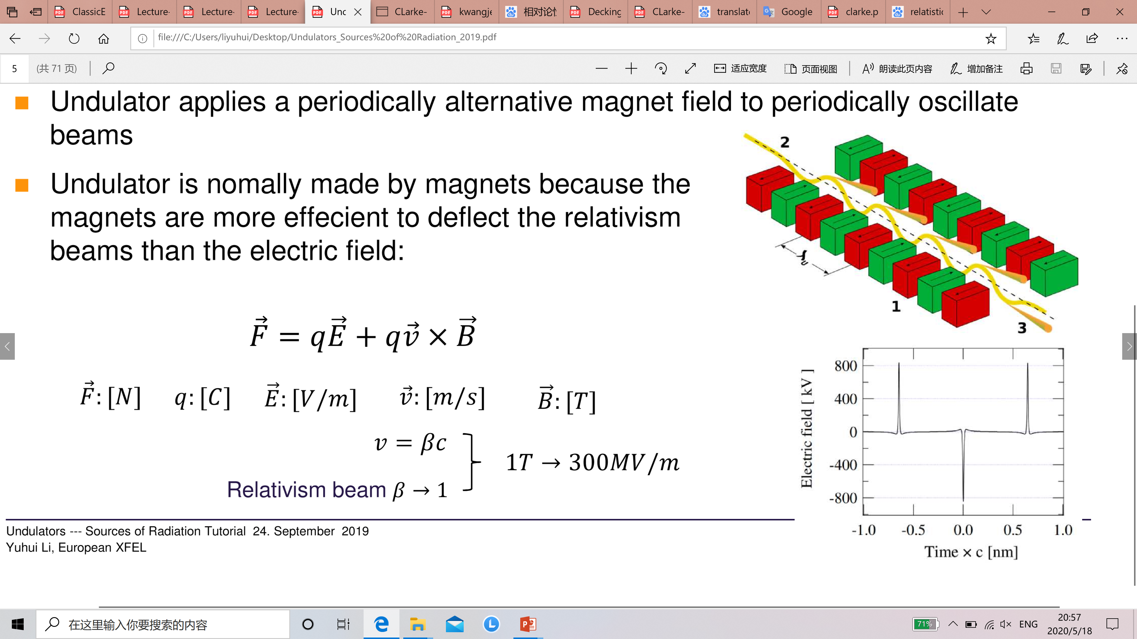
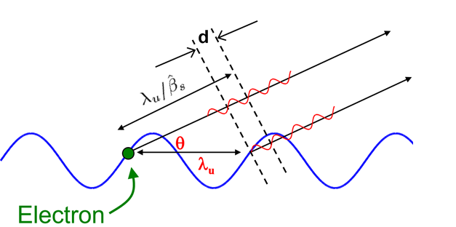

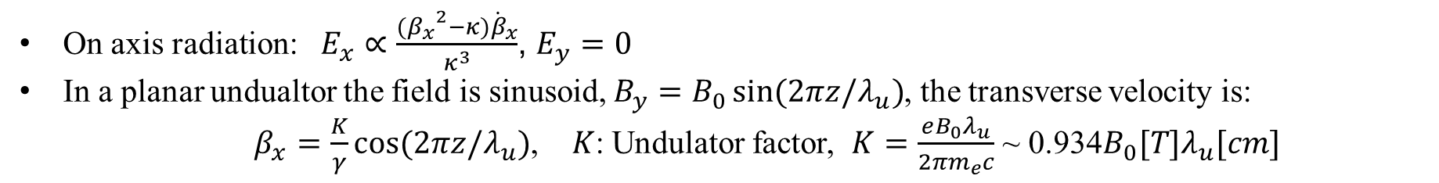
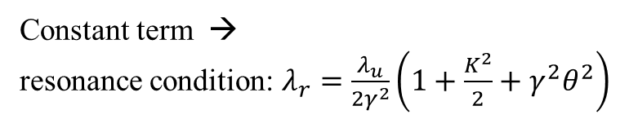
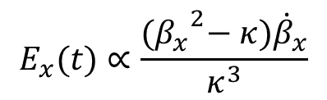

Undulator spontaneous radiation
On axis radiation: $E_{x}∝\frac{{{(β}_{x}}^{2}−κ){\dot{β}}_{x}}{κ^{3}}$, $E_{y}=0$
In a planar undualtor the field is sinusoid, $B_{y}=B_{0}\sin{(2πz/λ_{u})}$, the transverse velocity is:
$β_{x}=\frac{K}{γ}\cos{(2πz/λ_{u})}$, $K$: Undulator factor, $K=\frac{eB_{0}λ_{u}}{{2πm}_{e}c}$ ~ 0.934$B_{0}{[T]λ}_{u}[cm]$
$$T/2±δ$$
Angular Coefficient
Oscillation term
$$E_{x}(t)∝\frac{{{(β}_{x}}^{2}−κ){\dot{β}}_{x}}{κ^{3}}$$
Time squeeze
Time squeeze factor
Optical Phase
In the frequency domain:$E_{x}\left(ω\right)\sim \int_{−∞}^{+∞}{E_{x}\left(t\right)e^{iωt}dt}$,
$t=t^{′}\frac{1+\frac{K^{2}}{2}+γ^{2}θ^{2}}{2γ^{2}}+\frac{K^{2}}{8{γ^{2}ck}_{u}}\sin{(4ck_{u}t′)}−\frac{Kφ}{ck_{u}γ}\sin{(2ck_{u}t′)}$
Constant term →
resonance condition: $λ_{r}=\frac{λ_{u}}{2γ^{2}}\left(1+\frac{K^{2}}{2}+γ^{2}θ^{2}\right)$
Fast oscillation term

Slide 27

Optical phase

Slide 28




Example of field and practical formular

Slide 29
Technical solutions
Electro Magnetic (EM) Undulators
Superconducting (SC) Wigglers / Undulators
Permanent Magnet (PM) Undulators

Slide 30



EM and PPM magnet and scaling law
$\oint{Hds}=\frac{B_{Gap}Gap}{μ_{0}}=j_{surface}Δl_{m}=Ml_{m}$
$$B_{Gap}=\frac{μ_{0}M}{Gap/l_{m}}$$

Slide 31

Electro magnet undulators
Only for large period lengths $λ_{u}≧\sim$150mm → “Wigglers”
Ineffective for small $λ_{u}$
Conventional technology
High power demand and costs (Order of 100k€/a)
AC excitation possible with laminated cores
Variations:
  → Crossed / Helical undulators ( fast switching if AC)
  → Elliptical undulators
  → EM / PM combinations “PM biased EM undulators”
Special devices with limited applications!

Slide 32




Infrared undulator in FLASH @ DESY
Operation Cost 25% Usage:
80kW * 0.2€/kWh*(356*24)h *0.25=35k€/a

Slide 33

Helical EM undulator

Slide 34

Superconducting inserting devices

Slide 35






Example of SC wiggler @ IHEP
Peak field |  | T | 2.6
Design maximum current |  | A | 400
Operation current |  | A | 350
Period number |  | - | 8
Pole number (including ending poles) |  | - | 28+4
Period length |  | mm | 170
Gap |  | mm | 68
Wiggler length |  | mm | 1360
Number of winding |  | - | 32 * 24 = 768
Good field range（H/V） |  | mm | 46 / 20
1st field integral |  | Gs·cm | < 500
2nd field integral |  | Gs·cm² | < 50000
NbTi cable | Cross section size | mm | 1.20 * 0.75
 | Thickness of insulation | mm | 0.04
 | Cu/SC ratio | - | 1.3
 | Critical current | A | 604@7T，408@8T
Maximum field @ coil |  | T | 6.5
Maximum magnet force |  | N | 4.79*10⁵
Tension force in the main coil |  | N | 1.9*10⁴
Storage electromagnet energy |  | kJ | 286
inductance |  | H | 3.58
$$B(T)$$
$$g/λ$$

Slide 36






Example of SC undulator @ IHEP
Cryostat & magnet coil assembly
Peak field | T | 1.02
current | A | 400
gap | mm | 6.5
period | mm | 15
Period number | - | 100
1.5m planar SCU
The maximum loading current reaches 420A，and the phase error is 7.3° @ 400A。
The magnet field resembles it in the vertical test, confirming the magnetic coil keeps unchanged through procedures
RMS phase error：
200A 3.4°
300A 6.0°
350A 6.8°
400A 7.3°
420A 8.4°

Slide 37








Superconducting undulator design
SCU prototype @ IHEP
Parameters | Value
Period $λ_{u}$(mm) | 15
Number of Period | 100
Pole Width (mm) | 3
Cross section of cable slot (mm×mm) | 4.5×6.5
Cross section of iron core (mm×mm) | 47(H)×90(W)
Cable material | NbTi/Cu
Iron core material | DT4
Gap (mm) | 7/9.5
Peak Field (T) | 1/0.55
Y
X
Z
Developing stages
Short module with 5 period
0.5m protype R&D
1.5m full length SCU, vertical & horizontal measurement

Slide 38










Key technology for SCU coil
Coil winding
Epoxy impregnation
No power filling
Glass-fiber filling
Coil training

Slide 39




Vertical measurement for 0.5m prototype
0.5m prototype field scan
Measurement guider and driving system
Field measurement
8

Slide 40






Vertical measurement for 1.5m SCU
1.5m SCU magnet coil diagram
Initial status from the vertical measurement
Mechanical error is excluded from the reason of the large phase error
Large phase error of 16° in the initial status

Slide 41





Phase error mitigation by gap correction
Field as a function of gap
Field correction by adjusting the local gap
$$g=−\frac{2}{k_{u}}\ln\left(\frac{π}{4μ_{0}}\frac{k_{u}}{j}\frac{1}{\sin\left(\frac{k_{u}a}{2}\right)\left(1−e^{−k_{u}b}\right)}\frac{B_{y}\left(z\right)}{\sin\left(k_{u}z\right)}\right)$$
$$∆g=−\frac{2}{k_{u}}\ln\left(\frac{B_{y}\left(z\right)+∆B}{B_{y}\left(z\right)}\right)$$
Gap adjustment calculation
Peak field after gap adjustment
Phase error after the correction: 6.4°(300A) 8.2°(400A)

Slide 42





Implement into cryostat
Vacuum chamber and magnet coil
Vacuum chamber in the cryostat
Frame for the magnet coil assembly
Vacuum chamber： 51.5 mm($W$)×6.5 mm(H) race track shape aperture
wide horizontal aperture for SR passage;
sufficient vertical aperture for beam clear range
Slit and magnet gap：0.75mm slit between chamber and magnet coil
0.75mm chamber wall ⇨ magnet coil gap of 9.5mm：
Vacuum chamber is positioned by G10 stick
Vacuum chamber material：
cold mass of 6063 Al alloy
316L stainless steer for the cryostat
Al-steer bimetal composite plate
Vacuum chamber is cooled through cold mass cooling power 20W@20K
Vacuum temperature10K
Vacuum chamber and cryostat joint section

Slide 43




Thermal deposition and temperature distribution
Simulation of the thermal deposition and temperature calculation
SynRad+
Molflow+
MAX:28℃
MAX:38℃
MAX:30℃
MAX:0.12mm
MAX:0.04mm
MAX:0.03mm
Impact | Power
Absorption power from upstream section | 88.94 + 365 W（①＋②）
Power deposition at the vacuum chamber in the cryostat | 0.025 W
Power to the downstream section | 75.49 W
SCU SR power yielded @350A | 1633 W
MAX:34MPa
MAX:59MPa
MAX:16MPa

Slide 44





Cryostat assembly and horizontal test
1.5m SCU magnet and support frame
SCU sag deformation
Parameter | Value
Vacuum leakage rate | ＜1×${10}^{−10}$ $mbar∙L/s$
SCU magnet Temp. | 4.2 K
Vac Chamber Temp. | ~10 K
Vacuum level | 2.0×${10}^{−7}$ Pa
Maximum current | 450A
Heat load @ 400A | ＜3 W
SCU cooling process

Slide 45






SCU horizontal measurement
SCU training in horizontal & vertical test
SCU horizontal field measuremnt
SCU field scan in the horizontal status
SCU peak fields in multi-measurements

Slide 46




Ending coil for field correction
RMS
phase error：
200A 3.4°
300A 6.0°
350A 6.8°
400A 7.3°
Peak field @ different currents
Phase error in vertical & horizontal status
Ending coil design
Correction to the 2nd field integral

Slide 47






Hall probe measurement and eddy current
Oscillation was observed in the field measurement
Measured field oscillation at differ velocity
$$B_{0}=0.45T$$
$$v=5mm/s$$
↓↓
evaluation~20 Gauss
measurement~15 Gauss
Model for evaluating the eddy current impact

Slide 48
Challenges in SC insertion devices
Heat load by SR, especially in small gap short period devices.
Shielding reduces usable gap
Infrastructure and continuous maintenance required: Liquid Helium, or Cryo-coolers, and additional electricity consumption
Magnetic measurements
Error compensation schemes available
Further researches for the mass production of high quality undulators

Slide 49

Permanent magnet undulators

Slide 50

Planar permanent magnet undulators

Slide 51

Magnet field simulation codes

Slide 52

Magnet design steps

Slide 53


Example: hybrid magnet UND design

Slide 54

Practical design formular

Slide 55

Comparison EM-PPM-Hybrid-SCU

Slide 56




Pole height tuning

Slide 57

Tuning by magnet shimming

Slide 58



C-frame structure

Slide 59

H-Frame structure

Slide 60

C-frame revolver undulators

Slide 61

Invaccum undulators

Slide 62

PPM UND for variable polarization APPLE (Advanced Polarized Permanent Light Emmitter)

Slide 63

Delta type undulator

Slide 64
Summary and outlook
Three technologies are used for Undulators
  PM technology is most advanced and used on a large scale worldwide for >90% of the devices
  Pure PM devices offer options for variable polarization
  SCUs made progress: Once mature may deliver shorter periods higher field. → shorter λRad at given γ
  EM technology only for niche applications: Very long λu, moderate fields, AC excitation
  Potential for further developments: IVUs, variable polarization
  Future challenges: Long term operation in SC accelerators: EXFEL, LCLSII Radiation damage ↔ small gap
  Not touched:
    Drive & Motion Control; Control systems
    Magnetic measurements

Slide 65

THANKS FOR YOUR ATTENTION!

