Slide 1


Project Methodology of Large-Scale Cryogenic System:
ESS ACCP as A Case Study
Xilong Wang
Dalian Institute of Chemical Physics, CAS, China
March 29 2025

Slide 2

Contents
01
Introduction
02
ESS Cryogenic System
03
Project Management
04
ESS ACCP as a project

Slide 3
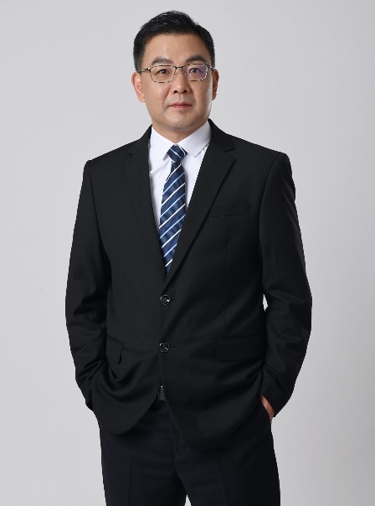






About Myself
2002-2005- Institute of Technical Physics and Chemistry (TIPC)
Ph. D
2004-2006 IHEP/BEPCII, ALHZ, IP/CSNS, China
Process Engineer
2007-2012 DESY, Germany
Scientist
2012-2020 ESS, Sweden
Senior Scientist
2020- Dalian Institute of Chemical Physics (DICP), CAS, Dalian
Group leader
2020- Institute of Advanced Science Facilities (IASF), Shenzhen
SCT Division Head
Xilong Wang
DESY/European XFEL Accelerator Module Test Facility (AMTF)
From Sketch to the End
DESY/European XFEL Cryomodules
Prototype and Series Production
DESY/European XFEL Accelerator Cryogenic System
CDS and safety system Design
ESS Accelerator Cryoplant
From Sketch to the End

Slide 4
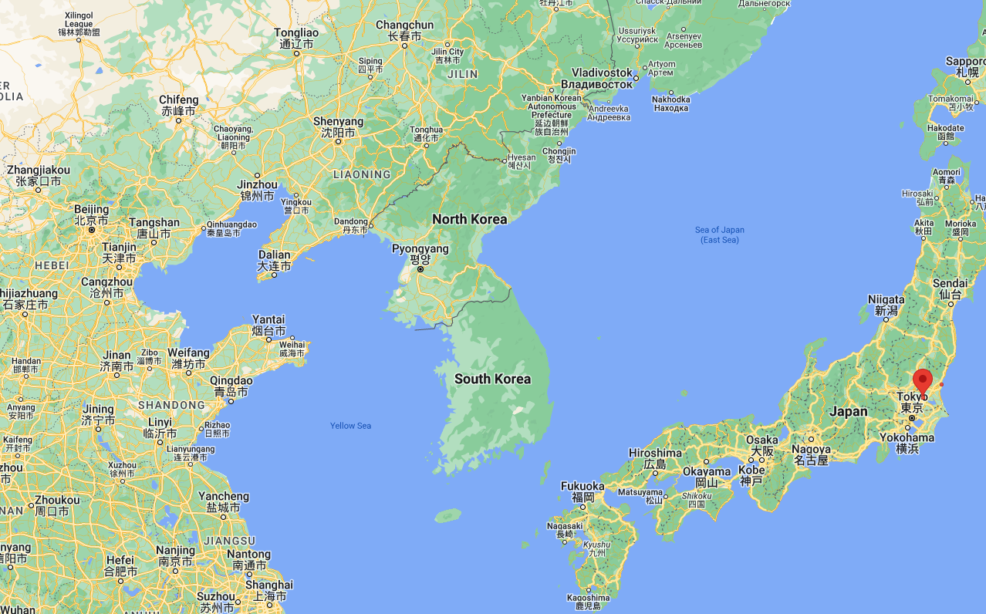
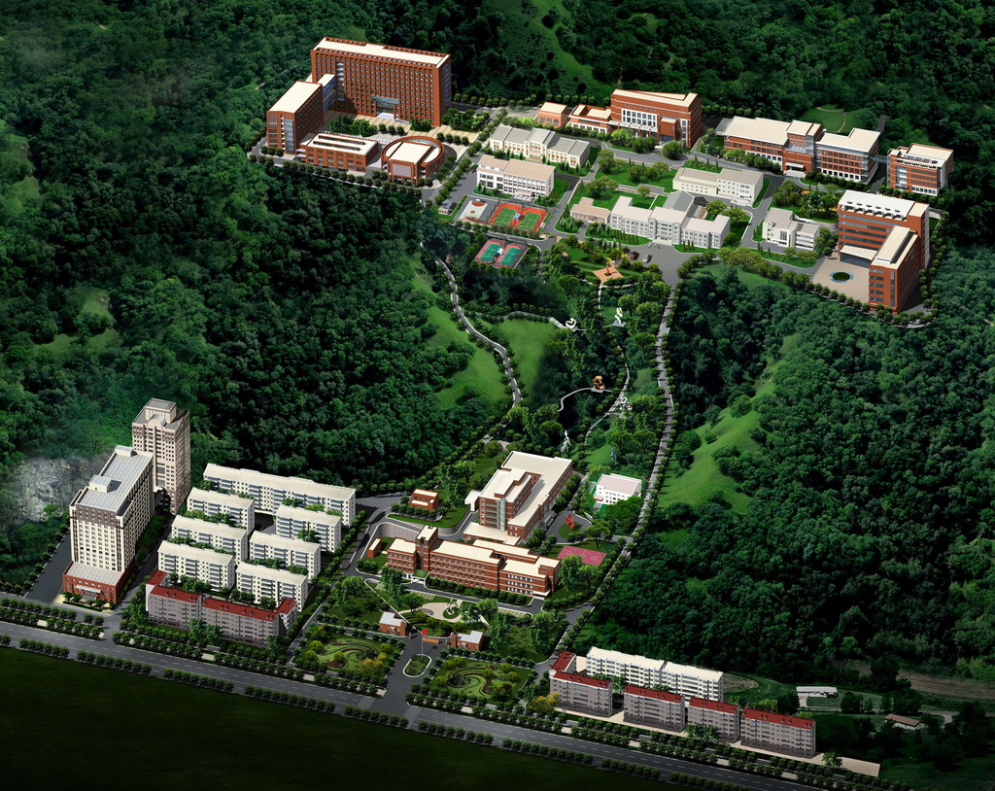
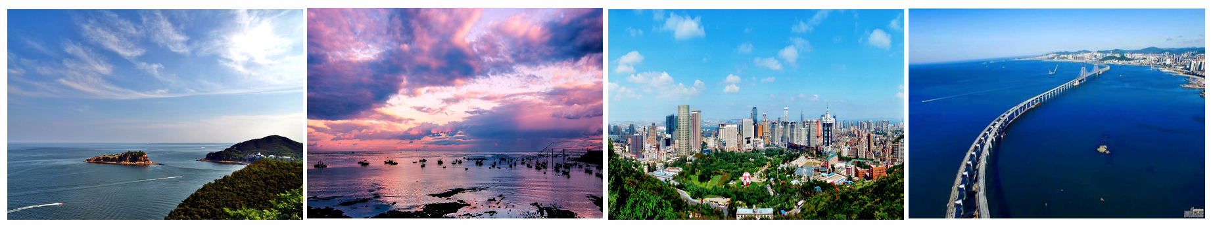
Dalian Institute of Chemical Physics (DICP)
Beijing
Dalian

Slide 5

DICP Research Areas
Fundamental Research: Catalytic chemistry, Molecular reaction dynamics
Applied Research: Chemical engineering, Analytical chemistry, Biotechnology
Dalian National laboratory for clean energy (DNL)
Clean fossil energy utilization, Clean energy technology, Renewable energy
Facilities: Dalian Coherent Light Source (DCLS)

Slide 6
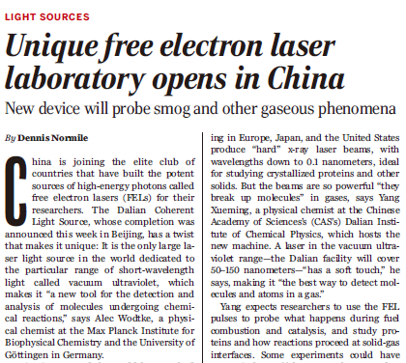
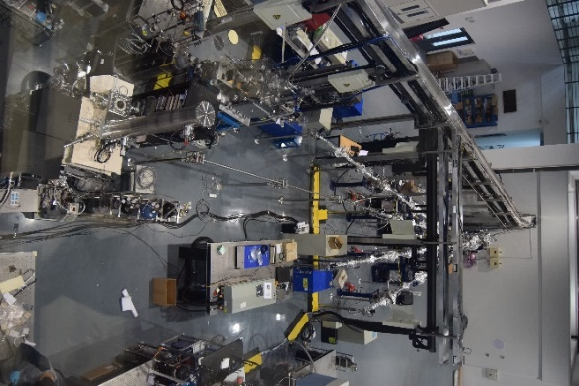
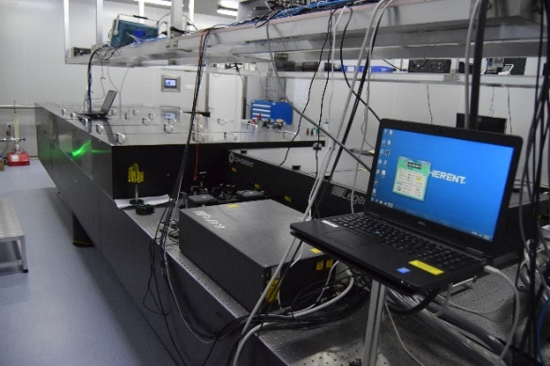
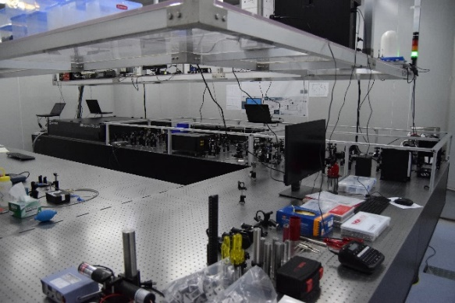
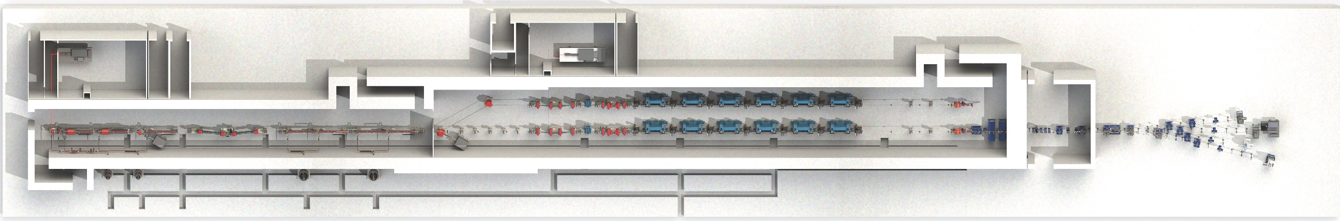
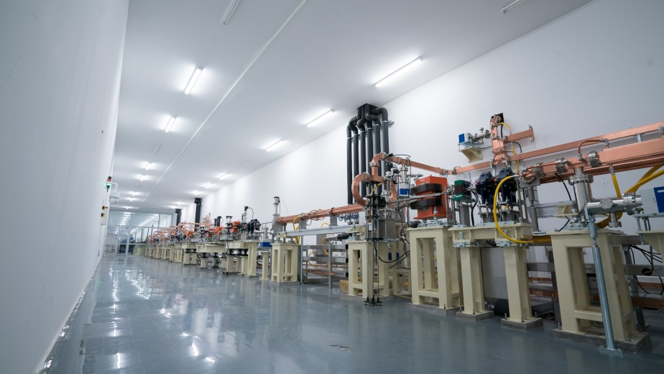
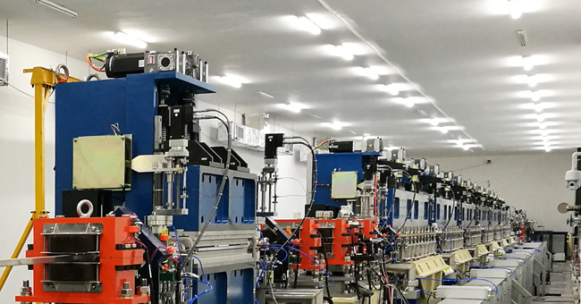
Dalian Coherent Light Source (DCLS)
Driving Laser
Seed Laser
Experimental Hall
LINAC
Undulator
Warm accelerator:0.3 GeV
Tunable Wavelength: 50-150 nm
Pulse Energy: > 100 µJ
Pulse length: 100 fs
Repetition Rate: 50 Hz
Operation since Aug. 2018
More than 6000 hours per year
ASSCA 2023, KEK, 03/Feb/2024

Slide 7
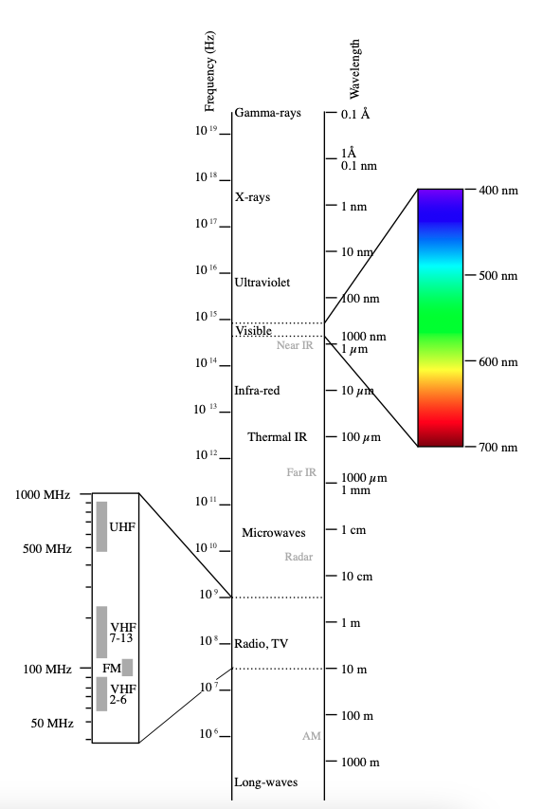
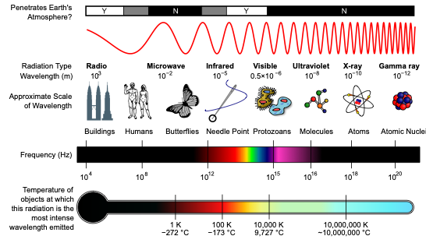
Electromagnetic Spectrum
S³FEL
DALS

Slide 8
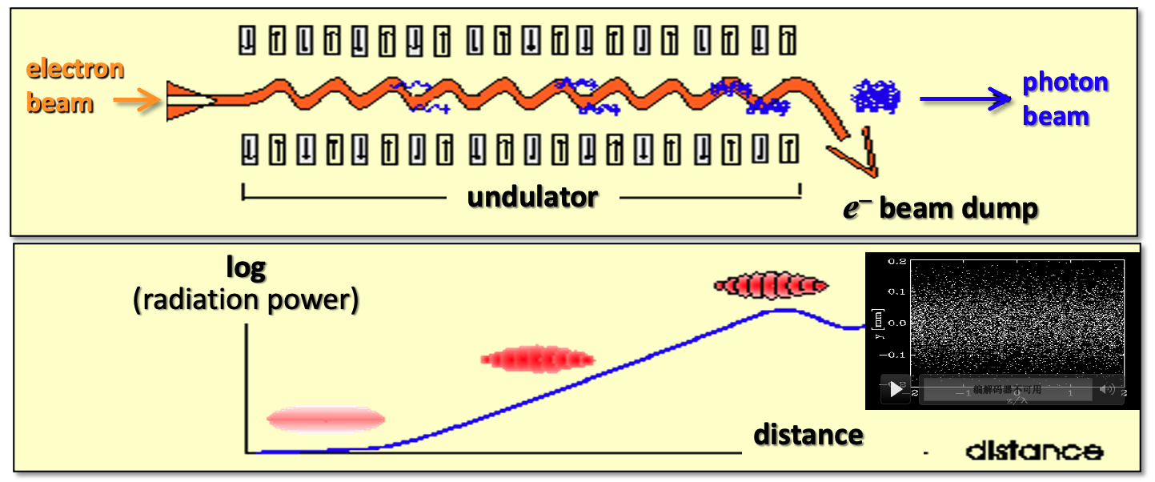
Important tools for physical and material sciences
Advanced FEL features
High brightness, ultrafast pulse duration and full coherence
A transformative tool for basic science research and cutting-edge technology R&D
Quantum materials, Atmospheric Chemistry, Catalysis, Interstellar chemistry, Biomolecules, Atomic and molecular physics
Meeting national great strategic demands and helping to maintain sustainable development of China
Energy, environment, health and new material

Slide 9
XFELs Worldwide
Facility | Wavelength | Country | LINAC | Beam energy/GeV | Photon energy | Rep. rate/Hz | Status
European XFEL | Hard X-ray | EU | SRF | 17.5 | 8.4-30 keV | 27,000 | Operation
LCLS-II | Hard X-ray | US | CW SRF | 4 to 8 | 0.2-5 keV | 1,000,000 | Operation
SHINE | Hard X-ray | CN | CW SRF | 8 | 0.4-25 keV | 1,000,000 | Under construction
FLASH | Soft X-ray | DE | SRF | 1.25 | 14-300 eV | 5000 | Operation
DALS | EUV X-ray (6.5-180 nm) | CN | CW SRF | 1.0 | 8-600 eV | 1,000,000 | Proposed
S³FEL | Soft X-ray (1-30 nm) | CN | CW SRF | 2.5 | 0.04-1 keV | 1,000,000 | Approved
There is no EUV & Soft X-ray FEL facilities operating at MHz repetition rate in the world!

Slide 10
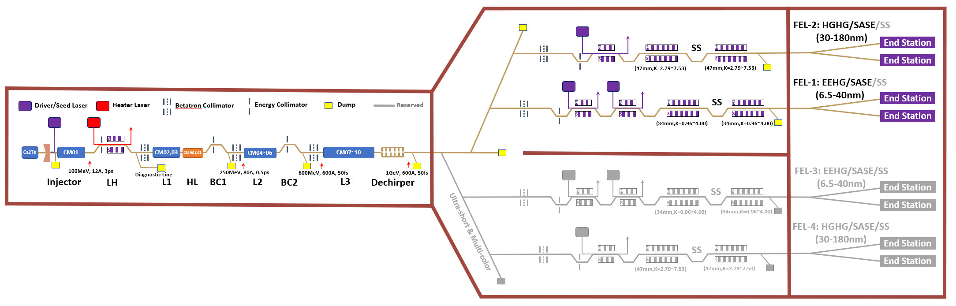
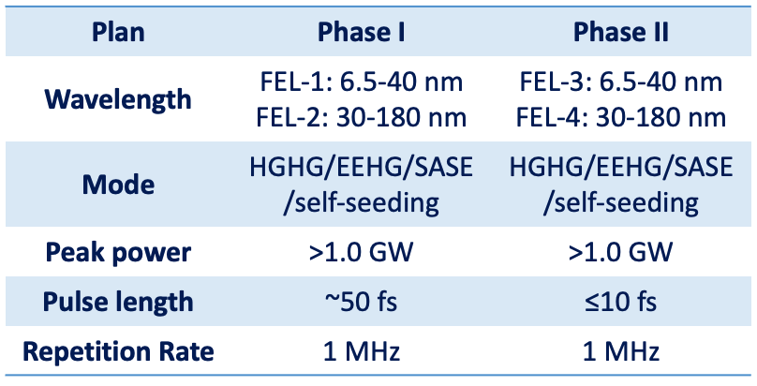
Dalian Advanced Light Source (DALS)
http://www.dcls.dicp.ac.cn/
https://cryo.dicp.ac.cn/
Located at Dalian, Northeast of China
EUV Free Electron laser machine
Proposed by Dalian Institute of Chemical Physics (DICP)
1.0 GeV CW SRF accelerator
Ten 1.3 GHz Cryomodules & two 3.9 GHz Cryomodules
~100 SRF Cavities
One dedicated cryoplant (~3 kW @ 2 K)

Slide 11
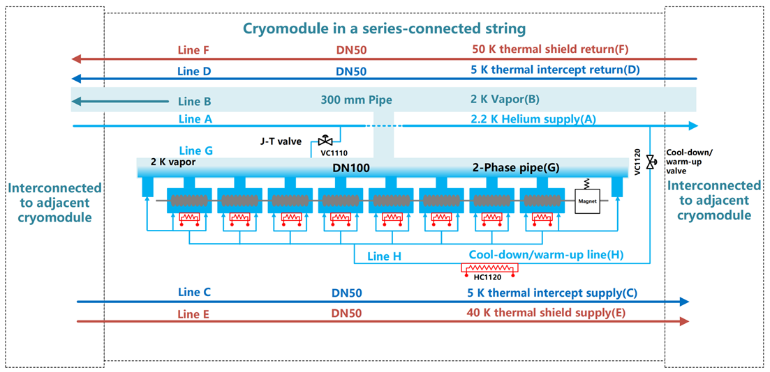
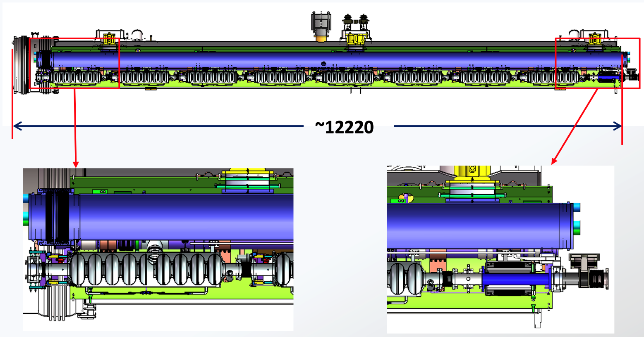
Cryomodule Structures & Components
Based on TTF Type I-V
Eight 9-cell dressed TELSA SRF cavities
Eight fundamental power couplers (FPC)
Eight Tuners & Piezo
One BPM + one SCQ magnet + two GVs
Cryomodule length: ~12.3 m & 38” vacuum vessel
Three supports for cold mass
Two adjustable stands
300 mm –ID, 12 m long tube, as backbone for cavity string piping system and safety release
Cryogenic Piping system
50 K aluminum shielding
JT and CD cryogenic valves
Instrumentations

Slide 12
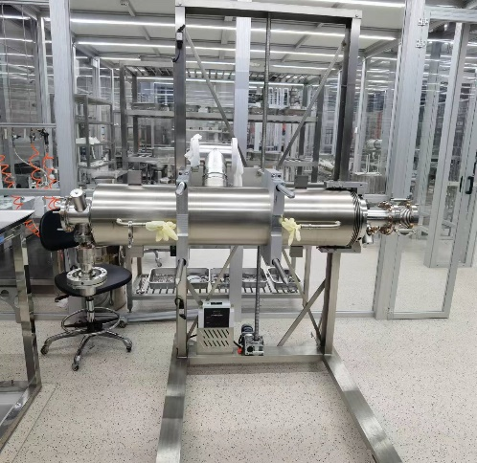
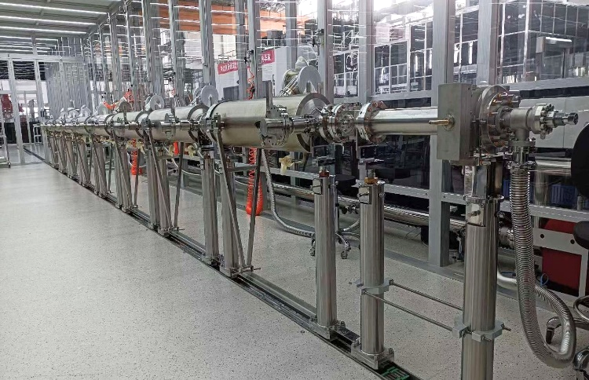
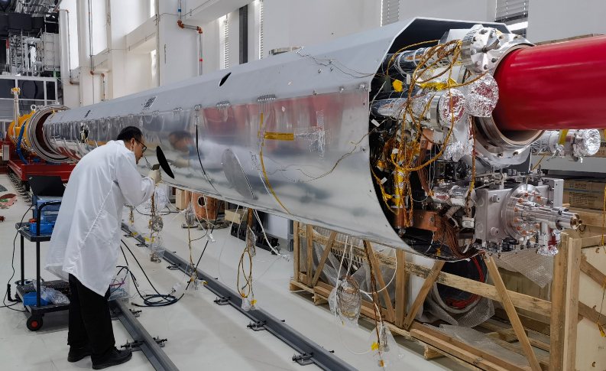
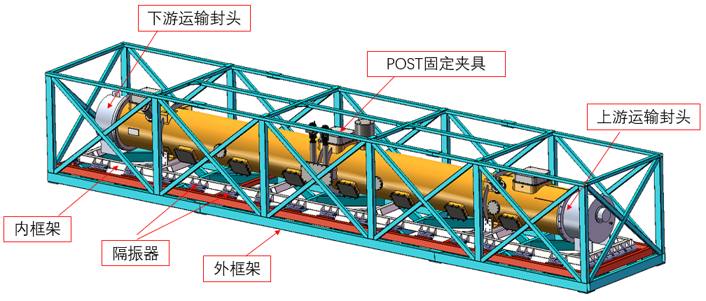
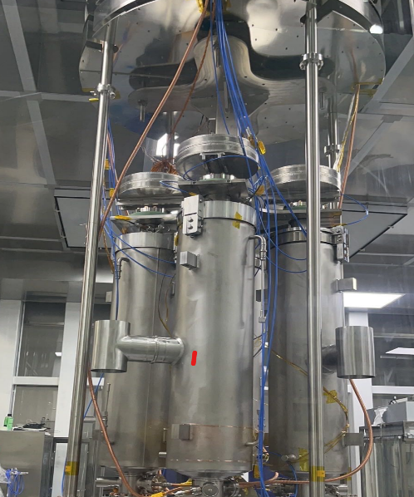
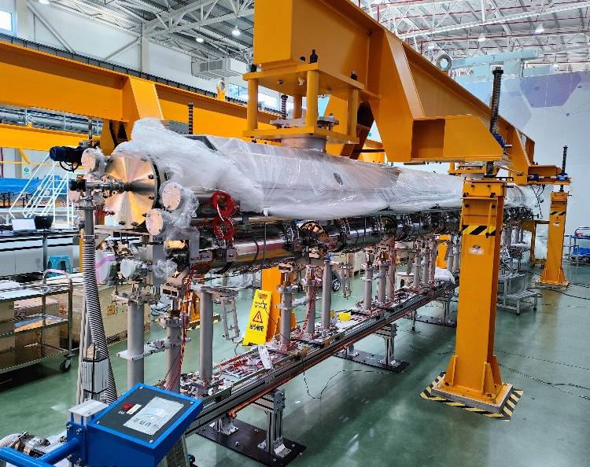
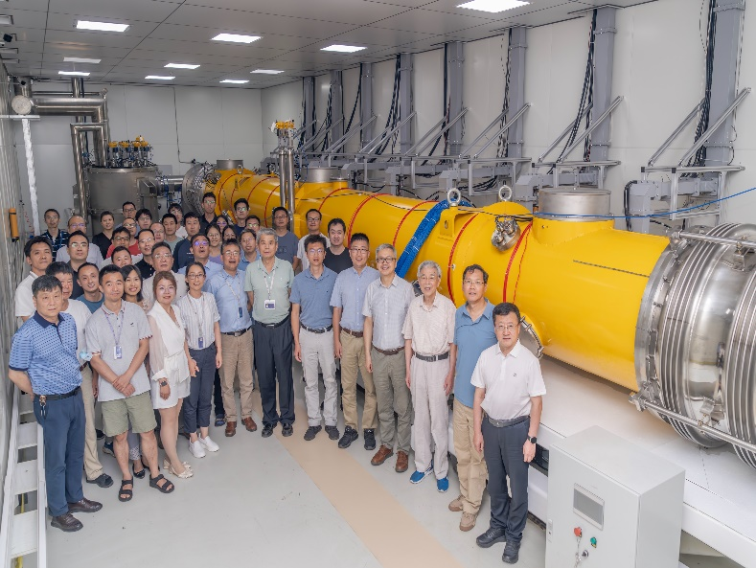
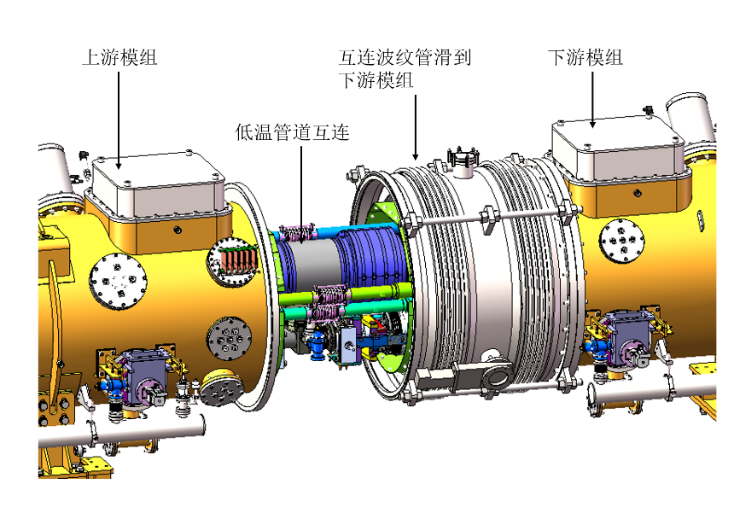
Cryomodule Series Production Chain
Dressed cavity
(8-12 per week)
Cavity vertical test
(4 per week)
Cavity string assembly
(1 per 2 weeks)
Cold mass assembly
(1 per 2 weeks)
Horizontal tests
(1 per 4 weeks)
Transportation
(1 per 2 weeks)
Tunnel installation
(1 per 2 weeks)
1
2
3
4
5
6
7
1
3
4
6
2
4
5
7

Slide 13
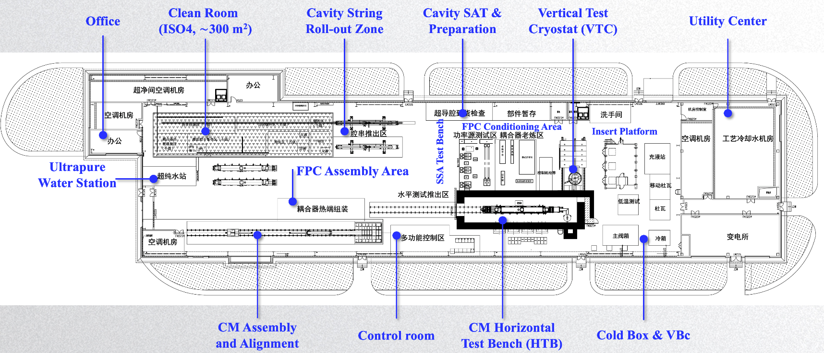
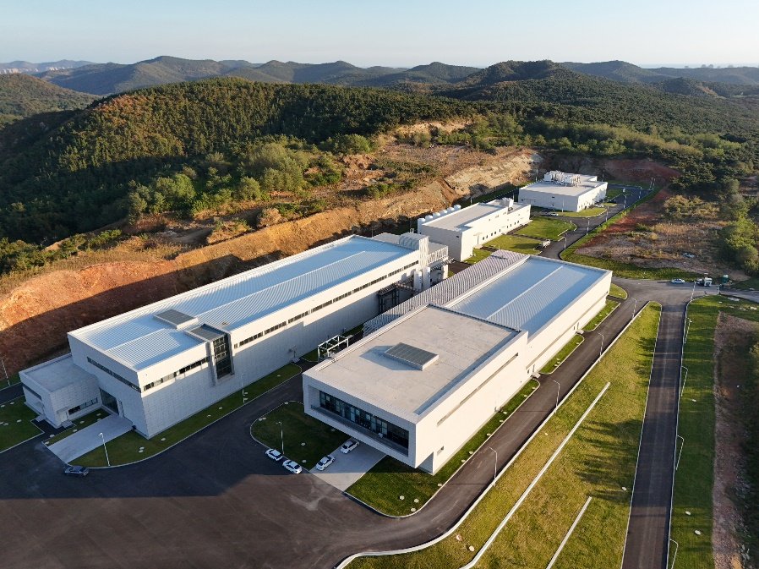
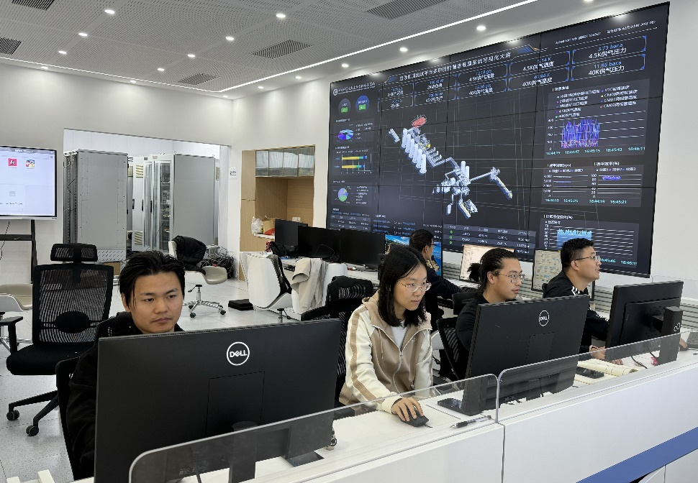
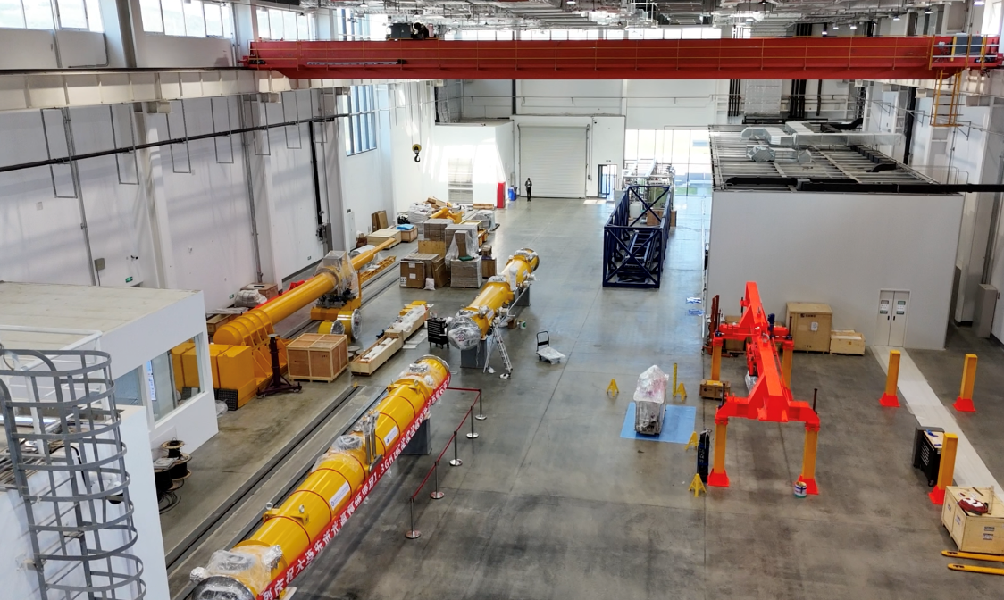
DALS Module Test Facility (DMTF)
Funded by Dalian local government and real project (2019-2024)
One Vertical Test Cryostat
One CM Test Bench
CMAI infrastructures
Clean Room (ISO4/Class 10, 250 m²)
Cryogenic System (370 W @ 2 K)
In operation since 2025

Slide 14
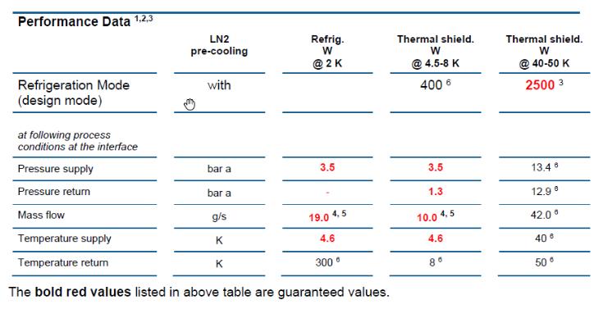
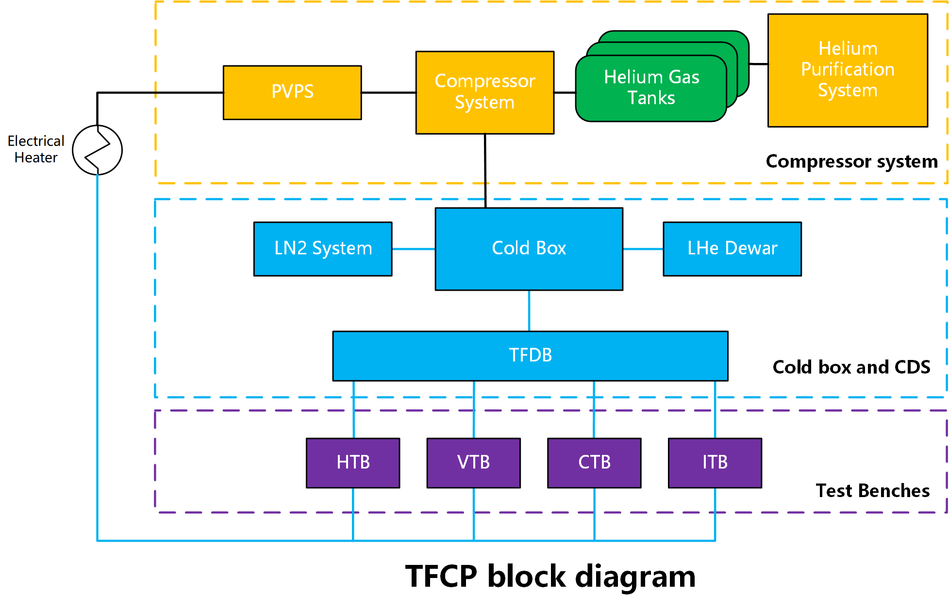
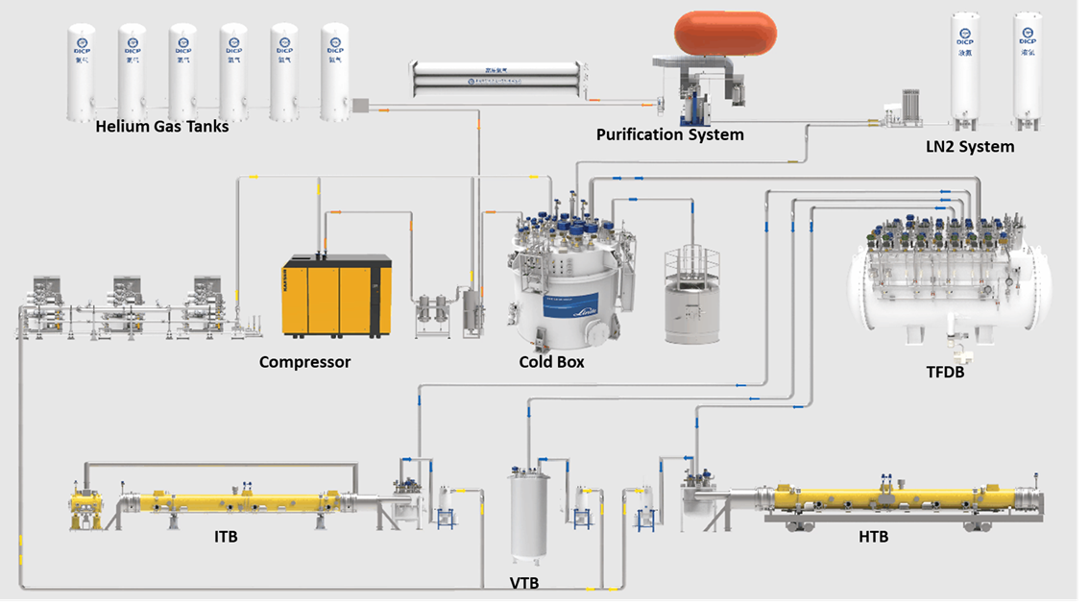
Test Facility CryoPlant (TFCP)
370 W @ 2 K, 400 W @ 5-8 K, 2500 W @ 40-80 K
Key design choices: PVPS for 2 K, LN₂ pre-cooling
FCD: More than 50 g/s @ 4.5 K, 3 bara
CD/WU of each test bench independent
LKT refrigerator, all the rest
in house design & domestic manufactured
In operation since 2025

Slide 15
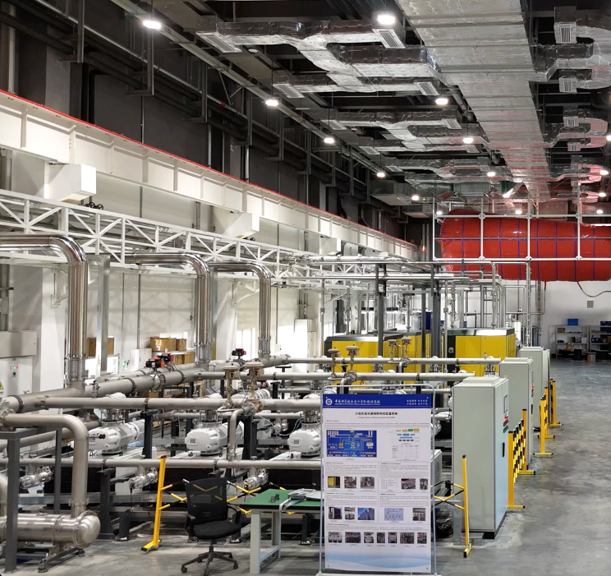
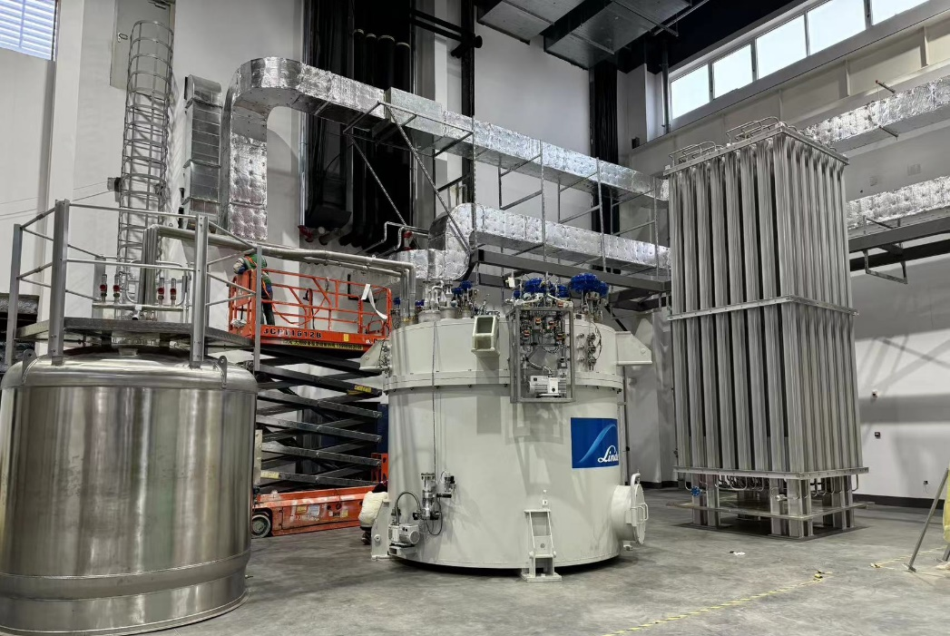
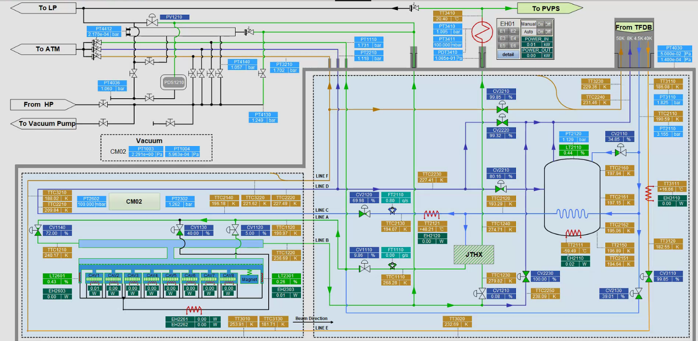
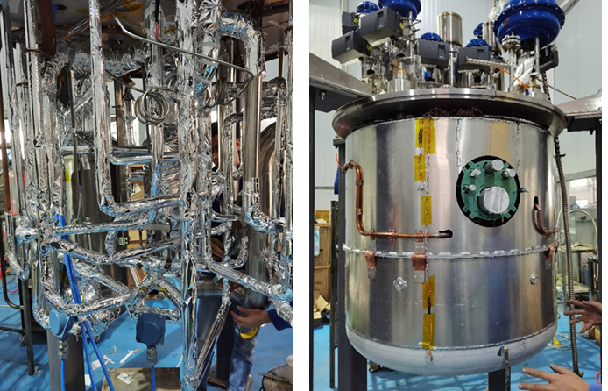
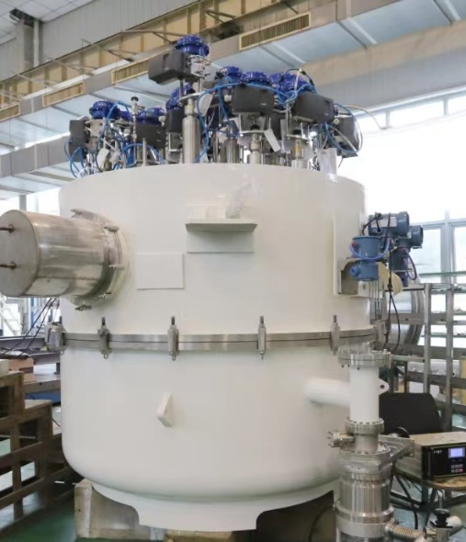
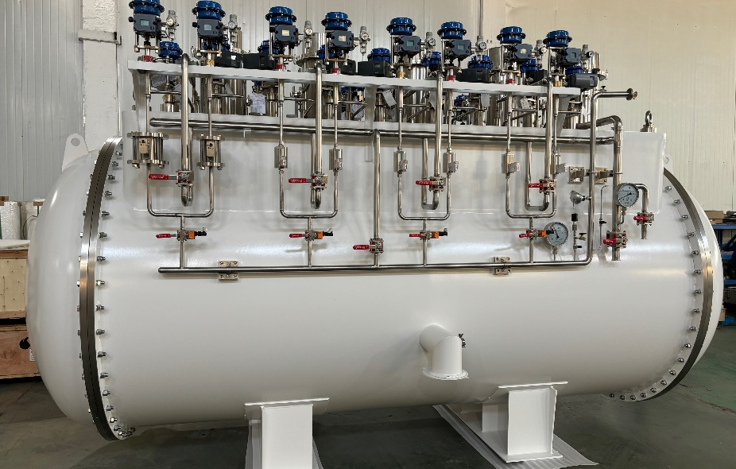
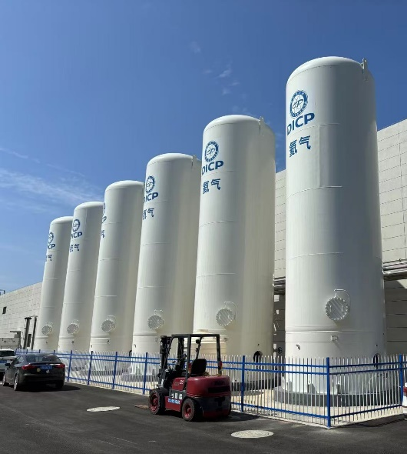
Test Facility CryoPlant (TFCP)
In operation since 2025

Slide 16

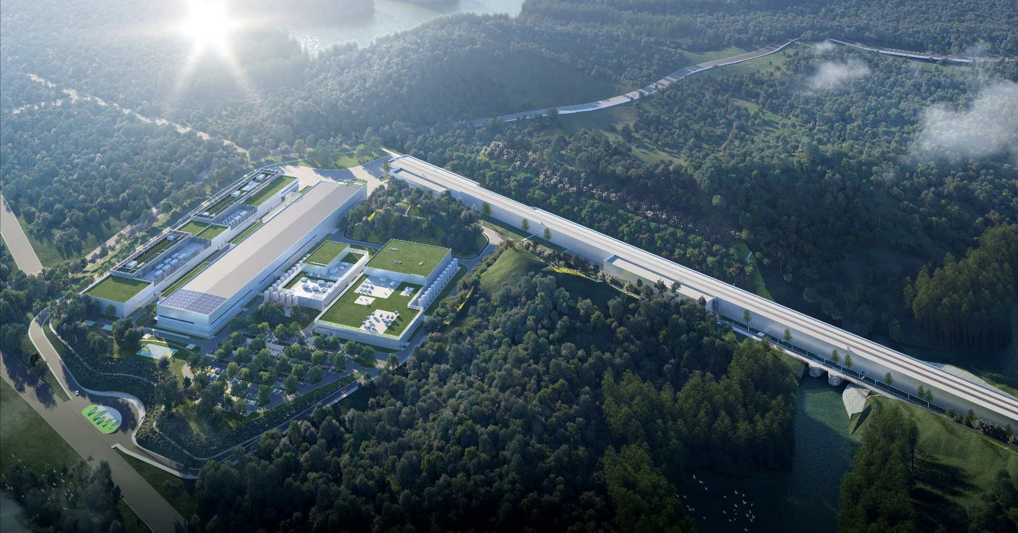
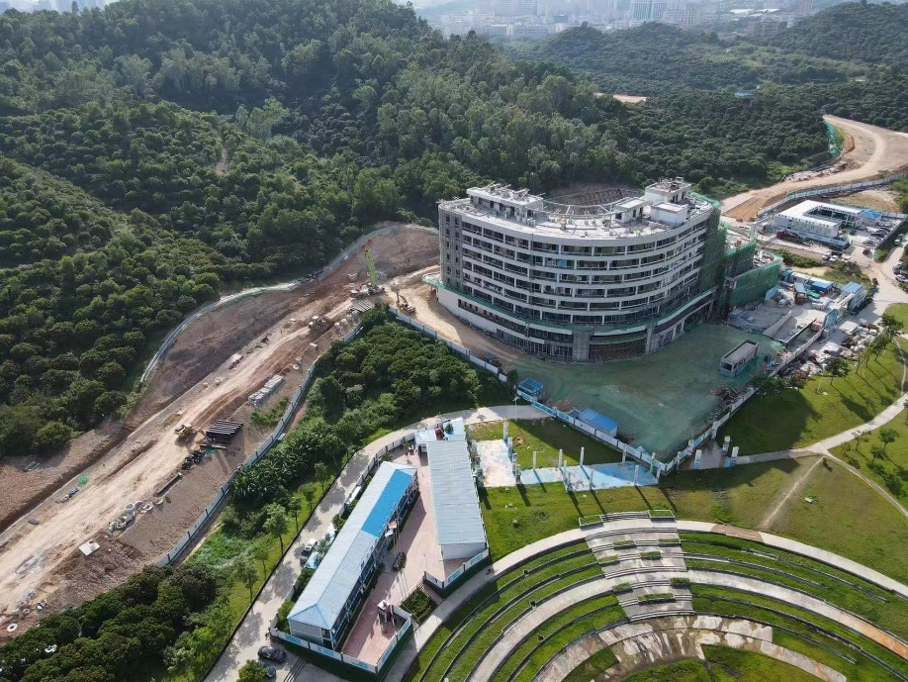
Institute of Advanced Science Facilities, Shenzhen (IASF) established in Sept 2020
Two large-scale science facilities’ whole life cycle planning, construction, operation & maintenance
Shenzhen Superconducting Soft X-ray Free Electron Laser (S³FEL)
Approved and fully funded by Shenzhen local government
Primary schedule:2026-2031

Slide 17
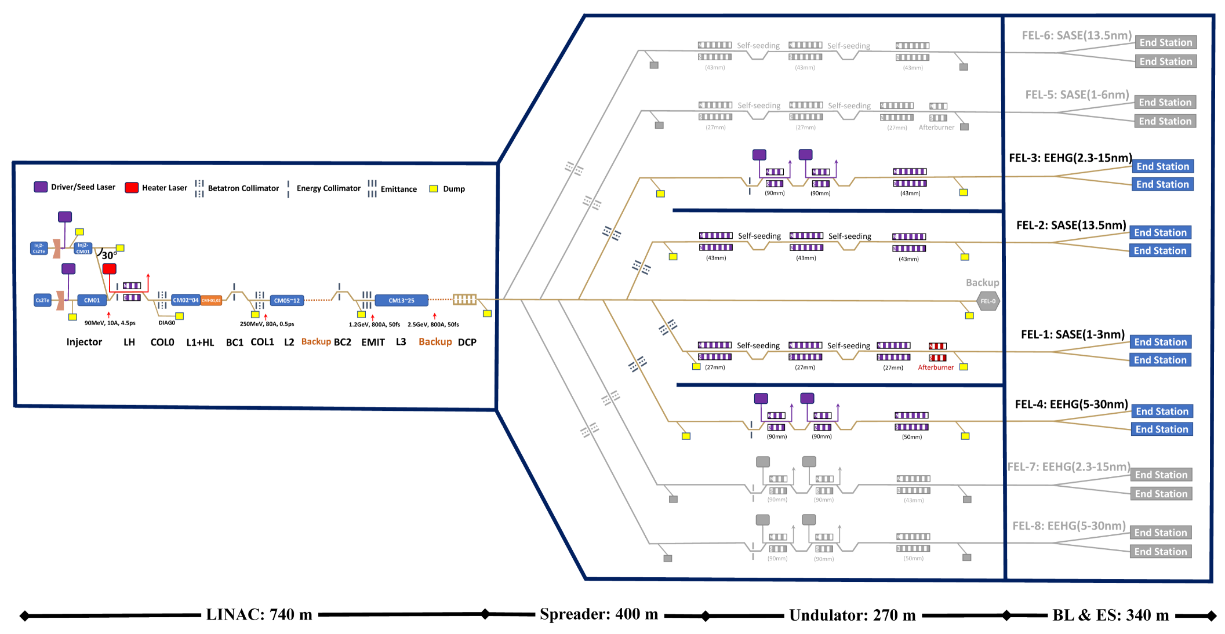
Shenzhen Superconducting Soft X-Ray FEL (S³FEL)
2.5 GeV CW SRF accelerator
Charge/pC: 100
Emittance/mm-mrad: 0.5
Injectors
SRF LINAC
Beam lines
Repetition rate/MHz: 1
FEL wavelength/nm: 1-30
~300 SRF cavities, 28 CMs

Slide 18
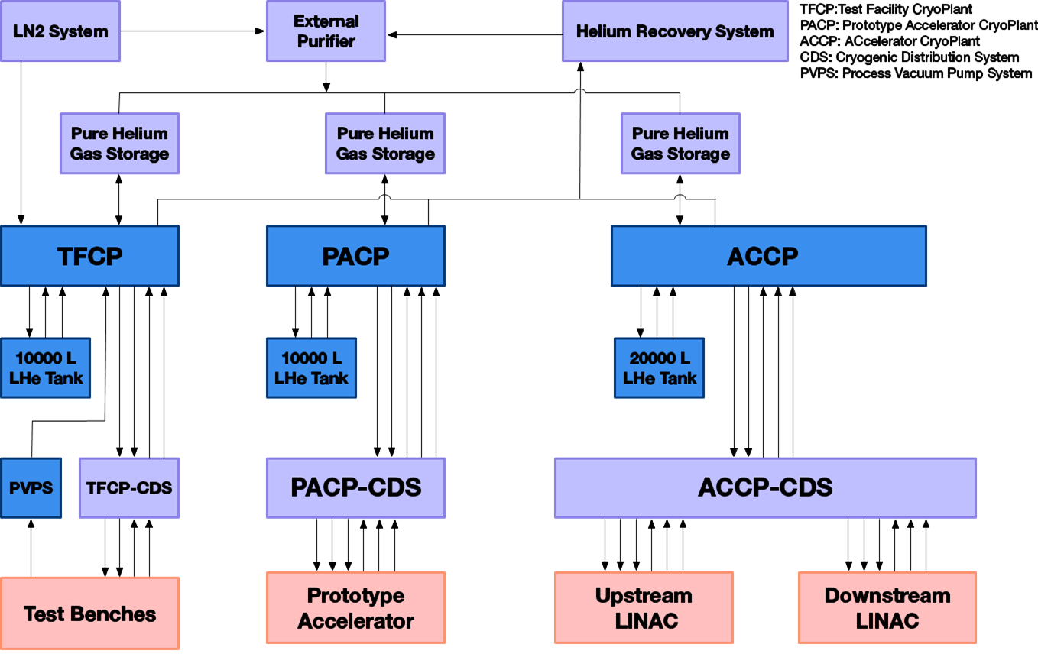
S³FEL Cryogenic System

Slide 19
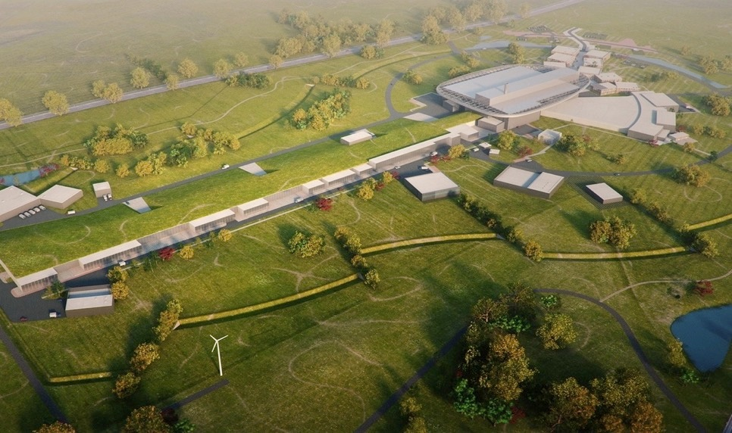
European Spallation Source (ESS)
Target Station
5MW average power
42 beam ports
SRF Accelerator
Energy: 2 GeV
Rep. Rate: 14 Hz
Current: 62.5 mA
16 Instruments in Construction budget
Committed to deliver 22 instruments by 2028
Ion Source
Total cost: 1843 MEuros ₂₀₁₃
http://europeanspallationsource.se/

Slide 20
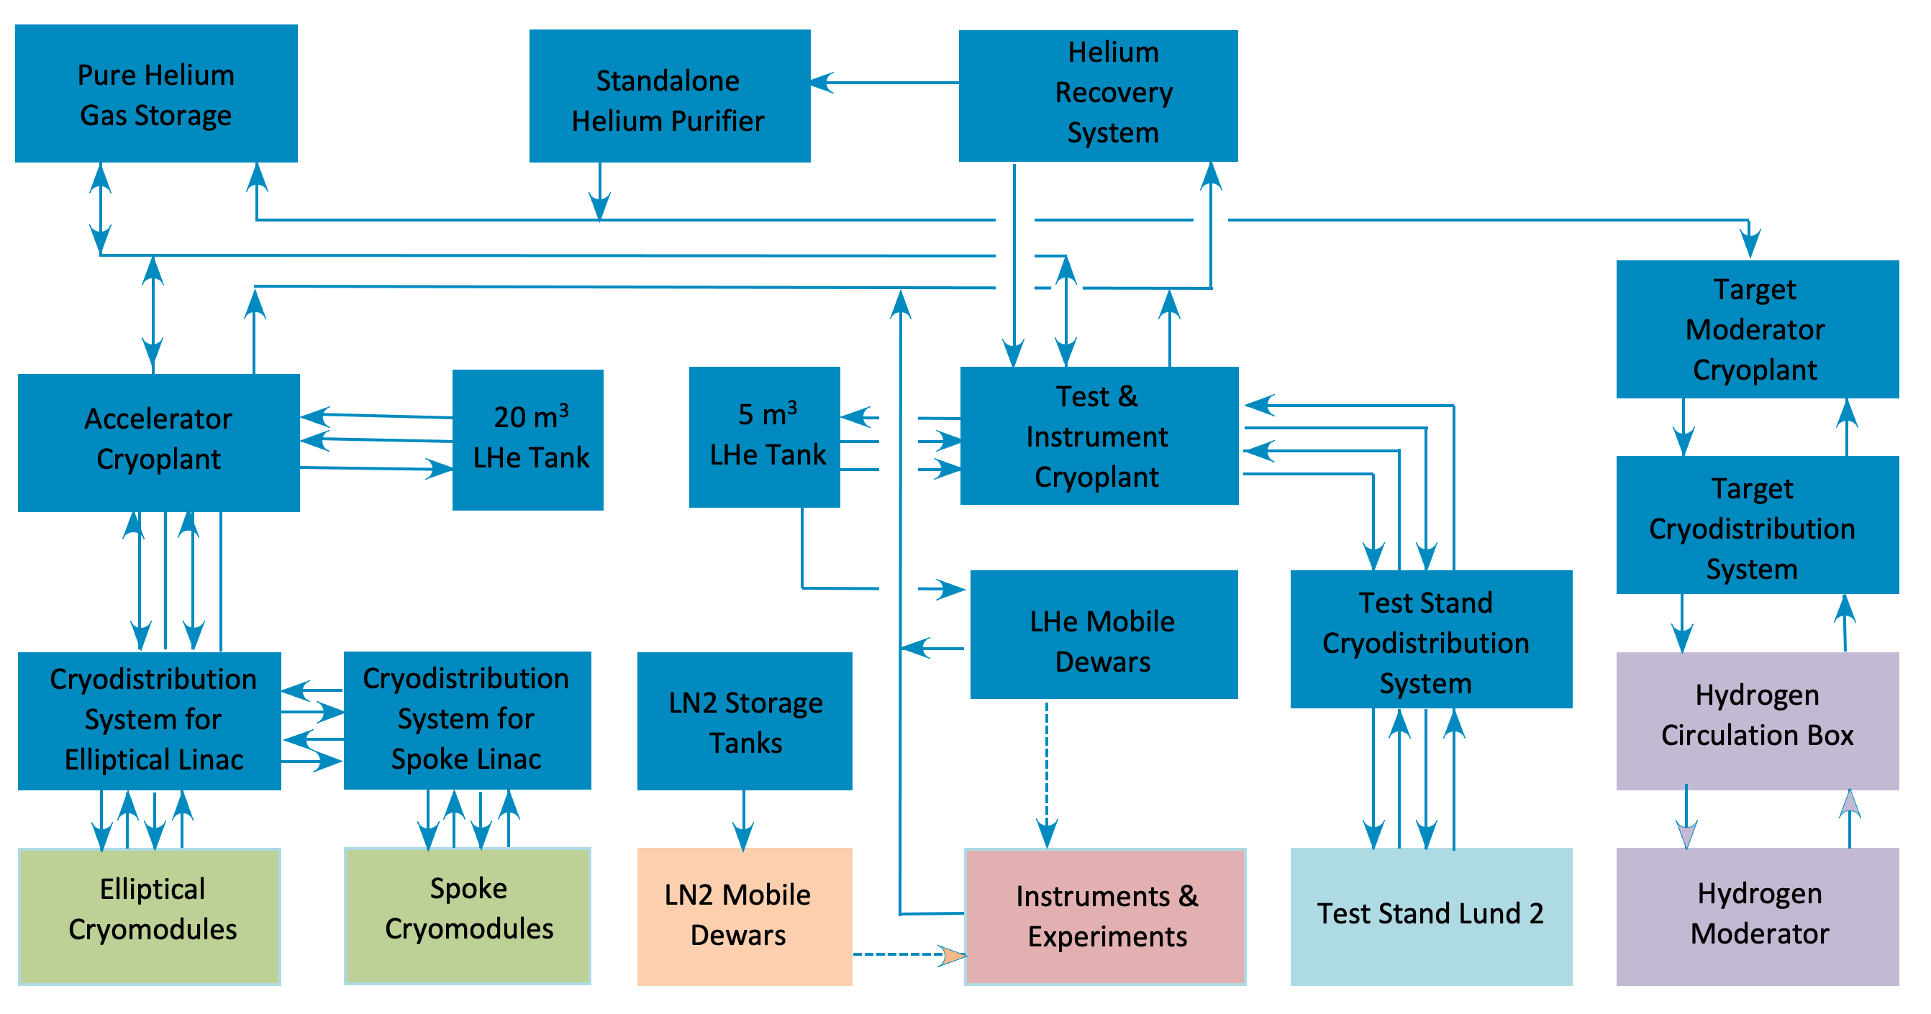
ESS Cryogenic System Overview

Slide 21
ESS Accelerator Cryoplant (ACCP)
Performance & Process
Three warm compressors, six turbines, three cold compressors and several bunches of plate fin heat exchangers
Mixed compression cycle at 2 K plus helium guard system for SP compressor
Capacity control
  Floating pressure cycle for HP compressor
  VFD for SP, LP compressors and CCs
  Exchange of CCs flow parts
All built-in acceptance test equipment
Energy recovery
20

Slide 22
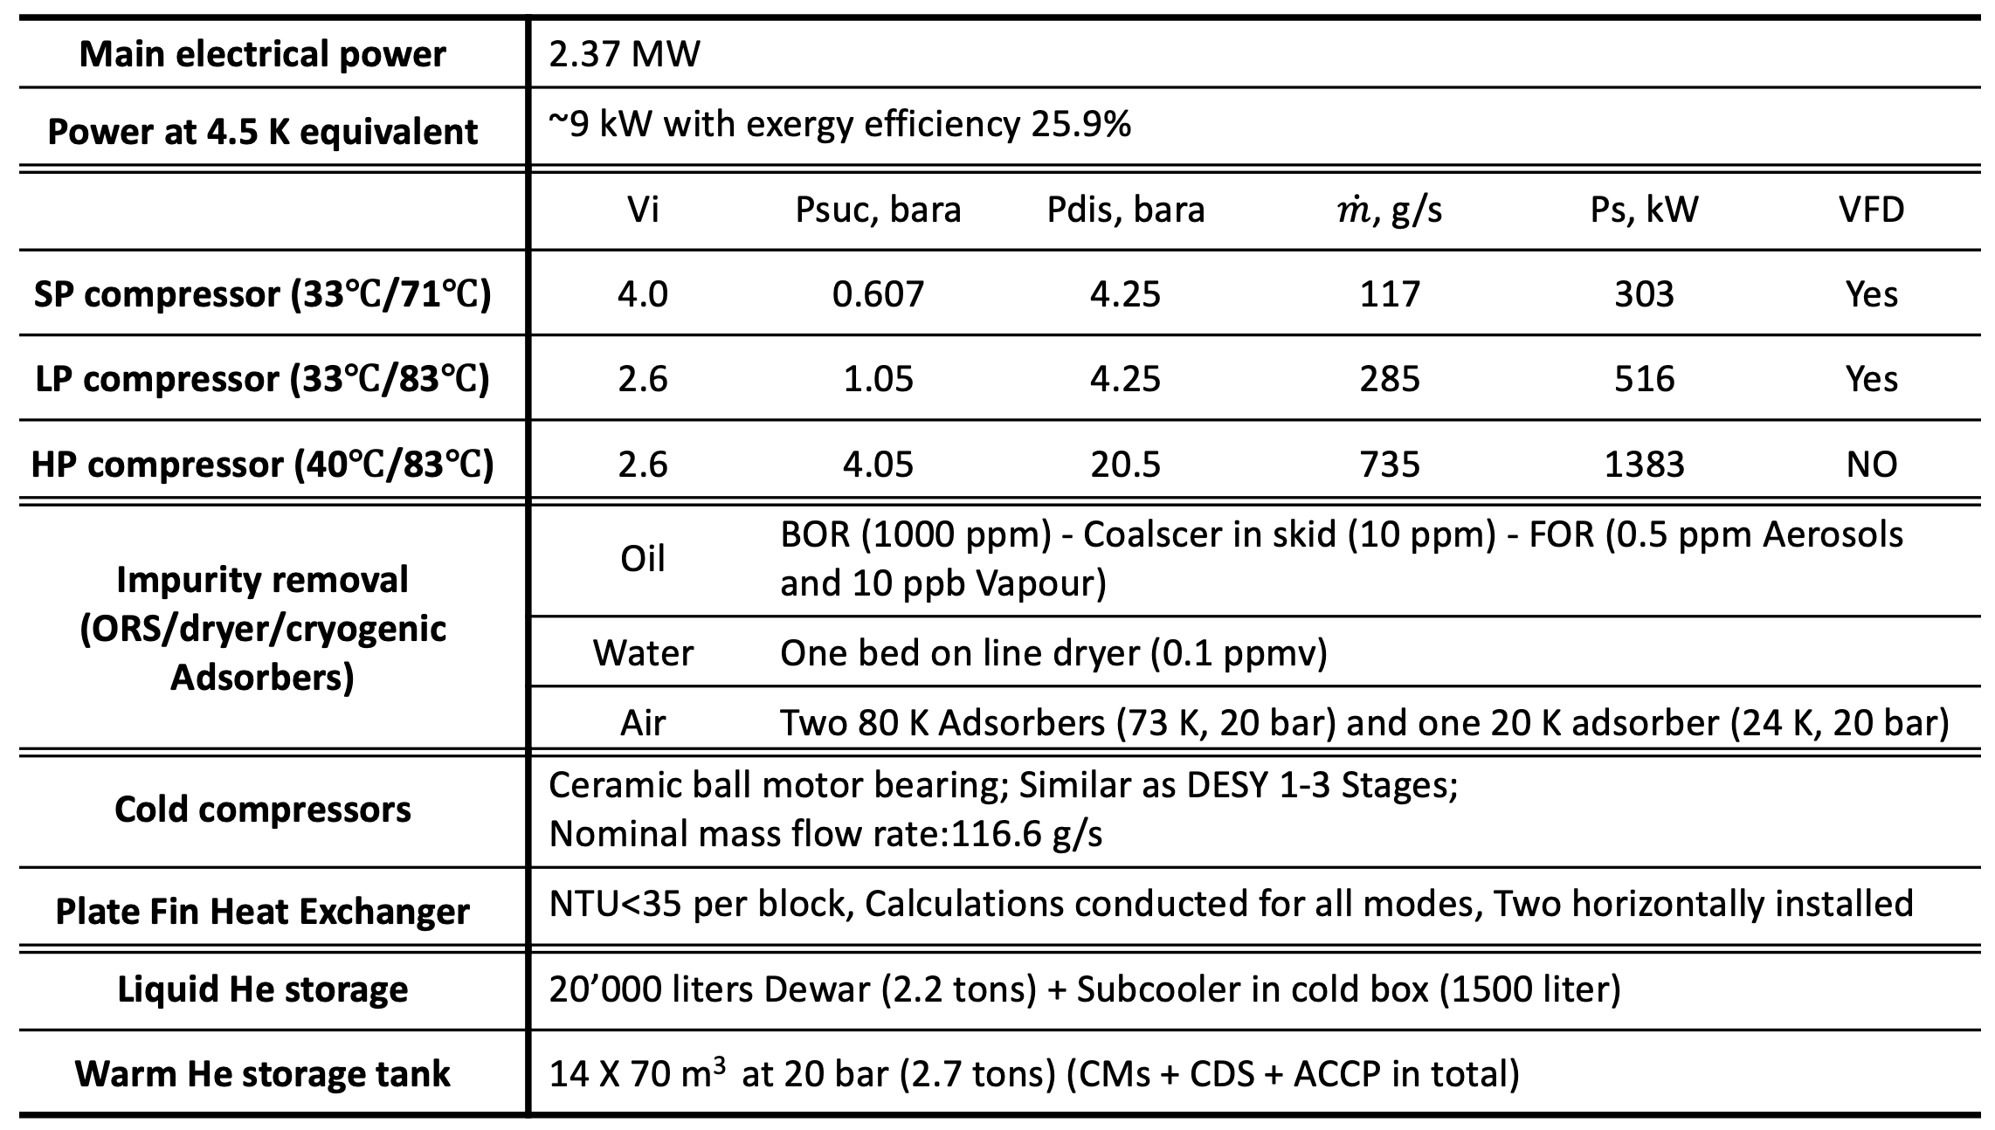
ESS Accelerator Cryoplant (ACCP)
System Parameters

Slide 23
ESS Accelerator Cryoplant (ACCP)
Exergy Efficiencies at various operation modes of two stages
Flow parts exchange
Warm compressor control
Floating pressure cycle
VFDs for SP&LP and CCs
VFDs for SP&LP
Only HP and T3 in operation

Slide 24
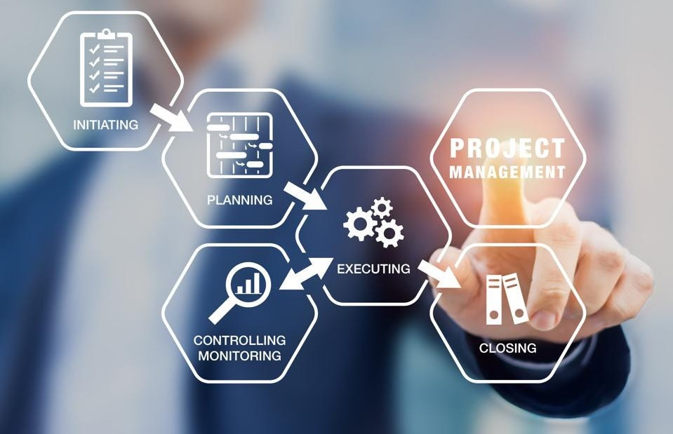

Project Management
Project management is the practice of using knowledge, skills, tools, and techniques to complete a series of tasks to deliver value and achieve a desired outcome
Stay Organised. The biggest benefit…
Stay Disciplined. ...
Learn to Coordinate and Plan. ...
Learn to Work with Different People. ...
Learn to Solve Problems and deal with Challenges
Plan a vacation or Party, Starting a hobby, buy a new car, search for a new career…
Life is a project!

Slide 25
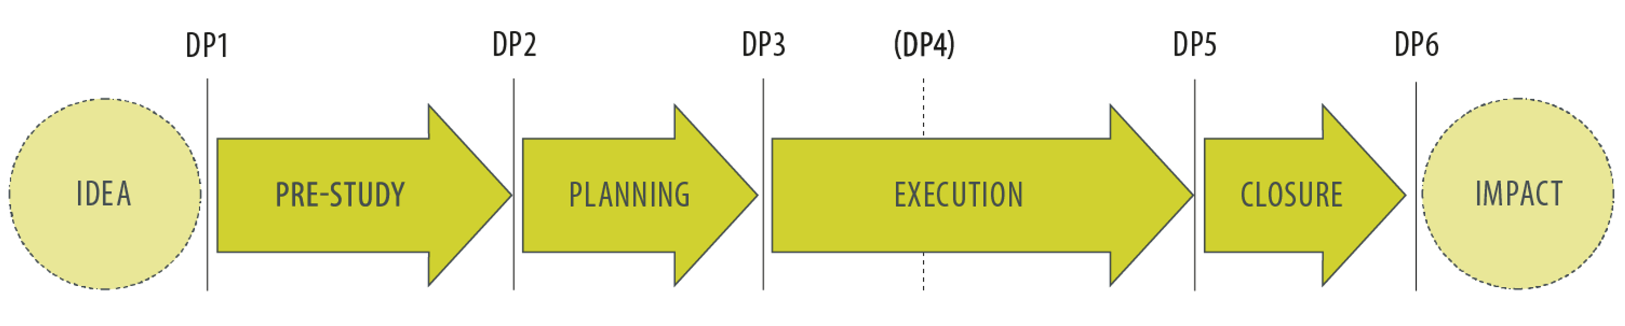
Project Lifecycle
Pre-Study
Planning
Execution
Closure
Decrease uncertainties
Document requirements
Define the scope
Select a solution
Select a method
Draw up a plan
Define the activities
Organize the resource
Calculate the cost
Handle the risk
Create and hand over the results
Follow up the activities and costs
Deliveries
Evaluate the project
Take advantage of lessons learned

Slide 26
Typical projects in a large-scale cryogenic system
Helium Refrigerator (WCS, Cold box & LHe Storage Tank)
Cryogenic Distribution System (Valve Boxes and Cryogenic Transfer Lines)
Recovery and Purification System (External purifier, Recovery Compressor, Gas Bag, etc.)
Pure Helium tank (PHS)
Interconnection piping
Control System
Instruments (Temperature Sensors, Flow Meters, Level Meters, etc.)
Cryomodules

Slide 27
ACCP as a project
From a project management point of view
Pre-Study
Planning
Execution
Closure
Visiting
Schedule & Timing
Meeting & Reviews
Documentation
Demand Investigation
Staffing
Intermediate inspection
Lessons learnt
Performance
Budget
Delivery
Staging & operation modes
Others
Installation
Scope
Technical specification
Industry study
Call for tender
Commissioning

Slide 28
Pre-study-Visiting
Name | Machine Type | Lab | Capacity | Comments
LHC | Accelerator | CERN | 2.4 kW @ 1.8 K 0.3 kW @ 4.5 K 33 kW @ 50-75 K | 8 plants 18 kW @ 4.5 K Eqiv. 3CC+SP compressor (ALAT) 4CC+SP compressor (LKT/IHI)
XFEL | Accelerator | DESY | 2.4 kW @ 2 K 4.0 kW @ 5-8 K 30 kW @ 40-80 K | Two HERA plants: 12 kW @ 4.5 K Eqiv. Upgrade to: 8 kW @ 4.5 K Eqiv. Each 4CC to LP
AMTF | Accelerator | DESY | 0.8 kW @ 2 K 0.5 kW @ 5-8 K 3 kW @ 40-80 K | Vacuum pump
CMTF | Accelerator | FERMI | 0.5 kW @ 2 K 0.6 kW @ 5-8 K 5 kW @ 40-80 K | 3CC + SP compressor/Pumps
SNS | Accelerator | ORNL | 2.4 kW @ 2.1 K 15 g/s @ 4.5 K liq. 8.3 kW @ 35 K | 4CCs to LP
CEBAF II | Accelerator | JLAB | 4.6 kW @ 2.1 K 10 g/s @ 4.5 K liq. 12 kW @ 35 K | Two plants 5CC to LP
W-7X | Stellarator | IPP | 3 kW @ 3.4 K 25 g/s @ 4.5 K liq. 14 kW @ 80 K | Two cold circulators
FAIR | Accelerator | GSI | 35 kW @ 4.5 K 33 g/s @ 4.5 K liq. 24 kW @ 50 K | 40 kW @ 4.5 K Eqiv. Magnets
KSTAR | Tokamak | NFRI | 5.3 kW @ 4.3 K 17 g/s @ 4.5 K liq. 270 g/s @ 50-70 K | 9 kW @ 4.5 K Eqiv. Two cold circulators Magnets
Big science facility community encourages free and open exchange of scientific knowledge & expertise
Take any possible chances to visit similar projects/Labs and Vendors: Lab visiting, Conferences, Workshop, etc.
Discuss overview, design consideration, technical issues, challenges, experiences and lesson learned with a short meeting in person and a site visit
Pay particular attention to:
History/Background (CERN, DESY)
Specific application (PVPS)
Machine type (LN₂ pro-cooling)
Make summary and make friends
You can never get your experience only from paper and reading!

Slide 29
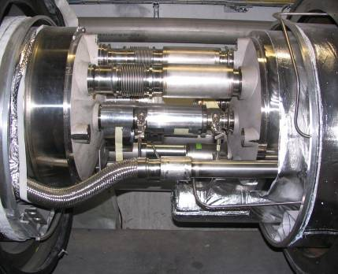


Pre-study-Visiting
CERN: The Sector 3-4 incident (just before the 1st ramp)
19th September 2008 at 11:18.36
last test of the last sector: 7kA (4TeV) towards 9.3 kA (5TeV)
Electrical arc at 8.7 kA in the interconnection
Rupture of bellows, expansion of liquid Helium with MLI debris

Slide 30

Pre-study-Visiting
2009 - overall repair and consolidation

Slide 31

Pre-study-Visiting
The Higgs particle was discovered on 4th July 2012
Peter W. Higgs & Francois Englert: 2013 Noble price

Slide 32


Pre-study- Demand investigation
ESS LINAC Layout
ESS ACCP Block-Diagram

Slide 33


Pre-study- Demand investigation
CNRS-IN2P3, SLHIP4, 2014
Customer/user first: Cryomodules + Cryogenic Distribution System (CDS)
CM temperature levels: cavities@2 K, thermal Shield@ 40-50 K, couplers @ 4.5-300 K
Optimus design:13 Spoke CMs + 9 MBCMs + 21 HBCMs, Contingency: additional 14 HBCMs
CDS: Cryogenic transfer line, one valve box for each CM with a jumper connection
Collect CM&CDS information as much & accuracy as possible (mass, volume, helium inventory)

Slide 34


Pre-study- Performances
ESS LINAC Layout
  Heat loads
    3 kW @ 2 K
    9 g/s @ 4.5 K
    11380 W @ 40-50 K
  Continuous Operation
    24 h per day / 7 days per week
    2 years without scheduled shut-down
Safety factors
  Availability
    > 99 % not count utilities & process control

Slide 35

Pre-study- Staging & Operation Modes
  Stage 1 (2019-2023) and Stage 2 (2023-…)
  Operation Modes：
    Nominal Design (Beam on)
    Turn Down (Beam off)
    4.5 K Standby (Maintenance)
    40 K standby (Summer break)
    Max. Liq. Mode (Don’t forget)
    Transition modes (CD/WU, Purge, etc.)
Report on ESS operation (Dec 2012)

Slide 36


Pre-study- Performances
Maximum design capacity
Turndown: ~60 % within one stage
Current state of the art
Max. turndown: ~45 % , even lower

Slide 37

Pre-study- Scope

Slide 38
Pre-study- Industry Study
  Design Choices
    Process, Machine, LN₂ cooling, heat recovery, control, Efficiency, etc.
  Layout and footprint
  Utility requirements: Electricals, CW, IA and HVAC
  Schedule:
    Proposal, Design, Manufacture, Delivery, Installation & Commissioning
Laydown and staging area for installation
Preventive maintenance plan
Spare parts and redundancy (hot spare)
Interfaces
Budget
…

Slide 39

Planning – Schedule & Timing
  One year specification (Draft, External review, Internal procurement procedure)
  Half year procurement (Proposal preparation, Evaluation, complain of tenderers)
  Four years execution (Design, manufacture, installation and commissioning)
ESS ACCP project real schedule
  Delayed in total of 14 months
  LKT takes ~10 months
  ESS takes ~4 months

Slide 40
Planning – Staffing
External
Internal
ESS Project manager
CDS
Utilities (CW, IA, Electricals, HVAC)
Control
LKT Project manager
Safety
QA/QC
RAMI
CMs
Piping
CF
PPS/ODH
Alignment
  Process
  Mechanics/Designer
  Control & Instruments
  Vacuum
  Conventional Facilities

Slide 41
Planning – Budget
Start of contract: 5%
Preliminary Design Review 1 (order WCS, PFHX): 20%
Preliminary Design Review 2 (order Vessel, Turbines, CC, CV): 15%
Detail Design Review 1 (Start CBX fabrication): 25%
LDR & Detail Design Review 2: 5%
Delivery of WCS: 10%
Delivery of CBX: 10%
Provisional Acceptance Certificate: 10%

Slide 42
Planning – Others
  Control strategy and architecture/infrastructure
  PED and Work environment authority
    ASME, EN13445, AD2000, Safety valve inspection
  Quality assurance and control
    Notify body (third party), Vendor internal QA/QC and Lab QA/QC
  Naming convention
  Date management system (CHESS, confluence, JIRA)
  Documentation
  …

Slide 43
Planning – Technical Specification
Codes and Norms
Site condition / Utility interfaces
Performance
Key component (WCS and Cold box)
Spare parts
Control
Instrumentation, interlocks and electrical design
Requirements on mechanical design, manufacture and mounting
Test
Quality management
Documentation

Slide 44
Planning – Call for tenders
Tender documents (2014-06-16)
Tender Evaluation
ACCP – A01 Tender Management (2 pages)
CAPEX: Price, 30%
ACCP – A02 Company Qualification (7 pages)
OPEX: Power Consumption, 30%
ACCP – A03 Instruction to Bidders (7 pages)
Qualitative: Almost equal, 40%
ACCP – A04 Statement of Work (23 pages)
ACCP – A05 Technical Specification (117 pages)
Award recommendation
ACCP – A06 Evaluation Criteria (5 pages)
ACCP – A07 Draft Supply Agreement (27 pages)
Contract signed in March 2015
ACCP – A08 General Conditions of Tender (4 pages)

Slide 45
Execution – Meeting & Reviews
Mar 2015
  Contract signed
Jan 2016
  FMEA
May 2015
  KOM
Mar 2016
  CDR-1
Aug 2015
  PDR-1
June 2016
  IDR
Oct 2015
  HAZOP
Aug 2016
  LDR
Nov 2015
  PDR-2
Sept 2016
  CDR-2
Apr 2017
  IRR
July 2019
  SAT
Apr 2018
  WCS/CB start-up

Slide 46
Execution – Intermediate Inspection
Inspection and Test Plan (ITP)
External experts or consultants
Hold and Witness points
Factory Acceptance Test (FAT)
Apr 2016
  PFHE
Mar 2017
  Compressor skid leak test
Jun 2016
  Motors
May 2017
  Control loop check
Jul 2016
  Compressor
May 2017
  GMP & ORS & Dryer
Feb 2017
  Cold box internal
Jun 2017
  Dewar
Mar 2017
  Compressor skid functional
Mar 2018
  CB software tests

Slide 47





Execution – Delivery
Buildings: May 2017
Warm Tanks: Oct 2017
Warm piping: Dec 2017
Utilities: Last minute
HVAC
Crane
Cable
Warm piping

Slide 48



Execution – Delivery
Key components have been delivered starting from July 2017
Delivery Schedule, Lifting plan (Risk Analysis), Professional on-site team

Slide 49



Execution – Installation
Scope and Sequence
Interconnecting piping installation (CB-WCS)
Grouting compressor skids
Equipment placement and installation
Platform installation
WCS/CB hall piping installation
Mechanics verification tests (NDT, PT, LT)
Electrical installation (Cabling, wiring, earthing)
Electrical verification tests (loop check, test protocols)
Final documentation

Slide 50




Execution – Installation
Ready at May 2018 – at least half year behind the schedule

Slide 51




Execution – Installation
How we work
Area Supervisor
WSCP/Work Order
Certificate and training
  Hot work
  Fall protection
  Forklift
  Crane
  First aid
Work Safety

Slide 52


Execution – Installation
Lessons learned
Parallel work & conflictions
  Framework with one company will help a lot and P&DP request
Under-estimation of civil engineering
  Foundation, grouting, holes, etc.
Key equipment failure, damage, repair & replacement
  See an example next slides
Two months delay
On site quality control and inspection
  Well experienced staff and sound engineering sense
Leak searching and fixation
Design drawbacks or mistakes
Missing pressure and T sensors, isolating valves
Reserve enough margin in your schedule

Slide 53




Execution – Installation
Lessons learned-Key equipment failure and replacement
Two oil coolers corrosions / replacement (At least six months delay)

Slide 54



Execution – Installation
Lessons learned-On site inspection
Flexible
Fixed
Flexible
Fixed

Slide 55



Execution – Installation
Lessons learned-Leak searching and fixation
Leak here!

Slide 56




Execution – Installation
At least but not limited to…
Noise protection (Sound hoods)
Double safety valves
Safety valve re-calibration
WCS and CB platforms
Wiring tagging in cabinets
Escape way for fire safety
  900 mm in Sweden regulation
Piping interfaces
  In-house design will be a good solution

Slide 57
Execution – Commissioning
Design
Design
Mass flow and power consumption is fulfilled
Both isothermal and volumetric efficiencies much better than the design
Impurities keep constant during tests (N₂: 15 vpm, H₂O: 5 vpm)
Vibration less than 3 mm/s (Design: 10 mm/s)
Integrated noise level: 90 dB (A) (unofficial value, Design: 110 dB (A) each compressor)

Slide 58
Execution – Commissioning

Slide 59
Closure
Prepare your staff as early as possible
Make the interfaces as simply as possible
Framework with one installation company
Piping in-house design
Bring Helium recovery system on line early
Make your utilities available as early as possible
Start the commissioning as early as possible
Reserve enough margin in your schedule

Slide 60
  Team spirit
  Stay hungry
  Stay foolish
  No details too small

Slide 61
References
Project management, Bo Tonnquist, third edition, www.sanomautbildning.se/project
The European Spallation Source Design, Roland Garoby et al 2018 Phys. Scr. 93 014001
ESS Technical Design Report, April 23, 2013, ESS-doc-274, http://eval.esss.lu.se/cgibin/public/DocDB/ShowDocument?docid=274 , ISBN 978-91-980173-2-8
Accelerator Cryoplant (ACCP) Status at European Spallation Source ERIC, Xilong Wang, Philipp Arnold, John Weisend II, Cryo-Ops 2018, Beijing, China
Commissioning of the Warm Compressor System for the ESS Accelerator Cryoplant , X L Wang, R Wischhoefer, P Selva, P Nilsson, J Råström, R Goncalves, M Olsson and P Arnold, IOP Conf. Series: Materials Science and Engineering 755 (2020) 012087 doi:10.1088/1757-899X/755/1/012087
Xilong Wang, Philipp Arnold, Wolfgang Hees, J Hildenbeutel, JG Weisend II, ESS accelerator cryoplant process design, IOP Conference Series: Materials Science and Engineering 101 (2015) 012012
Xilong Wang, Philipp Arnold, JaroslawFydrych, Wolfgang Hees, John M Jurns, Daniel Piso, John Weisend, Specification of the ESS accelerator cryoplant, Physics Procedia 67 (2015), 89-94
Xilong Wang, J.G. Weisend II, T. Koettig, W. Hees, C. Darve, ESS accelerator cryoplant, HVAC&R Reseach (2014) 20, 1-6
X. L. Wang, S. Barbanotti, J. Esche, K. Jensch, R. Klos, W. Maschmann, B. Petersen, O. Sawlanski, Thermal performance analysis and measurements of the prototype cryomodule of European XFEL accelerator – Part I, Nuclear Instruments and Methods in Physics Research A 763 (2014) 701-710
X. L. Wang, S. Barbanotti, J. Esche, K. Jensch, R. Klos, W. Maschmann, B. Petersen, O. Sawlanski, Thermal performance analysis and measurements of the prototype cryomodule of European XFEL accelerator – Part II, Nuclear Instruments and Methods in Physics Research A 763 (2014) 688-700
Wolfgang Hees, P Arnold, J Fydrych, H Spoelstra, XL Wang, JG Weisend II, The ESS cryomodule test stand, Physics Procedia 67 (2015), 791-795
J Fydrych, P Arnold, W Hees, P Tereszkowski, XL Wang, JG Weisend II, Cryogenic distribution system for the ESS superconducting proton linac, Physics Procedia 67 (2015) 828-833
Commissioning of the Large-Scale 2 K Helium Refrigeration System at ESS, J. Zhang, P. Arnold, N. Kolev & A. Rueegge, CEC28-ICMC 2022: Proceedings of the 28th International Cryogenic Engineering Conference and International Cryogenic Materials Conference 2022 pp 101–108
The real “life” of operation, Vacuum for Particle Accelerators, Glumslov, Sweden, V. Baglin, 6 - 16 June, 2017

Slide 62
References

Slide 63


