Slide 1


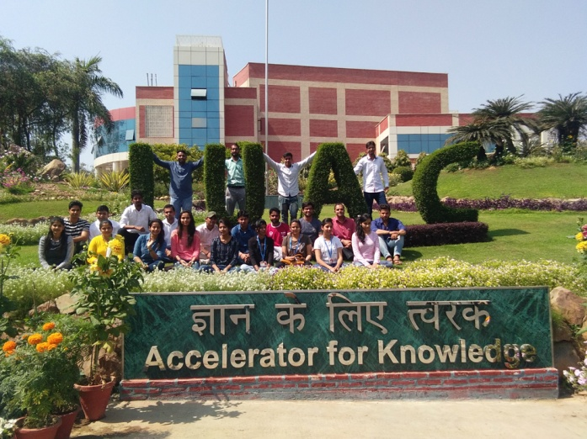

Cryogenics : How to Achieve Low Temperature and Production of Cryogen : Process Cycle/ Thermodynamics
T S Datta (Retired From )
Indian Institute of Technology. Kharagpur. India
&
Inter University Accelerator Centre. Delhi

Slide 2
Outline of my Lectures
Introduction on Cryogenics
How to Produce Cryogen
    Thermodynamic Process ( Carnot )
    Liquefaction Cycle
    Performance of Cycle
Practical Helium Liquefier/ Refrigerator
    How far from theoretical Cycle
    Components
4. Properties of Material at Cryogenic Temperature
( If Time Permits ): Most Probably No

Slide 3
Temperature Scale
6000K
Sun
373K
Water Boils
Lowest Temp:
500 pico K
300K
Room Temp
273K
Ice
263K
SO2 -liquid
Why?
240K
NH3- liquid
120K
Cryogenics
boundary
111K
CH4 –liquid ( LNG)
90K
LOX -liquid Oxygen
Cryogenic
Temperature
range
77K
LN2 -liquid Nitrogen
20K
LH2 -liquid Hydrogen
4.2K
LHe -liquid Helium
2.1K
Superfluid Helium
0 K - Absolute Zero

Slide 4
Cryogenics
DIRECT
Indirect Through Superconductivity
LNG
Gas Separation
Power Application ( Cable, Motor, SFCL)
Cooling of IR Detector,
80 K
Preservation ( Food, Blood, Stem Cell), Cryo Surgery
Space
20 K
4.2 K
MRI / NMR
Cryo Pump
Particle Accelerator

Slide 5
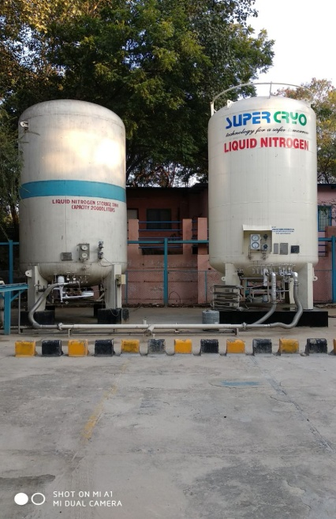
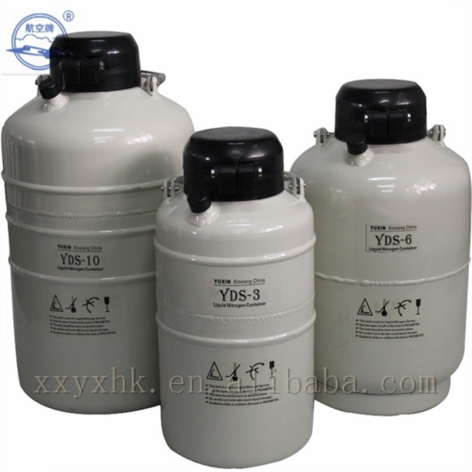
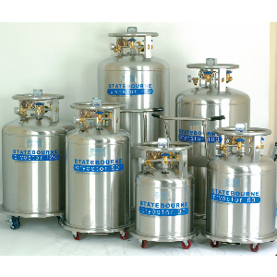
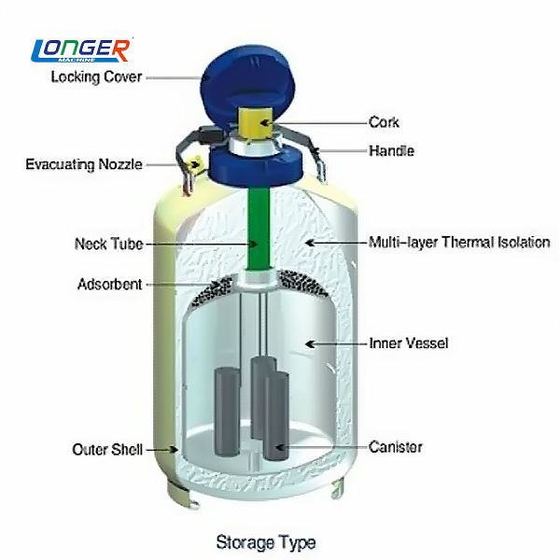
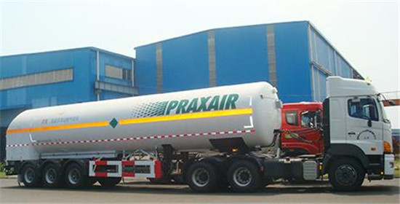
CRYOGEN STORAGE VESSEL
100- 500L Pressurized
Small container 10- 60 L
20,000 L Storage Vessel
at IUAC
Transport Vessel

Slide 6
WHY STORAGE IS SO CRITICAL ?
A. LOW LATENT HEAT ( L)
B. LARGE TEMPERATURE DIFFERENCE ( T_{r}- T_{b})
Property | He | N2 | Water
Boiling Point | 4.2K | 78K | 373K
Density | 0.12kg/liter | 0.81kg/liter | 1kg/litre
Heat of Vaporisation | 20KJ/ kg | 198 | 2250
Liquid evaporated on 100 W Heat input | 140 L/ hr | 2.2 L/hr | 0.16 L/hr
1 W HEAT LOAD EVAPORATES 34 LITRES LH_{e} / DAY
THANKS TO MLI ( MULTILAYER INSULATION TECHNOGY)
EVAPORATION RATE ONLY 1 LITRES/day in 100 Litres Vessel

Slide 7
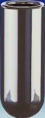
PERMENANT GASES
Earlier Laboratory techniques for reducing temperatures and Liquefaction
Liquefaction of gas at high pressure in a thick-walled glass tube surrounded by ice ( 273 K),
A rapid expansion of the vapor phase to atmospheric pressure through a valve.
The temperature of the remaining liquid phase then dropped to its NBP.
Ethylene, could be liquefied with a critical temperature of 282 K and a normal boiling point temperature of 169 K,
LPG
Liquid at High Pressure
Liquid at NBP
Methane, Nitrogen, hydrogen, Helium that could not be liquefied by this technique, even with pressures up to 40 MPa, were called “permanent”gases.
ICE
a) Isothermal Compression
b) Rapid Expansion

Slide 8
CRYOGENIC RANGE
T(boil)
T(critical)
P(critical)
SO₂ 263K 432K 79 Bar
Tc [SO2/NH3] > 273K ( ICE temp)
NH₃ 240K 405K 115 Bar
gas
Pressure
C₂H₄ 169 282 50
CH₄ 112 191K 46 Bar
liquid
O₂(LOX) 90K 155K 50 Bar
Permanent Gases
N₂ (LN2) 78K 126K 34Bar
Tc [N2/He] < 273 K (ICE Temp)
H₂ ( LH2) 20K 33K 13Bar
gas
He(LHe) 4.2K 5.2K 2.2 Bar
Whatever Pressure ?
LNG
&
LPG ??
No liquid
Permanent Gases
Hence they are called
Ar, N₂, O₂, Air, Ne, H₂ and He

Slide 9
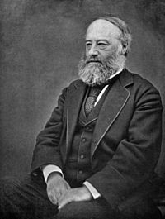
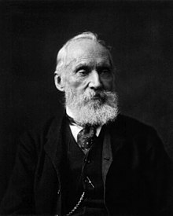
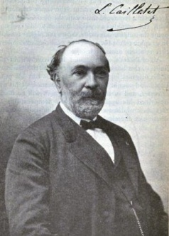
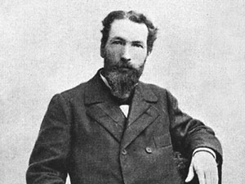
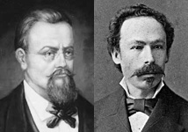
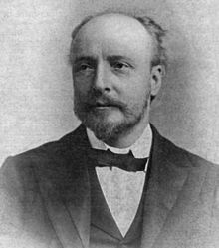
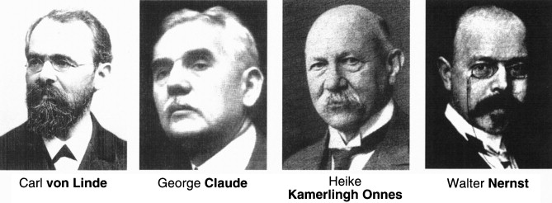
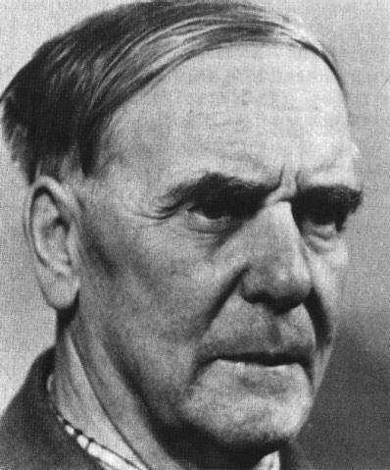
HISTORY ON LIQUEFACTION OF PERMANENT GASES
1852
JT Effect Discovered
James Joule
W. Thomson
1877- 1883
Oxygen / Nitrogen Liquefied
L. Cailletet
Pictet
1898
Wroblewski and Olszewski
Hydrogen Liquefied
James Dewar
1902
Expansion Engine for Air
July 10, 2008
Helium Liquefaction
1934
Helium Liquefaction with Claude Cycle
P. Kapitsa

Slide 10
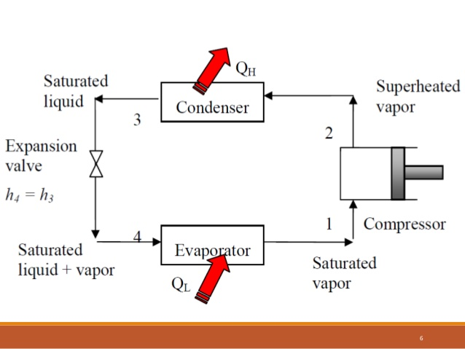
DOMESTIC REFRIGERATOR
We can not use similar principle for Cryogenic Refrigerator, because Critical Temperature of Cryogenic gases are much below Room Temperature

Slide 11
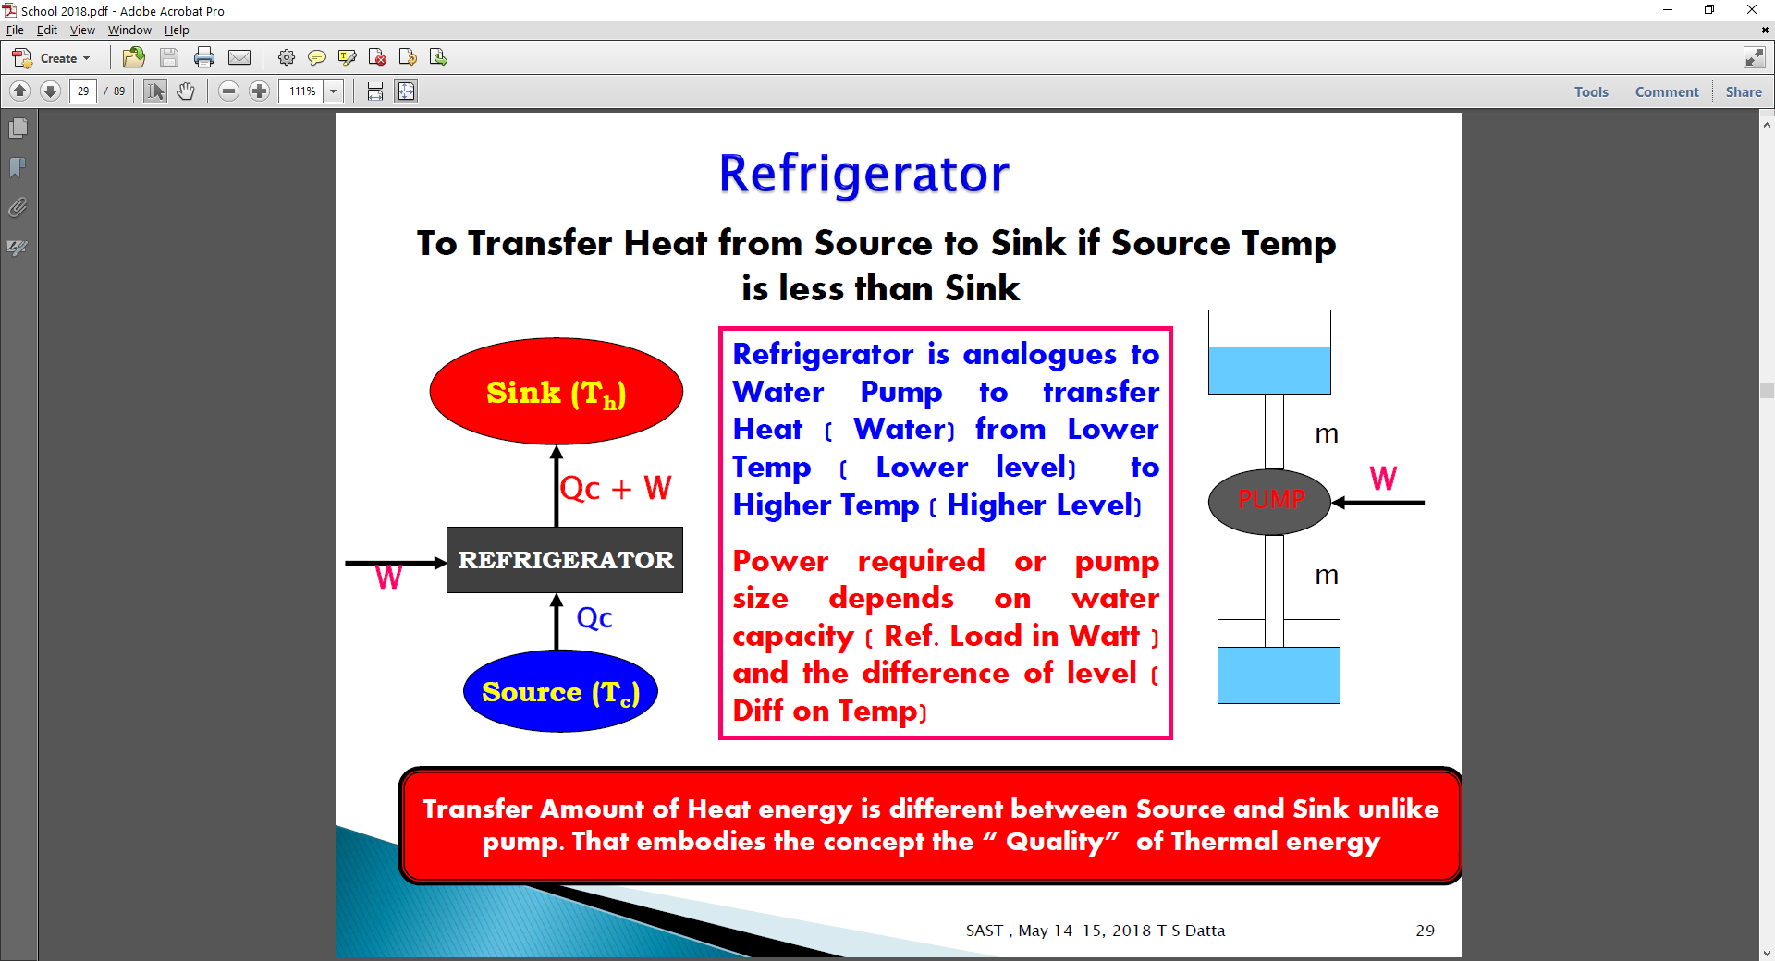

Slide 12
REFRIGERATOR & HEAT ENGINE
Second Law of Thermodynamics: It is impossible to extract an amount of heat Q_{H} from a hot reservoir and use it all to do work W .
T_{h}
T_{h}
Q_{h}= Q_{C}+W
W =Q_{h}-Q_{C}
Q_{h}
W
Q_{C}
Q_{C}
T_{C}
T_{C}
COP _{R,Carnot} =Q_{c}/ W
= T_{C}/( T_{h}- T_{C})
2nd Law of Thermodynamics: It is not possible for heat to flow from a colder body to a warmer body without any input of Work

Slide 13
Power ( W) required to extract 1 W refrigeration at Tc is : 1/ ( COP) =
T_{h} = 300 K T_{c} vary from 200 K to .000001 K
T_{C}=200 K , W = 0.5 W
LN₂ : T_{c} = 78 K , W = 1.68 W
LH_{e} : T_{c} = 4.2 K, W = 70 W
Tc= 2 K , W = 150 W
T_{c} = 0.01 W= 30k W
These are Theoretical minimum Power. We have to multiply first with efficiency of the Cycle and then multiply with mechanical efficiency of all Components ( Compressor, Heat Exchanger, Expander of refrigerator)
Actual work = W_{c}/( η_{Cycle} * η_{Comp})
Total efficiency may be 10 to 30 % at 4.2 K
Required Plug Power for 1 W refrigeration at 4. 2 K = 500- 225 W
Required Plug Power for 1 W refrigeration at 2K = 1000- 1500 W

Slide 14
BASIC THERMODYNAMIC PROCESS FOR COOLING
A. ISOTHERMAL COMPRESSION ( Compressor)
B. ADIABATIC EXPANSION ( Turbine)
C. ISENTHALPIC EXPANSION ( JT VALVE)
D. ISOBARIC COOLING ( Heat Exchanger, Precooler)
Insulation
Process A
Process B
dQ=0
P1, V1,T1
P2,V2, T1
P1, V1, T3
T3 < T1 ( Cooling)
Isothermal compression is achieved with water/ air cooling System. W = m. T ( R/ M) ln ( P2/P1) . Example : 1 gm/s gas T= 300 K, P2/ P1 = 15
Helium : 1600 W ( 20 NM³), N2 = 200 W (2. 8 NM³ )

Slide 15
For Process Cycle Evaluation we use the following Thermodynamic Parameters
AND
Energy & Mass Balance
Fundamental :
Pressure ( P)
Temperature ( T)
Volume ( V)
Gas Constant (R)
Work ( W)
Heat ( Q)
Internal Energy ( U)
Entropy ( S)
Enthalpy ( H )
W
m₁( p₁,T₁)
m₂( p₂,T₂)
h₁
h₂
m₃( p₃,T₃)
Q
h₃
dW
dQ
P1, V2,T2
Try to understand difference of Cp and Cv . Home work ?
P1, V1,T1

Slide 16
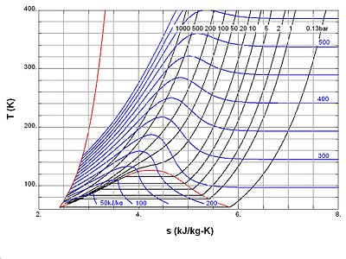
SAMPLE TEMPERATURE- ENTROPY CHART FOR NITROGEN
Constant Enthalpy Curve
1( 1bar, 280 K)-2 (100, 280) : Isothermal Compression
2(100,280)-3(100,150) : Isobaric Cooling ( HX)
3(100,150) -4( 1,78) : Isenthalpic Cooling ( JT)
5(1,78) -1(1,280) : Isobaric Heating ( HX)
Constant Pressure Line
Liquid Vapour Inter-phase
2
1
2 (100, 280)-2a ( 10-155):
Adiabatic Expansion/
Isentropic Cooling
3
Critical Temp
2a
4
5

Slide 17
LIQUEFACTION OF PERMANENT GASES
Q_{r} = Sensible Heat + Heat of Vaporization
Work
GAS AT 300 K
LIQUID AT NBP
_{Qr}
(Q_{r}) = Nitrogen 234 J/ gm ( 300K to 78 K ) + 199 J/gm
Helium : 1542 J/ gm ( 300 K to 4.2 K) + 20 J/ gm
Sensible Heat
Latent Heat

Slide 18

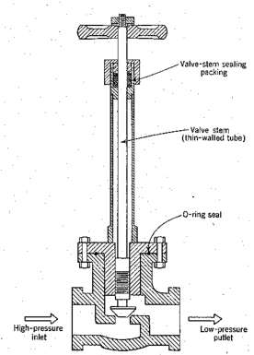
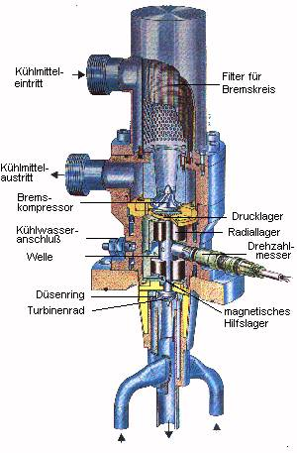
To Liquefy Permanent Gases
Cooling
Isenthalpic
(JT)
Isentropic
Indirectly By Other Cold Liquid/ Gas
( Heat Exchanger
By JT Valve
( No External Work)
By Expansion Engine/Turbine
( Do External Work)
High Pressure to Low pressure
Cooling co- efficient
μ should be positive
Higher is Better

Slide 19
Isenthalpic /JT Cooling
For an Ideal Gas
For an Ideal Gas
Fortunately Gas does not behave ideally
Real Gas : Vander Wall

Slide 20
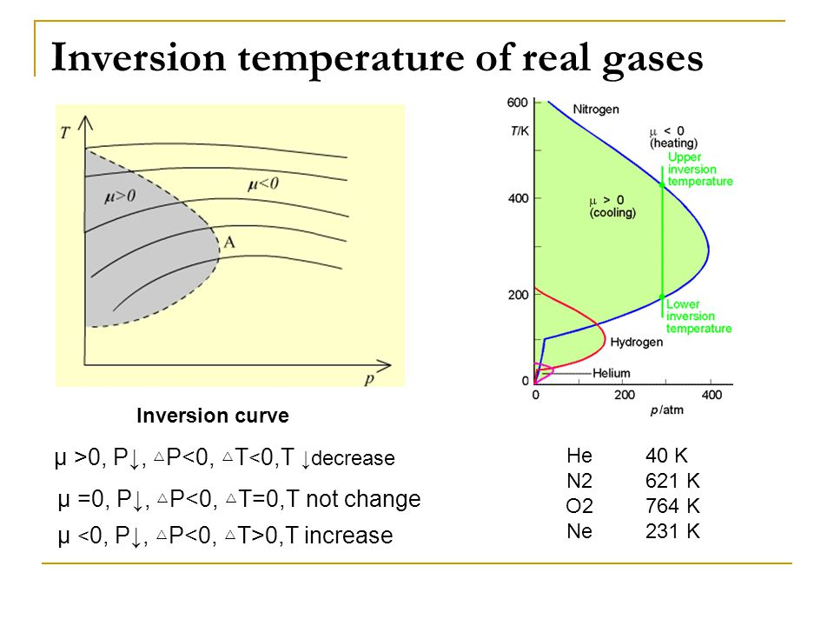
Isenthalpic /JT Cooling
At large specific volumes
b
When , 2a/RT > b,
0r T < 2a/bR
μ_{jT} is Positive , Hence Cooling
When , 2a/RT < b,
μ_{jT} is Negative , Hence Heating
Inversion curve is represented
by all points , where μ_{jT} =0
Maximum Inversion Temperature
T_{imax} = 2a/bR ( at p=0 or b/v=0)

Slide 21
Above Max inversion temperature ( T_{imax} )we will not be able to cool the gas for any set of pressure combination.
Gas | He | H2 | Ne | N2 | Ar | O2
T_{imax (K)} | 45 | 205 | 250 | 621 | 794 | 761
Above RT
Just below their max inversion temperature drop in temperature is not significant and temperature drop increases as we lower the inlet temperature and max above their critical temperature.
Temp Drop Less
That's the reason JT is always incorporated in the last stage of liquefaction cycle. It can also handles liquid gas mixture unlike turbine
Temp Drop More

Slide 22
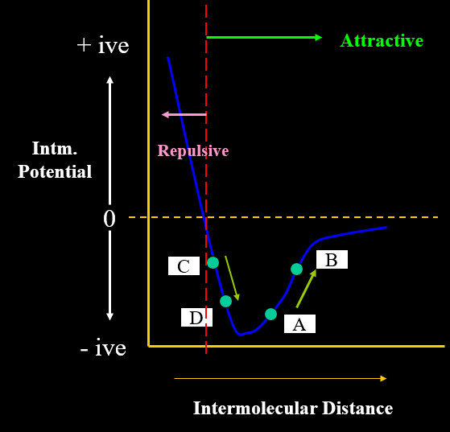
The internal Energy is the sum of thermal kinetic energy and thermal potential energy. Thus, even if the internal energy does not change, the temperature can change due to conversion between kinetic and potential energy;
JT COOLING/ HEATING
Pdv=0 , dh=0 and
Hence du=0
Difference ( KE+ PE) = 0
Expansion from A to B :
Potential Energy increases and hence KE decreases ( Temp Drop)
Expansion from C to D :
Potential Energy decreases and KE increases , Temp increases
Pressure

Slide 23
Adiabatic Expansion ( Isentropic Cooling)
High Pressure Gas does an External work (Lifting Piston) and comes out at low Pressure and low temperature
Insulation
dQ=0
High Pr
Low Pr
P1, V1, T3
dS=0 ( Isentropic)
Always Positive
( Only Cooling )
Unlike JT Expansion, There will be always cooling effect on adiabatic expansion at any temperature and Pressure
Temperature drop is much higher compared to JT Expansion

Slide 24
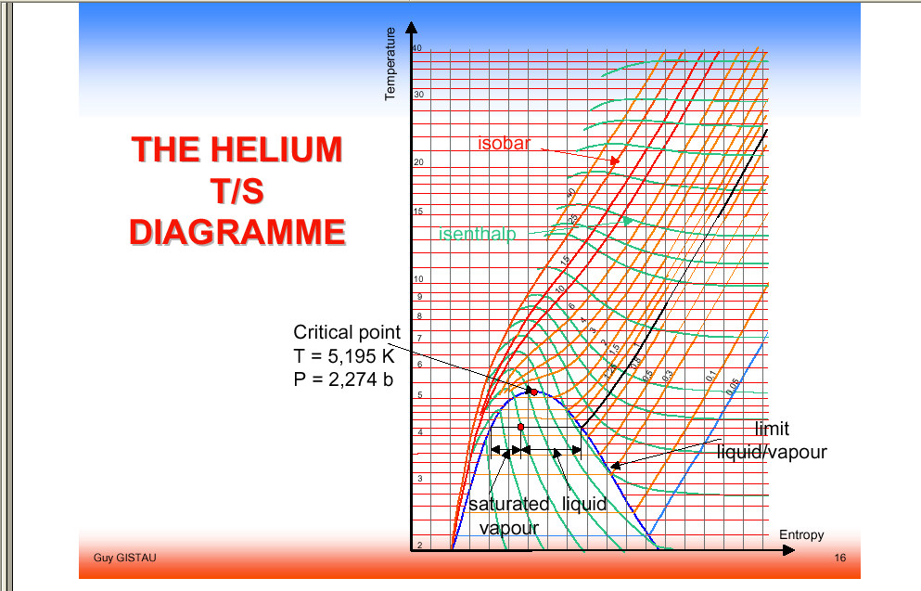

Comparison of Cooling Effect by JT & Isentropic Expansion
Through T- S Chart
(dT)_{s} >>(dT)_{h}
1
Isenthalpic
1 (19k, 10 bar) - 2 ( 17 K, 1 Bar) : JT Cooling
Drop only 2 K
2
Isentropic
3
1 (19k, 10 bar) - 3 ( 7 K, 1 Bar) :
Isentropic Cooling
Drop 12 K

Slide 25
Adiabatic ( Isentropic) Expansion
= 1.66 ( He, Monatomic Gas)
=1.4 ( N2, Diatomic Gas)
Example : If Helium Gas is Expanded from 220 Psi ( p₁) to 18 Psi ( p₂) at
Inlet temperature ( T₁) = 60 K
T₂ = 23.4 K , Actual Case it is 30K
Efficiency = 80 %

Slide 26
LIQUEFACTION SYSTEM PARAMETERS
Work Required per unit mass liquefied = W/m_{f}
Yield ( What fraction of Compressed Gas is liquefied) , y= m_{f}/m
Ideal work required per unit mass liquefied= W_{i}/m_{f}
Figure of Merit : Ideal work/ Actual work for the cycle
FOM= (W_{i}/m_{f})/ (W/m_{f}) : 0 to 1

Slide 27
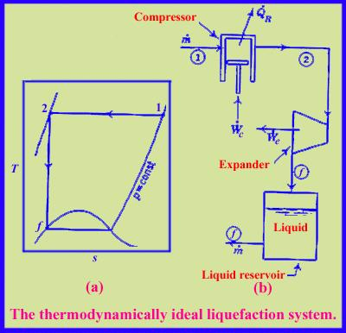
Ideal Thermodynamic Liquefaction Cycle
1----2 : Isothermal Compression
2----f : Isentropic Expansion
Not Possible , Why ???
For N_{2,} if P ₁ is I bar, then P₂ must be 700000 Bar ( very high pressure) to liquefy all the gases
Not Practical
Liquid Yield ( Y) = m_{f}/m= 1
Ideal Work Requirement for 1 Kg Liquid Production
N2 = 768 KJ, He = 6800 KJ,

Slide 28
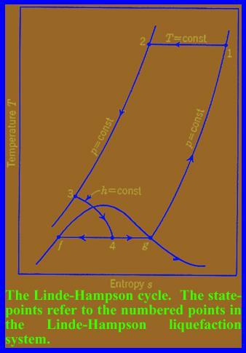
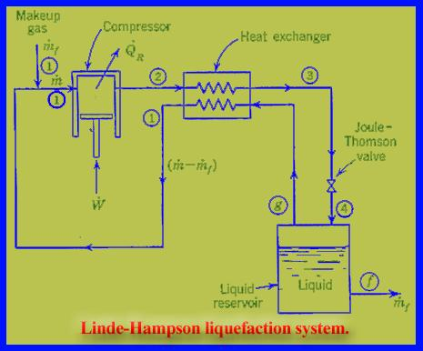
Primary Practical Nitrogen Liquefier ( Linde- Hampson Cycle)
It is only for those gases ( N2, O2, Ar) whose
T_{imax} is above RT
1-2,Isothermal Compression
2-3 ,Isobaric Cooling
<<1
3-4 Isenthalpic Cooling
We need Compressor / High Pressure Gas cylinder , Heat Exchanger & JT to Produce LN2
Yield can be increased by Increasing Pressure ( lower h2), Other parameters are fixed but at what cost ??

Slide 29
A simple table on liquid yield and work required per unit production of liquid nitrogen for various compressor discharge pressure is presented here
( T₁ = 300 K, P₁ = 1 bar absolute pressure, h _{f} = 30 J /gm. h₁ = 462 J/ gm )
Pressure (P₂ ) | h₂ | Y=m_{f} /m | W/m_{f} | FOM
20 bar | 454 | 0.02 | 12888 | 0.06
50 | 448 | 0.03 | 9937 | 0.08
100 | 438 | 0.06 | 7200 | 0.11
200 | 425 | 0.09 | 5564 | 0.13
FOM = Ideal Work Required/ Actual Work
We Need Very High Pressure to have Significant Percentage of Liquid Production on this L- H Cycle

Slide 30
Pressure | Yield mf/m | W/mf ( J/ Kg)
100 Bar | 0.06 | 7200
Analysis on Linde- Hampson Cycle
For 10 liter/ hr (8 kg/hr) liquid nitrogen production : Compressor capacity required at 100 bar discharge pressure
m= m_{f} x y = 8 kg/hr/0.06 = 133 kg/hr = 106 M³/hr
Theoretical Power : 7200 kJ/kg x 8/ 3600 = 16 kW ?
Considering the efficiency of Compressor and Heat Exchanger, the Actual power Requirement will be more than Double 40 kW
Power Cost of Liquid nitrogen will be Rs 20/ Litre
You can calculate the cost of Liquid nitrogen based on your own parameter
Actual Power cost is only Rs 5/ litre
This Cycle is Simple but not Cost Effective
Can we use the same Cycle for Helium Liquefaction ?? No

Slide 31
Heat Exchanger Efficiency on Linde Cycle
Example : p1= 1 bar ,p2= 200 bar, N2, 300 K
0.08
Yield
If Efficiency less than 0.87 , Production will be zero
0.0
0.87
1.0
0.8
Effectiveness of Hx

Slide 32

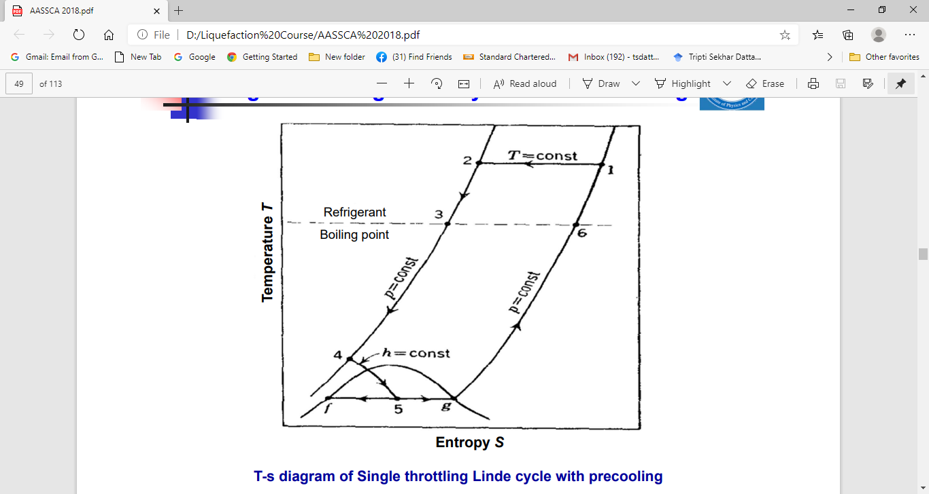
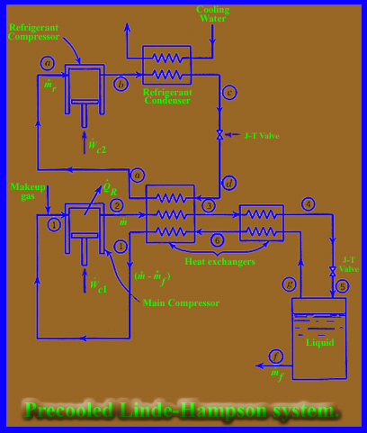

3
Yield is higher, Hence W/ mf will be less

Slide 33
LIQUID YIELD for Nitrogen CAN BE INCREASED BY PRECOOLING
( by lowering the value h1)

Slide 34
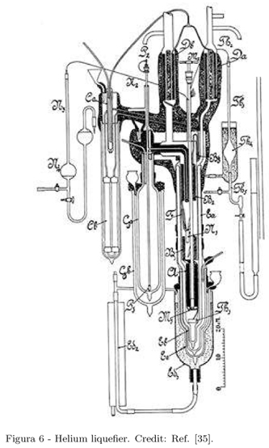
LIQUEFACTION OF HELIUM
Max Inversion Temperature for Helium : 45 K ( Below RT)
Basic Linde- Hampson system will have Heating Effect.
We have to Precool with Liquid Nitrogen ( 78 k) and Liquid Hydrogen ( 20 K) prior to JT .
( First Liquefaction of Helium in 1908 : By Precooling L- H)
ALTERNATIVELY : ADDING ONE ADIABATIC EXPANSION PROCESS BY USING A TURBINE : Next
First Helium Liquefier
By Kamerlingh Onnes
100 bar
80 K
LN₂
15 K
PUMP
9 K
LH₂

Slide 35
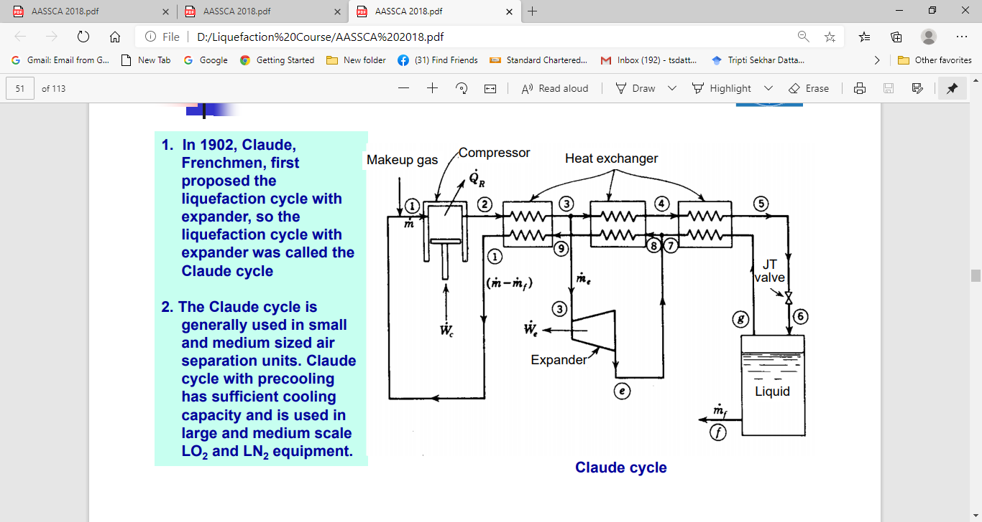
CLAUDE CYCLE

Slide 36
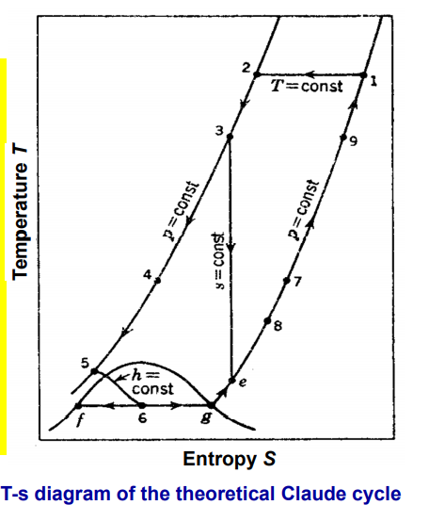

Optimized value with
Single Expander
X~ 60 to 80 %
m
m_{f}
m
m-m_{e}
m_{e}
Higher flow rate through the Expander will have higher cooling, that reduces the temperature (5). More fraction of liquid
m-m_{f}
e’
m_{f}
m-m_{e}-m_{f}
Remember, Mass flow rate through JT is also reducing

Slide 37
Assumptions
Compressor and Expander Efficiency is 100%
Heat Exchanger Effectiveness is 1
Pressure drop is negligible
Heat Transfer to the Cold system from the Surrounding is Zero
We will consider the effect of efficiency on cycle performance in later stage

Slide 38
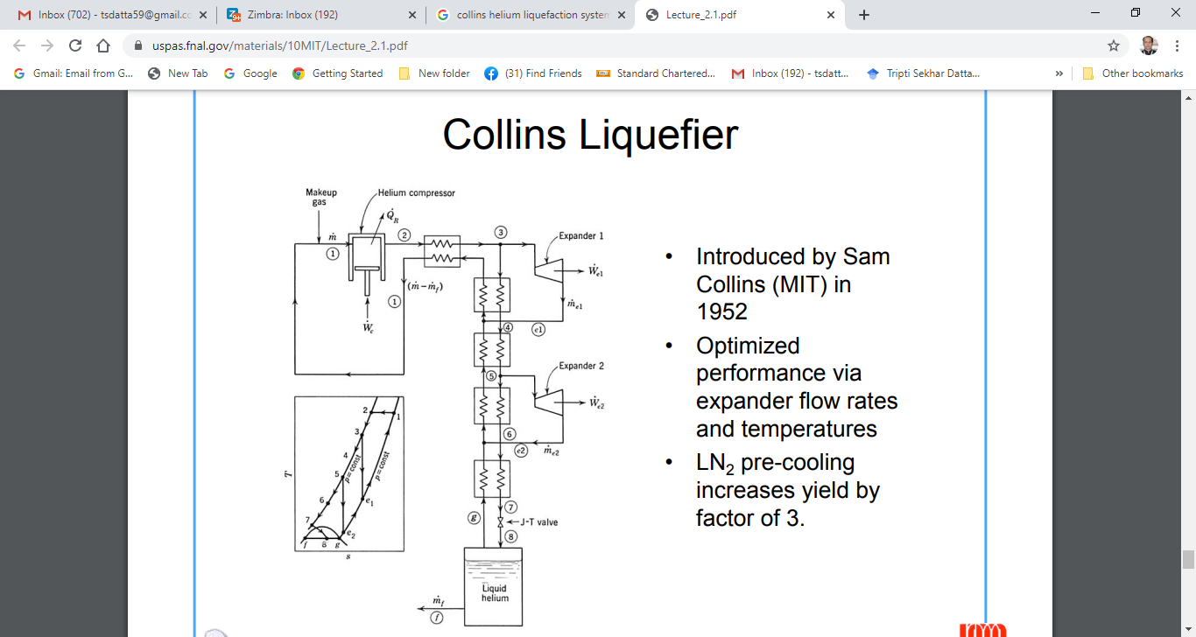
Popular During 1950-80

Slide 39
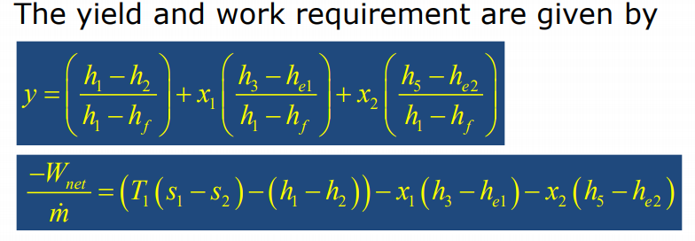
Here Yield can be optimized with
T₃, T₅, x₁ and x₂ at
different pressure ( p₂)
For standard Helium Liquefier T3= 60 K, T5 = 20 K
X1= 15 %, x2 = 40 %

Slide 40
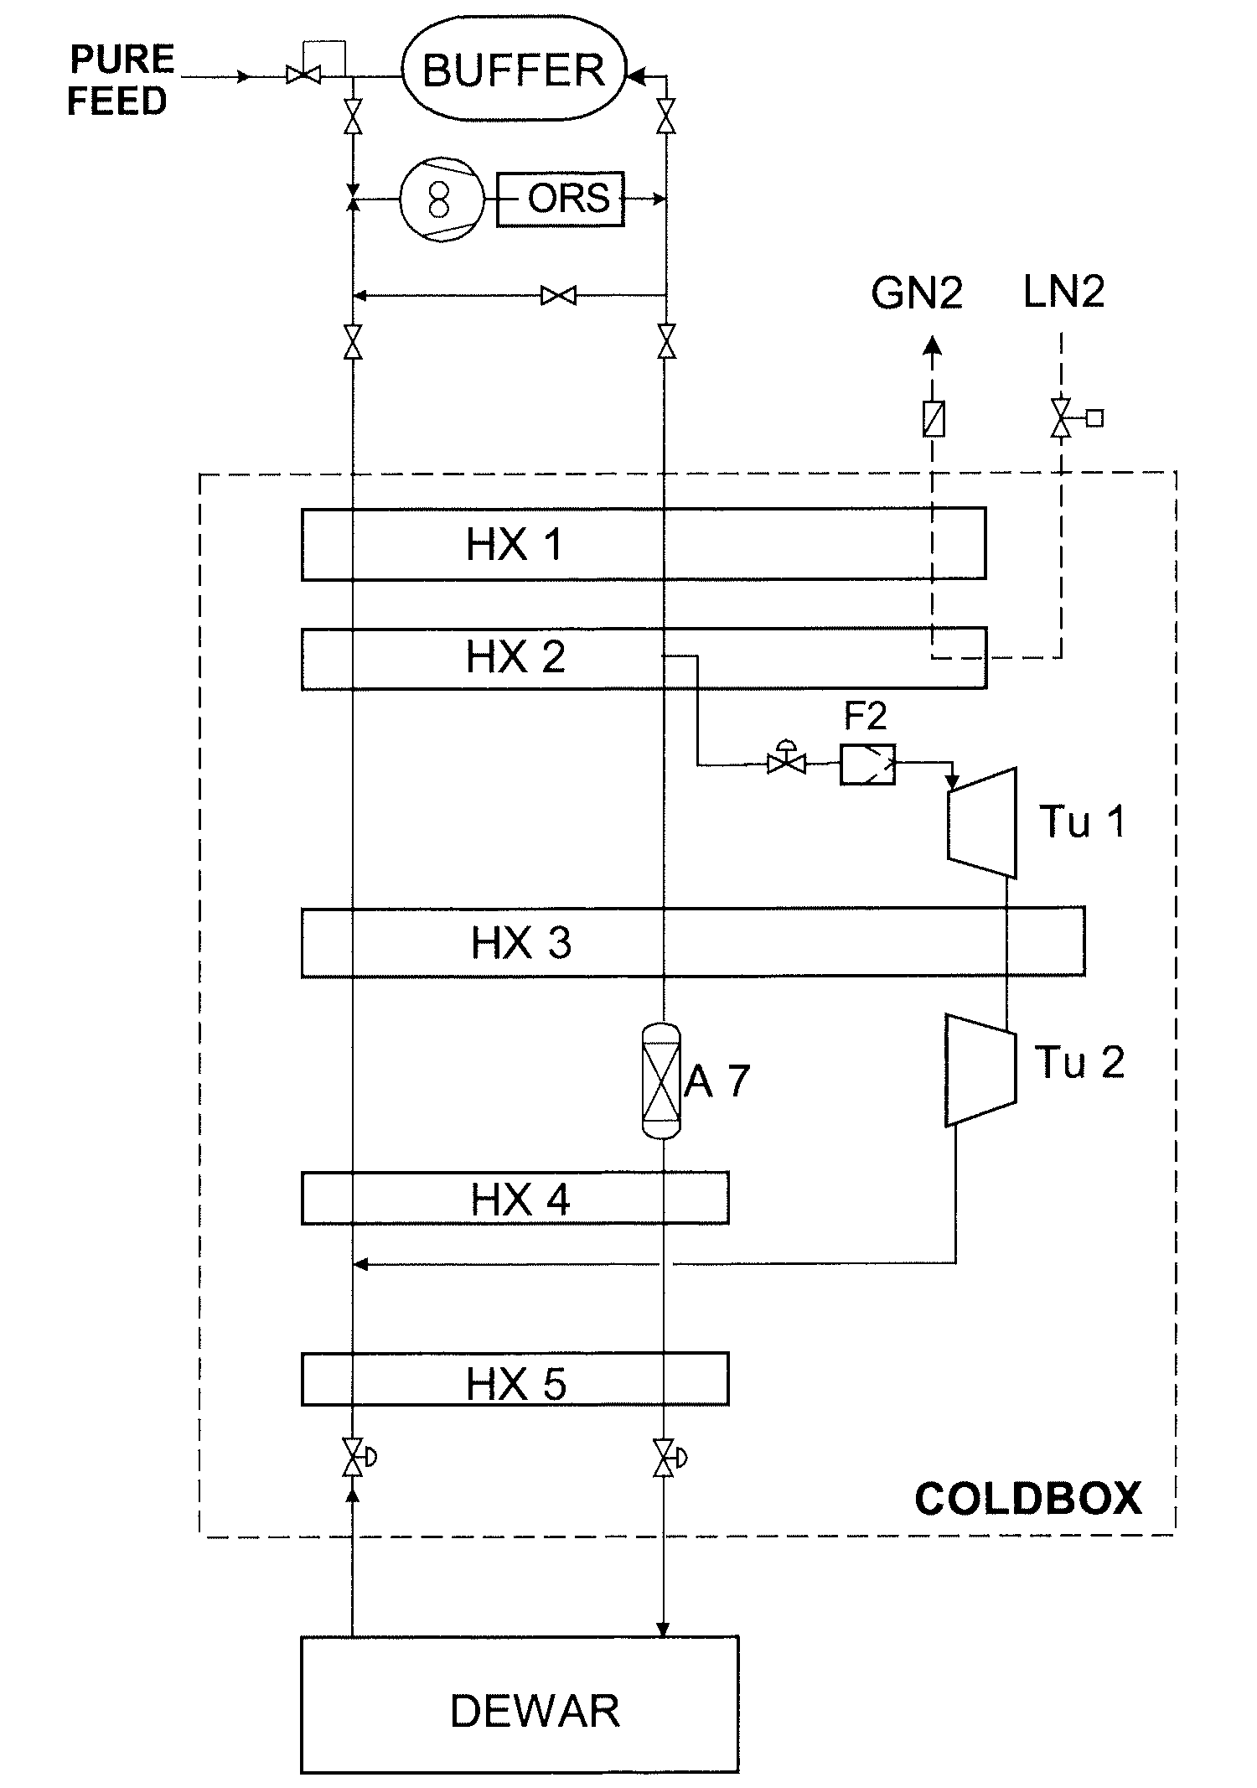
HELIUM LIQUEFIER WITH TURBINE
Capacity can be further enhanced by using two Expander and precooled with liquid Nitrogen. This is called Modified Claude Cucle.
Initial year, isentropic expansion was achieved by Reciprocating Piston type and later Turbine
Standard 1 kW class Refrigerator
300 litres/hr
Advantage : Turbines are more reliable than the expansion engines because the latter are susceptible to performance deterioration due to contamination.
Disadvantage : Turbines do having a limited expansion ratio, that is a limited ratio of inlet to outlet pressures.
That was the reason Turbine are used in series rather than parallel for Reciprocating Expander

Slide 41
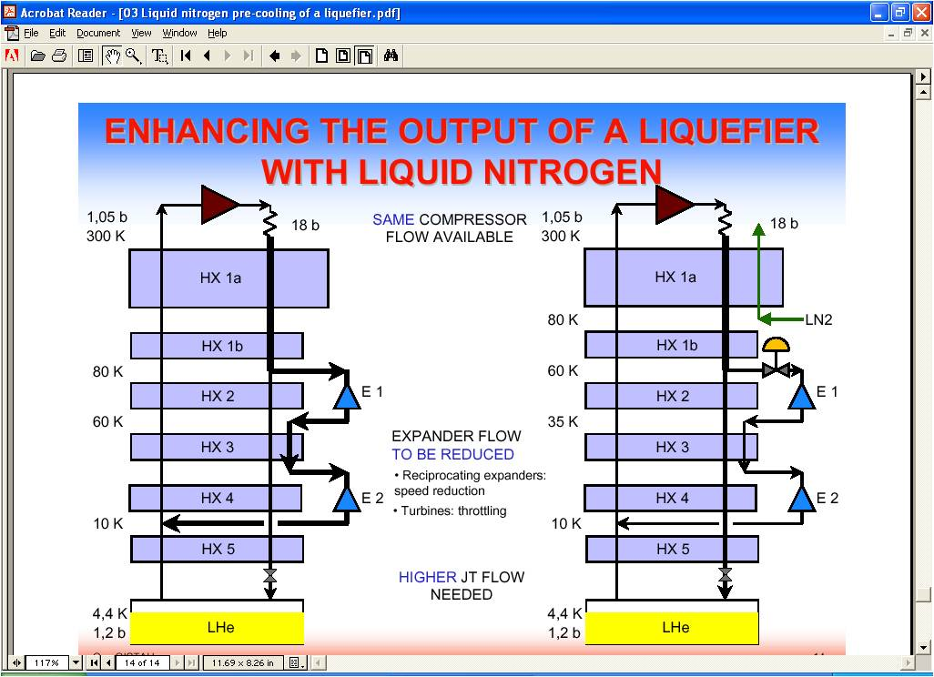
Commercial Helium Liquefier with Temperature at Different Process Point
Major Components :
Compressor
Heat Exchanger
Expander
JT Valve

Slide 42
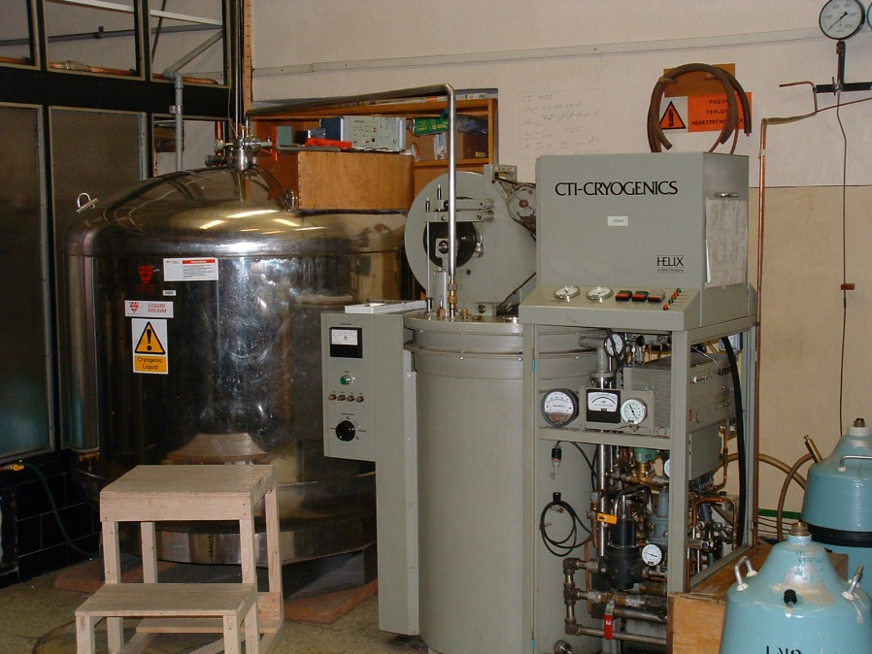
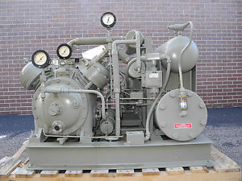
Most Popular Helium Liquefier in Low Temperature Laboratories ( 1965 – 1980)
ADL to CTI 1400
Capacity : 10 litre/hr ( single Compressor) : Reciprocating 2 stage; 100 NM3/hr , Reciprocating Expansion Yield = .08
CTI 1410 KOCH PSI LINDE ( L 1410)
Automatic Engine speed, Screw Compressor, Modular
Production rate : 10 litres/ hr to 50 litres/ hr

Slide 43
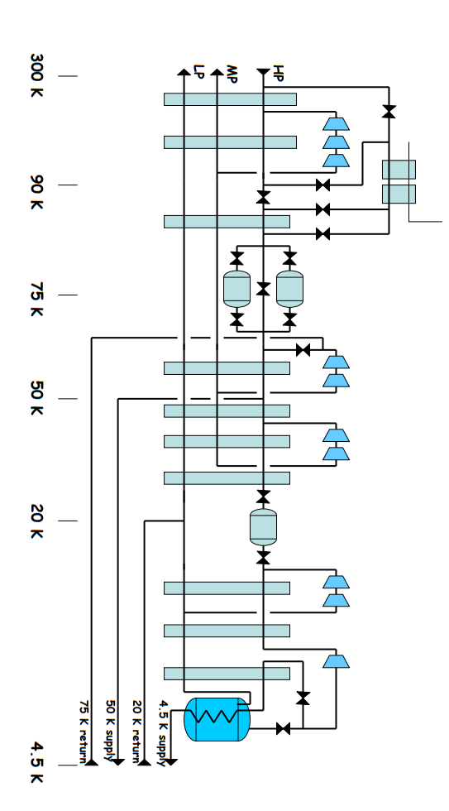
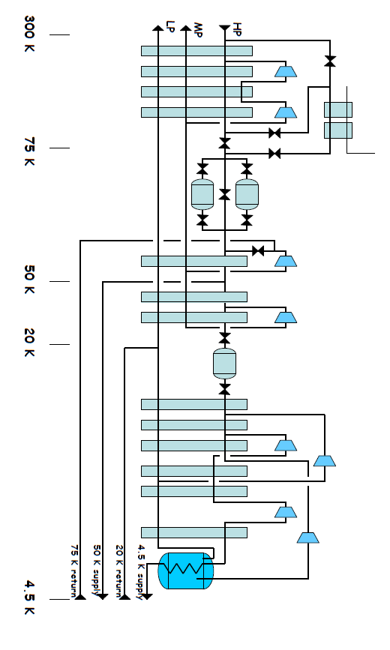
18 kW at 4.5 K Helium Refrigerator for CERN LHC Project
LINDE
AIR Liquide
Largest helium refrigerator with Single Cold Box
Next 20 / 25kW ??

Slide 44
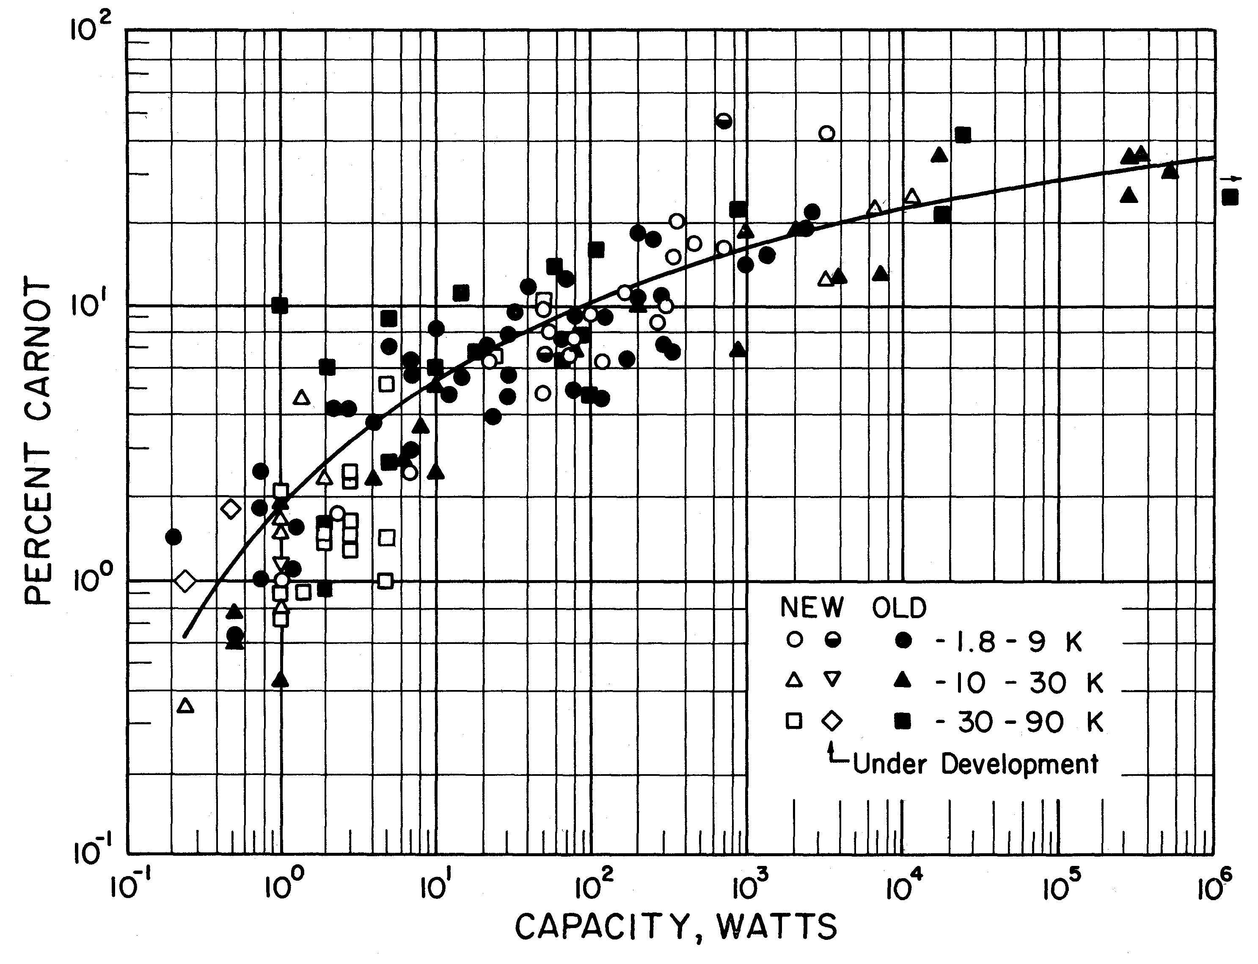
Strobridge Survey (Efficiency) 1974
GM Cryocooler ; 4 kW for 1W refrigeration at 4.2 K
Laboratory Scale Helium Refrigerator ( ~ 100 W) : 700 W for 1 W
Medium Range 1kW Class ( 300 W for 1W Range)
Large Helium Refrigerator ( 18 kW for CERN : 225 W for 1 W
Whether we have reached peak value of 225 W ??

Slide 45
STANDARD HELIUM LIQUEFIER/ REFRIGERATOR CYCLE
Standard 1 kW at 4.3 K Helium Refrigerator needs a Compressor with capacity 100g/s and discharge pressure at 13 bar (g)
Isothermal Operation : Work required
Actual Plug Power ; 305 kW
Compressor Efficiency : 49%
Inverse COP = 300 W/ W

Slide 46
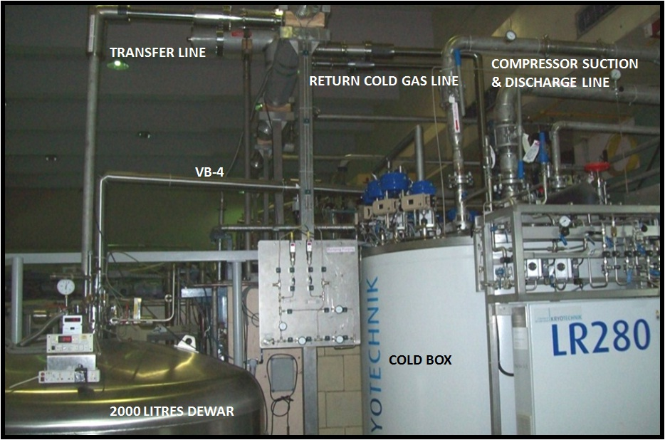
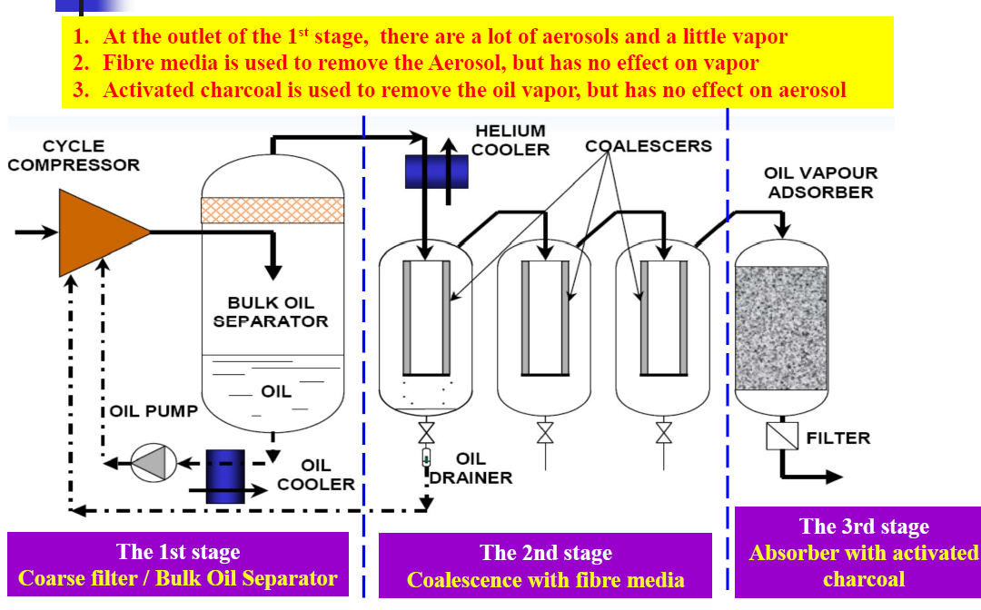
Major Components of Helium Refrigerator
Turbine
Oil Removal System
Heat Exchanger

Slide 47
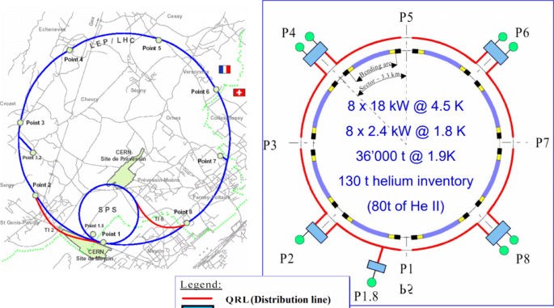
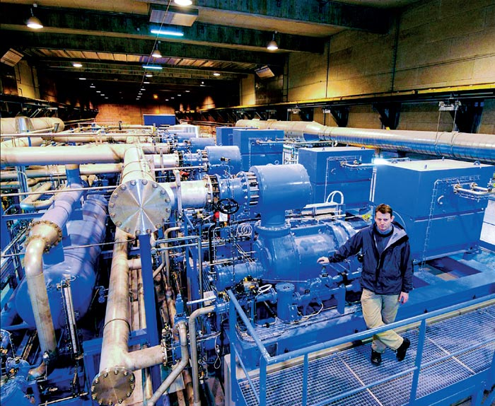
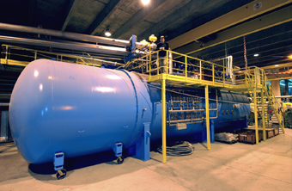
18 kW Refrigerator
LHe Distribution Line
Beam Line
Helium Refrigerator Layout @CERN
Cold Box
Compressor Station

Slide 48
Liquefaction Vs. Refrigeration ?? I Important
Same Thermo dynamical Cycle as Liquefaction Cycle. Difference in way of operation
HOW?
warm
gas
Warm Gas
300K
Cold Box
Cold Box
Cold
vapour
Cold
vapour
Load may be the
S.C. magnets
& Cavities
4.2K
L
O
A
D
LHe
Load
Refrigerator Mode
Liquefaction Mode

Slide 49
Liquefaction Vs. Refrigeration
Liquefier 100 L/hr = 3.33 g/sec = 3.33 x 20 j/g = 66.6 W
But we can get << 300W on Running as Refrigerator
Thumb Rule: 1L/hr ~ 3-4 W
Why ???
Cold Enthalpy 4.2- 300 K is used
JT Temp will be lower and hence yield

Slide 50



Thanks
Contact mail : tsdatta59@gmail.com
What is my and Yours Carnot Efficiency ???
See you on Sunday ( @ Beautiful Great Wall of China)
Namaste
Next : Let’s move to the real world of Cryogenics through Lectures from Prof. Zhengrong Ouyang, Prof. Hirotaka Nakai , Prof. Xilong Wang and Prof. Ge Rui

