Slide 1
High temperature superconducting magnet for particle accelerators at IHEP-CAS
Rui Kang, on behalf of the SMG-IHEP
2025.03.25, Huairou
ASSCA-2025
Notes:
各位老师好，我是超导磁体组的博士后康芮，今天汇报一下我一年以来的工作情况。

Slide 2
Preface
2
The workers of the “How shall I make a magnet from this superconductor?”, whose field I call applied superconductivity, deal only with classical physics: electricity and magnetism, fluid flow, heat transfer, stress, and strain.
It might be thought that classical studies are less adventurous than quantum studies, but applied superconductivity has a novel twist that gives it great intrinsic interest.
—— Stability of Superconductors, by Lawrence Dresner, 1995

Slide 3
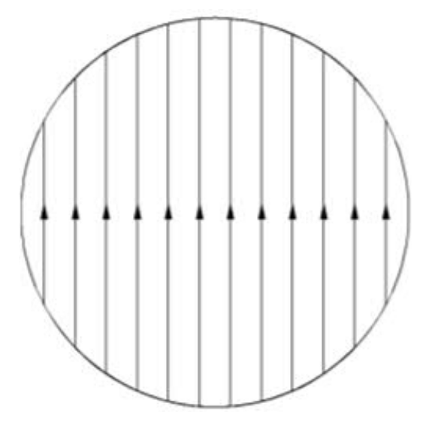
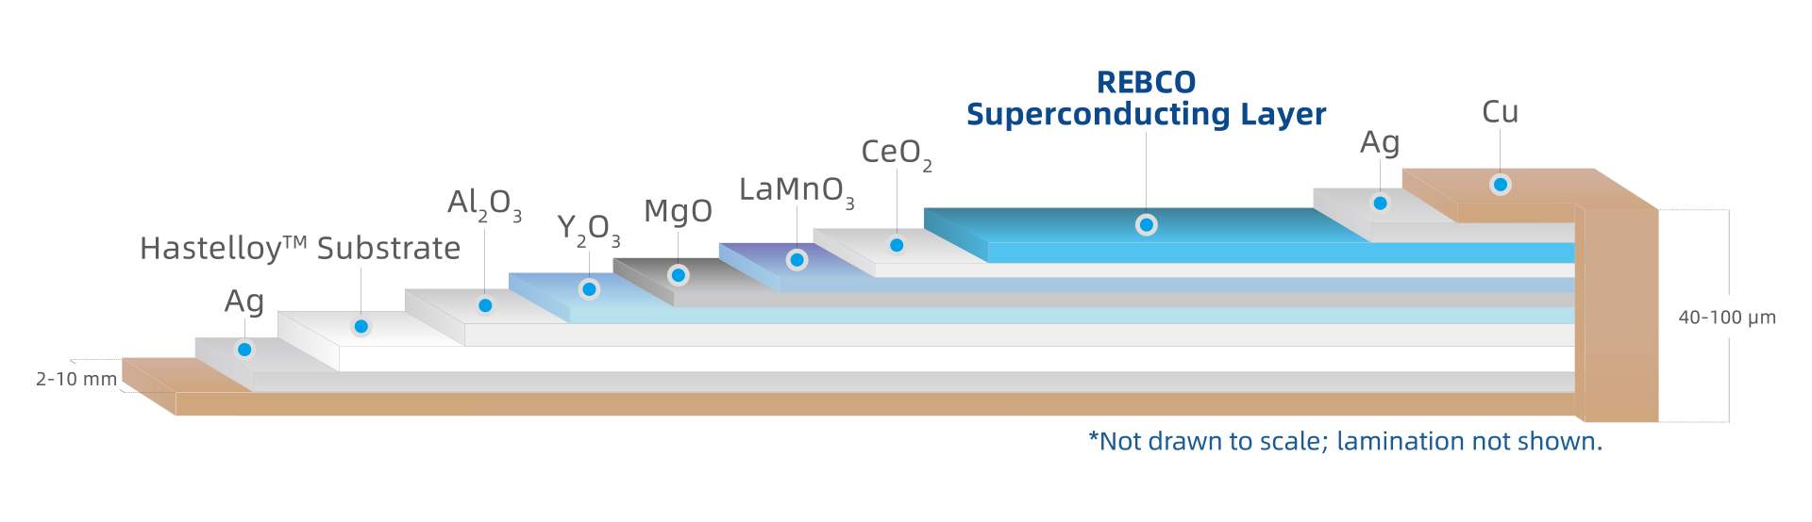
Preface
3
How shall we make an accelerator dipole magnet with HTS, and more specifically with the REBCO coated conductor?
Unfortunately, the answer to the question is still vague.
This course will introduce the effort and lessons learnt at IHEP about HTS dipole magnets, hopefully to give you some insights.
REBCO coated conductor
(also known as 2G HTS tape)
Dipole field
Notes:
As you may already been introduced with the basic knowledge about

Slide 4
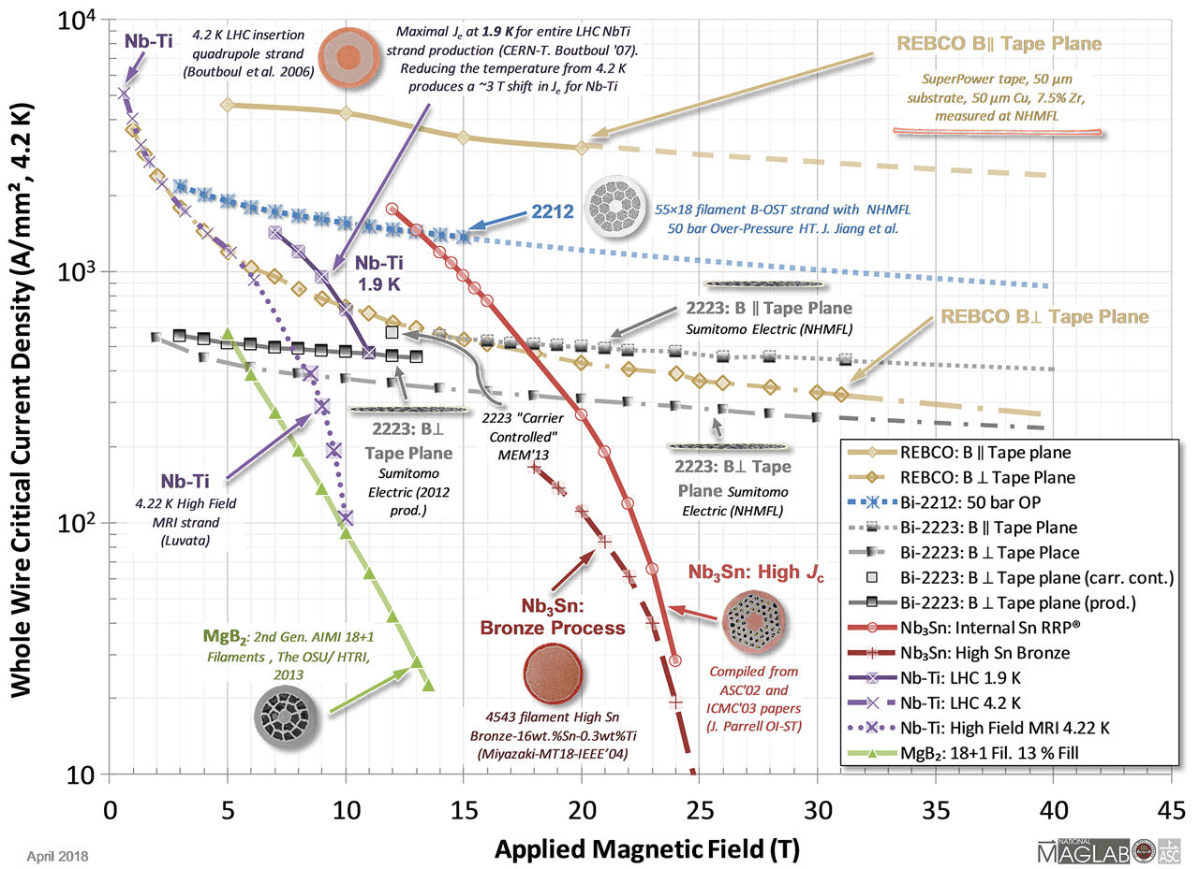
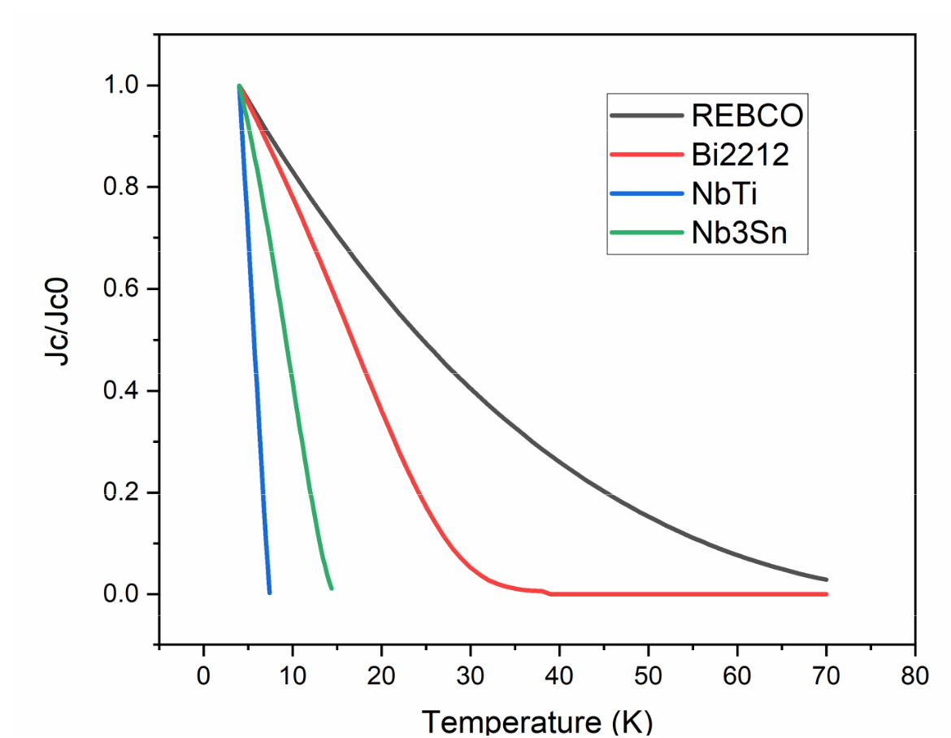
What HTS promises to accelerator magnets?
4
We already have NbTi that worked perfectly and Nb3Sn on its way, why HTS?
Higher dipole magnetic field: >15 T
Higher operating temperature: more stable operation, less load on cryogenic system
Reasonable for an accelerator magnet
Jc V.S. B
Jc V.S. T
Notes:
As you may already been introduced with the basic knowledge about

Slide 5
Table of Contents
5
What have we learnt from LTS accelerator magnet?
What have we learnt about HTS?
Experience and lessons learnt at IHEP
Notes:
As you may already been introduced with the basic knowledge about

Slide 6
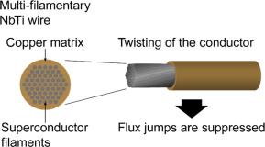
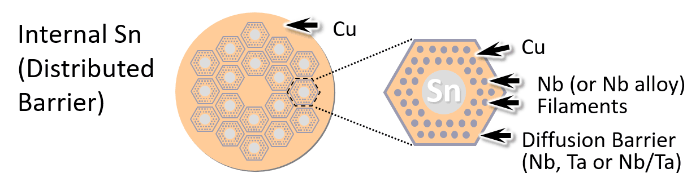
What have we learnt from LTS accelerator magnet?
6
At conductor/wire level
The LTS wires must be made of transposed (by twisting) multifilament round wires, stabilized with high purity copper, to:
  Suppress flux jump;
  Reduce AC losses
  Increase the stability
NbTi multifilament wire
Nb3Sn multifilament wire
Notes:
As you may already been introduced with the basic knowledge about

Slide 7
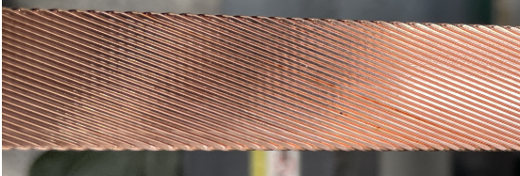
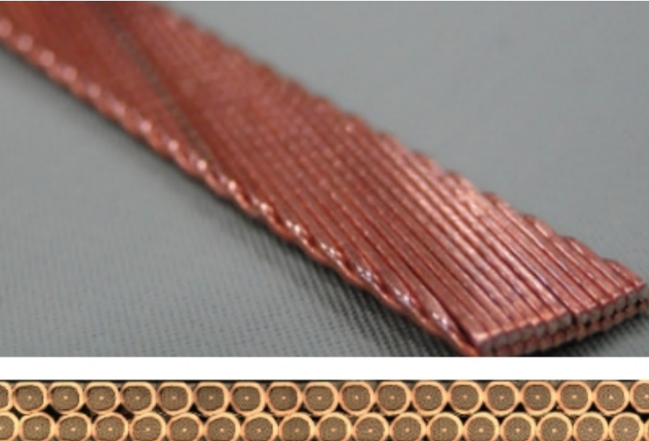

What have we learnt from LTS accelerator magnet?
7
At cable level
A superconducting magnet with a significant scale should be wound with a multi-strand cable, to:
  Have a reasonable inductance:
  Reduce the charging voltage;
  Benefit the quench protection;
  Enhance the operation stability.
Rutherford cable is most often used in accelerator magnet:
$$L∝n^{2}$$
Inductance increases to 16 times
Rutherford cable
Notes:
As you may already been introduced with the basic knowledge about

Slide 8
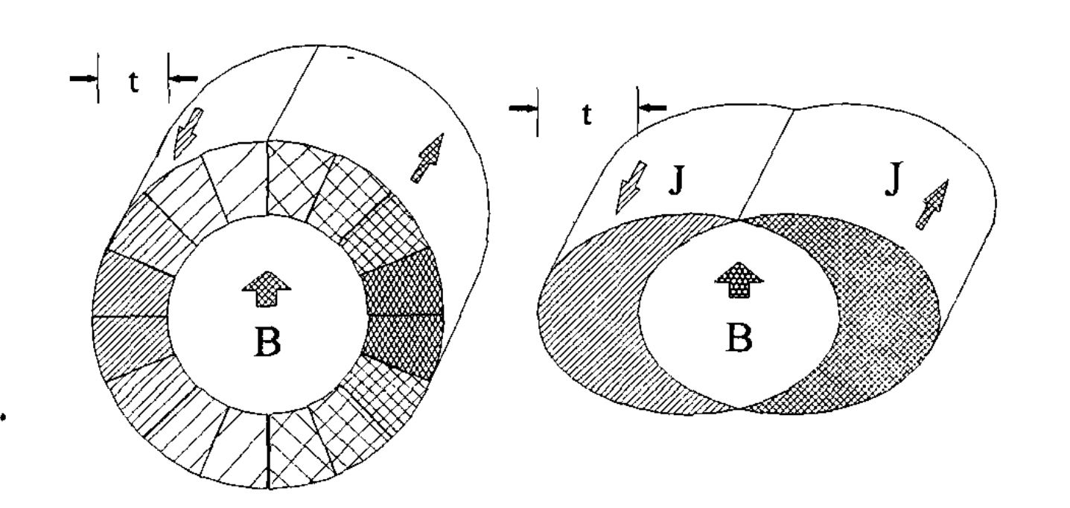
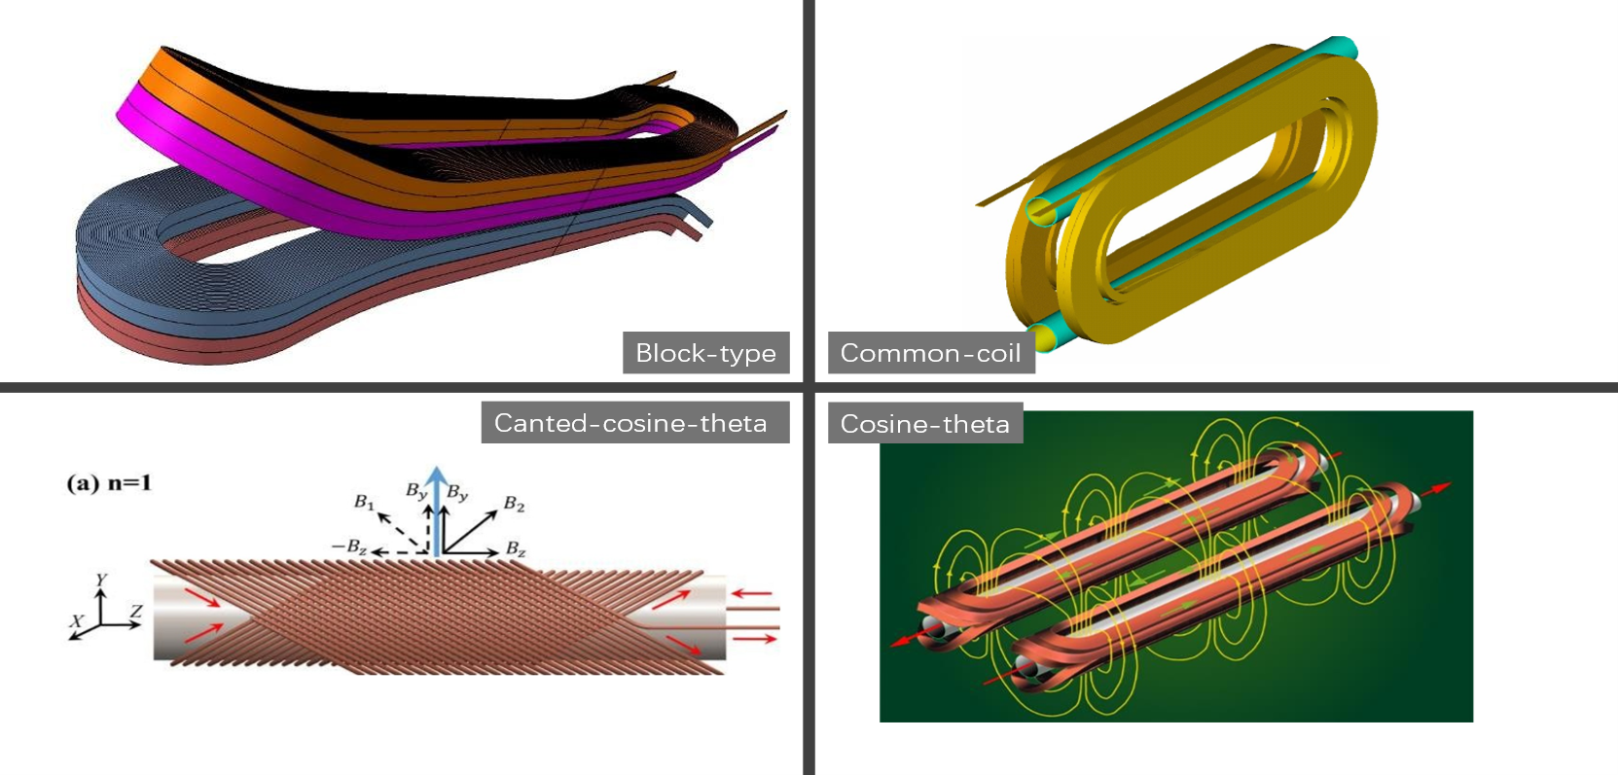
What have we learnt from LTS accelerator magnet?
8
At magnet level
Most of superconducting dipole magnets on operation uses cosine-theta coils for its good field quality, but another three types have been studied.
Cosine-theta current density
overlapping ellipses uniform current density
Notes:
As you may already been introduced with the basic knowledge about

Slide 9
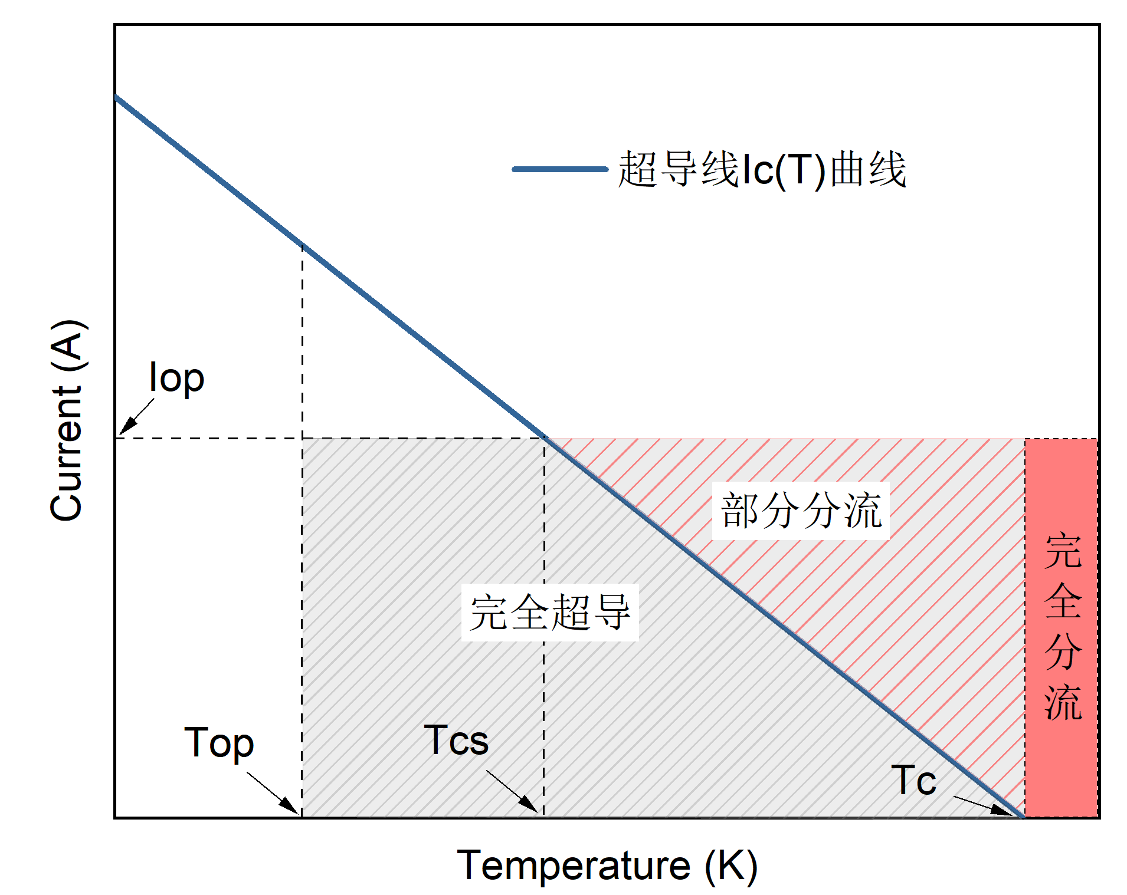
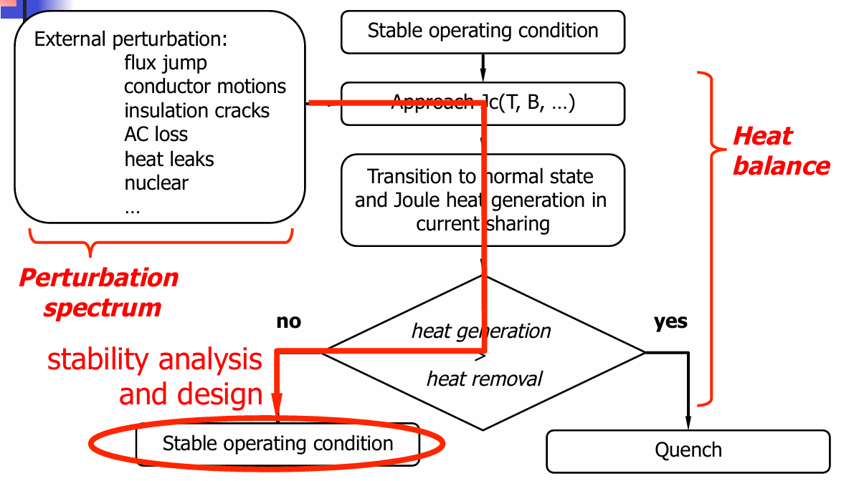
What have we learnt from LTS accelerator magnet?
9
Stability and quench
LTS conductor can lose superconductivity very easily due to the low energy margin
Large heat generation
Working point
Current sharing of a superconductor
An event tree for stability and quench
Notes:
As you may already been introduced with the basic knowledge about

Slide 10
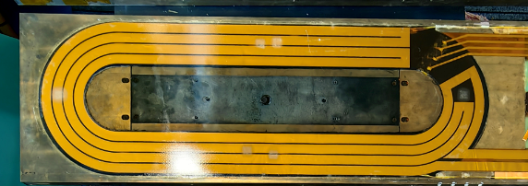
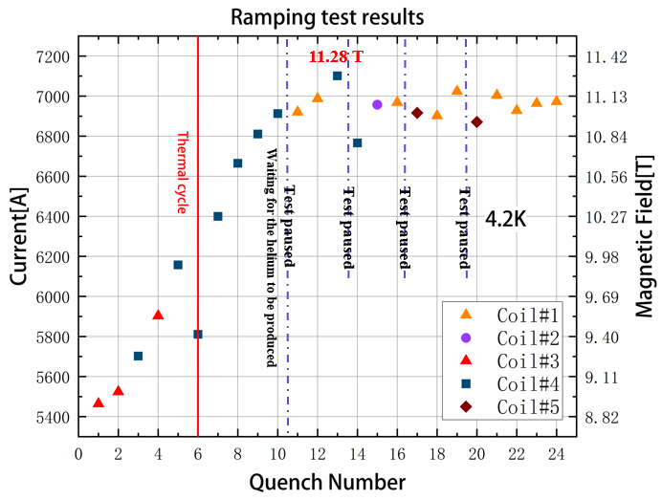
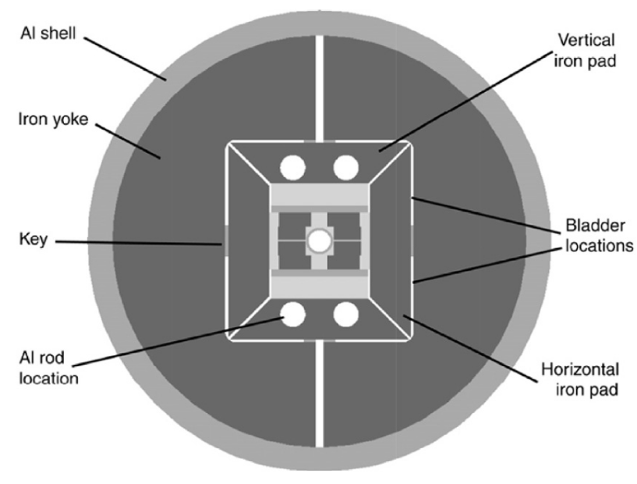
What have we learnt from LTS accelerator magnet?
10
Training and stress management
Quench current of a LTS magnet could be gradually “trained” higher after quenches；
Potting and pre-stress are required to react against the Lorentz forces and prevent or reduce training quenches.
Typical epoxy-resin potted LTS coil
Typical key-bladder structure to apply pre-stress
Typical training curve of a LTS magnet
Notes:
As you may already been introduced with the basic knowledge about

Slide 11
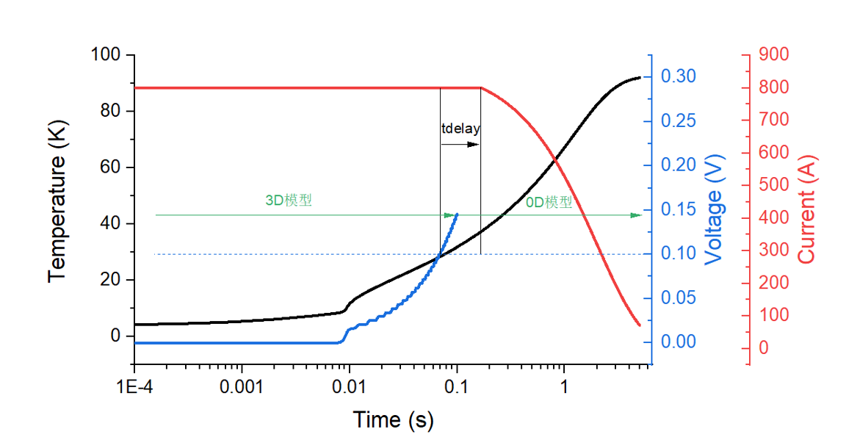
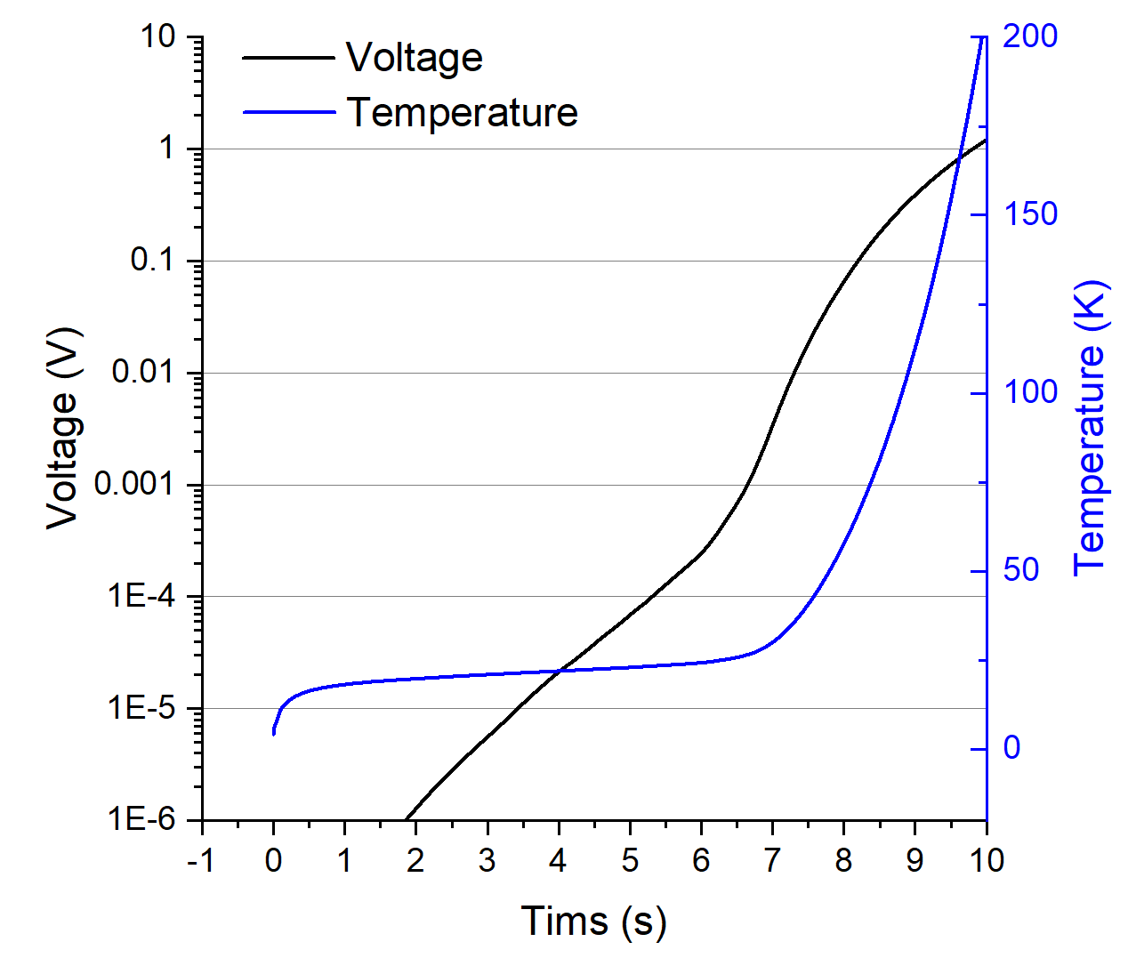
What have we learnt from LTS accelerator magnet?
11
Quench protection
A quench event must be detected by coil voltage and actives a certain protection scheme.
Several quench protection methods have been developed: dump resistor, quench heater, CLIQ, ...
Temperature and voltage in a non-protected quenched SC magnet
Temperature and voltage in a properly protected quenched SC magnet
Notes:
As you may already been introduced with the basic knowledge about

Slide 12
What have we learnt from LTS accelerator magnet?
12
A summary of the key lessons from LTS accelerator magnets
Make Transposed multifilament wire;
Make fully transposed Rutherford cable;
Adopt the cosine-theta coil geometry;
Ensure a good stability by retain enough margin, potting the coil with epoxy-resin and applying pre-stress;
Detect magnet quench by monitoring voltage, and safely release the energy by dump resistor or heating up.
Can we transplant these principles to REBCO?
Should we?
Notes:
As you may already been introduced with the basic knowledge about

Slide 13
Contents
13
What have we learnt from LTS accelerator magnet?
What have we learnt about HTS?
Experience and lessons learnt at IHEP
Notes:
As you may already been introduced with the basic knowledge about

Slide 14
What have we learnt about REBCO?
14
REBCO conductor
Up to present, the conductor microstructure of REBCO is dominated by the maximization of the critical current and the manufacturability in long length:
Single large filament, with extremely high aspect ratio (e.g. 4 mm wide, 1 μm thick).
Multi-layer structure, with significant fraction of Hastelloy that has poor conductivity.
No transposition.
Highly anisotropic characteristic.
The REBCO conductor contradict with the LTS lessons, but many high field records have been achieved with it outside of accelerator community.
Could accelerator magnets live with it, or the REBCO conductor must be modified?
REBCO coated conductor
(also known as 2G HTS tape)
Notes:
As you may already been introduced with the basic knowledge about

Slide 15
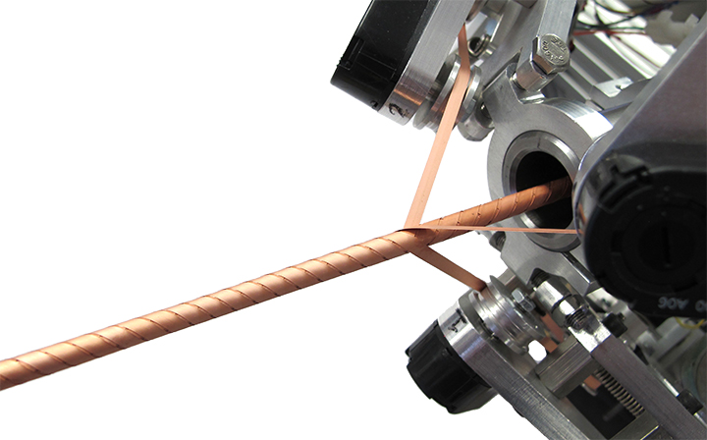
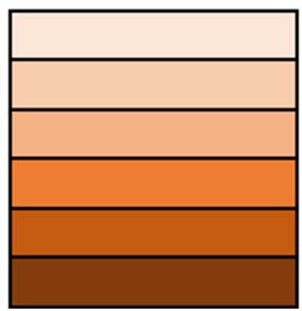
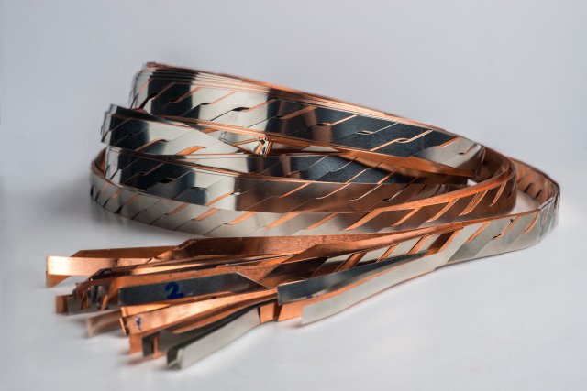
What have we learnt about REBCO?
15
Cabling of REBCO
Up to present, no ultimate solution as Rutherford cable for LTS due to the extremely high aspect ratio:
Roebel cable ensures fully transposition, but at a relatively high price.
CORC cable enables much flexible cabling and winding, but with greatly reduced current density.
What about a simple non-twisted stack?
Roebel cable
CORC cable
Non-twisted stack
Notes:
As you may already been introduced with the basic knowledge about

Slide 16
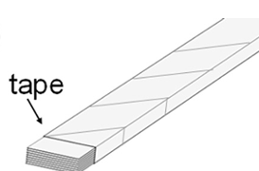
What have we learnt about REBCO?
16
Cabling of REBCO
Would Non-twisted stacked tape conductor be a good cable concept for accelerator magnet?
Simple (package tapes or co-winding)
Smallest winding strain
Highest current density
Avoidance of stress concentration
Non-significant increase of AC loss
To be figured out:
Stability (unbalanced current induced quench)
Field quality
Packaged tapes
Co-winding
Notes:
As you may already been introduced with the basic knowledge about

Slide 17
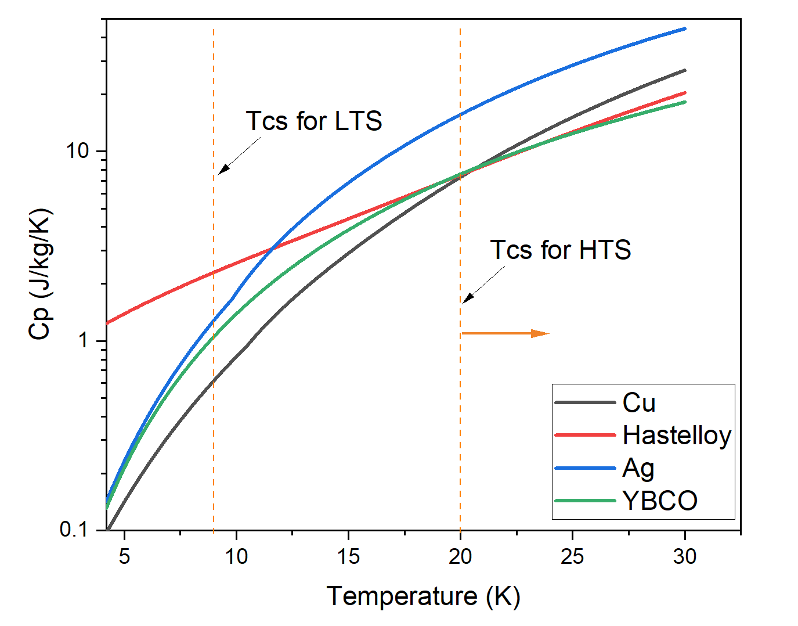
What have we learnt about REBCO?
17
Stability of REBCO
The higher critical temperature enables much higher stability margin for HTS
Higher current sharing temperature
Higher specific heat capacity
Notes:
As you may already been introduced with the basic knowledge about

Slide 18
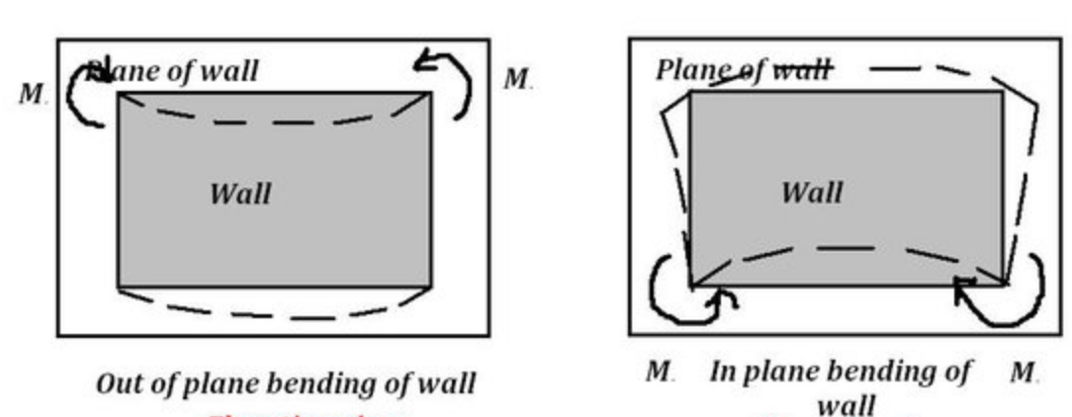
What have we learnt about REBCO?
18
Magnet geometry
The extremely high aspect ratio (>40) strongly limits the coil geometry for an HTS magnet.
Out-of-plane-bending
In-plane-bending
A direct simple way to roughly evaluate if a coil geometry is windable with a REBCO tape is to try it with a paper tape
Notes:
As you may already been introduced with the basic knowledge about

Slide 19
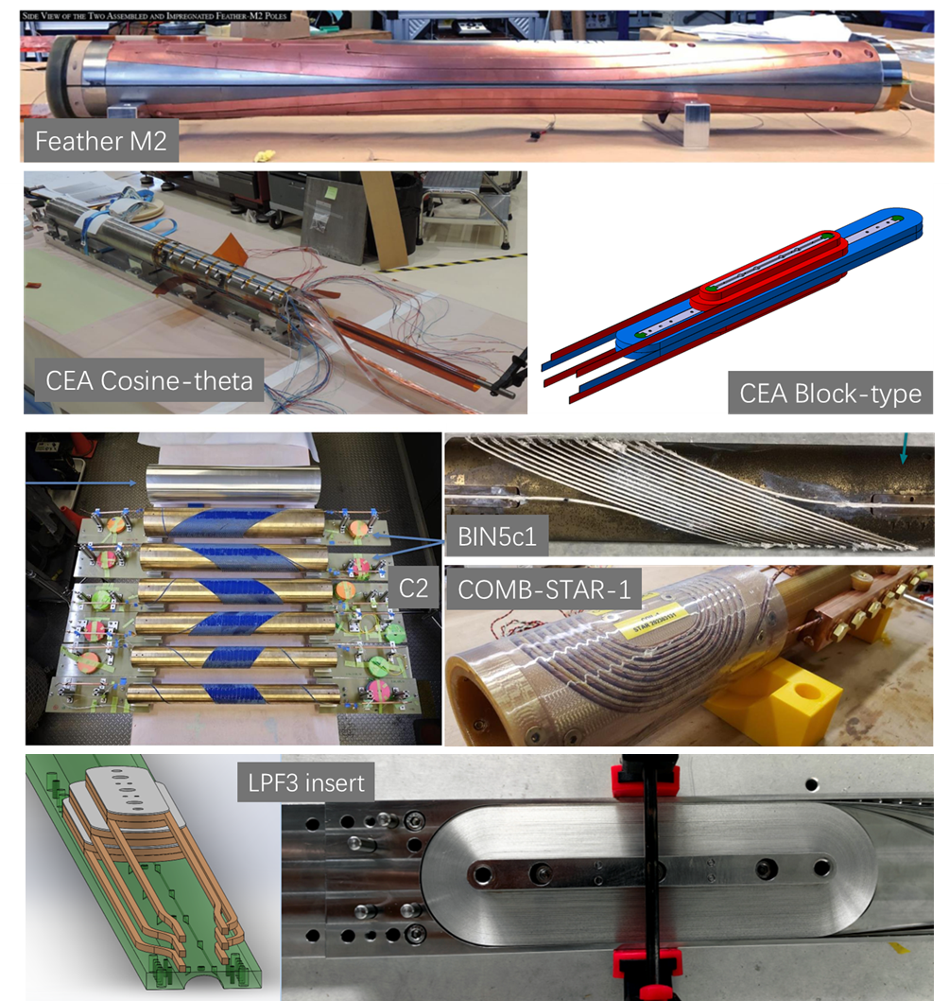
What have we learnt about REBCO?
19
Magnet prototype developed in the worldwide community?
Magnet name | Cable | Coil type | Temperature | Max current | Max field | Aperture | Year
Feather M2 (CERN) | Roebel cable | Block-type | 4.5 K | 9 kA | 4.5 T | 40 mm | 2020
Cos-theta (CEA) | Roebel cable | Cosine-theta | 4.5-6 K | 3 kA | 1.5 T | 40 mm | 2022
Block-type (CEA) | Stacked tape | Block-type (NI) | 4.2 K | 2.8 kA | 5.4 T | 40 mm | 2018
BIN5c1 (LBNL) | Bi-2212 Rutherford cable | Canted cosine theta (CCT) | 4.2 | 3.2 kA | 1.47 T | 31 mm | 2021
C2 (LBNL) | CORC wire | Canted cosine theta (CCT) | 4.2 | 6.29 kA | 2.9 T | 65 mm | 2021
COMB-STAR-1 (Fermilab) | STAR wire | Cosine-theta | 1.8 - 4.2 K | 3.27 kA | 1.5 T | 60 mm | 2024
LPF3-insert (IHEP) | Stacked tapes | Block-type (NI) | 4.2 K | designed 1.8 kA | designed 7 T | 20 mm | 2025
Notes:
As you may already been introduced with the basic knowledge about

Slide 20
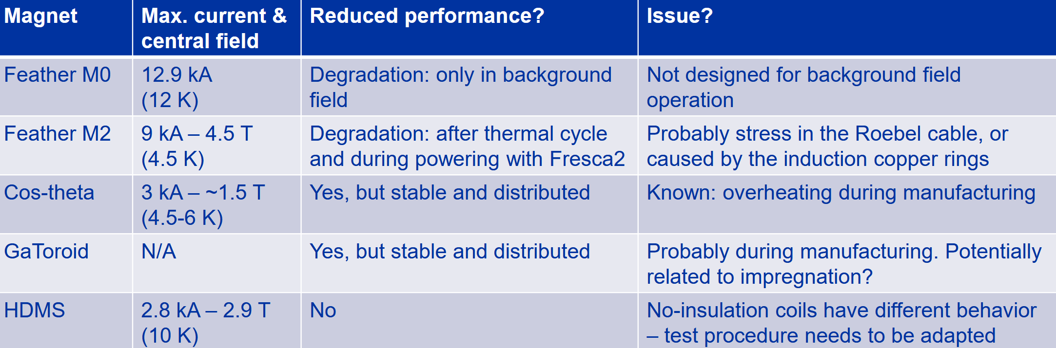
What have we learnt about REBCO?
20
Free of training due to high stability, but frequently sees degradation due to:
Mismatch of thermal contraction?
Cyclic Lorenz forces?
Stress concentration?
Overheating?
……
No Common understanding are concluded yet.
A summary of the EuCARD2 HTS magnet []
Notes:
As you may already been introduced with the basic knowledge about

Slide 21
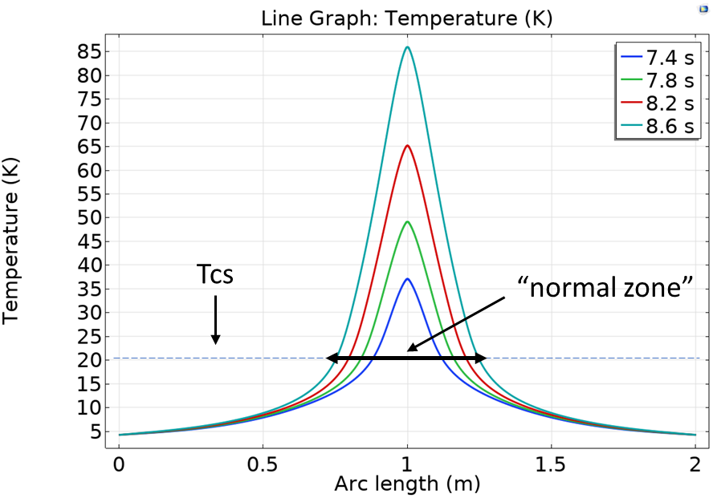
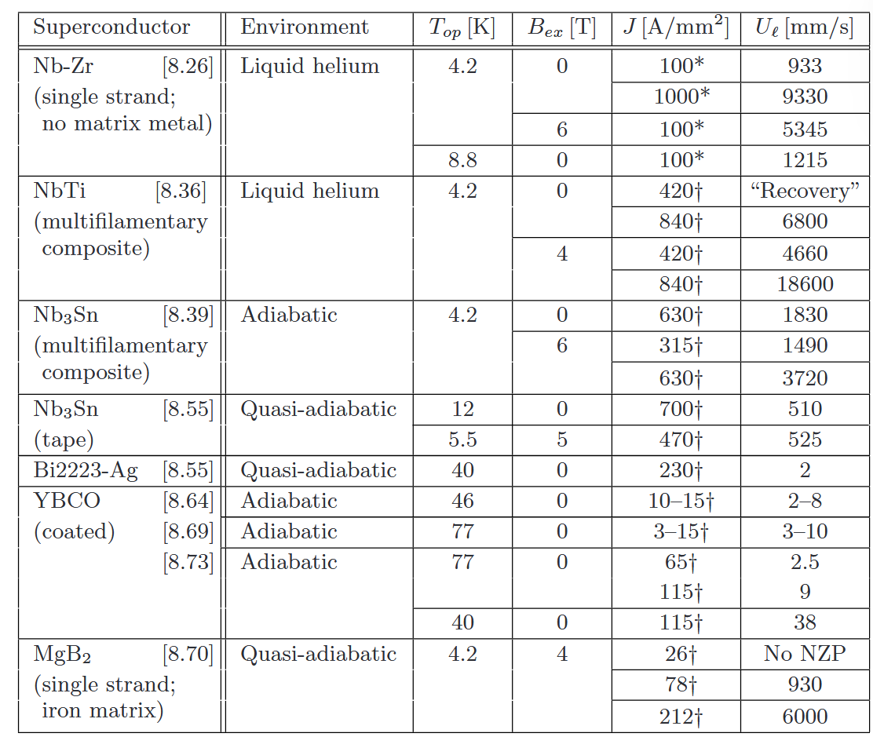
What have we learnt about REBCO?
21
Quench detection and protection
The prices paid for the excellent thermal stability are the challenges for quench detection and protection:
Low NZPV lead to low resistive voltage increase, critical for quench detection
High thermal stability also questions the efficiency of quench protection methods that evenly heat up the whole magnet, like quench heaters and CLIQ.
Higher specific heat capacity
Conductor temperature profile during quench development
A comparison of normal zone propagation velocity
Notes:
As you may already been introduced with the basic knowledge about

Slide 22
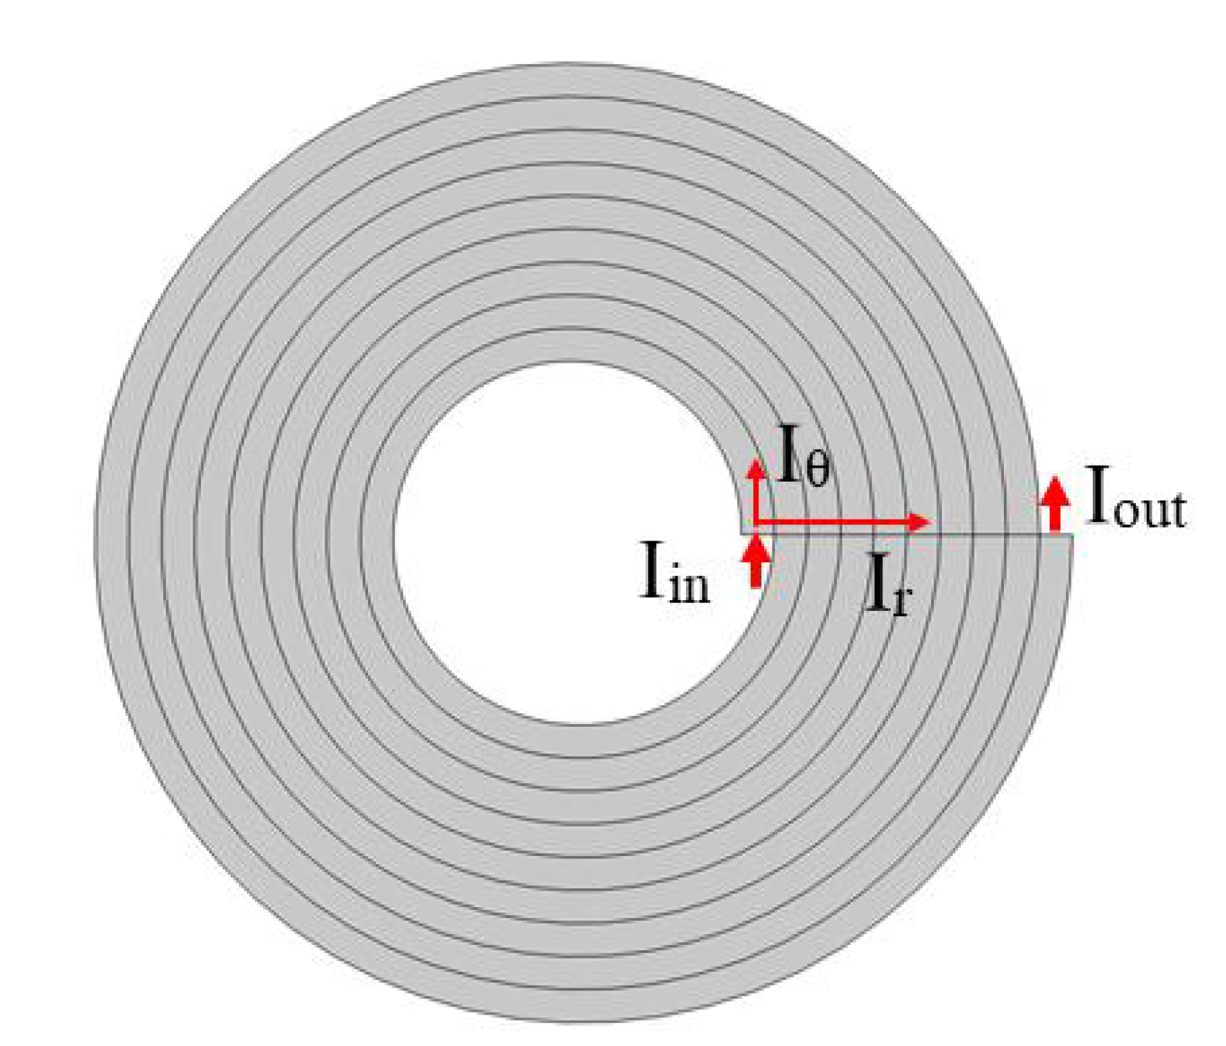
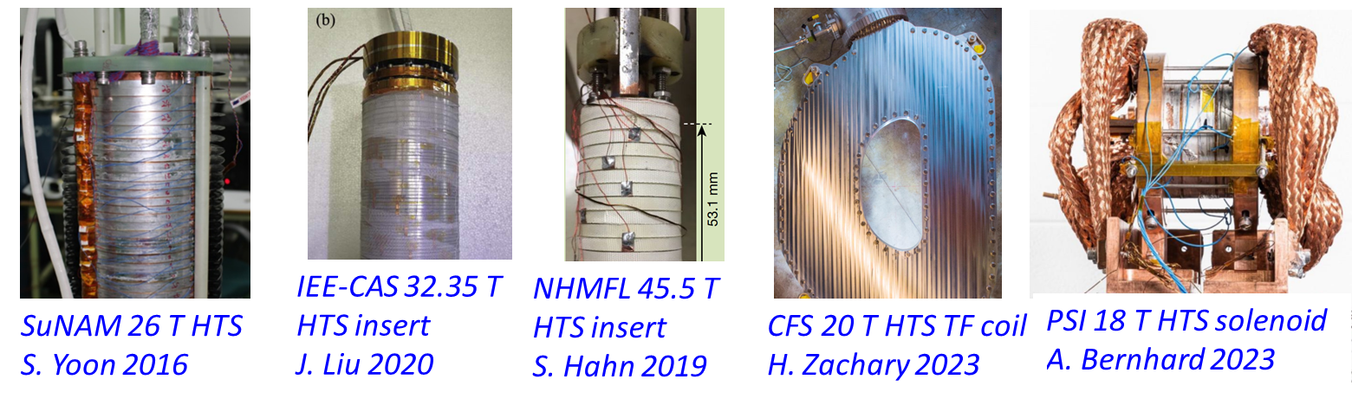
What have we learnt about REBCO?
22
The no-insulation coil winding
Even better stability (NI-LTS could also be free of training);
Passive quench protection mechanism;
Highest coil current density;
To be figured out:
Field delay
Field quality
Dump resistor is not available for quench protection
A no-insulation coil winding
Remarkable high magnetic field has been achieved with the NI coils.
Could it also be used at accelerator magnets?
I_{θ}
I_{p}
L
I_{r}
R_{r}
Notes:
As you may already been introduced with the basic knowledge about

Slide 23
A comparison between LTS and HTS
23
Up to now, the REBCO HTS conductor has shown significant differences in almost every step to make a dipole magnet as the LTS.
What would be a best, or at least a good approach to make a HTS dipole magnet?
 | Lessons from LTS | Status of HTS
wire | Transposed multifilament round wire | Single large filament, with extremely high aspect ratio
Cable | Transposed Rutherford cable | Various: Roebel, CORC, non-twisted stack
Magnet | Usually adopt the cosine-theta coils | Various: cosine-theta, block-type, CCT, common-coil
Stability | Ensure a good stability by retain enough margin, potting the coil with epoxy-resin and applying pre-stress; | Stable, free of quench, but observed degradation
Quench protection | Detect with resistive voltage, protect with dump resistor, quench heater, CLIQ… | Efficient and reliable detection and protection are both to be found out. No-insulation winding with passive pretection.
Notes:
As you may already been introduced with the basic knowledge about

Slide 24
Table of Contents
24
What have we learnt from LTS accelerator magnet?
What have we learnt about HTS?
Experiences and lessons learnt at IHEP
Notes:
As you may already been introduced with the basic knowledge about

Slide 25
Experience and lessons learnt at IHEP
25
R&D activities about REBCO dipole magnet at IHEP
Development of a partially transposed Roebel cable.
Study of No-insulation coils for accelerator dipole magnets.
Development of a LTS quench detector for REBCO magnet.
Development of a block-type REBCO dipole prototype.
Development of a CCT REBCO dipole prototype.

Slide 26
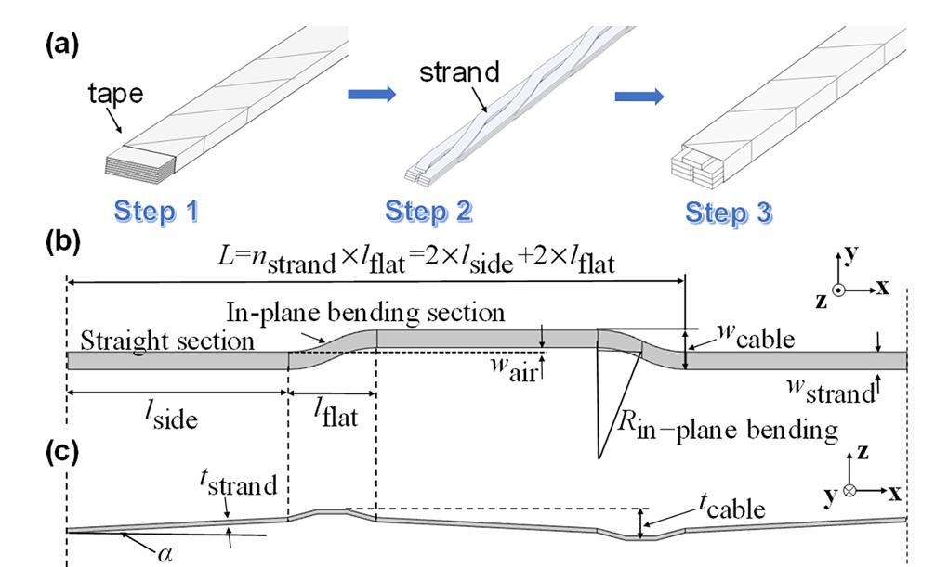
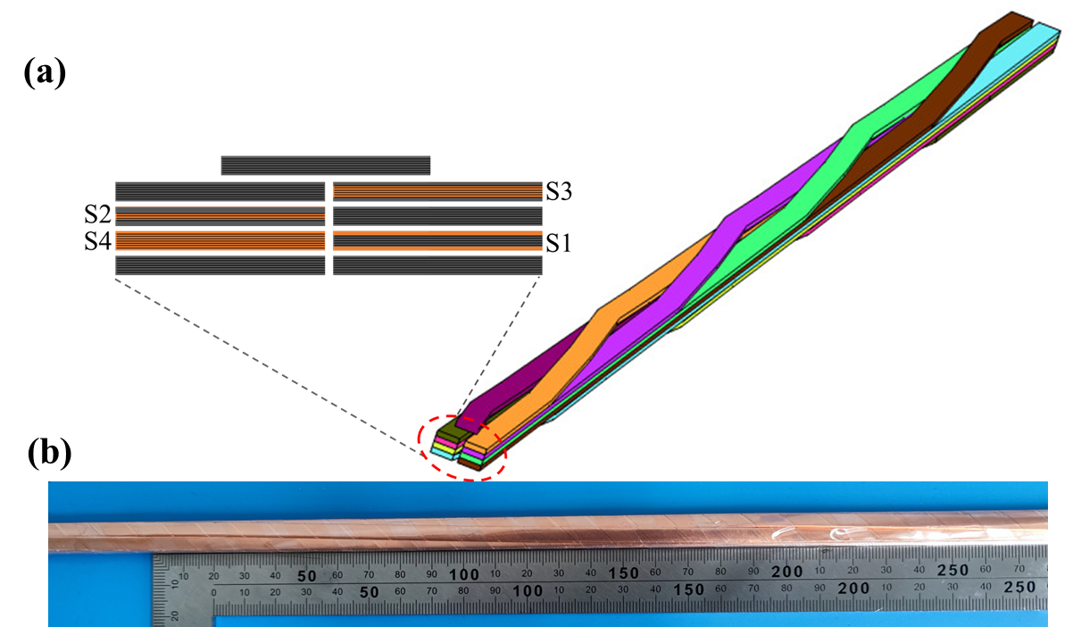
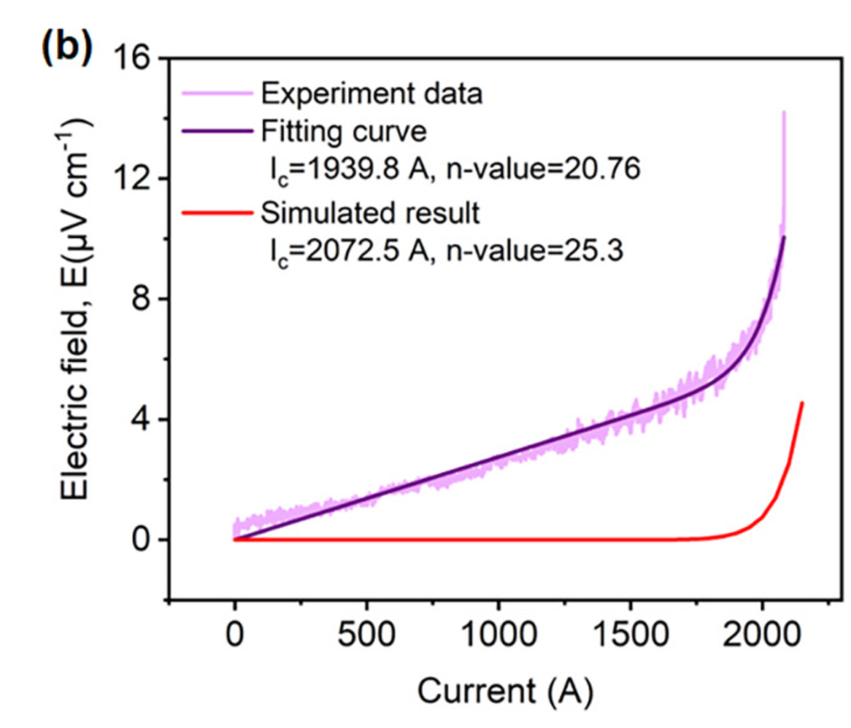
Experience and lessons learnt at IHEP
26
Development of a partially transposed Roebel cable
Prototype cable with 20 tapes
Configurations of the partially transposed Roebel cable

Slide 27
Experience and lessons learnt at IHEP
27
Study of No-insulation coils for accelerator dipole magnets
Bad field quality?
Real time field measurement and feedback control
Thermal instability by Joule heating?
Field excitation as desired
Additional inter-turn current
Pre-calculate the current charging curve based on coil characteristics
Higher stress due to Lorenz forces?
Quantitative description of the passive quench protection mechanism?
The challenges should not be a direct rejection of NI coils for accelerator magnets.
Instead, they offer many interesting research topics to study.

Slide 28
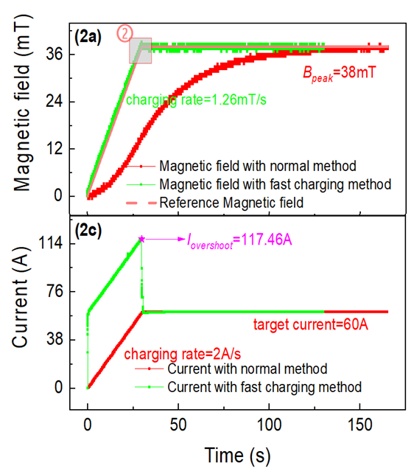
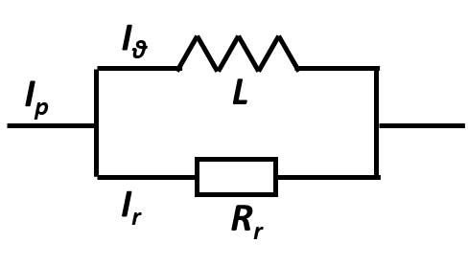
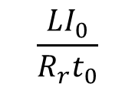






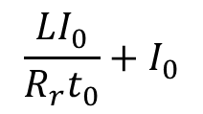
Experience and lessons learnt at IHEP
28
Study of No-insulation coils for accelerator dipole magnets
Field excitation as desired
$$I_{p}=I_{θ}+I_{r}$$
$$I_{θ}=\frac{I_{0}}{t_{0}}t$$
I_{p}
$$\frac{LI_{0}}{R_{r}t_{0}}+I_{0}$$
$$I_{r}R_{r}=L\frac{dI_{θ}}{dt}$$
$$I_{0}$$
$$I_{r}=\frac{L}{R_{r}}\frac{dI_{θ}}{dt}=\frac{LI_{0}}{R_{r}t_{0}}$$
$$\frac{LI_{0}}{R_{r}t_{0}}$$
$$I_{p}=\frac{LI_{0}}{R_{r}t_{0}}+\frac{I_{0}}{t_{0}}t$$
0
t₀
t
Relies on accurate prediction of the coil current distribution and generated magnetic field

Slide 29
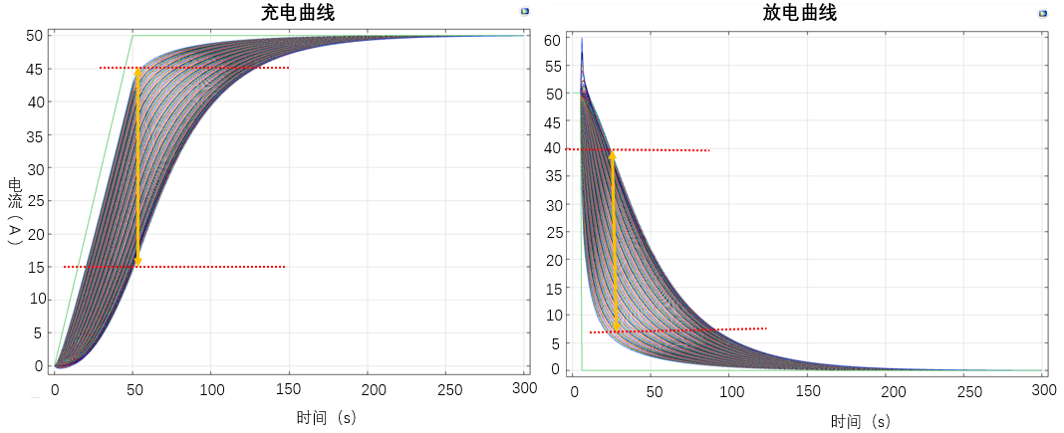
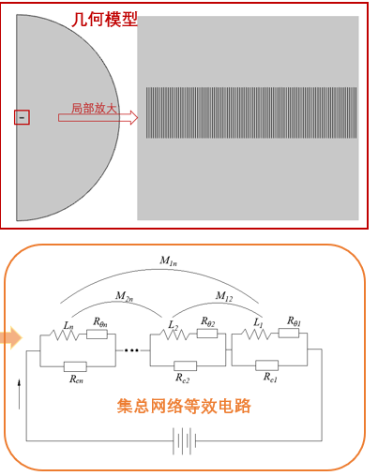
Experience and lessons learnt at IHEP
29
Study of No-insulation coils for accelerator dipole magnets
Field prediction by circuit network model
Current in different turns during charging
Current in different
turns during discharging
The current coupling inside a NI coils becomes much more complex as the scale of coil increase, and the lumped circuit model failed to precisely predict the field.
More dedicated model like circuit network model is being developed to predict an accurate coil current for a desired field.

Slide 30
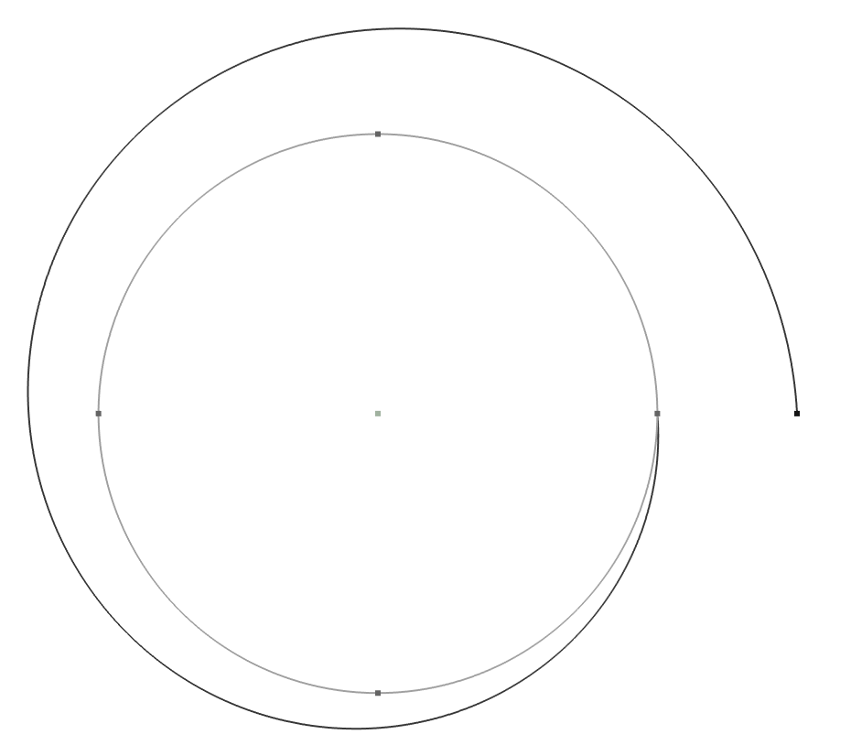
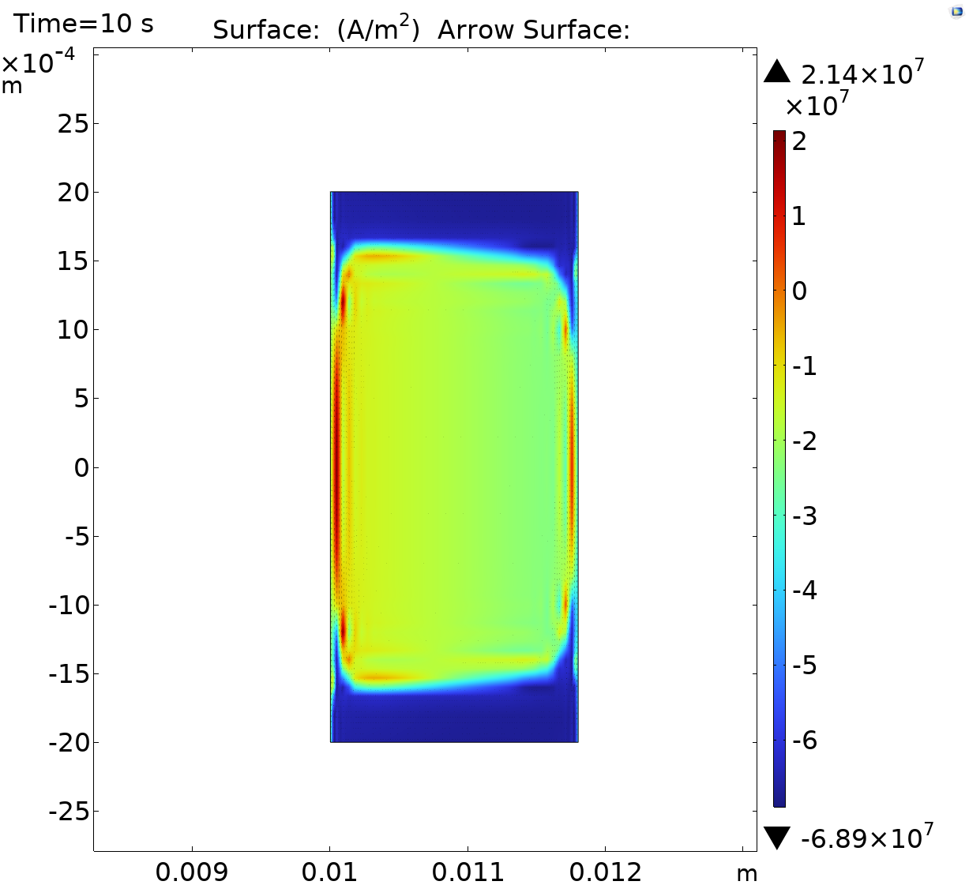


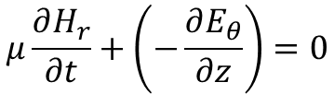





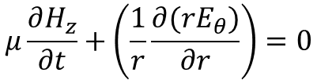

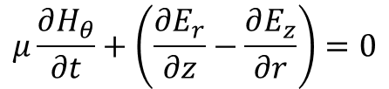
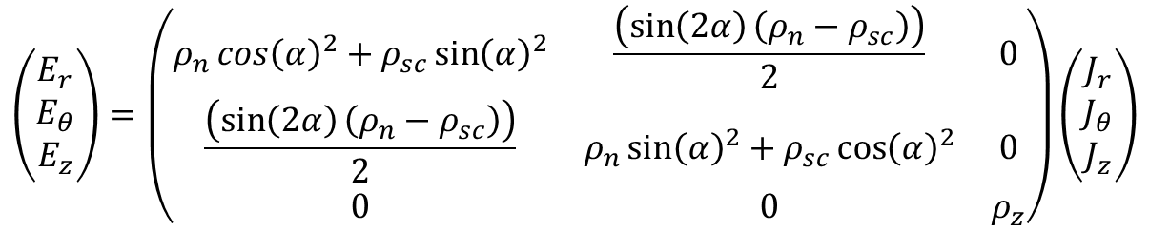

Experience and lessons learnt at IHEP
30
Study of No-insulation coils for accelerator dipole magnets
Field prediction by FEM model adopting rotated anisotropic resistivity
$$μ\frac{∂H_{r}}{∂t}+\left(−\frac{∂E_{θ}}{∂z}\right)=0$$
$$J_{r}=−\frac{∂H_{θ}}{∂z}$$
$$μ\frac{∂H_{θ}}{∂t}+\left(\frac{∂E_{r}}{∂z}−\frac{∂E_{z}}{∂r}\right)=0$$
$$J_{θ}=\frac{∂H_{r}}{∂z}−\frac{∂H_{z}}{∂r}$$
$$\hat{θ}$$
$$\hat{n}$$
$$\hat{r}$$
$$μ\frac{∂H_{z}}{∂t}+\left(\frac{1}{r}\frac{∂({rE}_{θ})}{∂r}\right)=0$$
$$J_{z}=\frac{1}{r}\frac{∂{(rH}_{θ})}{∂r}$$
$$−\hat{θ}$$
$$α$$
$$\hat{t}$$
$$\left(\begin{matrix}E_{r} \\ E_{θ} \\ E_{z}\end{matrix}\right)=\left(\begin{matrix}ρ_{n}{\cos\left(α\right)}^{2}+ρ_{sc}{\sin\left(α\right)}^{2} & \frac{\left(\sin\left(2α\right)\left(ρ_{n}−ρ_{sc}\right)\right)}{2} & 0 \\ \frac{\left(\sin\left(2α\right)\left(ρ_{n}−ρ_{sc}\right)\right)}{2} & ρ_{n}{\sin\left(α\right)}^{2}+ρ_{sc}{\cos\left(α\right)}^{2} & 0 \\ 0 & 0 & ρ_{z}\end{matrix}\right)\left(\begin{matrix}J_{r} \\ J_{θ} \\ J_{z}\end{matrix}\right)$$

Slide 31
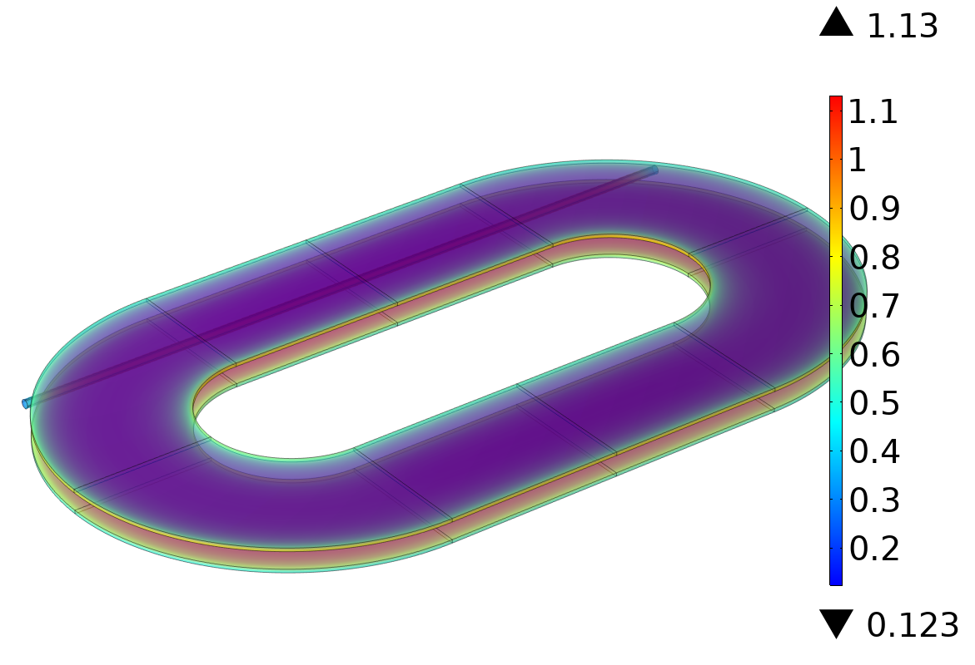
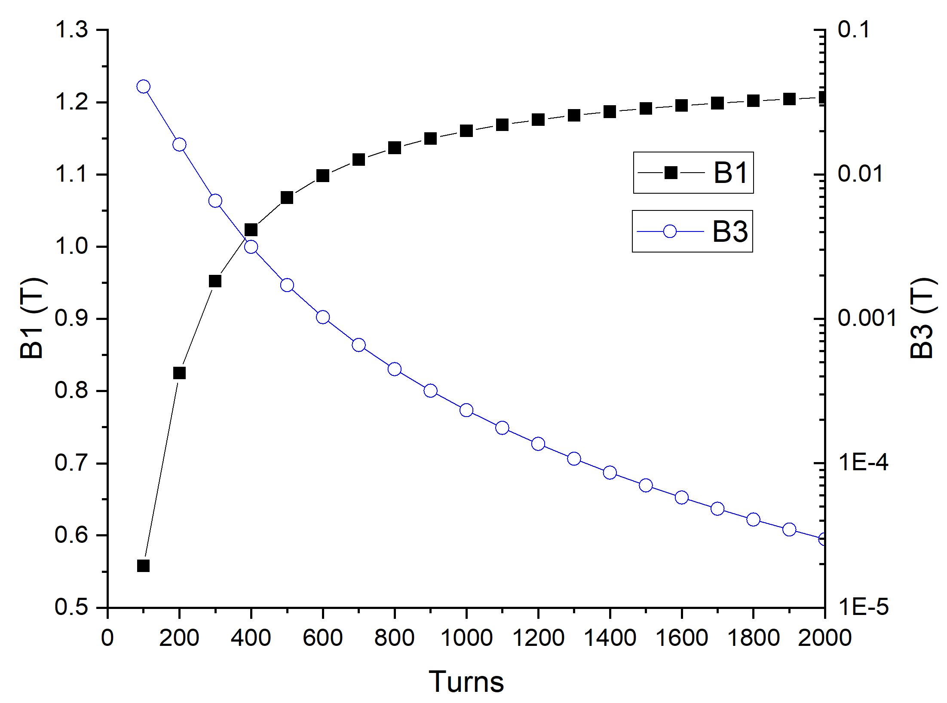
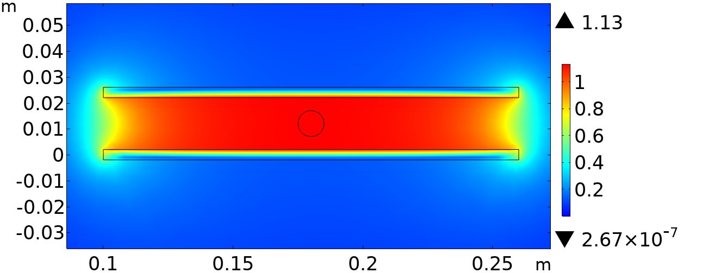
Experience and lessons learnt at IHEP
31
Study of No-insulation coils for accelerator dipole magnets
A simple example
As a first step, the dipole field generated by two racetrack single pancake coils are studied.
The field is calculated assuming insulated configuration and uniform current density.
Each coil is assumed with 800 turns for the later comparison.
Tape width | 4 mm
Tape thickness | 0.2 mm
Coil inner radius | 0.1 m
Length of straight section | 0.4 m
Coil spacing | 20 mm
Reference radius | 5 mm
Current in one tape | 200 A
Turns | 800

Slide 32
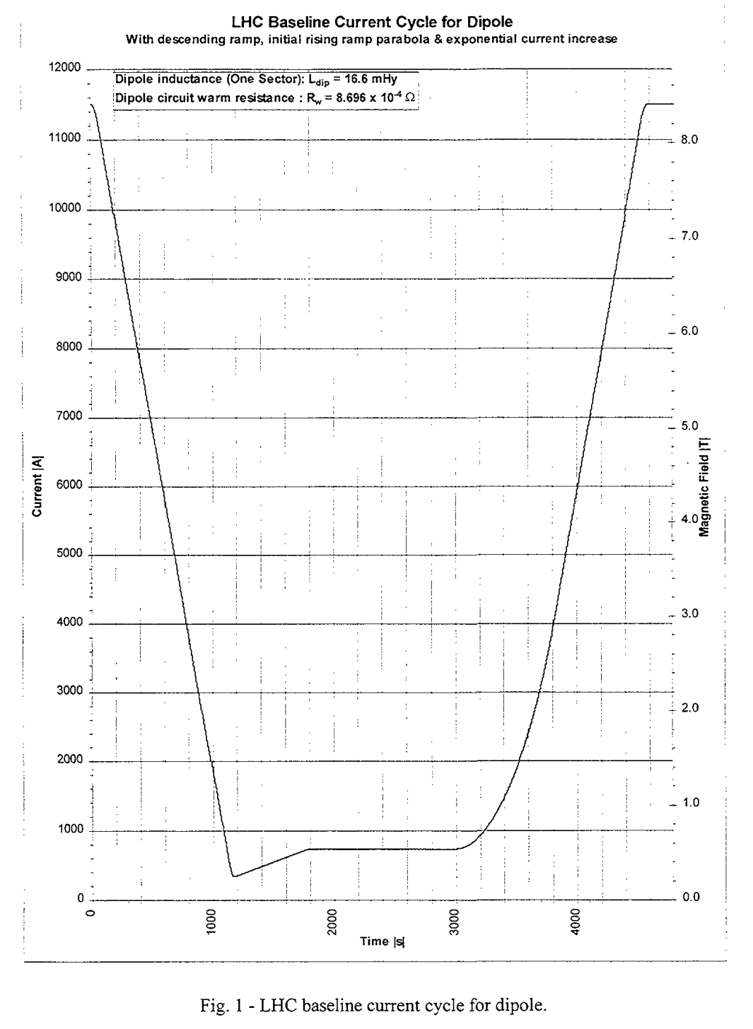

Experience and lessons learnt at IHEP
32
The self-inductance of each coil is calculated as about 0.49 H.
If the pair of racetrack coils are wound with NI method, assuming a contact resistivity Rc low to 1 μΩ·cm² (will be discussed later), then the total inter-turn resistance Rr is about 10 μΩ.
Consequently, the time constant of the circuit is about 13.2 h.
It means a day long field exciting with a conventional charging method and an extremely small field excitation speed low to Gs/s. As a comparison, it takes less than 30 min for a LHC dipole to finish one excitation, with the rate less than 10 mT/s.
To achieve a similar field excitation rate (10 mT/s), the additional current, that is the inter-turn current (I_{r}), has to be charged to the coil is then:
L. Bottura 1998
$$I_{r}=\frac{L}{R_{r}}\frac{dI_{θ}}{dt}\sim$$
8384 A >> 200 A
It is a very large value, but if we look at the current density:
J_{θ}~200/(0.004·0.0002)=2.5e8 A/m² >> J_{r}=8384/(1.93·0.004)=1.08e6 A/m²

Slide 33
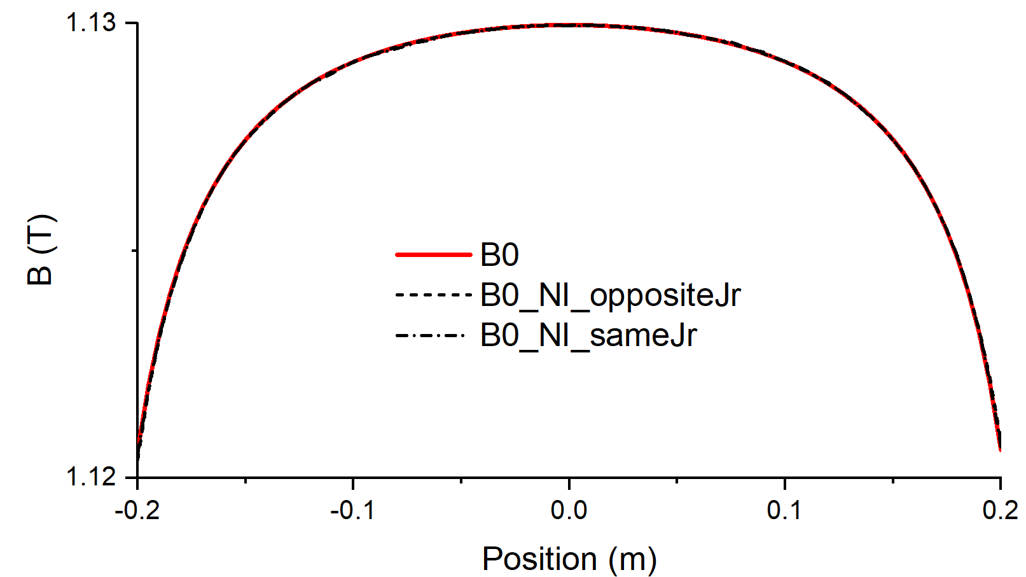
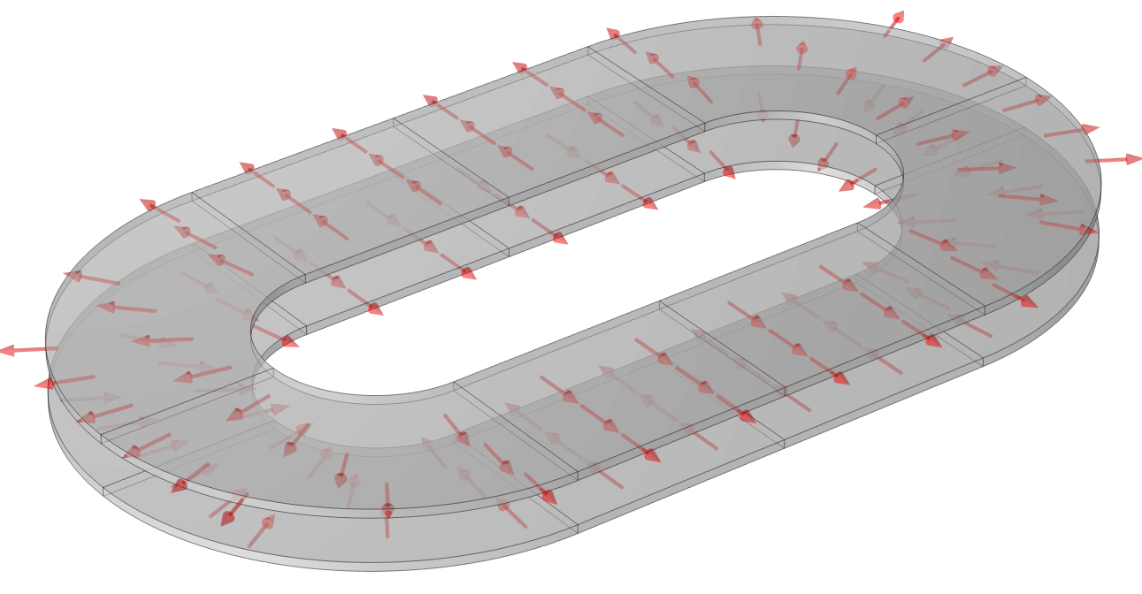



Experience and lessons learnt at IHEP
33
The radial currents in two coils could have different directions.
Calculation shows in both direction the radial current has little influence on field quality, the variation of b2 and b3 are less than 0.0001 even with the high I_{r}~8384 A.
  Magnetic field depends on current density, instead of current:$J=∇×H$
Field components along the straight section

Slide 34







Experience and lessons learnt at IHEP
34
Compared to field quality, Joule heating power is a much more critical problem: Pr~728W!
On the other hand, even in traditional insulated coils, turns and operating current are two factors always to be played to get suitable coil inductance and operating current.
In a Ni coil:
$$I_{0}\sim \frac{1}{n}$$
$$L\sim n^{2}$$
$$R_{r}\sim \left(n−1\right)\sim n$$
but
$$I_{r}(n)=\frac{LI_{0}}{R_{r}t_{0}}$$
Is independent on number of turns.
$$τ=\frac{L}{R_{r}}\sim n$$
Adiabatic temperature rising
We can conclude some important facts from the above relations:
Enhance the operating current of each turn (as well as tapes in each turn) could reduce the number of turns and the delay time constant τ；
However, if the same exciting rate of field is required, then I_{r} doesn’t change, but the joule heating power changes with n:
Therefore, by playing with n, the thermal effect could be greatly reduced for almost the same coil.
$$P_{r}=I_{r}^{2}R_{r}\sim n$$

Slide 35




Experience and lessons learnt at IHEP
35
$$h=10000∙{∆T}^{1.5} W/{(m}^{2}K)$$
V. Sciver 1986
Assuming a good thermal contact for the tapes (corresponding to a low Rc), then even if there is only the outermost turn is applied with a helium cooling, the coil temperature could be greatly reduced.

Slide 36



Experience and lessons learnt at IHEP
36
In the above analysis, the Rc of NI coil is actually assumed a very small value~1μΩ·cm2；
If it is increased, then Ir and related heat load could both be greatly reduced.
The question is, what would be a proper value regarding quench protection
$$P_{r}=I_{r}^{2}R_{r}$$
$$I_{r}=\frac{LI_{0}}{R_{r}t_{0}}$$
Assumed in this discussion
Better quench protection
Lower field delay and Joule heating

Slide 37

Experience and lessons learnt at IHEP
37
Study of No-insulation coils for accelerator dipole magnets
Impregnation with Fusible alloy
Fusible alloy | Melting point [℃] | Resistivity at 77 K [Ω·m]
Pb43-Bi50-Cd7 | 82 | 2.20×10⁻⁷
Pb40-Bi52-Cd8 | 92 | 2.99×10⁻⁷
Pb30-Sn18-Bi52 | 100 | 3.52×10⁻⁷
Cd25-In75 | 120 | 5.60×10⁻⁷
Sn43-Bi57 | 138 | 1.67×10⁻⁷
Pb47-Sn29.5-Bi23.5 | 152 | 4.30×10⁻⁸
Nearly linear relation between Rc and resistivity
No degradation after impregnation
What if the tape is coated with high resistance metal or alloy? Experiments are on going

Slide 38

Experience and lessons learnt at IHEP
38
Development of a LTS quench detector for REBCO magnet.
LTS as quench detector for HTS
Difference in resistivity variation as temperature is the principle
Simulated voltage in REBCO and NbTi quench detector

Slide 39

Experience and lessons learnt at IHEP
39
Development of a LTS quench detector for REBCO magnet.
At the favorable field for REBCO ( >15 T), only Nb3Sn could retain some critical current, however
Nb3Sn needs heat treatment up to 600+ ℃ and becomes very fragile afterwards.
REBCO loss its superconductivity very soon at high temperature above 200℃.
How to overcome the above contradictions, to detect quench of REBCO magnet with Nb3Sn conductor？
Heater
SC coil
Is it possible to reverse the process of the quench heater, to make quench detectors?
Quench heater could heat up SC coils to quench in 10 ms, the reverse process is expected to be more efficient.
Quench detector could be manufactured and reacted alone, and then impregnated with REBCO coil together.
Quench heater
SC coil

Slide 40




Experience and lessons learnt at IHEP
40
Development of a LTS quench detector for REBCO magnet.
NbTi and Nb3Sn quench detectors have been made and tested.
V-T curves of cooling down and warming up of NbTi quench detector
NbTi quench detector
Nb3Sn quench detector
Response of NbTi quench detector to a heat pulse

Slide 41





Experience and lessons learnt at IHEP
41
Development of a CCT REBCO dipole prototype.
“Tilted solenoid” wound by non-twisted stacked tapes:
Free of in-plane-bending.
High current density.
No need for cabling or co-winding.
Can be wound automatically with constant tension.
Higher critical current due to field angle.
“Tilted solenoid” type CCT @ IHEP
Typical CCT：
Easy to manufacture the coil former.
Un-avoidable in-plane-bending at small radius.
Winding with hand with unstable winding tension.
Othe HTS CCT coil
Typical CCT
CCT with CORC
Low current density；
Higher critical bending radius；
CCT with CORC

Slide 42

Experience and lessons learnt at IHEP
42
“Tilted solenoid” type CCT @ IHEP
Typical CCT
Bending strain of one REBCO tape for different CCT coil geometry

Slide 43



Experience and lessons learnt at IHEP
43
A 3 T prototype magnet
Tilted angle | 20° | Size of tape channel [mm] | 4.2×4.2
Inner radius of inner layer [mm] | 7.5 | Tape numbers | 56 (53 in reality)
Outer radius of inner layer [mm] | 15.9 | Turns | 22
Inner radius of outer layer [mm] | 16.6 | Coil length [mm] | 384/425
Outer radius of outer layer [mm] | 23.5 | Magnetic length [mm] | 308
Turn spacing [mm] | 14 | Operating current [A] | 220×4
Average length per turn [mm] | 173/272 | Target field [T] | 3 (2.79 for 53 tapes)
Size of REBCO tape [mm] | 4×0.07

Slide 44


Experience and lessons learnt at IHEP
44
To adapt a pair of 1 kA current lead, the 53 tapes in each layer of coil are divided into 13 sections (4×12+5) and are connected as drawn below. In such a way, the joint resistance is included inside the coil.
Consequently, the current in coil could be eternally shared to the radial direction!
The joints
I_{θ}
I_{p}
L
R_{j}
simplified
I_{r}
R_{r}

Slide 45


Experience and lessons learnt at IHEP
45
The HTS-CCT insert is tested in LN2, and the field only reaches about 30%, indicating a significant influence from joint resistance.
Using an electrical circuit grid simulation model, Rc and Rj are swept for the influence on the charging process.
With Rc of 40 μΩ·cm² and Rj of 100 nΩ, the simulated field agrees well with tested results.
The result exclude the NI-CCT coil with many joints.
LN2 tested results

Slide 46




Experience and lessons learnt at IHEP
46
The coil is greatly damaged even before its own testing, possibly due to:
Assembly with the Nb3Sn coils and the pre-stress procedure.
Mismatch of thermal contraction between coil former (aluminum alloy) and the REBCO tapes
Cyclic load generated during charging and quench of Nb3Sn coils (most likely, deduced from the wrinkles among the tapes.)

Slide 47



Experience and lessons learnt at IHEP
47
A new test coil is being developed:
Assembled 3D printed spliced stainless steel coil former.
Large current operation without joints.
Fossil alloy impregnated.

Slide 48


Experience and lessons learnt at IHEP
48
A new test coil is being developed:
6 REBCO tapes wound, with a critical current of 560 A as expected.
Very smell field delay even after solder impregnation, due to the SS former.
A full-scale test coil is to be manufactured soon.

Slide 49




Experience and lessons learnt at IHEP
49
Several block-type test coils are also being developed:
Wound by co-wound non-twisted stacks
No-insulation or stainless-steel tape co-wound
Degradation is also observed after cyclic load
A new coil is being tested this week

Slide 50
Summary
50
Learn the lessons, but be open minded.
 | Lessons from LTS | Status of HTS
wire | Transposed multifilament round wire | Single large filament, with extremely high aspect ratio
Cable | Transposed Rutherford cable | Various: Roebel, CORC, non-twisted stack
Magnet | Usually adopt the cosine-theta coils | Various: cosine-theta, block-type, CCT, common-coil
Stability | Ensure a good stability by retain enough margin, potting the coil with epoxy-resin and applying pre-stress; | Stable, free of quench, but observed degradation
Quench protection | Detect with resistive voltage, protect with dump resistor, quench heater, CLIQ… | Efficient and reliable detection and protection are both to be found out. No-insulation winding with passive protection.
 |  | ……
Thanks for your attention!

