Slide 1


Hands-on Training 2
Critical Current Measurement of Superconductors
Institute of High Energy Physics, CAS
Chunyan Li, Fan Ren
High Field Superconducting Magnet Group

Slide 2


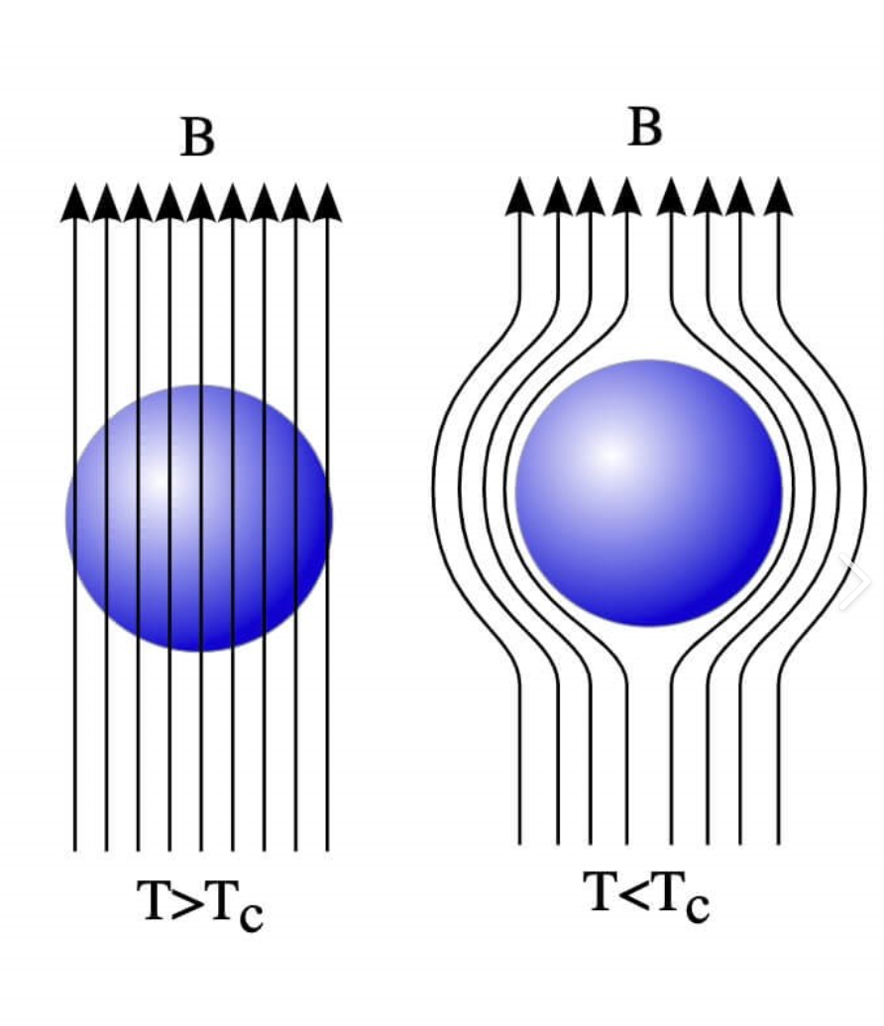
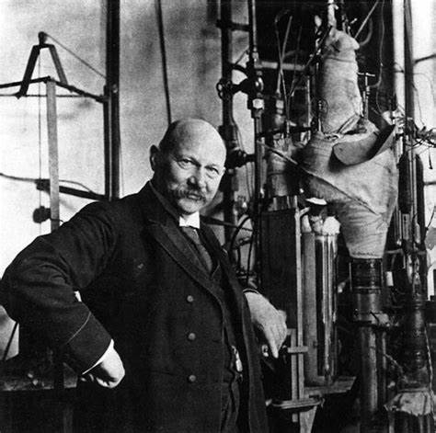
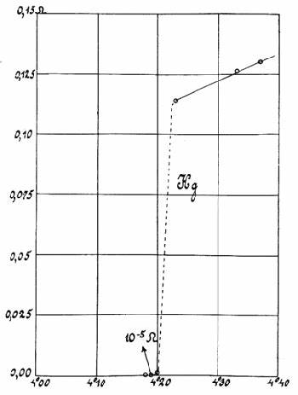
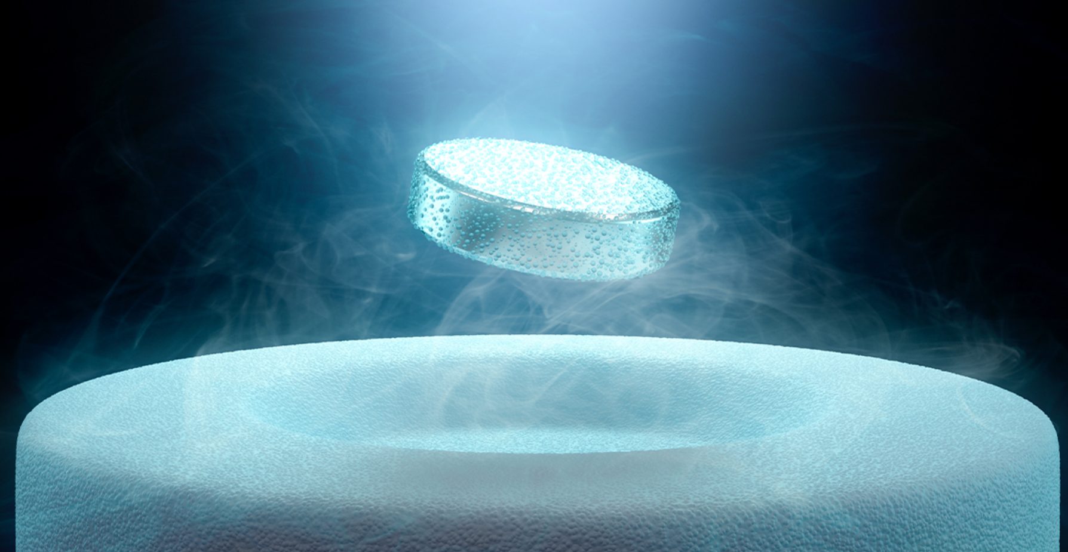
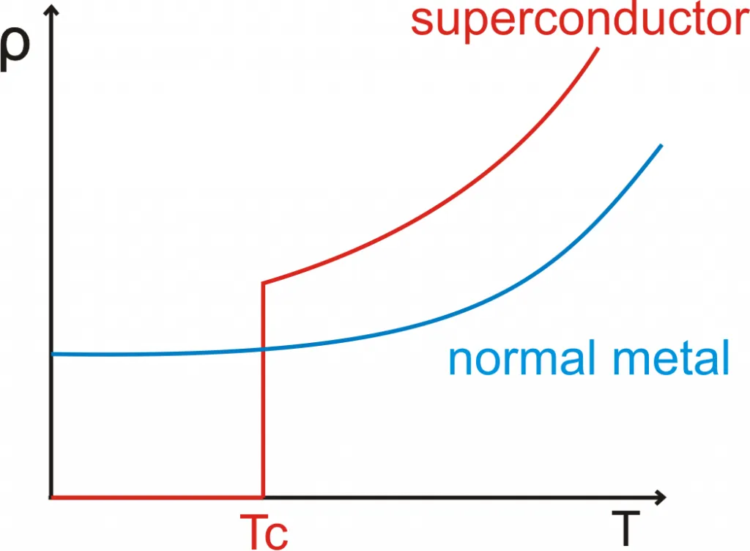
What is Superconductor（超导体）?
Superconductivity discovered in 1911 by Onnes:
Zero resistance of mercury (Hg) wire at 4.2 K
Meissner effect （迈斯纳效应）
Below its critical temperature (T_{c}), a superconductor exhibits the expulsion of magnetic fields.
Zero resistance （零电阻）
Below its critical temperature (T_{c}),
a superconductor’s resistance drops to zero.
Perfect diamagnetism (完全抗磁性）

Slide 3
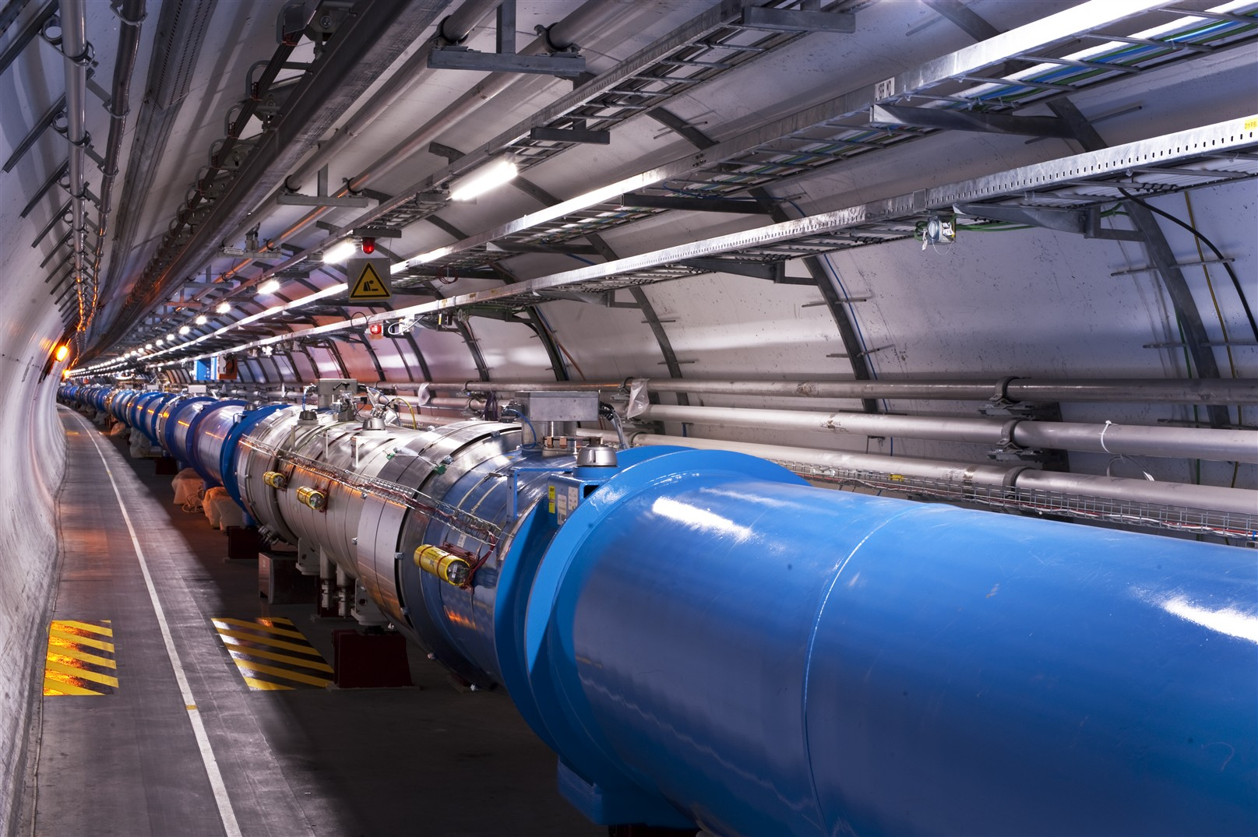
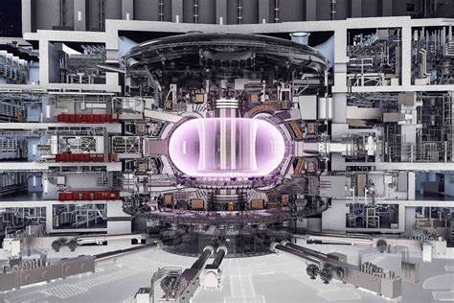
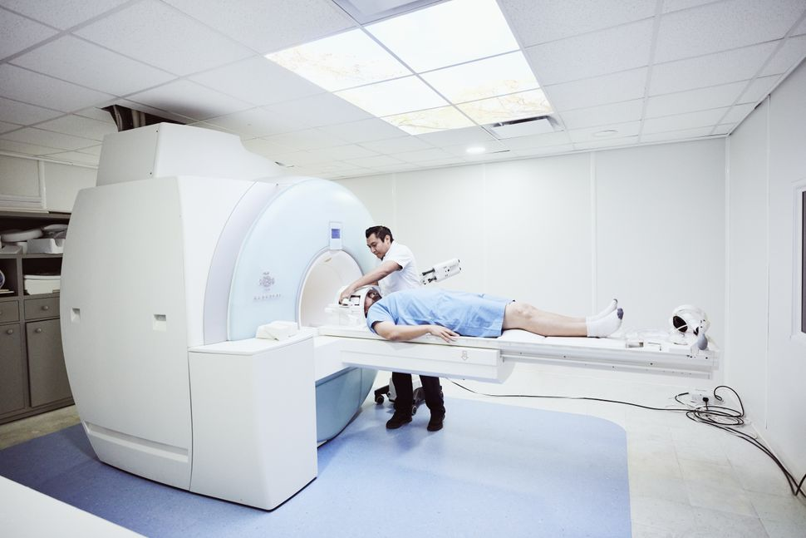
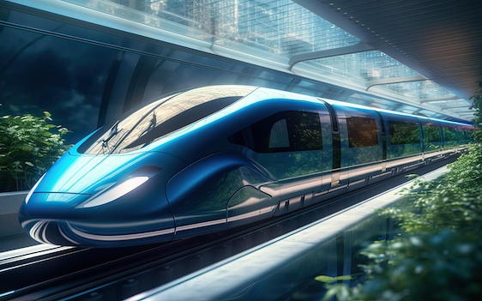
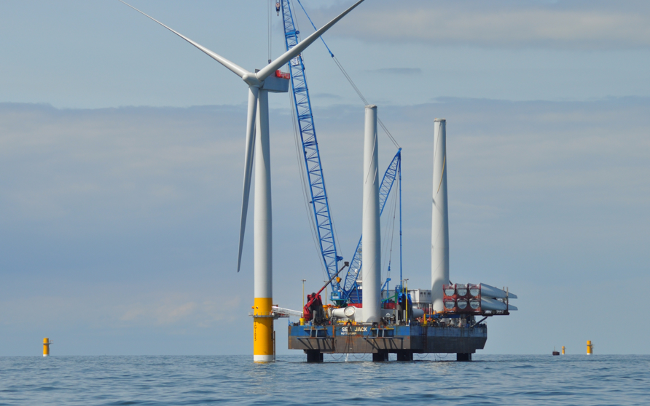
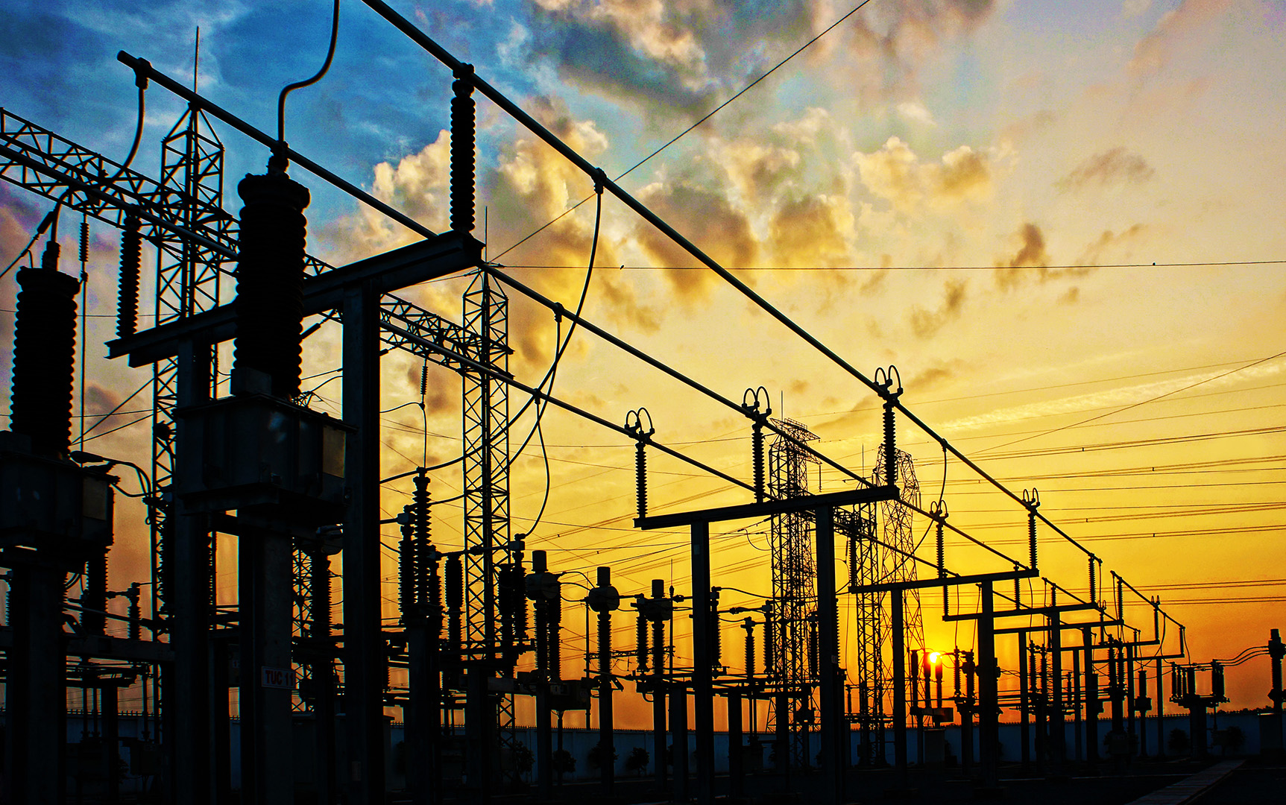
Application Fields
Particle Accelerator
Nuclear Fusion
Magnetic Resonance Imaging
Magnetic Levitation Train
Wind Turbine Generator
Power Transmission

Slide 4
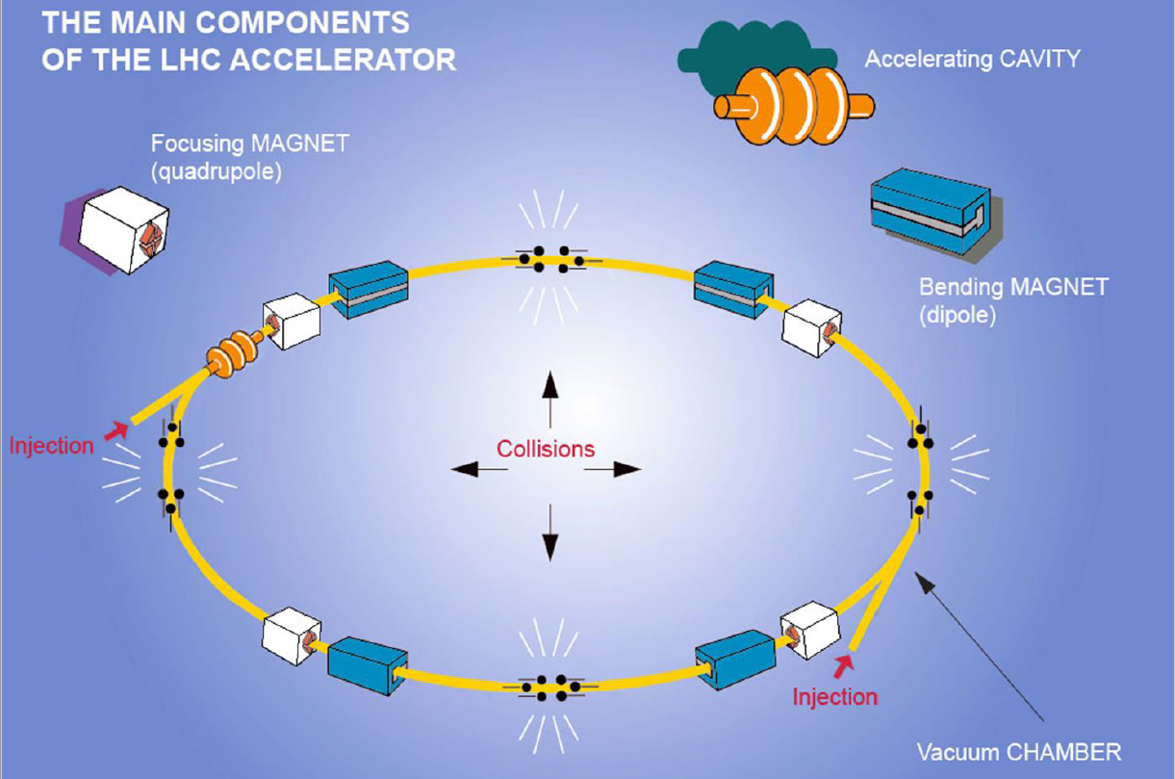
Circular Particle Accelerator
The energy of an accelerator is proportional to the magnetic field strength of the dipole magnets and the circumference of the ring.
Magnetic Field
磁场强度
Energy
质心能量
Circumference环的周长
Next generation super-high energy accelerator rely on high field (16-24 T) dipole magnet.

Slide 5
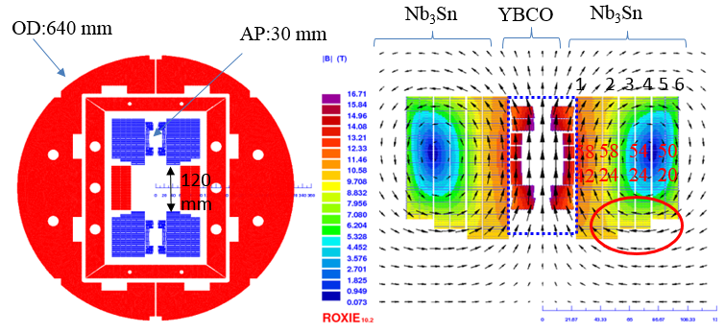
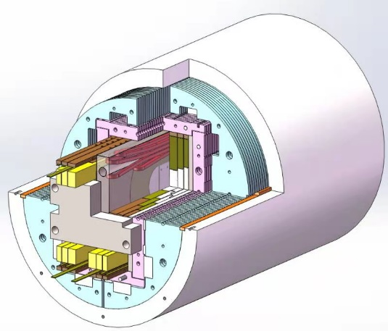
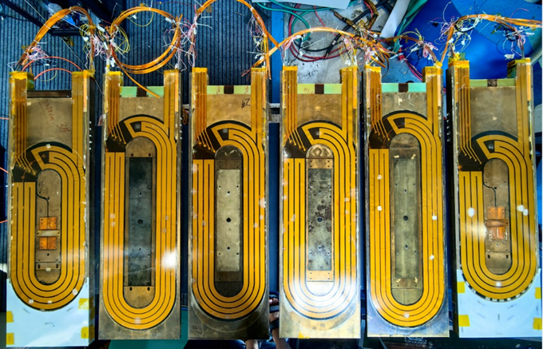
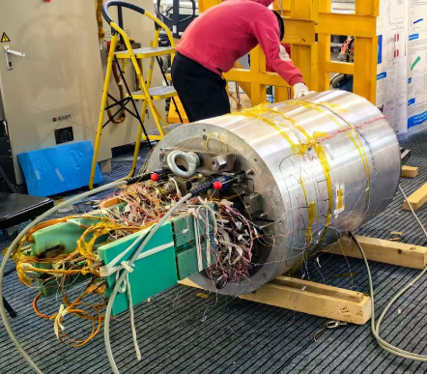
Superconducting Dipole Magnet-超导二极磁体
LTS + HTS
Electromatic and mechanical
design of superconducting
dipole magnet
B[T ]
Fabrication of racetrack coils
Dipole magnet assembly
Nb₃Sn coils
Dipole Magnet

Slide 6
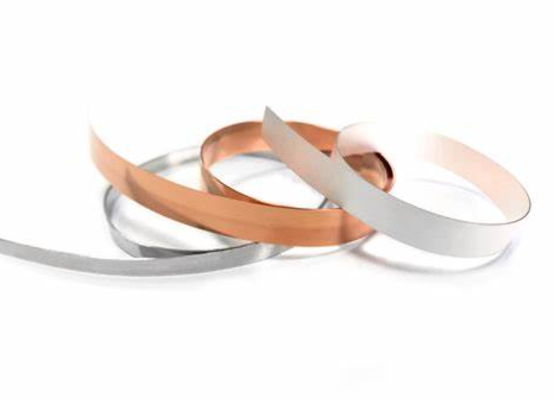
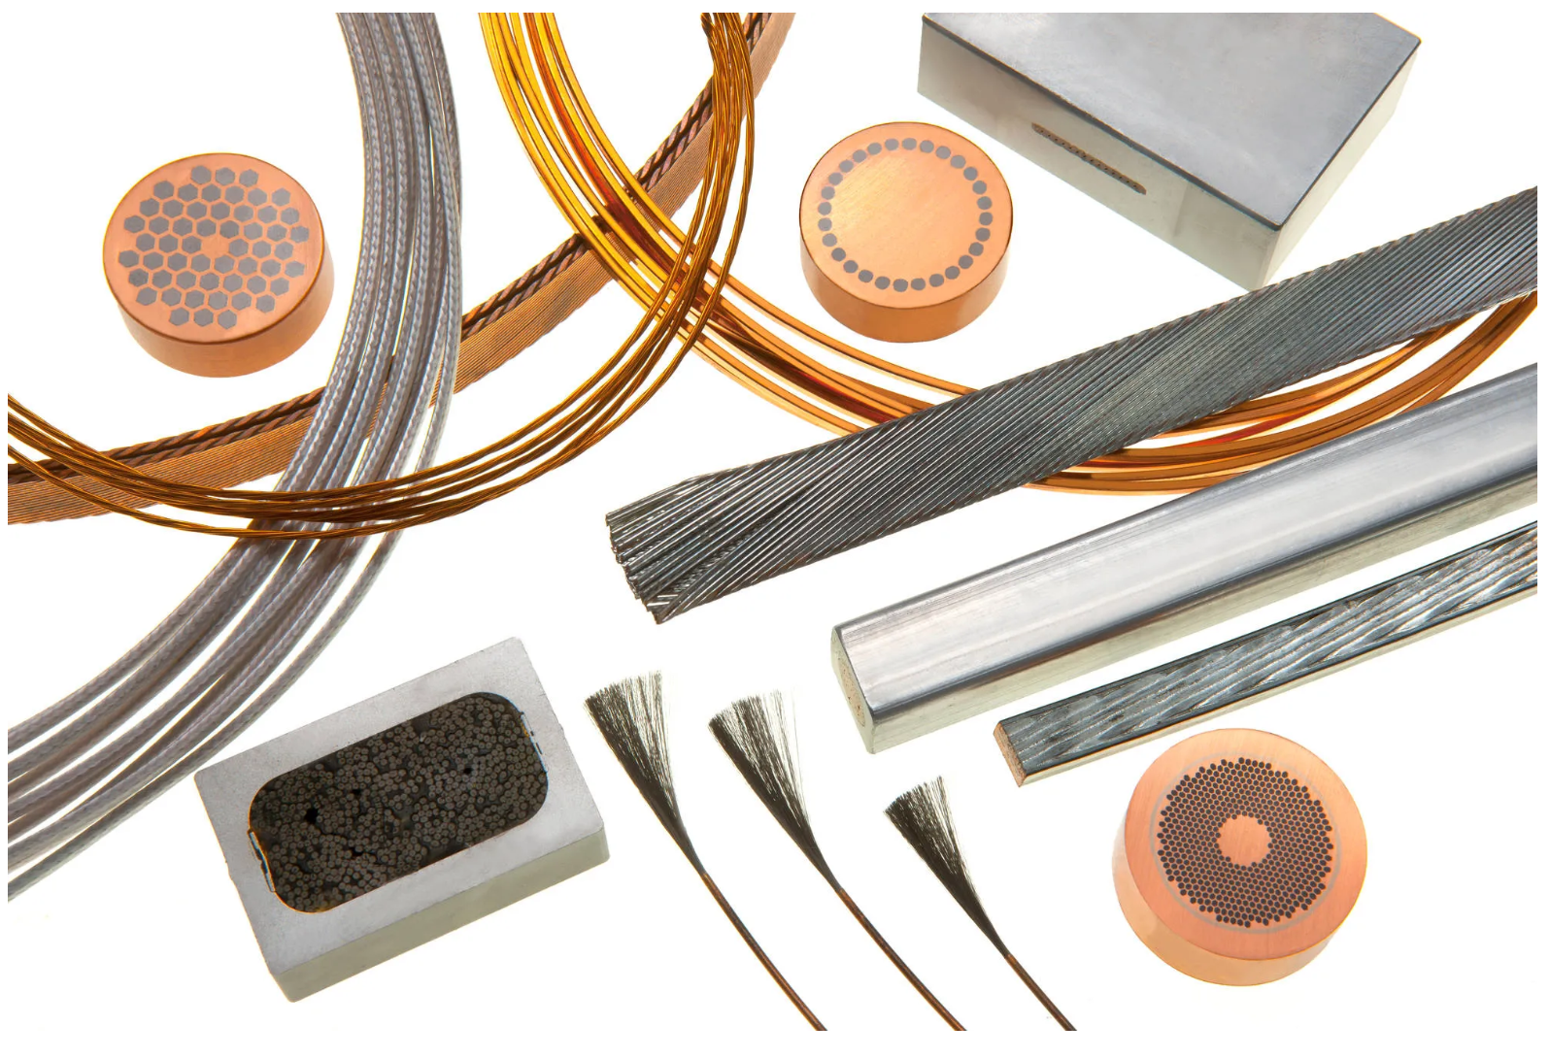
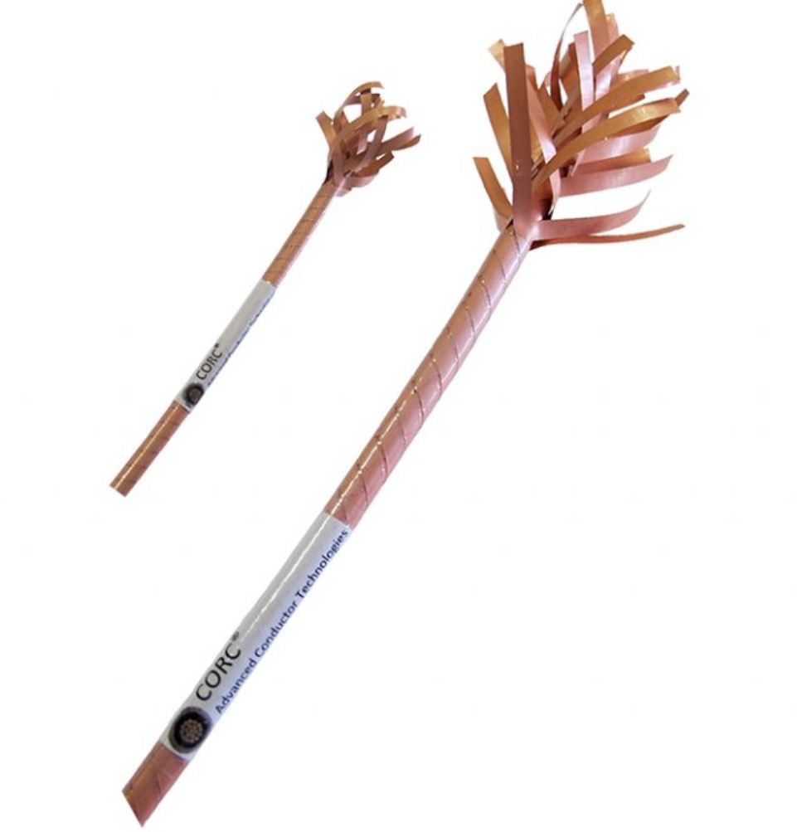
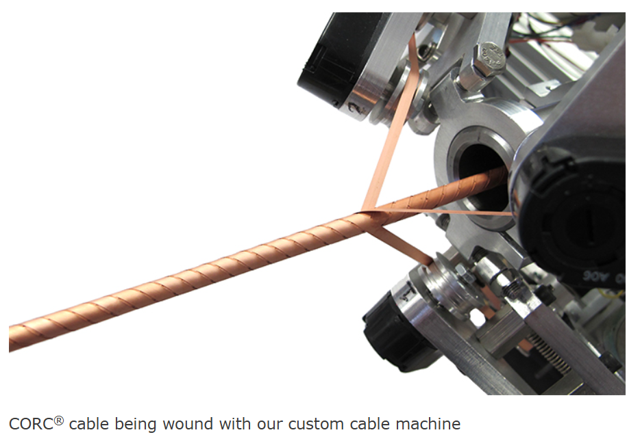
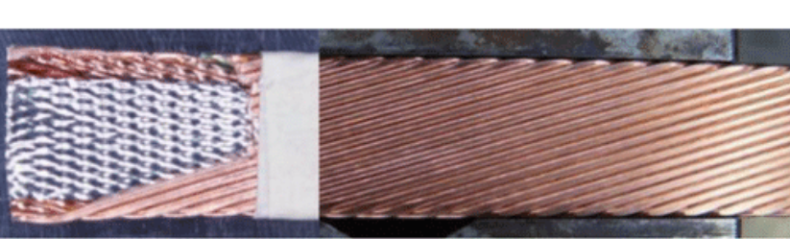
Superconductors (SCs)
Low temperature superconductor (LTS)
High temperature superconductor (HTS)
Luwata
SST 上海超导
NbTi (铌钛), Nb₃Sn (铌三锡) superconductors
Wires with single superconducting filament to tens of thousands of ultra fine filaments.
Rutherford cable
HTS tape - REBCO
Conductor on Round Core (CORC) cable
LTS is used in liquid Helium (4.2 K)
HTS can be used in liquid hydrogen (77 K)

Slide 7
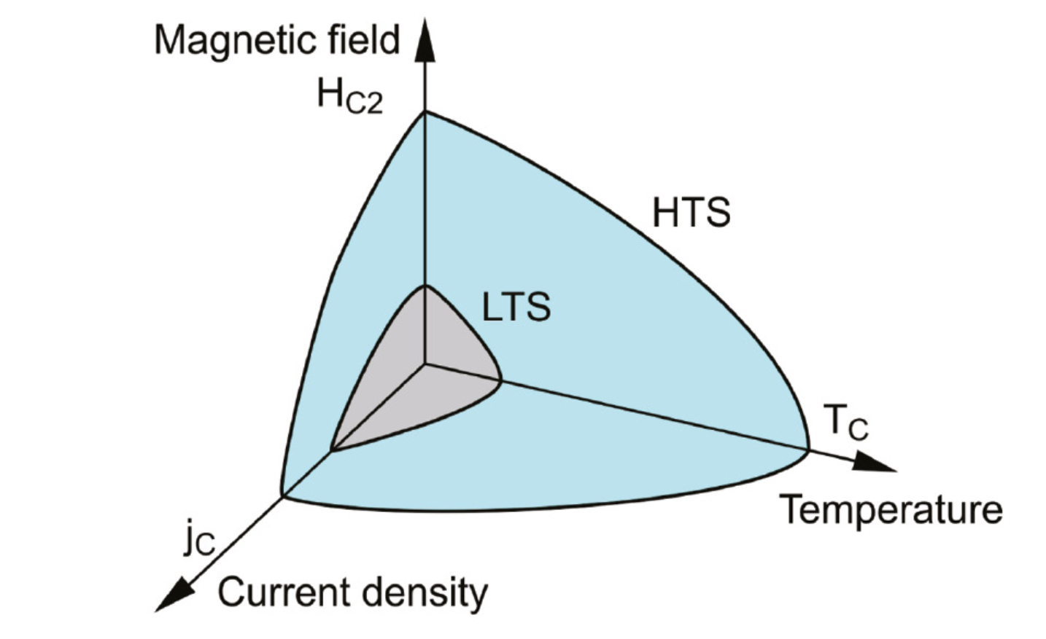
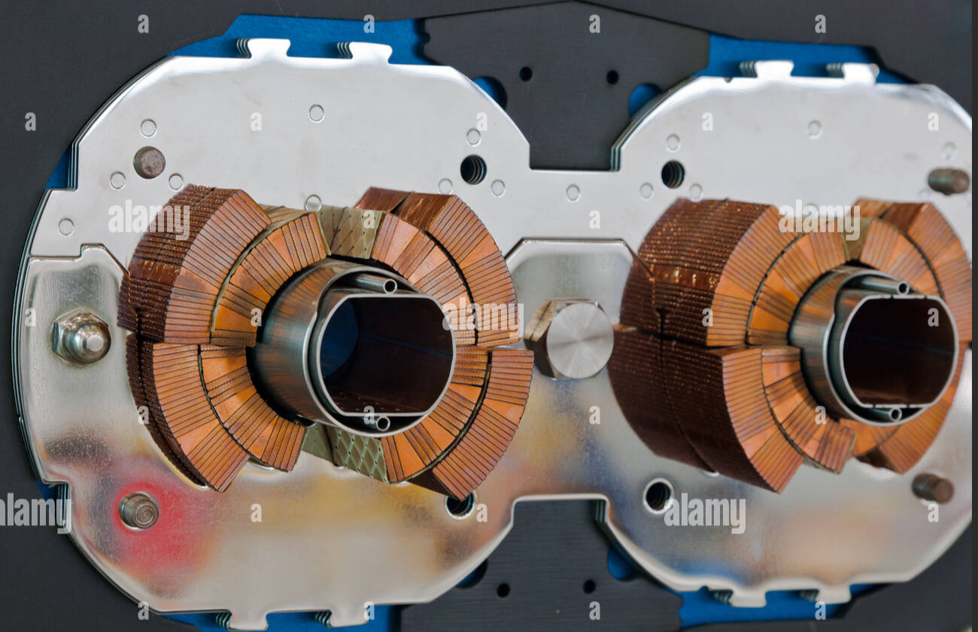
Critical Parameters of SCs
The critical temperature (T_{c}) 临界温度
Above T_{c}, the superconductor reverts to normal (non-superconducting) state.
Nb₃Sn (T_{c} =18 K); REBCO (T_{c} =92 K);
The critical field (H_{c2}) 临界磁场
Above H_{c2}, the superconductor reverts to normal (non-superconducting) state.
Nb₃Sn (H_{c2 , 4.2K} = 25 T); REBCO (H_{c2, 4.2K} ＞100 T);
The critical current (I_{c}) 临界电流
The maximum current the superconductor carries without losing its superconducting property.
J_{e} = I_{c} / (cross sectional area of the superconductor)
High I_{c} / J_{e}
High central field in magnet

Slide 8
Measurement of critical current (I_{c})
The Four Probe Method:
Current Leads: two outer probes supply a DC current (I).
Voltage Leads: two inner probes measure the voltage .
Steps of the I_{c} measurement:
Sample preparation
Cooling
Current ramping (Power supply)
Voltage monitoring
Quench protection
Data analysis (V-I curve)
1 µV/cm
Quench criteria for Ic determination:
I_{c} is the current producing 1 µV per cm between two voltage probes.

Slide 9
Thank You for Your Attention !

