Slide 1
Hands-on training 6
HEPS Cryogenic Hall
Mar. 24th-29th, 2025
Keyu Zhu & Changcheng Ma

Slide 2
OUTLINE
1
Cryogenics
2
Insulation support
3
Hands-on training

Slide 3
Cryogenics in HEPS
Cryogenic Hall
Refrigeration Room
106# Conference Room

Slide 4
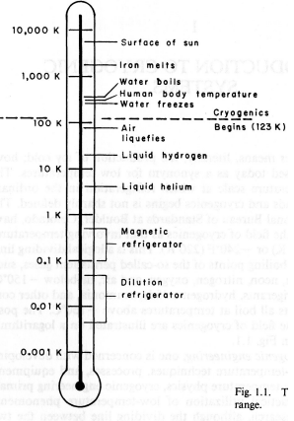
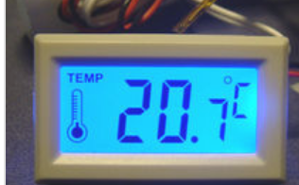
Cryogenics
Cryogenics is a branch of physics that studies what happens to things at low temperatures.
Temperature range is bellow 123 K= -150 ºC
0 ºC=273K
Room temperature

Slide 5
OUTLINE
1
Cryogenics
2
Insulation support
3
Hands-on training

Slide 6
Insulation support
Insulation support is a common component in cryogenic equipment, which plays a role in bearing weight load and reducing heat transfer. Choose materials carefully:
Good Mechanical properties for room temperatures & cryogenic temperatures
Low heat leak

Slide 7
Mechanical properties
Young’s Modulus E
E=$\frac{σ}{ε}$
σ is the stress (Pa ), representing the force per unit area.
ε is the strain ( dimensionless ), which represents the relative deformation of the material in the direction of force.
It reflects the stiffness of the material. The larger the Young 's modulus, the smaller the deformation of the material under stress.
Yield Stress
Yield stress is used to describe the critical stress value of plastic deformation (broken) ( permanent deformation ) when the material is subjected to external force. Specifically, when the stress on the material reaches the yield stress, the material will enter the plastic deformation stage from the elastic deformation stage.

Slide 8
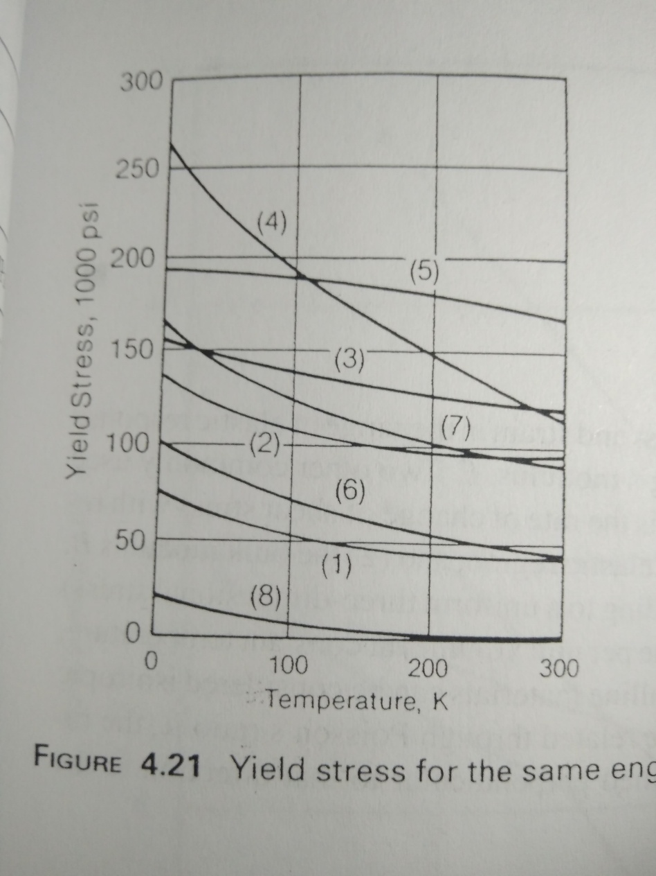
Solid Material
1psi=6.89kPa
Yield stress of metal
1000 psi
304
At low temperature, the yield stress of metal usually increases.
Metal
Good toughness at low temperature.
Cu

Slide 9
Three Ways to Transfer Heat
Conduction
Heat transfer through solid material
Convection
Heat transfer via a moving fluid
Natural or free convection – motion caused by gravity (i.e. density changes)
Forced – motion caused by external force such as a pump
Radiation
Heat transferred by electromagnetic radiation/photons
There is no such thing as a perfect insulator – though we can design systems with very small heat leaks
All matter above 0 K radiate heat
Remember we can’t get to 0 K – 3rd Law of Thermodynamics though we can get vanishingly close

Slide 10
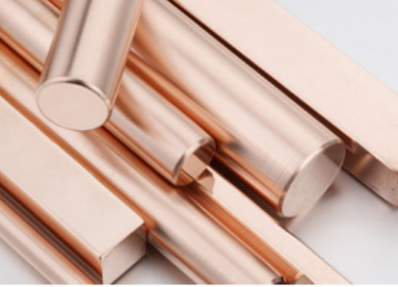
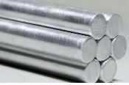
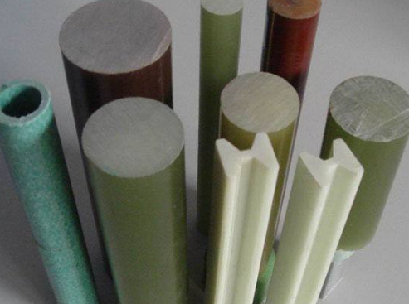
Thermal Conductivity
Copper
Stainless steel
G-10/PTFE
Compound glass fibre
From Lakeshore Cryotronics

Slide 11
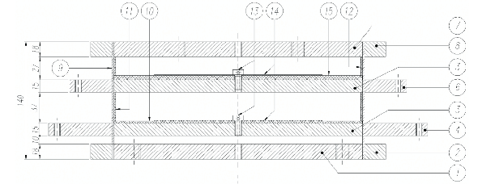
Structural Support of cryostat 1
316L SS
300 K
70 K
G-10
4 K
2 K
1 Can support up to 50 kN
2 Total Heat Leak (conduction & radiation)
70 K - 10.5 W
5 K - 0.9 W
2 K - 0.03 W

Slide 12
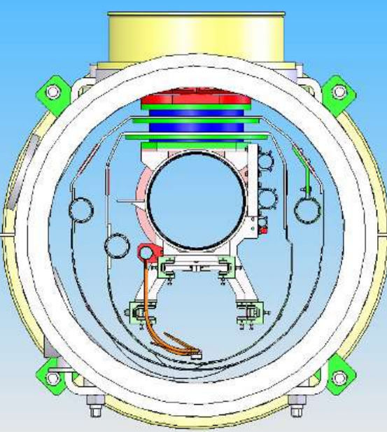
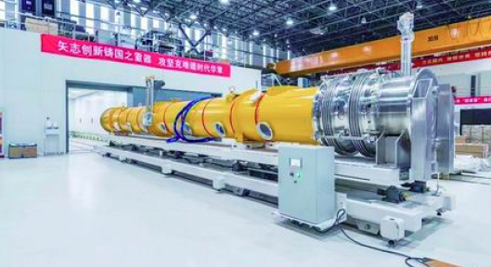
Structural Support of cryostat 1
Support from 300 K to 2K
Cavity assemblies tied to 300 mm pipe backbone
All other connections to 300 K have flex line.
Support
300 K
2 K
1.3G SRF cavity Cryomodule is designed by IHEP

Slide 13
Structural Support of cryostat 2
IHEP---CSNS II Spoke cavity Cryomodule : All components are tied to space frame which rolls into the vacuum vessel. Connections to 300 K done via flex lines and bellow.
Biphasic pipe
Supports
Spoke Cavity 2K
16 flex lines from 300K to 2K

Slide 14
OUTLINE
1
Cryogenics
2
Insulation support
3
Hands-on training

Slide 15
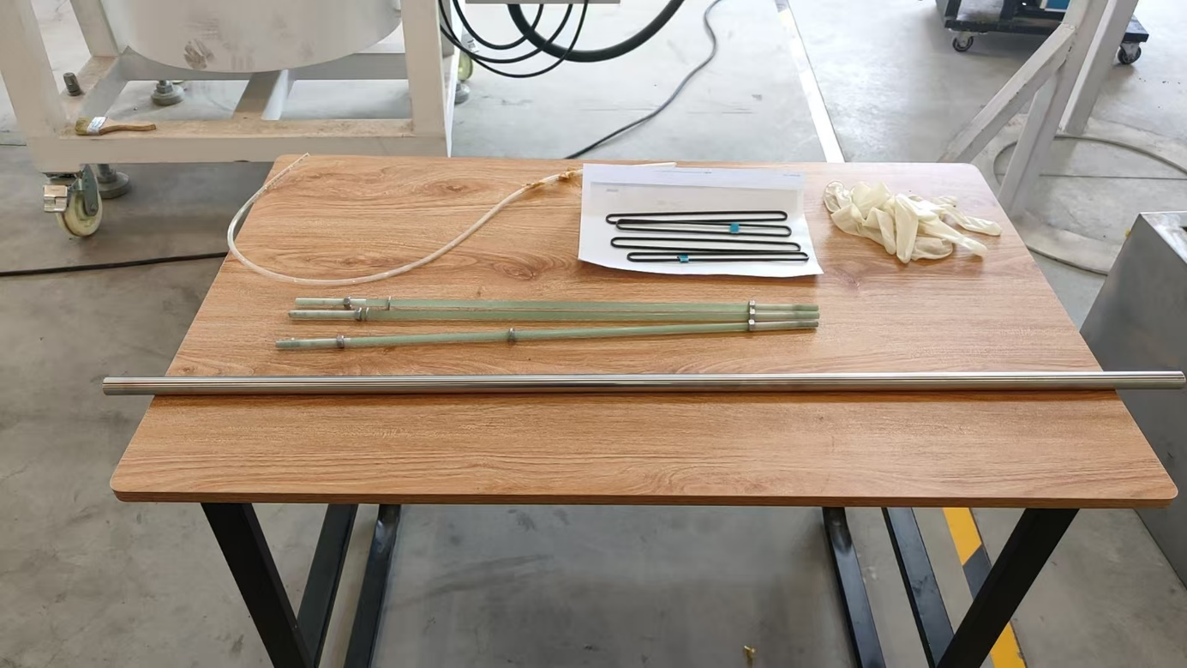
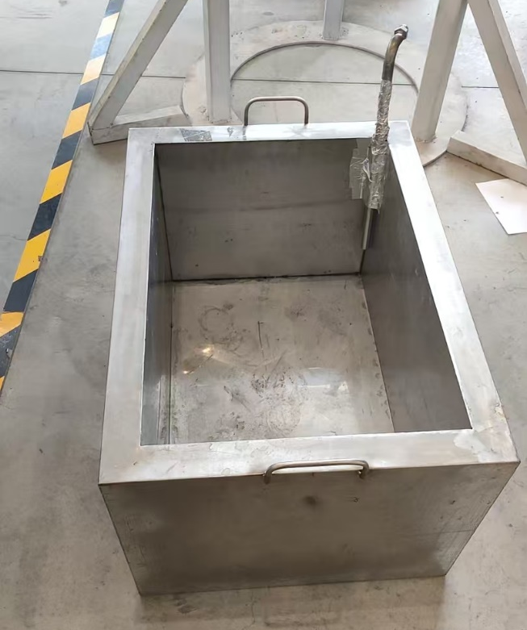
Training 1
Different materials in Liquid Nitrogen
Plastic tube
Carbon fiber rod
Be careful
Liquid Nitrogen Tank
304L tube
G10 bar
Rubber gloves

Slide 16
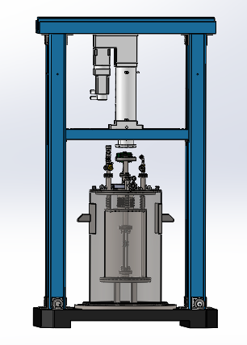
Training 2
Goal：Tests of Mechanical properties of materials at low temperature.
Unit: Power part, High precision sensor: tension sensor and displacement sensor, Cryostat, support.
Function: Maximum force 100kN~0.5%FS.
Power: Hydraulic cylinder
High force in a small package size
Linear displacement and power load
Cryostat : Temperature —80K~300K
Power
Tension
Serisor
Guide
rod
Cryogenic
Dewar
Ø260
Support

Slide 17
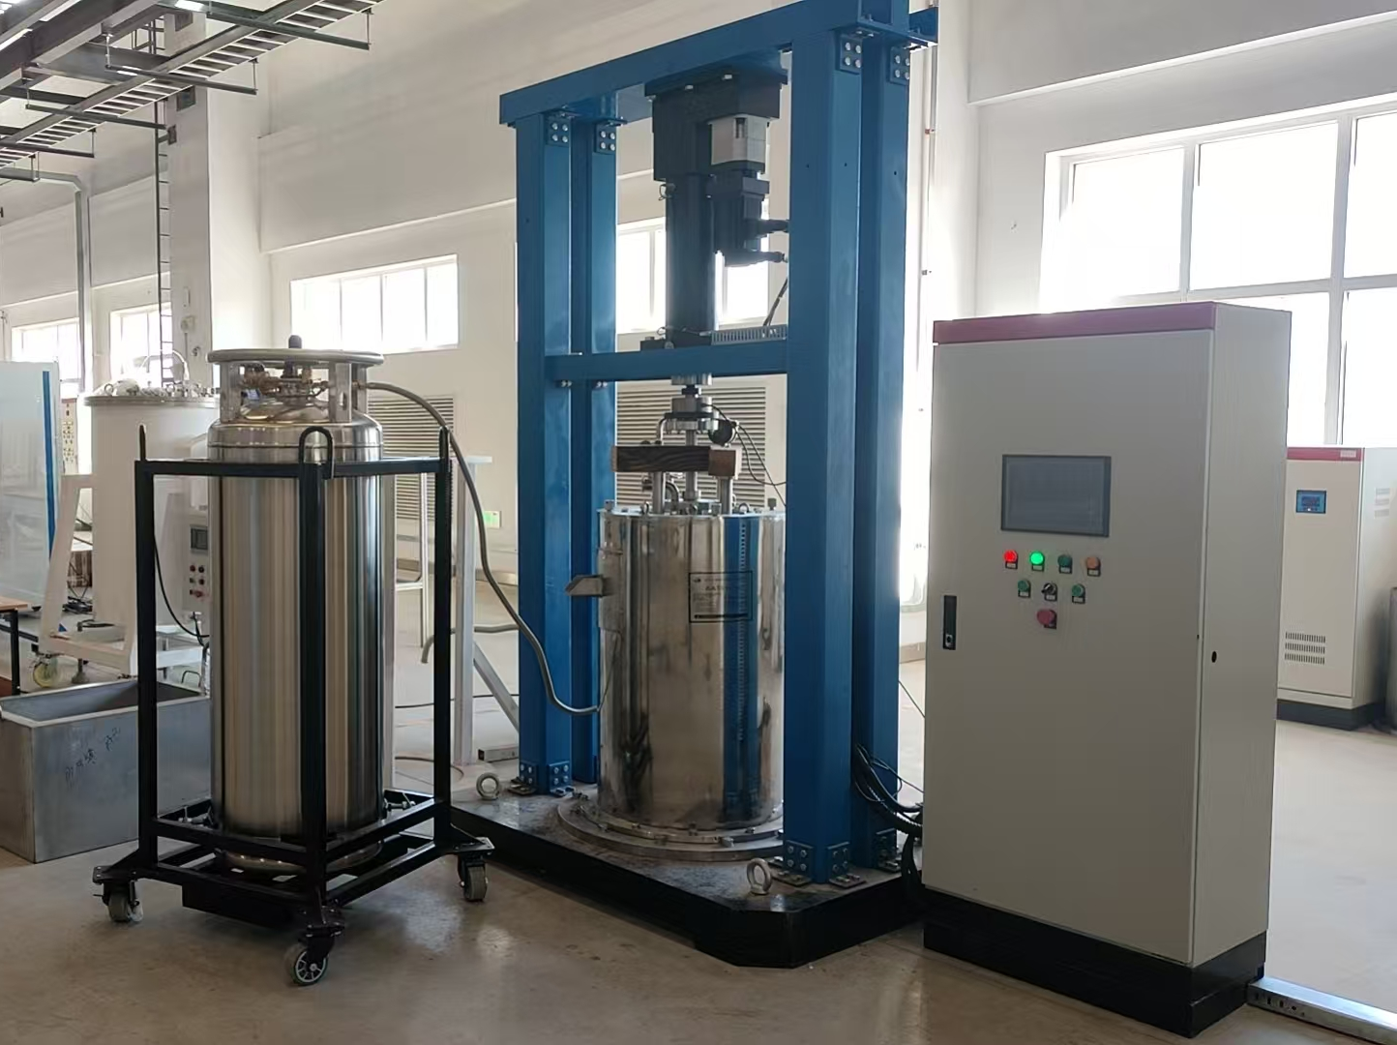
Training 2
Experimental Installation
Control Carbine
Liquid Nitrogen

Slide 18
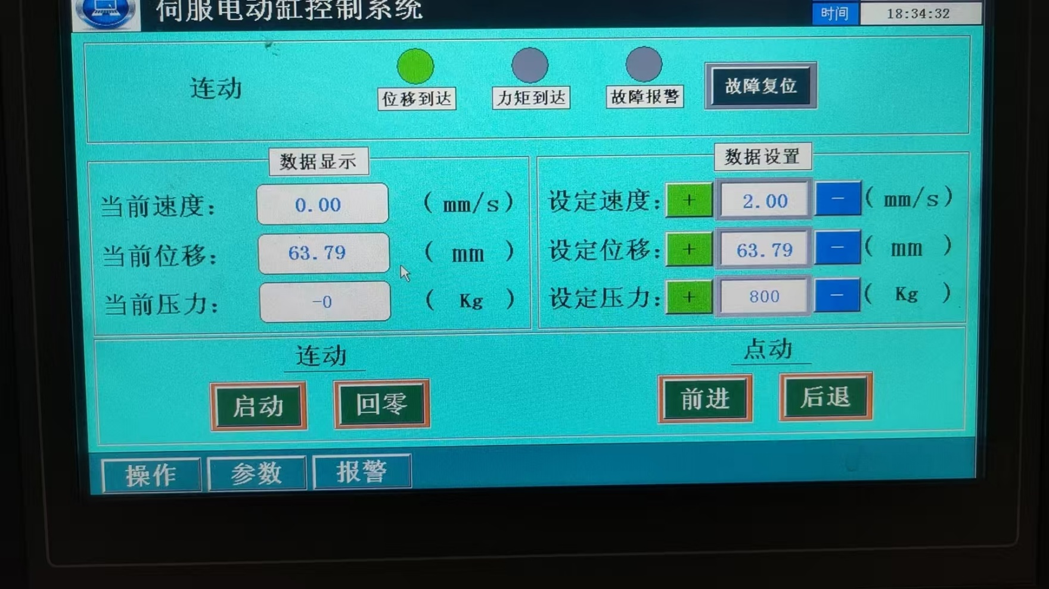
Training 2
Control Interface
Speed setting
Displacement setting
Pressure setting

