Slide 1
Hands-on training: Cavity RF measurement
Hongjuan Zheng, Jiyuan Zhai (IHEP, China)
2025-03

Slide 2
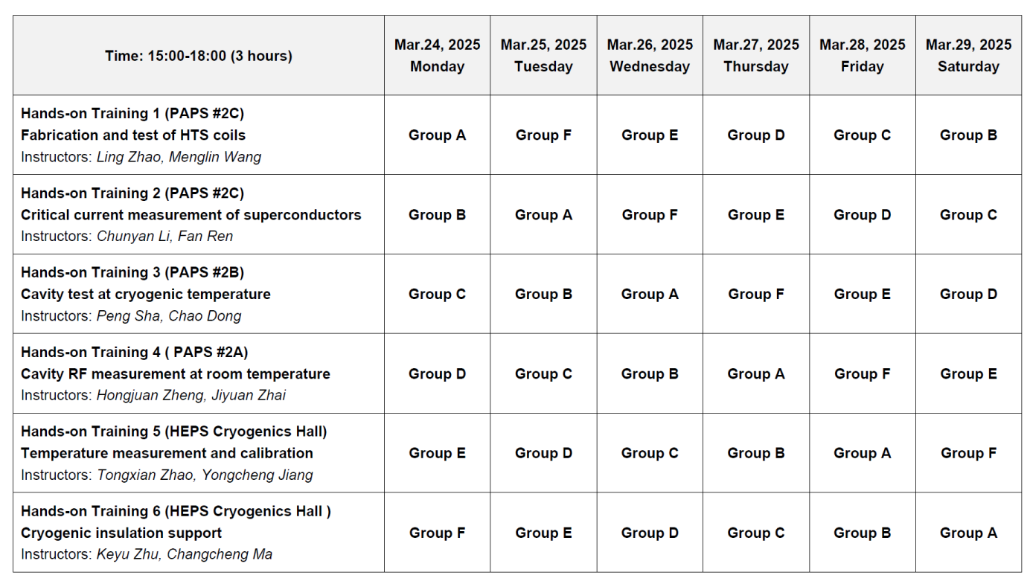
Cavity RF Measurement
H.J. Zheng , J.Y. Zhai (IHEP, China)
ASSCA2025, IHEP

Slide 3
Cavity RF Measurement
Site (building & lab)
PAPS #2A, VT control room
Prerequisites and reading requirements
Microwave Engineering
Objective
Basic operation of vector network analyzer, field profile measurement of the accelerating mode with perturbation method, Q₀ calculation, simulation and measurement, external Q simulation and measurement
H.J. Zheng , J.Y. Zhai (IHEP, China)
ASSCA2025, IHEP

Slide 4
Training Contents
Background introduction (30 min)
Vector Network Analyzer usage, calibration and error analysis (30 min)
Bead pull measurement of the on-axis electric field profiles of TM010 passband modes (50 min)
Question#1: Calculate the max frequency change and phase change of TM010 pi mode due to the metallic needle perturbation on axis.
HOM coupler Q_{ext} measurement of TM110 modes at room temperature (50 min)
Question#2: How to measure Q_{ext} of the input coupler and HOM coupler at 2 K? Can we measure Q₀ at 2 K only with RF method?
H.J. Zheng , J.Y. Zhai (IHEP, China)
ASSCA2025, IHEP

Slide 5
Bead-pulling Method
Preparation
Using a non-conducting wire (like a fishing line) to pull a bead (made of dielectric/metallic or ferromagnetic material) through a RF cavity to measure the electromagnetic fields distribution on resonance inside
Principle of bead-pull
Perturbation theory
Form factors of metallic and dielectric ellipsoids
Measurement techniques
Methods and tricks
Bead-pull setup, bead selection, S parameters by VNA
H.J. Zheng , J.Y. Zhai (IHEP, China)
ASSCA2025, IHEP

Slide 6
Principle of Bead-pull
Cavity performance like resonance frequency f or quality factor Q can be changed by introducing a small perturbation to the resonance EM fields.
Bead-pull measurement involves two types of perturbations:
Small material perturbation, like a small dielectric bead enters a large volume of cavity.
Small cavity volume change, like a small metallic bead enters a large volume of cavity.
Dielectric bead or metallic bead→ perturbation of EM field → frequency and phase changed of EM field→ pulling a metal or dielectric bead in an axial direction → record the frequency shift or phase shift caused by the ball at the corresponding position → get the relative field at that position
H.J. Zheng , J.Y. Zhai (IHEP, China)
ASSCA2025, IHEP

Slide 7
Frequency Shift (1)
Frequency change due to a metallic bead:
Frequency change due to a dielectric bead:
where U is the stored energy in the cavity, a is the radius of the bead, is the relative dielectric constant of the bead material, is the relative magnetic constant of the bead material, is the vacuum dielectric constant, is the vacuum magnetic constant.
H.J. Zheng , J.Y. Zhai (IHEP, China)
ASSCA2025, IHEP

Slide 8
Frequency Shift (2)
Pulling a bead to measure the cavity Δf(z)/f can measure the sqrt[E_{z}(r=0,z)]/U:
For example, using a Teflon sphere bead or syringe needle, H_{z}(r=0,z)≈0 in this case.
Here, F_{bead} or its alternative factor with multiplication to other constants is called bead form factor which is only defined by the bead geometry and material. So the bead-pull measurement can measure the normalized EM field distribution along the pulling direction which is not cavity frequency and drive power dependent parameter.
H.J. Zheng , J.Y. Zhai (IHEP, China)
ASSCA2025, IHEP

Slide 9
Frequency Shift (3)
The perturbation frequency shift Δf in any cavity resonance is found via the change in a S21 measurement according to the relation:
Where Q_{L}⁻¹= Q₀⁻¹+ Q_{in}⁻¹+ Q_{out}⁻¹ and X= f/f₀-f₀/f ≈ 2Δf/f₀. The Q_{in} and Q_{out} represent the external Q values of input and output probes respectively. From above, we can get the relation between frequency shift with phase shift Φ of S21:
H.J. Zheng , J.Y. Zhai (IHEP, China)
ASSCA2025, IHEP

Slide 10
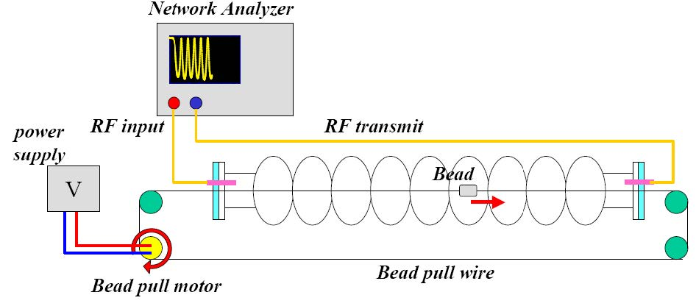
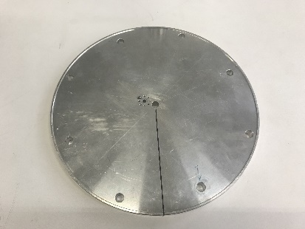
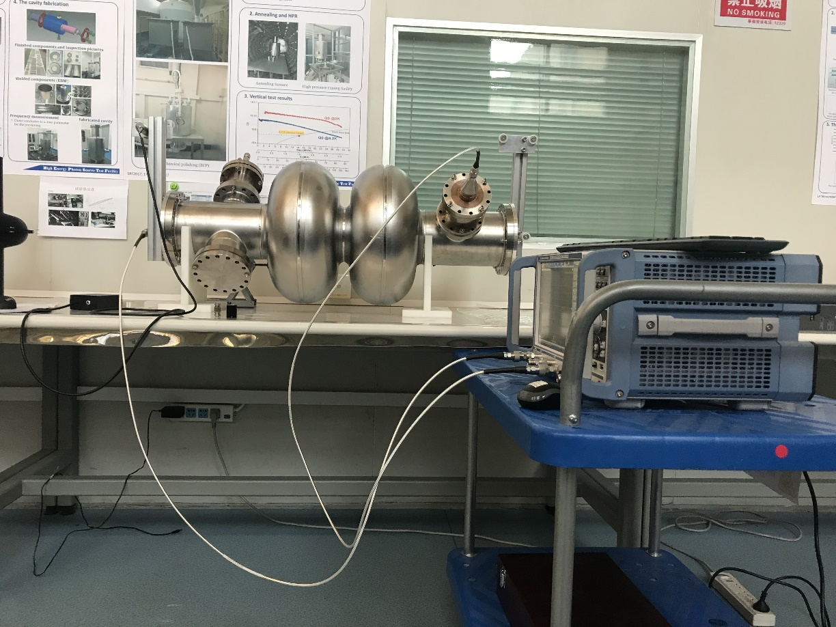
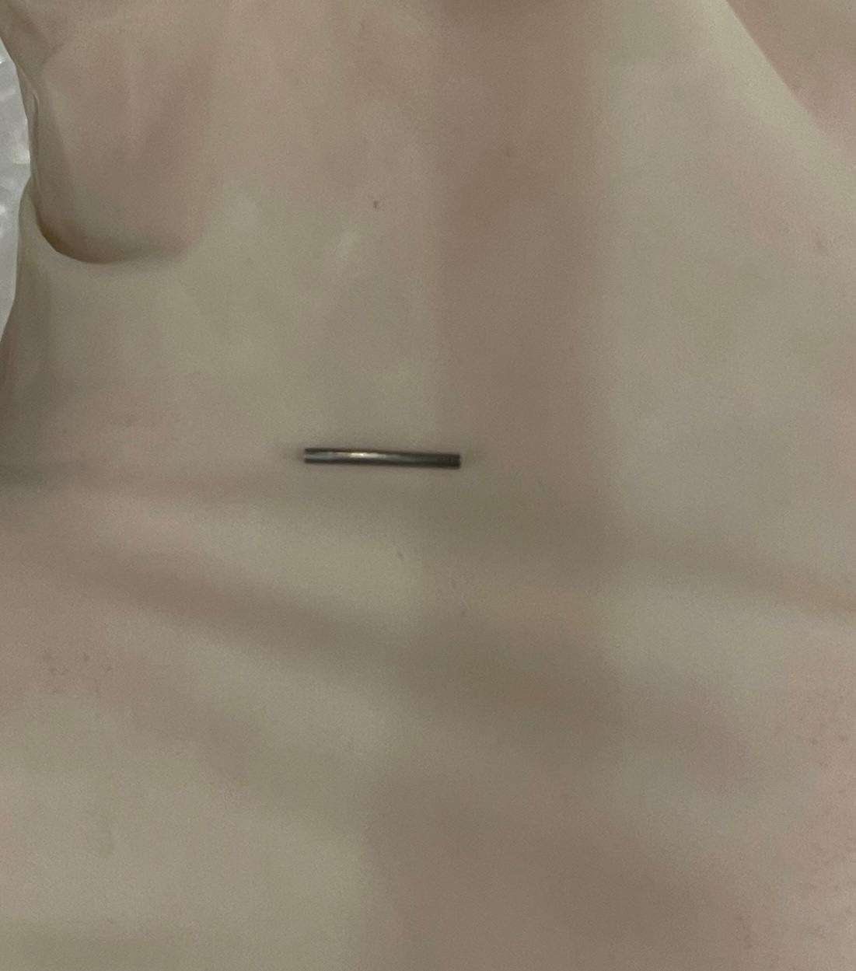
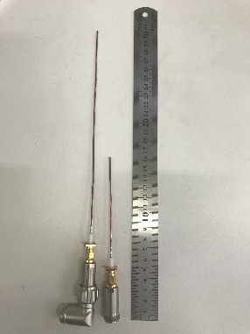
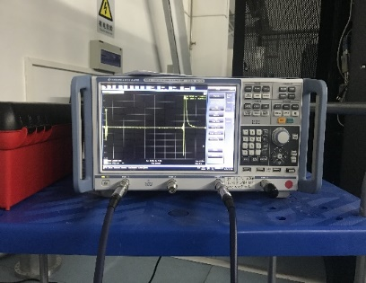
Bead-Pull Measurement System
Flange used for bead pulling
Bead pull motor
Fish line
The setup consists of a pulley-mounted driver motor to move the perturbing bead on a dielectric line (‘‘fish line’’) through the cavity.
Coupling to a resonance with a network analyzer can be obtained in cavity across the two beam pipes with antenna.
Antenna used for excitation and pick up
Metallic needle
VNA
H.J. Zheng , J.Y. Zhai (IHEP, China)
ASSCA2025, IHEP

Slide 11
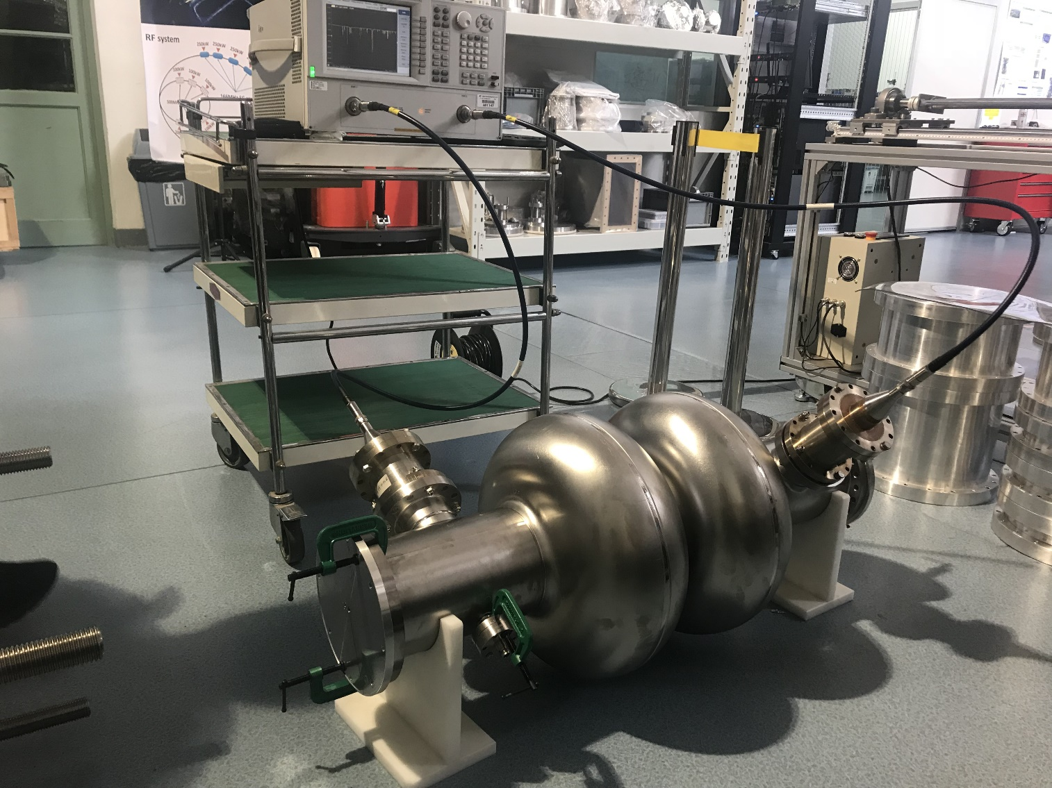
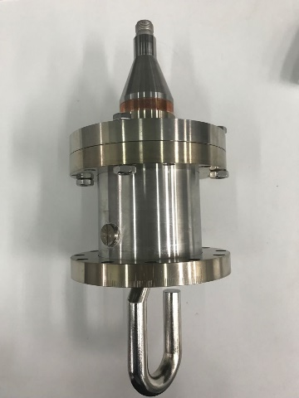
Experimental Set-up of RF Measurement
Vector Network Analyzer
Port1(~input)
Port2(~output)
HOM1
HOM2
2-cell cavity
HOM coupler
H.J. Zheng , J.Y. Zhai (IHEP, China)
ASSCA2025, IHEP

Slide 12
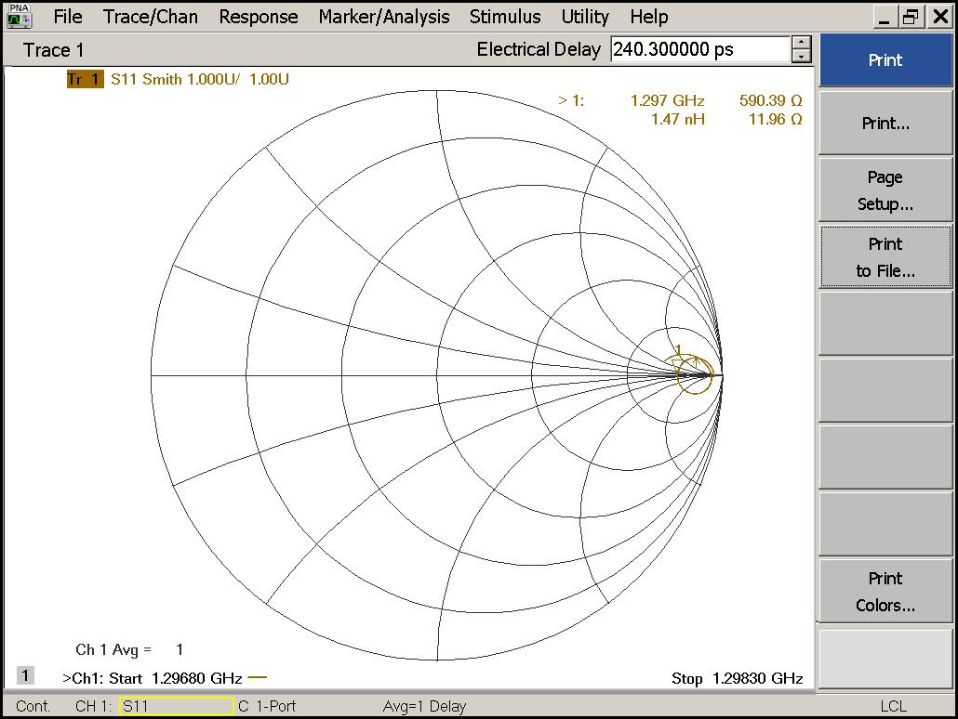
RF Measurement of 2-cell Cavity
Smith chart
Used to decide each port is under coupling, over coupling or matched.
under coupling
over coupling
r=1
Matched point
VSWR=1
H.J. Zheng , J.Y. Zhai (IHEP, China)
ASSCA2025, IHEP
Notes:
Voltage Standing Wave Ratio

Slide 13
RF Measurement of 2-cell Cavity
Different methods used to get the RF parameters of cavity:
Impedance method
Measure resonant VSWR S₀, arbitrarily VSWR S_{x}, resonant frequency f₀, arbitrarily frequency f_{x}
Reflection method
Measure f₀, 𝑄_{𝐿}, S11(dB), S22(dB)
Transmission method
Measure f₀, 𝑄_{𝐿}, S11(dB), S21(dB)
To get the Q₀ and Q_{e} for cavity in RT:
First, determine the coupling state of each port.
Second, chose measurement methods.
H.J. Zheng , J.Y. Zhai (IHEP, China)
ASSCA2025, IHEP

Slide 14
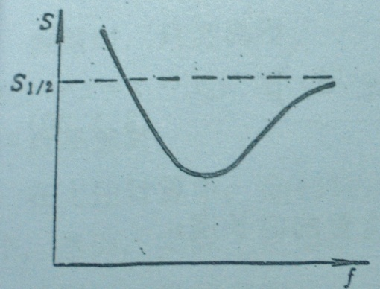
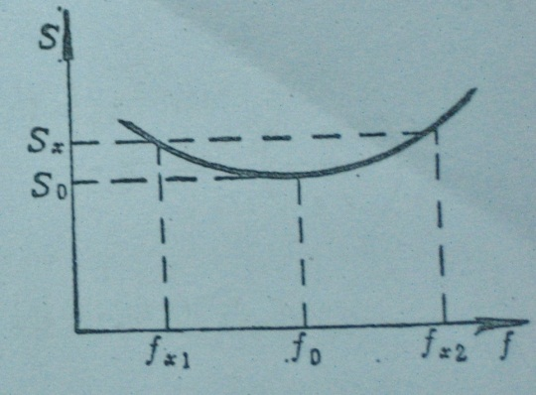
RF Measurement-Impedance Method
$Q_{0}$can be achieved by arbitrarily VSWR $S_{x}=\frac{1+\left|Γ\right|}{1−\left|Γ\right|}$
$$Q_{0}=\frac{ω_{0}}{∆ω}\sqrt{\frac{(S_{x}−S_{0})(S_{0}S_{x}−1)}{S_{x}}} (β>1 over coupling )$$
$$Q_{0}=\frac{ω_{0}}{∆ω}\sqrt{\frac{(\frac{S_{x}}{S_{0}}−1)(S_{x}−\frac{1}{S_{0}})}{S_{x}}} (β<1 under coupling )$$
$$β=S_{0} \left(over coupling\right)$$
$$β=\frac{1}{S_{0}} \left(under coupling\right)$$
$$\frac{Q_{0}}{β}=Q_{e}$$
$$Q_{L}=\frac{Q_{0}}{1+β}$$
Asymmetric VSWR curve
VSWR curve near the resonant frequency
H.J. Zheng , J.Y. Zhai (IHEP, China)
ASSCA2025, IHEP

Slide 15
RF measurement-Reflection Method
Measure $f_{0}$,$Q_{L}$,$S_{11}$(dB),$S_{22}$(dB)
$$Q_{0}=\left(1+β_{HOM1}+β_{HOM2}\right)Q_{\text{L}}$$
$β_{1}<1 , β_{2}<1$
$$β_{1}=\frac{1−{10}^{\frac{s_{11}}{20}}}{{10}^{\frac{s_{11}}{20}}+{10}^{\frac{s_{22}}{20}}}$$
$$β_{2}=\frac{1−{10}^{\frac{s_{22}}{20}}}{{10}^{\frac{s_{11}}{20}}+{10}^{\frac{s_{22}}{20}}}$$
$β_{1}<1 , β_{2}>1,$
$β_{1}>1 , β_{2}>1 ,$
$butβ_{2}>β_{1}+1$
$$β_{1}=\frac{1−{10}^{\frac{s_{11}}{20}}}{{10}^{\frac{s_{11}}{20}}−{10}^{\frac{s_{22}}{20}}}$$
$$β_{2}=\frac{1+{10}^{\frac{s_{22}}{20}}}{{10}^{\frac{s_{11}}{20}}−{10}^{\frac{s_{22}}{20}}}$$
$β_{1}>1 , β_{2}<1,$
${ β}_{1}>1 , β_{2}>1,$
$butβ_{1}>β_{2}+1$
$$β_{1}=\frac{1+{10}^{\frac{s_{11}}{20}}}{{10}^{\frac{s_{22}}{20}}−{10}^{\frac{s_{11}}{20}}}$$
$$β_{2}=\frac{1−{10}^{\frac{s_{22}}{20}}}{{10}^{\frac{s_{22}}{20}}−{10}^{\frac{s_{11}}{20}}}$$
This method has a limitation in that the coupling coefficient is not too small.
H.J. Zheng , J.Y. Zhai (IHEP, China)
ASSCA2025, IHEP

Slide 16
RF measurement-Transmission Method
Measure $f_{0}$,$Q_{L}$,$S_{11}$(dB),$S_{21}$(dB)
$$Q_{0}=\left(1+β_{HOM1}+β_{HOM2}\right)Q_{\text{L}}$$
$$P_{r}=P_{in}Γ^{2}=P_{in}{10}^{\frac{s_{11}}{10}}$$
$$P_{t}=P_{in}T^{2}=P_{in}{10}^{\frac{s_{21}}{10}}$$
$$P_{in}=P_{r}+P_{t}+P_{0}$$
$β_{1}<1$
$$β_{1}=\frac{{{(1−10}^{\frac{s_{11}}{20}})}^{2}}{1−{{10}^{\frac{s_{11}}{10}}−10}^{\frac{s_{21}}{10}}}$$
$$β_{2}=\frac{{10}^{\frac{s_{21}}{10}}}{1−{{10}^{\frac{s_{11}}{10}}−10}^{\frac{s_{21}}{10}}}$$
$β_{1}>1$
$$β_{1}=\frac{{{(1+10}^{\frac{s_{11}}{20}})}^{2}}{1−{{10}^{\frac{s_{11}}{10}}−10}^{\frac{s_{21}}{10}}}$$
$$β_{2}=\frac{{10}^{\frac{s_{21}}{10}}}{1−{{10}^{\frac{s_{11}}{10}}−10}^{\frac{s_{21}}{10}}}$$
This method was used for one port weak coupling.
H.J. Zheng , J.Y. Zhai (IHEP, China)
ASSCA2025, IHEP

Slide 17
References
[1] Haipeng Wang, Jiquan Guo, Bead-pulling Measurement Principle and Technique Used for the SRF Cavities at Jlab. US Particle Accelerator School, SRF Practices and Hands-on Measurements, Thomas Jefferson Lab, Newport News, VA 23606 Jan. 19-23, 2015.
[2] Hahn H, Calaga R, Jain P, et al. HOM identification by bead pulling in the Brookhaven ERL cavity. Nuclear Instruments and Methods in Physics Research Section A: Accelerators, Spectrometers, Detectors and Associated Equipment, 2014, 734: 72-78.
[3] Hong-Juan Zheng, Ji-Yuan Zhai, Tong-Xian Zhao, et al. HOMs simulation and measurement results of IHEP02 cavity. Chinese Physics C, 2015, 39(11): 117006.
[4] H. Padamsee, J. Konobloch, T. Hays. RF Superconductivity for Accelerators, Second edition (Strauss GmbH, Mörlenbach, Germany: WILEY-VCH Verlag GmbH & Co. KGaA, 2008), p.44-48, p.77-80, p.85-89.
[5] Material Properties for Engineering Analyses of SRF Cavities, Fermilab Specification: 5500.000-ES-371110.
H.J. Zheng , J.Y. Zhai (IHEP, China)
ASSCA2025, IHEP

Slide 18
Thank you for your attention!
H.J. Zheng , J.Y. Zhai (IHEP, China)
ASSCA2025, IHEP

Slide 19
Back slides
H.J. Zheng , J.Y. Zhai (IHEP, China)
ASSCA2025, IHEP

Slide 20
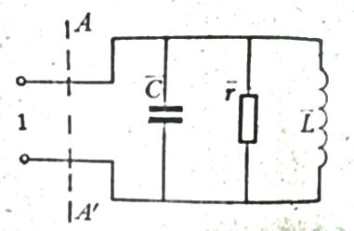
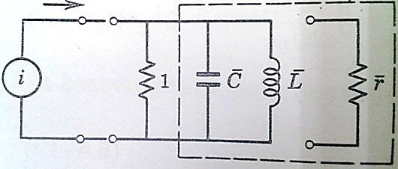
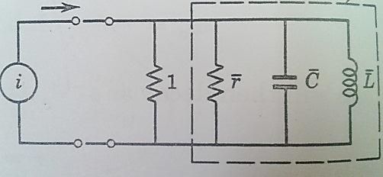
RF Measurement-Impedance Method
cavity
cavity
Equivalent circuit with normalized parameter(for Q₀ considerations)
Equivalent circuit for Qe considerations
Equivalent circuit for Q_{L} considerations
Normalized impendence:$\overline{z}=\frac{1}{\frac{1}{\overline{r}}+j\left(ω\overline{C}−\frac{1}{ω\overline{L}}\right)}=\frac{1}{\overline{g}+j\overline{b}}$
unload$Q_{0}$: $Q_{0}=\frac{ω_{0}W_{0}}{P_{cavity}}$ half power points: $P_{cavity1,2}=1/2P_{cavity}$
external $Q_{e}$: $Q_{e}=\frac{ω_{0}W_{0}}{P_{e}}$ half power points: $P_{e1,2}=1/2P_{e}$
loaded $Q_{L}$: $Q_{L}=\frac{ω_{0}W_{0}}{P_{cavity}+P_{e}}=\frac{ω_{0}W_{0}}{P_{L}}$ half power points: $P_{L1,2}=1/2P_{L}$
$${\overline{b}}_{1,20}=±\overline{g}$$
$${\overline{b}}_{1,2e}=±1$$
$${\overline{b}}_{1,2L}=±(1+\overline{g})$$
For a given measured VSWR at resonance, the VSWR’s that must be achieved at the half-power points for $Q_{0}$ and $Q_{e}$.
These points can be transferred to the smith chart.
H.J. Zheng , J.Y. Zhai (IHEP, China)
ASSCA2025, IHEP

Slide 21
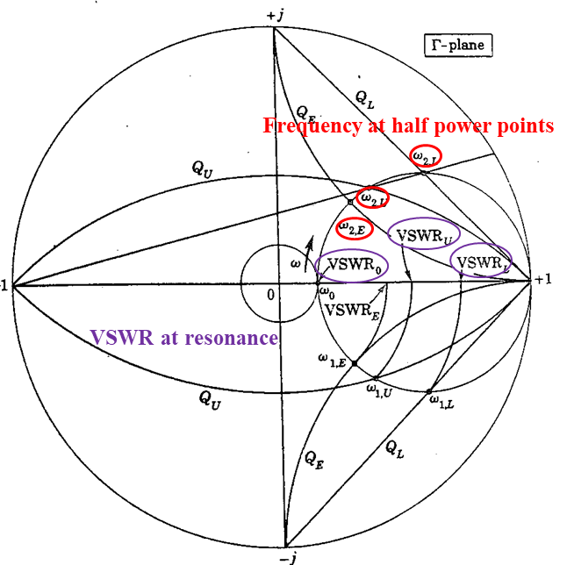
RF Measurement-Impedance Method
Reflection coefficient: $Γ=\frac{\overline{z}−1}{\overline{z}+1}$
VSWR: S=$S=\frac{1+\left|Γ\right|}{1−\left|Γ\right|}$
Resonant VSWR:$S_{0}=\overline{r} \left(r>1\right)$($β=\overline{r} coupling coefficient$)
${ S}_{0}=\frac{1}{\overline{r}} \left(r<1\right)$
Arbitrarily VSWR:$S_{x}=\frac{1+\left|\frac{\overline{z}−1}{\overline{z}+1}\right|}{1−\left|\frac{\overline{z}−1}{\overline{z}+1}\right|}$
VSWR at $Q_{0}$ half-power points:
$${{(S}_{1/2})}_{0}=\frac{2+β^{2}+\sqrt{4+β^{2}}}{2β} ({{(S}_{\frac{1}{2}})}_{0}<S_{0})$$
VSWR at $Q_{e}$ half-power points:
$${{(S}_{1/2})}_{e}=\frac{1+{2β}^{2}+2\sqrt{1+4β^{2}}}{4}$$
Smith chart Q-circle and half power points
$$\overline{z}→Γ→S_{1/2}{→f}_{1/2}→Q=\frac{ω_{0}}{∆ω}$$
H.J. Zheng , J.Y. Zhai (IHEP, China)
ASSCA2025, IHEP

Slide 22
RF Measurement-Impedance Method
From above, $Q_{0}$can be achieved by $S_{x}=\frac{1+\left|Γ\right|}{1−\left|Γ\right|}$
$$Q_{0}=\frac{ω_{0}}{∆ω}\sqrt{\frac{(S_{x}−S_{0})(S_{0}S_{x}−1)}{S_{x}}} (β>1 over coupling )$$
$$Q_{0}=\frac{ω_{0}}{∆ω}\sqrt{\frac{(\frac{S_{x}}{S_{0}}−1)(S_{x}−\frac{1}{S_{0}})}{S_{x}}} (β<1 under coupling )$$
$$β=S_{0} \left(over coupling\right)$$
$$β=\frac{1}{S_{0}} \left(under coupling\right)$$
$$\frac{Q_{0}}{β}=Q_{e}$$
$$Q_{L}=\frac{Q_{0}}{1+β}$$
Asymmetric VSWR curve
VSWR curve near the resonant frequency
H.J. Zheng , J.Y. Zhai (IHEP, China)
ASSCA2025, IHEP

Slide 23
Surface Resistance-NC Cavity
Classic expression:
Anomalous skin effect:
Dimensionless parameter:
The classical expression for surface resistance applies when α_{s}≦0.016. When α_{s} → ∞
ρl product is a material constant, independent of temperature, as α_{s} ≥ 3, the normal state surface resistance is
R(∞) is the surface resistance in the extreme anomalous limit. The anomalous limit is applicable to a very good conductor, such as copper at microwave frequency and at low temperatures.
For copper: ρl=6.8×10⁻¹⁶Ωm²
For Nb: ρl=6.0×10⁻¹⁶Ωm²
Conductivity
Skin depth
RF surface resistance
For normal conductor
H.J. Zheng , J.Y. Zhai (IHEP, China)
ASSCA2025, IHEP
Notes:
l is mean free path

Slide 24
Surface Resistance-SC Cavity
Surface resistance:
For T<T_{c}/2,
R_{BCS}: BCS resistance
R_{res}: residual surface resistance
R_{res}= 5nΩ for 650 MHz 2-cell cavity
f is the rf frequency in GHz
T_{c} for Nb is 9.2 K
H.J. Zheng , J.Y. Zhai (IHEP, China)
ASSCA2025, IHEP

Slide 25
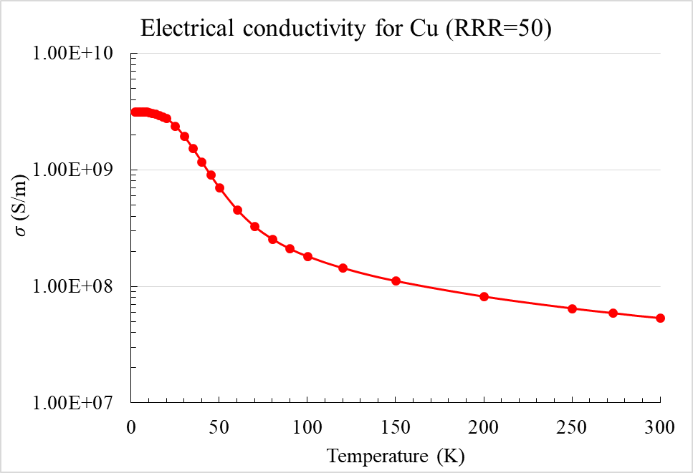
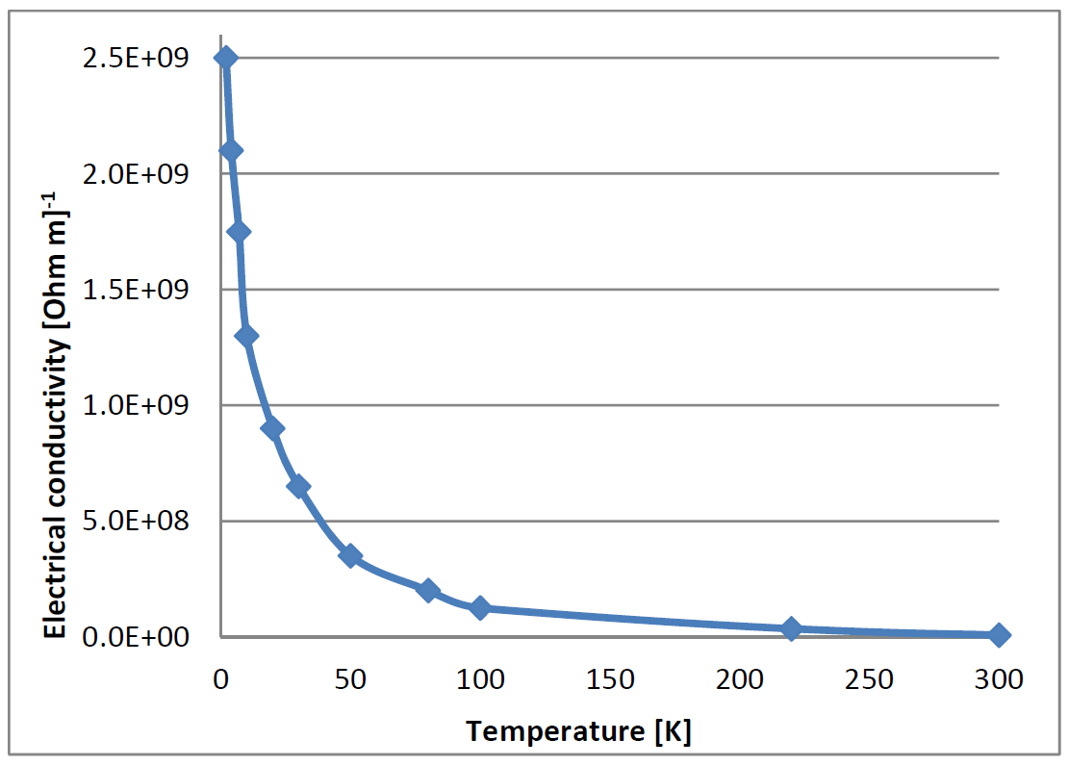
Electrical Conductivity for Cu and Nb
Electrical conductivity for Nb (RRR=300)
Temperature(K) | 2 | 4 | 10 | 80 | 300
σ-Cu (S/m) | 3.16E9 | 3.16E9 | 3.12E9 | 2.55E8 | 5.35E7
σ-Nb (S/m) | / | / | 1.30E9 | 2.00E8 | 7.50E6
H.J. Zheng , J.Y. Zhai (IHEP, China)
ASSCA2025, IHEP

Slide 26
Cavity Quality
Quality factor
Geometry constant
G is independent of the cavity size.
G=284Ω for 650 MHz 2-cell cavity.
R/Q=213Ω for 650 MHz 2-cell cavity.
H.J. Zheng , J.Y. Zhai (IHEP, China)
ASSCA2025, IHEP

