Slide 1
Sixth Asian School on Superconductivity and Cryogenics for Accelerators (ASSCA2025)
Hands-on training (Cryogenics)
Temperature Measurement and Calibration

Slide 2
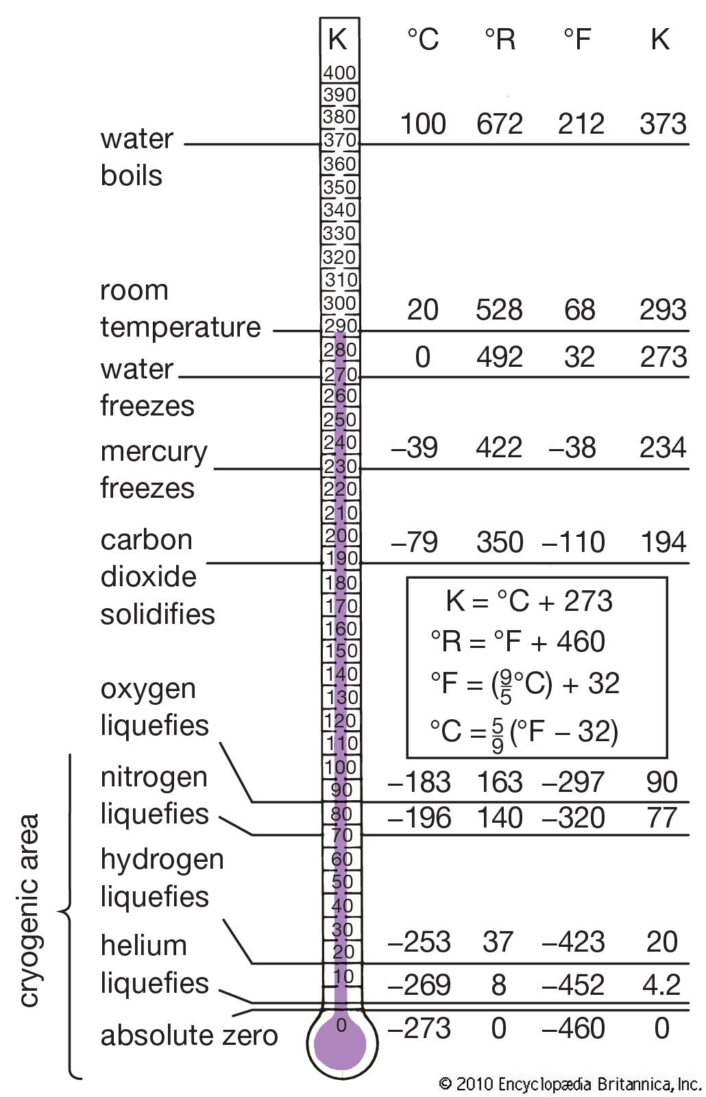
The cryogenic temperature range
In physics, cryogenics is the production and behaviour of materials at very low temperatures.
The cryogenic temperature range has been defined as from −150 °C (−238 °F) to absolute zero (−273 °C or −460 °F), the temperature at which molecular motion comes as close as theoretically possible to ceasing completely. Cryogenic temperatures are usually described in the absolute or Kelvin scale, in which absolute zero is written as 0 K, without a degree sign. Conversion from the Celsius to the Kelvin scale can be done by adding 273 to the Celsius scale.

Slide 3
Basic Theory of Temperature Measurement
Thermal conductivity
Thermal conductivity integral
Thermodynamic properties for various cryogenic liquids
Thermal contraction of selected materials between 293 K and 4 K
Resistivity of alloys
Saturated vapor pressure of helium
Notes:
低温-测量-注意点

Slide 4
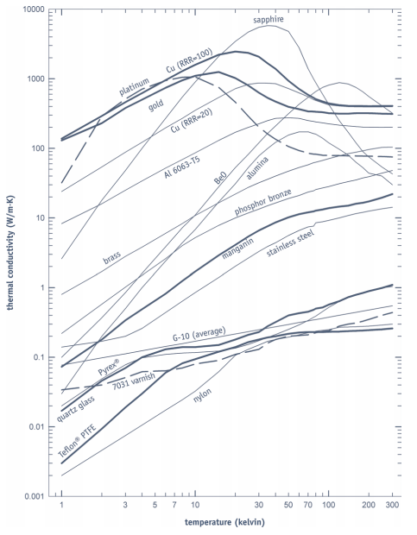
Cryogenic heat flow
K ：the thermal conductivity
A ：the cross-sectional area
∆T ：the temperature difference
L ：the length of the heat conduction path

Slide 5
Heat sinking length for wire sizes
—Wire heat-sinking length required to thermally anchor to a heat sink at temperature T to bring the temperature of the wire to within 1 mK of Tlower
— Values are calculated assuming wires are in a vacuum environment, and the specified thermal conductivity.
Thermal conductivity W/(m • k)
1 K | 0.034
4.2 K | 0.062
77 K | 0.22
100 K | 0.24
300 K | 0.44
Notes:
传感器引线长度参考

Slide 6
Sensor selection

Slide 7
Temperatures sensors
Type of sensor | precision | T range [K] | Price | Delay
Pt100 | + (+/- 0.5K) | 50-350 | + | ++
CLTS | +? (+/- 2K) | 4-350 | + | ?
Cernox (industrial) | +? (+/- 1K) | 4-350 | ++ | +++
Cernox (individually calibrated) | ++ (+/- 0.5%) | 1.5-350 | +++ | +

Slide 8
Sensor wiring
4-wire: For accurate sensor measurements, 4-lead connections are by far the superior option when adding a lead extension to both diodes and resistive temperature sensors.
2-wire: This option is useful if the number of electrical connections inside a system must be kept to a minimum. However, 2-lead connections add measureable resistance to sensor measurements. This additional resistance will cause a significant (but repeatable) shift on all sensors except diodes.
To avoid uncertainties associated with lead resistance
Notes:
传感器接法

Slide 9
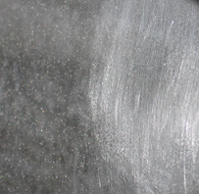
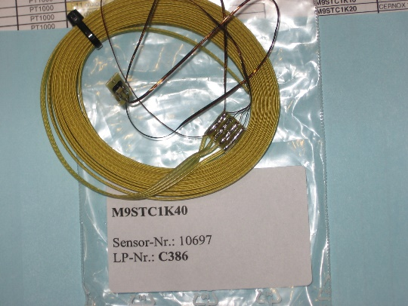
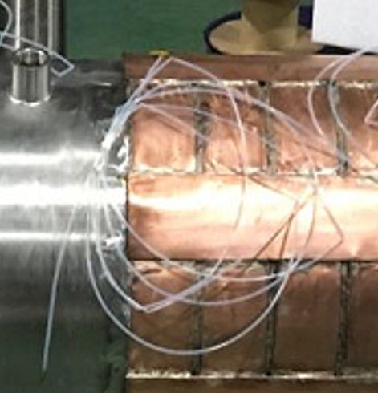
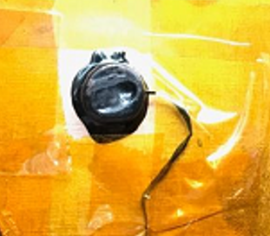
Procedure for Mounting The Sensor
Confirm the Serial number
Assemble location
Verify the room temperature resistance
Sand the sensor mount area/sensor PCB/Interface PCB
Clean the area
Stycast epoxy/Grease
Fixed
attach the wires to the surface
Record the temperature of the room

Slide 10
Calibrate a Low-Temperature Thermometer
Why?
How to?
Calibrating a low-temperature thermometer requires ensuring measurement accuracy and reliability

Slide 11
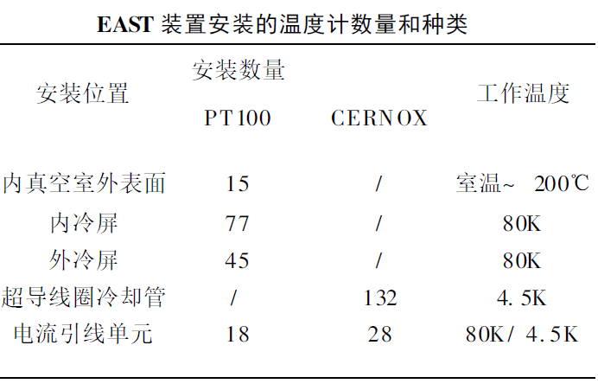

Slide 12
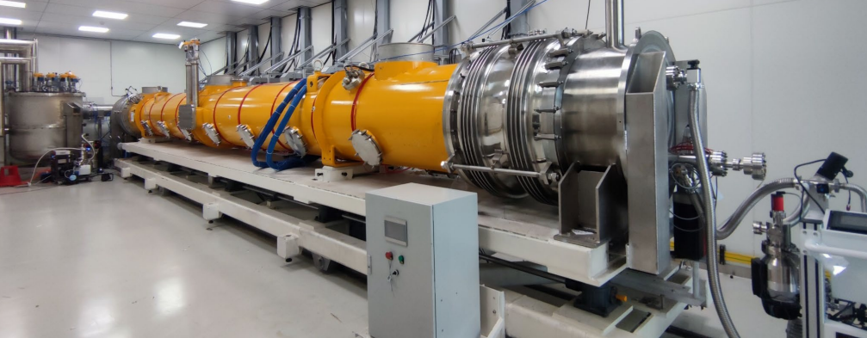

Slide 13
Calibrate a Low-Temperature Thermometer
Why?
How to?
Fixed-Point Calibration (High Accuracy)
Comparison Method(Common Practice)
- Perform initial calibration before first use.
- Recalibrate every 6–12 months or more frequently under harsh conditions (e.g., thermal cycling).
For ultra-high-precision applications (e.g., research or metrology), consider calibration by accredited laboratories or national metrology institutes.

Slide 14
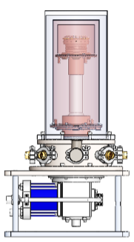
Introduction of test stand : Comparison Method
cryostat
Parameters of The Platform
• No liquid nitrogen
• No helium refrigeration
• GM refrigerator
• Cooling time: ~120 min
• Temperature stability: ± 5 mK
• Vacuum degree:~ 10-5 Pa
2.7K~300K/ 2.7K~70K
Control system
Computer
Lakeshore 336
Temperature
acquisition
instrument
High pressure intake pipe
Low pressure return pipe
signal line
Compressor
GM refrigerator
Vacuum pump
The number of thermometers
can be installed : 16+

Slide 15
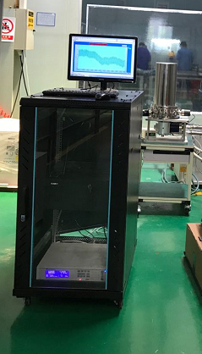
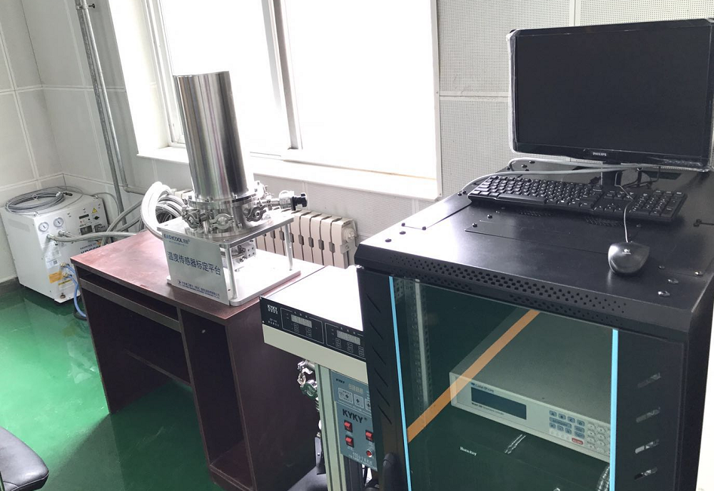
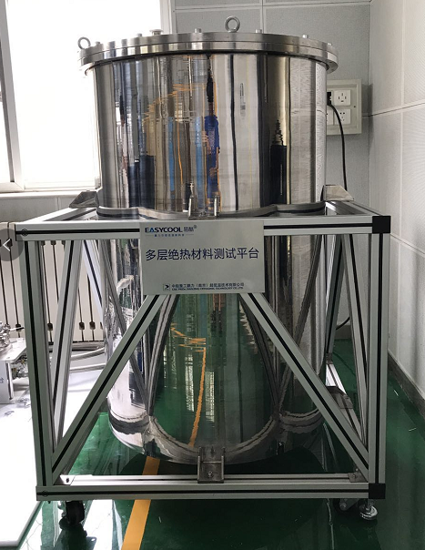
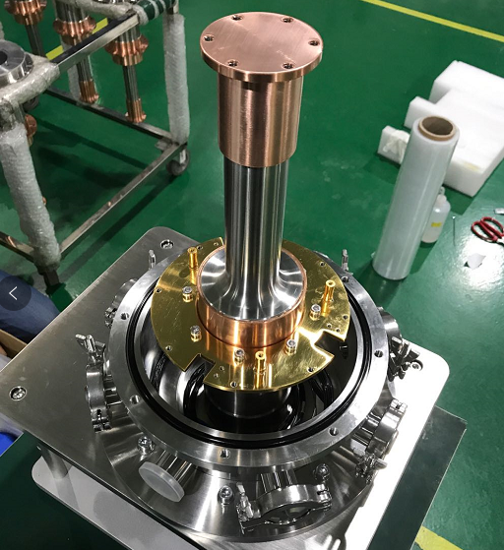
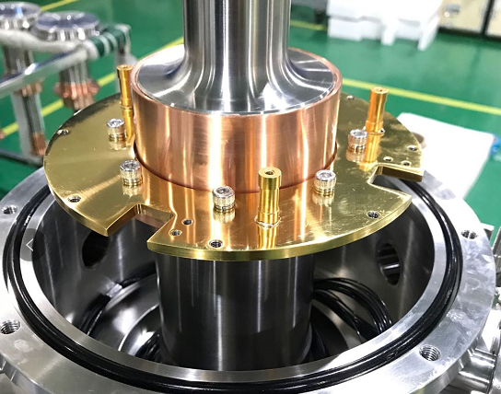
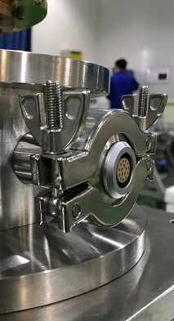
The test stand

Slide 16
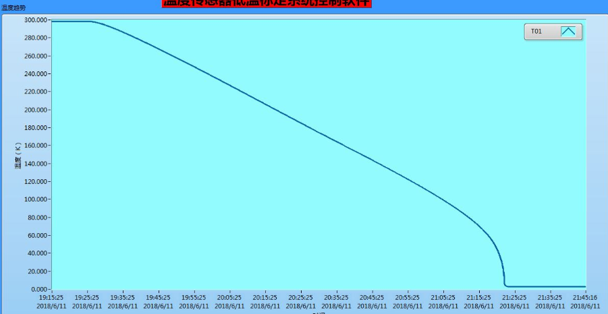
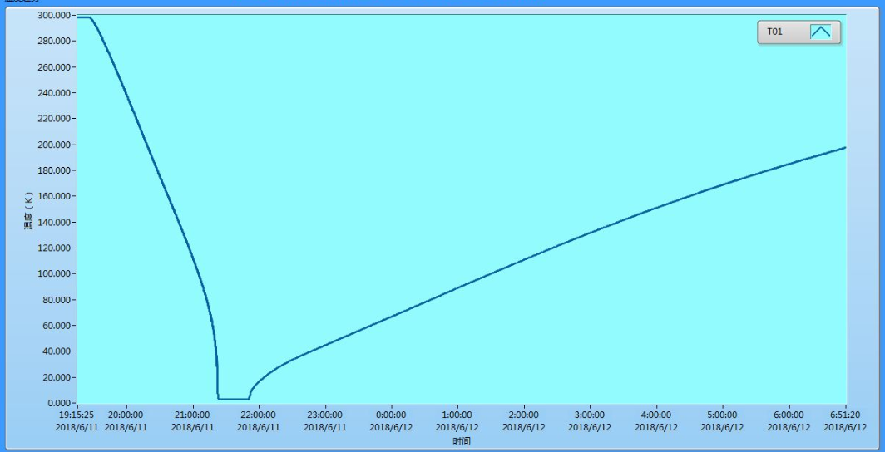
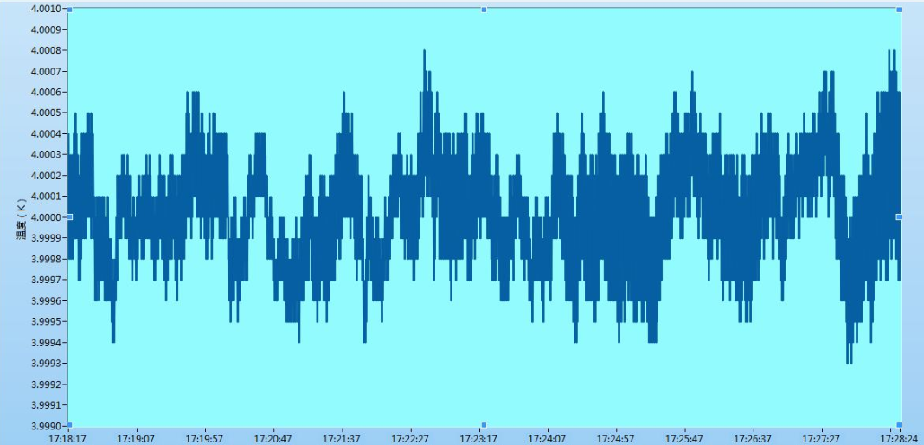
The Interface of test stand
rewarming speed 22K/h
300K->2.72K : 2Hours
the accuracy of measurement 3.9993-4.0008
Lakeshore CU 5mk

Slide 17
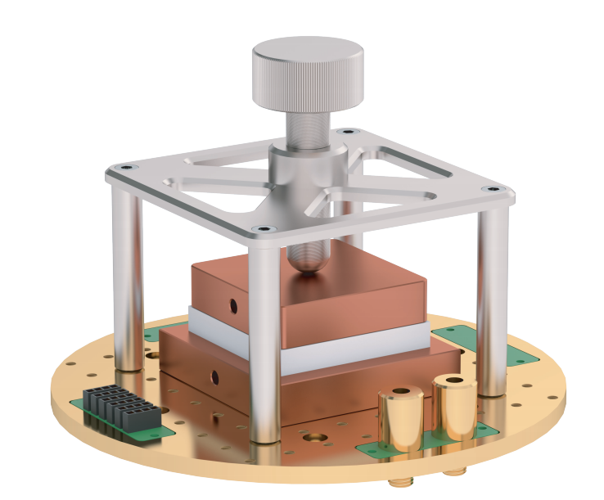
Test stand II
Parameters of The low-temperature platform
• No liquid nitrogen&helium refrigeration
• Stirling refrigerator
• Cooling time: ≤ 120 min
• Temperature stability: ± 5 mK
• Cooling power: 2 W @ 80 K/10 W @ 200 K/20 W @ 300 K
• Vacuum degree:~ 10-5 Pa
• Rated power: 100 W
74K~300K
Comprehensive performance evaluation system for wide temperature range thermoelectric materials and devices
宽温区热电材料&器件综合性能评价系统

Slide 18
Hand-on training
1: Everyone will receive a thermometer. (Cernox/Carbon/PT/CLTS)
2: Each thermometer has four leads, and their resistances are measured to obtain a reasonable resistance value for the thermometer itself.
3: Measure the resistance value of the thermometer in the ice-water mixture.
4: Measure the resistance value of the thermometer in liquid nitrogen.
5: Record the above data and enter it into the computer.
6: Analyze the resistance or temperature values read by the computer under liquid nitrogen.

Slide 19
2: Each thermometer has four leads, and their resistances are measured to obtain a “reasonable” resistance value for the thermometer itself.
R1：U+ U-
R2：U+ I-
R3：U+ I+
R4：U- I-
R5：U- I+
R6：I+ I-

Slide 20
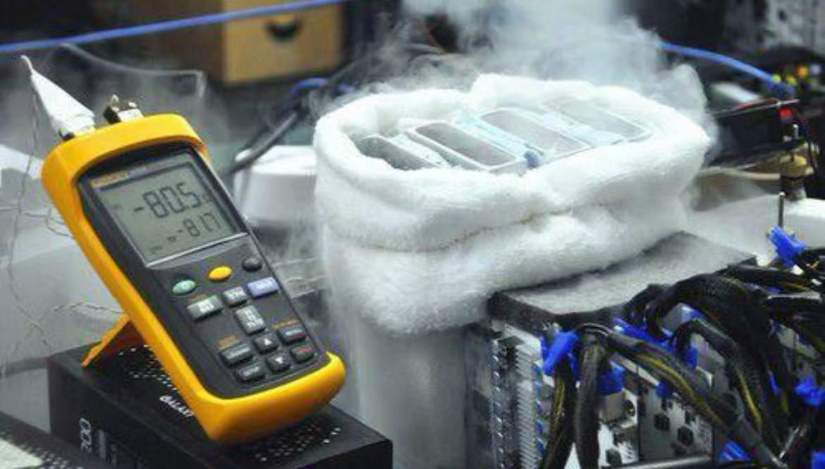
3: Measure the resistance value of the thermometer in the ice-water mixture.
4: Measure the resistance value of the thermometer in liquid nitrogen.

Slide 21
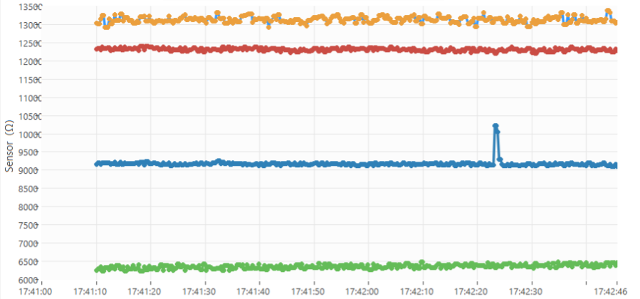
5: Record the above data and learn how to enter it into the computer.
6: Analyze the resistance or temperature values read by the computer under liquid nitrogen.

Slide 22
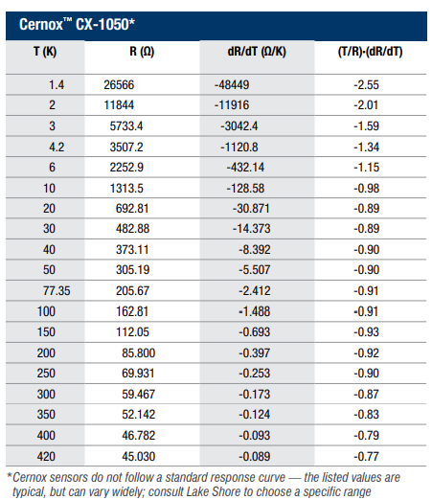
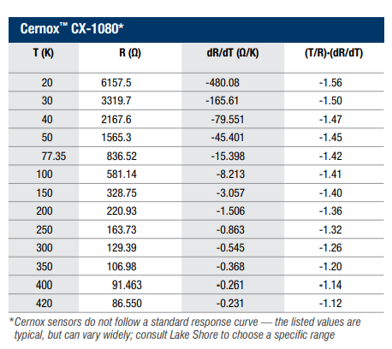
Cernox

