Slide 1
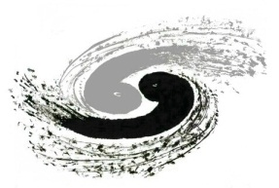
Hands-on Training: Fabrication and Testing of HTS Coils
Superconducting Magnet Group,
Institute of High Energy Physics
2025.3

Slide 2
Outline
What is a superconductor?
Why choose superconductor?
Comparison between HTS and LTS
​ReBCO superconductor
Coil design and winding
Introduction of the Experiment

Slide 3
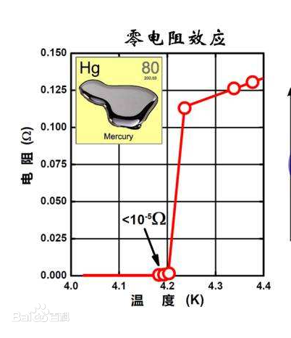
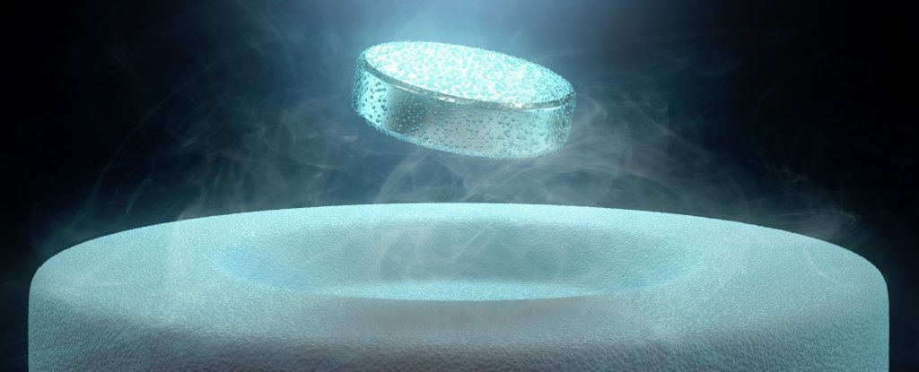
What is a superconductor?
Superconductors refer to certain materials that, at a specific temperature (i.e., the critical temperature), their resistance suddenly drops to zero and they simultaneously exhibit the property of perfect diamagnetism.
zero resistance: when an electric current flows through a superconductor, there is no energy loss, that is, there is no thermal effect.
Perfect diamagnetism is manifested as the superconductor being able to repel an external magnetic field, making the magnetic induction intensity inside it zero. This phenomenon is called the Meissner effect.
According to the differences in transition temperature, Superconductors are divided into Low temperature superconductor(LTS) & High temperature superconductor(HTS).​
LTS：For example, mercury (Hg), lead (Pb), niobium-titanium(NbTi), etc. The transition temperature is generally below 20K and liquid helium is required for cooling.​
HTS：Represented by YBCO and others, the transition temperature is higher than 77K, and liquid nitrogen can be used for cooling, with a relatively low cost.

Slide 4
Superconductors for use

Slide 5
Why choose superconductors?
Conventional electromagnet
superconducting magnet (LTS)
superconducting magnet (HTS)
1911
1986
Higher magnetic field
Lower energy loss
Smaller volume and weight
More stable magnetic field
No need for an iron core
Requires a low temperature operating environment

Slide 6
Comparison between HTS and LTS
 | superconducting magnet (LTS) | superconducting magnet (HTS)
PROS | Lower cost of conductor Mature manufacturing process More stable magnetic field Used for high-precision instruments，such as MRI. | Higher critical temperature, Higher critical magnetic field, Higher current-carrying density, Lower requirements for the low-temperature environment. Great potential in the field of power transmission and high-field magnets.
CONS | Requires a 4.2K operating environment | The stability of the superconductors, the manufacturing process, and quench protection still need further development. Higher cost of conductor
Superconductor | NbTi Nb₃Sn | Bi2223 Bi2212 ReBCO MgB₂

Slide 7
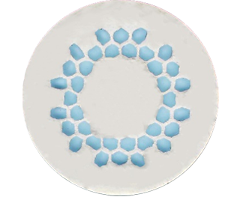
ReBCO superconductor
NbTi filament
Pure Copper
NbTi
ReBCO
Current-carrying performance of the YBCO tape： above 600A/cm ( @ 77K, self-field).
tensile stress (@ 77K) ： above 600MPa.​
Minimum bending radius: 10mm
With a thickness of only about 100 μm，tapes are prone to bending and tensile damage, and their Ic decays with increasing strain.
Not like LTS, ReBCO tape is primarily composed of some ceramic materials with poor thermal conductivity, when one point returns to the normal state, local resistance occurs, generating significant heat instantaneously and causing damage.

Slide 8
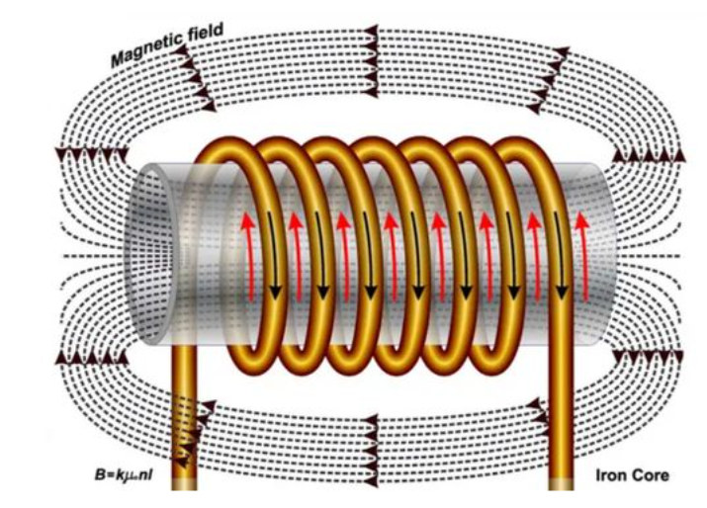
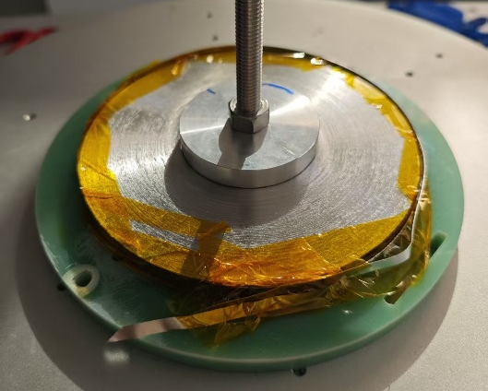
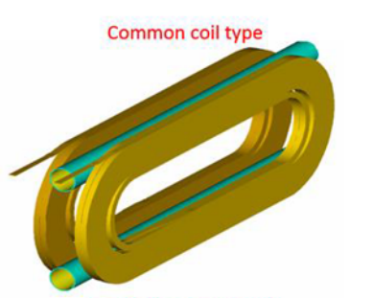
Type of coils: different shape
Solenoid
Pancake
Canted Cos-Theta (CCT)
dipole magnet

Slide 9
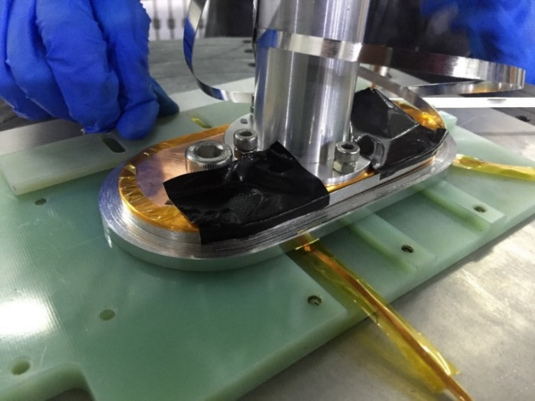
Coil design and winding

Slide 10
Insulation Methods for HTS coils
The current and heat can easily flow along the radial direction of the coil, which is helpful for the energy propagation during a quench.
Inter - turn current leads to a delay or inaccuracy in the magnetic field.
Reduce the risk of short - circuits.
Accurate magnetic field design.
During a quench, the current and heat are not easily dissipated, which may cause local damage.
A choice that lies in between the two.
Non
insulated
Stainless steel insulated
Kapton insulated

Slide 11
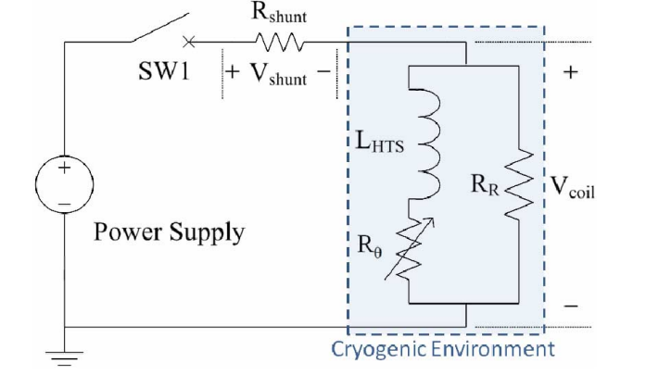
Issues of NI/MI HTS coil
BACKUP
When the radial current path with small resistance is connected, the current flows into the turns under the influence of inductance of the coil when ramp-up.

Slide 12
Introduction of the Experiment
 |  | coil1 | coil2 | coil3
Insulation |  | non | Kapton | stain steel
Turns |  | 60
Straight section length of the coil | （mm） | 80
Inner diameter of the arc section | （mm） | 60
Inductance | （μH） | 67.3 | 70.1 | 69.7
central field per unit current | （mT/A） | 0.764 | 0.734 | 0.739
Objective: To detect whether the coil has achieved the designed performance, such as critical current, magnetic field strength, etc.
Testing equipment：as show in the figure.
Testing method: Immersion cooling in liquid Nitrogen.
Attention: Liquid nitrogen is a cryogenic liquid. When operating, wear gloves to prevent frostbite.

Slide 13
Results Analysis
The critical current of the coil@ self-field,77K.
The influence of three coil winding methods on magnetic field delay.

Slide 14
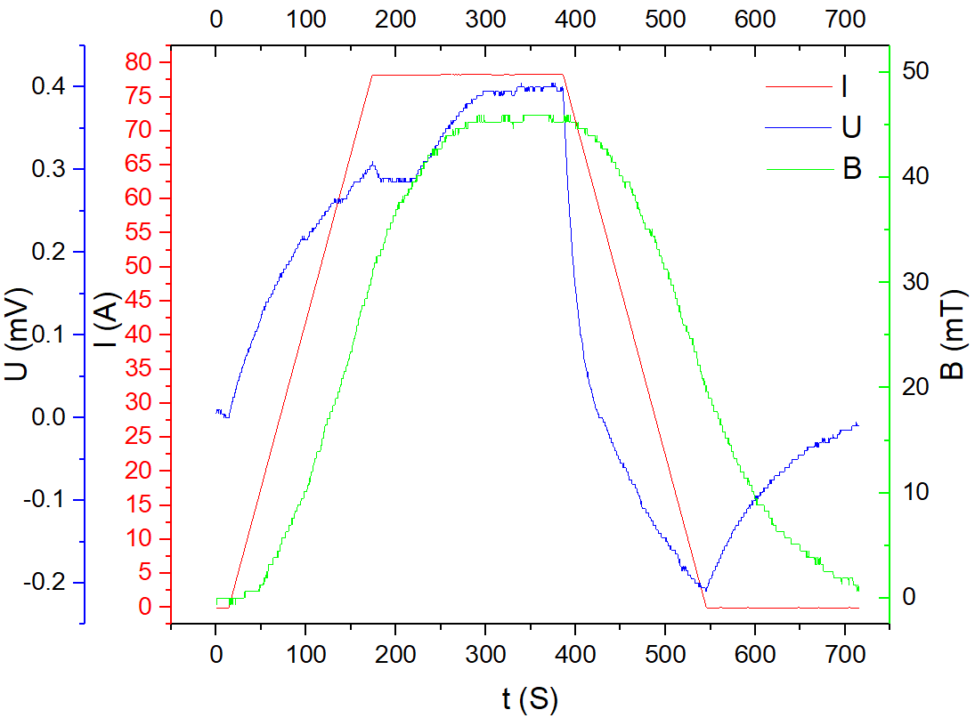
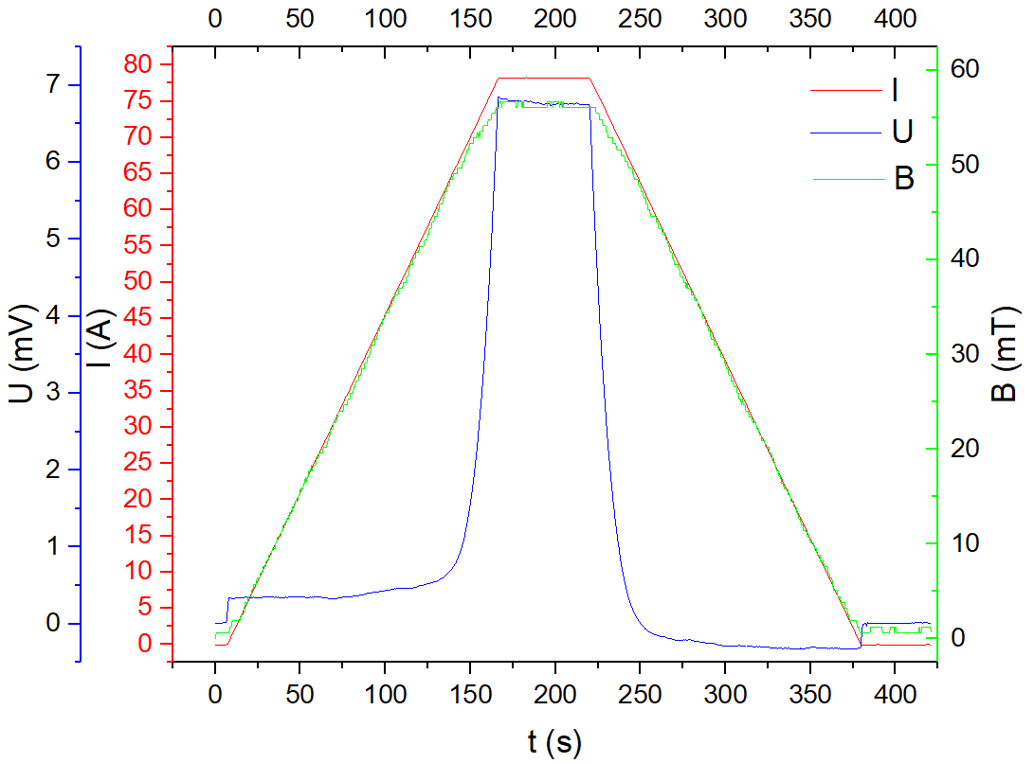
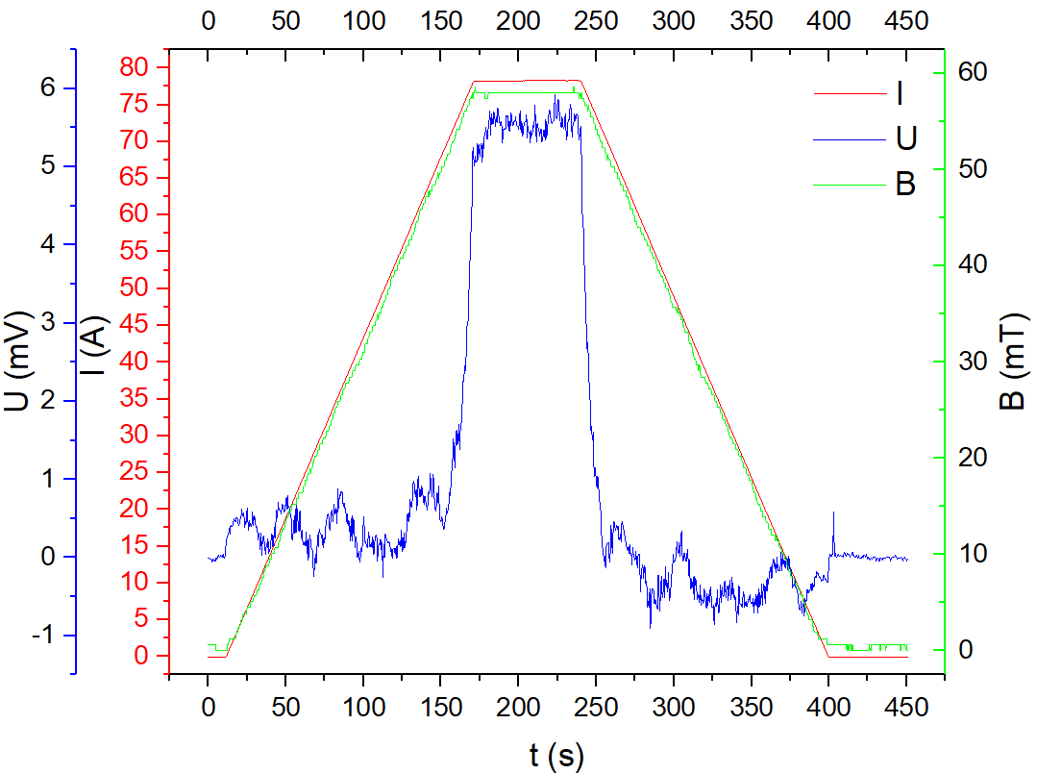
不同绝缘线圈的延时效应
BACKUP
0.5A/s升流速度进行实验，对延时效应进行研究。
NI
MI
Kapton insulotion
注：横坐标为时间，红色曲线代表电流，绿色曲线代表磁场，蓝色曲线代表电压。
无绝缘延时6 min，不锈钢绝缘延时2 s。

