Slide 1

Cavity Test at Cryogenic Temperature
Chao Dong, Peng Sha
March 23-30, 2025
Sixth Asian School on Superconductivity & Cryogenics for Accelerators

Slide 2
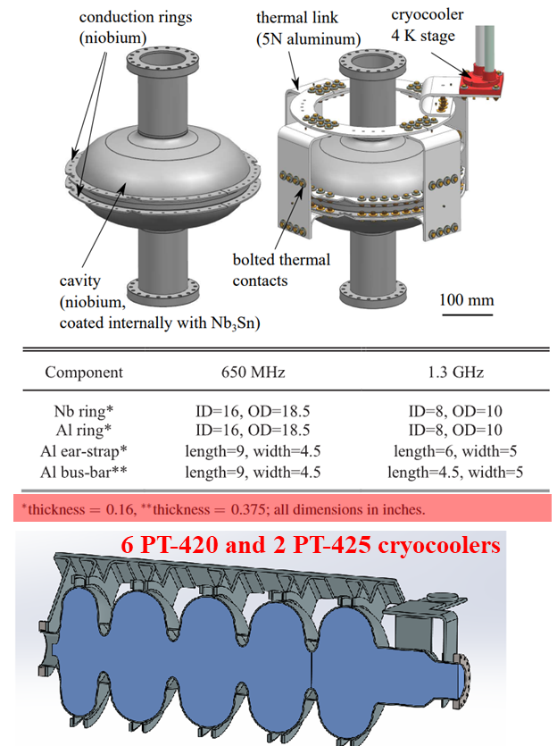
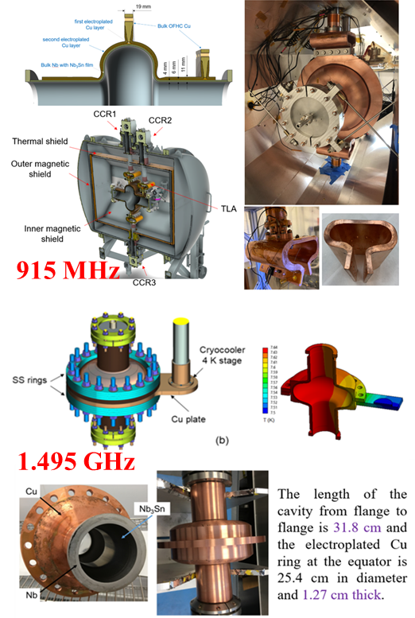
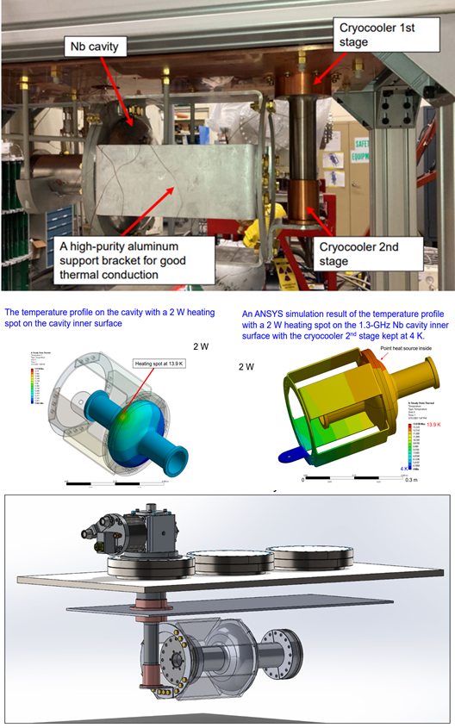
SRF Module by Conduction-cooling
The RF superconducting module cooled by small cryocoolers and heat conduction has gradually become a research hotspot internationally in recent years.
FNAL
JLAB
LANL
Advancements in superconducting cavity performance—particularly the significant improvement in intrinsic quality factor (Q₀​)—have reduced dynamic heat loads to the range of a few watts.
Concurrently, compact cryocooler technology has matured, with single-stage units now capable of providing cooling capacities up to 35 W @ 50 K and 2 W @ 4.2 K.
3 crycoolers

Slide 3
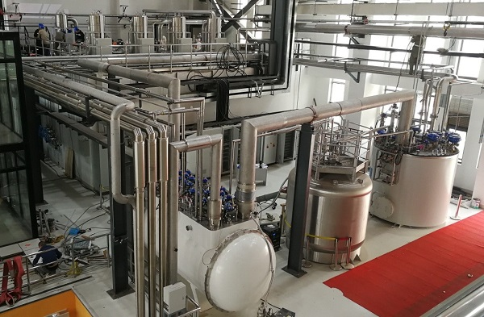
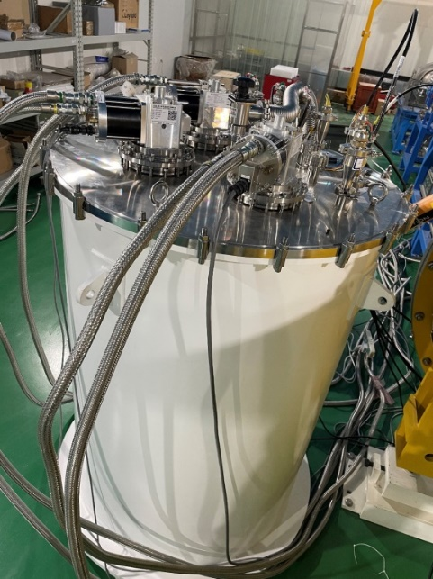
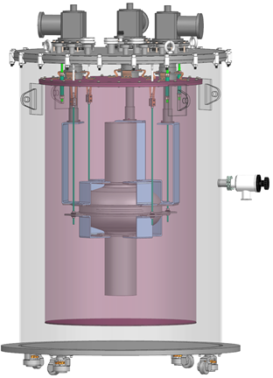
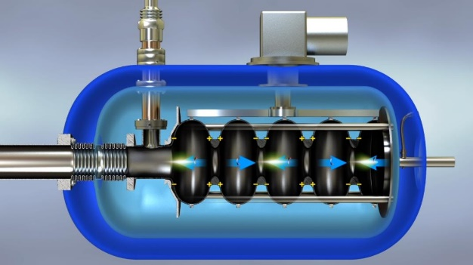
Different Vertical Test Methods
Real-World Photo
Schematic Diagram
Typical vertical test station of PAPS: liquid Helium, large，expensive, complex, powerful (~kW@4.2K)
Conduction-cooling vertical test: compact, cost-effective, convenient, power limited (~W@4.2K)

Slide 4
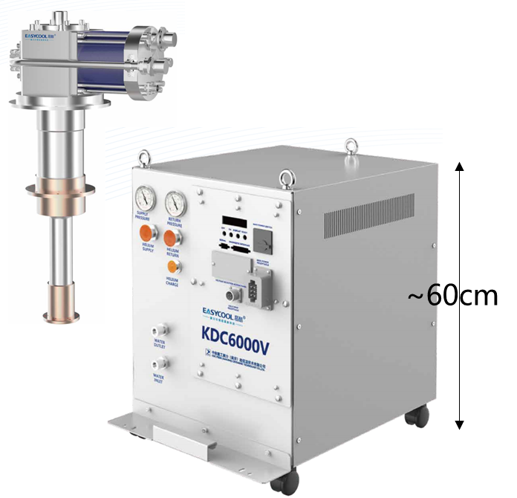
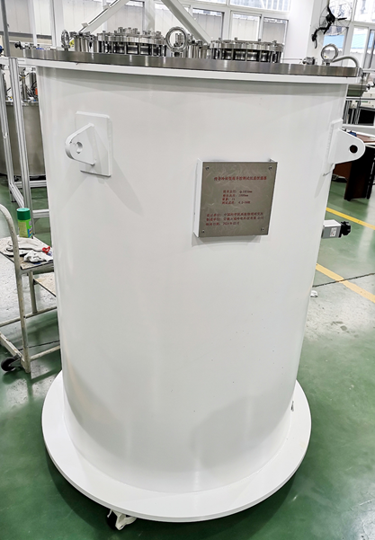
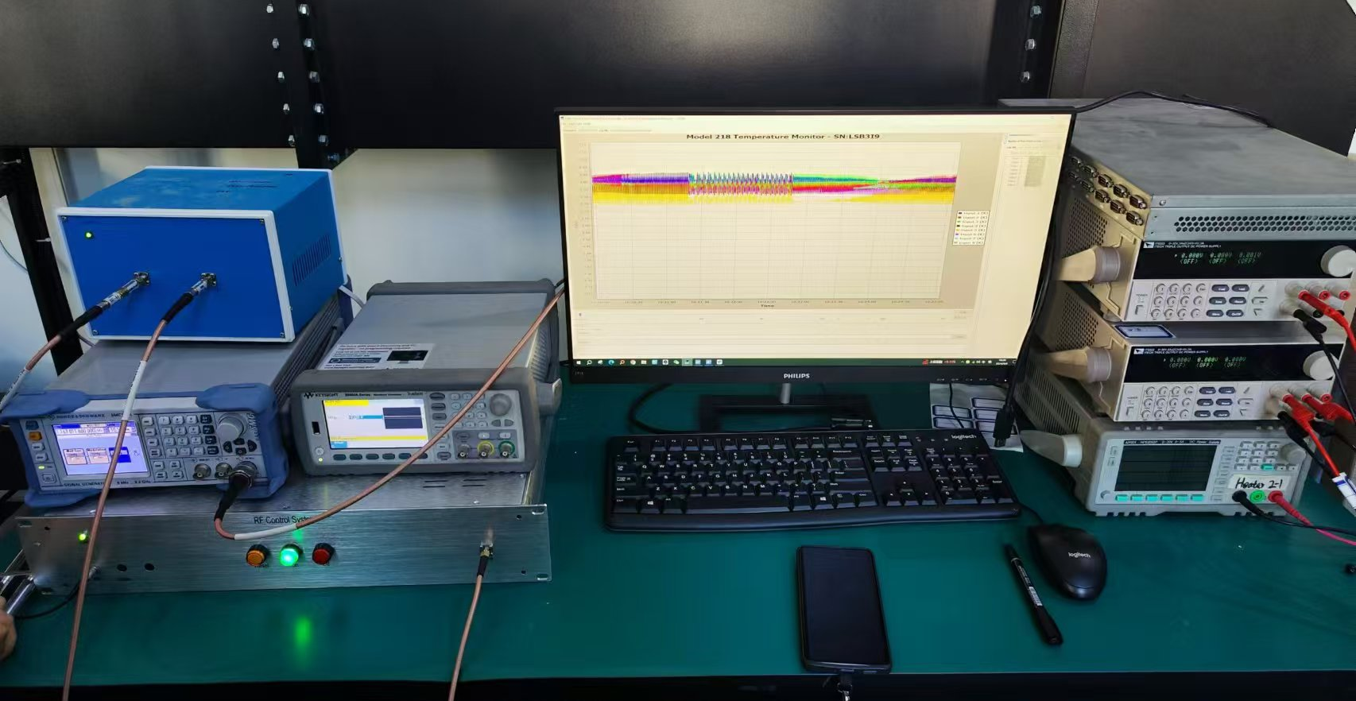
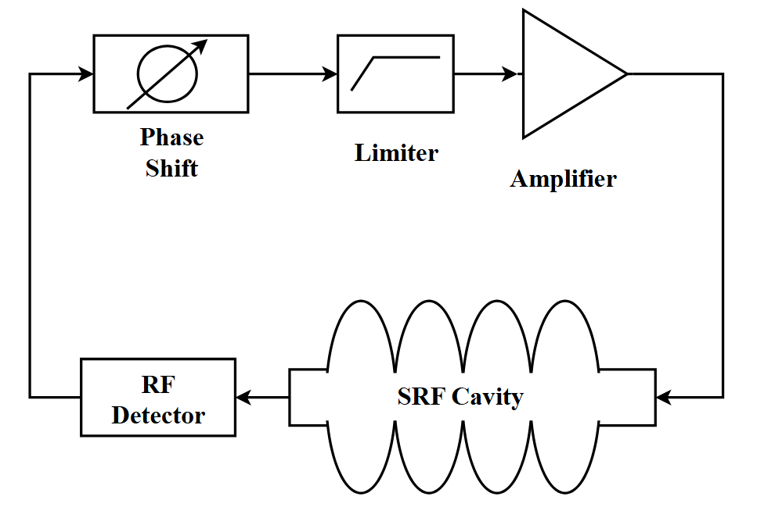
Conduction-cooling Setup in IHEP
Cryocooler without Liquid Helium:
1. Cooling Source:
Sumitomo SRDK418D*2, 1.8W @ 4.2K
Cryopride KDE418SA*1, 1.75W @ 4.2K
2. Superconducting Cavity:
1.3 GHz 1-cell Nb3Sn-coated cavity
3. Temperature Measurement System:
Cernox*6, PT100*15
4. RF Measurement :
Self-Excited Oscillation Circuit (SEL) of IHEP
KDE418SA
Liquid-Helium-Free Cryostat

Slide 5
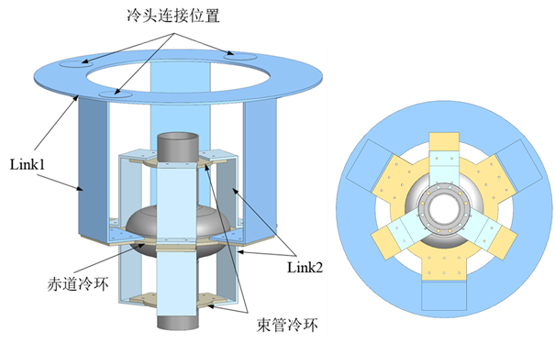
Conductive Cooling Structure for 1.3GHz 1-cell Cavity
The structure consists of three main components: equator cooling ring, beam-tube cooling rings, and thermal bridges.
Three cryocoolers are uniformly distributed and connected via Link1 to efficiently extract heat from the cavity.
The cooling rings are fabricated from niobium (RRR=300),
while the thermal bridges are made of 5N-purity aluminum.
3. The equator and beam-tube cooling rings are electron-beam welded to the cavity body and bolted to the thermal bridges.
Steady-state thermal simulations confirm that under total
thermal loads of 1.5–12 W:
  Maximum temperature on the cavity’s inner surface:
  3.56–8.42 K,
  Average temperature: 3.53–8.26 K,
  Maximum temperature gradient: 0.11–0.44 K.
ECR
BCR
These results demonstrate that the conductive cooling design effectively manages thermal loads, ensuring operational feasibility.

Slide 6
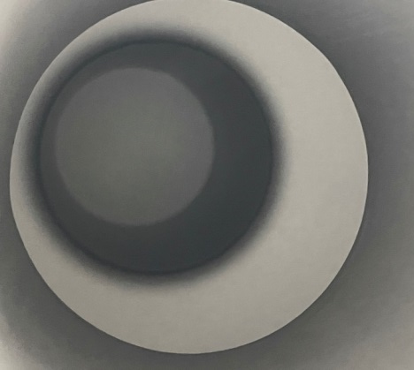
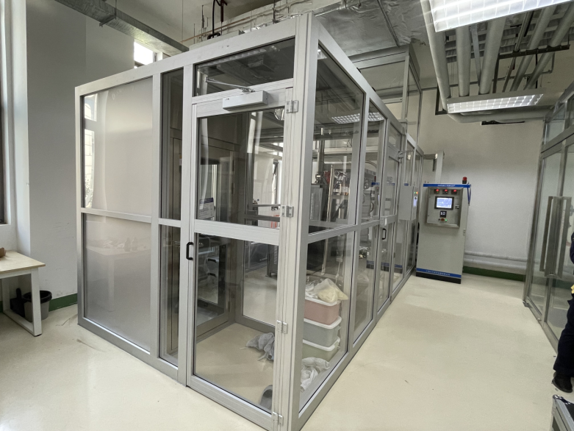
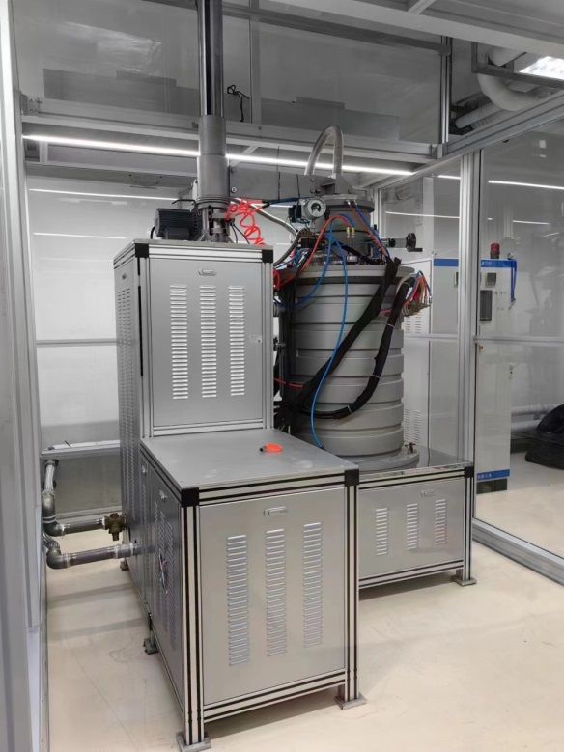
Niobium Cavity Coating with Nb₃Sn Film at IHEP
Degas: 150℃ 17h
Nucleation temperature & time
Crucible/Furnace: 850℃/540℃ 5h
Ramp-up: ~1h
Cleanliness
level:
Class 10,00
Furnace
Coating temperature & time
Crucible/Furnace: 1290℃/1130℃ 1-3h
Annealing temperature & time
Crucible/Furnace: None
E_{acc-max} 15.5 MV/m
Ramp-down to 40℃: ~25h
Coating Process

Slide 7
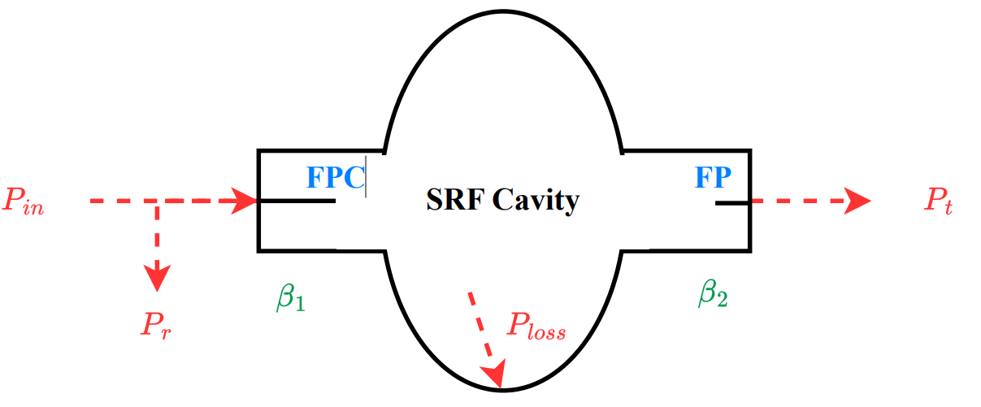
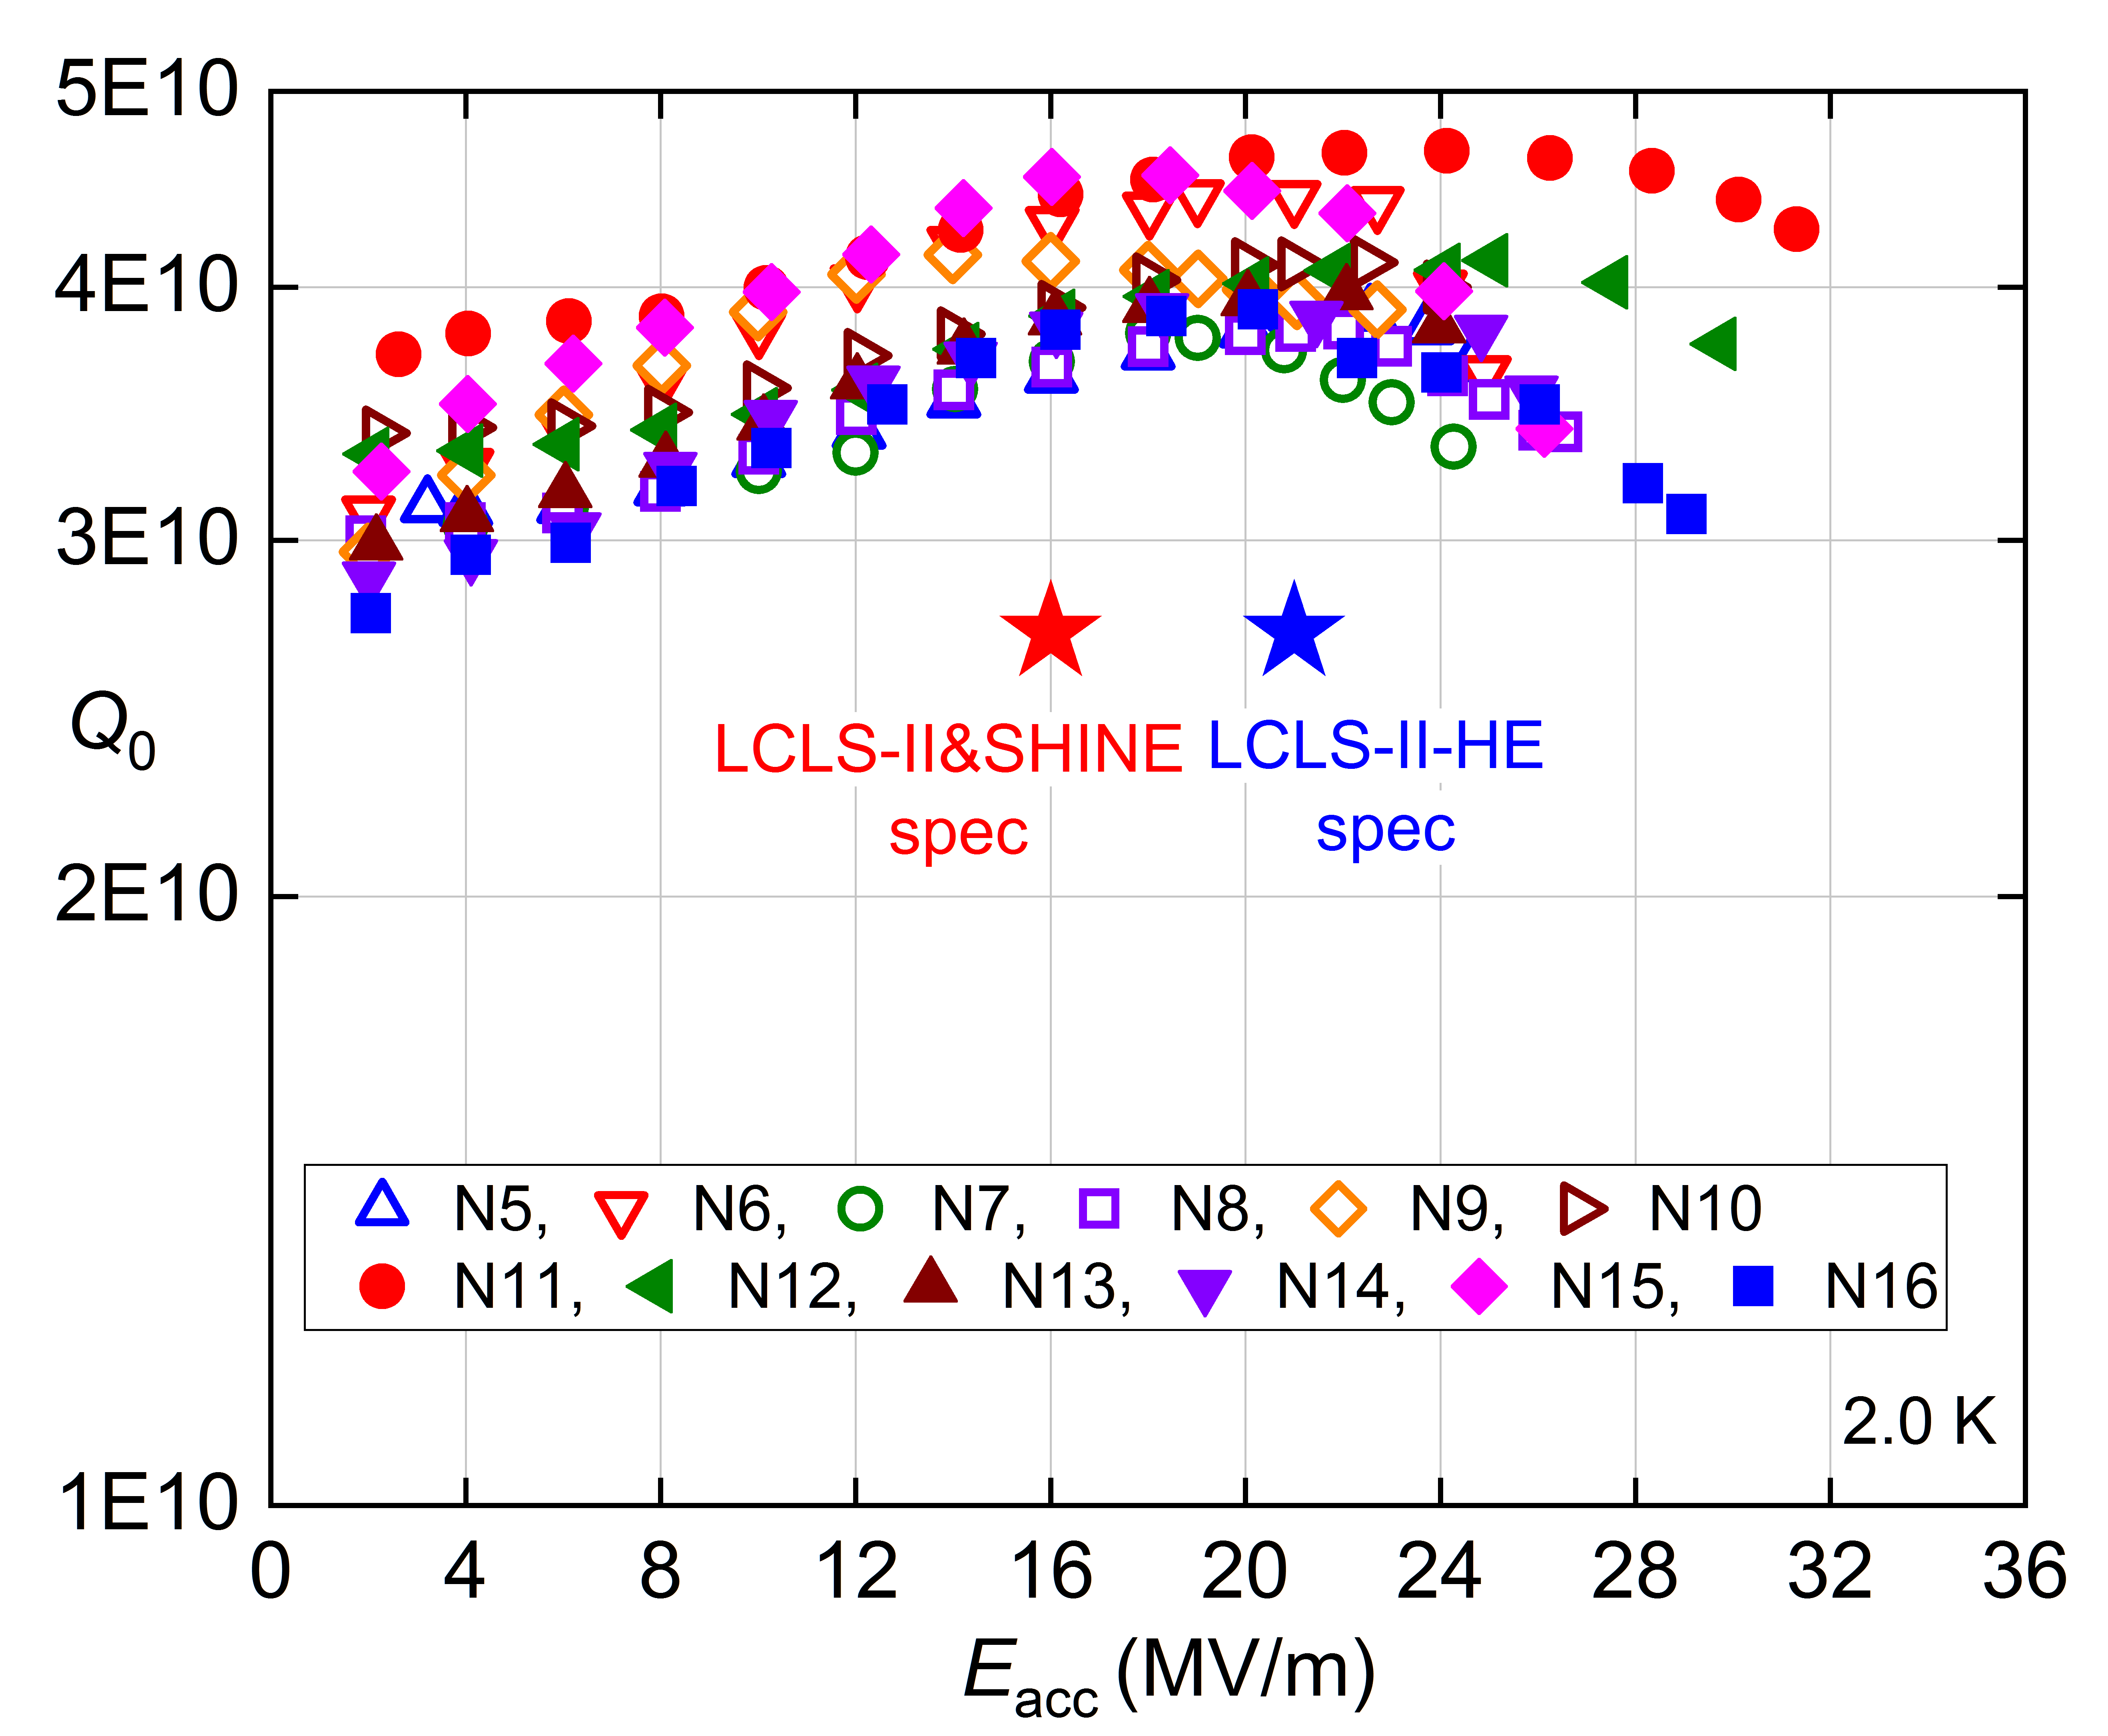
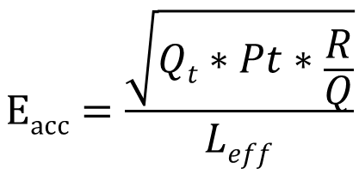
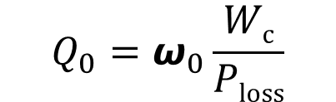

Vertical Test of SRF Cavity
Q₀ & E_{acc} could be measured during the vertical test of SRF cavity.
$$Ploss=Pin−Pr−Pt$$
$$Q_{0}=ω_{0}\frac{Wc}{Ploss}$$
$$Eacc=\frac{\sqrt{Qt∗Pt∗\frac{R}{Q}}}{Leff}$$

Slide 8
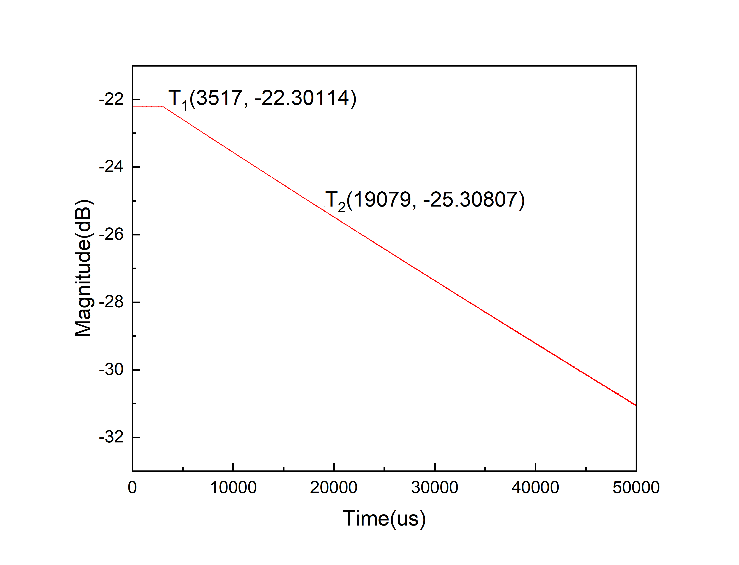

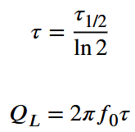
Measurement of τ
Switch RF off, measure τ (decay time of RF signal).
Usually, τ is measured as τ_{1/2}, which corresponds to -3dB (half-power point of P_{t}).
Switch RF Off:
-3dB=10*log0.5
τ_{1/2}≈
15.6ms

Slide 9
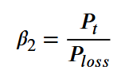

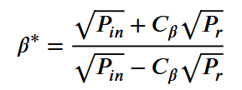


Calculation of Q₀ and E_{acc}
Measure the value of P_{in}, P_{r} and P_{t}.
For 1.3 GHz 1-cell cavity, R/Q=106Ω, L_{eff}=0.113m
$$Ploss=Pin−Pr−Pt$$
C_{β} = 1 overcoupled
C_{β} = -1 undercoupled
Q₀=(1+β₁+β₂)*Q_{L}
$$Eacc=\frac{\sqrt{Qt∗Pt∗\frac{R}{Q}}}{Leff}$$
Q_{t}=P_{loss}*Q₀/P_{t}
Q_{t} is a fixed value (usually 1E11~1E12). Then, you can increased the RF power and get the value of Q₀ at different E_{acc}.

Slide 10
Thanks for your attention!

