Slide 1
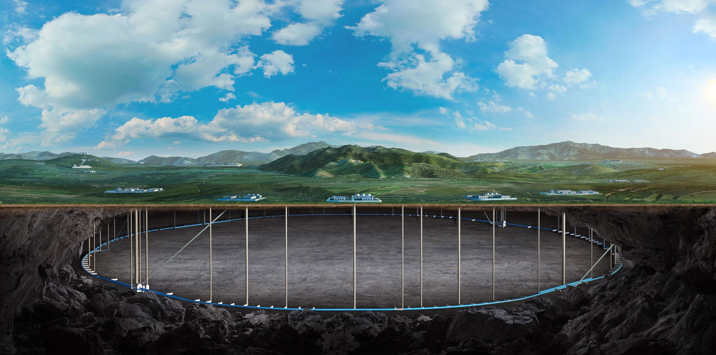

CEPC vacuum chamber production line
Discussion on vacuum chamber with photon absorber
Yongsheng Ma
Vacuum group, IHEP,CAS
Nov 27th 2024

Slide 2
Outline
CEPC vacuum chamber NEG coating & spraying production line progress
Layout of production line
NEG coating process
Spraying Process
Discussion on vacuum chamber with photon absorber
Changes to vacuum chamber
Changes to BPM, RF shielding bellows
Changes to the layout of vacuum devices
conclusion

Slide 3
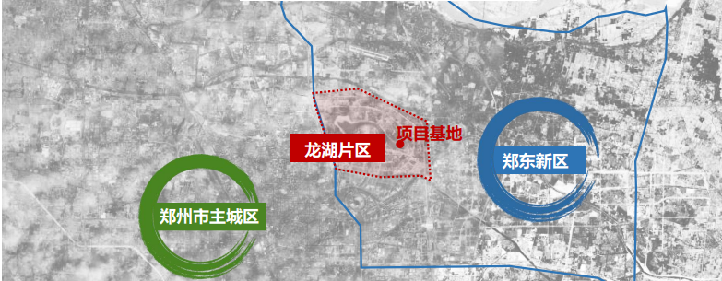
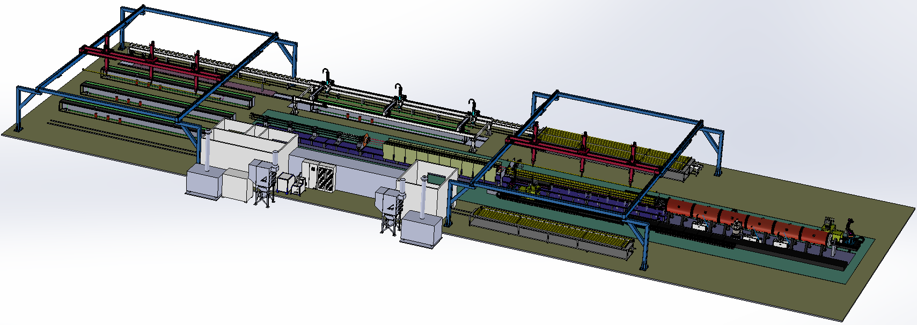
CEPC vacuum chamber production line
Requirement
Due to the difference in length, two production lines will be used to complete the production of vacuum chambers for the CEPC collider. The quantity of NEG coating and spraying facilities for the two lines varies to match the production speed.
With two production lines, the all vacuum chambers of collider will be finished in 5 years.
Advantages
More stable process, less manpower, less NEG coating facility, more adaptive capacity in production, etc.
Important nodes and progress
Technical scheme review
Procurement bidding
2024.10
2024.12
项目 | 设计参数
尺寸 | L 11400-d56-D62
重量 | 50~100kg
NEG 薄膜 | 厚度：200nm±30% SEY<1.1 抽速、容量、寿命
加热层 | 厚度<0.5mm 加热温度<300℃

Slide 4
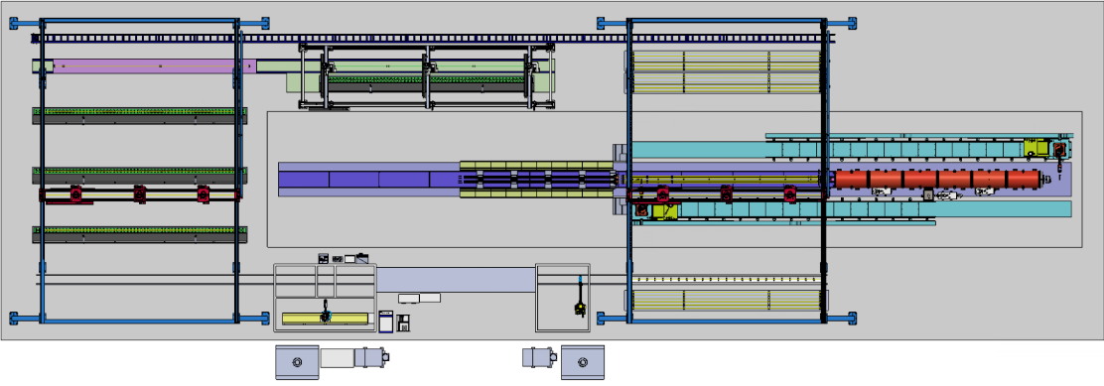
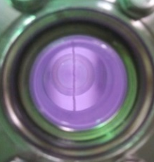
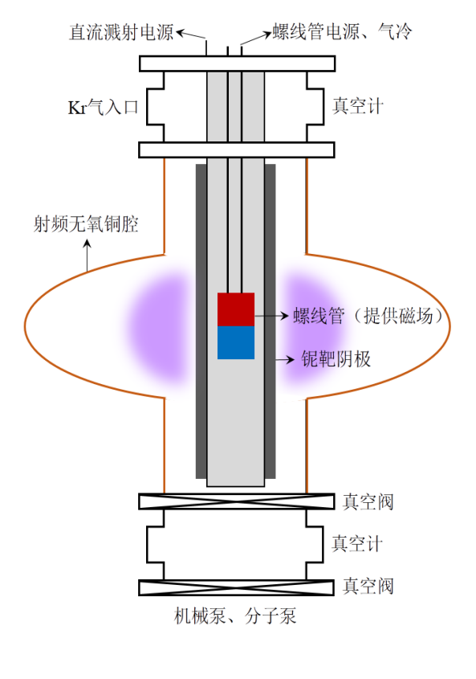
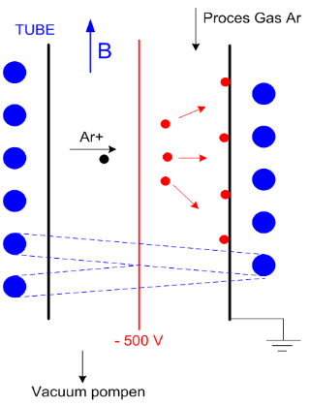
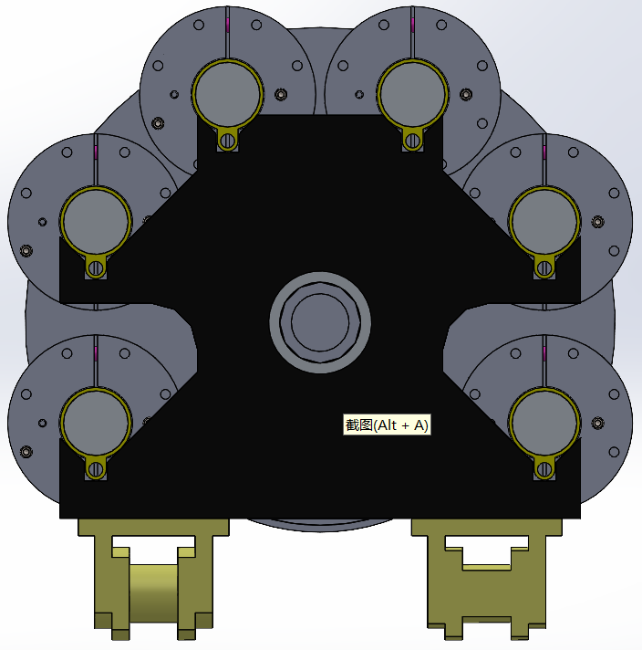
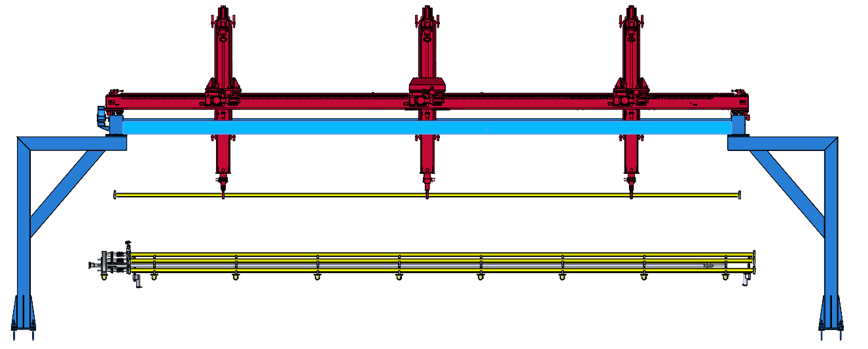
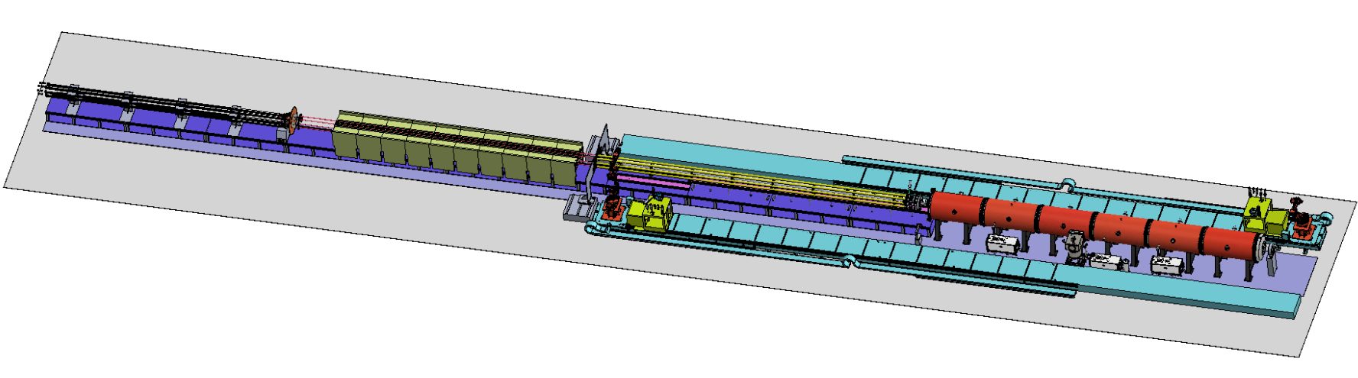
  Layout of production line
CSNS, BEPCII vacuum chambers;
Nb coating;
Kr+
磁环
阴极靶内置磁环
4

Slide 5
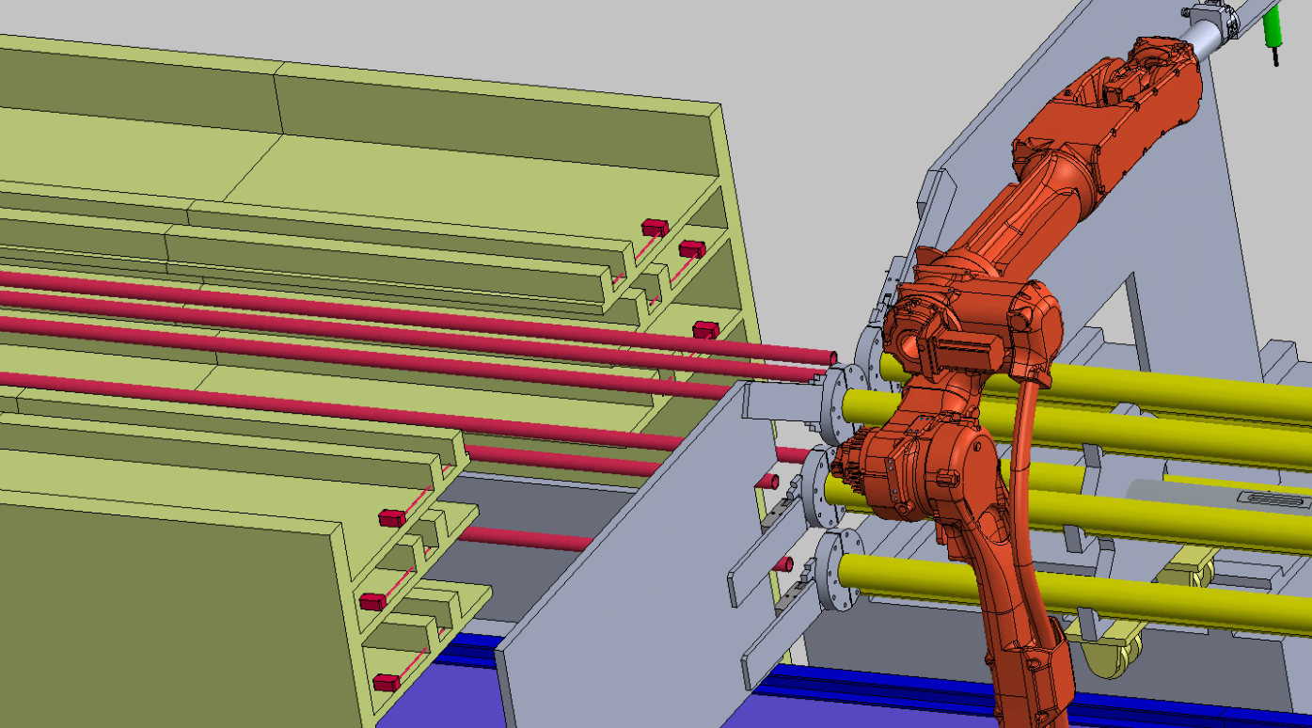
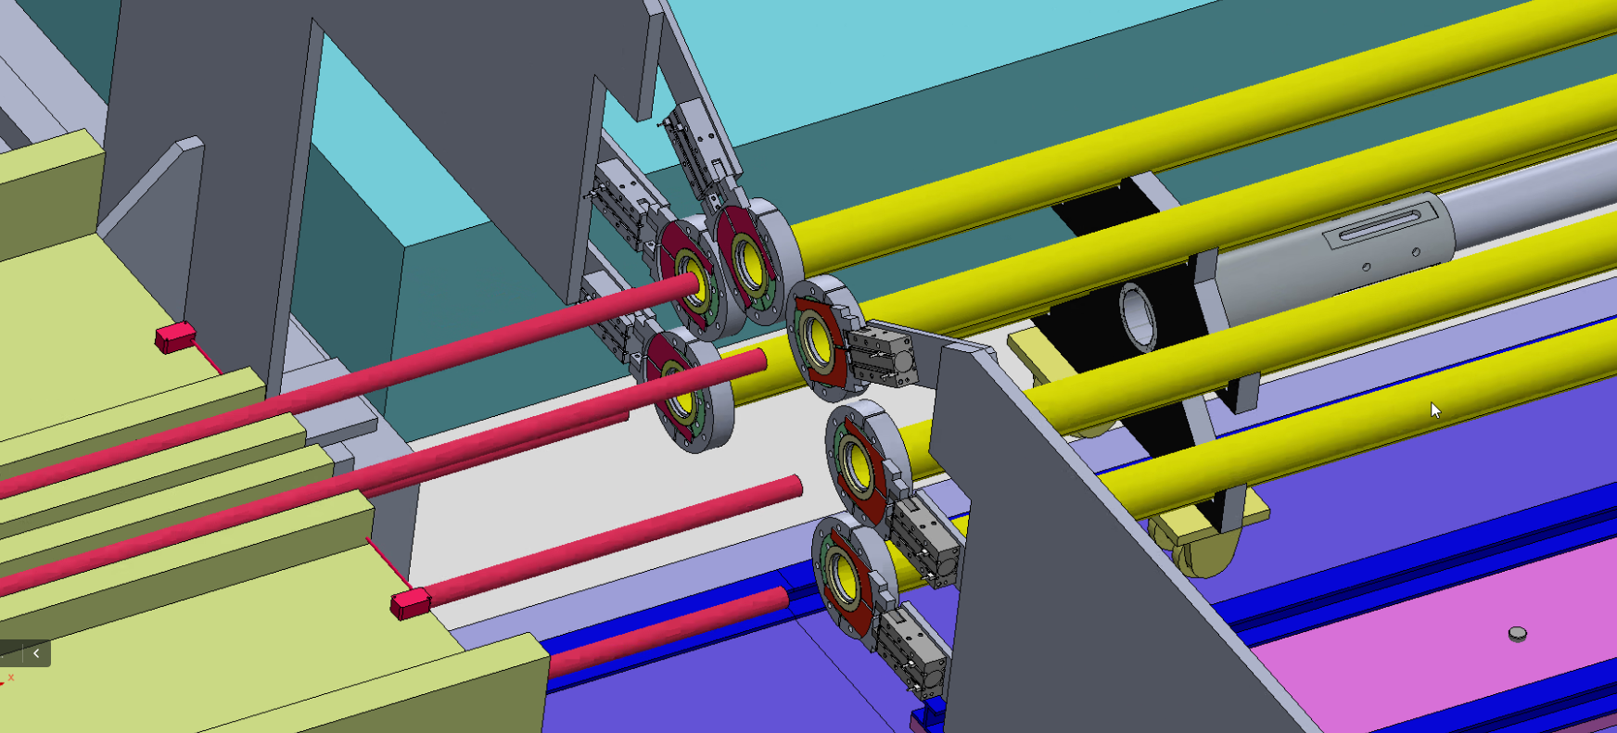
NEG coating process
NEG镀膜--真空盒装配、NEG镀膜、真空盒拆卸
结构组成：
铜真空盒NEG镀膜组装体
真空炉：低真空、加热、测控温系统
真空、水冷、充气、电气控制系统等。
自动拧紧、放铜垫
阴极靶水冷运动机构
阴极靶
真空腔体A
真空盒
分段轨道升降平台
真空炉
真空腔体C

Slide 6
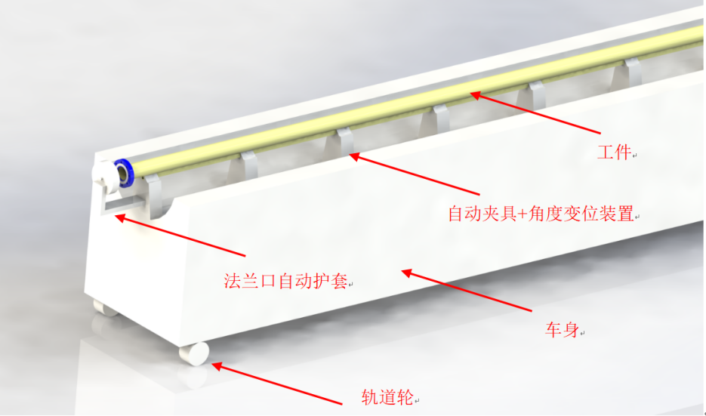
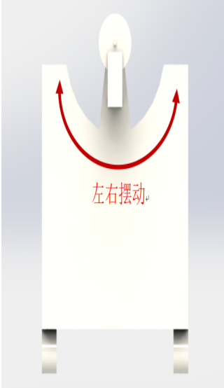
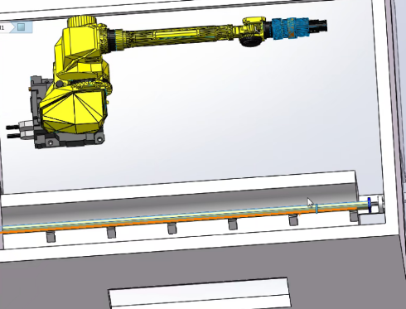
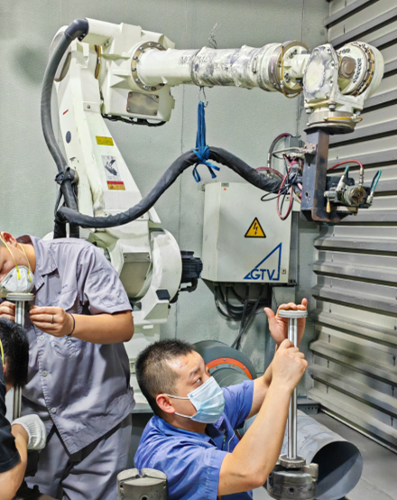
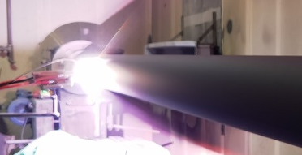
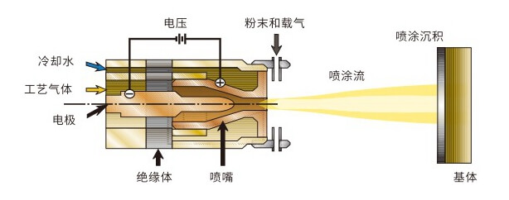
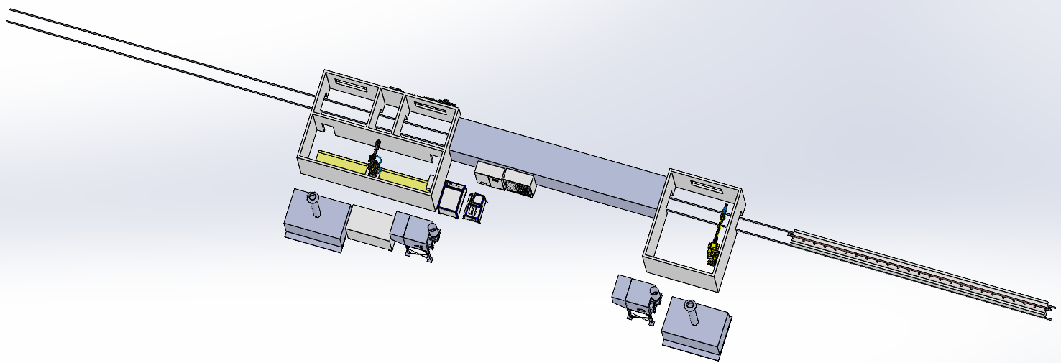
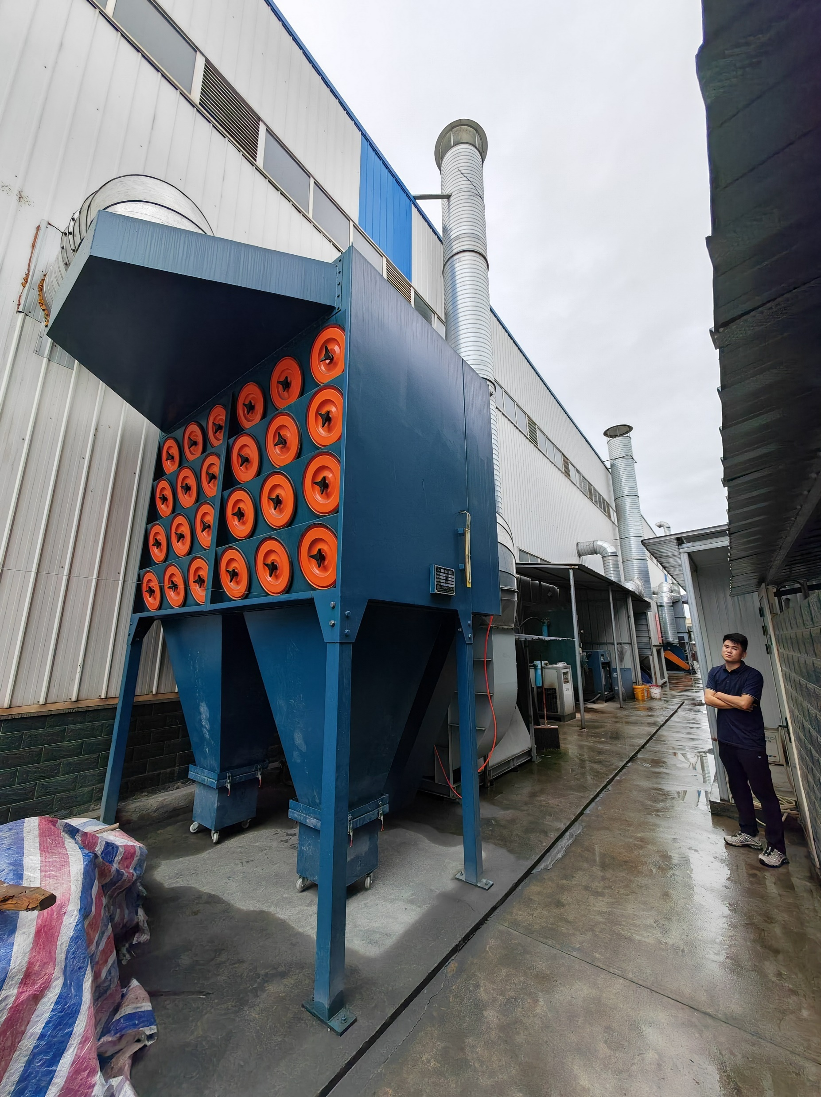
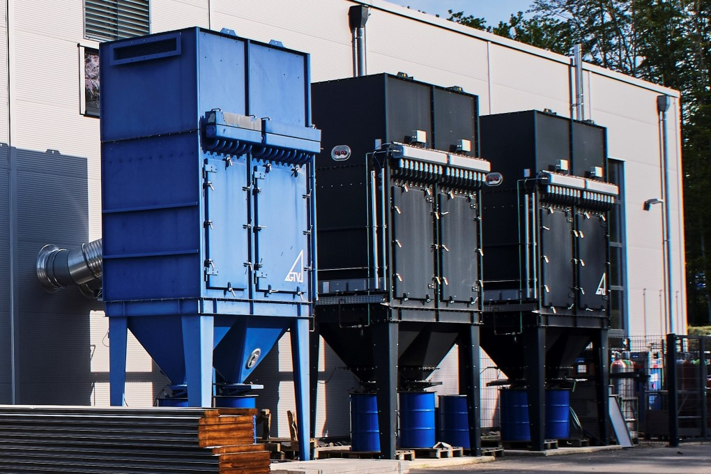
Spraying Process
喷砂、等离子喷涂、
下料区
绝缘层喷涂
吹扫清洁区
送粉器，控制端
底层、电阻层、电极喷涂
清洁、行程区
喷砂间
喷涂地轨机器人
上料区
室外除尘器
喷砂机器人
热交换器
热交换器
GTV-PPC
GTV电弧电源
GTV水电控制箱
室外除尘器

Slide 7
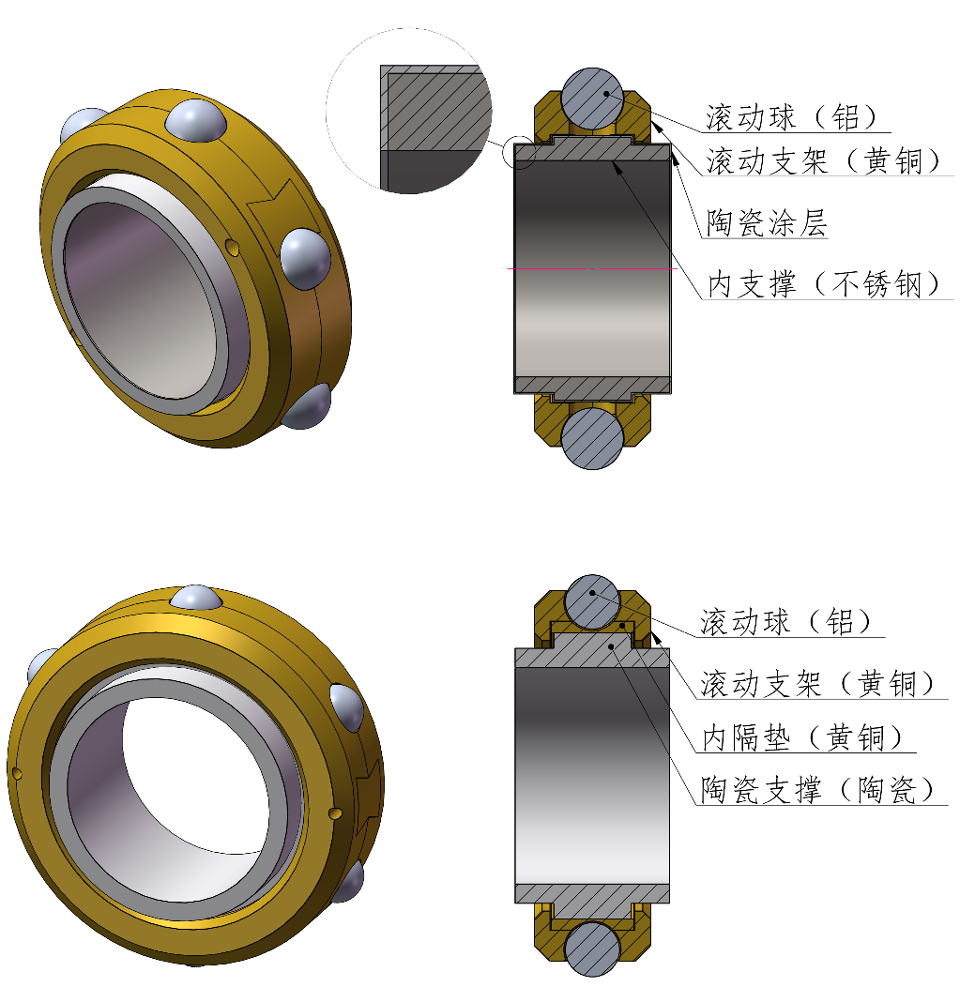
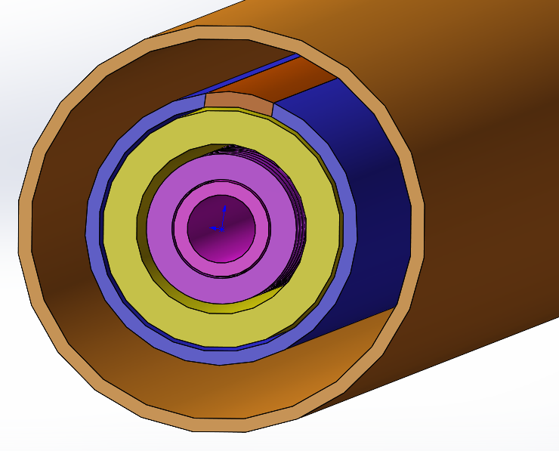
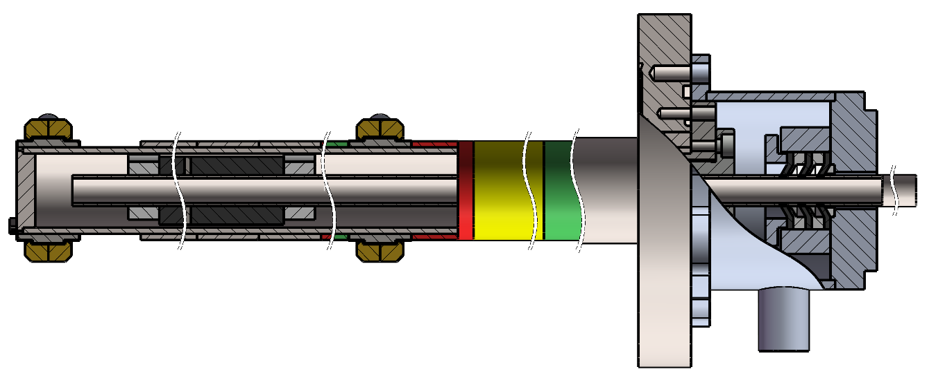
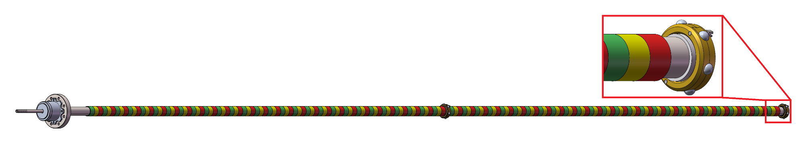
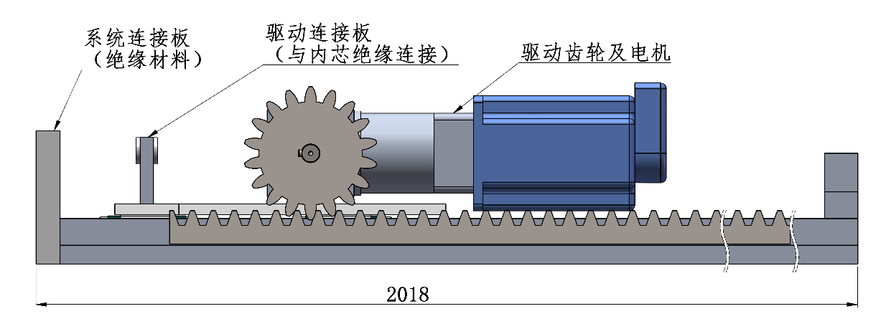
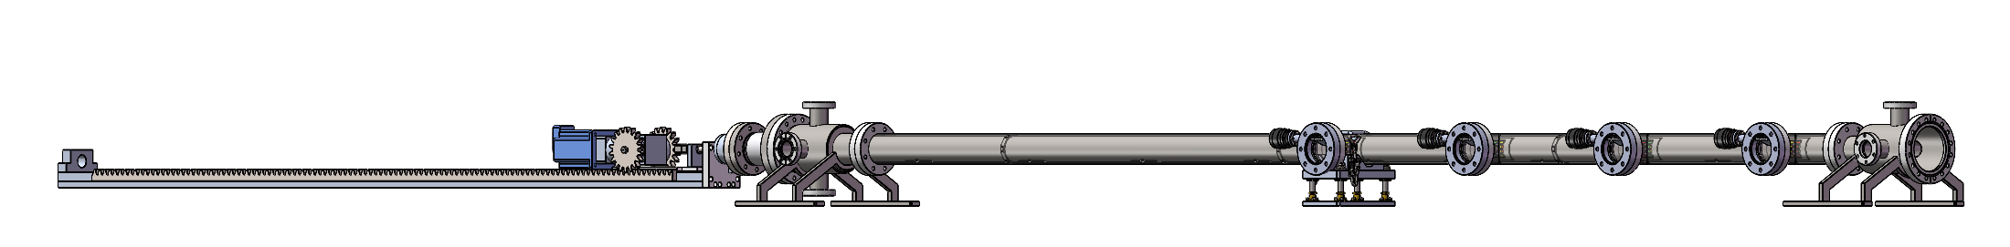
Prototype of cathode
dynamic sealing for water pipe
Magnets
Isolating and supporting ring
Water cooling pipe
~12000mm(12 meters)
Magnetron Cathode
The magnets will be driven by motor when NEG coating
Motor for magnets driven
23000mm(23 meters)
7

Slide 8
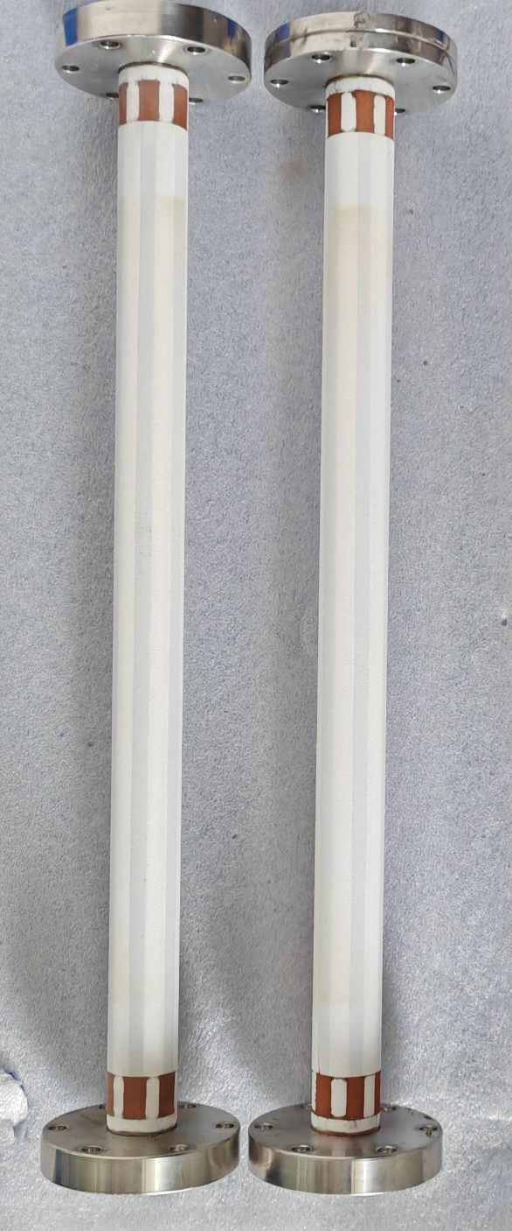
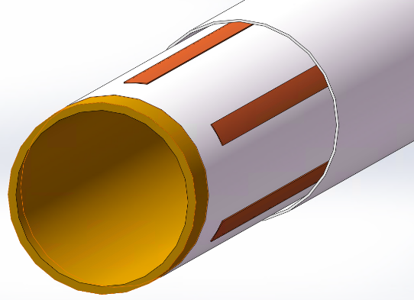
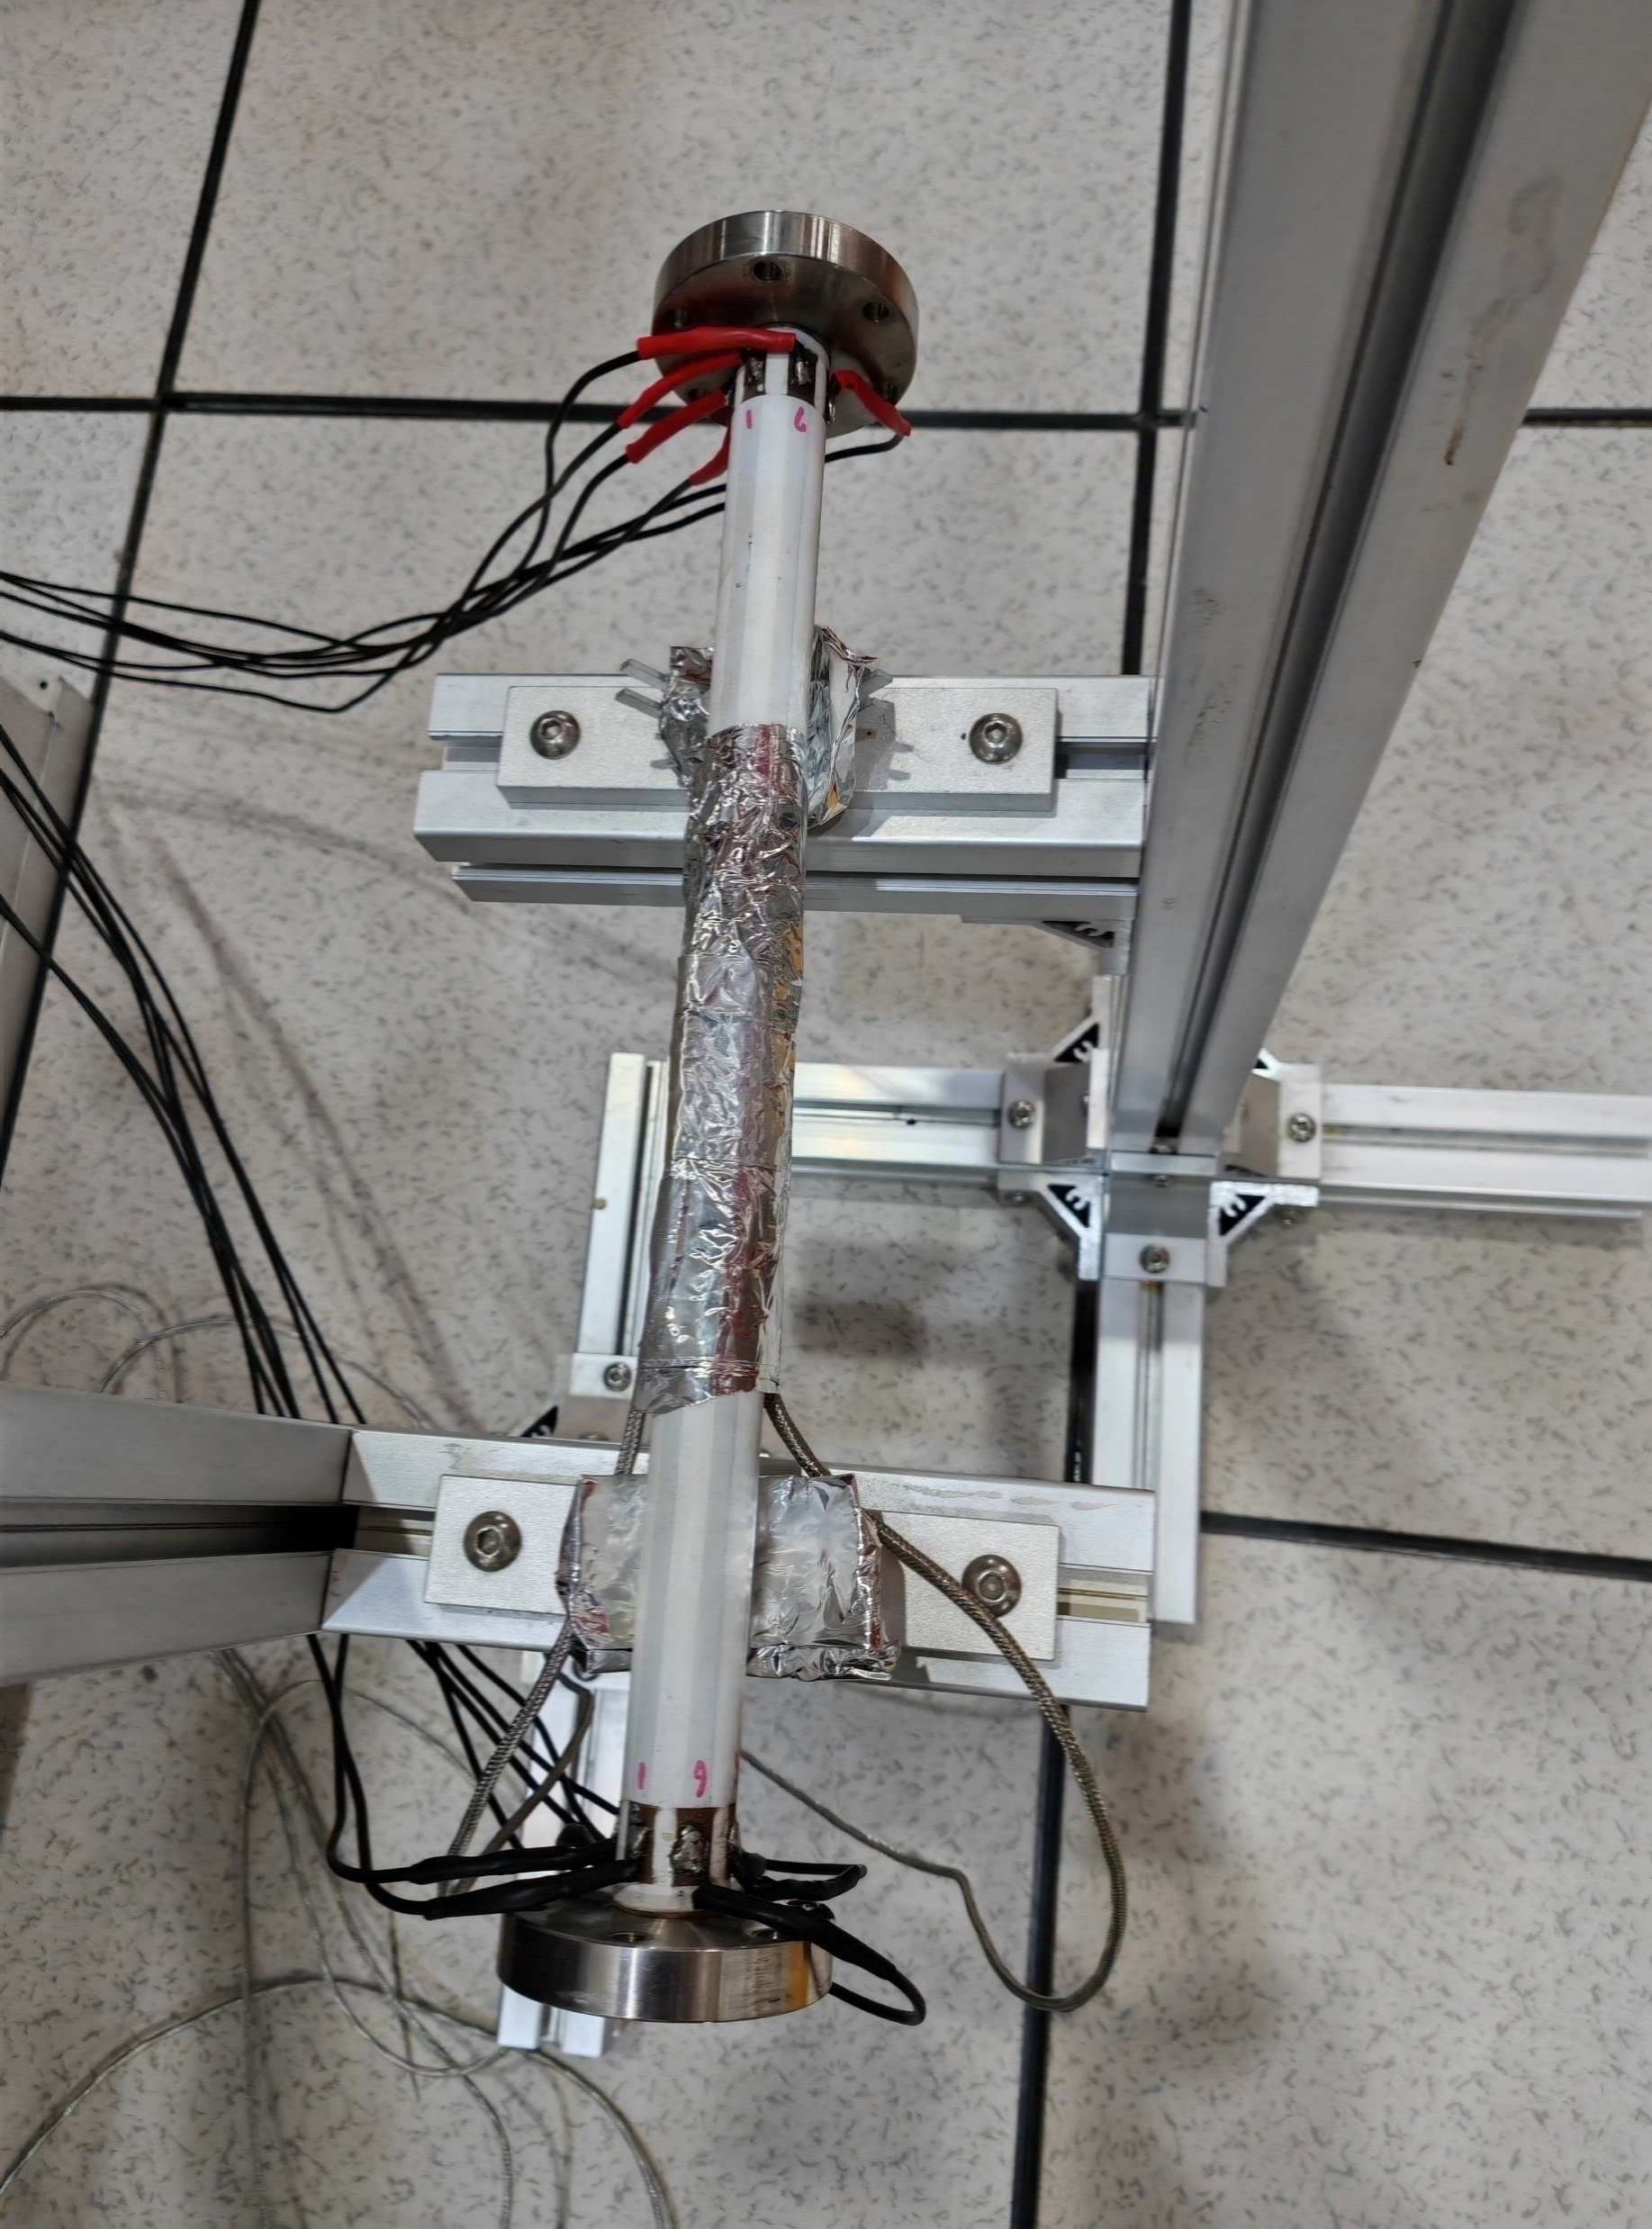
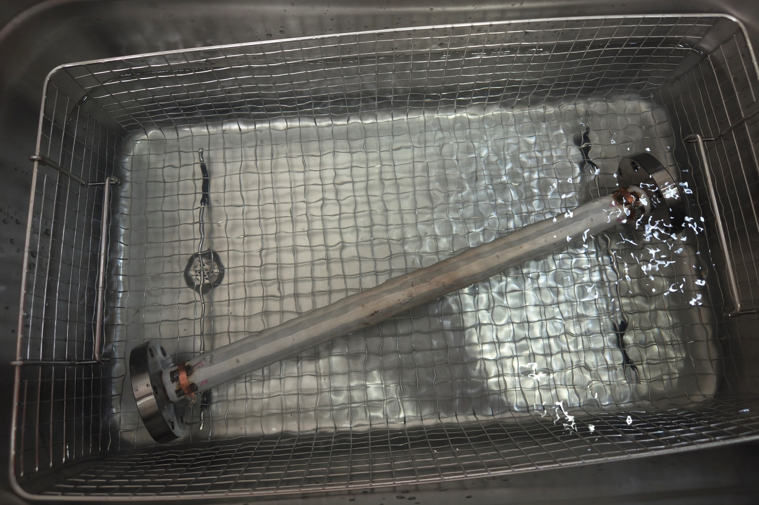
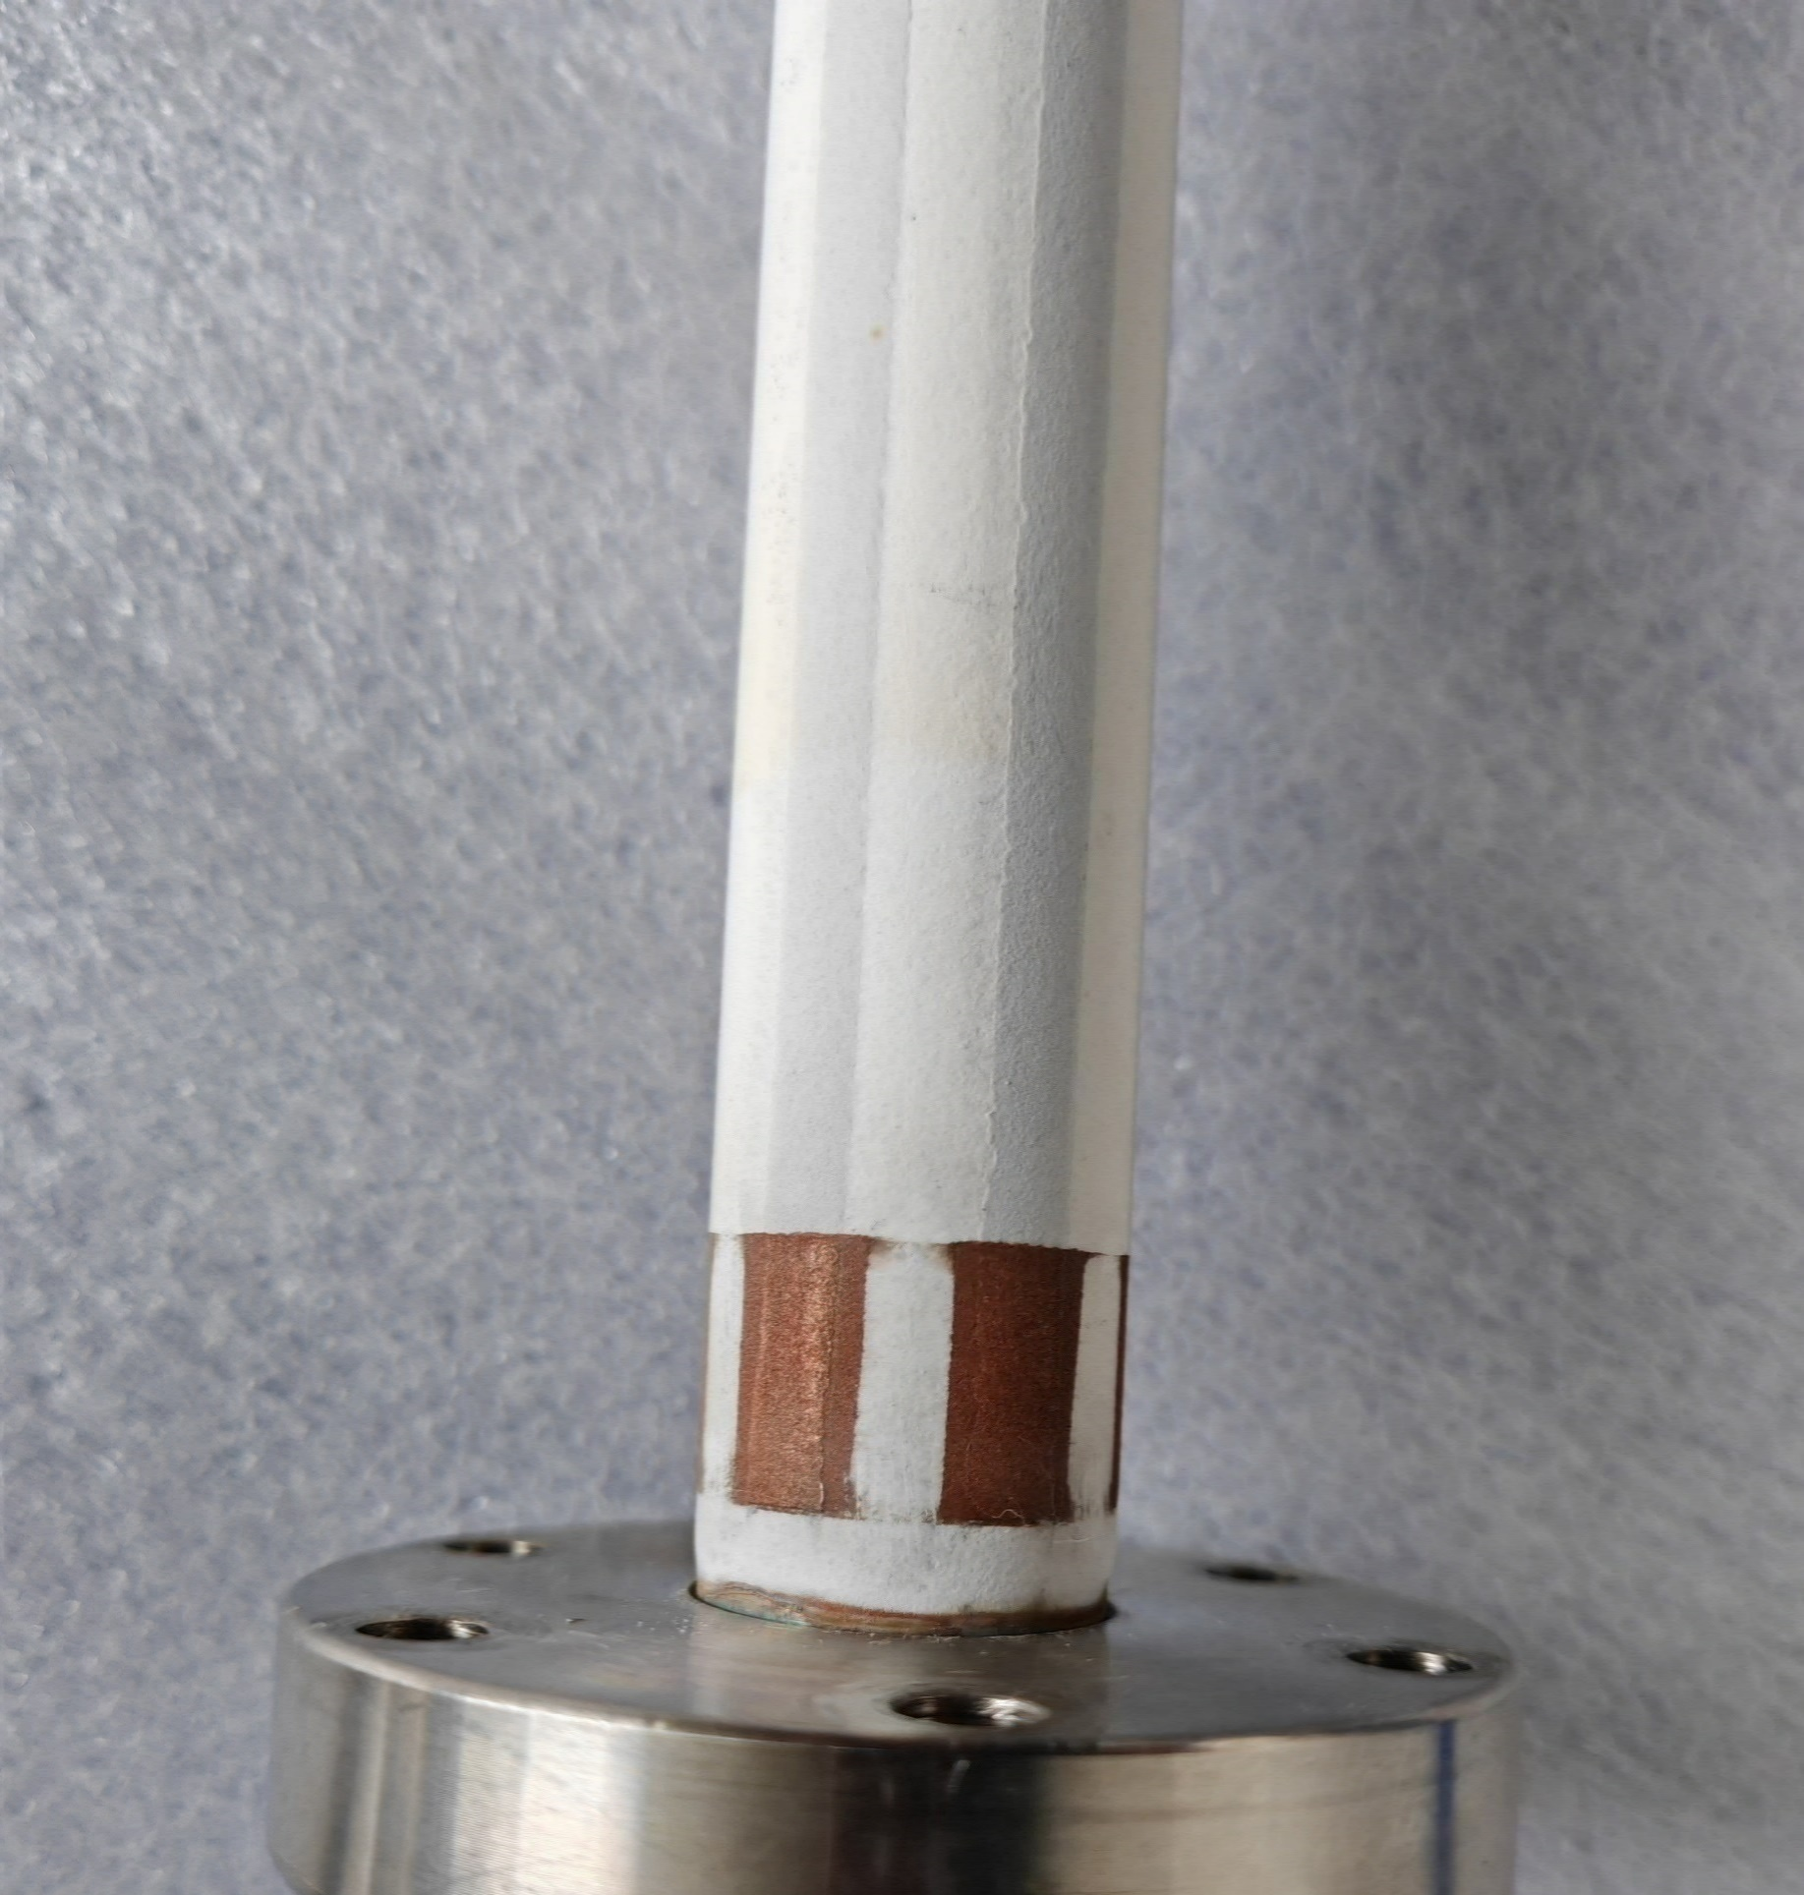
Prototype of Spraying heating film and tests
Reheating test more than 12 times
Adhesion test in ultrasonic resining
Dimension: L400*D24 Substrate: copper
Function | Materials | Thichness/um
Transition-layer | MCrAlY alloy | 50~100
Isolation-layer | Al2O3 cermic | ~150
Conductivity-layer | NiCr alloy | ~100~200
Isolation-layer | Al2O3 cermic | ~150
Contactor-layer | Copper | ~50
管外温度/℃
功率面密度W/cm2

Slide 9
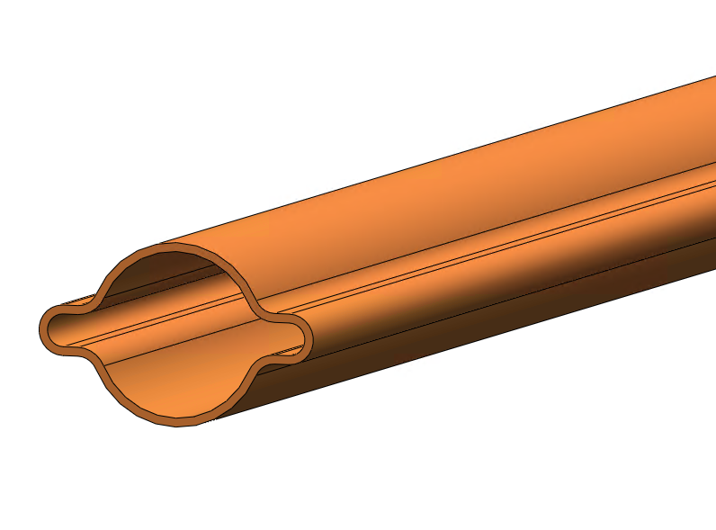
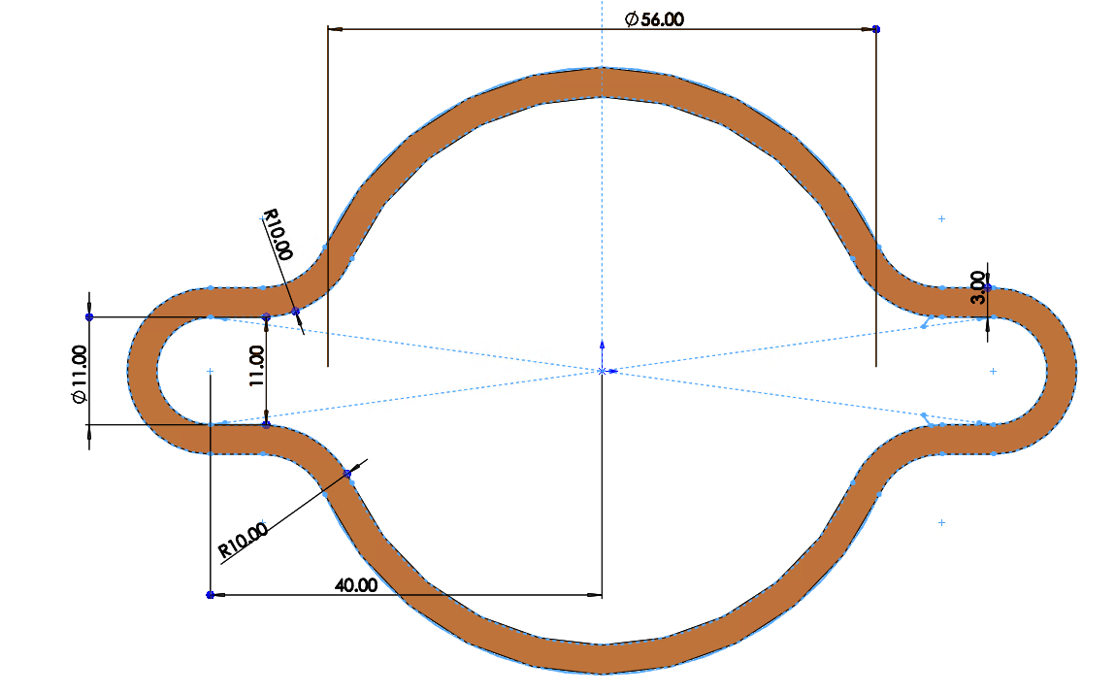
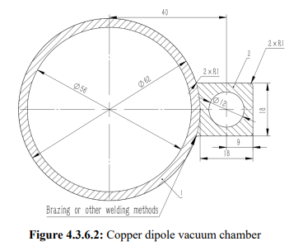
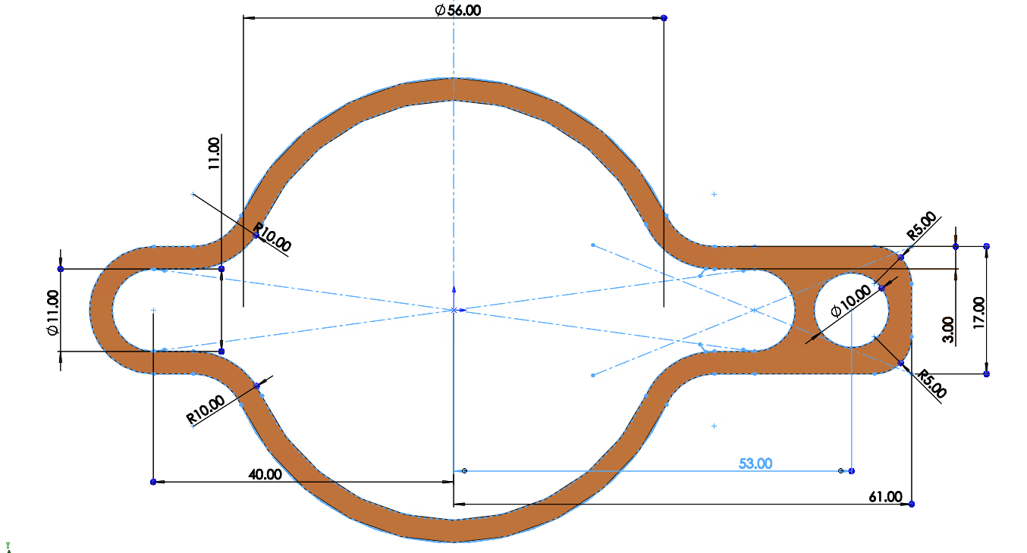
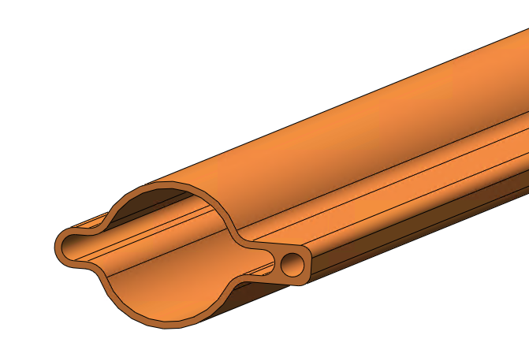
Discussion on vacuum chamber with photon absorber
Changes to vacuum chamber
The structure of vacuum chamber will be more complex.
The round vacuum chamber convert to antechamber;
Absorber will be welded together with vacuum chamber;
Colling pipe is necessary: the total heat load due to the resistive wall for collider single ring is about 2Mw under 50 mw mode; SR reflection from absorber.
NEG coating , spraying heating layer will be more complex.

Slide 10
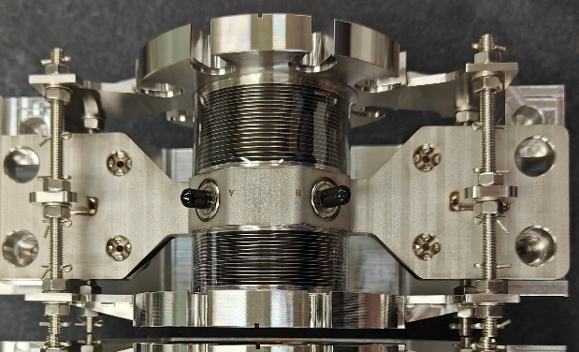
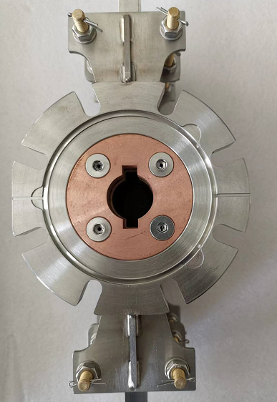
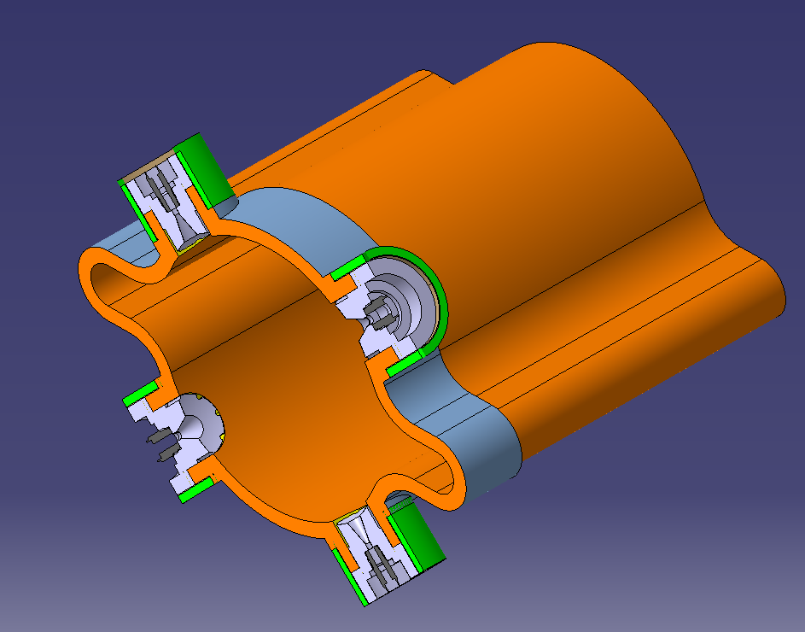
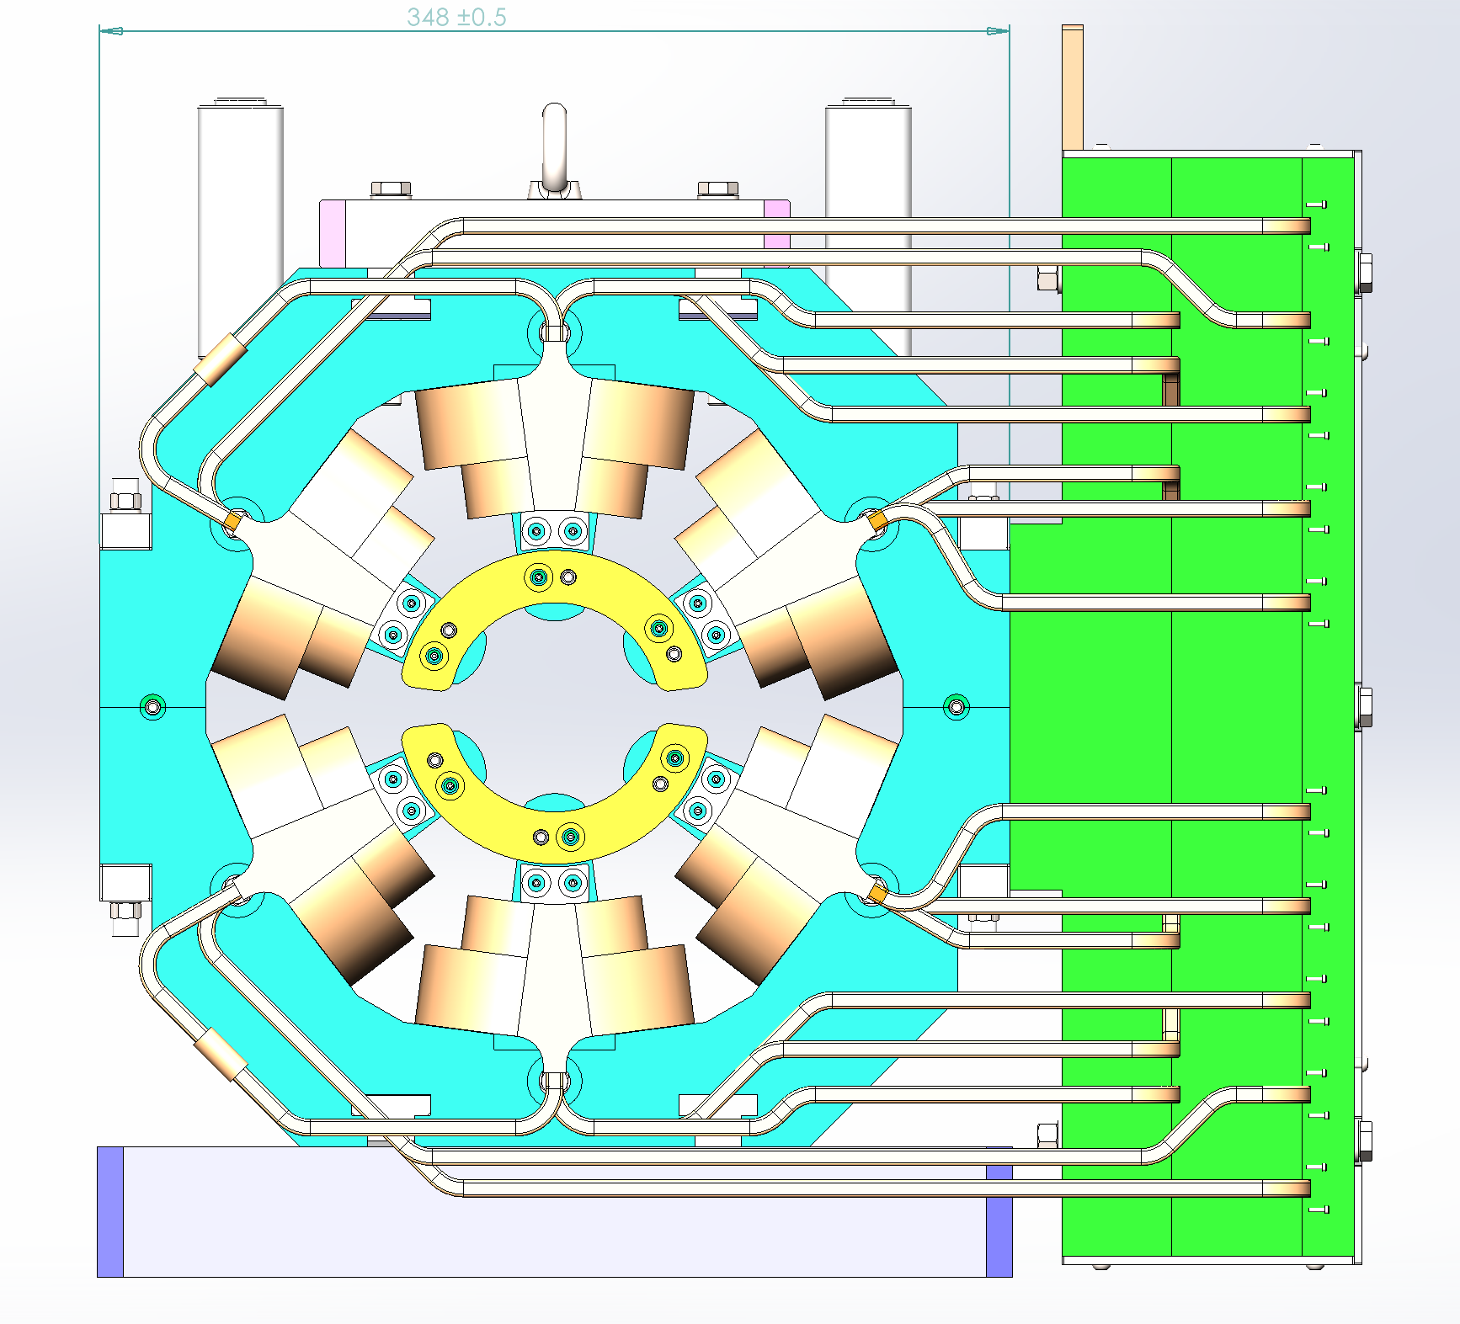
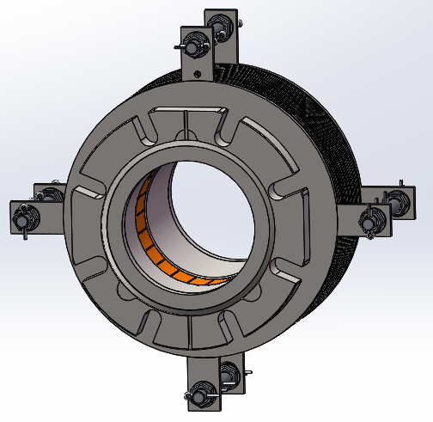
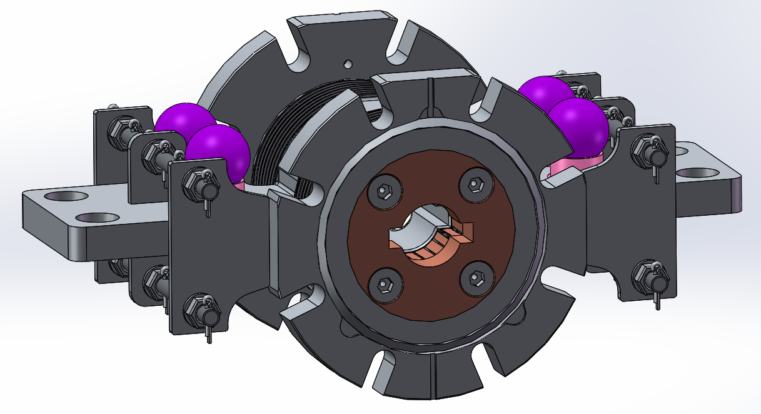
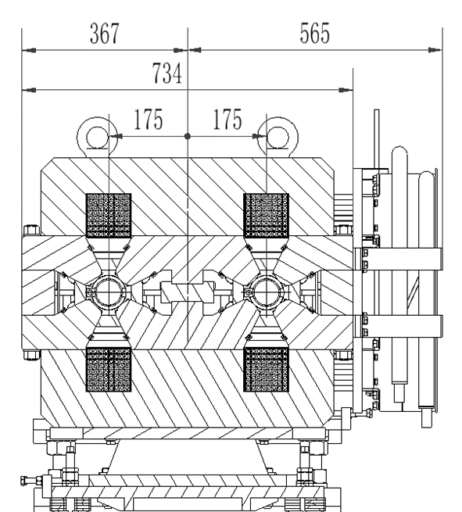
Changes to BPM, RF shielding bellows
The structure will be more complex.
The size of magnet needs to be reconsidered
The round vacuum chamber convert to antechamber
BPM
RF shielding bellows

Slide 11
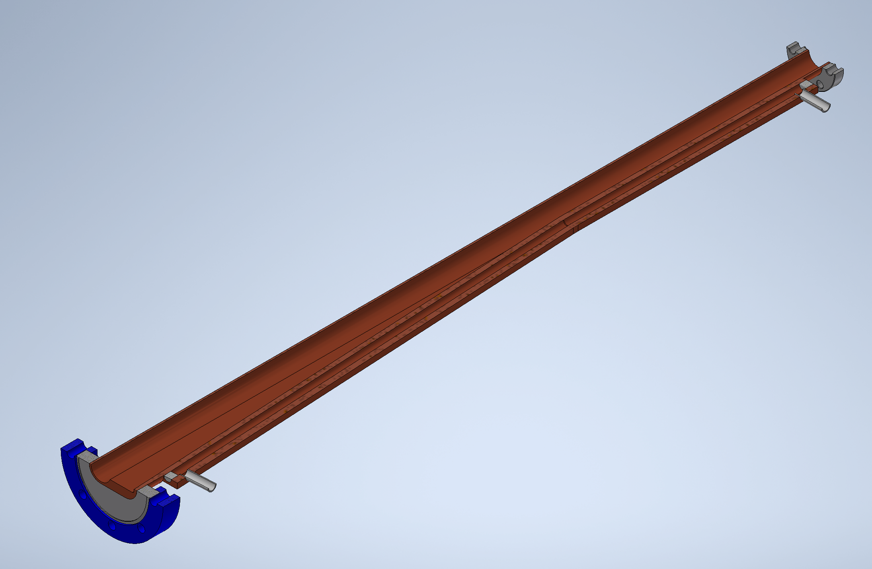
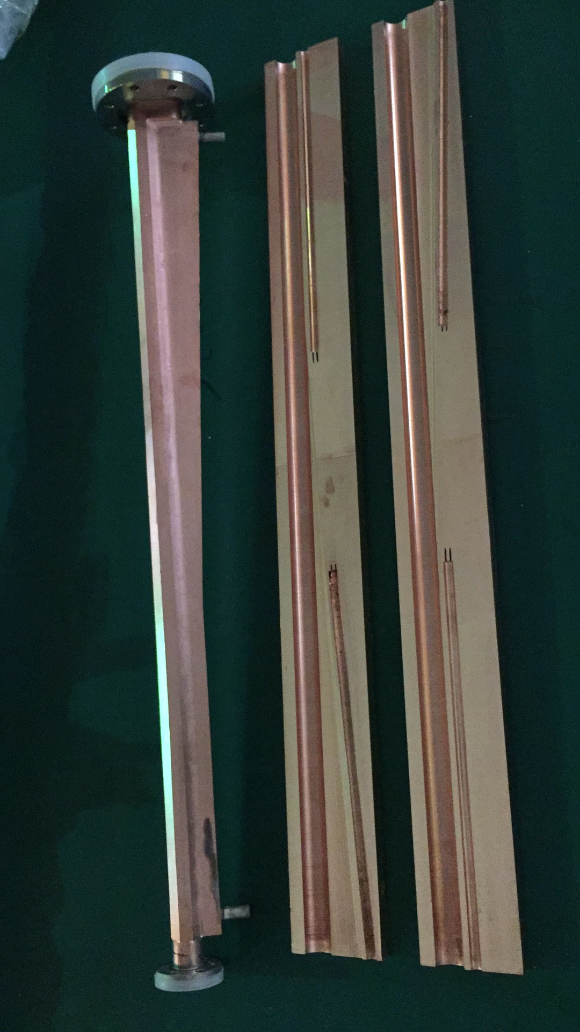
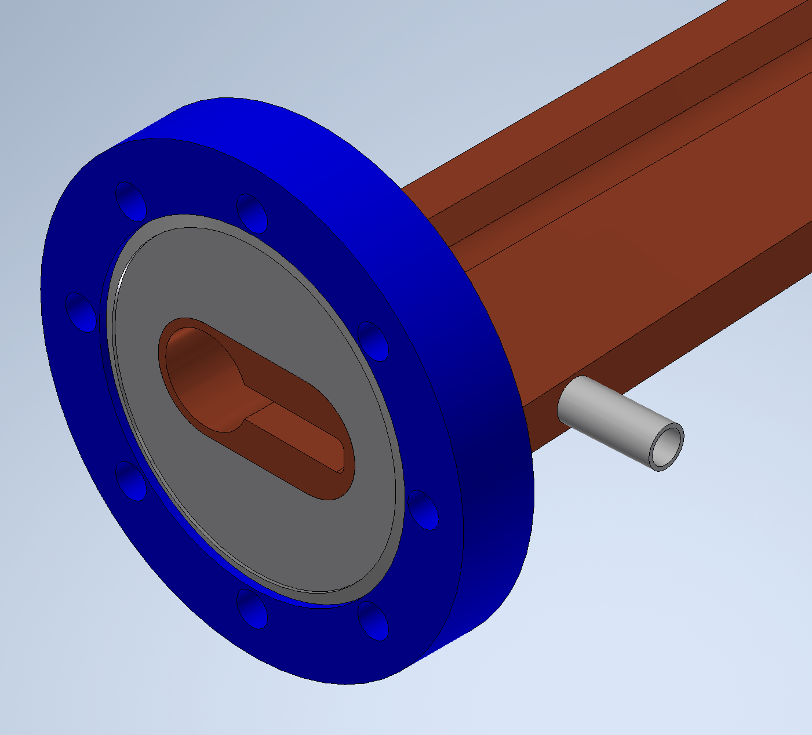
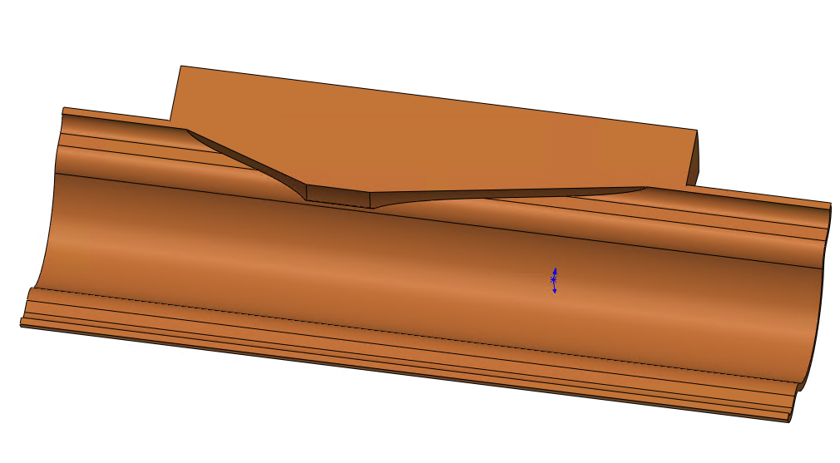
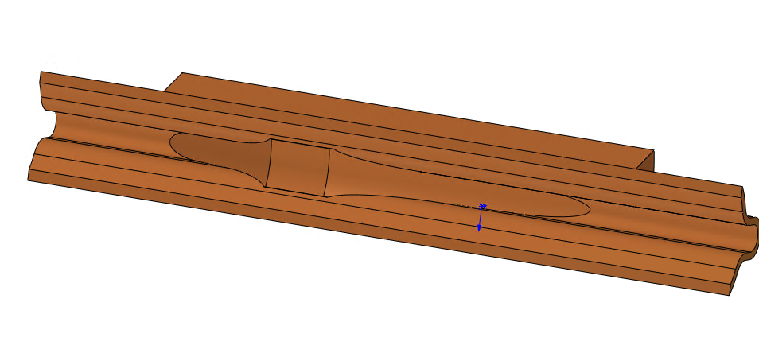
Changes to the layout of vacuum devices
The layout of vacuum devices will be more complex.
The length of vacuum chamber: 11.5m changes to 5.5m;
The space for absorber needs to be considered;
Absorbers bear high power density synchronous light deposition, requiring good machining and installation accuracy.
Dipole magnet n+i
The manufacture of absorbers is very challenging.
Dipole magnet n
SR reflection from absorber.
The heating deposits on VC;
Radiation;
SR power from dipole magnet | Power density | Area of absorber | Length of absorber
W | W/mm² | mm² | mm
4071.01 | 15 | 271.4 | 407.10

Slide 12
Cost
Vacuum chamber： unit price increase 30%, Approx. 300 million CNY
Photo absorber： approx. 795 million CNY
RF shielding bellow： unit price increase 20~30% due to antechamber, the quantity may also increases (20819 to 38483)due to high accuracy installation of absorber. approx. 200 million CNY
The total cost increases from 3.4 billion to 4.7 billion
unit price | quantity | total price
10000 CNY | / | 10000 CNY
3.0 | 26500 | 79500

Slide 13
Conclusion
Production line:
Technical scheme review for production line has been finished;
Procurement bidding will be held in Dec.
Absorber
The structure of vacuum chamber will be more complex, bad to NEG coating process;
The structure of BPM, RF shielding bellows will be more complex;
The space for absorber needs to be considered, and requiring good machining and installation accuracy;
The total cost will be increased from 3.4 billion to 4.7 billion

Slide 14
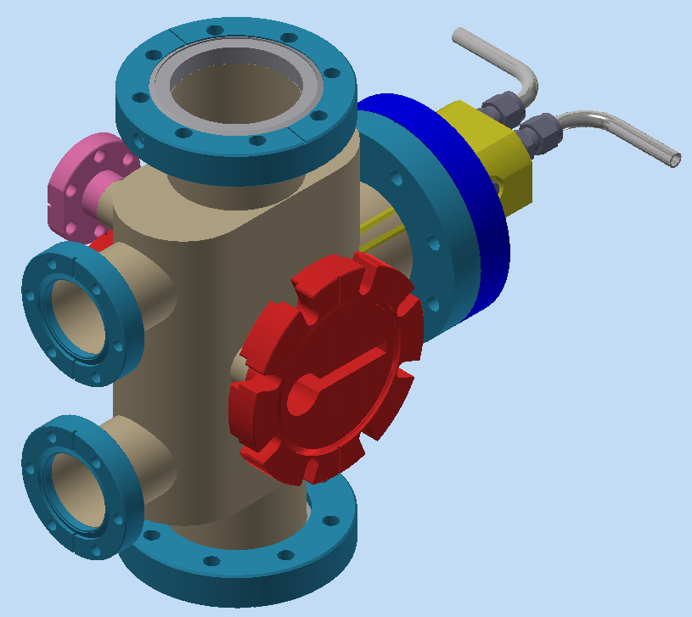








Photon absorber models
Qi Li

Slide 15




Photon absorber prototypes
Qi Li
1 GlidCop-AL15 and SS316L flange brazing in a vacuum furnace.
2 GlidCop-AL15 and SS316L flange brazing in a hydrogen furnace.
3 and 4 CuCrZr copper Integrating flange (no brazing).
1
2
3
4

Slide 16




Photon absorber prototypes
Qi Li
ABS4
ABS5
ABSR

Slide 17

4. Vacuum chamber geometry, and related issues
Extensive modelling is needed in order to make predictions of the vacuum commissioning duration
Modern tools, based on coupled ray-tracing Montecarlo simulations allow to do this (SYNRAD+, Molflow+)
It’s easy to prove that a NEG-coated VC has a clear advantage in terms of average pressure and commissioning time over a lumped-pump configuration with no NEG-coating; also, the final cost is lower for a NEG-coated configuration, since it allow large savings in term of a largely reduced number of cables for the lumped pumps
CEPC copper chamber (from TDR)
FCC-ee Copper Extrusion

Slide 18

5. Arcs and MDI
The arcs and the MDI share some common design for the vacuum system, but at the same time differ in some key aspects
The arcs’ VCs must present as smooth and continuous as possible cross-section, minimizing the changes of cross-section: LEP already had a continuous elliptical chamber (131x70 mm²), common to dipoles and quadrupoles; CEPC plans to have a circular cross section (impedance), while FCC-ee is looking into a modified SUPERKEKB cross-section, with a round pipe (70 or 60 mm ID) with two “winglets” in the plane of the orbit, to be able to install recessed SR absorbers (SRAs)
Antechamber for NEG strip
Pumping slots
LEP:
ellipse 131x70 mm²
FCC-ee:
115 mm wide, 70 mm ID
Lead shielding
The specific conductance of FCC-ee is ~1/2 that of LEP, ~100:50 l·m/s
The proposed 60 mm ID version for FCC-ee would have a 37% conductance decrease, i.e. only ~1/3 that of LEP

Slide 19




Another example: 3D-PRINTED SR ABSORBER, with INTEGRATED COOLING CIRCUIT AND SWIRL TAPE TO IMPROVE HEAT EXCHANGE
FCC-ee

Slide 20





FCC-ee: Initial geometry of the SR photon absorber, now superseded by 3D-printed one
B
300 mm
18 mm
A
175 mm
A
B
3D-printed SR absorber, with integrated splitting cooling channel (~300 mm long)

Slide 21

45.6
80
120
175
182.5
50 m

