Slide 1


  Possibility studies of 3T solenoid detector field for CEPC Z pole operation
Yiwei Wang
CEPC day, Nov 27, 2024, IHEP

Slide 2
Outline
Solenoid field compensation in CEPC TDR
Possibility studies of 3T solenoid detector field for CEPC Z pole operation
  Local, non-local scheme
Work to be done and summary

Slide 3
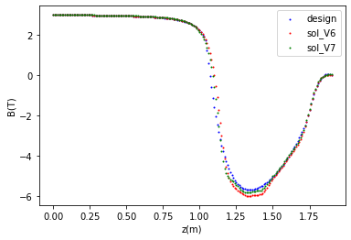
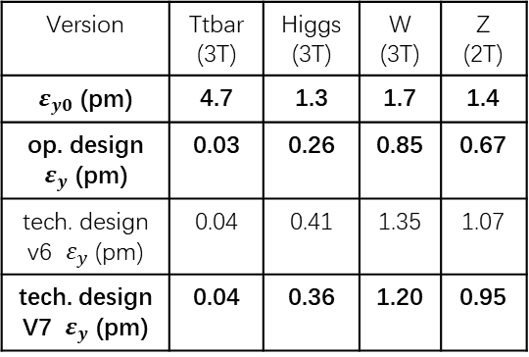
  Solenoid field compensation in CEPC TDR
Updated detector solenoid field @ W/Higgs/ttbar
(Scaled to 2T at IP @ Z)
The detector solenoid are compensated locally with anti-solenoids
From IP to the entrance of Q1A (0 to 1.9m):
  ∫Bzdz cancled between the IP and the entrance of final quadrupole with strong anti-solenoid field in 1.1m to 1.9m.
  Field configuration optimized to get emittance minimum and iterate with anti-solenoid technical constraints
From the entrance of Q1A to Q3(1.9m to 10.55m)
  Bz keep fully cancellation along this region
From the Q3 to the last bend (farer than 10.55m)
  ∫Bzdz from detector only < 0.5 T*m.
  Along beam line (not z), fully cancelation in Q3 and pre-cancelation in some extension region (with length of 1m) for the long tail of the detector solenoid field
Data from Feipeng Ning
tentative, to be optimized with the evolution of the detector design
Z(m)
Compensated solenoid field from IP to the entrance of Q1A (same with TDR for combined field)
Emittance contribution from the from IP to the entrance of Q1A
Version | Ttbar (3T) | Higgs (3T) | W (3T) | Z (2T)
$ε_{y0}$ (pm) | 4.7 | 1.3 | 1.7 | 1.4
op. design $ε_{y}$ (pm) | 0.03 | 0.26 | 0.85 | 0.67
tech. design v6 $ε_{y}$ (pm) | 0.04 | 0.41 | 1.35 | 1.07
tech. design V7 $ε_{y}$ (pm) | 0.04 | 0.36 | 1.20 | 0.95
Z scaled to 2T

Slide 4
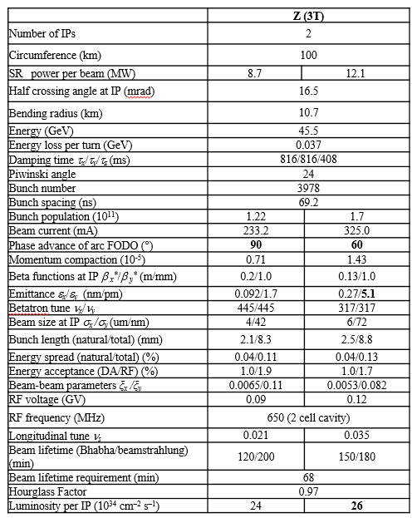
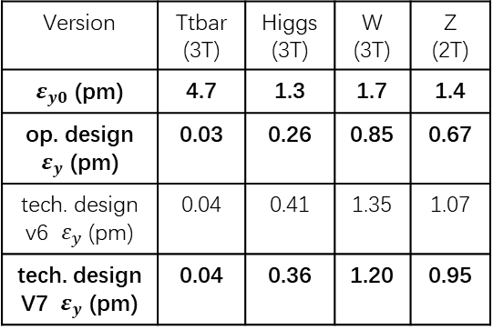
Possibility studies of 3T solenoid detector field for CEPC Z pole operation
Para table by D. Wang, Nov 2024
If keep local compensation scheme
  Bz0 2 T=>3 T
  vertical emittance 0.95pm => 7.2pm, possible to reduced to 5.1 pm (excluded other region) by optimize the technical design
Compensated solenoid field from IP to the entrance of Q1A (same with TDR for combined field)
Emittance contribution from the from IP to the entrance of Q1A
Version | Ttbar (3T) | Higgs (3T) | W (3T) | Z (2T)
$ε_{y0}$ (pm) | 4.7 | 1.3 | 1.7 | 1.4
op. design $ε_{y}$ (pm) | 0.03 | 0.26 | 0.85 | 0.67
tech. design v6 $ε_{y}$ (pm) | 0.04 | 0.41 | 1.35 | 1.07
tech. design V7 $ε_{y}$ (pm) | 0.04 | 0.36 | 1.20 | 0.95
Z scaled to 2T
Lumi may be a bit lower due to coupling in other regions
Highl lumi Z: 115*10^34/cm^2/s

Slide 5
Possibility studies of 3T solenoid detector field for CEPC Z pole operation
If non-local compensation scheme
  Bz0 2 T=>3 T
  asumming same length of anti-solenoid in front of the final quadrupoles, dBz 5.7 T => 3 T, vertical emittance 0.95pm => 0.04pm
  effect on Beam dynamics : Peak luminosity will not be limited by the vertical emittance, but the residual orbit and dispersion will disturb the beam dynamics: beam lifetime, polarization
  effect on MDI: Ani-solenoid Bzmax 5.7 T => 3 T, synchrotron radiation power will be reduced with 1/Bzmax^2

Slide 6
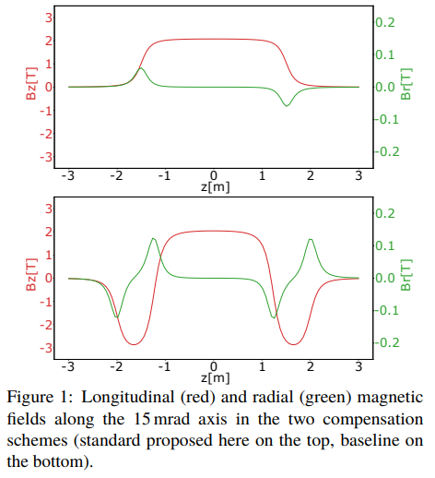
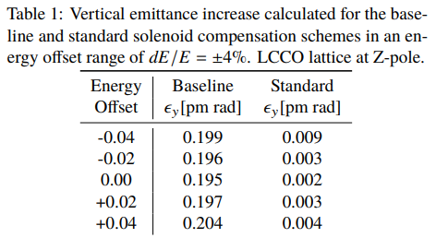
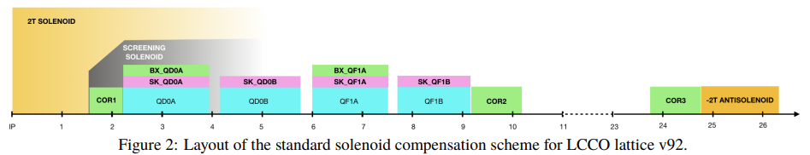
FCCee local vs. non-local compensation
A. Ciarma, H. Burkhardt, P. Raimondi et al
A. Ciarma et al, IPAC24
Emittance reduced 0.195 pm to 0.002 pm
SR power reduced from 80 kW to 12 kW/IP
local
Non-local

Slide 7
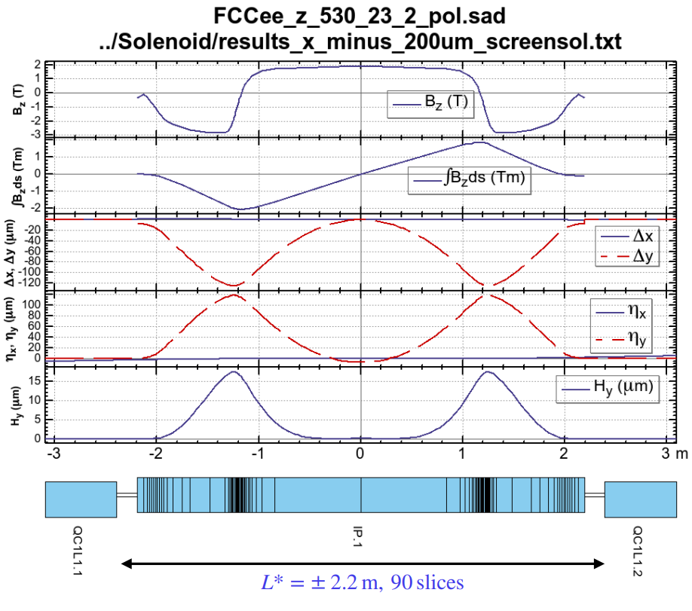
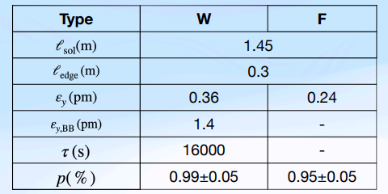
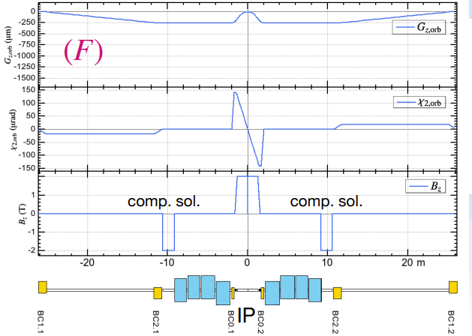
FCCee local vs. non-local compensation
K. Oide
K. Oide, 11 Nov 2024
Emittance reduced 0.43 pm to 0.24 pm
The vertical emittance of type F still looks larger than Burkhardt/Ciarma’s, but it is already enough small.
  The recent required lattice vertical emittance is 1.0 pm
• The type F with seems usable, except for the polarization.
  • A polarization tuning such as vertical bump in the arc is necessary
local
Non-local

Slide 8
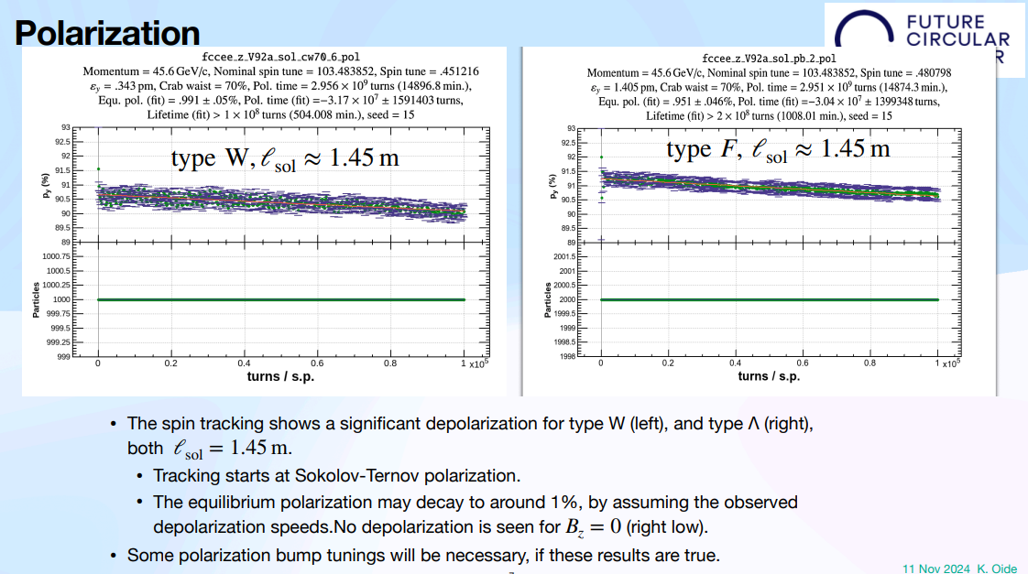
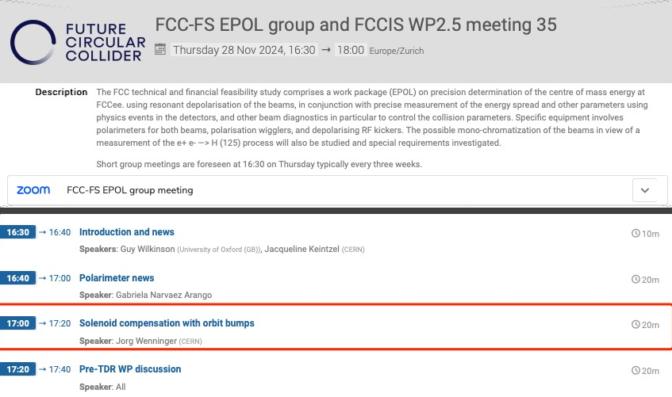
FCCee local vs. non-local compensation (cont.)
K. Oide
The type F with seems usable, except for the polarization.
  • A polarization tuning such as vertical bump in the arc is necessary

Slide 9
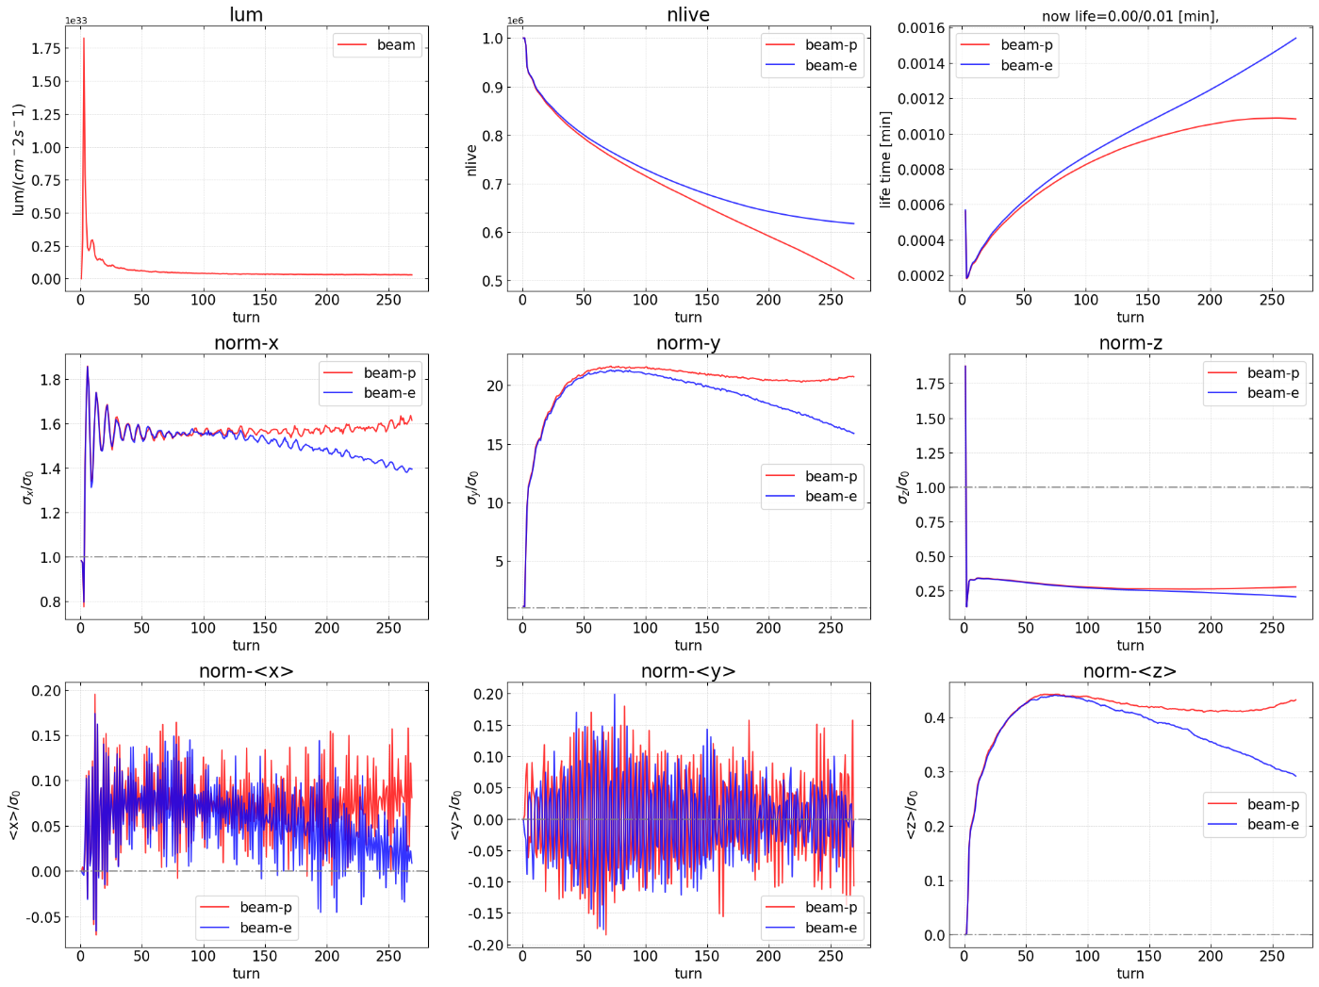
Beam-Beam with solenoid (local scheme)
Beam lost

Slide 10
Summary
Possibility studies of 3T solenoid detector field for CEPC Z pole operation
  With local compensation scheme: 115 => 26E34/cm^2/s
  With non-local compensation scheme
    effect on Beam dynamics : Peak luminosity will not be limited by the vertical emittance, but the residual orbit and dispersion will disturb the beam dynamics: beam lifetime, polarization (to be checked)
    effect on MDI: Ani-solenoid Bzmax 5.7 T => 3 T, synchrotron radiation power will be reduced with 1/Bzmax^2

Slide 11
backup

Slide 12
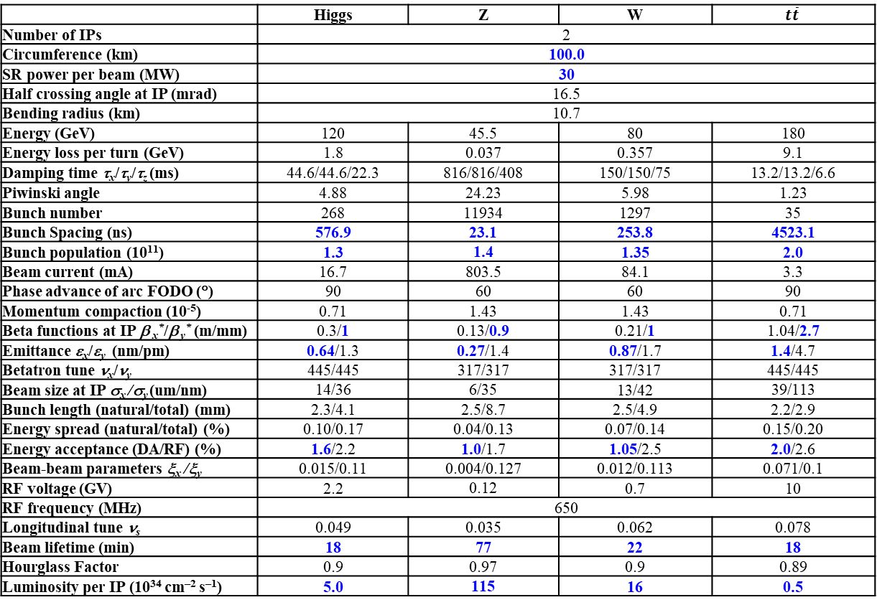
CEPC Design Parameters
 | Higgs | Z | W | $$t\overline{t}$$
Number of IPs | 2
Circumference (km) | 100.0
SR power per beam (MW) | 30
Half crossing angle at IP (mrad) | 16.5
Bending radius (km) | 10.7
Energy (GeV) | 120 | 45.5 | 80 | 180
Energy loss per turn (GeV) | 1.8 | 0.037 | 0.357 | 9.1
Damping time τ_{x}/τ_{y}/τ_{z} (ms) | 44.6/44.6/22.3 | 816/816/408 | 150/150/75 | 13.2/13.2/6.6
Piwinski angle | 4.88 | 24.23 | 5.98 | 1.23
Bunch number | 268 | 11934 | 1297 | 35
Bunch Spacing (ns) | 576.9 | 23.1 | 253.8 | 4523.1
Bunch population (10¹¹) | 1.3 | 1.4 | 1.35 | 2.0
Beam current (mA) | 16.7 | 803.5 | 84.1 | 3.3
Phase advance of arc FODO (°) | 90 | 60 | 60 | 90
Momentum compaction (10⁻⁵) | 0.71 | 1.43 | 1.43 | 0.71
Beta functions at IP β _{x}*/β _{y}* (m/mm) | 0.3/1 | 0.13/0.9 | 0.21/1 | 1.04/2.7
Emittance ε_{x}/ε_{y} (nm/pm) | 0.64/1.3 | 0.27/1.4 | 0.87/1.7 | 1.4/4.7
Betatron tune ν_{x}/ν_{y} | 445/445 | 317/317 | 317/317 | 445/445
Beam size at IP σ_{x} /σ_{y} (um/nm) | 14/36 | 6/35 | 13/42 | 39/113
Bunch length (natural/total) (mm) | 2.3/4.1 | 2.5/8.7 | 2.5/4.9 | 2.2/2.9
Energy spread (natural/total) (%) | 0.10/0.17 | 0.04/0.13 | 0.07/0.14 | 0.15/0.20
Energy acceptance (DA/RF) (%) | 1.6/2.2 | 1.0/1.7 | 1.05/2.5 | 2.0/2.6
Beam-beam parameters ξ_{x} /ξ_{y} | 0.015/0.11 | 0.004/0.127 | 0.012/0.113 | 0.071/0.1
RF voltage (GV) | 2.2 | 0.12 | 0.7 | 10
RF frequency (MHz) | 650
Longitudinal tune ν_{s} | 0.049 | 0.035 | 0.062 | 0.078
Beam lifetime (min) | 18 | 77 | 22 | 18
Hourglass Factor | 0.9 | 0.97 | 0.9 | 0.89
Luminosity per IP (10³⁴ cm^{–2} s^{–1}) | 5.0 | 115 | 16 | 0.5
𝛽y∗ and emittance chosen for luminosity
adequate bunch population Ne for the luminosity and the achievable energy acceptance for lattice design
Number of bunches Nb is adjusted to keep the beam current
Updated bunch spacing for the requirement from detector (D. Wang, Aug 2024, CEPC day)
Ref: CEPC TDR; Radiation Detection Technology and Methods (2024) 8:1–1105, https://doi.org/10.1007/s41605-024-00463-y;

