Slide 1
Tingxuan inserted the DATA write function
1 DCB+
@Cosmic TRIGGER
1 GEMROC & 2 GEMROCs: no IRQ problem, no DATA write error, tested three times for 1 hour; 3 GEMROC no IRQ problem for at least 40 min, but DATA write error after 30 minutes
11 GEMROCs, it appears and repeats very often the message "stop marker check failed ", less often "data format error“, no IRQ PROBLEM, tested three times for more than 40 minutes
Tingxuan removed the DATA write function
9 GEMROCs, no IRQ problem, also 60 minutes
@4kHz TRIGGER
9 GEMROCs, no IRQ problem only for less than10 minutes
Start again with 1 GEMROC
->I think it is useful to have back the write function, in order to understand what happens

Slide 2
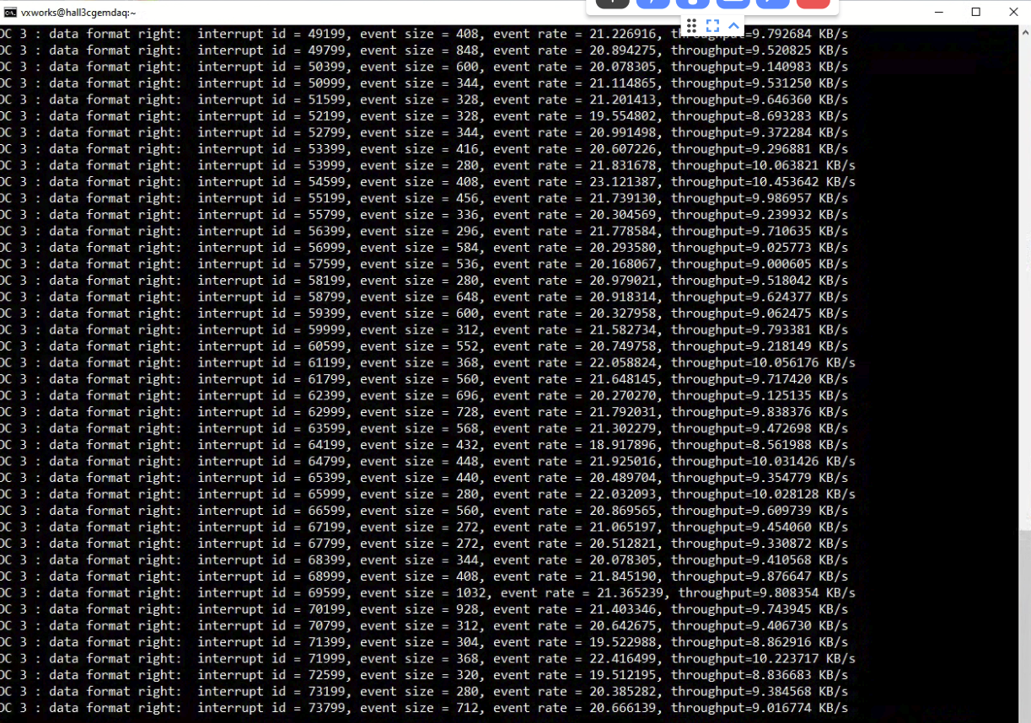
@Cosmic TRIGGER

Slide 3
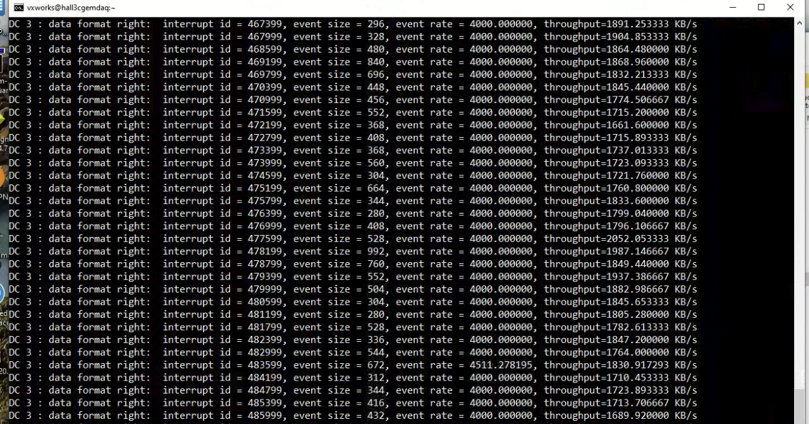
@4 kHZ

