Slide 1
学生汇报
汇报人：张彪

Slide 2
报告内容
LW背景噪声观测实验
文献调研
碳纳米管纤维耐高温实验

Slide 3
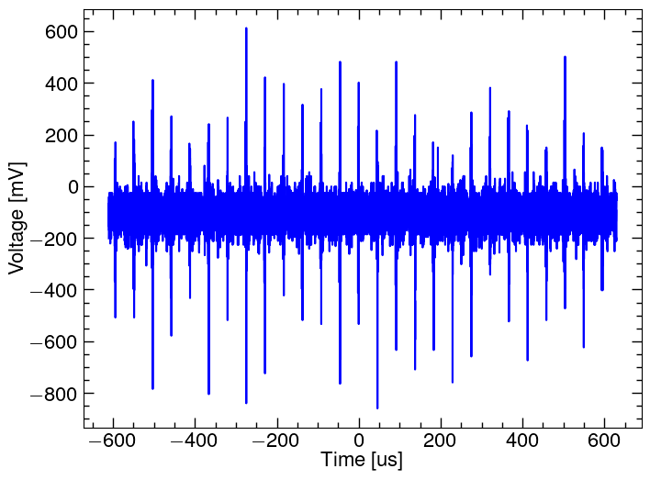
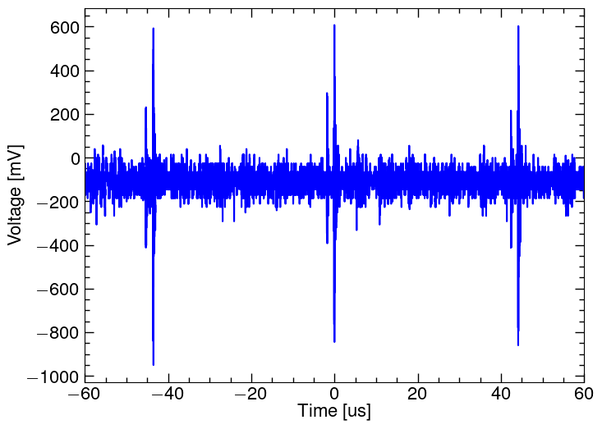
LW背景噪声观测实验
实验设置(无束流状态)：
1.法拉第桶→MCP→C₂放大器（40dB）→示波器
2.偏转磁铁开4.4A
3.MCPin:-1000V MCPout:-200V
实验过程：
1.观察BPM信号未出现异常
2.加入CMC，关MCP高压，关磁铁信号均未发生变化

Slide 4
LW背景噪声观测实验
猜测：
1.C2前放出问题：
测试前放，前放空接观察热噪声
2.法拉第筒空间耦合：
利用旧法拉第筒

Slide 5
文献调研
The advantages of the laser profile monitor system over the conventional wire scanner system are:
(1) H beam profiles can be measured during normal operations, as opposed to the 100 ms, 10Hz duty factor restriction needed to prevent damage to carbon wires;
(2) there are no moving parts inside the vacuum system, thus reducing the possibility of a vacuum system failure;
(3)the profile measurement can be conducted in a parasitic manner for an operational neutron production beam;
(4) a longitudinal beam scan can be conducted by using a pico-second pulsed light source such as a mode-locked laser and adjusting the phase between ion and laser pulses.

Slide 6
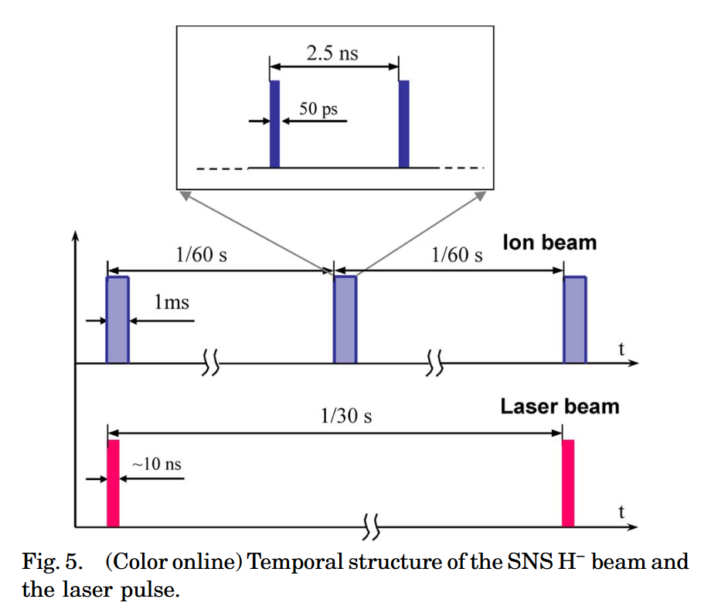
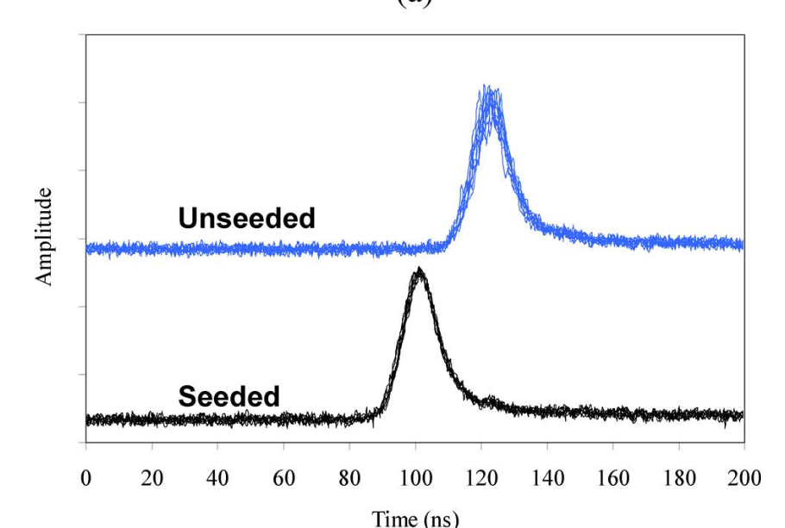
文献调研
Parameter | SNS | CSNS | Unit
Laser wavelength λ | 1.064×10⁻⁴ | 1.064×10⁻⁴ | cm
Laser pulse width | 1×10⁻⁸ | FWHM ≤ 9 ×10⁻⁹ | s
Laser pulse energy | 0.05 | 0.8 | J
Laser pulse repetition rate | 30 | 1~10 | Hz
Laser beam initial diameter 2wi | 1.5 | 0.7~0.9 | cm
Ion beam current | 0.03 | 0.015 | A
Ion beam energy | 1×10⁹ | 80×10⁶ | eV
Ion beam micropulse width | 3×10⁻¹¹ | 1.74×10⁻¹¹ | s
Ion beam micropulse repetition rate | 4.025×10⁸ | 3.24×10⁸ | Hz
Ion beam waist | 0.2 | 0.3 | cm
Photon-ion cross-section | 3.51×10⁻¹⁷ | 3.51×10⁻¹⁷ | cm²
Lens focal length f | 20 | 30 | cm
The seeder reduces the jitter of the Q-switched laser pulse from several nanoseconds to around 1 ns.
By operating the laser with the BeamLok assembly, we observed a beam shot-to-shot jitter within 20 μrad, corresponding to 5 mm spatial variations at the foremost measurement station.
Measurement of ion beam profiles in a superconducting linac with a laser wire

Slide 7
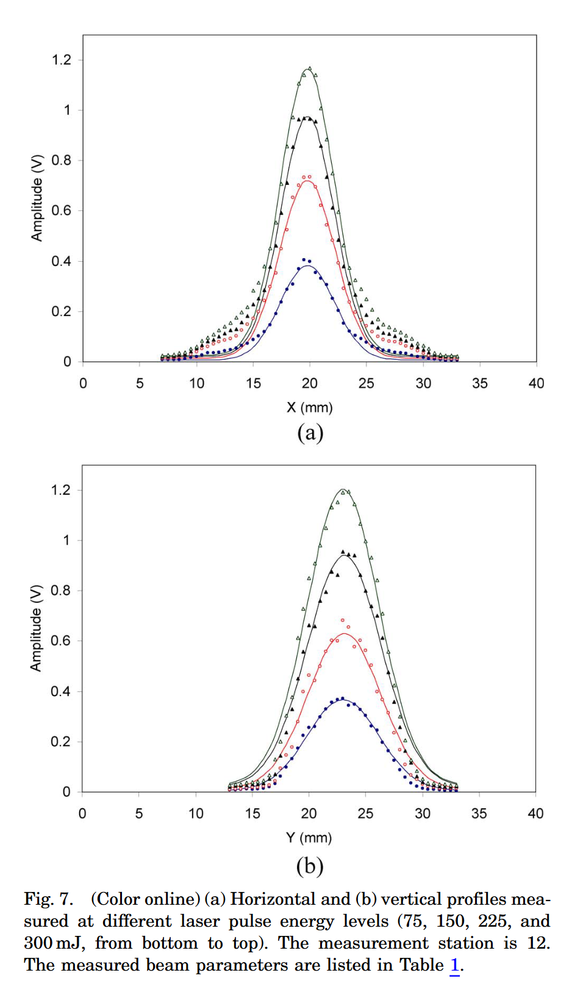
文献调研
Data analysis shows that the measured beam position shift is about 15% larger than the beam position monitor (BPM) readings in the horizontal direction and 15% smaller than the latter in the vertical direction.
At the current setup, we have measured the background noise level to be about 0:1 pC, while the profile peak can easily exceed 30 pC, which results in a dynamic range of 300. The dynamic range can be raised by a number of improvements: (i) installation of high antireflection coated vacuum windows (current reflection is estimated to be a few percent), (ii) redesign of the vacuum chamber configuration so that the laser light hits the window at a Brewster angle, and (iii) application of a gated detection of the detached electrons.
Measurement of ion beam profiles in a superconducting linac with a laser wire

Slide 8
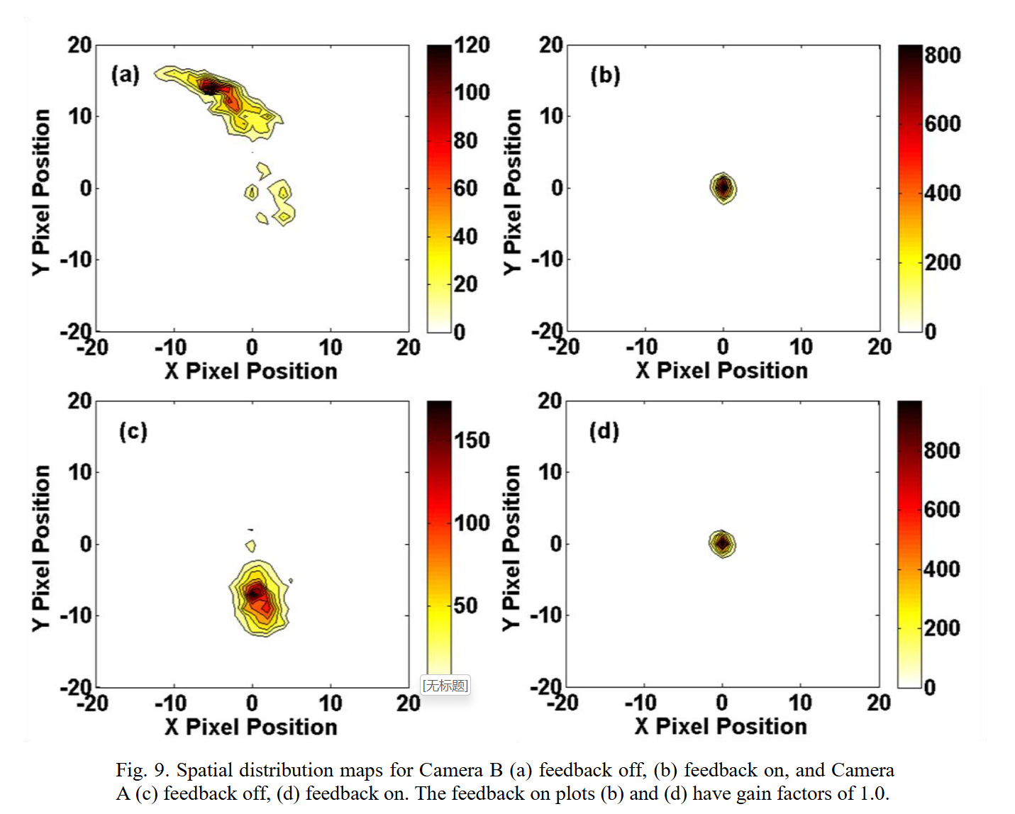
文献调研
0.75 mm (1 pixel)
For these data the standard deviations with the feedback off range from 1.8 to 5.9 pixels, while the range of standard deviations with the feedback on only range from 0.61 to 1.0 pixel, producing reduction ratios of 0.15 to 0.36.
Active beam position stabilization of pulsed lasers for long-distance ion profile diagnostics at the Spallation Neutron Source (SNS)

Slide 9
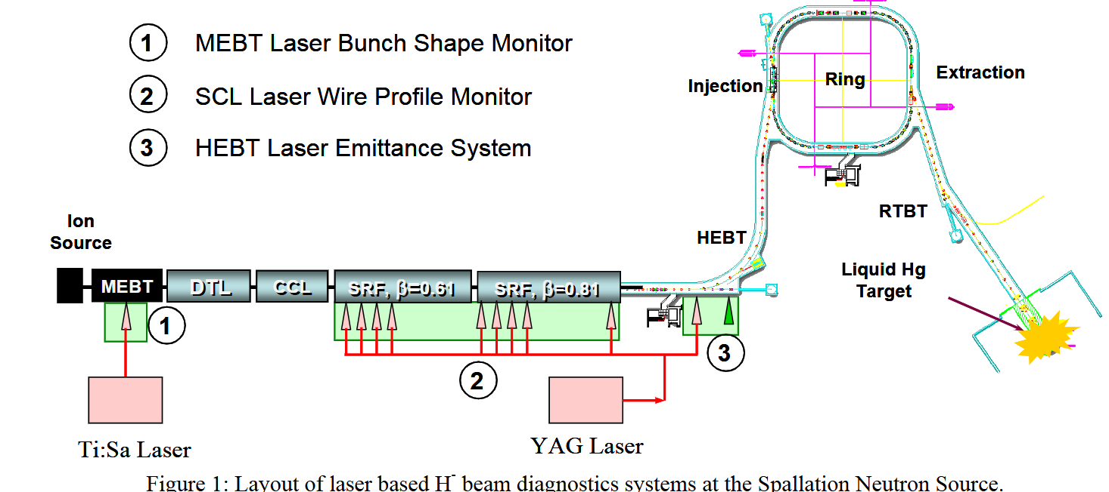
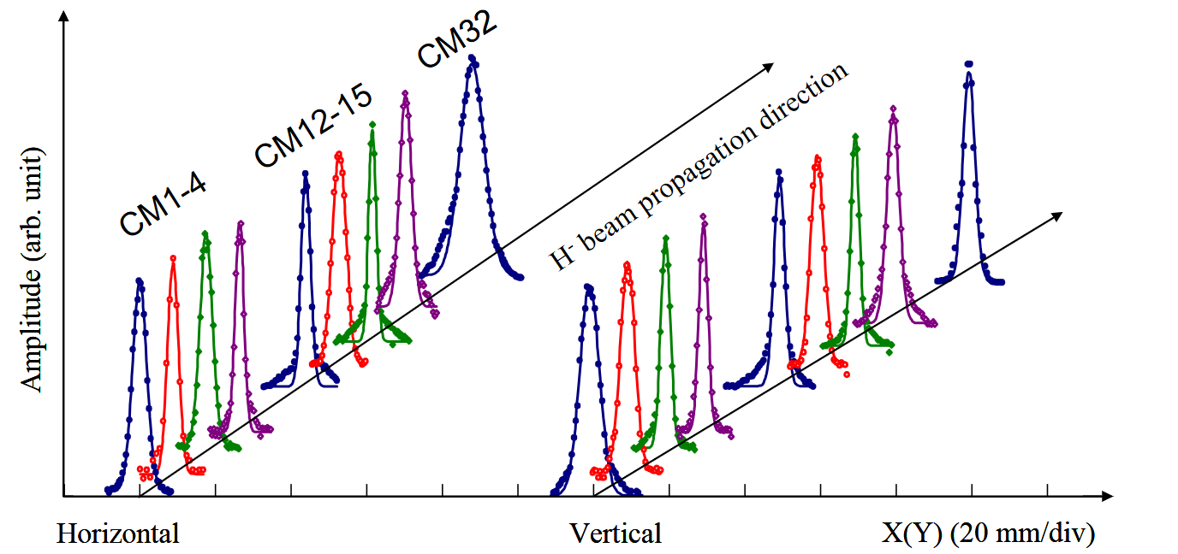
文献调研
The profile measurement performance has been investigated against laser and ion beam parameters. The measured profile shape, beam size, and beam center position show very little variation versus the change of the laser power, spatial beam jitter, and the ion beam position.
LASER BASED DIAGNOSTICS FOR MEASURING H- BEAM PARAMETERS

Slide 10
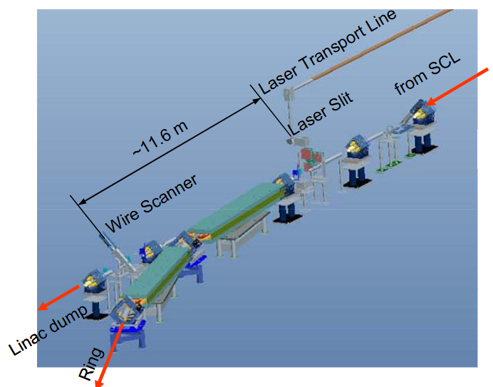
文献调研
The laser wire scanning slit is located about 45 meters away from the laser source. The scanning station has an identical design to that of the laser wire system. The laser beam has a diameter of about 2 cm on the surface of the focusing lens which consequently focuses the laser beam to a narrow slit with a diameter of a few tens of micrometers. The wire scanner is about 11.6 meters away from the laser slit. The neutralized H₀ beam is intercepted with a 50 um diameter titanium wire and the stripped electrons are detected by a Faraday cup through a collection magnetic field, similar to the detection in the laser wire stations.
LASER BASED DIAGNOSTICS FOR MEASURING H- BEAM PARAMETERS

Slide 11
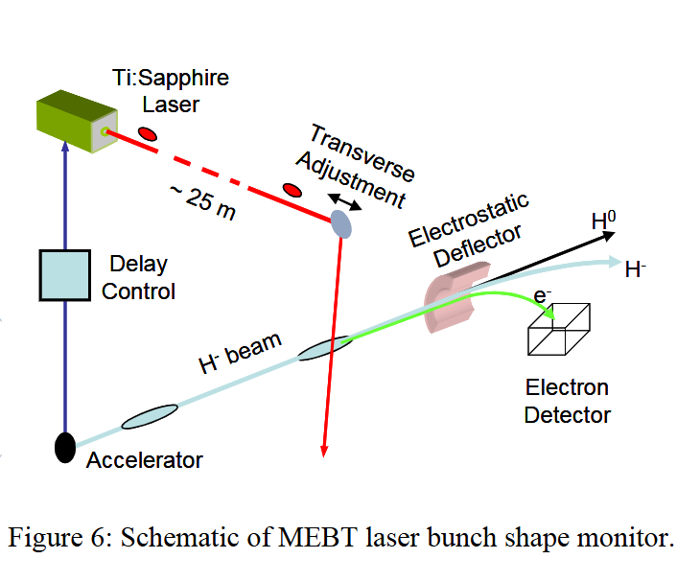
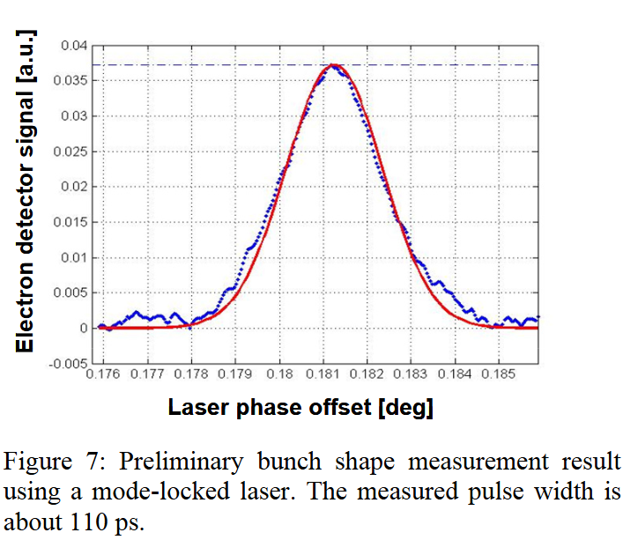
文献调研
LASER BASED DIAGNOSTICS FOR MEASURING H- BEAM PARAMETERS

Slide 12
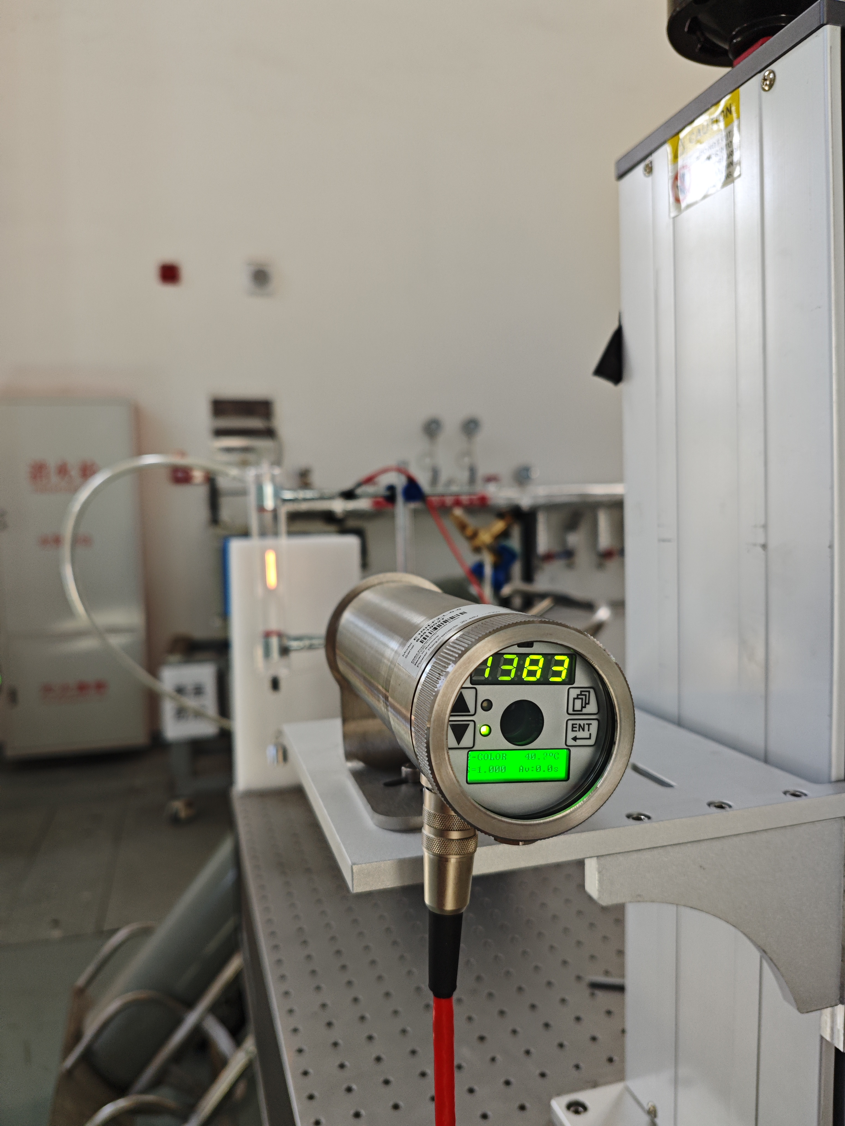
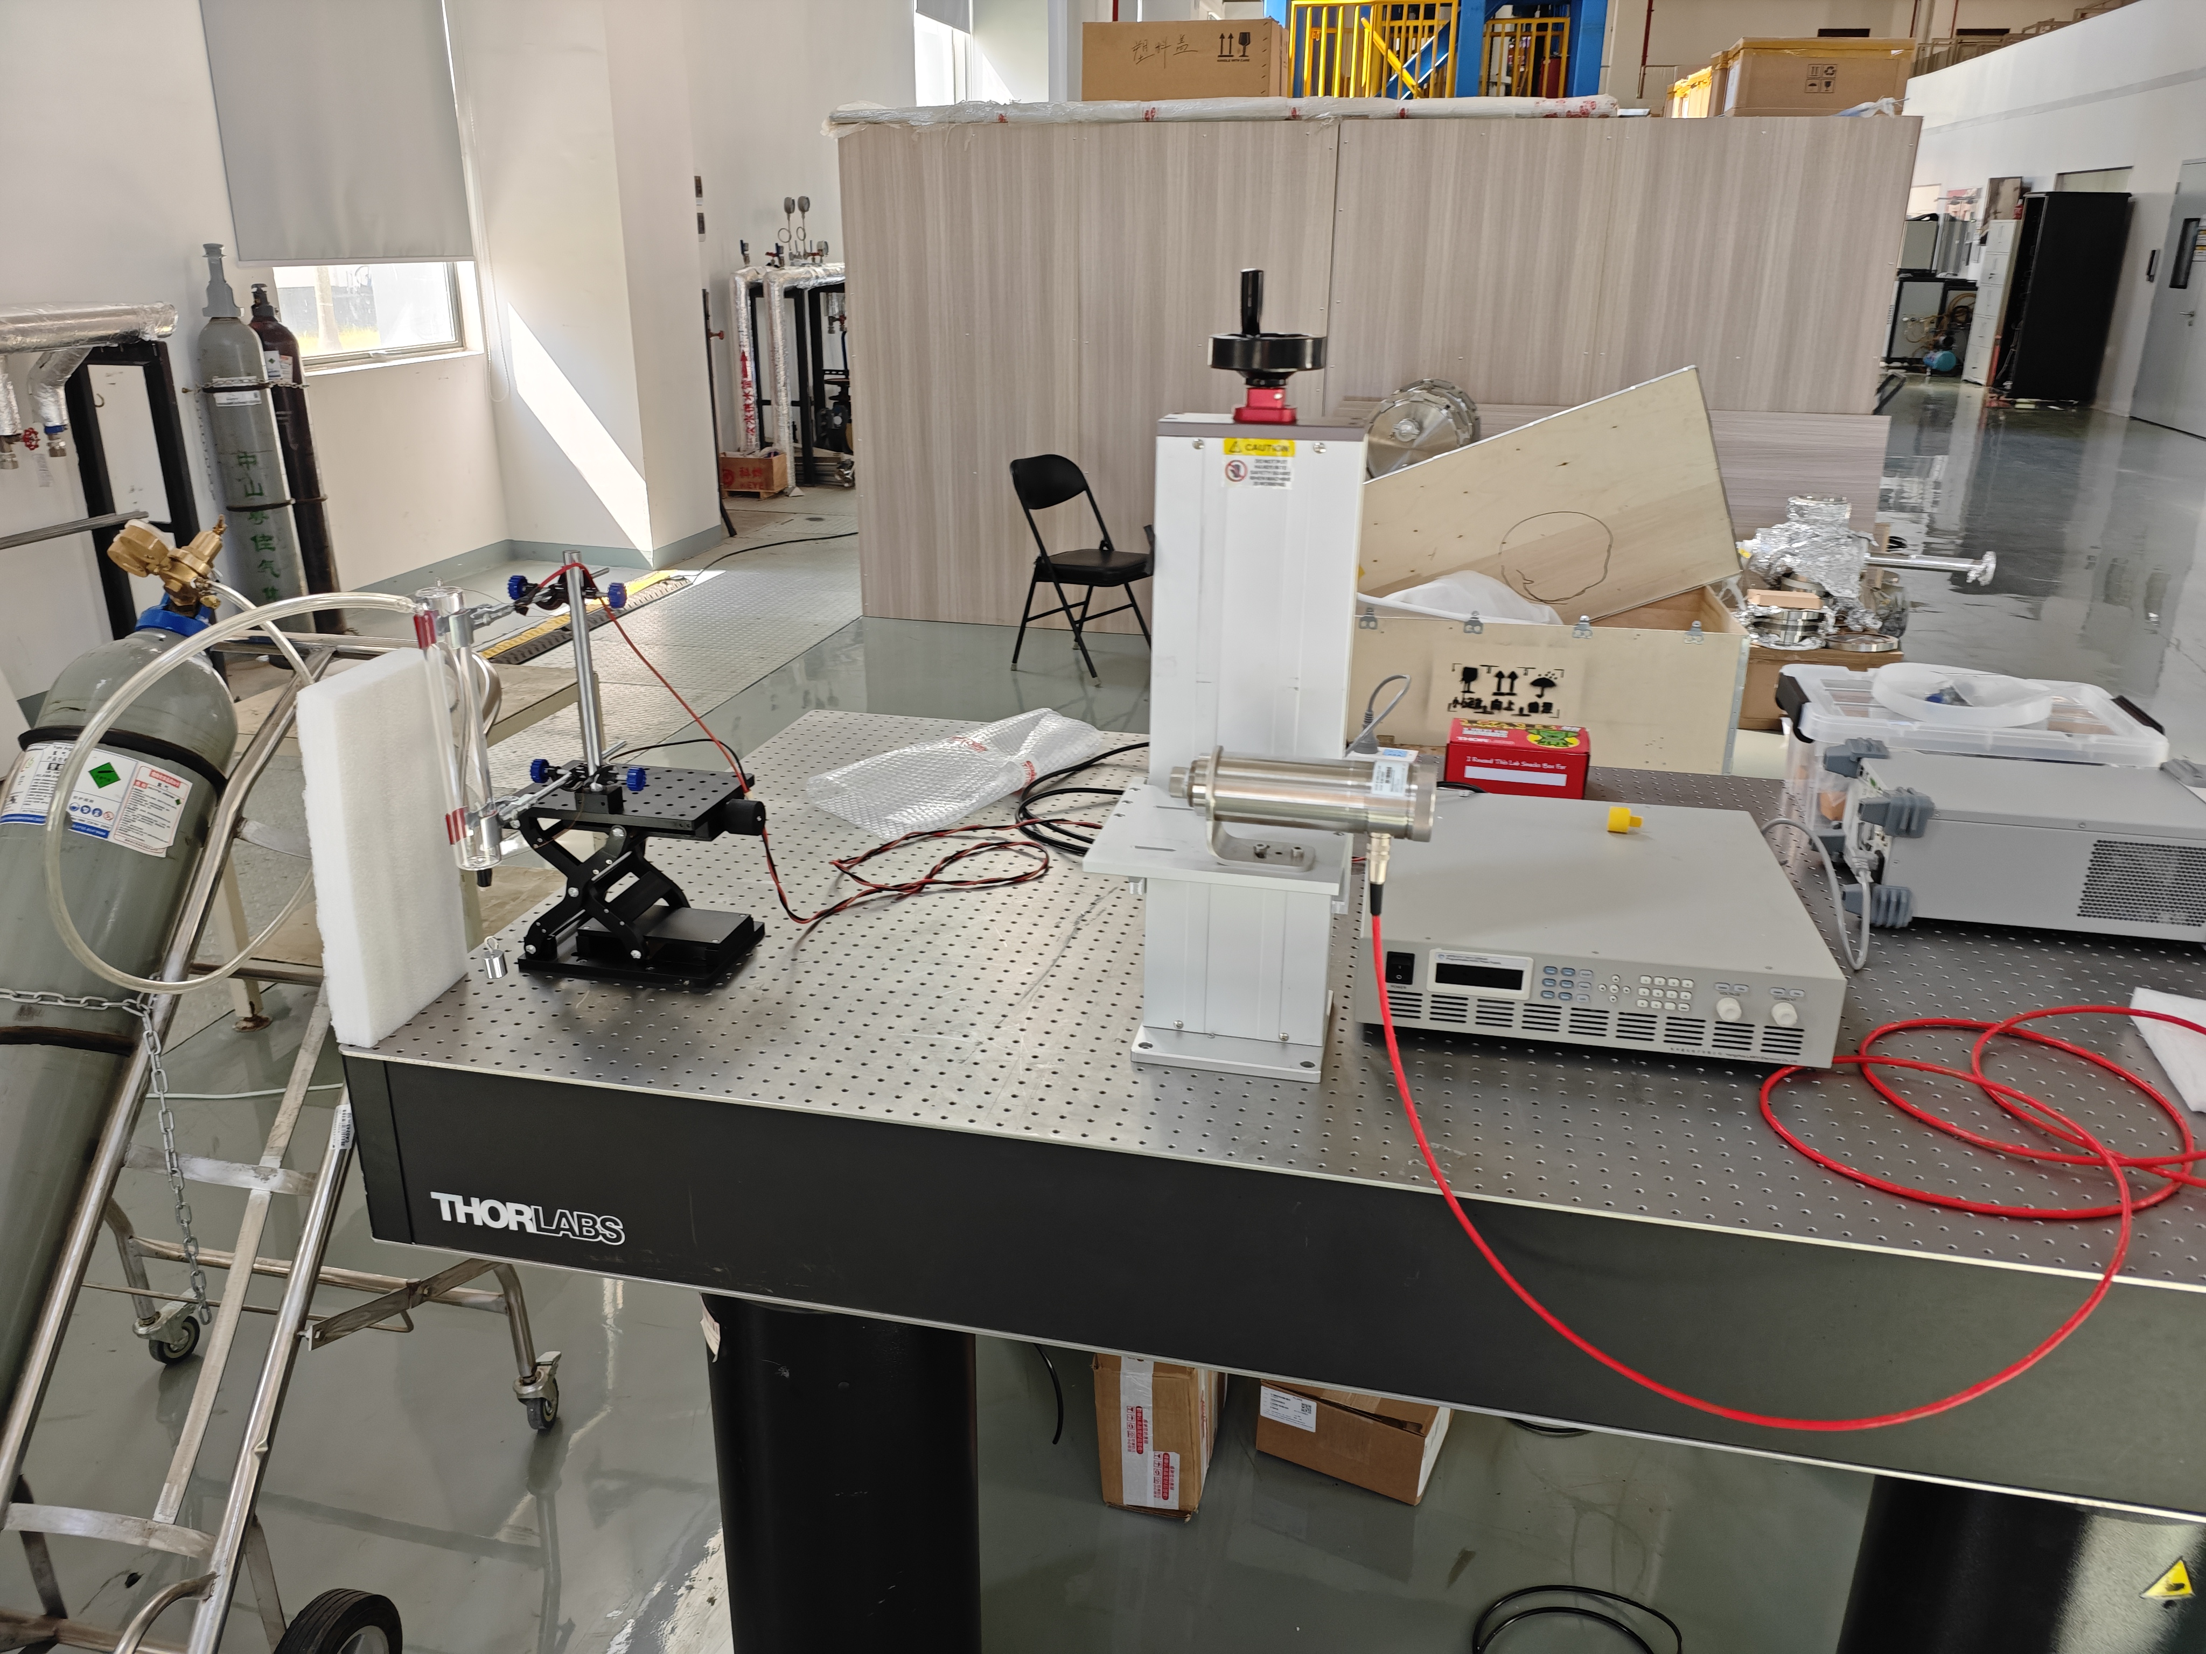
CNT实验台搭建

Slide 13
CNT实验台搭建

