Slide 1
2024.10.14 group meeting
陈伟文

Slide 2
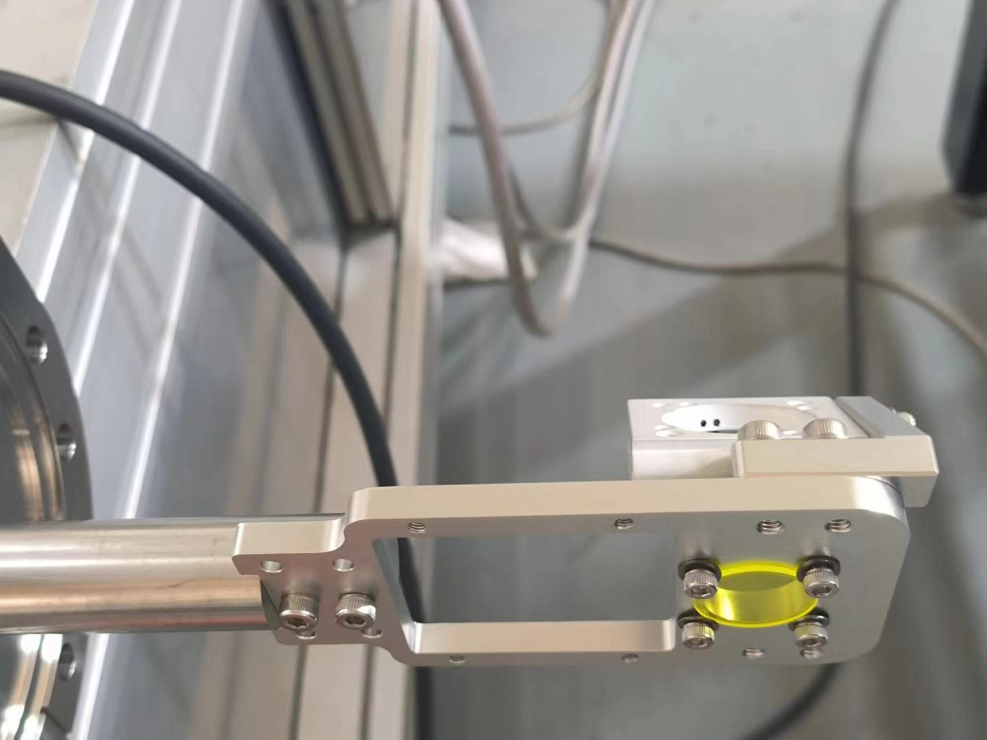
EM install for C-band RF gun
Parameter to be calibrated
Parameters | Value | Measurement method
Slit1 to slit2 |  | Joint arm measurement system (measurement accuracy~20-30 $μm$)
Screen1 to slit1
Screen2 to slit1
The angle of two slit | 0.174°(3 mrad)
Slit1 to top reference place
Slit2 to top reference place
Screen1 to top reference place
Screen2 to top reference place
The angle of two slits affects the second slit acceptance angle, the requirement is 0.17 mrad in slit thickness is 1 mm and slit width is 10 $μm$
The other parameters will be calibrated after we meet the angle requirement
At present, the joint surface is polished and measured by a coordinate machine to correct its parallelism

Slide 3
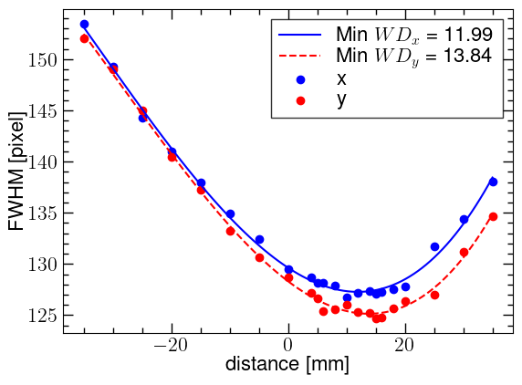
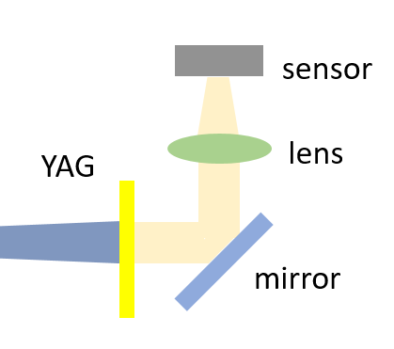
The optical adjustment test
The optical system should be adjusted before each measurement. A Adjustment scheme is tested
To obtain the WD of the lens, an optical beam has been observer versus distance. The WD is chosen in the minimum point of the fitting curve
Camera: Basler 4200
Laser beam spot
WD = $L_{1}$ + $L_{2}$
laser
$$L_{2}$$
$$L_{1}$$

Slide 4
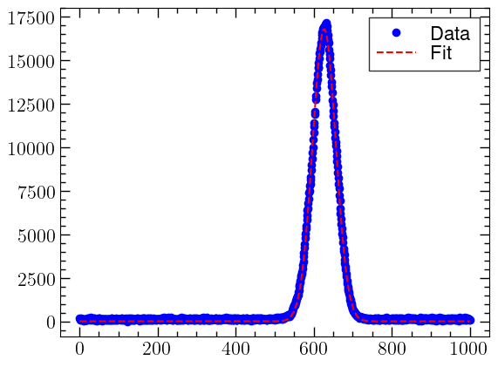
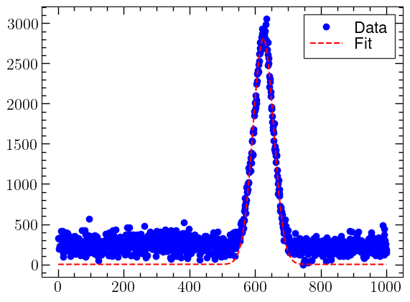
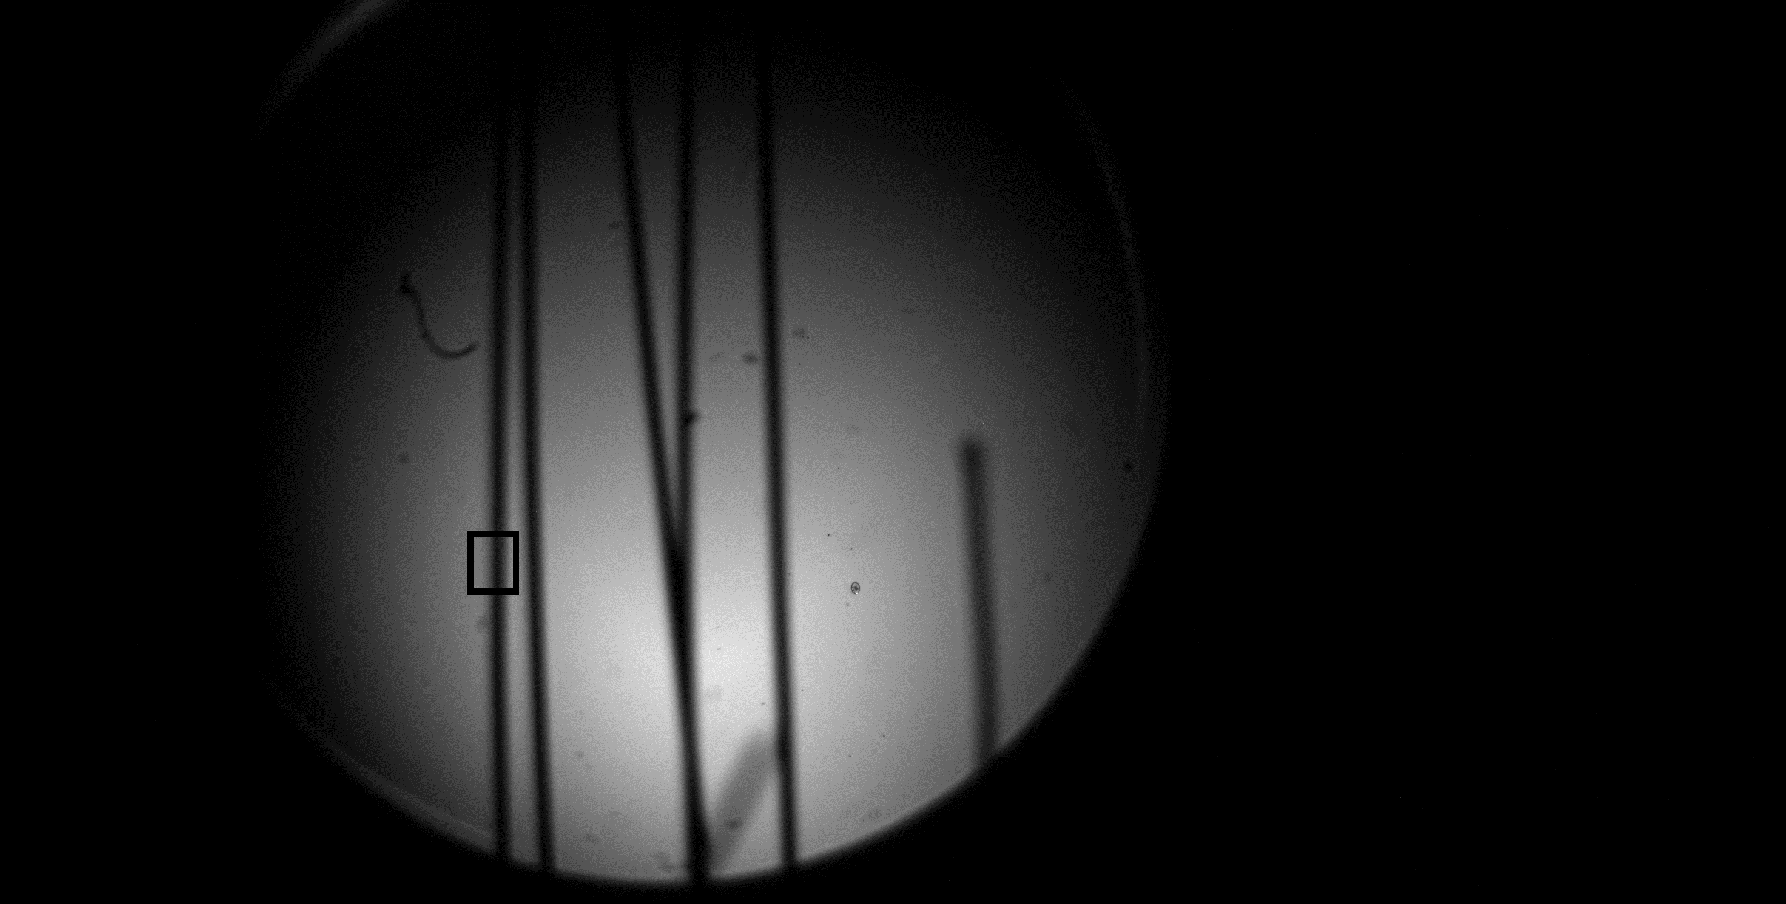
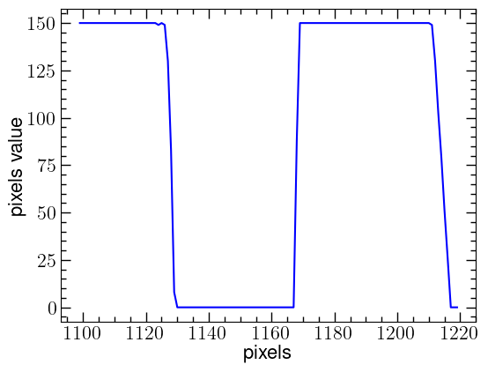
Camera magnification calibration
Beam spot analyzer
Using beam spot analyzer to confirm the incidence beam size
Wire picture
Through camera to observer tungsten wire of diameter 203 $μm$
Both of the above methods to confirm that the camera zoom is 2.2 (pixel size = 2.5 $μm$)
After attenuate
Near saturation

Slide 5
Next plan
Continue to follow up the EM mechanical installation and optical system installation
Improve the calculation procedure from the measurement picture to the final emittance, and determine the interaction with the control system

