Slide 1



CEPC vertex Detector
Zhijun Liang
(On behalf of the CEPC physics and detector group)
Oct. 21st, 2024, CEPC Detector Ref-TDR Review

Slide 2
Content
Introduction
Requirements
Technology survey and our choices
Technical challenges
R&D efforts and results
Detailed design including electronics, cooling and mechanics
Readout electronics & BEC
Performance from simulation
Research team and working plan
Summary

Slide 3
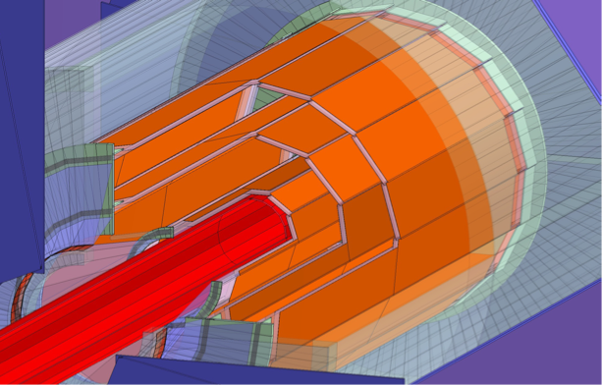
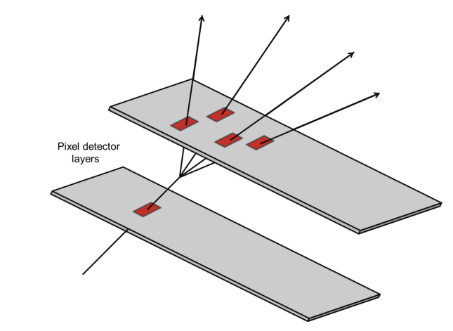
Introduction: vertex detector
Vertex detector optimized for first 10 year of CEPC operation (ZH, low lumi-Z runs)
  Low lumi Z runs is ~20% instant luminosity of high lumi Z runs
Motivation:
  Aim for impact parameter resolution and vertexing capability
  For H → bb/ H → cc/ H → light quark or gluons analysis
  The observation H → cc or H → gg is important goal for CEPC

Slide 4
Vertex Requirement
  Inner most layer (b-layer) need to be as close to beam pipe as possible
    Challenges: b-layer radius (11mm) is smaller compared with ALICE ITS3 (18mm)
  High data rate: (especially at Z pole , ~43MHz, 1Gbps per chip )
    Challenges: 1Gbps per chip high data rate especially at Z pole
  Low material budget ( less than 0.15%X0 per layer)
  Detector Cooling with air cooling (power consumption<=40 mW/cm²)
  Spatial Resolution (3-5 um)
  Radiation level (~1Mrad per year in average)

Slide 5
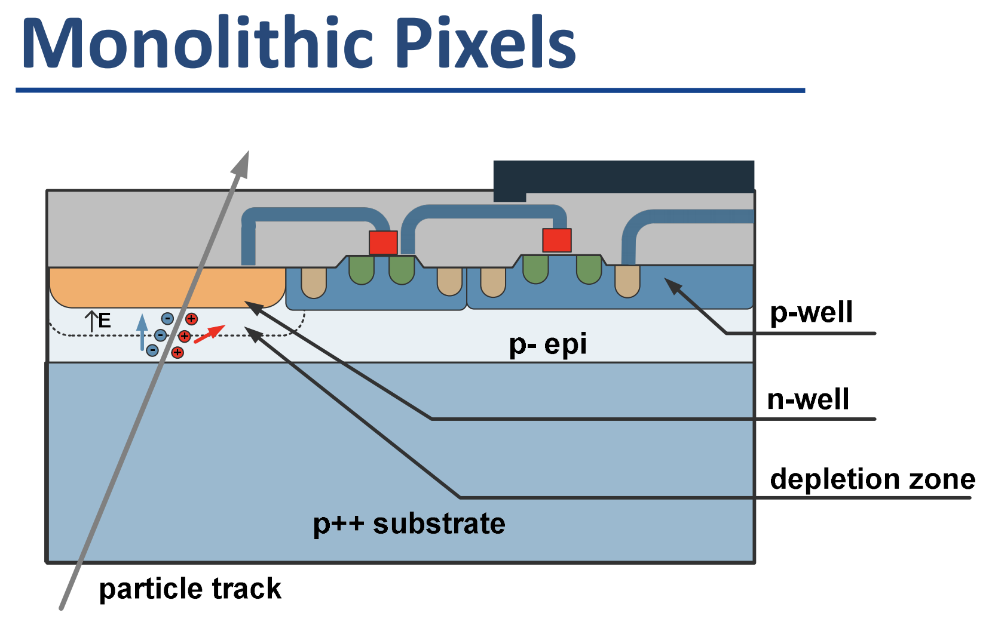
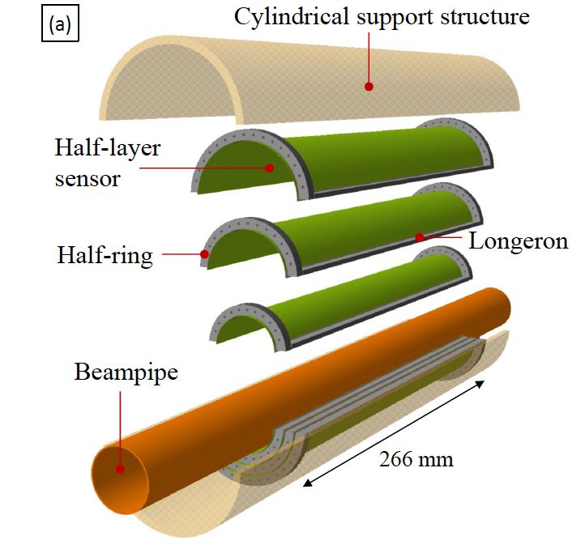
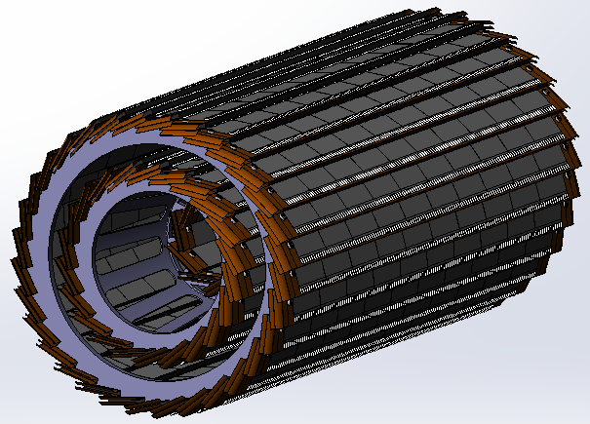
Technology survey and our choices
Vertex detector Technology selection
  Baseline: based on curved CMOS MAPS (Inspired by ALICE ITS3 design[1] )
    Advantage: 2~3 times smaller material budget compared to alternative (ladder options)
  Alternative: Ladder design based on CMOS MAPS
Monolithic active Pixel CMOS (MAPS)
Baseline: curved MAPS
Alternative: ladder based MAPS
[1] ALICE ITS3 TDR: https://cds.cern.ch/record/2890181

Slide 6
R&D status and final goal
Key technology | Status | CEPC Final goal
CMOS chip technology | Full-size chip with TJ 180nm CIS | 65nm CIS
Detector integration | Detector prototype with ladder design | Detector with bent silicon design
Spatial resolution | 4.9 μm | 3-5 μm
Detector cooling | Air cooling with 1% channels (24 chips) on | Air cooling with full power
Bent CMOS silicon | Bent Dummy wafer radius ~12mm | Bent final wafer with radius ~11mm
Stitching | 11*11cm stitched chip with Xfab 350nm CIS | 65nm CIS stitched sensor

Slide 7
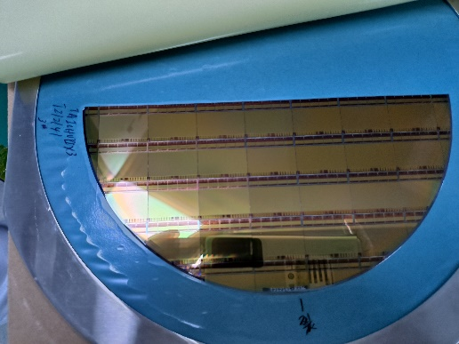
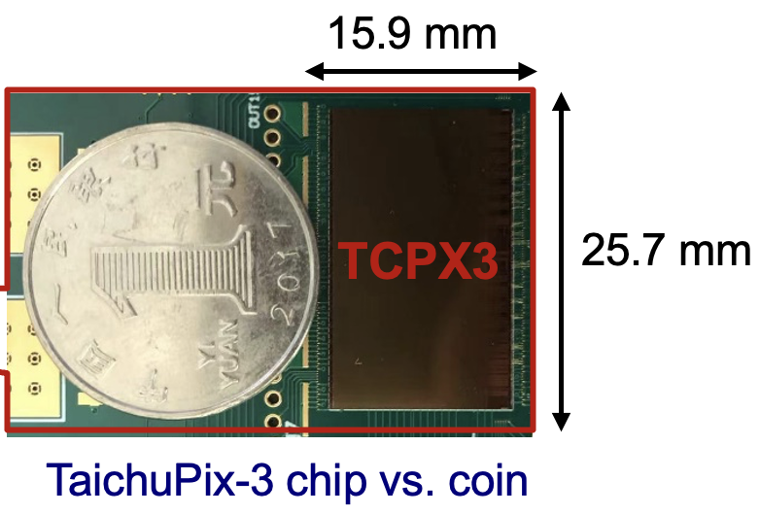
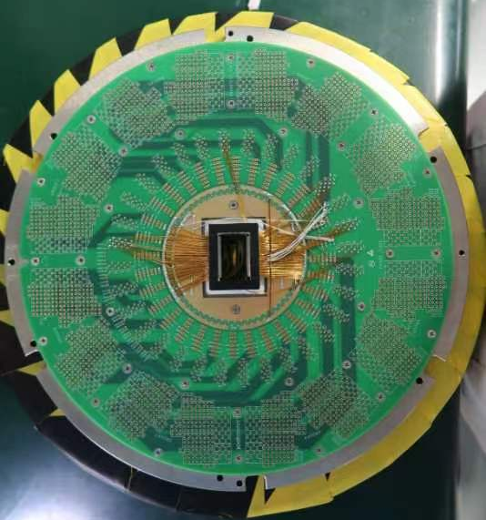
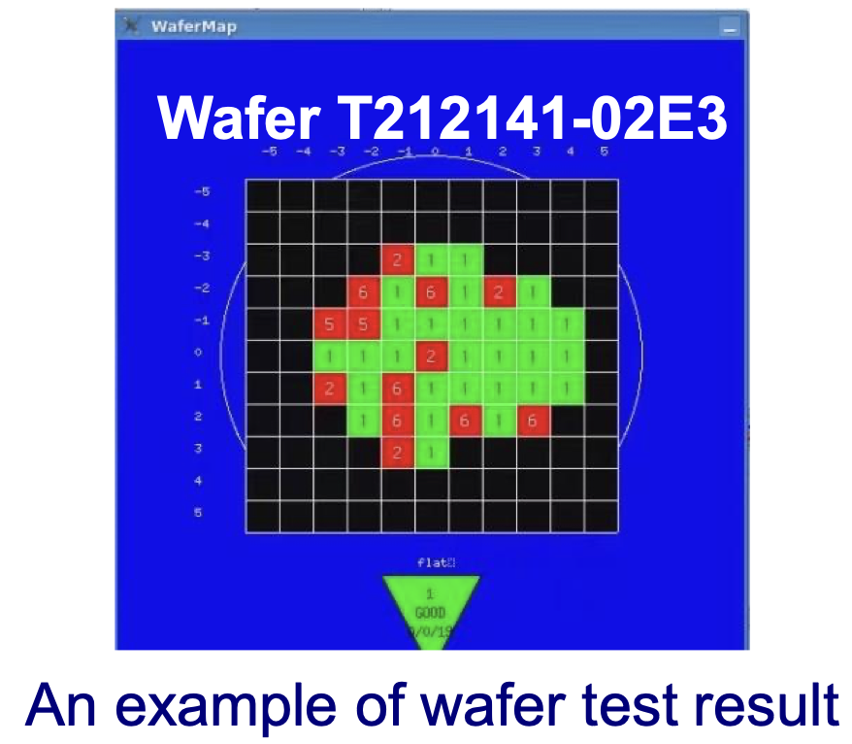
R&D efforts: Full-size TaichuPix3
Full size CMOS chip developed, 1st engineering run
  1024×512 Pixel array, Chip Size：15.9×25.7mm
  25μm×25μm pixel size with high spatial resolution
  Process: Towerjazz 180nm CIS process
  Fast digital readout to cope with ZH and Z runs (support 40MHz clock)
 | Status | CEPC Final goal
CMOS chip technology | Full-size chip with TJ 180nm CIS | 65nm CIS

Slide 8
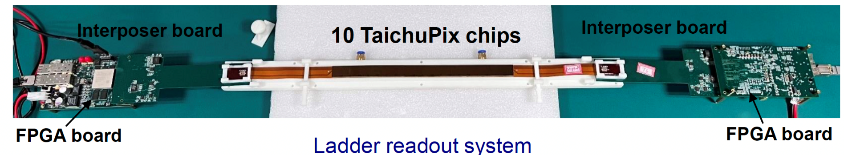
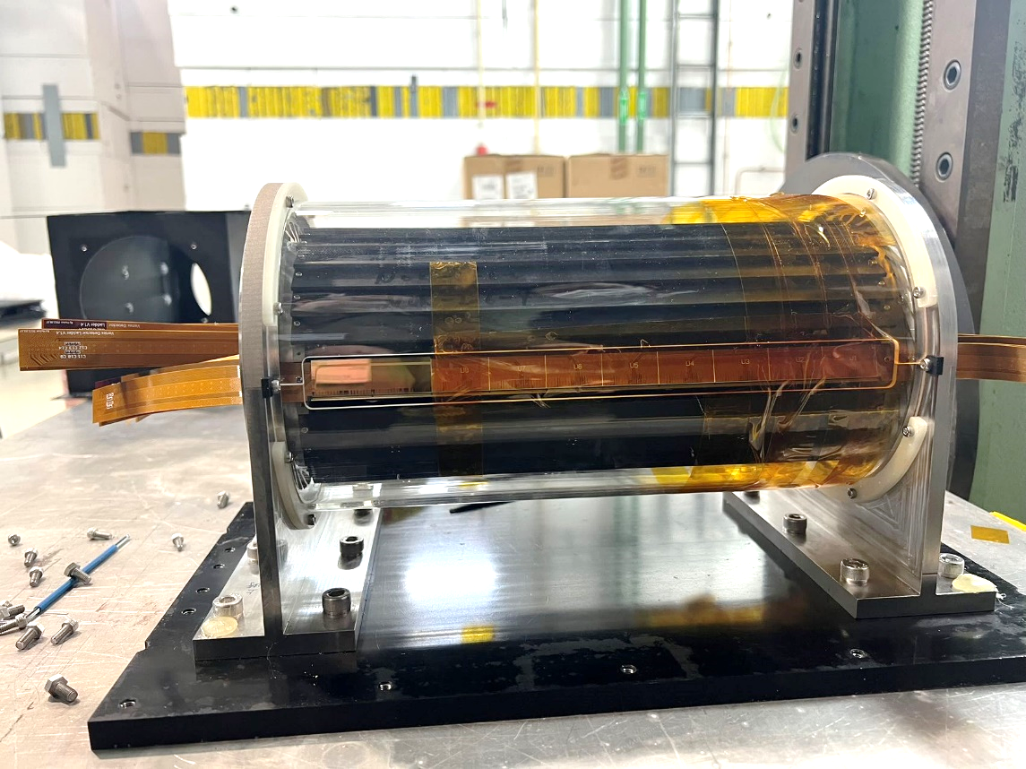
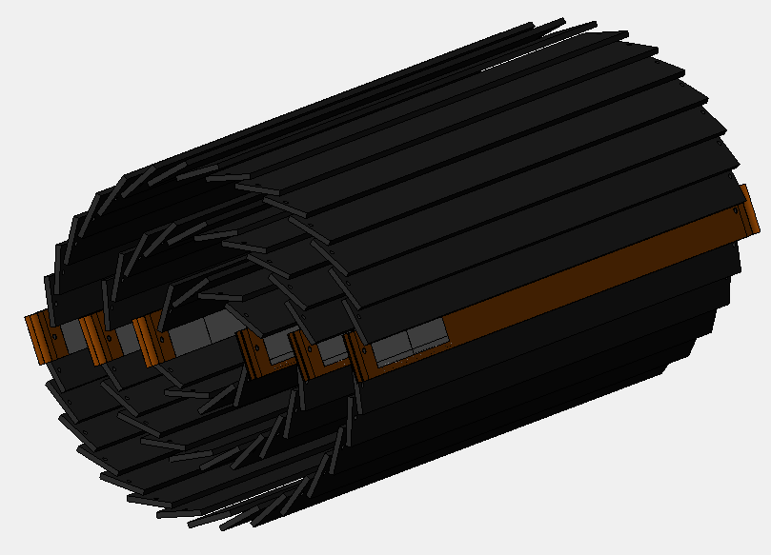
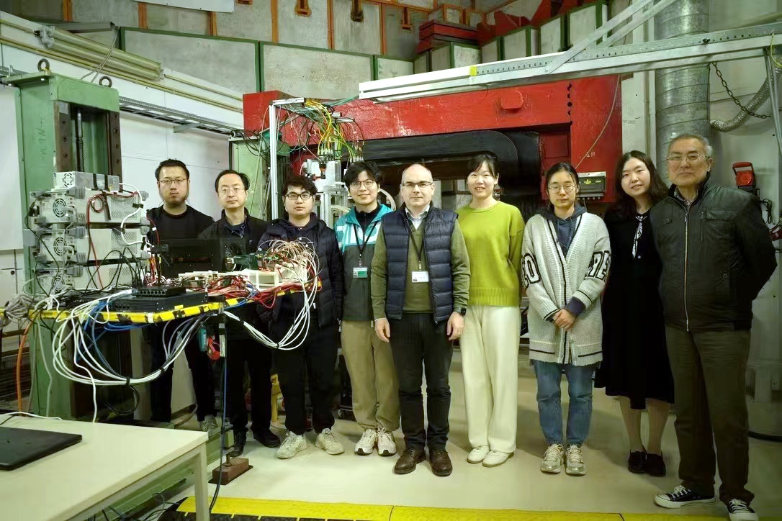
R&D effort: vertex detector prototype
TaichuPix-based prototype detector tested at DESY in April 2023
Spatial resolution ~ 4.9 μm
6 double-sided ladders
 | Status | CEPC Final goal
Detector integration | Detector prototype with ladder design | Detector with bent silicon design

Slide 9
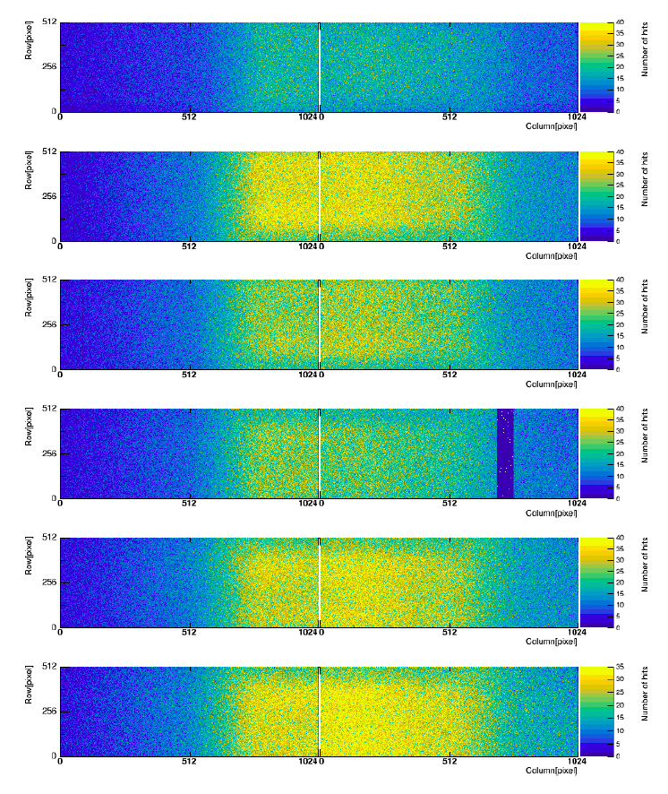
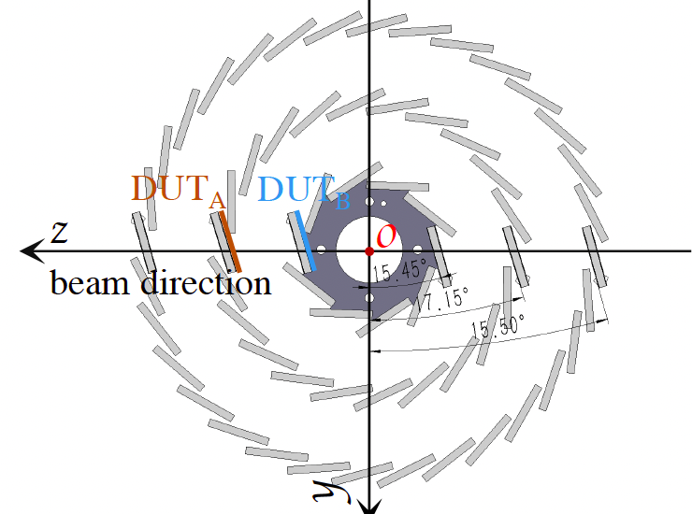
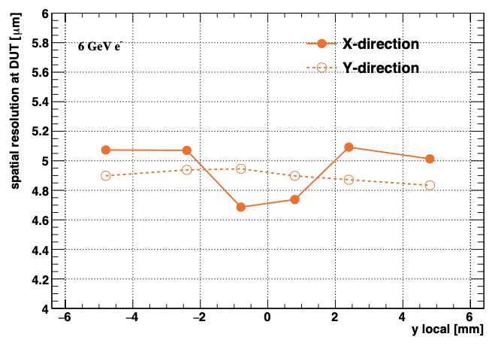
R&D efforts and results: vertex detector prototype beam test
Hit maps of multiple layers of vertex detector
Spatial resolution ~ 5 μm
Beam spot
 | Status | CEPC Final goal
Spatial resolution | 4.9 μm | 3-5 μm

Slide 10
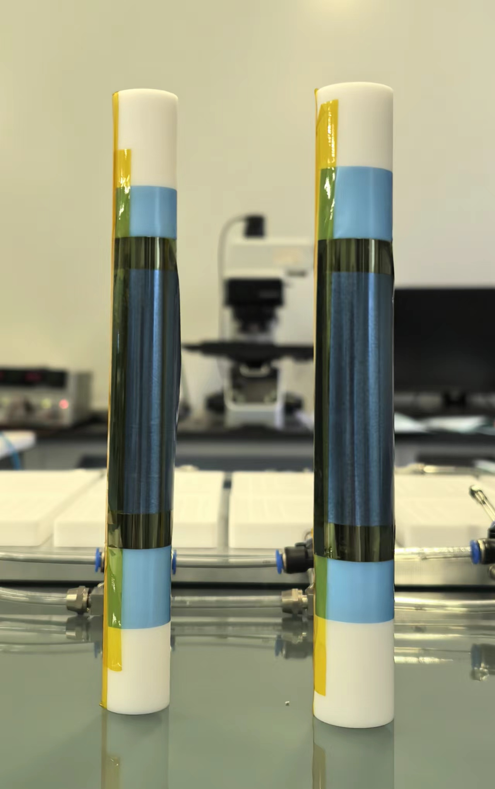
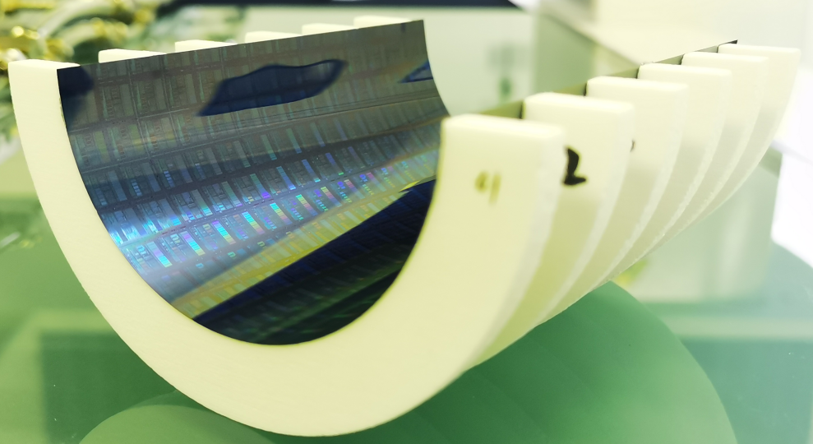
R&D efforts curved MAPS
  CEPC b-layer radius (11mm) smaller compared with ALICE ITS3 (radius=18mm)
  Feasibility study: Mechanical prototype with dummy wafer can curved to radius ~12mm
    Thinning silicon wafer to 40um
12 mm
14 mm
 | Status | CEPC Final goal
Bent silicon with radius | Bent Dummy wafer radius ~12mm | Bent final wafer with radius ~11mm

Slide 11
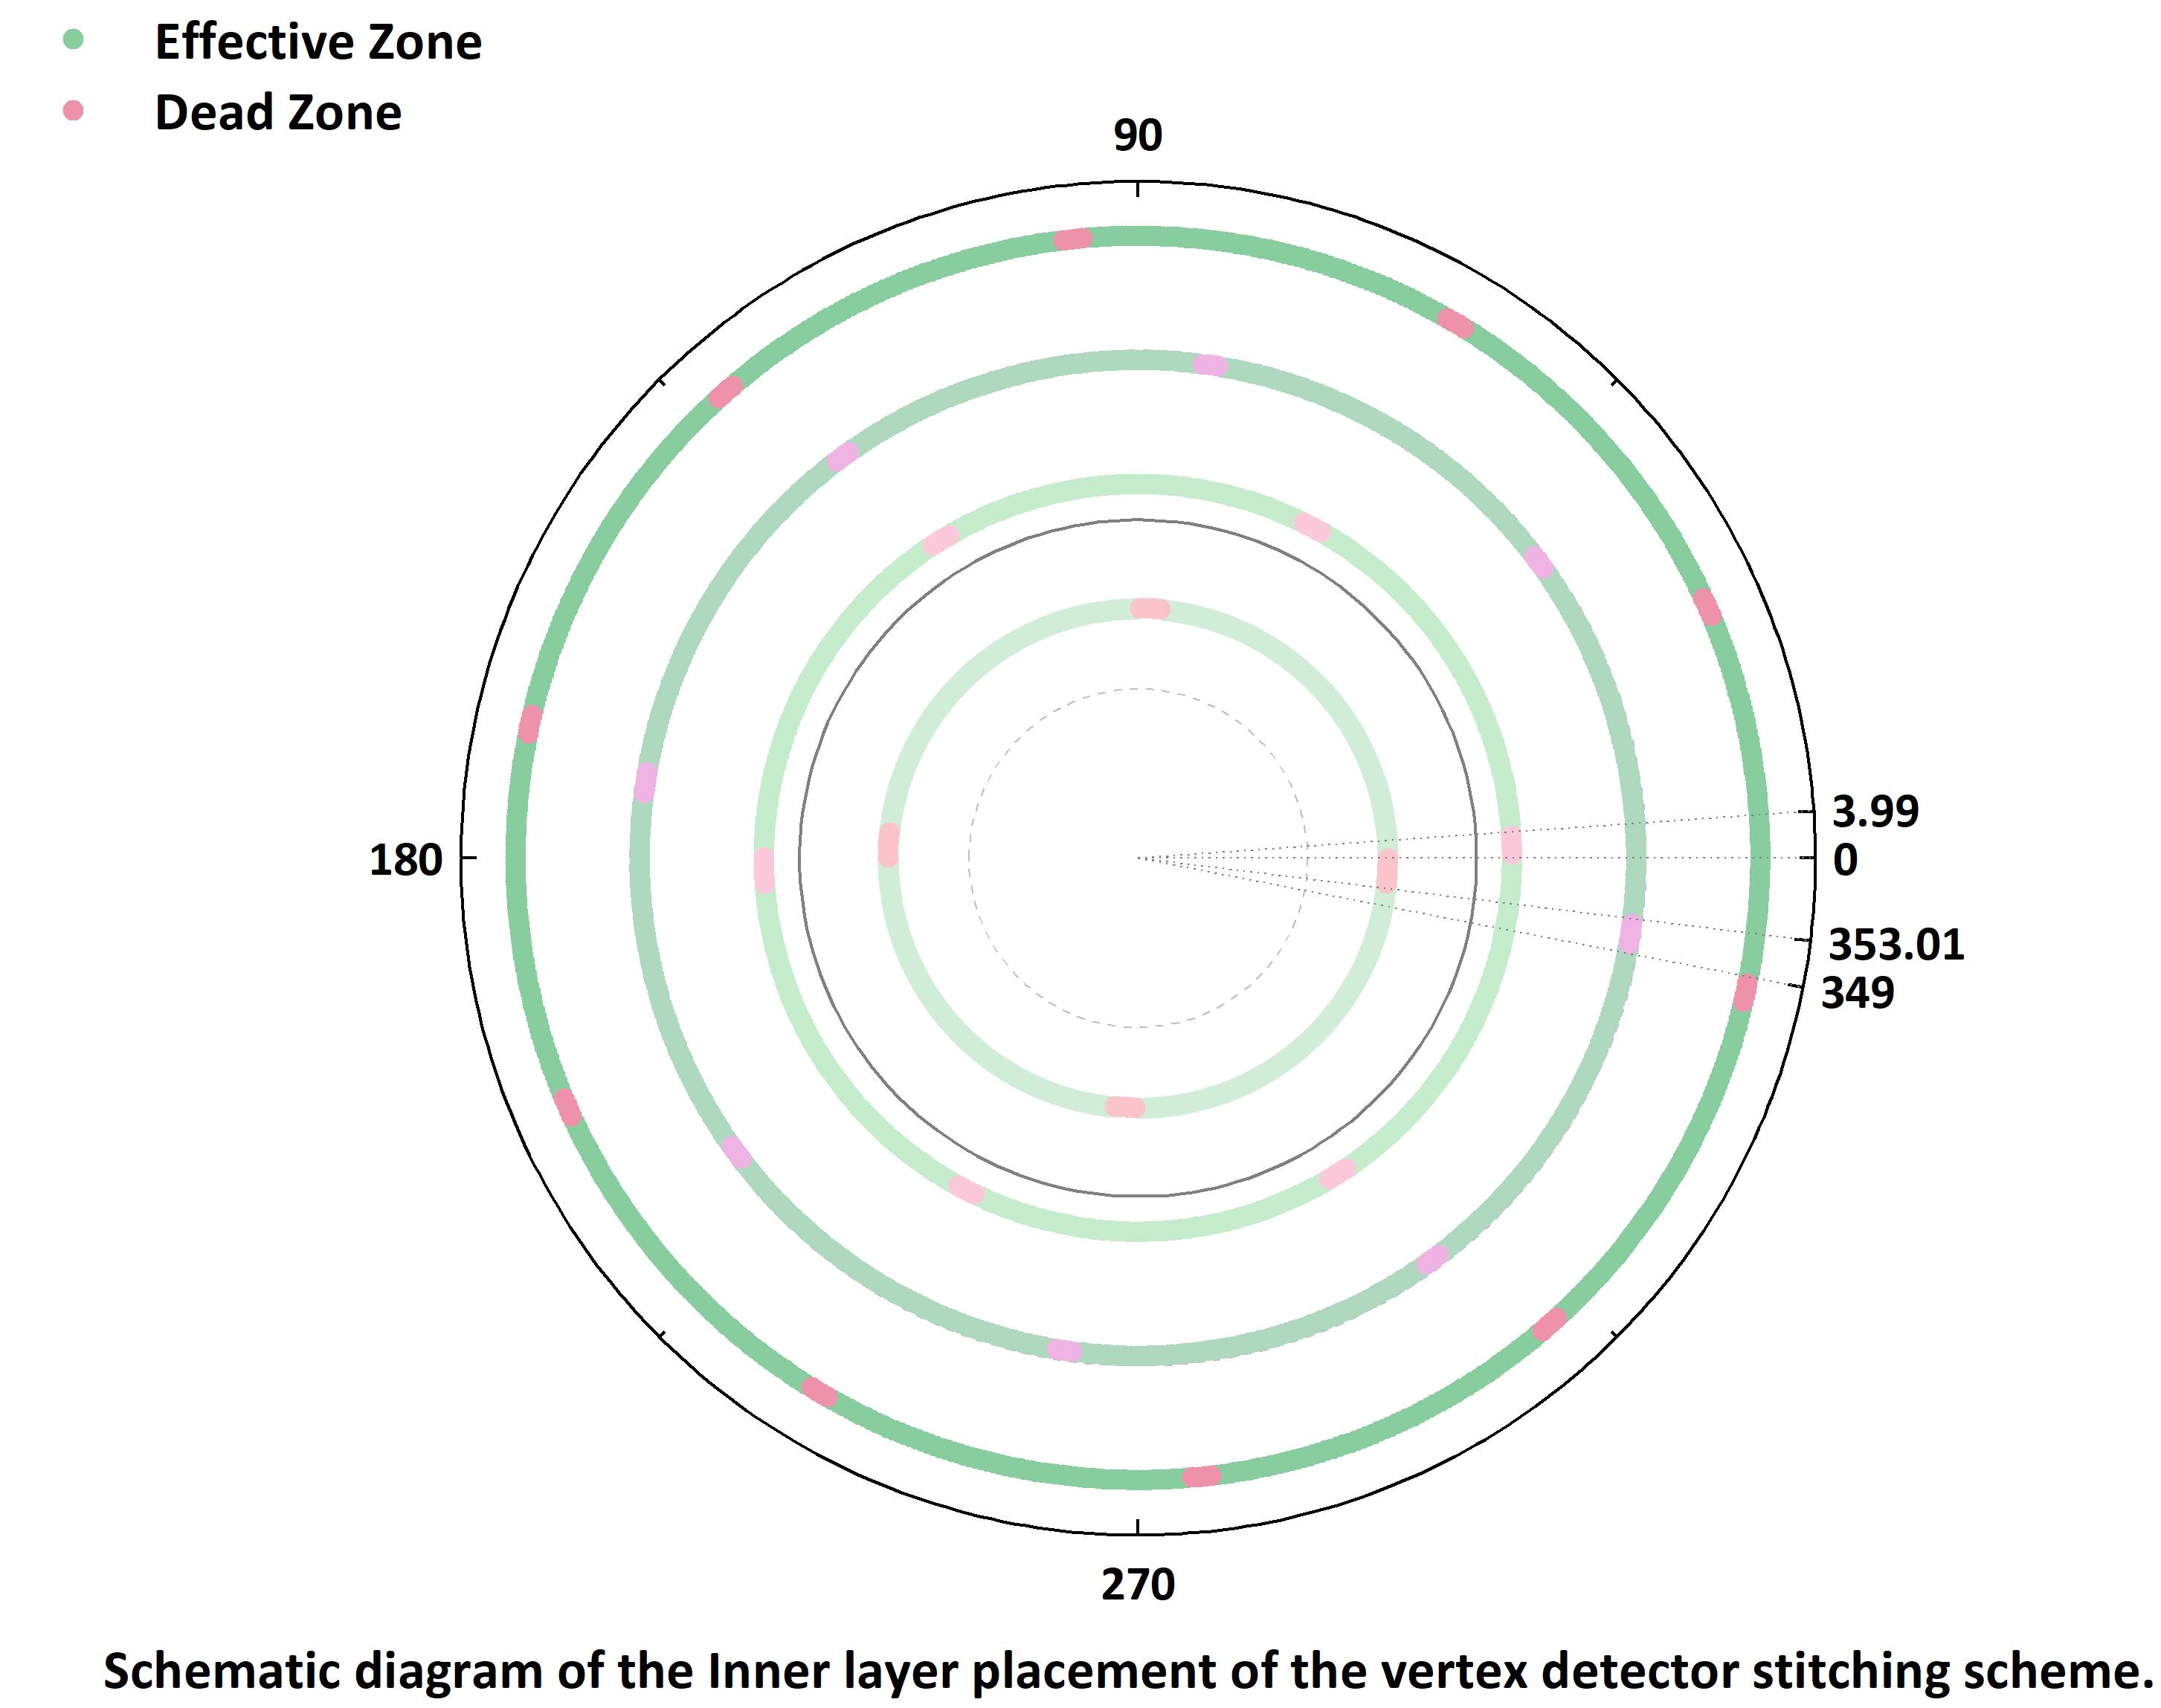
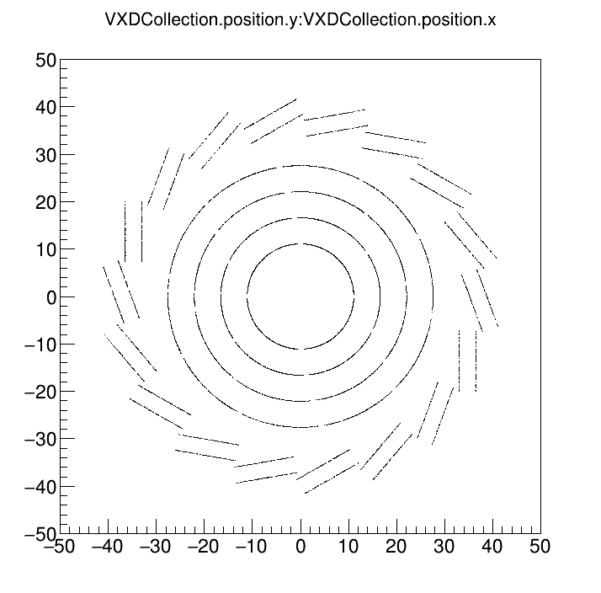
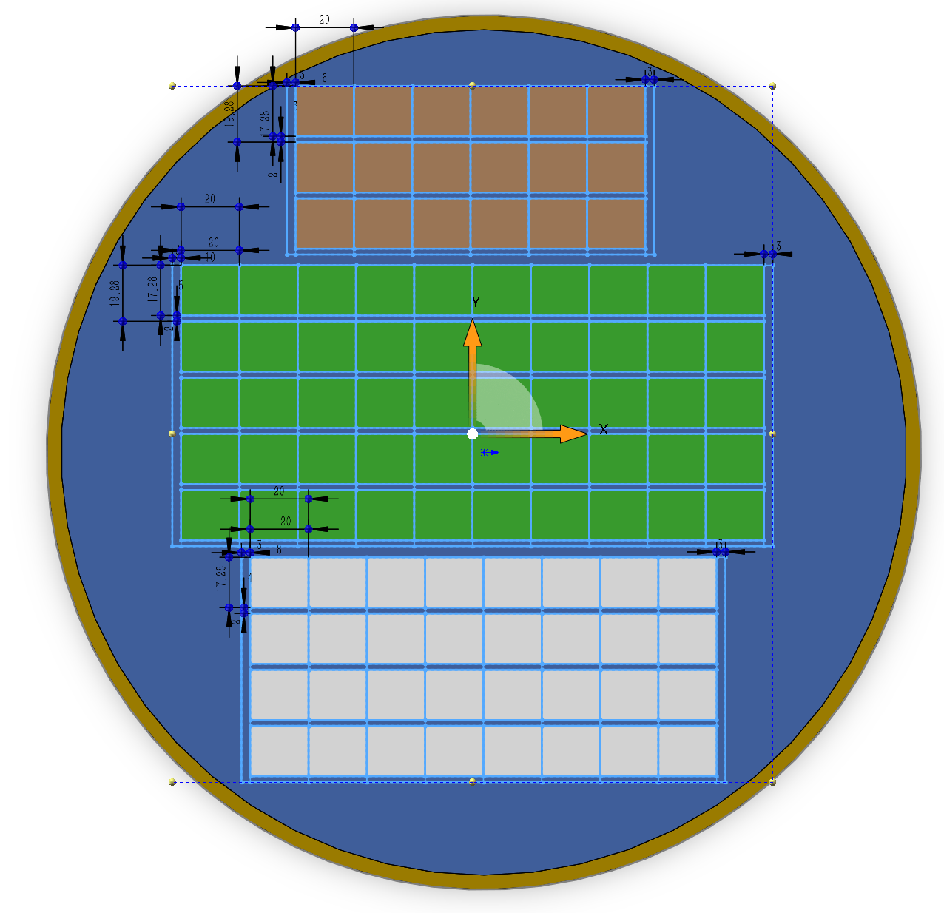
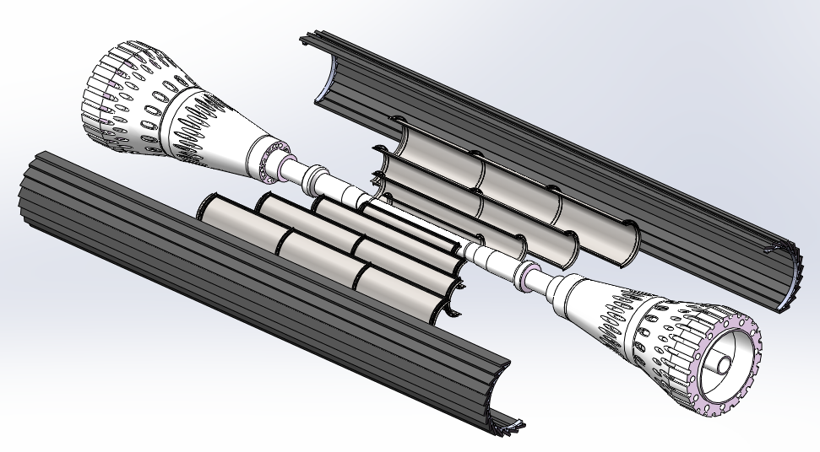
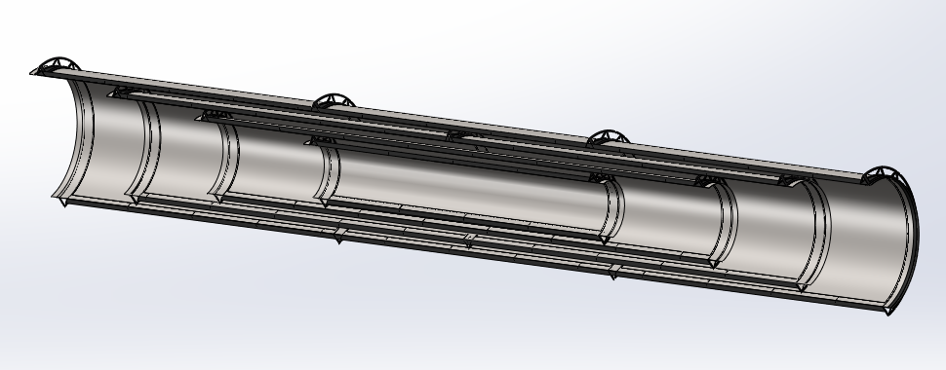
baseline: bent MAPS
  4 single layer of bent MAPS + 1 double layer ladder
    Material budget is much lower than alternative option
  Use single bent MAPS for Inner layer (~0.15m²)
    Low material budget 0.06%X0 per layer
    Different rotation angle in each layer to reduce dead area
Long barrel layout (no endcap disk)
to cover cos θ<=0.991
layer | Radius | Material
Layer 1 | 11mm | 0.06% X0
Layer 2 | 16.5mm | 0.06% X0
Layer 3 | 22mm | 0.06% X0
Layer 4 | 27.5mm | 0.06% X0
Layer 5/6 (Ladders) | 35-40 mm | 0.33% X0
Total |  | 0.57% X0
Layer 2
Layer 4
Layer 3
Layer 1

Slide 12
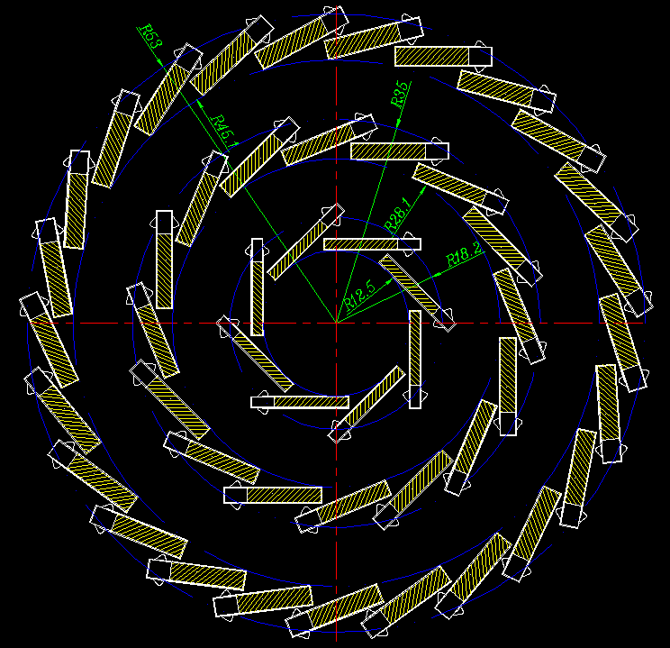
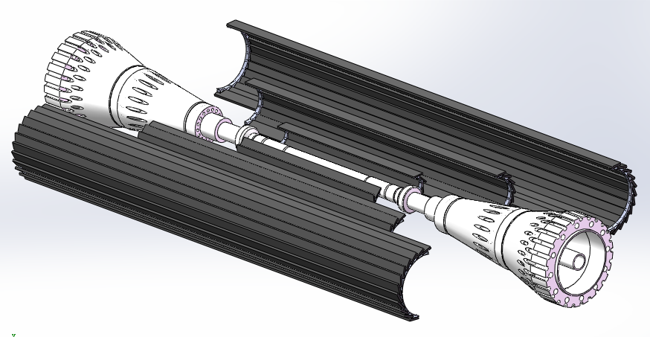
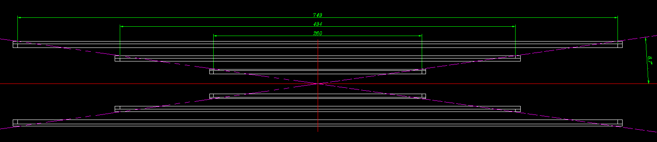
Alternative : CMOS ladder
Alternative: CMOS chip with long ladder layout
  3 double-side layer with ladders design
  2 times of material compared to baseline layout
layer | Radius | Material
Layer 1/2 | 12.5 -18 mm | ~0.33% X0
Layer 3/4 | 28 - 35mm | ~0.33% X0
Layer 5/6 (Ladders) | 45 - 53mm | ~0.33% X0
Total |  | ~1% X0

Slide 13
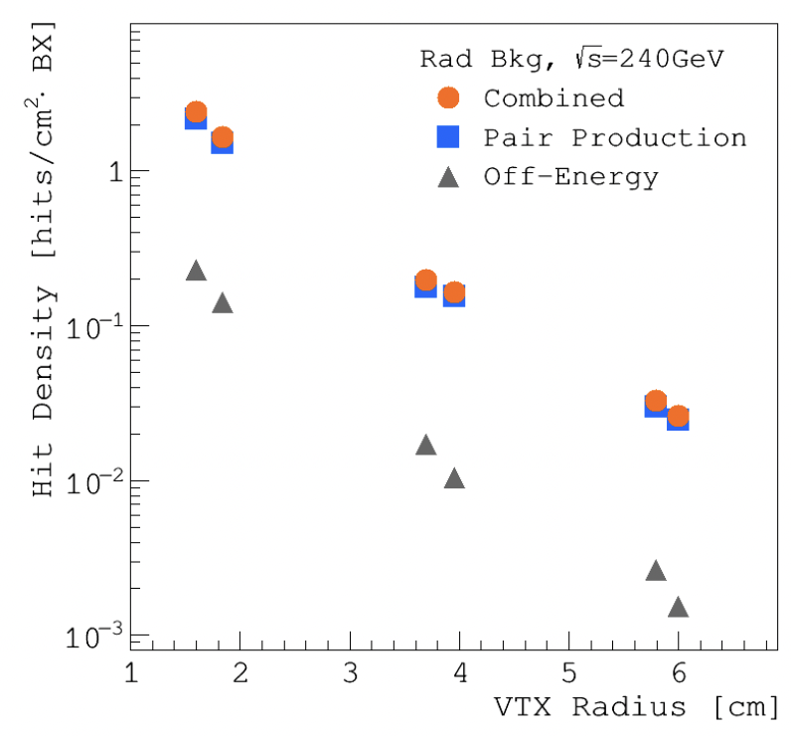
Data rate estimation of vertex detector
 | Hit rate (MHz/cm²) | Data rate@triggerless (Gbps) | Data rate@trigger (Gbps)
Higgs | 0.61 | 0.18 | <0.01
W | 3.16 | 0.98 | <0.01
Low lumi Z pole | 3.9 | 1.2 | ~0.1
Hit density from background (from CDR)
Data rate is dominated by background from pair production
  Estimated based on old version of software
  More details in Haoyu’s MDI talk this afternoon
WW runs and low Lumi Z runs (20% of high lumi Z)
Data rate @1Gbps per chip for triggerless readout

Slide 14
Chip design for ref- TDR and power consumption
Power consumption
  Fast priority digital readout for 40MHz at Z pole
  65/55nm CIS technology
  Power consumption can reduced to ~40mW/cm²
Air cooling feasibility study
  Baseline layout can be cooled down to ~20 ℃
    Based on 3 m/s air speed, estimated by thermal simulation
 | Matrix | Periphery | DataTrans. | DACs | Total Power | Power density
TaiChu3 180nm chip @ triggerless | 304 mW | 135 mW | 206 mW | 10 mW | 655 mW | 160 mW/cm²
65nm for TDR @ 1 Gbps/chip (TDR LowLumi Z ) | 60 mW | 80 mW | 36 mW | 10 mW | 186 mW | ~40 mW/cm²

Slide 15
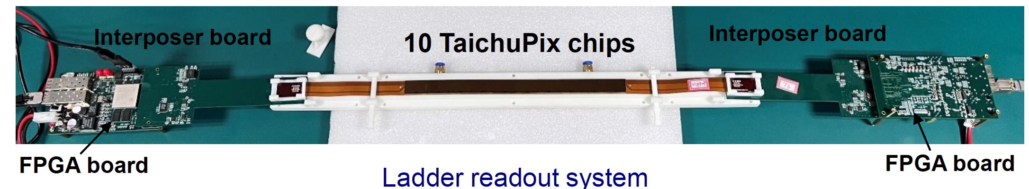
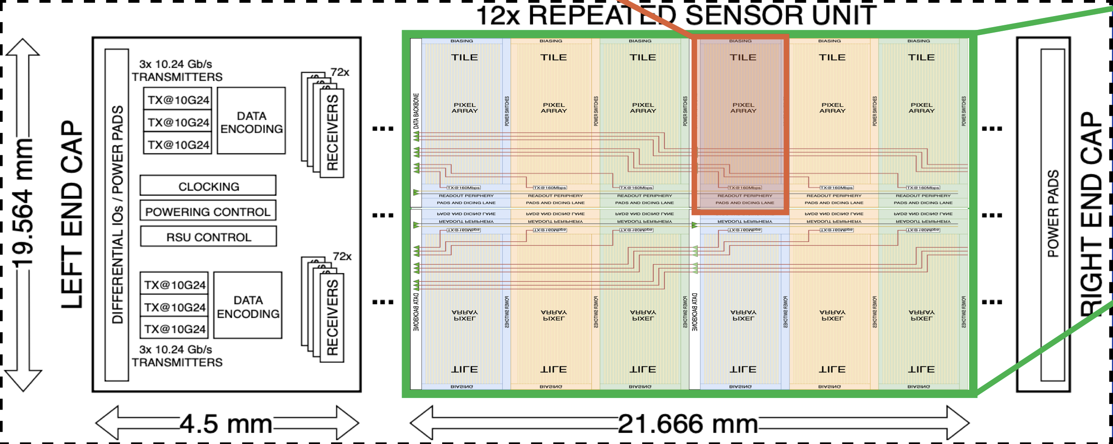
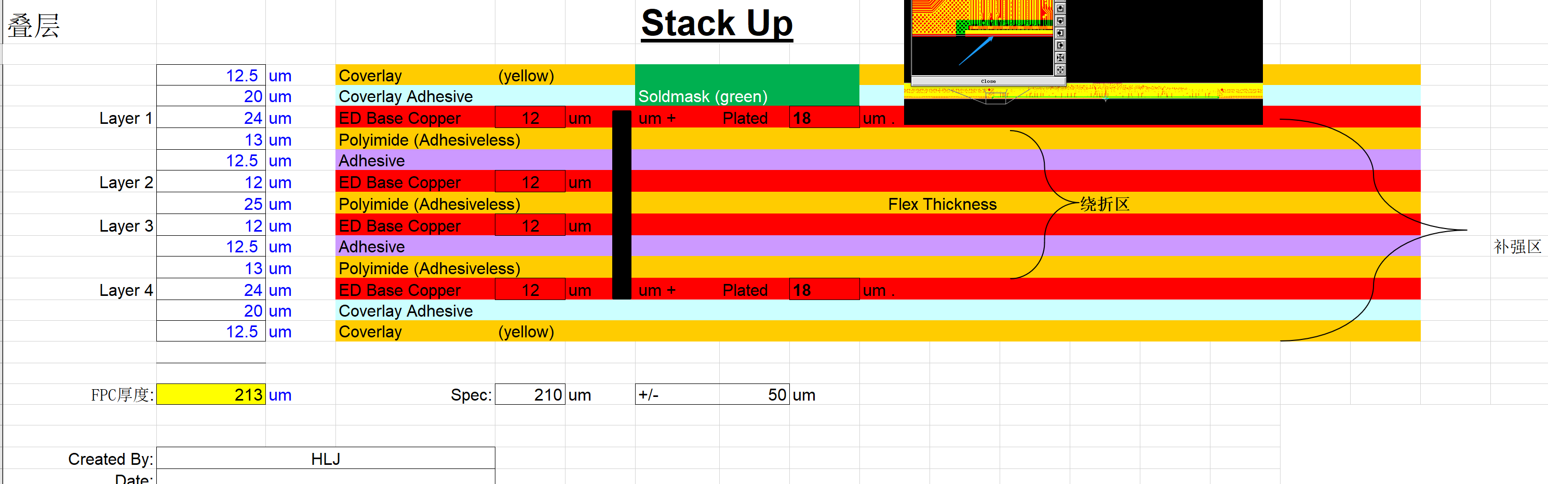
Ladder Electronics
  Baseline: stitching and RDL metal layer on wafer to replace PCB
  Alternative: flexible PCB
    Signal, clock, control, power, ground will be handled by control board through flexible PCB
Baseline: ALICE ITS3 like stitching
Alternative: flexible PCB
[1] ALICE ITS3 TDR: https://cds.cern.ch/record/2890181

Slide 16
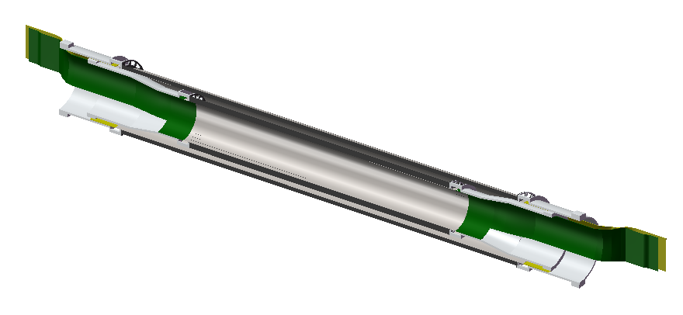
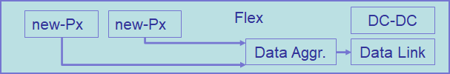
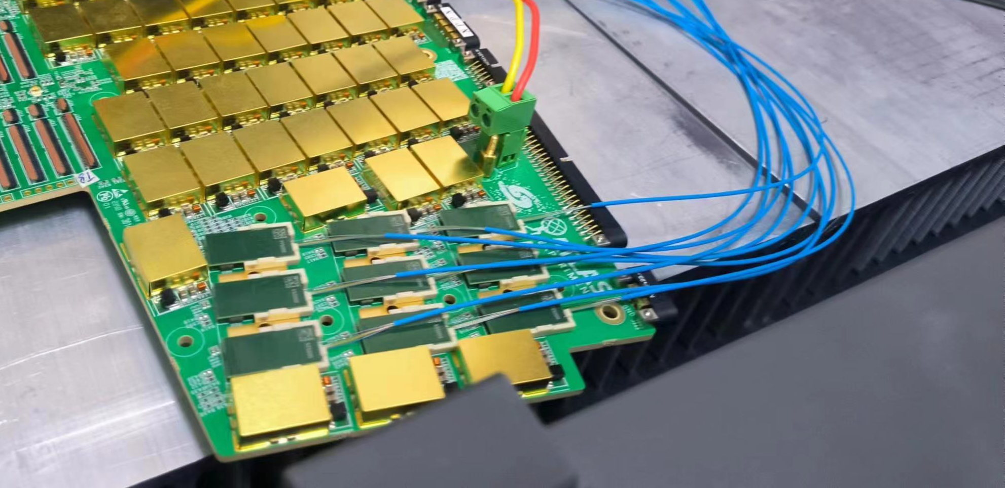
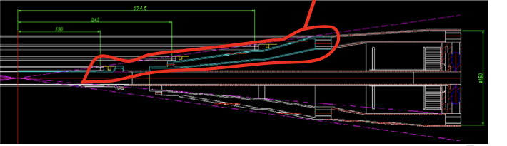
Vertex technologies: Cable and service
Limited space in MDI region for cable and service
  Use DC-DC powering , MAPS silicon substrate needed a common negative bias
  Fast signal through Flexible PCB, and then transferred into optical fiber
Example from ATLAS HGTD upgrade

Slide 17
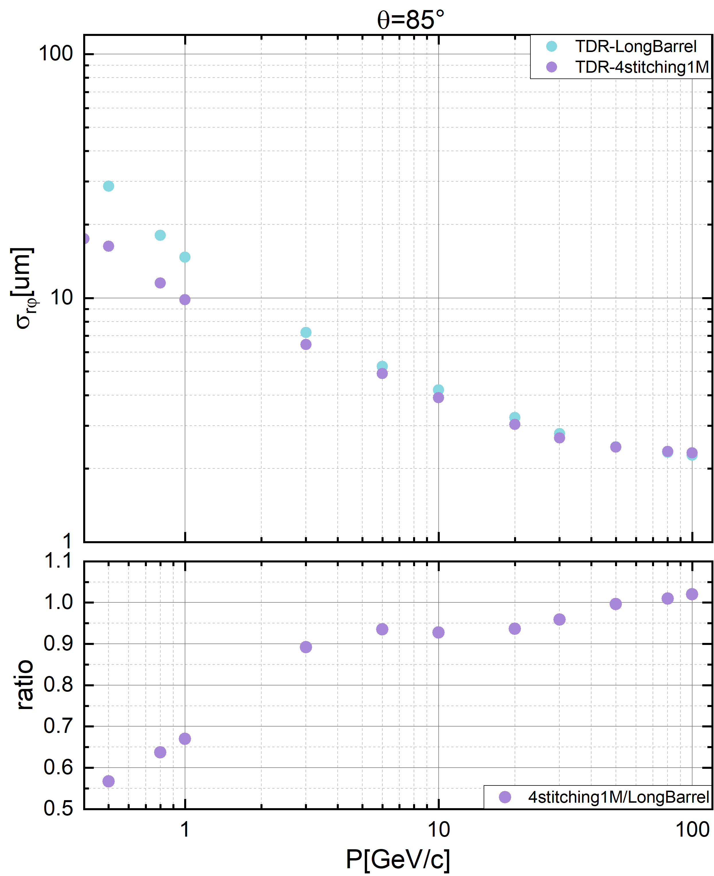
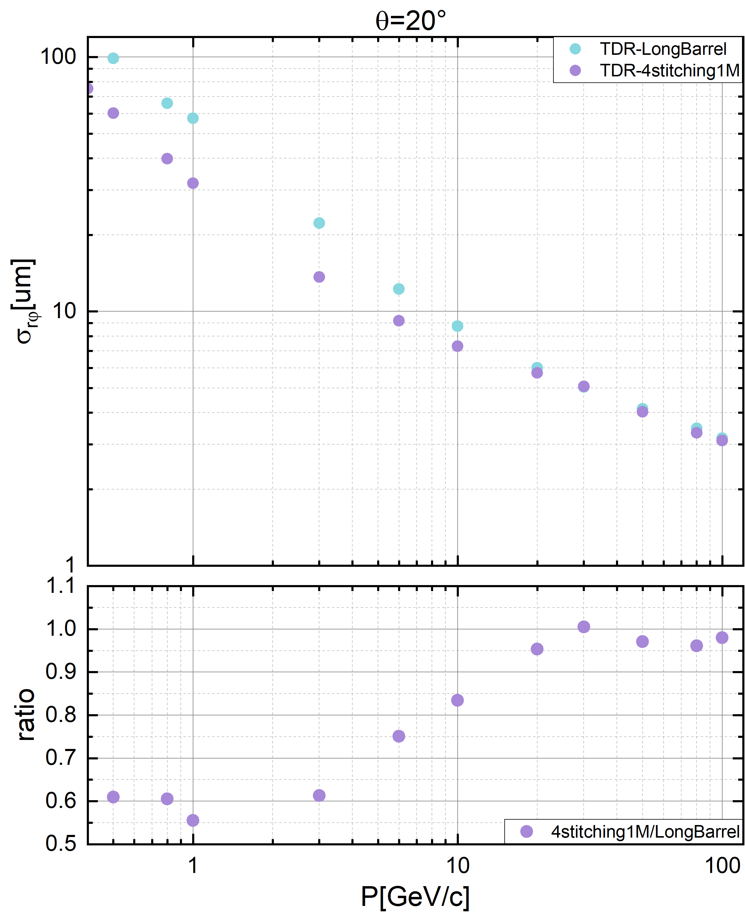
Performance: impact parameter resolution
Compared to alternative (ladder) option
  baseline (stitching) has significant improvement (~45%) in low momentum case
    Different rotation angle in each layer
    to reduce dead area
Barrel regions
forward regions
~45%
~40%

Slide 18
Research team
IHEP: Joao Costa, et al, 15 faculty, 5 postdoc, 6 students
  CEPC vertex prototype, X-ray camera, ATLAS ITK and HGTD upgrade
IPHC/CNRS: Christine Hu et al (3 faculty)
  CEPC Jadepix design, ALICE ITS3 pixel upgrade
IFAE: Chip design , Sebastian Grinstein et al (2 faculty, 1 student)
  CEPC Taichupix chip design, ATLAS ITK pixel and HGTD upgrade
ShanDong U.: stitching chip design (3 faculty, 1 postdoc, 3 students )
CCNU: chip design, ladder assembly (3 faculty, 1 postdoc, 5 students )
Northwestern Polytechnical U. : Chip design (5 faculty, 2 postdoc, 5 students )
Nanchang U. : chip design, (1 faculty, 1 students)
Nanjing: irradiation study, chip design : (2 faculty, 4 students)
Total : 36 faculty, 9 postdoc, 26 students

Slide 19
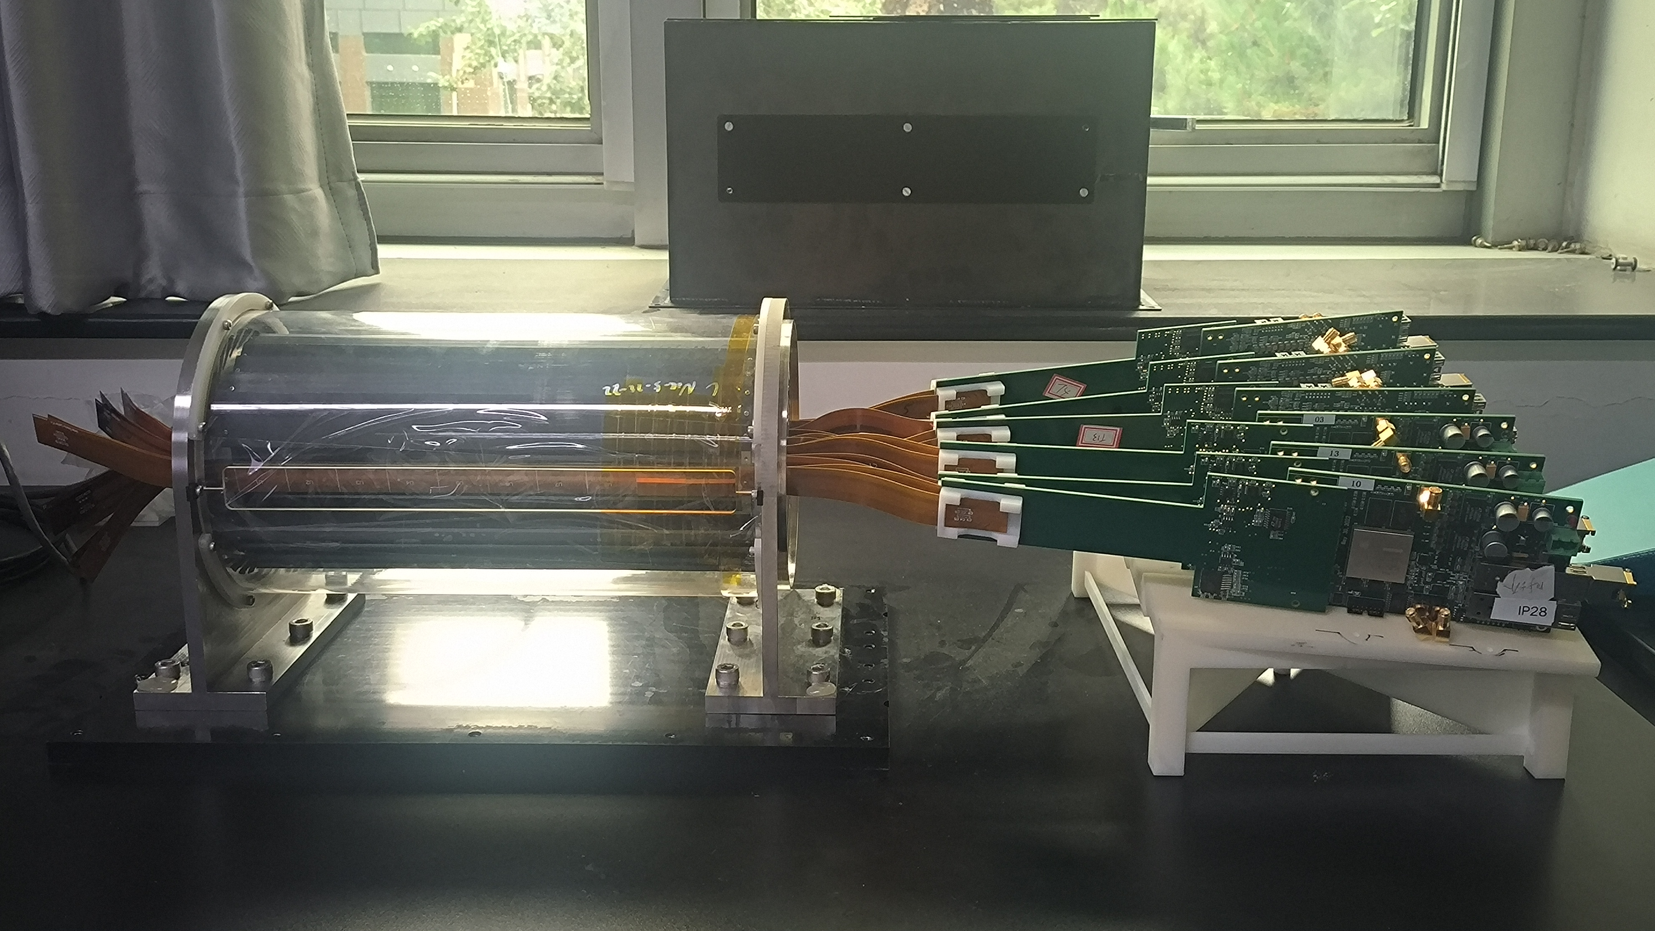

Summary
1st full-size Prototype based ladder design for CEPC vertex detector developed
Curved MAPS option chosen as baseline for Reference detector TDR.
We are active expanding international collaboration and explore synergies with other international projects (especially framework of DRD7 (electronics) and DRD8 (mechanics and integration) more than DRD3 (solid state detectors).
CEPC vertex conceptional design (2016)
CEPC vertex prototype (2023)

Slide 20
Summary: working plan
CEPC vertex detector timeline is about 3-4 years after AlICE ITS3 upgrade
  will benefit from experience from Alice ITS3 upgrade
 | CEPC Final goal | CEPC Expected date | AlICE ITS3 schedule
CMOS chip technology | 65nm CIS | 2028 Full-size 65nm chip | 2025
Spatial resolution | 3-5 μm with final chip | 2028 | 2025
Stitching | 65nm CIS stitched sensor | 2029 | 2026 wafer production
Bent silicon with small radius | Bent final wafer with radius ~11mm | 2030 | 2027
Detector cooling | Air cooling with full power | 2027：thermal mockup | 2027
Detector integration | Detector with bent silicon design | 2032 | 2028

Slide 21
Thank you for your attention!
Aug. 7th, 2024, CEPC Detector Ref-TDR Review

Slide 22
Items in meeting with IDRC chair
Total area and Timeline for ALICE ITS3, should compare with CEPC vertex
  ALICE ITS3 timeline is about 2~3 years earlier (ITS3 2032installation)
  ITS3: 0.06 m², CEPC: 0.15 m²
Material budget for normal ladders ( especially for carbon fiber )
  mu3E ladders has 0.1% X0 per layer (we quoted 0.25% X0 per layer)
  Carbon fiber thickness in CEPC prototyping can reach 0.12mm, same level as mu3E
Accessibility for 65/55 nm technology in China
  TowerJazz 65nm CIS can be submitted by TJ agency in China
  R & D of SMIC 55nm technology is on going
Serial powering is widely used in ATLAS/CMS upgrade, should look into it
  DC-DC powering is selected , MAPS silicon substrate needed a common negative bias

Slide 23
Summary: working plan
 | Status | CEPC Final goal | CEPC Expected date
CMOS chip technology | Full-size chip with TJ 180nm CIS | 65nm CIS | 2027: Full-size 65nm chip
Spatial resolution | 4.9 μm | 3-5 μm with final chip | 2028
Stitching | 11*11cm stitched chip with Xfab 350nm CIS | 65nm CIS stitched sensor | 2029
Bent silicon with small radius | Bent Dummy wafer radius ~12mm | Bent final wafer with radius ~11mm | 2030
Detector cooling | Air cooling with 1% channels (24 chips) on | Air cooling with full power | 2027：thermal mockup
Detector integration | Detector prototype with ladder design | Detector with bent silicon design | 2032

Slide 24
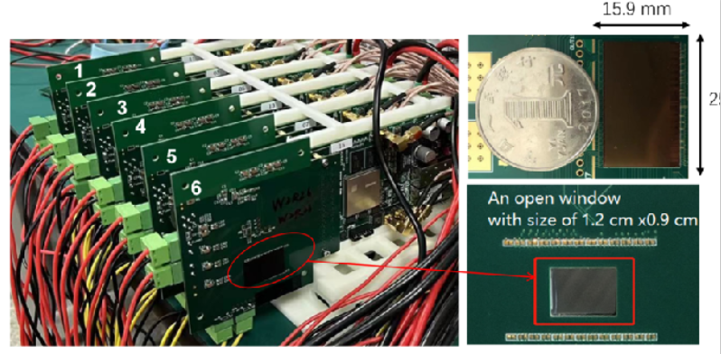
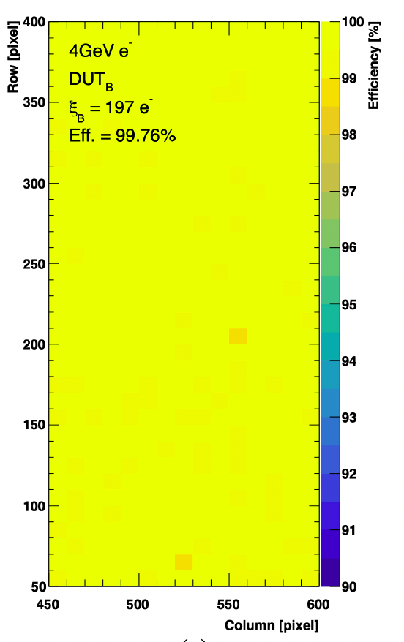
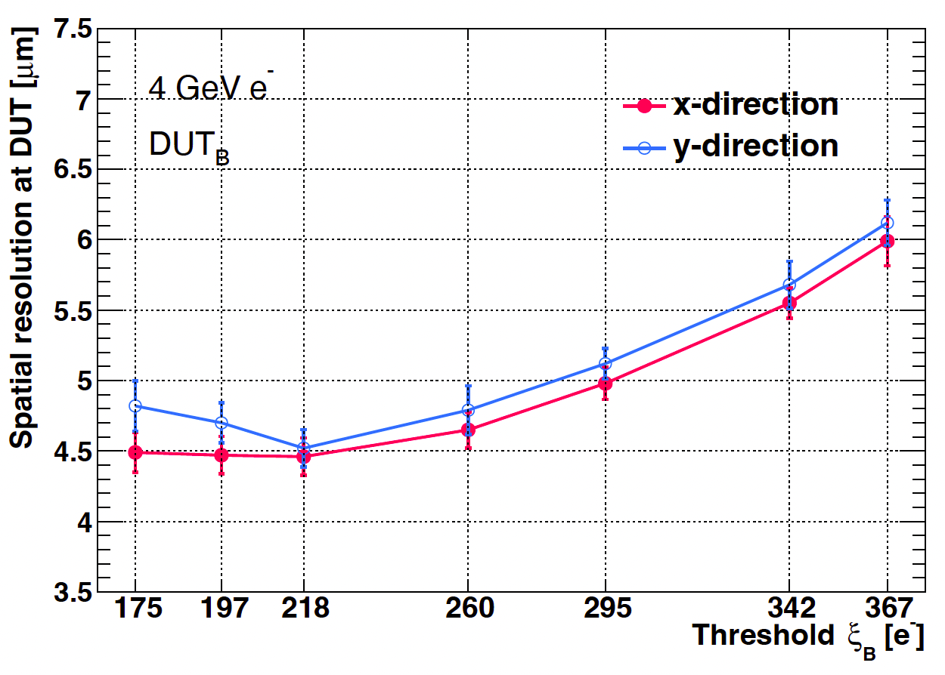
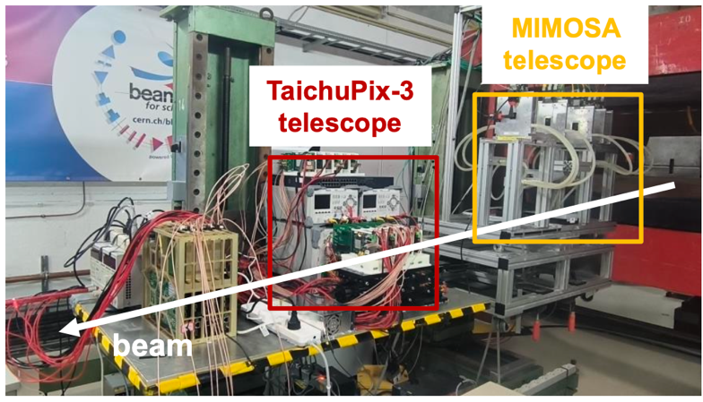
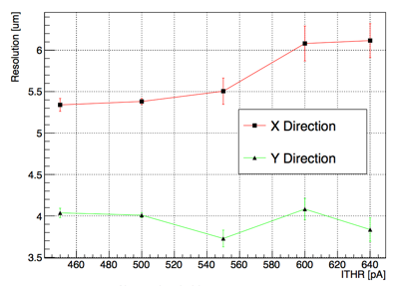
R&D efforts and results: Jadepix3/TaichuPix3 beam test @ DESY
Spatial resolution 4~5um, Efficiency >99%
TaichuPix3 efficiency
TaichuPix3 resolution
JadePix3 resolution
JadePix3
telescope
Collaboration with CNRS and IFAE in Jadepix/TaichuPix R & D

Slide 25
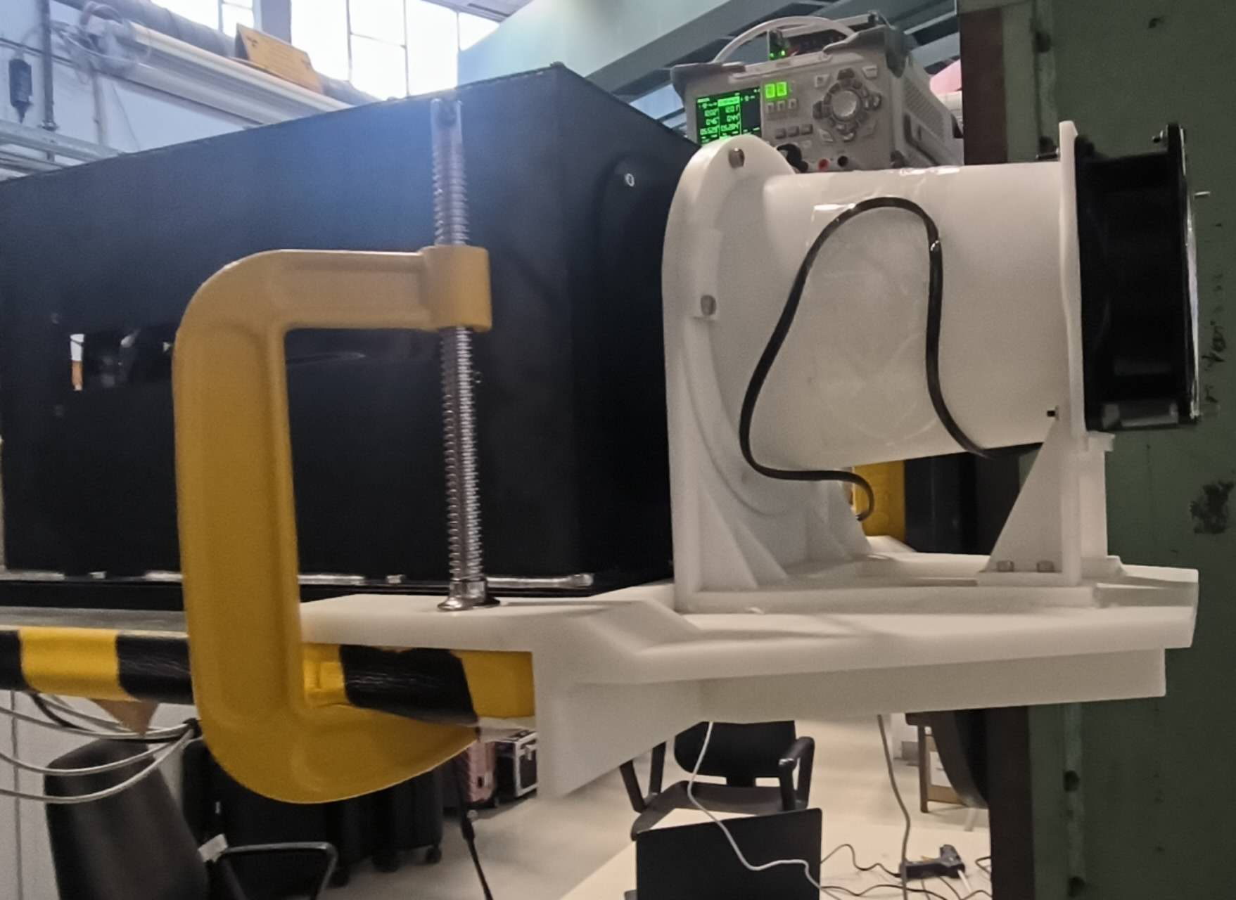
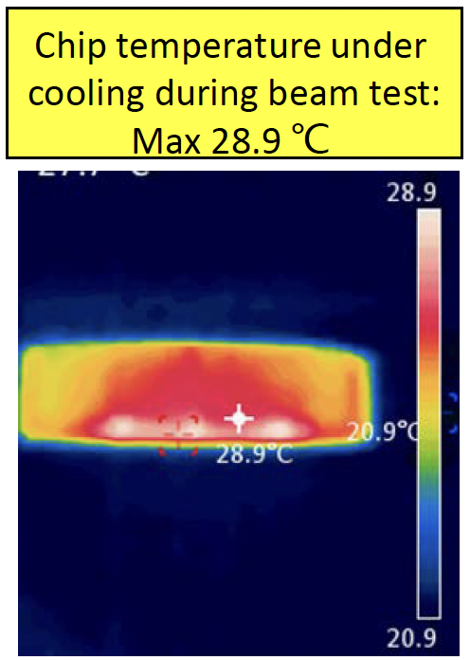
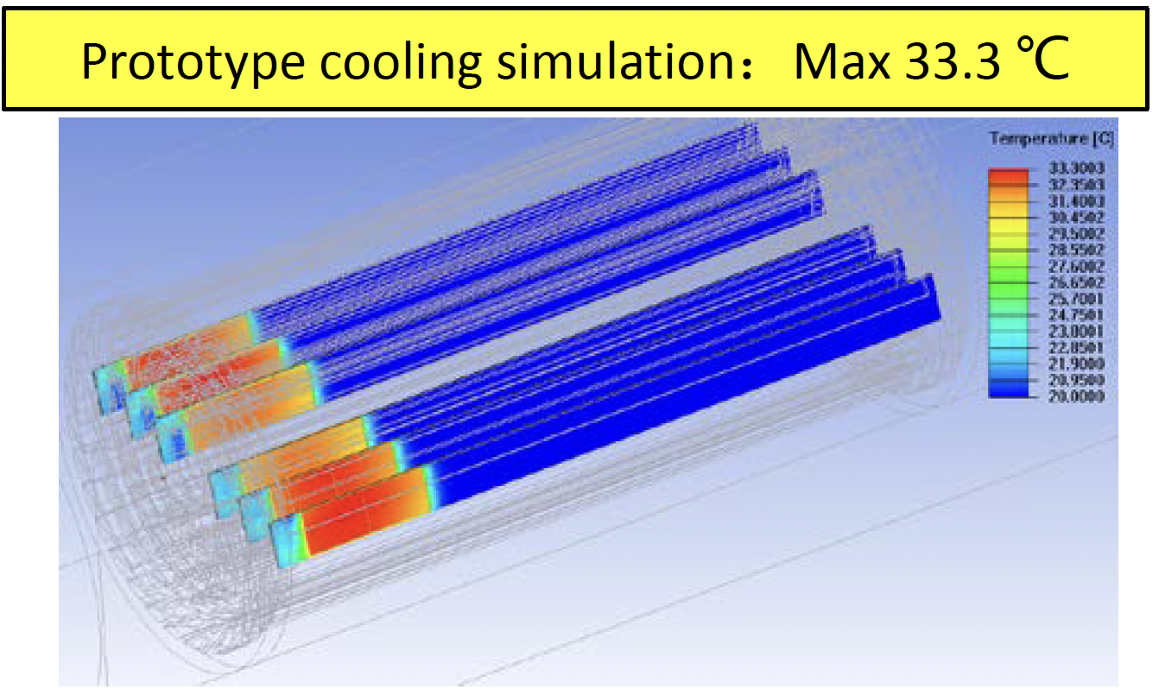
R&D efforts: Air cooling in vertex prototype
Dedicated air cooling channel designed in prototype.
  Measured Power Dissipation of Taichu chip: ~60 mW/cm² (17.5 MHz in testbeam)
  Before (after ) turning on the cooling, chip temperature 41 °C (25 °C)
    In good agreement to our cooling simulation
    No visible vibration effect in spatial resolution when turning on the fan
Key technology | Status | CEPC Final goal
Detector cooling | Air cooling with 1% channels (24 chips) on | Air cooling with full power

Slide 26
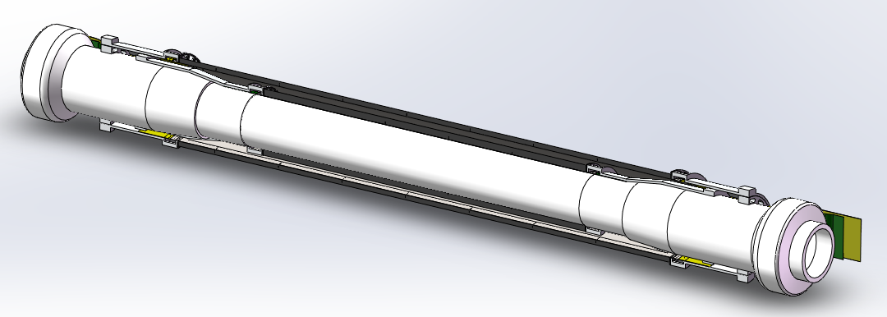
Backup: Mechanics

Slide 27
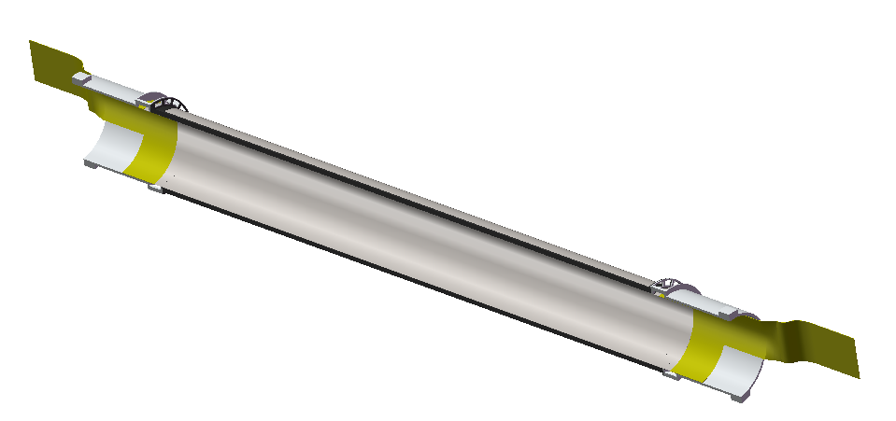
Backup : Cable and service

Slide 28
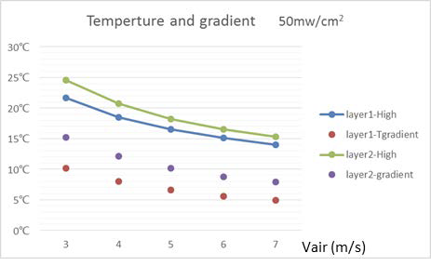
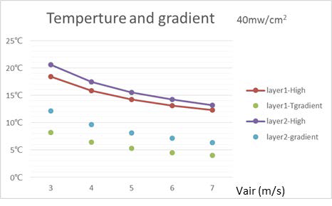
Backup : air cooling simulation

Slide 29
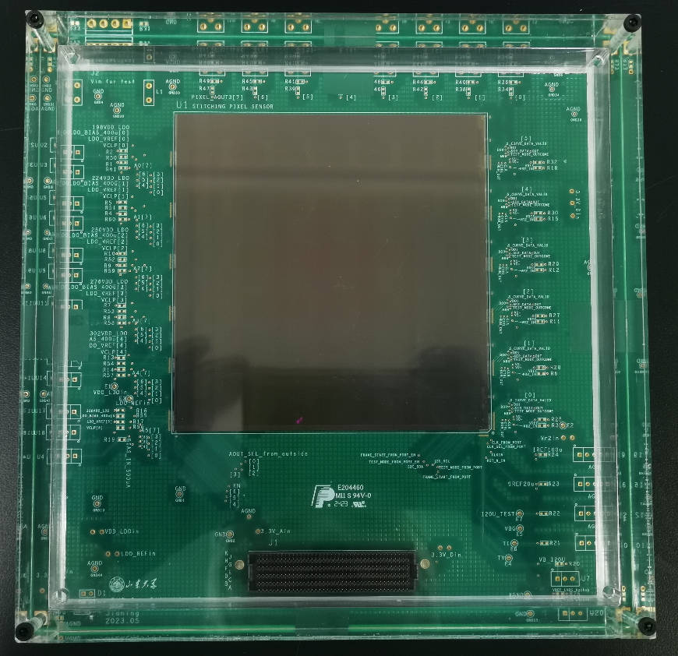

R&D efforts and results: R & D for curved MAPS
Stitching chip : 11 ×11 cm²
Stitching chip design (by ShanDong U.)
  350nm CIS technology Xfabs
  Wafer level size after stitching ~11 ×11 cm²
  reticle size ~2 ×2 cm²
  2D stitching
  Engineering run, chip under testing
Key technology | Status | CEPC Final goal
Stitching | 11*11cm stitched chip with Xfab 350nm CIS | 65nm CIS stitched sensor

Slide 30




Overview of CEPC vertex detector prototype R & D
CMOS Sensor chip development
Vertex detector prototype
Detector module
(Ladder) Prototyping

Slide 31

Silicon Pixel Chips for Vertex Detector

Slide 32


Vertex Requirement
1st priority: Small inner radius, close to beam pipe (11mm )
2nd priority: Low material budget <0.15% X0 per layer
^{3rd} priority: High resolution pixel sensor： 3~5 μm

Slide 33





CEPC physics program
An extremely versatile machine with a broad spectrum of physics opportunities
→ Far beyond a Higgs factory
Operation mode |  |  | ZH | Z | W⁺W⁻ | $$t\overline{t}$$
$$\sqrt{s} [GeV]$$ |  |  | ~240 | ~91.2 | ~160 | ~360
Run time [years] |  |  | 10 | 2 | 1 | 5
CDR (30 MW) |  | L / IP [×10³⁴ cm⁻²s⁻¹] | 3 | 32 | 10 | -
 |  | $\int{L dt}$ [ab⁻¹, 2 IPs] | 5.6 | 16 | 2.6 | -
 |  | Event yields [2 IPs] | 1×10⁶ | 7×10¹¹ | 2×10⁷ | ⁻
Run Time [years] |  |  | 10 | 2 | 1 | ~5
Latest | 30 MW | L / IP [×10³⁴ cm⁻²s⁻¹] | 5.0 | 115 | 16 | 0.5
 | 50 MW | L / IP [×10³⁴ cm⁻²s⁻¹] | 8.3 | 191.7 | 26.6 | 0.8
 |  | $\int{L dt}$ [ab⁻¹, 2 IPs] | 20 | 96 | 7 | 1
 |  | Event yields [2 IPs] | 4×10⁶ | 4×10¹² | 5×10⁷ | 5×10⁵
Huge measurement potential for precision tests of SM: Higgs, electroweak physics, flavor physics, QCD/Top
Searching for exotic or rare decays of H, Z, B and 𝜏, and new physics
CEPC community joined ECFA Phy focus
Both 50 MW and $t\overline{t}$ modes are currently considered as CEPC upgrades.

Slide 34



R&D efforts : Curved MAPS testbeam
R & D of curved maps with MIMOSA28 chip
  No visible difference in noise level or spatial resolution before/after bending
d1 = 25 mm
d2 = 30 mm
d₁
d₁
d₂
d₁
d₁
_{Beam}
Ref1
Ref2
Ref3
DUT
Ref4
Ref5
Trigger

Slide 35

Long barrel : cluster size vs incident angle

Slide 36
TaichuPix design
Pixel 25 μm × 25 μm
  Continuously active front-end, in-pixel discrimination
  Fast-readout digital, with masking & testing config. logic
Column-drain readout for pixel matrix
  Priority based data-driven readout
  Readout time: 50-100 ns for each pixel
2-level FIFO architecture
  L1 FIFO: de-randomize the injecting charge
  L2 FIFO: match the in/out data rate
  between core and interface
Trigger-less & Trigger mode compatible
  Trigger-less: 3.84 Gbps data interface
  Trigger: data coincidence by time stamp
  only matched event will be readout
Features standalone operation
  On-chip bias generation, LDO, slow control, etc

Slide 37




TaichuPix3 vertex detector prototype
The first vertex detector (prototype) ever built in China

Slide 38
Research team
IHEP: overall intergration, chip design, detector assembly, electronics, offline
  Overall : Joao, Zhijun ,Ouyang Qun
  Mechnical: Jinyu Fu
  Electronics: Wei wei, Ying Zhang, Jun Hu, Yunpeng Lu , Yang Zhou, Xiaoting Li
  DAQ: Hongyu Zhang
  Detector assembly: Mingyi Dong
  Physics: Chengdong Fu, linghui Wu, Gang Li
IFAE: Chip design , Sebastian Grinstein, Raimon Casanova et al
IPHC/CNRS: chip design , Christine Hu, Yongcai Hu et al
ShanDong: chip design , Meng Wang, Liang Zhang, Jianing Dong
CCNU: chip design, ladder assembly, Xiangming Sun, Ping Yang
North West U. : Chip design Xiaoming Wei, Jia Wang, Yongcai Hu
Nanchang U. : chip design, Tianya Wu
Nanjing: irradation study: Ming Qi , Lei Zhang

