Slide 1
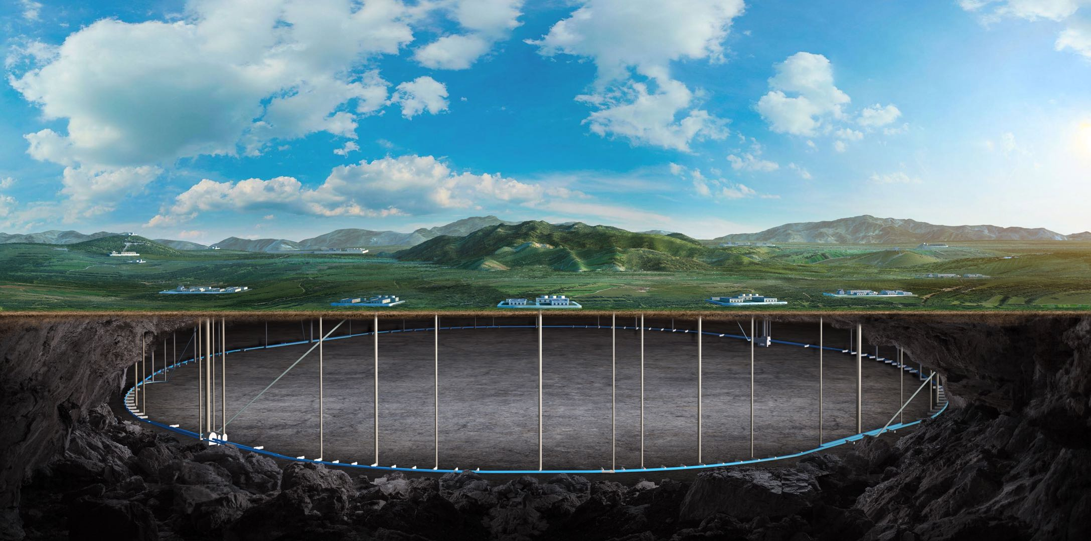
CEPC Detector Mechanical integration
Ji Quan
Oct. 22th, 2024, CEPC Detector Ref-TDR Review

Slide 2
Content
Introduction
Requirements
Technical challenges
Overall installation plan
Detail installation design
Research team
Summary and working plan

Slide 3
Introduction
CEPC Detector Mechanical integration : (Ref-TDR)
1. Detectors overall mechanical layout drawing
Based on the design requirements of the sub-detectors and its electronics
2. Connection structure design between the sub-detectors
and installation design for each sub-detector
Provide design direction for the interface design of each sub detector
3. Configuration design of the underground experimental room
Vertical shaft hoist and lifting equipment , etc.
4. Others (Underground ancillary room , Ground room)

Slide 4
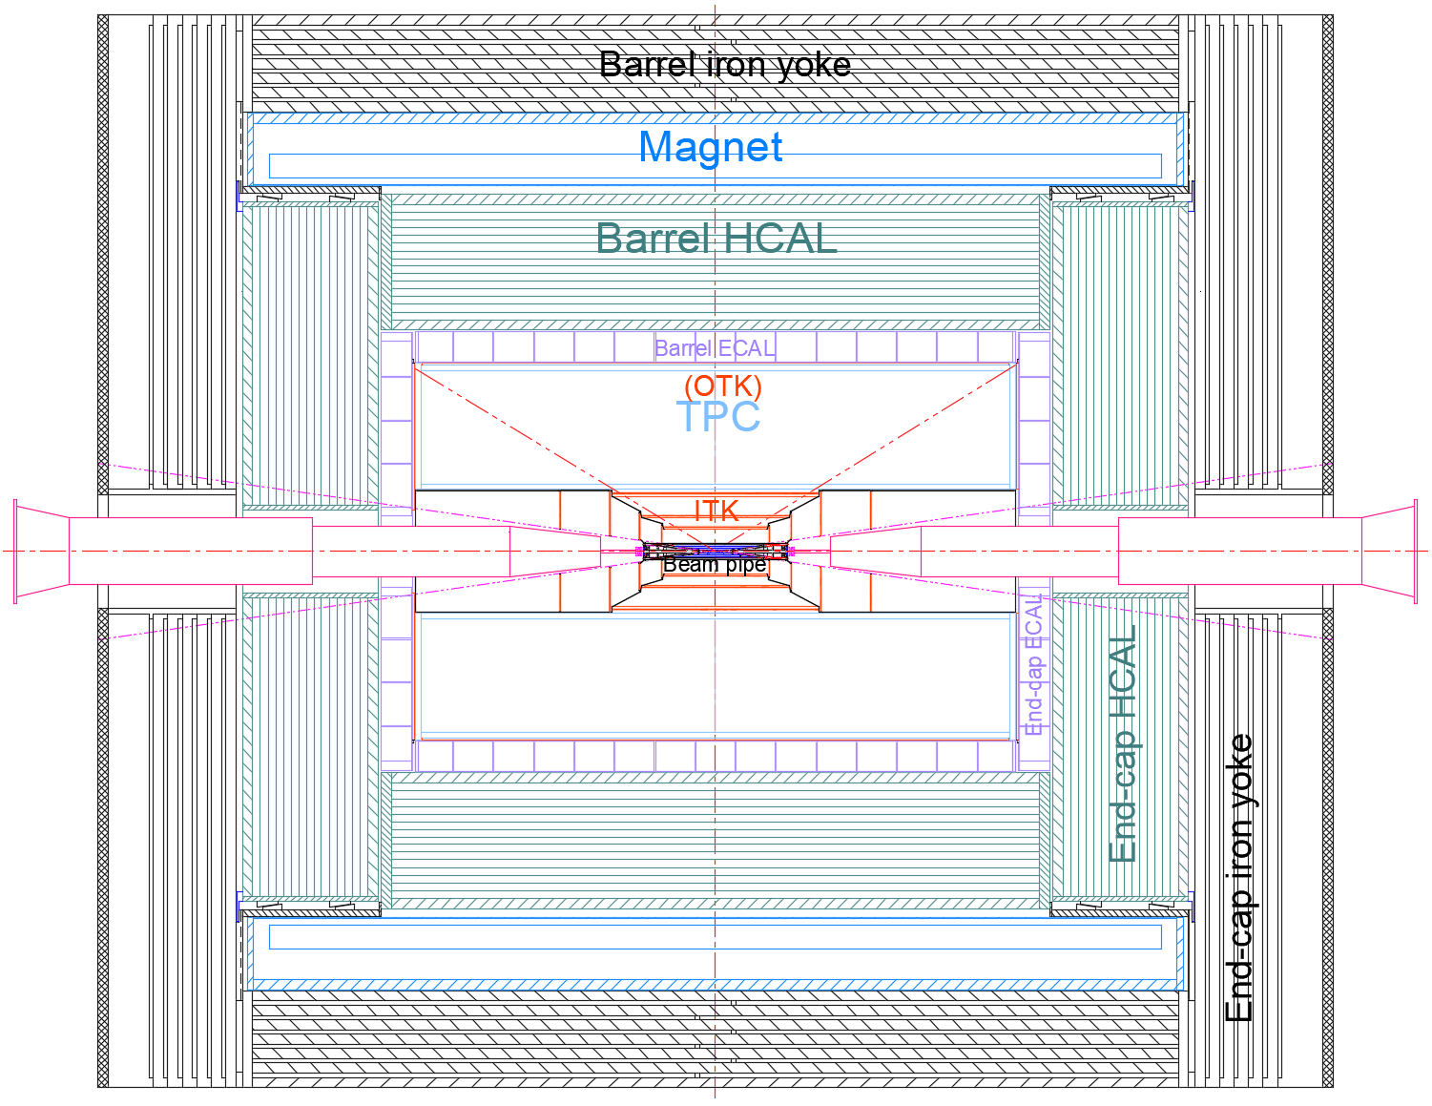
Introduction
1. Detectors overall mechanical layout drawing :
From outside to inside
Barrel(7)
End(3)
MDI(1)
Yoke
(Muon)
Magnet
HCAL
ECAL
TPC
(OTK)
ITK
Beampipe
(VTX LumiCal)
Yoke
(Muon)
HCAL
ECAL
(OTK)
ACC component

Slide 5
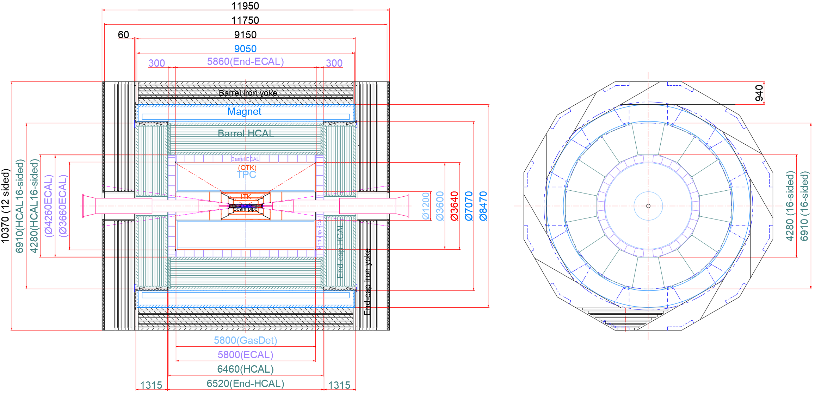
Introduction
2. Initial size distribution :
Dimension :
length : 11950 mm
Height : 10370 mm
Further optimization and improvement are needed

Slide 6
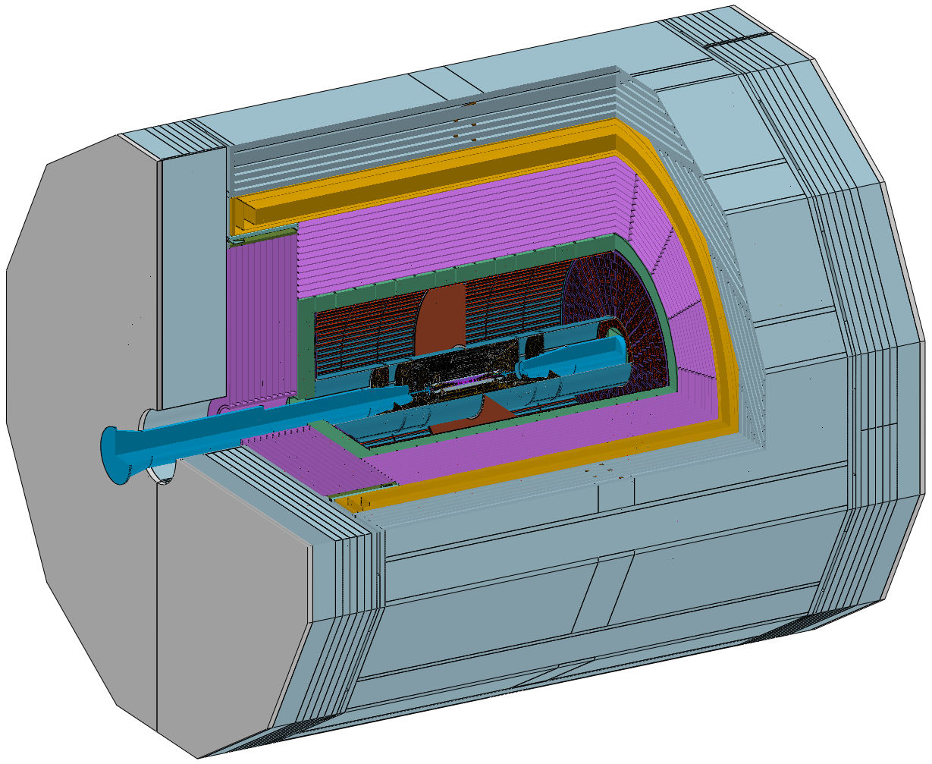
Introduction
Total weight :
≈ 5150 t
Yoke : ≈ 2960 t
(Barrel: 1560 t End: 700 X 2 t)
Magnet : ≈ 290 t
HCAL : ≈ 1660 t
(Barrel: 960 t End: 350 X 2 t)
……

Slide 7
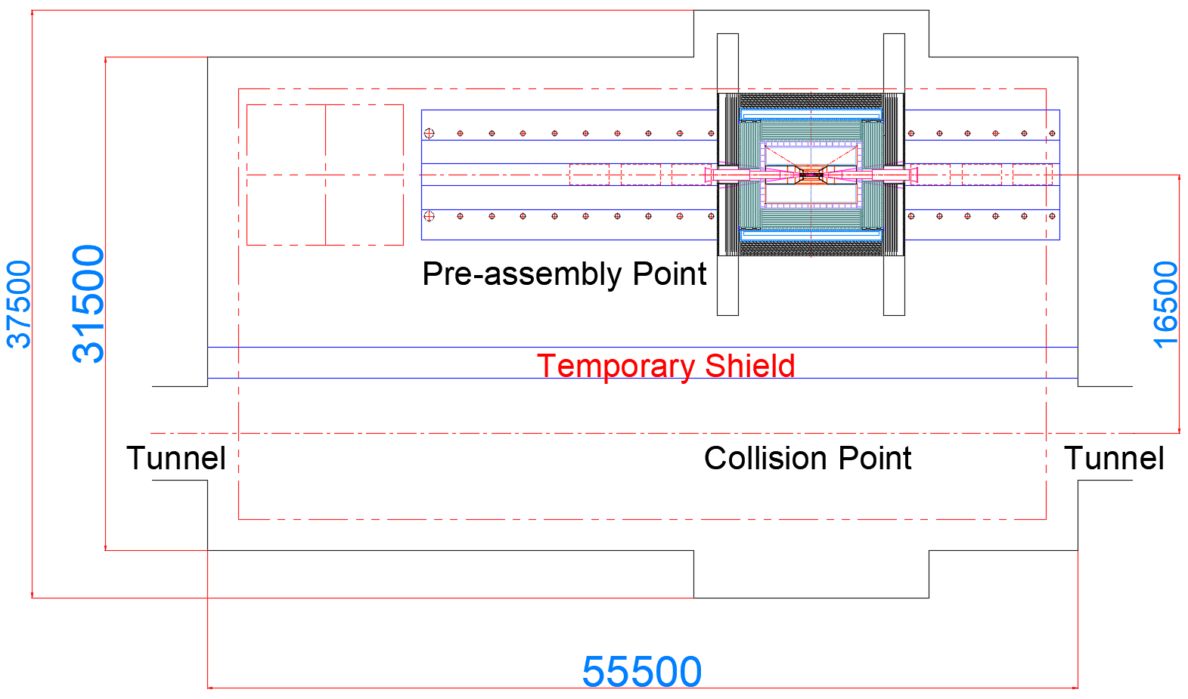
Introduction
3. Layout of installation scheme for “Pre-assembly point“ :
Main width : 31500 mm
Length : 55500 mm
This is a very compact design
Installation location :
Pre-assembly point

Slide 8
Requirements
1. Installation Clearance and accuracy : (See the following table)
Profile Tolerance(mm) |  | installation accuracy(mm) |  | positioning accuracy Coaxiality(mm)
 |  | Collimation accuracy (mm) | GAP (mm)
Yoke | ± 1 | < 1 |  | ±0.5
Magnet | Outer: 0 to -5, inner: 0 to +5 | < 2 | 10 | ± 1
HCAL | Outer: 0 to -5, inner: 0 t0 +5 | ± 2 | 10 | ± 0.5
ECAL | Outer: 0 to -5, Inner: 0 t0 +5 | ± 2 | 10 | ± 0.5
TPC | Outer: 0 to -2, Inner: 0 t0 +2 | ± 1 | 5 | ± 0.1
ITK | Outer: 0 to -2, Inner: 0 t0 +2 | ± 1 | 5 | ± 0.1
Beampipe | Outer: 0 to -0.3, Inner: 0 t0 +0.3 | ± 0.5 | 2 | ± 0.1
Minimum gap principle :
As small as possible
Note :
1. The deformation during the installation process of the sub detector must meet the gap requirements
2. The data in the table will continue to be optimized as the design progresses

Slide 9
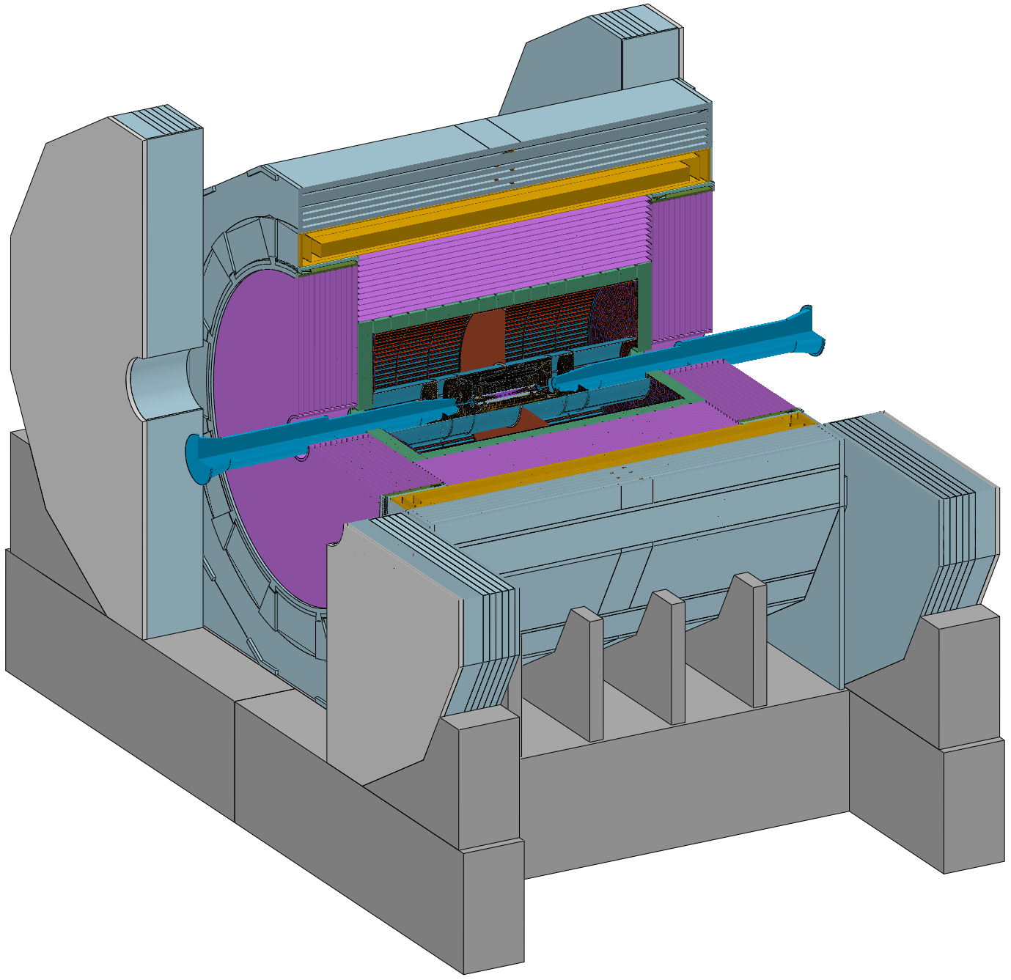
Requirements
Connection design :
1. The connection structure should follow
the principle of proximity connection
2. The connection structure should be adjustable (Remote automatic)
Barrel Yoke : Fixed on the Base
Magnet : Fixed on the Barrel Yoke
Barrel HCAL : Fixed on the Barrel Yoke
Barrel ECAL : Fixed on the Barrel HCAL
TPC+OTK : Fixed on the Barrel ECAL
ITK : Fixed on the TPC
Beampipe(Vertex and LumiCal) : Fixed on the ITK
End-cap ECAL+OTK : Fixed on the Barrel HCAL
End-cap HCAL : Fixed on the Barrel HCAL
(Auxiliary cylinder or Flange)
End Yoke : Fixed on the Base
Base

Slide 10
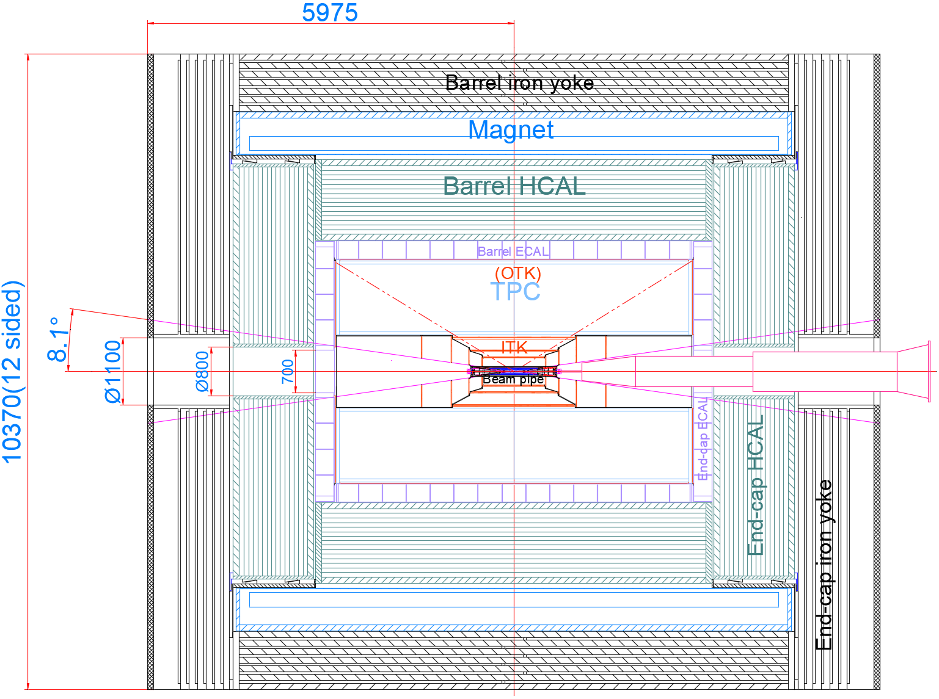
Requirements
MDI boundary
Consists of 4 sections :
Detection angle : 8.1 ° (arccos0.99)
(Before ECAL)
(After ECAL)
ECAL : 700 X 700 mm
HCAL : Ø800 mm
Yoke : Ø1100 mm
Conical hole and stepped holes are
reserved spaces for accelerators

Slide 11
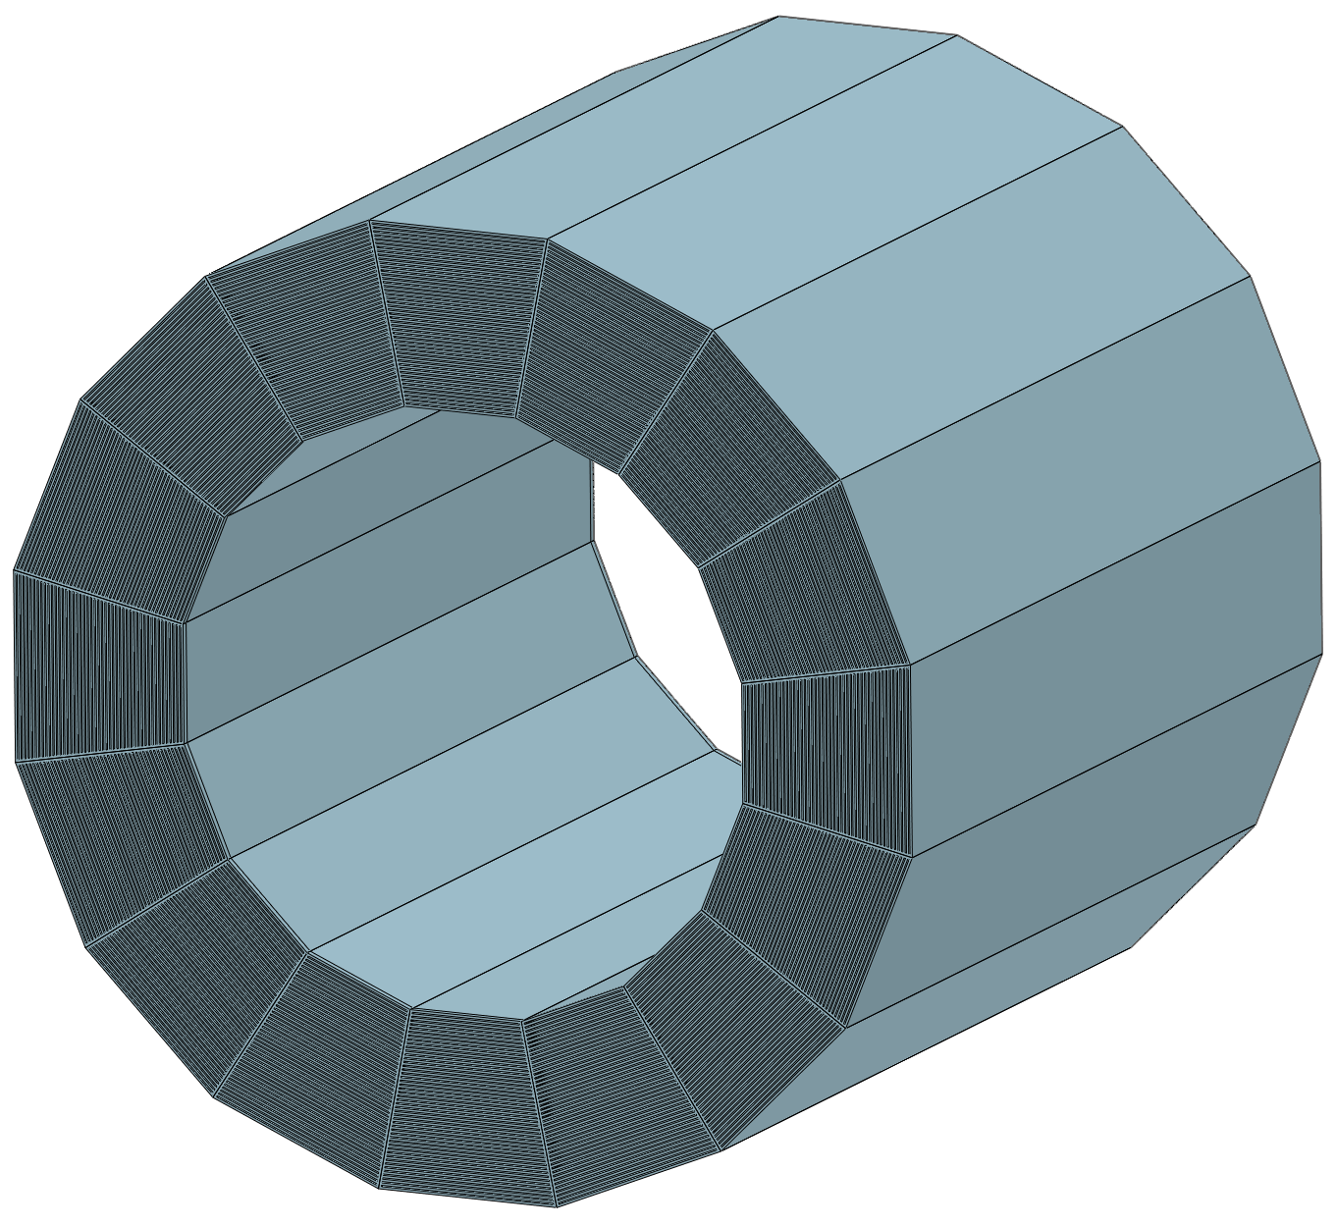
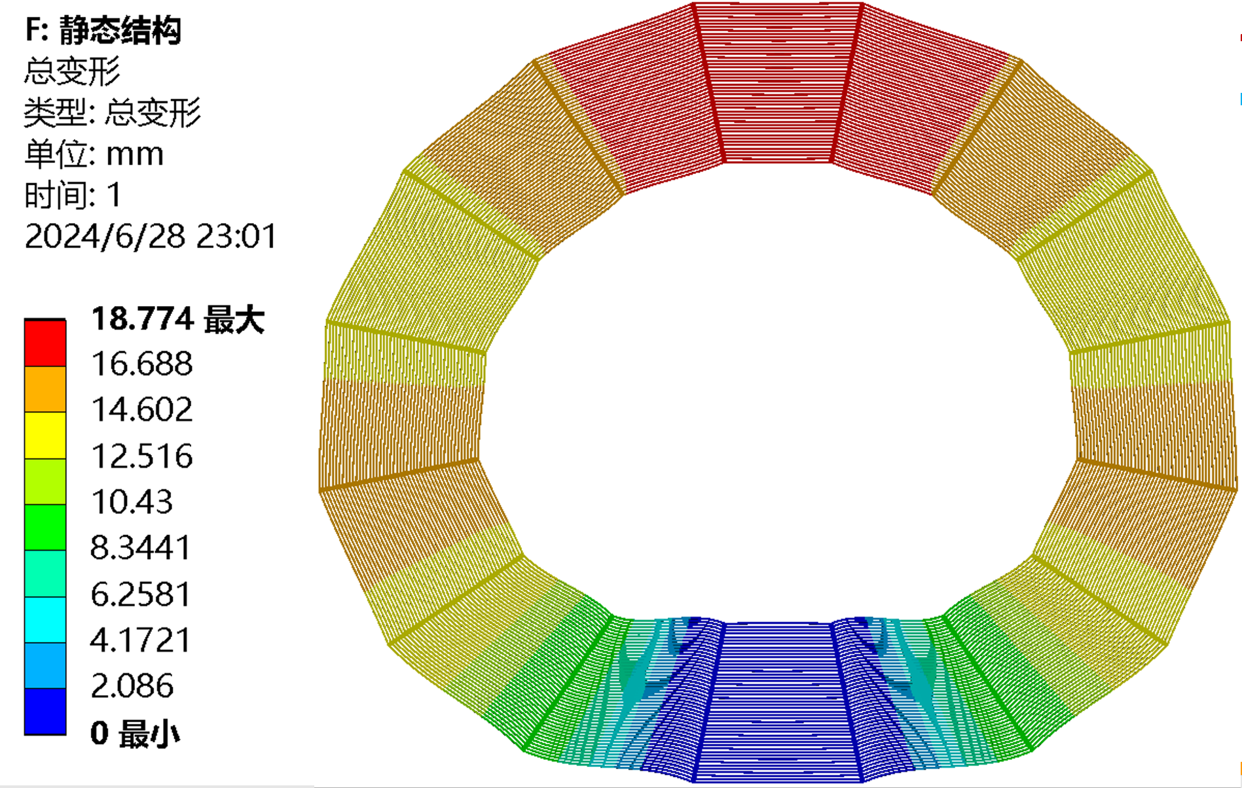
Technical challenges
In the current mechanical design process, we encounter many technical challenges:
1. The contradiction between self weight deformation and installation clearance
Key :
Deformation must be controlled
through mechanical optimization
design
How to
Control Deformation?
Requirements :
GAP between HCAL and Magnet : 10 mm
GAP between HCAL and ECAL : 10 mm
Self weight deformation :
18.8 mm (> 10mm)

Slide 12
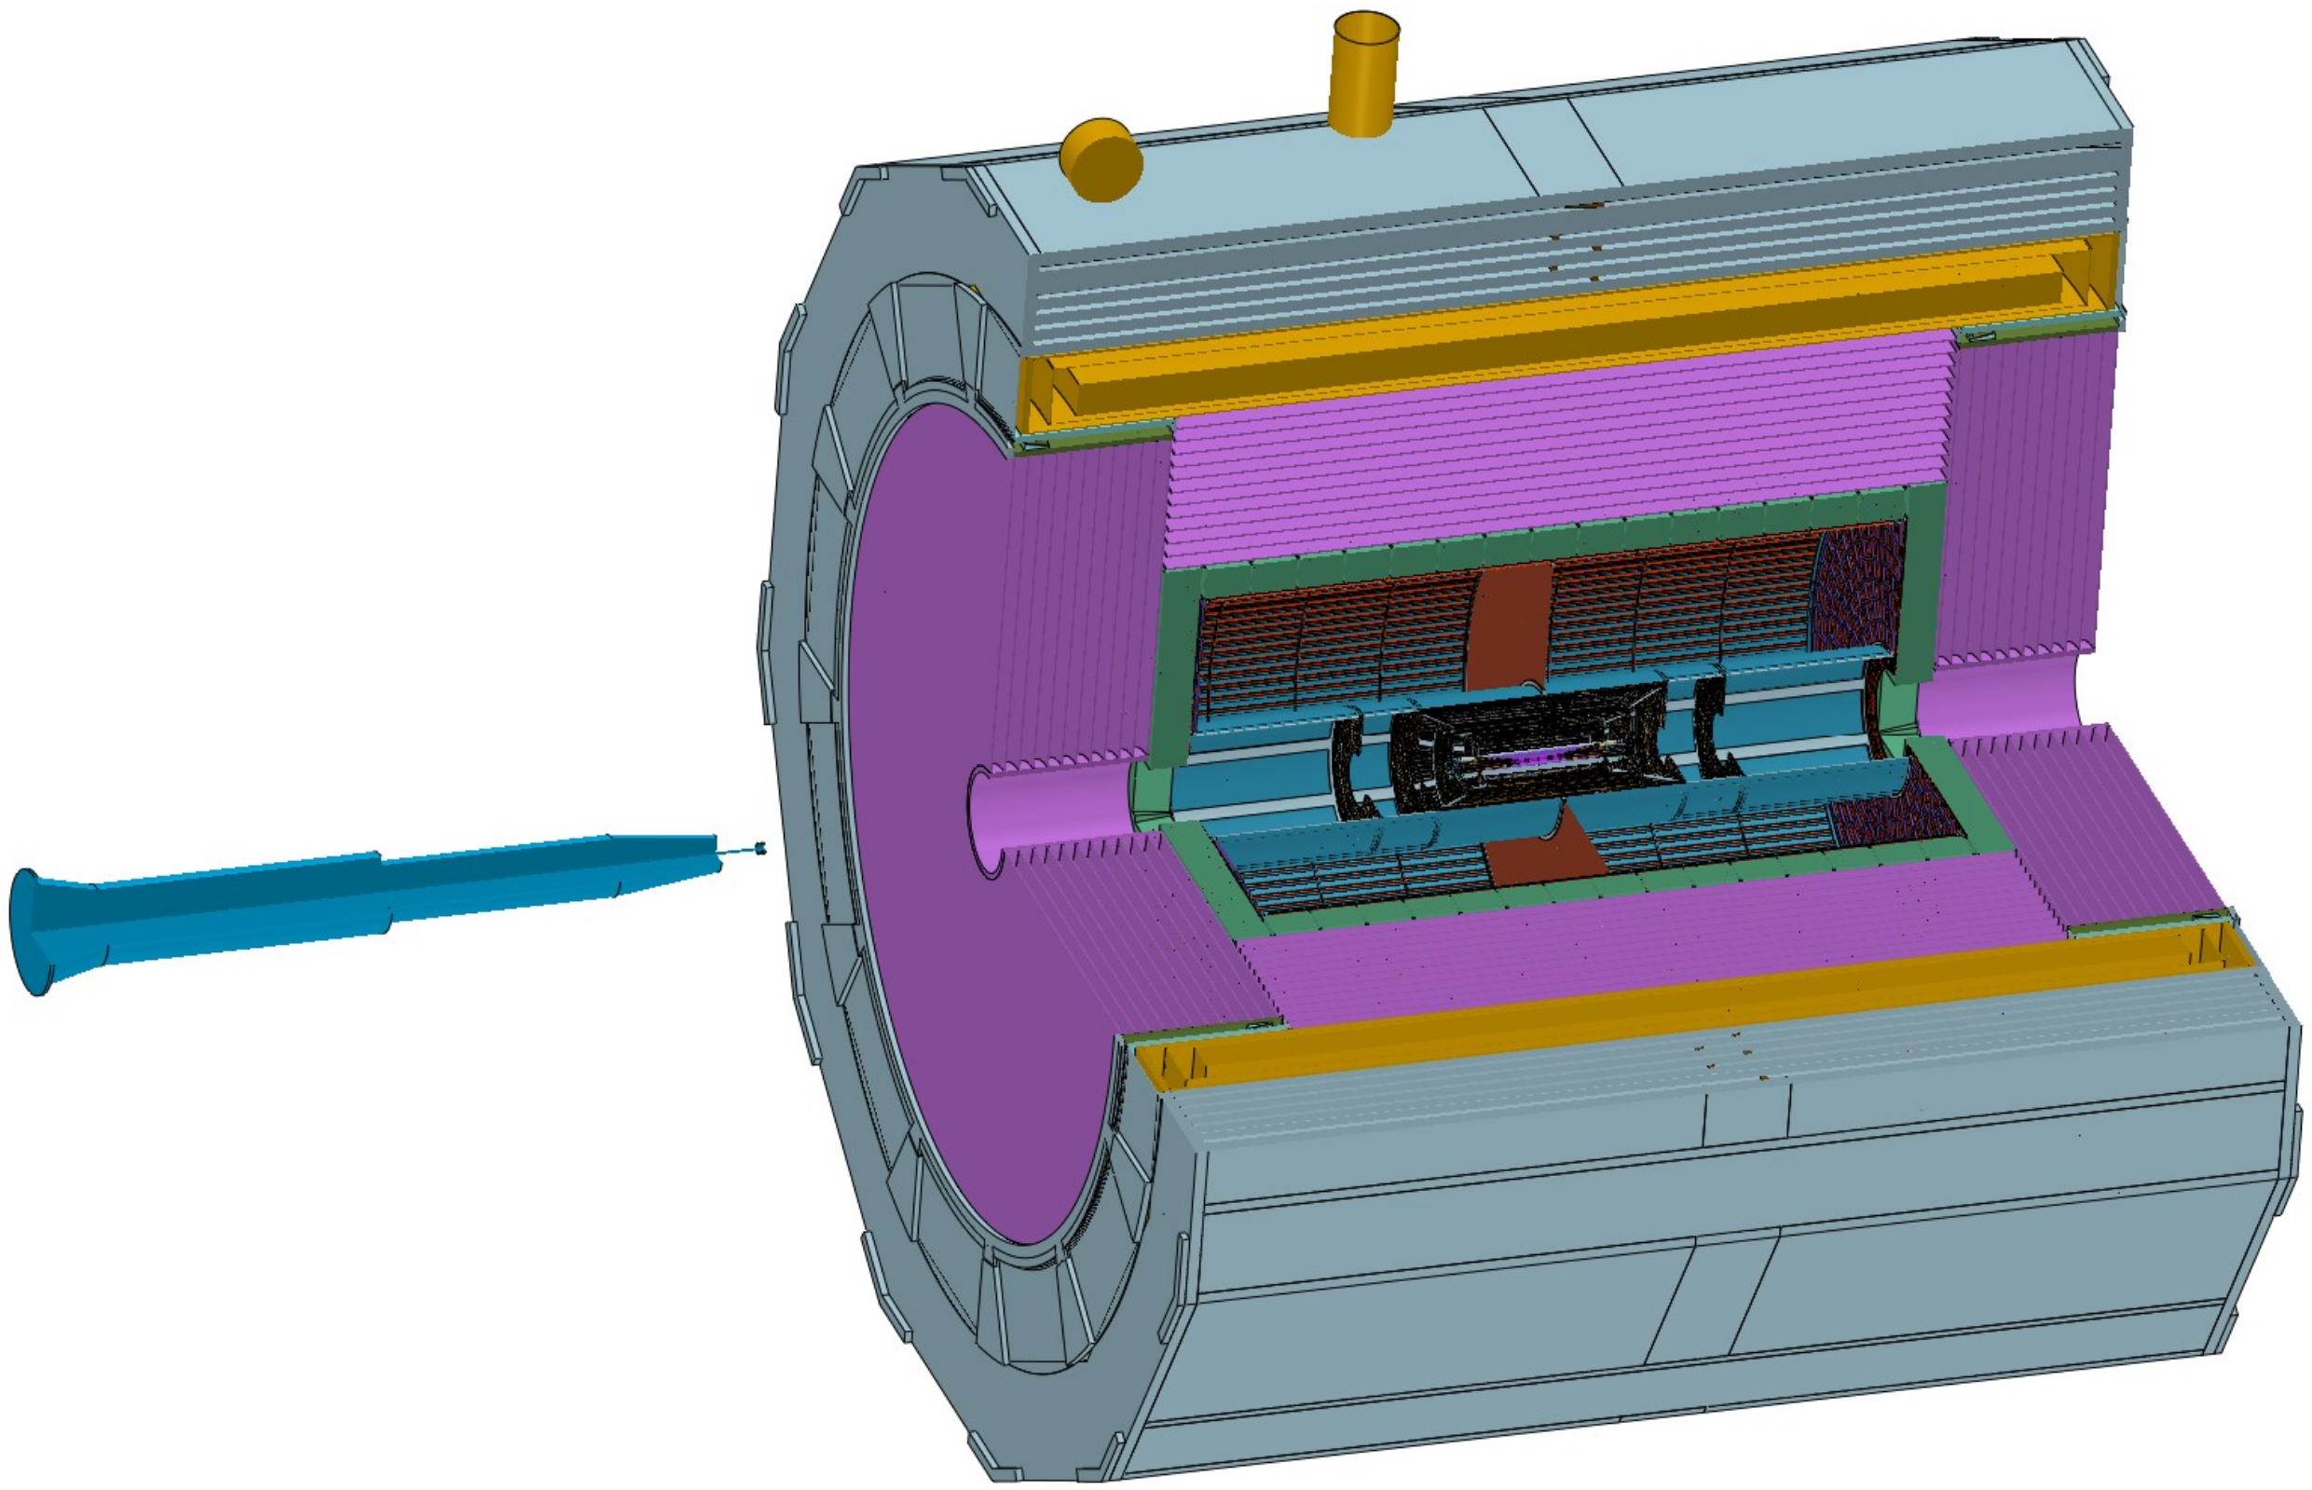
Technical challenges
In the current mechanical design process, we encounter many technical challenges:
2. Vacuum sealed Connection between the Acc MDI component and the Be beampipe
This is a connection design that
cannot be operated
using conventional methods
Acc MDI component
Technical difficulties :
leak rate : 2.66 X 10 ⁻¹¹ Pa *m³ /s
Beampipe
Need to improve and develop current technology
Pillow seal maybe used for remote vacuum automatic connection

Slide 13
Overall installation plan
Follow three principles ：
1. Installation location :
Pre-assembly point
Advantage : Beam-tuning experiments and detectors installation can be carried out
2. Installation design :
● Installation and disassembly processes are reversible
● Retention of installation benchmarks (Mounting rail)
Purpose: To facilitate the maintenance and replacement of the detectors

Slide 14
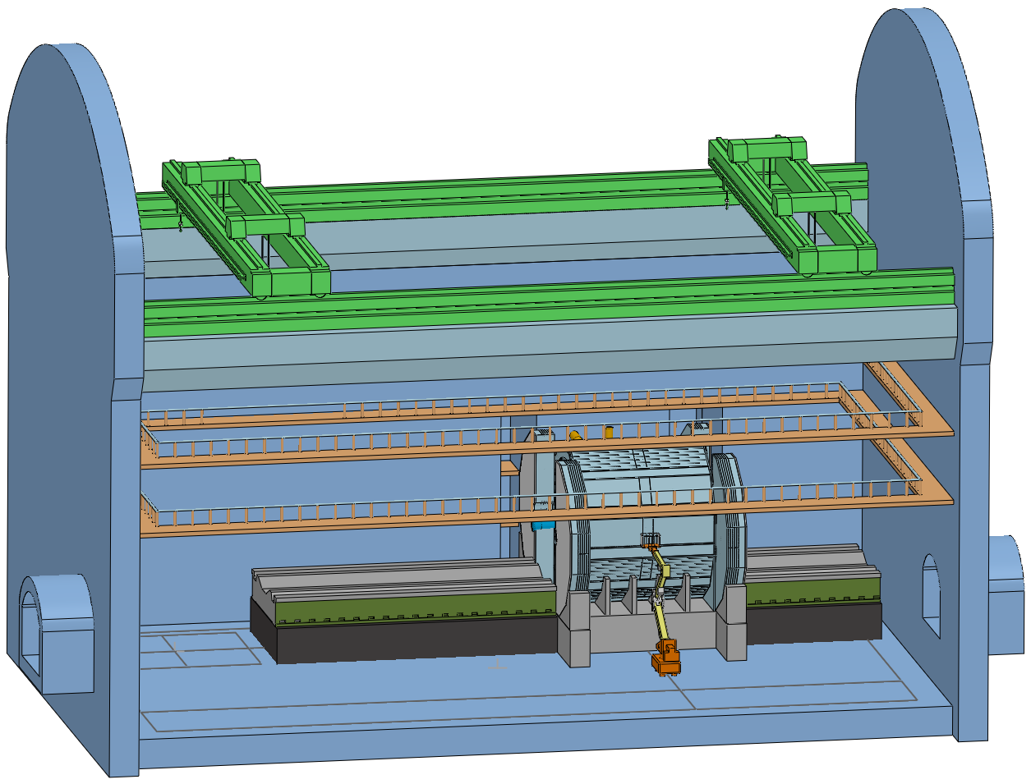
Overall installation plan
3. Modern installation :
Installation operation design must be suitable for completion through a robotic arm
Overhead travelling crane
Design requirement :
1. The auxiliary tools is as fewer as possible
2. Operation is as sample as possible
If Possible
Future detector installations will be easily installed through
a combination of robotic arms and two overhead cranes
Collision point
robotic arm

Slide 15
Detail installation design
Detail installation design:
1. Reliability and safety assessment of integral detectors and their connecting structures
(FEA --- stress and deformation)
2. Overall installation steps
3. Installation process of the detectors
4. Modular lifting and integral lifting of components

Slide 16
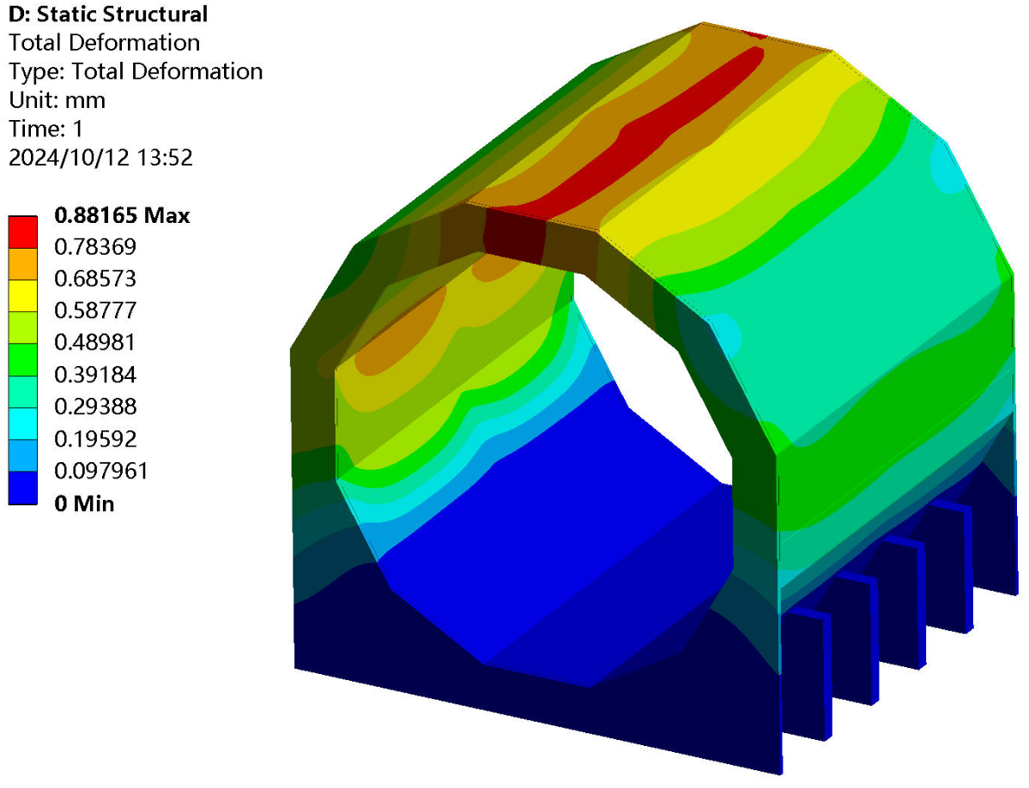
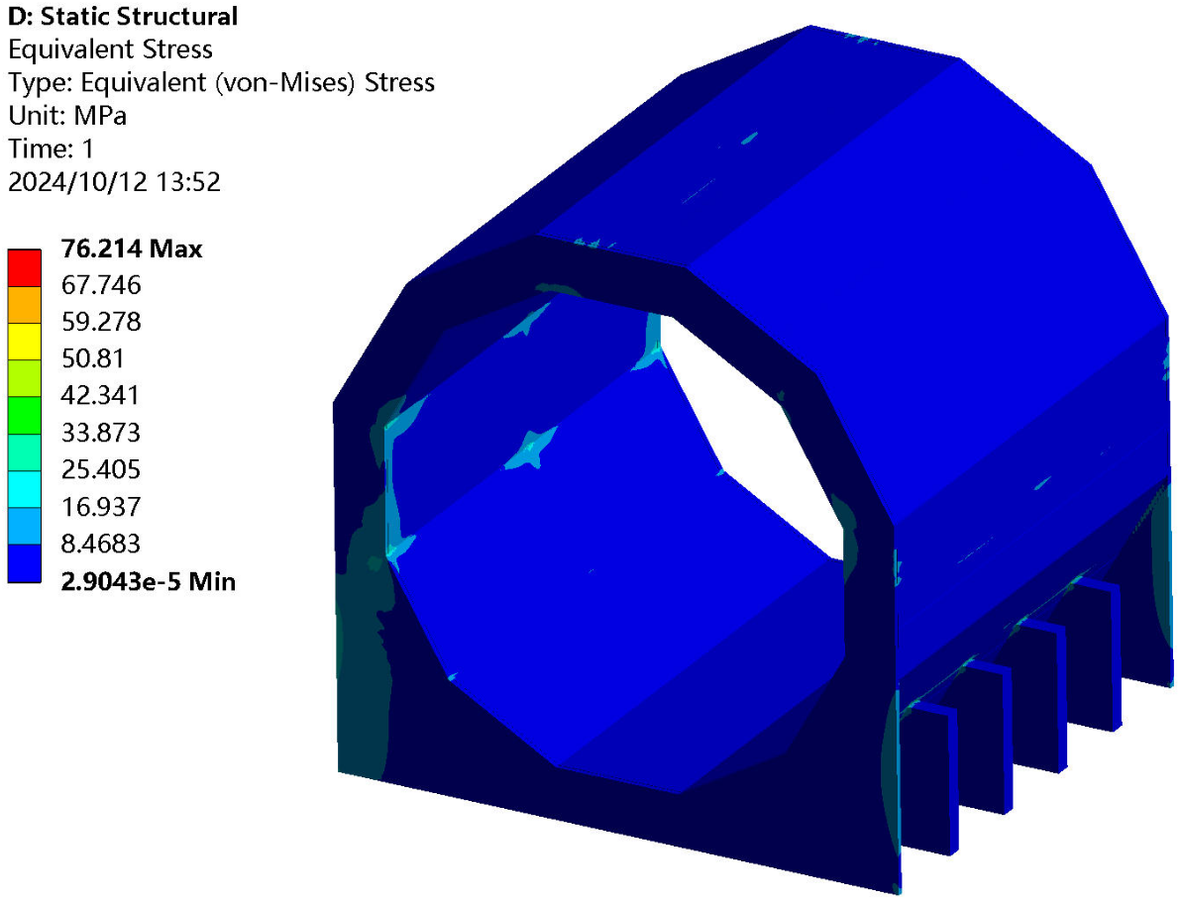
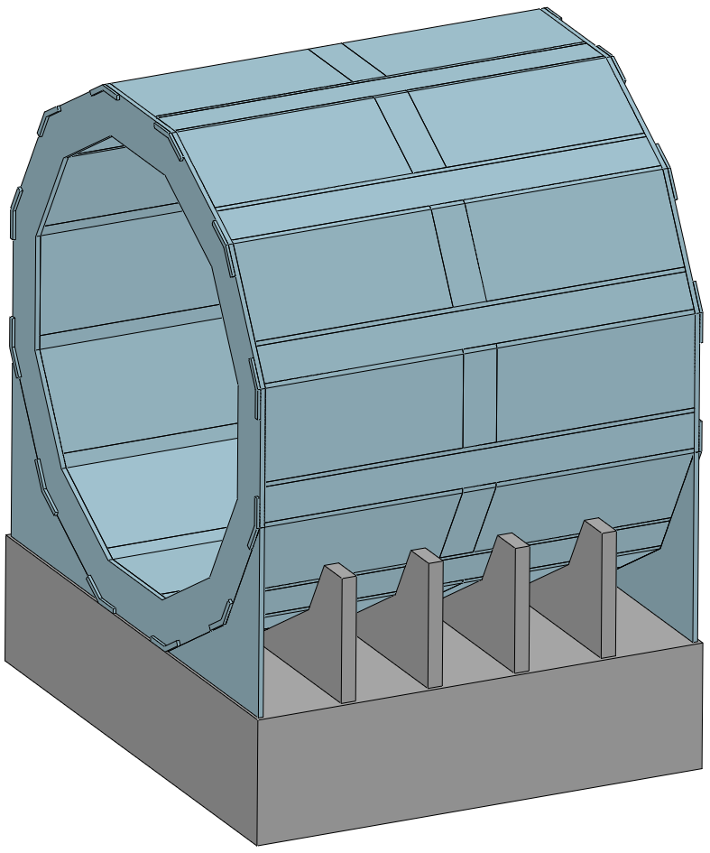
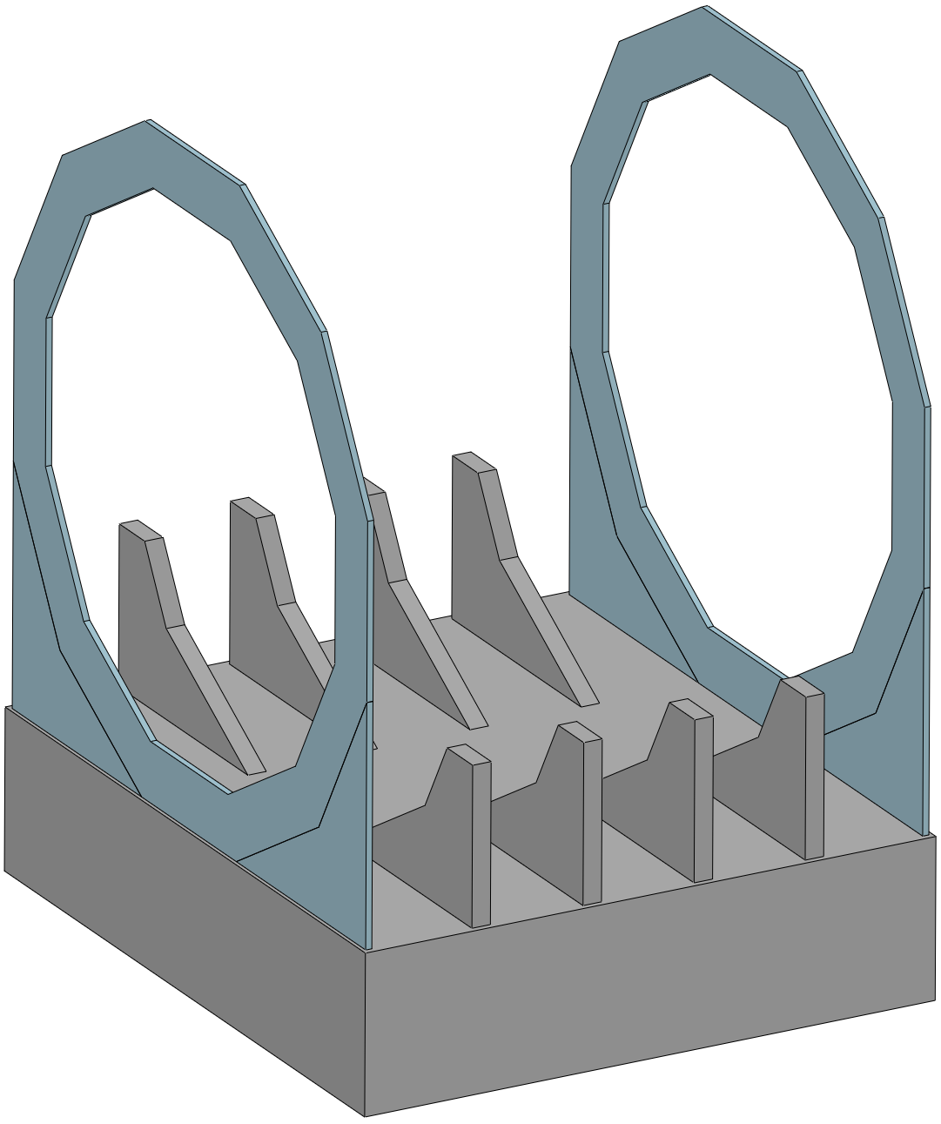
Detail installation design
1. Overall reliability and safety assessment
Yoke : 1560 t
Assembly deformation of yoke
without detector
Deformation : ≈ 0.9 mm
Stress : ≈ 76 MPa
Conclusion :
Meet requirement
(< 1 mm)
two end flange
and
barrel supports
can reduce the deformation
End Support
Barrel supports
Drawing of the End and Barrel support

Slide 17
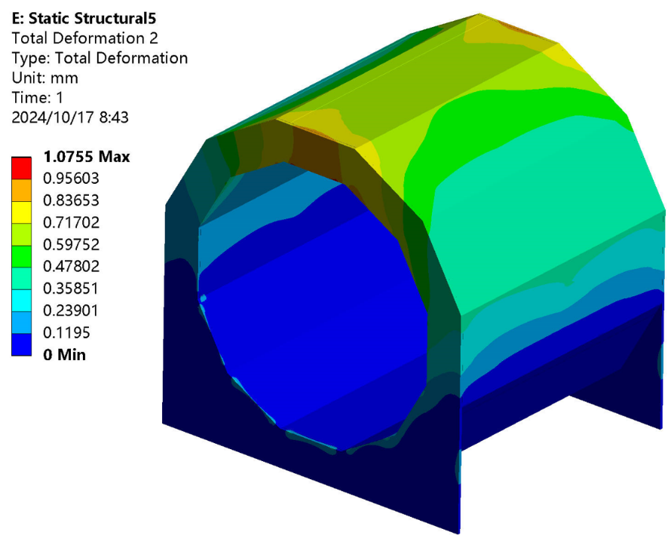
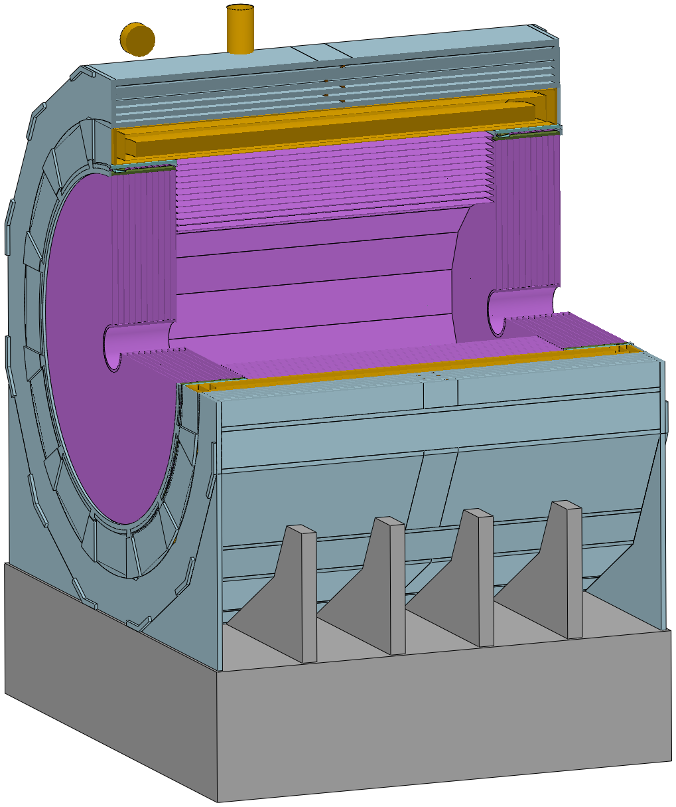
Detail installation design
1. Overall reliability and safety assessment
Focus on the deformation of the Yoke
Deformation of the yoke
in the presence of a sub-detectors
Yoke : 1560 t
Magnet : ≈ 290 t
HCAL : ≈ 1660 t
(Barrel: 960 t End: 350 X 2 t)
1950 t
Load
Other lighter components
are ignored
Deformation within reasonable limits
Deformation : 1.07 mm
It’s safety
Deformation : ≈ 0.9 mm

Slide 18
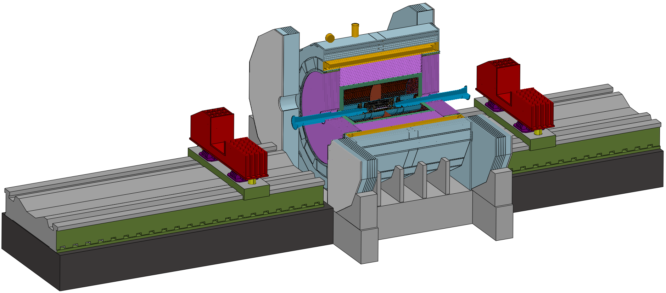
Detail installation design
2. Overall installation steps
General installation drawing
Barrel Yoke
Note :
Mounting rail is the installation reference,
and must be pre-collimation with yoke
Mounting rail
The steps are as follows :
1. In the ground room
Complete the assembly work of each sub-detector, including electronics, etc.
2. In the shaft
Each sub-detector is lifted into the underground experimental room through vertical shaft in sequence
3. In the underground experimental room ---
Assemble each sub detector on the mounting rail and push them into the yoke in sequence
most important part of the installation

Slide 19
Detail installation design
2. Overall installation steps
Installation sequence of detectors(As shown in the exploded view) :
Step 1 Install the barrel sub-detector first, in the following order :
Yoke, Magnet, HCAL, ECAL, TPC(OTK), ITK, Beampipe(Vertex)
Step 2 Install the end sub-detectors, in the following order :
End ECAL(OTK), End HCAL, End Yoke
ACC Component
Beampipe
(Vertex)
End HCAL
End ECAL(OTK)
ITK
TPC(OTK)
ECAL
HCAL
Magnet
Yoke

Slide 20
Detail installation design
3. Installation process of detectors --- Different detectors use different installation methods
Step 1 Alternating installation : Yoke and Magnet (2) --- Barrel Detectors
Step 2 Core shaft installation : Barrel HCAL and Barrel ECAL (2) --- Barrel Detectors
Step 3 Cantilever installation : TPC(OTK) ITK Beampipe(Vertex + LumiCal) (3) --- Barrel Detectors
End HCAL and End ECAL --- End Detectors
Step 4 Installation : Yoke --- End Detectors
Step 5 Move the detectors from the Pre-assembly point to Collision point
Push the accelerator vacuum component into the center of the detector and connect it with the beam tube vacuum

Slide 21
Detail installation design
3. Installation process of detectors --- Different detectors use different installation methods
Step 1 Alternating installation : Yoke and Magnet (2)
Install Yoke and Magnet
Method :
Design of mutually supportive ‘zero-tool’ assemblies
Advantage :
No redundant tooling, which reduces installation time
Preparation : All components are lifted from the shaft
Step 1 : Place the both end Yoke flanges on the Base
Step 2 : Install the lower half module first
Step 3 : install the Magnet
Step 4 : Install the Upper half module
This is an efficient installation design
(‘zero-tool’ achieves the installation of two detectors)

Slide 22
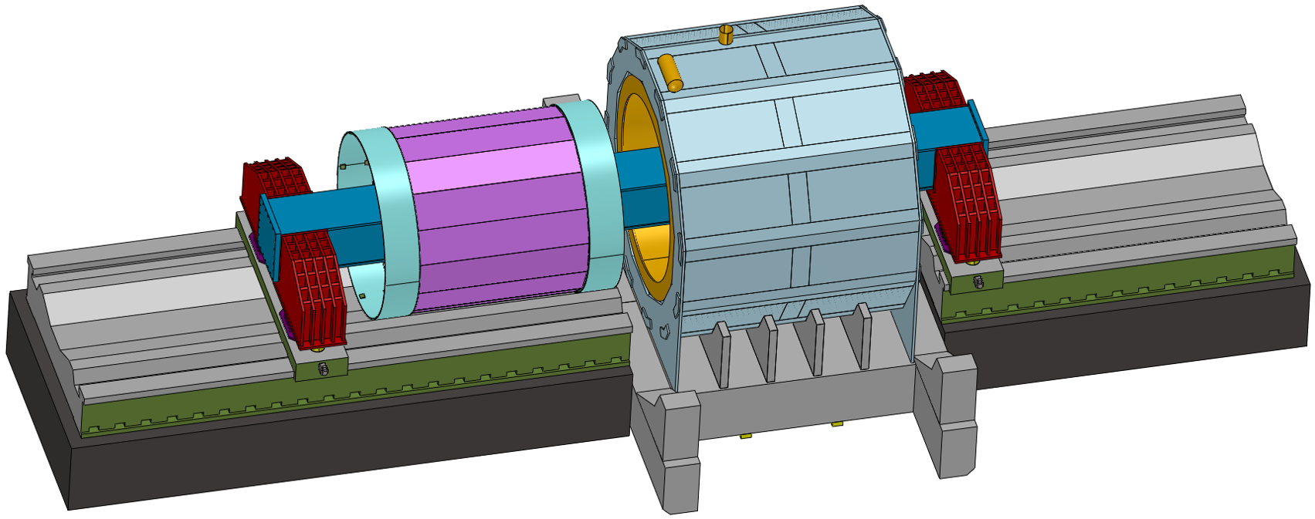
Detail installation design
3. Installation process of detectors --- Different detectors use different installation methods
Step 2 Core shaft method installation : HCAL and Barrel ECAL (2) --- Barrel
Clearance requirement : 10 mm
Core shaft method installation of HCAL
Installation Method Instructions :
1. Place HCAL on the core shaft
2. Moving the HCAL using external guide rails

Slide 23
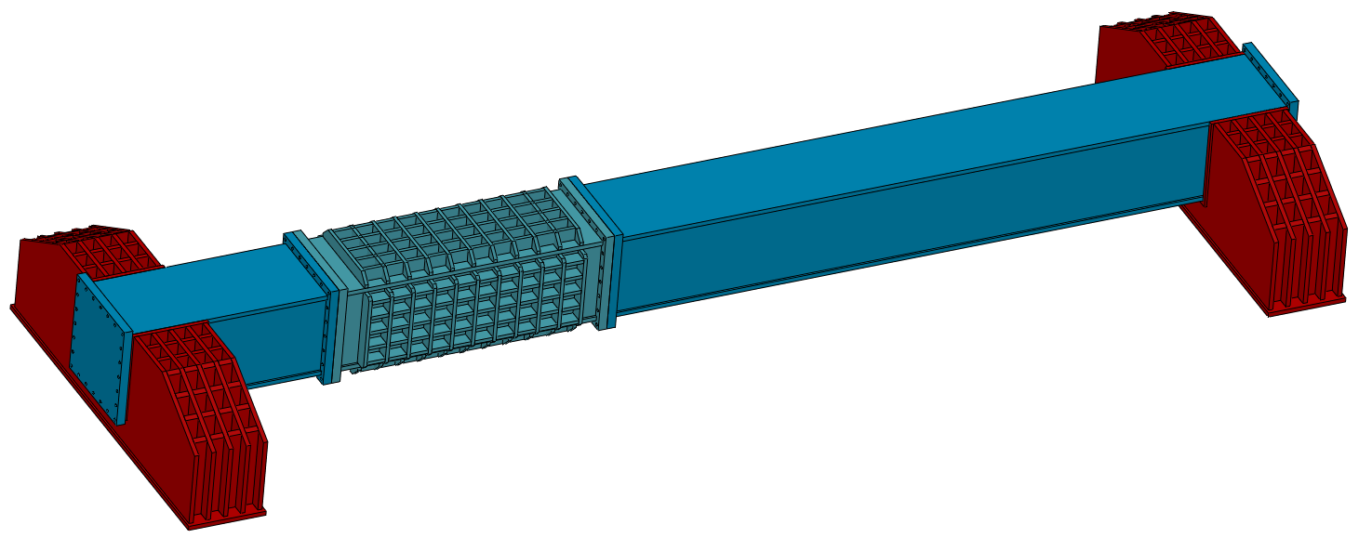
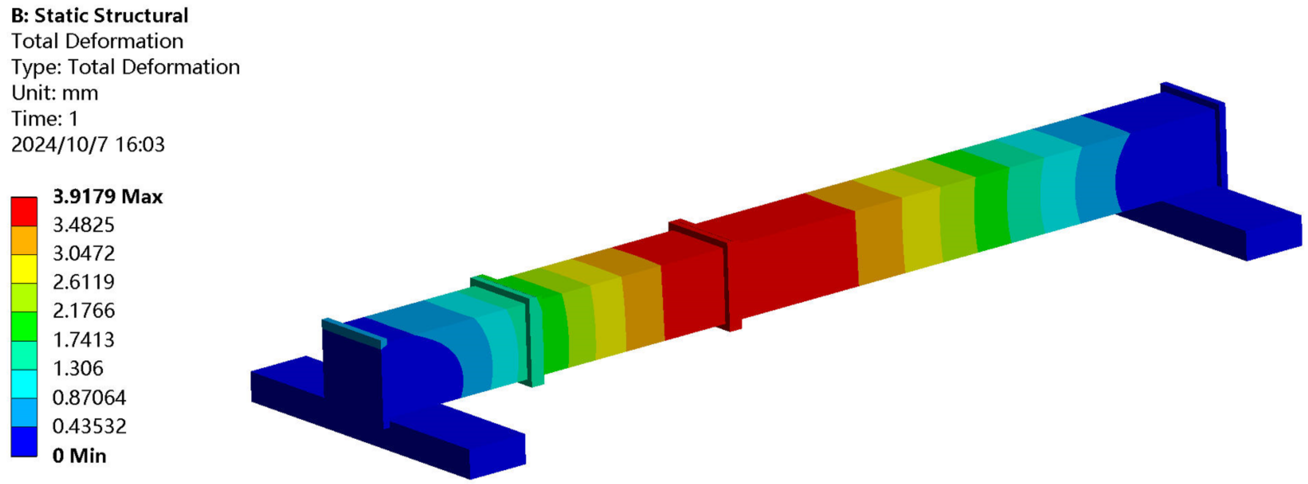
Detail installation design
3. Installation process of detectors --- Different detectors use different installation methods
Constraints :
Fixed at both ends
Step 2 Core shaft method installation : HCAL and Barrel ECAL (2) --- Barrel
Load :
1. Self-weight
2. 1000 tons HCAL
(ECAL 150 tons)
Design of Combination core shaft
Adjustable base
Short core shaft
Long core shaft
Result :
Max Deformation : ≈ 3.9 mm
< 10 mm (Gap)
Middle core shaft
Hight : 2000 mm
Width : 2000 mm
Length : 27300 mm
Conclusion :
Meet installation requirement
For HCAL and ECAL

Slide 24
Detail installation design
3. Installation process of detectors --- Different detectors use different installation methods
Step 2 Core shaft method installation : HCAL and Barrel ECAL (2) --- Barrel
Install Barrel HCAL
Preparation : Assembly axis of HCAL is 10mm lower
than the magnet axis
Step 1 : Place the both end HCAL(Barrel) rings on the guide rail
Step 2 : Install the lower half module first
Step 3 : Place the long core shaft on the guide rail
Step 4 : Place the counterweight short core shaft onto the guide rail
at the other end
Step 5 : Install the middle core shaft
Step 6 : Install the upper half module
Step 7 : Lift 10 mm
Step 8 : Move HCAL(Barrel) into the Magnet
Step 9 : Install connection rings at both end

Slide 25
Detail installation design
3. Installation process of detectors --- Different detectors use different installation methods
Step 2 Core shaft method installation : HCAL and Barrel ECAL (2) --- Barrel
Install Barrel ECAL
Step 1 : Place the long and short core shafts on the guide rail (Omitted)
Step 2 : Lifting ECAL from the shaft into the hall
(Middle core shaft and ECAL are assembled)
Step 3 : Connect the ECAL(middle core shaft) to the long and short shafts
Step 4 : Move ECAL(Barrel) into the HCAL(Barrel)

Slide 26
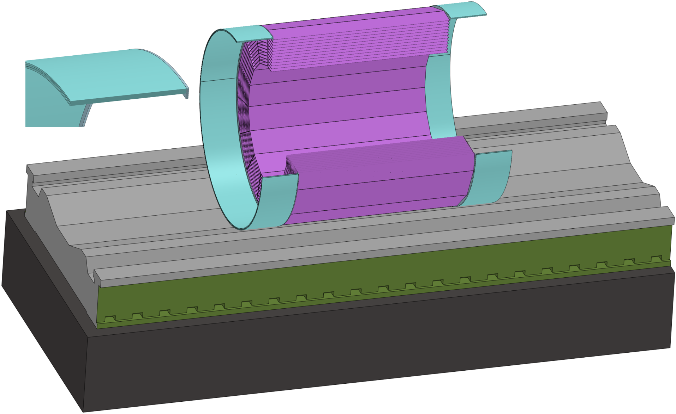
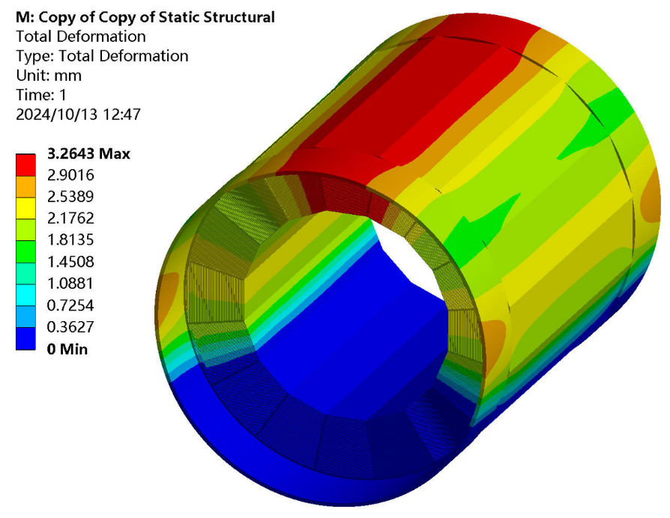
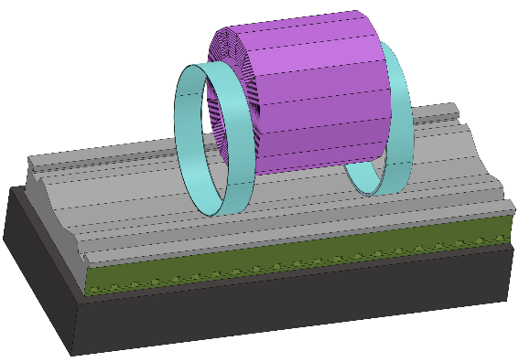
Overall installation design
3. Installation process of detectors --- Different detectors use different installation methods
Step 2 Core shaft method installation : HCAL and Barrel ECAL (2) --- Barrel
How to
Control Deformation?
Deformation : 3.3 mm
L-shaped
End Ring
If necessary, further optimization can be done to achieve smaller deformation

Slide 27
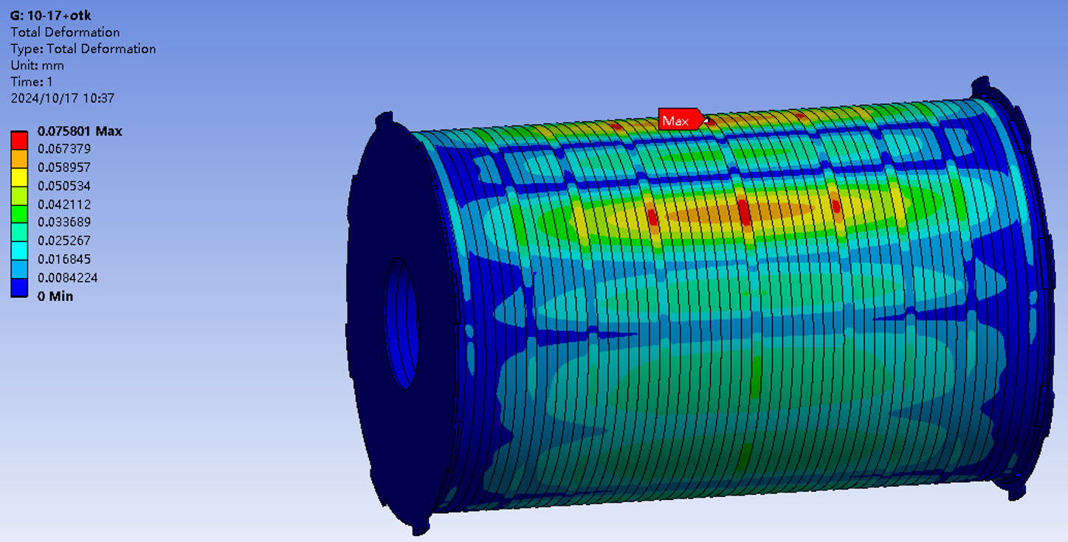
Detail installation design
3. Installation process of detectors --- Different detectors use different installation methods
Step 3 Cantilever method installation : TPC(OTK) ITK Beampipe(Vertex + LumiCal) (3) --- Barrel
Deformation : 0.08 mm
(< 5 mm Gap)
Calculation conditions
Install TPC(OTK)
Load : 250 kg (OTK)
Constraint : Fixe both end
Installation :
1. Cantilever installation
2. Supported at both ends on the cantilever shaft
Step 1 : Place the long core shafts on the guide rail (Omitted)
Step 2 : Lifting TPC from the shaft into the hall
(Middle core shaft and TPC are assembled)
Step 3 : Connect the TPC(middle core shaft) to the long shafts
Step 4 : Move TPC into the ECAL(Barrel)

Slide 28
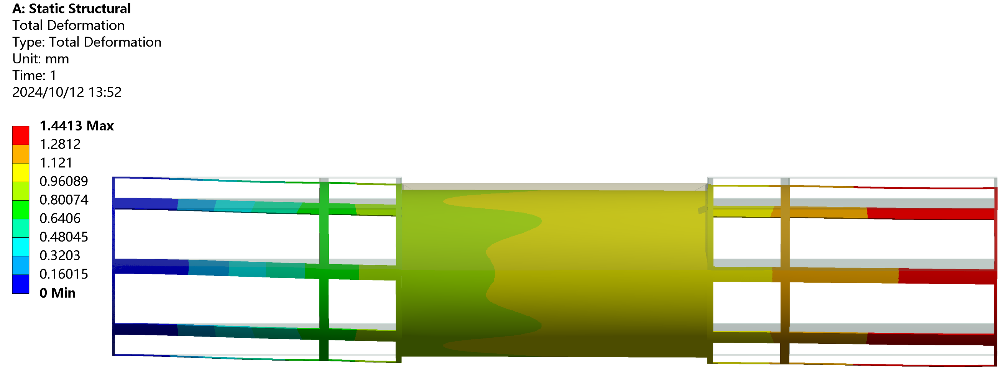
Detail installation design
3. Installation process of detectors --- Different detectors use different installation methods
Step 3 Cantilever method installation : TPC(OTK) ITK Beampipe(Vertex + LumiCal) (3) --- Barrel
Deformation : 1.4 mm
(< 5 mm Gap)
Calculation conditions
Install ITK
Load : Self weight
Constraint : Fix one end
Step 1 : Place the long core shafts on the guide rail (Omitted)
Step 2 : Lifting ITK from the shaft into the hall
(Middle core shaft and ITK are assembled)
Step 3 : Connect the ITK(middle core shaft) to the long shafts
Step 4 : Move ITK into the TPC

Slide 29
Detail installation design
3. Installation process of detectors --- Different detectors use different installation methods
Step 3 Cantilever method installation : TPC(OTK) ITK Beampipe(Vertex + LumiCal) (3) --- Barrel
Install Beampipe(Vertex + LumiCal)
Step 1 : Place the long core shafts on the guide rail (Omitted)
Step 2 : Connect the Beampipe installation axis to the long shafts
Step 3 : Lifting Beampipe from the shaft into the hall
(Installation flange and beampipe are assembled)
Step 4 : Move Beampipe into the ITK

Slide 30
Detail installation design
3. Installation process of detectors --- Different detectors use different installation methods
Step 4 Cantilever method installation : ECAL(OTK) HCAL Yoke --- End (3) --- End
Install END ECAL(OTK)
Step 1 : Place the long core shafts on the guide rail (Omitted)
Step 2 : Connect the ECAL(End) Flange to the long shafts
Step 3 : Lifting ECAL from the shaft into the hall
Step 4 : Move ECAL(End) into the HCAL(Barrel)

Slide 31
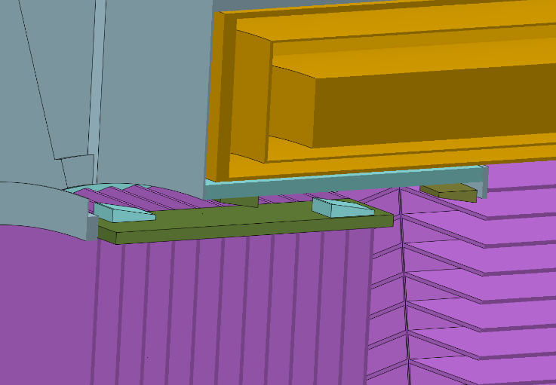
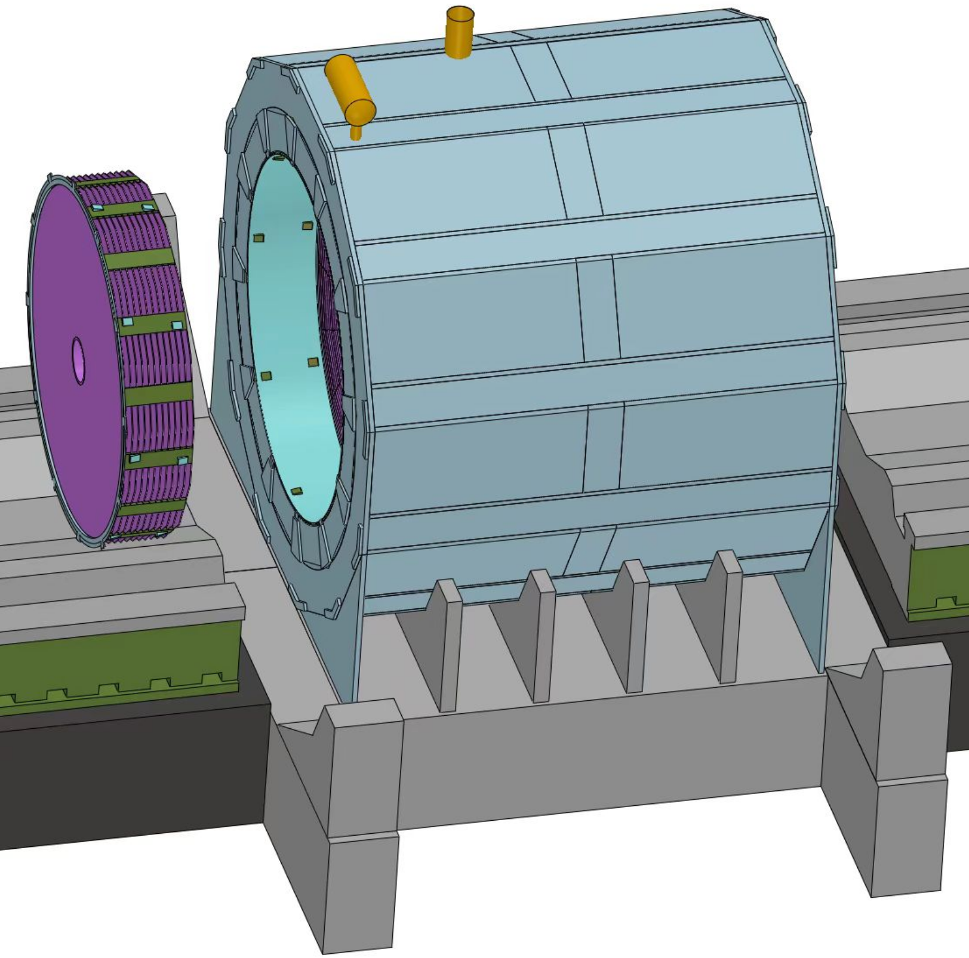
Detail installation design
3. Installation process of detectors --- Different detectors use different installation methods
Step 4 Cantilever method installation : ECAL(OTK) HCAL Yoke --- End (3) --- End
Install End HCAL and End Yoke
Step 1 ：Install the End HCAL
(The same as install ECAL)
Step 2 : Install the End Yoke

Slide 32
Detail installation design
3. Installation process of detectors --- Different detectors use different installation methods
Step 5 Move the Detectors from Pre-assembly point to Collision point
Push the accelerator vacuum component into the center of the detector and connect it with the beam tube vacuum
Step 1 : Move the detectors from the Pre-assembly point
to collision point
Move distance : 16500 mm
Hydraulic cylinder movement distance : ≈ 2.1 m
Hydraulic cylinder thrust : 50 t (> 30 t)
(6000*0.005=30 t hydrostatic guideway)
Step 2 : Install the ACC vacuum component
This is a basically viable installation design
Better installation routes may be found in future optimized designs

Slide 33
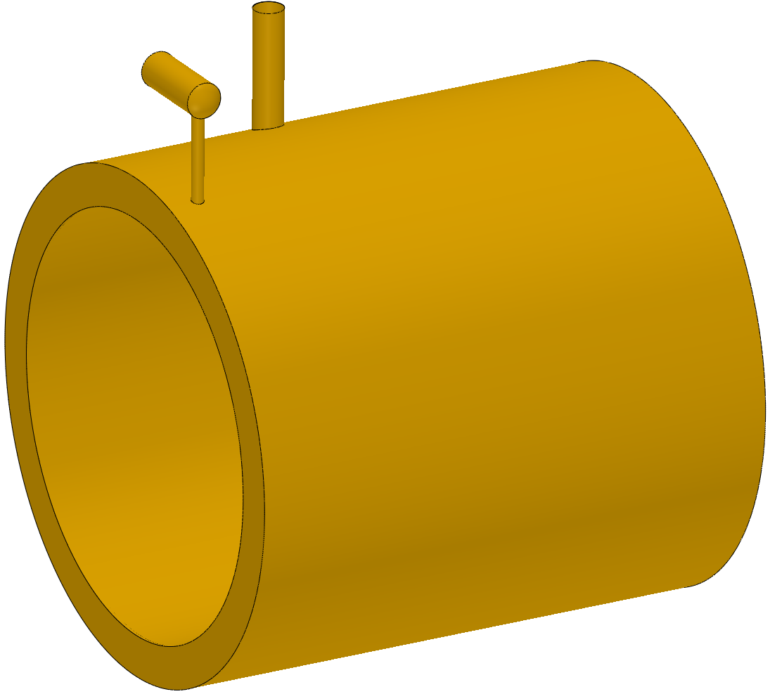
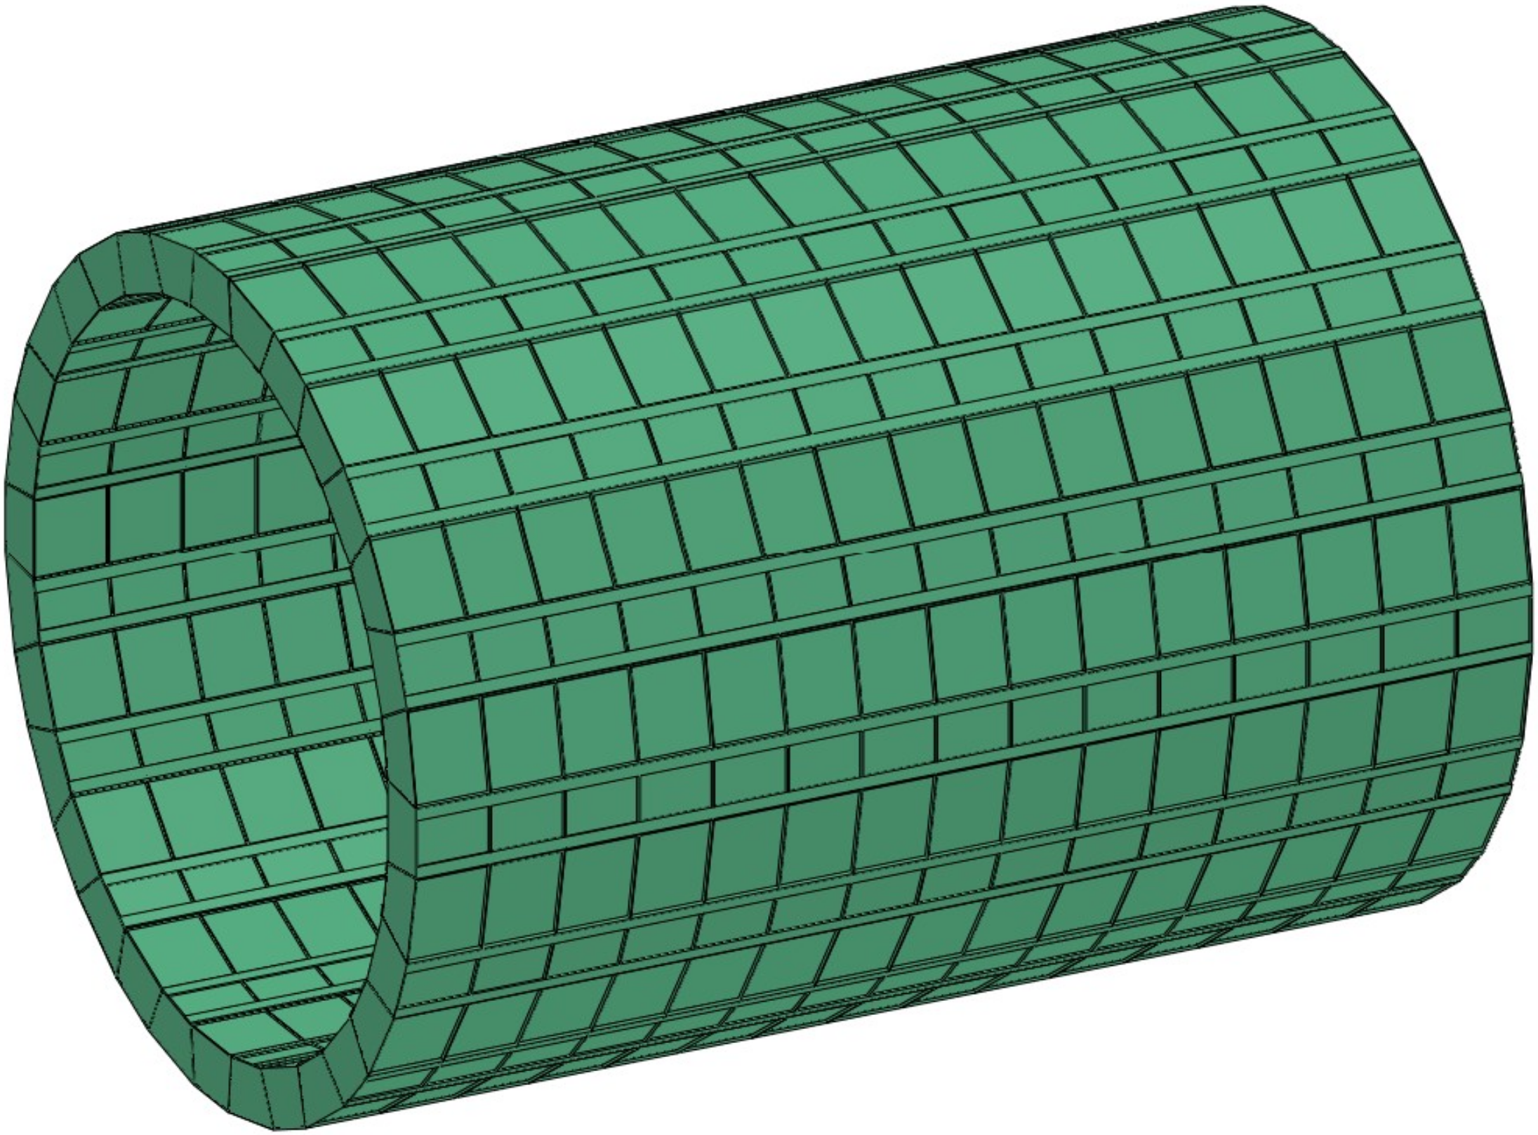
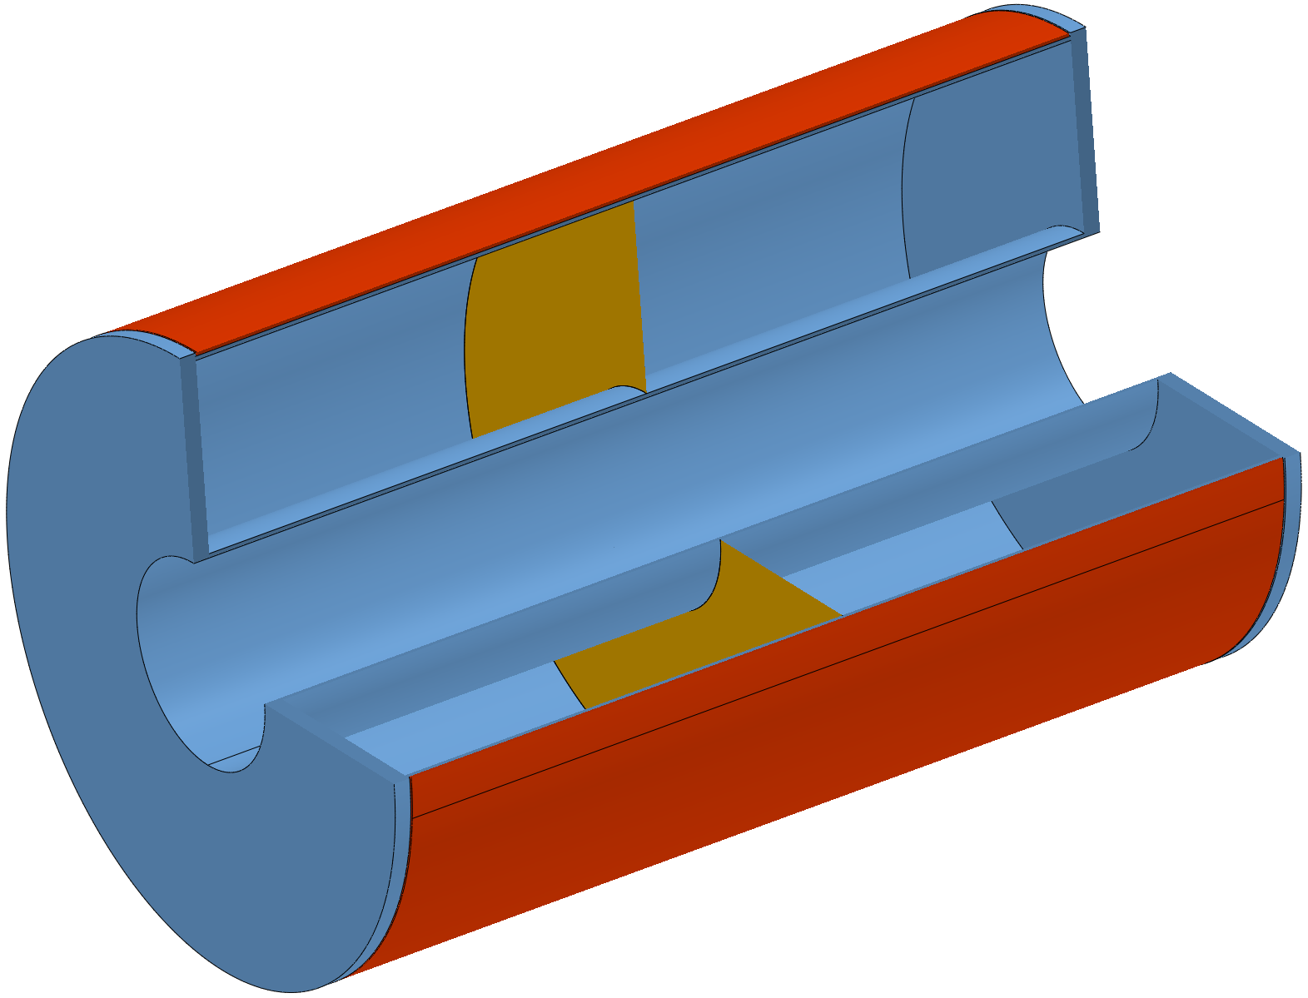
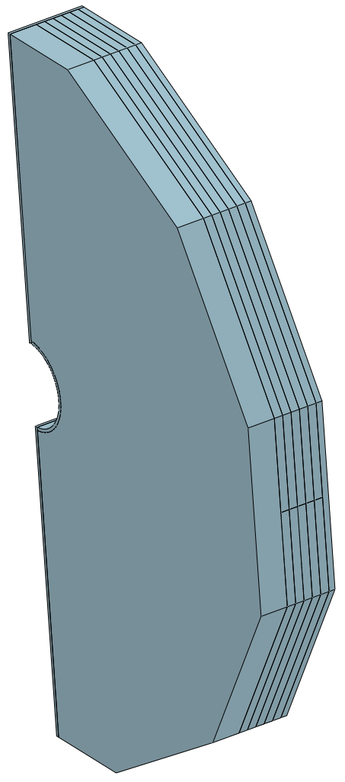
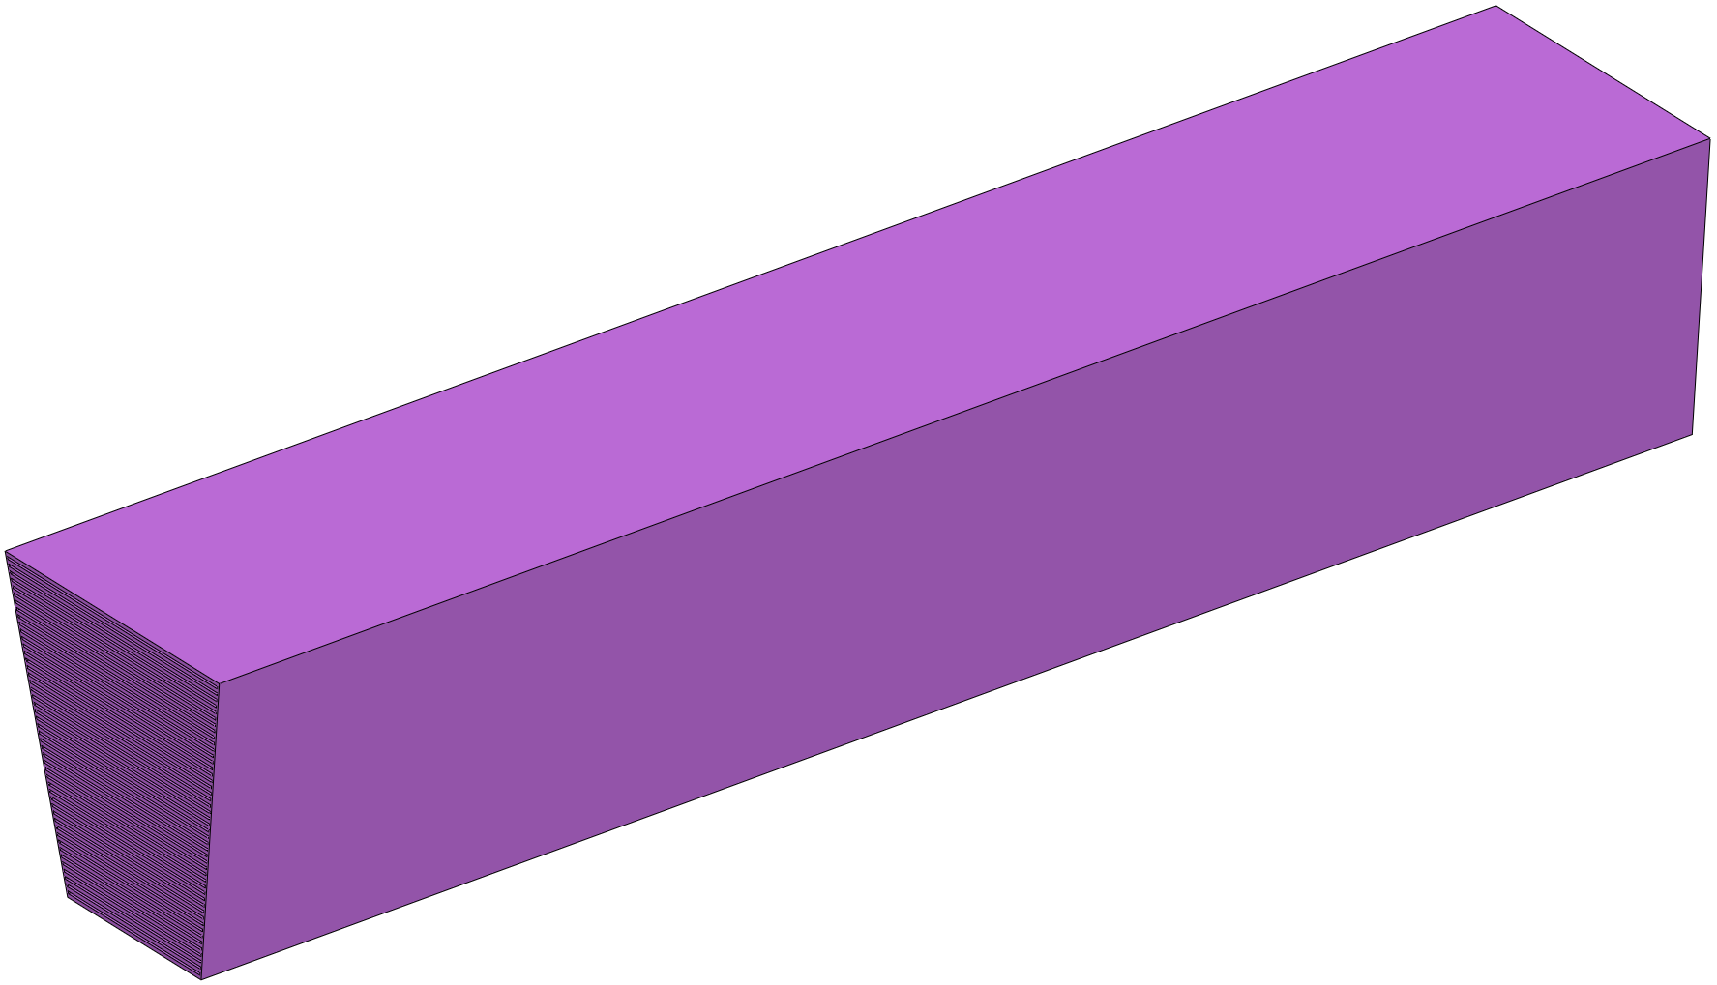
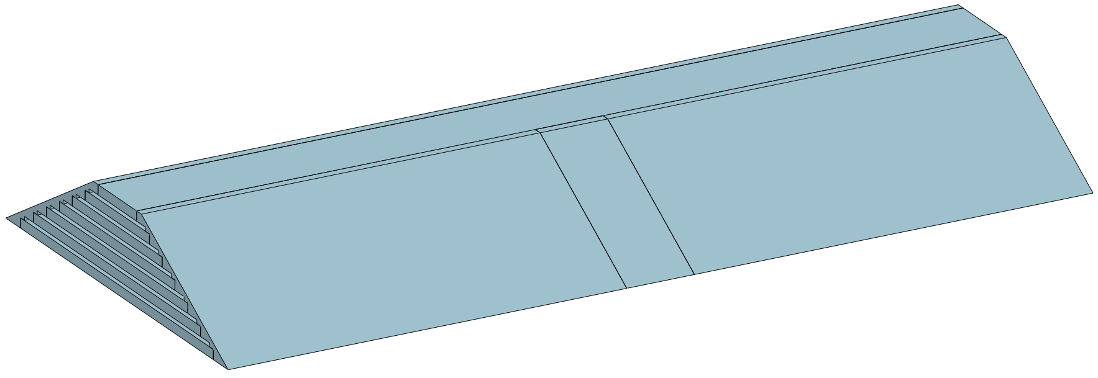
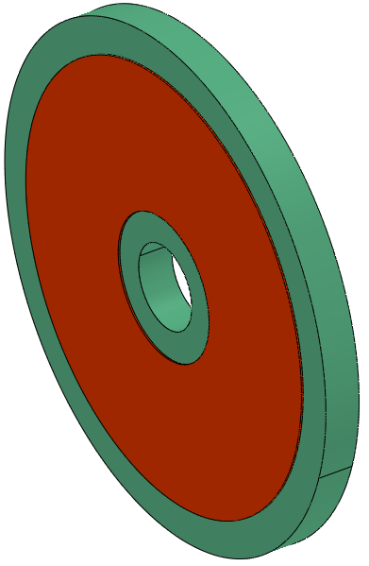
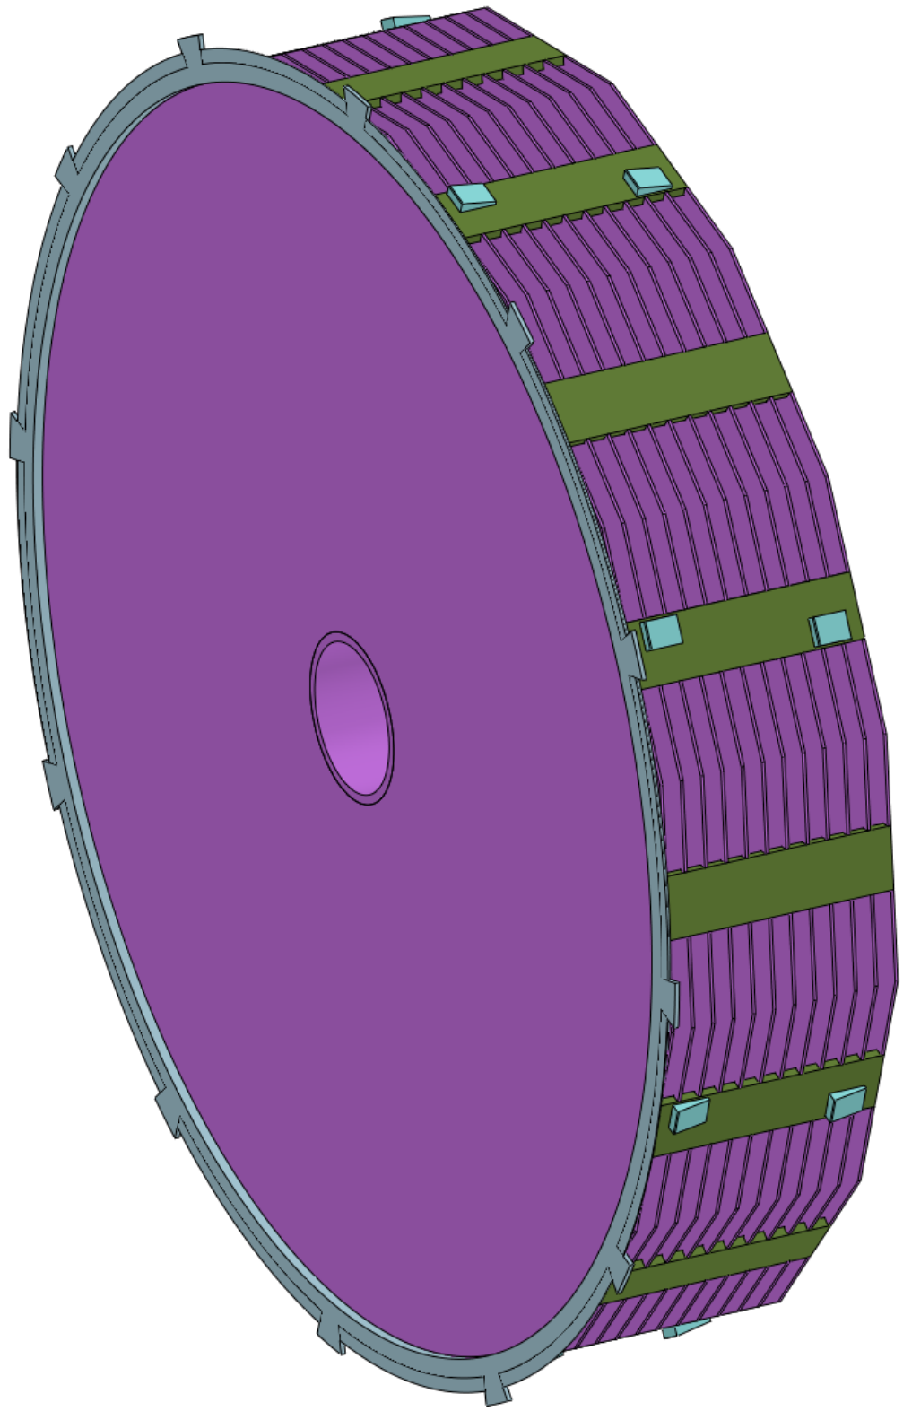
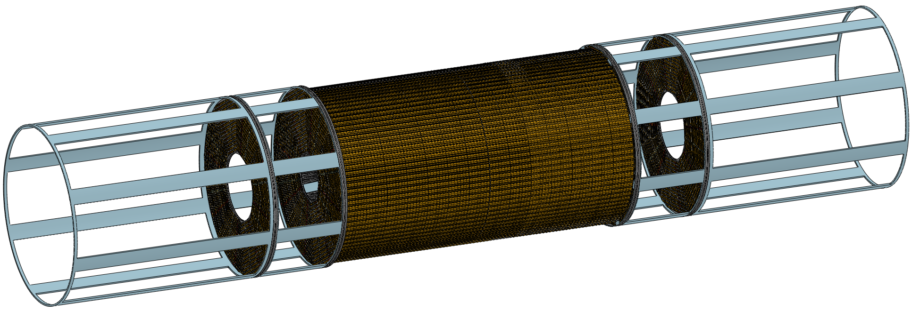
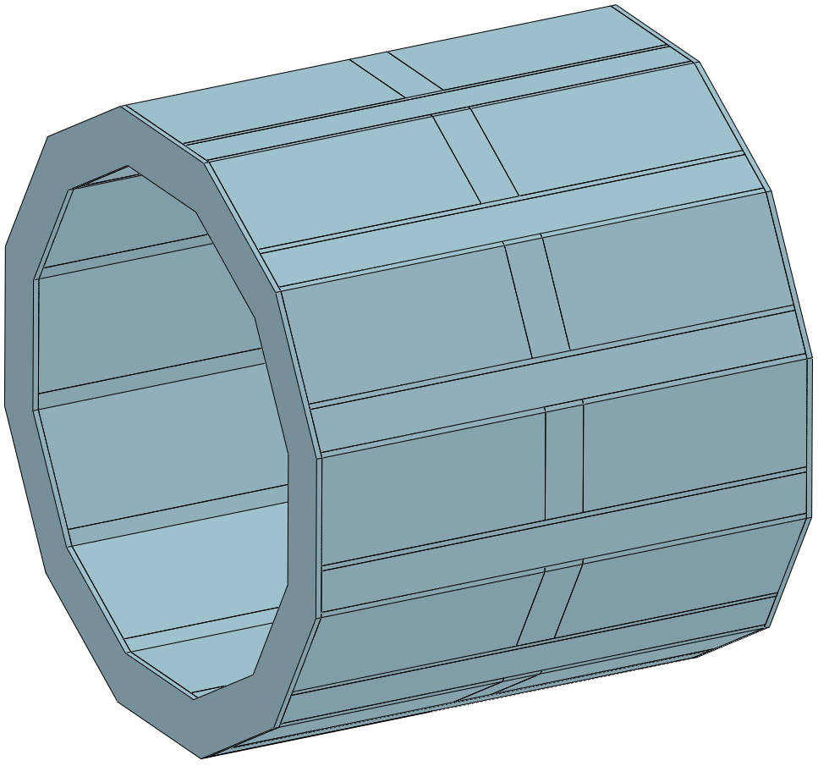
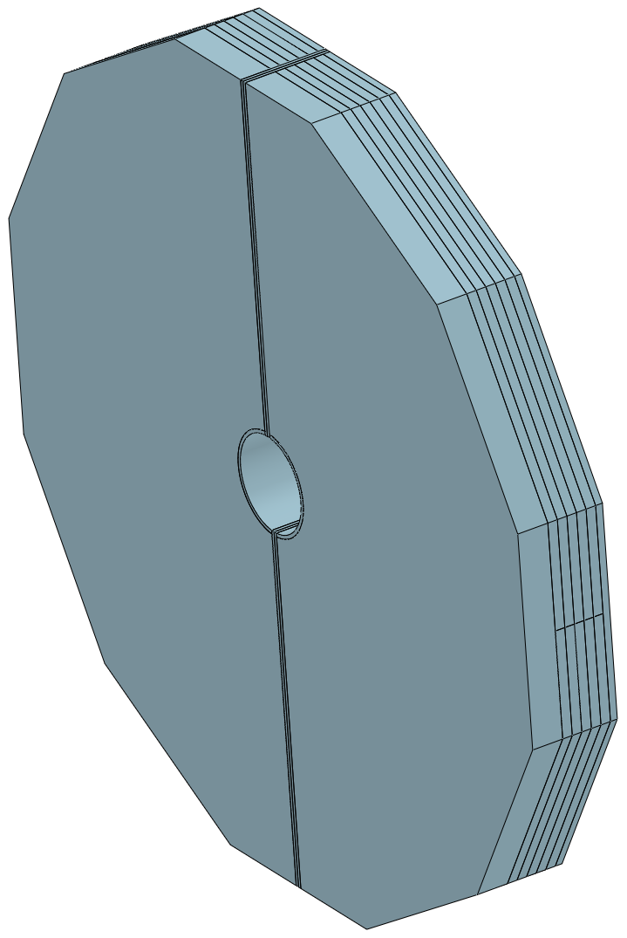
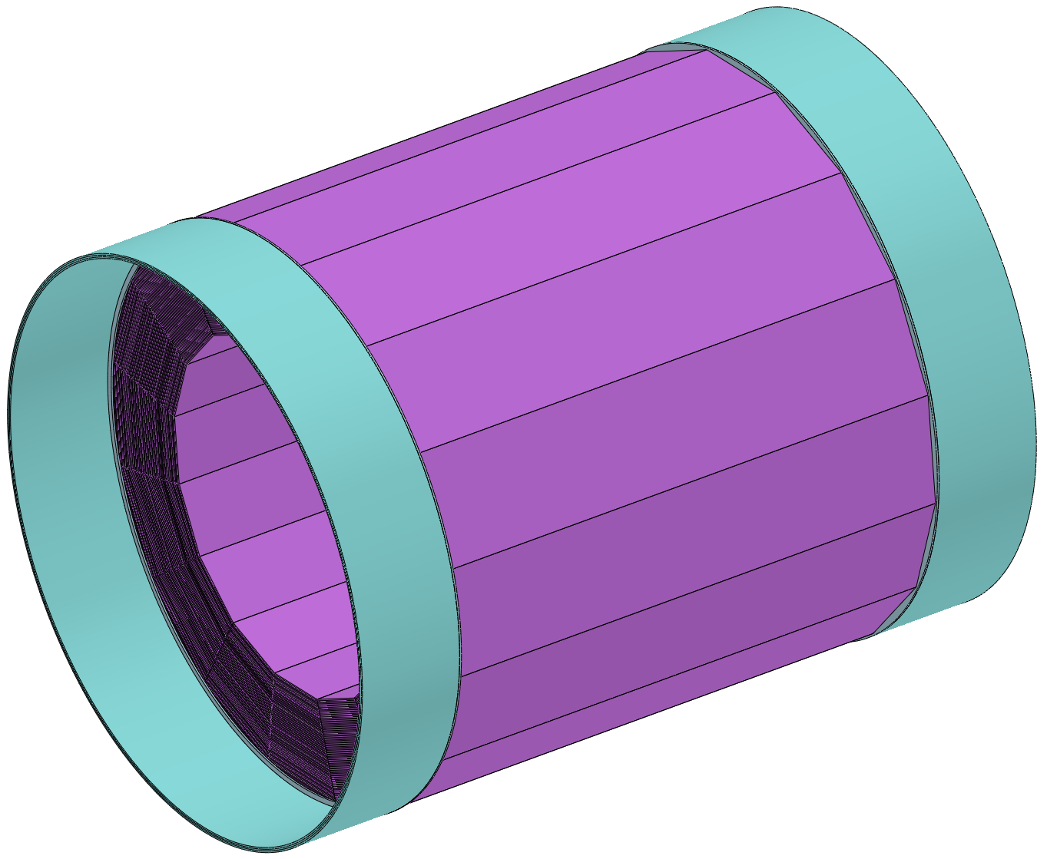
Detail installation design
4. Modular lifting and integral lifting for components : (relates to the design of the shaft and the hoists)
Modular lifting (3)
Integral lifting (7)
heaviest single module
≈ 350 t
Largest single size
9050 L X Ф 8470
Magnet
ECAL
TPC+OTK
Yoke
End Yoke
HCAL
ITK
Beampipe
End - ECAL
End - HCAL

Slide 34
Research team
Team characteristics:
1. Optimize and configure the engineering design team with the mechanical engineers from the High Energy Institute as the core
2. Resource allocation is comprehensive and reasonable, can complement each other's shortcomings
Students
Xia Shang Doctor
He LongYan Master
Calculation team
University
Hunan University
University of South China
Southwest Jiaotong University
Such a team is able to
undertake CEPC design tasks
IHEP (5)
Design units
Zhejiang University
Manufacturing units
CITIC Heavy Industry
Design team
Future planning and visioning :
1. Allocate more mechanical engineers to join CEPC R&D as needed
2. Seeking cooperation units in special fields
3. Seek international cooperation

Slide 35
Summary and working plan
Summary
1. The overall installation scheme for the detector has been basically completed
Question :
The design of the connection structure only meets basic function,
far from achieving automatic adjustment and convenient operation

Slide 36
Summary and working plan
Working plan
1. Optimization and refinement of existing installation programmes
2. Refine the connection design of sub detectors
3. Optimize the layout of the underground experimental hall and its auxiliary hall
4. Start planning the layout design of the ground hall

Slide 37
Thank you for your attention!
Aug. 7th, 2024, CEPC Detector Ref-TDR Review

