Slide 1



CEPC Detector Magnet
Feipeng Ning
On behalf of Detector magnet team
Oct. 21-23, 2024, CEPC IDRC Meeting

Slide 2
Content
Introduction
Requirements
Technology survey and our choices
Technical challenges
R&D efforts and results
Detailed design of the solenoid magnet
Cryogenic system
Mechanical design
Research team and working plan
Summary

Slide 3
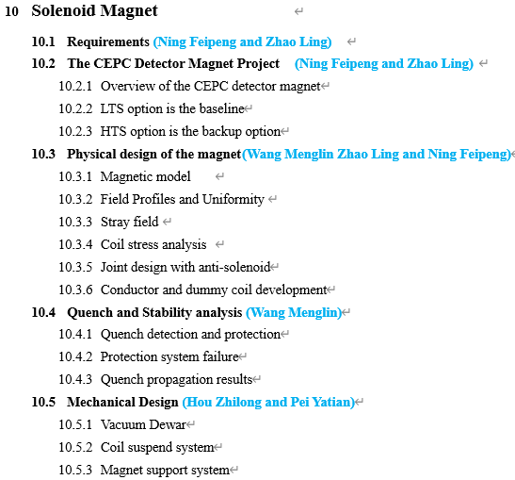
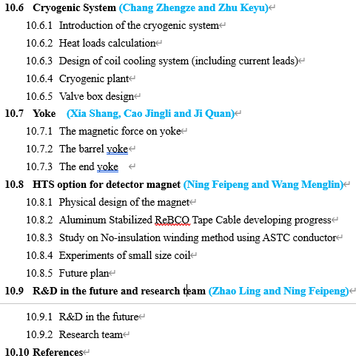
Introduction
This report is about the design and development of the detector magnet for the Ref-TDR.
This report relates to the Ref-TDR Chapter 10.

Slide 4
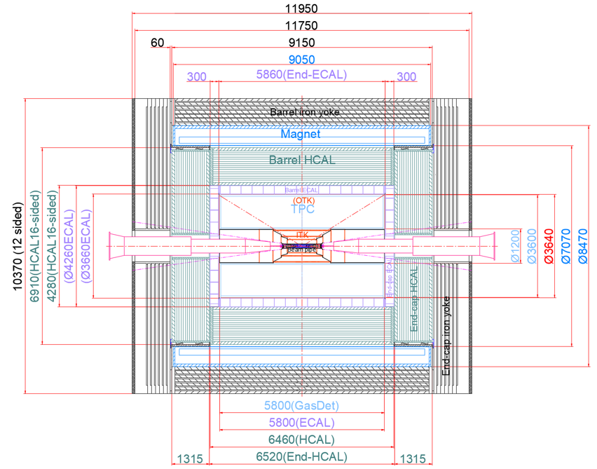
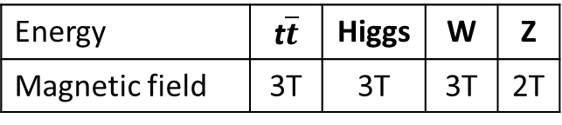
Requirements
Position and size
Magnetic field
Inner diameter | 7070 mm
Thickness | 700 mm
Outer diameter | 8470 mm
Length | 9050 mm
Yoke + Muon
Magnet
Hcal
Energy | t$\overline{t}$ | Higgs | W | Z
Magnetic field | 3T | 3T | 3T | 2T
Magnet

Slide 5
Technology survey and our choice
Low Temperature Superconductor (LTS) or High Temperature Superconductor (HTS)
 | LTS | HTS
advantages | Mature cable processing technology Mature coil winding and epoxy impregnation process Mature coil quench detection and protection methods Low cost | High mechanical strength High current density Can work at higher temperature, reducing the operating costs of cryogenic systems
disadvantages | Easy to quench High operating cost of cryogenic system | No effective quench detecting method No coil proper winding method High cost

Slide 6

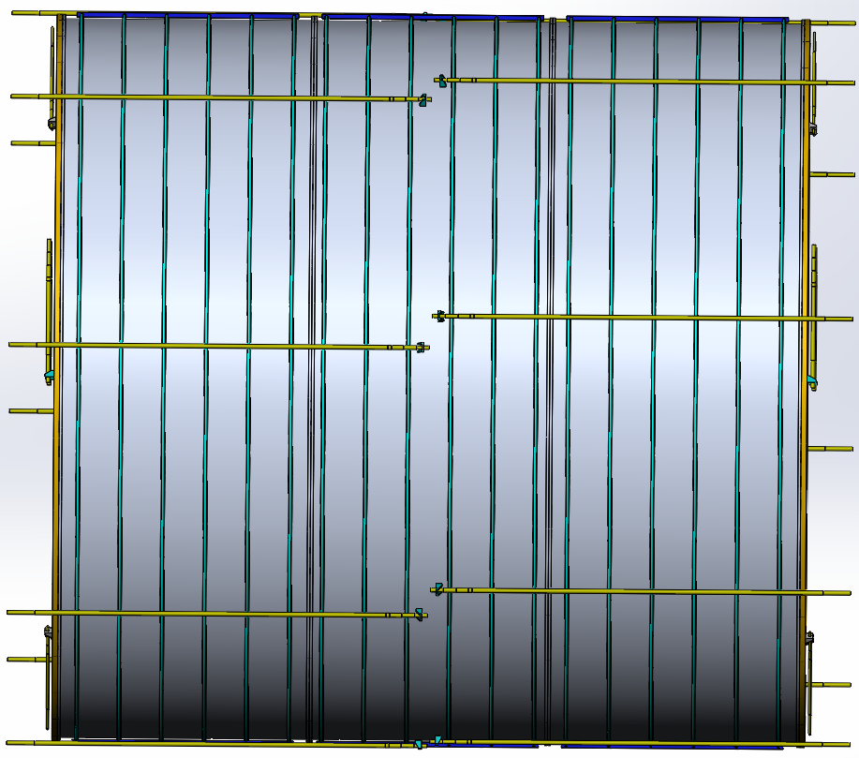
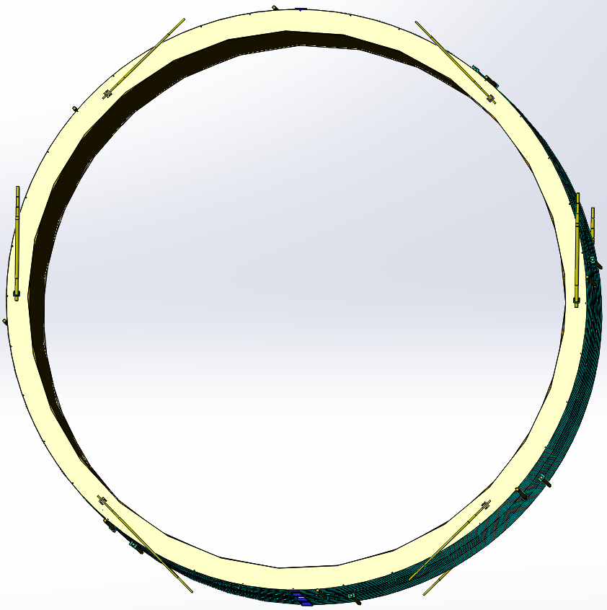
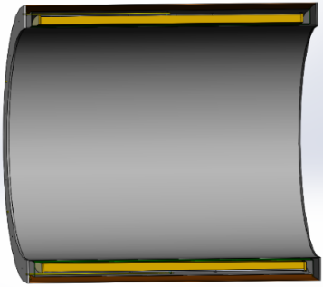
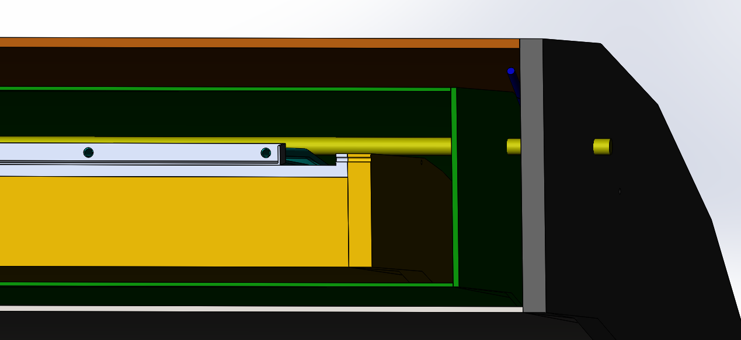
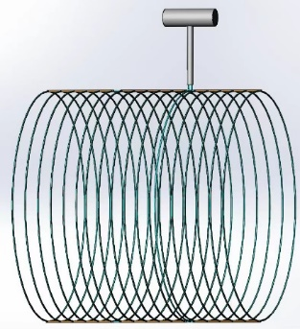
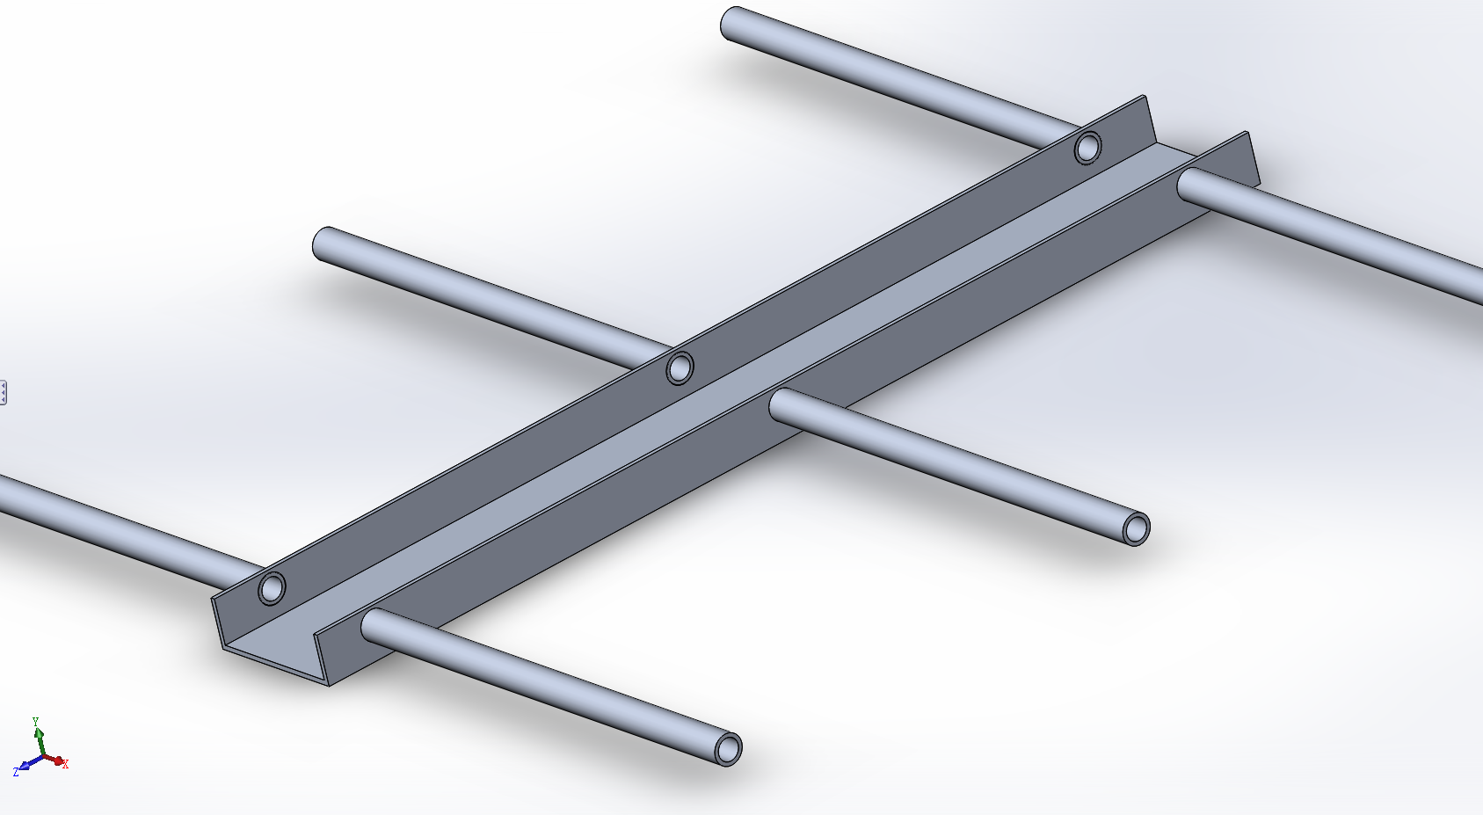
Main Technical Challenges
Large-size and high-strength Aluminum stabilized superconducting cable;
Suspension system of the huge coil (185 tons);
High precision machining and assembly of large scale coil；
There are lots of welds in low-temperature pipes, including pipes and coil supports, pipes and liquid/gas helium tanks.
In summary, most of the challenges are related to processing techniques.

Slide 7
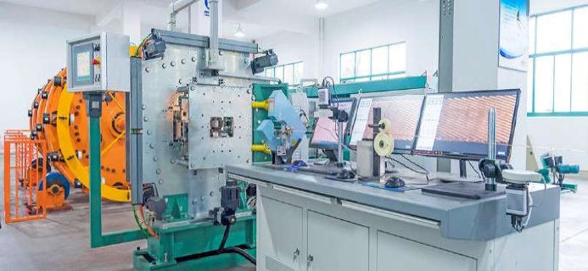
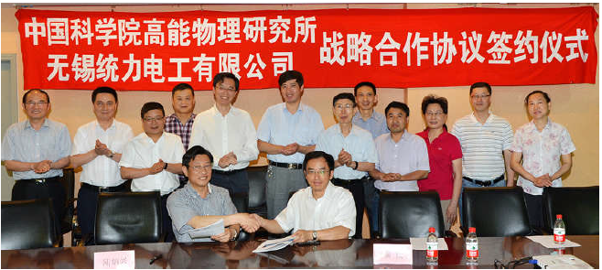
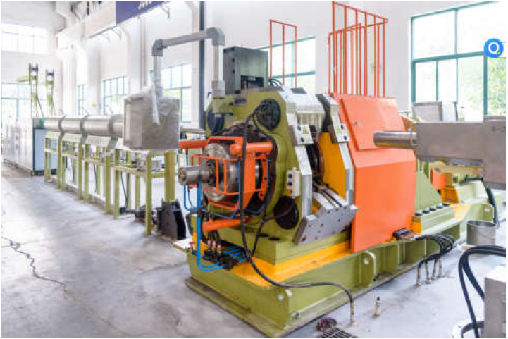
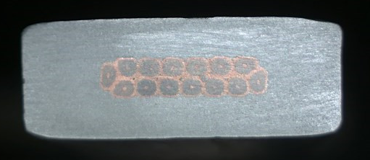
R&D efforts and results
Conductors
  Conductor is the foundation of the magnet development. Most of the detector magnets used or will use the Aluminum-stabilized Nb-Ti/Cu conductors.
Rutherford Cable
Aluminum stabilized NbTi/Cu conductor
The IHEP and Toly company have jointly established an aluminum coated conductor production line in 2015.
Extrusion machine
7

Slide 8
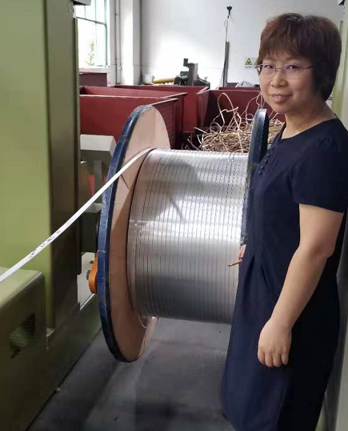
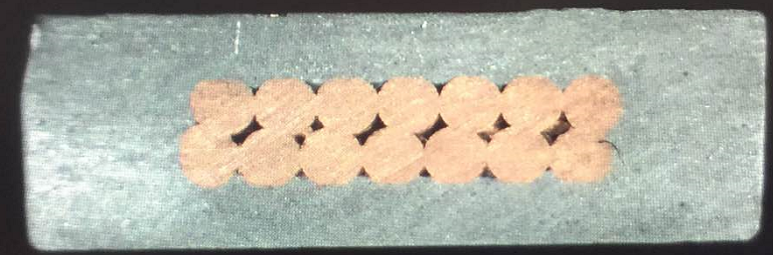
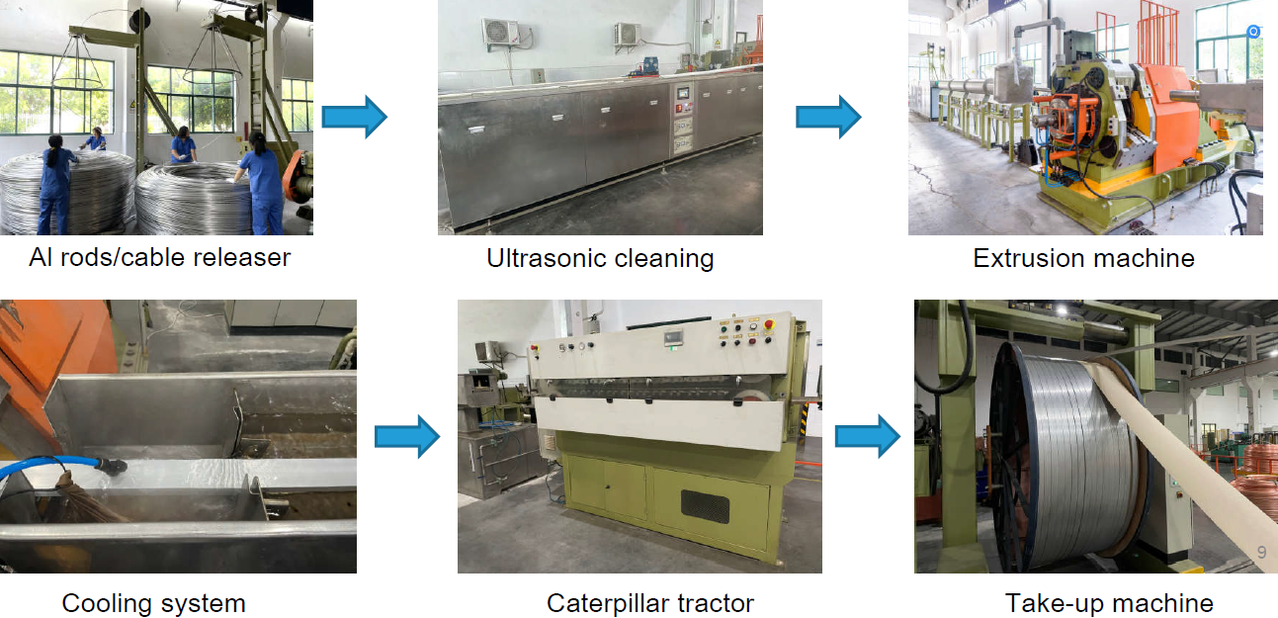
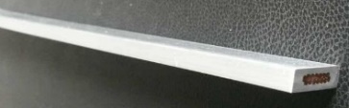
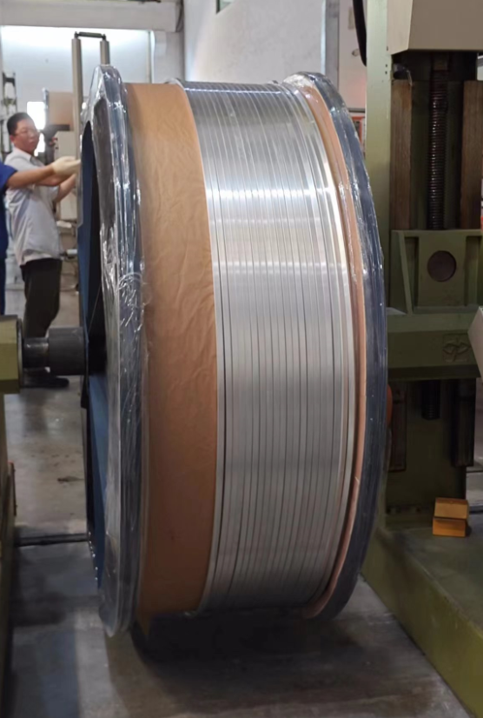
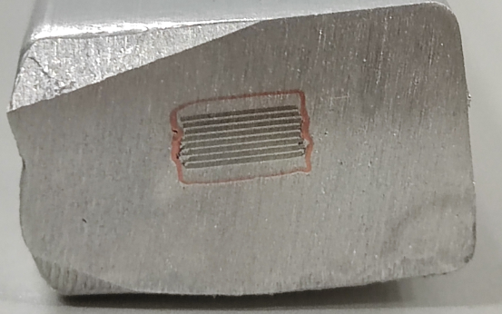
R&D efforts and results
LTS: Aluminum stabilized NbTi Rutherford cable
Al-stabilized Conductors
1.5 km
HTS: Aluminum stabilized Stacked REBCO Tape Cable
Aluminum coated conductor production line
100 m
8

Slide 9
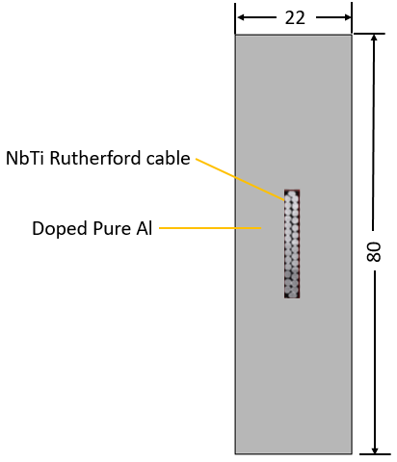
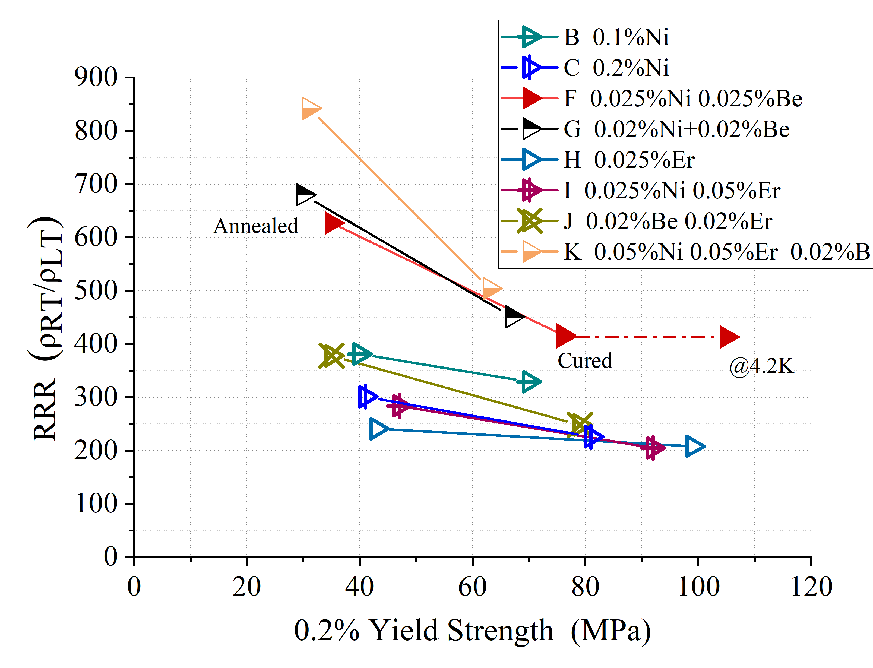
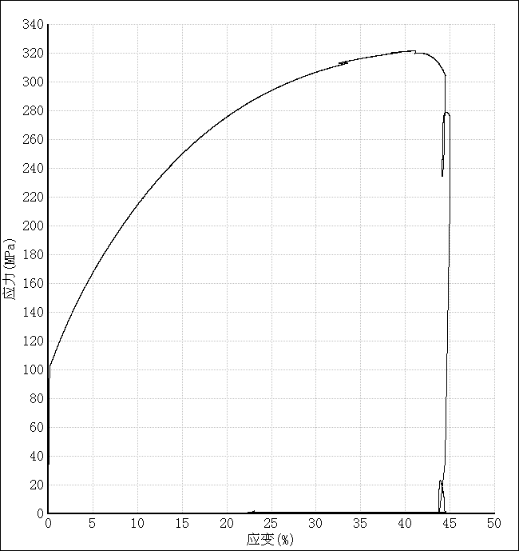
R&D efforts and results
R&D of High Strength and High RRR Aluminum- Stabilizer for Superconducting Cable
High strength and High RRR aluminum stabilizer
Yield strength > 100 MPa@4.2K, 74 MPa at room temperature, RRR value > 400
By doping Ni-0.025% Be-0.025.
The Al-0.025%Ni-0.025%Be alloy prepared from 4N8-aluminum achieved high 0.2% yield strength of 75MPa (R.T.) with RRR of 417.
Poisson’s ratio | 0.33/0.34
Young modulus | See the curve
Thermal expansivity | 14.23×10⁻⁶ K⁻¹
4.2KRp_{0.25} | 105MPa
9

Slide 10
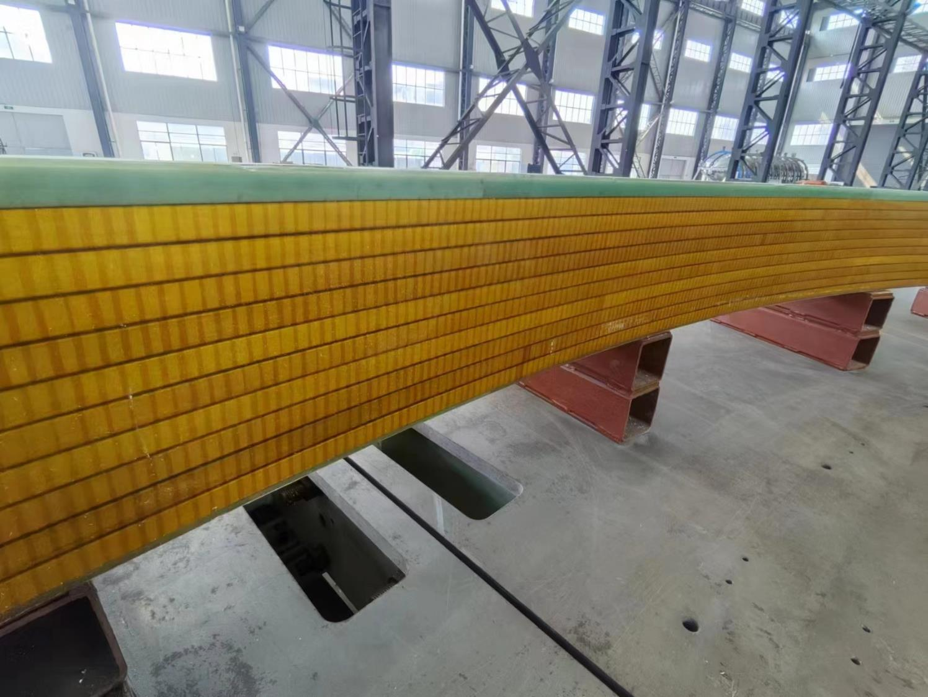
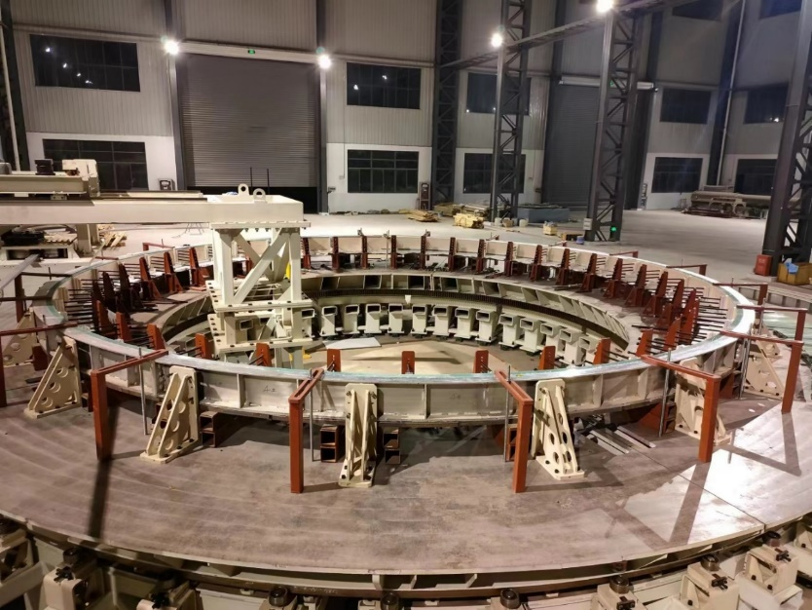
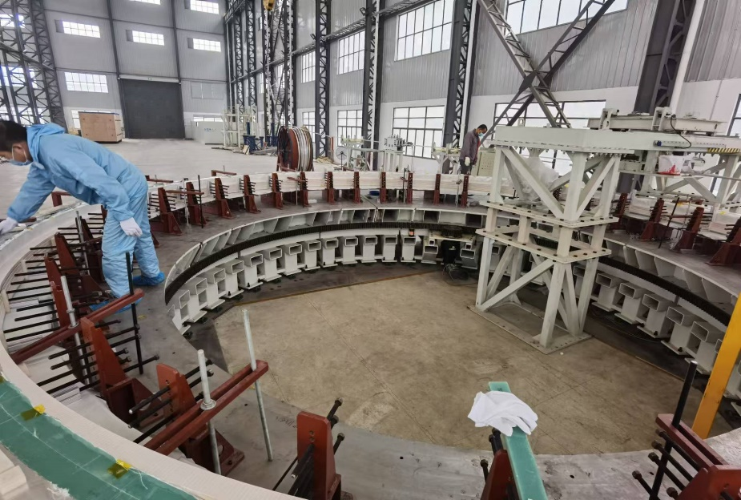
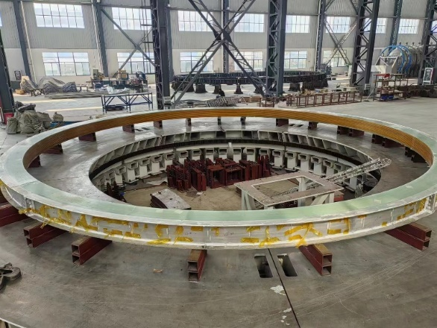
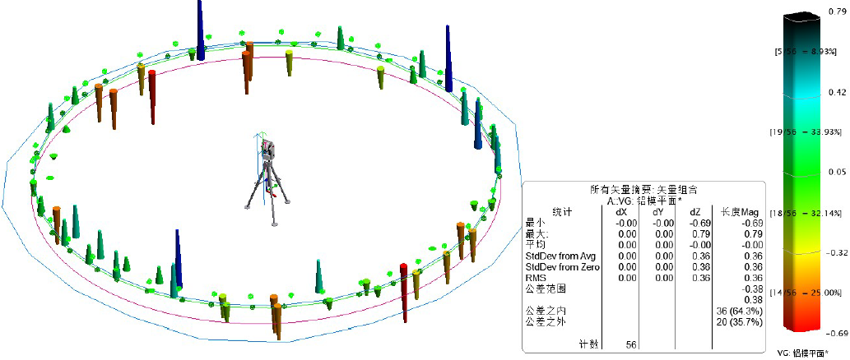
R&D efforts and results
Dummy coil development
Coil winding, vacuum leak detection, epoxy impregnation curing.
4 layers*10 turns
φ7.2m dummy coil
Large scale superconducting coil winding platform
Coil winding
The manufacturing accuracy is controlled within ± 1mm
Dummy coil
10

Slide 11
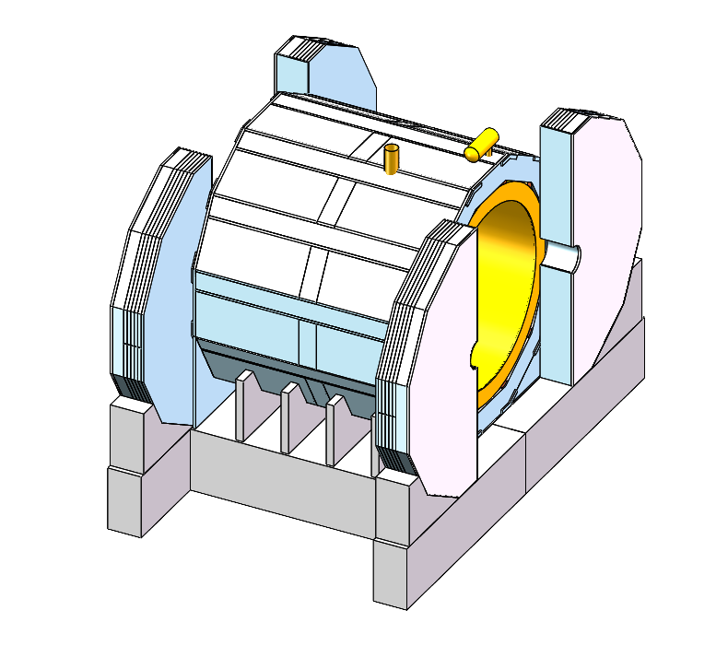
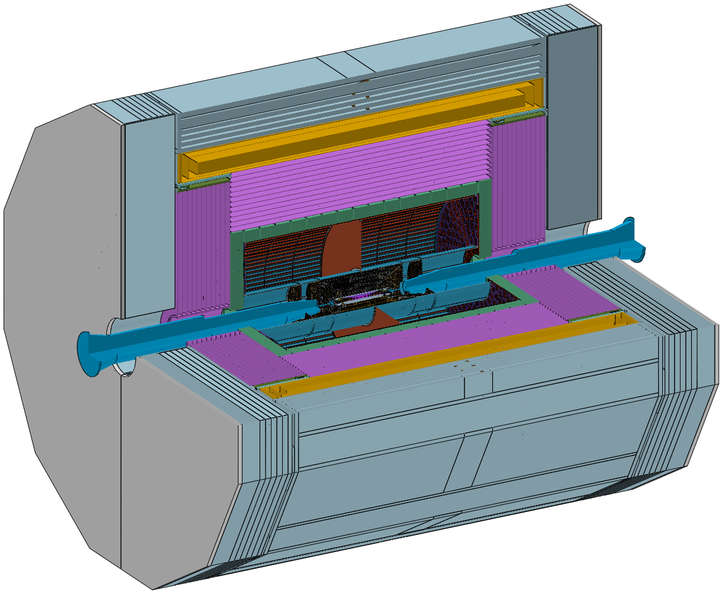
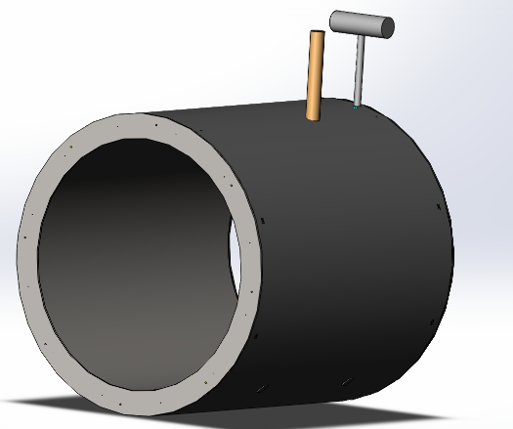
Detailed design of the solenoid magnet
Design of the magnet
Magnet parameters:
Yoke + Muon
Solenoid magnet
Central magnetic field | 3 T
Inner diameter | 7070 mm
Outer diameter | 8470 mm
Thickness | 700 mm
Length | 9050 mm
Cold mass | 185 tons
Yoke weight | 2960 tons
Magnet weight | 290 tons
HCal
11

Slide 12
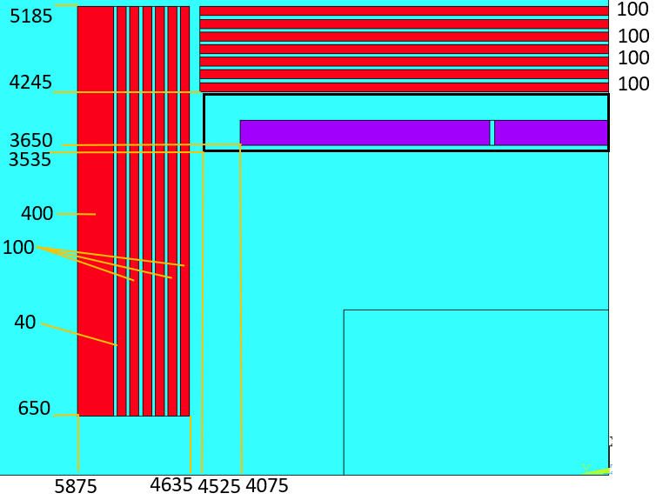
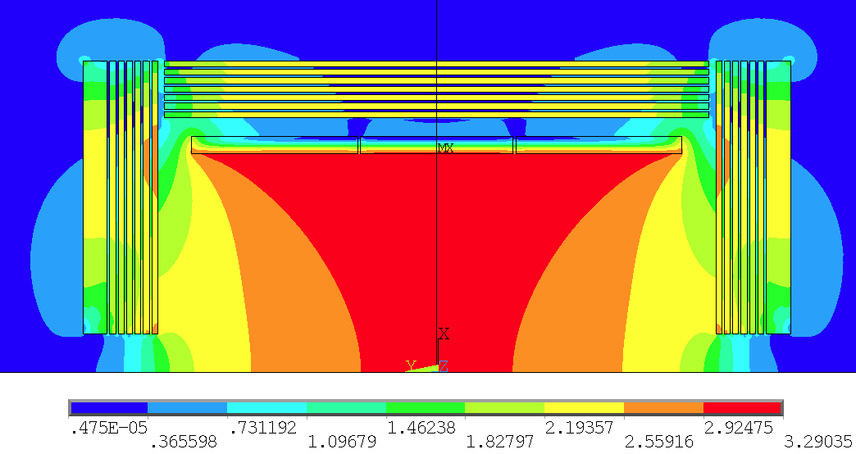

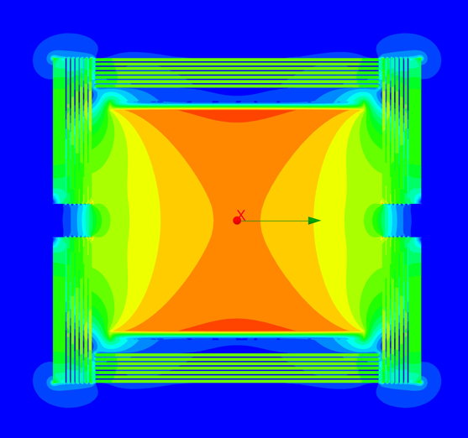

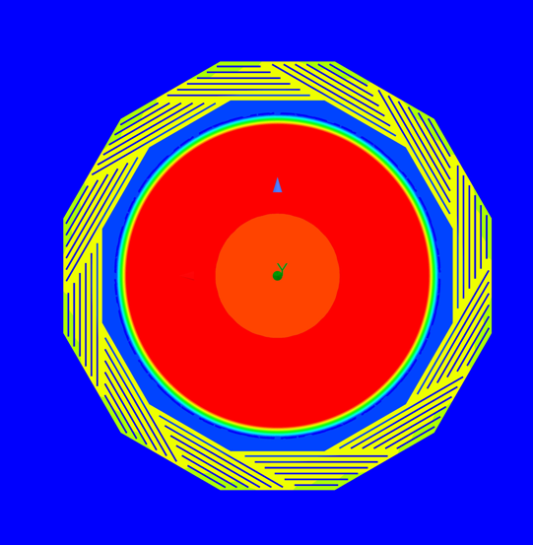
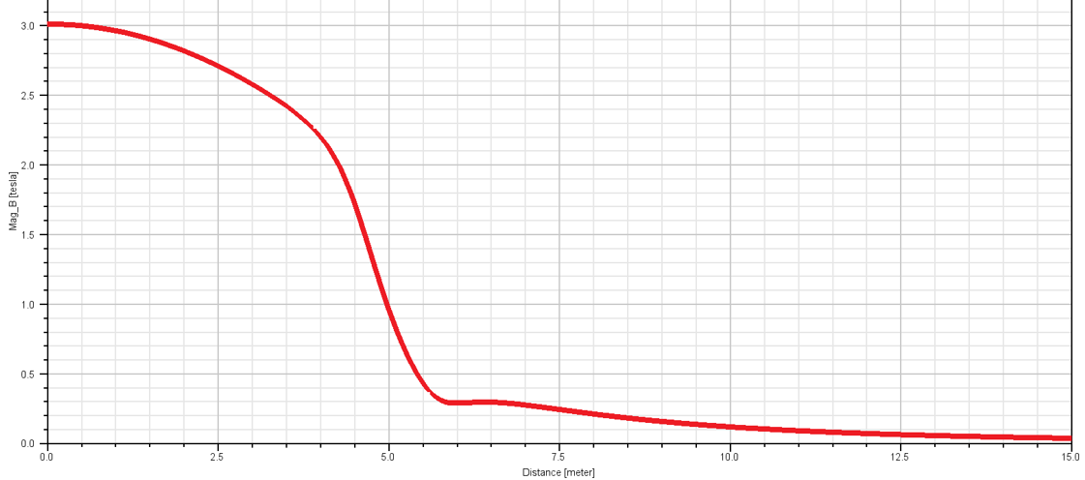
Detailed design of the solenoid magnet
Physical design of the magnet
Coil parameters:
Central magnetic field | 3 T
Inner diameter | 7300 mm
Operating current | 17000 A
Cable length | 33 km
Inductance | 11 H
Stored Energy | 1.54 GJ
2D Magnetic field simulation
12
Magnetic field distribution on the axis
3D Magnetic field simulation
3D Magnetic field simulation

Slide 13
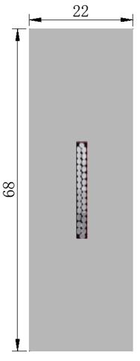
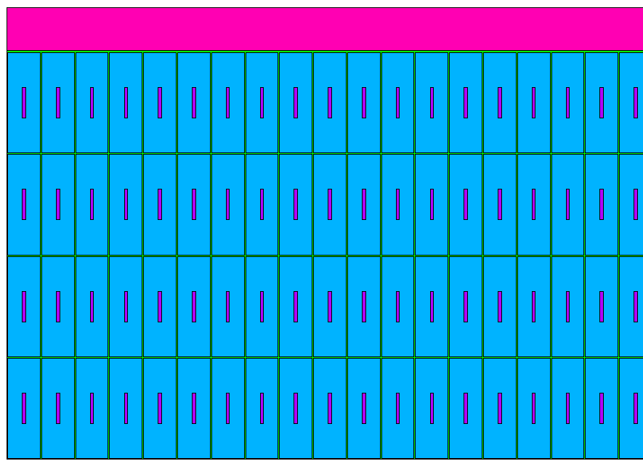
Detailed design of the solenoid magnet
Physical design of the magnet
Stress analysis
NbTi Rutherford cable
Material | Von Mises stress (MPa)
Coil at 4.2 K
Aluminum stabilizer | 4.4-86.1
SC cable | 174-243
Al alloy support | 4.6-36.2
Coil at 4.2 K, energized
Aluminum stabilizer | 41.5-95.9
SC cable | 54.9-221
Al alloy support | 43.2-87.4
High strength and High RRR Al stabilizer
Coil structure
Cable structure
The maximum stress of each part of the coil is controlled within the stress range of the material.
13

Slide 14
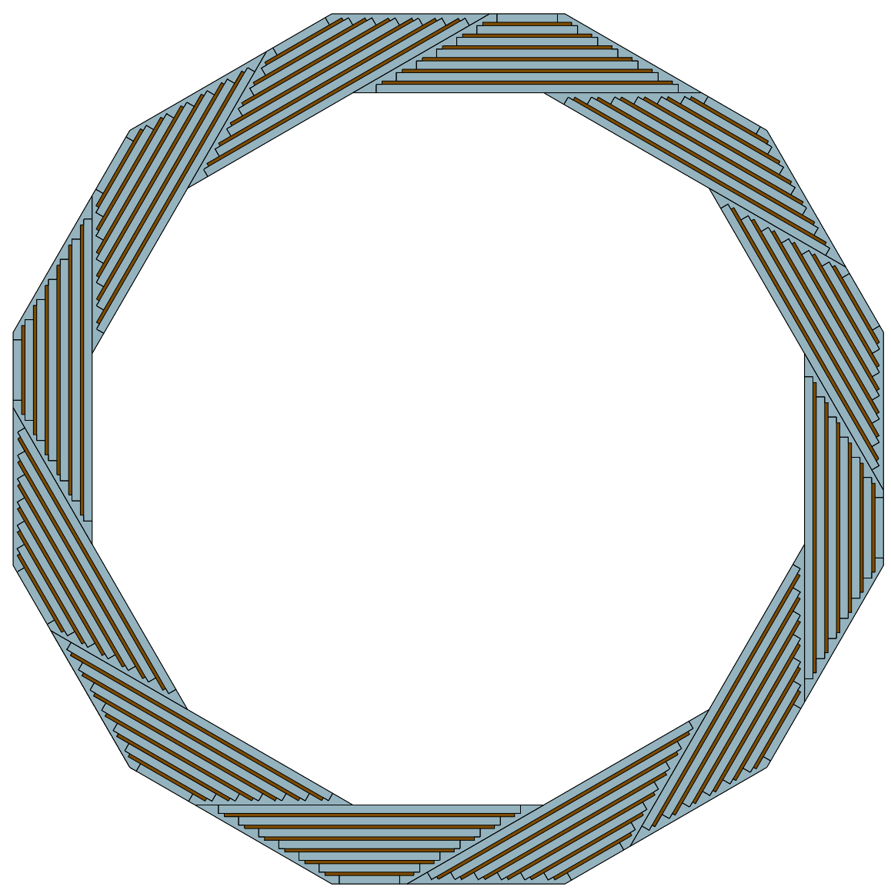
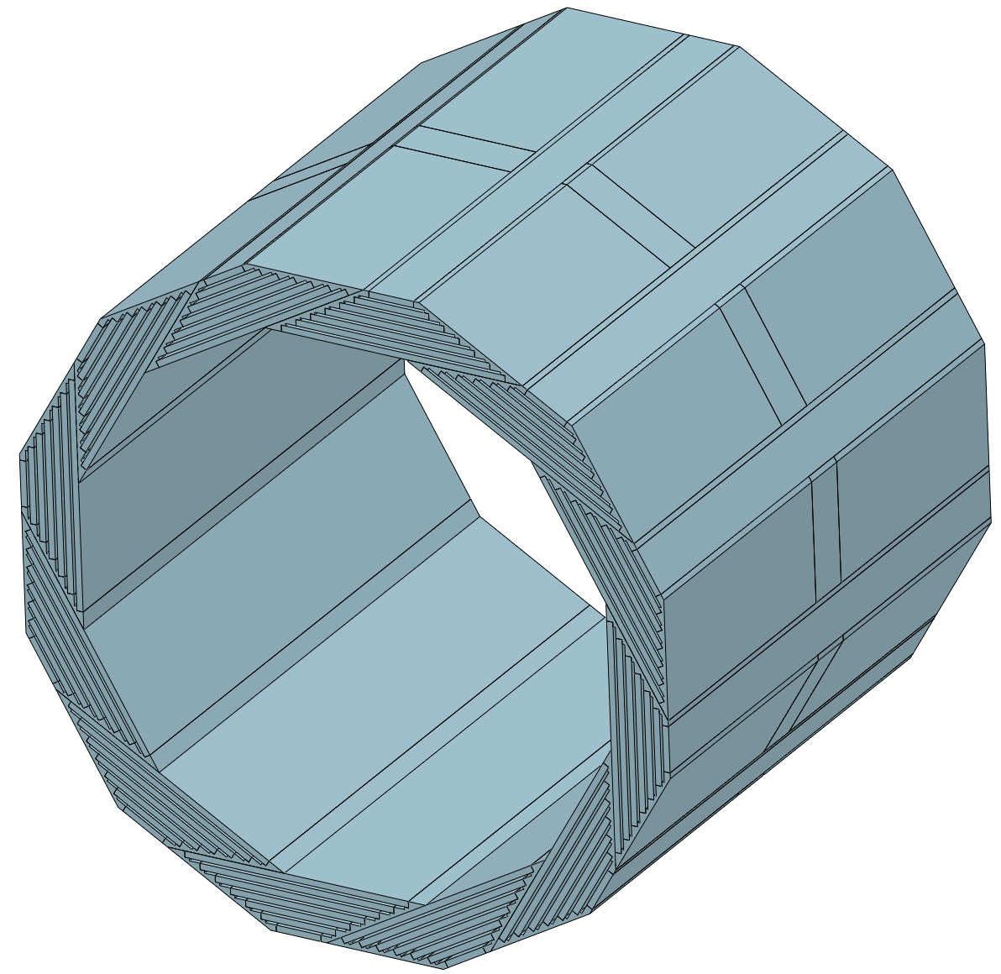
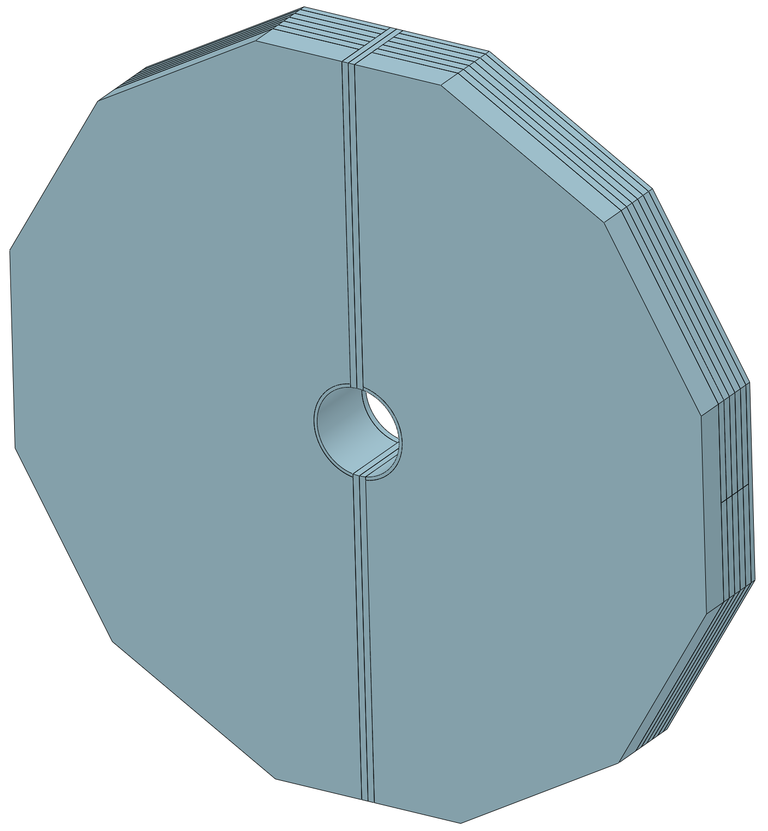
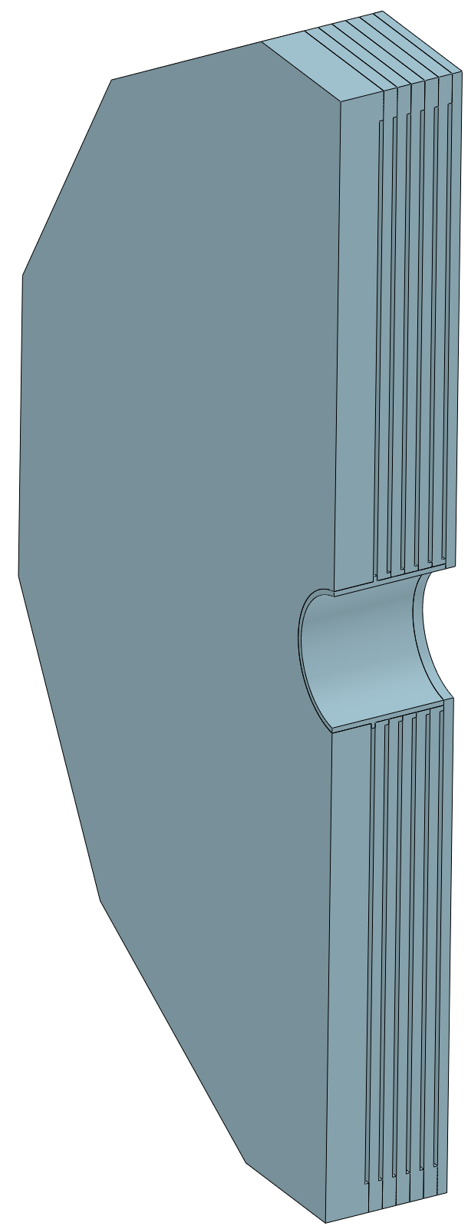
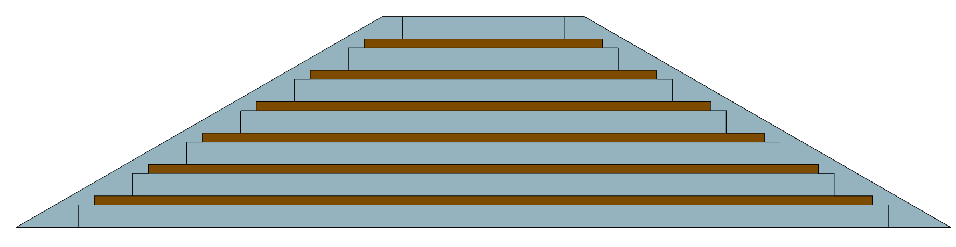
Detailed design of the solenoid magnet
Yoke
Yoke parameters：
In order to reduce the detection dead zone of the muon detector, the barrel yoke is designed as a spiral structure.
Barrel yoke (ton) | 1560
Each End yoke (ton) | 700
Total Yoke (ton) | 2960
Diameter(m) & length (m) | 10.37&11.75
Barrel yoke: 1560 tons
Single module of the barrel yoke
130 tons
End yoke
700 tons
14

Slide 15
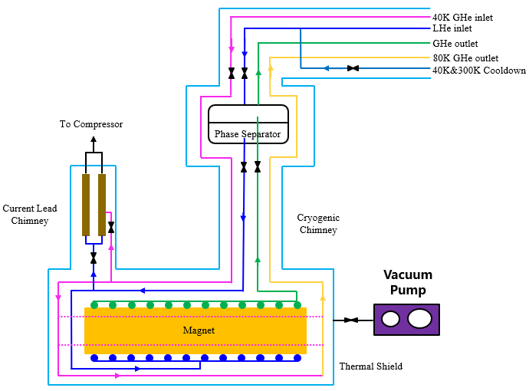
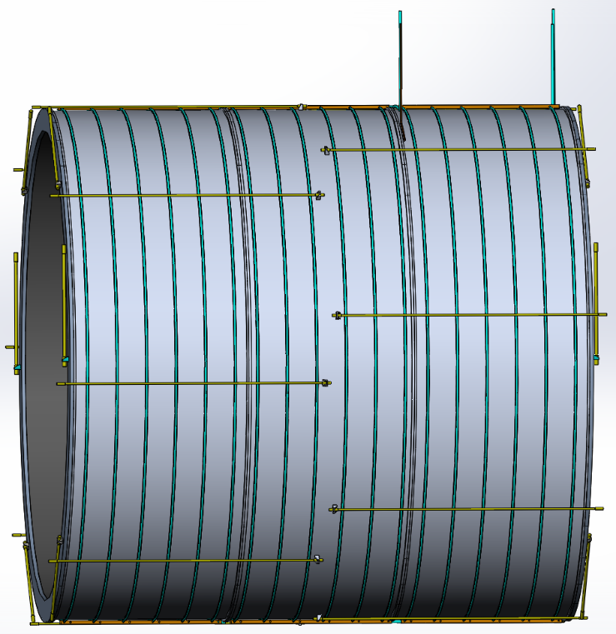
Cryogenic system
Cooling methods: Thermal siphon
Uniform temperature distribution;
High heat transfer efficiency, not limited by source pressure and pressure drop;
Low cost. No need for liquid helium circulation pump
Heat Loads：
4 K ：370 W
60 K：2700 W
The verification experiments are being designed.
Cooling process diagram
Cooling structure
15

Slide 16
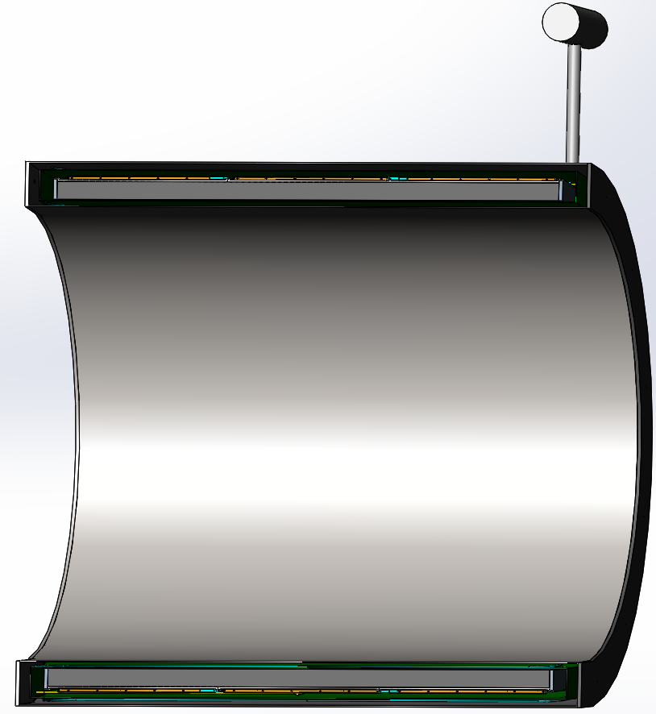
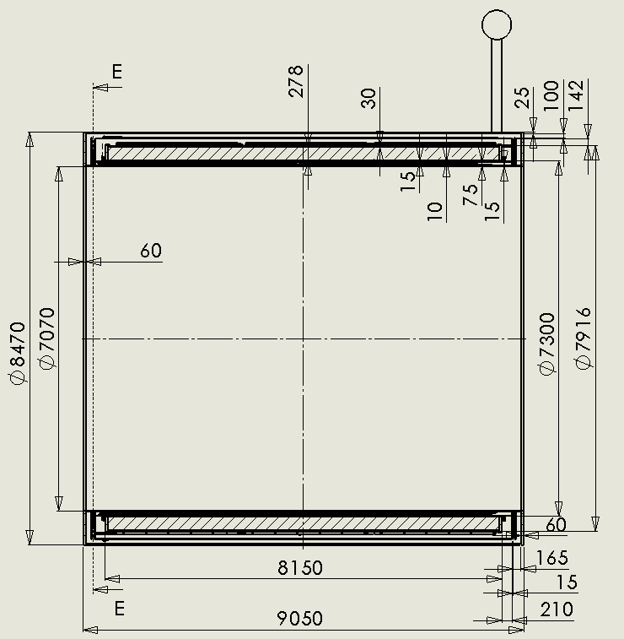
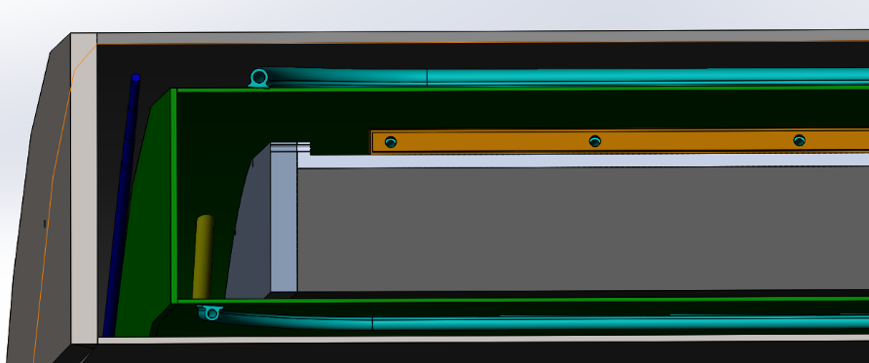
Mechanical design
2D
Completed the design of the 2D chain and the space occupied by each component.
3D
Completed the design of the 3D structure, added suspension system, cooling pipes, thermal shield and connection structure.
Thermal shield
coil
suspension rod

Slide 17
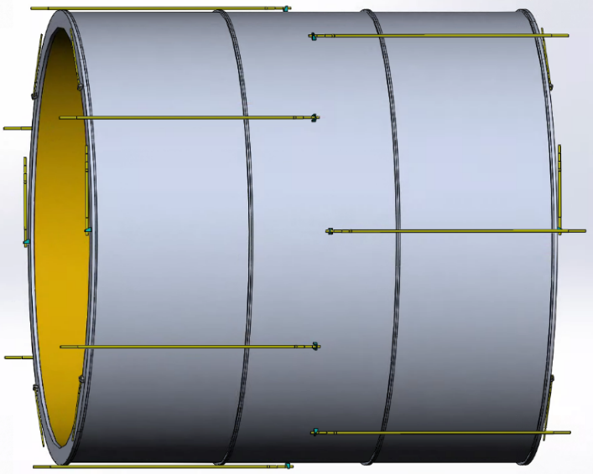
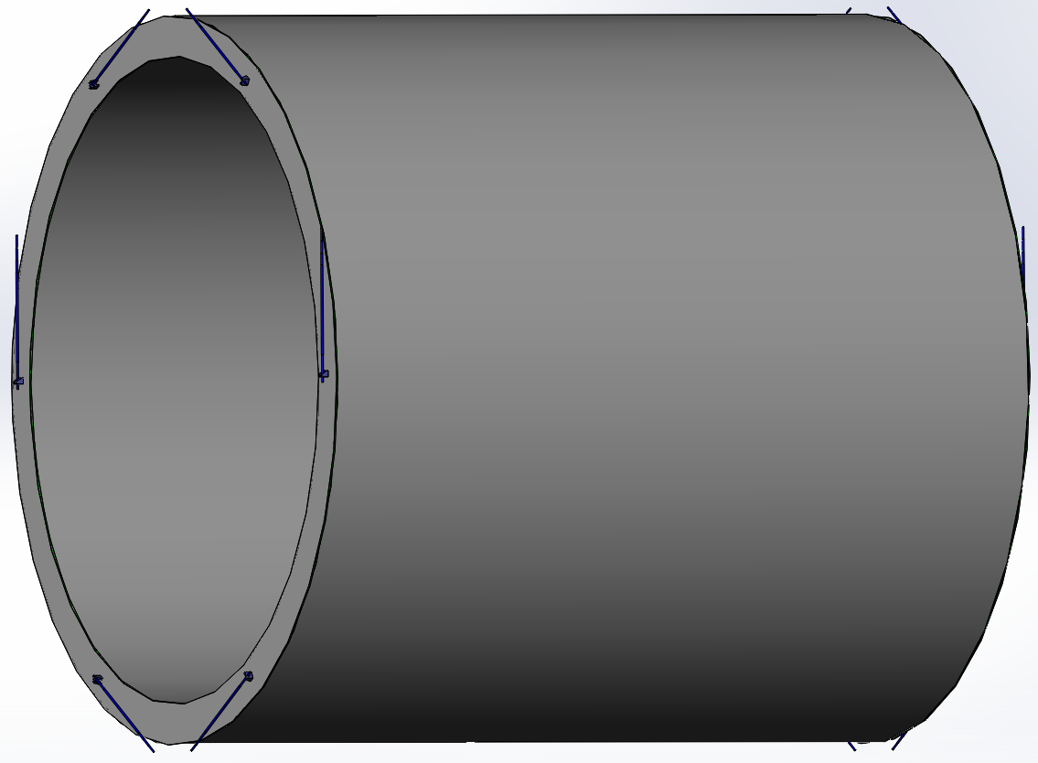

Mechanical design
Suspension system
Coil suspension system (185 tons):
8 axial rods each end
6 radial rods each end
Material: titanium alloy
 | Diameter | Length | amount
Axial rods | 30 mm | 3530 mm | 16
Radial rods | 40 mm | 1700 mm | 8
Main pull rods | 48 mm | 1650 mm | 4
Forces and torques resulting from axial and radial offset, and from angular tilt of the coil.
Thermal shield suspension system:
6 radial rods each end
Material: titanium alloy
Axial displacement (cm) | 1 | 3 | 10
Axial force (kN) | 484 | 1498 | 5034
Radial displacement (cm) | 1 | 3 | 10
Radial force (kN) | 34.3 | 236 | 656
Angular tilt (angle) | 1/407.5 =0.14° | 3/407.5 =0.42° | 10/407.5 =1.41°
Torque (kN.m) | 1965 | 6170 | 19935

Slide 18

Research Team
IHEP: staff 13; engineer 5; post doctor 1; students 3
Cooperative institutes and Universities: SJTU, SWJTU, NCEPU, TSINGHUA, IEE, IPC, IPP and so on.
Cooperative companies: Wuxi Toly (aluminum stabilized conductors), Hefei Keye ( coil winding platform and dummy coil development), Xinjiang Zhonghe ( Aluminum stabilizer), WST ( LTS wires), SSCT ( HTS tapes), and so on.
Welcome international cooperation.

Slide 19



Research Team
Experience: BES III detector magnet
Design, processing, manufacturing, and assembly experience of BES III detector magnet;
Safe, stable, and accident free operation for nearly 20 years.

Slide 20





Research Team
Experiences: 12T Dipole Magnet
12T Dipole Magnet
Development of the LPF1 NbTi+Nb₃Sn dual-aperture model dipole magnet from 2017.
Dipole field reached 12 T in 2*Φ14 mm apertures in May 2021 and 12.47 T in July after a thermal cycle.

Slide 21



Research Team
Experience: Aluminum stabilized superconducting conductors
LTS: NbTi cable
Aluminum stabilized NbTi Rutherford cable
HTS: ReBCO cable
Aluminum stabilized Stacked REBCO Tape Cable
Dimensions: 15*4.7mm²
Number of strands ：14
Materiel : Al(99.99% purity)
Complete time:2017.8
Shear strength (COPPER &Al) > 35MPa
Length: 1.5 km
Dimensions: 15*10 mm²
Number of tapes ：14
Materiel: Al 1100
Complete time: 2023.12
Length: 100 m
1.5 km
100 m
This is the only aluminum coated superconducting cable production line in the world at present.

Slide 22
R&D plan
R&D items | Time
Further optimize the physical design of the coil, including magnetic field distribution, conductor structure, quench calculation and so on | 2024.11
Optimize the workflow of cryogenic system | 2024.12
Refine the design of mechanical structures | 2025.3
Full size superconducting conductors development | 2025.12
HTS plan R&D | 2027.12

Slide 23




Ref-TDR progress
We have already started writing the Ref-TDR, and more content is being added.

Slide 24
Summary
1. After comparison, we have selected a solution and carried out the physical design, mechanical design, and cryogenic system design of the magnet.
2. The research team has a lot of experience in developing superconducting magnets. We are confident that we will finish all the required elements and will put this part into Ref-TDR.

Slide 25
Thank you for your attention!
Oct. 21-23, 2024, CEPC IDRC Meeting

