Slide 1
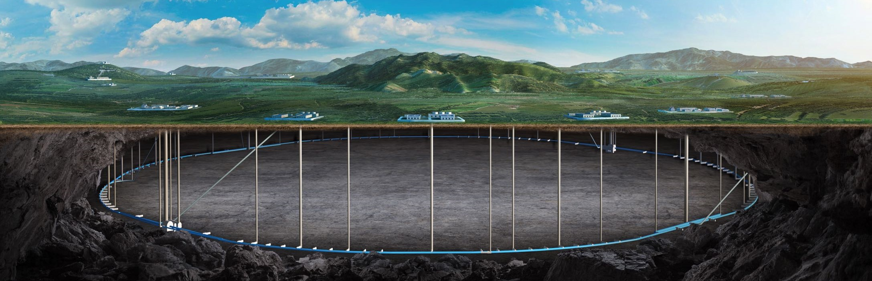

Brief Overview
of CEPC Detector Ref-TDR
Jianchun Wang
IHEP, CAS
Oct. 21-22, 2024, CEPC Detector Ref-TDR Review

Slide 2
Content
Motivation of Ref-TDR
Technology Selections for The Ref-TDR
R&D Efforts and The Team
Ref-TDR Preparation Timeline

Slide 3
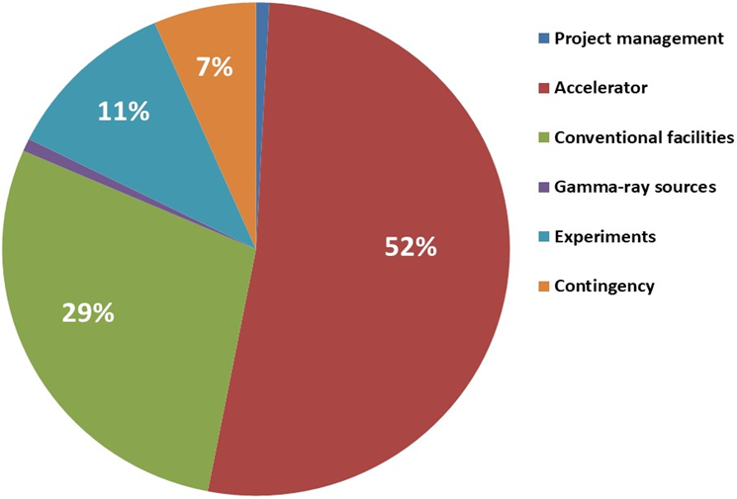
CEPC CDR and TDR
Accelerator TDR
Released (2023.12.25)
CDR Released (2018.11)
arXiv:2312.14363
1114 authors
278 institutes
(159 foreign institutes)
38 countries
arXiv: 1809.00285
arXiv: 1811.10545
Total 36.4B CNY
1143 authours
222 institutes (140 foreign)
24 countries
TDR of a reference detector by 2025.06
To demonstrate the readiness and feasibility of detector technologies
Aim for domestic endorsement

Slide 4
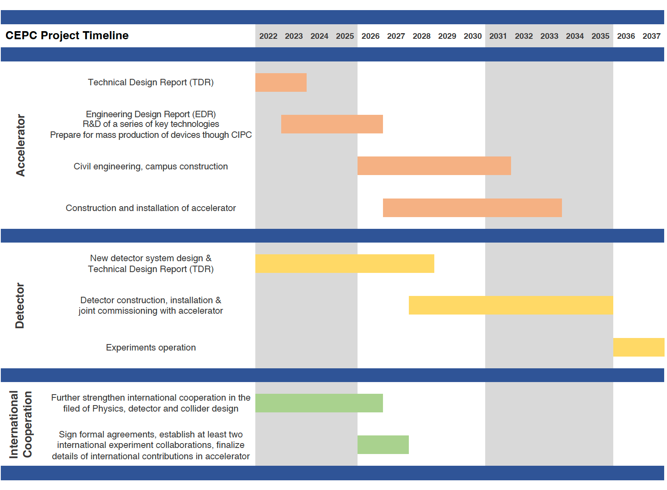
Ideal Timeline of CEPC
Completion of
Accelerator TDR
15th FY
16th FY
Completion of
Accelerator EDR
TDR of a Ref-Detector
@ June 30, 2025
International
Collaborations

Slide 5
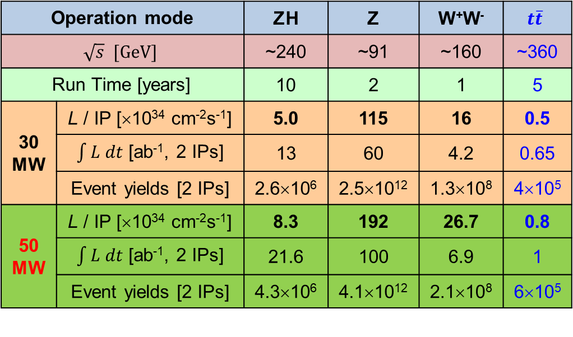
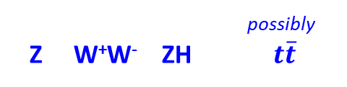
CEPC Operation Plan
possibly
Z W⁺W⁻ ZH $t\overline{t}$
Operation mode |  | ZH | Z | W⁺W⁻ | $$t\overline{t}$$
$$\sqrt{s} [GeV]$$ |  | ~240 | ~91 | ~160 | ~360
Run Time [years] |  | 10 | 2 | 1 | 5
30 MW | L / IP [×10³⁴ cm⁻²s⁻¹] | 5.0 | 115 | 16 | 0.5
 | $\int{L dt}$ [ab⁻¹, 2 IPs] | 13 | 60 | 4.2 | 0.65
 | Event yields [2 IPs] | 2.6×10⁶ | 2.5×10¹² | 1.3×10⁸ | 4×10⁵
50 MW | L / IP [×10³⁴ cm⁻²s⁻¹] | 8.3 | 192 | 26.7 | 0.8
 | $\int{L dt}$ [ab⁻¹, 2 IPs] | 21.6 | 100 | 6.9 | 1
 | Event yields [2 IPs] | 4.3×10⁶ | 4.1×10¹² | 2.1×10⁸ | 6×10⁵
CEPC accelerator TDR (Xiv:2312.14363)
While aiming to meet the needs of the whole energy range, emphasize more on the Higgs operation mode.

Slide 6
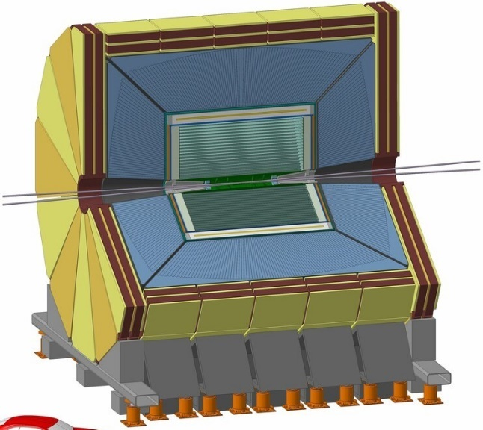
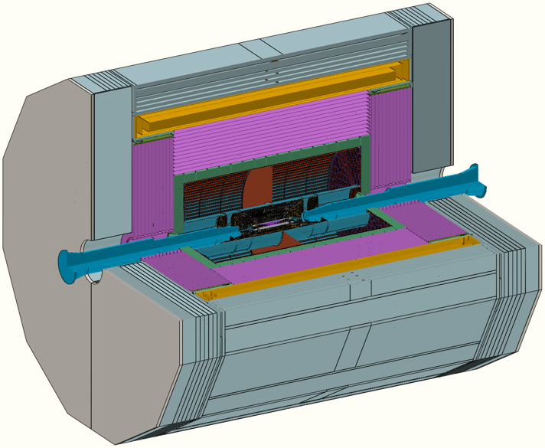
Conceptual Detector Design
(Baseline Design)
Particle Flow Algorithm
IDEA concept
(also proposed for FCC-ee)
Magnet
(3T/2T)
2T Magnet
Yoke + Muon
(RPC or μ-RWELL)
Preshower (μ-RWELL)
LumiCal
Dual-readout calorimeter
Silicon wrapper
PFA HCAL
Drift chamber
Yoke + Muon (μ-RWELL)
PFA ECAL
Si Pixel Vertex
Si Pixel Vertex
The 4th Concept
SIT TPC SET
FTD ETD
Scint Glass HCAL
TPC (Pixelated)
FST concept
(Full Silicon Tracker)
OTK (AC-LGAD)
Crystal ECAL
(Transverse bar)
ITK (SiPixel)

Slide 7
Technologies For Ref-TDR
The CEPC study group started to compare different technologies in January, 2024
By the end of June, 2024 the baseline technologies were chosen.
Multiple factors were considered in the process: performance, cost, R&D efforts, technology maturity, …
Radius

Slide 8
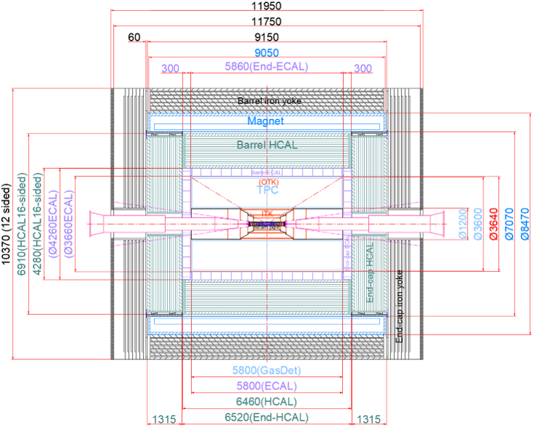
Geometry and Mechanical Support
Subsystem | Supported By
Barrel Yoke | Base
Magnet | Barrel Yoke
Barrel HCAL | Barrel Yoke
Barrel ECAL | Barrel HCAL
TPC+ Barrel OTK | Barrel ECAL
ITK | TPC
Beampipe+VTX+LumiCal | ITK
Endcap Yoke | Base
Endcap HCAL | Barrel HCAL
Endcap ECAL+OTK | Barrel HCAL

Slide 9
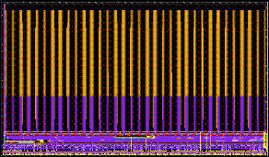
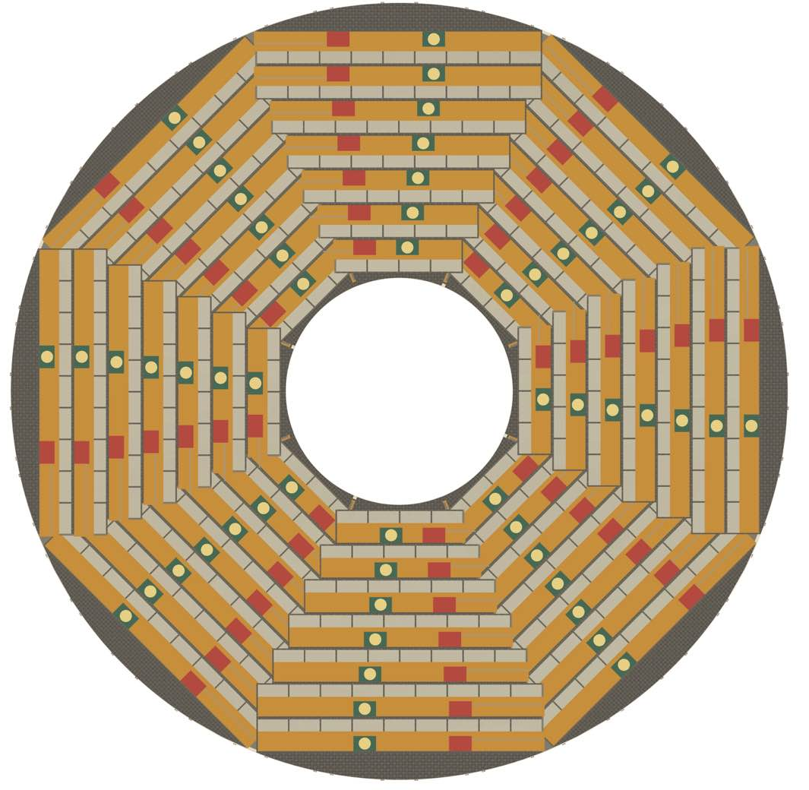
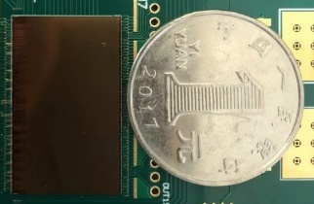
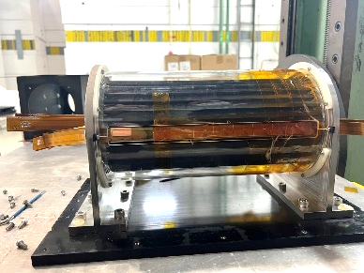
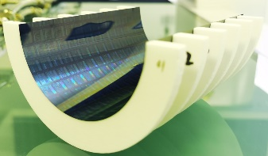
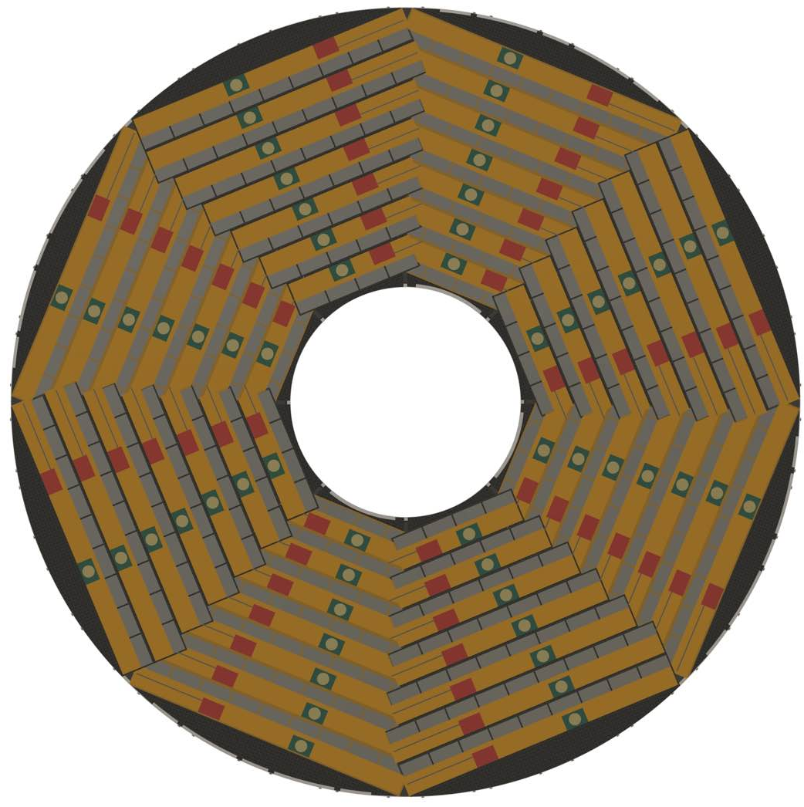
Detector R&D: Silicon Detectors
HV-CMOS
Inner Tracker
AC-LGAD Outer Tracker
55nm COFFEE chip
Stave
LGAD
Barrel
JadePix4
Pixel Vertex
CMOS Strip
Endcap Inner Tracker
Front view
TaichuPix3
Prototype VTX
Curved MAPS
Back view

Slide 10
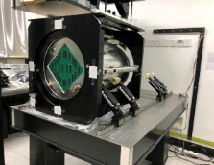
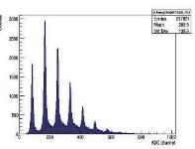
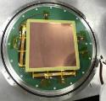
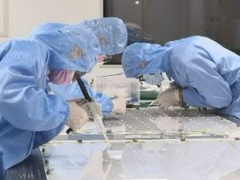
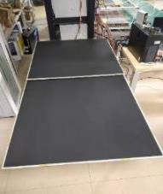
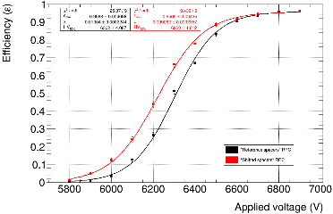
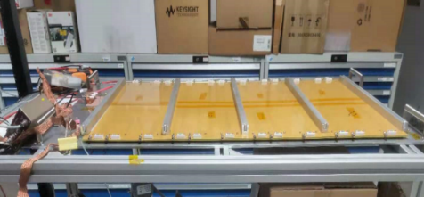
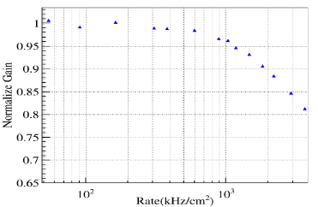
Detector R&D: Gaseous & Muon Detector
TPC Prototype
Scintillator Bar Muon
PID Drift
Chamber
GRPC SDHCAL
Simulation & Recons.
Signal Height
RWell SDHCAL
T [ns]

Slide 11
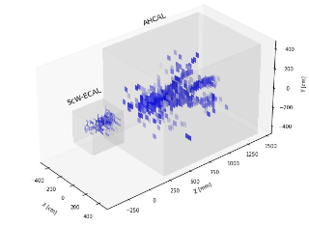
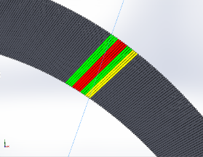
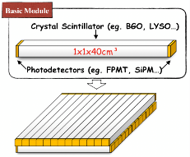
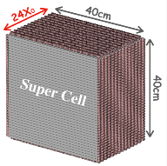
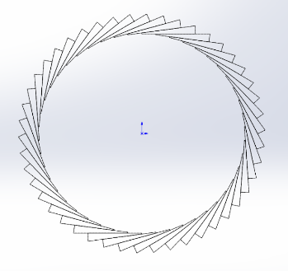
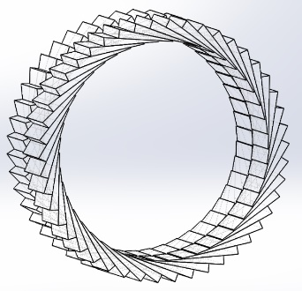
Detector R&D: Calorimeters
Prototype sampling
ECAL & HCAL
Glass
Scintillator
AHCAL
ECAL
4D Crystal
Bar ECAL
Stereo
Crystal ECAL
𝛼 = 30 °
14 layers
𝛼
FE readout
D
R1
φ
R2
adjacent layers
𝛼’ = -𝛼
IP
Incident
particles

Slide 12
Domestic Teams on Detector R&D
Projects | 任务分工 | HR Estimate
1 | Pixel Vertex Detector | 30
2 | Inner Silicon Tracker | 30
3 | Outer Silicon Tracker | 24
4 | Gas Tracker | 25
5 | Muon Detector | 20
6 | Electromagnetic Calorimeter | 16
7 | Hadron Calorimeter | 30
8 | Machine Detector Interface | 15
9 | Luminosity Calorimeter | 20
10 | Fast Luminosity Monitor | 10
11 | Super Conducting Magnet | 20
12 | Mechanical and Integration | 20
13 | General Electronics | 20
14 | Trigger and DAQ | 17
15 | Offline Software | 20
16 | Physics Study | 30
Researchers from ~32 major domestic institutes actively participate in the CEPC detector R&D
More institutes join, while the projects progress and funding support increases
JUNO will switch to operation mode soon. More researchers, especially engineers, will shift focus onto CEPC
The estimates include staff members, postdocs, and students. There are small overlaps between different projects.

Slide 13
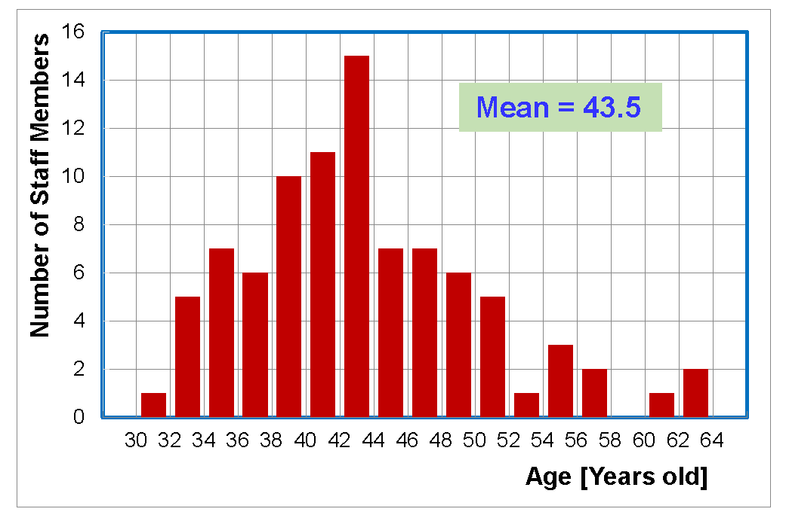
Staff Aging Structure
Staff members working on the CEPC detector and physics:
  IHEP ~90
  Other institutes ~200
Many of them were key members in building major China-based successful experiments: BES, DayaBay, JUNO, LHAASO, …
Some take fast rising significant roles in major experiments abroad: ATLAS, CMS, LHCb, ALICE, AMS, …
A team of healthy age structure.
IHEP staff members
on CEPC Physics and Detector

Slide 14
International Collaborative Efforts
The CEPC detector design incorporates experience from other future Higgs factory proposals, e.g. ILD.
International participations (~20 institutes) in subdetector R&Ds, e.g. MAPS detector, TPC, PID Drift chamber, …
International detector R&Ds
  Some detector R&D efforts were within the international detector R&D collaborations, e.g. CALICE, LCTPC, & RD*
  Much broader participation in the ECFA DRD program
Sub-system | DRD | Sub-system | DRD | Sub-system | DRD
Pixel Vertex Detector | 3 | Electromagnetic Calorimeter | 6 | Super Conducting Magnet
Inner Silicon Tracker | 3 | Hadron Calorimeter | 1, 6 | Mechanical and Integration | (8)
Outer Silicon Tracker | 3 | Machine Detector Interface |  | General Electronics | (7)
Gas Tracker (TPC / DC) | 1 | Luminosity Calorimeter |  | Trigger and DAQ | (7)
Muon Detector | 1 (RPC) | Fast Luminosity Monitor | 3 | Offline Software

Slide 15
Document Preparation of Ref-TDR
Physics Goal and Requirements
Concept Introduction
MDI and Luminosity Detectors
Vertex Detector
Silicon Trackers
Gaseous Trackers
Electromagnetic Calorimeter
Hadron Calorimeter
Muon Detector
Superconducting Solenoid Magnet
General Electronics
Trigger and Data Acquisition
Software and Computing
Mechanics and Integration
Physics Performance
Overall Cost and Project Timeline
The ref-TDR has 16 chapters, which may be re-structured later.
Each chapter has a responsible team, including members from domestic and international institutes.
Prof Tianchi Zhao kindly agreed to be the chief editor. A small editorial team will assist him
Report at this meeting

Slide 16
Ref-TDR Timeline
Date | Actions and/or Expectations
Jan 1, 2024 | Start the ref-TDR process by comparing different technologies
Jul 1, 2024 | Baseline technologies are chosen; start to write TDR and address key issues
Aug 7, 2024 | Report to the IDRC chair Prof Daniela Bortoletto
Oct 21-23, 2024 | Review of ref-TDR progress by the IDRC
Oct 23-30, 2024 | Discuss the ref-TDR at the CEPC workshop, report progresses to the CEPC IAC
~ January 2025 | The first draft of the ref-TDR is ready for internal reviews
~ April 2025 | Finish international reviews
Jun 30, 2025 | The ref-TDR is ready

Slide 17
Charge To CEPC IDRC
Review the overall status of the R&D efforts for the CEPC detectors, which will be highlighted in the presentations.
Offer initial observations or suggestions for improvements across the project.
Identify technical risks associated with the detector design and propose mitigation strategies.
Discuss the feasibility and readiness of critical technologies and components for the detector system, considering the proposed Ref-Detector and alternative technologies, and taking into account the overall detector performance and physics performance expectations.
Prepare for subsequent review meetings by establishing the framework for ongoing evaluation and feedback processes.
Other -- any comments and suggestions pertaining to the Ref-Detector TDR.

Slide 18

Thank you for
your support to CEPC!
Oct. 21-22, 2024, CEPC Detector Ref-TDR Review

Slide 19
国内国际主要合作团队
国内合作参与研究机构列表
1 | 清华大学 | 气体径迹探测器
2 | 北京大学 | 物理模拟
3 | 上海交通大学 | 外径迹和飞行时间、电磁量能器、物理模拟、超导磁体
4 | 山东大学 | 顶点探测器、内径迹探测器、气体径迹探测器、离线软件、触发与数据获取、电子学、物理模拟
5 | 中国科学技术大学 | 电磁量能器、强子量能器
6 | 郑州大学 | 外径迹和飞行时间、气体径迹探测器、离线软件、触发与数据获取、物理模拟
7 | 南开大学 | 触发与数据获取、缪子探测器、物理模拟、外径迹和飞行时间
8 | 浙江大学 | 内径迹探测器
9 | 华中师范大学 | 顶点探测器、电子学、物理模拟
10 | 复旦大学 | 缪子探测器、电子学、离线软件、物理模拟
11 | 西北工业大学 | 顶点探测器、电子学
12 | 南京大学 | 亮度探测器、快速亮度监测器
13 | 吉林大学 | 亮度探测器
14 | 中山大学 | 内径迹探测器、外径迹和飞行时间、离线软件
15 | 西南交通大学 | 超导磁体
16 | 华北电力大学 | 超导磁体
17 | 湖南大学 | 机械、内径迹探测器
18 | 大连民族大学 | 内径迹探测器
国内合作参与研究机构列表
19 | 华南师范大学 | 缪子探测器、离线软件
20 | 哈尔滨工程大学 | 强子量能器
21 | 哈尔滨工业大学 | 强子量能器
22 | 四川大学 | 强子量能器
23 | 井冈山大学 | 强子量能器
24 | 南昌大学 | 顶点探测器
25 | 中国计量大学 | 强子量能器
26 | 中国科学院硅酸盐研究所 | 电磁量能器
27 | 中国科学院微电子研究所 | 内径迹探测器、外径迹和飞行时间
28 | 中国科学院上海精密光学研究所 | 强子量能器
29 | 中国科学院赣江研究院 | 强子量能器
30 | 山东高等技术研究院 | 内径迹探测器
31 | 中研院物理研究所 | 亮度探测器、快速亮度监测器
32 | 中国建材总院 | 强子量能器
33 | 北京科维泰信 | 内径迹探测器
34 | 北京玻璃研究院 | 强子量能器
35 | 上海超导科技股份有限公司 | 超导磁体
36 | 中信重工机械股份有限公司 | 机械
37 | 黄河勘探规划设计研究院有限公司 | 机械
38 | 无锡统力电工有限公司 | 超导磁体
国际合作参与研究机构列表
1 | CERN DRD合作组 | 半导体探测器、气体径迹探测器等
2 | 法国IPHC研究所 | 顶点探测器
3 | 法国CNRS | 物理模拟
4 | 法国CEA-Saclay研究所 | 气体径迹探测器
5 | 德国卡尔斯鲁厄大学 | 内径迹探测器
6 | 德国伯恩大学 | 气体径迹探测器
7 | 德国DESY | 气体径迹探测器
8 | 英国兰开斯特大学 | 内径迹探测器
9 | 英国爱丁堡大学 | 内径迹探测器
10 | 英国布里斯托尔大学 | 内径迹探测器
11 | 意大利核物理国家实验室（INFN） | 内径迹探测器、外径迹和飞行时间、气体径迹探测器
12 | 意大利巴里理工大学 | 气体径迹探测器
13 | 荷兰NIKEHF研究所 | 气体径迹探测器
14 | 日本东京大学 | 电磁量能器
15 | 日本信州大学 | 电磁量能器
16 | 塞尔维亚温查研究所 | 亮度探测器
17 | 西班牙IFAE研究所 | 顶点探测器
18 | 俄罗斯LPI研究所 | 物理模拟
19 | 俄罗斯BINP研究所 | 粒子鉴别
20 | 俄罗斯联合核子研究所 | 离线软件

Slide 20
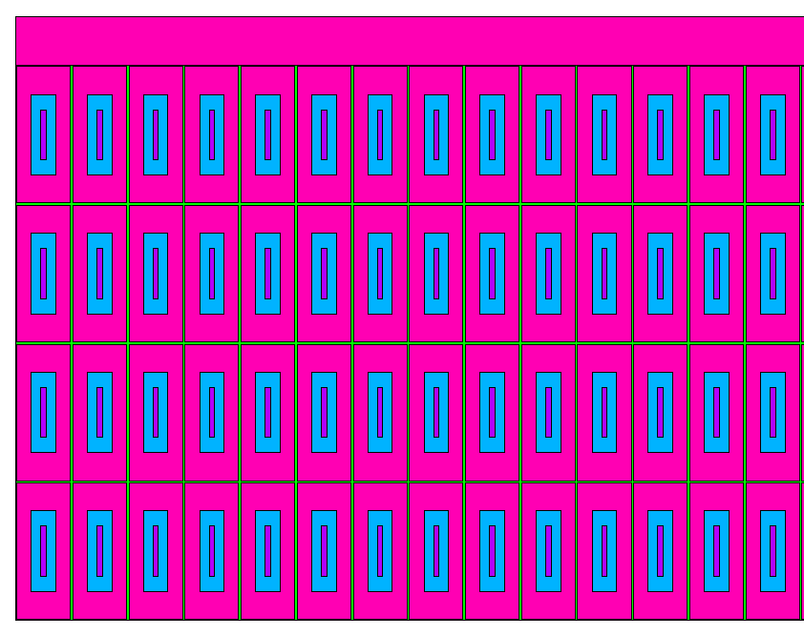
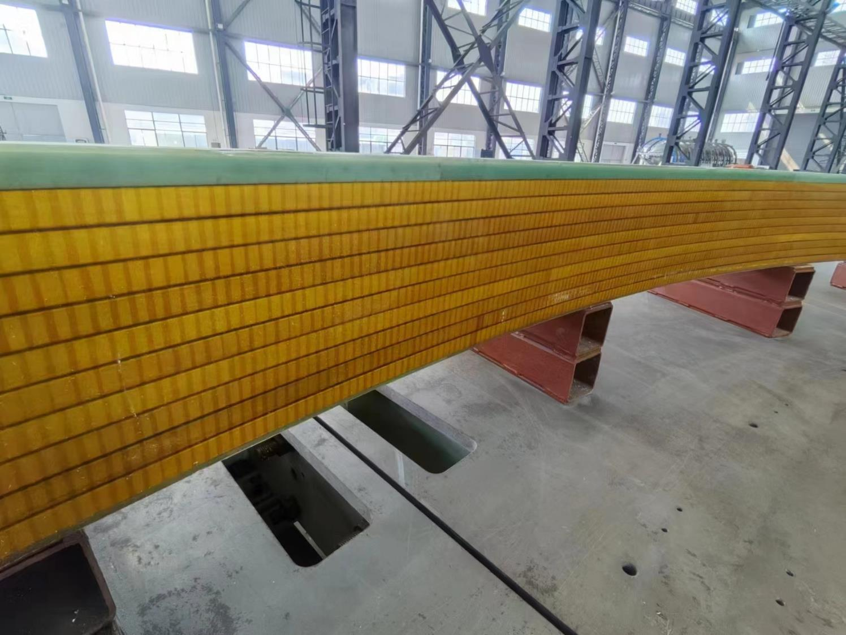
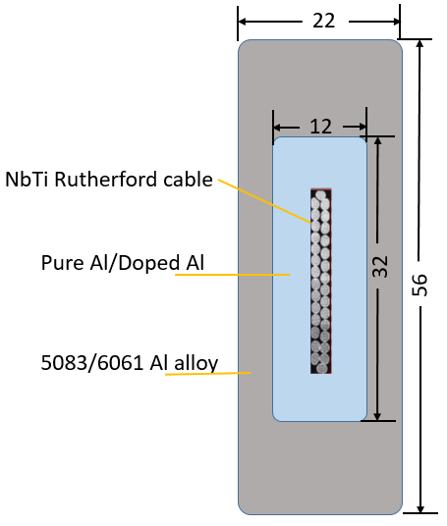
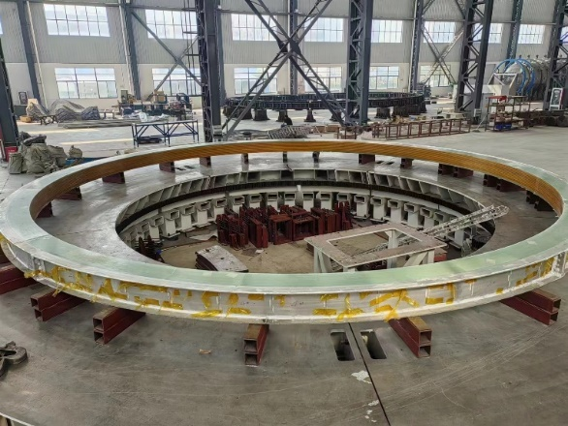
4 layers××10 turns
φ7.2m dummy coil
SC coil schematic diagram
8 | Machine Detector Interface | 15
9 | Luminosity Calorimeter | 20
10 | Fast Luminosity Monitor | 10
11 | Super Conducting Magnet | 20
12 | Mechanical and Integration | 20
13 | General Electronics | 20
14 | Trigger and DAQ | 17
15 | Offline Software | 20
Aluminum stabilized
NbTi Rutherford cable
Dummy coil

Slide 21
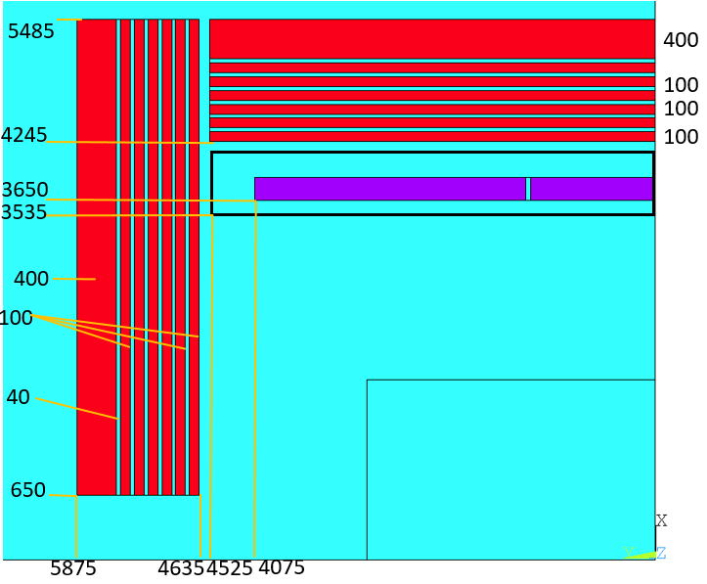
探测器超导磁铁
4 layers××10 turns
φ7.2m dummy coil
SC coil schematic diagram
Coil parameters:
Central magnetic field | 3 T
Inner diameter | 7300 mm
Operating current | 16702 A
Cable length | 33 km
Inductance | 11 H
Stored Energy | 1.54 GJ
Aluminum stabilized
NbTi Rutherford cable
Dummy coil

Slide 22
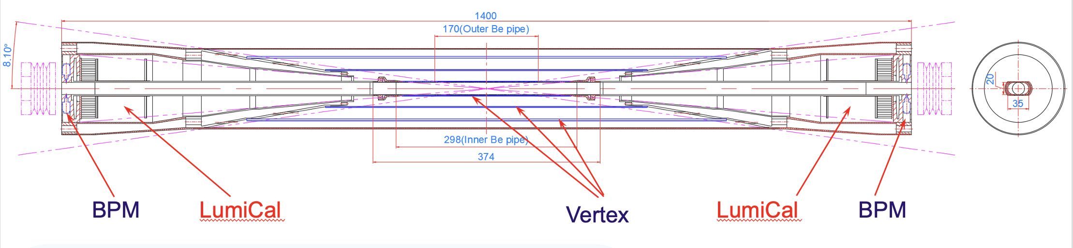
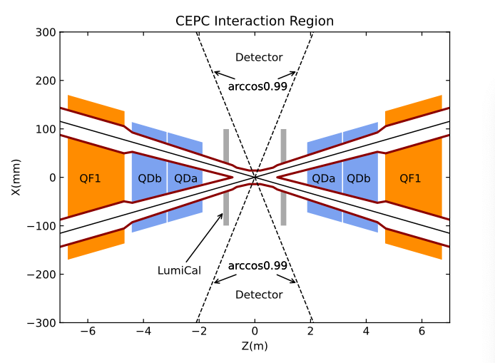
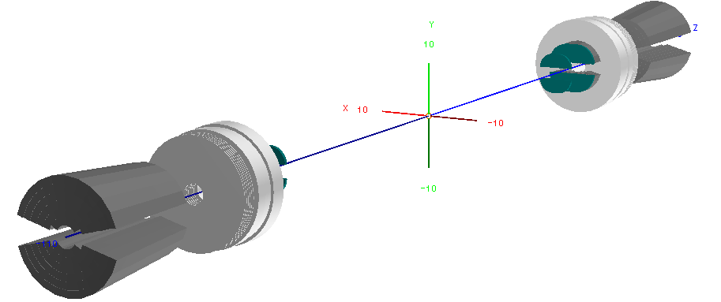
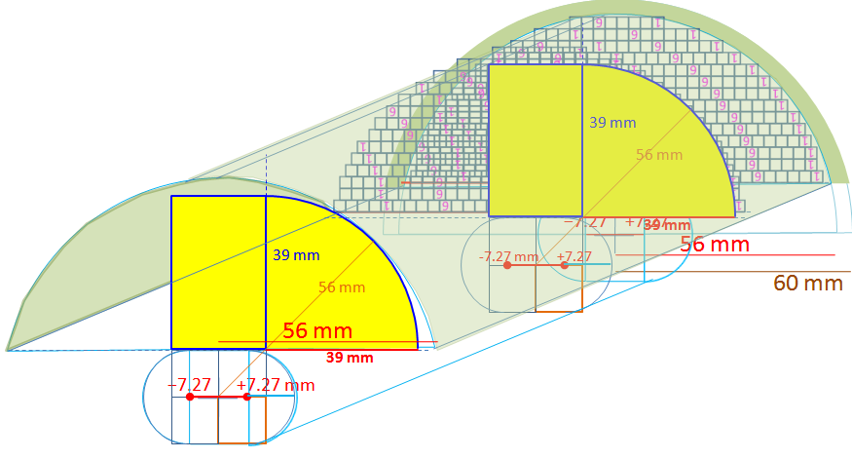
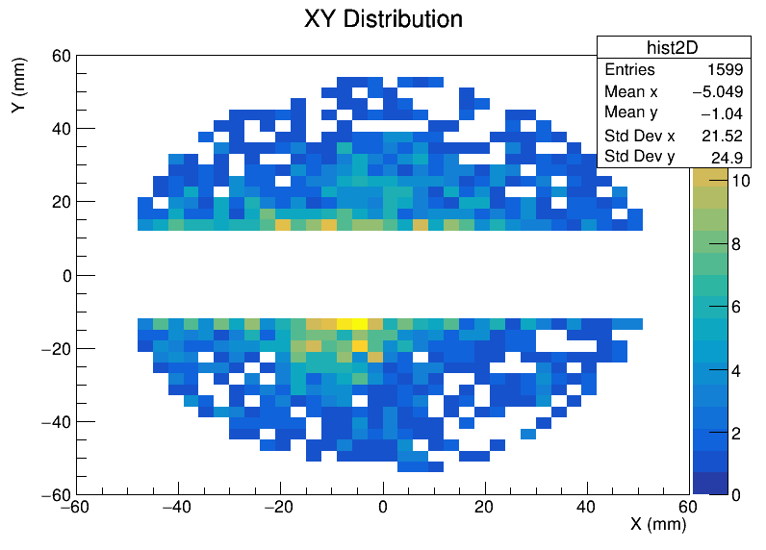
MDI与对撞亮度测量
Beampipe Design
Beam pipe
  Inner Diameter 20mm
  Inner Layer with thickness of 0.20mm
  Gap for coolant with thickness of 0.35mm
  Water chosen as coolant instead of paraffin
  Outer Layer with thickness of 0.15mm
LumiCal
  2 parts, first Si wafer + LYSO, second LYSO only
  First Silicon Wafer locates at 560mm, than 640mm
  First LYSO has a length of 23mm(starts from 647mm)
  Second LYSO has a length of 200mm(starts from 900mm)
  Half Moon-cake like design
  Height ~ 39mm, radius ~ 56 mm
LumiCAL
SiPixDet ×2 + LYSO bars 3×3×(23+200) mm³
LYSO 200 mm = 17.4 X₀
Z= 560-700 900 - 1100 mm

Slide 23
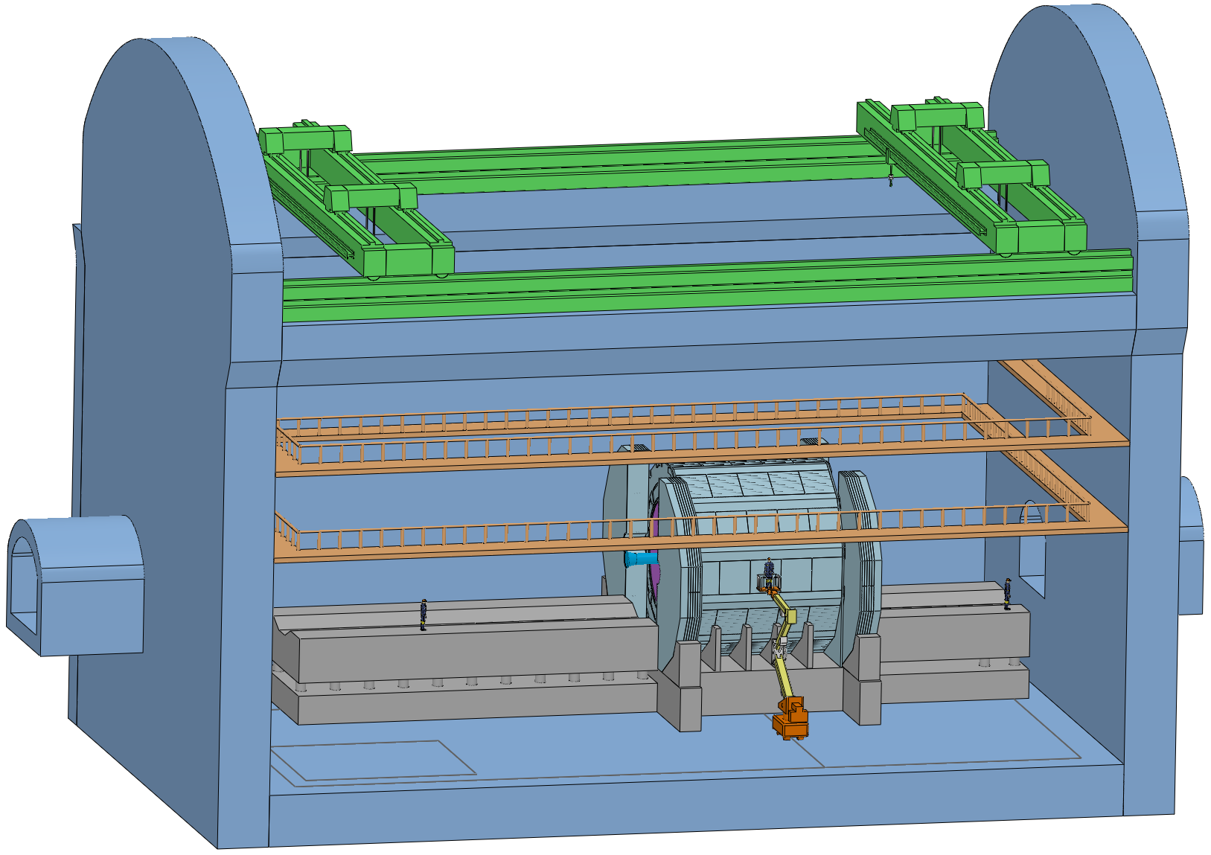
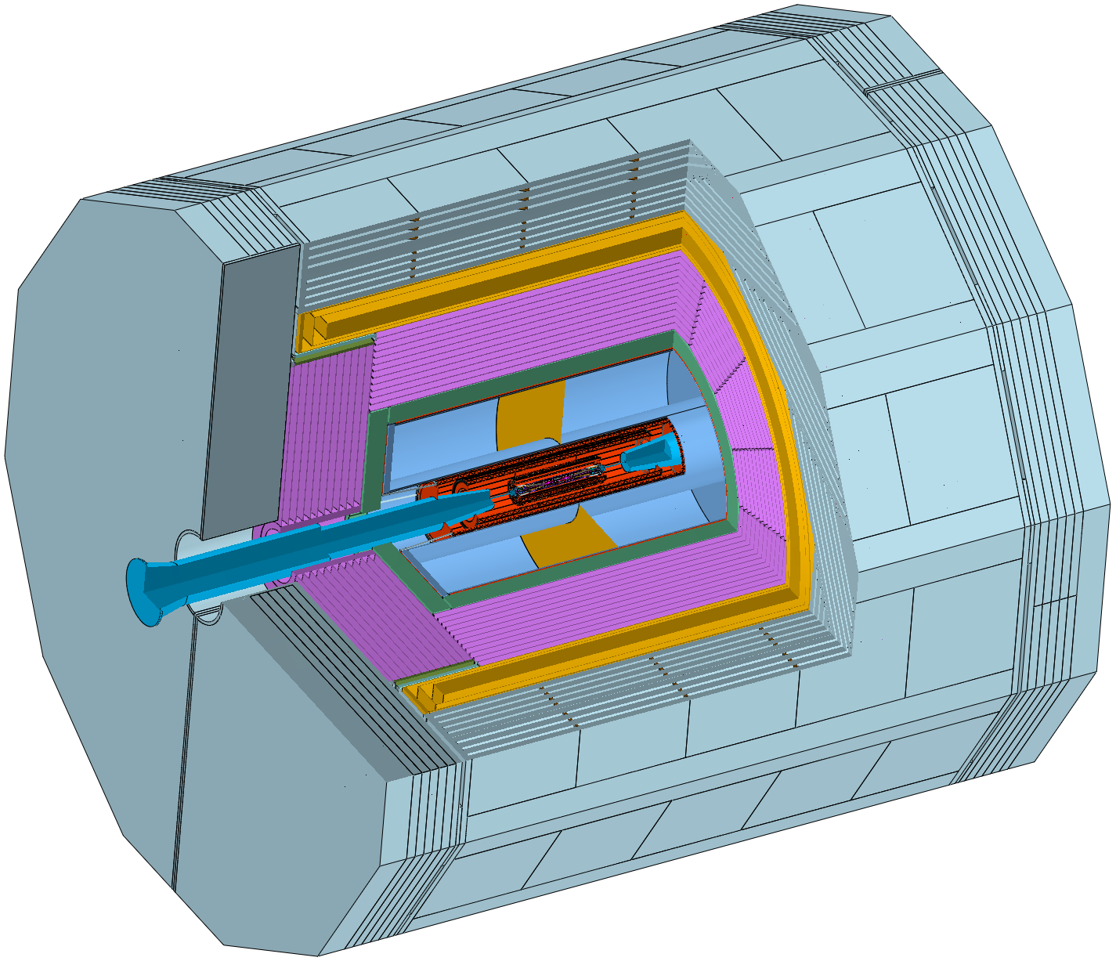
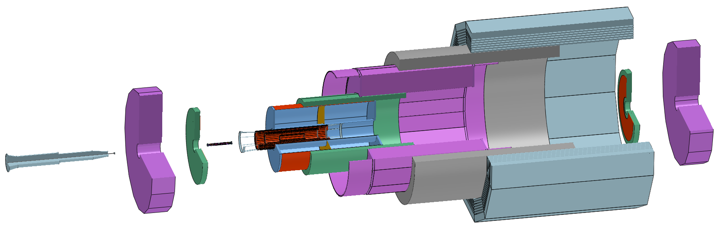
实验大厅总体布局和探测器安装
地下实验大厅
初步完成地下实验大厅的布局设计，确定探测器安装程序
探测器安装
ACC Component
Beampipe
(Vertex)
End HCAL
End ECAL(OTK)
ITK
TPC(OTK)
ECAL
HCAL
Magnet
Yoke

