Slide 1
Group meeting Anomalous ${\text{U}\text{(1)}}_{A}$ couplings and the Columbia plot
Rui Wen
2024.10.12

Slide 2
arXiv:2401.06130 Phys.Rev.Lett. 132 (2024) 25, 251903
arXiv:2410.08185

Slide 3
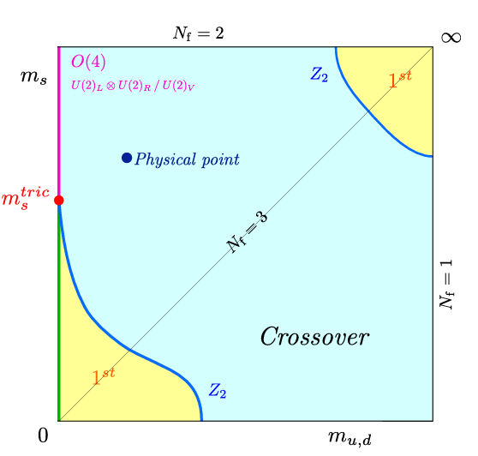
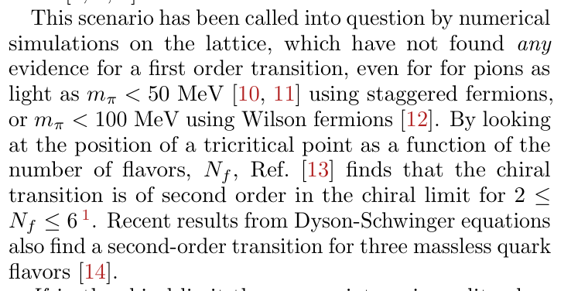
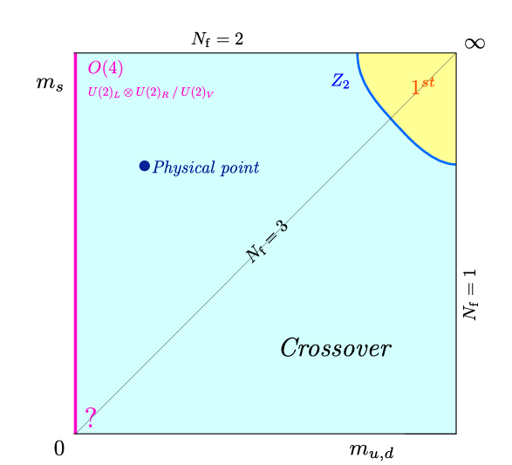

Slide 5
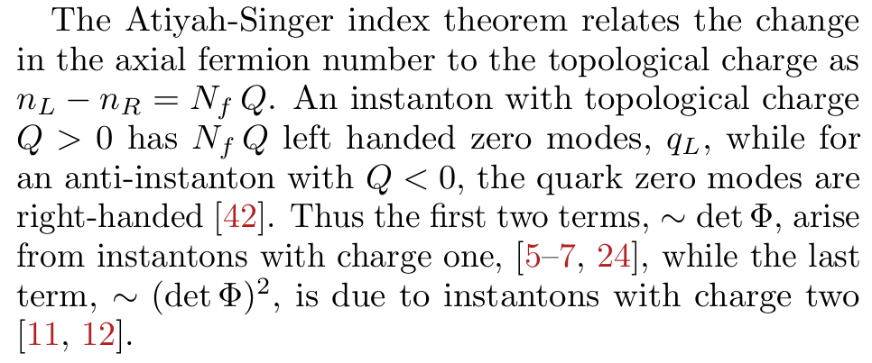

Slide 6
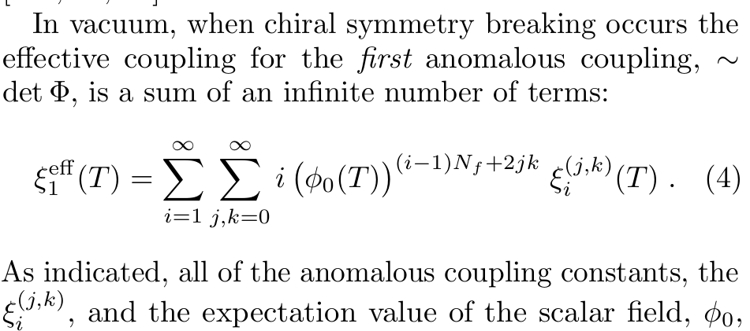
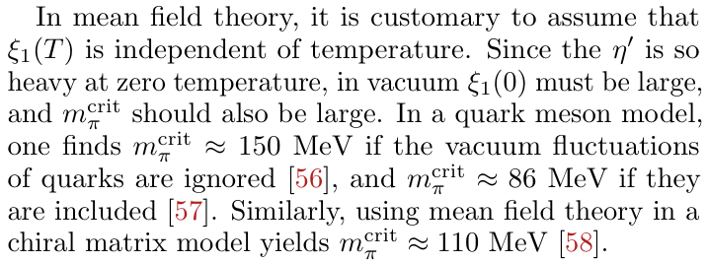

Slide 7
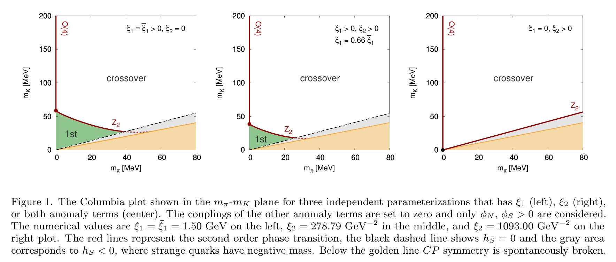
arXiv:2410.08185

Slide 8
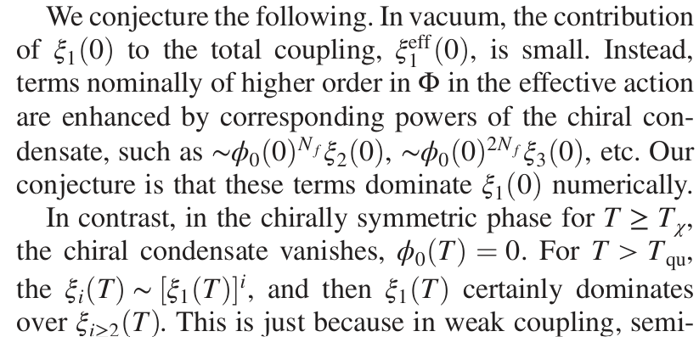

Slide 9
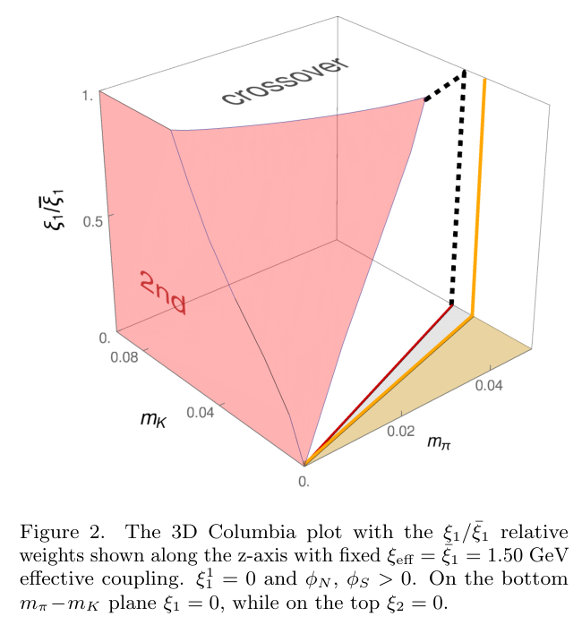

Slide 10
Signal 1
Signal 2

Slide 11
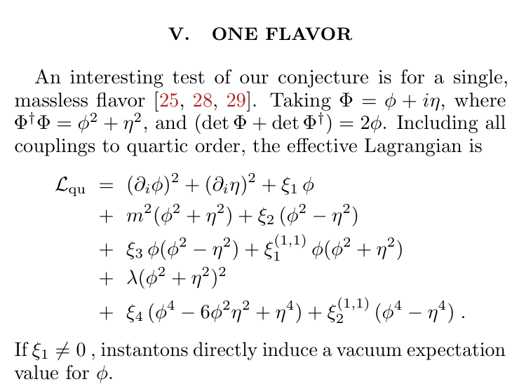
may be no true chiral phase transition, there could well be a sharp crossover from a low temperature phase

