Slide 1
Progress and Plan
Mingyi Dong
2024.10.14

Slide 2
Progress in the experimental hall last week
 | Planned tasks last week | Time needed (day) | person in charge | Status
1 | Remove the cable carriage of CGEM | 1/2 (Oct.7) | Italy team | done
2 | Remove the long rail | 1/2 (Oct.7) | Facilities Operation group (Jing Xiaoping) | done
3 | (1)Leakage check and gas sealing of MDC (2) Installation of the shielding plate on east side | 1 (Oct.7-8) | Mingyi Dong | done
4 | Laser measurement after installation of CGEM | 1 (Oct.9) | Lingling Men | done
5 | Remove the support legs on east side | 1 (Oct.8) | Facilities Operation group (Jing Xiaoping) | done
6 | Set up platform for CGEM electronics (GEMROC and low voltage crate) | 2 (Oct. 10-11) | Facilities Operation group (Jing Xiaoping) | done
7 | CGEM cabling |  | Italy team | on schedule

Slide 3
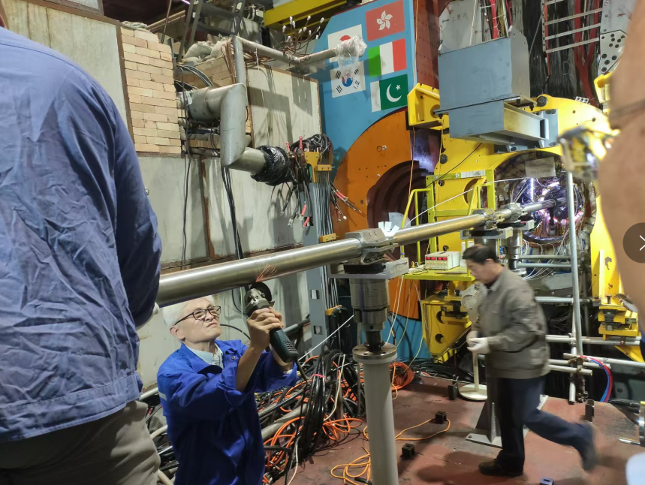
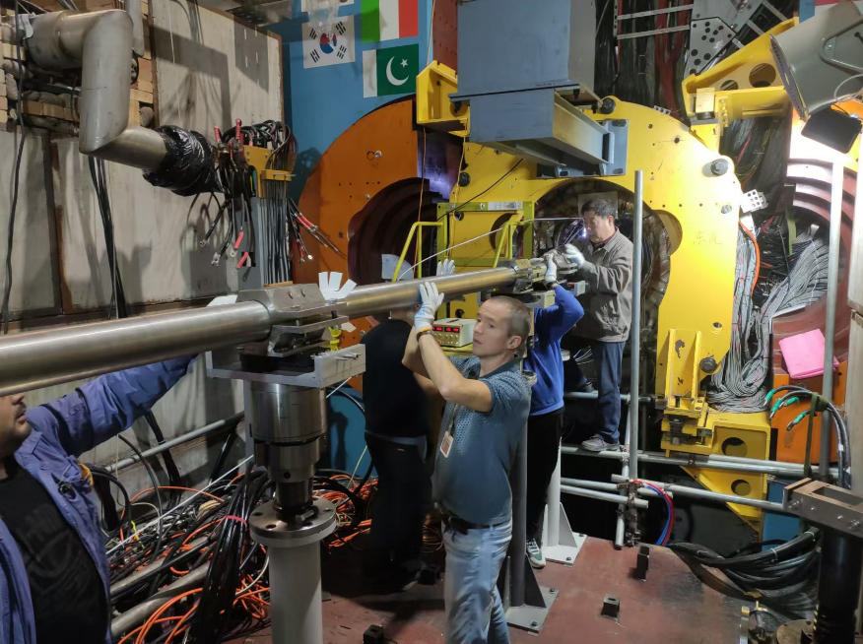
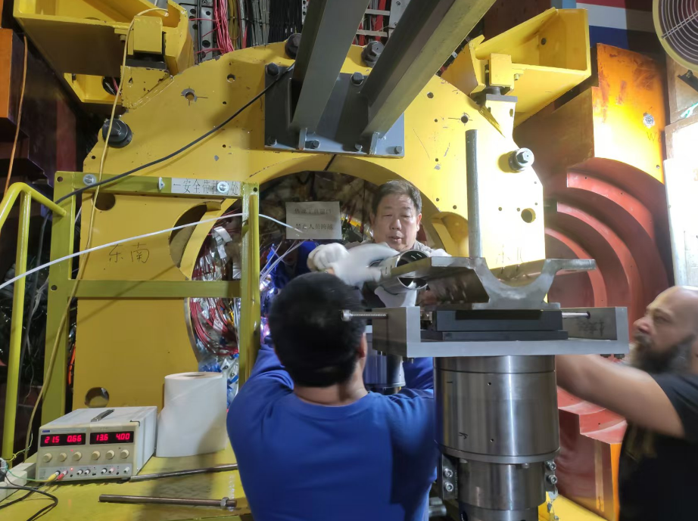
Removal of the long rail and legs
Oct. 7 and 8
Removed the long rail
Removed the legs on east side

Slide 4
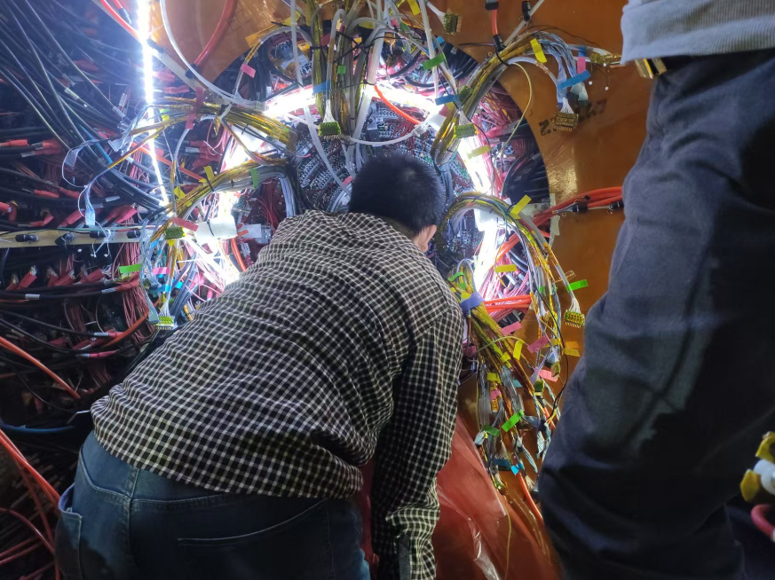
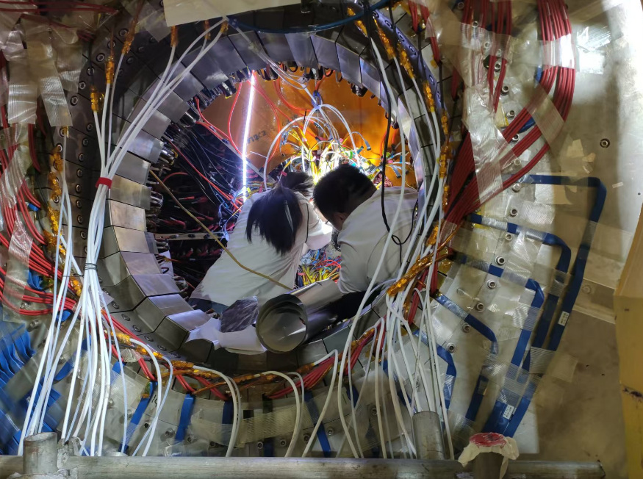
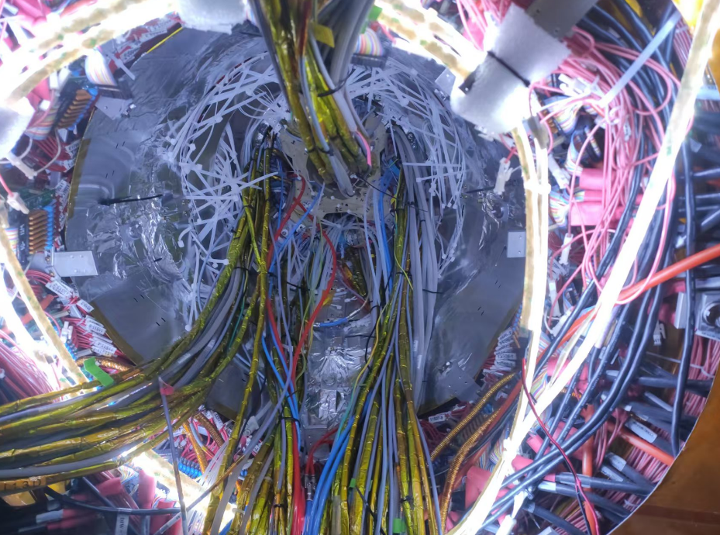
Gas sealing and Installation of Shielding plates
Oct.7-8
Leakage check and gas sealing of MDC. Large leaks were found around the screw holes fixing CGEM on both sides. Sealed with silicon RTV (two times on west side)
Installation of the shielding plate on east side

Slide 5
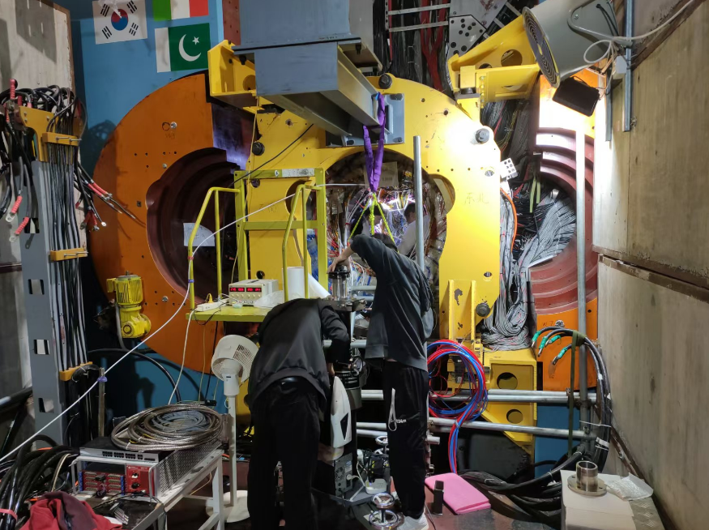
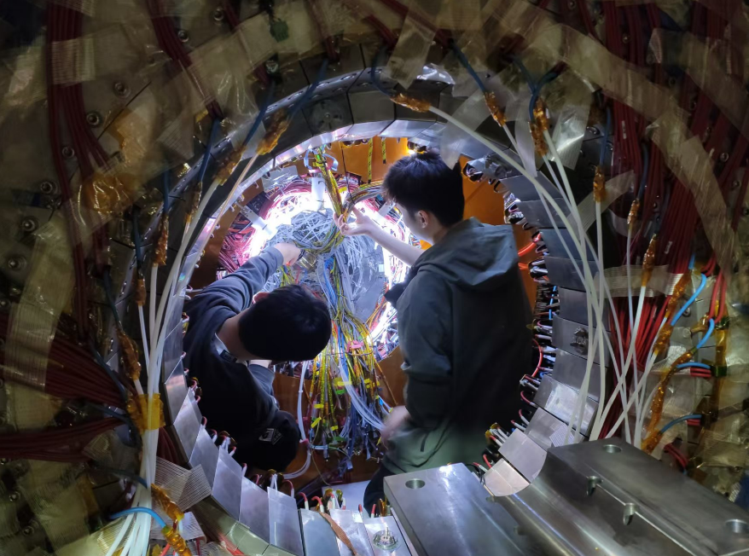
Laser measurement after CGEM installation
Oct. 9
Measured MDC and CGEM position after CGEM installation
No change of MDC after CGEM installation
Have a preliminary measurement results of CGEM position
Test position | Deviation of the center in the X direction/mm | Deviation of the center in the Y direction/mm
East flange _1 | -0.643 | -0.436
East flange_2 | -0.648 | -0.408
West flange_1 | 0.016 | -0.1
West flange_2 | 0.18 | -0.088

Slide 6
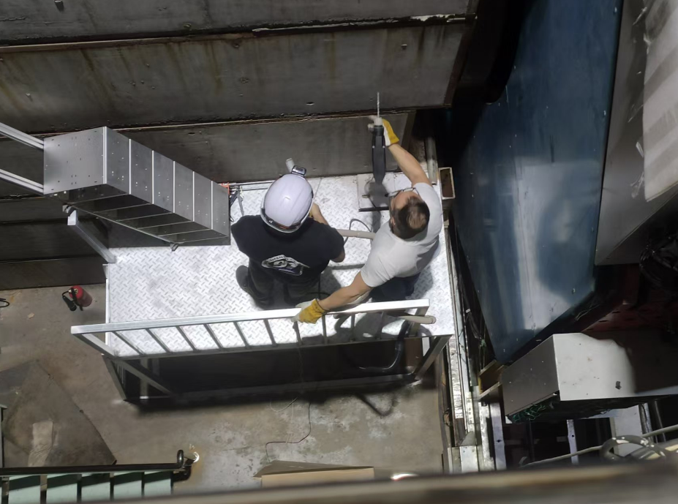
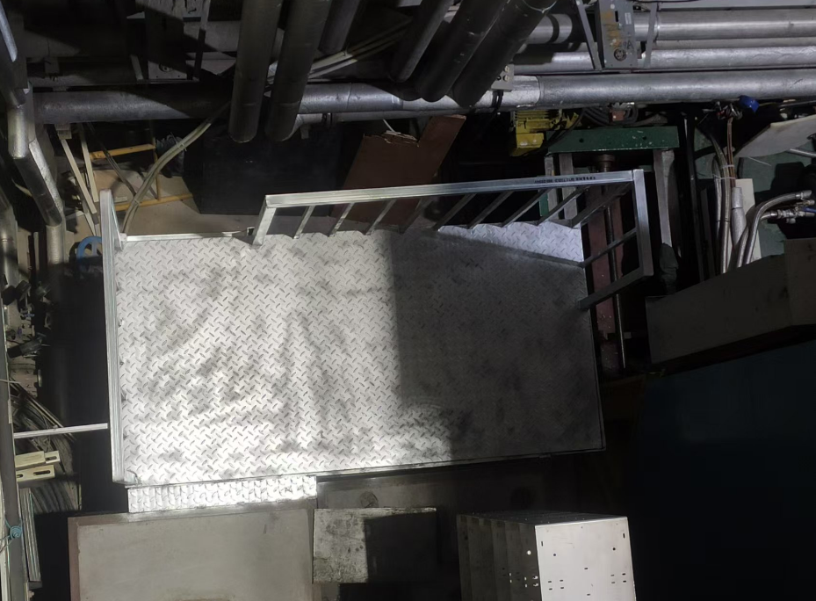
Platform for CGEM electronics
Oct. 10-11
Set up platforms for CGEM electronics (GEMROC and low voltage crate) on both sides. (about 1m *2m, height: 2.5m)
Minimized of signal and LV cable lengths as much as possible

Slide 7
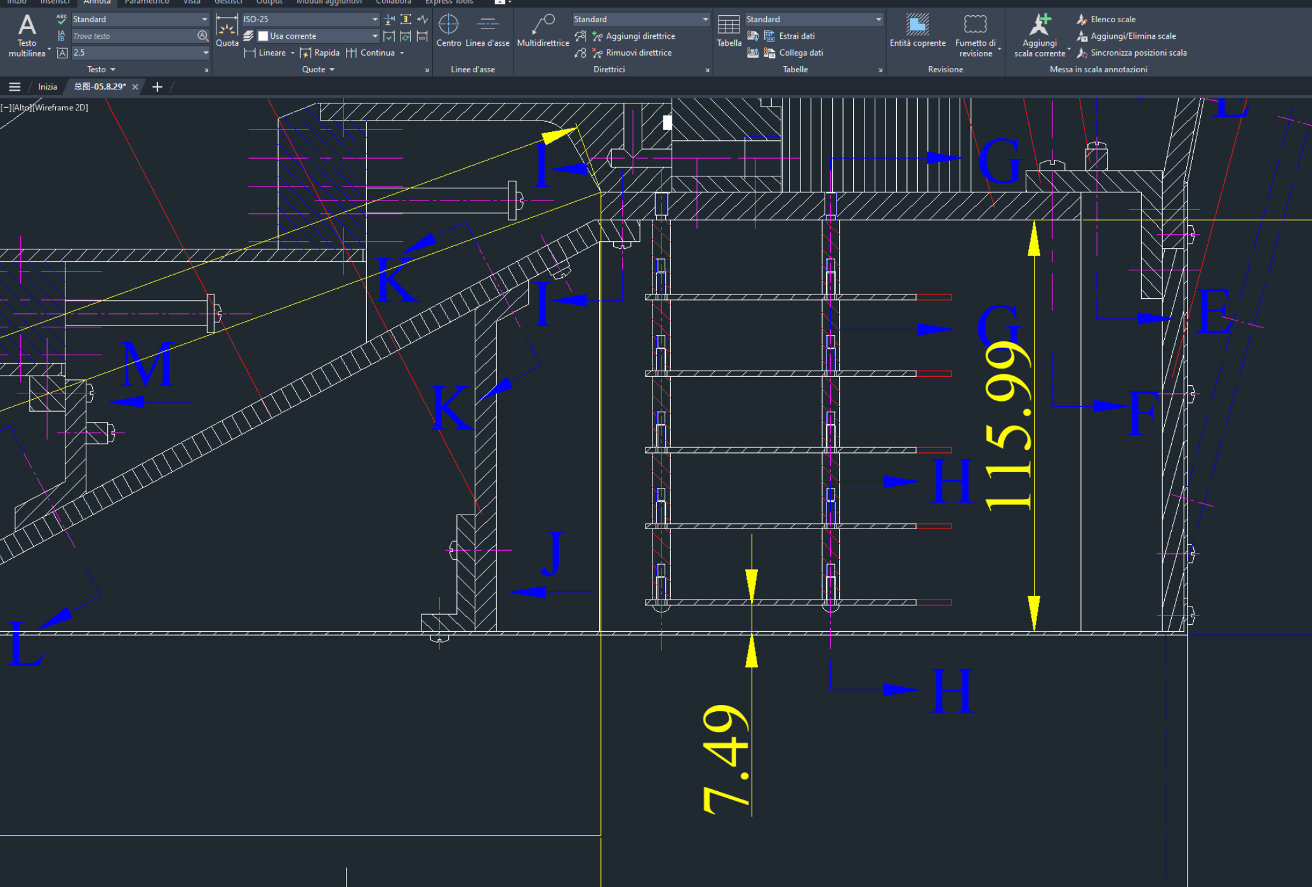
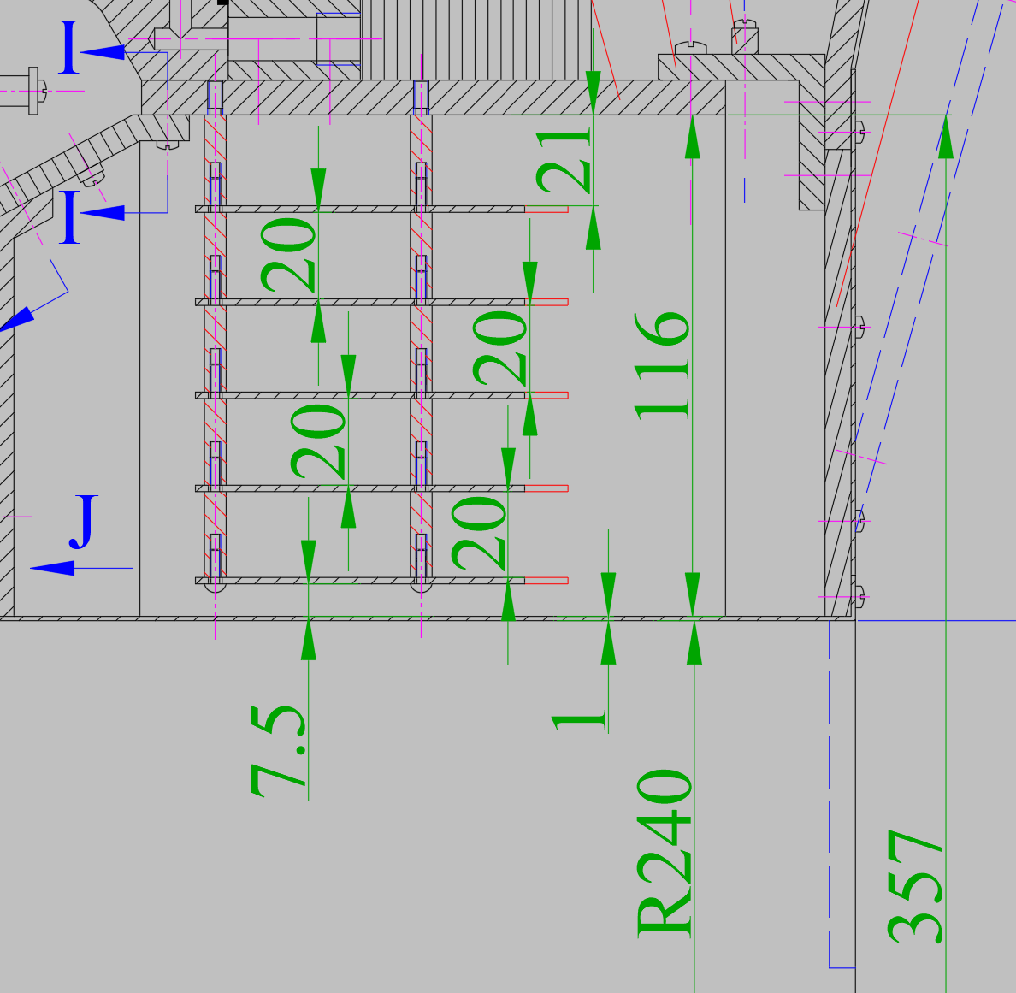
Other issues (Installation space for CGEM FED, HV cabling)
Oct.11
The space between the MDC preamps and the original shielding plates is not enough for CGEM FED
Measured the diameter of the focusing magnet support structure (400mm) and the diameter of the drift chamber step shielding plates (480mm)
Determined to increase the support block of the step shielding plates by 20mm to leave an additional 20mm of installation space for the CGEM FED. (Stefano, Qun and Mingyi)
With the new support blocks for shielding, CGEM cable fixing brackets can be added.
Oct.12
Discussion and on-site investigation on HV cabling with Stefano, Matias, and Michela
Determined the high-voltage cable routing path and the approximate cable fixing scheme

Slide 8
Plan for next week
 | Planned tasks last week | Time needed (day) | person in charge
1 | HV training and cosmic-ray test of MDC if it is possible | 2-3 | Mingyi Dong
2 | Preparation of new blocks and plates for shielding |  | Jinyu Fu
3 | CGEM cabling |  | Italy team

Slide 9
Backup

Slide 10
Schedule (may be updated each week)
No. | tasks | Duration（day） | Start time and stop time | Sub-system involved | Status
1 | Removal of equipment of machine |  | July 1- Aug. 6 | Utility, Small angle lum. Detector and ZDD, Beam pipe, slow control | done
2 | Pull-out of EEMC |  |  | Utility, EMC, TOF, MDC | done
3 | Removal of inner chamber（Operate simultaneously on both sides ） | 51 | Aug. 7- Sep.7 Sep.8- Sep. 28 | MDC, MDC electronics, Gas, Mechanics, Laser measurement group, Trigger, DAQ, Slow control | done
4 | Installation of CGEM | 44 | Sep.29- Nov. 11 | CGEM group, MDC, MDC electronics, Gas, Mechanics, Laser measurement group, Trigger, DAQ, Slow control | On Schedule
5 | Recover EEMC |  | Nov. 12-Dec.30 | Utility, EMC, TOF, MDC
6 | Recover equipment of machine |  |  | Utility, Small angle lum. Detector, ZDD, Beam pipe, slow control
total |  | 180 days | July 1- Dec.30

