Slide 1
Progress and plan of DAQ or SC
Tingxuan Zeng, Sheng Dong, Si Ma
2024-10-14

Slide 2
DAQ TEST
Optimized the data file parsing code, the time difference between adjacent events' timestamps matches the event rate of Hall 3.
Familiarize with the BESIII framework code to prepare for further development.
Can test with the system once it is ready.

Slide 3
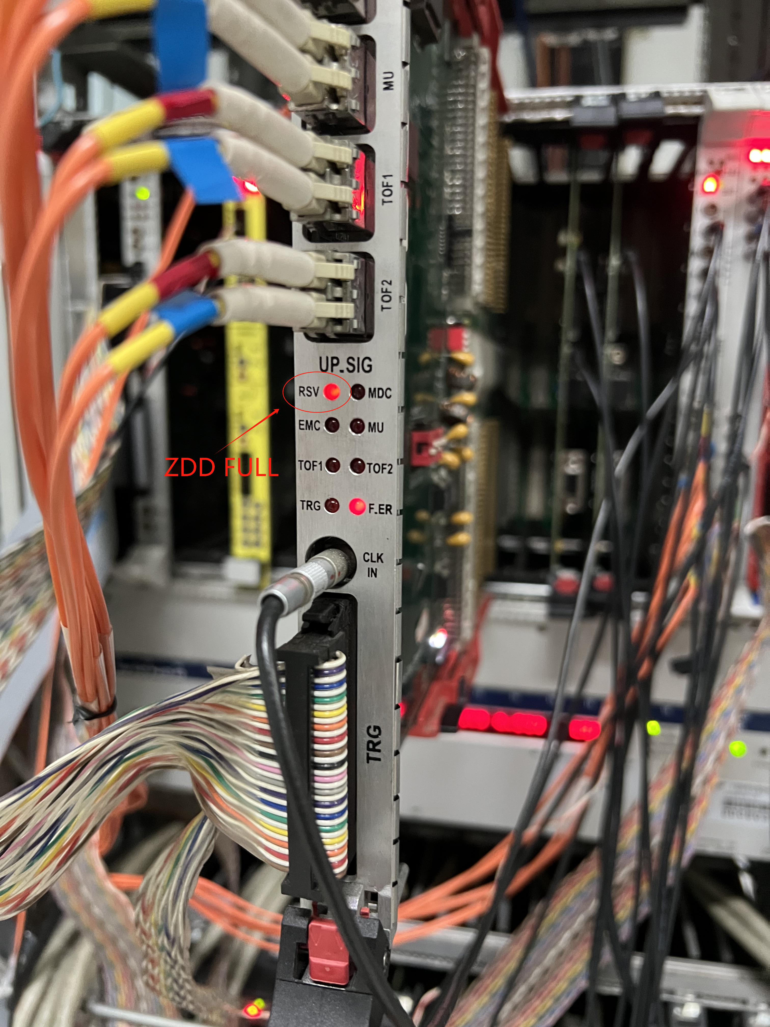
FULL TEST
Electrical tests confirmed that the hardware and optical fiber link have no issues.
A software configuration bug was identified and resolved. Previously, the full signal was always masked (a historical issue).
Now, the ZDD full signal can be detected by the back-end electronics and functions as expected, such as blocking L1.
Verify the full output of the GEM ROC once it is ready.
The FULL signal is detected on FCTL (Fast Control Board).

Slide 4
Slow control commissioning plan
Commissioning Plan of CGEM Slow Control
Debugging tasks need to be done | Conditions required | Time needed
The final version of HV, LV and GEMROCs software debugging with devices solely, without connecting to the detector. | HV, LV Mainframes and all GEMROCs. | ~1 week
Cooling software debugging with cooling sensors, valves and the pump. | All cooling devices | ~1 week
Check interlock procedure of CGEM detector. | With CGEM experts together | ~1 week
Integrated with GCS and Interlock system. | Slow control team | ~ 1 week
Gigi confirmed the automated process of HV control after the trip occurred, with 5v/s ramping up at once to injectable.
For other undefined abnormal situations, just turn off the detector.
For slow control, to ensure the software is delivered on schedule, CGEM experts will take into account the time required for debugging.

Slide 5
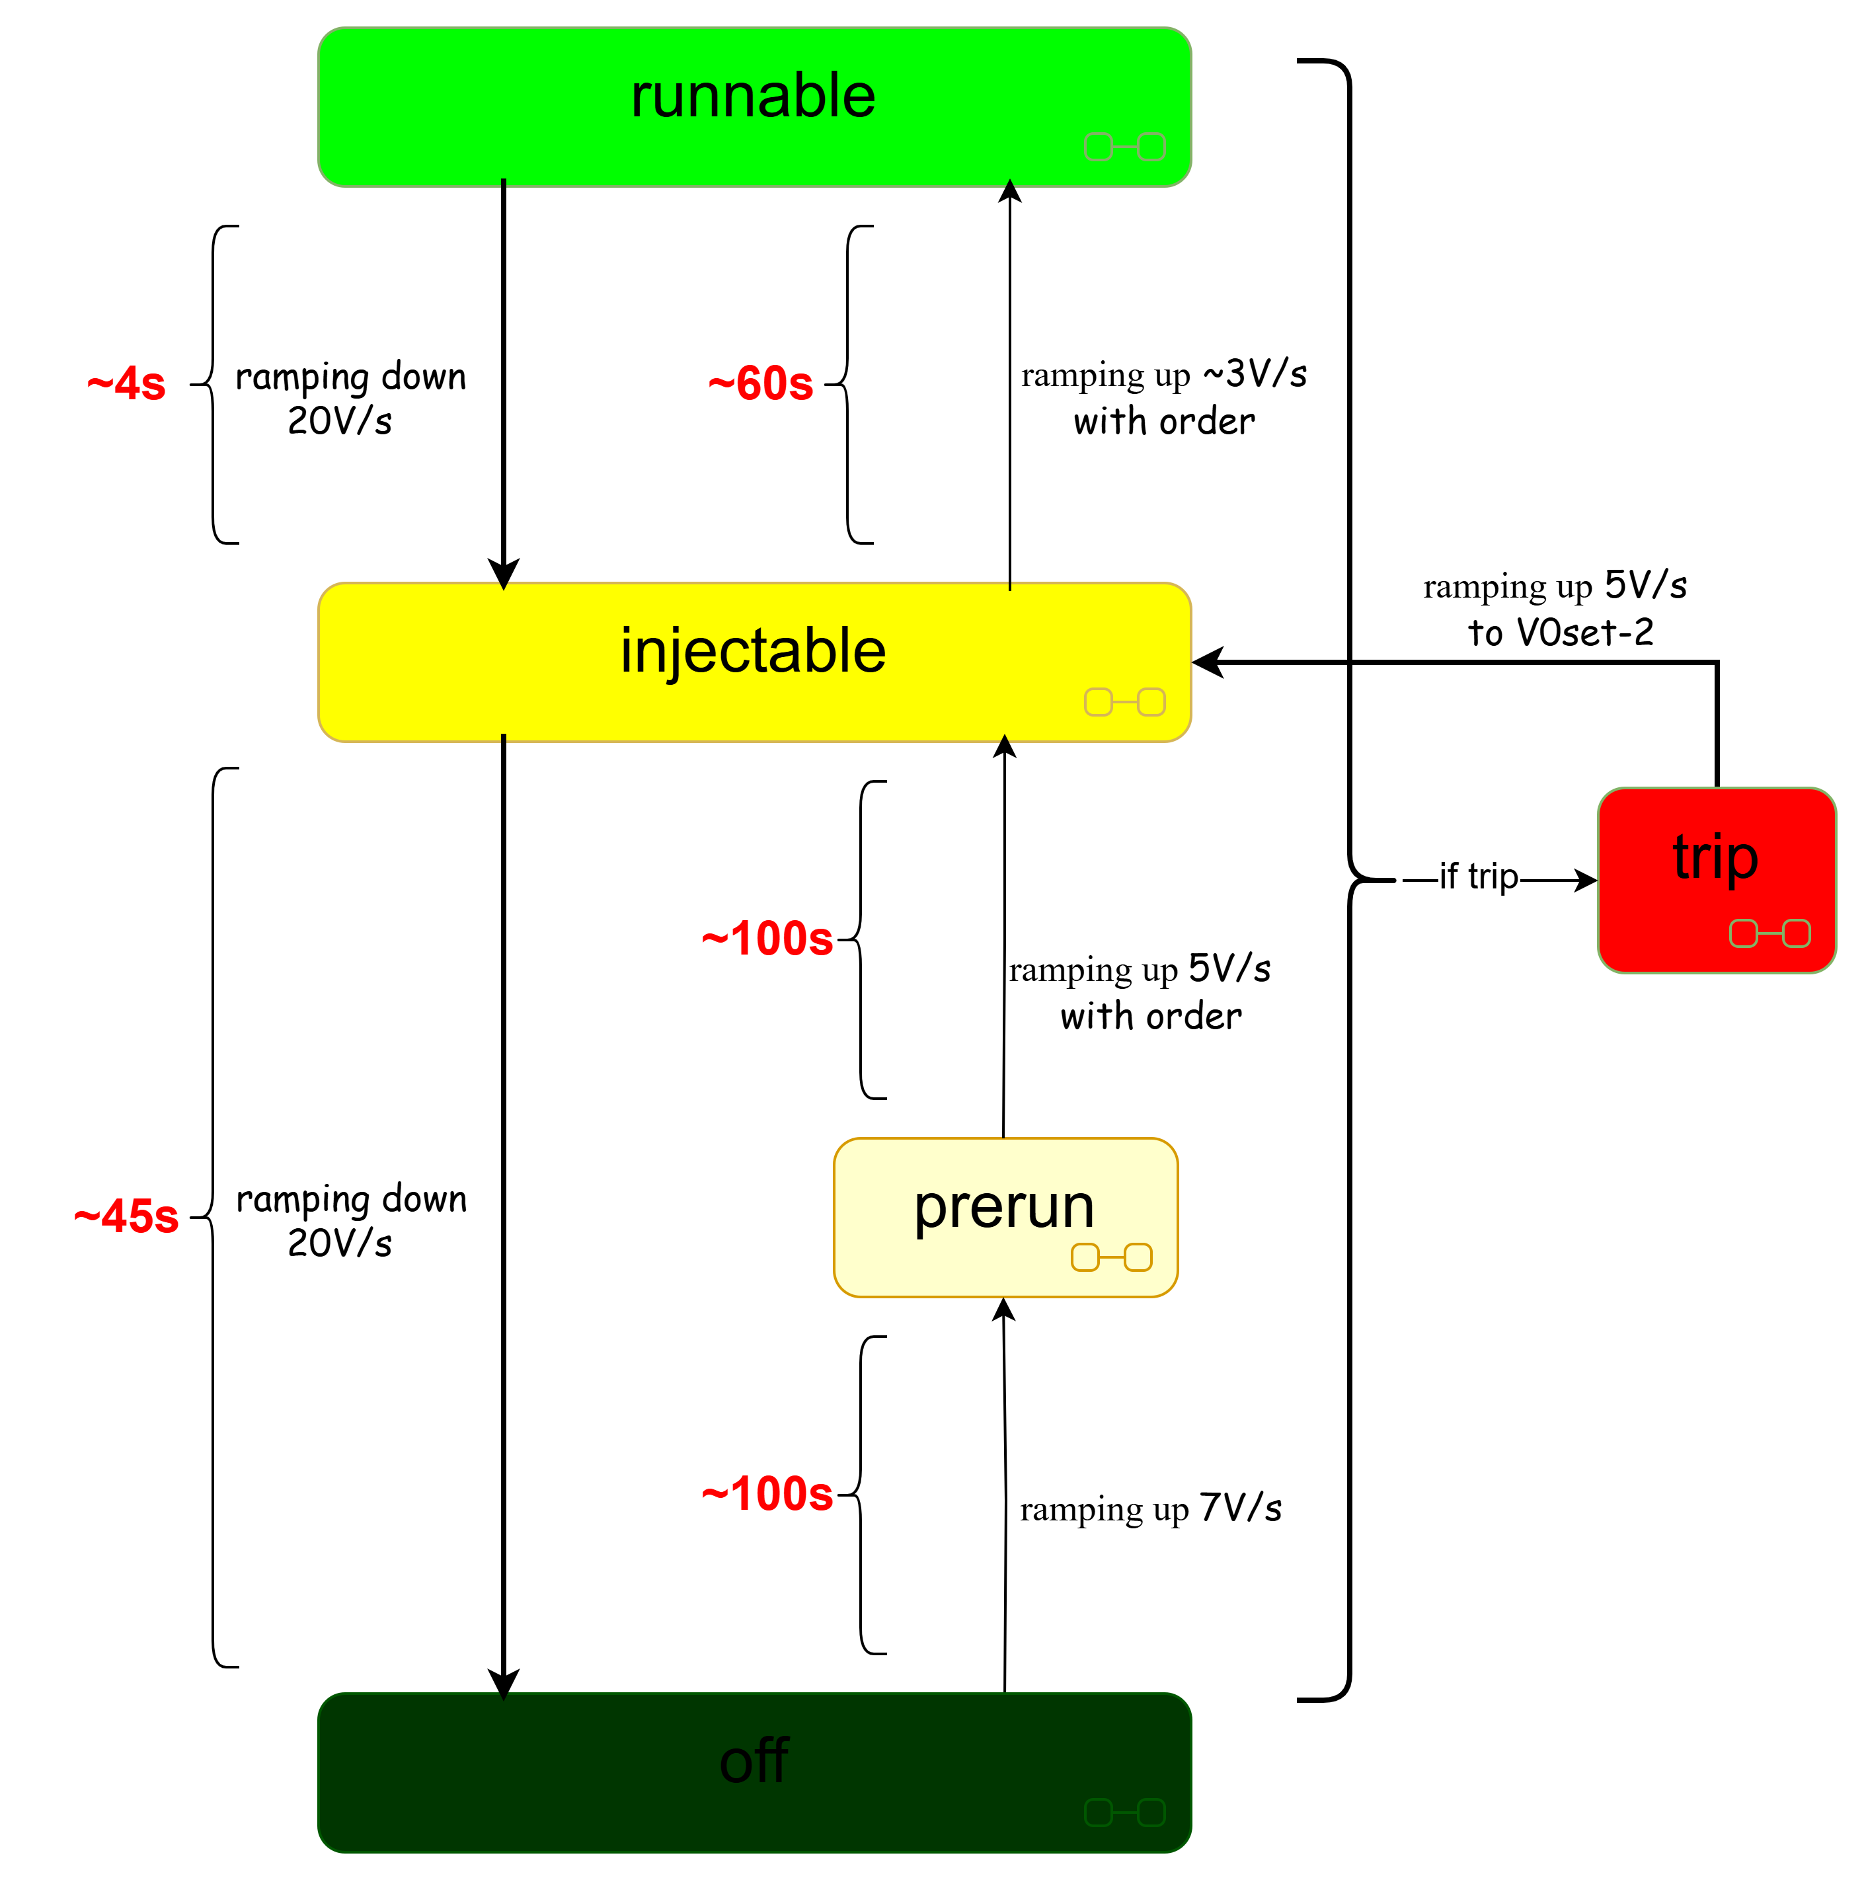
Provided by Michela
Injectable parameters
V0Set-2 | V | RUp | OnOrder
IND | 900 | 5 | 1
G3 | 220* | 5 | 2
T2 | 600 | 5 | 3
G2 | 220* | 5 | 4
T1 | 600 | 5 | 5
G1 | 220* | 5 | 6
DRIFT | 750 | 5 | 7
Runnable parameters
V0Set-runnable | V | RUp | OnOrder
IND | 900 | 1 | 1
G3 | 275* | 3** | 2
T2 | 600 | 1 | 3
G2 | 280* | 3** | 4
T1 | 600 | 1 | 5
G1 | 280* | 3** | 6
DRIFT | 750 | 1 | 7
* as reference, GEM values will be defined after operation tests in BESIII
** we will confirm after operations in BESIII

