Slide 1
Gas Circuit Scheme
Confirmation of gas parameters
20241014
Gas type and score
90% Ar+10% i-C₄H₁₀
Argon gas
Purity is 99.999% or more (grade 5.0 or more).
Ratio after mixing is 90% (tunable).
Unit gas pressure is 1.2 - 1.4 bar.
Iso-C₄H₁₀ gas
Purity is 99.99% (grade 4.0 or more).
99.9% available. It is difficult to use 99.99%. The gas source requires special purification and The new gas source will require a new gas supply line.
Ratio after mixing is 10% (tunable).
Unit gas pressure is 1.2 - 1.4 bar.
Flow rate and pressure of the mixing gas
The overall volume of the three chambers is 21.6L.
Before: 5-7 chamber volumes are replaced per day. The flow rate is about 72-100sccm.
After: 5-7 chamber volumes are replaced per hour. The flow rate is about 1650 - 2500sccm.
Replacement of smaller flow meters with larger ones has been completed based on detector requirements.
The internal pressure of the detectors is about 5-10 mbar (never above 20 mbar).
The bubblers are empty and could be set up as desired.
Buffer tank parameters
Buffer tank pressure, 0.5-0.9 Bar.
Buffer tank volume, about 0.3m³ (diameter 0.5m, height 1.5m).
Buffer tank temperature，controlled between 23 ± 5 degrees, placed indoors.
In the event of a power outage or when the mass flow meter is not working, this buffer tank will supply gas for 60-135 minutes at the new flow demand.

Slide 2
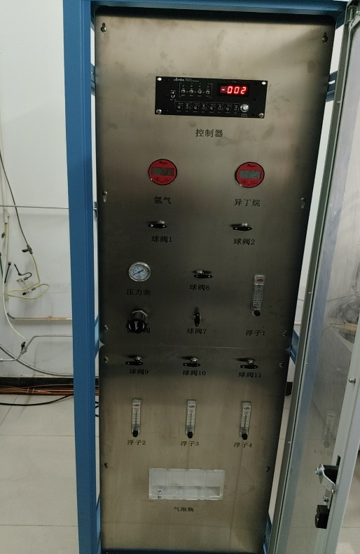
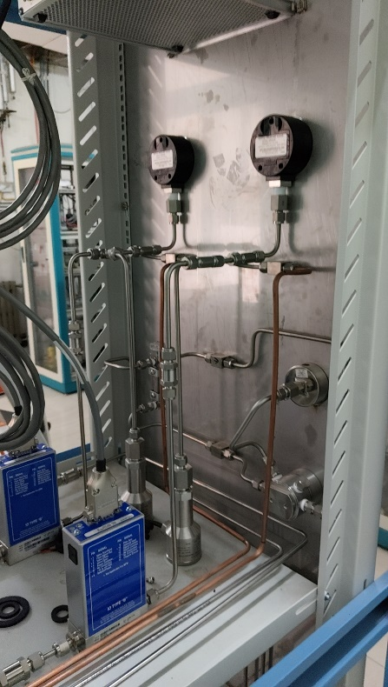
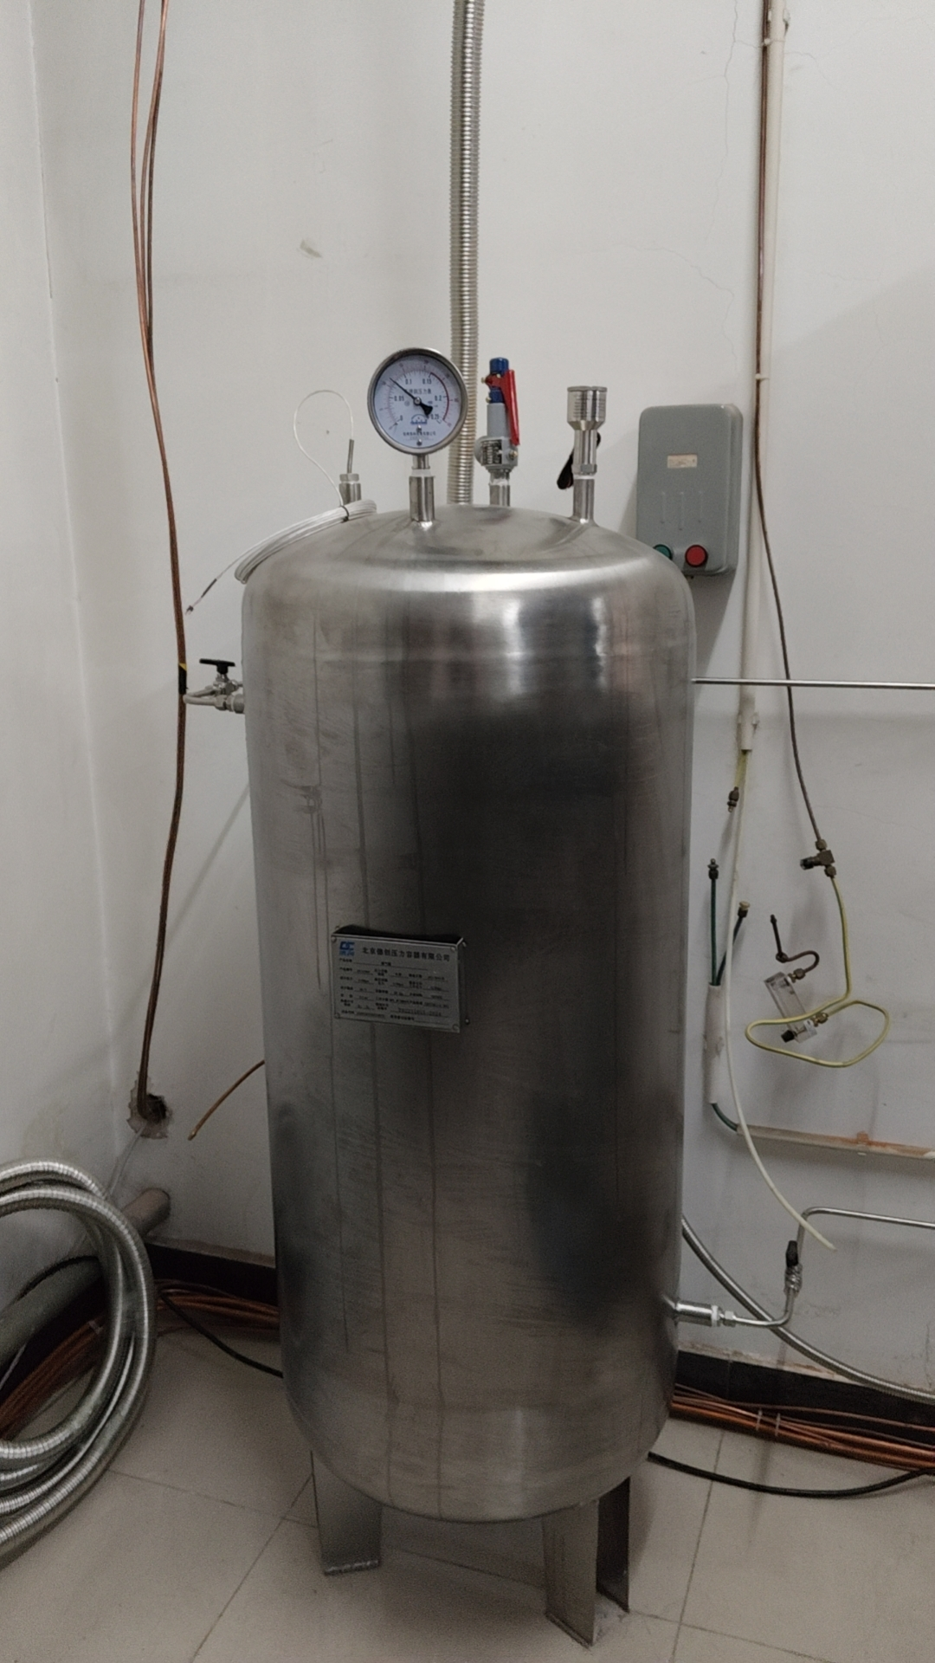
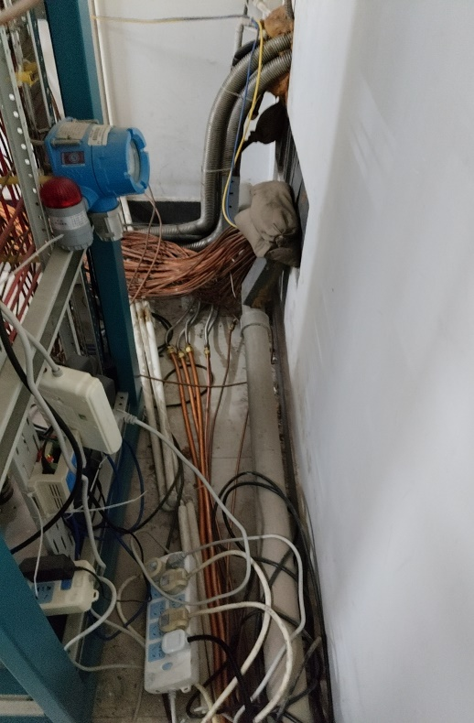
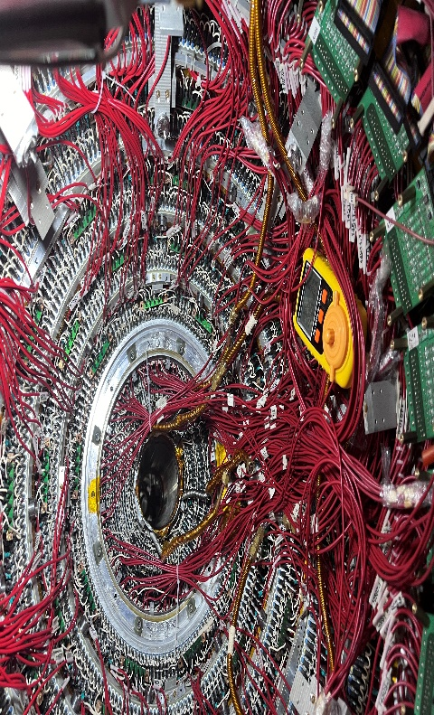
CGEM gas system status
Gas rack Mixing gas buffer pipes Pipe ports to detectors
Currently the gas system has been completed according to the above requirements
All unit gas and gas mixture piping connections.
All mixture ratio settings and pressure and flow rate adjustments.
Mixture replacement for buffer tanks.
Prepare to connect the detector.

Slide 3
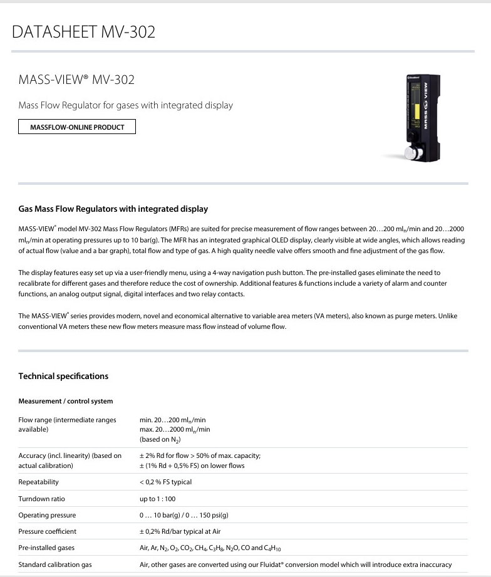
Knew request last week
New mass flow meters
Regarding the request to adopt four mass flow meters to replace the existing float flow meters, I did research last week about the conditions of use of this equipment, how to purchase it, how to install it, etc. There are two companies that can offer similar products. One is a Dutch company and one is a Swiss company, The two companies responded that it would take at least two months procurement time. The fastest way to do the replacement would be to procure from Europe and I can assist detectors with these flow meters in the installation and commissioning.
Three new pressure monitoring points
Three new pressure monitoring points were added to the detector, and equipment procurement and installation are under way.

