Slide 1
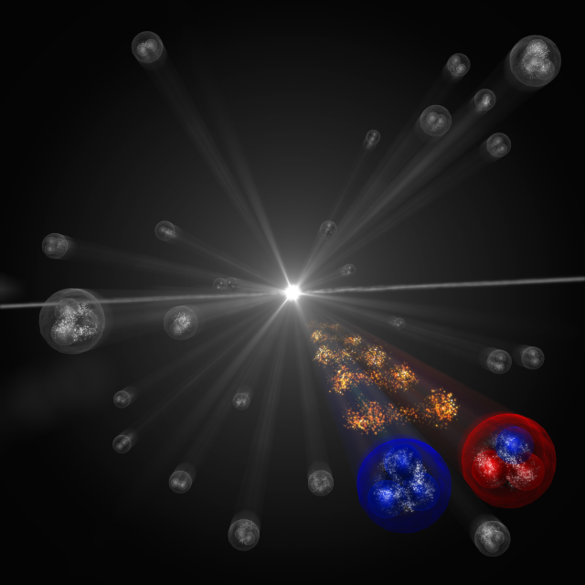
第十届XYZ研讨会 2025年4月11— 15日 中国·长沙
费米镜技术研究奇特强子态
Li-Sheng Geng（耿立升）@ Beihang U.
(Image: CERN)

Slide 2
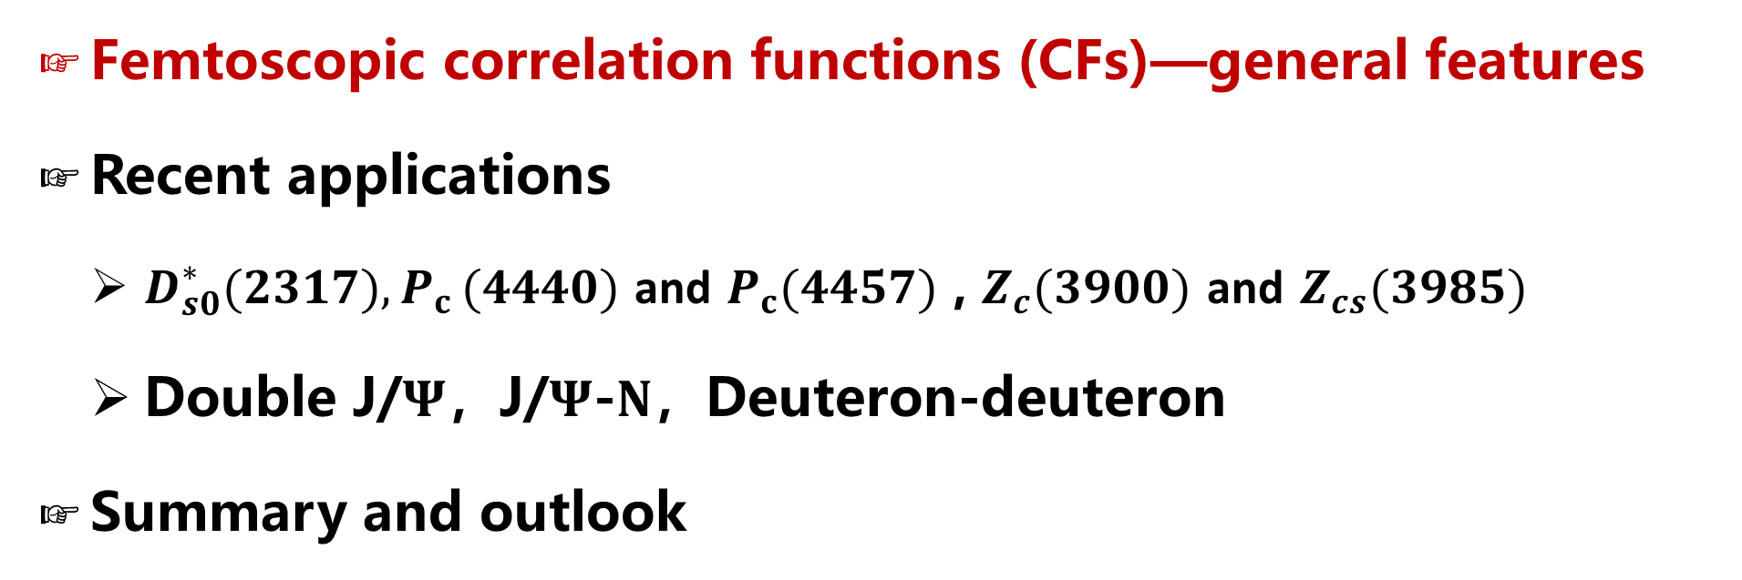
Contents
Femtoscopic correlation functions (CFs)—general features
Recent applications
  $D_{s0}^{∗}(2317){,P}_{c}(4440)$ and $P_{c}(4457)$ , $Z_{c}(3900)$ and $Z_{cs}(3985)$
  Double J/$Ψ$，J/$Ψ$-$N$，Deuteron-deuteron
Summary and outlook

Slide 3











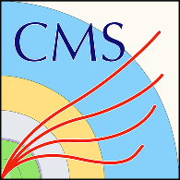







































Many more exotic hadrons discovered
$$X_{0}(2866)$$
$$X_{1}(2904)$$
$D_{s1}$(2460)
$$\text{X}\text{(4160)}$$
$$\text{Y}\text{(4220)}$$
$Z_{c}$(4100)
$$\text{Y}\text{(4660)}$$
$Z_{c}$(4020)
$$P_{c}(4380)$$
$Ξ$(1620)
$$X(6900)$$
X(6900)
X(7200)
$D_{s0}$(2317)
$$\text{Y}\text{(4260)}$$
$$\text{X}\text{(3915)}$$
$$\text{X}\text{(4274)}$$
$Z_{c}$(3900)
$$P_{c}(4450)$$
$$\text{Y}\text{(4390)}$$
$$P_{cs}(4459)$$
$$\text{Y}\text{(4500)}$$
$$\text{Y}\text{(4360)}$$
$Ω$(2012)
$$P_{c}(4337)$$
2003
2005
2006
2007
2009
2011
2013
2014
2015
2016
2018
2019
2020
2021
2022
2023
$$\text{X}\text{(3960)}$$
$$\text{X}\text{(3872)}$$
$Z_{c}$(4430)
$X$(4140)
$Z_{c}$(4200)
$$P_{c}(4457)$$
$$P_{cs}(4338)$$
X(6900)
X(6600)
X(7100)
$$\text{X}\text{(5568)}$$
$$P_{c}(4440)$$
$Z_{cs}$(3985)
$$T_{cs}(2900)$$
$Y$(3940)
$$P_{c}(4312)$$
$T_{cc}$(3875)
$Z_{b}$(10610)
$Z_{b}$(10650)
$Λ_{c}$(2940)

Slide 4
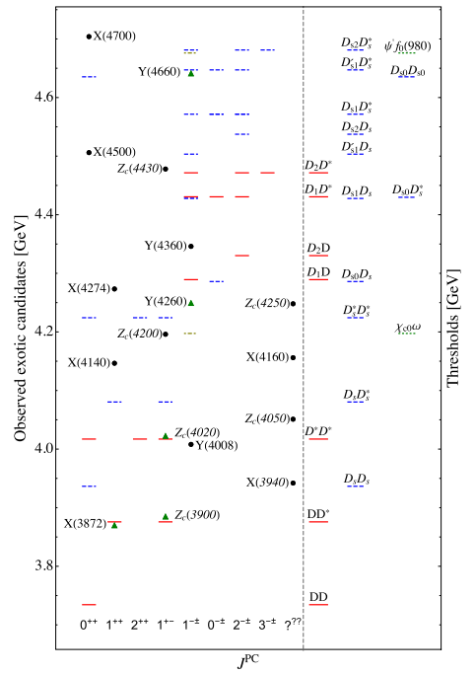
Most of them close to thresholds— hadronic molecules
Feng-Kun Guo, Christoph Hanhart,
Ulf-G. Meißner, Qian Wang,
Qiang Zhao, Bing-Song Zou.
Rev.Mod.Phys. 90 (2018) 015004
Richard F. Lebed, Ryan E. Mitchell,
Eric S. Swanson,
Prog.Part.Nucl.Phys. 93 (2017) 143
Atsushi Hosaka, Toru Iijima, Kenkichi Miyabayashi, Yoshihide Sakai , Shigehiro Yasui,
PTEP 2016 (2016) 062C01
Hua-Xing Chen, Wei Chen, Xiang Liu
Shi-Lin Zhu,
Phys. Rept.639 (2016) 1
……

Slide 5
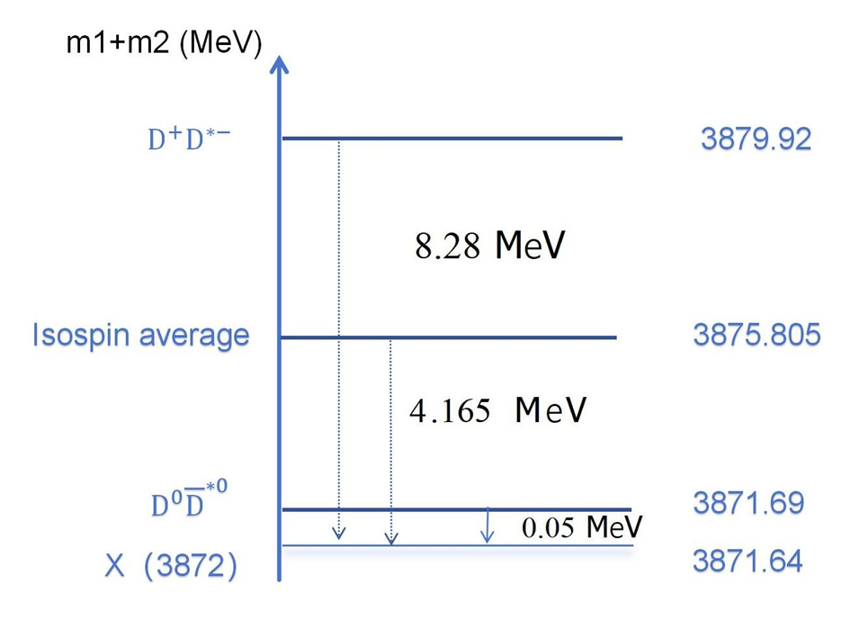
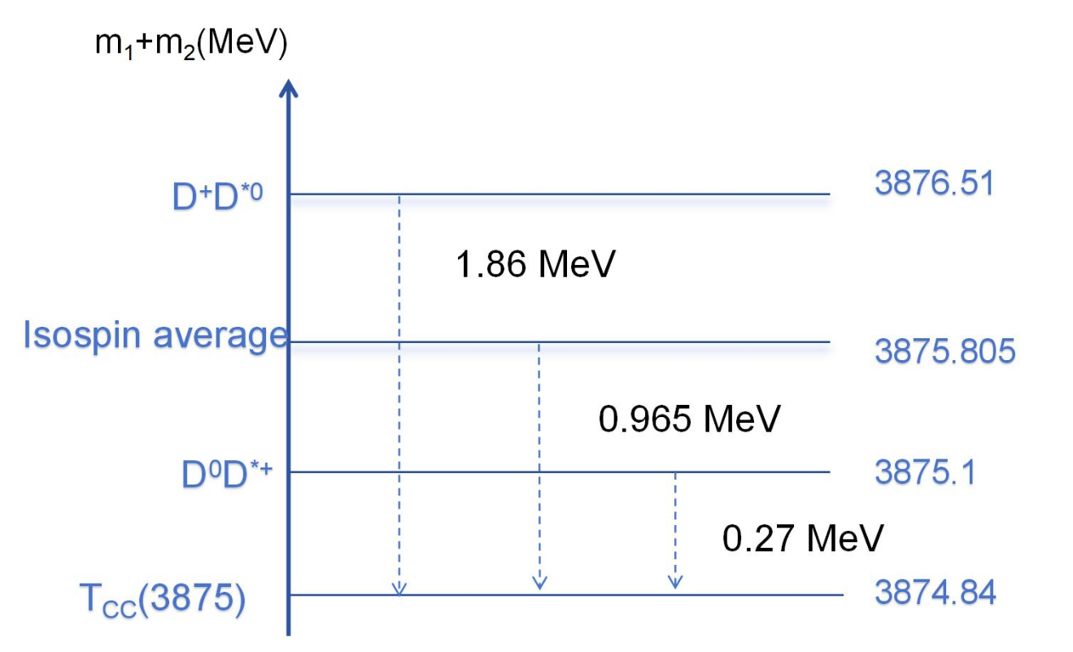
X(3872) & Tcc(3875)
Below or above

Slide 6

How to check the molecular picture?

Slide 7
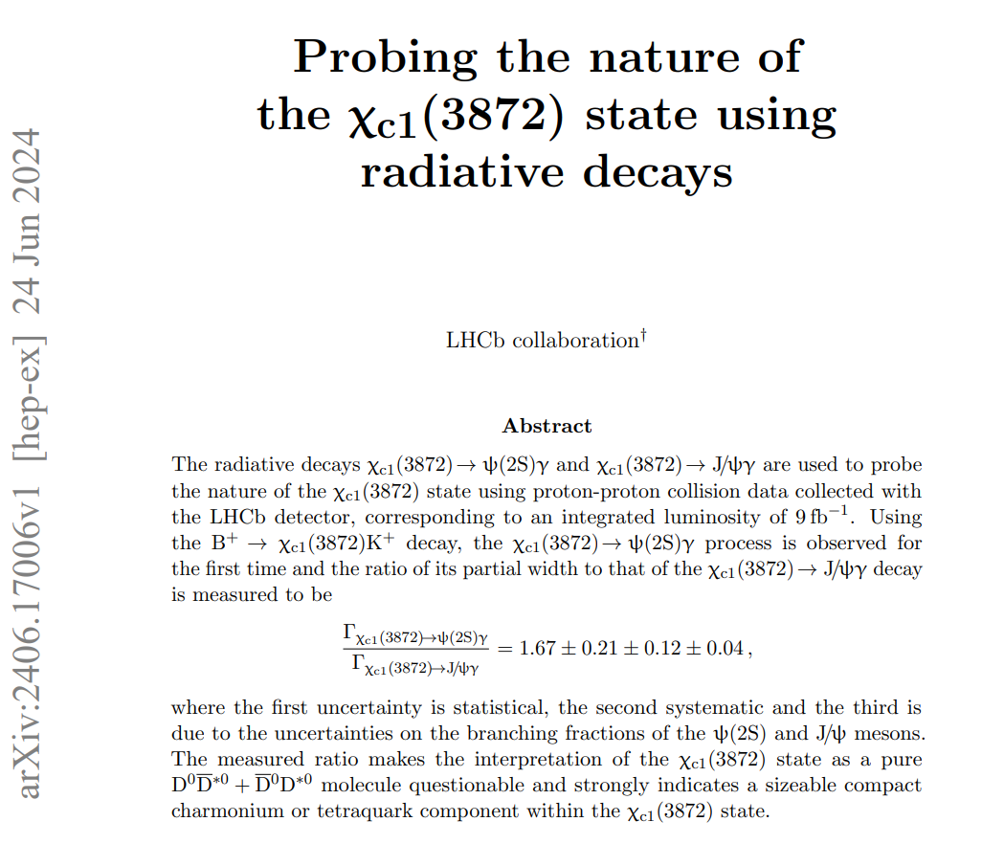
How to check the molecular picture?

Slide 8
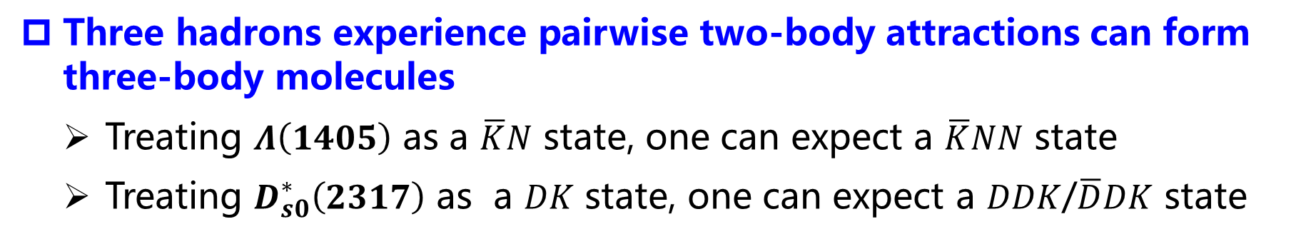
Three ways to decipher the nature of exotic hadrons
Symmetries in the two-hadron interactions imply the existence of multiplets of hadronic molecules
  Heavy-quark spin/flavor symmetry: there are seven Pc states
  Heavy antiquark diquark symmetry: there are ten dibaryon states
  SU3 symmetry: there are Pcs states
Three hadrons experience pairwise two-body attractions can form three-body molecules
  Treating $Λ\left(1405\right)$ as a $\overline{K}N$ state, one can expect a $\overline{K}NN$ state
  Treating $D_{s0}^{∗}\left(2317\right)$ as a $DK$ state, one can expect a $DDK$/$\overline{D}DK$ state
Direct measurement of the two-hadron interactions

Slide 9
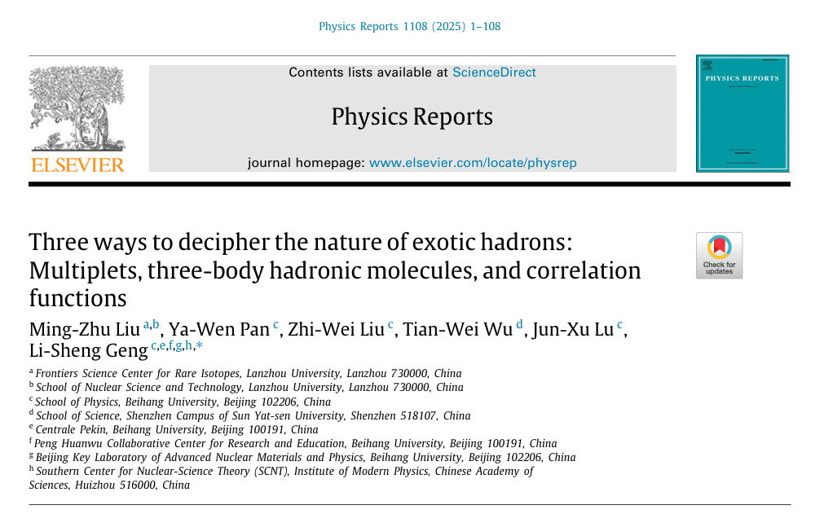

Slide 10
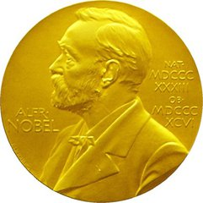
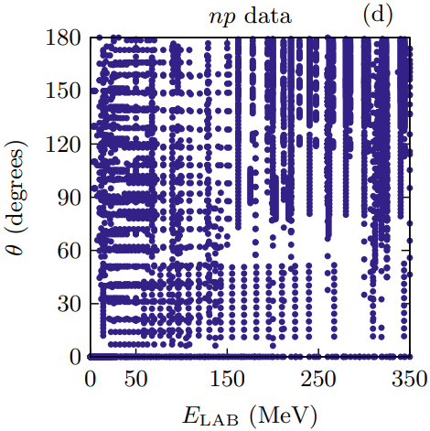
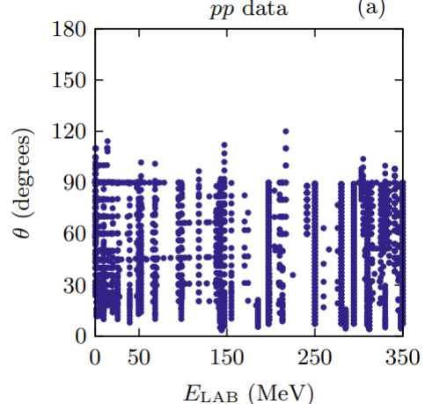
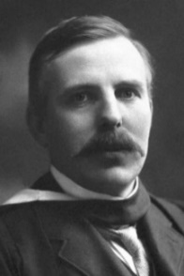
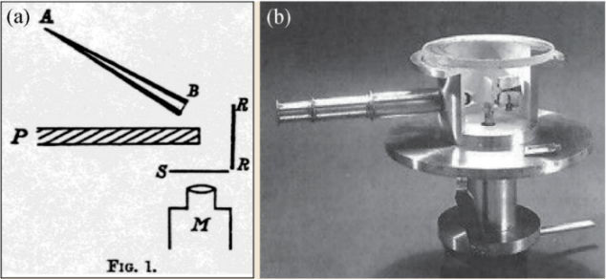
立项依据—传统散射实验
Lecture III—Femtoscopy
For stable hadrons, scattering experiments are extremely valuable in extracting their interactions
NN scattering，8125 data
Foundation of high-precision nuclear force
Ernest Rutherford
Rutherford Scattering Experiment
Notes:
传统上，散射实验是研究相互作用的主要实验方法
最成功的例子是卢瑟福散射实验，其揭示原子的核式结构模型，至今仍然是研究强相互作用的基本手段
例如核子散射实验，8000多个NN散射数据是开展高精度核力研究的坚实基础。
然而，对于不稳定了强子，传统的散射实验非常困难。短寿命的强子，很难产生大量炮弹粒子，也无法制作固定靶。
例如，超子-核子的散射数据只有35个，这也进一步制约了核物理、天体物理领域的发展。

Slide 11
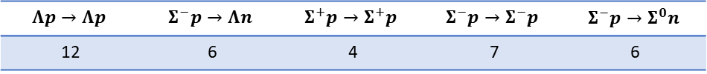
立项依据—传统散射实验
Lecture III—Femtoscopy
For stable hadrons, scattering experiments are extremely valuable in extracting their interactions
NN scattering，8125 data
Foundation of high-precision nuclear force
Ernest Rutherford
Rutherford Scattering Experiment
For unstable particles, direct scattering experiments are impossible!
  Difficult to get large quantity of beam particles
  No fixed targets available
$$Λp→Λp$$ | $$Σ^{−}p→Λn$$ | $$Σ^{+}p→Σ^{+}p$$ | $$Σ^{−}p→Σ^{−}p$$ | $$Σ^{−}p→Σ^{0}n$$
12 | 6 | 4 | 7 | 6
Hyperon-nucleon low energy scattering, 35 data
Hindering hyper-nuclear physics and neutron star studies
Notes:
传统上，散射实验是研究相互作用的主要实验方法
最成功的例子是卢瑟福散射实验，其揭示原子的核式结构模型，至今仍然是研究强相互作用的基本手段
例如核子散射实验，8000多个NN散射数据是开展高精度核力研究的坚实基础。
然而，对于不稳定了强子，传统的散射实验非常困难。短寿命的强子，很难产生大量炮弹粒子，也无法制作固定靶。
例如，超子-核子的散射数据只有35个，这也进一步制约了核物理、天体物理领域的发展。

Slide 12




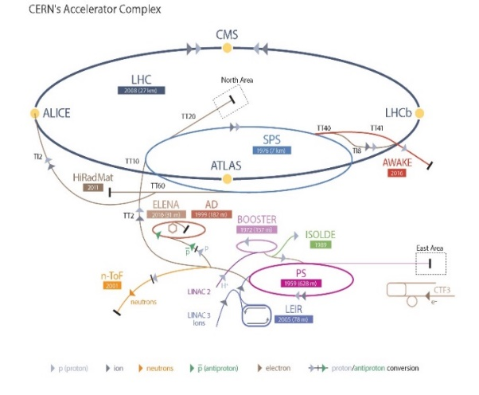
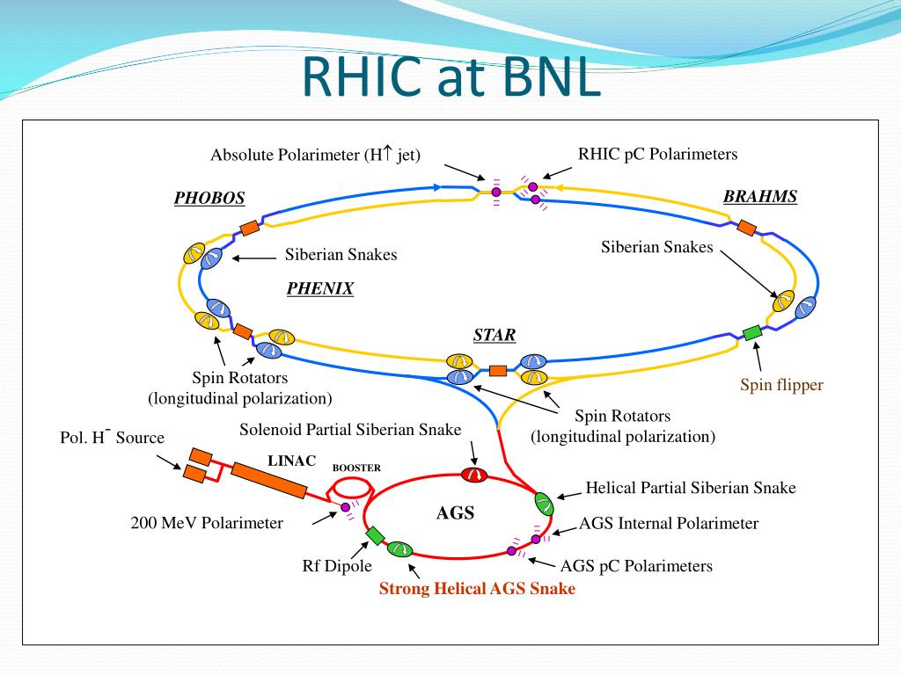
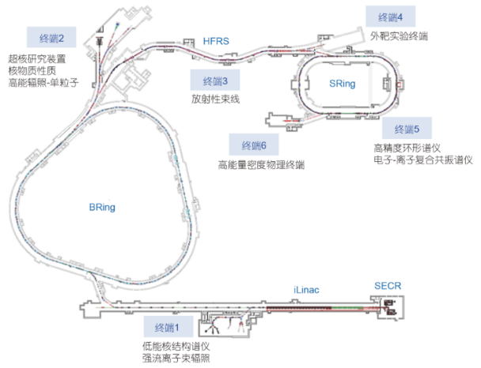
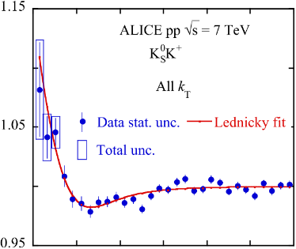
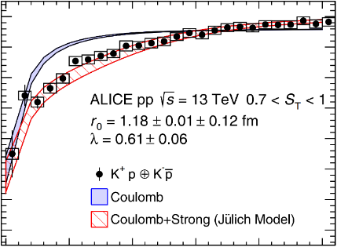
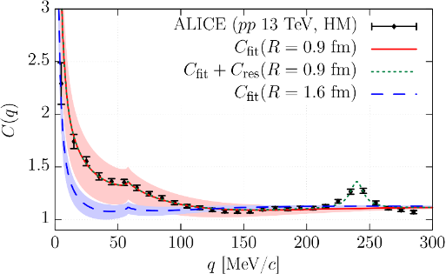
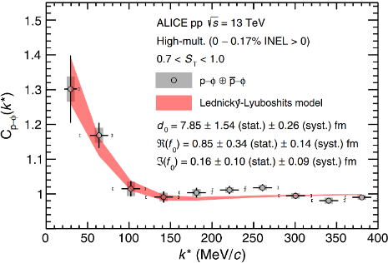
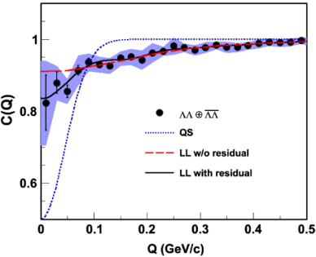
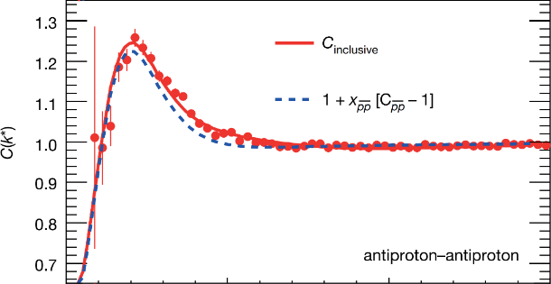
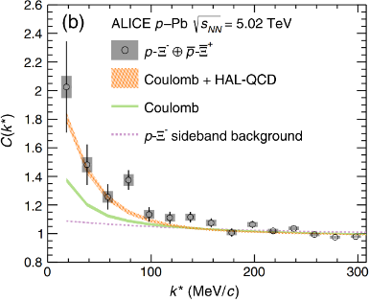
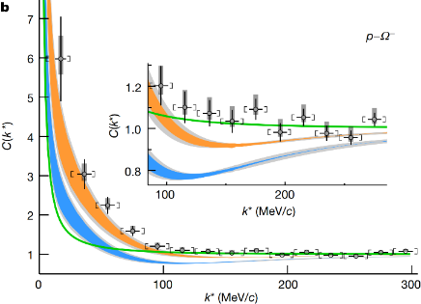
















New probe—femtoscopic correlation functions
$$K_{S}^{0}K^{±}$$
$$K^{±}p$$
$$K^{−}p$$
$$ϕp$$
$$\overline{p}\overline{p}$$
$\text{Λ} \text{Λ}$
$${\text{X}}^{−}p$$
$$^{−}p$$
$$K^{−}d$$
$$Σ^{0}p$$
$$ΛΞ$$
$$ΞΞ$$
$$ΩΩ$$
$$pD$$
$$ppp$$
PLB 2019
PRL 2020
PRL 2020
PRL 2021
Nature 2015
PRL 2015
PRL 2019
Nature 2020
$$ppΛ$$

Slide 13
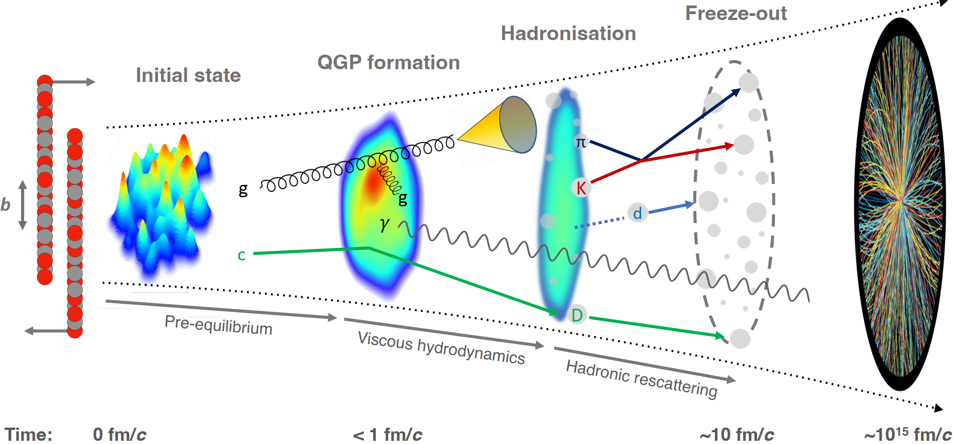
Abundant particles produced in AA, pA, and pp collisions
Final-State Interaction

Slide 14
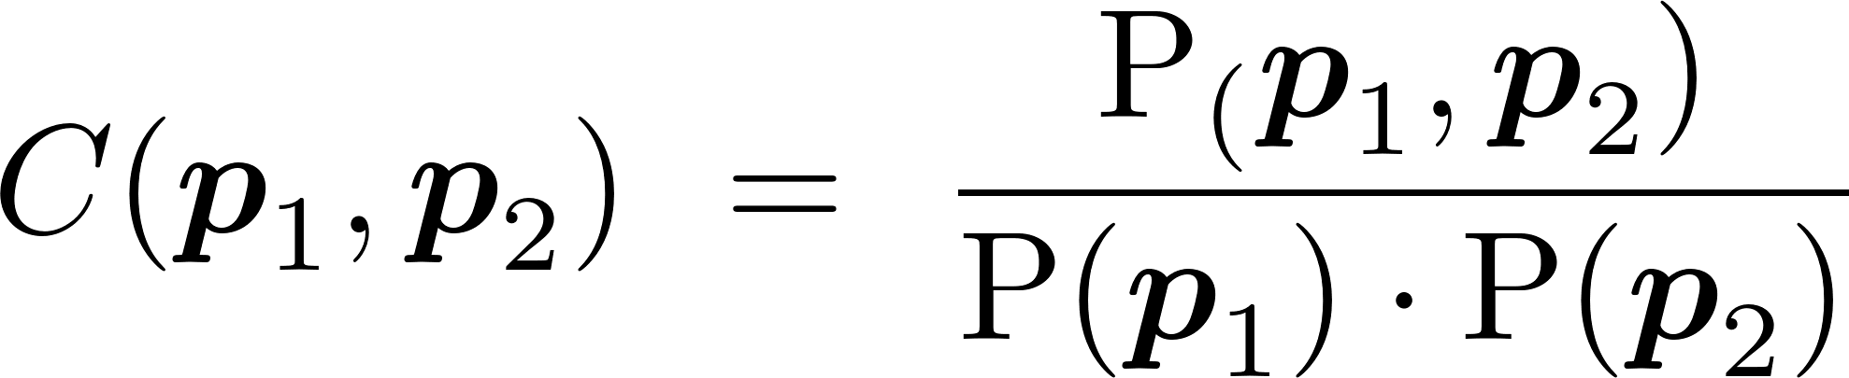
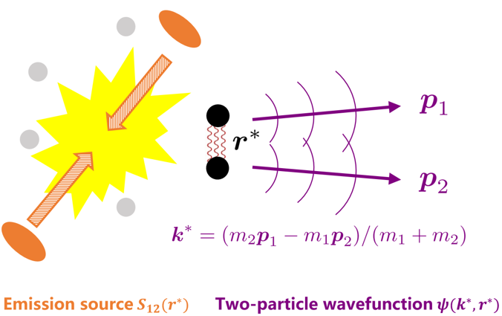
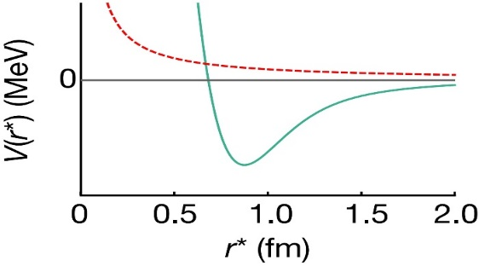
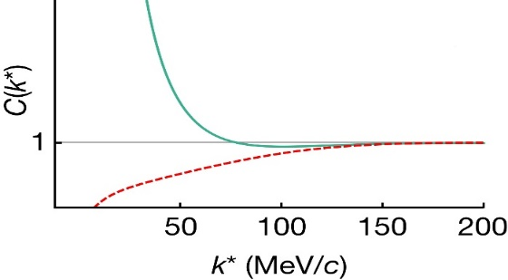
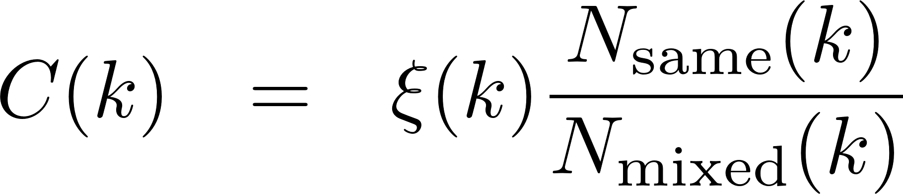
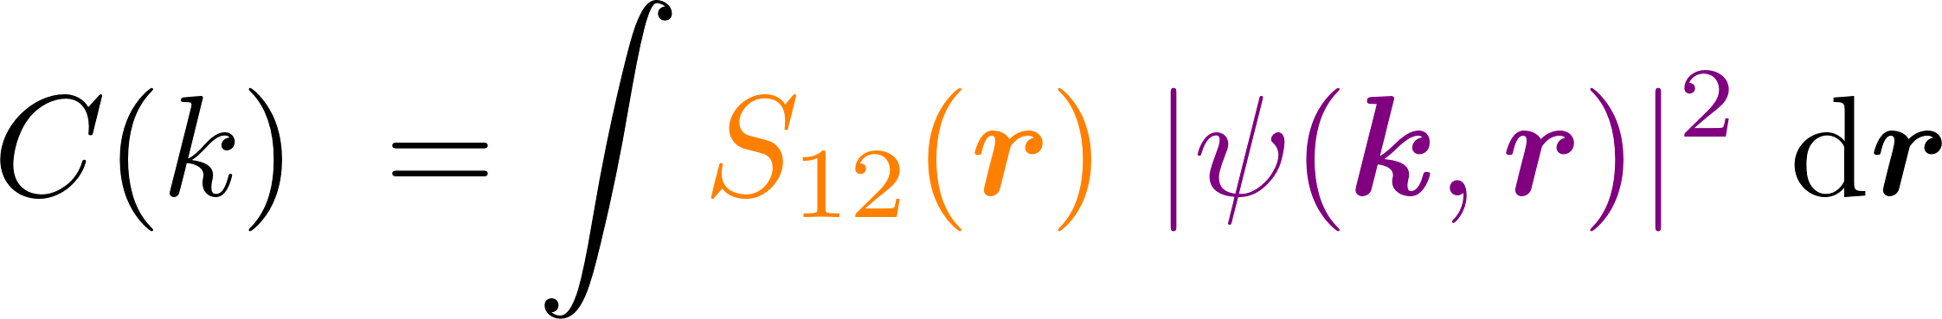
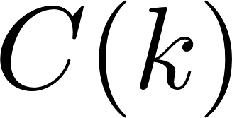


Femtoscopic correlation functions (CFs)
Interacting potential
Correlation function
repulsive
attractive
attractive
repulsive
Schrödinger equation
Two-particle wavefunction$ψ(k^{∗}, r^{∗})$
Exp. measurement
mixed-event technique
Theo. description
Koonin–Pratt formula
Basic Properties
>1 if the interaction is attractive
=1 if there is no interaction
<1 if the interaction is repulsive
$N_{same}$: the same event distributions
$N_{mixed}$: the mixed event distributions
$ξ$: the corrections for experimental effects
final-state interactions
quantum statistics effects
coupled-channel effects
spacial structure

Slide 15
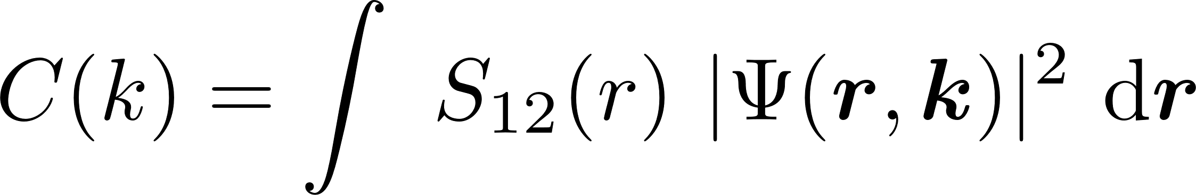
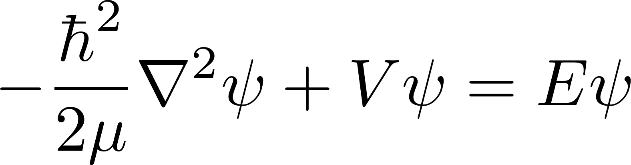
Femtoscopic correlation functions (CFs)
S. E. Koonin, Phys. Lett. B 70 (1) (1977) 43
A. Ohnishi, Nucl. Phys. A 954 (2016) 294
Koonin–Pratt (KP) formula
Only S-waves
Common static and spherical Gaussian source
Scattering wave function
the Schrödinger equation
the Lippmann-Schwinger equation

Slide 16
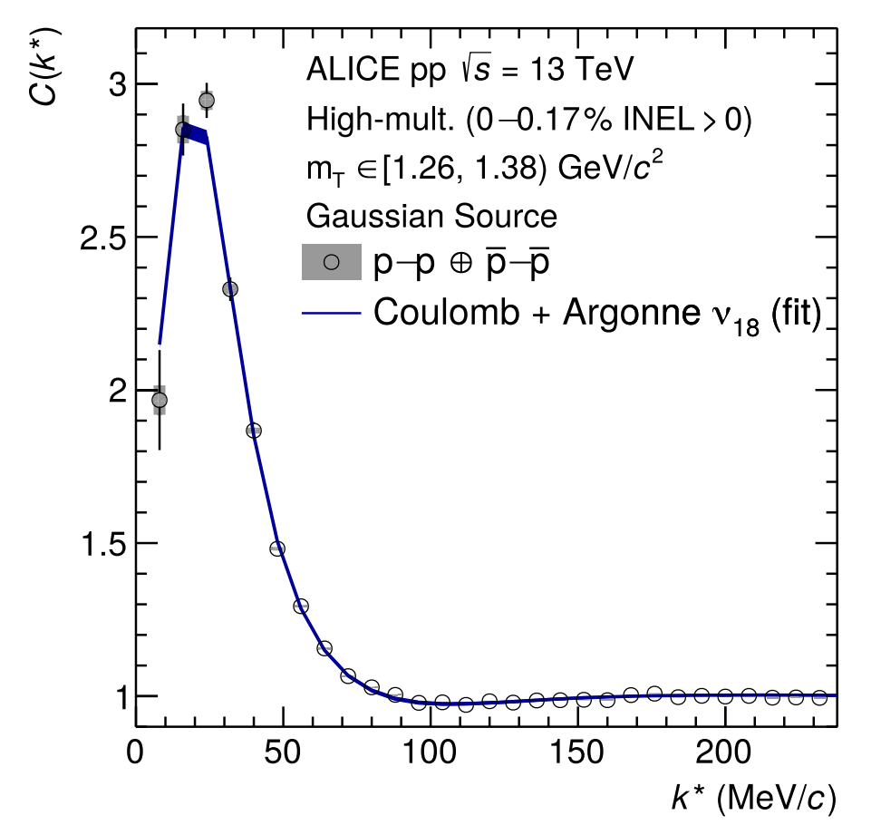
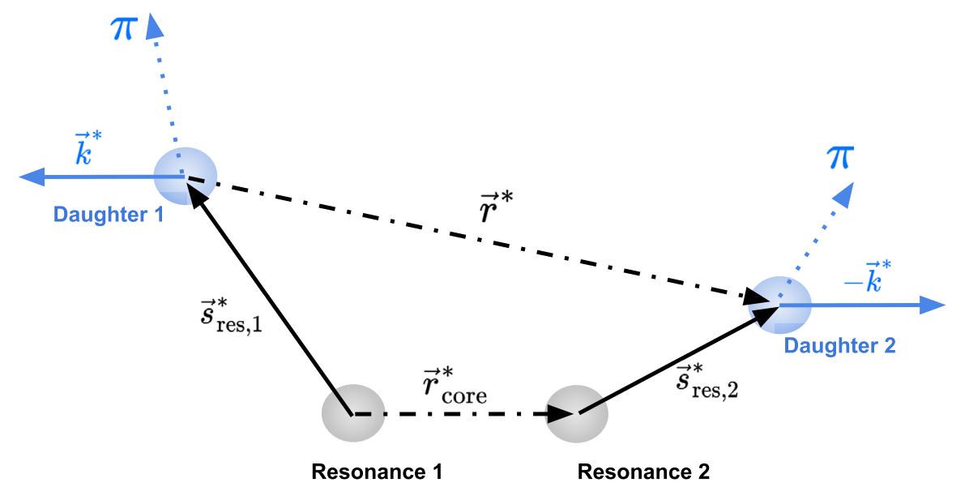

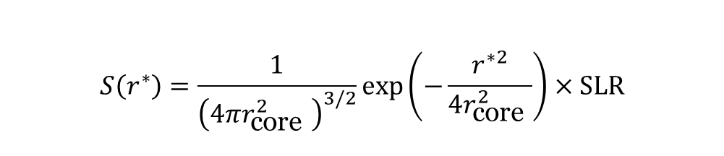
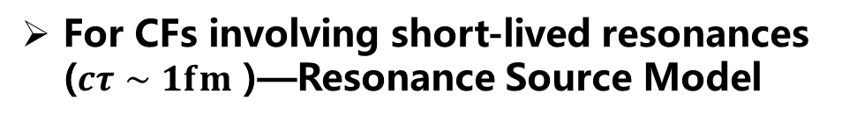
Constraining the source function
Using the well-known proton-proton interaction to calibrate the source
$$C\left(k^{∗}\right)=\int{S}\left({\vec{r}}^{∗}\right){\left|ψ\left({\vec{k}}^{∗},{\vec{r}}^{∗}\right)\right|}^{2}d^{3}{\vec{r}}^{∗}$$
For CFs involving short-lived resonances ($cτ∼1fm$ )—Resonance Source Model
$$S\left(r^{∗}\right)=\frac{1}{{\left(4πr_{\text{core} }^{2}\right)}^{3/2}}exp⁡\left(−\frac{r^{∗2}}{4r_{\text{core} }^{2}}\right)×SLR$$
ALICE, PLB, 811 (2020) 135849

Slide 17

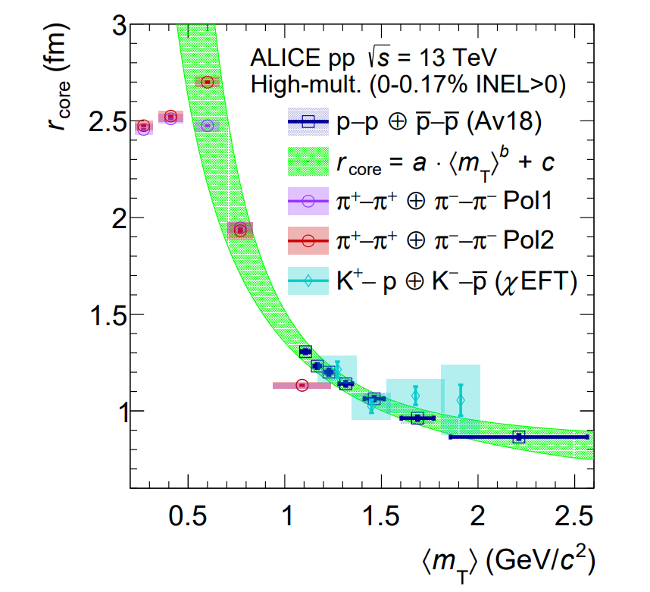
Constraining the source function
2311.14527v1.
… “providing compelling evidence for the presence of a common emission source for all hadrons in small collision systems at the LHC …”

Slide 18


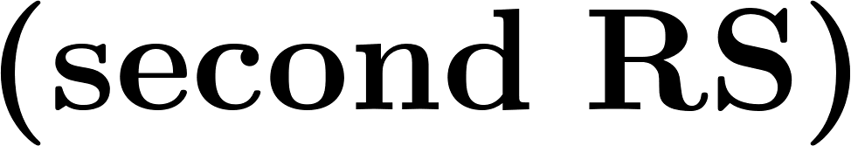

Classification of hadron-hadron interactions
repulsive
attractive
nonexistent
weaker attraction
resonant
state
stronger attraction
weak attraction
deeply bound state
shallow bound state
virtual
state

Slide 19
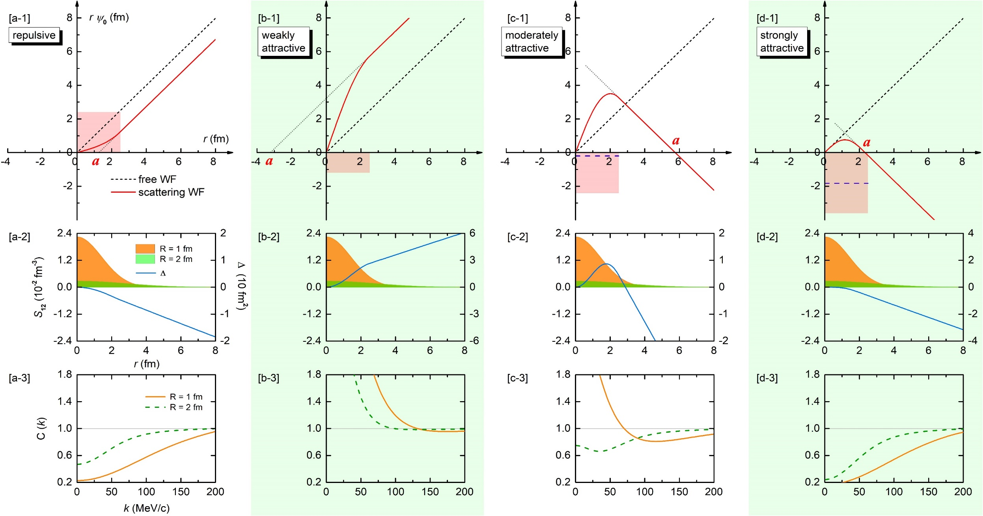
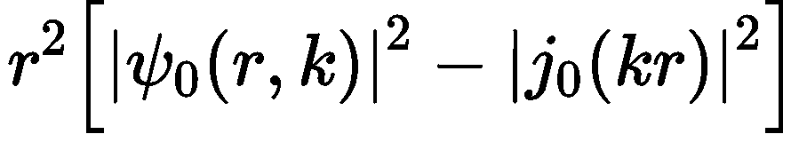
CFs in the presence of bound states
Zhi-Wei Liu, Jun-Xu Lu and LSG*, PRD 107, 074019 (2023)
Notes:
In the same plot, the difference between the free and scattering wave functions squared ∆ ≡ r 2 (|ψl=0| 2 − |jl=0| 2 ) in Eq. (7) is also shown as the blue solid line. Panels (a3–d3): Correlation function as a function of the relative momentum k.

Slide 20
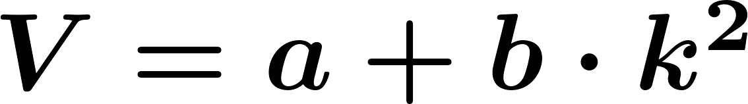
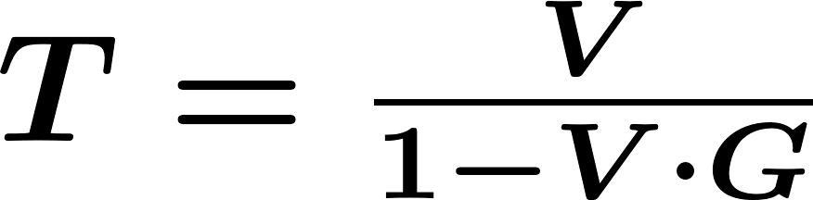
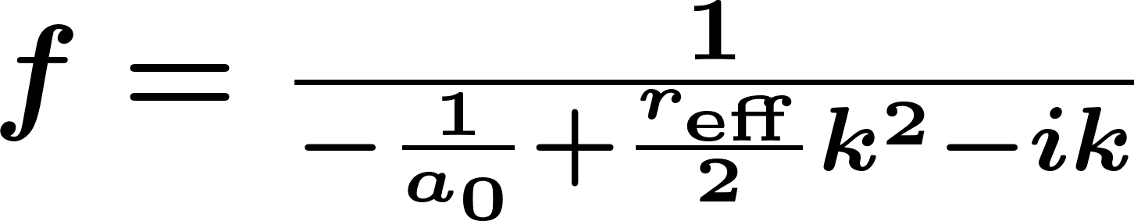
CFs in the presence of resonant and virtual states
Zhi-Wei Liu, Ming-Zhu Liu, Jun-Xu Lu and LSG*, 2404.18607
vs

Slide 21
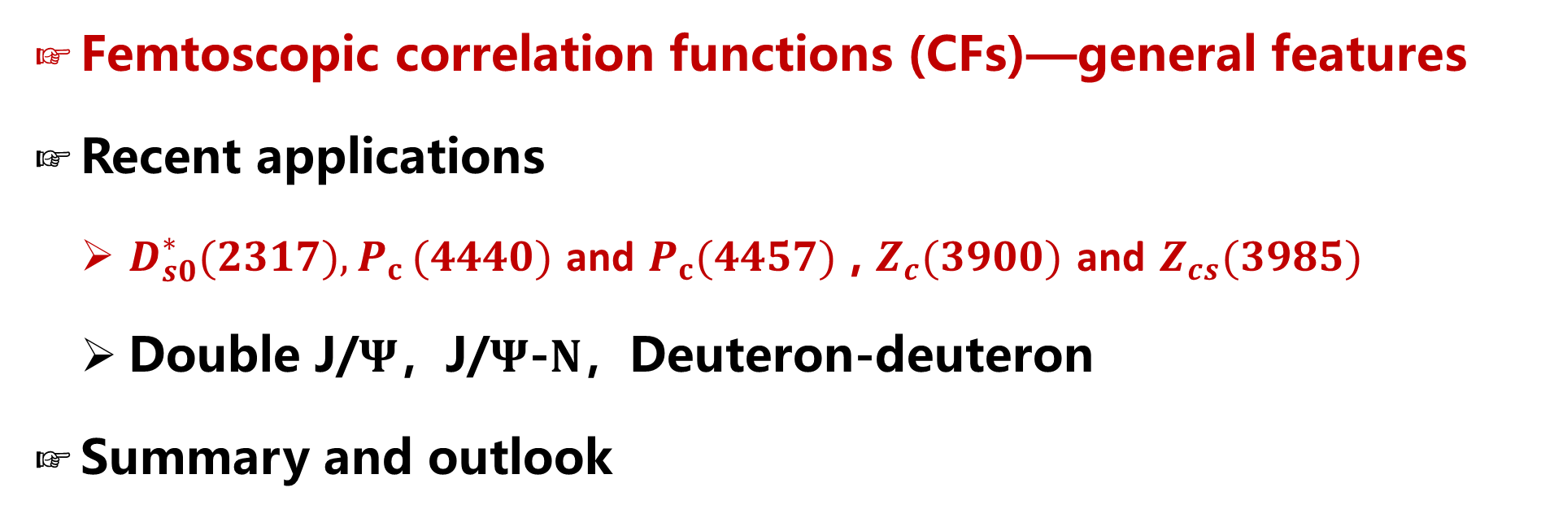
Contents
Femtoscopic correlation functions (CFs)—general features
Recent applications
  $D_{s0}^{∗}(2317){,P}_{c}(4440)$ and $P_{c}(4457)$ , $Z_{c}(3900)$ and $Z_{cs}(3985)$
  Double J/$Ψ$，J/$Ψ$-$N$，Deuteron-deuteron
Summary and outlook

Slide 22
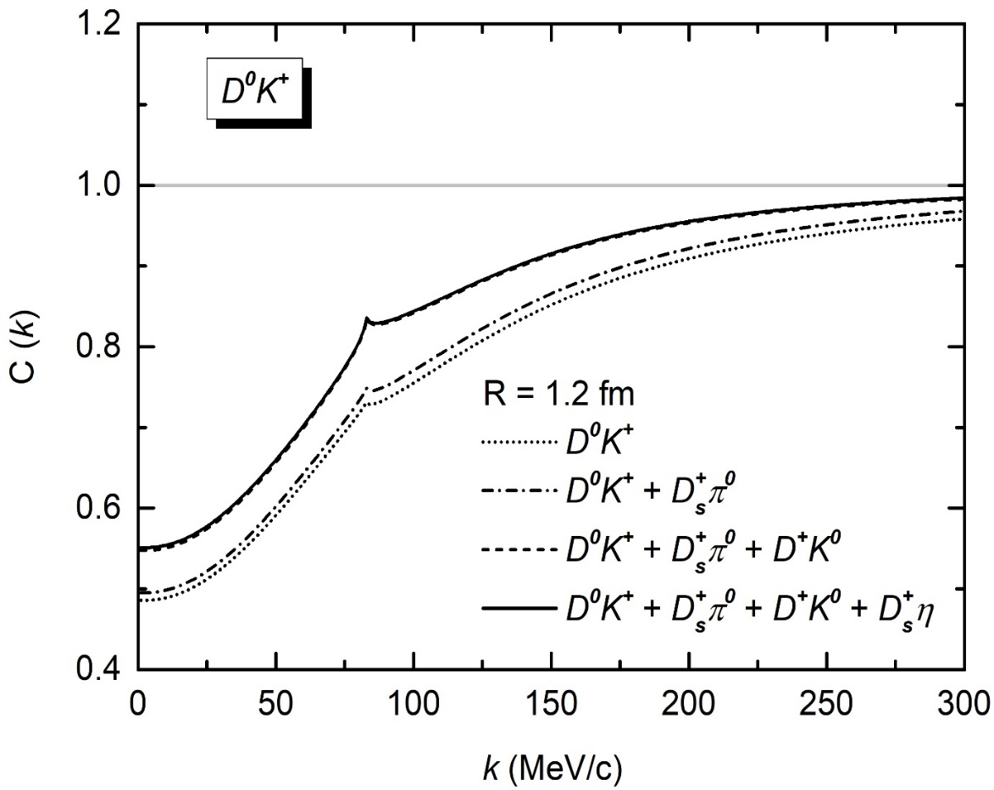


$DK$CFs and its source size dependence
$$D^{+}K^{0} → D^{0}K^{+}$$
Typical feature of deeply bound states
Zhi-Wei Liu, Jun-Xu Lu and LSG*, PRD107(2023)074019

Slide 23




Confirmed by two subsequent studies

Slide 24



Spin-averaged $Σ_{c}{\overline{D}}^{∗}$CFs
$\text{Scenario} \text{A}$: higher mass, larger spin
model independent
CF for shallow bound state
$$Σ_{c}^{++}D^{∗−}→Σ_{c}^{+}{\overline{D}}^{∗0}$$
CF for deep bound state
Scenario B: higher mass, smaller spin
Zhi-Wei Liu, Ming-Zhu Liu, Jun-Xu Lu and LSG*, PRD108(2023)L031503

Slide 25


Invariant mass distributions fail to distinguish vir. or res.
Virtual state scenario
Resonant state scenario
M.-L. Du, M. Albaladejo, F.-K. Guo, and J. Nieves, PRD105(2022)074018
Data are compatible with either a resonant or virtual state.

Slide 26

$D^{0}D^{∗−}$CFs for $Z_{c}(3900)$
Zhi-Wei Liu, Ming-Zhu Liu, Jun-Xu Lu and LSG*, 2404.18607
Resonant state scenario
Virtual state scenario
Bound state scenario
Typical feature of broad resonant state

Slide 27

$D^{0}D_{s}^{∗−}$CFs $Z_{cs}(3985)$
Zhi-Wei Liu, Ming-Zhu Liu, Jun-Xu Lu and LSG*, 2404.18607
Resonant state scenario
Virtual state scenario
Bound state scenario
Typical feature of narrow resonant state

Slide 28

Contents
Femtoscopic correlation functions (CFs)—general features
Recent applications
  $D_{s0}^{∗}(2317){,P}_{c}(4440)$ and $P_{c}(4457)$ , $Z_{c}(3900)$ and $Z_{cs}(3985)$
  Double J/$Ψ$，J/$Ψ$-$N$，Deuteron-deuteron
Summary and outlook

Slide 29








Tetracharm states — near $J/ΨJ/Ψ$ threshold
Two coupled-channel: $J/ΨJ/Ψ$, $J/ΨΨ(2S)$
near $J/ΨJ/Ψ$ threshold:
virtual state
resonance
bound state
Three coupled-channel: $J/ΨJ/Ψ$, $J/ΨΨ(2S)$, $J/ΨΨ(3770)$
near $J/ΨJ/Ψ$ threshold:
virtual state
bound state
How to decipher the nature of possible state near the $J/Ψ$-pair threshold ?

Slide 30


Preliminary $J/Ψ$-pair CFs
Attraction:
resonant < virtual < bound state
Typical low-momentum features of different pole positions
BEc + bound state < BEc
BEc + resonant state > BEc
BEc + virtual state > BEc

Slide 31




Charmonium-nucleon Interaction: Background
OZI suppression
  Predominant multiple-gluon exchanges at low energies
S. Okubo, Phys. Lett. 5, 165 (1963)
G. Zweig, “An SU(3) model for strong interaction symmetry and its breaking. Version 2,”
DEVELOPMENTS IN THE QUARK THEORY OF HADRONS. VOL. 1. 1964 - 1978
J. Iizuka, Prog. Theor. Phys. Suppl. 37, 21 (1966)
Nucleon mass origin
  Gluon trace anomaly contribution to the nucleon mass
Taken from Bing Wu’s report on “East Asian Workshop on Exotic Hadrons 2024”
Y. Hatta et al., JHEP 12 (2018) 008
X.-D. Ji, Phys. Rev. Lett. 74, 1071 (1995)
hidden-charm pentaquark states
  $P_{c}$ states observed by LHCb
  — $P_{c}$(4312), $P_{c}$(4440) and $P_{c}$(4457)
LHCb Collaboration, PRL 115 (2015) 072001 LHCb Collaboration, PRL 122 (2019) 222001
In-medium properties of charmonia
A. Sibirtsev and M. B. Voloshin,
Phys. Rev. D 71, 076005 (2005)
N. Brambilla et al.,
Eur. Phys. J. C 74, 2981 (2014)

Slide 32



Charmonium-nucleon phase shifts from HAL QCD
Phase shifts for J/$Ψ$-$N$ and $η_{c}$-$N$
Lyu, Takumi Doi , Tetsuo Hatsuda, and Takuya Sugiura,
Phys. Lett. B 860 (2025) 139178
Phase shifts to correlation functions
evaluated with
gaussian source

Slide 33



J/𝚿-proton CFs
Zhi-Wei Liu, Duo-Lun Ge, Jun-Xu Lu, Ming-Zhu Liu and LSG*, 2504.04853
Attraction: ${}_{}^{4}{S_{3/2}}$< ${}_{}^{2}{S_{1/2}}$

Slide 34




$η_{c}$-$N$ CFs
Attraction: $η_{c}$-$N$ < J/𝚿-$N$
LL model: not suitable for small source

Slide 35





Deuteron-deuteron Interactions and CFs
Deuteron-deuteron Interactions
  Cluster model: treat ${}_{}^{4}{He}$ as two deuterons
  Deuteron-deuteron fusion cross-section
M. Shojaei and N. Roshanbakht, Chinese Journal of Physics (2015)
X. Z. Li, Q. M. Wei, and B. Liu, Nuclear Fusion 48, 125003 (2008)
P.R. Goncharov, Atomic Data and Nuclear Data Tables, 120:121–151, 2018
Recent CF measurements
Y. Wang et al., Phys. Lett. B 825, 136856 (2022)
STAR Collaboration, Physics Letters B, 864:139412,2025

Slide 36




Framework in configuration space
Solving Schrödinger equation with Woods-Saxon potential
  For each partial wave:
Correlation function for identical bosons
${}_{}^{1}{S_{0}}$ and ${}_{}^{5}{S_{2}}$
Well
Barrier
${}_{}^{3}{P_{0}}$, ${}_{}^{3}{P_{1}}$ and ${}_{}^{3}{P_{2}}$
Quantum Statistic (QS) effect
Total weight: $S$ wave — $2/3$, $P$ wave — $1/3$

Slide 37



Deuteron-deuteron Interactions
Duo-Lun Ge, Zhi-Wei Liu, Jun-Xu Lu and LSG*, 2502.18872
Bound state found for ${}_{}^{1}{S_{0}}$ ➡ ${}_{}^{4}{He}$
repulsive ${}_{}^{5}{S_{2}}$ interaction
observed suppression in CFs
Y. Kanada-En’yo and D. Lee, Phys. Rev. C 103, 024318 (2021)

Slide 38


Deuteron-deuteron CFs
Gaussian source radii is the only parameter
The difference in $P$-wave phase shifts can be reflected by CFs
  $P$-wave interactions cannot be neglected

Slide 39

Summary and outlook
  Femtoscopy offers high-precision tests of the strong interaction between pairs of (un)stable particles and can be valuable to decipher the nature of the many exotic hadrons discovered so far.
    $DK$ correlation functions can be used to verify or refute the molecular picture of $D_{s0}^{∗}(2317)$
    $Σ_{c}{\overline{D}}^{(∗)}$ correlation functions can be used to discriminate the spins of $P_{c}(4440)$ and $P_{c}(4457)$
    $D{\overline{D}}^{∗}/D{\overline{D}}_{s}^{∗}$ correlation functions can tell whether $Z_{c}(3900)/Z_{cs}(3985)$ is a resonance, virtual state, or bound state
    Double $J/Ψ$ correlation functions can be used to decipher the nature of possible $X(6200)$
    $J/Ψ$-proton and $η_{c}$-proton correlation functions can unveil valuable insights into charmonium-nucleon interaction
    Deuteron-deuteron correlation functions can be used to study deuteron-deuteron interaction

Slide 40












Summary and outlook
$$Σ_{c}{\overline{D}}^{∗}$$
  More two-hadron correlations involving s, c, b quarks
$$BD$$
$DD^{∗}$, I. Vidana, A. Feijoo, M. Albaladejo, J. Nieves, and E. Oset, PLB 846 (2023) 138201
$DD^{∗}$, Y. Kamiya, T. Hyodo, and A. Ohnishi, EPJA 58 (2022) 131
${BB}^{∗}$, A. Feijoo, L. R. Dai, L. M. Abreu, and E. Oset, PRD 109 (2024) 016014
$\text{B}D,$ H.P. Li, J.Y. Yi, C.W. Xiao, D.L. Yao, W.H. Liang, and E. Oset, CPC (2024)
……
$$N\overline{D}$$
$$ΞN$$
$$ΛN$$
$$ΛΛ$$
$$D{\overline{D}}^{∗}$$
$$NN$$
$$DK$$
  Three-particle correlations — genuine three-body effects
ppp, pp$Λ$, ALICE Collaboration, Eur. Phys. J. A 59 (2023) 145
pp$K^{±}$, ALICE Collaboration, Eur. Phys. J. A 59 (2023) 298
ppp, A. Kievsky and et al., Phys. Rev. C 109 (2024) 034006

Slide 41
Thanks a lot for your attention!
(Image: CERN)

Slide 42



Better understanding of the nonperturbative strong interaction
Asymptotic Freedom
Color Confinement
Millennium Problems
Yang–Mills and Mass Gap
Experiment and computer simulations suggest the existence of a "mass gap" in the solution to the quantum versions of the Yang-Mills equations. But no proof of this property is known.

Slide 43


Summary and outlook
One can also perform inverse studies and extract hadron-hadron interaction from the exp. CF data
Inverse problem in femtoscopic correlation functions: The Tcc(3875)+ state,
Albaladejo , Feijoo , Vidaña , Nieves , and Oset, 2307.09873

