Slide 1
第十届XYZ研讨会
2025.04.12 长沙-湖南
第一性原理方法研究原子核奇特结构
李健国
中国科学院近代物理研究所
合作者
许甫荣 教授, Nicolas Michel,李红蕙,胡柏山, 左维 研究员,

Slide 2
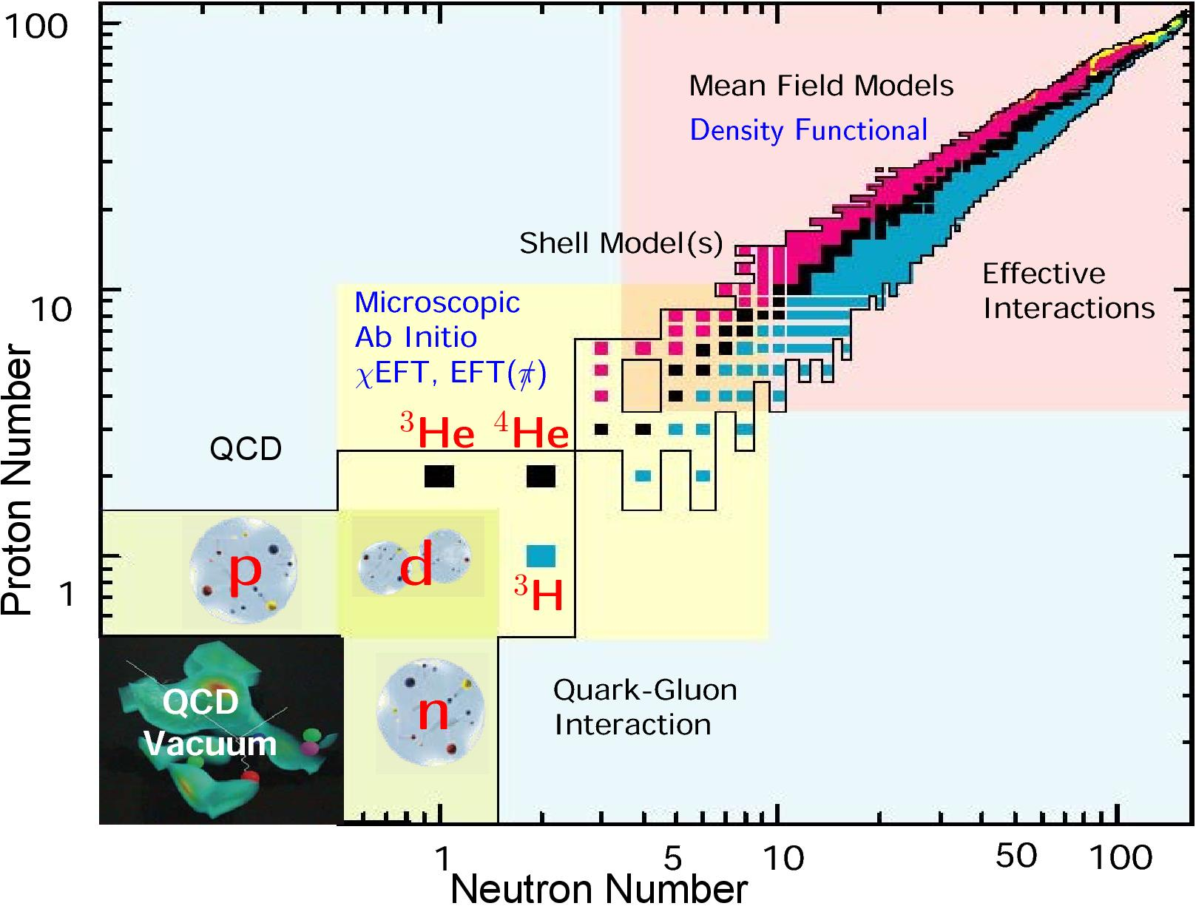
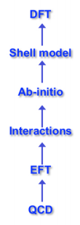
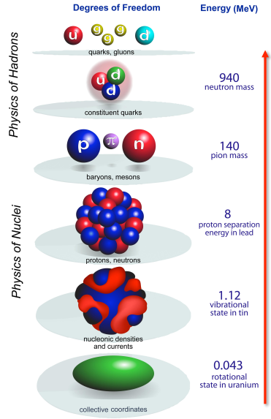
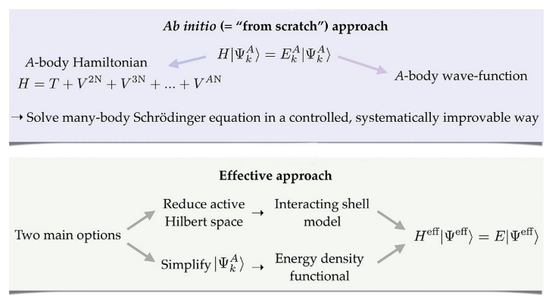
原子核多体方法

Slide 3
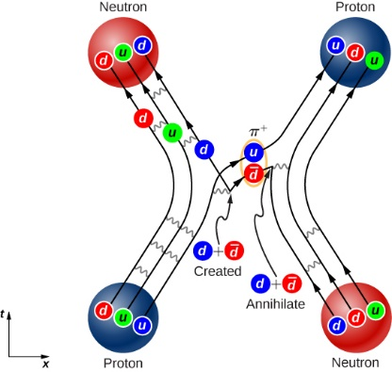
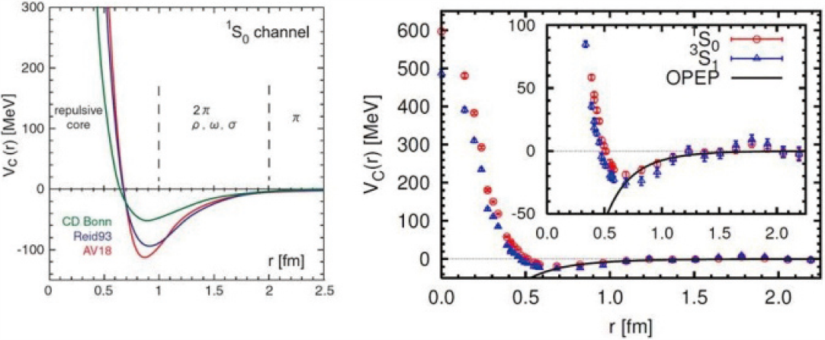
原子核的复杂性
1. 核力-强相互作用的剩余相互作用
左侧：经验的核相互作用势
右侧：使用格点量子色动力学求解的核势
Ishii, Aoki, Hatsuda 2007
2.原子核是由质子、中子构成的量子多体系统
少体
(A<5)
多体
(A<300)
多体
(A>300)
比较容易求解
求解困难，
需要发展先进的多体方法
利用统计的思想求解

Slide 4
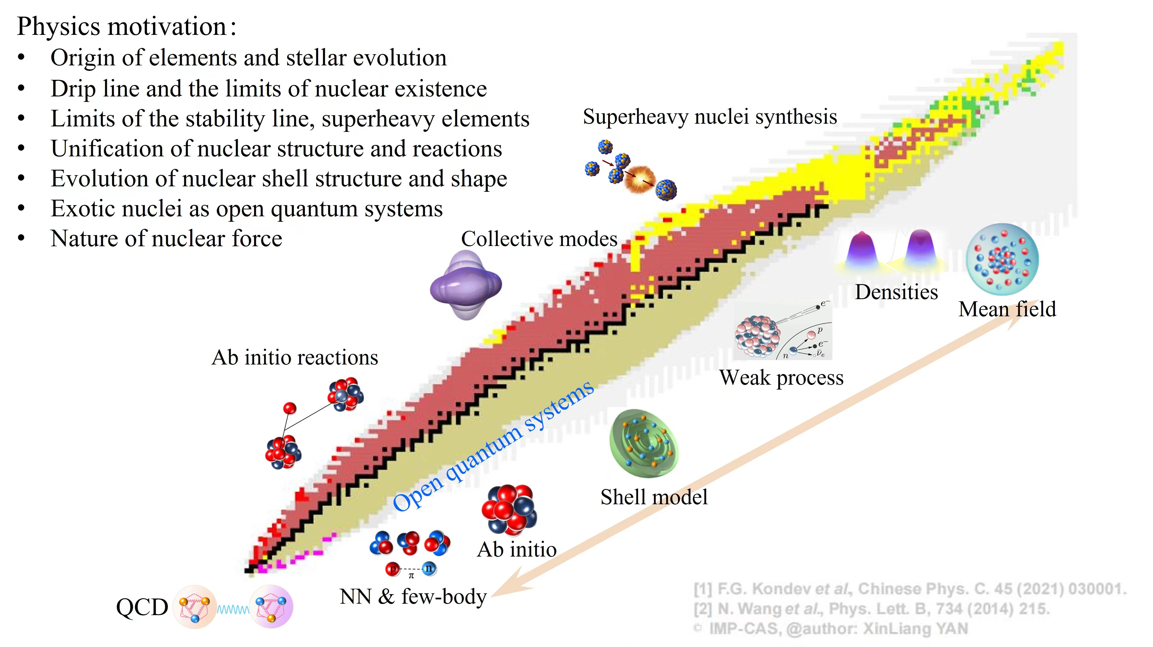
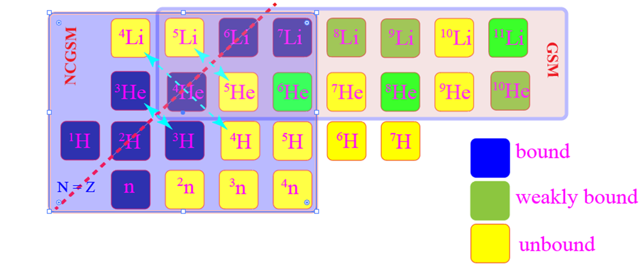

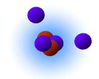
滴线原子核
¹⁰He
Resonance
滴线原子核奇特
晕结构 ^{6,8}He,¹¹Li,¹¹Be,⁸B,¹⁷Ne,²⁹F
粒子发射 p,n,2p,2n,4n,2n+2n,...
Thomas Erhman-shift
…
HIAF 上重要的科学目标
给当前的理论模型提出了巨大的挑战

Slide 5
滴线原子核
¹⁰He
热点的滴线外原子核 ： ⁴n,²⁸O, ⁷H,¹⁸Mg 等
Resonance
滴线原子核奇特
晕结构 ^{6,8}He,¹¹Li,¹¹Be,⁸B,¹⁷Ne,²⁹F
粒子发射 p,n,2p,2n,4n,2n+2n,...
Thomas Erhman-shift
…
HIAF 上重要的科学目标
给当前的理论模型提出了巨大的挑战

Slide 6
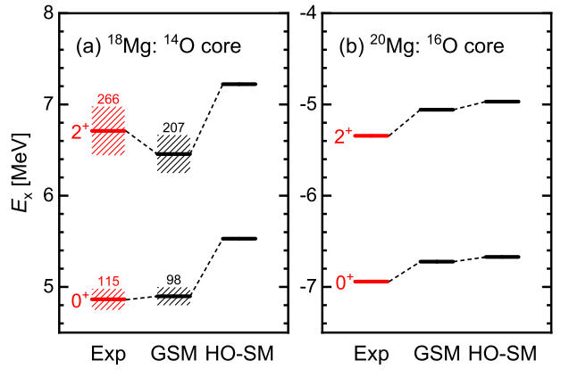

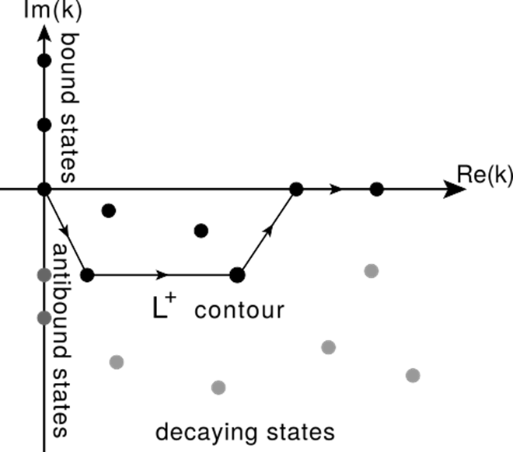
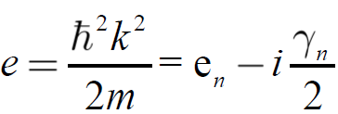
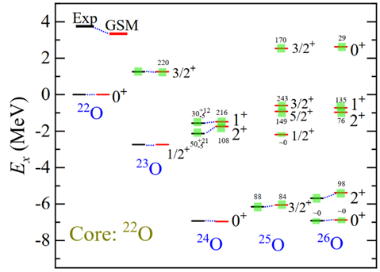

共振态-粒子发射
共振态具有粒子发射特性，是一个时间相关性的量子多体问题
Berggren 复动量空间，将时间相关问题转化为时间无关问题，便于求解薛定谔定态方程
径向波函数
Y. Jin et al., Phys. Rev. Lett. 127, 262502 (2021).
T. Berggren, Nucl. Phys. A109 (1968) 265
J. G. Li, et al. Phys. Rev. C 103, 034305 (2021)

Slide 7
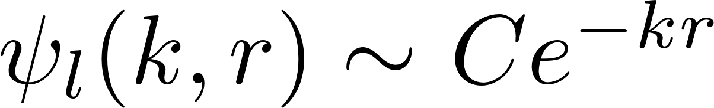
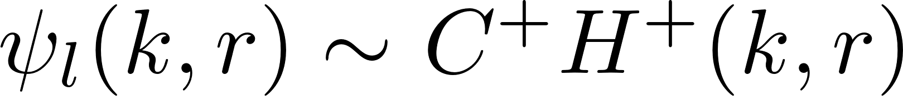
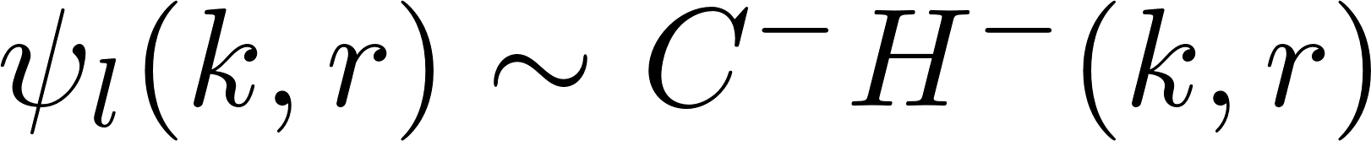
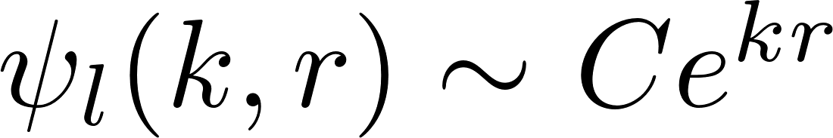
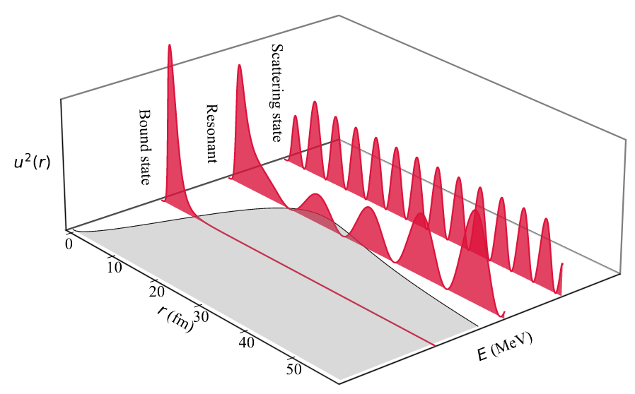

Berggren 基矢
r$≥$R 处的边界条件为：
Im(k)
束缚态
共振态
散射连续态
捕获态
虚态
Bound state
Resonance
L⁺
Re(k)
Antibound state
Capturing state
Decaying state
N. Michel et al., Phys. Rev. C 74 (2006) 054305
正交性和完备性:
T. Berggren, Nucl. Phys. A109 (1968) 265
统一地描述束缚态、共振态和散射连续态。

Slide 8
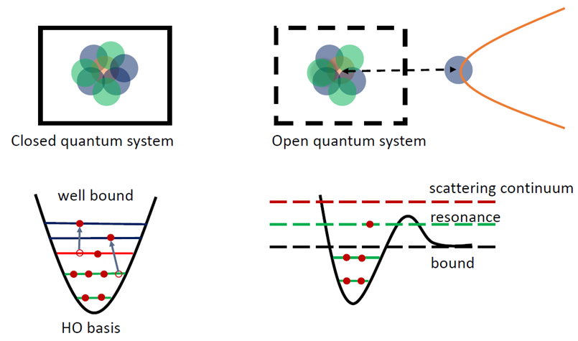

量子多体计算- HO /Berggren 完备基矢
$H=−\sum_{i}{\frac{ℏ^{2} }{2m}}▽_{i}^{2}+\sum_{ij}{V_{ij} }+\sum_{ijk}{V_{ijk}}$
NCSM/SM
NCGSM/GSM
Berggren 基矢自洽的包含共振与连续谱耦合
Berggren basis
N. Michel, M. Płoszajczak, The Gamow Shell Model, Springer ; N. Michel, et al., JPG 36,013101 (2009)
J. G. Li, et al., Physics 3, 977 (2021)
J. G. Li, et al., Phys. Rev. C 100, 054313 (2019)
J. G. Li, et al., Phys. Rev. C 104, 024319 (2021)
E. Caurier, et al. RMP 77,427 (2005)
T. Otsuka, et al, RMP. 92,015002 (2020)
B. R. Barrett, P. Navratil, and J. P. Vary PPNP 69,131(2013)

Slide 9
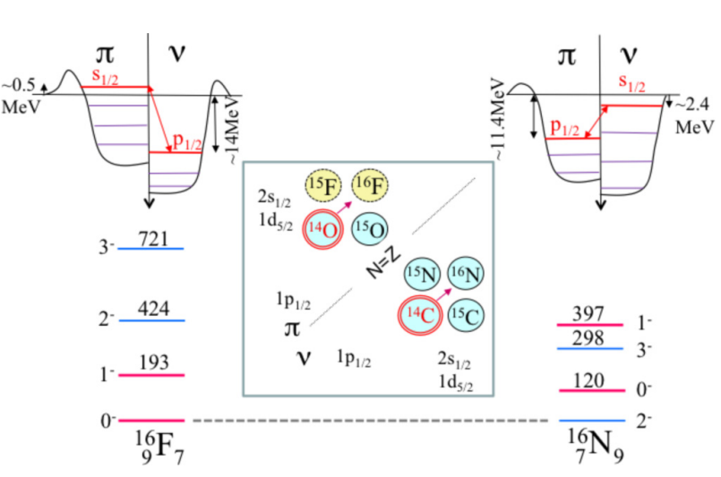
滴线原子核中的连续谱效应 : 举例
¹⁸Mg : 4p-decay to ¹⁴O
¹⁶F/¹⁶N ground state inversion
⁶He: Two-neutron Halo
Resonance and continuum coupling
I.Stefan et al., PRC 90, 014307(2014)
N. Michel, J. G. Li, et al PRC 106, L011301(2022)
S. Zhang, F. R. Xu et al, submitted to PRC
also for radius
Theoretical calculations :J. G. Li and N. Michel
Resonance and continuum coupling
Y. Jin et al., PRL. 127, 262502 (2021).
J. G. Li, et al., in preparation
连续谱耦合在滴线区原子核中非常关键，理论模型中需要很好的考虑！

Slide 10
第一性原理Gamow壳模型
第一性原理Gamow 壳模型(GSM):
G. Hagen et al., Phys. Rev. C 73 (2006) 064307; K. Tsukiyama et al., Phys. Rev. C 80 (2009) 051301; Z. H. Sun et al., PLB 769 (2017) 227–232;
GSM = Chiral EFT + Berggren basis + Many-body methods
从手征核力出发
与基本理论QCD直接相关;
系统性的改善;
采用Berggren基矢，包含共振和连续态 多体共振态: |SD^{(n)}>;
自然得到多体渐近行为;
Rigged 希尔伯特空间
复对称哈密顿量;
多体方法
多体微扰理论;
Many-body dynamics
Systematic improvements
Open channels
Figure updated from C. Forssén et al., Phys. Scr. 2013 014022

Slide 11
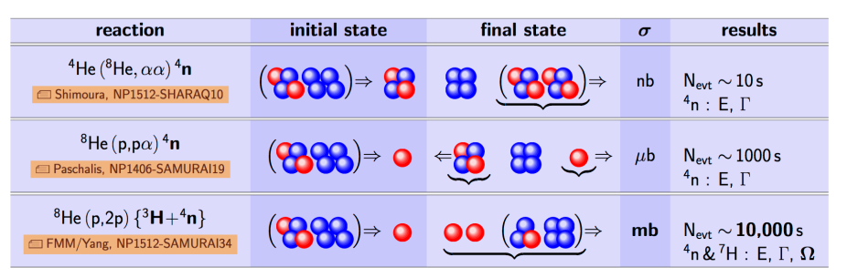
多中子态研究历史
More than 50 years of multi-neutron searches, especially the tetraneutron.
See arXiv:1608.00169[nucl-th] (2016) Eur. Phys. J. A 57,105(2021),
Earlier experiments gave negative results, no information about the multi-neutron systems.
In 2002, Marqués et al reported the possible existence of a bound tetraneutron observed in a breakup reaction of the ¹⁴Be→¹⁰Be+4n channel. Marqués et al., PRC 65, 044006 (2002)
In 2016, Kisamori et al observed of few events of tetraneutron in the doubly charge-exchange reaction ⁴He(⁸He,⁸Be) . Interpreted the tetraneutron as a candidate resonance with Er = 0.83 ± 0.65(stat) ± 1.25(syst) MeV and width Γ ≤ 2.6 MeV. Kisamori et al., PRL 116, 044006 (2016)
Future tetraneutron experiments
Nature 2022

Slide 12
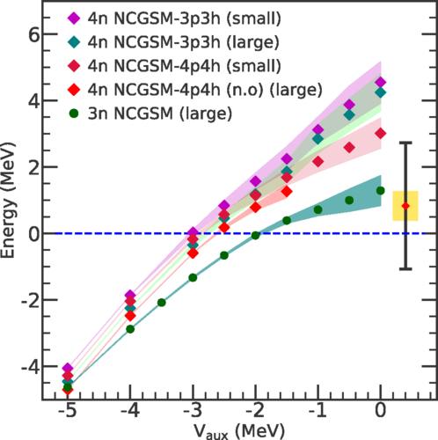
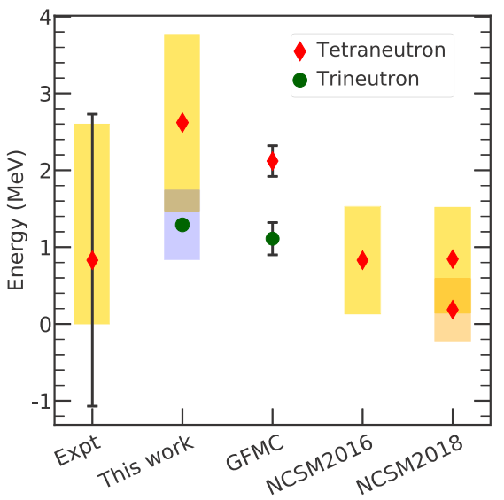
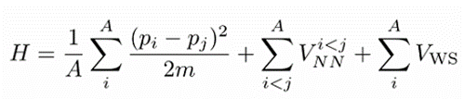
第一性原理无芯Gamow壳模型计算多中子共振态
相互作用 : N3LO
ab initio NCGSM
E(³n) = 1.29 MeV Γ(³n) = 0.91 MeV
E(⁴n) = 2.64 MeV Γ(⁴n) = 2.38 MeV
三中子的能量比四中子低.
与量子蒙卡的外推结果接近
多中子体系
非束缚
连续态耦合强
☺三中子共振态的宽度比四中子共振态小.
☺ 三中子共振态在实验上比四中子共振态更容易探测
J. G. Li, N. Michel, B. S. Hu, W. Zuo, and F. R. Xu*, Phys. Rev. C 100, 054313 (2019)

Slide 13
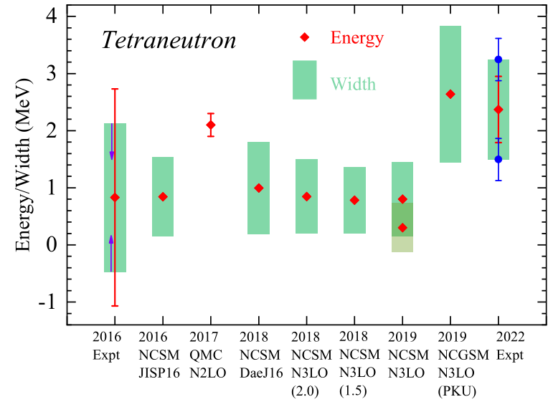
四中子研究-理论+实验
2016 Expt : Kisamori et al., PRL 116, 044006 (2016)
2016 NCSM: A. M. Shirokov,et al, PRL 117,182502 (2016)
2017 QMC : S. Gandofi, et al., PRL 118, 232501(2017)
2018 NCSM : A. M. Shirokov,et al AIP Conf. proc 020038 (2018)
2019 NCSM : A. M. Shirokov Presentation in Nanjing@China 2019
2019 NCGSM : J. G. Li, N. Michel, B. S. Hu, W. Zuo, and F. R. Xu*, Phys. Rev. C 100, 054313 (2019)

Slide 14
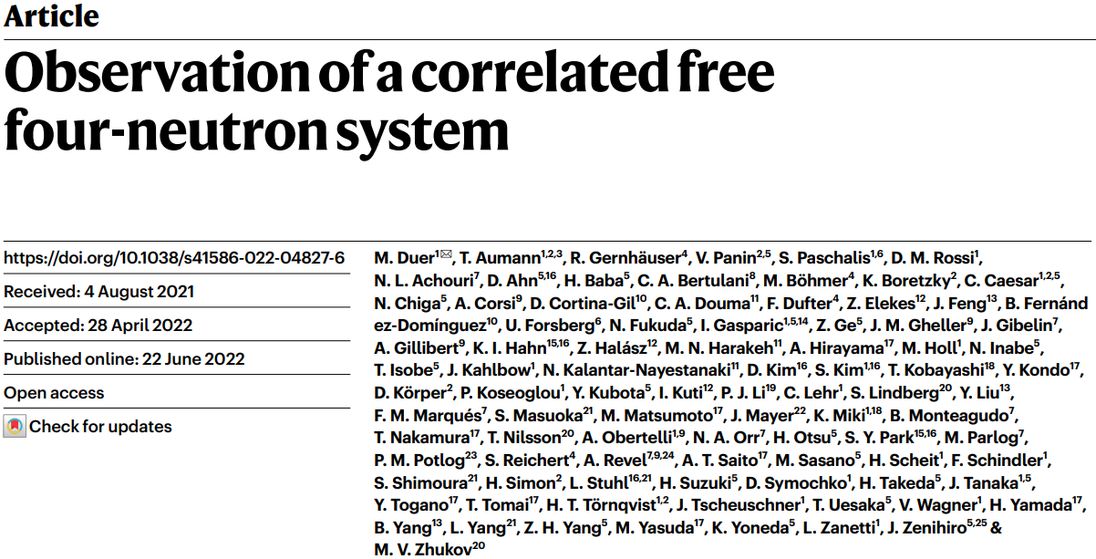
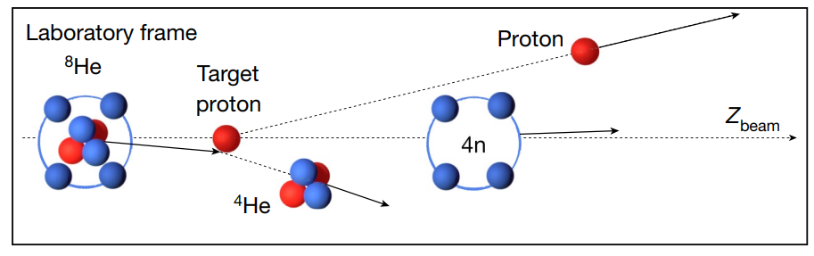
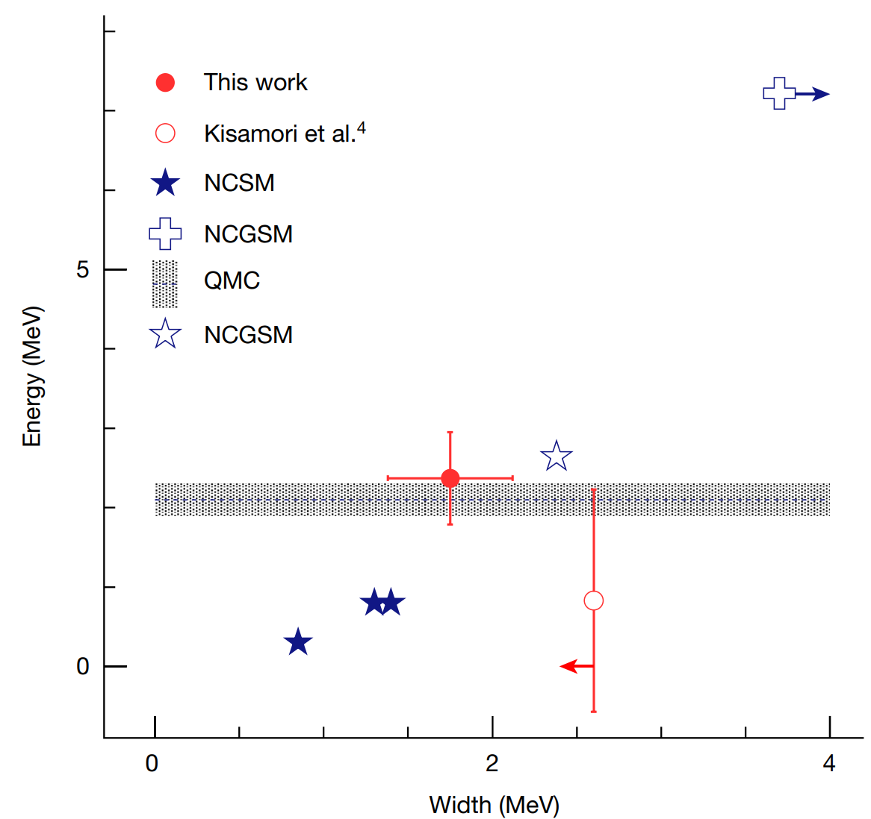

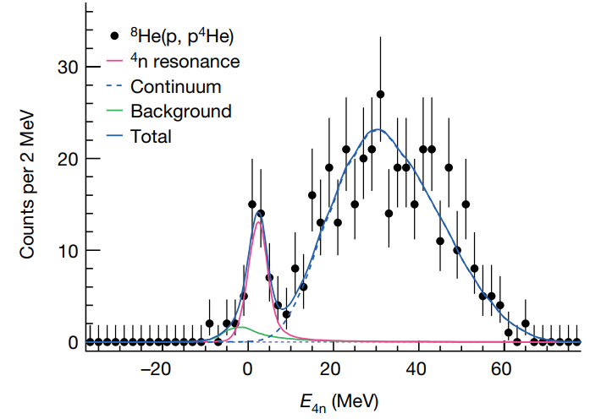
实验探测到四中子共振态
our NCGSM result

Slide 15
四中子研究-理论+最新实验
2016 Expt : Kisamori et al., PRL 116, 044006 (2016)
2016 NCSM: A. M. Shirokov,et al, PRL 117,182502 (2016)
2017 QMC : S. Gandofi, et al., PRL 118, 232501(2017)
2018 NCSM : A. M. Shirokov,et al AIP Conf. proc 020038 (2018)
2019 NCSM : A. M. Shirokov Presentation in Nanjing@China 2019
2019 NCGSM : J. G. Li, N. Michel, B. S. Hu, W. Zuo, and F. R. Xu*, Phys. Rev. C 100, 054313 (2019)
2022 Expt : M. Duer et al. Nature 606, pages678–682 (2022)

Slide 16
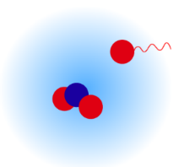

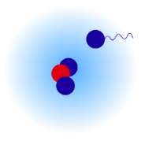
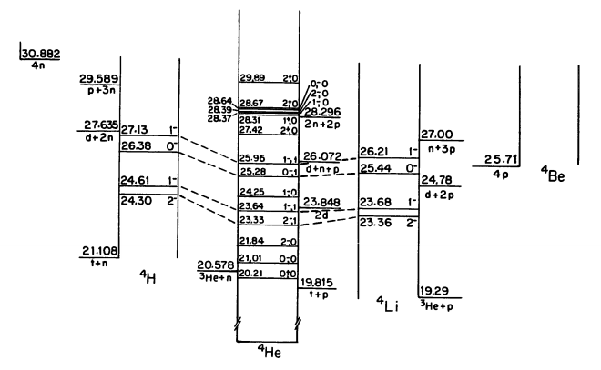
A = 4 (⁴H, ⁴He and ⁴Li ) 原子核系统
⁴Li, ⁴He and ⁴H, all the states, except the ground state of ⁴He, are unbound bearing broad widths.
The experimental energies and widths of the ground state of ⁴H and ⁴Li are either not very conclusive or even contraction.
The T = 1 isospin multiplet states: the ground states of ⁴Li and ⁴H, and the excietd state of ⁴He → Isospin symmetry breaking
Energy levels of light nuclei A =4 D.R. Tilley et al. Nucl. Phys. A541 (1992) 1-104

Slide 17
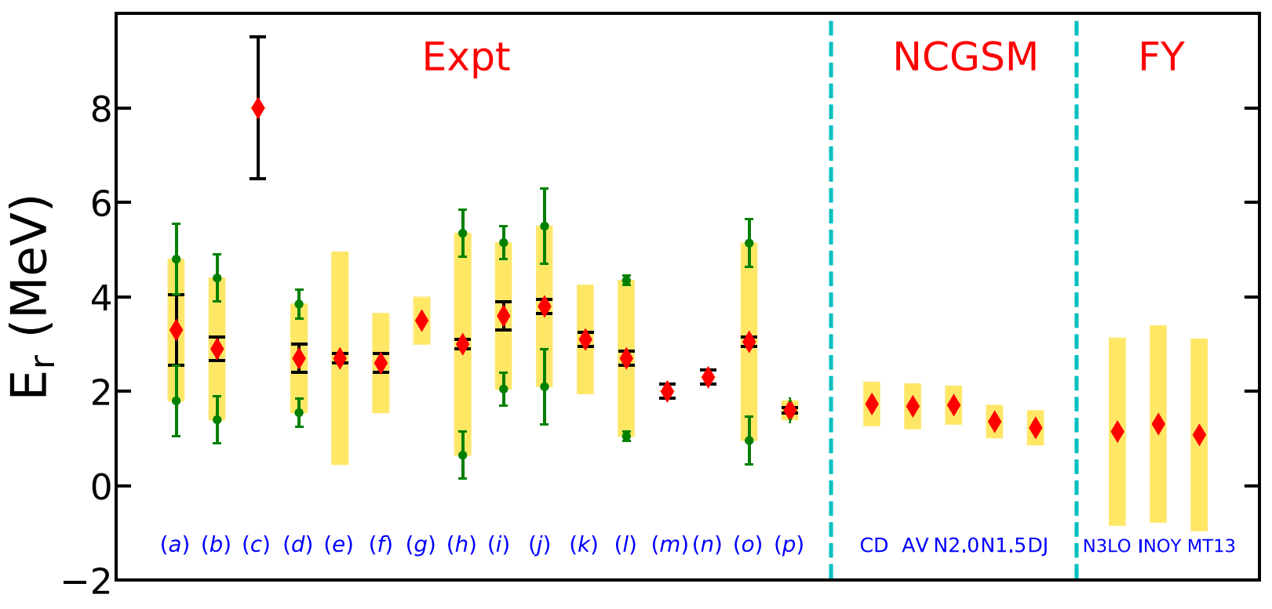
NCGSM 计算 ⁴H
CD-Bonn-SRG2.0
AV18-SRG2.0
N3LO-SRG2.0
N3LO-SRG1.5
DJ16
No coulomb force.
Er ~ 1.23-1.74 MeV
Γ ~ 725-951 keV
测量时间的顺序排列
J.G. Li, N. Michel, W. Zuo and F.R. Xu*, Phys. Rev. C 104, 024319 (2021)

Slide 18
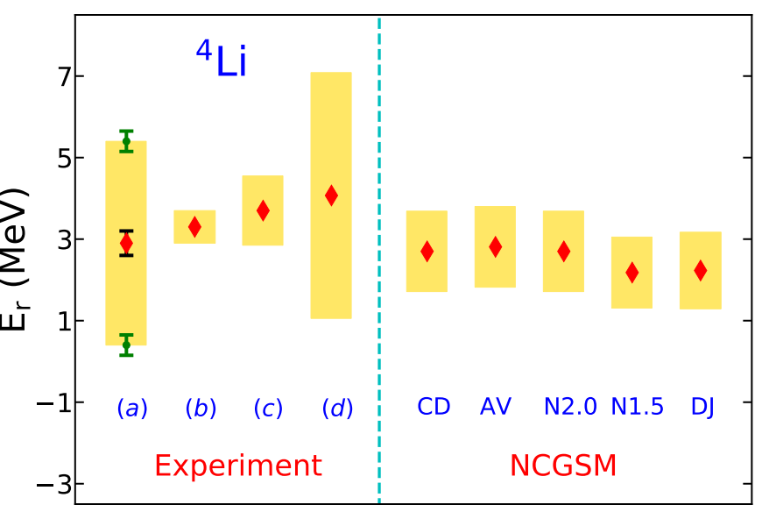
Ab initio NCGSM 计算⁴Li
AV18-SRG2.0
CD-Bonn-SRG2.0
N3LO-SRG2.0
N3LO-SRG1.5
DJ16
Coulomb force (long-range) need to be well treated.
Er ~ 2.23-2.70 MeV
Γ ~ 1881-1972 keV
J.G. Li, N. Michel, W. Zuo and F.R. Xu*, Phys. Rev. C 104, 024319 (2021)

Slide 19
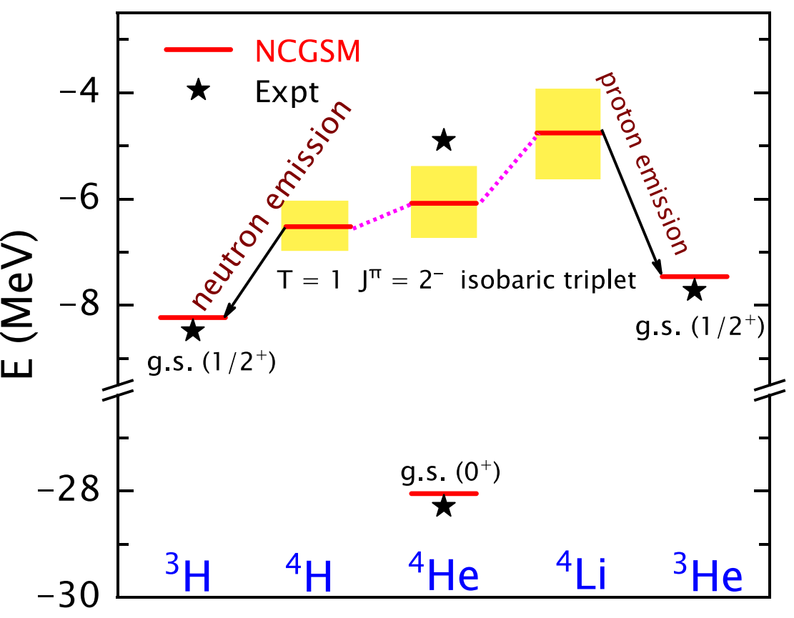
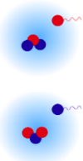


A = 4 (⁴H, ⁴He and ⁴Li ) T = 1 态
Comparing the calculated spectra of the A = 4 systems , the ground states ⁴Li (T= 1), ⁴H (T=1) (2- and 1-) with the ground state of ⁴He (T = 0) and 2⁻ (T= 1) excited states.
The isospin breaking is mainly caused by the Coulomb force.
The energies and widths are both different due to the isospin breaking.
The splitting of the T =2 isobaric triplet states.
T ≈ 0.71
N3LO-SRG2.0
J.G. Li, N. Michel, W. Zuo and F.R. Xu*, Phys. Rev. C 104, 024319 (2021)

Slide 20
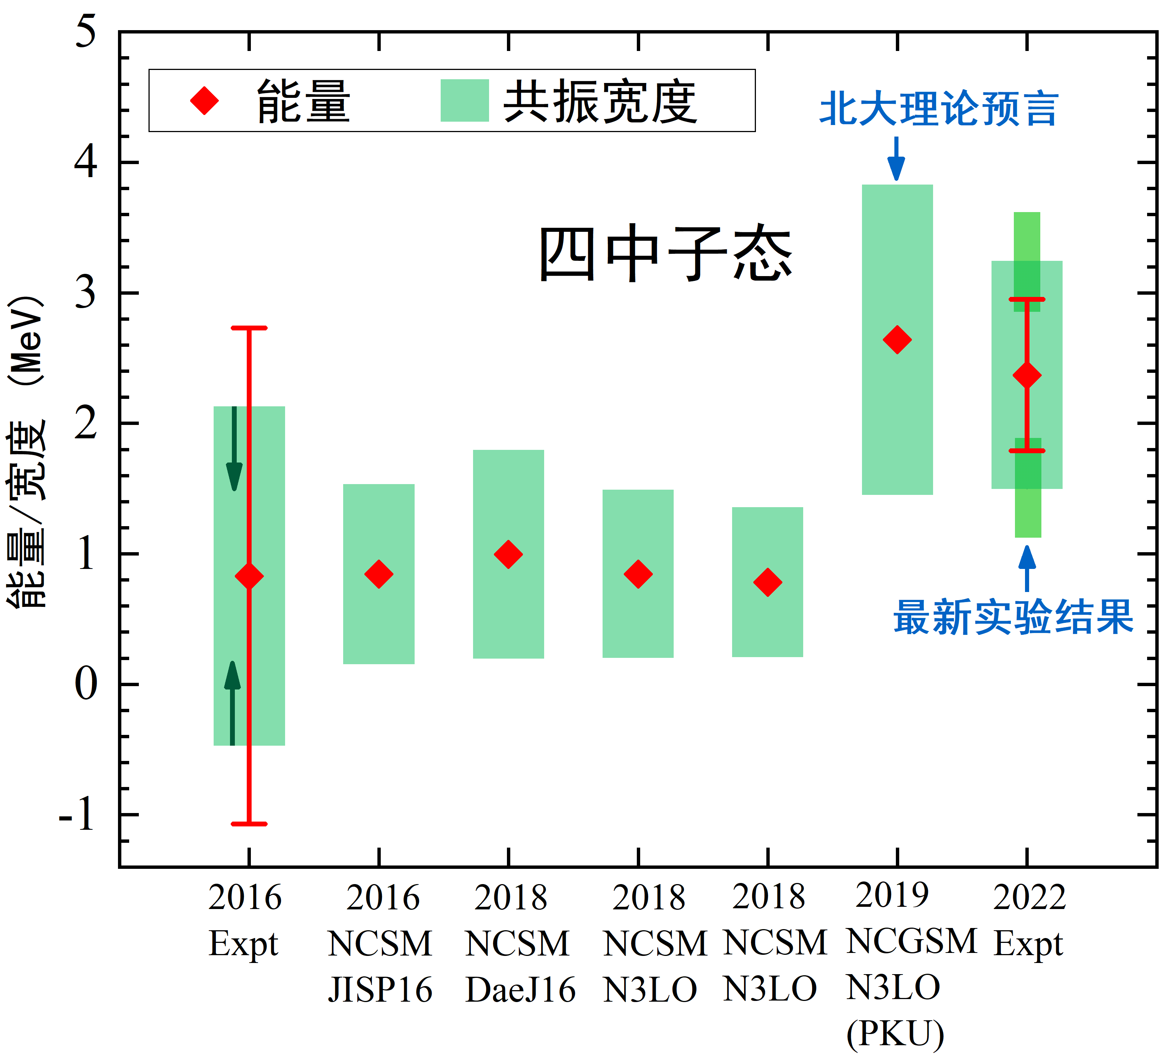
第一性原理无芯Gamow壳模型
四中子共振态
A=4 T =1 共振态
⁶He: 双中子晕结构
共振与连续谱耦合
T ≈ 0.71
N3LO-SRG2.0
半径计算类似
J. G. Li, et al., Phys. Rev. C 100, 054313 (2019)
J.G. Li, et al., PRC 104, 024319 (2021)
J. G. Li, et al., 文章准备中
无芯Gamow壳模型只能计算A≤6的体系,我们正在发展DMRG方法,计算稍重的共振原子核

Slide 21
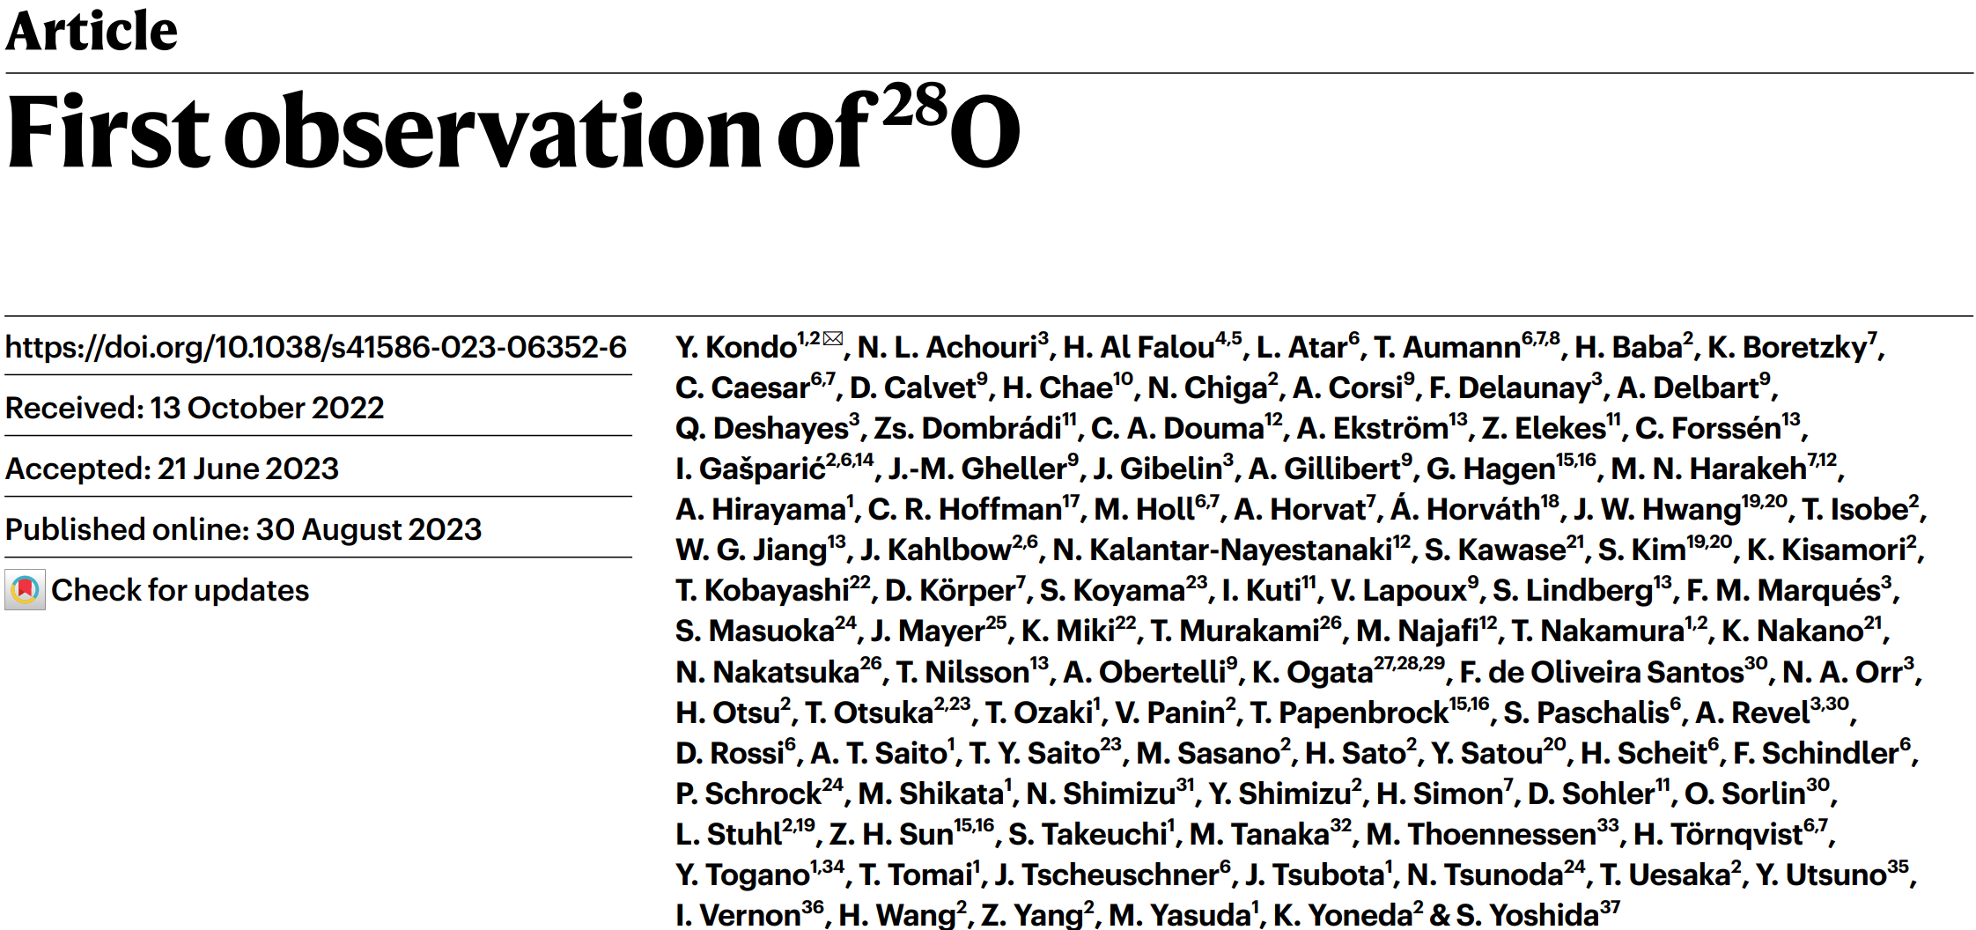
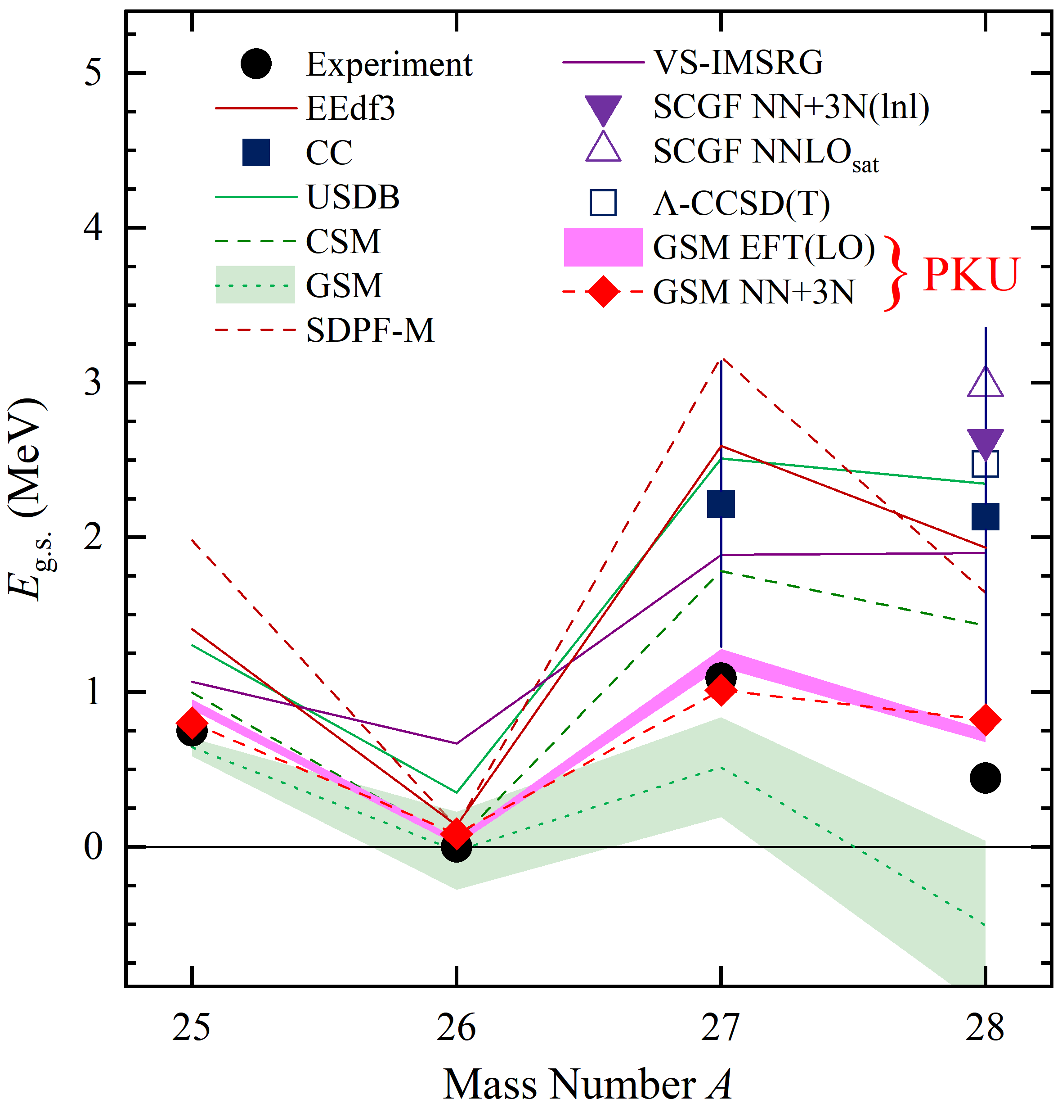
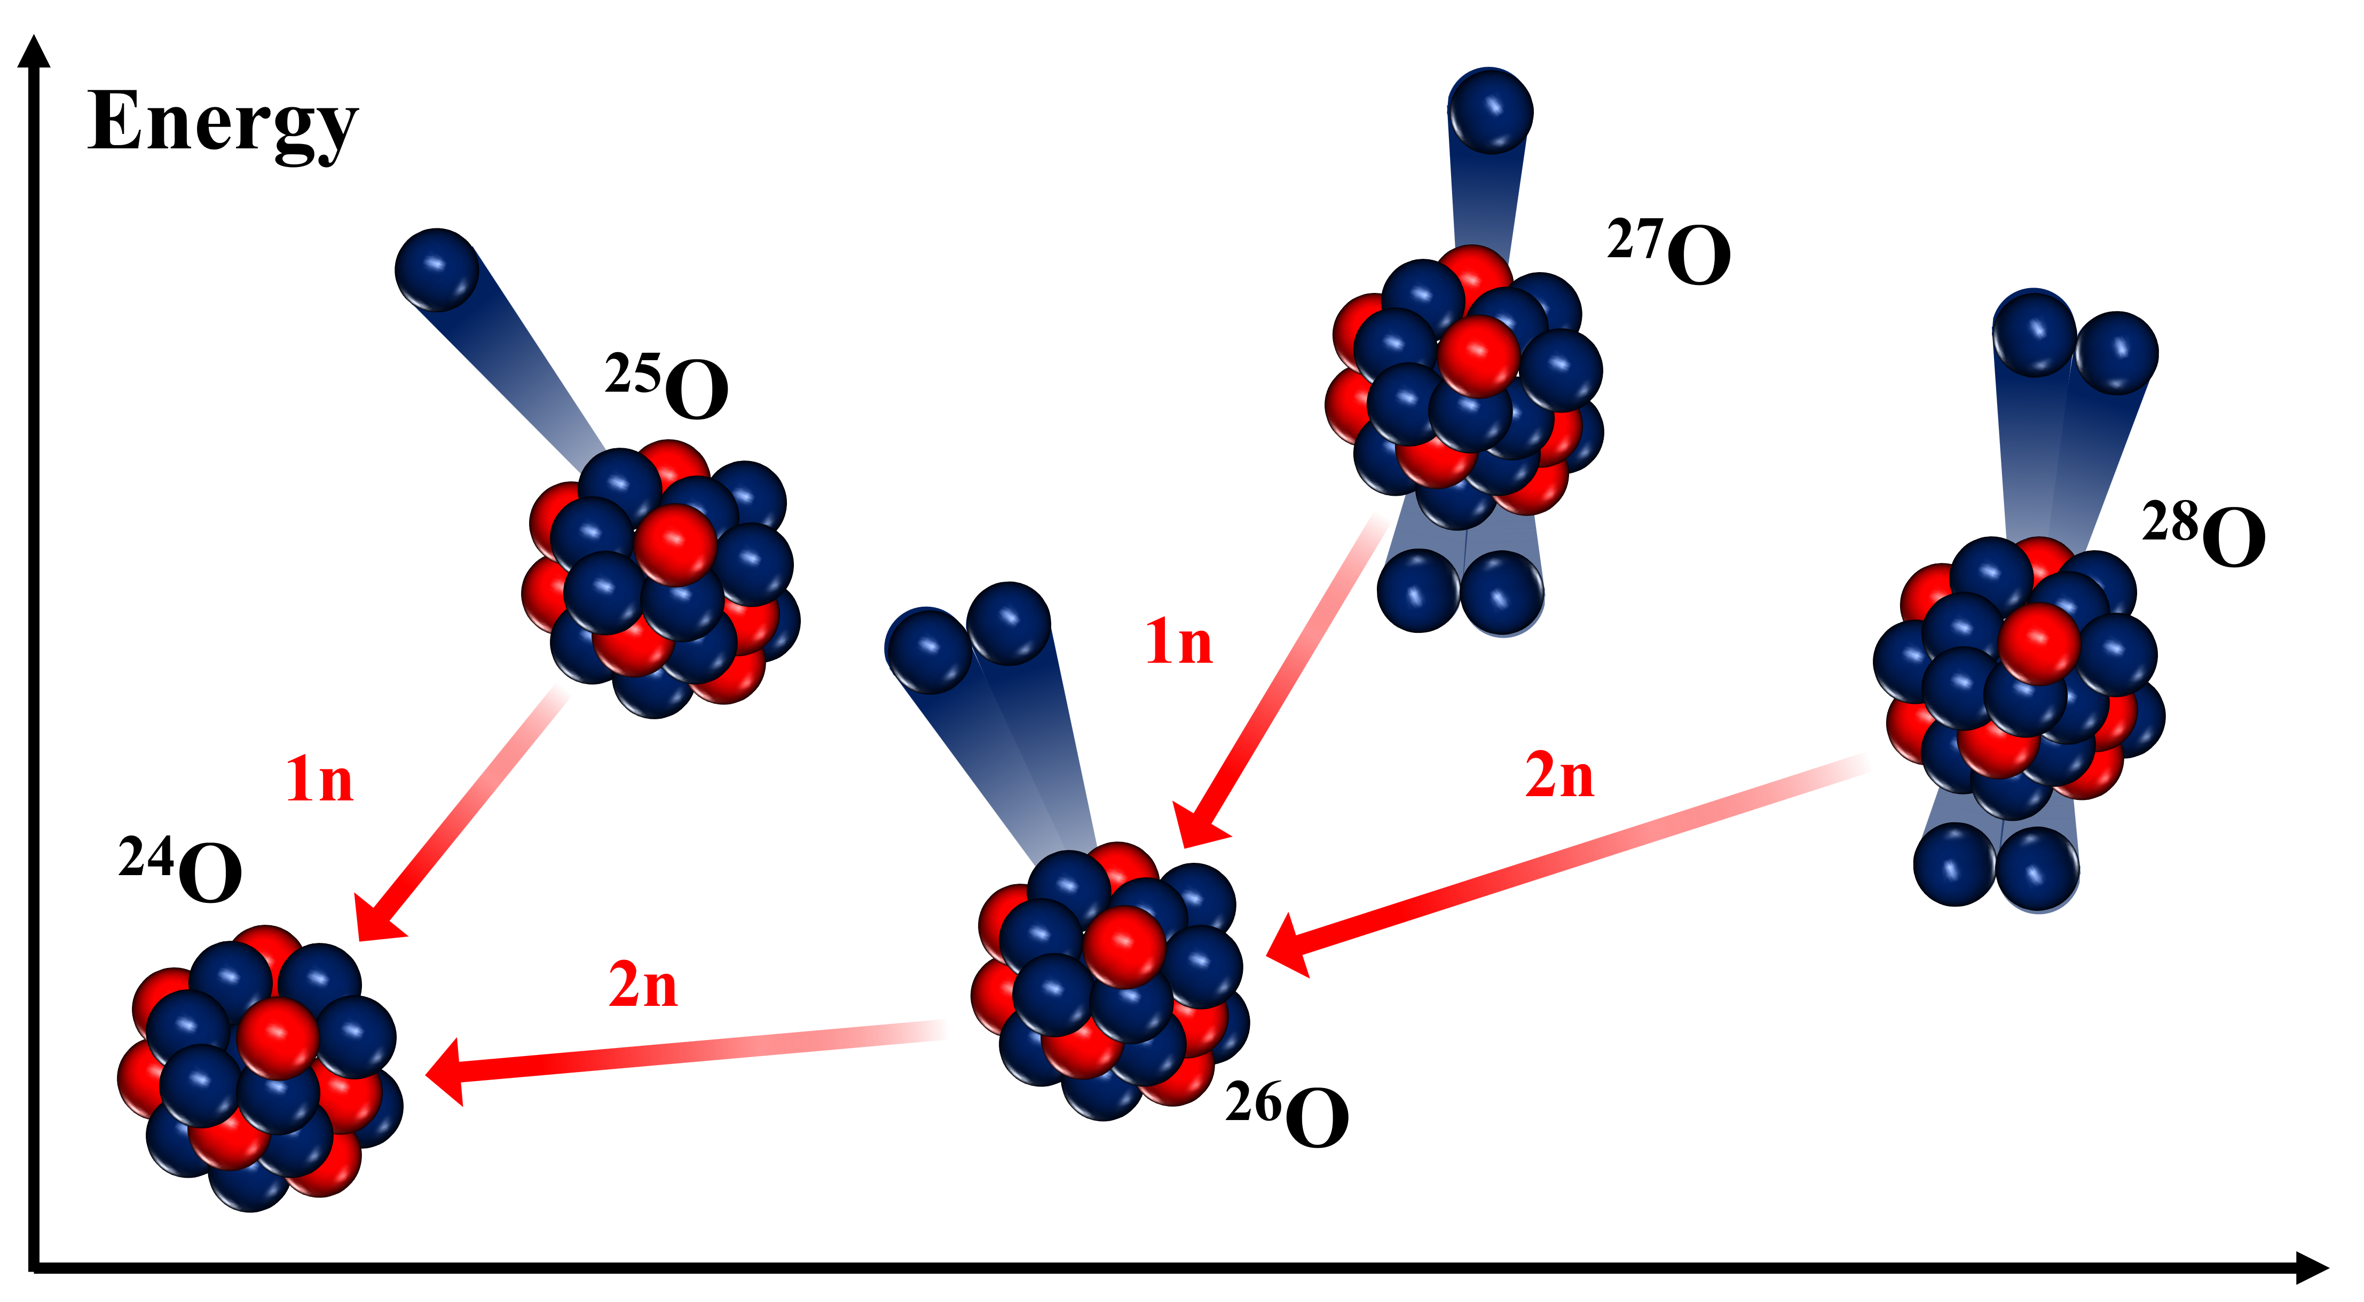
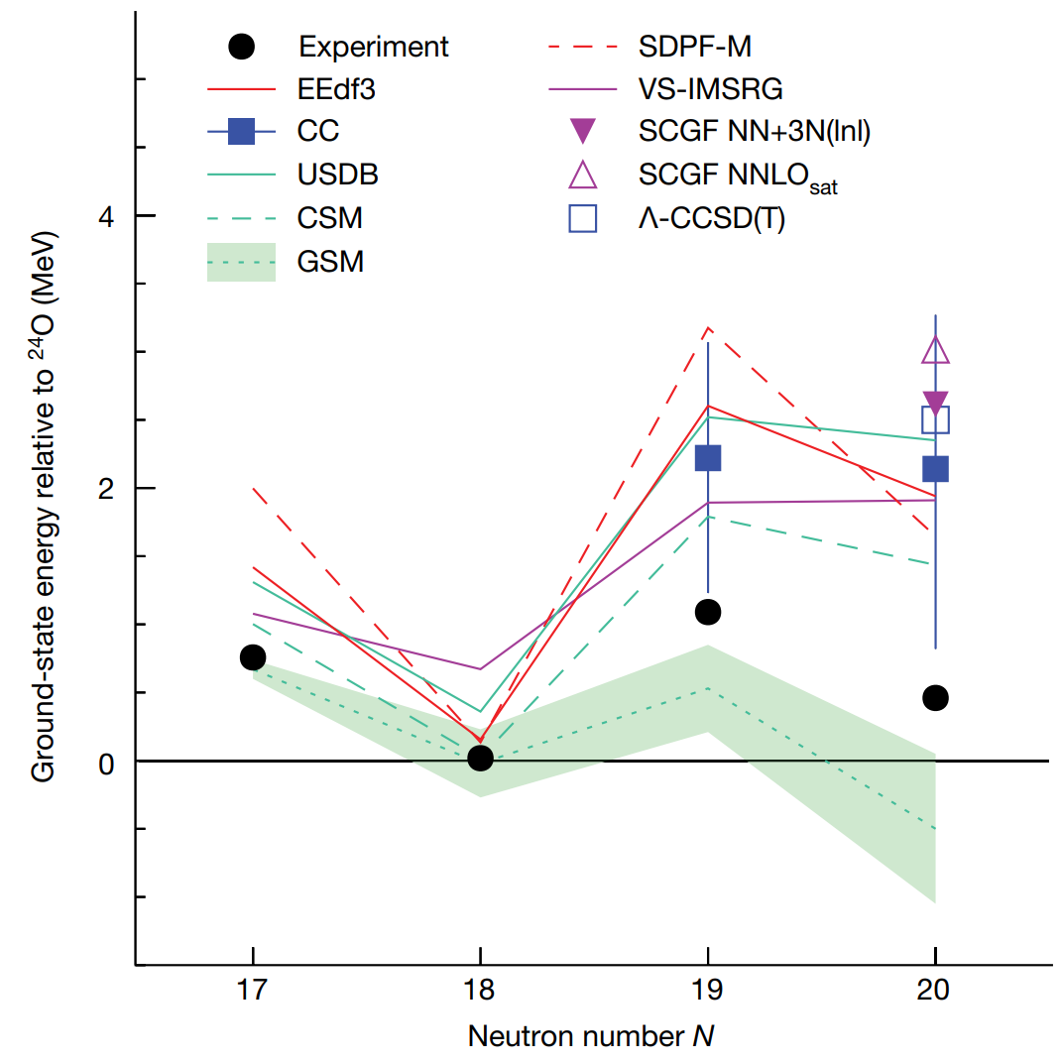
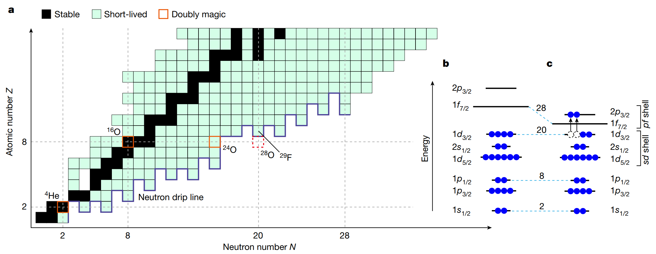
Gamow壳模型研究滴线外的共振核: ²⁸O
J.G. Li, N. Michel, W. Zuo and F.R. Xu. PRC 103, 034305 (2021)
S. Zhang, Y. Z. Ma, J. G. Li, et al.,. PLB 827, 136958 (2022)

Slide 22
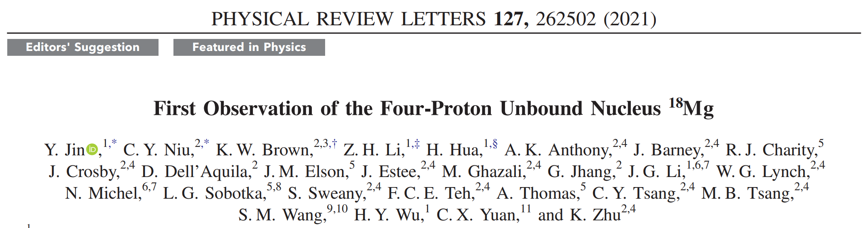

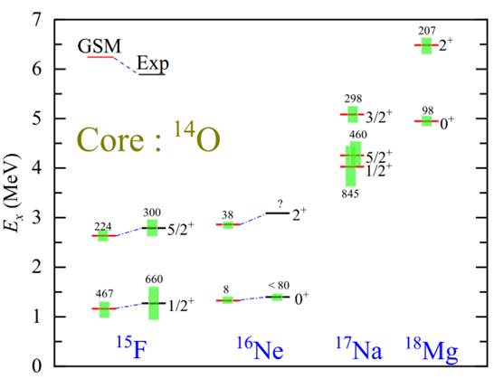
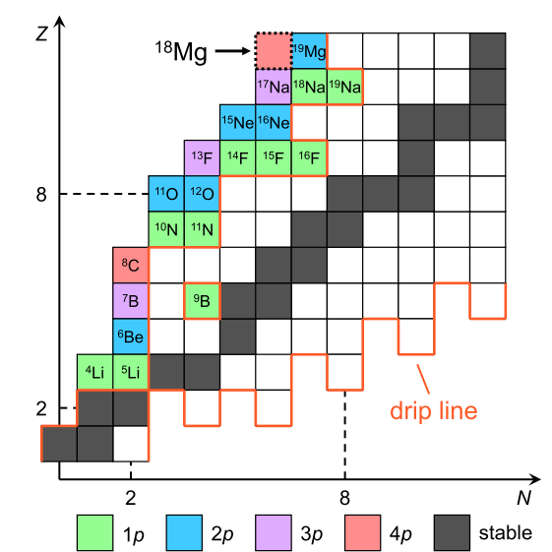
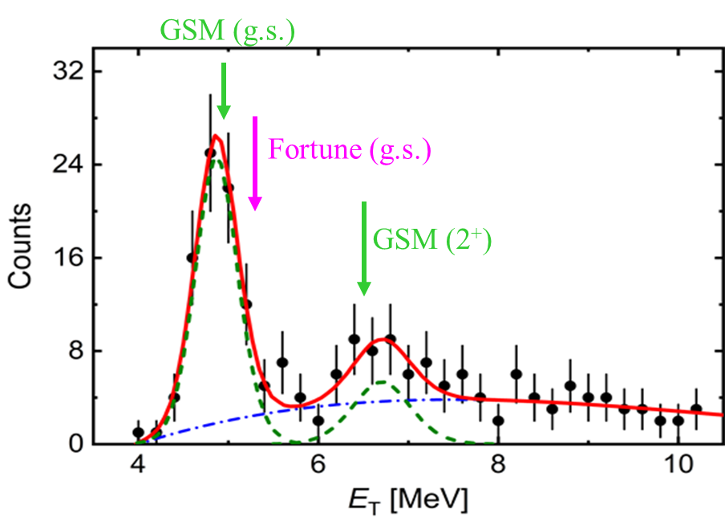
Gamow壳模型研究预言的¹⁸Mg共振结构
Gamow壳模型研究预言¹⁸Mg四质子发射
N. Michel, J. G. Li, F. R. Xu, and W. Zuo, Phys. Rev. C 103, 044319 (2021)
预言的¹⁸Mg能量与共振宽度与实验符合很好

Slide 23
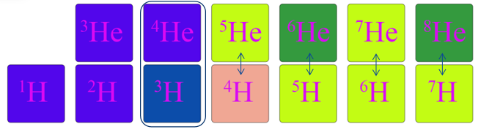
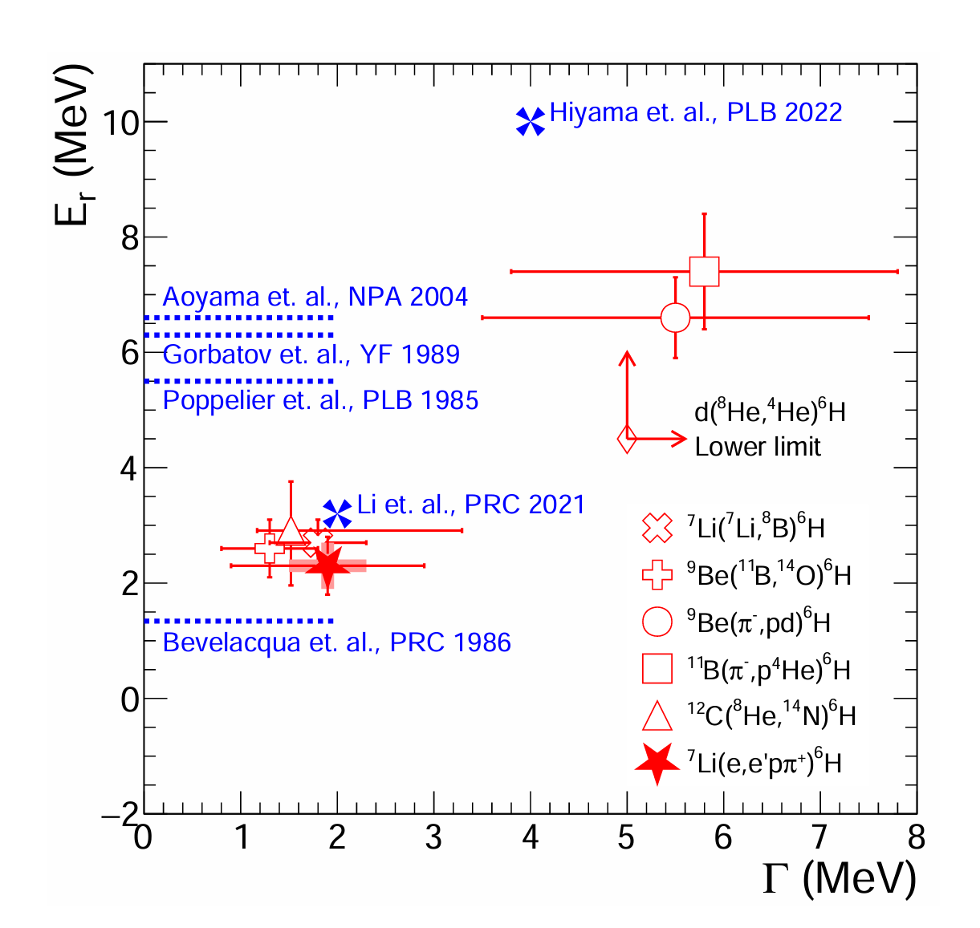
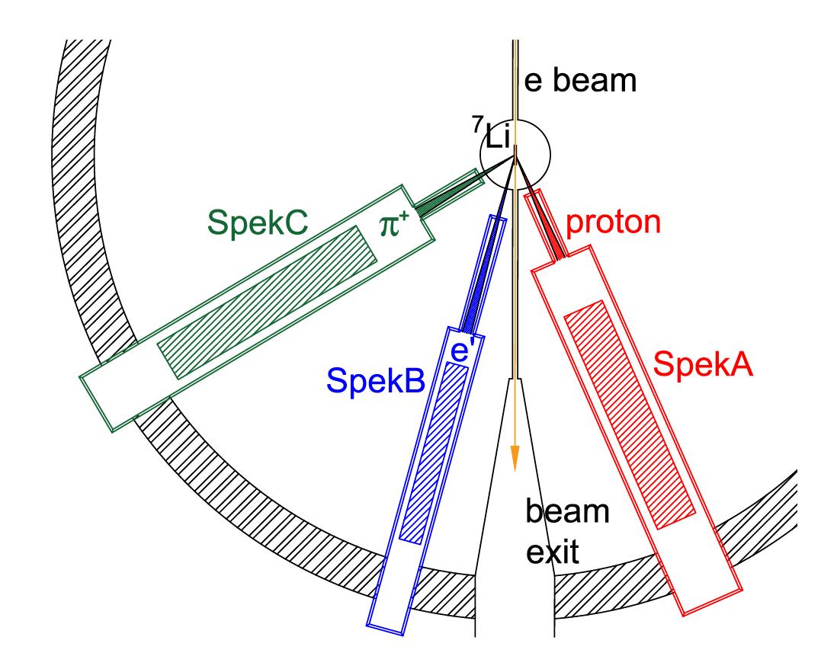
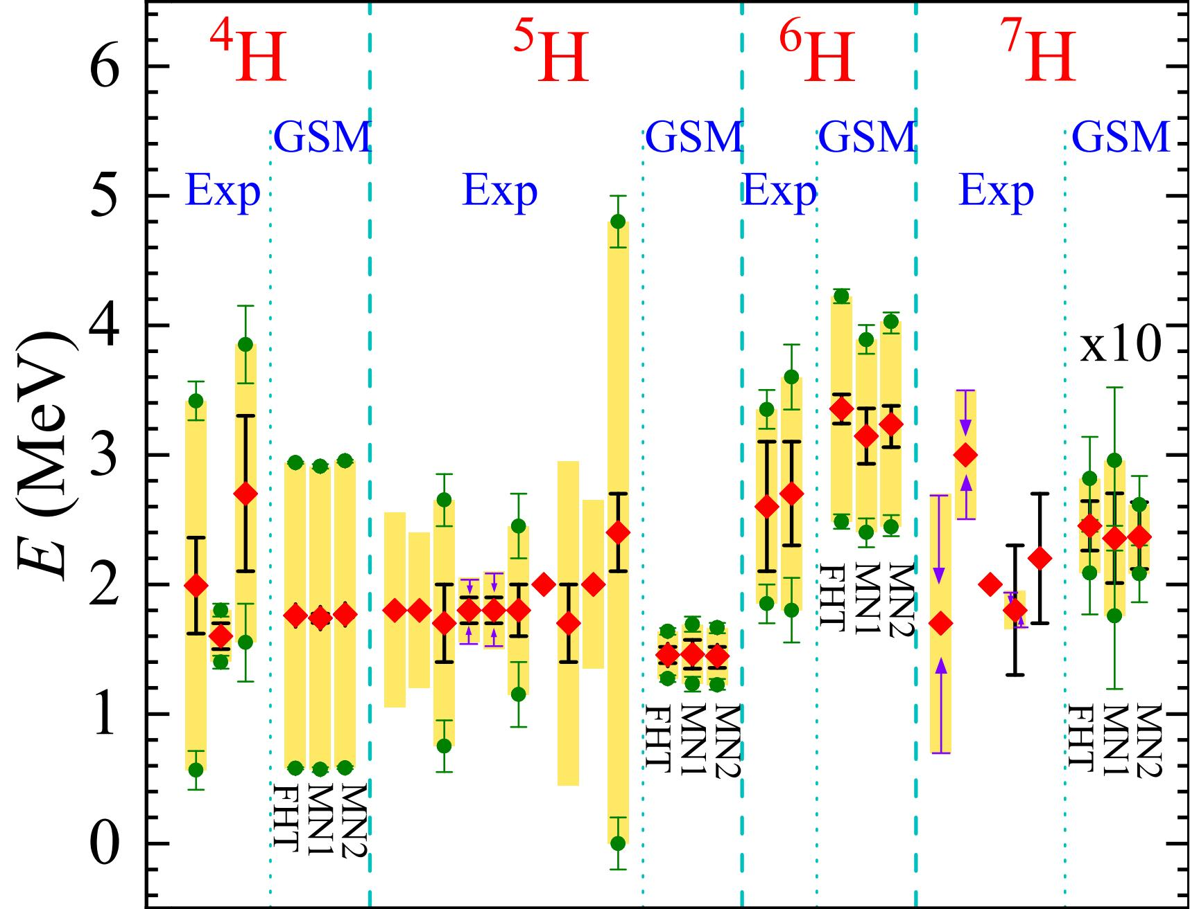
Gamow壳模型研究预言的^{6,7}H共振结构
复旦大学马余刚院士团队测量⁶H共振态性质
⁷Li(e, e′pπ+)⁶H
⁷H 基态: 窄共振态
A1 Collaboration
Gamow壳模型对于⁶H能量与共振态宽度的理论预言结果与实验符合最好
H. H. Li, J. G. Li, N. Michel, and W. Zuo, Phys. Rev. C 104, L061306 (2021)

Slide 24
总结
第一性原理无芯Gamow壳模型计算多中子共振态的能量与宽度（三中子+四中子）
    计算的四中子共振态的能量与宽度被RIKEN实验证实(Nature 606, 678 (2022)).
    三中子在是实验上比四中子更容易被探测
    发展DMRG计算更重的共振态结构，并与NCGSM-CC结合计算反应等性质
Gamow壳模型计算滴线外共振原子核:
共振原子核 | Gamow shell model | 实验
²⁸O~ ²⁴O+4n | J. G. Li, N. Michel, W. Zuo, and F.R. Xu. Phys, Rev. C 103, 034305 (2021) | 实验工作-RIKEN Nature 620, 965 (2023)
¹⁸Mg~ ¹⁴O+4p | N. Michel, J. G. Li, F. R. Xu, and W. Zuo, Phys. Rev. C 103, 044319 (2021) | 北京大学华辉老师课题组 PRL 127, 262502 (2021)
⁷H~ ³H + 4n | H. H. Li, J. G. Li, N. Michel, and W. Zuo, Phys. Rev. C 104, L061306 (2021) | RIKEN实验工作-未发表
⁶H~ ³H + 3n
 |  | 复旦大学马余刚院士团队 PRL accepted (2025)

Slide 25
谢谢各位老师，请批评指正！

Slide 26
History of theoretical researches for the multi-neutron systems
Year | Author | Journal | Conclusion
2003 | Bertulani et al | J. Phys. G 29, 2431 | gave no bound 4n combined dineutron-dineutron molecule and a toy NN potential
2003 | Steven C. Pieper | PRL. 90, 252501 | employed the GFMC calculated the tetraneutron, showed the modern nuclear force can not tolerate a bound tetraneutron and suggested the a tetraneutron resonance near 2MeV
2005 | Lazauskas and Carbonell | PRC 72, 034003 | used Complex scaling based on Reid 93 NN potential: no low-lying 4n resonances : no low-lying tetraneutron resonance.
2016 | E.Hiyama et al | PRC 93, 044004 | employed Complex scaling using AV8’+(toy)NNN, low 4n resonance possible only by strongly strongly modify the nuclear force
2016 | A.M.Shirokov et al | PRL 117,182502 | performed the NCSM with JISP16 interaction conformed a resonant state in tetraneutron around 0.8 MeV, width 1.4 MeV
2017 | S. Gandofi et al | PRL 118, 232501(2017) | presented the QMC calculations of multi-neutron systems, suggested the trineutron and tetraneutron were both resonance
2016 experiment

Slide 27
History of theoretical researches for the multi-neutron systems
Year | Author | Journal | Conclusion
2017 | K. Fossez et al. | PRL 119, 032501 | performed NCGSM gave energy of tetraneutron may be compatible with experimental value, but the width must be too large
2018 | A.Deltuva | PRC 97, 034001 (2018), PLB 782, 238 (2018) | employed Faddeev method gave the absence of an observable trineutron and tetraneutron resonance based on modern two-body force
2018 | A.M.Shirokov et al. | AIP Conf. proc 020038 | Performed NCSM for tetraneutron with different two-body force, similar results are obtained
2019 | A.M.Shirokov et al. | Presentation in Nanjing@China 2019 | updated their calculations and gave two resonance states in tetraneutron
2019 | J. G. Li et al. | PRC 100 054313 | Performed NCGSM for trineutron and tetraneutron, predicting that E (³n) = 1.29 MeV Γ (³n) = 0.91 MeV E(⁴n) = 2.64 MeV Γ (⁴n) = 2.38 MeV
2020 2021 | Michael D. Higgins et al. | PRL 125,052501 PRC 103 024004 | Using adiabatic hyperspherical framework, Predicting that that no resonance and no bound state exists for the tetraneutron system

Slide 28
滴线外的共振核: ²⁸O (Z = 8, N = 20)

Slide 29

滴线外的共振核: ²⁸O (Z = 8, N = 20)

Slide 30


滴线外的共振核: ²⁸O (Z = 8, N = 20)
GSM 计算
相互作用 : pionless LO EFT
optimized to experimental data
²⁸O 中 4中子发射：2n-2n
^{A}O
sdpf
GSM prediction:
²⁷O: 1.16 -1.28 MeV ²⁸O: 0.67 - 0.76 MeV
J.G. Li, N. Michel, W. Zuo and F.R. Xu. Phys. Rev. C 103, 034305 (2021)

Slide 31
滴线外的共振核: ²⁸O (Z = 8, N = 20)

Slide 32


Density of unbound states
J.G. Li, N. Michel, W. Zuo and F.R. Xu. PRC 103, 034305 (2021)
共振态密度分布在较远处具有震荡行为

