Slide 1
Practical parametrization of two-pole structure
周智勇
东南大学
in collaboration with Junxi Cui and Zhiguang Xiao
2025年4月12日，湖南师范大学，长沙

Slide 2
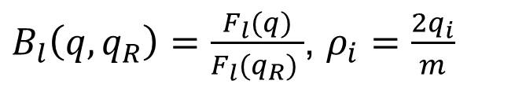
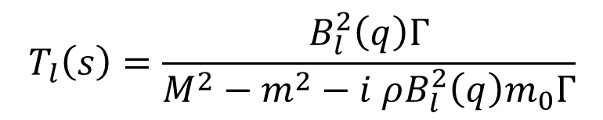
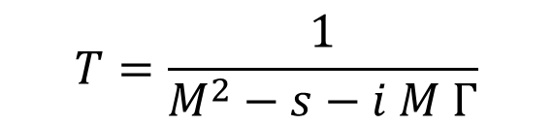
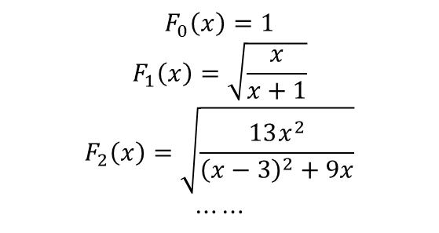
Background
How to describe a resonance
The simplest Breit-Wigner
$$T=\frac{1}{M^{2}−s−i M Γ}$$
Or Breit-Wigner distribution with energy-dependent width
Blatt-Weisskopf Barrier Factors
$$T_{l}\left(s\right)=\frac{B_{l}^{2}\left(q\right)Γ}{M^{2}−m^{2}−i ρB_{l}^{2}\left(q\right)m_{0}Γ}$$
$$F_{0}\left(x\right)=1$$
$$F_{1}\left(x\right)=\sqrt{\frac{x}{x+1}}$$
$$F_{2}\left(x\right)=\sqrt{\frac{13x^{2}}{{\left(x−3\right)}^{2}+9x}}$$
$$⋯⋯$$
$B_{l}\left(q,q_{R}\right)=\frac{F_{l}(q)}{F_{l}(q_{R}) }$, $ρ_{i}=\frac{2q_{i}}{m}$
by Hippel and Quigg (1972)

Slide 3
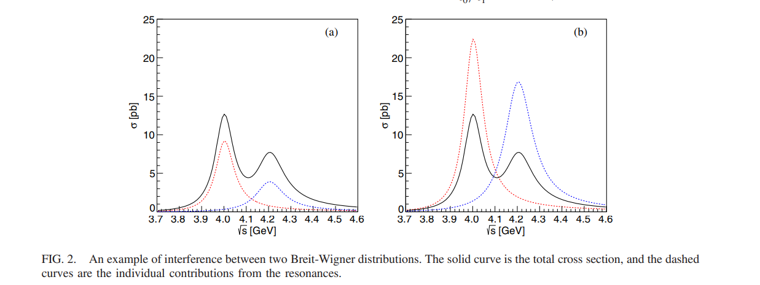
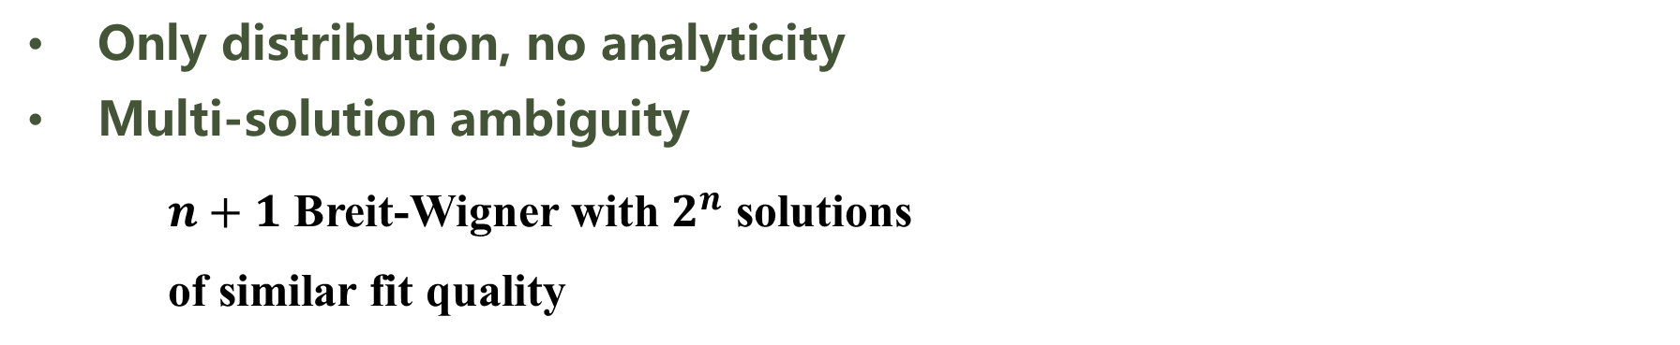
Motivation
What we should know about Breit-Wigner distribution in the experimental analysis
Only distribution, no analyticity
Multi-solution ambiguity
$n+1$ Breit-Wigner with $2^{n}$ solutions
of similar fit quality
K. Zhu et. al., IJMPA 26, 4511 (2011)
A. D. Bukin, arXiv:0710.5627
X. Han and C. P. Shen, CPC 42, 043001 (2018)
Y. Bai and D.Chen, PRD 99, 072007
PRD 99, 072007

Slide 4
Motivation
What we should know about Breit-Wigner distribution in the experimental analysis
Only distribution, no analyticity
Multi-solution ambiguity
No constraints from unitrarity

Slide 5
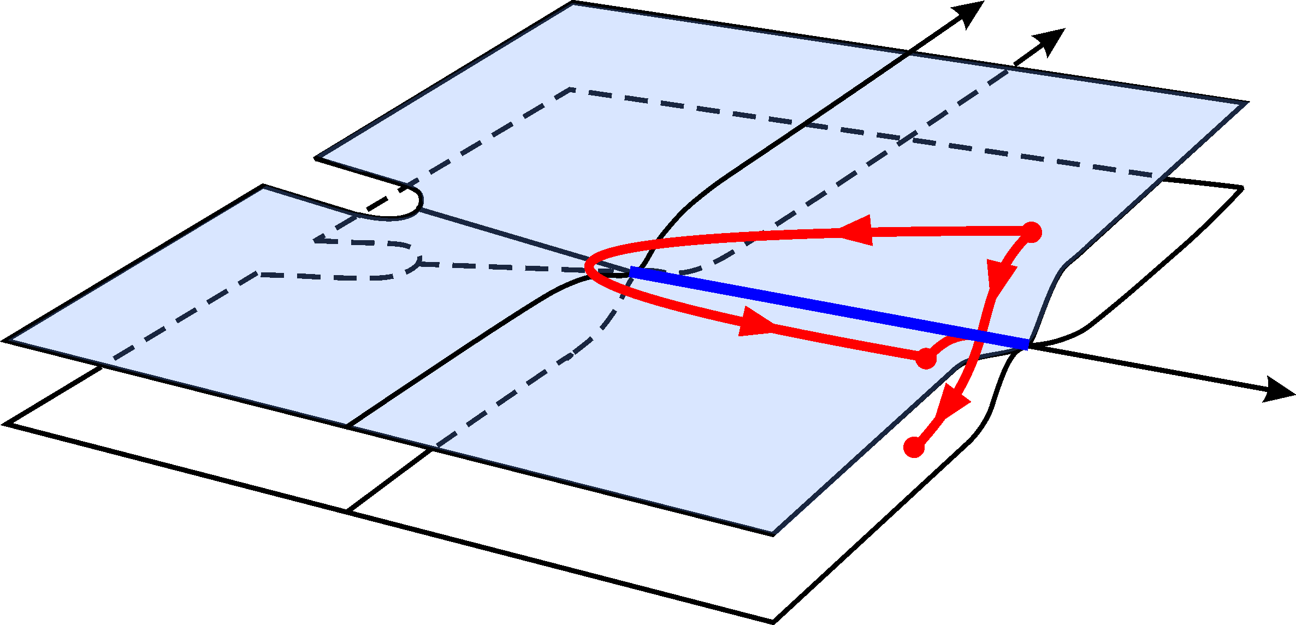
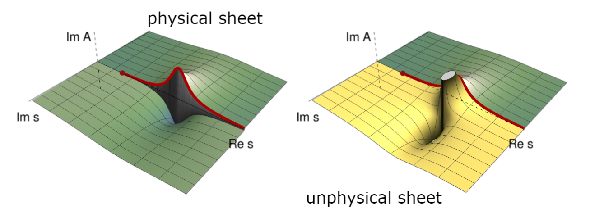
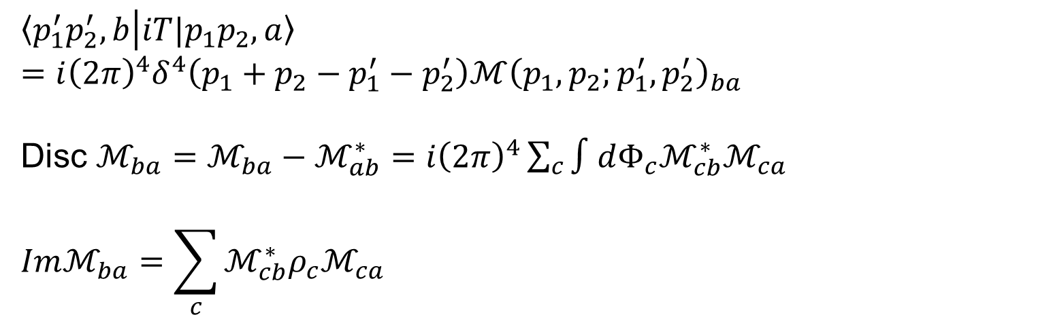
Background
How to describe a resonance
黎曼面结构
$${\left\langle p_{1}^{′}p_{2}^{′},b | iT|p_{1}p_{2},a\right\rangle }_{}=i{\left(2π\right)}^{4}δ^{4}\left(p_{1}+p_{2}−p_{1}^{′}−p_{2}^{′}\right)ℳ{\left(p_{1},p_{2};p_{1}^{′},p_{2}^{′}\right)}_{ba}$$
Disc $ℳ_{ba}=ℳ_{ba}−ℳ_{ab}^{∗}=i{\left(2π\right)}^{4}\sum_{c}{∫dΦ_{c}ℳ_{cb}^{∗}ℳ_{ca}}$
$$Imℳ_{ba}=\sum_{c}{ℳ_{cb}^{∗}ρ_{c}ℳ_{ca}}$$
Unitarity and analyticity
PDG review

Slide 6
Friedrichs-Lee model
Background
Gamow态的数学基础
  Energy eigenfunction with a complex eigenvalue, proposed by G.Gamow to understand alpha decay.
  However, in Hilbert space, a self-adjoint operator can only admit real eigenvalues. A rigorous treatment to Gamow state require an extension of Hilbert space to Rigged Hilbert space(RHS).
Friedrichs-Lee 模型
  A solvable model to demonstrate the properties of Gamow state.
Several variants:
  Lee model
  Fano model
  Anderson model
G.Gamow , Z.Phys. 51 (1928) 204-212
A.Bohm, M.Gadella, Dirac kets, Gamow vectors, and Gelfund Triplets, Springer Lectures Notes in Physics Vol.348, Springer, Berlin
K. O. Friedrichs, Communications on Pure and Applied Mathematics 1, 361 (1948).
T. D. Lee, Phys. Rev. 95, 1329 (1954),
U. Fano, Phys. Rev. 124, 1866 (1961).
P. W. Anderson, Phys. Rev. 124, 41 (1961).

Slide 7
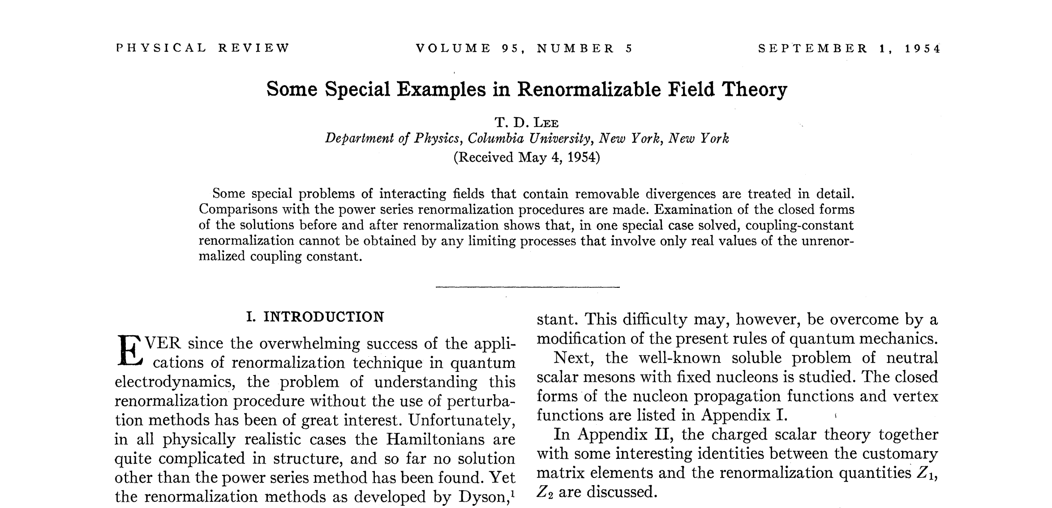
Friedrichs-Lee model
T. D. Lee, Phys. Rev. 95, 1329 (1954),

Slide 8
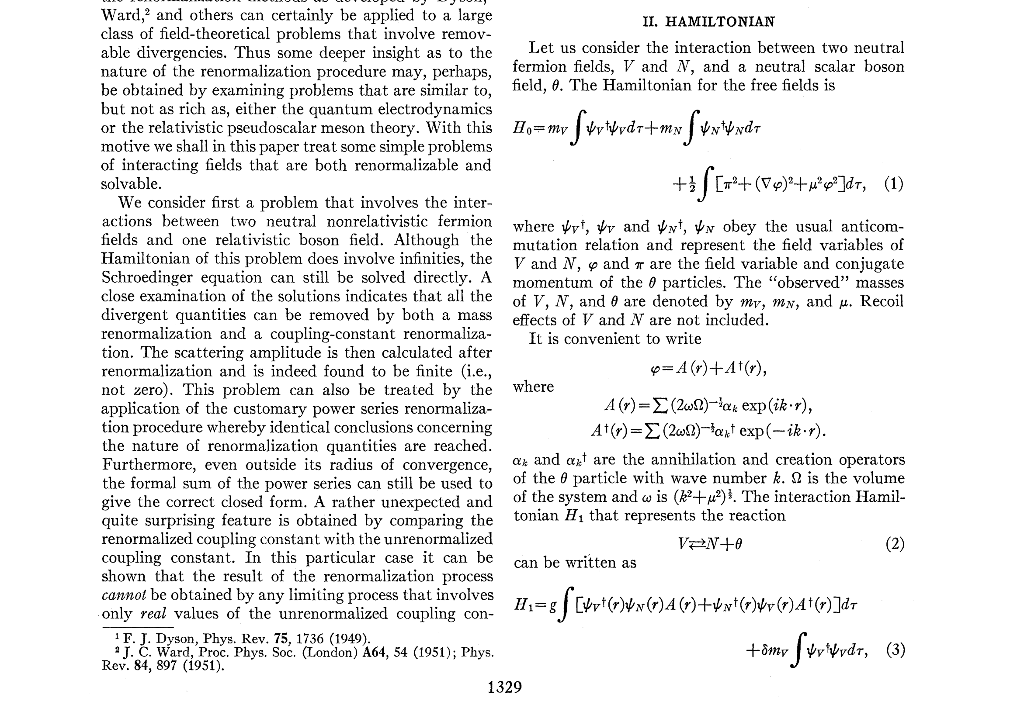
Friedrichs-Lee model
T. D. Lee, Phys. Rev. 95, 1329 (1954),

Slide 9
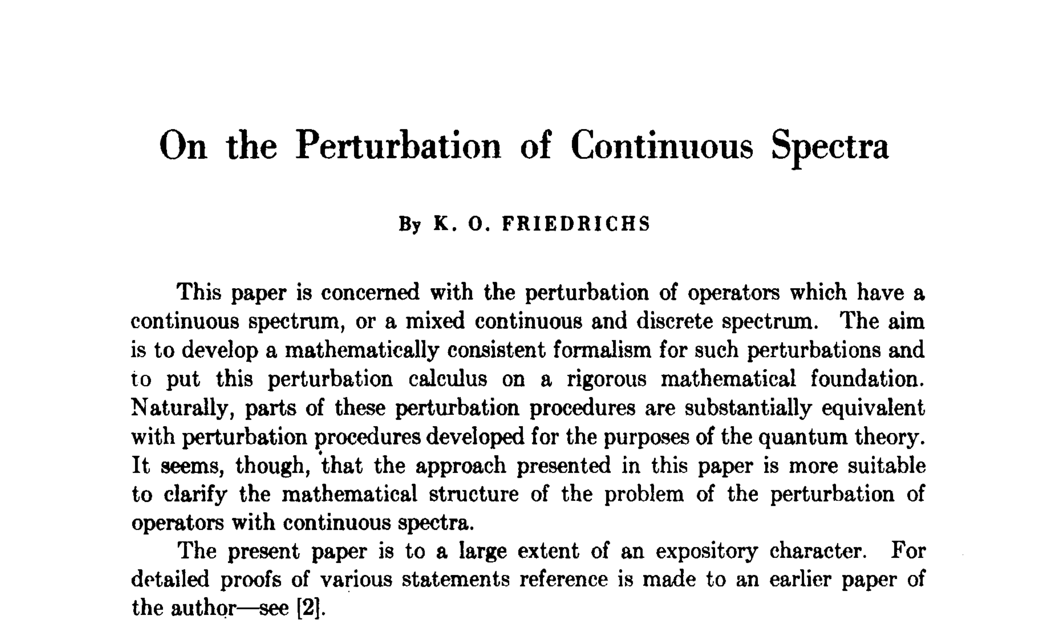
Friedrichs-Lee model
K. O. Friedrichs, Communications on Pure and Applied Mathematics 1, 361 (1948).

Slide 10
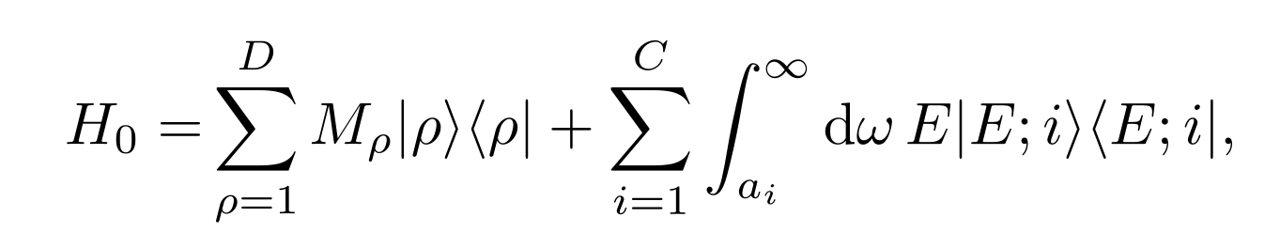
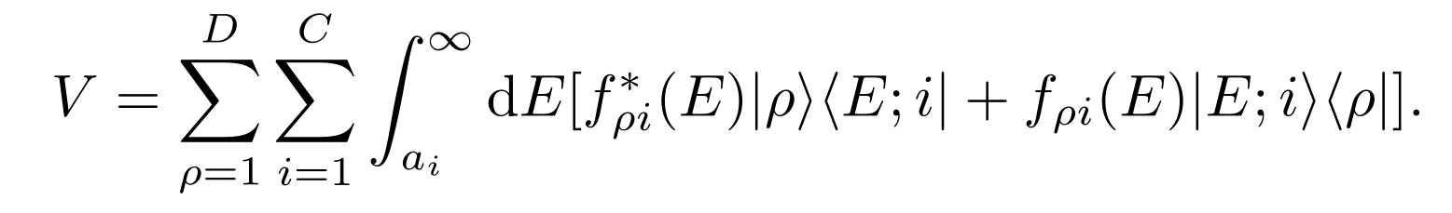
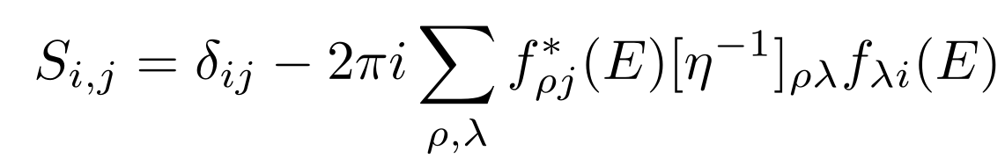
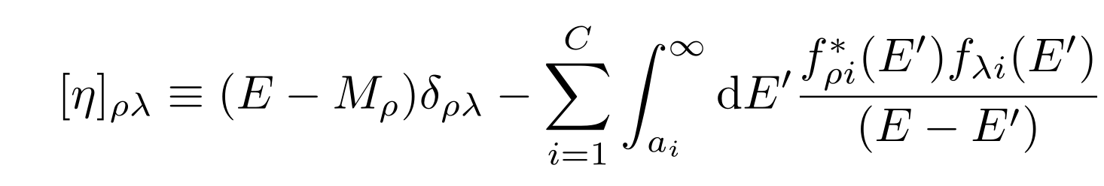
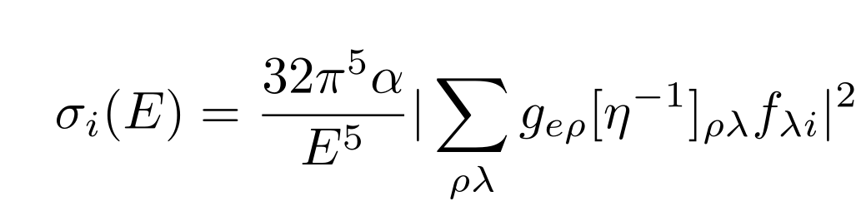
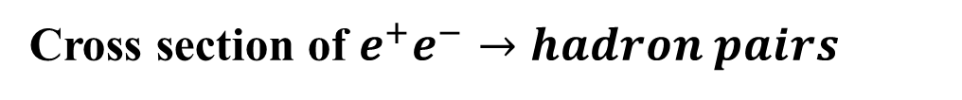
Extended Friedrichs-Lee-QPC scheme with multi discrete and continuous states
多粒子多道的Friedrichs-Lee-QPC框架
Arxiv: 2310.14937
Arxiv: 2304.07052
Hamiltonian
类比：
HEFT Jia-Jun Wu
Berggren 基矢 Jian-Guo Li
Scattering matrix
Cross section of $e^{+}e^{−}→hadron pairs$

Slide 11
Lee-Friedrichs parametrization
可以在实验分析中尝试，与Breit-Wigner parametrizaiton进行比较

Slide 12
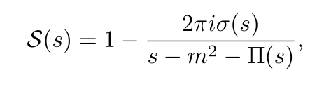

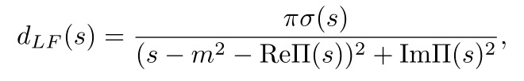
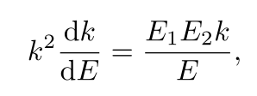

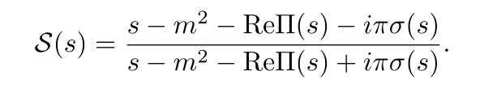


parametrization : (1,1) case Relativistic scenario
The (1,1) case 1 discrete state, 1 decaying channel
Scattering matrix
Distribution function
Spectrum density function?
Phase space
Threshold constraints
Exponential suppression
Principlevalue integral
Numerically integrated

Slide 13
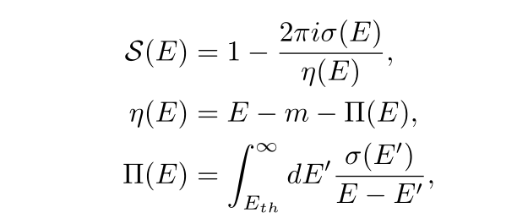
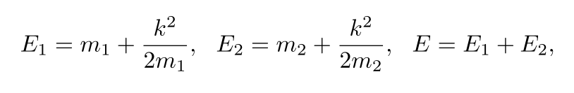
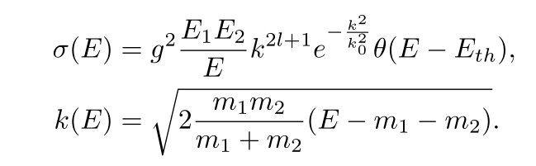
New parametrization : (1,1) case non-relativistic scienario
Similar equations:

Slide 14
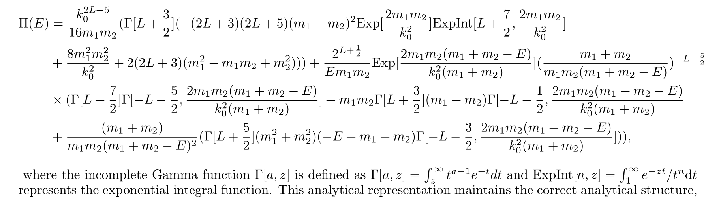
New parametrization : (1,1) case non-relativistic scienario
The dispersive integral could be analytically represented
大大节省计算时间！！！

Slide 15
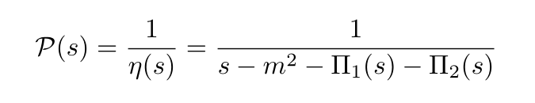
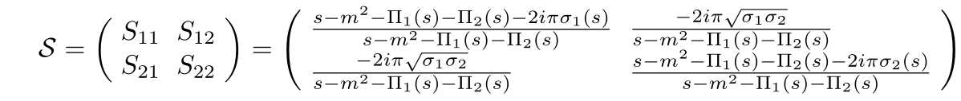
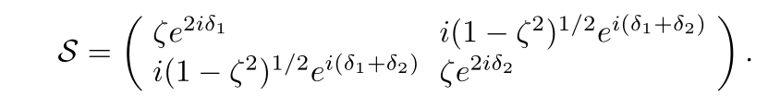
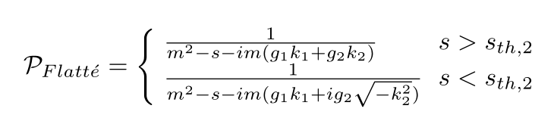
The（1,2)-case LF parametrization V.S. Flatte parametrization
The (1,2) case 1 discrete state, 2 decaying channels
Dressed propagator
Scattering matrix
satisfy
Comparing with Flatte parametrization

Slide 16
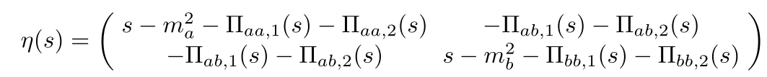

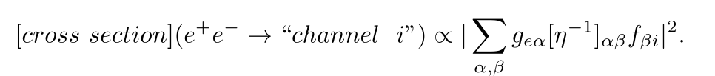
(2,2)-case and general case
The (2,2) case 2 discrete state, 2 decaying channels
S-matrix element
Observables: as

Slide 17
Poles’ structure

Slide 18
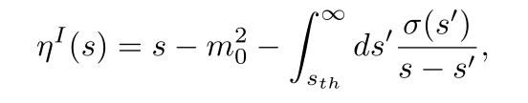



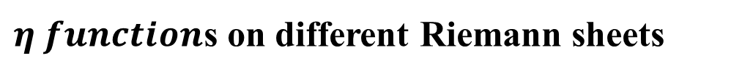
Pole structure of (1,1) case
S-matrix element
$η function$s on different Riemann sheets
Pole of S-matrix is zero of $η function$s on unphysical Riemann sheets

Slide 19
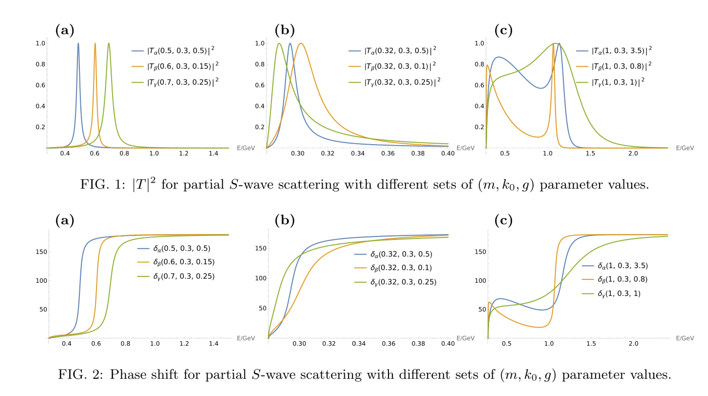
Sum rule of Phase shift for two-pole structure
Lineshapes of different parameter sets

Slide 20
Several examples

Slide 21
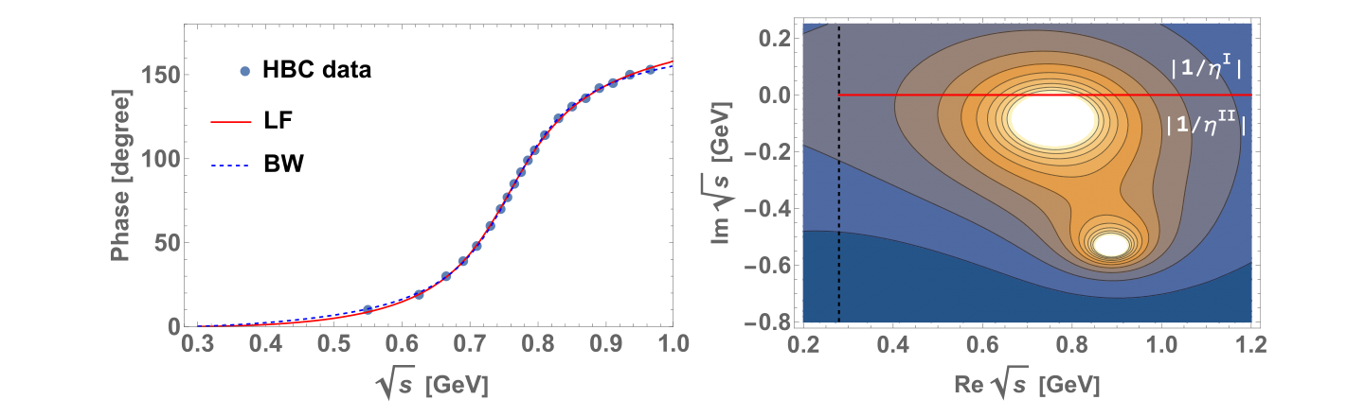
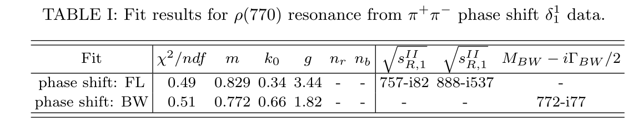
$ρ(770)$: fit $ππ$ phase shift data

Slide 22
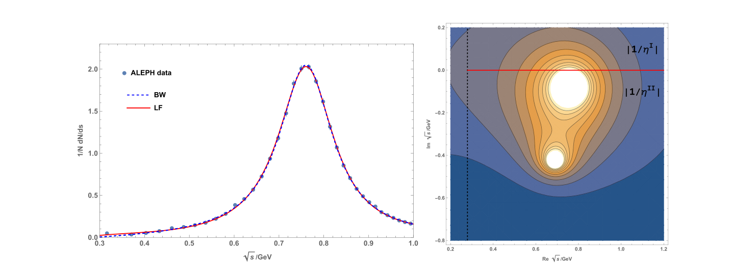
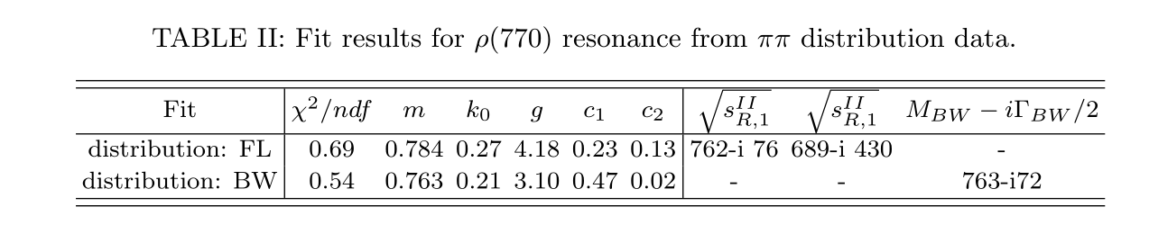
$ρ(770)$ : fit spectral function of $τ→ππν_{τ}$

Slide 23
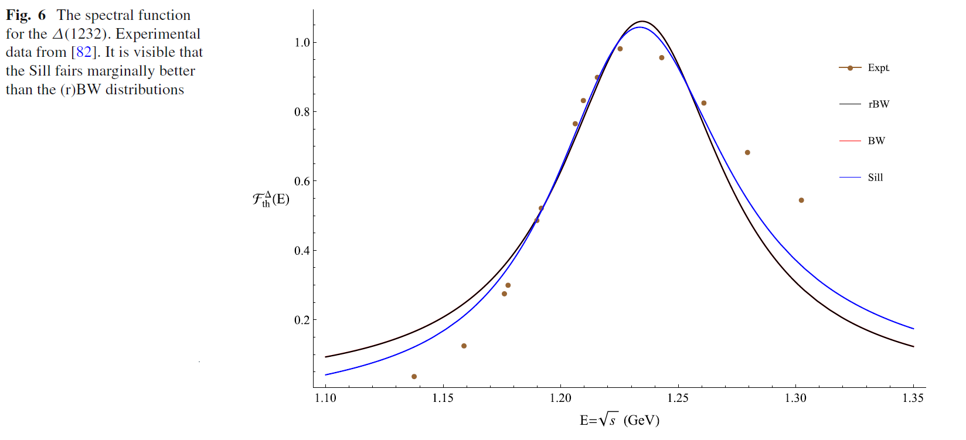
$Δ\left(1232\right)$ : fit $πp$ phase shift and cross section data
Asymmetric Lineshapes of $Δ(1232)$
Fit of traditional BW distribution and Sill distribution
Eur. Phys. J. A (2021) 57:336

Slide 24
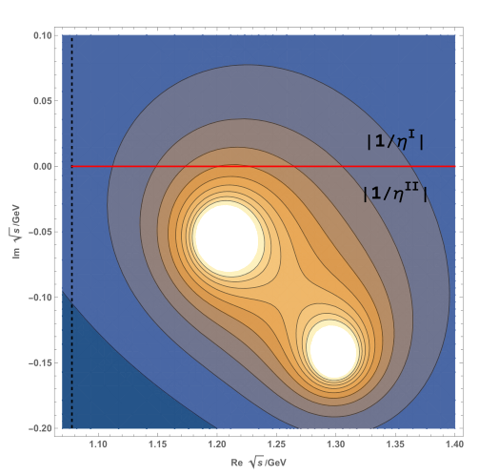
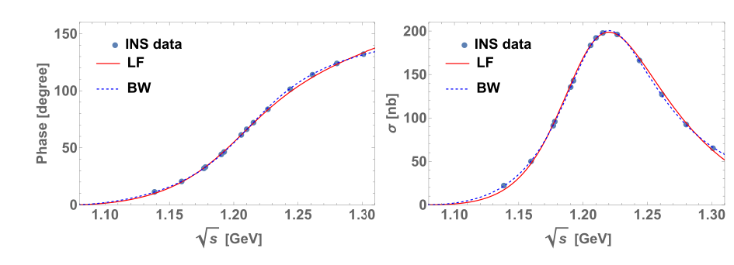
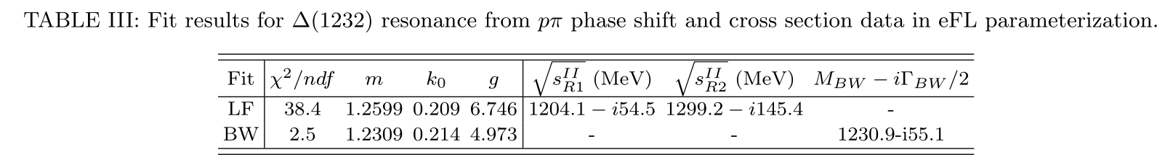
$Δ\left(1232\right)$ : fit $πp$ phase shift and cross section data
Asymmetric Lineshapes of $Δ(1232)$
Fit of LF distribution and improved BW distribution

Slide 25
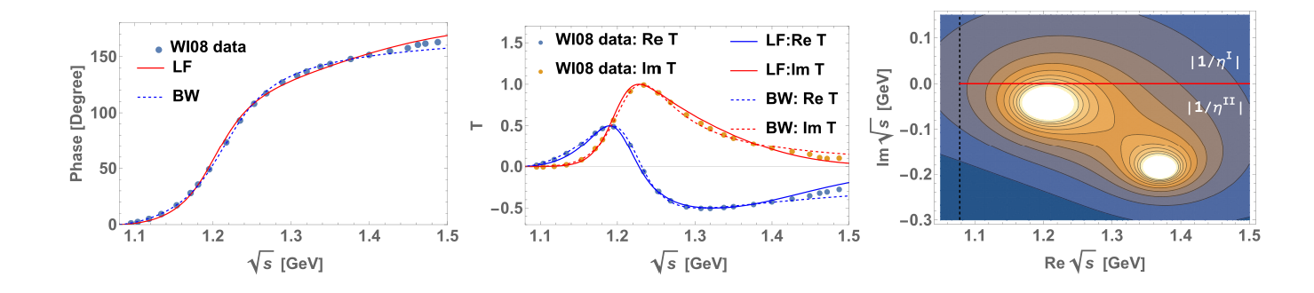
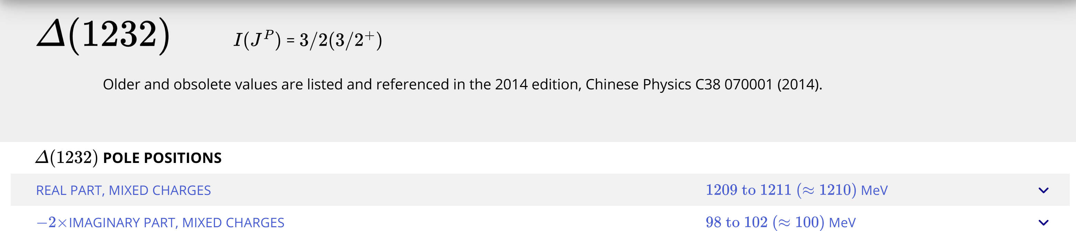
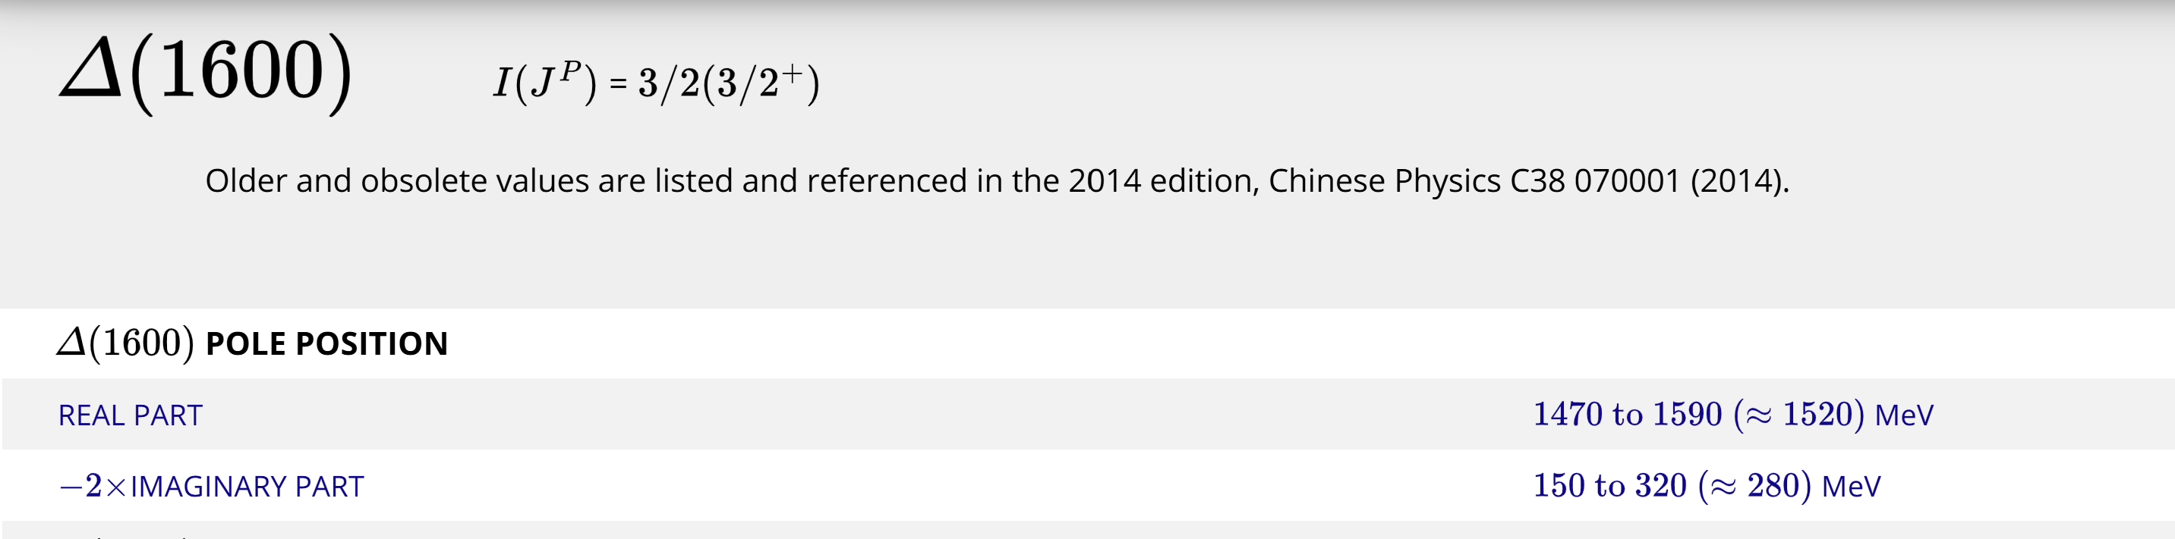

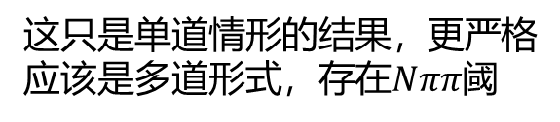
$Δ\left(1232\right)$ : fit $πp$ phase shift and cross section data
Asymmetric Lineshapes of $Δ(1232)$
Fit of LF distribution and improved BW distribution
$1202−\frac{i}{2}88MeV$ $1370−\frac{i}{2}378MeV$
$Δ(1232)$ $Δ\left(1600\right)???$
这只是单道情形的结果，更严格应该是多道形式，存在$Nππ$阈

Slide 26
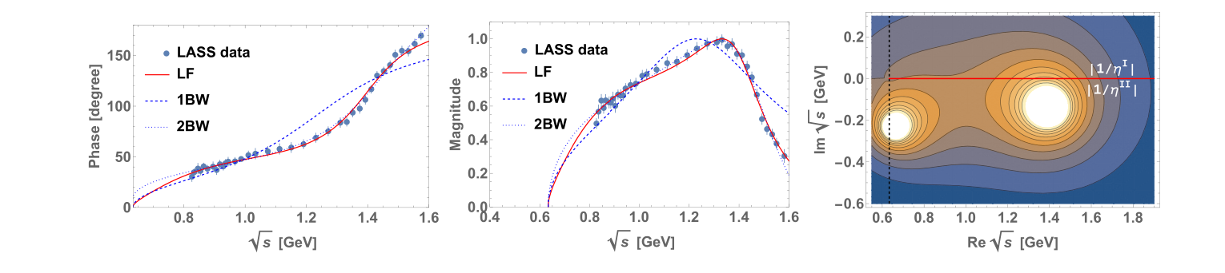
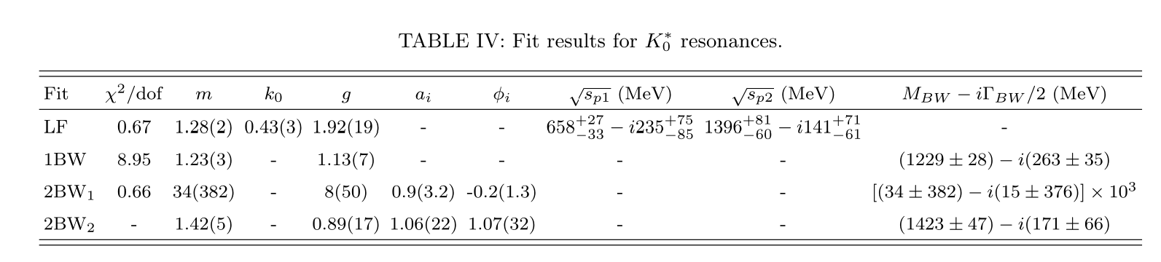
$K_{0}^{∗}\left(700\right)and K_{0}^{∗}(1430)$: fit $πK$ scattering phase and magnitude in $IJ=\frac{1}{2}0$
Only three parameters

Slide 27
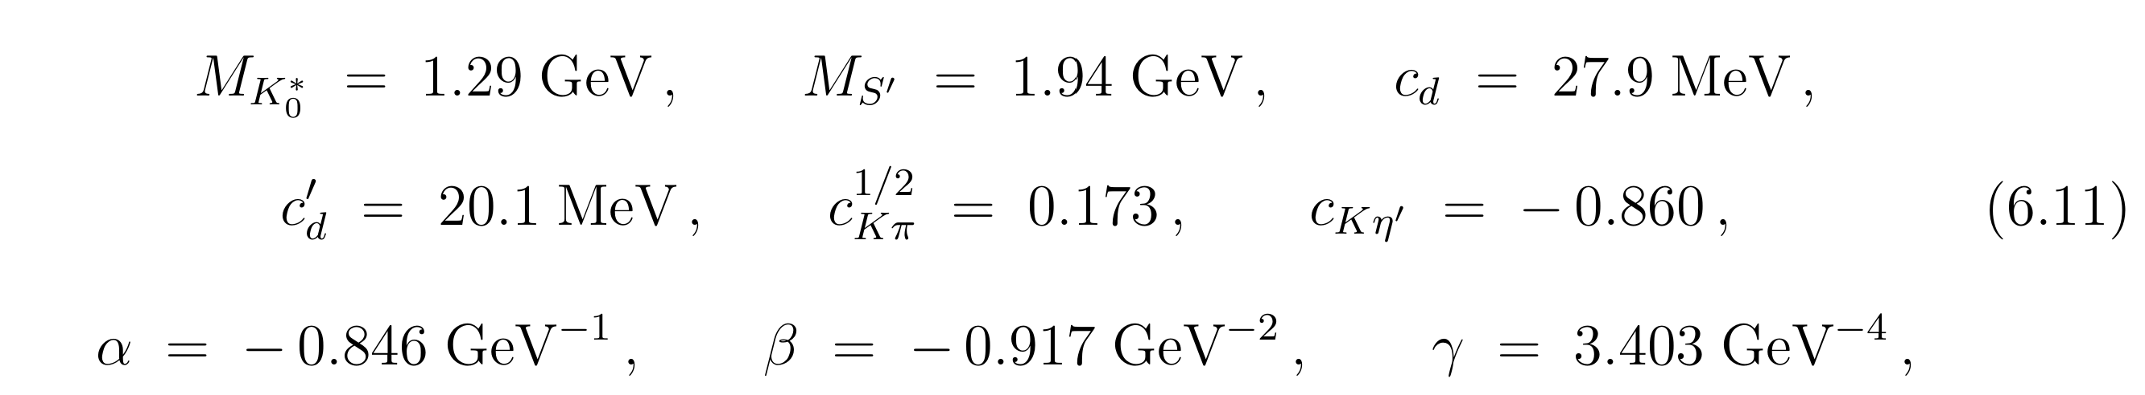
$K_{0}^{∗}\left(700\right)and K_{0}^{∗}(1430)$: fit $πK$ scattering phase and magnitude in $IJ=\frac{1}{2}0$
RchPT fit result
M. Jamin, J. A. Oller, and A. Pich, Nucl. Phys. B 587, 331 (2000)

Slide 28

$f_{0}$: fit the BESIII data of $J/ψ$ $→γππ$

Slide 29

Some proposals about X(3872) and X(4012)
LHCb, Phys. Rev. Lett. 133(2024)131902

Slide 30



Some proposals about X(3872) and X(4012)
Conjecture: $χ_{c1}\left(2P\right)$ coupled to ${\overline{D}D}^{∗}$ generate $X(3872)$ and a higher state
ZYZ, Zhiguang Xiao, Phys.Rev.D 96 (2017) 5, 054031
Lee-Friedrichs parametrization:
Some lineshapes of $J/ψππ$ and $\overline{D}D^{∗}$ with different parameter sets put by hand
Qian Deng, Ru-Hui Ni, Qi Li,Xian-Hui Zhong,
Phys.Rev.D 110 (2024) 5, 056034
Phys.Rev.D 110 (2024) 5, 056034

Slide 31

Some proposals about X(3872) and X(4012)

Slide 32
Some proposals about X(3872) and X(4012)
Use Lee-Friedrichs parametrization with fewer parameters

Slide 33

Summary
A simple parametrization based on Lee-Friedrichs model.
Easy to extract the nearby poles
Parametrizing Two resonances (elementary one and dynamical one) might be economic and necessary.
Many states could be two-pole structure, such as $Δ(1232)$.
Effectiveness of LF parametrization form need to be verified.
Suggestion of refitting $X(3872)$ and $X(4012)$ in such a form.

Slide 34
Two-pole structures and predictions

Slide 35



Relativistic Friedrichs-Lee-QPC scheme
Two-pole structure(双极点结构)
resolvent function
$$η\left(s\right)=s−ω_{0}^{2}−\int_{sth}{ds′\frac{ρ(s′)}{s−s^{′}+iε}}$$
$$ρ\left(s\right)≡2ω_{0}\frac{kE_{1}E_{2}}{\sqrt{s}}α{\left(k\right)}^{2}$$
双极点结构：一个裸态产生两个共振极点.
Phys.Rev.D 83 (2011) 014010
Eur.Phys.J.C 80 (2020) 12, 1191
Eur.Phys.J.C 81 (2021) 6, 551

Slide 36

Two pole structure
猜测：双极点结构的普遍性（预言）
Eur.Phys.J.C 80 (2020) 12, 1191
Eur.Phys.J.C 81 (2021) 6, 551
An ambitious prediciton with only a few parameters in this scheme
(1) Some Bare Masses (2) a global coupling $γ$

Slide 37
Thanks for your patience！
zhouzhy@seu.edu.cn

