Slide 1
Reveal short range interactions between u/d quarks in the NN, D₀₃, and D₃₀ systems
吕齐放
湖南师范大学
合作者：董宇兵、沈彭年、张宗烨
Based on our work Sci. China Phys. Mech. Astron. 68, 232011 (2025) and research highlight: Sci. China Phys. Mech. Astron. 68, 232031 (2025).
长沙 2025.04.12

Slide 2
Outline
Background
Model and method
Results and discussions
Summary

Slide 3
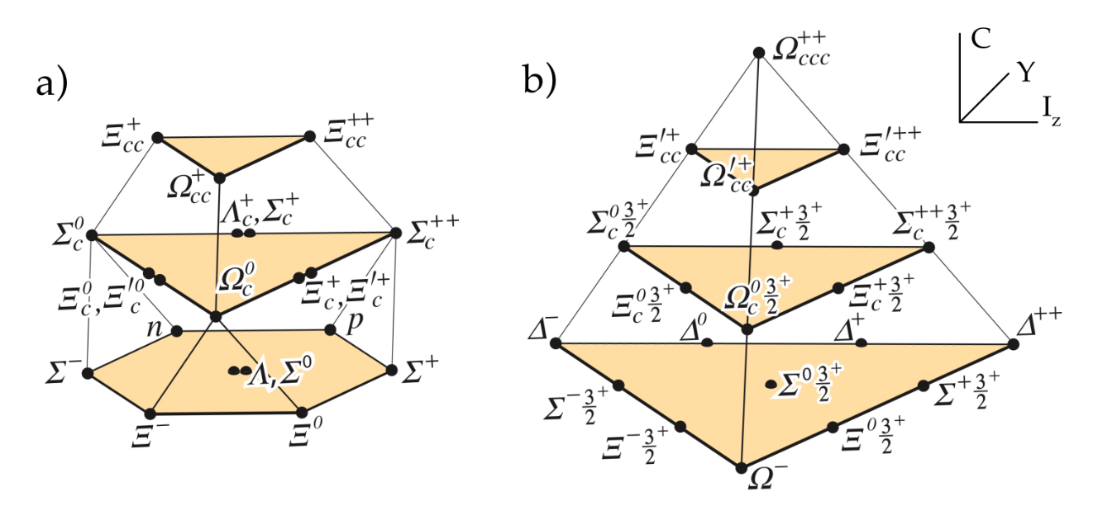
Conventional baryons
Conventional baryons
S. Navas et al. (Particle Data Group), Phys. Rev. D 110, 030001 (2024)

Slide 4
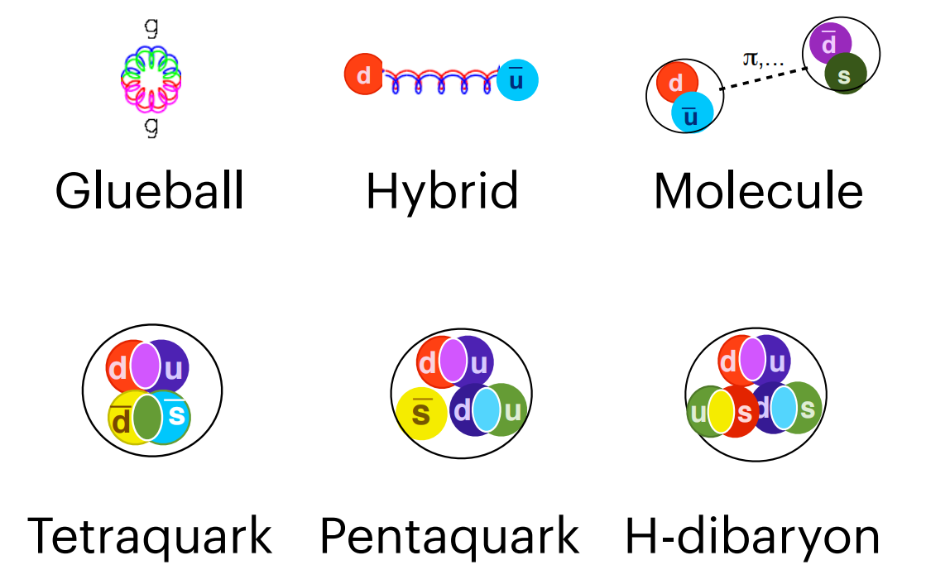
Exotic states
In addition to the conventional states, QCD also permits the existence of other types of hadrons, known as exotic states.
Some tetraquark candidates observed recently：X(6900), X(2900), Z_{cs}(3985), Z_{cs}(4000), T_{cc}(3875) ...

Slide 5
Nonstrange dibaryon sextet
Nonstrange dibaryons | BB | Threshold (MeV) | Particle/Candidate | Binding energy
D₀₁ | NN | 1878 | Deuteron | 2.2 MeV
D₁₀ | NN | 1878 | A virtual state | 67 keV
D₁₂ | NΔ | 2171 | Evidence | UN
D₂₁ | NΔ | 2171 | Evidence | UN
D₀₃ | ΔΔ | 2464 | d*(2380) | ~80 MeV
D₃₀ | ΔΔ | 2464 | No signal | UN

Slide 6
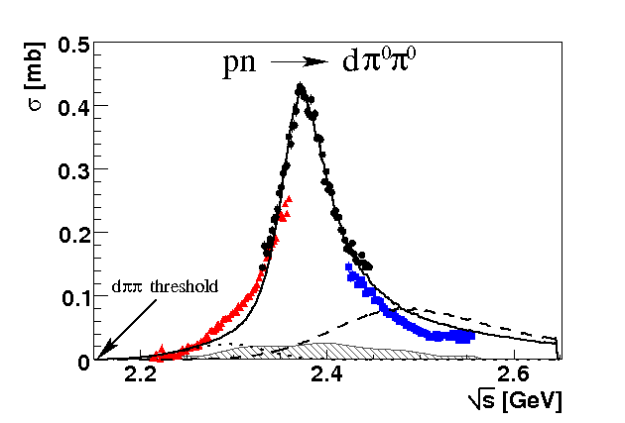
Experimental observation of d*(2380)
P. Adlarson, et al. [WASA-at-COSY Collaboration], Phys. Rev. Lett. 106, 242302 (2011).

Slide 7
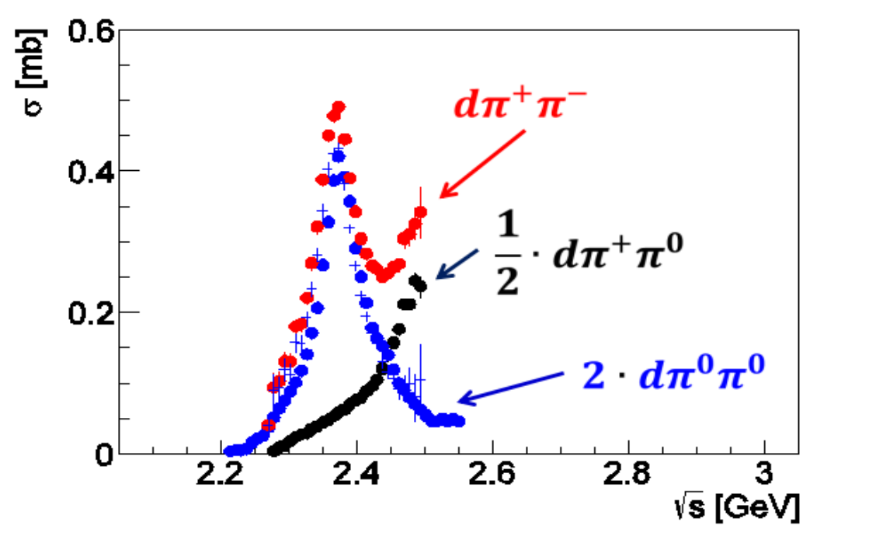
Experimental observation of d*(2380)
P. Adlarson, et al. [WASA-at-COSY Collaboration], Phys. Lett. B 721, 229 (2013).

Slide 8
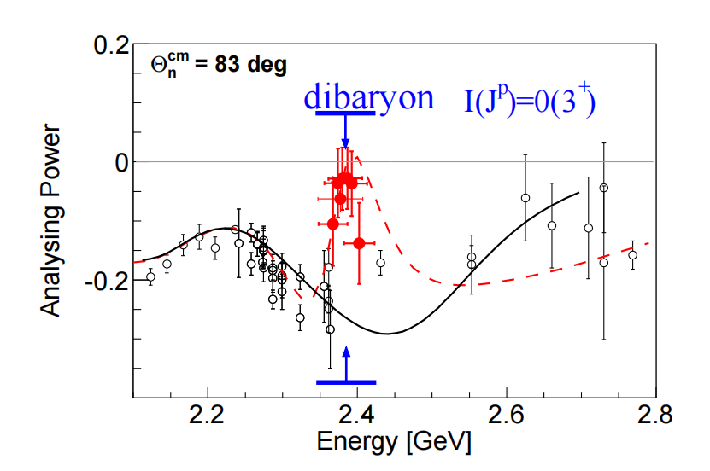
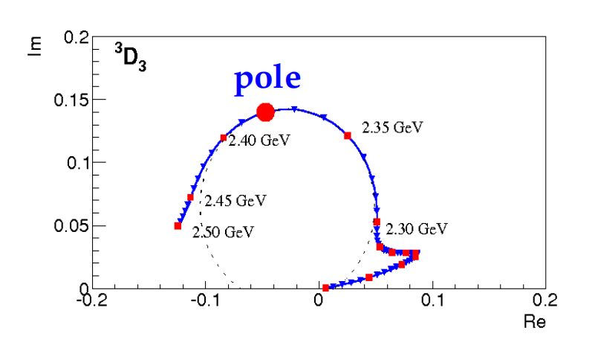
Experimental observation of d*(2380)
Analysing power data and Argand diagram
P. Adlarson et al., Phys. Rev. Lett. 112, 202301 (2014).
R. L. Workman, W. J. Briscoe and I. I. Strakovsky, Phys. Rev. C 93, 045201 (2016); Phys. Rev. C 94, 065203 (2016).
P. Adlarson et al., Phys. Rev. C 90, 035204 (2014).

Slide 9
Experimental observation of d*(2380)
Channels: pn→dππ, pd→³Heππ, dd→⁴Heππ, pn→pnππ ...
Binding energy : 80 MeV below the ΔΔ threshold.
A large binding energy suggests that it has a small size, which may be compact.
Total width: 70 MeV.
A small width compared with Δ baryon.

Slide 10
Notations and references
We use symbol D to represent the dibaryon.
D_{IJ} is used to denote the isospin I and spin J.
The d*(2380) is a good candidate of the D₀₃ state.
Many theoretical and experimental works exist. Some recent reviews：
Y. Dong, P. Shen and Z. Zhang, Prog. Part. Nucl. Phys. 131, 104045 (2023).
L. Dai, Y. Wang, L. Chen and T. Zhang, Symmetry 15, 446 (2023).
M Bashkanov et al, J. Phys. G: Nucl. Part. Phys. 51, 045106 (2024).

Slide 11
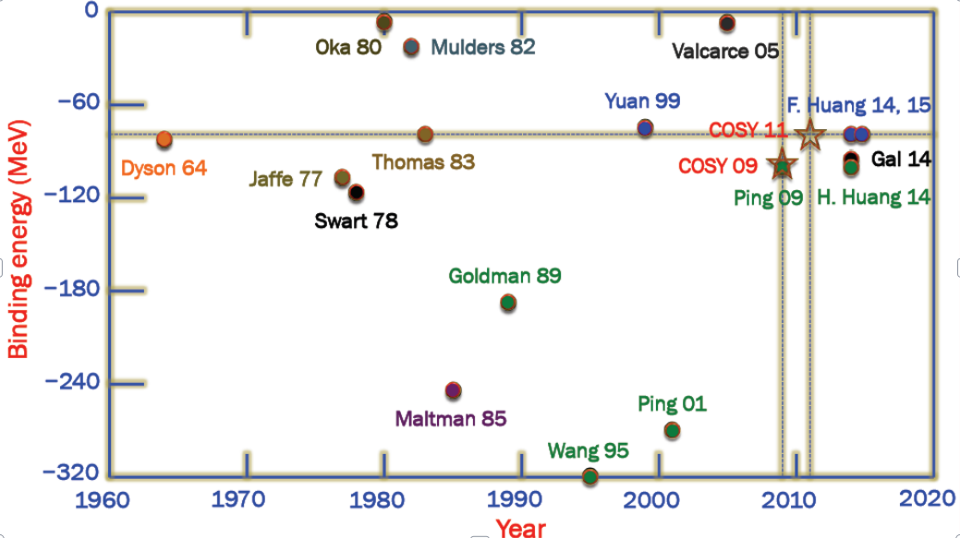
Some theoretical calculations of D₀₃

Slide 12
A long-standing problem in the quark models
One gluon exchange or vector meson exchange, which one dominates the short range interactions between light quarks?
Which systems are suitable for investigating this problem?
Our proposal: investigating the NN, D₀₃, and D₃₀ systems jointly in the extended chiral SU(3) quark models

Slide 13
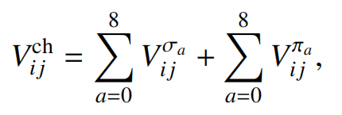
The extended chiral quark models
Chiral quark model: OGE, confinement, pseudoscalar and scalar mesons
Extended chiral quark model: extra vector meson exchanges
L. R. Dai, Z. Y. Zhang, Y. W. Yu and P. Wang, Nucl. Phys. A 727, 321-332 (2003).
F. Huang, P. N. Shen, Y. B. Dong and Z. Y. Zhang, Sci. China Phys. Mech. Astron.
59, 622002 (2016).

Slide 14
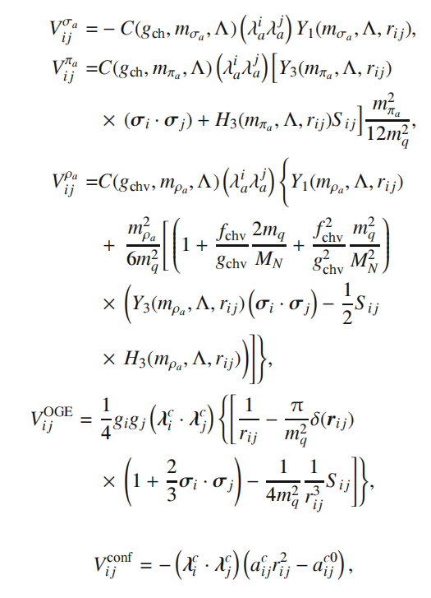
The extended chiral quark models

Slide 15
Wave functions for D₀₃
Solving the RGM equation to obtain the mass of a dibaryon.

Slide 16
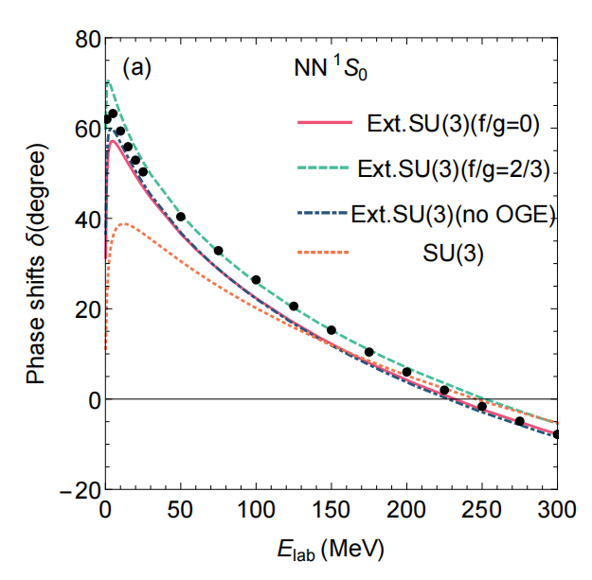
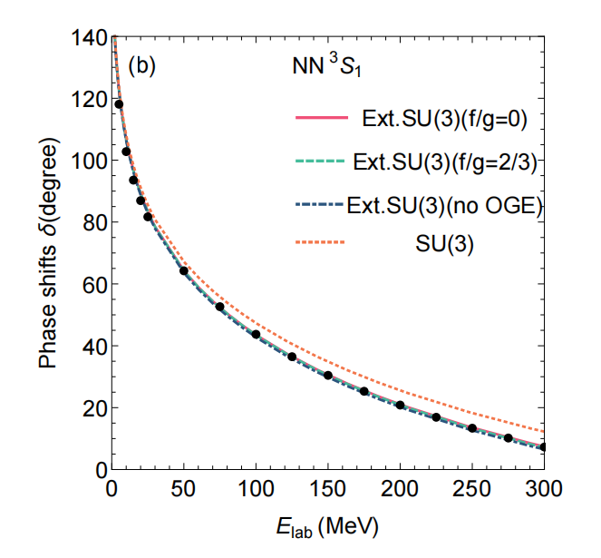
Results for NN scattering phase shifts
NN scattering phase shifts. Other higher partial waves can be also described well. Insensitive to the short range interactions.

Slide 17
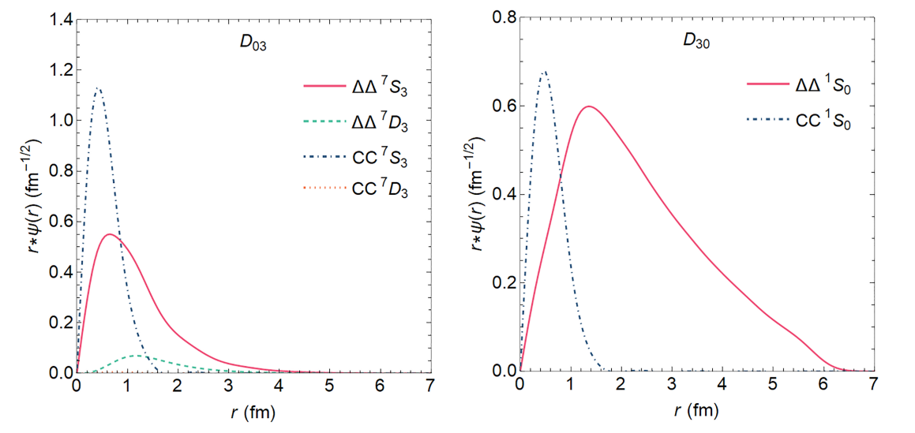
Results for D₀₃ [d*(2380)] and D₃₀
Wave functions of D₀₃ [d*(2380)] and D₃₀
Not only the colorless ΔΔ, but also hidden color components.

Slide 18
Results for D₀₃ [d*(2380)] and D₃₀
Vector meson exchange is essential for the correct binding energies
Compact nature of the D₀₃ state
The D₃₀ state is a weekly bound state (about 5~12 MeV)

Slide 19
Short range interactions between light quarks
The deuteron cannot help us to distinguish the short range interaction, since it is a loosely bound state.
The results of D₀₃ and D₃₀ states indicate that the vector meson exchange interactions dominate the short range interactions.
The small residual one gluon exchange coupling strength is also allowed.
Our work: Q. F. Lü, Y. B. Dong, P. N. Shen and Z. Y. Zhang, Sci. China Phys. Mech. Astron. 68, 232011 (2025).
Research Highlight: B. S. Zong, Sci. China Phys. Mech. Astron. 68, 232031 (2025).

Slide 20
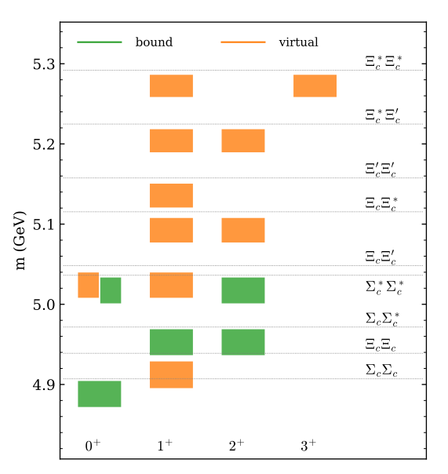
More evidence from other works
The empiric vector dominance for the interactions between hadrons containing light quarks at the hadron level.
Vector meson exchange can improve the description of meson and baryon spectra.
X. K. Dong, F. K. Guo, B. S. Zou, Commun. Theor. Phys. 73, 125201 (2021).
B. R. He, M. Harada and B. S. Zou, Phys. Rev. D 108, 054025 (2023).

Slide 21
Other problems
Why is the binding energy of d*(2380) so large?
Large hidden color components exist in the d*(2380).
It has a sizable compact core.
Quark exchange effects are significant.

Slide 22
Other problems
What about the mirror state D₃₀?
The mirror state D₃₀ is a weakly bound state.
It also has a significant hidden color component.
Only S-wave channels exist in this system.
No signal of D₃₀ is observed until now. (Near threshold?)

Slide 23
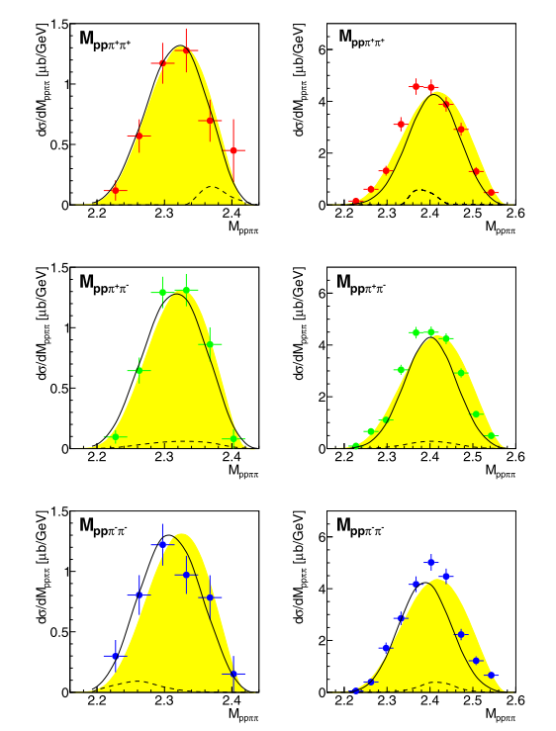
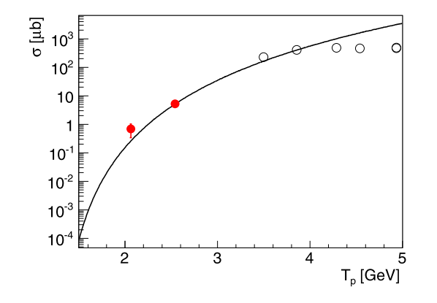
Searching for the D₃₀ state
Invariant masses for ppππ and the total cross section. Limited data.
P. Adlarson et al. (WASA-at-COSY Collaboration), Phys. Lett. B 762, 455-461 (2016).

Slide 24
Further investigations
Other possible channels for d*(2380):
γd→dππ, γd→dπππ, e⁺e⁻ collisions, ϒ decay
The D₃₀ state can be searched for in the pp→ppπ⁺π⁺π⁻π⁻ reaction
Possible nonstrange D₁₂ and D₂₁ states which are composed of ΔN and hidden color components
Systems like NN*(1535), ηd, and so on
Systems with strange, charm, and bottom quarks
T. Ishikawa, et al., Phys. Rev. C 104, L052201 (2021); Phys. Rev. C 105, 045201 (2022).

Slide 25
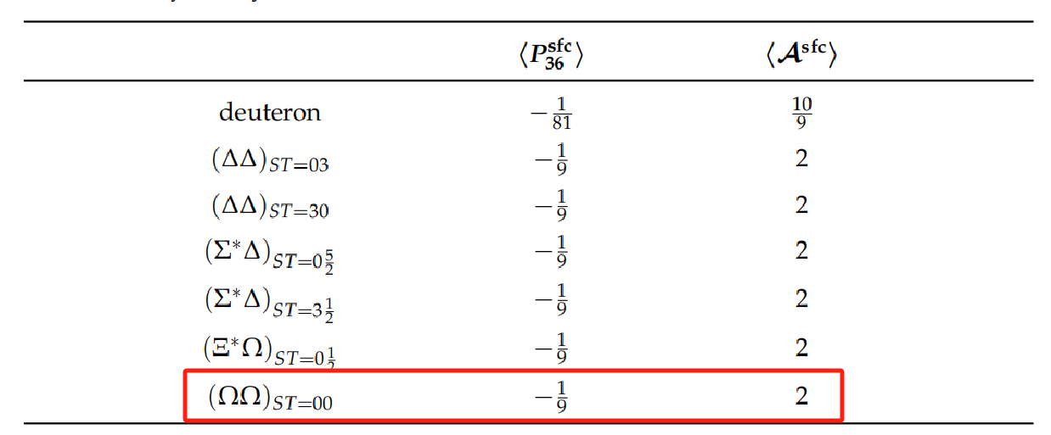
Symmetry analysis
When antisymmetrizer A^{sfc} is large enough, the system is very possible to become a bound state. More systems like ΔΔ?

Slide 26
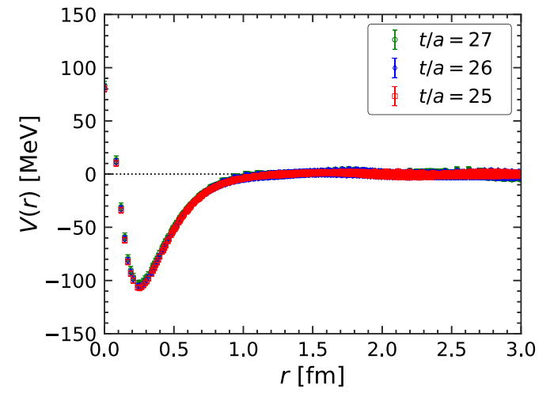
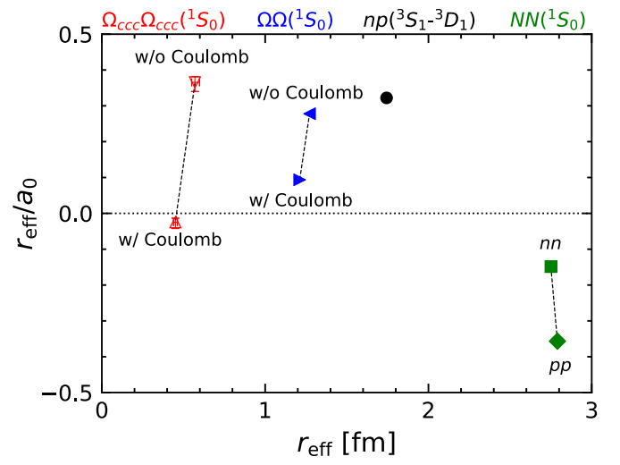
Example of lattice calculations on Ω_{ccc}Ω_{ccc} system
Y. Lyu, H. Tong, T. Sugiura, S. Aoki, T. Doi, T. Hatsuda, J. Meng and T. Miyamoto, Phys. Rev. Lett. 127, 072003 (2021).

Slide 27
Summary
The vector meson exchange interactions dominate the short range interactions between light quarks.
The d*(2380) is a ΔΔ system with large hidden color component.
Predicting the mirror state D₃₀, which is a weakly bound state.
Needing more investigations on other systems.
More works about spectroscopy for mesons, baryons, tetraquarks, pentaquarks, and hexaquarks can be found in
My homepage https://inspirehep.net/authors/1383269

Slide 28
Thanks for your attentions！

