Slide 1
高激发态轻强子性质的研究
刘成郗
兰州大学
合作者：王利明，田文鑫，李亭彦，刘翔
2025.4.13
第十届XYZ研讨会
C.X.Liu, L.M.Wang, T.Y.Li and X.Liu, Phys. Rev. D 110, no.11, 114049 (2024)
L.M.Wang, W.X.Tian, T.Y.Li, C.X.Liu and X.Liu, Phys. Rev. D 110, no.7, 074021 (2024)

Slide 2
Outline
1. Background
2. Mass spectrum
3. Decay behaviors
4. Summary

Slide 3
Background

Slide 4
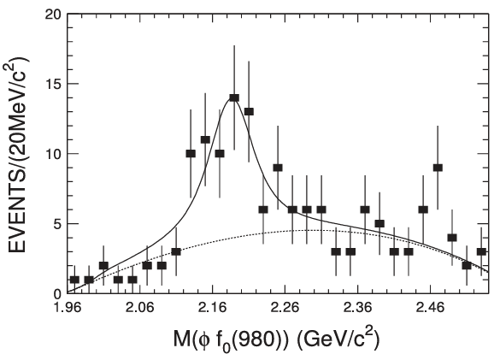
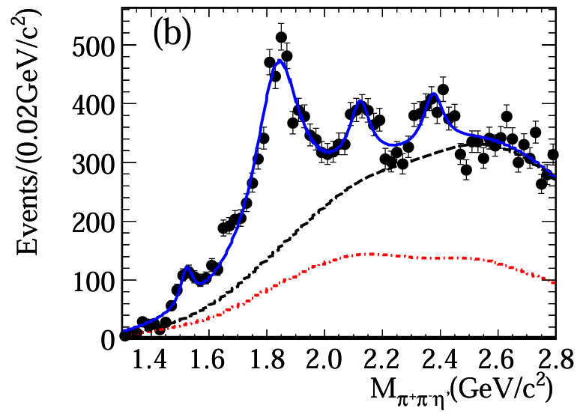
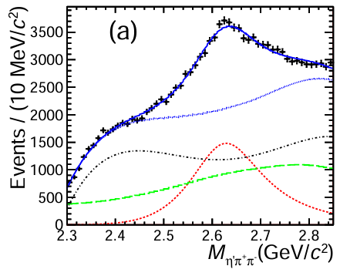
New observed high-lying states
Observation of $Y(2175)$
Phys. Rev. Lett. 106, 072002 (2011)
Observation of $X(2370)$
Phys. Rev. Lett. 100, 102003 (2008)
Observation of $X(2600)$
Phys. Rev. Lett. 129, 042001 (2022)
We propose that it is an appropriate time to establish high-lying mesons

Slide 5
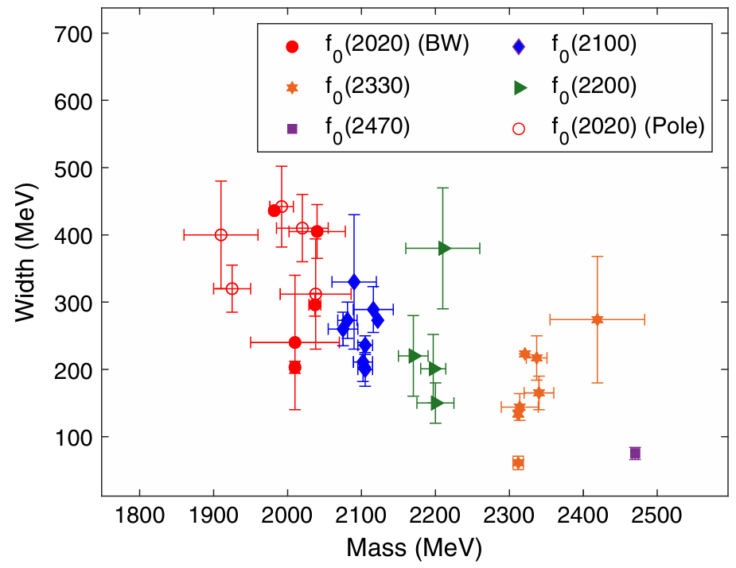
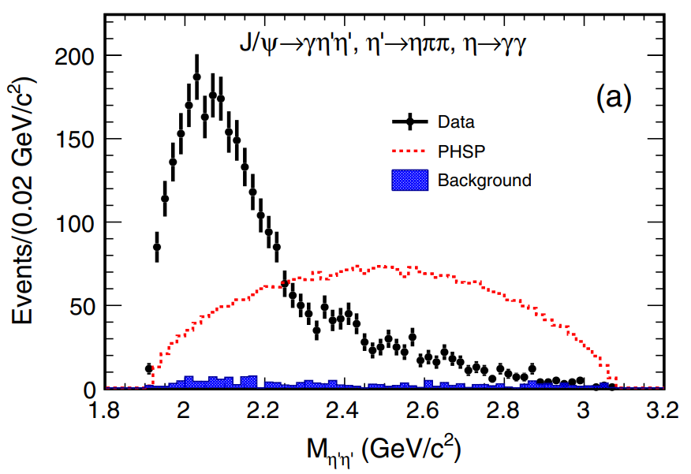
High-lying scalar states
High-lying scalar states $f_{0}\left(2020\right)$, $f_{0}\left(2330\right)$ and $f_{0}\left(2470\right)$
This mess situation should be clarified by further studies
Phys. Rev. D 105, 072002 (2022)

Slide 6
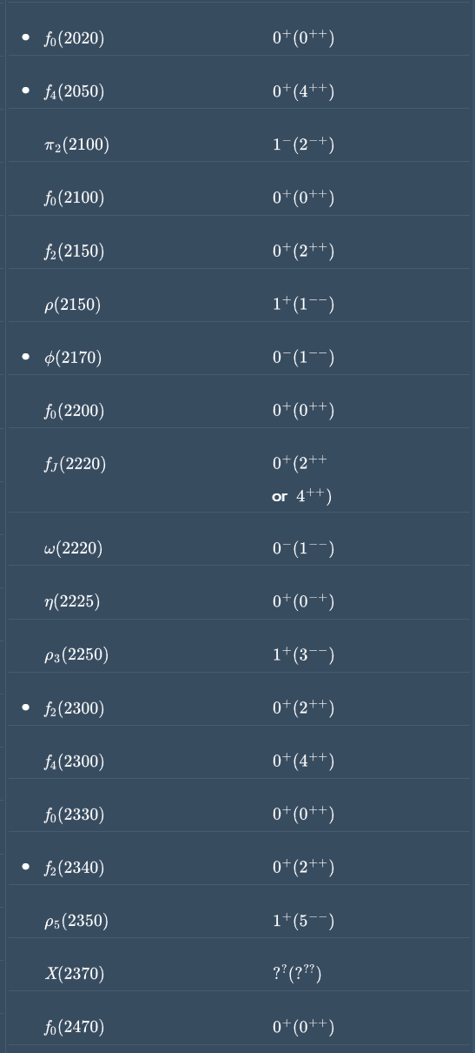
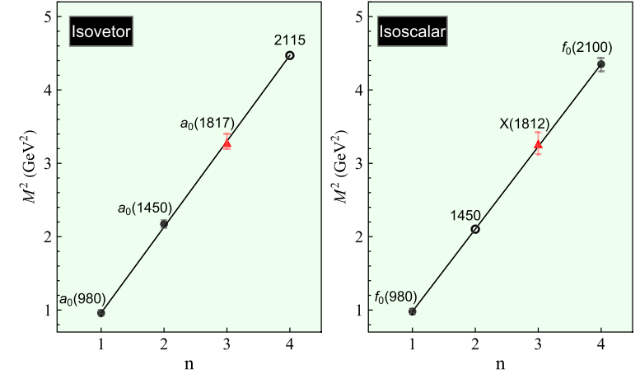
Our previous work of scalar mesons
Low-lying scalar mesons family including new observed $a_{0}(1817)$
$←$ Our prior research focused on selected low-mass scalar meson states
These high-lying states also have not been established in our work $→$
Phys. Rev. D 105, 114014 (2022)

Slide 7
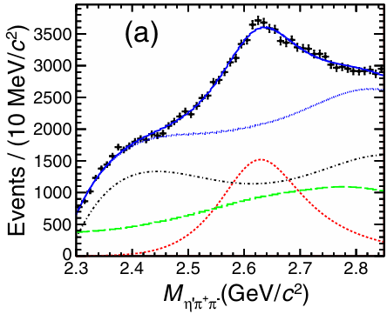
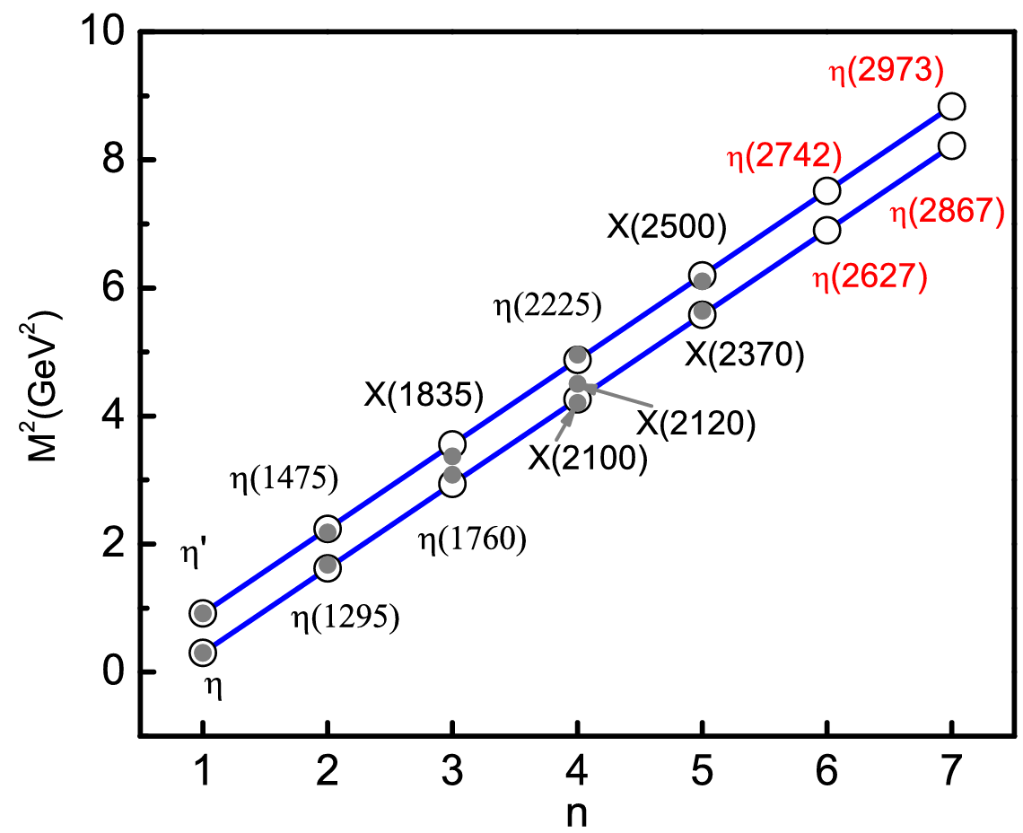
New observed $X(2600)$
The quantum numbers $J^{PC}$ of the $X(2600)$ could be either $0^{−+}$or $2^{−+}$. In our previous work, it is proposed as an $η(6S)$ state
The $X(2600)$ state
Phys. Rev. D 102, 114034 (2020)
Phys. Rev. Lett. 129, 042001 (2022)
The possibility of the $X(2600)$ being a pseudotensor meson with $J^{PC}=2^{−+}$ still needs to be examined

Slide 8
The $η_{2}$ family
The summary table in the PDG includes the $η_{2}(1645)$ and $η_{2}(1870)$ states
The $η_{2}(2030)$ and $η_{2}(2250)$ are listed as further states
Including the previously discussed $X(2600)$, there are five isoscalar pseudotensor states awaiting classification
Phys. Lett. B 477, 19 (2000)
Phys. Lett. B 491, 47 (2000)

Slide 9
Mass spectrum

Slide 10
The Regge trajectories
In our previous work, we studied low-lying scalar mesons and pseudoscalar mesons using the Regge trajectory
The Regge trajectory shows that the masses of hadrons follow a pattern that can be written as
$$M^{2}=M_{0}^{2}+\left(n−1\right)μ^{2}$$
Phys. Rev. D 102, 114034 (2020)
Phys. Rev. D 105, 114014 (2022)
Phys. Lett. B 477, 19 (2000)

Slide 11
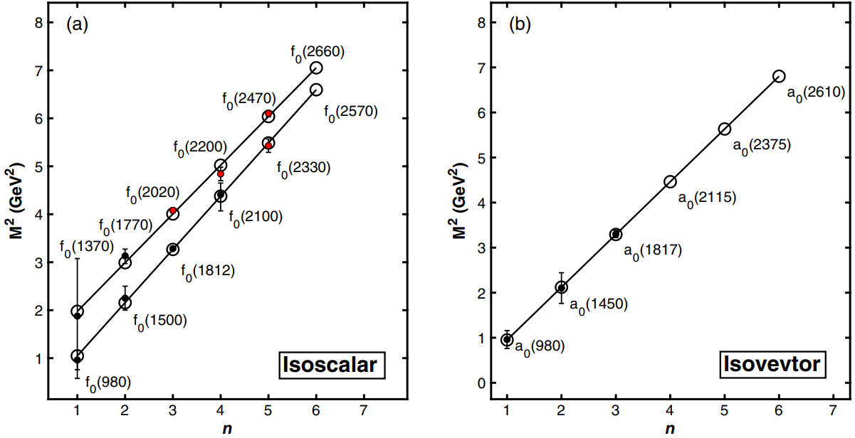
The Regge trajectories of scalar mesons
Three Regge trajectories of the scalar mesons family: $f_{0}$ states (a) and $a_{0}$ states (b), while $f_{0}$ states can be categorized into $n\overline{n}$ states ($f_{0}(980)$) and $s\overline{s}$ states ($f_{0}(1370)$)
$←$ The states are studied in our work
Not included $f_{0}(500)$ and $f_{0}\left(1710\right)$
$n\overline{n}$: u and d quarks
$s\overline{s}$: s quarks
Phys. Lett. B 477, 19 (2000)
Notes:
$n\overline{n}$ states

Slide 12
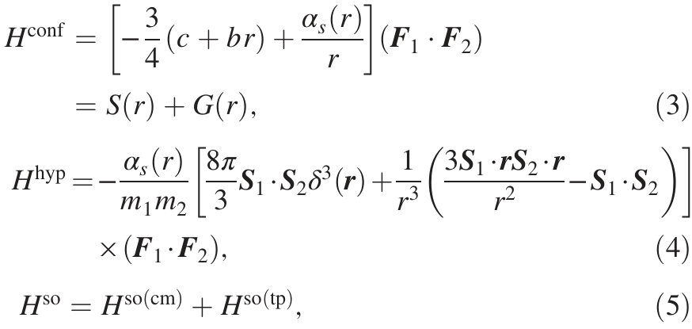
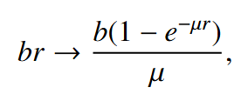
The Godfrey-Isgur (GI) model
In the nonrelativistic limit, the effective potential：
To account for relativistic effects, two modifications are introduced, a smearing function and momentum-dependent factorsare
↑ Cornell potential
The screening effect replaces the line potential to account for the unquenched effect
Phys. Lett. B 477, 19 (2000)

Slide 13
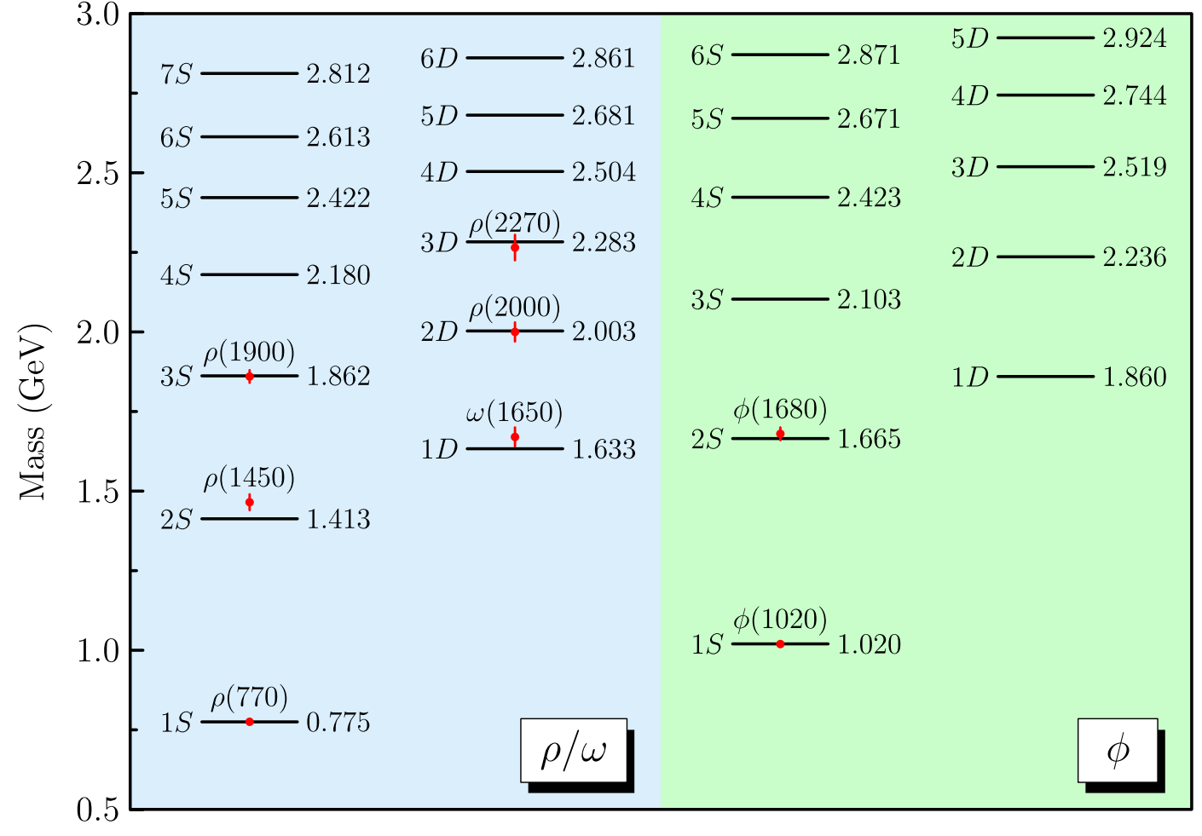
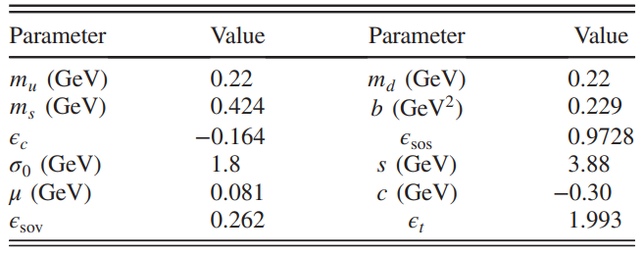
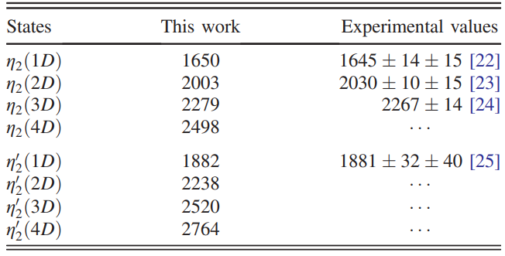
The mass spectrum of $η_{2}$ family
The parameters involved in the GI model from our previous work
The mass spectrum of $ρ, ω, φ$
Comparison of the calculated results and the experimental data
Phys. Rev. D 105, 034011 (2022)
Phys. Lett. B 477, 19 (2000)

Slide 14
Decay behaviors

Slide 15
The Quark-Pair-Creation model
$γ=7.1$ for the scalar mesons, $γ=6.57$ for the $η_{2}$ family
The simple harmonic oscillator (SHO) wave function

Slide 16
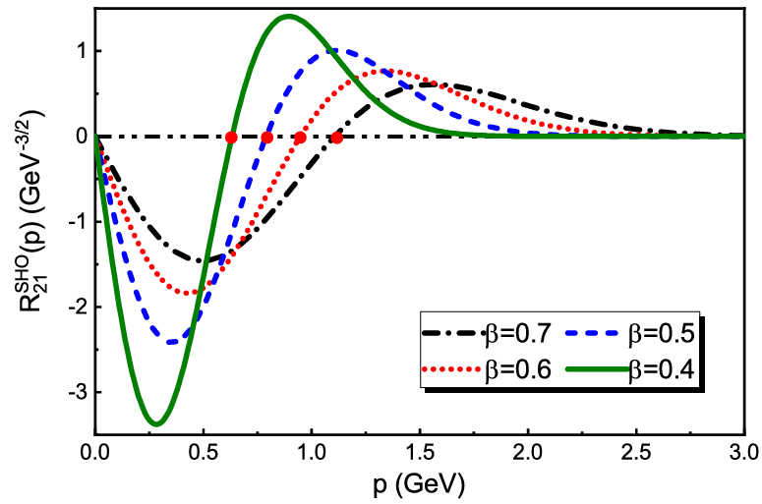
Decay behaviors of $f_{0}$ (2330)
Node effect $→$
$↑$
Center R value $±$ 0.5
Consist with the result of BESIII Collaboration
R value:
Major decay channels: $πa_{1}(1260)$ $ππ(1800)$ and $ππ(1300)$
Phys. Rev. D 72, 094004 (2005)
Phys. Rev. D 55, 4157 (1997)
Phys. Rev. D 101, 054029 (2020)

Slide 17
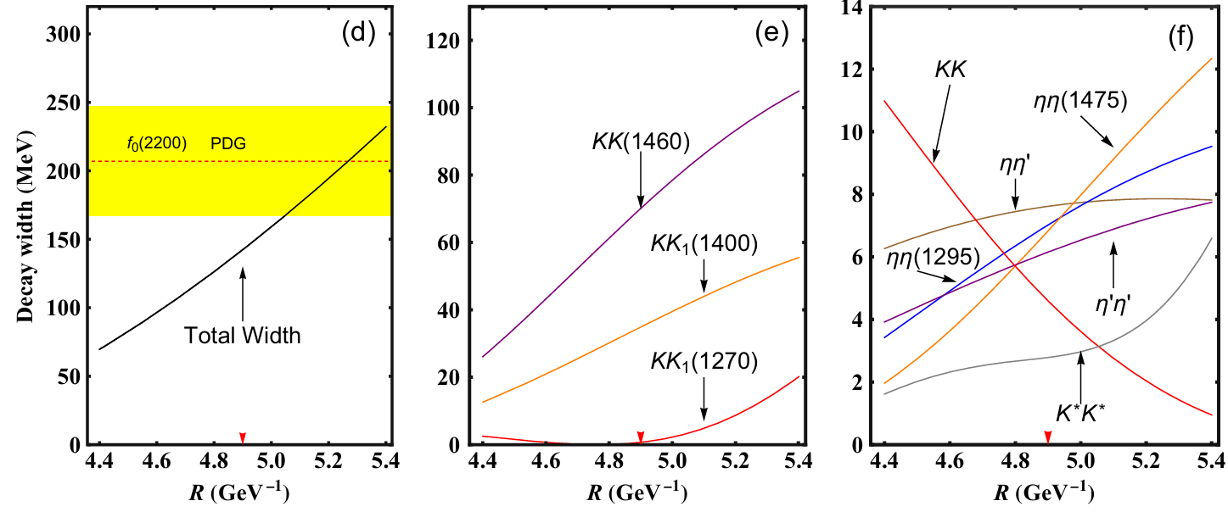
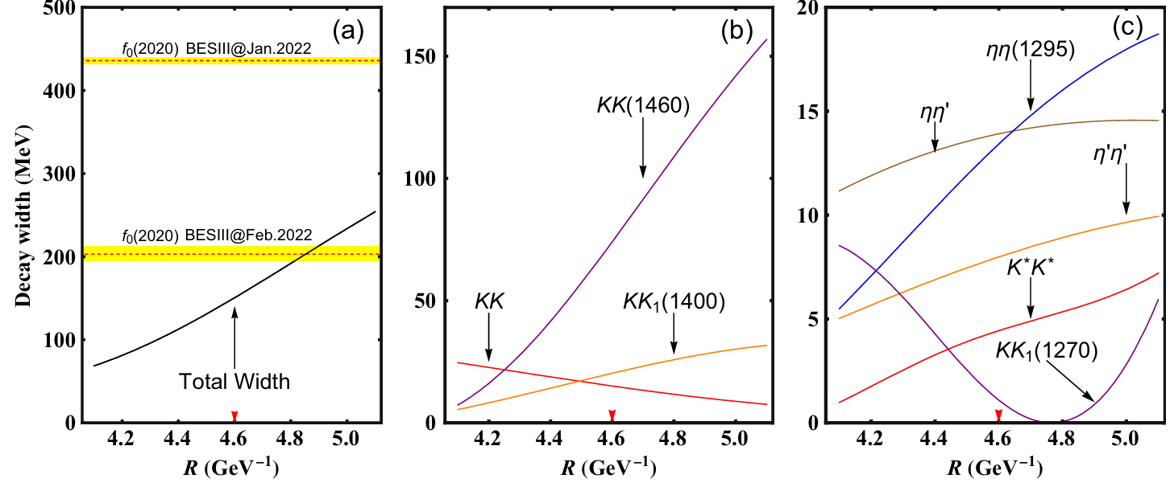
Decay behaviors of other scalar states
Consist with PDG data at R = 5.0 to 5.4
Consist with PDG data at R = 4.7
$J/ψ→γη^{′}η′$ result $→$
Phys. Rev. D 105, 072002 (2022)
$J/ψ→γηη′$ result $→$
Phys. Rev. D 106, 072012 (2022)
$f_{0}(2020)$ requires further study

Slide 18
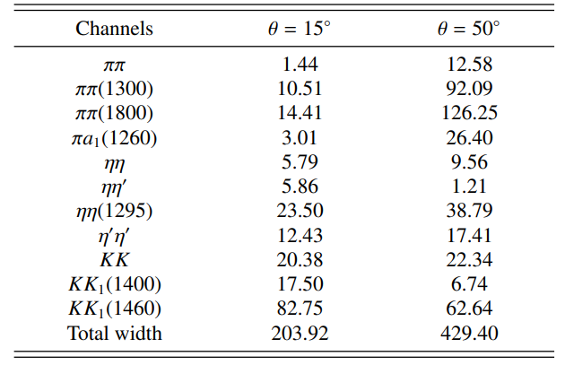
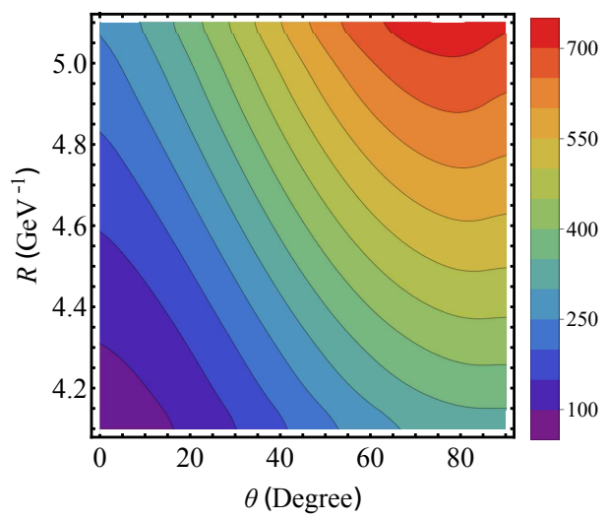
The mixing of $f_{0}$ (2020)
The mixing scheme of $f_{0}(2020)$
The partial decay widths of $f_{0}(2020)$ when taking center R value at 4.6 GeV
The total decay widths of the $f_{0}(2020)$
Assuming $R=4.6 GeV^{−1}$and considering $θ=15°$ or $50°$, we derive different decay widths as reported by BESIII collaboration

Slide 19
The predicted scalar mesons
$f_{0}(2570)$, decay width is about 200 MeV at center R value
$a_{0}(2375)$, decay width is about 80 MeV at center R value
$f_{0}(2660)$, decay width is about 300 MeV at center R value
$a_{0}(2610)$, decay width is about 100 MeV at center R value

Slide 20
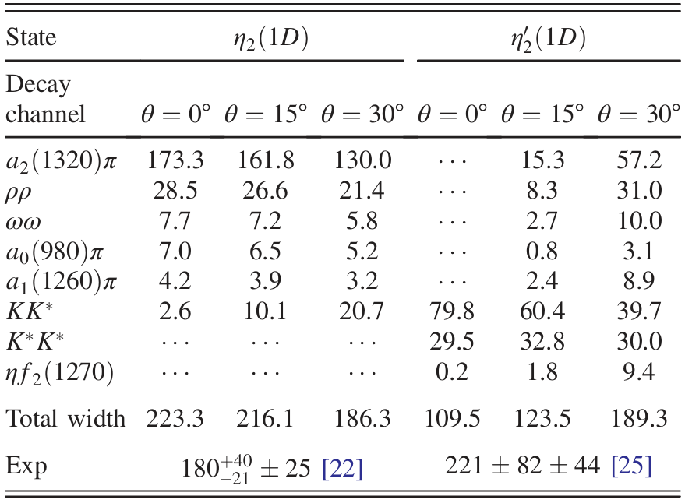
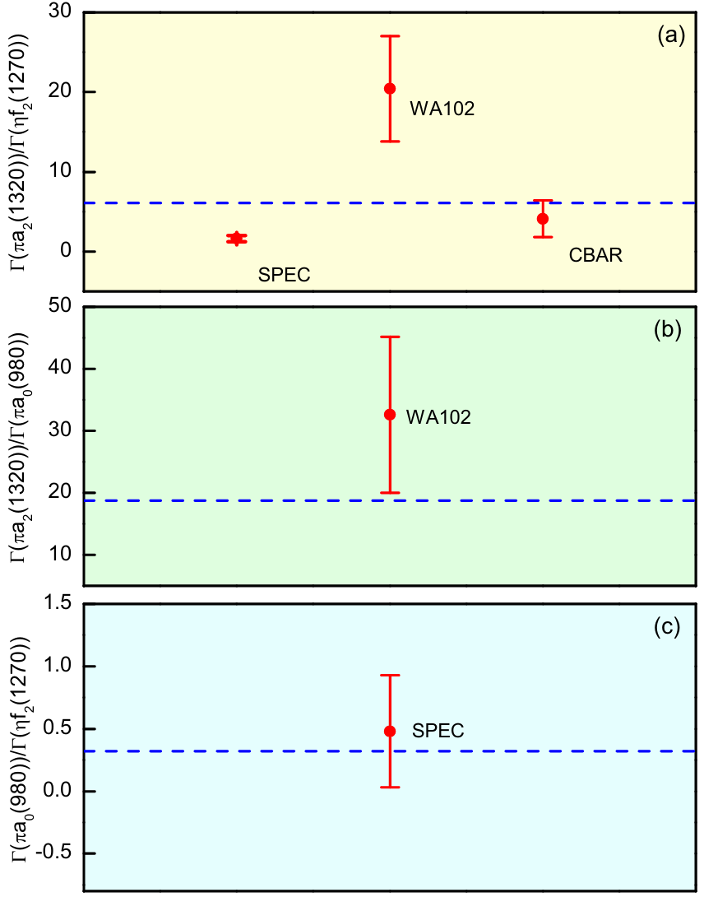
The decay behaviors of $η_{2}$ family
The mixing within the $η₂$ family
The mixing angles $θ$ for all 𝜂₂ meson states are constrained to $θ < 30°$
The branching ratio of $η_{2}(1870)$

Slide 21
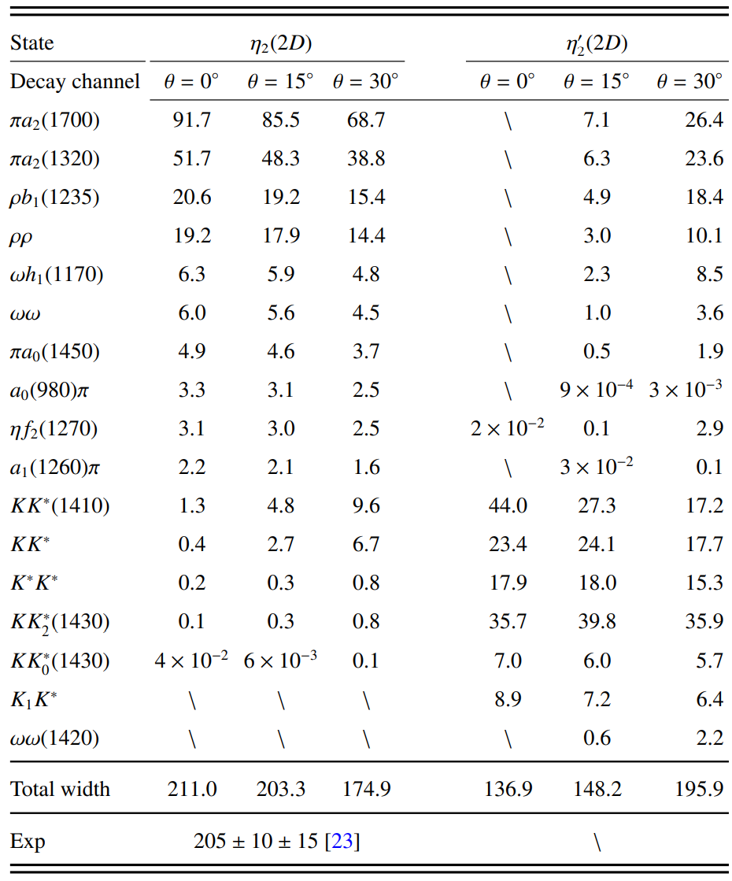
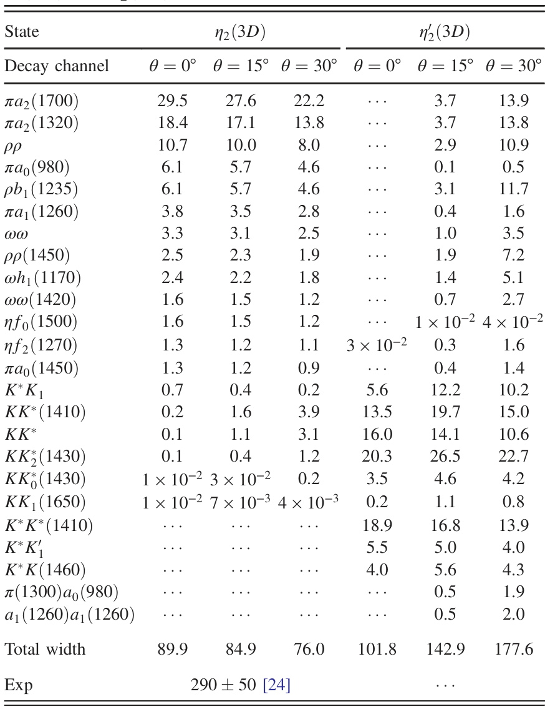
The $η_{2}$ mesons
The $η_{2}(2030)$ and $η_{2}\left(2250\right)$ are currently listed as tentative state in the PDG

Slide 22
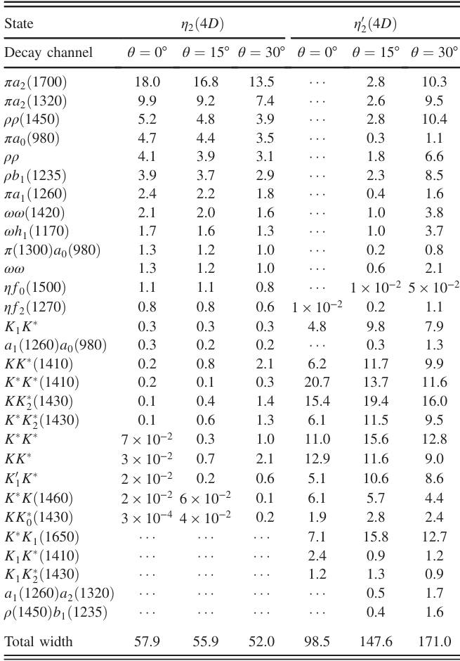
The $η_{2}(4D)$ and $X(2600)$
Calculated decay width is significantly lower than $X(2600)$
This discrepancy rules out the possibility of identifying the $X(2600)$, as a ${η′}_{2}(4D)$ state
Proved our earlier result
Still need further exploration

Slide 23
Summary
1. We conduct a systematic investigation of high-lying scalar and $η_{2}$ mesons.
2. The mass spectrums are constructed for scalar mesons and $η_{2}$ states through Regge trajectory and GI model.
3. Strong decay behaviors are analyzed via the QPC model, calculating partial widths and branching ratios.
4. The study of high-lying states may be a new task for experimental study.
THANKS!

