Slide 1
第十届XYZ粒子研讨会
Topological diagrams
of bottom baryon decays
报告人： 王 迪
单 位：湖南师范大学
arXiv:2503.22170

Slide 2
第十届XYZ粒子研讨会
Contents
1
Motivation
2
Topologies of bottom baryon decays
3
Linear correlation of topologies
4
Summary

Slide 3
第十届XYZ粒子研讨会
Contents
1
Motivation
2
Topologies of bottom baryon decays
3
Linear correlation of topologies
4
Summary

Slide 4
第十届XYZ粒子研讨会
Bottom baryon decays
Bottom baryon decays play an important role in studying perturbative and nonperturbative strong interactions and searching for new physics beyond the Standard Model.
Compared to bottom meson decays, the non-zero spin of baryons provides opportunities to study decay dynamics via more observables beyond branching fractions.
CPV in bottom baryon decays
R. Aaij et al. [LHCb], “Observation of charge-parity symmetry breaking in baryon decays,” [arXiv:2503.16954 [hep-ex]].
4

Slide 5
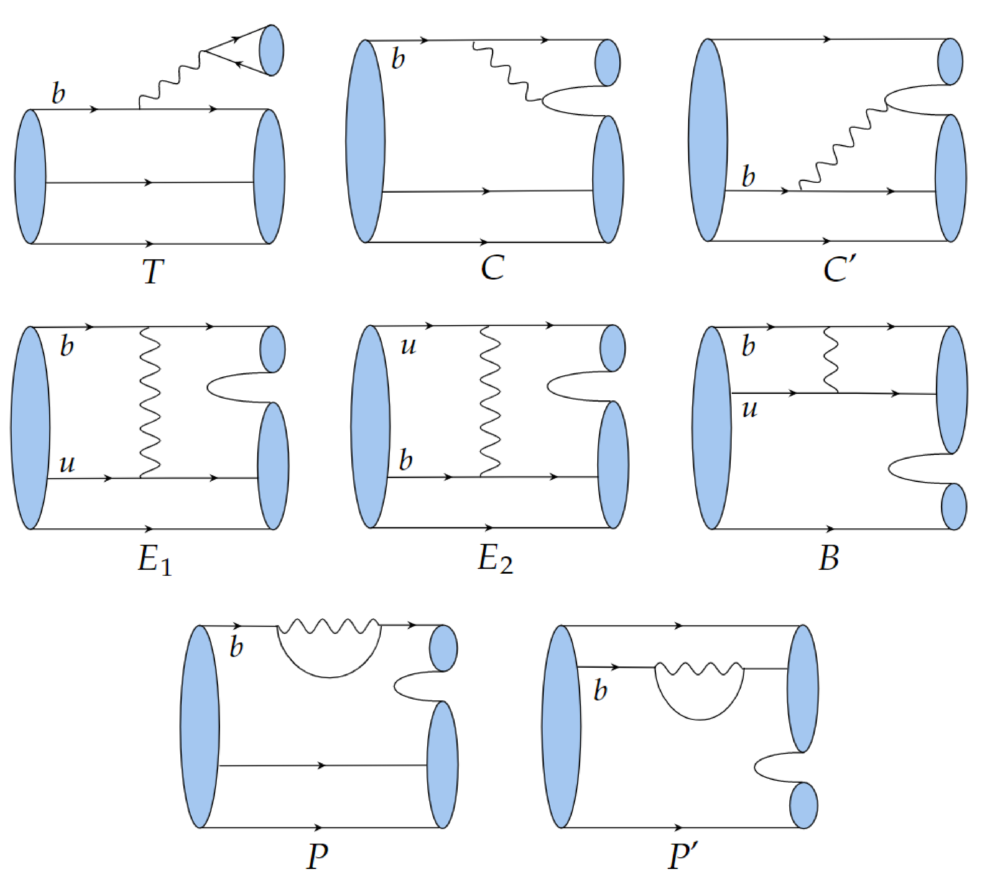
第十届XYZ粒子研讨会
Topological diagram
First step of calculation
Z. D. Duan, J. P. Wang, R. H. Li, C. D. Lv and F. S. Yu, [arXiv:2412.20458 [hep-ph]].
5

Slide 6
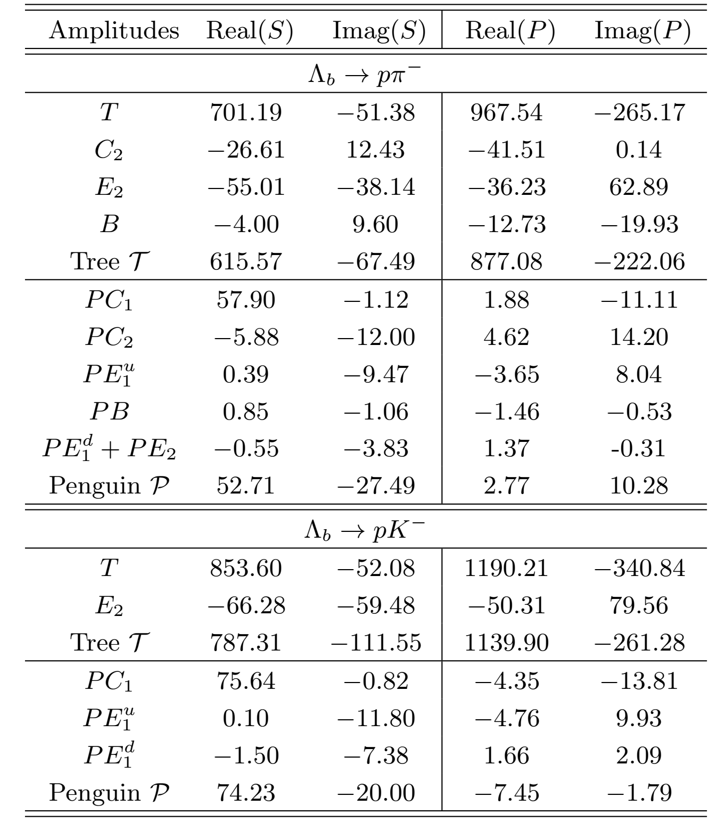
第十届XYZ粒子研讨会
Topological diagram
J. J. Han, J. X. Yu, Y. Li, H. n. Li, J. P. Wang, Z. J. Xiao and F. S. Yu, [arXiv:2409.02821 [hep-ph]].
SU(3)
Symmetry?
6

Slide 7
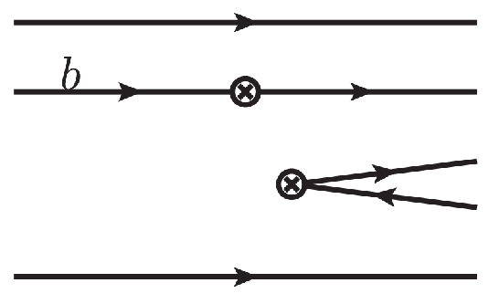
第十届XYZ粒子研讨会
Meson .vs. Baryon
Wavefunction
Pauli Exclusion Principle
7

Slide 8
第十届XYZ粒子研讨会
Contents
1
Motivation
2
Topologies of bottom baryon decays
3
Linear correlation of topologies
4
Summary

Slide 9
第十届XYZ粒子研讨会
Topologies of bottom baryon decays
Effective Hamiltonian
Operator
CKM
Hadrons
…
9

Slide 10
第十届XYZ粒子研讨会
Topology Invariant Tensor
CG coefficient, mode-dependent
Reduced matrix element, mode-independent
Index-contraction Quark flowing
10

Slide 11
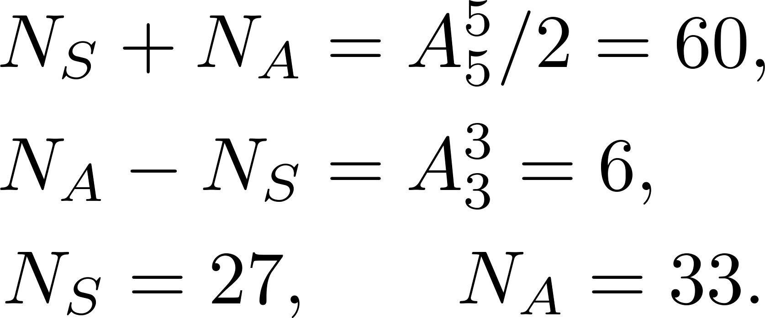
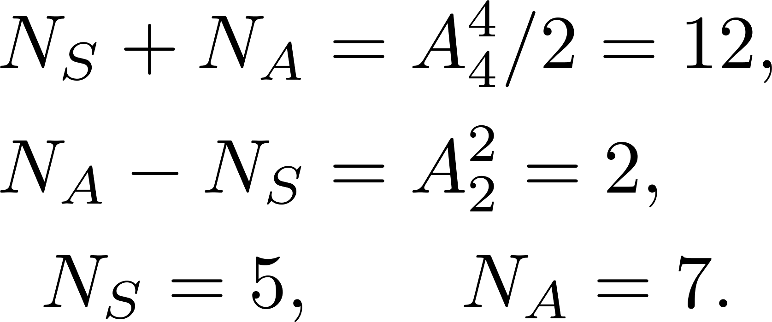
第十届XYZ粒子研讨会
Completeness of topologies
Wavefunction of octet baryon
Decay amplitude
Completeness of topologies
Tree,
Penguin
Charm loop
11

Slide 12
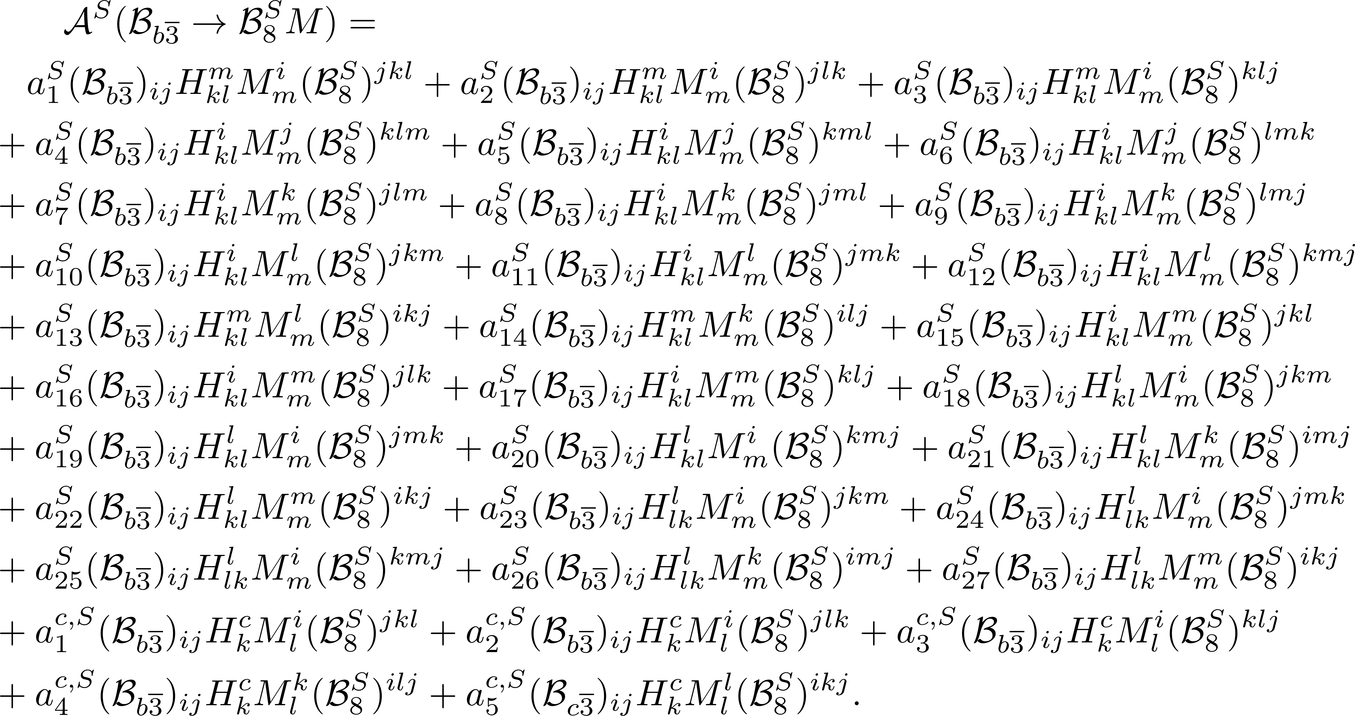
第十届XYZ粒子研讨会
Topologies of bottom baryon decays (S)
12

Slide 13
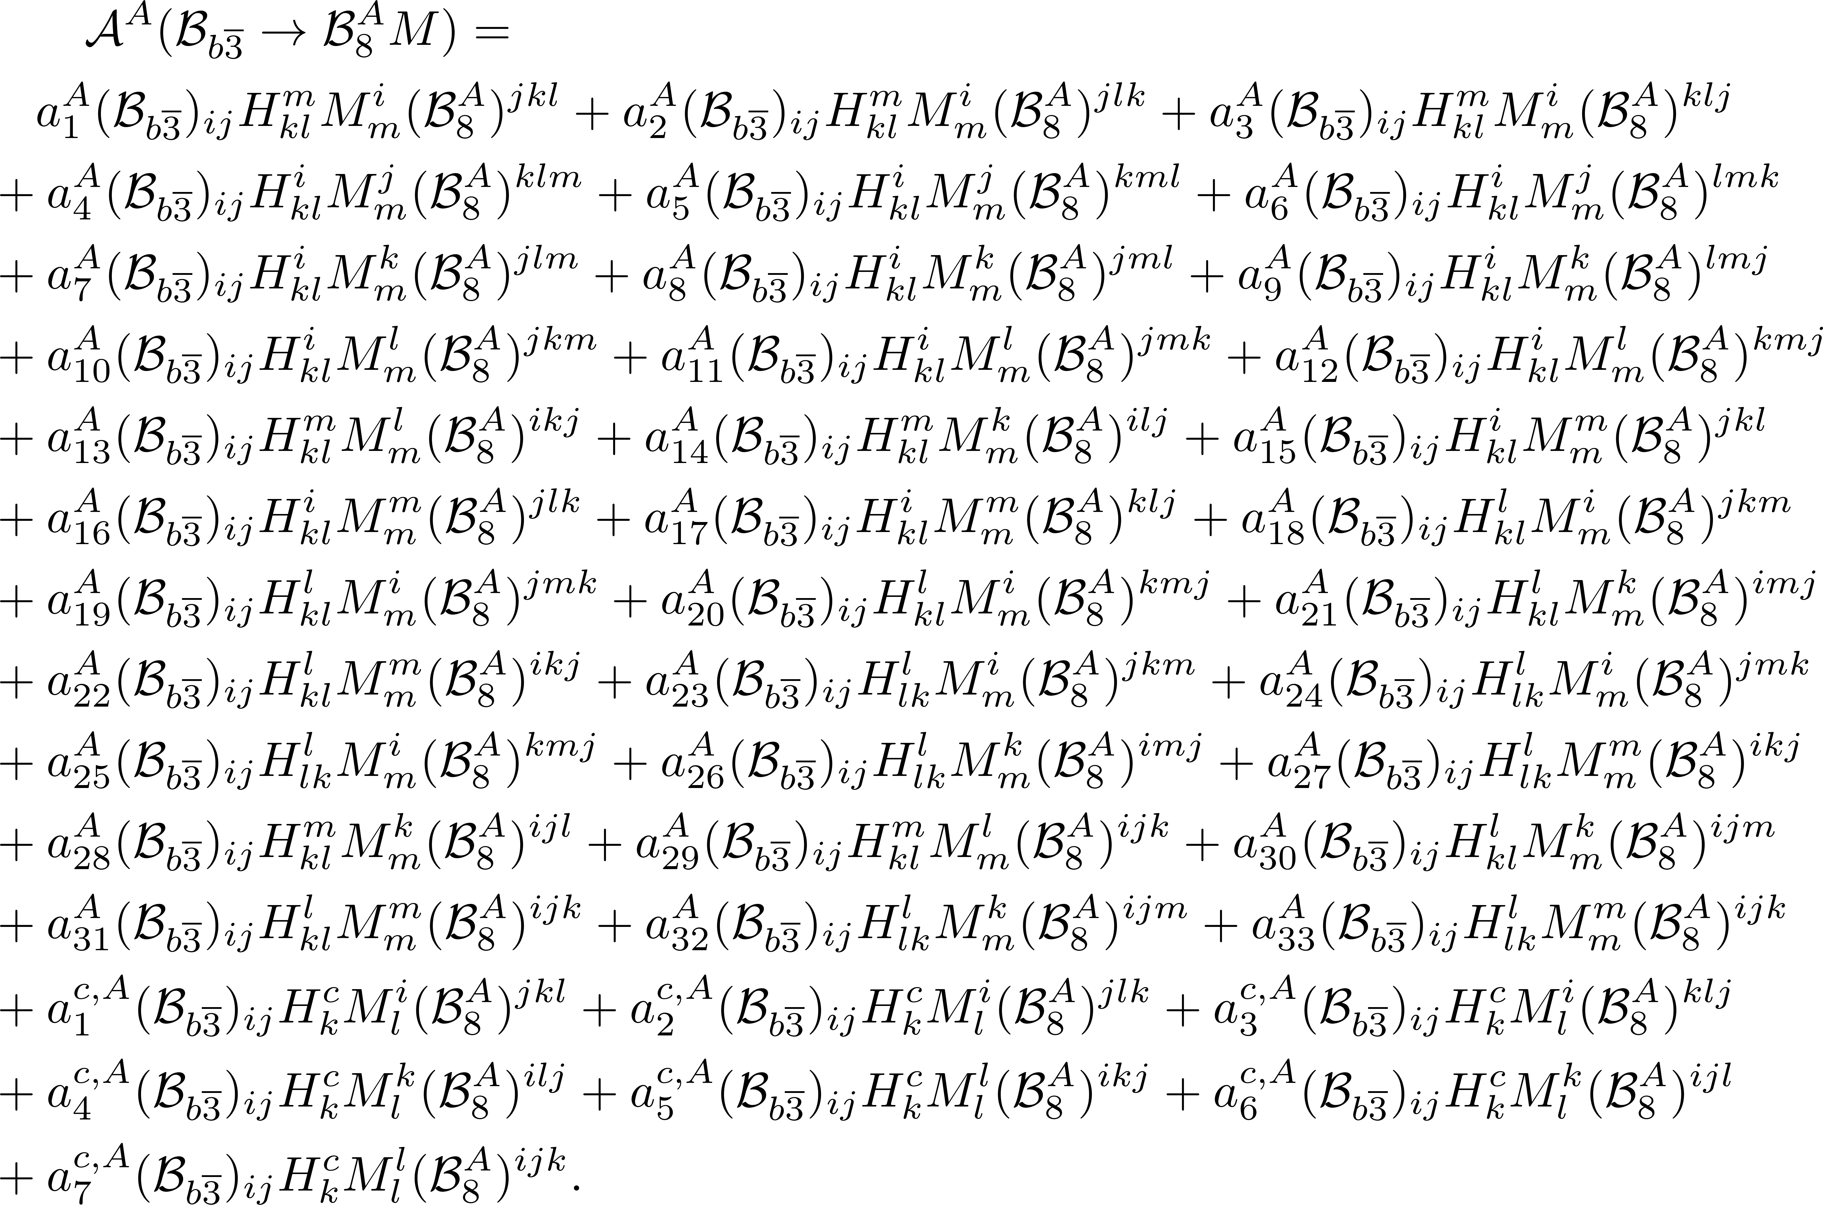
第十届XYZ粒子研讨会
Topologies of bottom baryon decays (A)
13

Slide 14
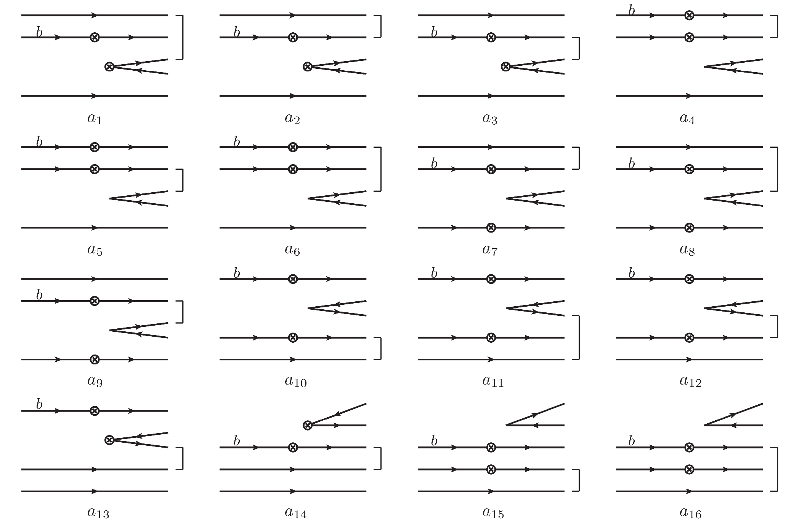
第十届XYZ粒子研讨会
Topologies in bottom baryon decays (A)
14

Slide 15
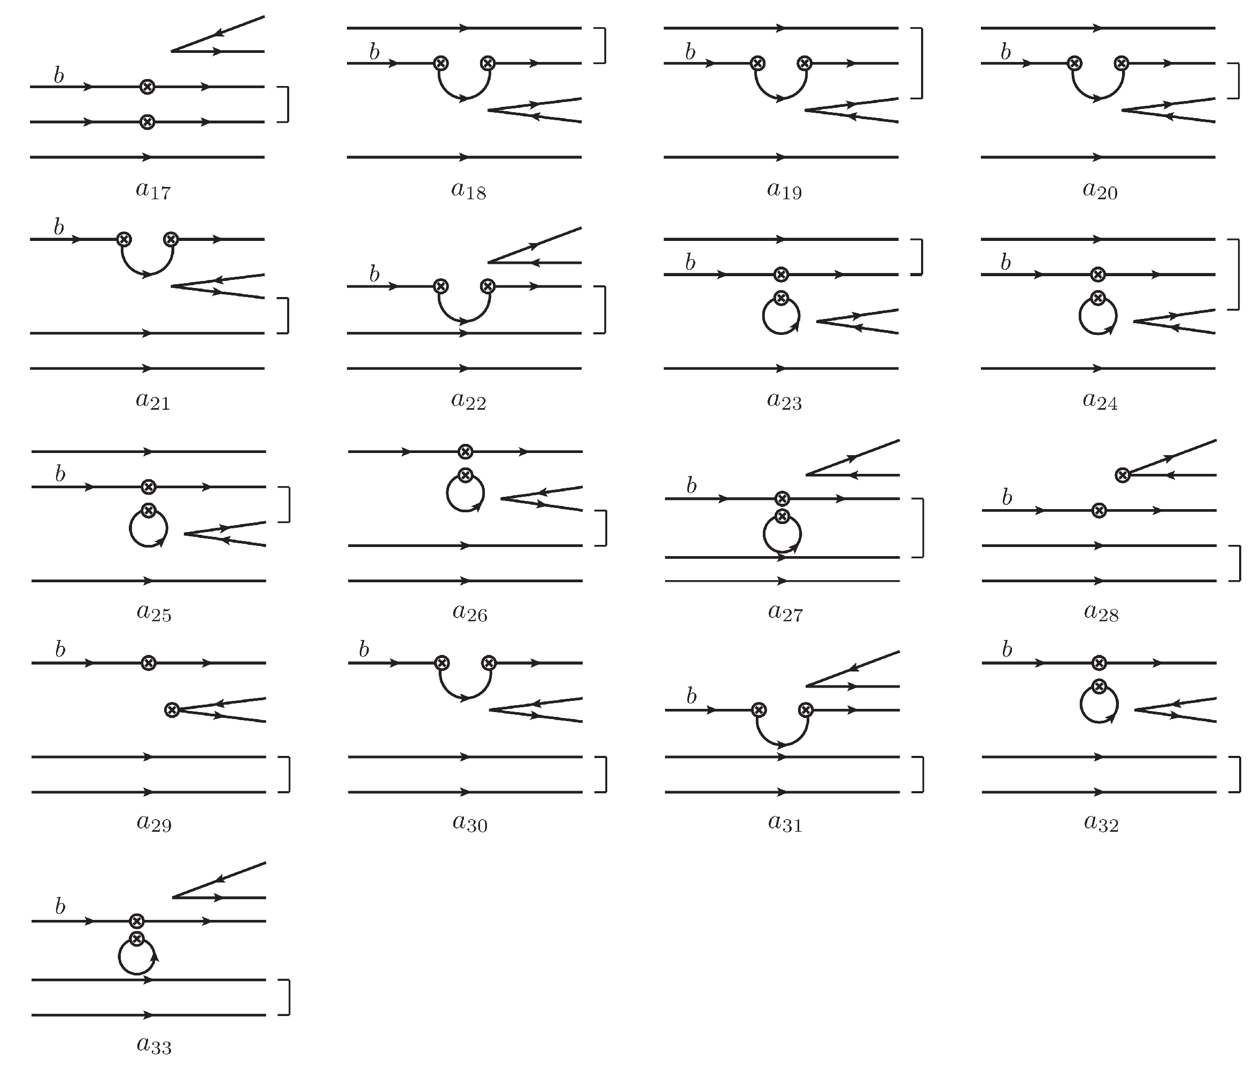
15

Slide 16
第十届XYZ粒子研讨会
Contents
1
Motivation
2
Topologies of bottom baryon decays
3
Linear correlation of topologies
4
Summary

Slide 17
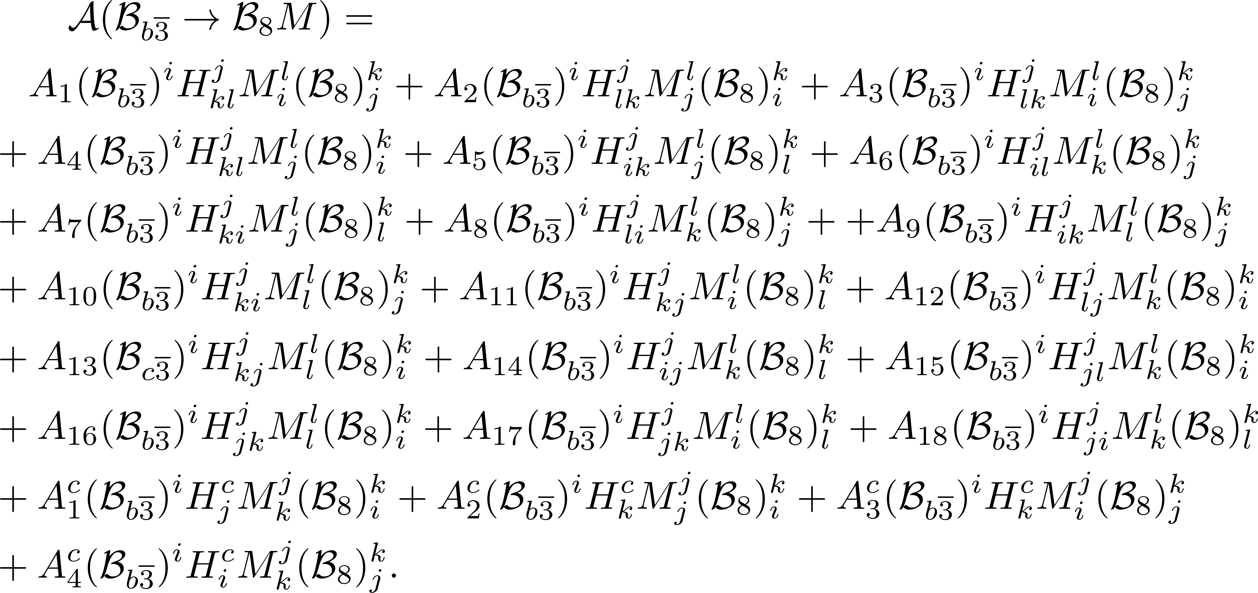
第十届XYZ粒子研讨会
(1,1)-rank Topologies
18+4=22
17

Slide 18
第十届XYZ粒子研讨会
Linear correlation of topologies
Relation between three- and (1,1)-rank octets
Example
18

Slide 19
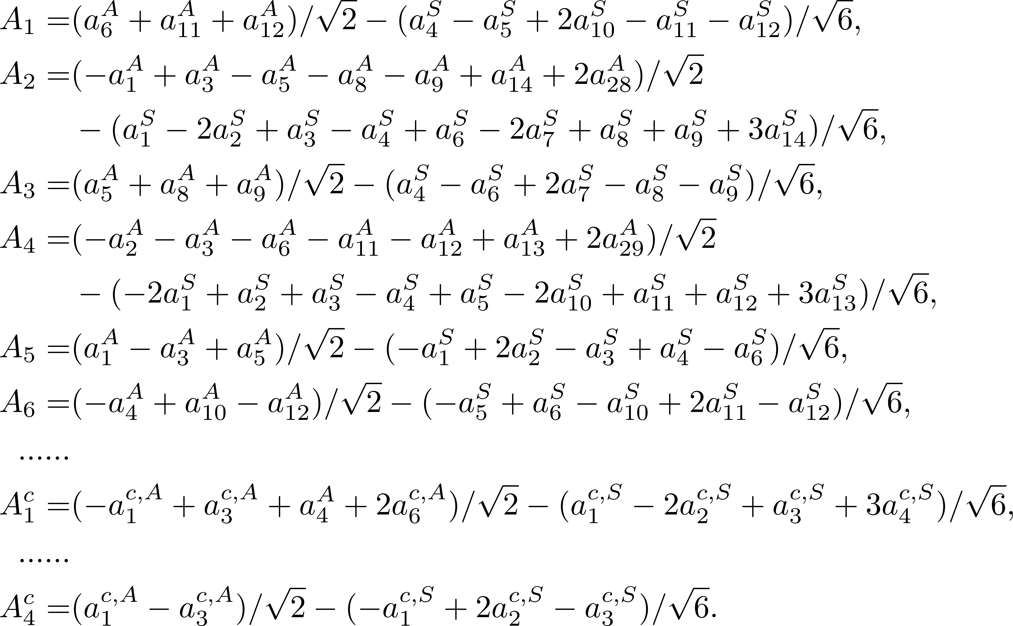
第十届XYZ粒子研讨会
Linear correlation of topologies
19

Slide 20
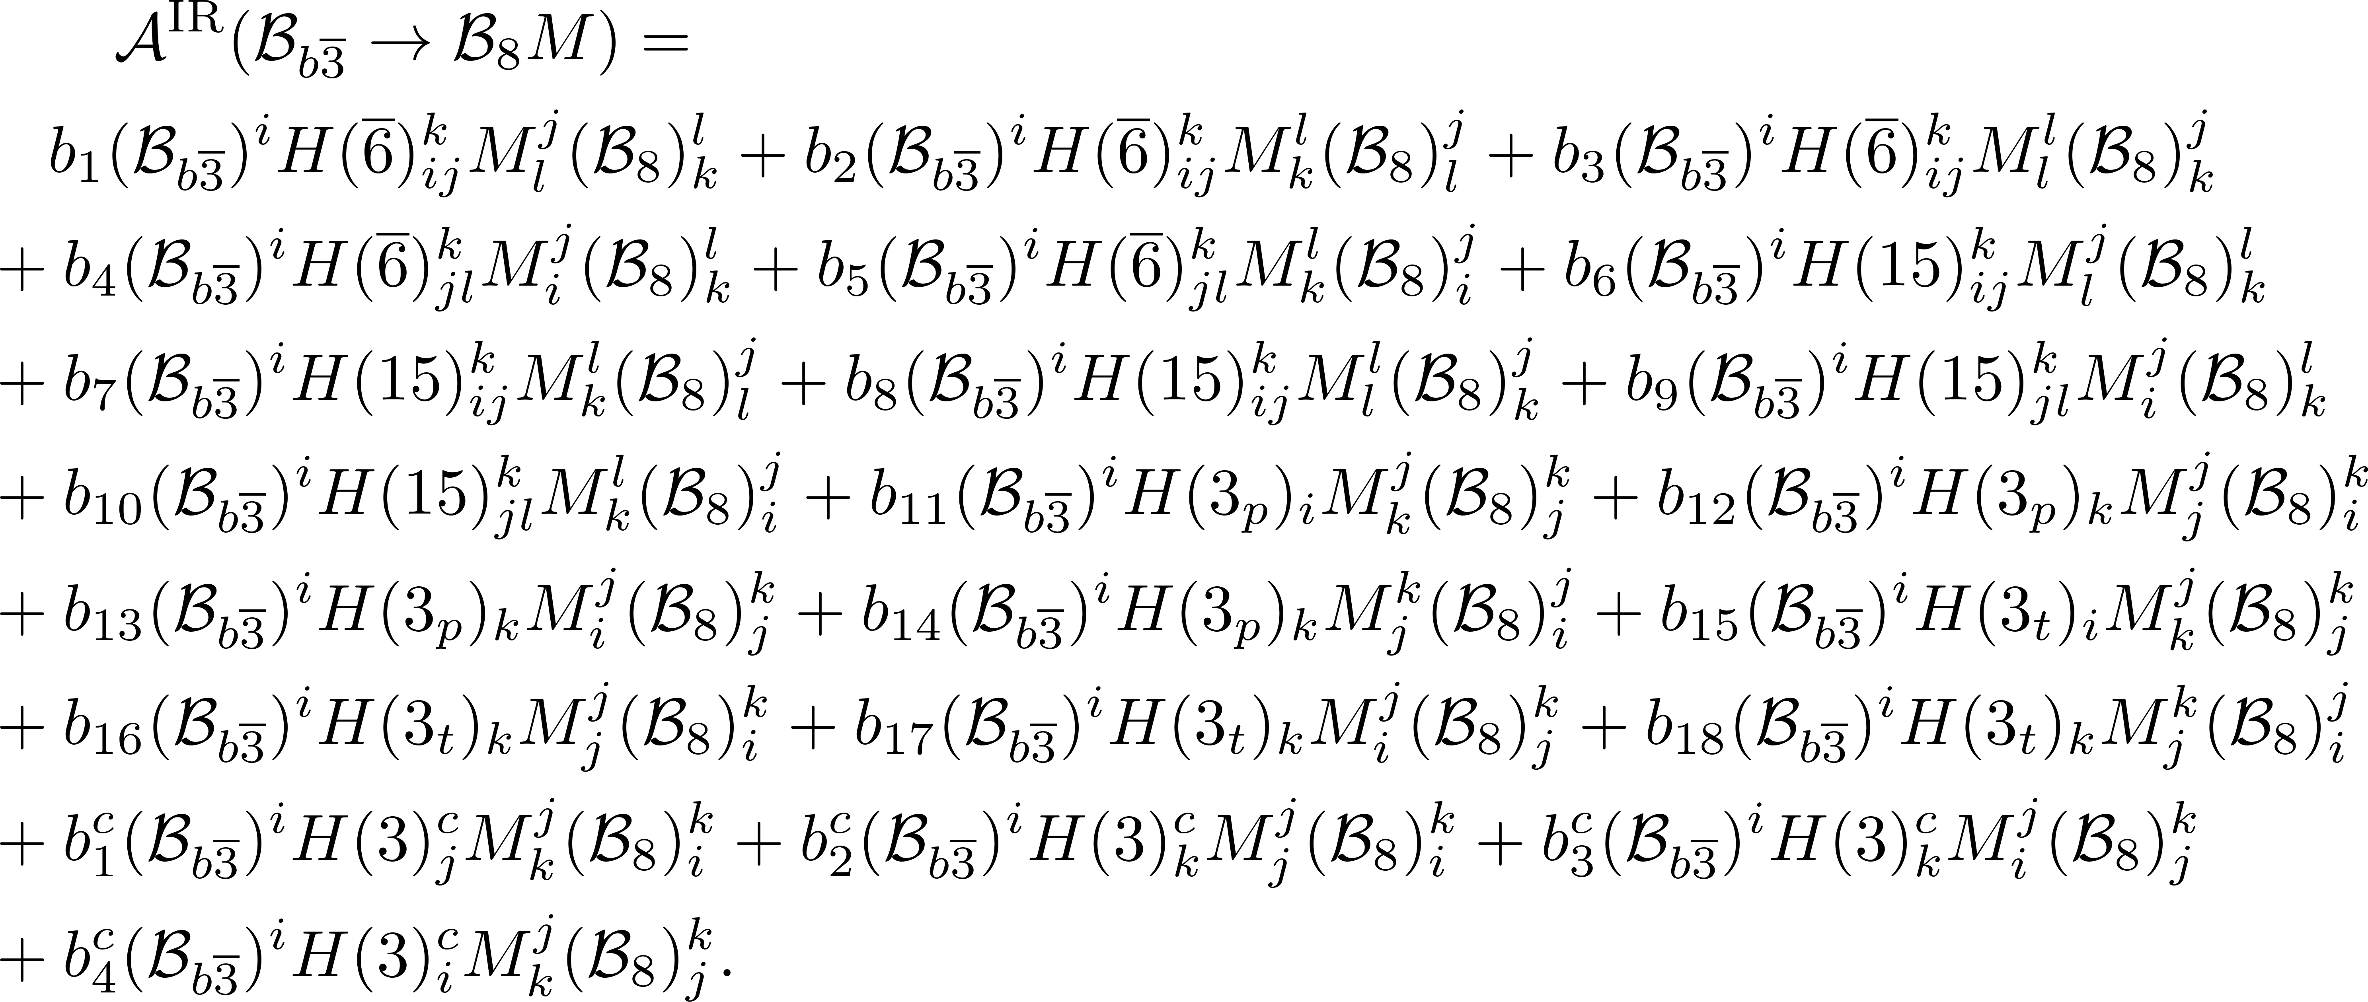
第十届XYZ粒子研讨会
SU(3) irreducible amplitude
(1,1)-rank TDA = IRA
20

Slide 21
第十届XYZ粒子研讨会
Linear correlation
Property of SU(3) group
21

Slide 22
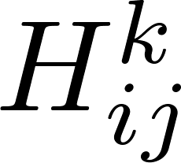
第十届XYZ粒子研讨会
Topologies in the Standard Model
Effective Hamiltonian
Non-zero
22

Slide 23
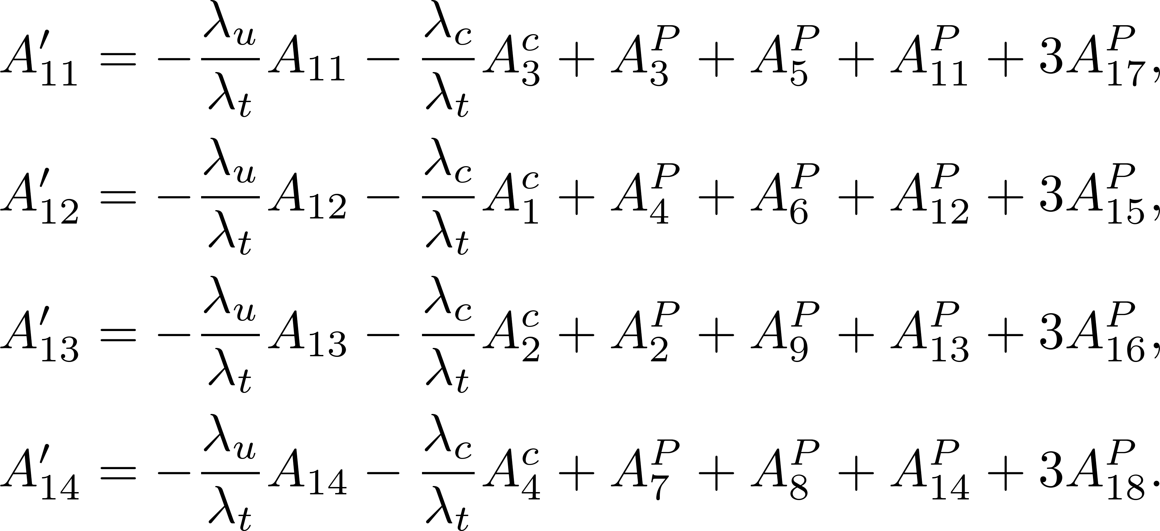
第十届XYZ粒子研讨会
Topologies in the Standard Model
The penguin induced amplitudes 、quark loop amplitudes can be absorbed into four amplitudes.
13 independent amplitudes in the SU(3)F limit.
9: Tree
4: Up-loop、Charm-loop、Penguin
23

Slide 24
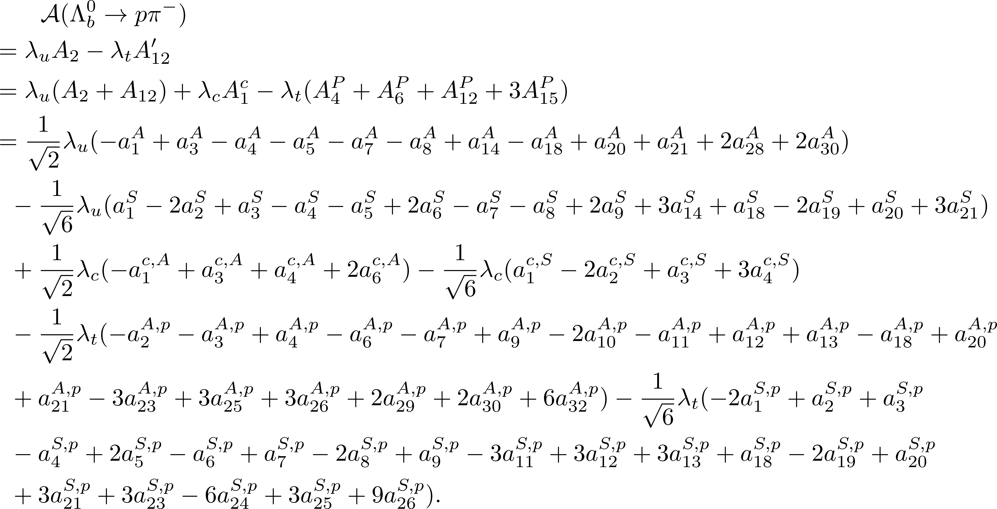
第十届XYZ粒子研讨会
Topologies in the Standard Model
Example:
24

Slide 25
第十届XYZ粒子研讨会
Contents
1
Motivation
2
Topologies of bottom baryon decays
3
Linear correlation of topologies
4
Summary

Slide 26
第十届XYZ粒子研讨会
Summary
Topologies contributing to the two-body decays of bottom baryons are presented.
The linear relations of topologies are derived by tensor contraction and SU(3) decomposition.
13 independent amplitudes in the SU(3)F limit: 9+4=13.
Thanks for your attention!
26

