Slide 1
CEE-TPC数据分析方法和进展
——杨远胜 2024/11/30
时间投影室实验技术暨第二届MTPC研讨会

Slide 2
CEE-TPC简介
Unpacker
Cluster Reconstruction
Track Reconstruction
总结和展望

Slide 3
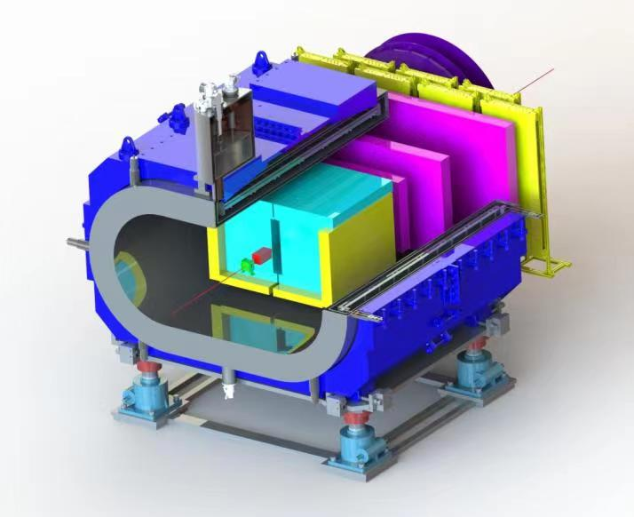
CEE-TPC简介
时间投影室 (TPC)
低温高密核物质测量谱仪（CEE，CSR External-target Experiment ）中的主要径迹探测器
覆盖大角度区
功能：测量带电粒子的三维径迹，粒子鉴别
电子学：SAMPA（10M samples/s, 10 bit ADC）

Slide 4
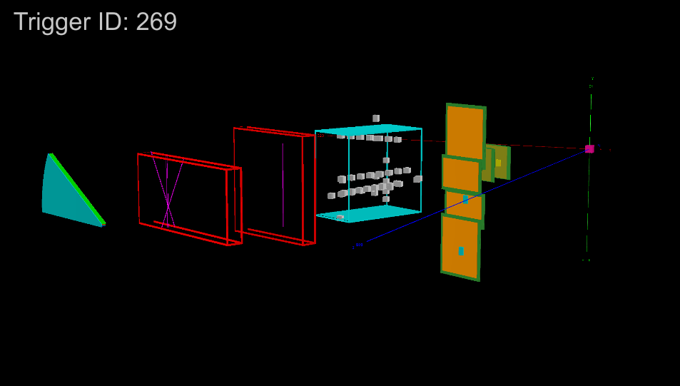
CEE-TPC简介
Online Event display (Beam test)

Slide 5
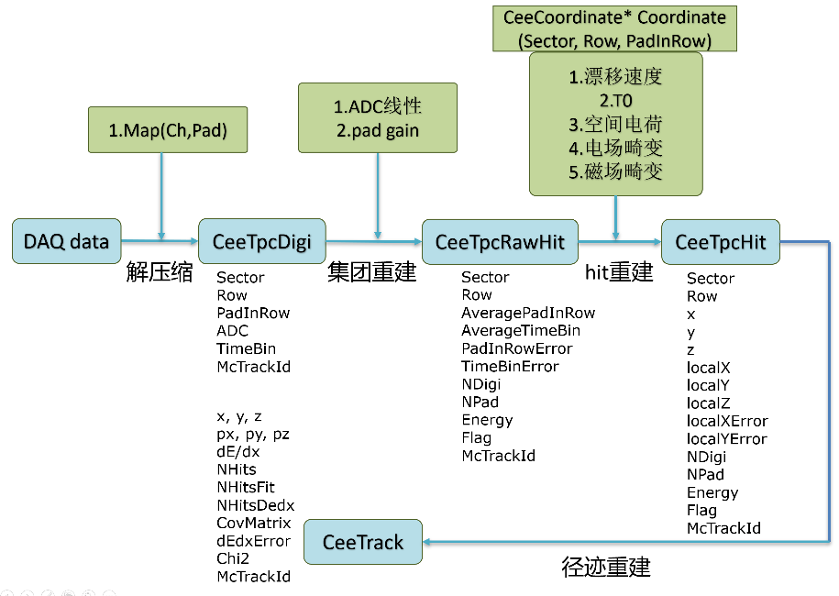
Work flow of data analysis
Based on FairRoot (FairTask, FairRootManage)

Slide 6
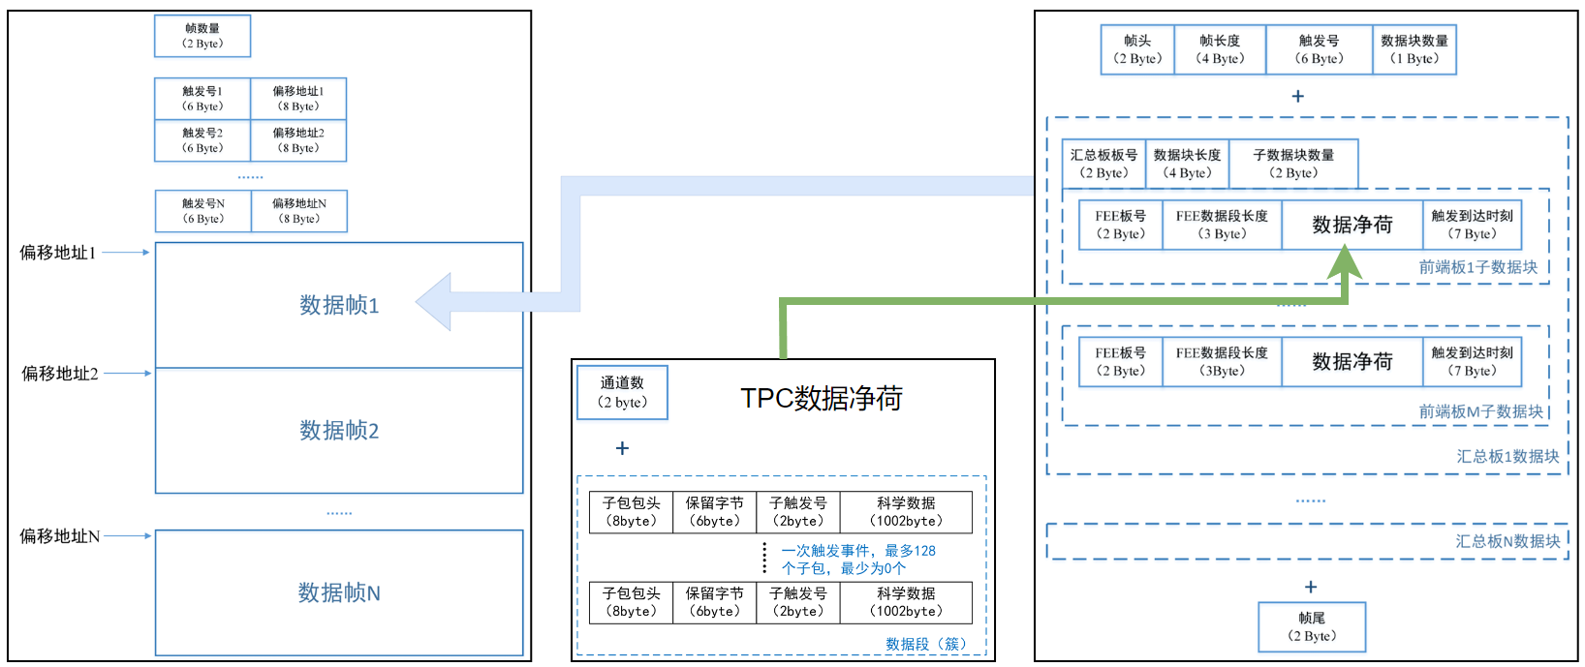
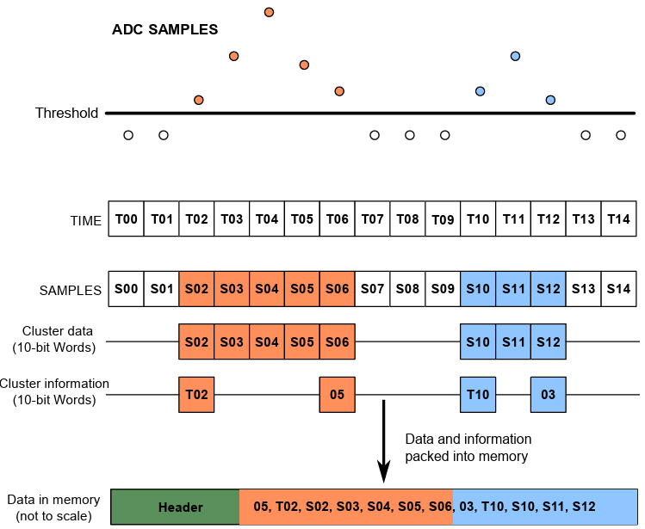
Unpacker
DAQ file structure
Raw data → digi (held by TClonesArray)
Data packed by SAMPA chip

Slide 7
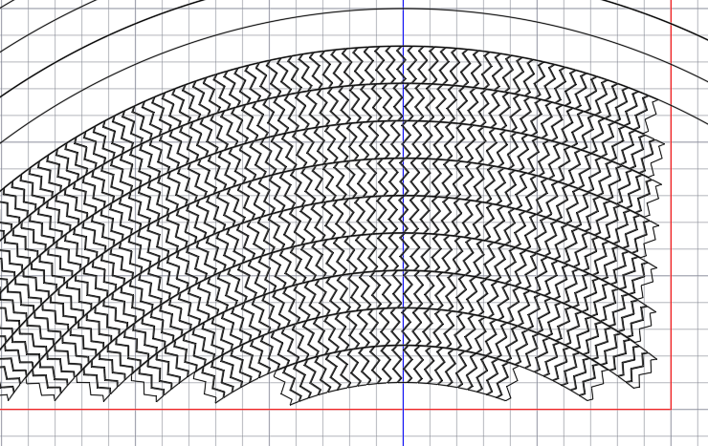
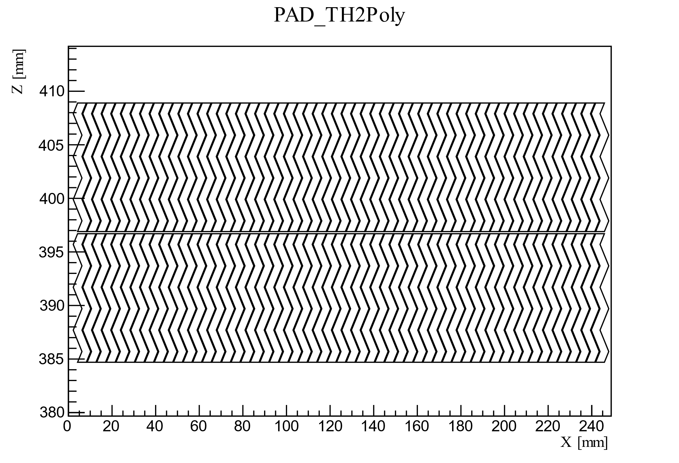
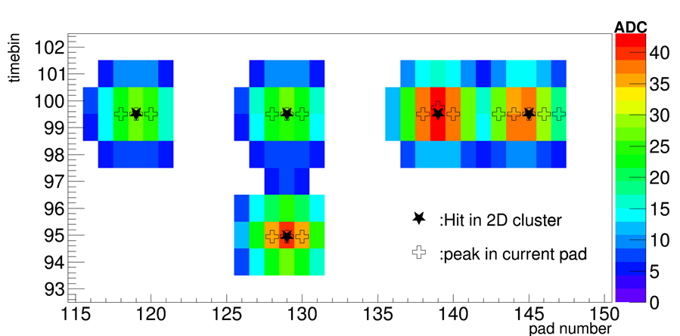
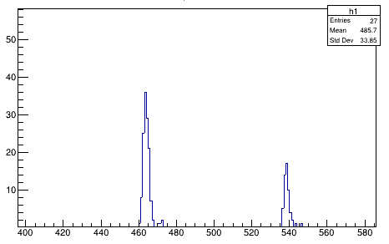
Cluster reconstruction
time bin
Pad number
One layer (row)
find 2d-cluster
find peaks in cluster
collect peaks
create hits

Slide 8
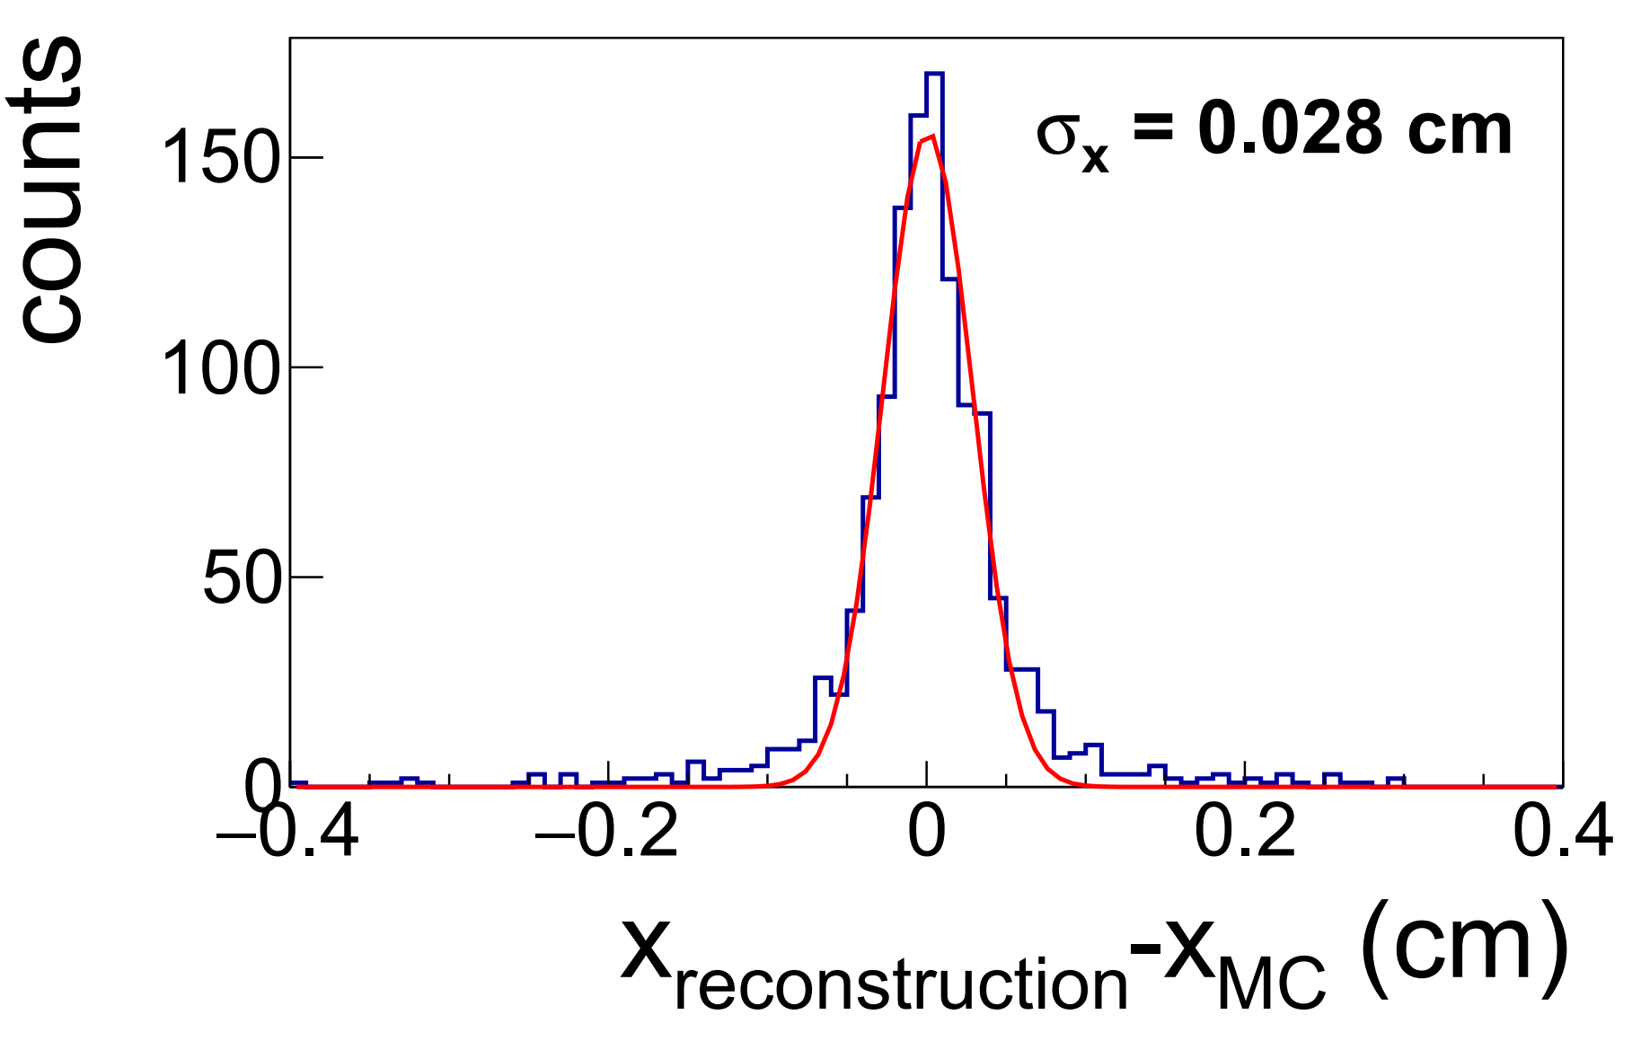
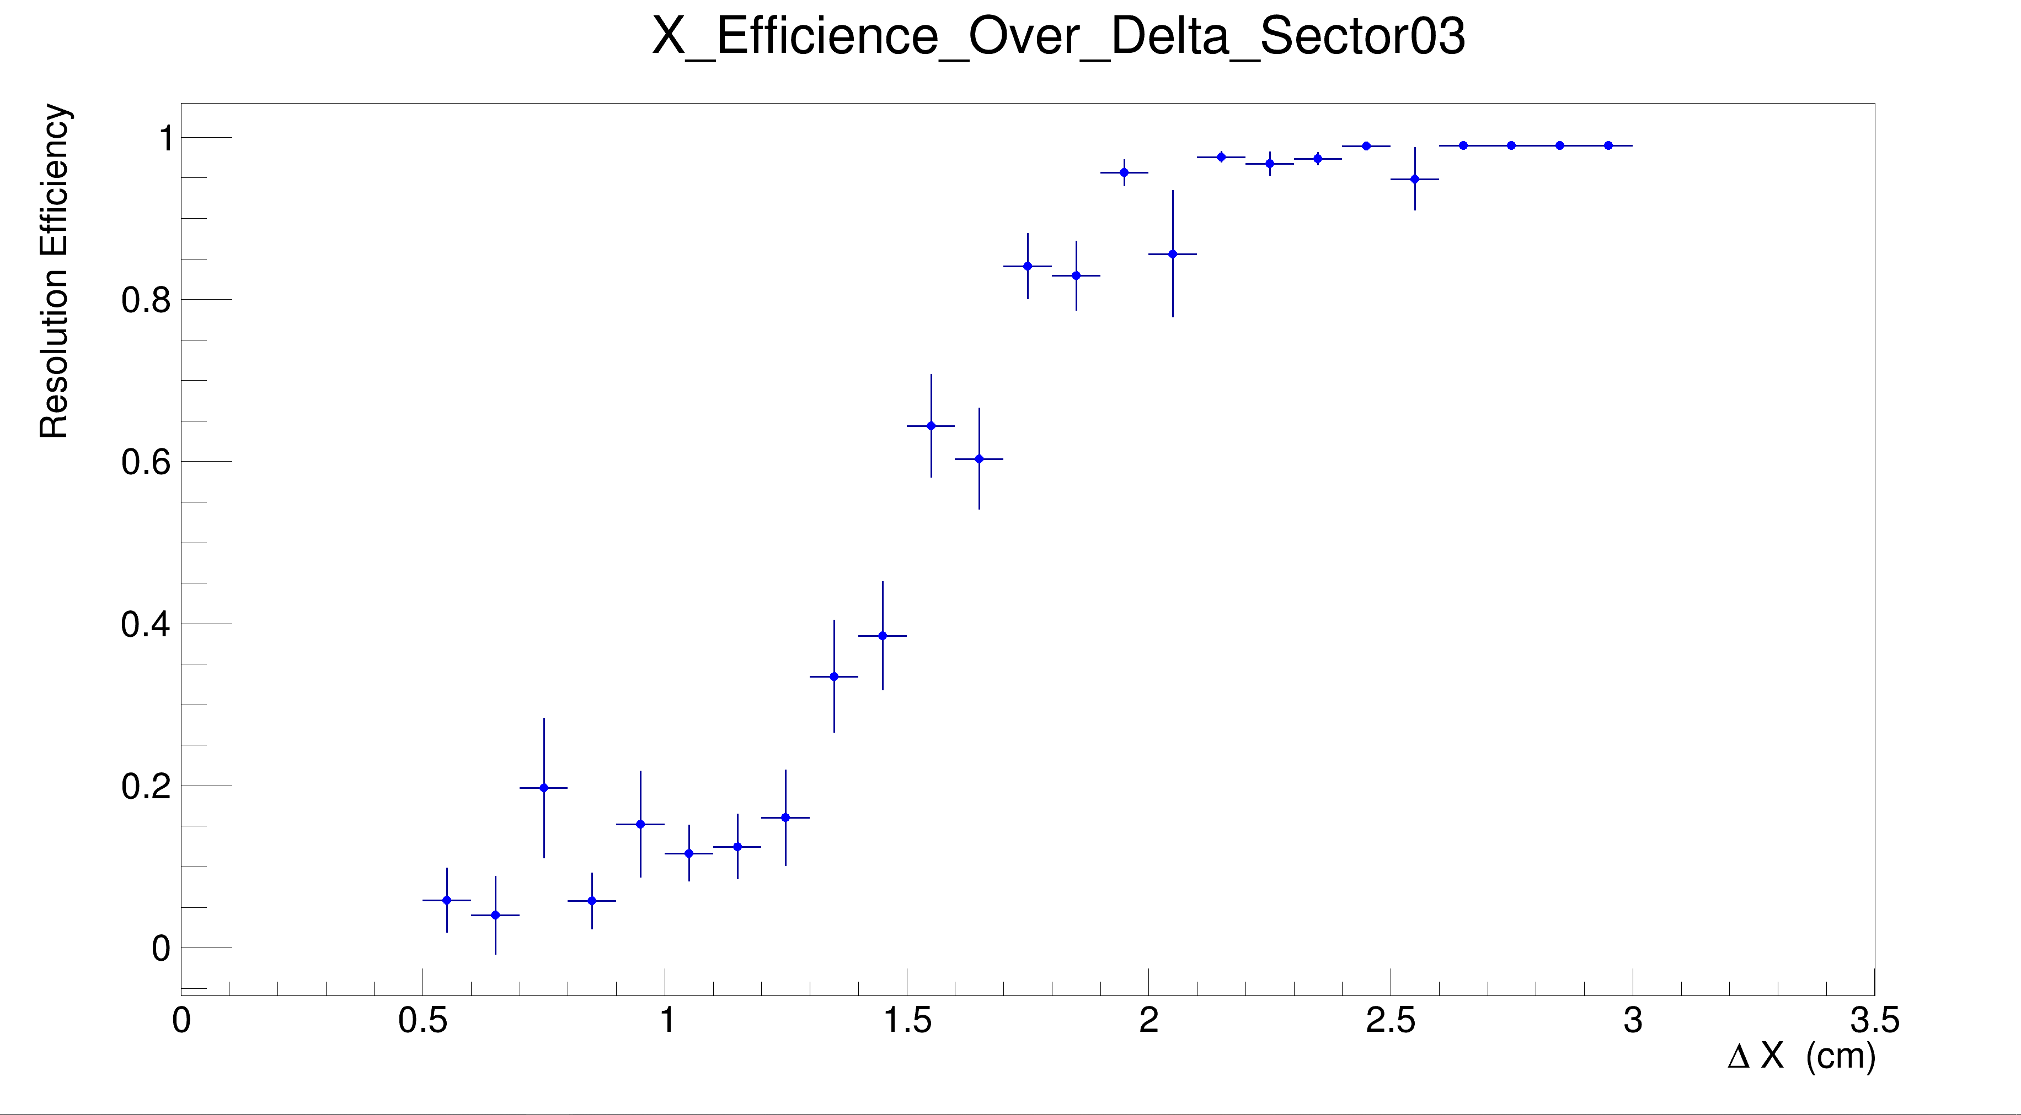
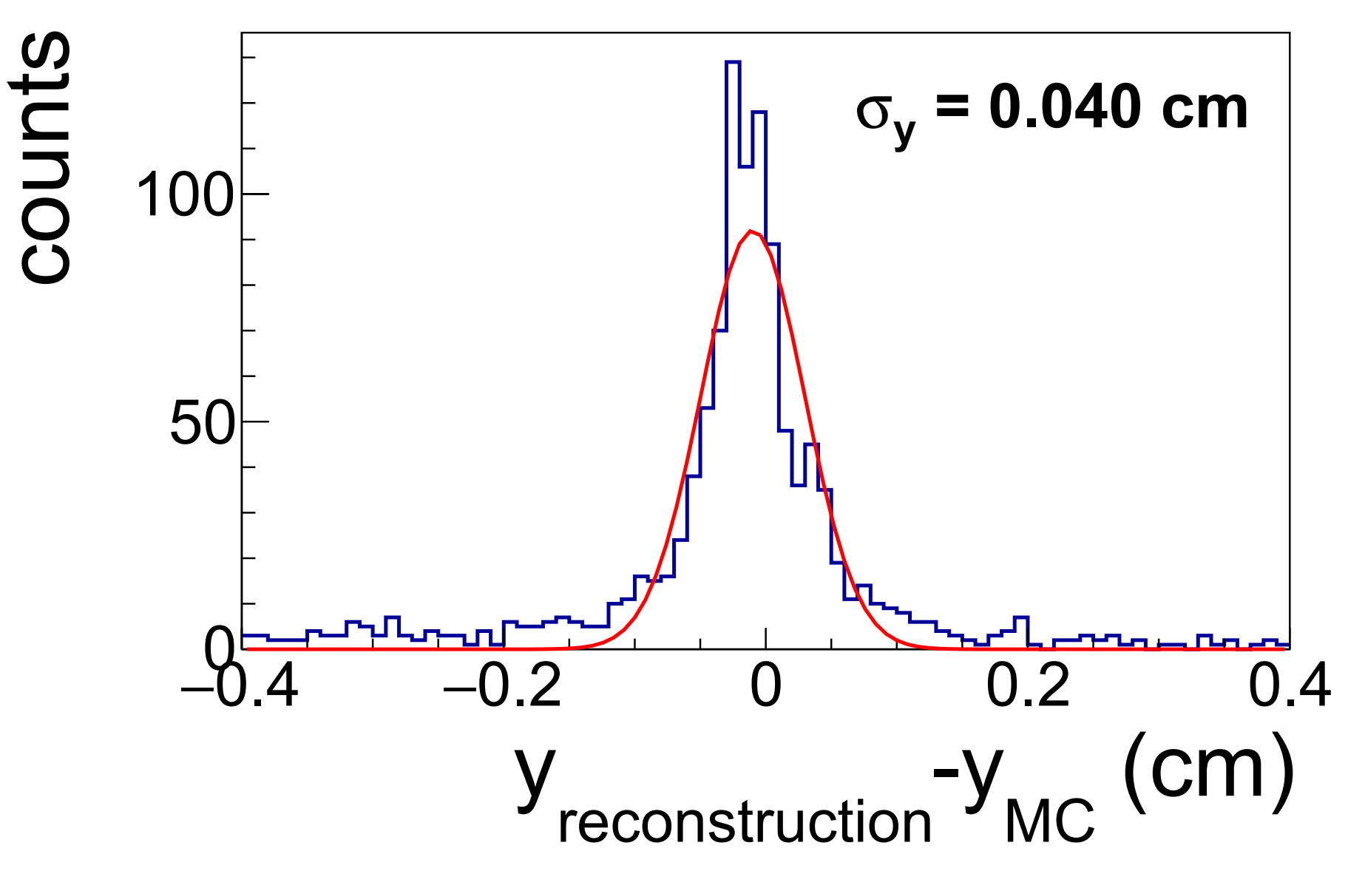
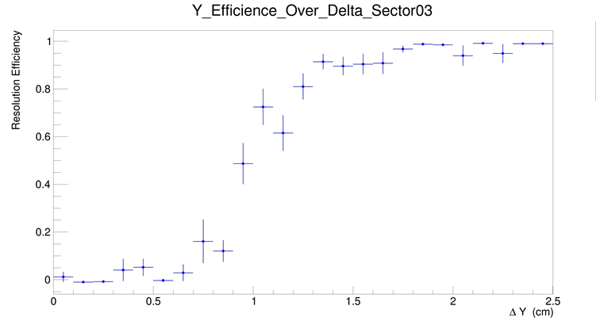
Cluster reconstruction
Cluster reconstruction performance

Slide 9
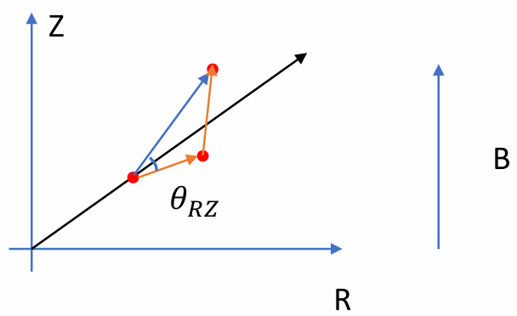
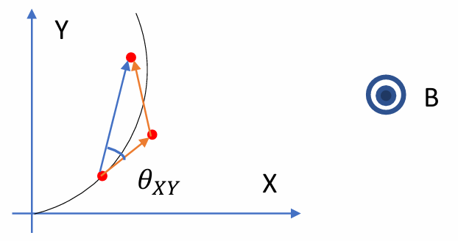
Track reconstruction
cellular autometa

Slide 10
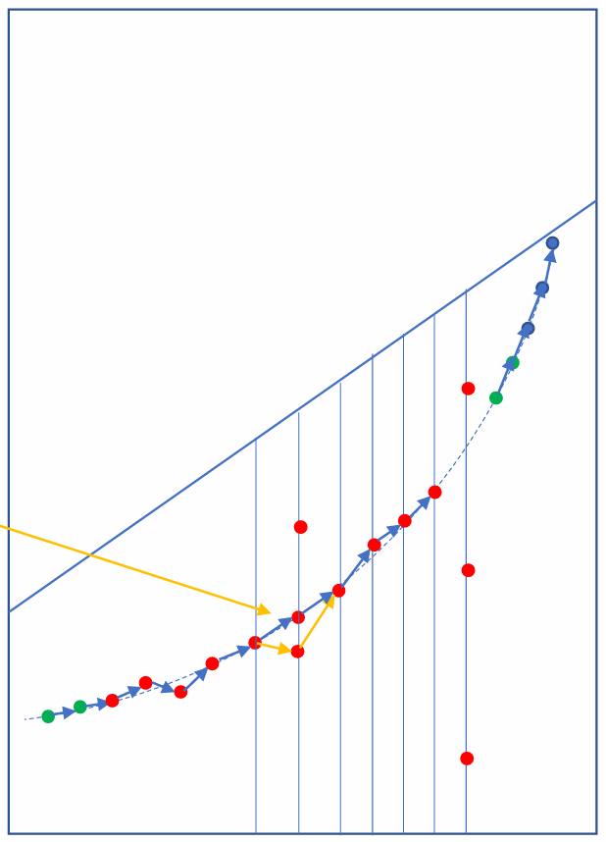
Track reconstruction
Length > 5
Each root cell can create multiple track candidates
fit tracks by Kalman Filter algorithm
Multiple track candidates with same length

Slide 11
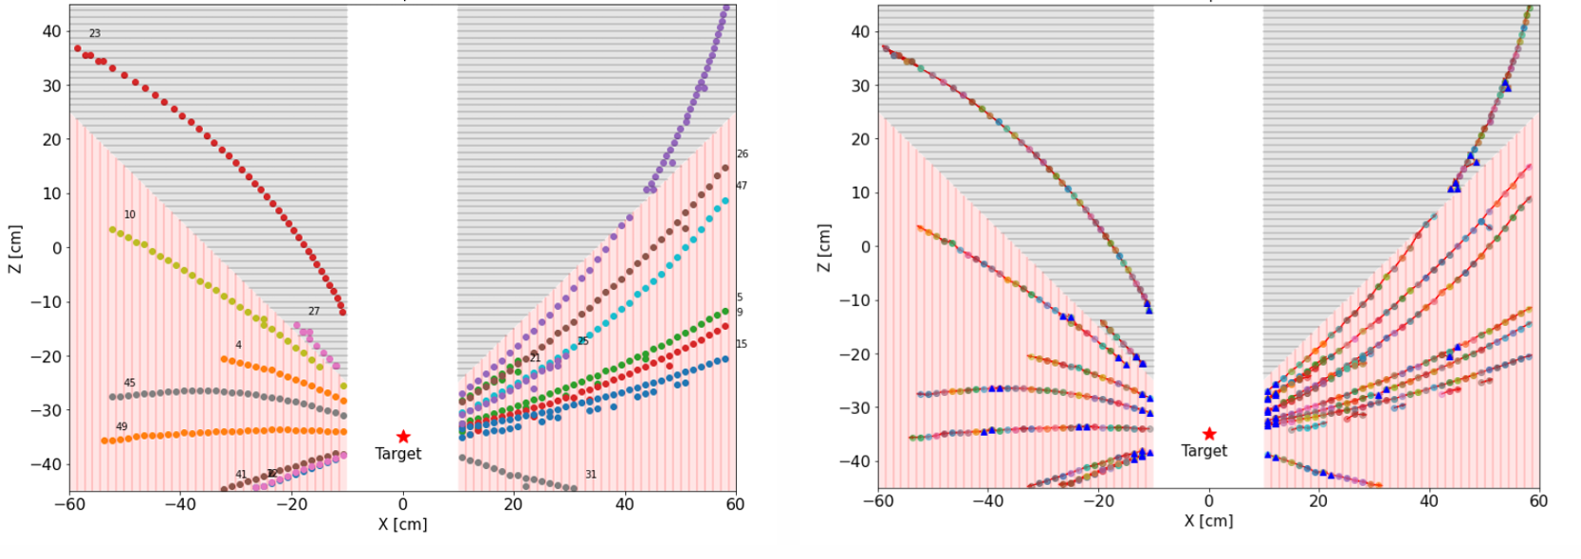
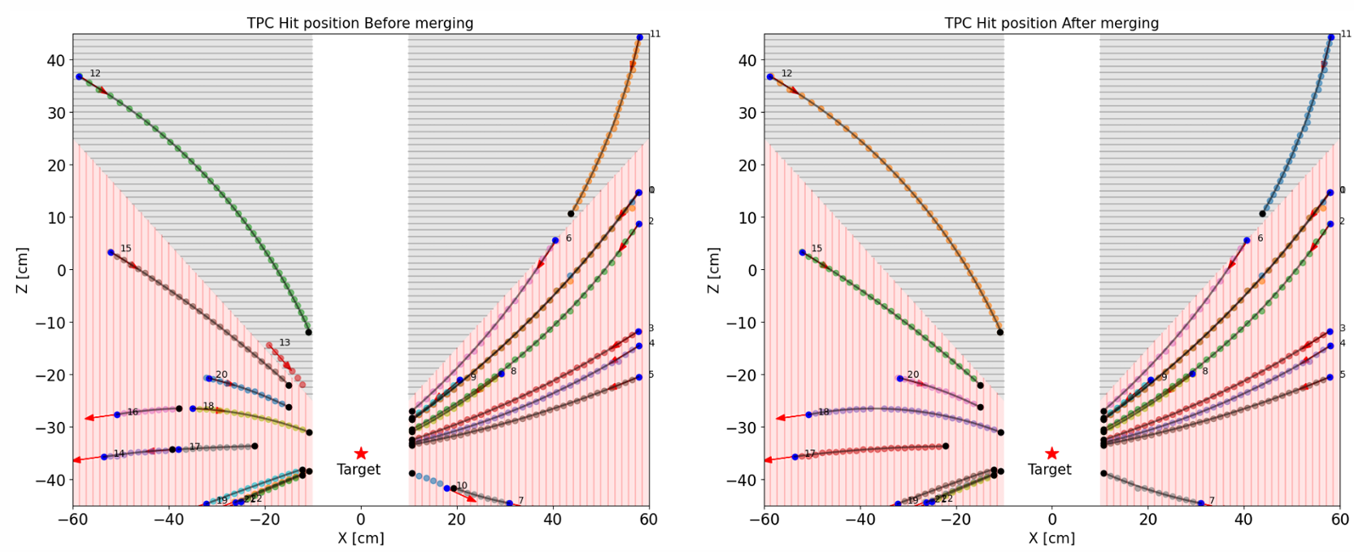
Track reconstruction
Generated Hit
Found Cells by CA
Track before merge
Track after merge

Slide 12
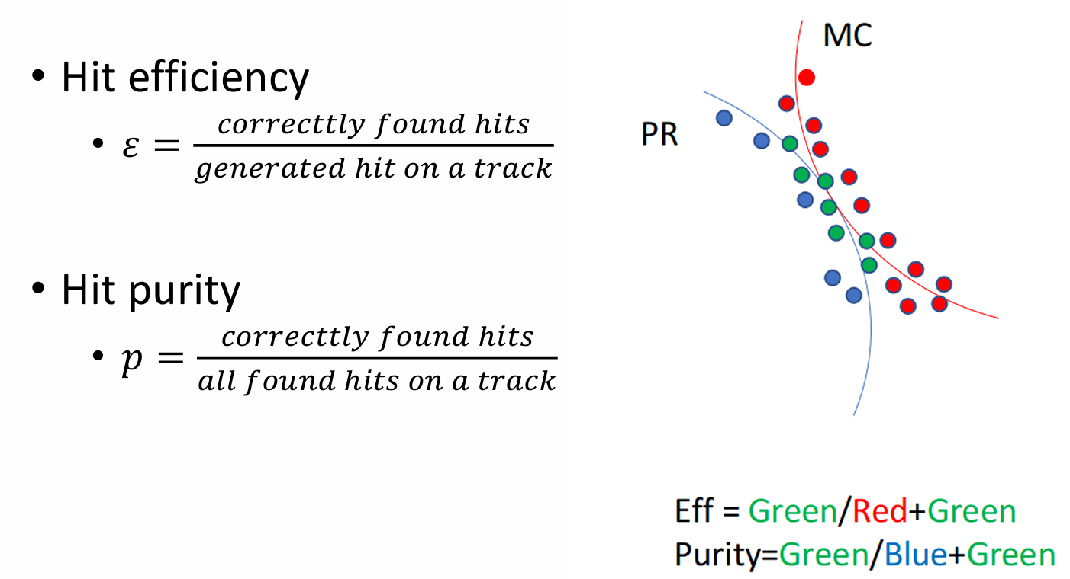
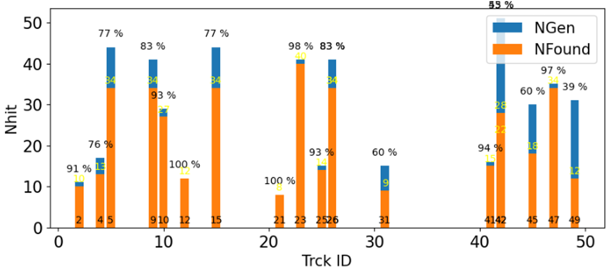
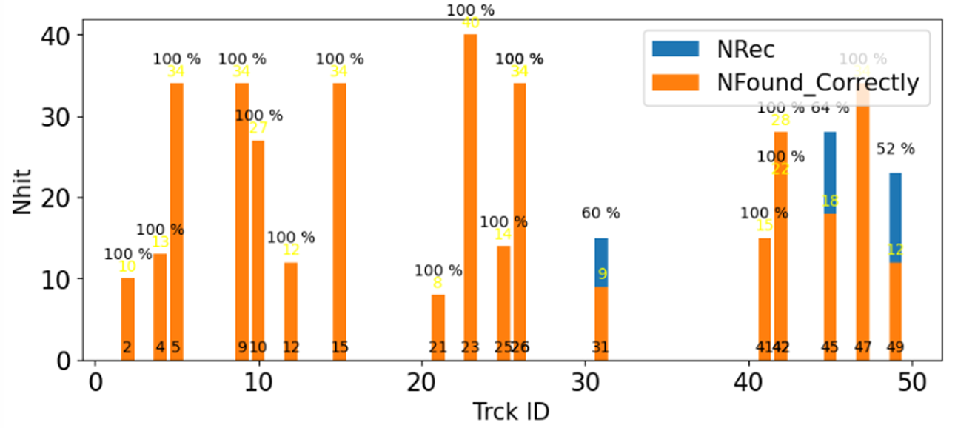
Track reconstruction
Efficiency
Purity

Slide 13
总结和展望
总结：
利用Unpacker解包原始数据，以采样点（digi）为单位存储
在timebin vs. pad number平面中通过迭代寻找相邻信号点（digi）重建2D cluster，进一步使用find peak和电荷重心法重建出hit 点
结合CA（元胞自动机）和KF（卡尔曼滤波）方法完成了径迹重建
动量分辨 < 5%，重建效率 > 90%（MC数据）
展望：
刻度软件（激光刻度漂移时间、速度和电场畸变等）
状态监测
https://gitee.com/CEESM/CeeRoot

Slide 14
The End

