Slide 1
Identify a event is a physic event or a dark noise event in the water phase
2024/10/15
Liu Ximing (Nankai University)

Slide 2
Outline
Briefly introduced The Jiangmen Neutrino experiment and my current work
Background
Research method and preliminary result
Plan

Slide 3
Jiangmen Neutrino experiment
The Jiangmen Underground Neutrino Observatory (JUNO) is a 200,000-ton multi-purpose underground liquid scintillation detector with the primary physical goal of determining the mass ordering of neutrinos.
I’m working on distinguishing between a physical event and dark noise event in the water phase.

Slide 4
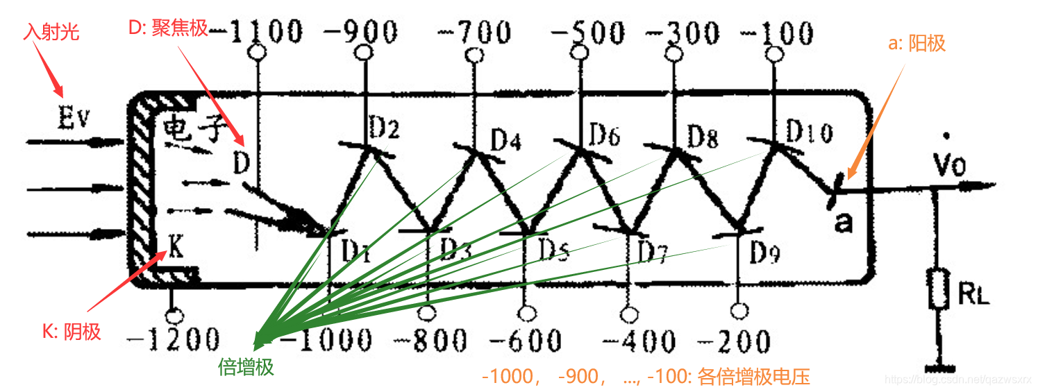
Motivation
My research was conducted inside the CD detector, and there are many PMTS inside and outside the CD detector.
The process of PMT response is that the cathode captures the photon and releases the electron, amplifies the signal step by step, and outputs the pulse signal. However, due to the influence of dark current, some PMTS can release electrons on their own, causing them to be triggered,and when the physical reaction inside the detector produces secondary particles that are captured by PMT light signals, PMT will also be triggered. The former is a dark noise case, and the latter is a physical case. Distinguishing the two cases plays an important role in the follow-up research.
The first corresponding time of PMT is called First hit time.

Slide 5
Background
Detection Principle:Cherenkov lights in water phase.
Generation of Cherenkov radiation: Cherenkov radiation occurs when charged particles moving in a medium at a rate exceeding the phase velocity of light in that medium interact with atoms or molecules in the medium, causing the electrons of the atoms or molecules to be polarized and subsequently releasing photons. The emission of these photons forms Cerenkov light.
Low energy.

Slide 6
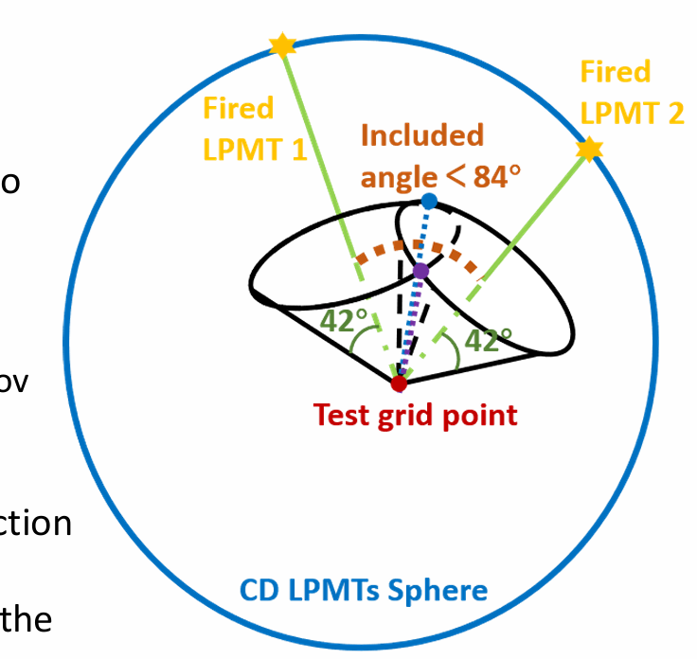
Research method and preliminary result
Research method:Circle hough transformation
We take the connection between the test grid point and fired PMT as the axis, and the Angle between the axis and the conical busbar is 42°(By calculation), forming a cone.
If the Angle between the two axes is less than 84°, two intersecting lines will be generated, and the direction information of the two intersecting lines will be saved to in hough space.

Slide 7
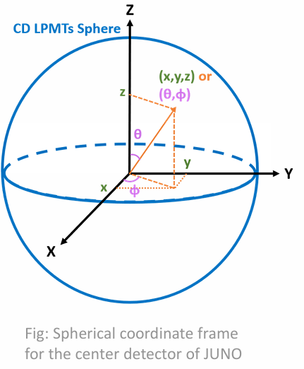
Research method and preliminary result

Slide 8
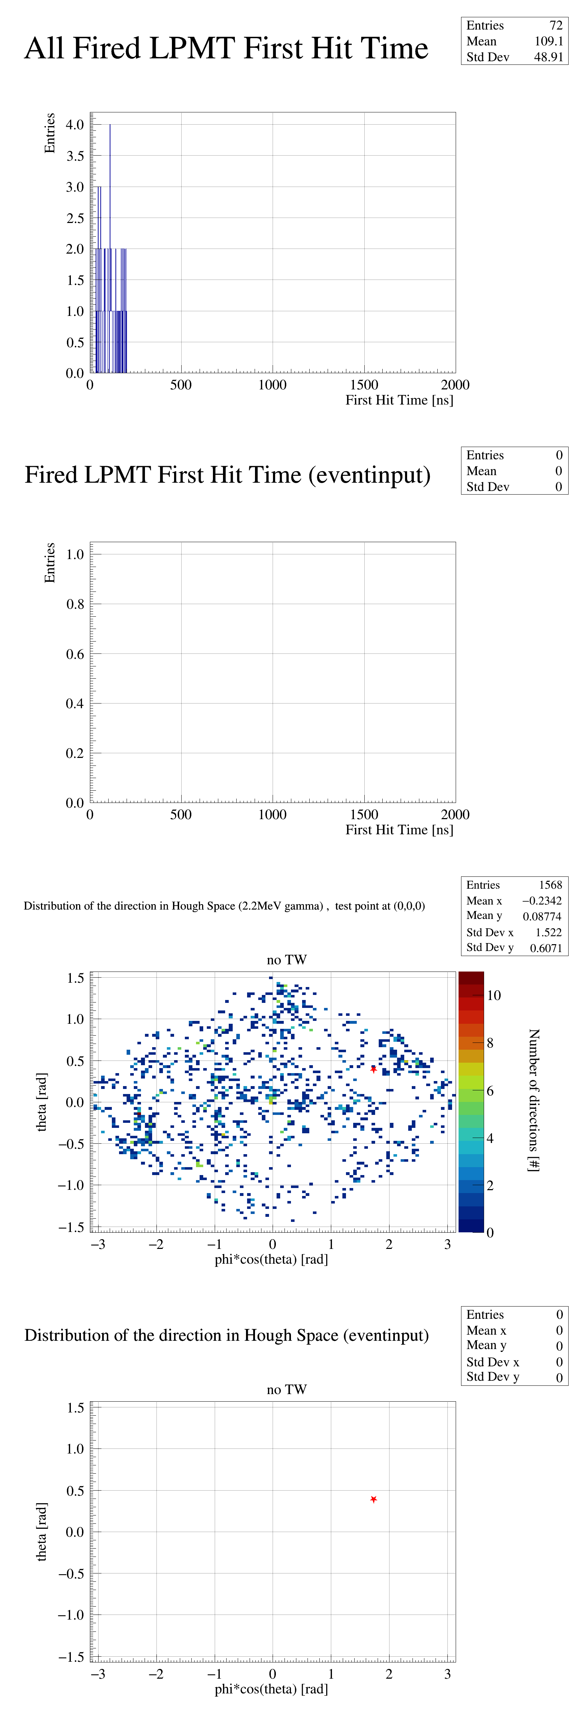
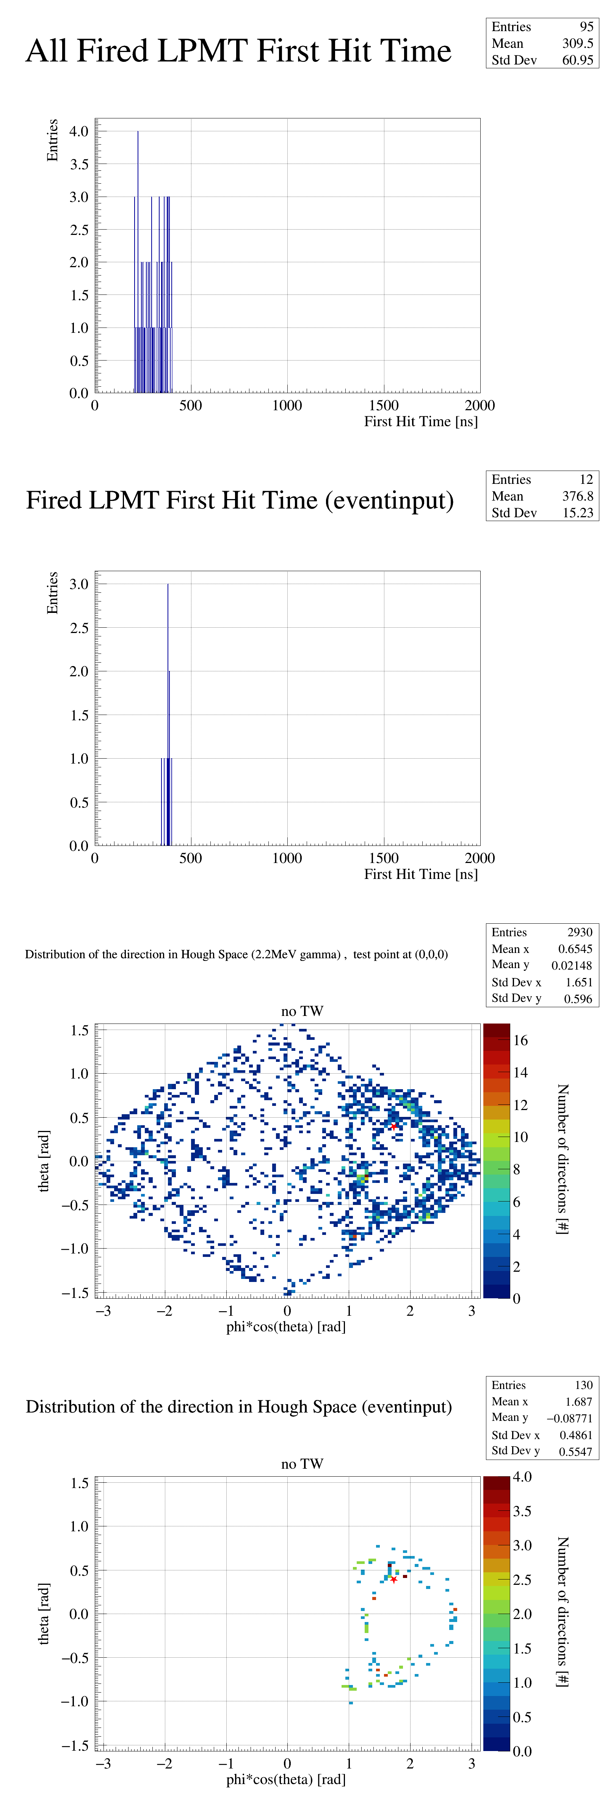
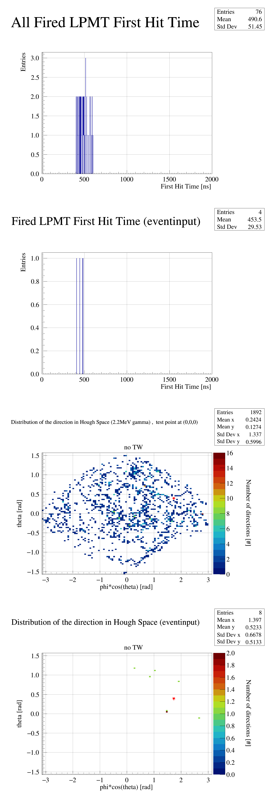
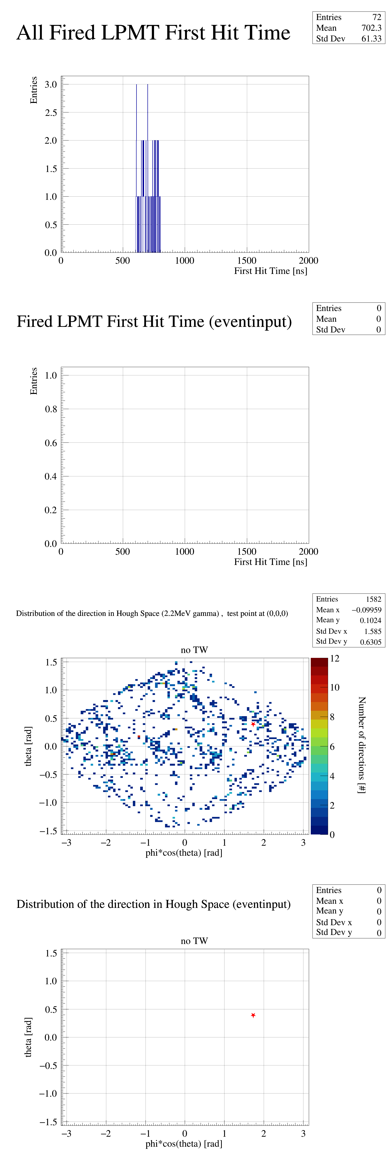
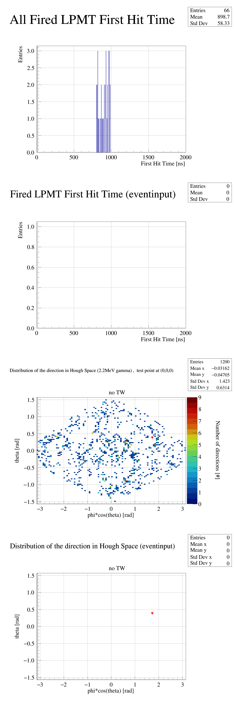
the time window as 200ns(Take a physic event )
No timewindow
Timewindow(0,200ns]
Timewindow(200,400ns]
Timewindow(400,600ns]
Timewindow(600,800ns]
Timewindow(800,1000ns]

Slide 9
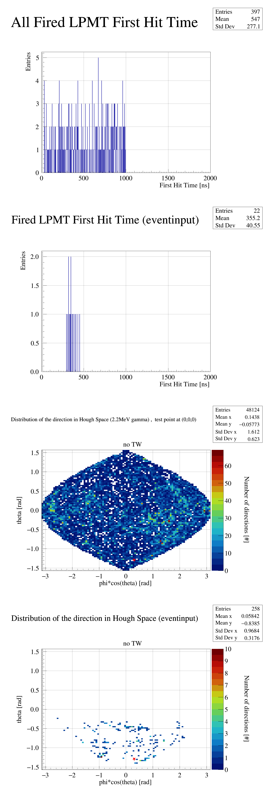
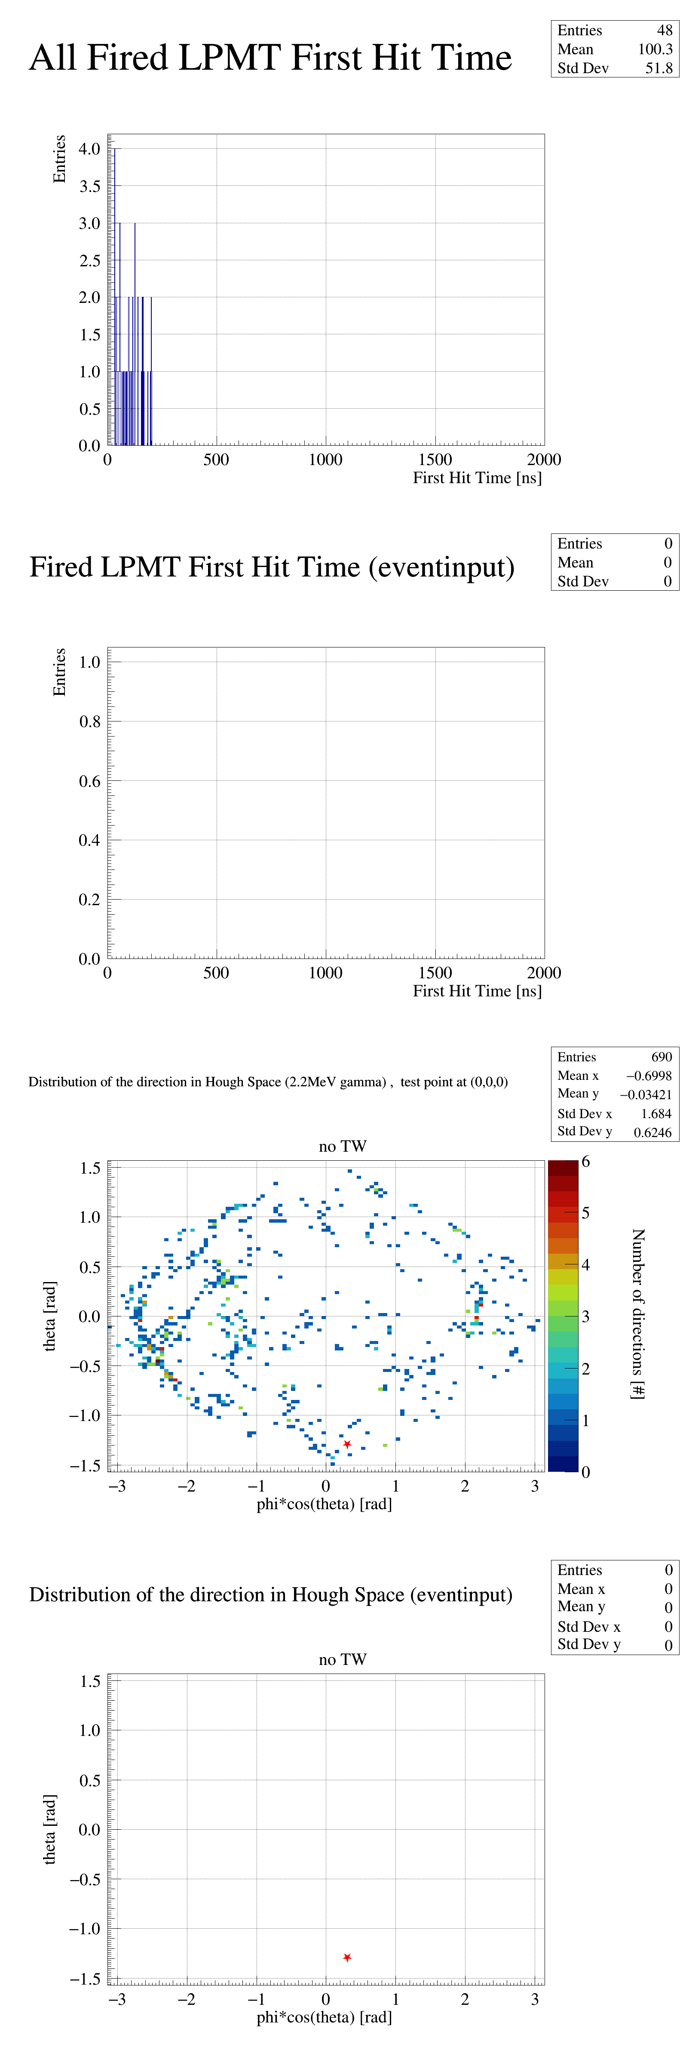
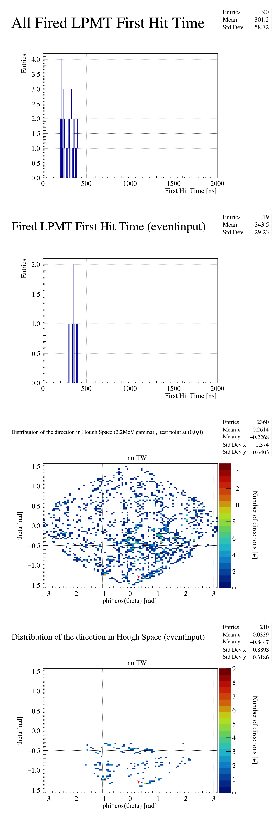
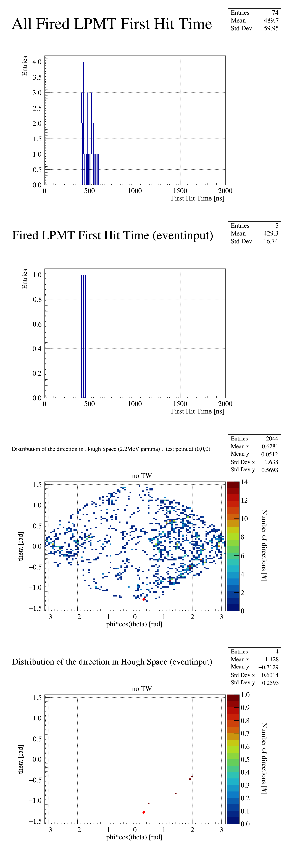
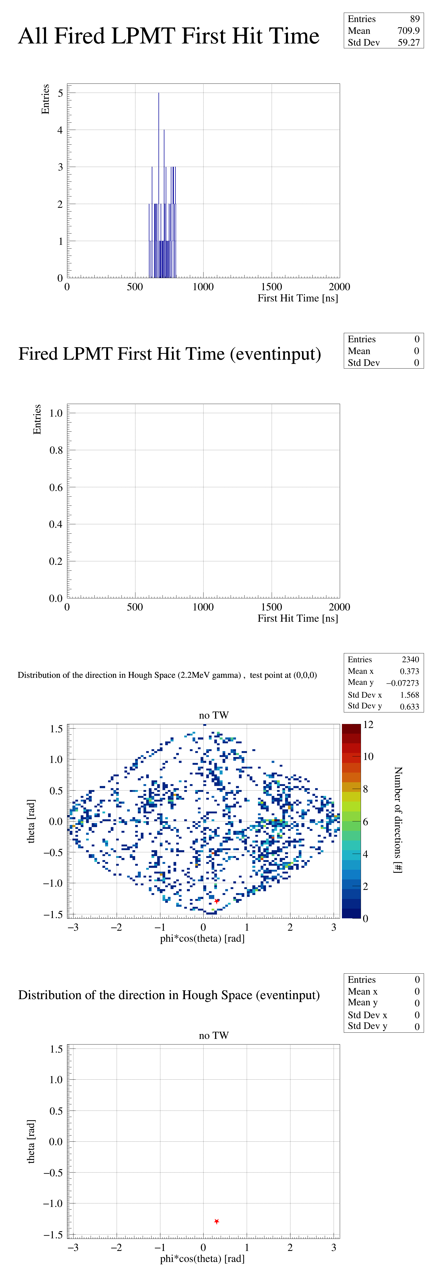
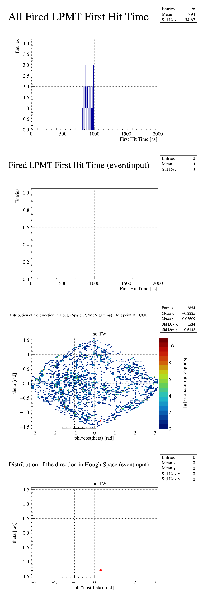
the time window as 200ns(Take one event as an example2)
No timewindow
Timewindow(0,200ns]
Timewindow(200,400ns]
Timewindow(400,600ns]
Timewindow(600,800ns]
Timewindow(800,1000ns]

Slide 10
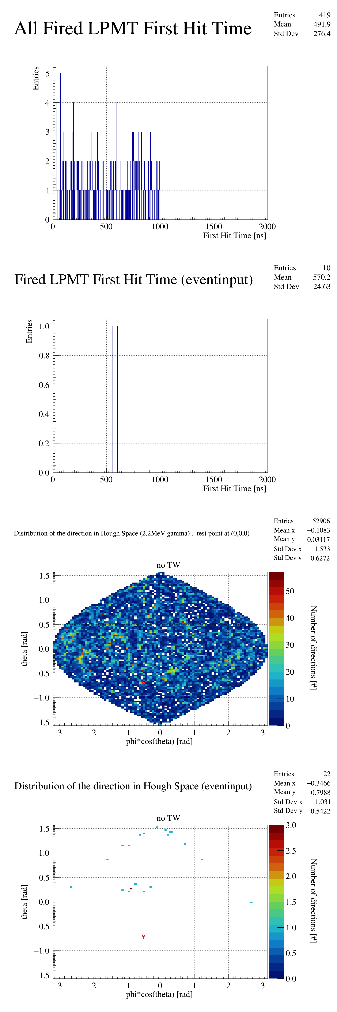
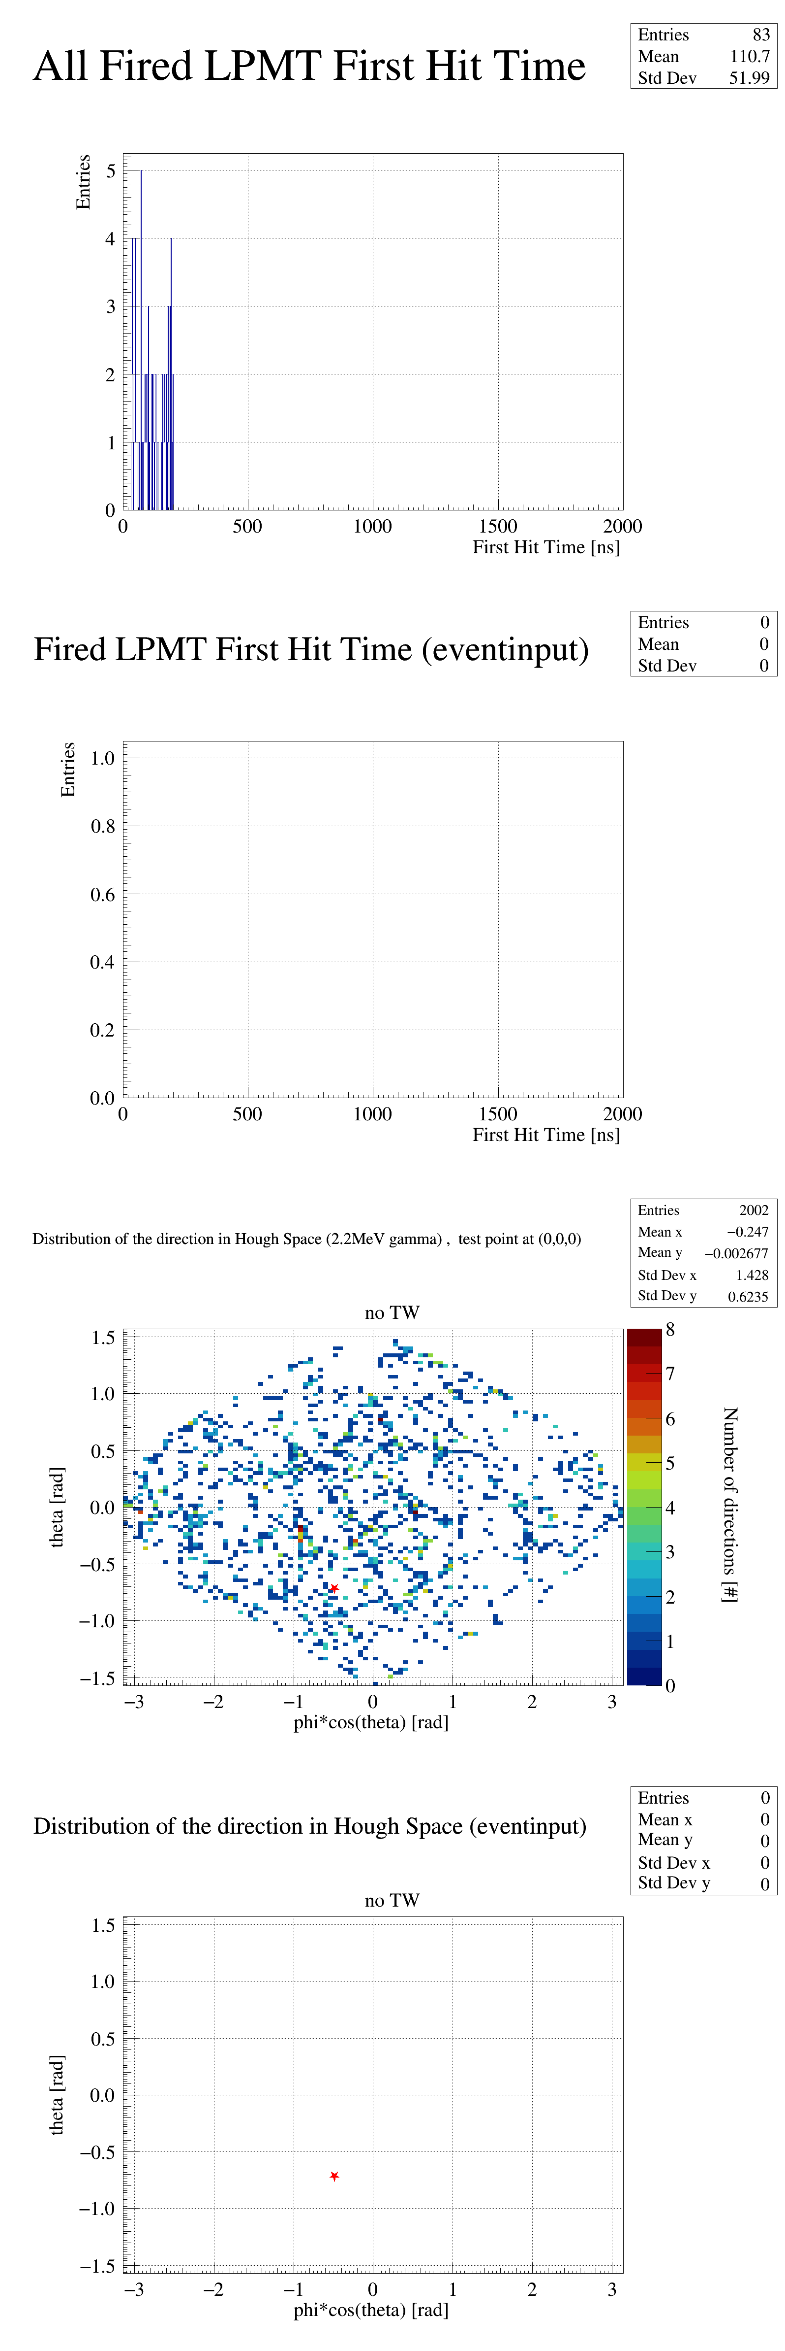
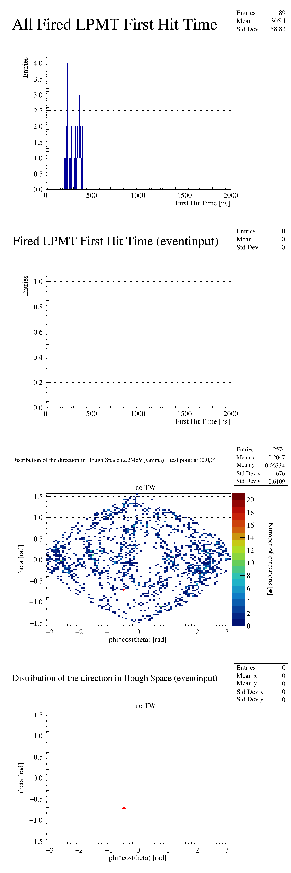
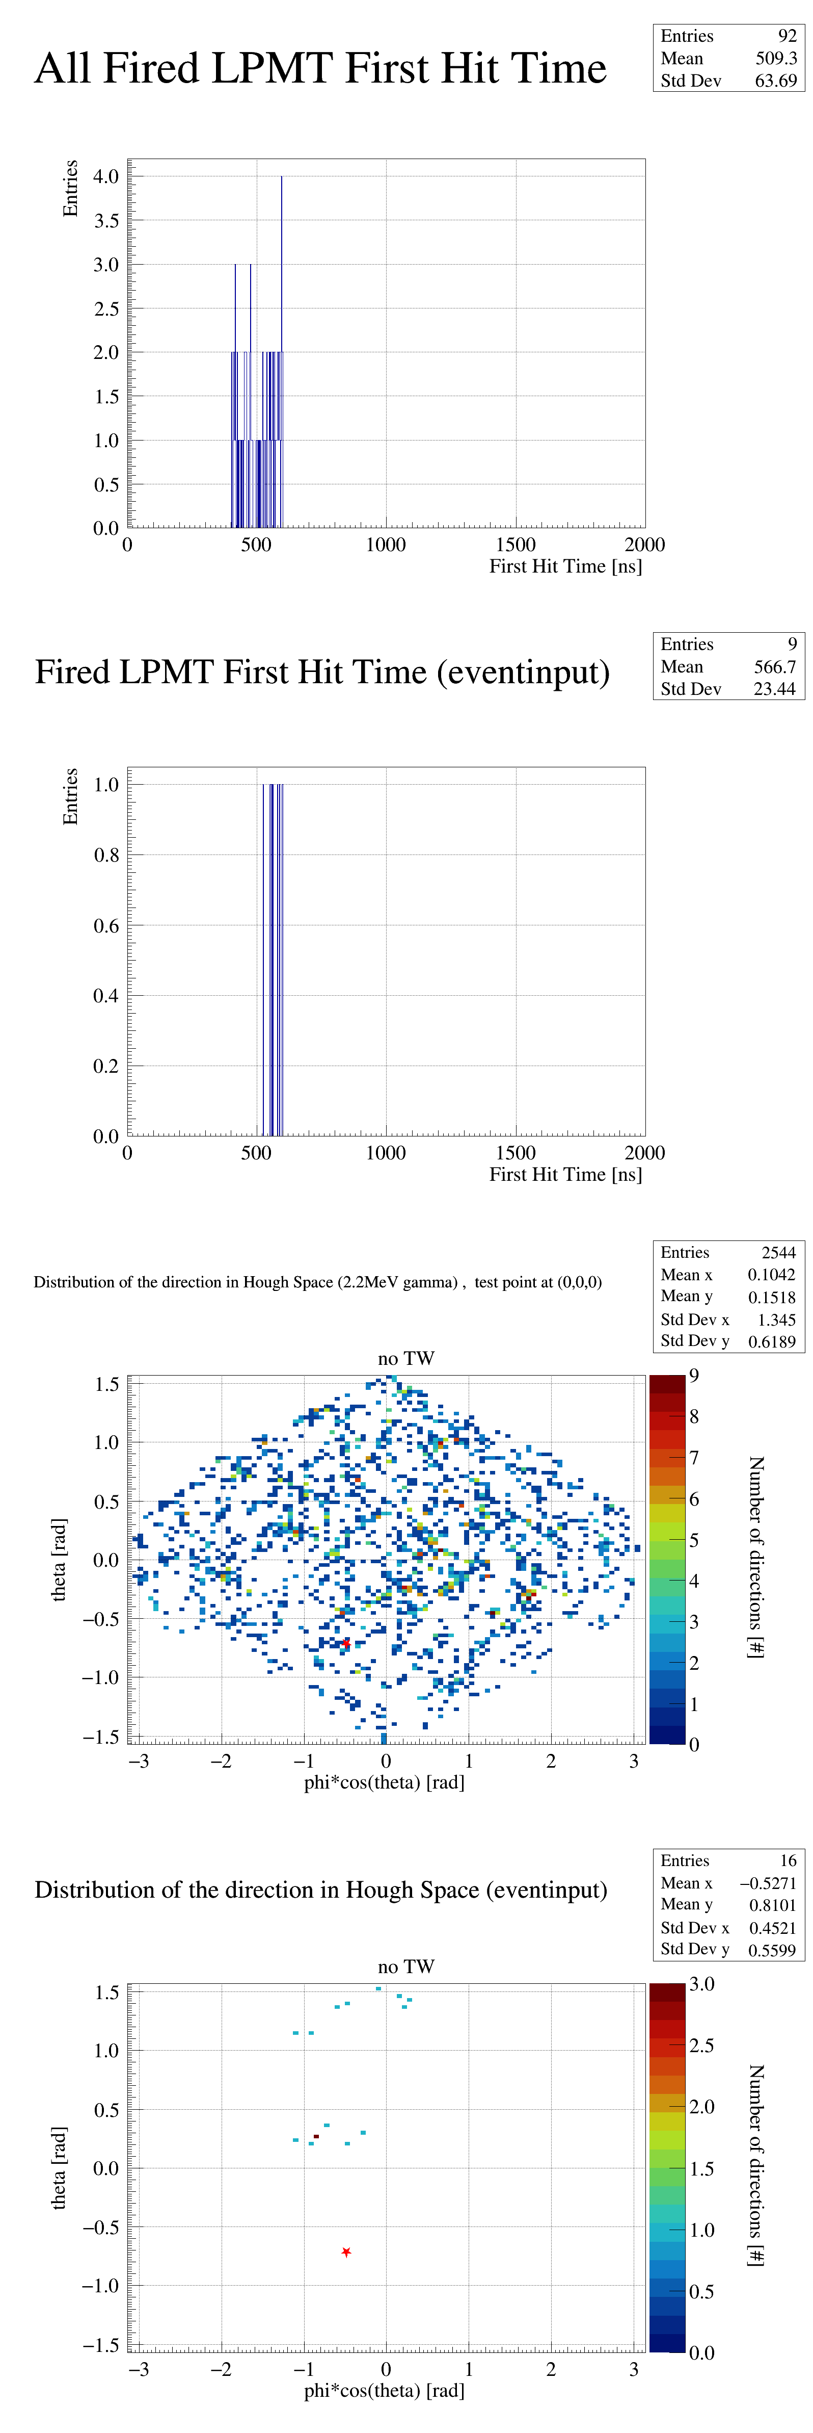
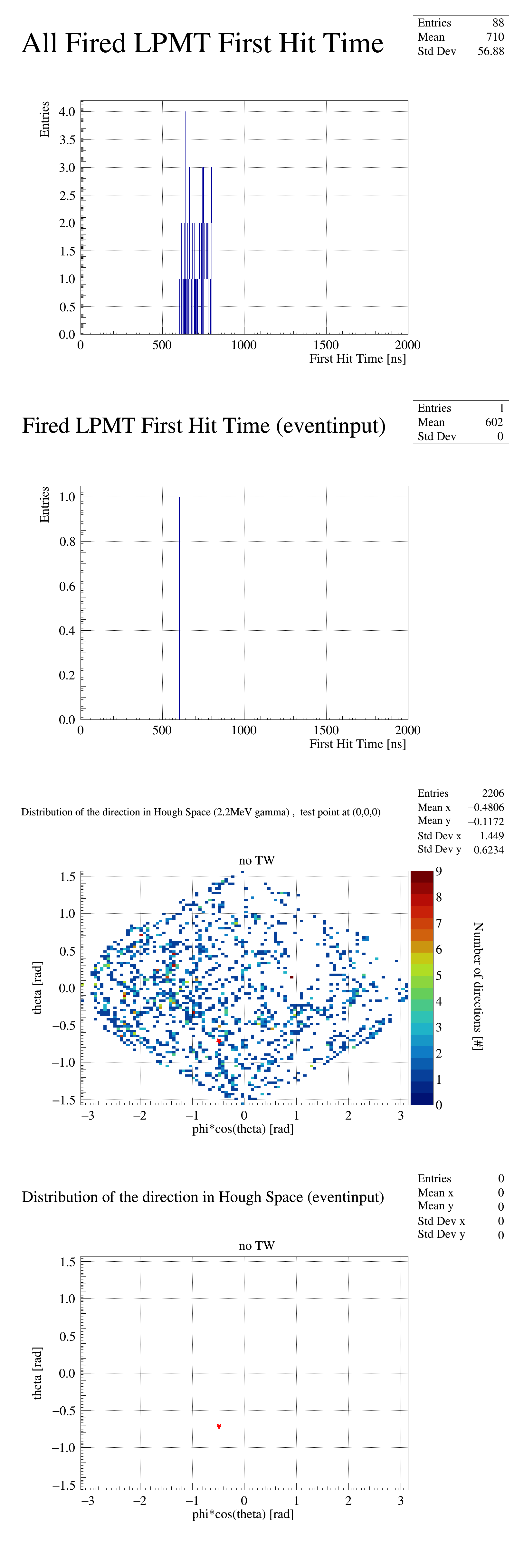
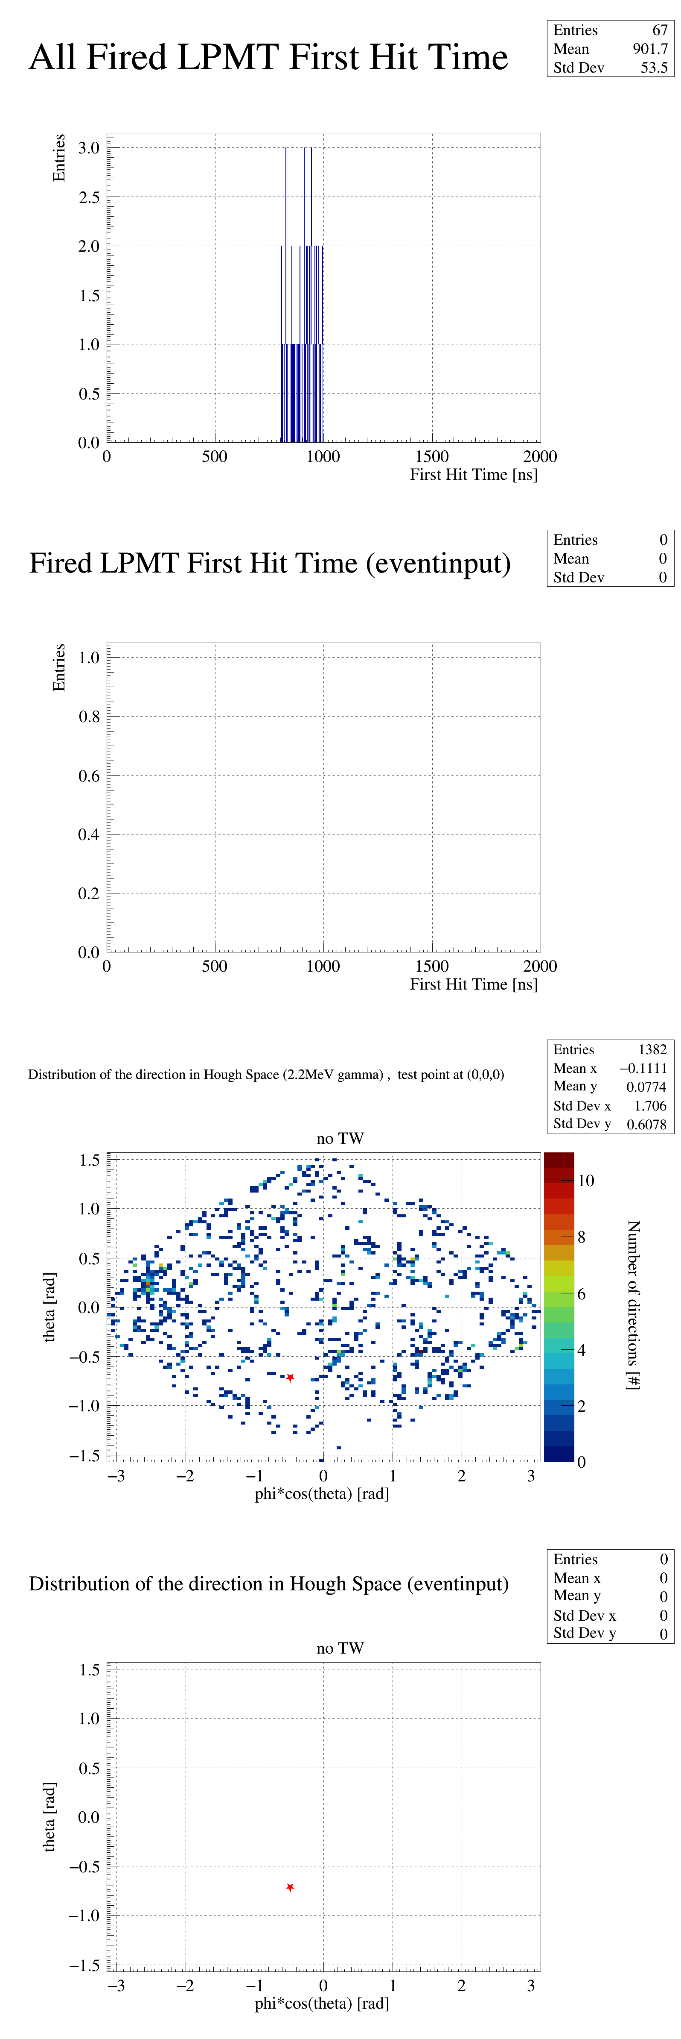
the time window as 200ns(Take one event as an example3)
No timewindow
Timewindow[0,200ns]
Timewindow[200,400ns]
Timewindow[400,600ns]
Timewindow[600,800ns]
Timewindow[800,1000ns]

Slide 11
Plan
Charge distribution
Cluster finding(two new method)

