Slide 1
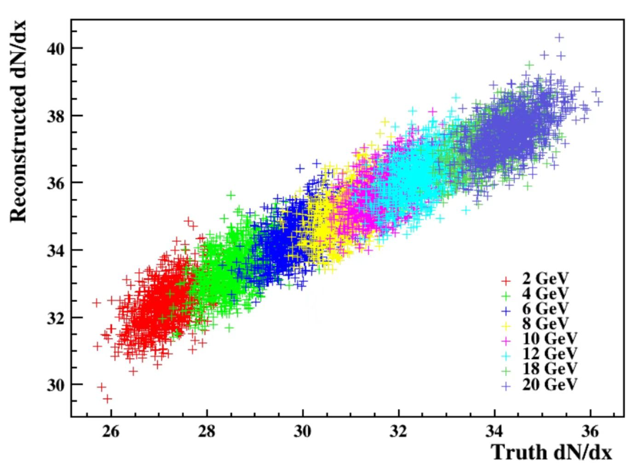
Variation of Truth and reconstructed dN/dx results with particle momentum.
The threshold algorithm exhibits strong stability for particles with different momenta.

Slide 2
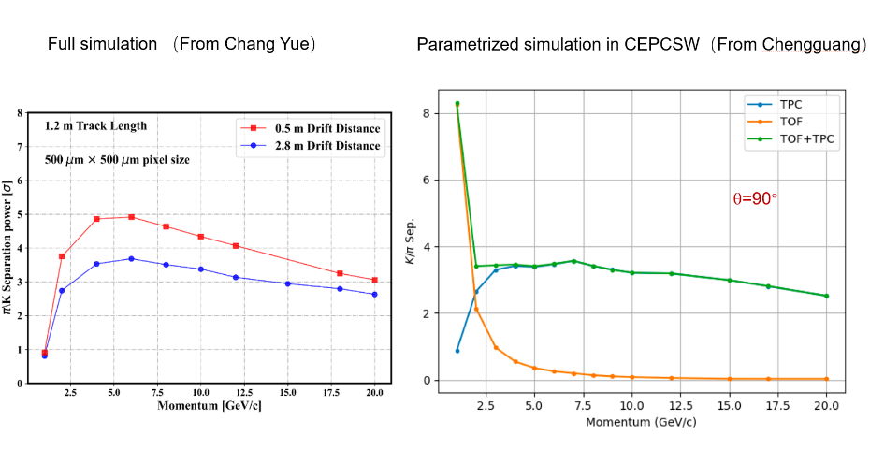
Simulation results based on Pixelated simulation framework and CEPCSW

Slide 3
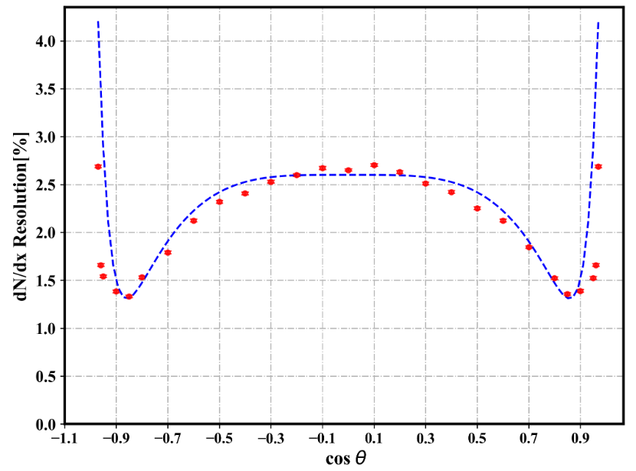
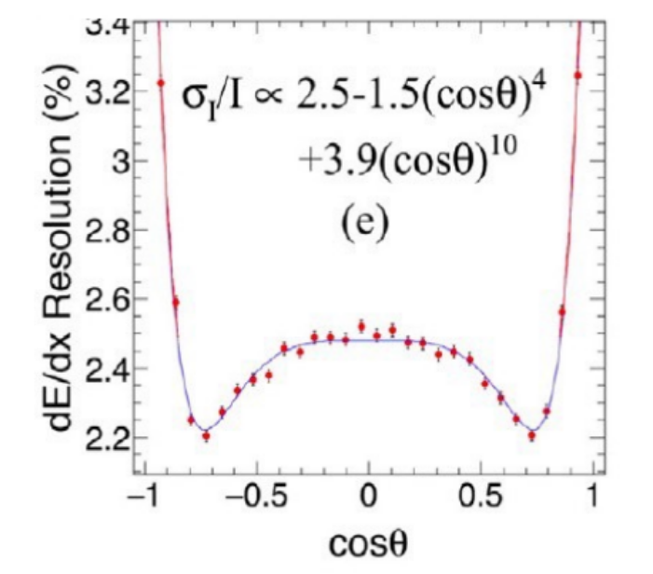
Simulation results based on Pixelated simulation framework and Manqi’s group

Slide 4
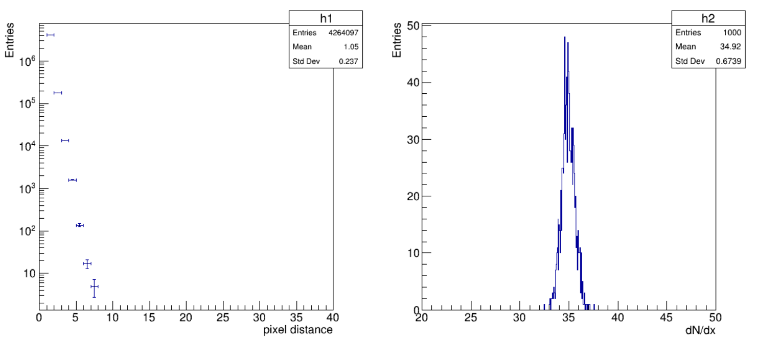
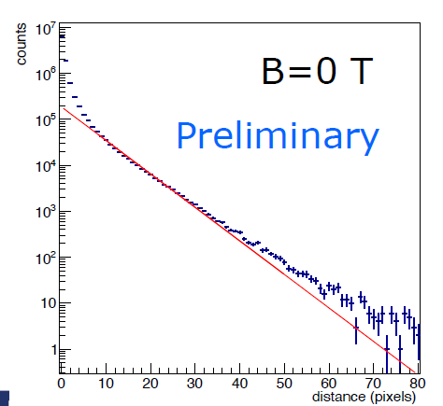

Slide 5
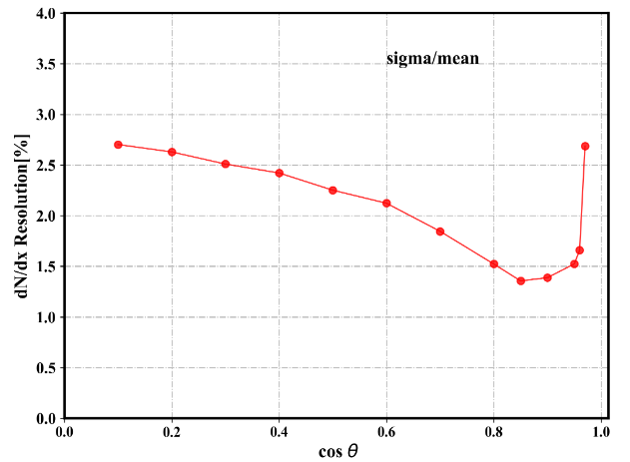
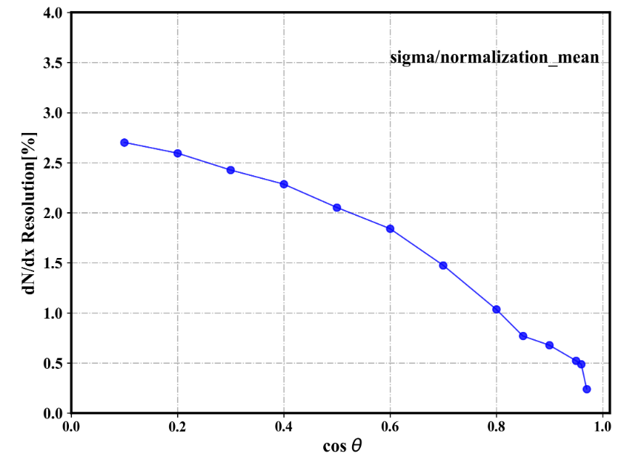

Slide 6
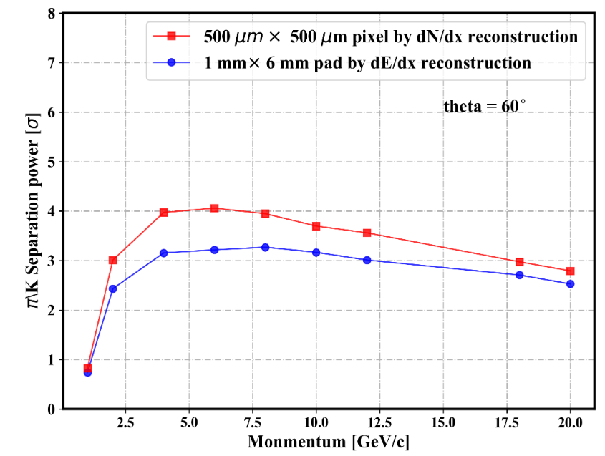
Some new results
Sp随动量的变化
分辨随cosθ的变化（sigma/mean）

Slide 7
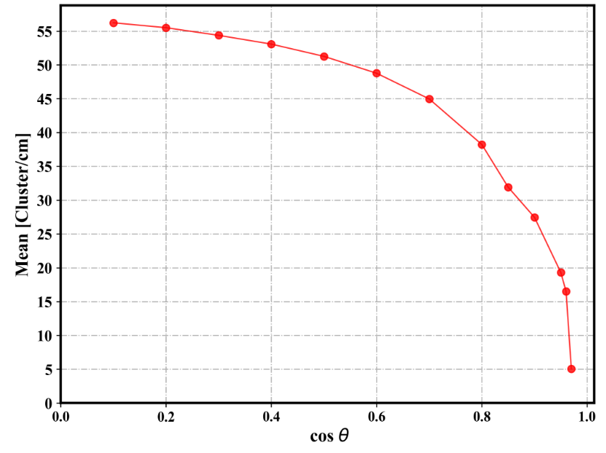
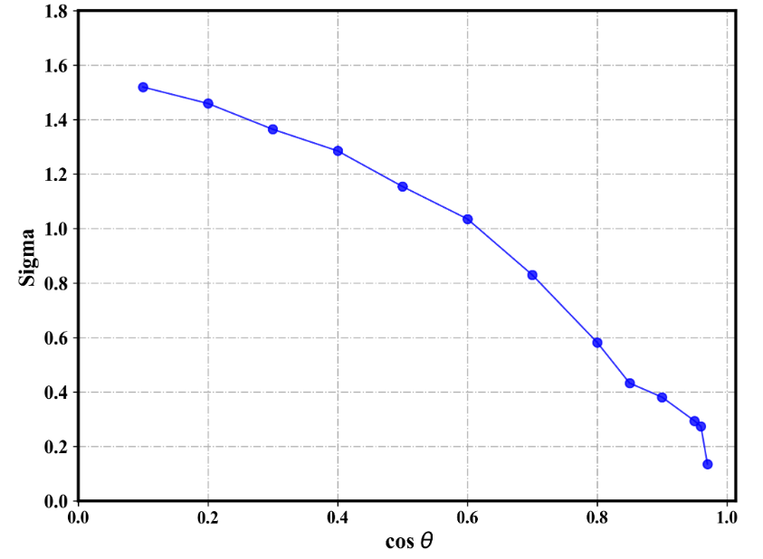
Mean , sigma 随cos theta的变化(根据径迹长度归一化)
Mean随cos theta的变化
Sigma 随cos theta的变化

Slide 8
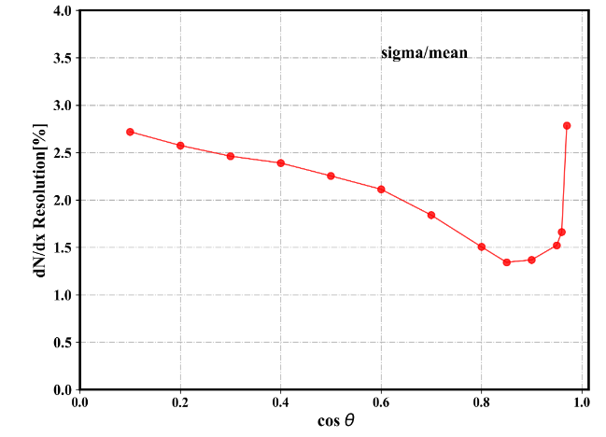
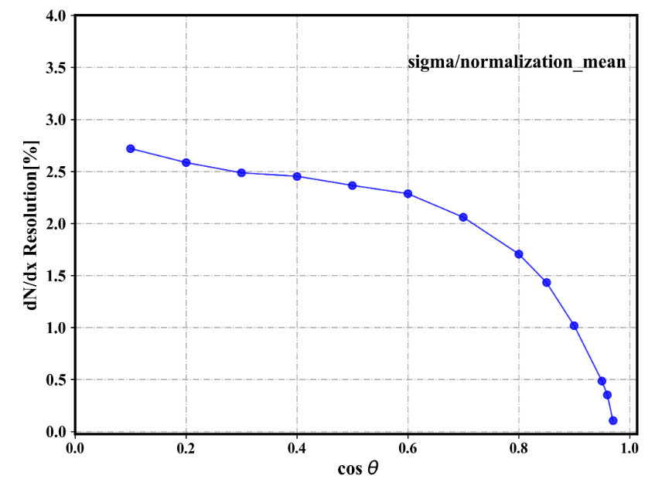
没有归一化的分辨

Slide 9
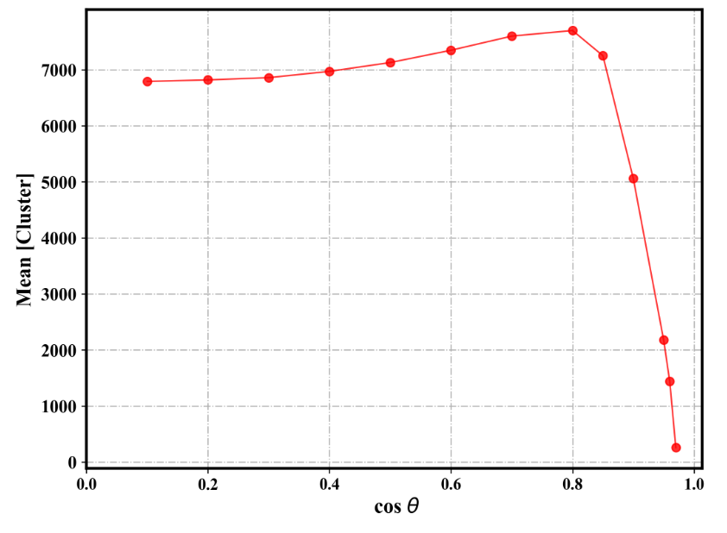
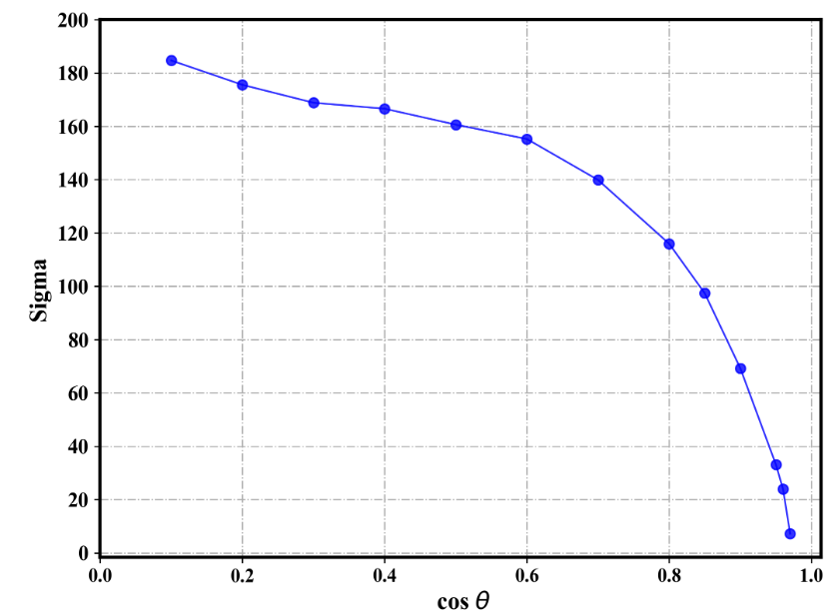
Mean , sigma 随cos theta的变化(没有归一化)

