Slide 1
MPT2321读出电子学
Ming-Kuan Yuan
Fudan University
2024.10.18
weekly report
yuanmk@mail2.sysu.edu.cn / cepc_muon_electronics · GitLab (ihep.ac.cn)
2024/10/18
mkyuan23@m.fudan.edu.cn
1

Slide 2
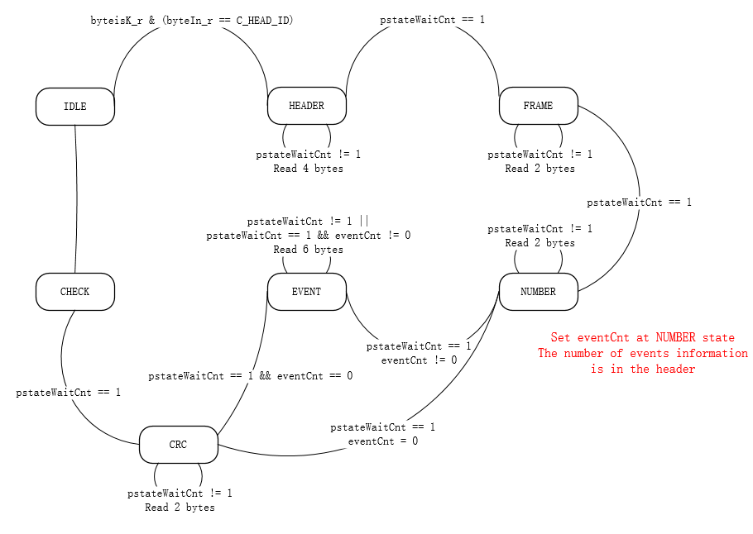
KLaus6 data decoder
10b to 8b decoder can be reused directly
deformat() module need to be changed
Some information on the header of data packet
The event data is 6 bytes
16-CRC

Slide 3
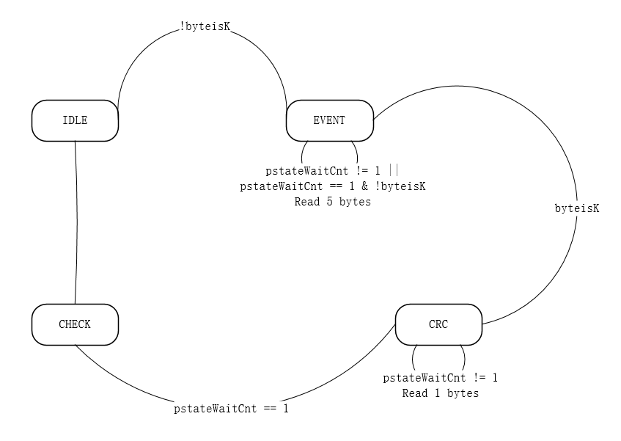
MPT2321 data decoder
10b to 8b decoder can be reused directly
deformat() module need to be changed
No information on the header of data packet
The event data is 5 bytes
8-CRC

Slide 4
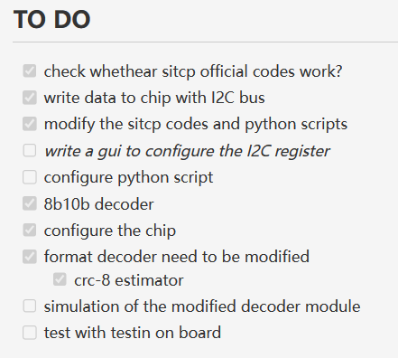
TO DO

