Slide 1
Study of $γγ→γψ(2S)$ at BelleII
2024.10.18

Slide 2
Data sample and MC simulation
MC simulation:
Signal MC
using TREPS, M=3.922GeV/$c^{2}$,$J^{PC}=2^{++}.$
Decay chain: $χ_{c_{2}}\left(3930\right)→γψ\left(2S\right),$ $ψ\left(2S\right)→π^{−}π^{+}J/ψ$, $J/ψ→π^{−}π^{+}$or $μ^{−}μ^{+}$.
Number: $5×{10}^{5}$.
ISR event
officially produced. (it is main background.)
Decay chain: $e^{−}e^{+}→nγ_{ISR}+ψ\left(2S\right)$.
Number: $1×{10}^{6}$.

Slide 3
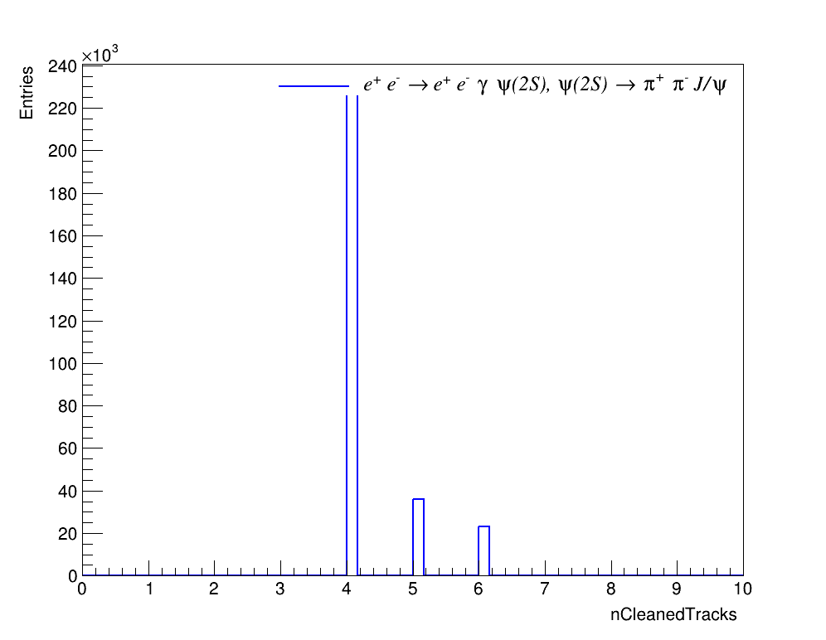
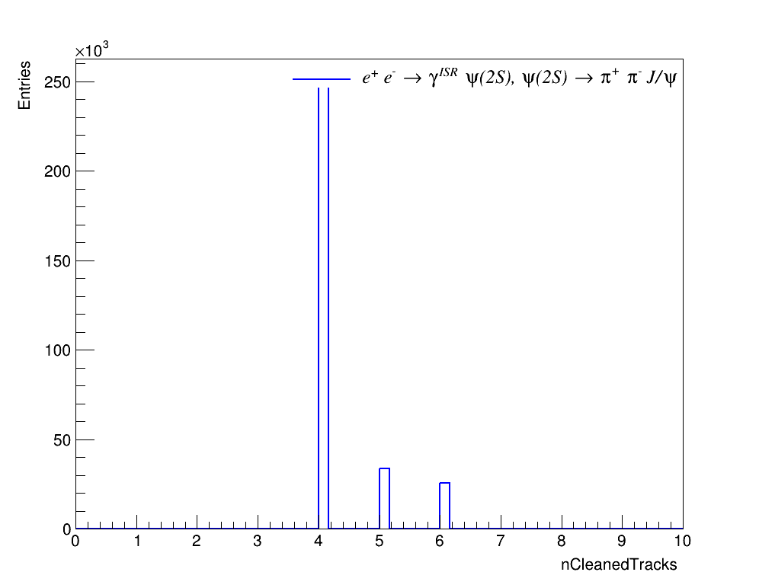
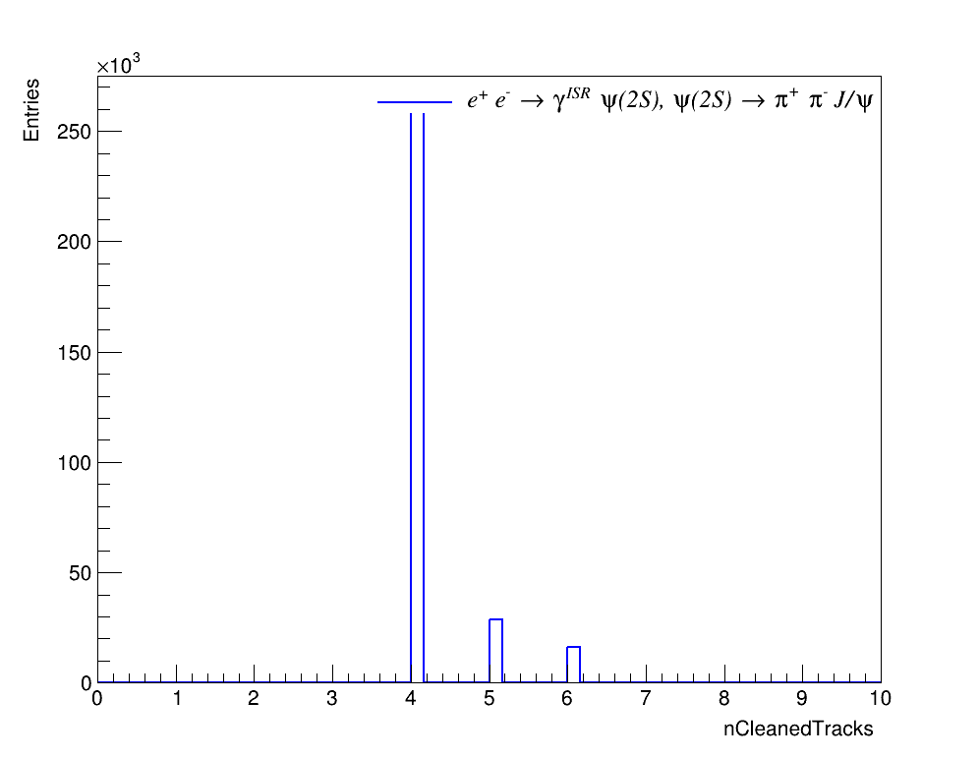
Number of charged tracks
Signal
ee_mode
ISR background
ee_mode
Signal
mm_mode
ISR background
mm_mode
$N_{track}<5$ is required.

Slide 4
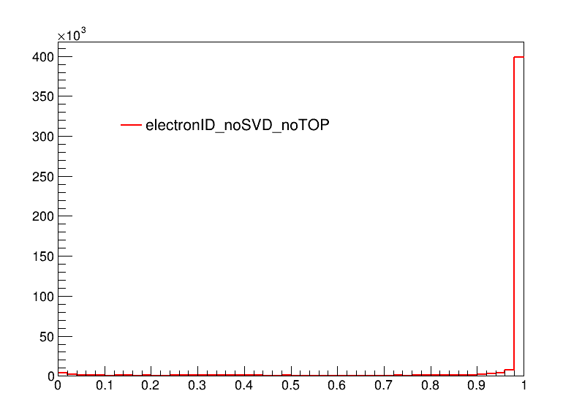
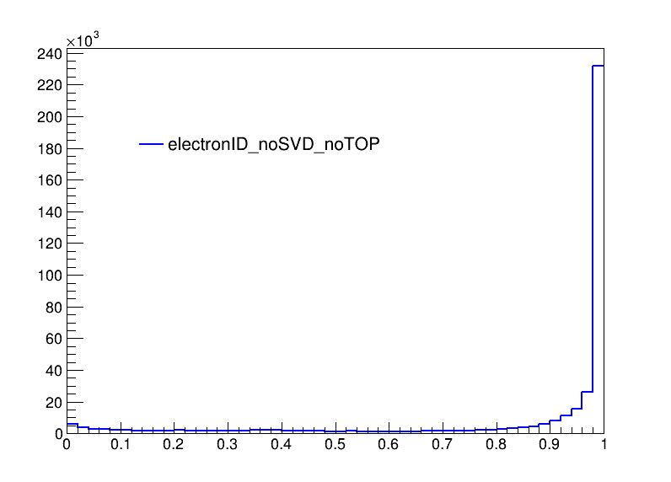
Particle Identification-electronID
Require one electron candidate to have eID_noSVD_noTOP > 0.9 to study another electron candidate.
Both electron candidates are required to have eID_noSVD_noTOP > 0.1.
Signal
ISR background

Slide 5
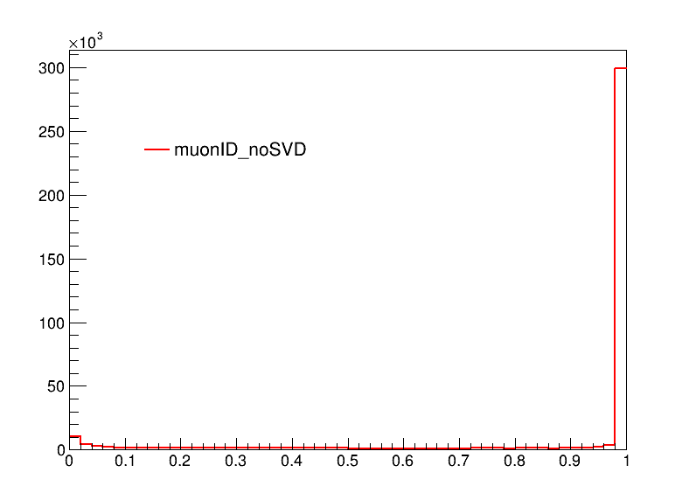
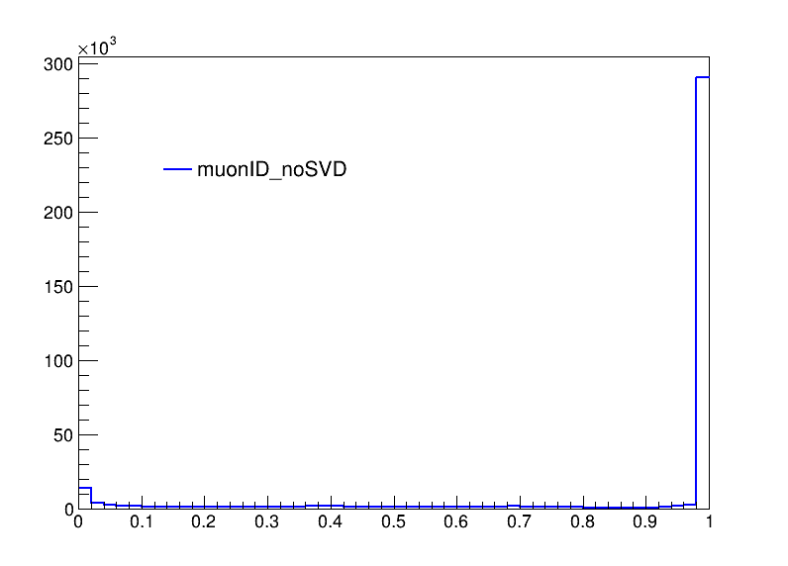
Particle Identification-muonID
Require one muon candidate to have muonID_noSVD > 0.9 to study another muon candidate.
Muon could have $L\left(μ\right)=0$.
One of muon candidate should have $L\left(μ\right)>0.1$.
Signal
ISR background

Slide 6
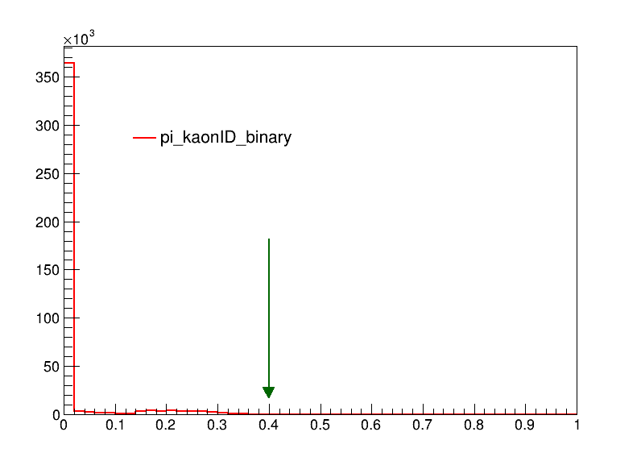
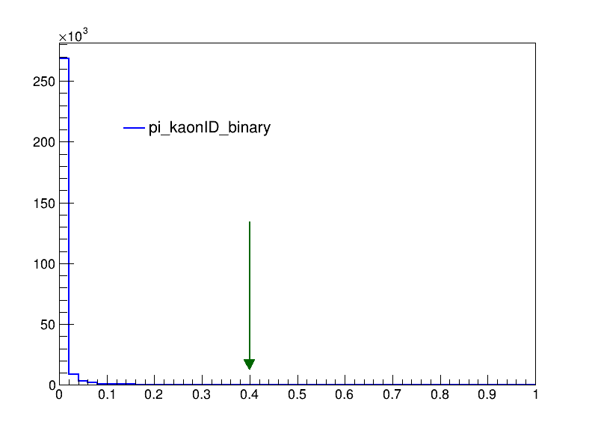
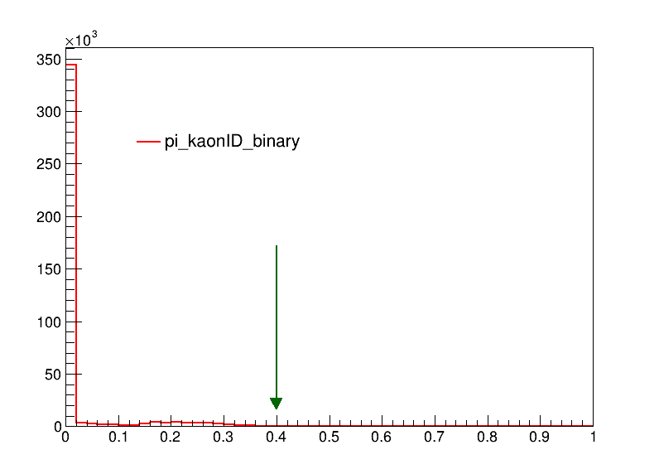
Particle Identification-kaonID
Signal
ee_mode
ISR background
ee_mode
Signal
mm_mode
ISR background
mm_mode
$KaonID_{binay}<0.4$ is required.

Slide 7
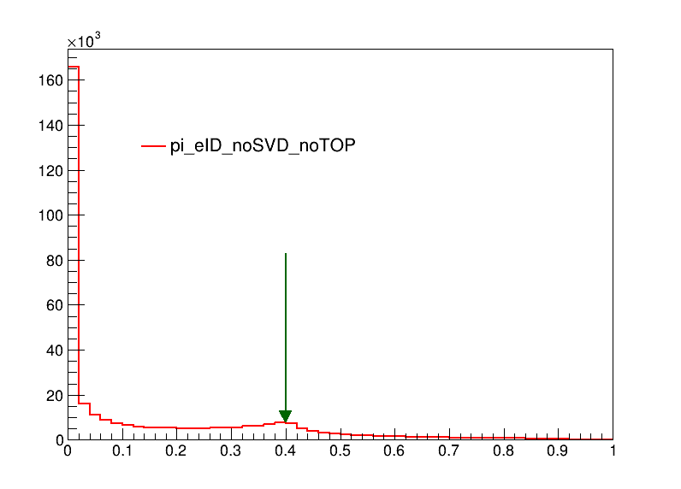
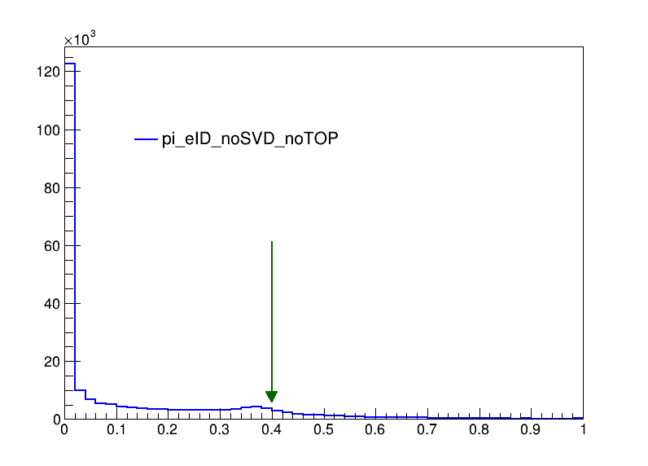
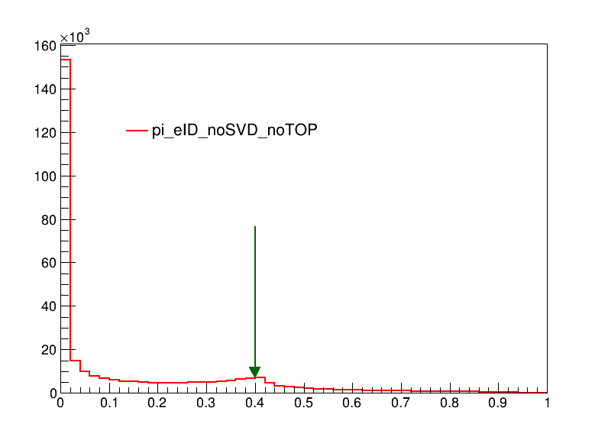
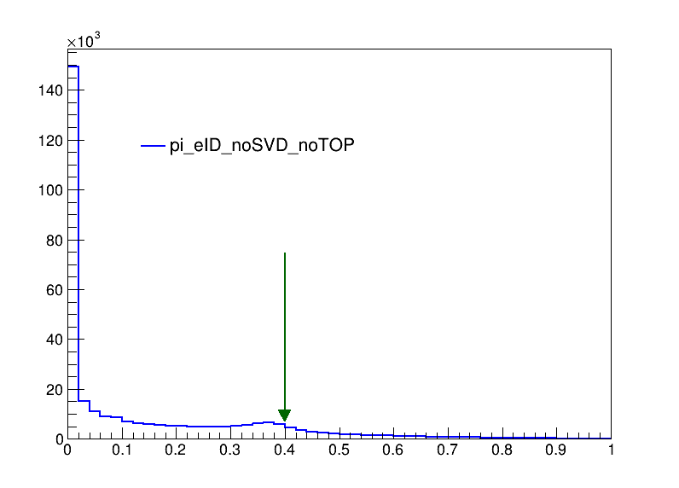
Particle Identification-electronID
Signal
ee_mode
ISR background
ee_mode
Signal
mm_mode
ISR background
mm_mode
$L(e)<0.9$ to remove $γ$-conversion background.

Slide 8
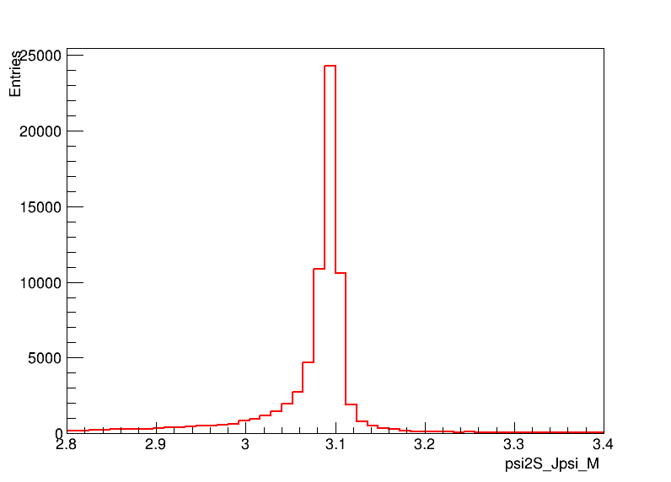
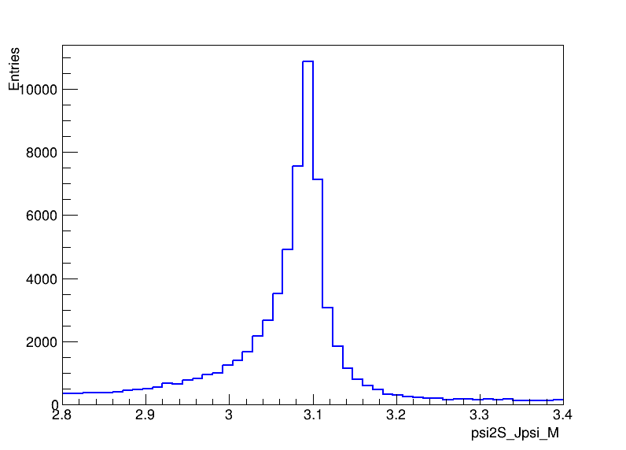
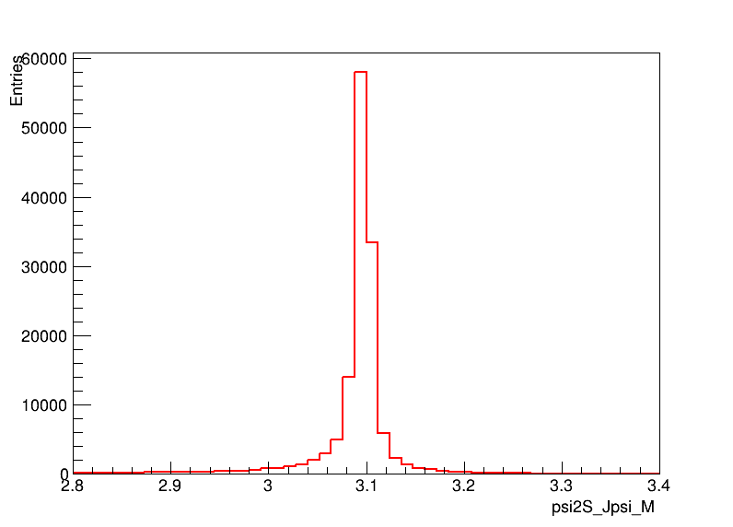
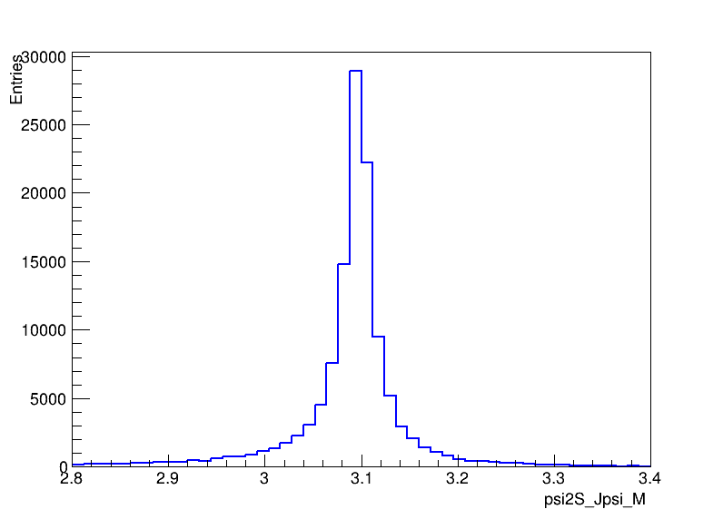
$J/ψ$ $signals$
Signal
ee_mode
ISR background
ee_mode
Signal
mm_mode
ISR background
mm_mode
$R=\frac{N_{e^{+}e^{−}}^{obs}}{N_{μ^{+}μ^{−}}^{obs}}=0.610 \left( signal \right),0.615 \left( ISR background \right).$

Slide 9
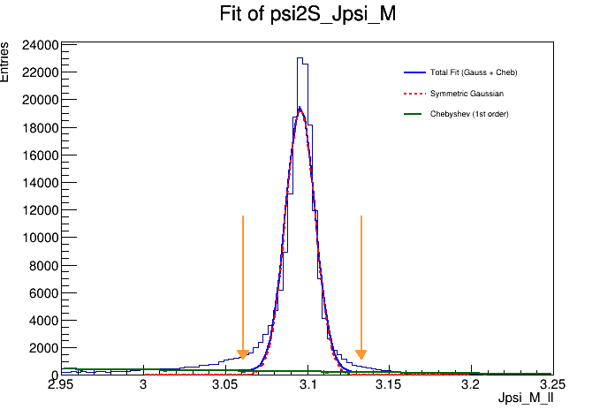
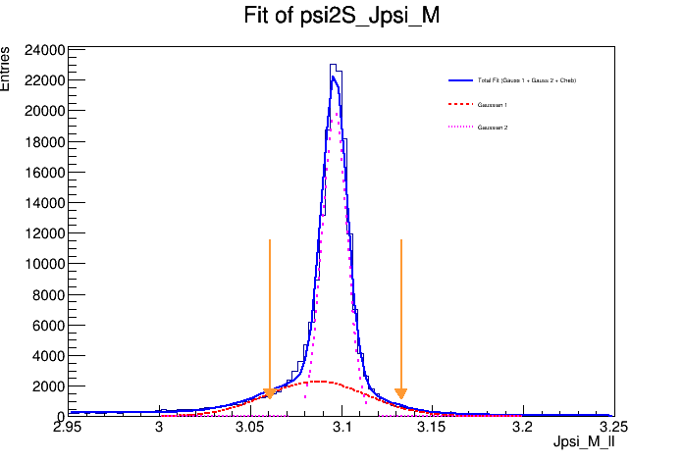
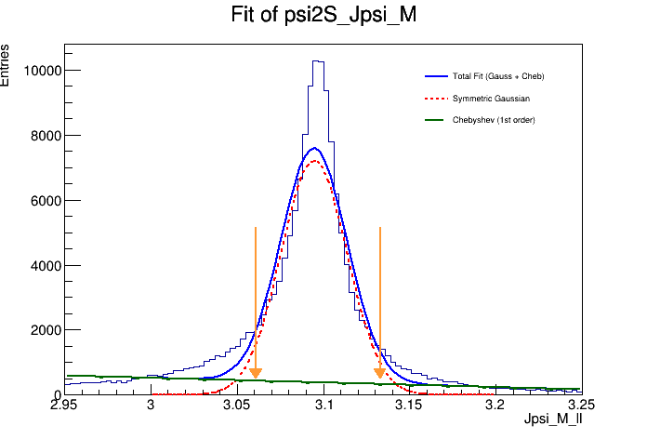
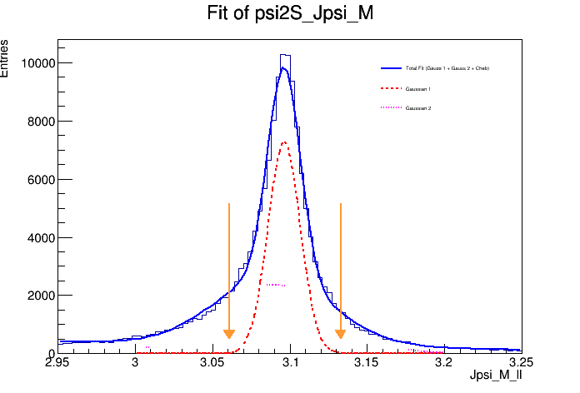
$$Fit to J/ψ signals$$
Signal(ee+mm)
fit gauss + poly
$$σ≈9MeV$$
Signal(ee+mm)
Fit 2gauss + poly
$$σ≈9MeV$$
ISR(ee+mm)
fit gauss + poly
ISR(ee+mm)
Fit 2gauss + poly
$J/ψ$ signal mass window is defined as $\left|M_{l^{+}l^{−}}−m_{J/ψ}\right|<4σ$,here we take $σ$ = 9 MeV.

Slide 10
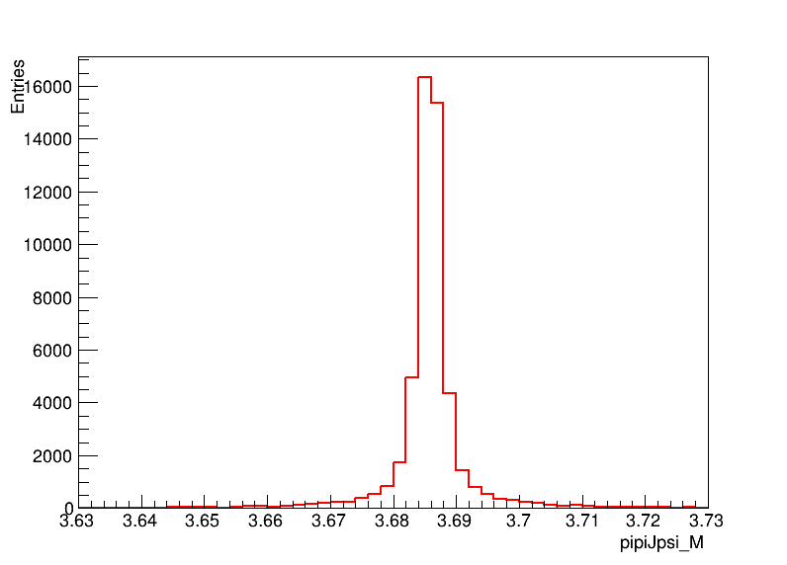
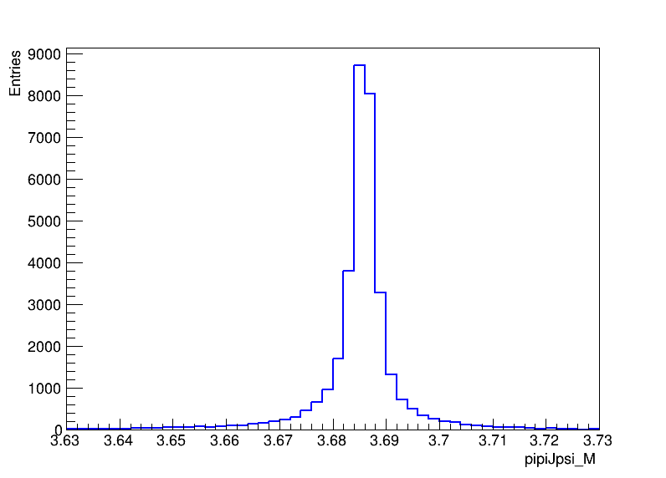
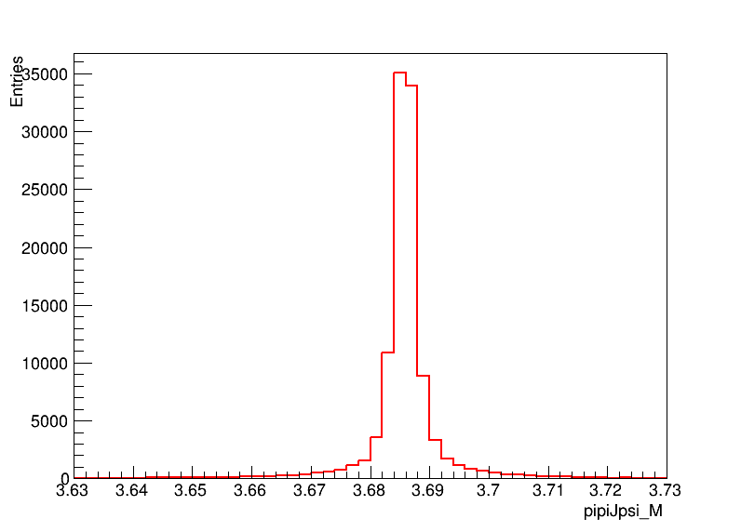
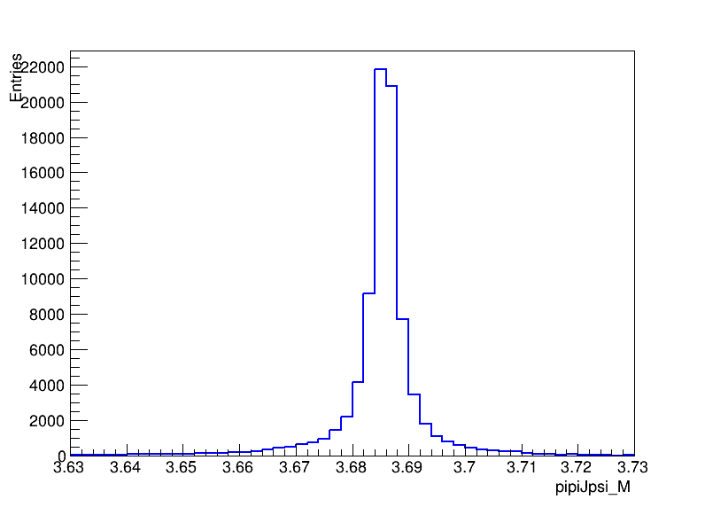
$ψ(2S)$ $signals$
Signal
ee_mode
ISR background
ee_mode
Signal
mm_mode
ISR background
mm_mode
$M_{π^{+}π^{−}J/ψ}$ is defined as $M_{π^{+}π^{−}J/ψ}=M_{π^{+}π^{−}l^{+}l^{−}}−M_{l^{+}l^{−}}+m_{J/ψ}$

Slide 11
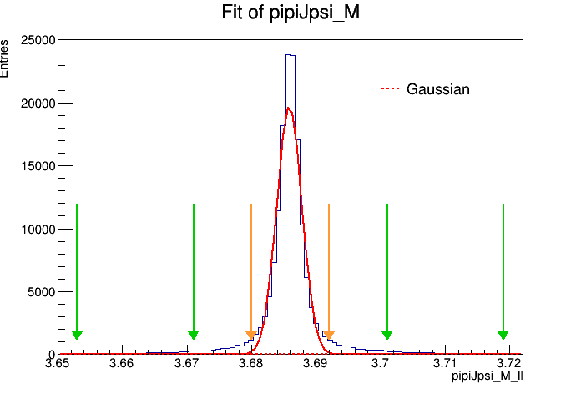
$$Fit to ψ(2S) signals$$
Signal(ee+mm)
$$σ≈（1.94±0.01）MeV$$
ISR(ee+mm)
$$σ≈（2.81±0.01）MeV$$
$M_{π^{+}π^{−}J/ψ}$ is defined as $M_{π^{+}π^{−}J/ψ}=M_{π^{+}π^{−}l^{+}l^{−}}−M_{l^{+}l^{−}}+m_{J/ψ}$.
Signal region: $\left|M_{π^{+}π^{−}J/ψ}−m_{ψ\left(2S\right)}\right|<3σ$,here we take $σ$= 2 MeV.
Sideband region: $\left|M_{π^{+}π^{−}J/ψ}−m_{ψ\left(2S\right)}±12σ\right|<4.5σ$.

Slide 12
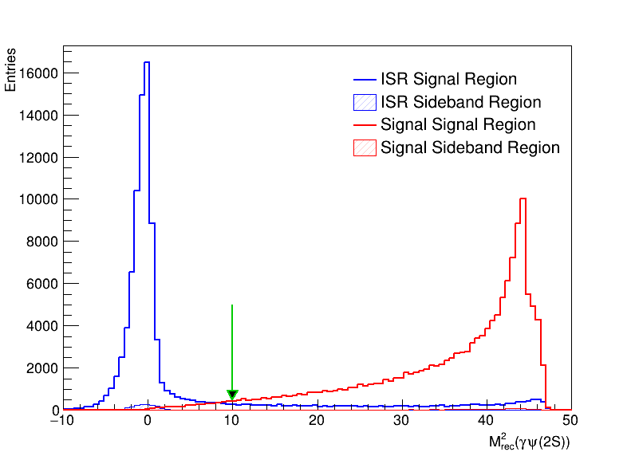
Recoil of $γψ(2S)$
$M_{rec}^{2}\left(γψ\left(2S\right)\right)>10(GeV/c^{2})$ is required to suppress ISR back grounds.

Slide 13
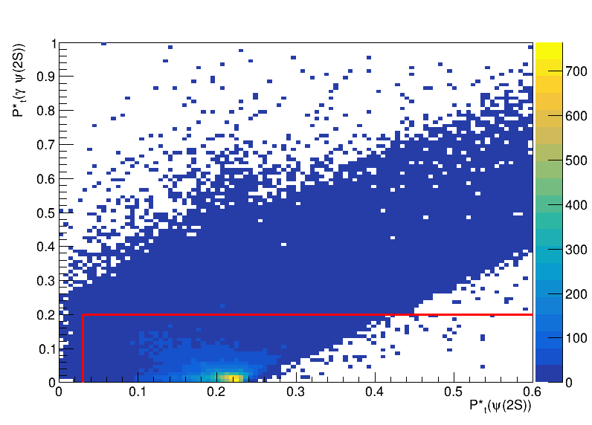
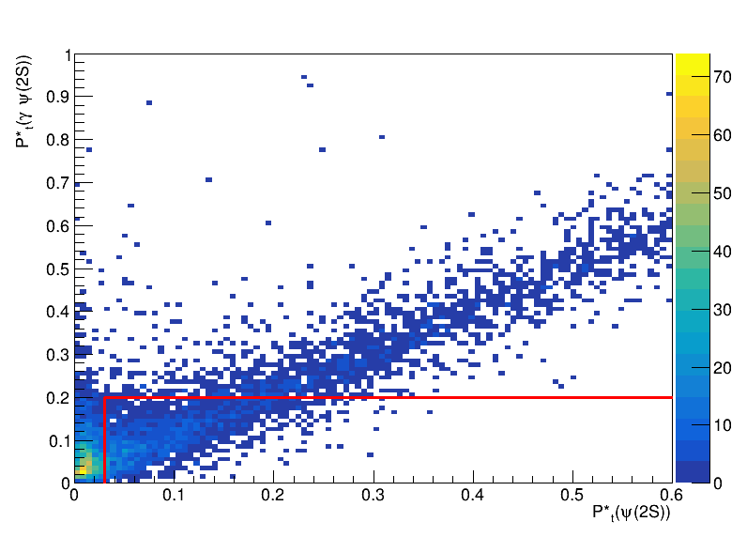
Study on transverse momenta
Signal(ee+mm)
ISR background(ee+mm)
The scatter plot is $P_{t}^{∗}(ψ(2S))$ vs $P_{t}^{∗}(γψ(2S))$.
The region enclosed by the red line is the transverse momenta selection criteria in Belle analysis work.

Slide 14
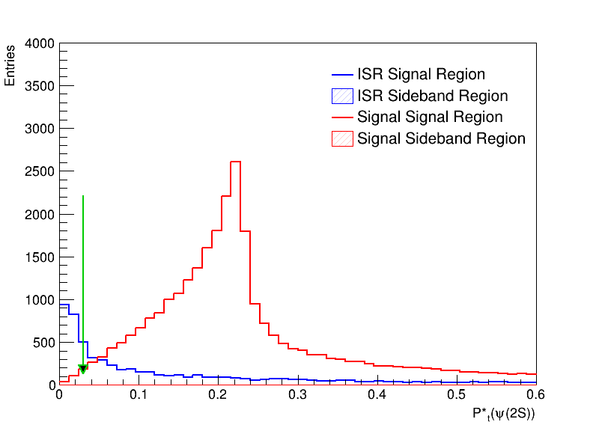
$P_{t}\left(π^{+}π^{−}l^{+}l^{−}\right)$distribution

Slide 15
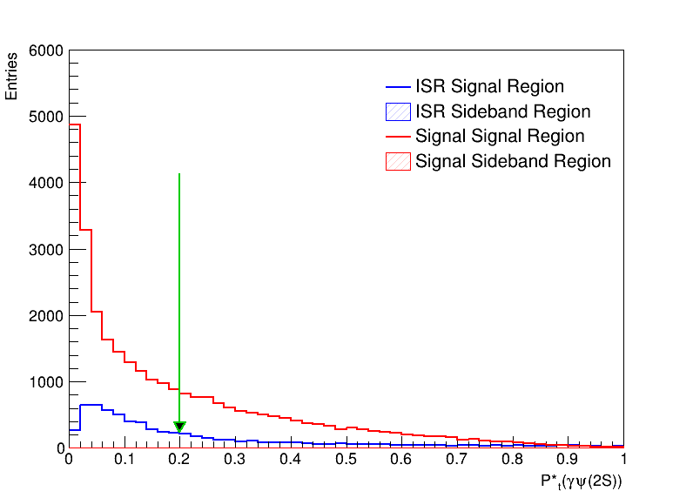
$P_{t}\left(γψ(2S)\right)$distribution

Slide 16
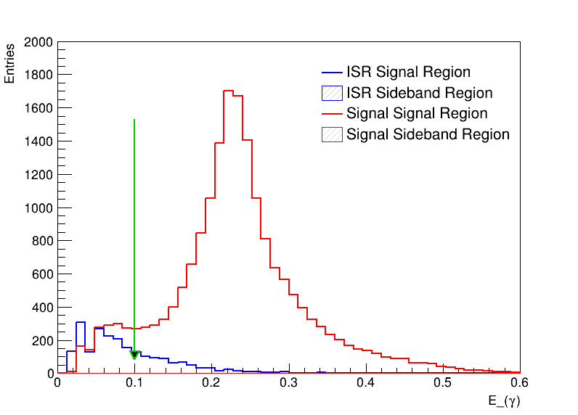
Energy of $γ$

Slide 17
$M_{γψ(2S)}$ from signal MC simulation

