Slide 1
GW from Metastable Cosmic String in Delayed Scaling Scenario
—— A Cosmological Perspective
Based on ArXiv: 2501.18380 Yifan Hu, Kohei Kamada
Speaker: Yifan Hu
21/4/2025

Slide 2
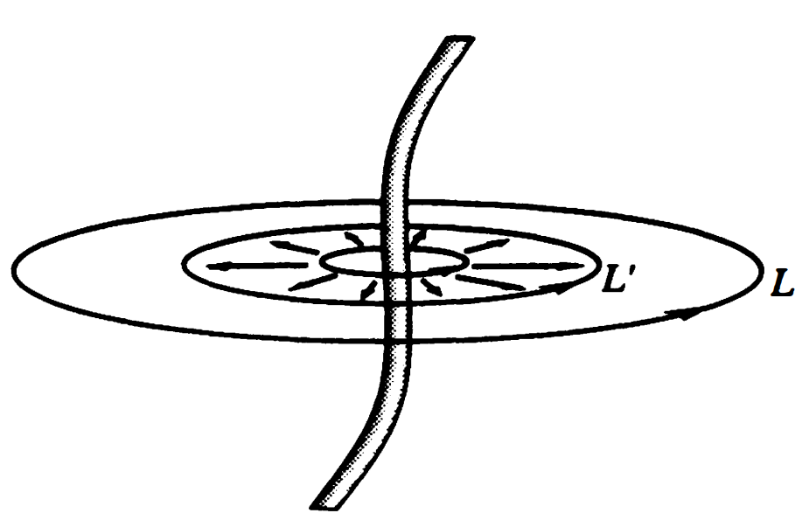
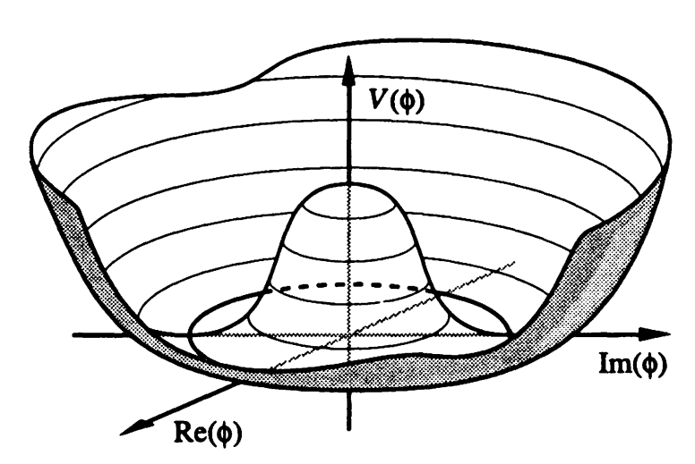
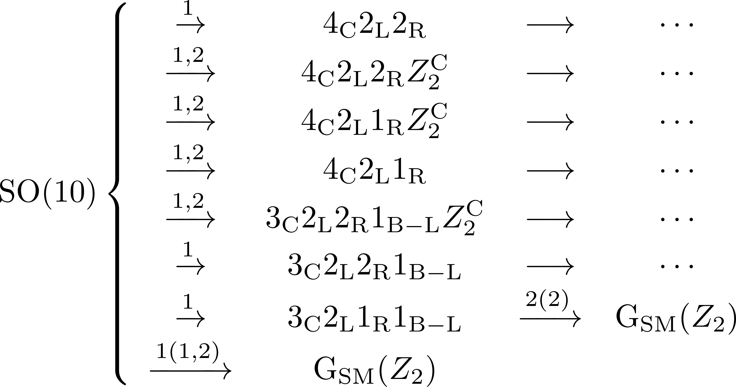
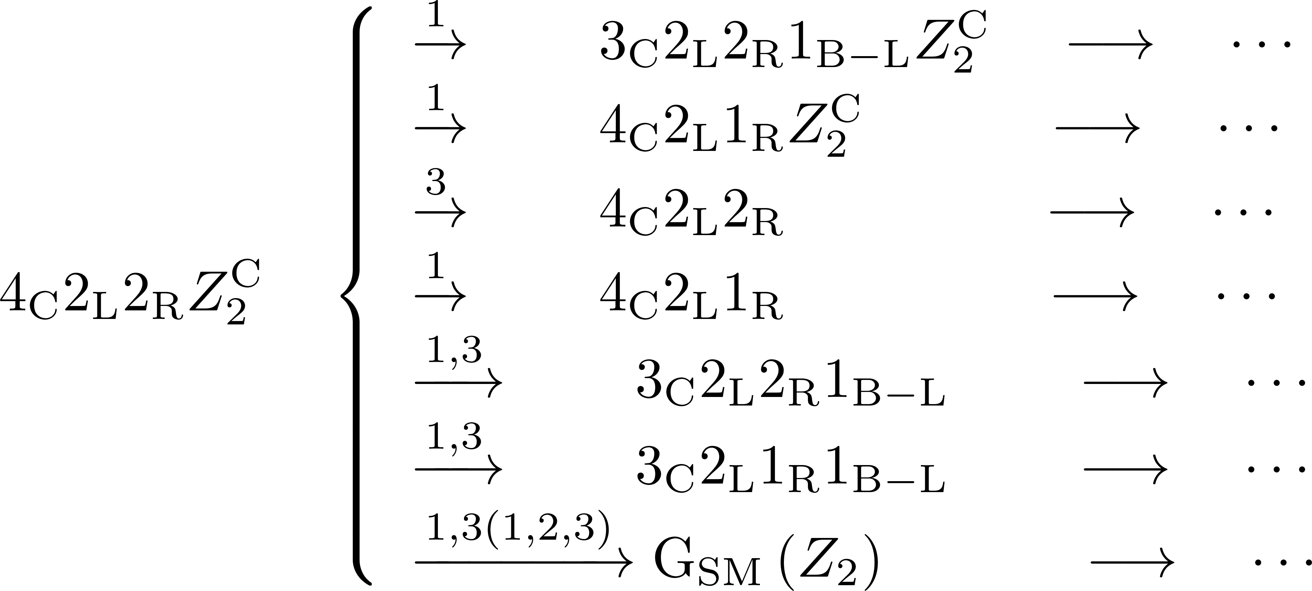
Topological Defects and GUT Symmetry Breaking
R. Jeannerot; ArXiv: hep-ph/0308134

Slide 3
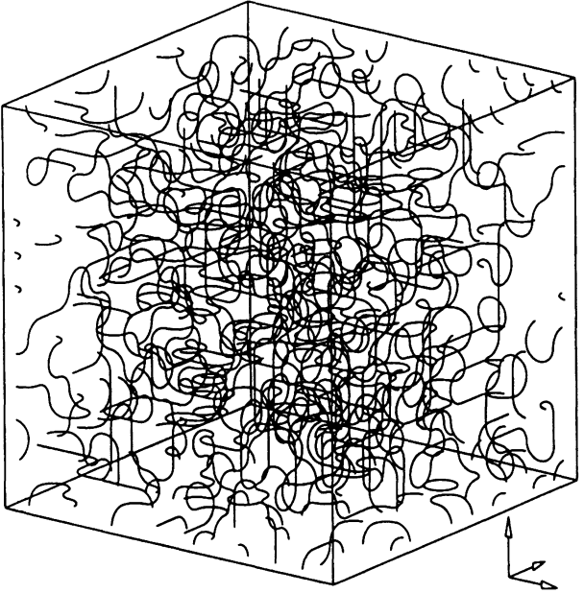
Cosmic String
Figures: Cosmic String and Other Topological Defects. Vilenkin. 1994.
Intersection
Kink
Shrink
Cusp

Slide 4
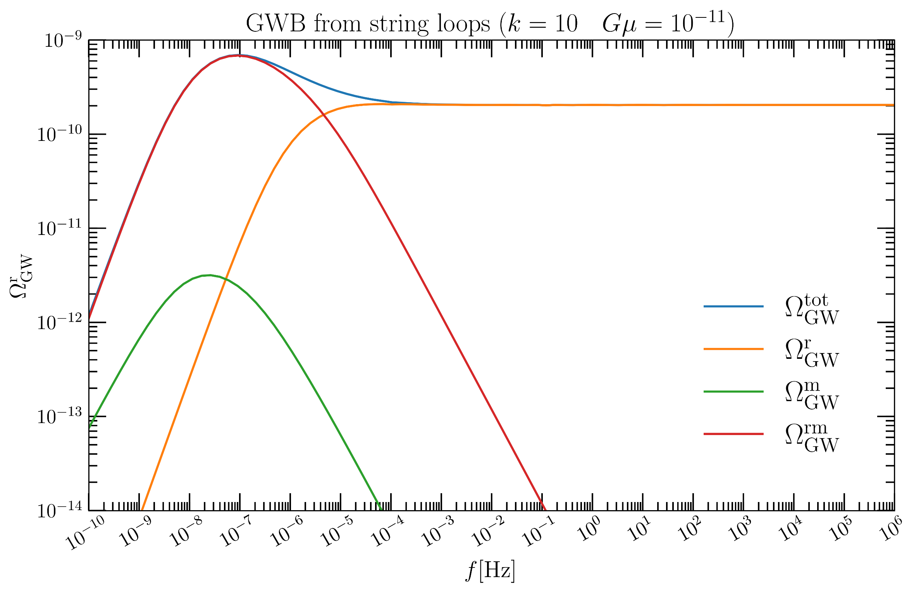

Slide 5
Metastable Cosmic String
Cosmic string can be metastable if there is another symmetry breaking that breaks down to , , and
The decay rate per unit length is characterized by , and
is determined by the hierarchy between two symmetry breaking scales.
In some approximation, it is expressed as .
A. Monin and M. B. Voloshin, arXiv: 0808.1693; arXiv: 0902.0407

Slide 6
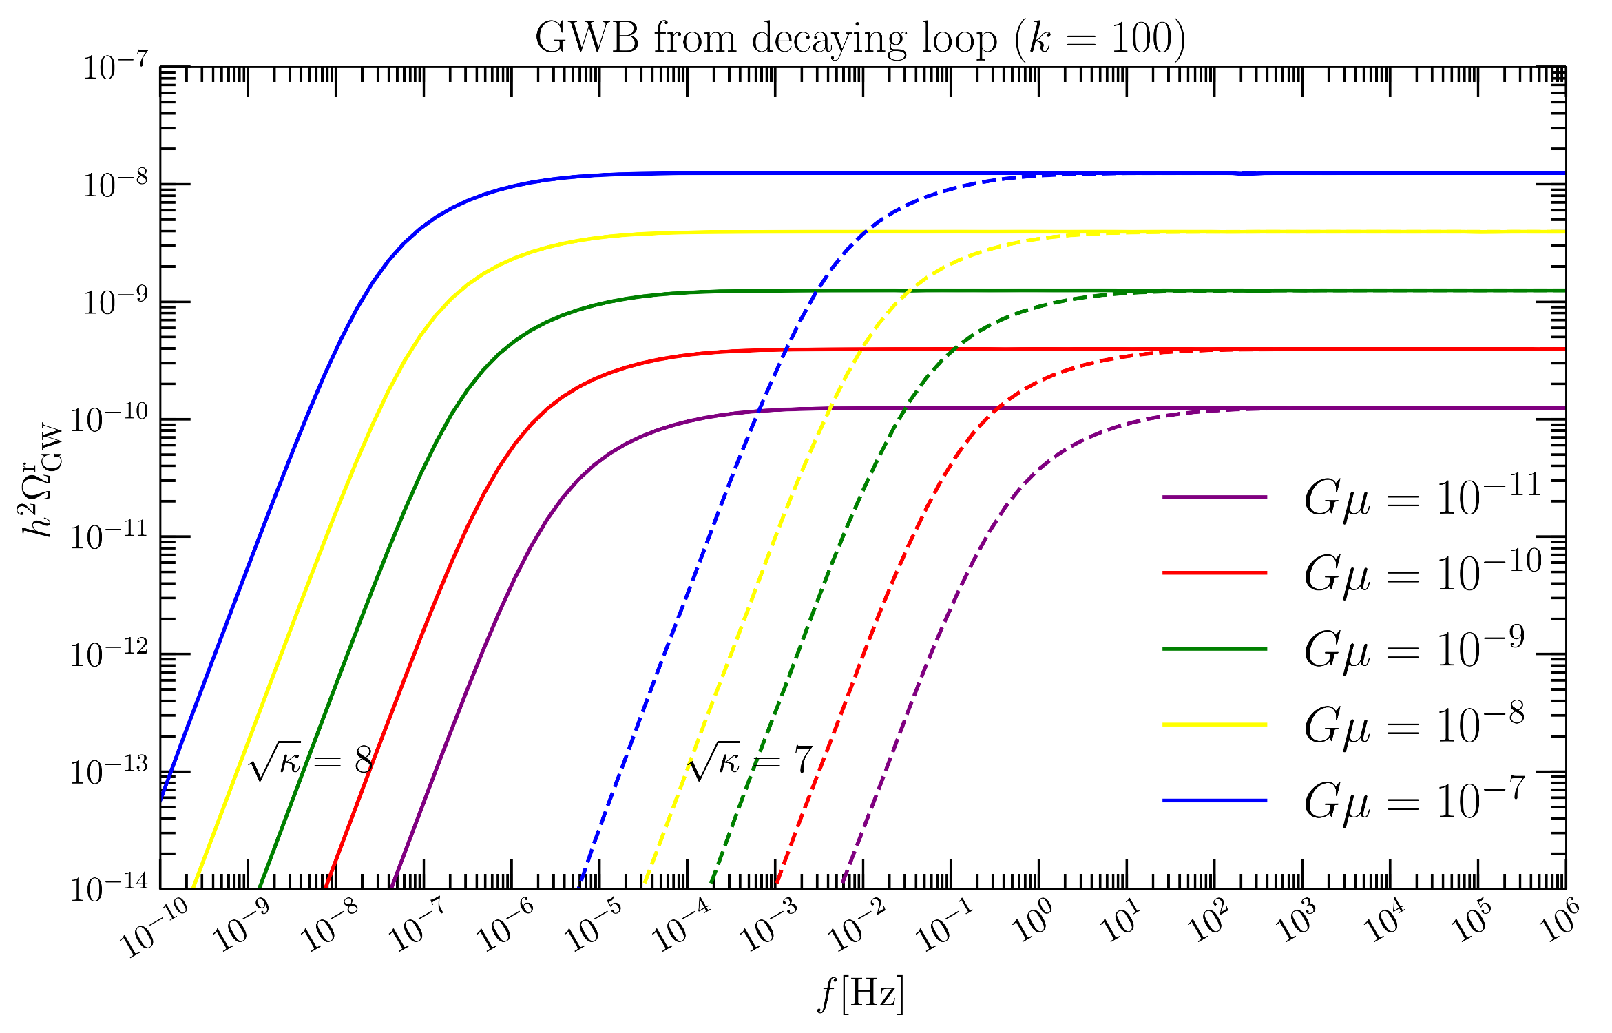

Slide 7
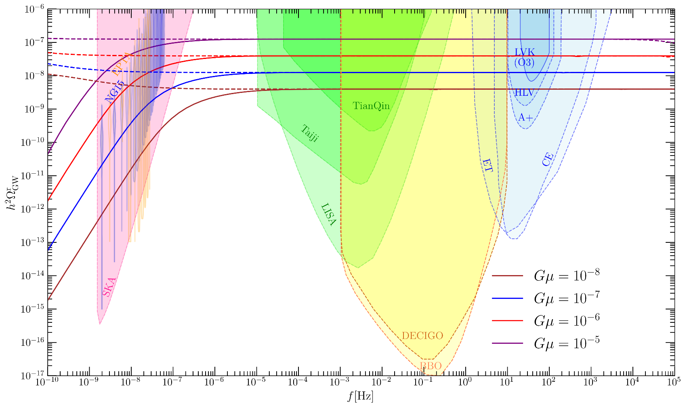
PTA Observation and Constrain from LVK
Evidently
dangerous to be ruled out
Cosmic string is a promising candidate
Sensitivity curve of detectors provided by public code in ArXiv: 2404.16931

Slide 8
Delayed Scaling Scenario
Symmetry
Strongly
Breaks
Diluted
Survive the Reheating
Inflation
start
Separation
Intersection
G. Lazarides and Q. Shafi. DOI: 10.1016/0370-2693(84)91605-8
Q. Shafi and A. Vilenkin. DOI: 10.1103/PhysRevD.29.1870
E. T. Vishniac, K. A. Olive, and D. Seckel. DOI: 10.1016/0550-3213(87)90403-2
L. A. Kofman and A. D. Linde. DOI: 10.1016/0370-2693(85)90381-8
J. Yokoyama. DOI: 10.1103/PhysRevLett.63.712
K. Kamada, Y. Miyamoto, J. Yokoyama. arXiv: 1204.3237

Slide 9
Gravitational Wave Spectrum
T. Vachaspati and A. Vilenkin. DOI: 10.1103/PhysRevD.31.3052
J. J. Blanco-Pillado and K. D. Olum. arXiv: 1709.02693
The power spectrum is
The energy density of GW per unit logarithm frequency interval
Infinity?
Redshift when string network reach a scaling regime
Coefficient is given by

Slide 10
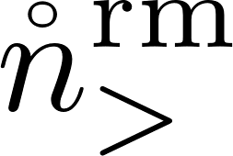
String Network Model for Metastable Cosmic String
Metastable cosmic string is characterized by decay rate per unit length.
Decay rate will determine time when almost all the long strings undergo monopole-antimonopole creation
In our study, we will choose Blanco-Pillado-Olum-Shlaer (BOS) model.
J. J. Blanco-Pillado, K. D. Olum and B. Shlaer. arXiv: 1101.5173, arXiv: 1309.6637.
Since is exponientally suppressed, radiation-dominated is employed.

Slide 11
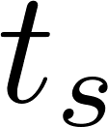
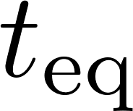
String Network Model for Metastable Cosmic String
The number density of string loops before ,
The number density of string loops after but before ,
The number density of string loops created during radiation dominated era but survived the matter dominated era is
L. Leblond, B. Shlaer, X. Siemens. arXiv: 1004.0890
W. Buchmuller, V. Domcke, K. Schmitz, arXiv: 2107.04578

Slide 12
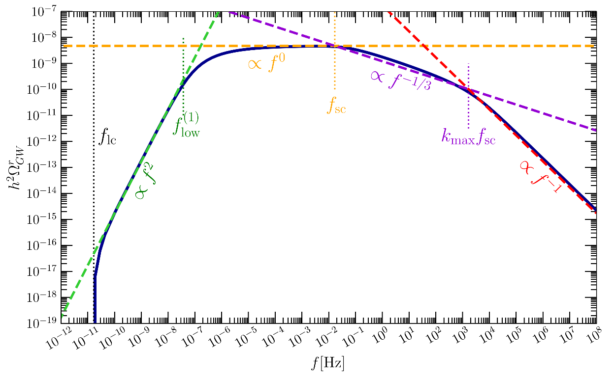
Gravitational Wave Spectrum
,
,
,
,
,

Slide 13
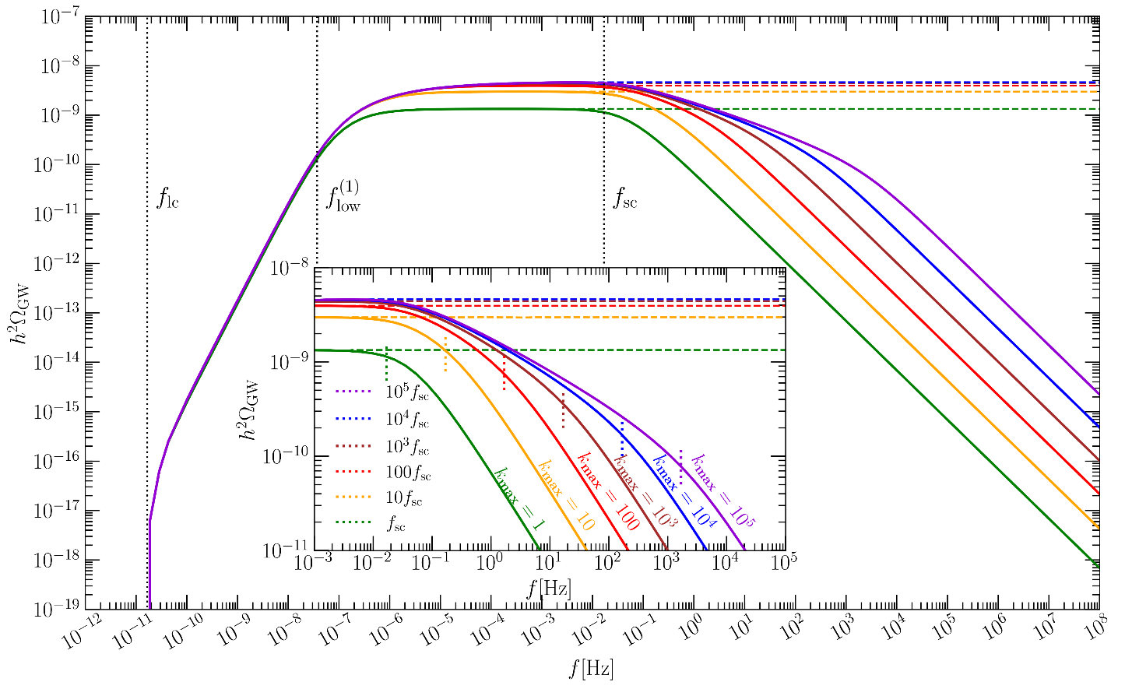
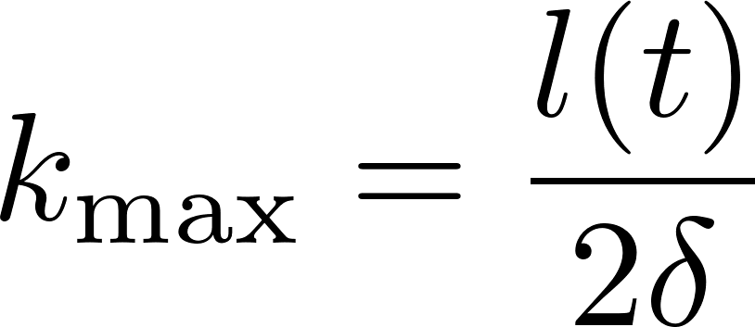
Restriction for High Frequency Tail
?
The maximum value of harmoinc mode number is given by
The loop length is
At physical time , the loop length should be longer than wavelength of GW it emits and both of them are larger than string width
The string width is .

Slide 14
Example
A string network with .
Formation Time .
Characteristic frequency
Corresponding GW wavelength
String width .

Slide 15
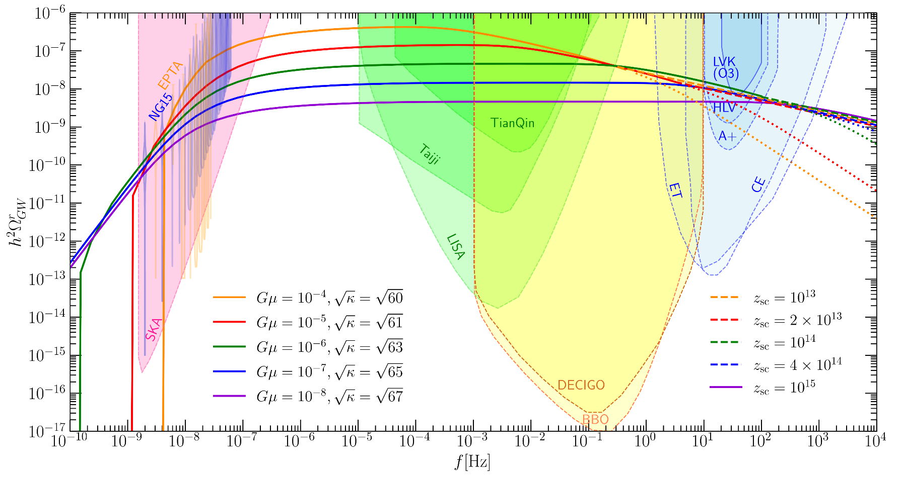
Perspective for Observation of GWB
High frequency tail
Below the LVK sensitivity

Slide 16
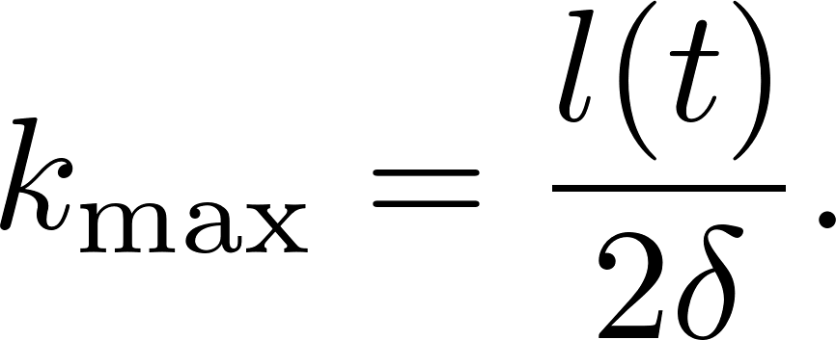
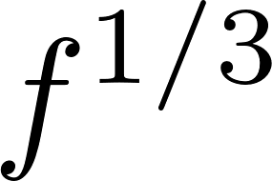
Summary
Prediction for GW from (meta)stable cosmic string with large string tension is now in conflict with observation from LVK.
If cosmic string forms during inflation, delayed scaling scenario will help to evade current bounds.
Spectrum is proportional to , where BOS model and RD is considered.
UV tail of spectrum is determined by string width and loop length, Detectable frequency band will fall off as , which is consistent with previous research.
GW from metastable string network with string tension
and decay rate is observable in future detection efforts.

Slide 17
Thanks for your attention

Slide 18
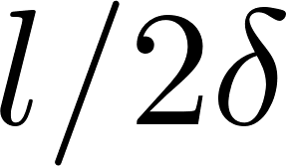
Examples
Example 1
A string network with .
Formation Time .
characteristic frequency is
corresponding GW wavelength is
string width .
It means all the harmonic mode contribute to the spectrum.

Slide 19
Delayed Scaling Scenario
Separation
Symmetry
Strongly
Separation
Breaks
Diluted
Survive the Reheating
Inflation
start
Intersection

Slide 20
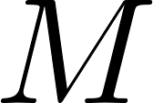
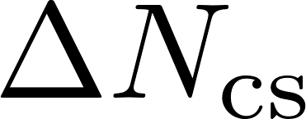
Delayed Scaling Scenario
The non-detection at high frequency can be avoid if symmetry breaks during inflation.
The monopole can be diluted enough to a superhorizon scale and prevent the string network from spoiling.
After the dilution, the average separation between long strings becomes subhorizion and string network forms much later than inflation and reheating period.
Assume the string separation when symmetry break is , with being the scalaron mass.
From symmetry breaking to the end of inflation, the e-fold number is .
The separation of long string when inflation ends is .
The separation grows after inflation .
In velocity-dependent one-scale (VOS) model, the string network forms when .
Induced Planck mass
Number of relativistic species
CMB temperature
Number of relativistic degree of freedom for entropy today

